Slide 1

Future Capabilities in Remote
Sensing and Air Quality Applications
DRI Training Course
June 11-14, 2012
ARSET - AQ
Applied Remote SEnsing Training – Air Quality
A project of NASA Applied Sciences
Richard Kleidman
Science Systems and Applications, Inc.
NASA GSFC

Slide 2
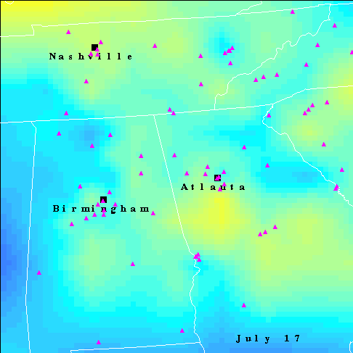
Why Use Remote Sensing Data?
Spatial Coverage
- Satellite (MODIS) Pixel Locations
White Areas – No Data
(Most likely due to clouds)
– Ground Monitors

Slide 3
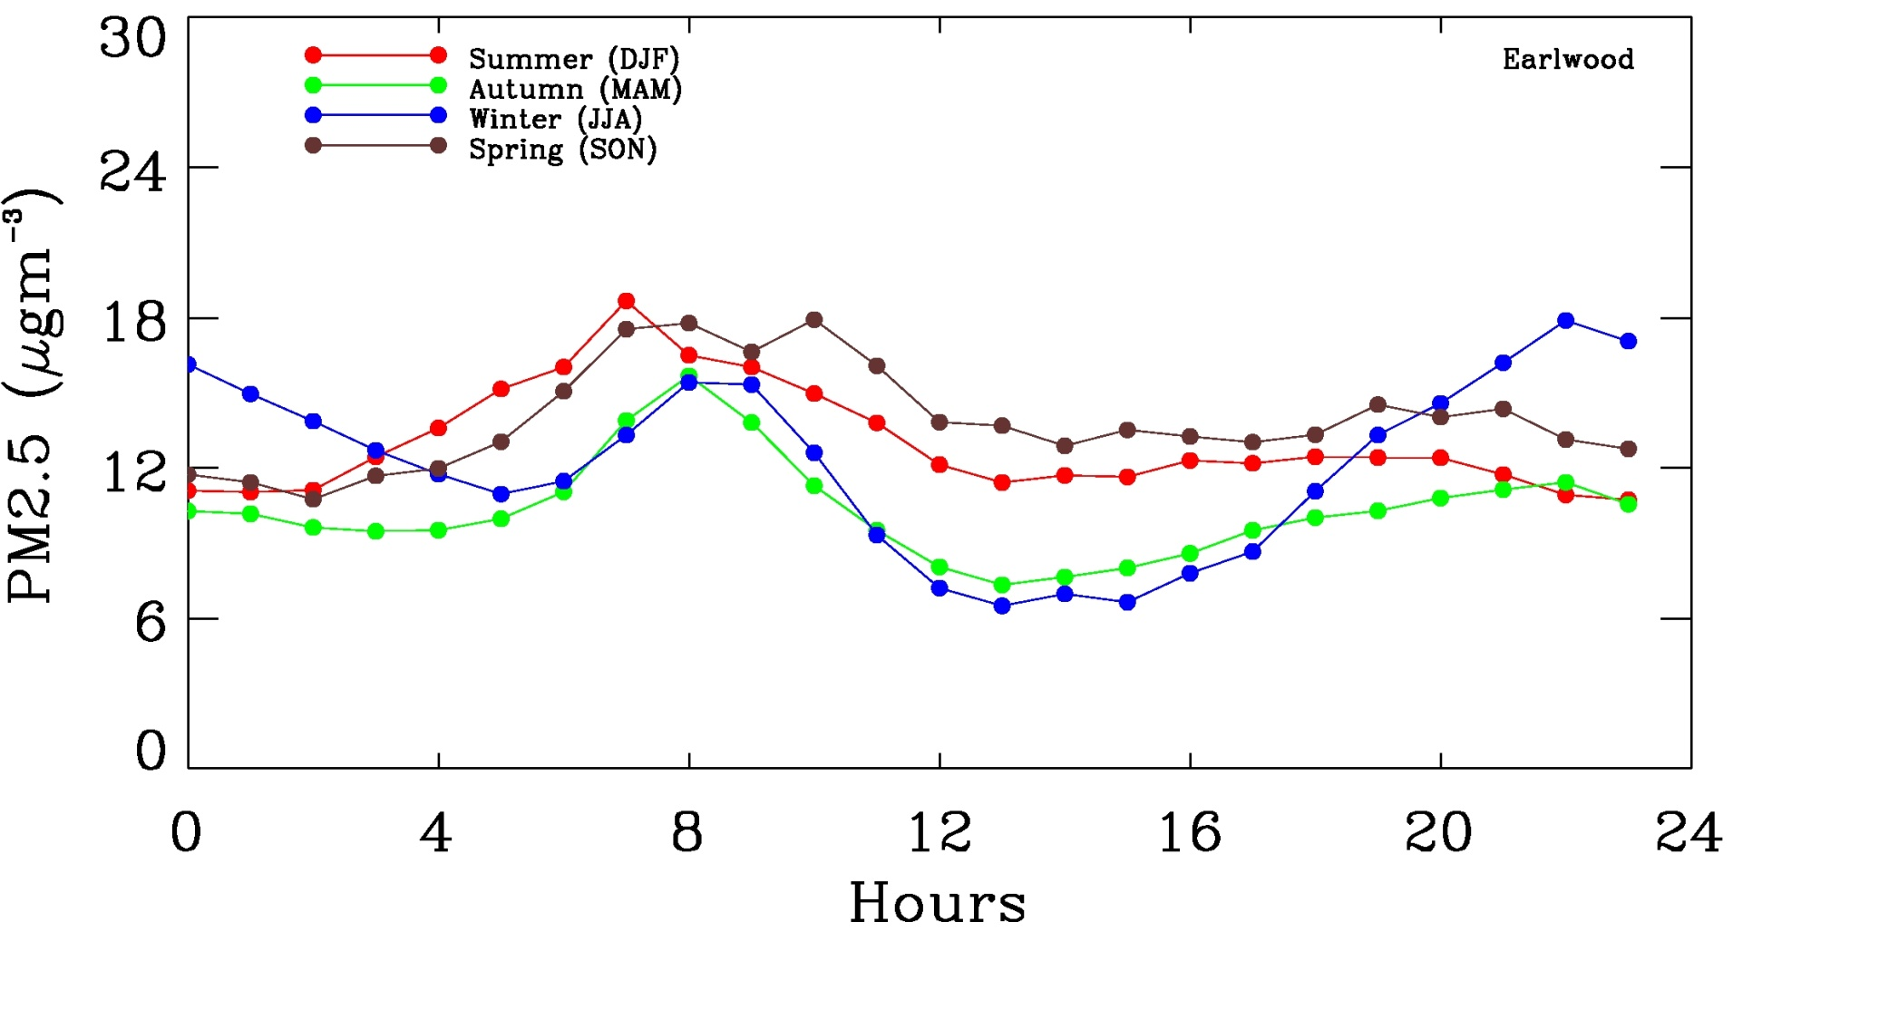
Temporal Coverage
Terra
MODIS (10:30)
Aqua
MODIS (1:30)
Polar orbiting satellites - one observation per day (under cloud-free conditions)
Future geo-stationary satellites - 10 – 15 minute observations

Slide 4
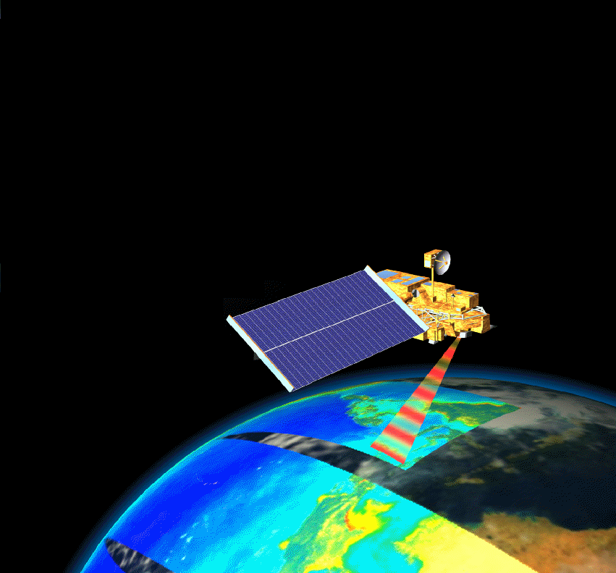
Passive Instruments
The vast majority
of instruments
are passive.
They have
large horizontal
spatial coverage

Slide 5
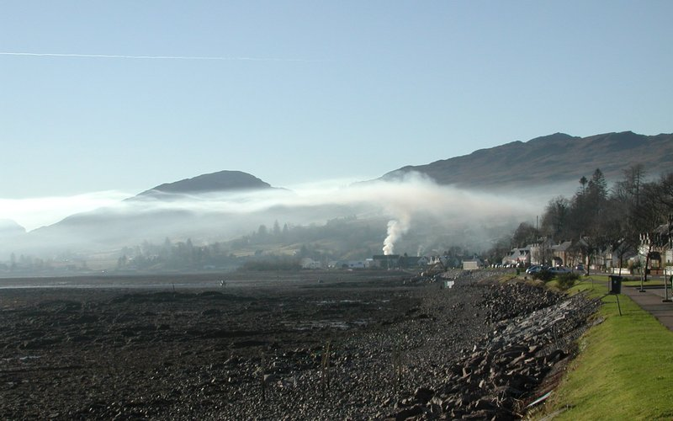

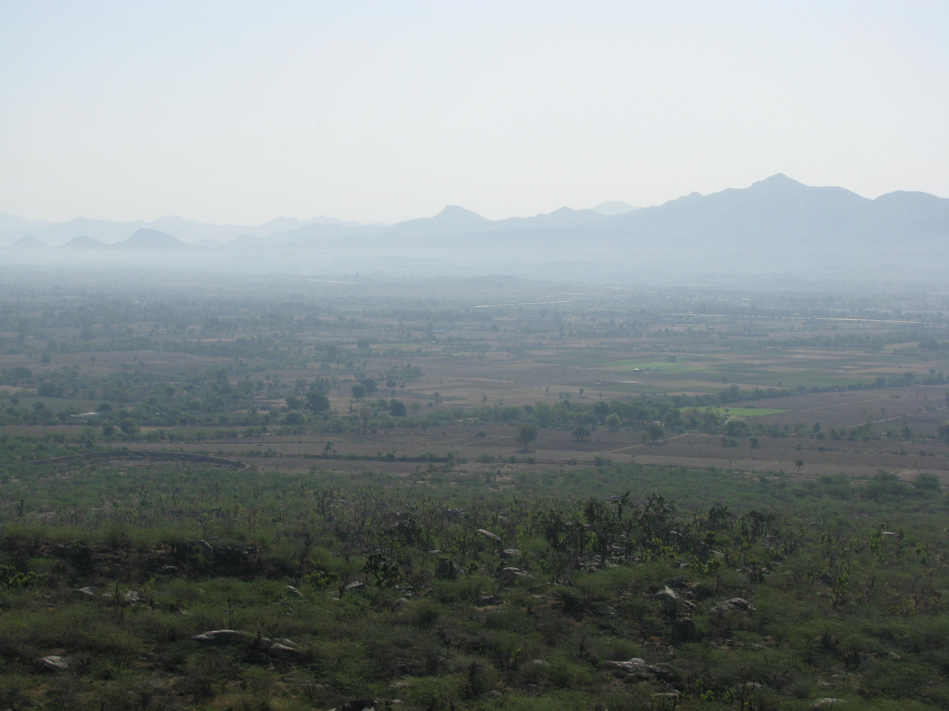
Door #1
Door #2
Door #3
Notes:
But satellite data on its own can’t give us all the answers. Look at the top left satellite image showing pollution in India. From the information this sensor gives us there is no way to tell if the aerosol is aloft or trapped near the ground or evenly mixed through the atmosphere. . What we really need to know is how much PM people are exposed do at ground level.

Slide 6
Notes:
But satellite data on its own can’t give us all the answers. Look at the top left satellite image showing pollution in India. From the information this sensor gives us there is no way to tell if the aerosol is aloft or trapped near the ground or evenly mixed through the atmosphere. . What we really need to know is how much PM people are exposed do at ground level.

Slide 7
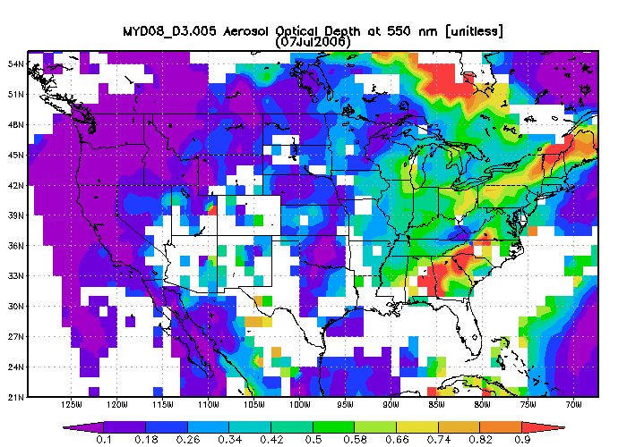
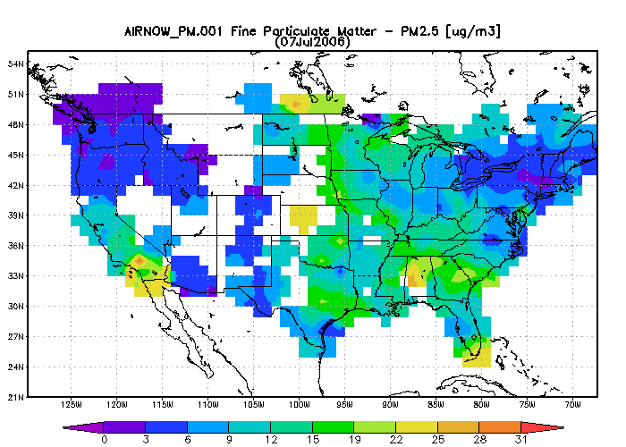
Satellite measurements are a total column, not always correlated with surface Air Quality !
MODIS AOD
AirNOW
PM 2.5
Notes:
The upper left shows the MODIS AOD product. That is a total column optical measurement from which we infer the amount of aerosol in the atmosphere. It can be related to the PM2.5 at the ground. On the bottom right is PM2.5 from the same day as determined from ground sensors in the U.S. EPA’s AirNOW system. If you look at the upper Northeast you can see that the AOD is not at all related to the ground level PM.

Slide 8
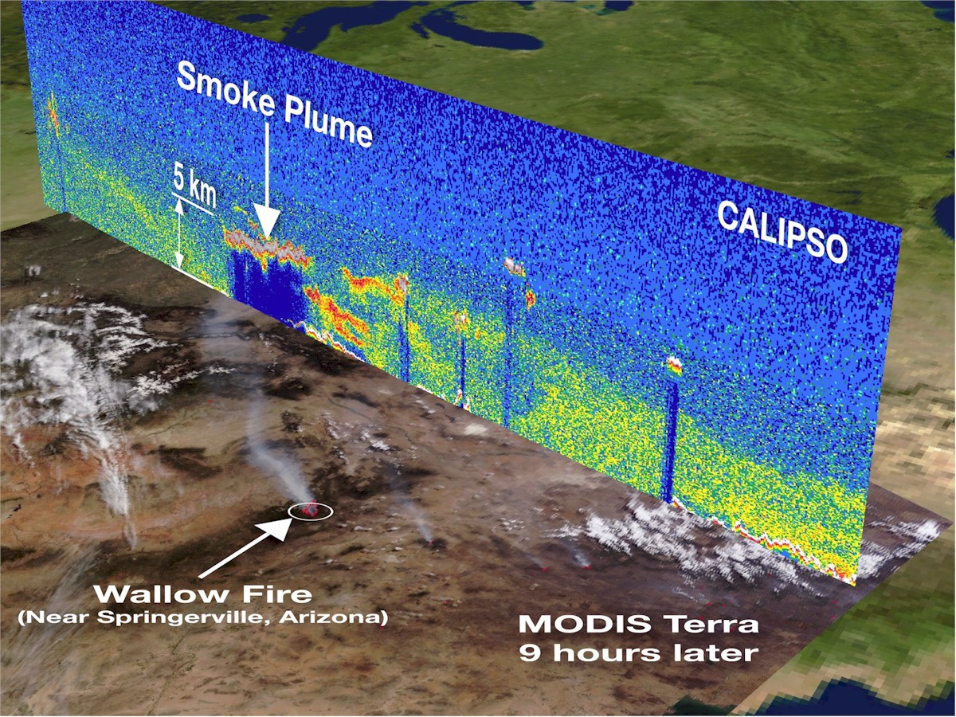
Surface vs Column

Slide 9
Principal Satellites in Air Quality
Remote Sensing
380 Km
MISR
1Km
CALIPSO
(CALIOP)
2300 Km MODIS
2400 Km OMI

Slide 10
Determining Ground Level Exposure Using Remote Sensing Data
  Past and current techniques
  Current and future methods
      Long term monitoring
      Real time measurements
      Air quality forecasting

Slide 11
Historical Methods
Relating Satellite AOD and Ground Level PM2.5
Correlations of MODIS and MISR AOD and PM 2.5

Slide 12
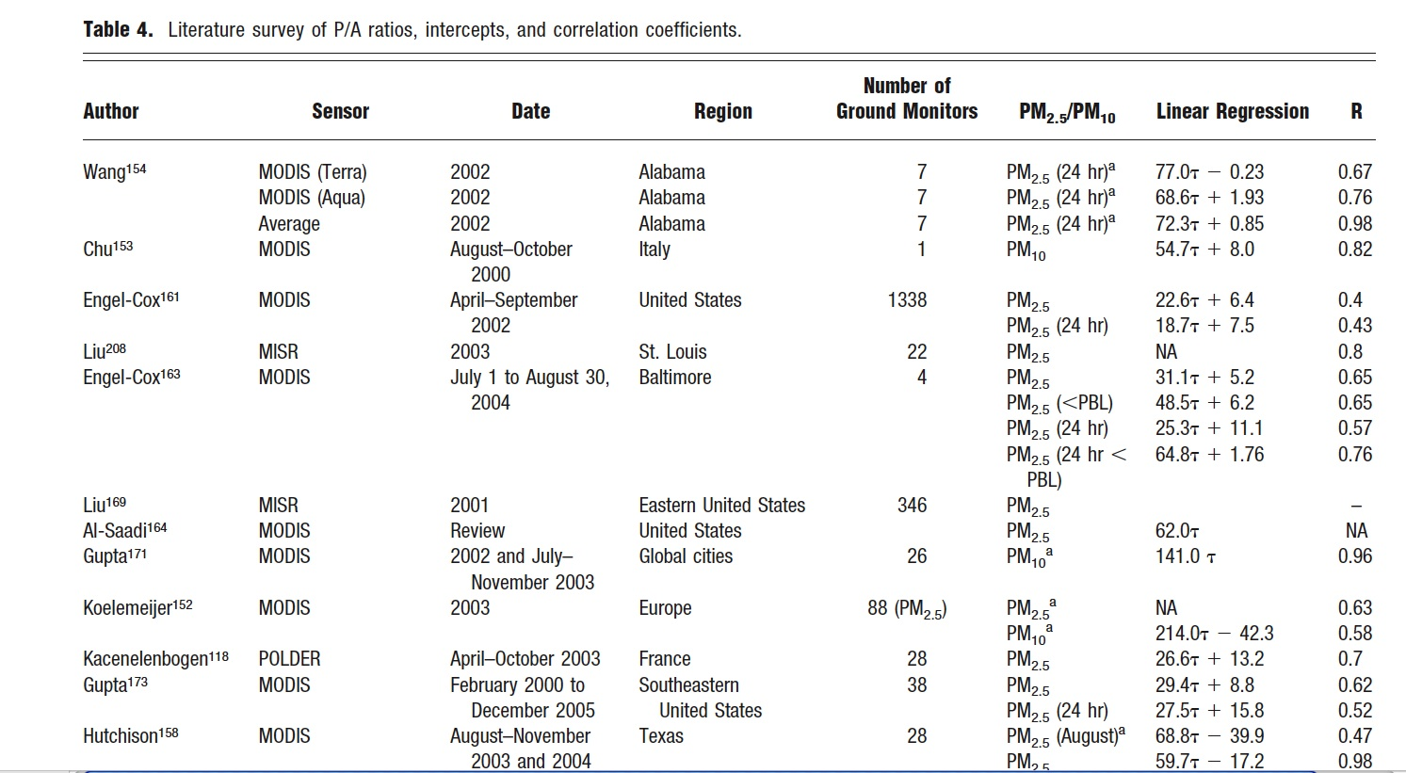
PM - AOD Relationships
Hoff and Christopher, 2009
Notes:
Note the wide range of regressions and R values.

Slide 13
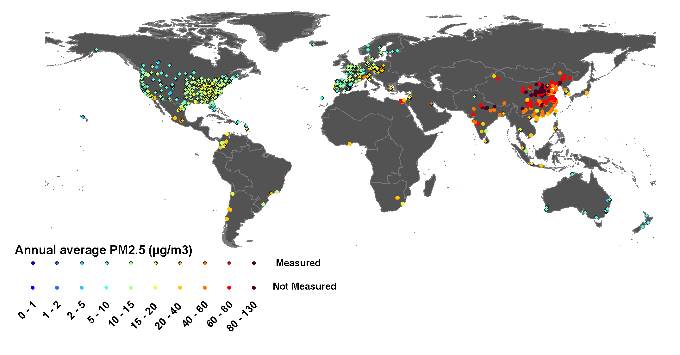
Global Status of PM2.5 Monitoring
Ground Sensor Network
  Many countries do not have PM2.5 mass measurements
  Spatial distribution of air pollution derived from existing ground networks does not correlate with high population density
  Surface measurements are not cost effective
Brauer M, Ammann M, Burnett R et al.
GBD 2010 Outdoor Air Pollution Expert Group 2011 Submitted –under review
  How about using remote sensing satellites?
Population Density
Notes:
Ground sensors give us by far the most accurate measurements of ground level pollutants. The ground sensor networks (not a complete list of all ground stations globally) are indicated by the colored dots on the upper image. The image on the lower right shows population density. You can see that several areas of the globe with significant populations have almost no monitors at all. In addition most of the sensors in India and China are measuring calculating PM 2.5 from PM 10 measurements. One important thing to note is that even in the U.S., the most completely instrumented country in the world, 2400 out of 3100 counties (31% of total population) have no PM monitoring.

Slide 14
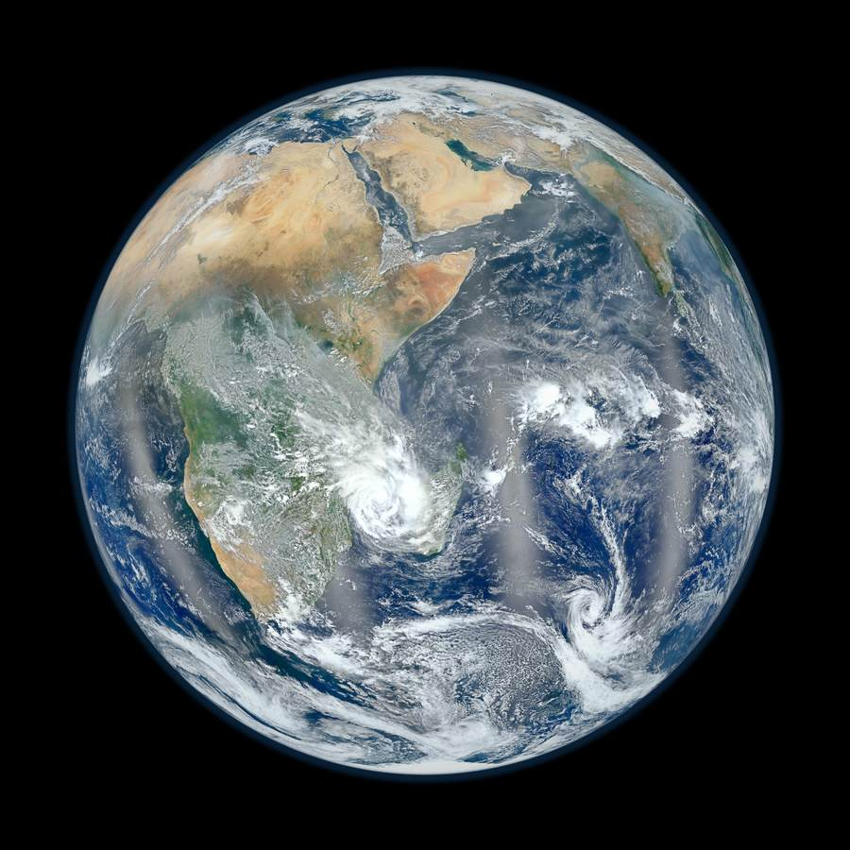
Our interest and what we obtain from satellite
To of the Atmosphere
10 km² Vertical Column
Aerosol Optical Depth
Particle size
Composition
Water uptake
Vertical Distribution
Surface Layer
Earth Surface
PM2.5 mass concentration (µgm⁻³) -- Dry Mass

Slide 15
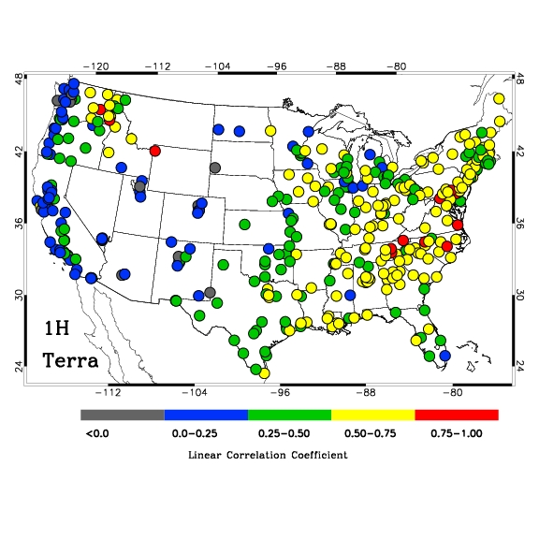
AOT-PM2.5 Relationship
Gupta, 2008

Slide 16
Critical Review of Column AOD to
Ground PM relationships
Hoff and Christopher, 2009
Widely varying slopes on this regression
Seasonal dependence, humidity dependence, PBL dependence, regional dependence
Error in the slopes lead to propagated error in the PM_{2.5} predictions
Likely not adequate for regulatory compliance

Slide 17
Environmental Agencies & Public Looking for…
Index
Values
Category
Cautionary Statements
PM_{2.5}
(ug/m³)
PM₁₀
(ug/m³)
0-50
Good
None
0-15.4
0-54
51-100
Moderate
Unusually sensitive people should consider reducing prolonged or heavy exertion
15.5-40.4
55-154
101-150
Unhealthy for Sensitive Groups
Sensitive groups should reduce prolonged or heavy exertion
40.5-65.4
155-254
151-200
Unhealthy
Sensitive groups should avoid prolonged or heavy exertion; everyone else should reduce prolonged or heavy exertion
65.5-150.4
255-354
201-300
Very Unhealthy
Sensitive groups should avoid all physical activity outdoors; everyone else should avoid prolonged or heavy exertion
150.5-250.4
355-424
WHO USA
15
35
150
-
Public
Decision/Policy Makers
Media
Researchers

Slide 18
Some Promising Methods
Using Existing Data
Combining Global Process Models with Satellite Data
Combining Statistical Models, Satellite Data and Ground Measurements
Combining Ground Instruments, Lidar and Satellite Measurements

Slide 19
Relating Column Measurements and Ground Concentrations
Following Liu et al., 2004:
Estimated PM_{2.5} = η· τ (AOD)
Vertical Structure
meteorological effects
diurnal effects
Aerosol mass
aerosol type
humidification of the
aerosol
Some key factors we may
need to know to
accurately determine
η
Correlations vary from region to region as do the factors
which have the greatest influence on η

Slide 20
Combining Global Process Model and Satellite Observations
Van Donkelaar et al. relate satellite-based measurements of aerosol optical depth to PM_{2.5} using a global chemical transport model
van Donkelaar et al., EHP, 2011
Following Liu et al., 2004:
Estimated PM_{2.5} = η· τ
Combined MODIS/MISR
Aerosol Optical Depth
vertical structure
aerosol type
meteorological effects
meteorology
diurnal effects
GEOS-Chem
η

Slide 21
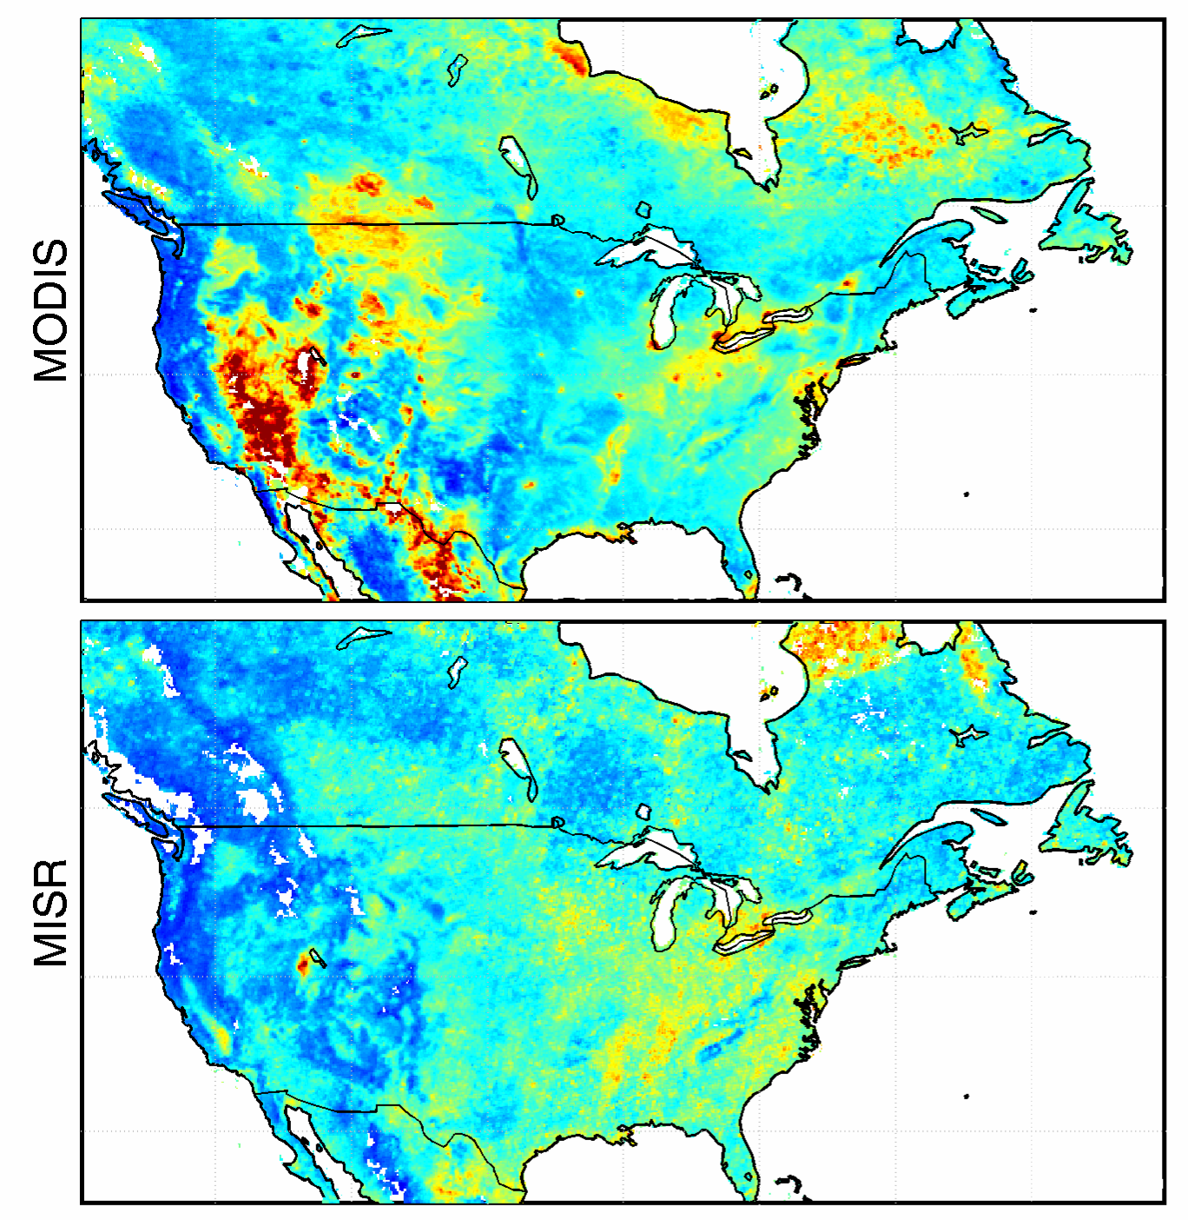
MODIS and MISR AOD
Mean τ 2001-2006 at 0.1º x 0.1º
MODIS AOD
1-2 days for global coverage
Requires assumptions about surface reflectivity
MODIS
r = 0.40
vs. in-situ PM_{2.5}
MISR AOD
6-9 days for global coverage
Simultaneous surface reflectance and aerosol retrieval
MISR
r = 0.54
vs. in-situ PM_{2.5}
0 0.1 0.2 0.3
τ [unitless]
van Donkelaar et. at.

Slide 22
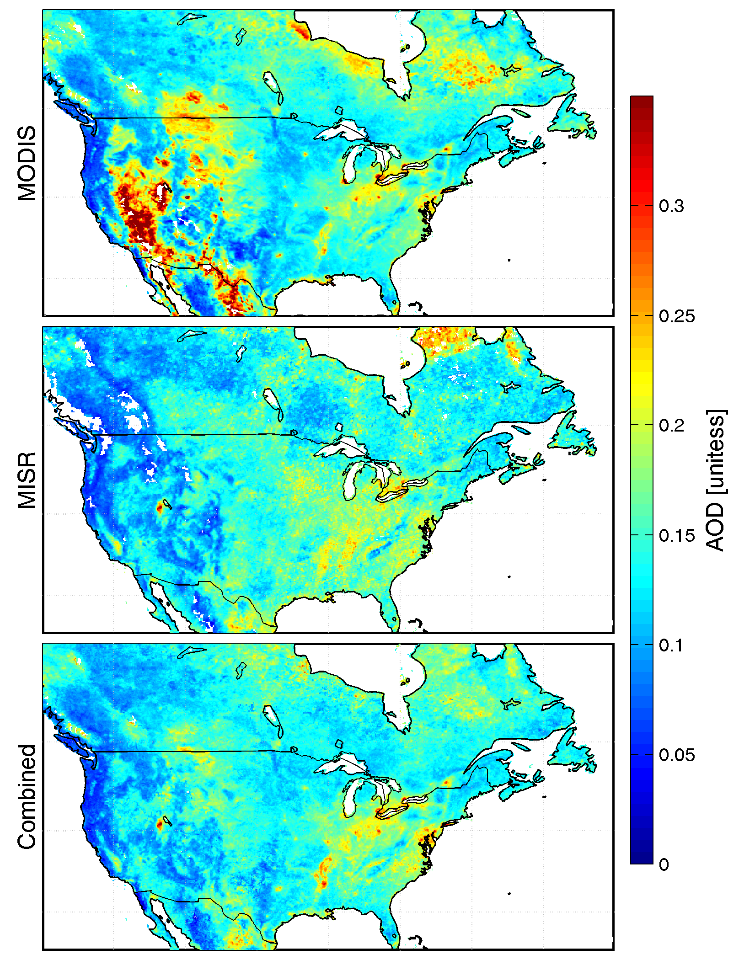
Combining MODIS and MISR improves agreement with PM_{2.5}
0.3
0.25
0.2
0.15
0.1
0.05
0
τ [unitless]
Combined
MODIS/MISR
r = 0.63 (vs. in-situ PM_{2.5})
MODIS
r = 0.40
(vs. in-situ PM_{2.5})
MISR
r = 0.54
(vs. in-situ PM_{2.5})
van Donkelaar et. at.

Slide 23
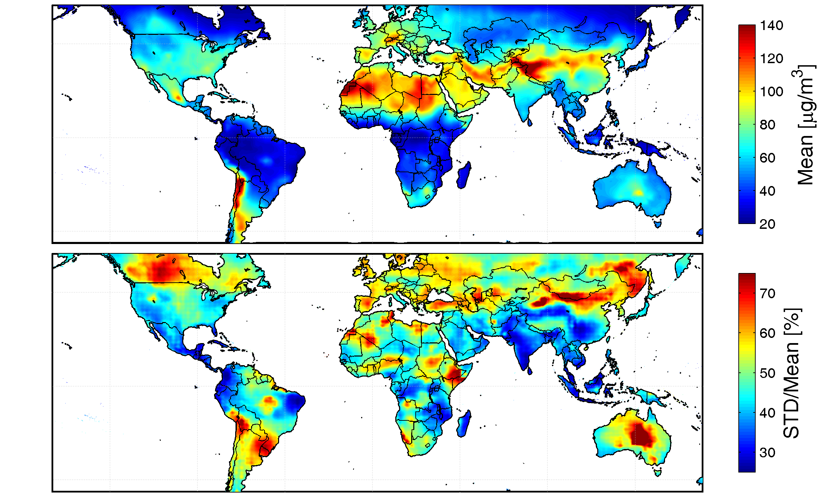
Global CTMs can directly relate PM_{2.5} to AOD
η
[ug/m]
GEOS-Chem
Detailed aerosol-oxidant model
2º x 2.5º
54 tracers, 100’s reactions
Assimilated meteorology
Year-specific emissions
Dust, sea salt, sulfate-ammonium-nitrate system, organic carbon, black carbon, SOA
van Donkelaar et. at.

Slide 24
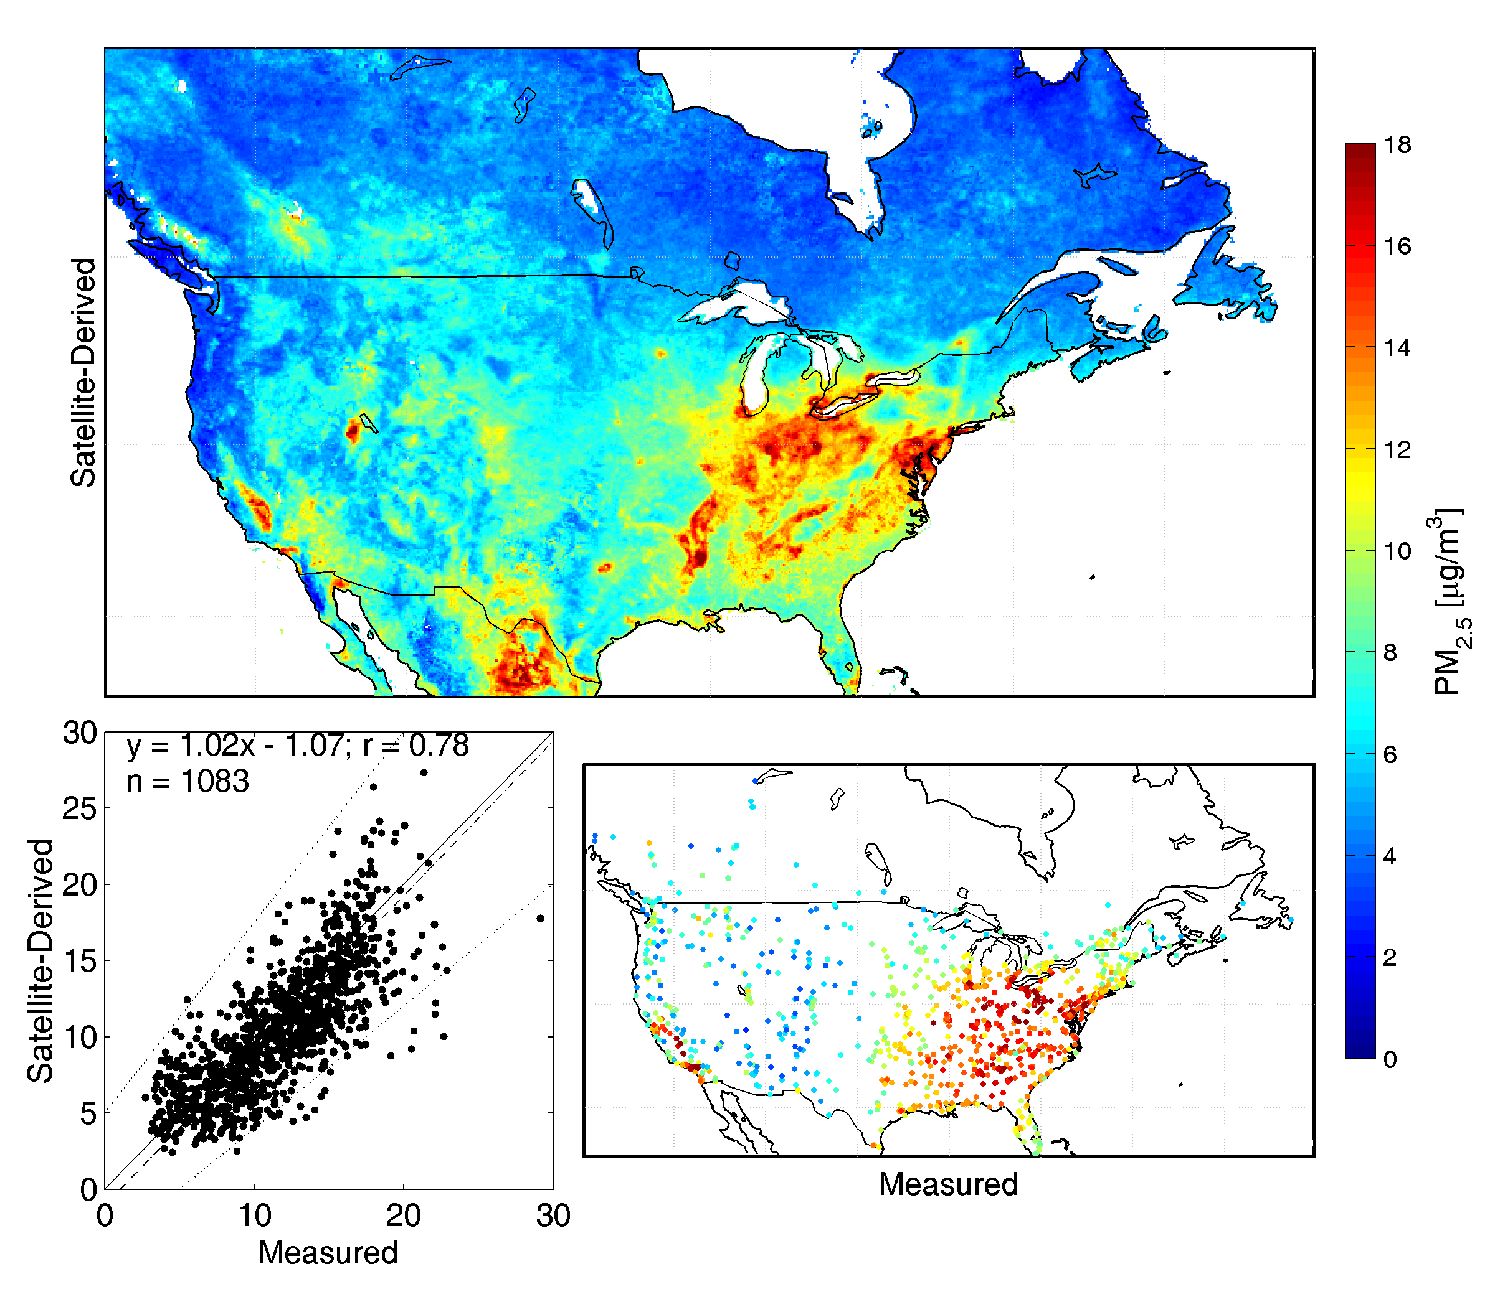

Reasonable agreement with coincident ground measurements over NA
 | r
MODIS τ | 0.40
MISR τ | 0.54
Combined τ | 0.63
Combined PM_{2.5} | 0.78
Annual Mean PM_{2.5} [μg/m³] (2001-2006)
Satellite
Derived
Satellite-Derived [μg/m3]
In-situ
In-situ PM_{2.5} [μg/m³]
van Donkelaar et. at.

Slide 25
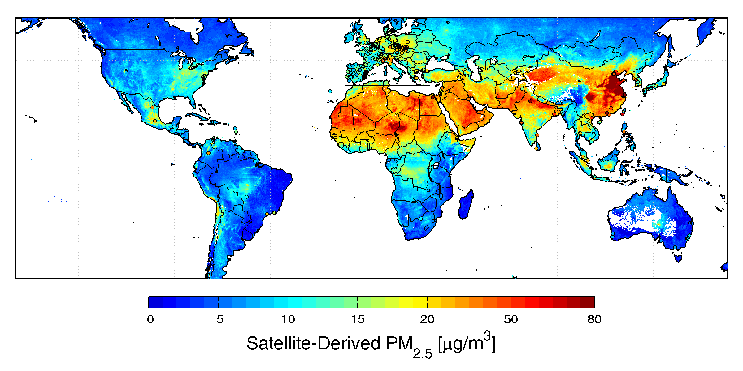
Method is globally applicable.
It is important to note that model performance can vary significantly with region
Annual mean measurements
  Outside Canada/US
  244 sites (84 non-EU)
r = 0.83 (0.91)
slope = 0.86 (0.84)
bias = 1.15 (-2.52) μg/m³
van Donkelaar et. at.

Slide 26
Creating Daily MODIS Correlation Maps Using PM2.5 Measurements
Lee et. al. Harvard School of Public Health
Combining Statistical Models, Satellite Data and Ground Measurements
Can be applied to any region
Results can be used to improve
daily correlations

Slide 27
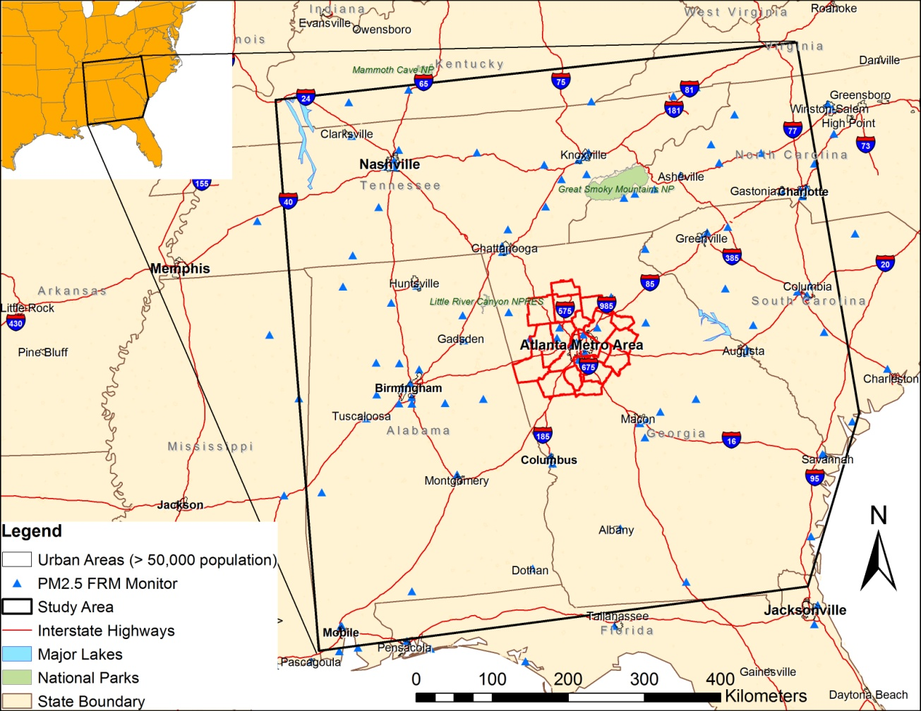
Current work by Yang Liu at Emory University
Using a statistical model to predict annual exposure
Number of monitoring sites: 119
Exposure modeling domain: 700 x 700 km²
27

Slide 28
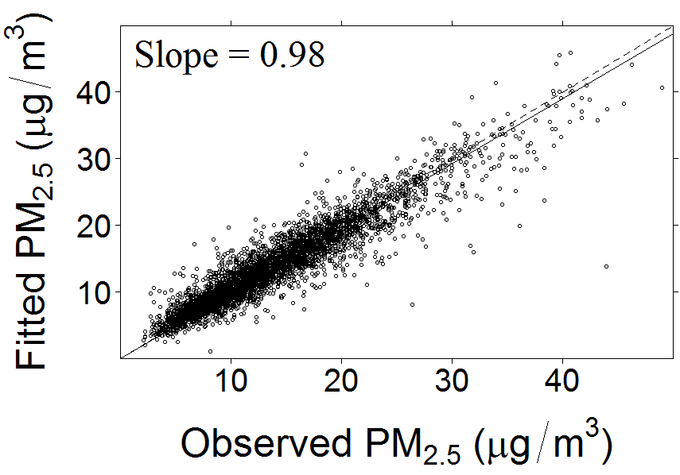
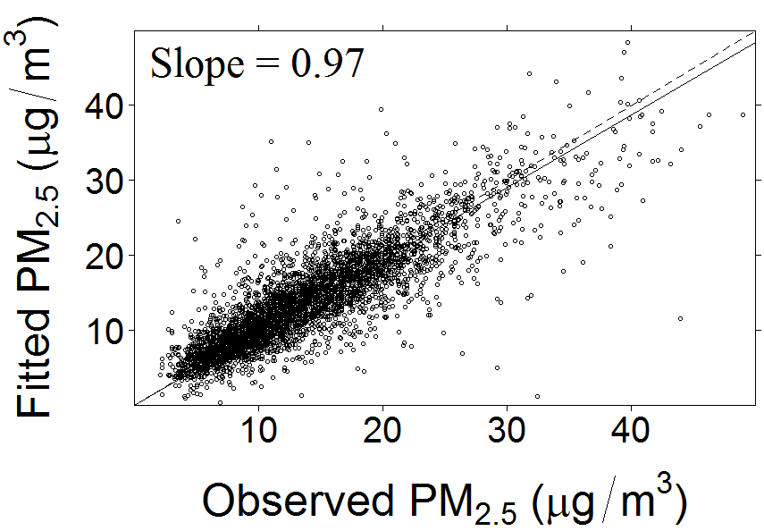
Model Performance Evaluation
 | Mean | Min | Max
Model R² | 0.86 | 0.56 | 0.92
CV R² | 0.70 | 0.22 | 0.85
Putting all the data points together, we see unbiased estimates
Model
CV
28

Slide 29
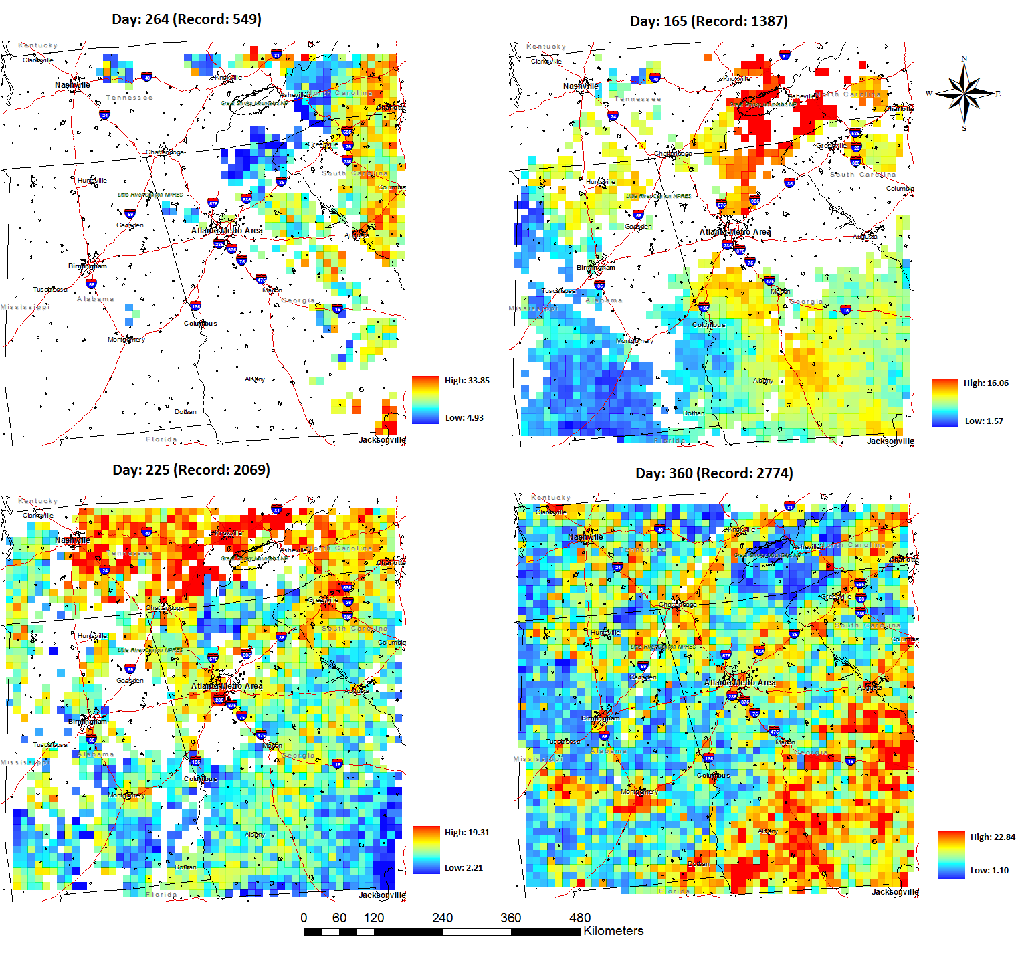
Predicted Daily Concentration Surface
29

Slide 30
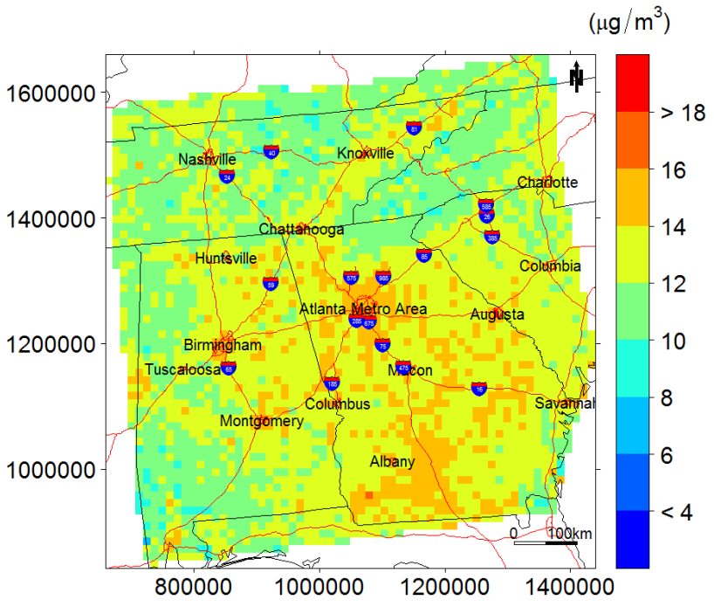
Model Predicted Mean PM_{2.5} Surface
Note: annual mean calculated with137 days
30

Slide 31
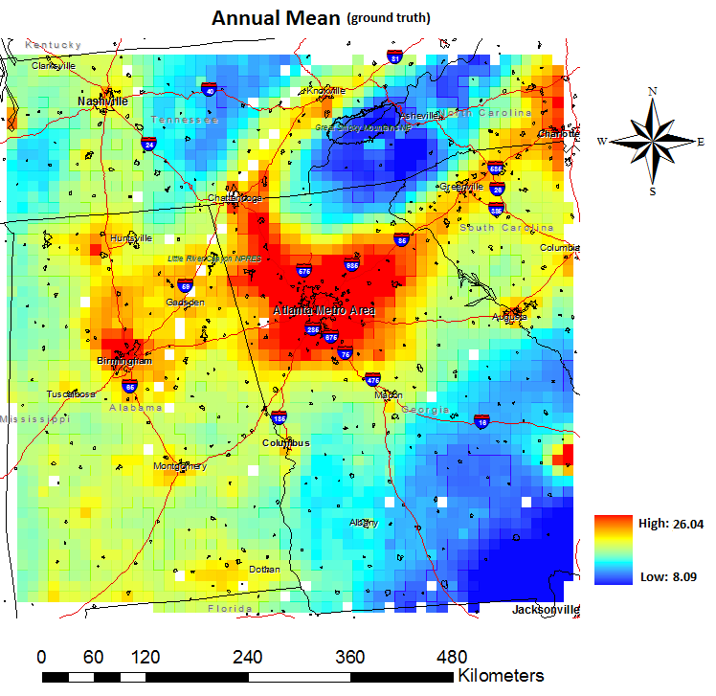
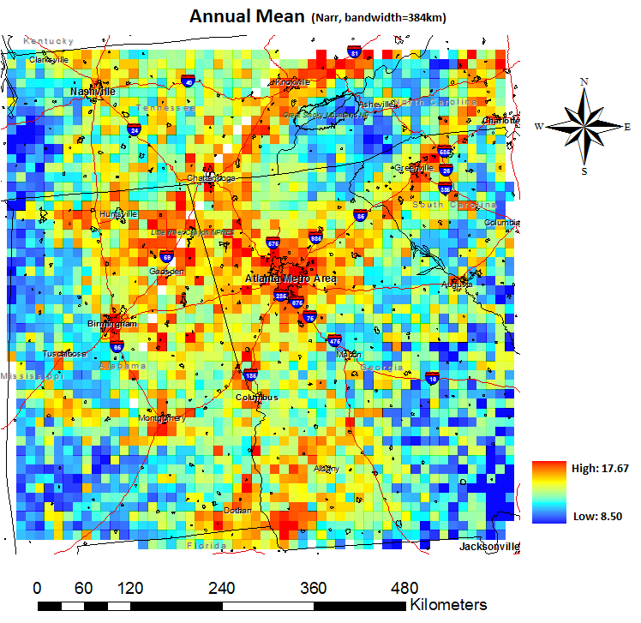
Comparison with CMAQ
General patterns agree, details differ

Slide 32
Using Coincident Ground Based Data,
Lidar, and Satellite Measurements.
Analysis of the relationship between MODIS aerosol optical depth and particulate matter from 2006 to 2008
Tsai et. al. 2011
Atmospheric Environment

Slide 33
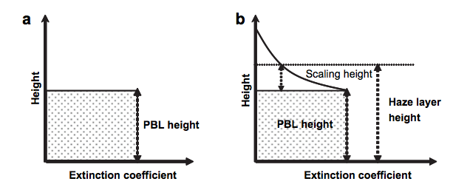
Lidar is used to identify the
Planetary boundary layer (PBL)
Haze layer. Elevated layer above the PBL

Slide 34
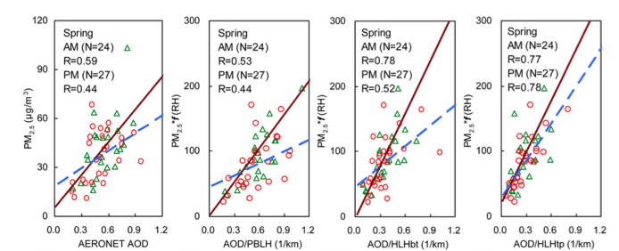
Haze layer
Bottom to Top
Haze layer
Top to Bottom
PM2.5 vs. AOD
PM2.5*f(RH)
vs. AOD/PBLH
PM2.5*f(RH)
vs. AOD/HLHbt
PM2.5*f(RH)
vs. AOD/HLHtp
Triangles indicate Terra data and circles indicate Aqua data.
Solid and dashed lines represent the linear regressions of AM and PM
of sunphotometer AOD corresponding to Terra and Aqua overpasses, respectively.

Slide 35
Steps Which Can Be Taken to
Improve Remote Sensing-PM_{2.5} Correlations
Tuning the Satellite AOD retrieval to local conditions.
Use of transport, forecast, numerical and statistical models.
Use of additional satellite aerosol and trace gas data.
Ground instrument networks for creating daily AOD – PM relationships
Use of ground and space borne lidars for vertical resolution of aerosols and boundary layers
Local meteorological data

Slide 36
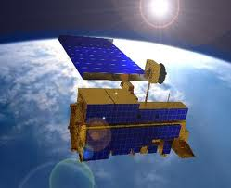
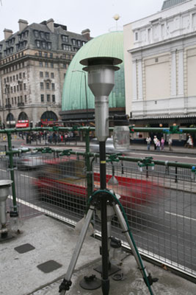

The Highest Quality of Data Rests on a Tripod
Satellite Data
Ground Measurements and In-Situ Data
Models
Notes:
Each segment of this three piece system which is necessary for high quality estimate of exposure – satellite data, ground measurements and models - feed back on and constantly improve each other. Satellites and models fill in the gaps in the ground data. The ground data is used to validate the satellite products, and provides raw data for the models. The models can help fill in gaps where we have no satellite retrievals, can improve the satellite retrievals themselves, and can give us a predictive capability to help forecast and avoid acute episodes of high exposure. The satellite retrievals provide raw data for the models as well as information for validating and improving the models. The satellite data and models can help us determine where we most need to obtain additional ground level data and other in-situ measurements.

Slide 37
Current and Future Prospects Satellite Data
Several Missions Beyond Design Life
Recent Launch of VIIRS
Loss of Main Vertical Resolving Sensor
Several New Missions in Development
Notes:
Current satellite data capabilities are adequate for this task. However several existing sensors are well beyond their design life and if they were to stop functioning would severely handicap our capabilities. Fortunately we have the recent successful launch of VIIRS . Our already limited ability to resolve aerosols vertically will be even more limited with the predicted loss of CALIPSO in the next couple of years. Fortunately there are many additional missions in development scheduled for launch over the next several years which should improve our net satellite capabilities by the end of the decade.

Slide 38
Remote Sensing Capabilities
- Current Missions
Sensor | Launch Date | Design Length | Resolution | End Date/Problems
Terra - MODIS | 1999 | 5 Years | 10/3/(1) KM | 2015 -2016
Terra – MISR | 1999 | 5 Years | 17.6 KM | 2015 -2016
Aqua - MODIS | 2001 | 5 Years | 10/3/(1) KM | 2018
Aura – OMI | 2004 | 6 Years | 13 x 27 KM | Loss of data
Parasol - POLDER | 2004 | 2 Years | 18 KM | Out of A-Train
Calipso - CALIOP | 2006 | 3 Years | 5 Km x .2 KM
ENVISAT – MERIS | 2002 |  | 10 KM
ENVISAT – AATSR | 2002 |  | 3x4, 10 KM
NPP - VIIRS | 2011 | 5 Years | 6 KM
Goestationary
MSG - SEVIRI | 2005 |  | 10 KM
GOES - GASP | 2006 | 5 Years | 4 KM/30 Min

Slide 39
Remote Sensing of Aerosol Capabilities - Upcoming Missions
Sensor | Launch Date | Measurements | Issues
GLORY - APS | ? | Aerosols | Narrow swath
LDCM | 2012 | Aerosols | Narrow swath/Few bands
ADM - Aoleus | 2013 | Aerosol/wind profiles | Narrow swath
GCOM – C | 2013 | Aerosols/Clouds
EarthCARE | 2015 | Aerosols/Clouds | LIDAR Narrow swath
OCO-2 | 2013 | CO2/Aerosols
TROPOMI | 2014 | Aerosols/Gases | 7 KM Resolution/7 Yr.
Sentinel-3 | 2012 - 2020 | Aerosols | Few bands
ACE | 2022 | Aerosols | Improve A-Train Capabilities
Goestationary
GOES-R | 2015 | Aerosols - geostationary
GEO-CAPE | 2020 | Aerosols - geostationary
Notes:
Blue – ESA sensors
Red – Japanese sensor
Green – Geostationary

Slide 40
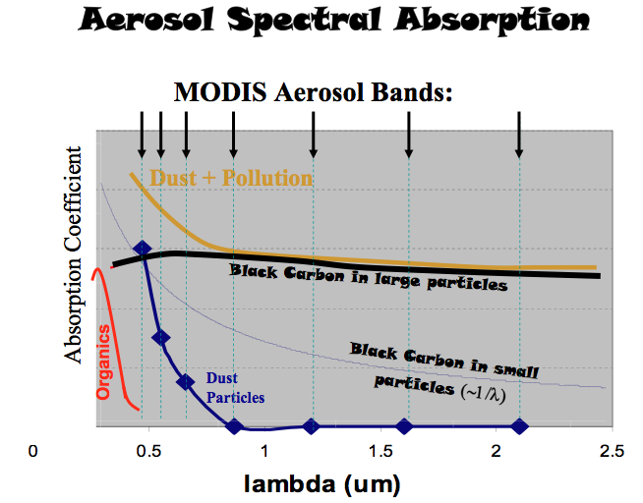

Slide 41
Models – Future Prospects
Increased computing power
Increased understanding of processes
Increasing availability of satellite data
Models
Notes:
All of the essentials that we need to improve process and transport models are in place. Limitations imposed by computing power are fast disappearing. We continue to improve our understanding of processes for inclusion in the models and as already mentioned the satellite data that drives them should improve by the end of the decade. Increases in computing power will continue to vastly improve the horizontal and spatial resolution of models for gases and aerosols.
Increased understanding of processes will improve models.
Increasing availability of satellite data and near-real time capabilities will improve models.
Predictive ability of statistical and combined statistical – process models will increase BUT
utility will be limited by lack of ground sensors

Slide 42
The Future of Remote Sensing and
Air Quality Applications
Current Status Ground Sensors and in-Situ Data
A major source of data for priority pollutants Ozone and PM
Provide Validation of Satellite Measurements
Provide Necessary Information for Satellite Retrievals
Data can improve process models.
Networks can be used for statistical modeling

Slide 43
Ground Instruments
The Weakest Link
2400 out of 3100 counties in the
US (31% of total population)
have no PM monitoring in the
county.
Most of the ~1,200 monitors
operate every 3 or 6 days.
Notes:
As you have seen there are huge gaps in the global coverage provided by ground instrumentations. Currently there is no organization or group that has a short term or long term plan to improve the situation. Many of the places where we most need information to improve our estimates of exposure which will allow us to take steps to improve human health don’t have the infrastructure to create and man their own monitoring networks. Unless we take action the uneven distribution of ground instruments and complete lack of instrumentation in some of the most densely populated regions of the world is expected to continue.

Slide 44
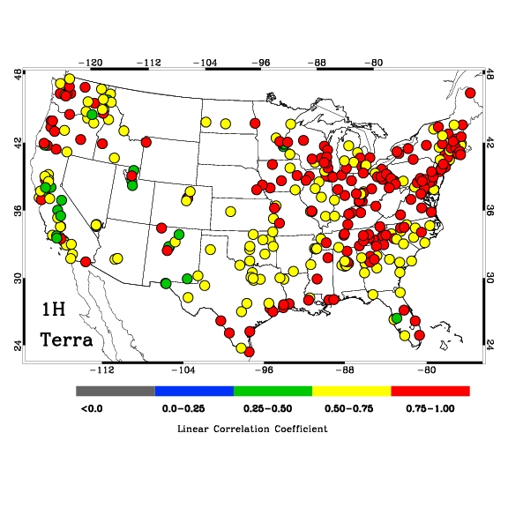
Advantages of using reanalysis meteorology along with satellite data
TVM
MVM

Slide 45
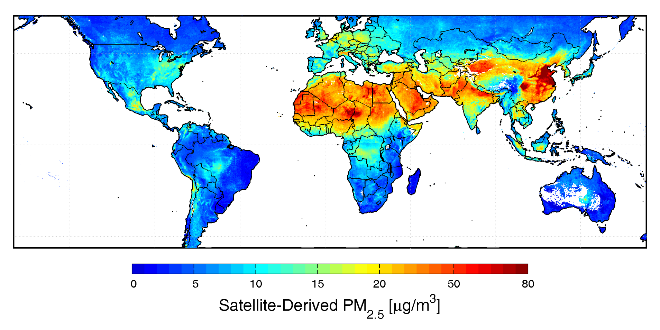
Getting Vertical Information from a Chemical Transport Model
van Donkelaar et al., 2006, 2009
Data Assimilation- Mathur et al., Koelemeijer et al.,

Slide 46
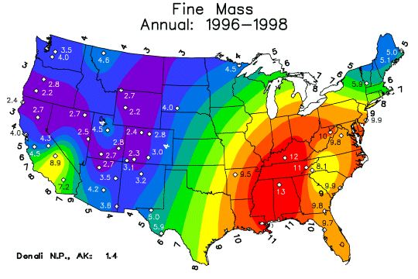
Motivation – Mortality
Many health studies in the past decade has shown the strong association of premature mortality with PM2.5 pollution.
Inter. Pros., 2005
10 µgm⁻³ increase in PM was associated with 8% to 18% increases in mortality risk [Pope et al., 2003].

