Slide 1
HDFLook
Some basic instructions on the functionality of
the HDFLook software.

Slide 2
HDFLook
Start the software by typing:
HDFLook
If the windows are too large to see the control
buttons at the bottom of the software window
start the software with:
HDFLook – z 80 (80 is just an example
you can use any % size tha works)

Slide 3
HDF_read_files window
will open when you start the software.
Use the buttons near the top
or type the directory you
want in the “Directory” window
to navigate to your file location.

Slide 4
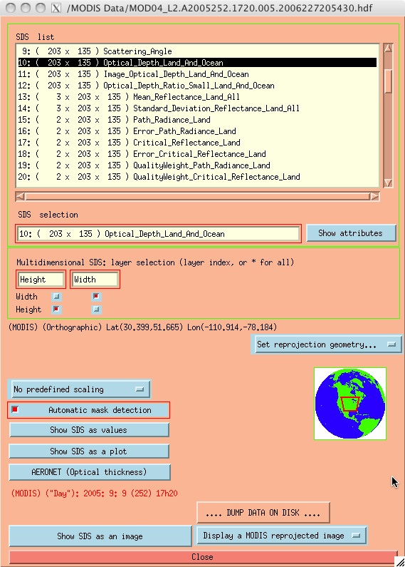
Parameter Selection and Control Window
Parameter Dimensions
Parameter Names
Dimensions and name of
selected parameter
Location of
selected file

Slide 5
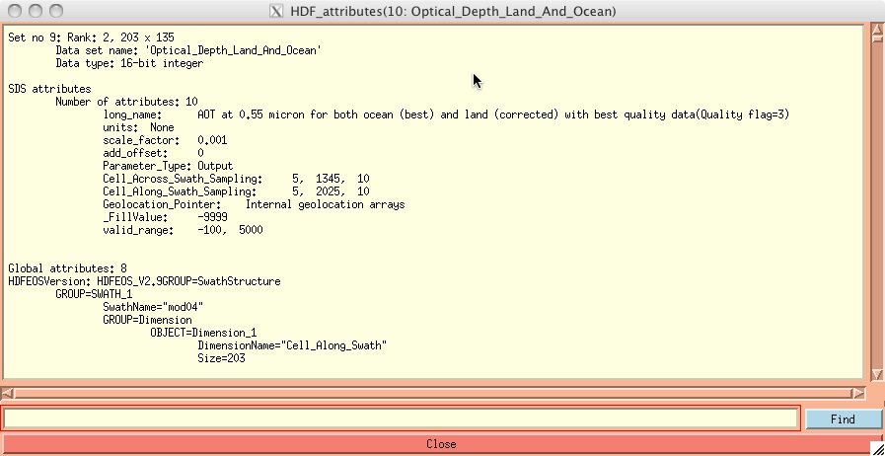
Show Attributes!!!!!!!
To learn more about the selected parameter
Click “Show Attributes”
This window will open with a description
of the selected parameter

Slide 6
Two Different Display Functionalities
Reprojected
Image Display
Controls
Raw Image Display
Controls

Slide 7
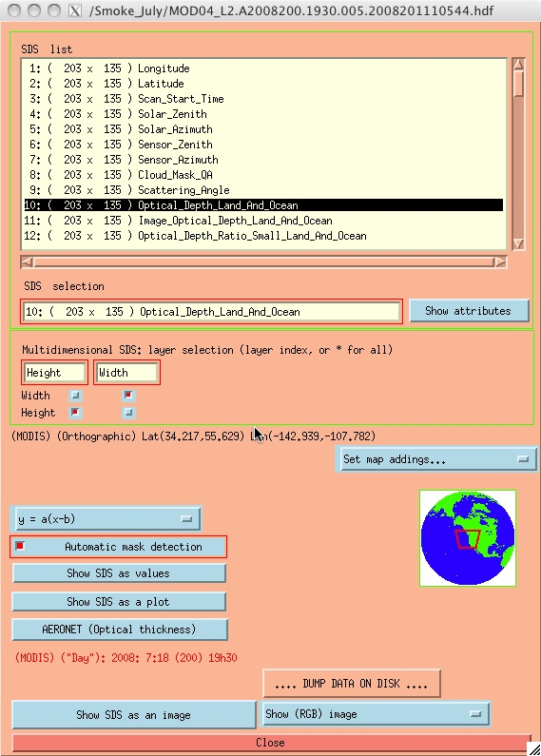
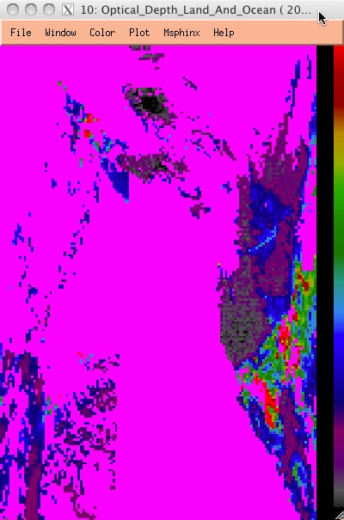
Raw SDS Image Controls
Click here to open a raw
(not reprojected) image of
the selected parameter.

Slide 8
Click on
“Automatic Mask Detection”
to change
the fill value
display from
majenta to black

Slide 9
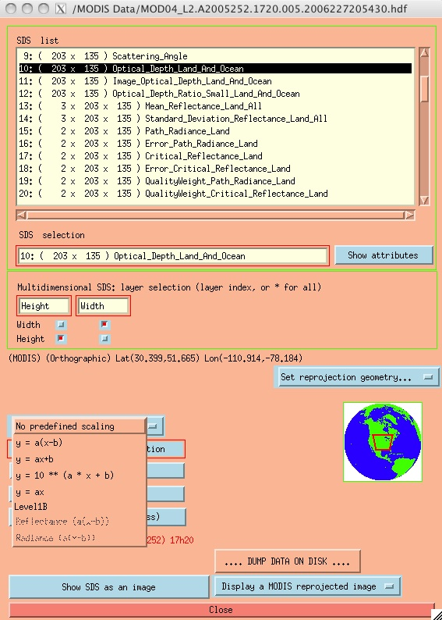
Set Scaling!!
This will not
change the display but will change the values from raw numbers to
actual parameter
values.
Select any of the following scalings:
y = a(x-b)
y = ax+b
y = ax

Slide 10
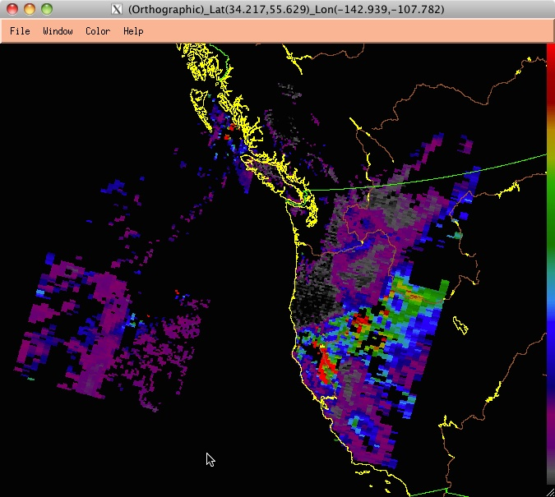
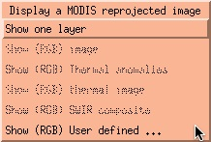
Reprojected Image Controls
For Level 2 Files:
Click and hold the
“Display a MODIS reprojected image” menu
Select “Show one layer”

Slide 11
Raw SDS vs Reprojected Image
The raw image is displayed as
simple rows and columns
The reprojected image is stretched
to reflect real world geography

Slide 12
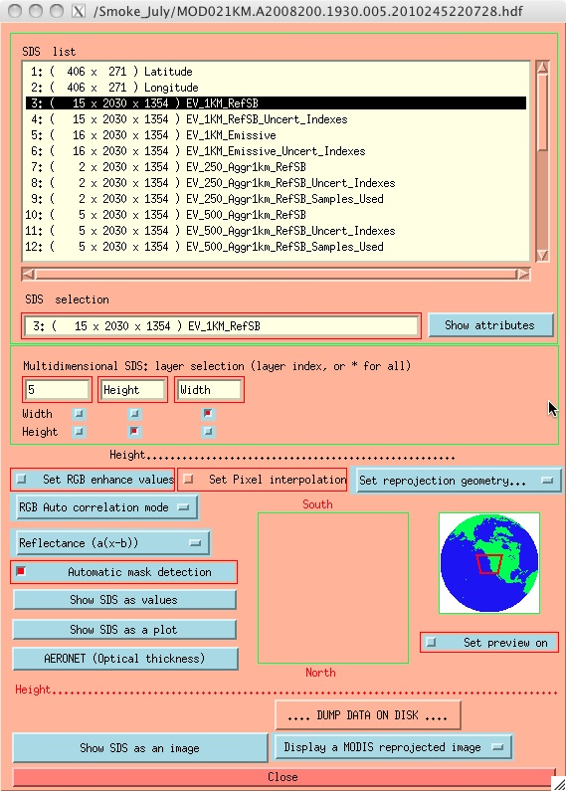
RGB Imagery in HDFLook
Load a MOD02 or MYD02
Level 1B file
Note that several of the available
options in the menus will change.

Slide 13
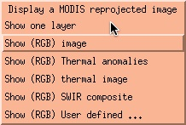
RGB Imagery in HDFLook
There are several pre-defined RGB options available.
The default RGB is a
“true color” image

Slide 14
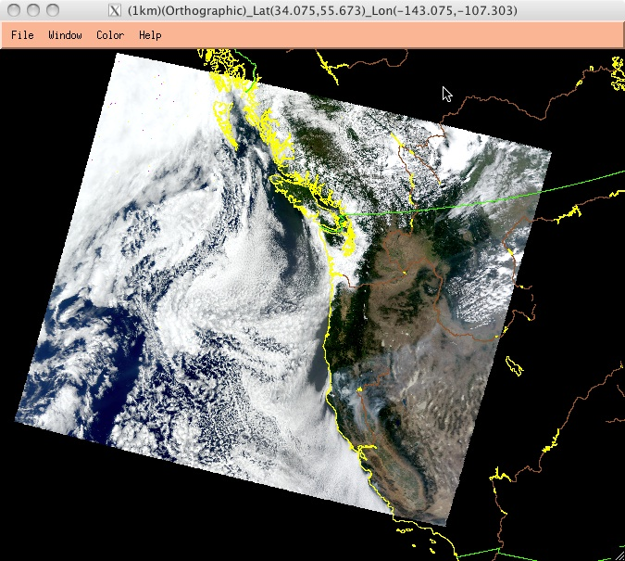
RGB Imagery in HDFLook
The default RGB is a
“true color” image

