Slide 1
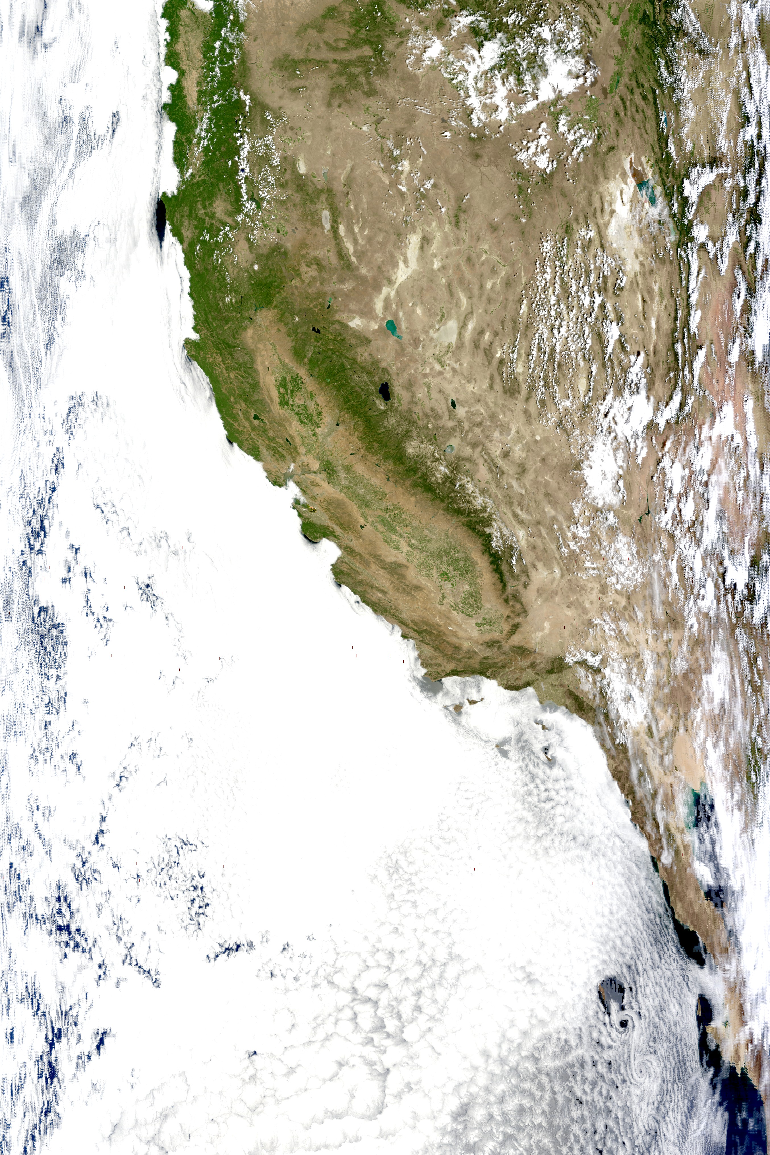
Western Great Basin Reflectance Analysis
and Model Performance
ATMS 792 – Remote Sensing

Slide 2
Outline
Data used / Domain of study / Hypothesis
Model algorithm
How does this model perform for our region?
  2-D spatial plots
  Scatter plots
Magnitude of error dependent on region
Overall climo (kind of…) stats
Conclusion

Slide 3
Data / Methods
Reduce noise and parse out mostly clear days for June-July 2010/2011
  Month w/ least amount of erroneous surface reflectance values
  Minimal monsoonal influence
Hand picked 24 days total to work with
  13 days in 2010
  11 days in 2011
NOTE: Snow caps during summer add higher values = increased variance

Slide 4
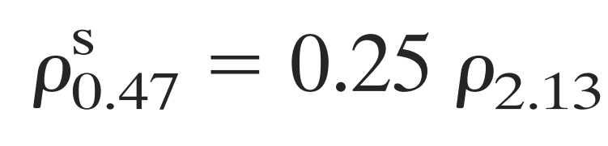
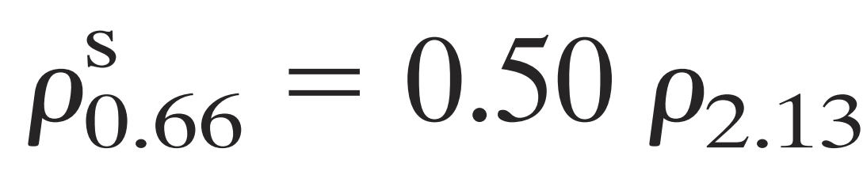
Theoretical Model Equations
Remer (2005)
Needs clear skies……… Good luck
Needs clean air…….. Good luck again
Works well in vegetated regions. Really?
How about arid regions? (East of Reno)

Slide 5
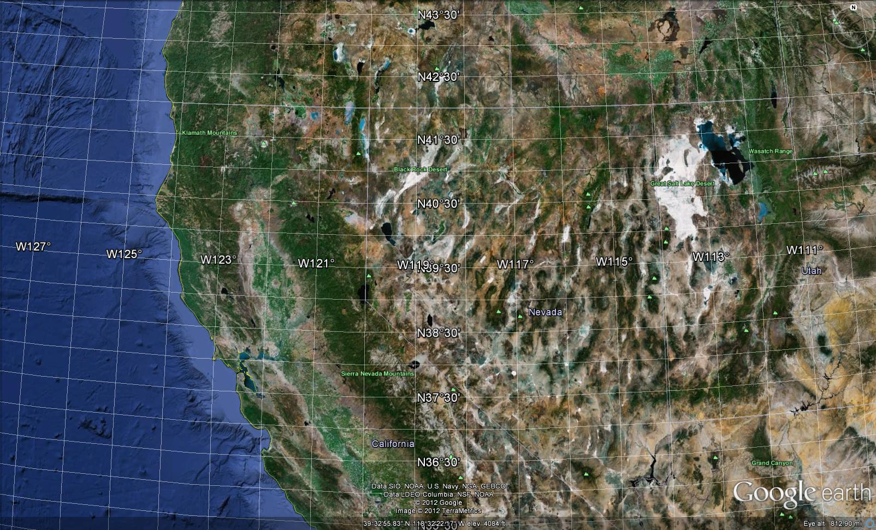

Slide 6
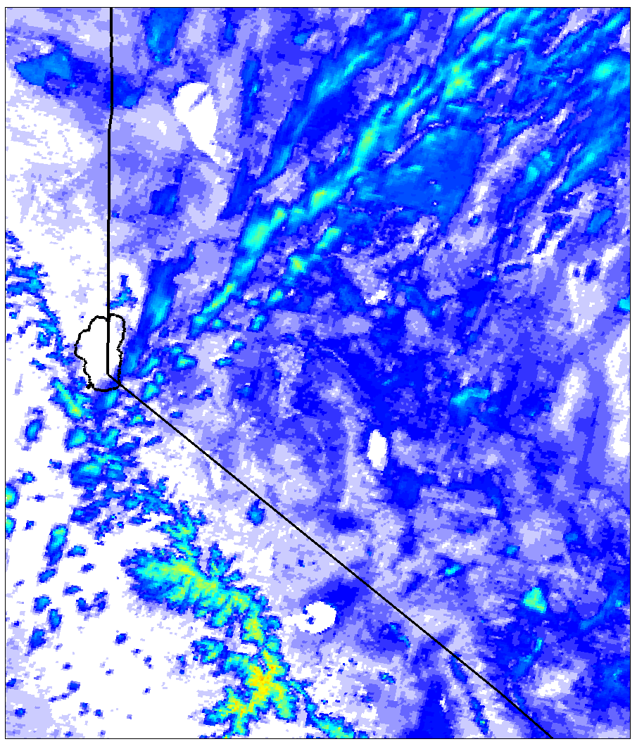
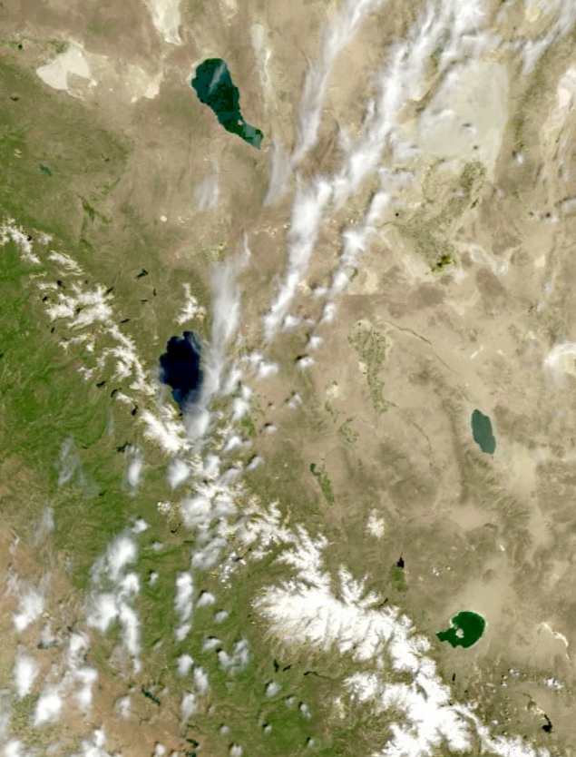
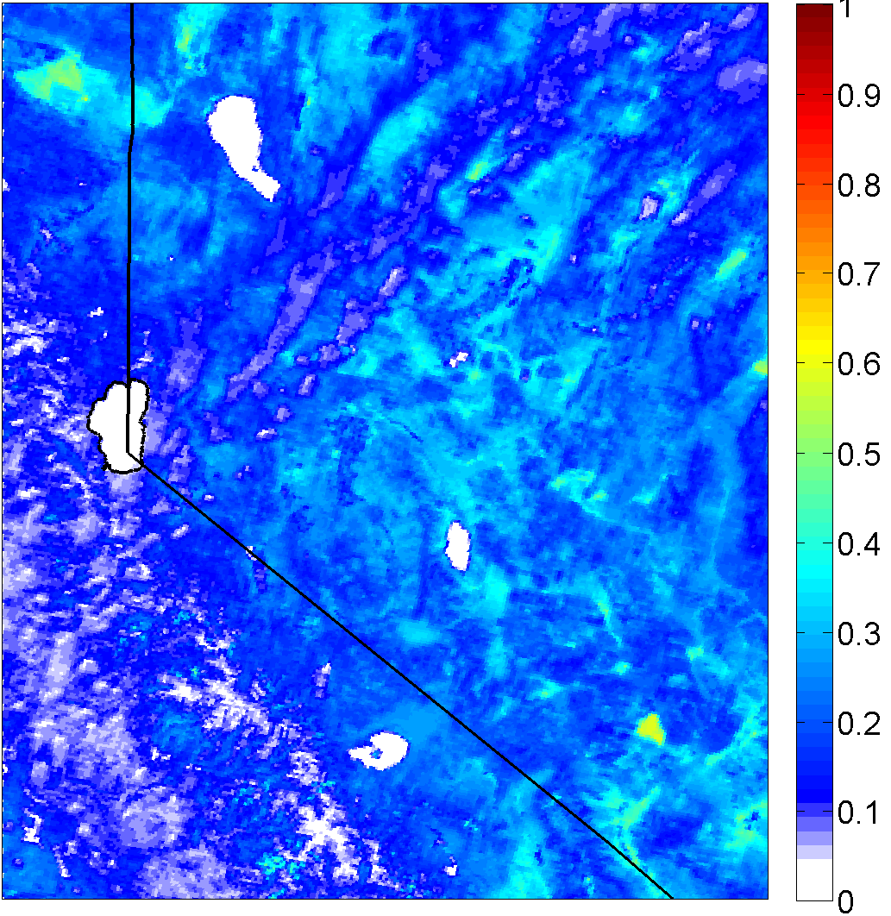
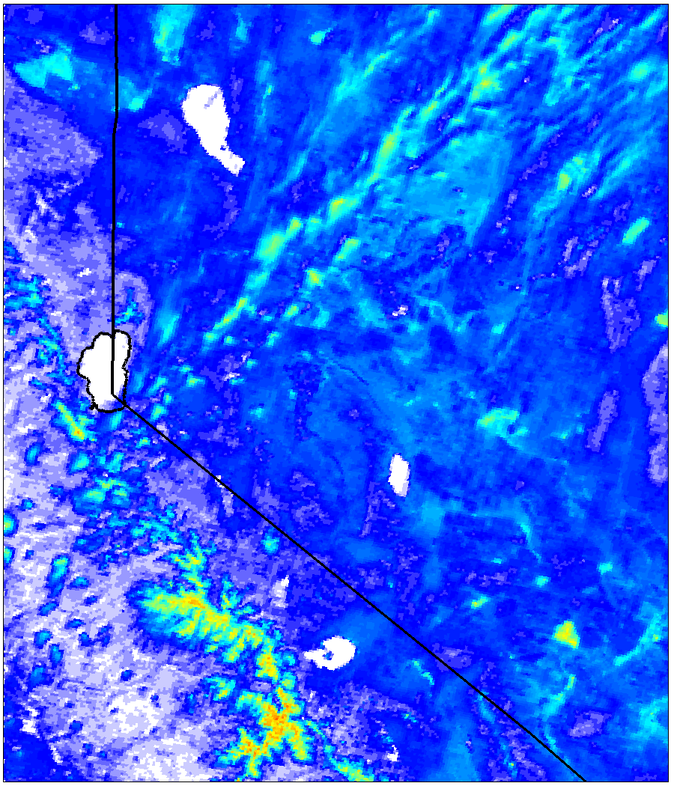
Raw images and their respective reflectance
21 June 2011 (Upper-level Cirrus)
470nm
2130nm
660nm

Slide 7
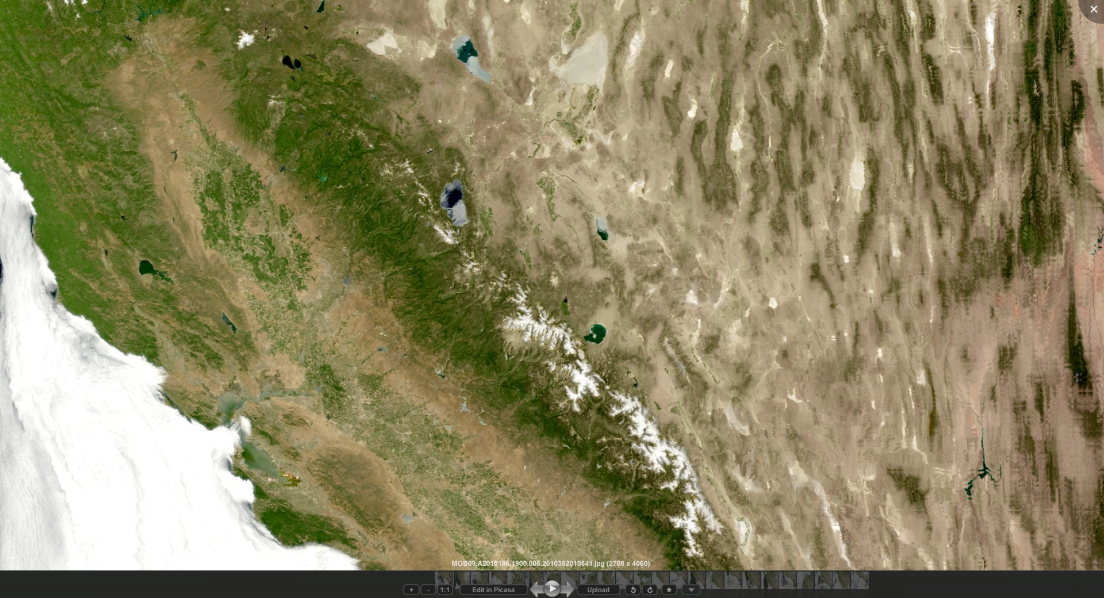
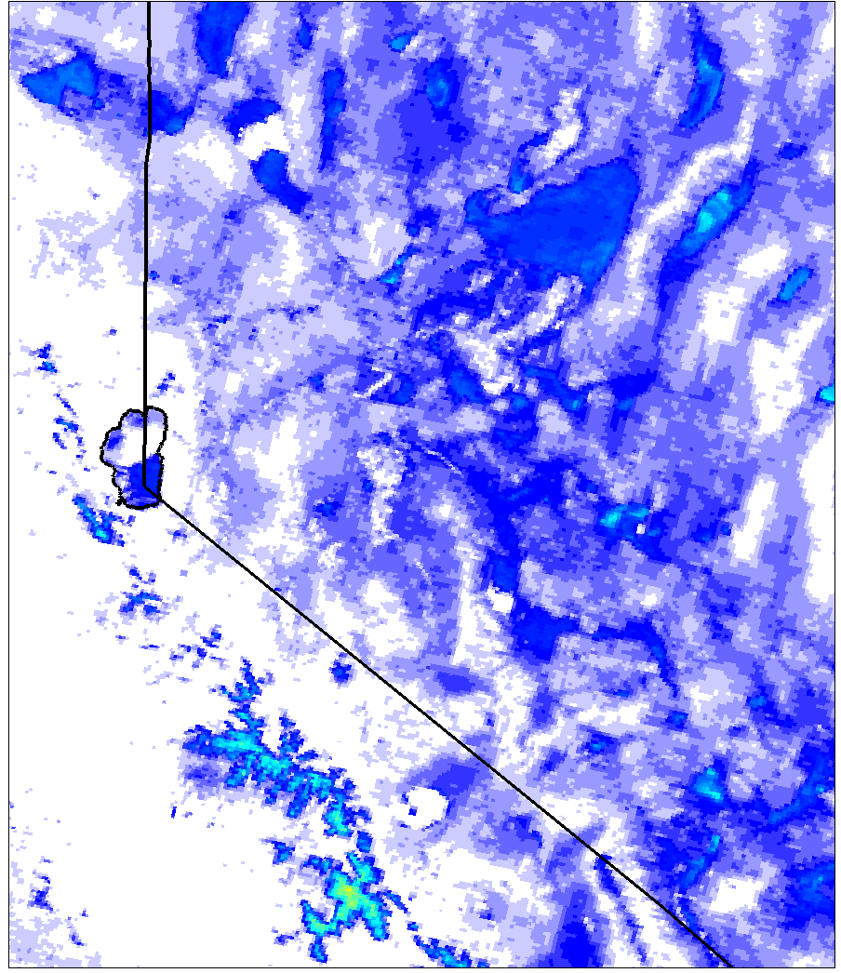
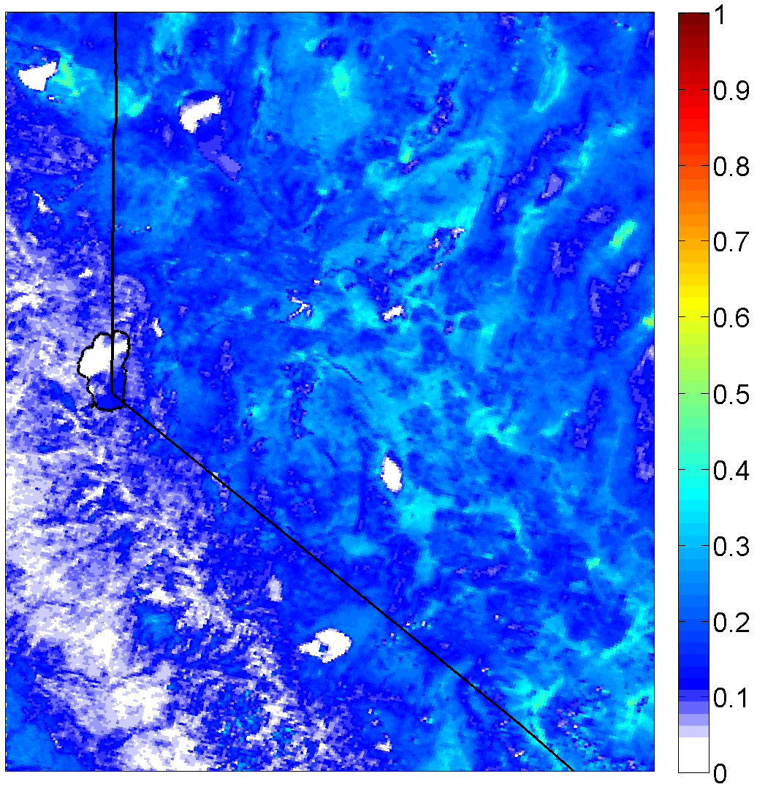
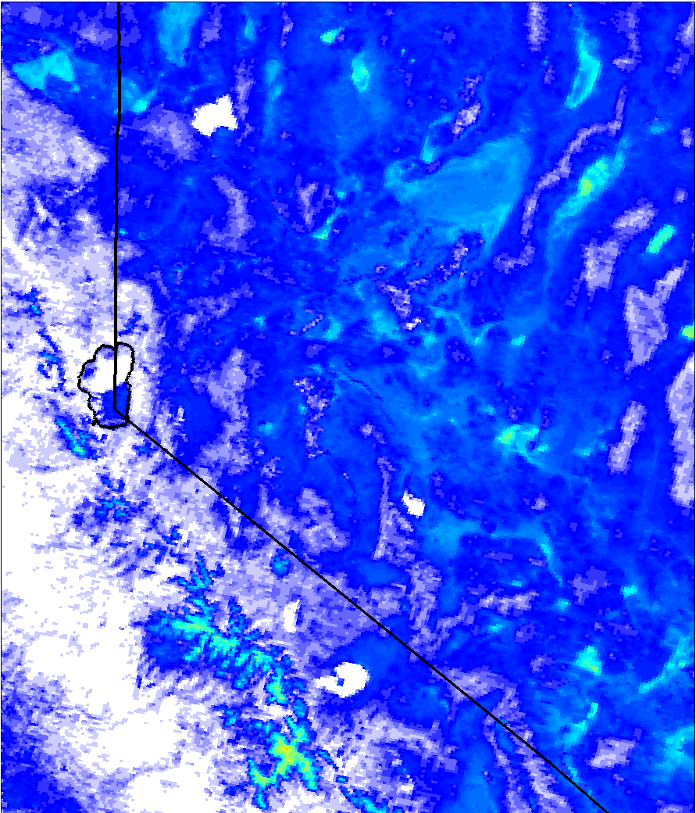
Raw images and their respective reflectance
5 July 2010 (Perfectly clear)
470nm
2130nm
660nm

Slide 8
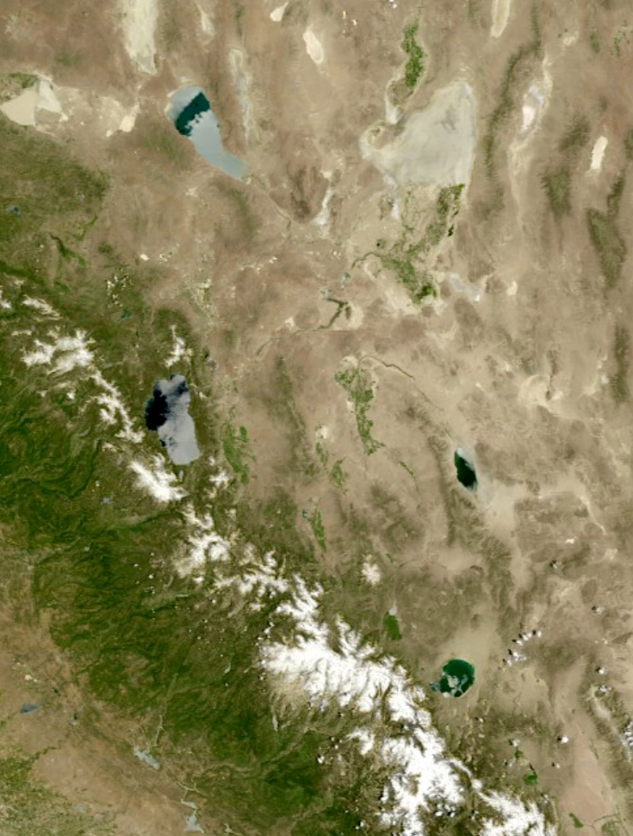
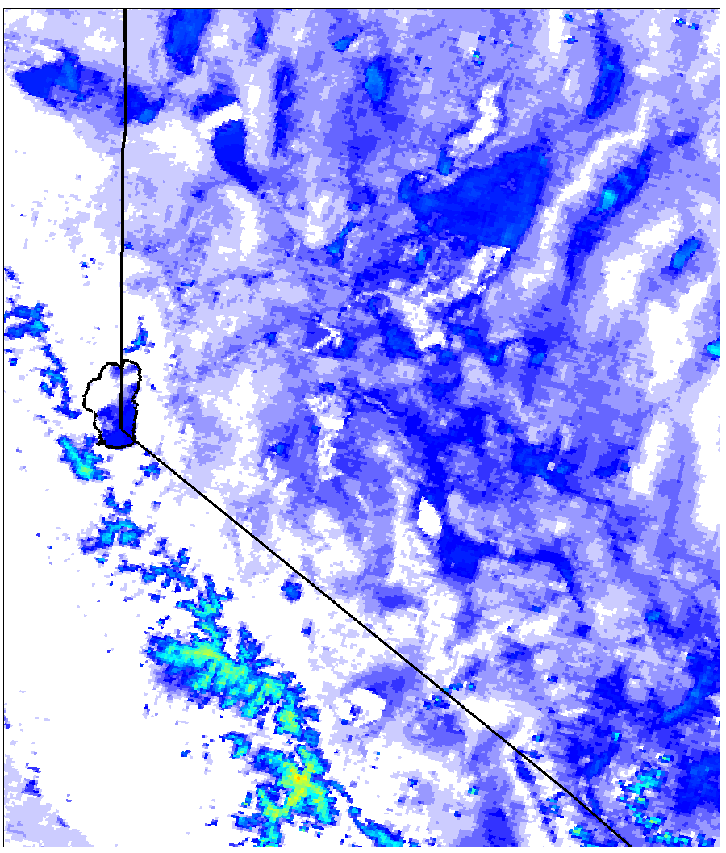
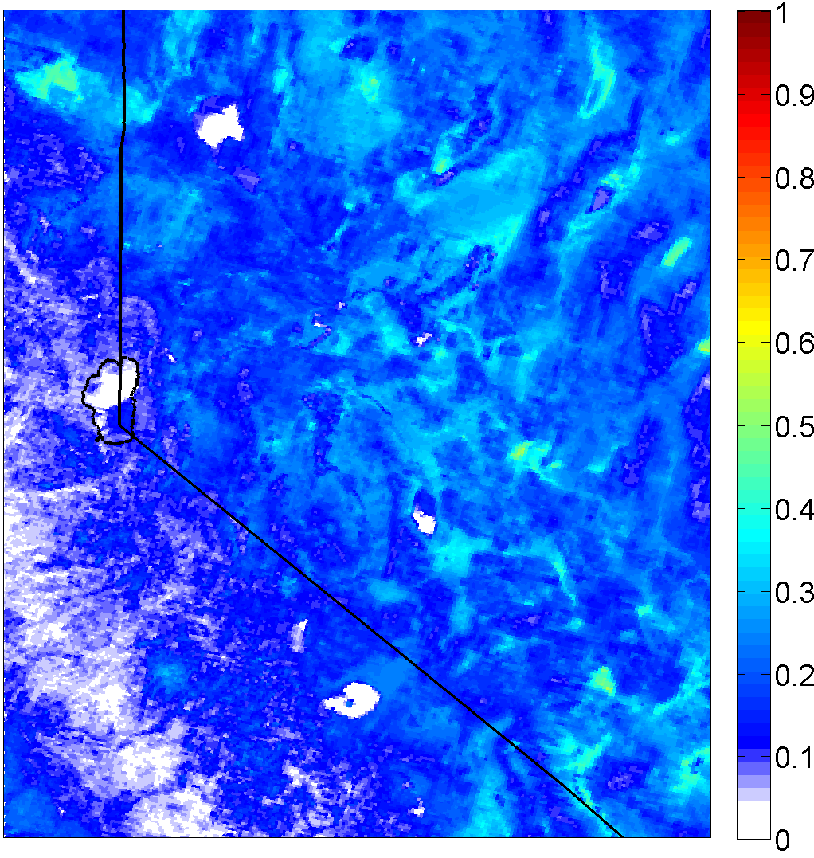
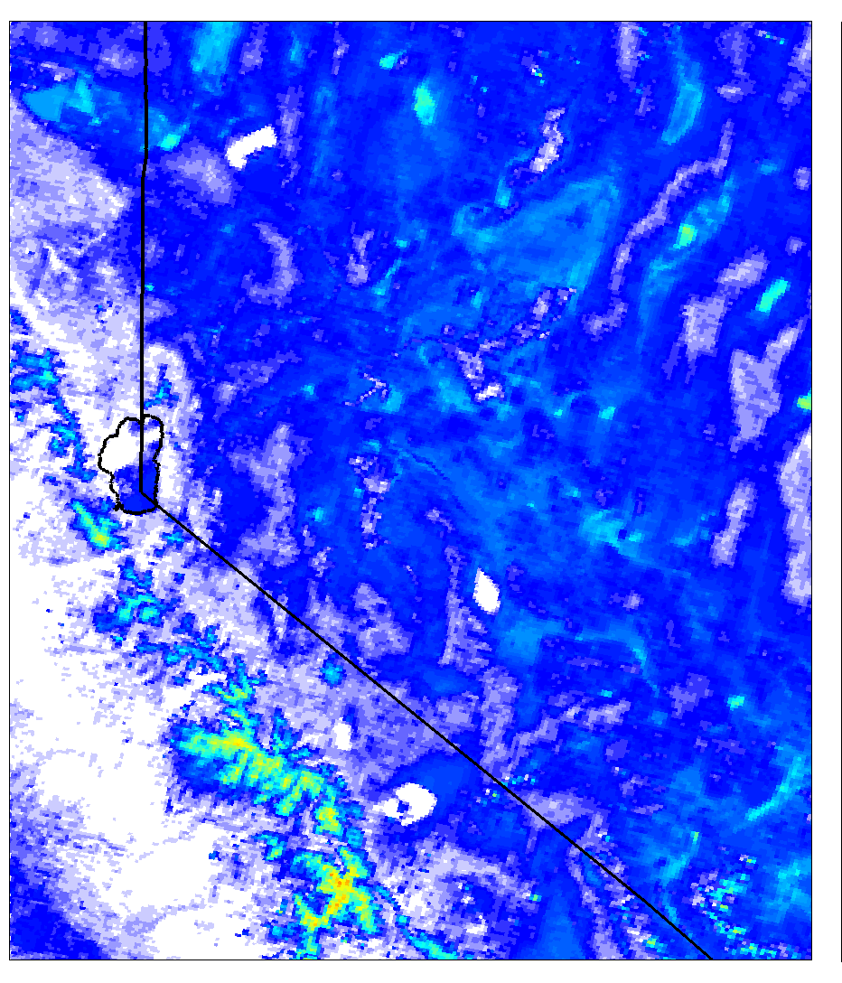
Raw images and their respective reflectance
8 July 2011 (Perfectly clear)
470nm
2130nm
660nm

Slide 9
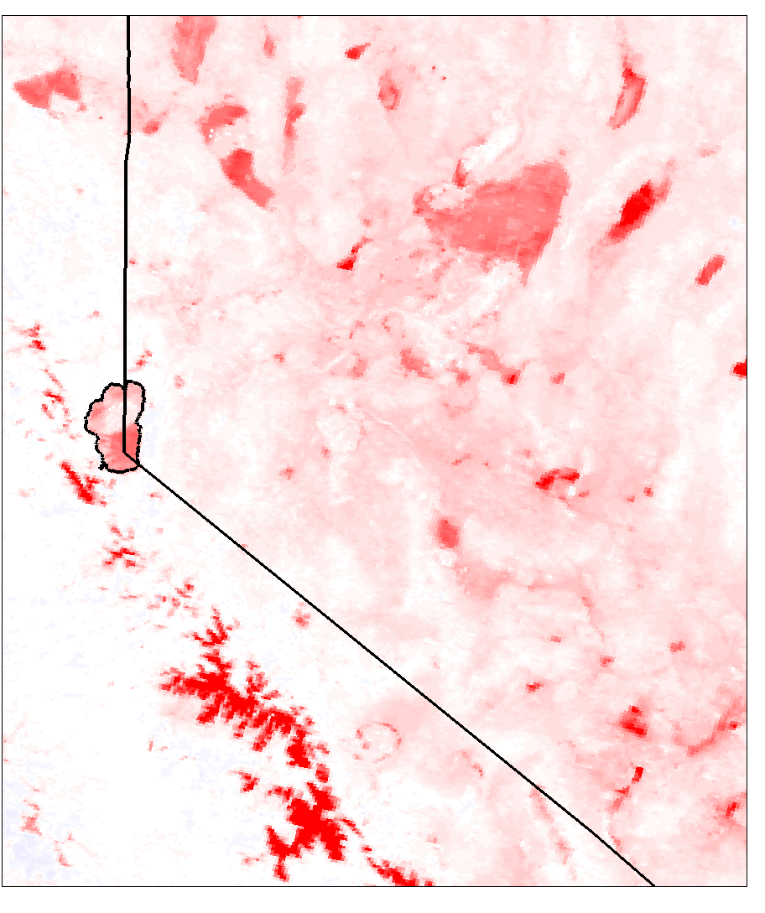
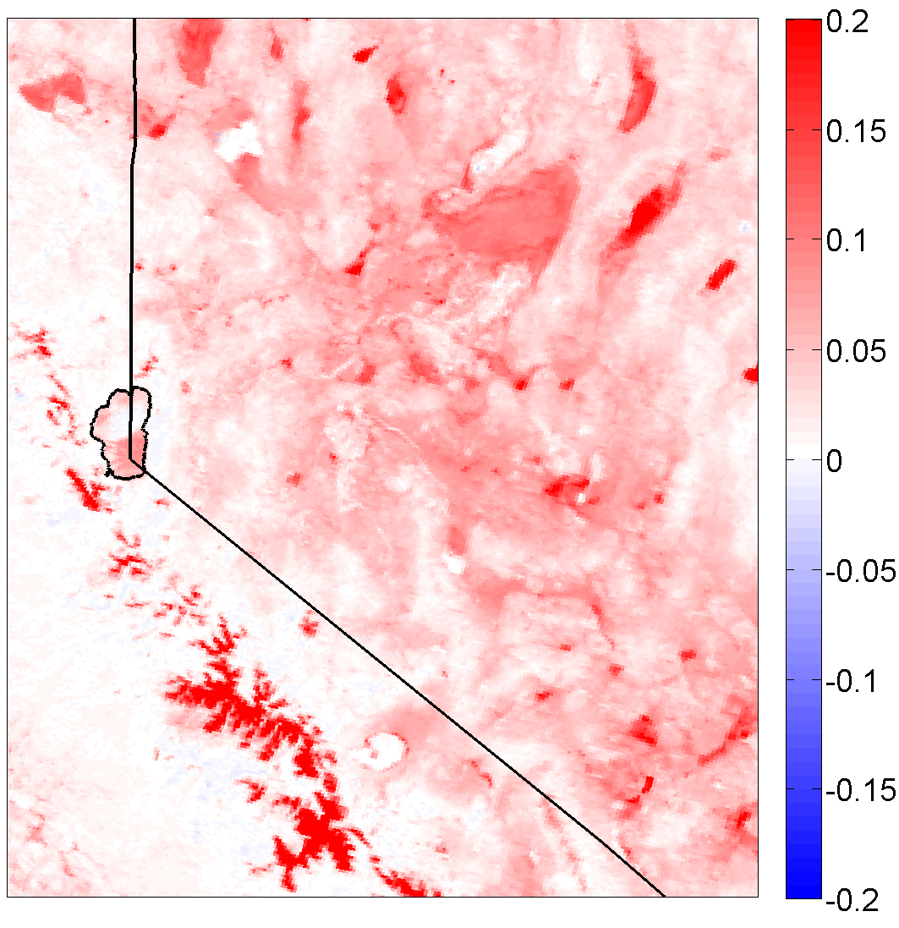
Spatial Anomalies (Target minus Predicted)
5 July 2010
470nm
660nm
Model under predicts reflectance at both wavelengths
Green-vegetated areas with no snow closely agree w/ model

Slide 10
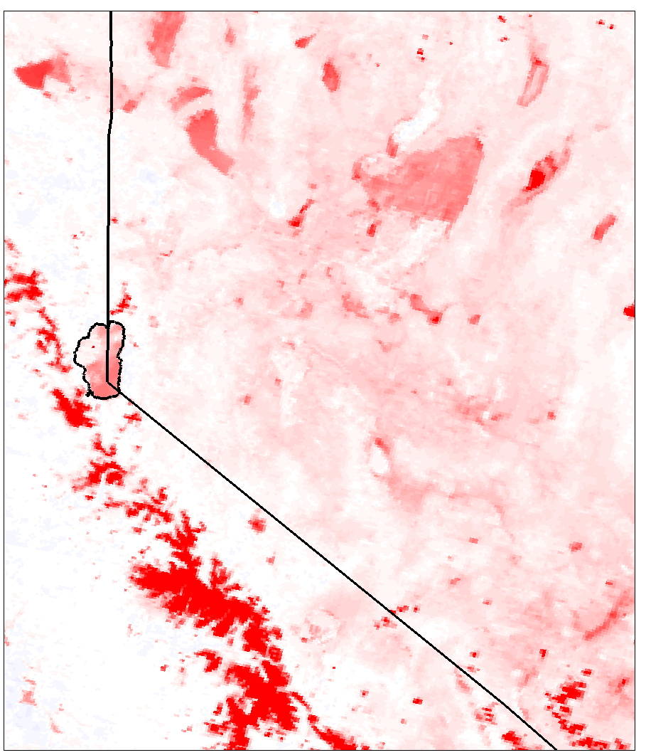
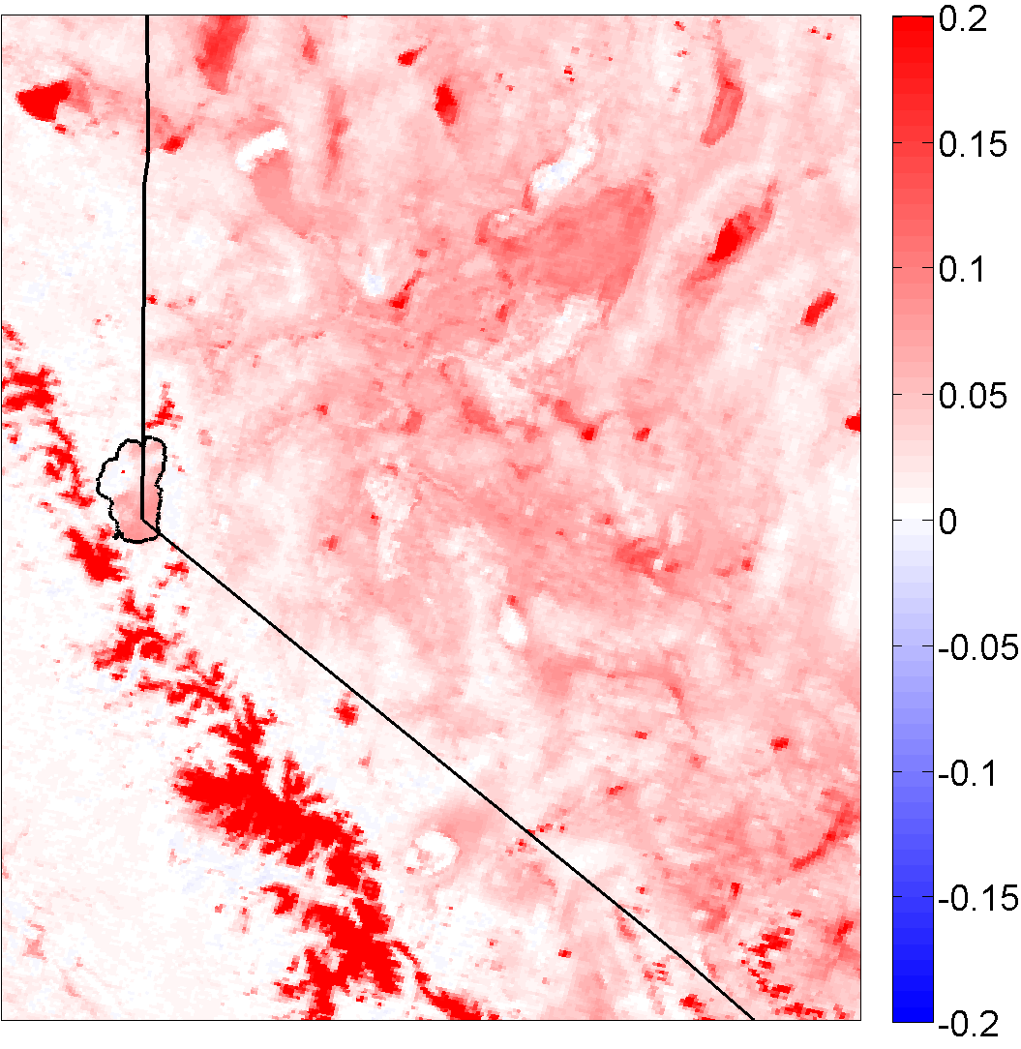
Spatial Anomalies (Target minus Predicted)
8 July 2011
470nm
660nm
Model under predicts reflectance at both wavelengths
Green-vegetated areas with no snow closely agree w/ model

Slide 11
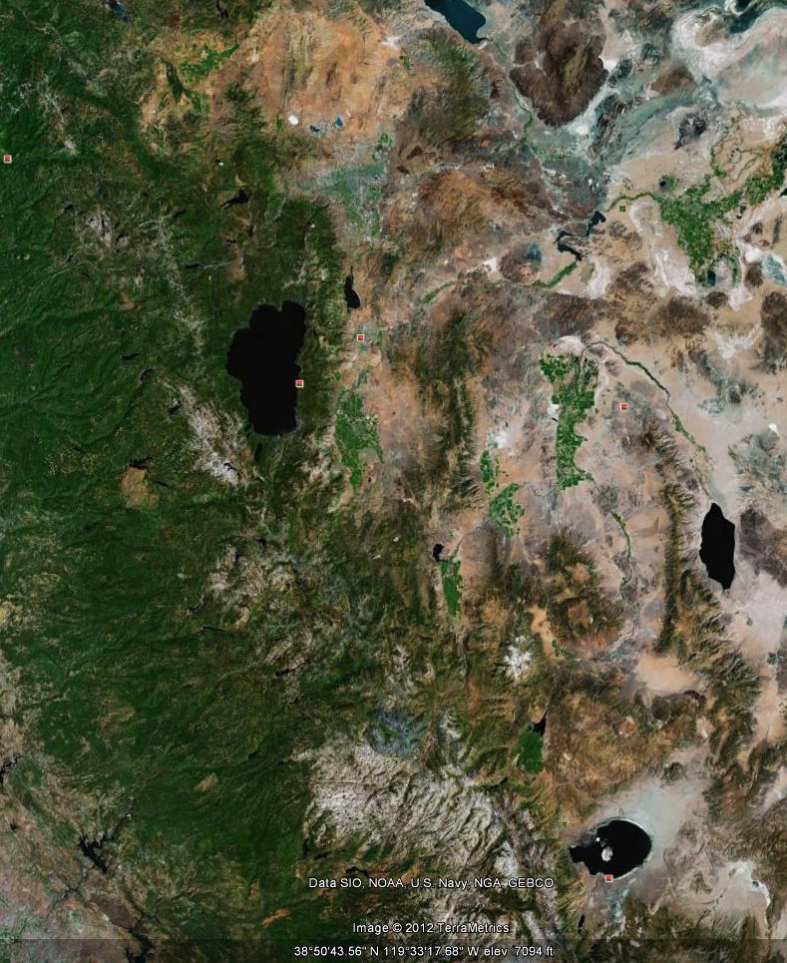
Divide data into two domains
  Green/Lush/Forest
  Dry/Arid/Desert
~ 9500 data points in each box
How does the Remer (2005) equation perform in both regions?

Slide 12
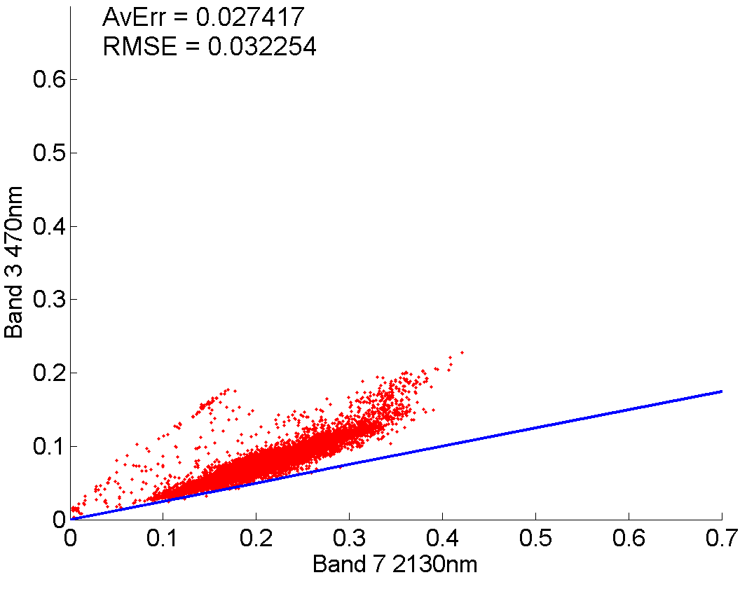
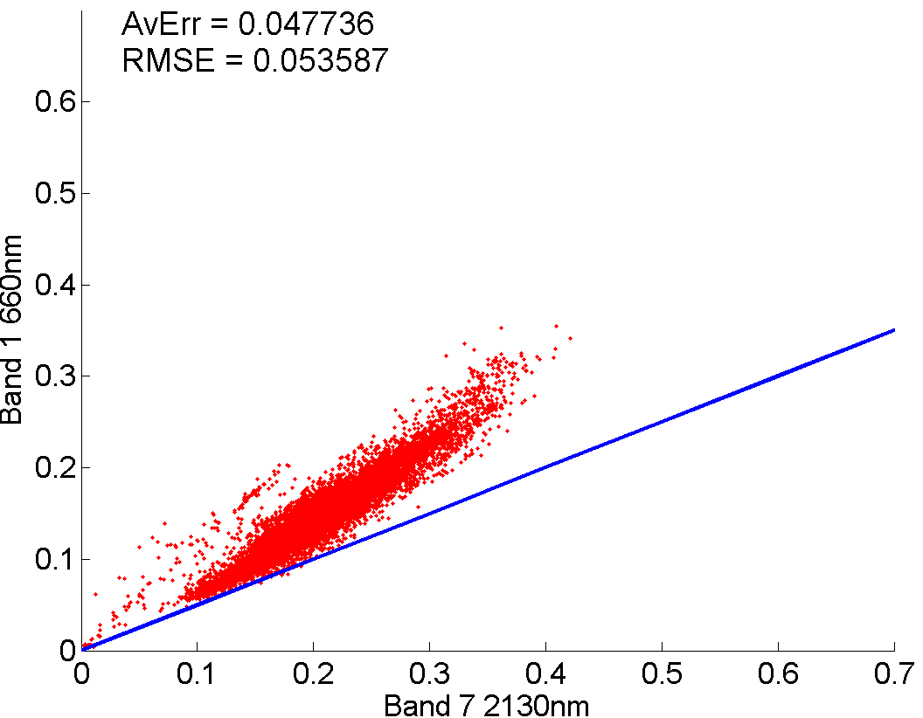
So how does the model perform in the two different land regimes?
5 July 2010 – Dry Regime
470nm Scatterplot
660nm Scatterplot
Y=.25x
Y=. 5x
470nm consistently out performs 660nm
Average Error and RMSE always greater at 660nm

Slide 13
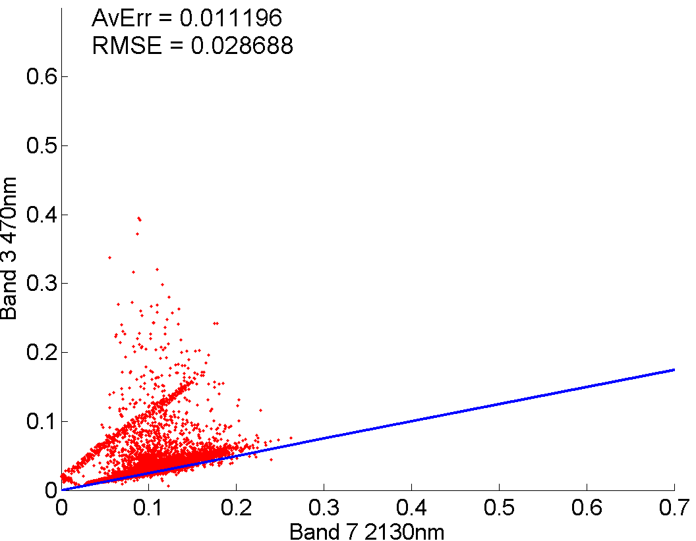
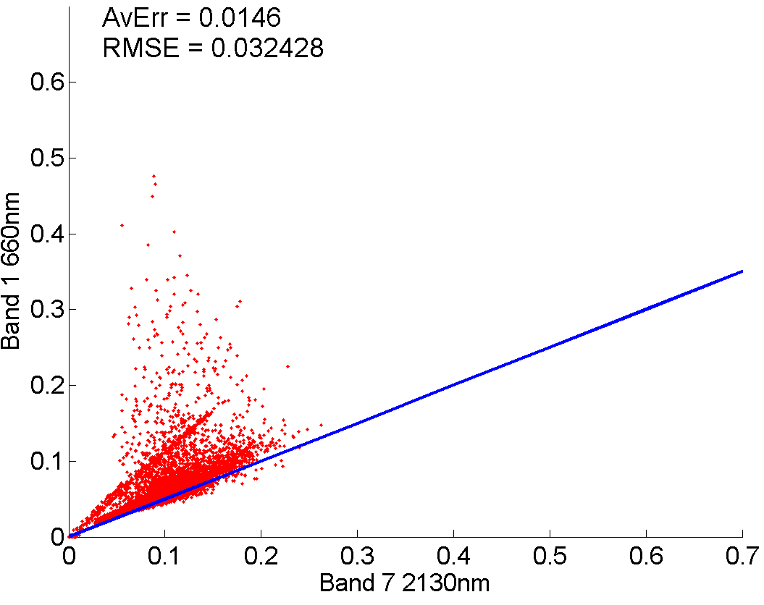
So how does the model perform in the two different land regimes?
5 July 2010 – Forest/Lush Regime
470nm Scatterplot
660nm Scatterplot
Y=.25x
Y=. 5x
Weird “line” of data points may be due Lakes in domain (1:1 ratio)
Only ~1-1.5% error

Slide 14
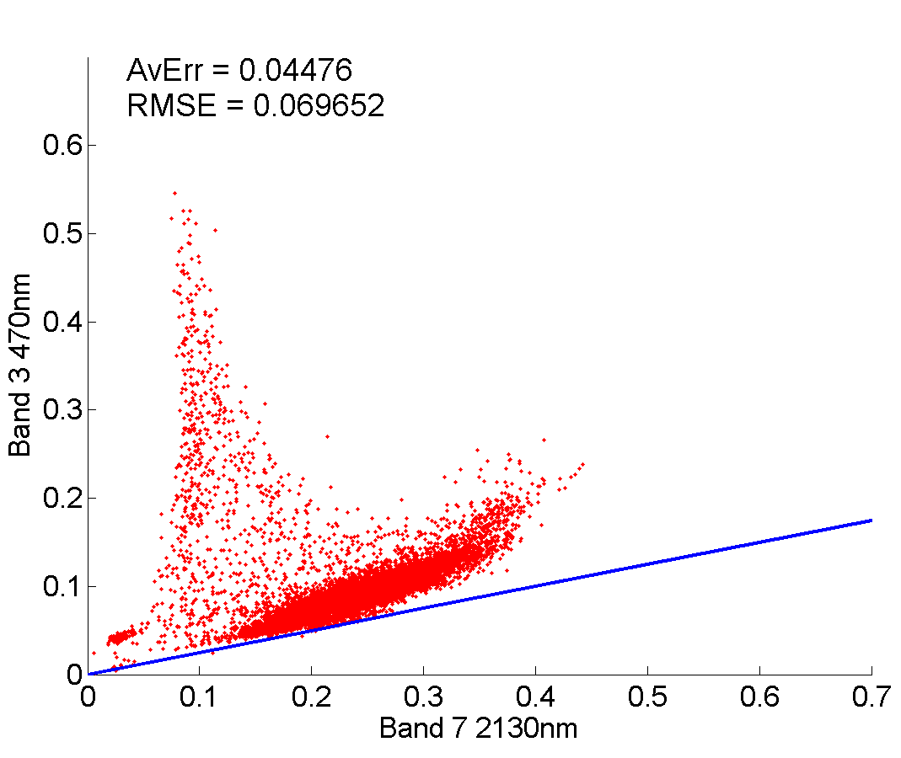
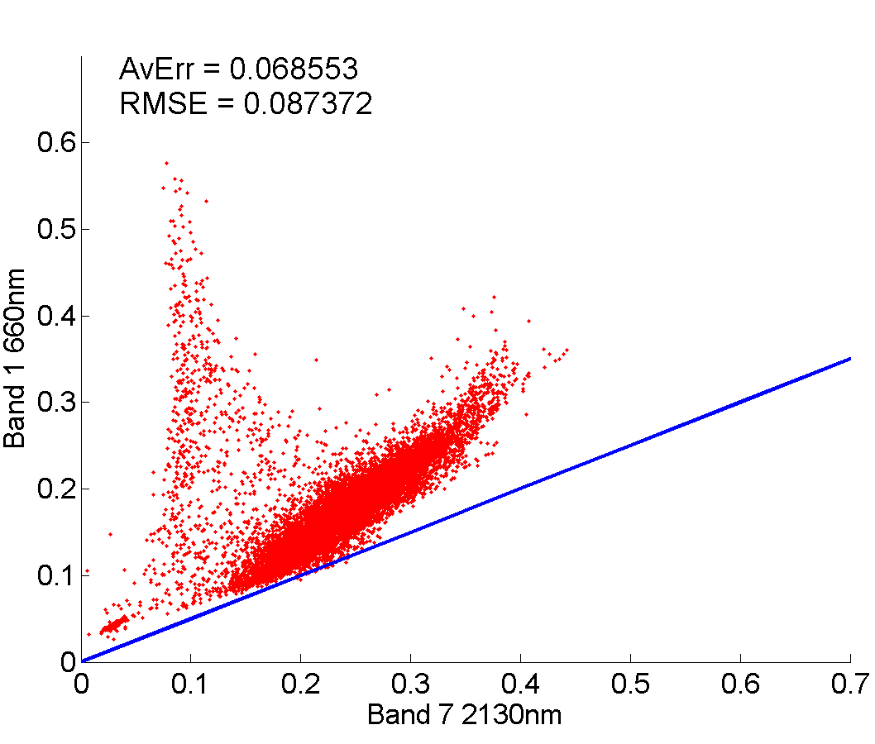
So how does the model perform in the two different land regimes?
8 July 2011 – Dry Regime
470nm Scatterplot
660nm Scatterplot
Y=.25x
Y=. 5x
470nm again out performs 660nm statistically

Slide 15
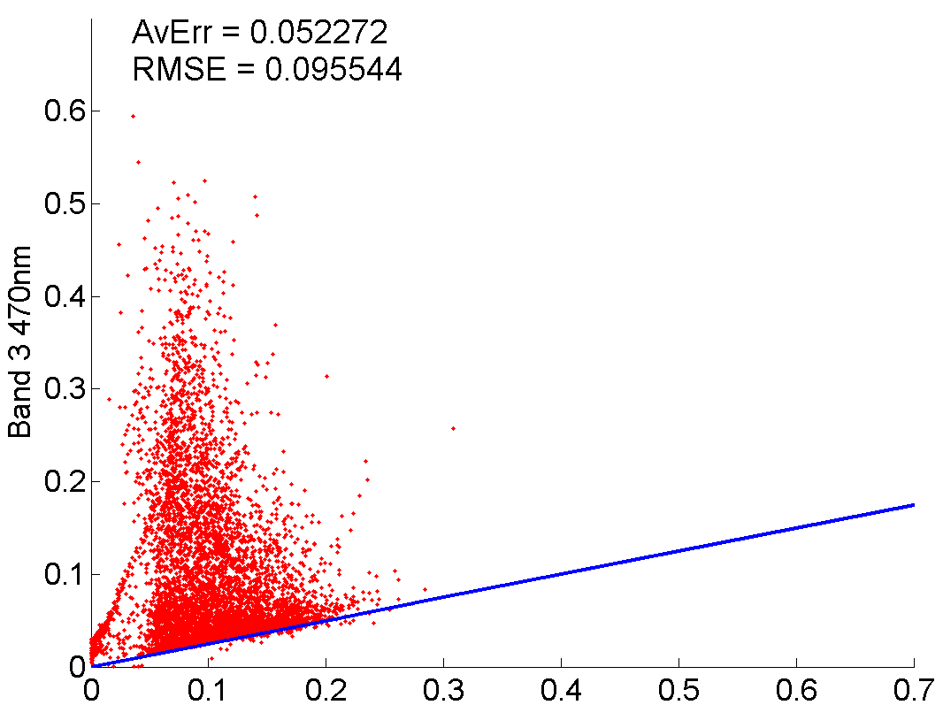
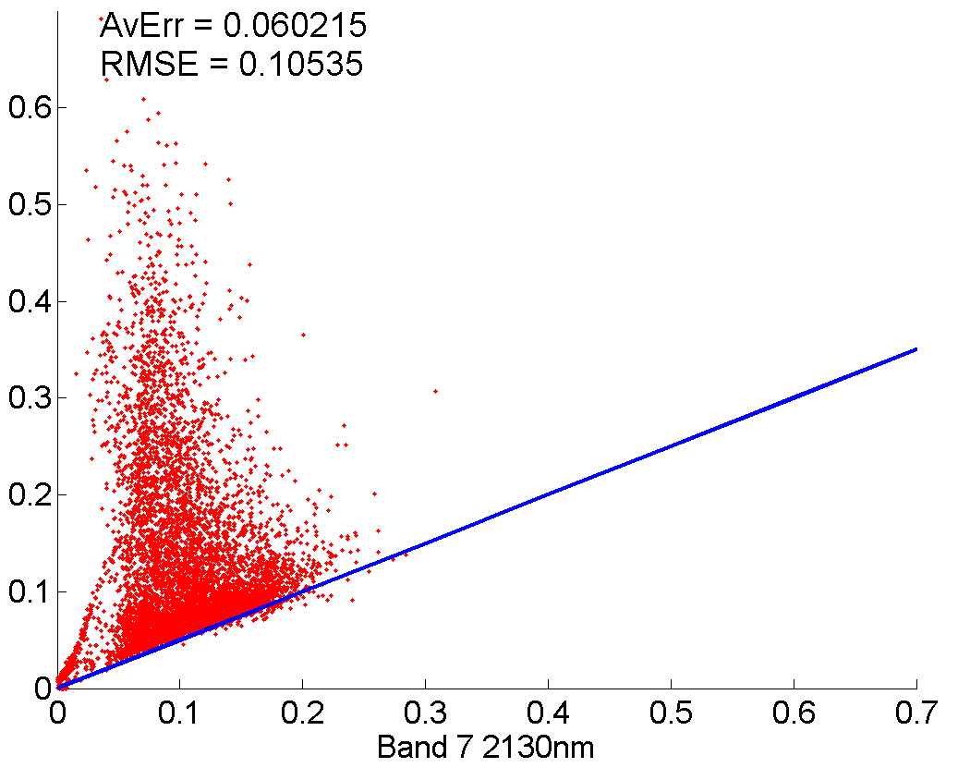
So how does the model perform in the two different land regimes?
8 July 2011 – Forest/Lush Regime
470nm Scatterplot
660nm Scatterplot
Y=.25x
Y=. 5x
Huge snow season before this summer
More widespread snow pack increases variance
Still only 5% error

Slide 16
Statistics
“Climatology” over all 24 days
 | 660 – 660th Forest/Lush Desert/Arid |  | 470 – 470th Forest/Lush Desert/Arid
Average Error | .0530 | .0550 | .0469 | .0338
Root Mean Square Error | .0938 | .0648 | .0852 | .0457

Slide 17
Conclusion
Observed reflectance > model reflectance in dry/desert regions of W. Great Basin
Observed reflectance is higher in mountains/forest/lush areas
  But… Data is skewed higher due to snow caps
  Would be almost 1:1 if snow caps didn’t exist.
Difficult to measure performance of observed and model due to seasonal variance (i.e. snow caps, monsoonal cloud tops, etc.)
Model best used in “greener” regions and not highly reflective desert surfaces
Best results after “drier” wet seasons.
Filtering/smoothing process could have been used but this muddles raw data.

Slide 18
Questions?

