Slide 1
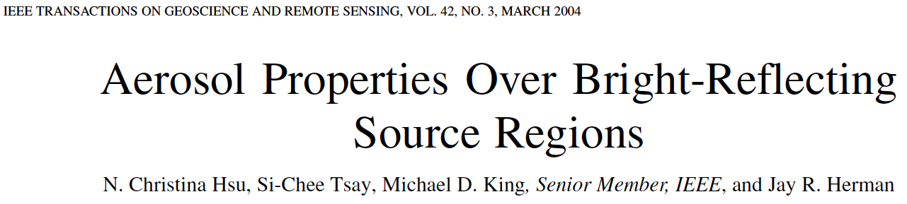
Deep Blue Algorithm: Retrieval of Aerosol Optical Depth using MODIS data obtained over bright surfaces
Example from the Saharan Desert.
Deep Blue Algorithm from this reference.

Slide 2
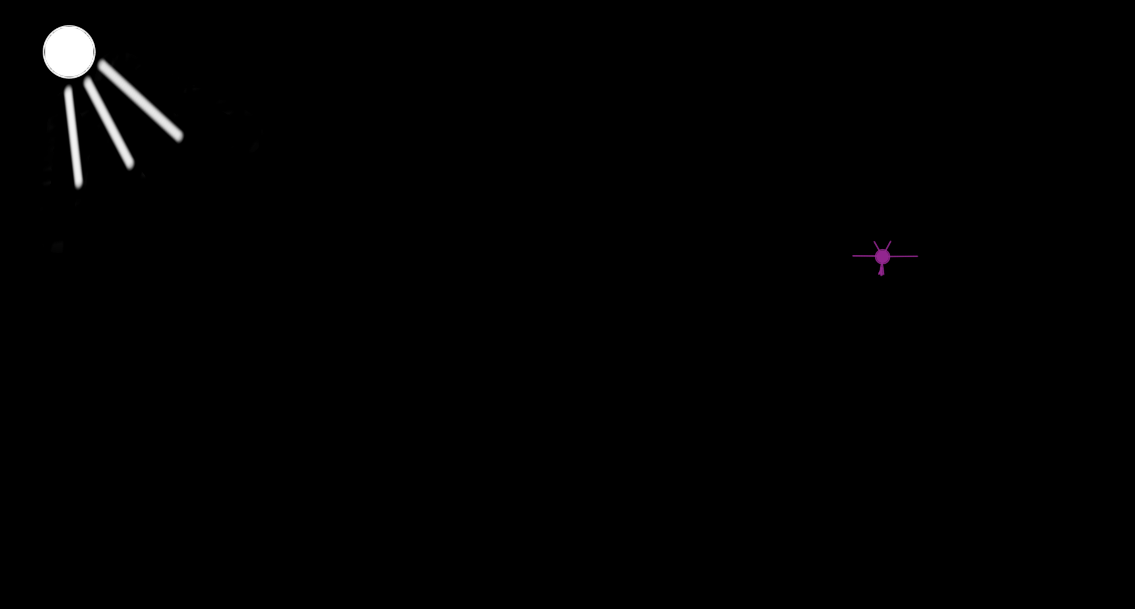
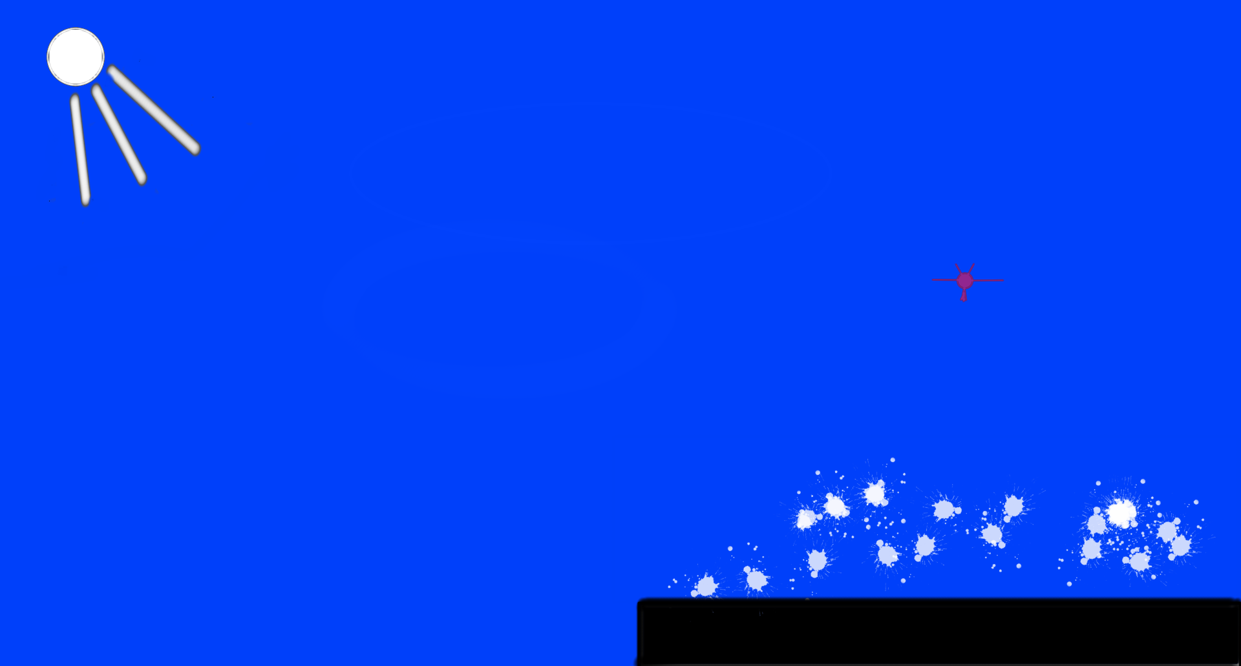

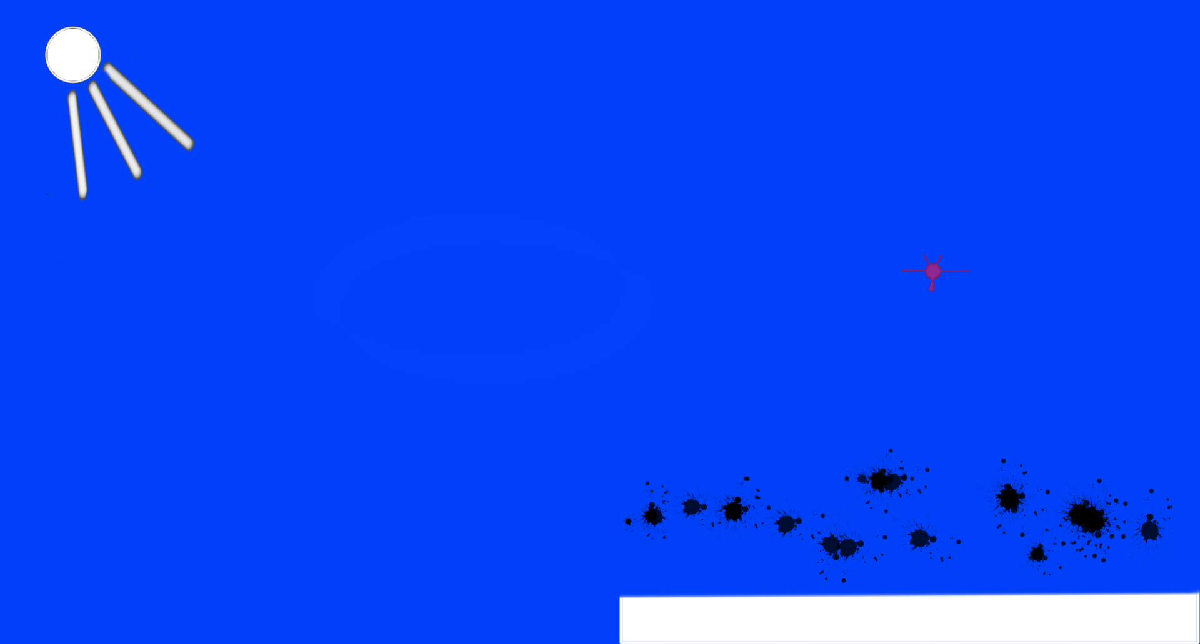
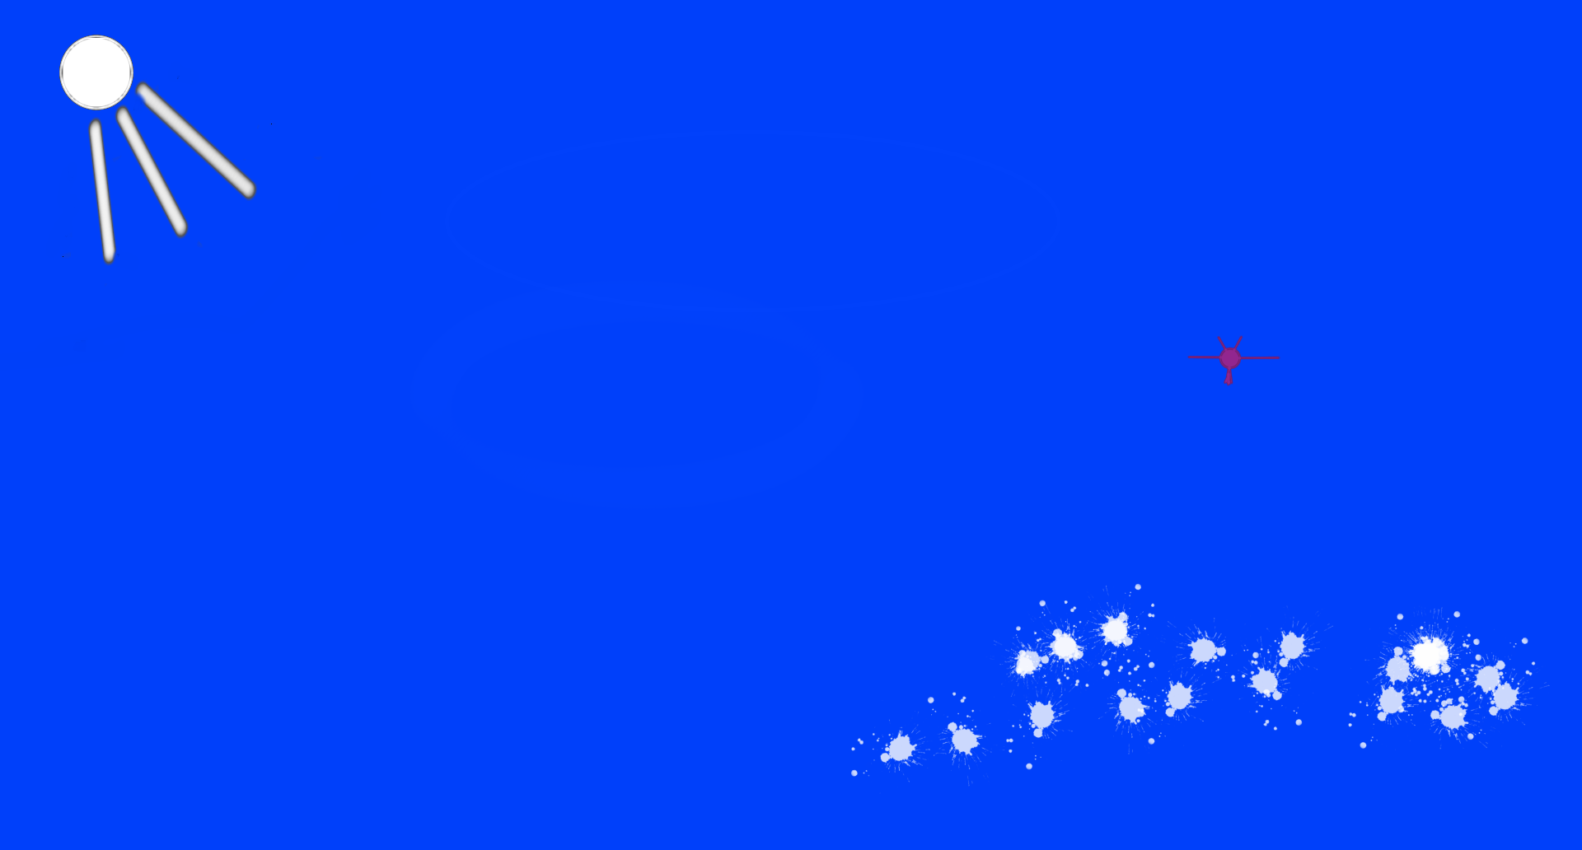
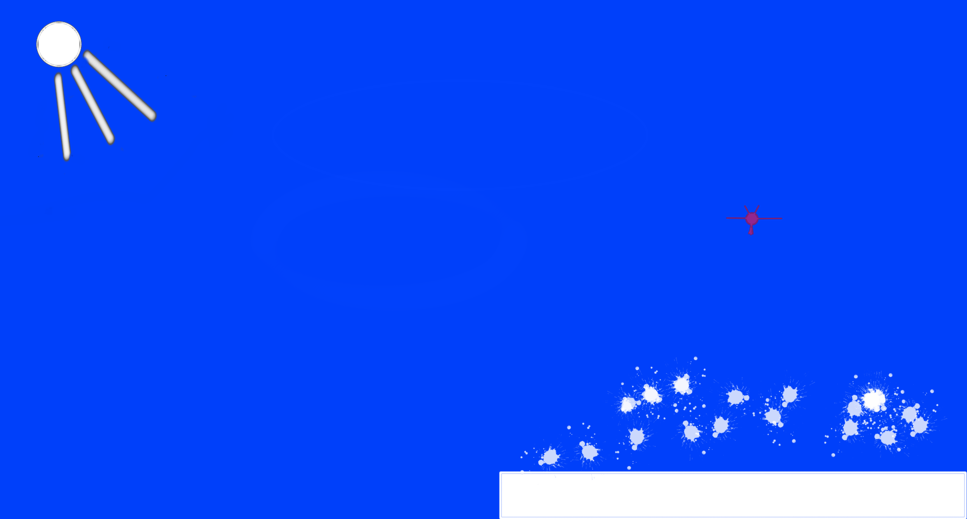
darkness
Bright aerosol
brighten dark surface
Blue sky
Dark aerosol
darken bright surface
Blue sky bright aerosol
Bright aerosol
above bright surface

Slide 3
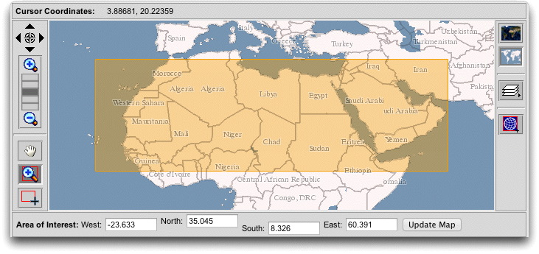
Suppose we want the AOD for this important region of the world …

Slide 4
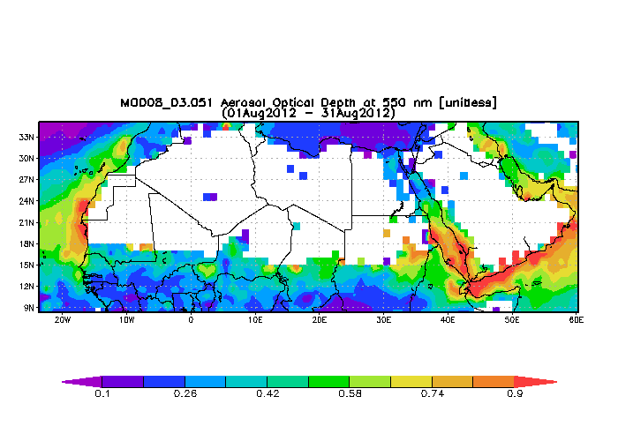
MODIS/TERRA, Standard ‘Dark Target’ Algorithm, provides no data for most of the region because the surface of the Saharan Desert is so bright.

Slide 5
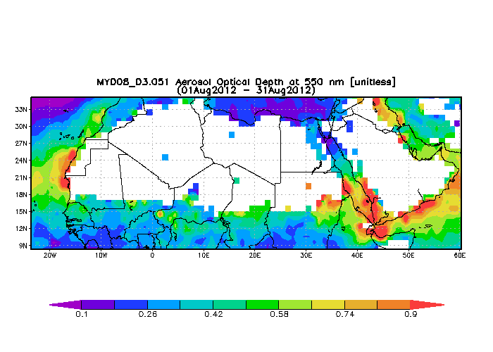
Same for MODIS/AQUA.

Slide 6
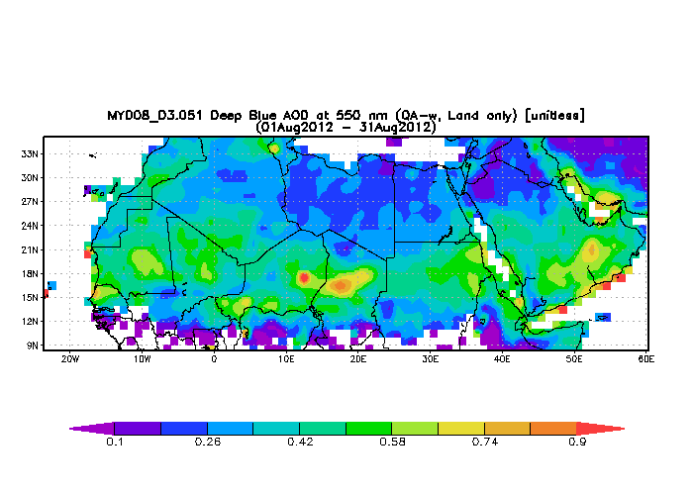
The Deep Blue Algorithm applied to MODIS/AQUA data does provide AOD retrievals ☺

Slide 7
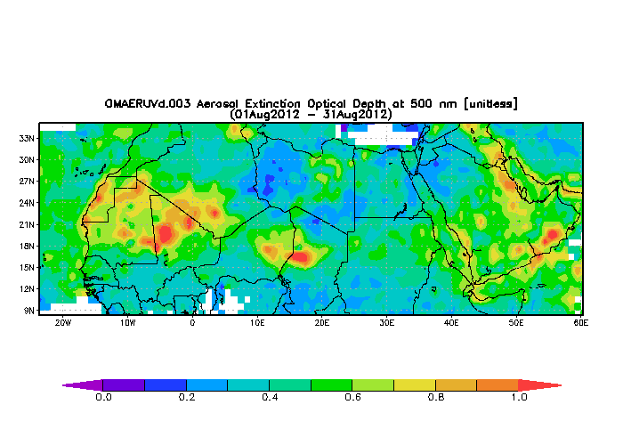
Compare: Aerosol Optical Depth from the Ozone Monitoring Instrument data set retrieval.

Slide 8
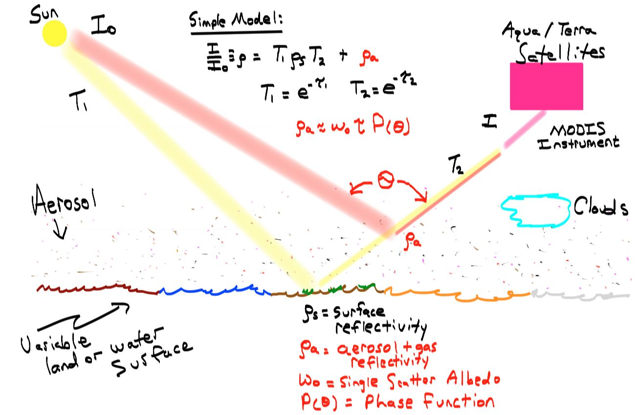
Review: Two pathways for light to MODIS
Can we adjust aerosol amount, and surface reflectivity, so that clear sky reflectivity
(Rayleigh scattering only) would be the same as in the aerosol case?

Slide 9
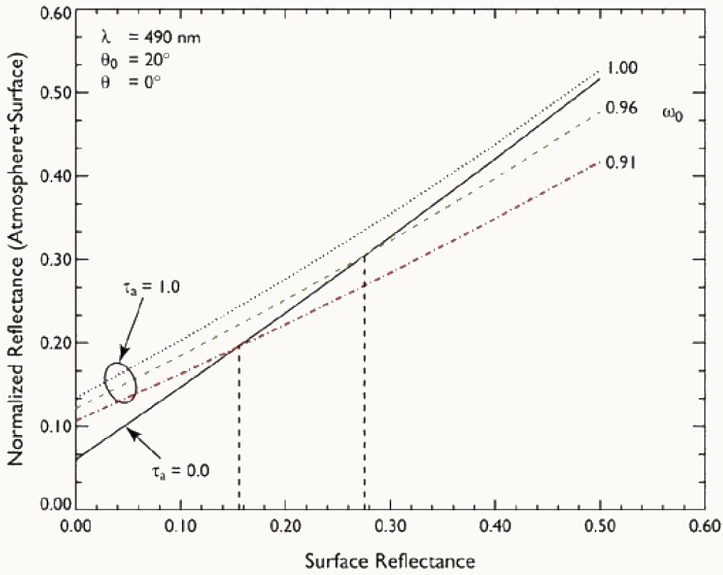
Radiative Transfer Model Calculations for Combined Reflectivity by Surface and Atmosphere: Illustrates the problem.
Dashed lines are where clear sky and aerosol laden sky reflectivities are the same: Unique retrieval not possible. Solution(s) for the problem? Use wavelengths where the surface reflectivity is lowest, near UV, e.g. 412 nm.

Slide 10
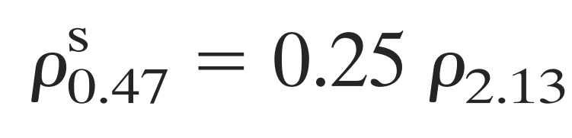
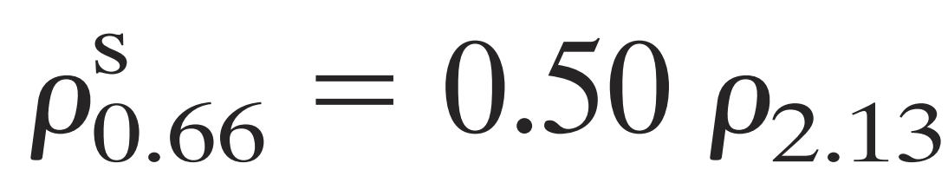
Recall the standard ‘Dark Target’ method for obtaining surface reflectivity and AOD.

Slide 11
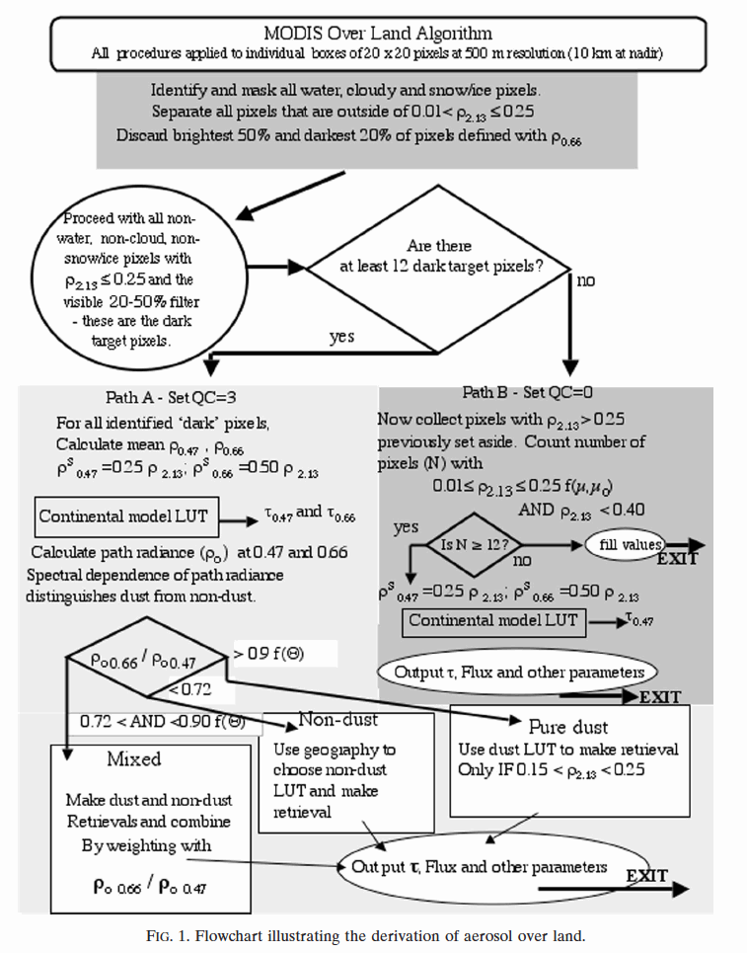
Review: MODIS ‘Dark Target’ Aerosol Retrievals Over Land Algorithm

Slide 12
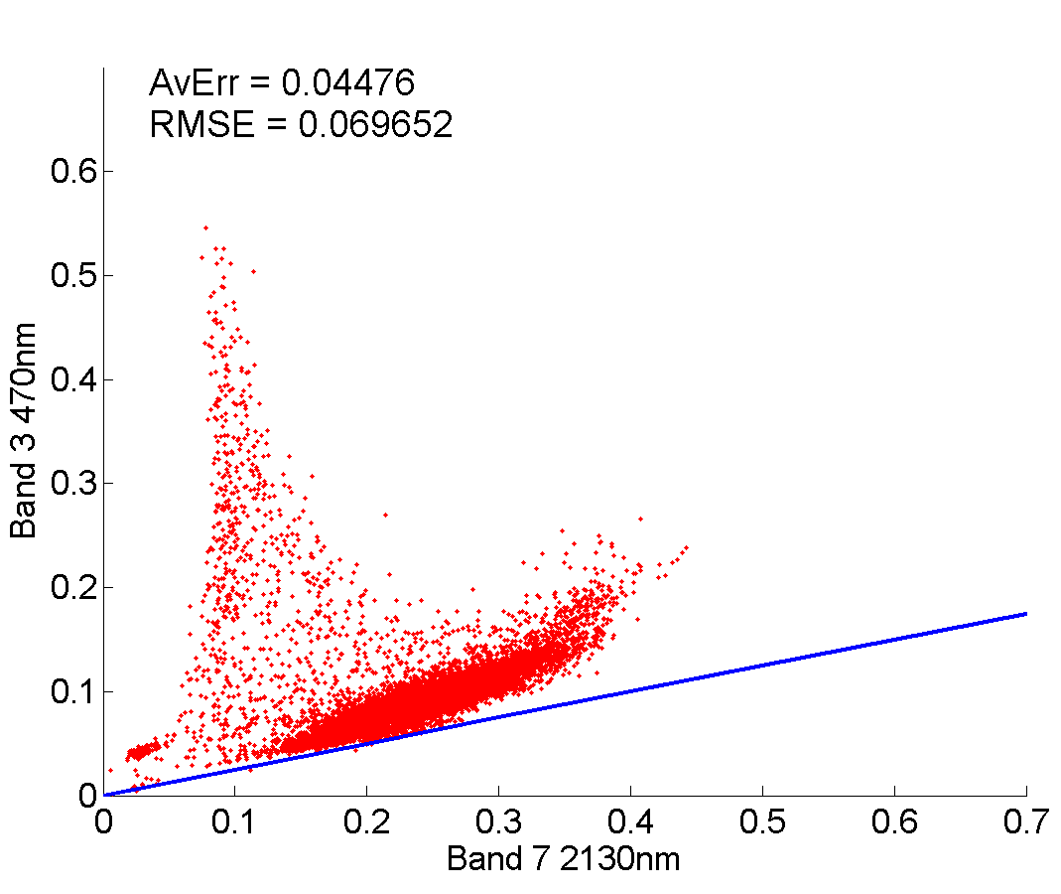
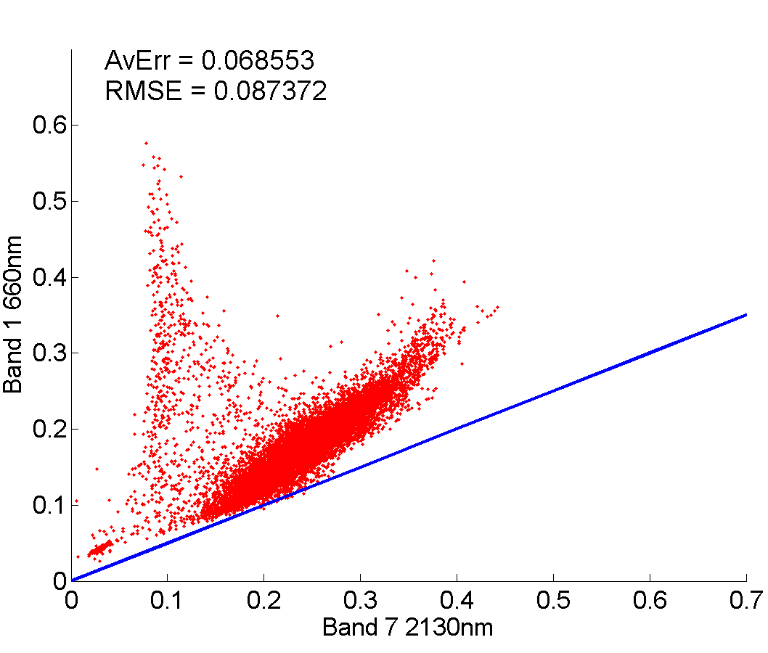
So how does the model perform in the two different land regimes? (Andrew Joros results for the Great Basin)
8 July 2011 – Dry Regime
470nm Scatterplot
660nm Scatterplot
Y=.25x
Y=. 5x
470 nm has lower reflectivity than 660 nm. Model and measurements match at only a few points. Green shaded region used in the ‘safe’ part of the ‘Dark Target’ algorithm. Red shaded region used for the alternate ‘Dark Target’ algorithm (note model disagreement).

Slide 13
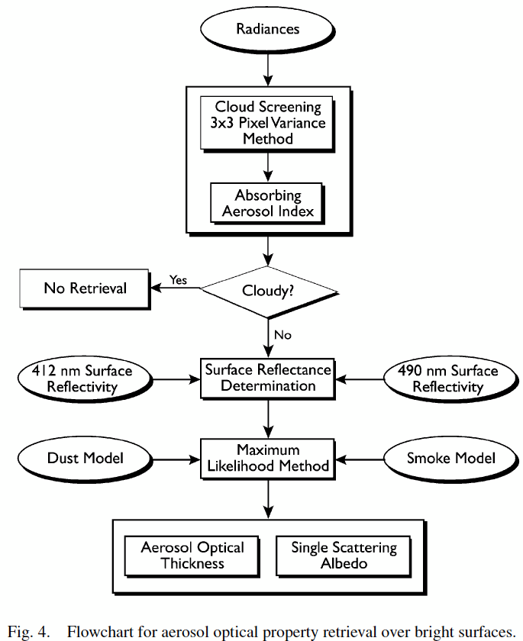
Deep Blue AOD Algorithm
Data base from measurements under clear sky conditions, and during different seasons.

Slide 14
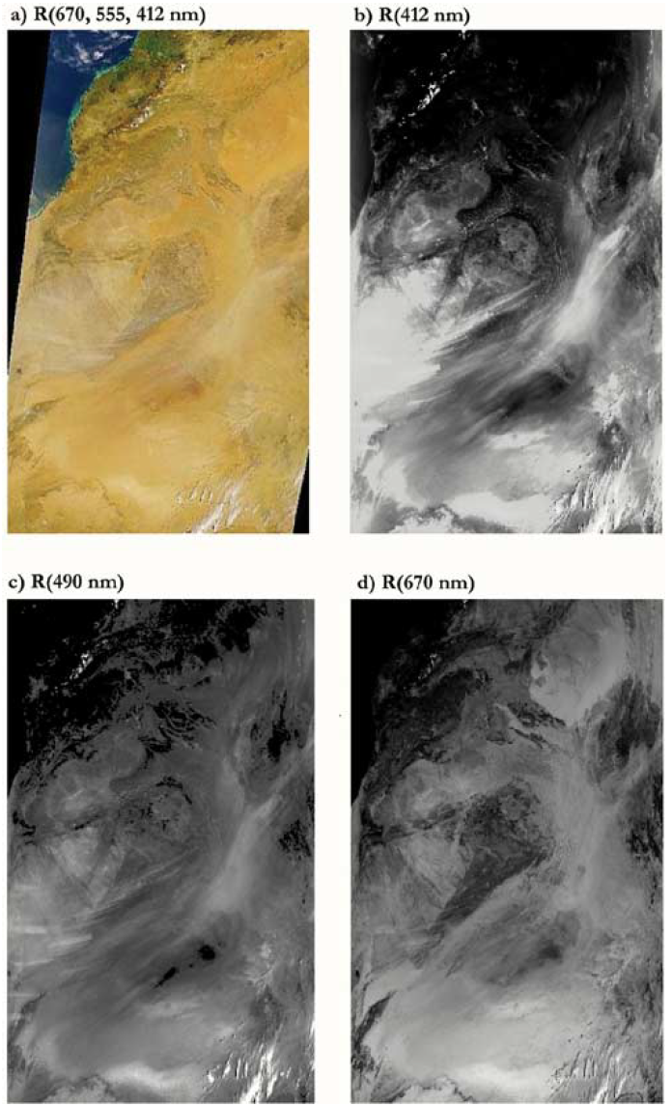

Basic Idea: Desert regions are darker at shorter wavelengths so aerosol show up better.

Slide 15
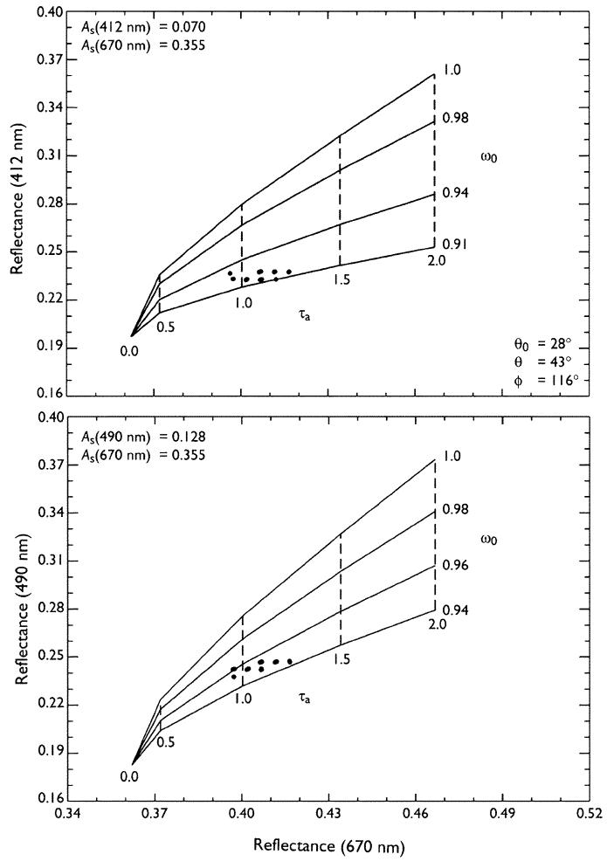
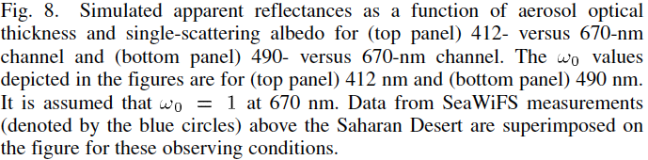
Reflectivity Study

Slide 16
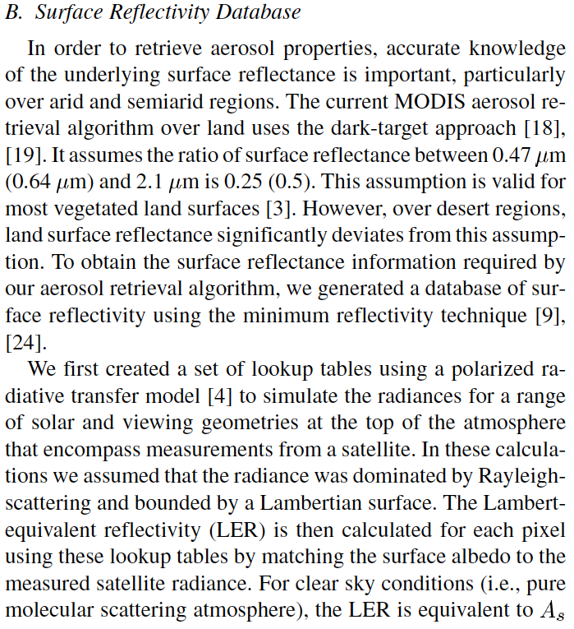
Surface reflectivity

Slide 17
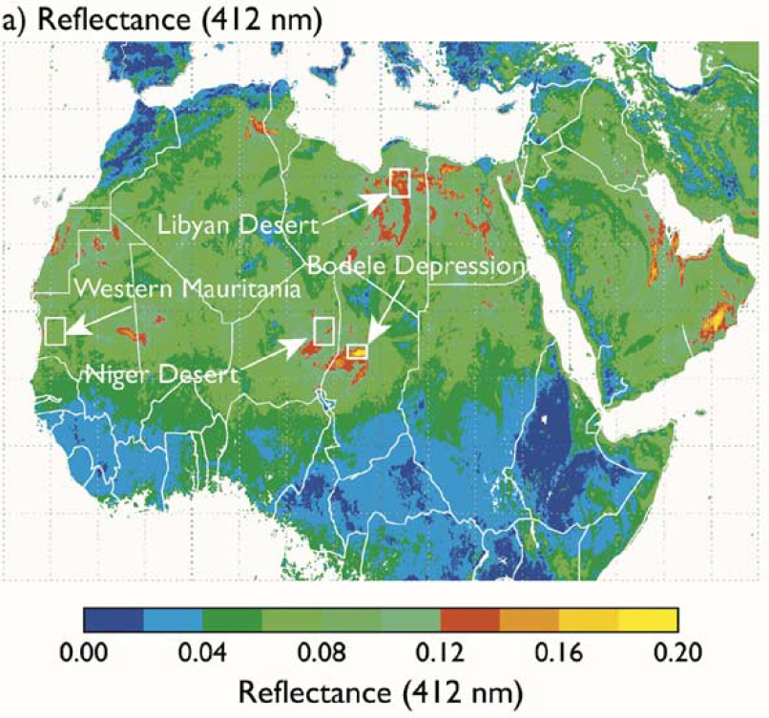
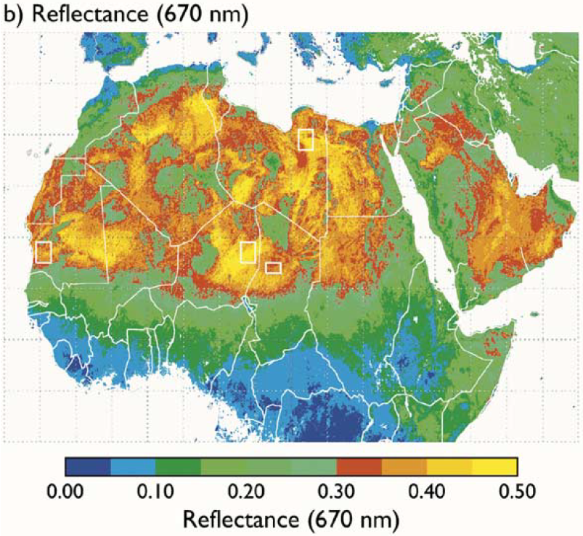
Surface Reflectance Values Used in The Algorithm

Slide 18
Rapid changes of Vegetation may cause issues.
Next slides, Sierra Madre of Mexico surface reflectivity indices in relatively time periods. (Slides from Stephen Noble.)

Slide 19
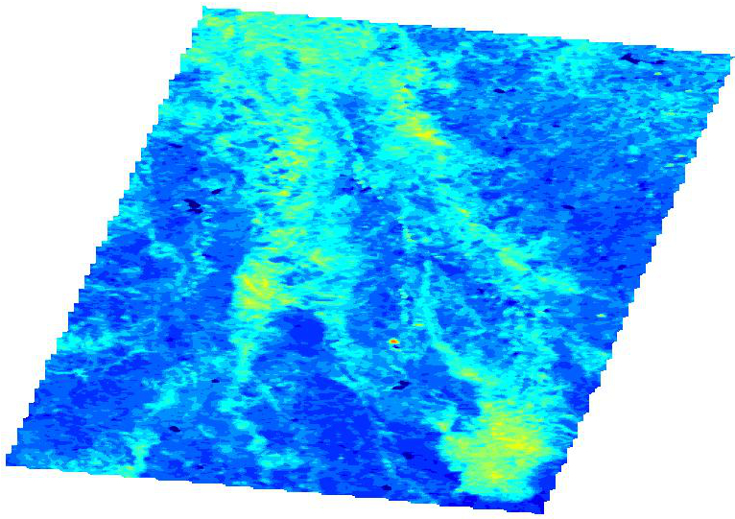
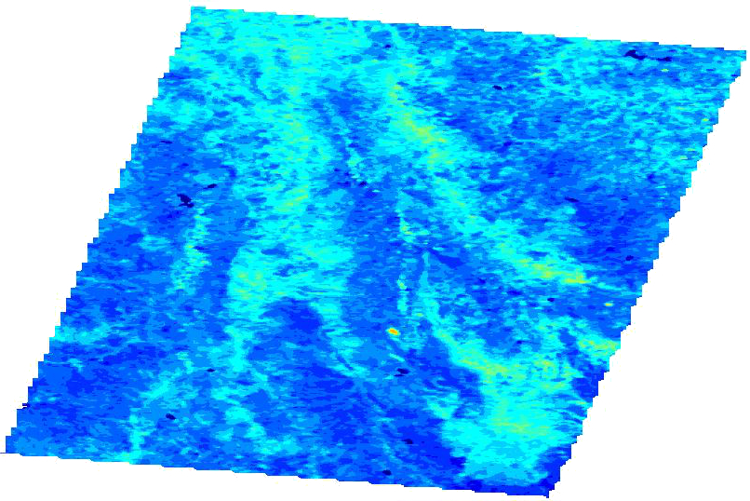

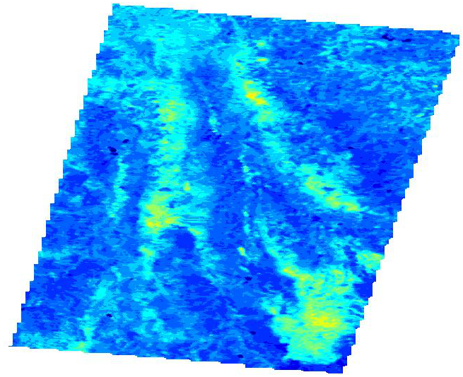
J.D. 72
J.D. 97
Normalized Difference Vegetation Index (NDVI) using 660nm and 860nm bands because plants reflect near-infrared above 700nm.
Shows the death of the vegetation over the time period from day 72 to 115.
NDVI=(R₈₆₀-R₆₆₀)/(R₈₆₀+R₆₆₀)
J.D. 115

Slide 20
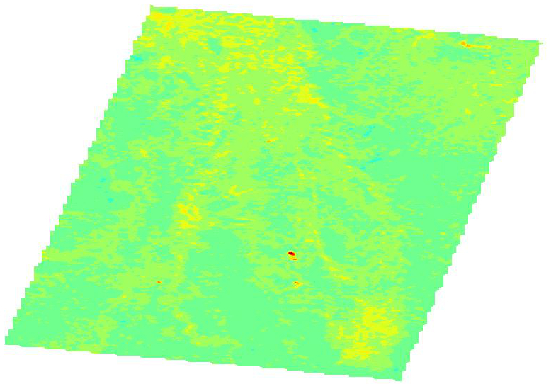
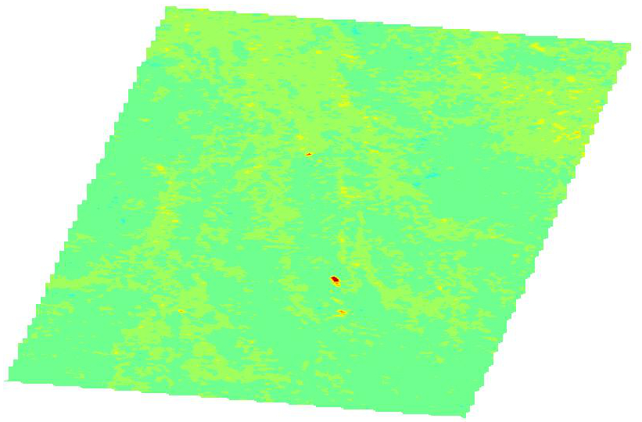
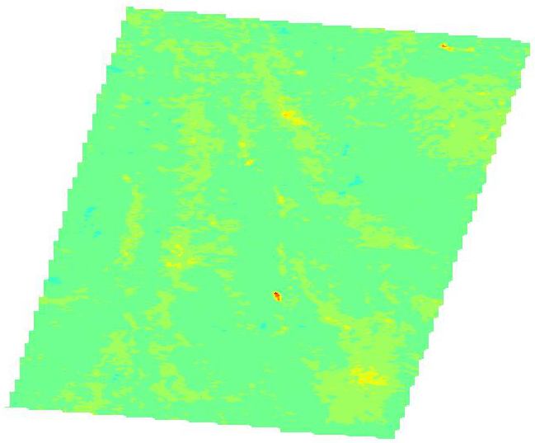
J.D. 72
J.D. 97
J.D. 115
Green Index (GI) shows an enhancement of the plants reflecting green light.
Shows the death of the vegetation over the time period from day 72 to 115 at the bottom of the study area (top of image).
GI=(R₅₅₀)/(R₆₆₀+R₄₇₀)

Slide 21
A poem
First the sun, then the earth;
Earth was dark,
satellite saw none.
Then came sky and air;
Satellite saw Rayleigh.
Then came dark aerosol;
Rayleigh went away.
Then came bright aerosol;
Satellite saw more,
Rayleigh grew a beard.
Then came the brightest snow ball earth;
Satellite saw only it,
Darkened only by soot and UV sand.
Bright aerosol make a dark surface brighter.
Dark aerosol make a bright surface darker.
Bright aerosol are hard to detect above a bright surface.
Dark aerosol could be detected above a bright surface, if the surface is known.
Dark aerosol are hard to detect above a dark surface.
Optimal: Dark surface, bright aerosol. Choose wavelengths to make this happen.

