Slide 1
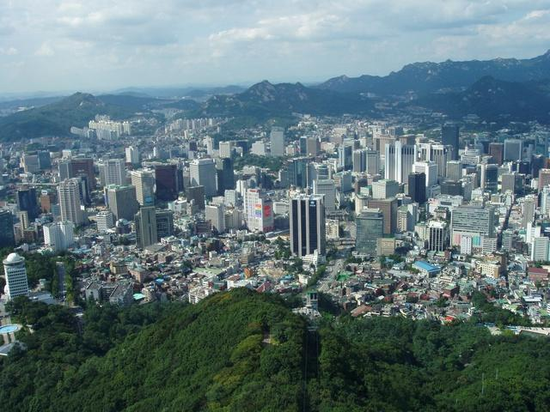
Seoul, South Korea

Slide 2
Background
Population of 9,794,304 (in 2010)
605.28 km² (233.7 mi²)
From a Travel site: “Air quality in Seoul is fine and improving. However, Seoul inhabitants sometimes wear different types of masks outdoors for allergies smog and yellow dust storms (mostly in March-April).”

Slide 3
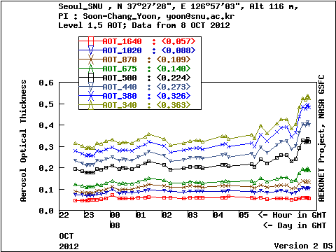
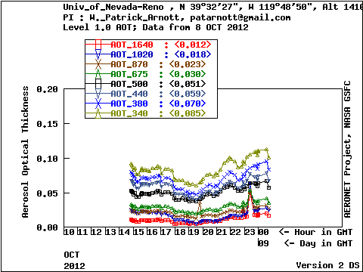
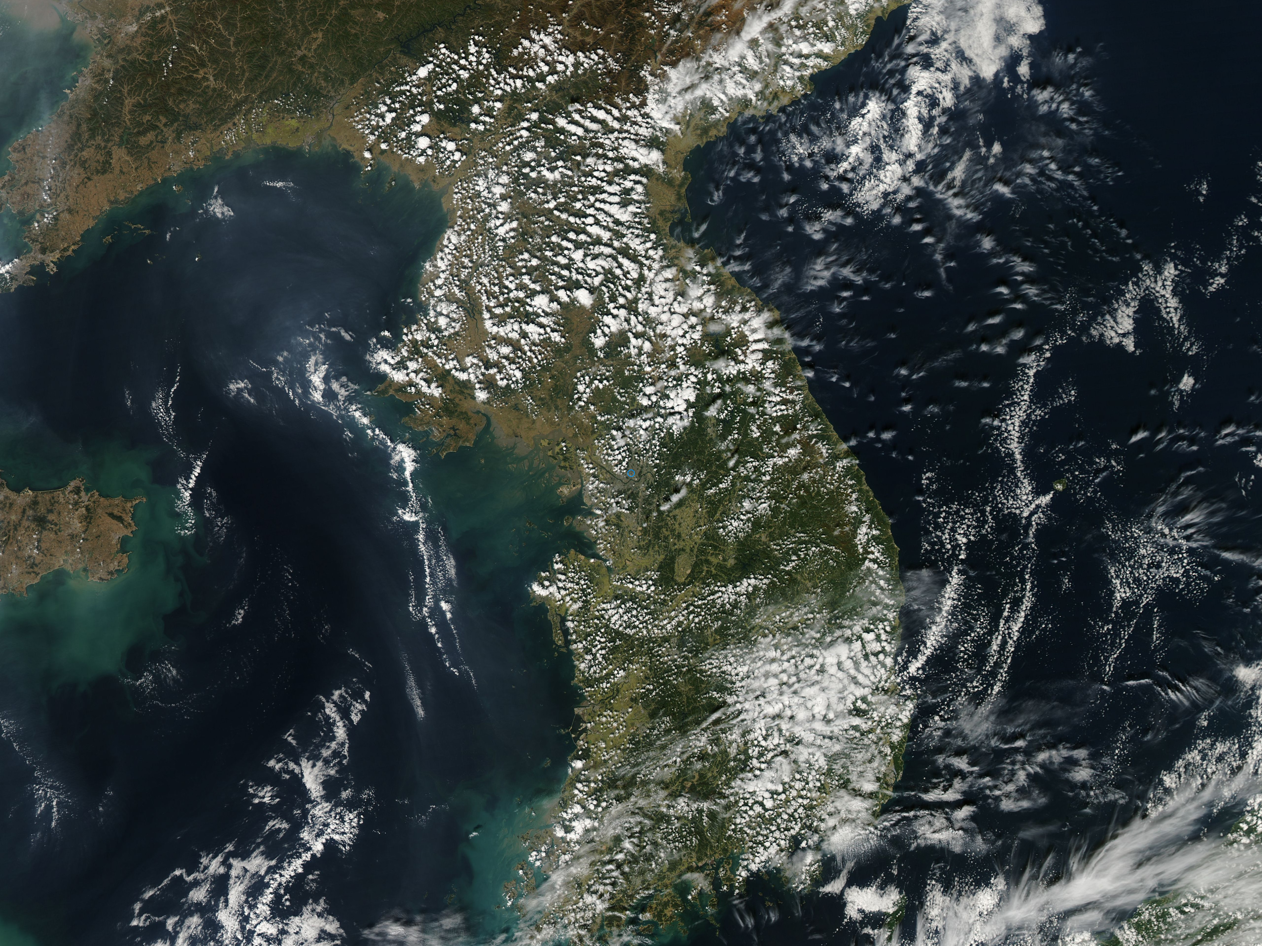
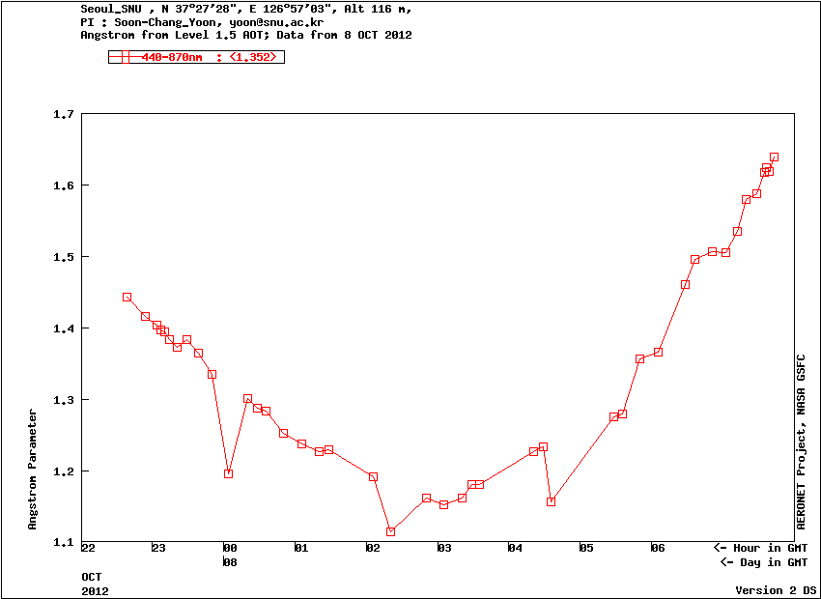
October 8, 2012
*Seoul is GMT + 9:00

Slide 4
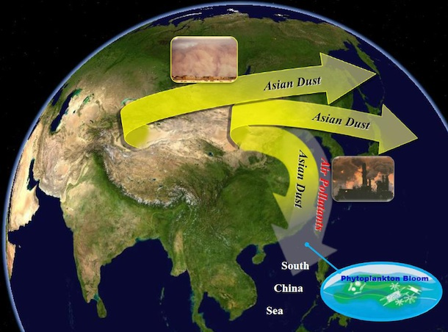
Taklimakan Desert
Gobi Desert
Beijing
Seoul

Slide 5
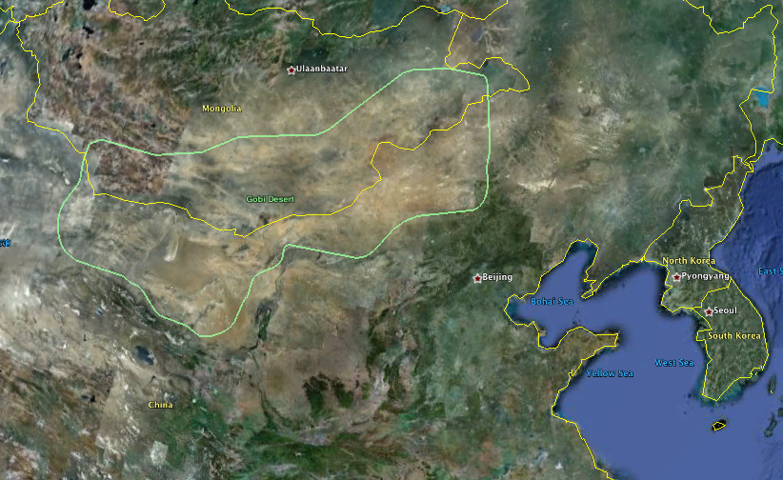
Gobi Desert
Located along border of Mongolia and China
Dust storm April 26th and 27th

Slide 6
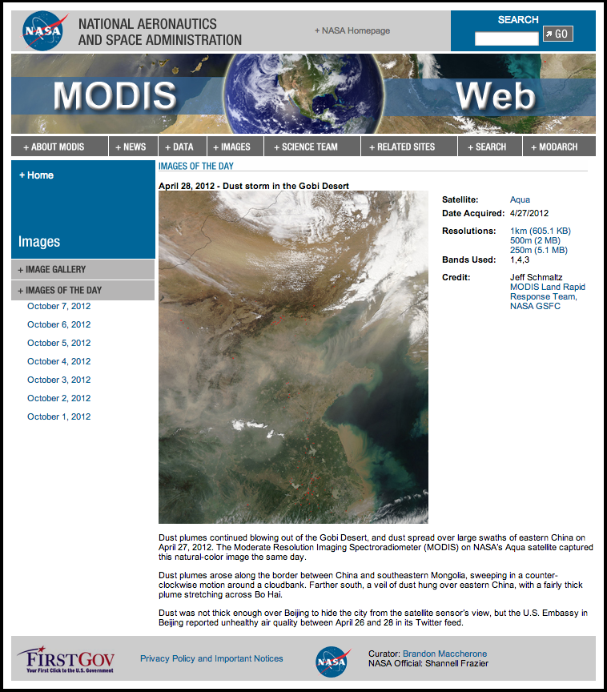
Gobi Dust Storm 2012
Beijing

Slide 7
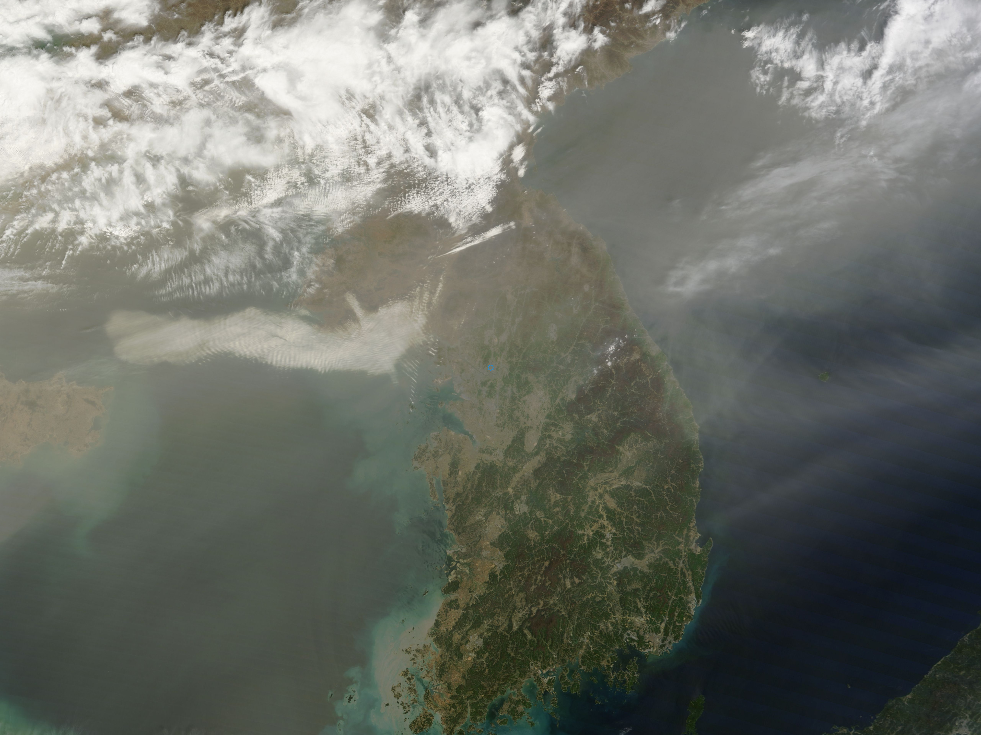
TERRA 4/28

Slide 8
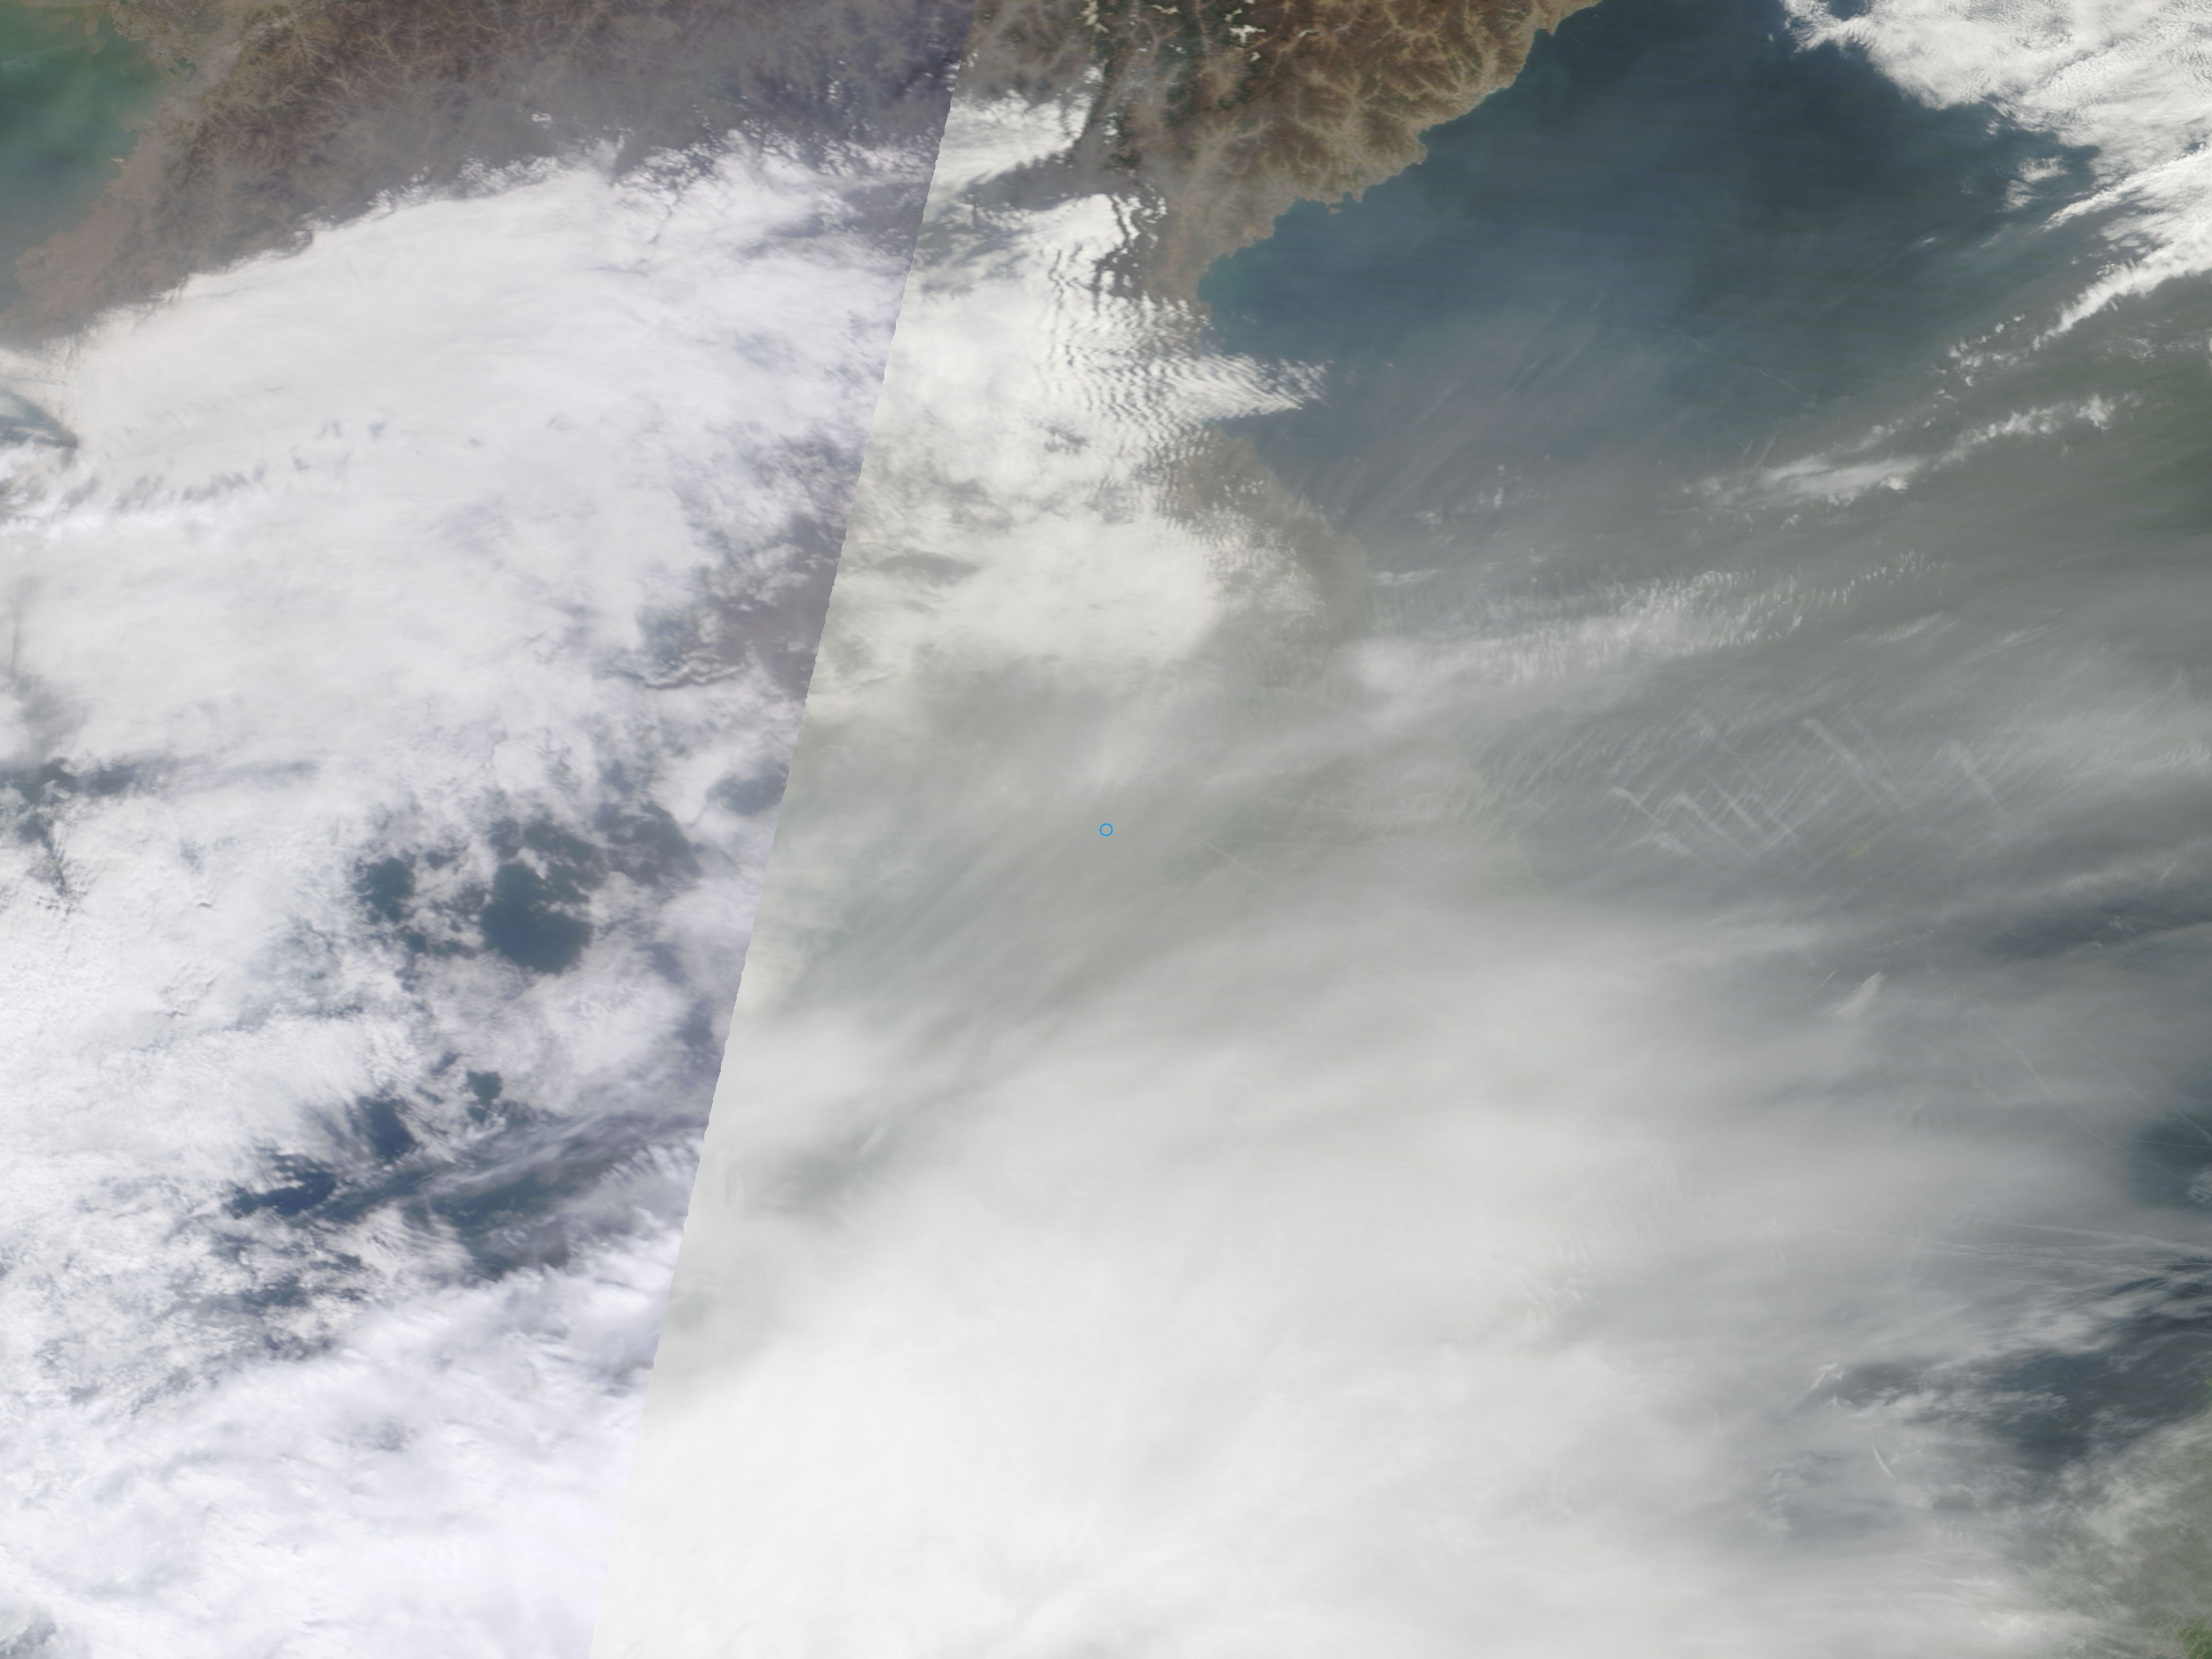
TERRA 4/29

Slide 9
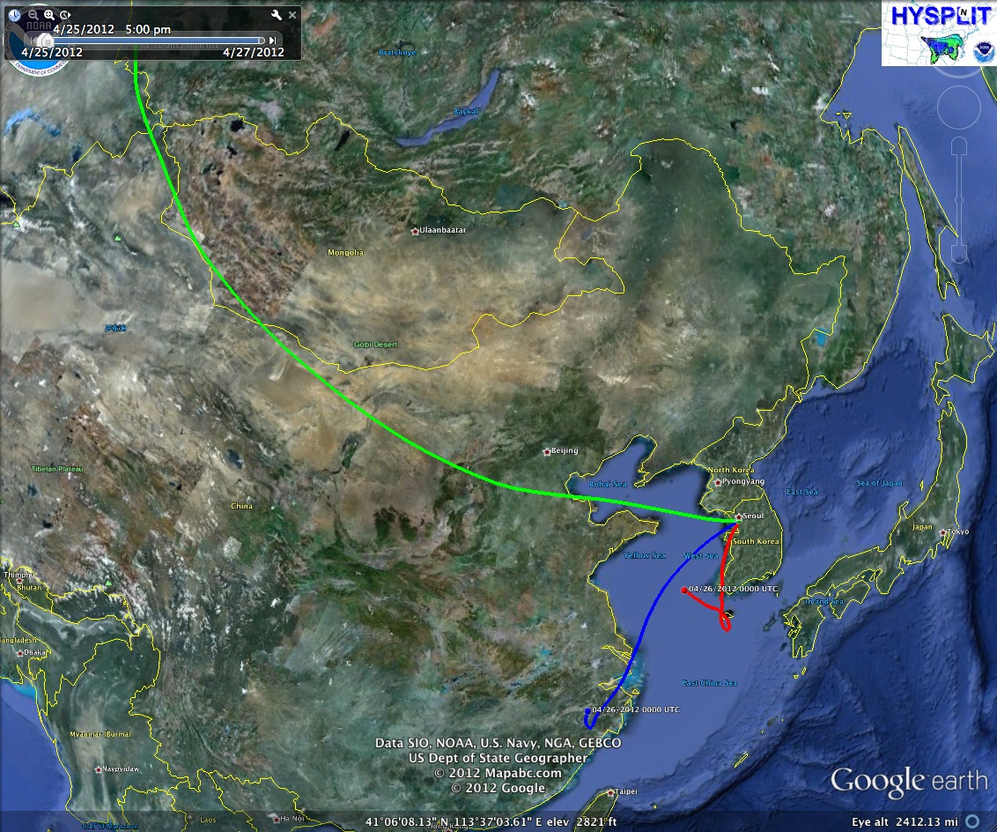
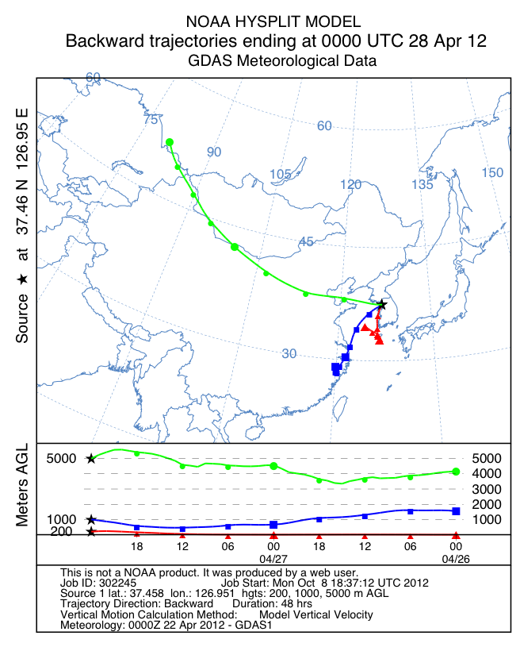
Backtrajectory

Slide 10
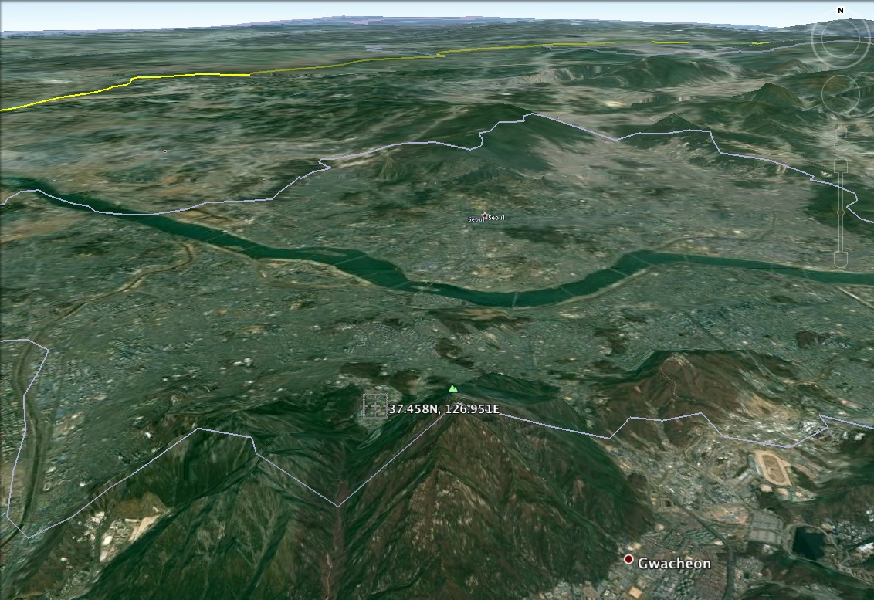
AERONET Station

Slide 11
AERONET AOT
*Seoul is GMT + 9:00

Slide 12
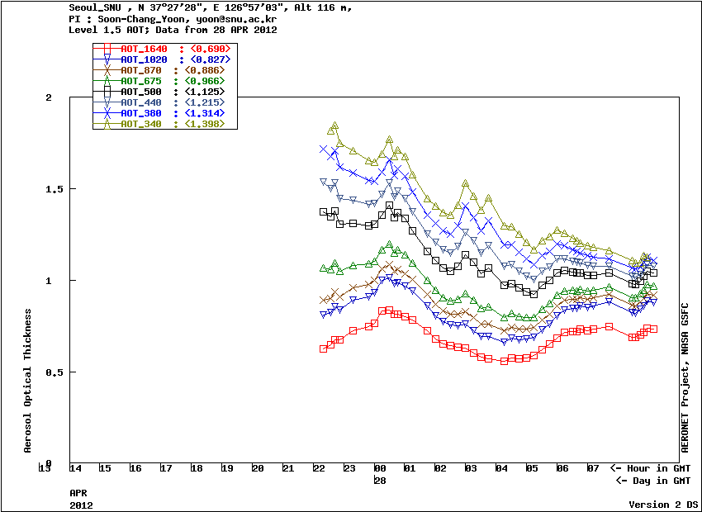
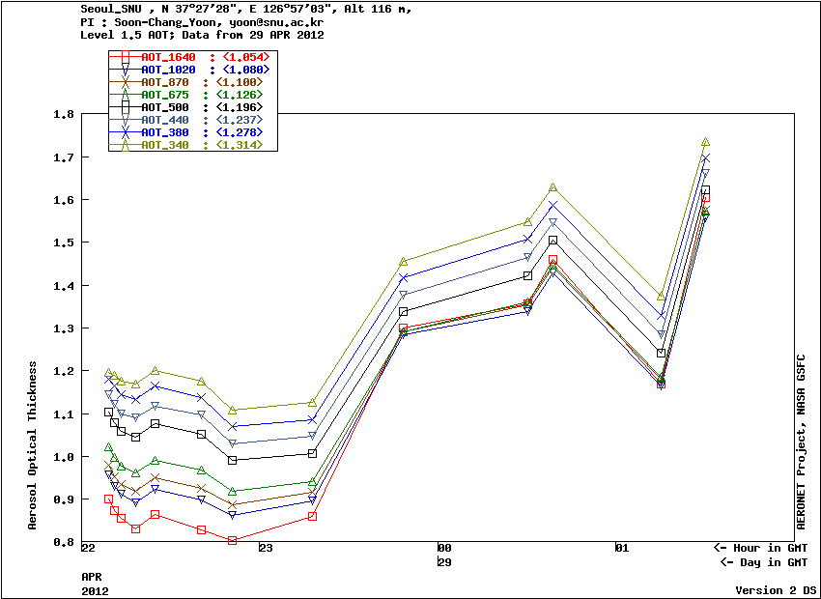

Slide 13
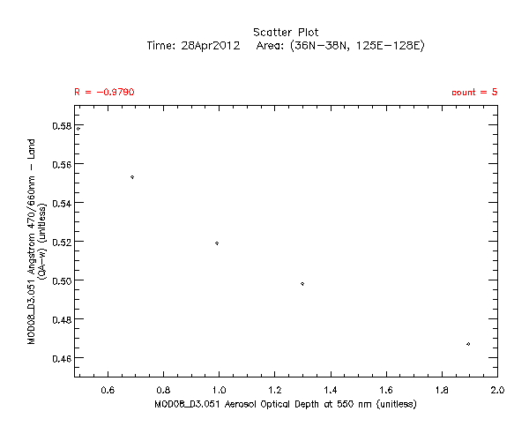
Angstrom/Aeronet

Slide 14
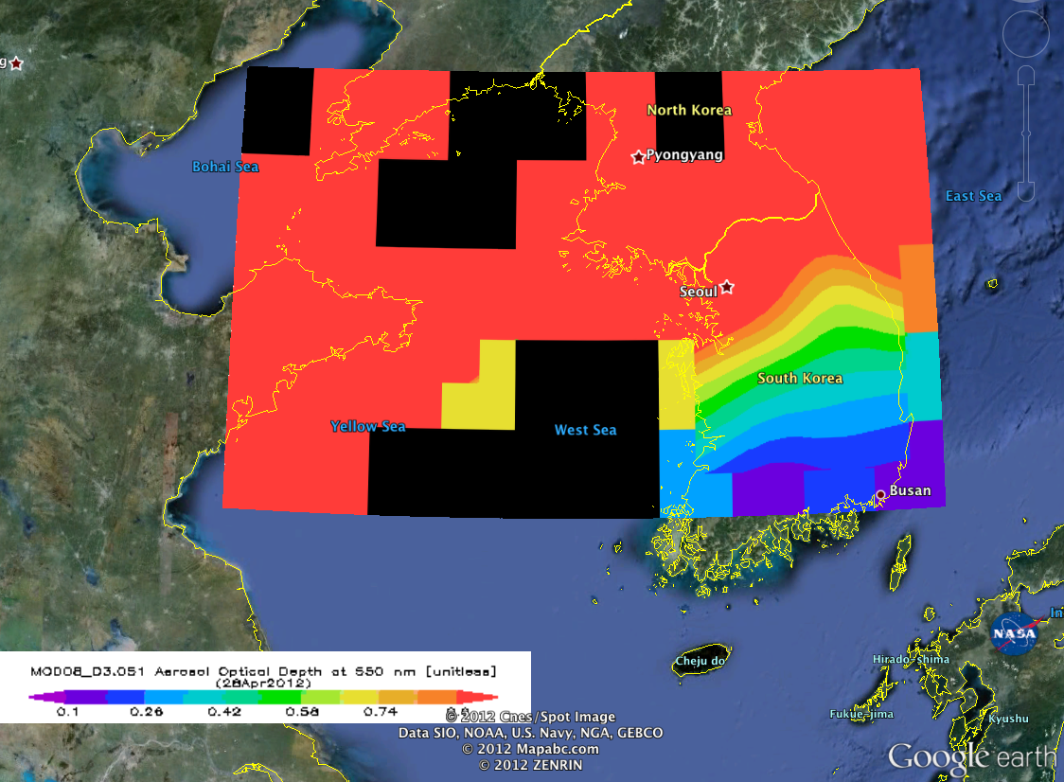
MODIS TERRA 550nm April 28th

Slide 15
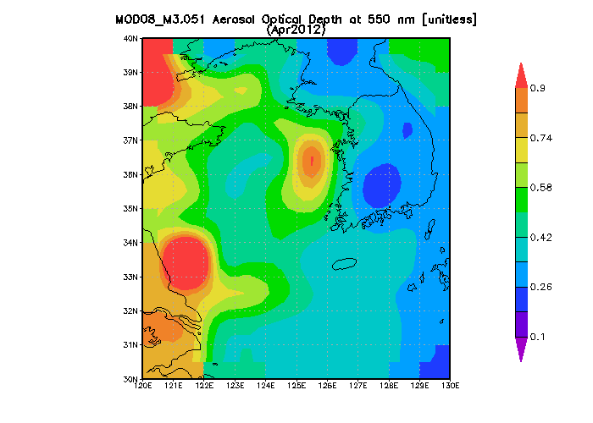
MODIS TERRA 550nm April 2012

Slide 16
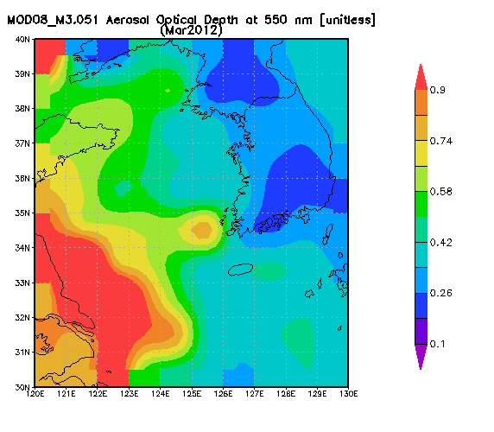
MODIS TERRA 550nm March and April 2012

Slide 17
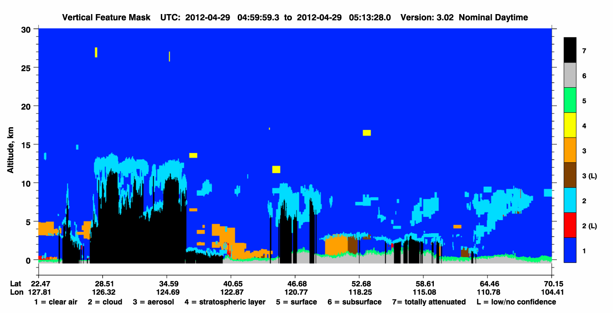
LIDAR 4/29

Slide 18
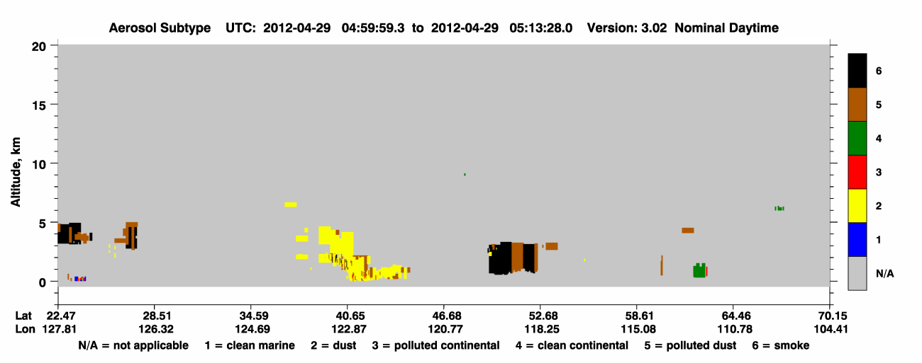
LIDAR 4/29

Slide 19
Seoul Air
Asian Dust
Pollution from Beijing/Tokyo
Pollution from 10 million people
Sea salt

Slide 20
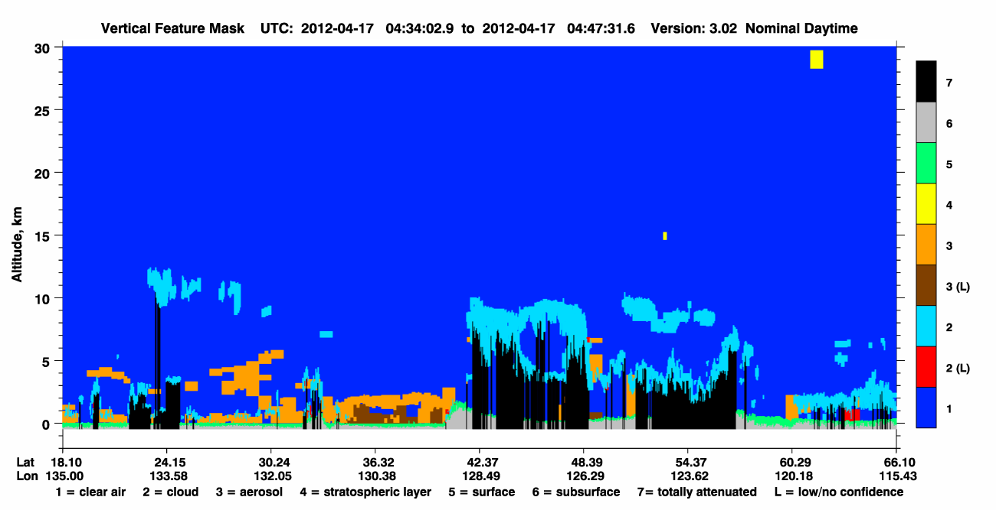

Slide 21
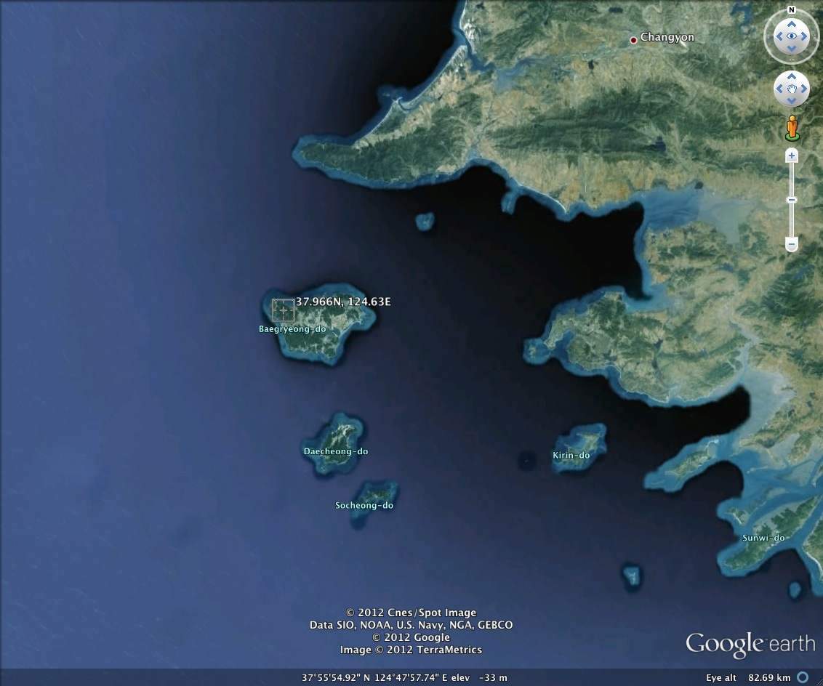
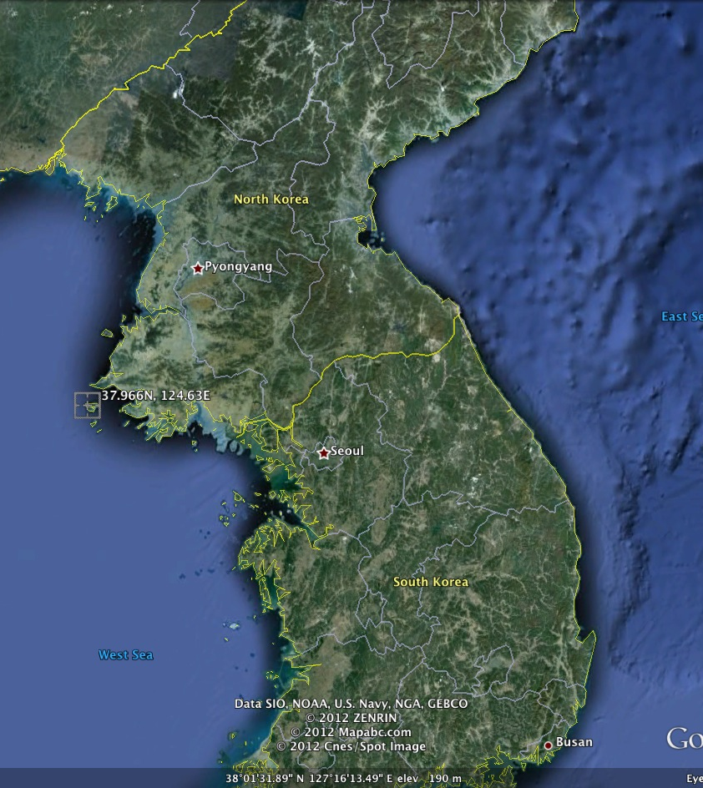
Comparison to North Korea
No AERONET in NK
I know, right?

Slide 22
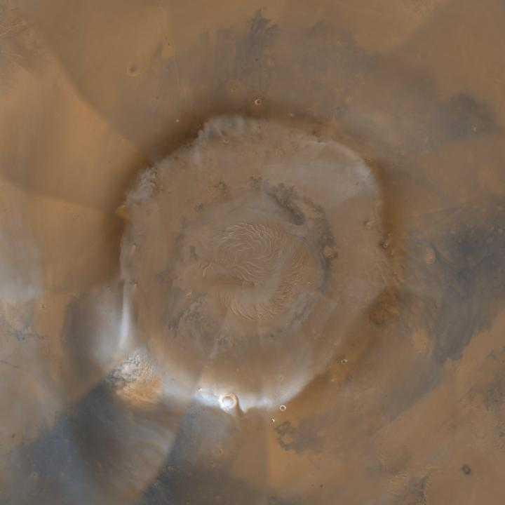
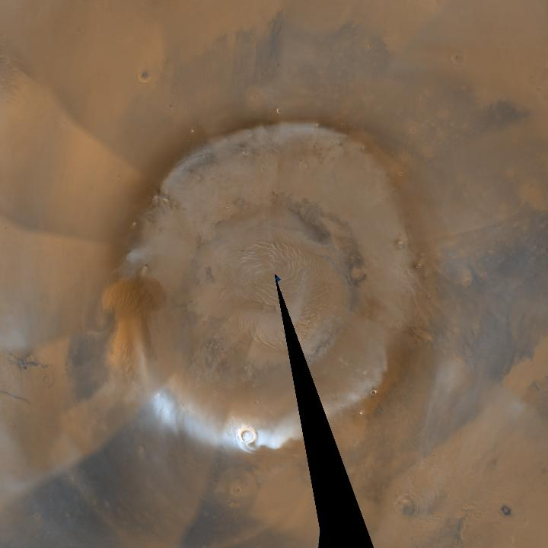
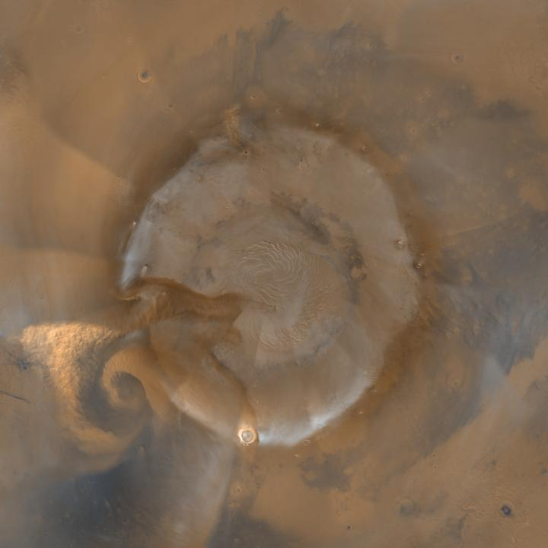
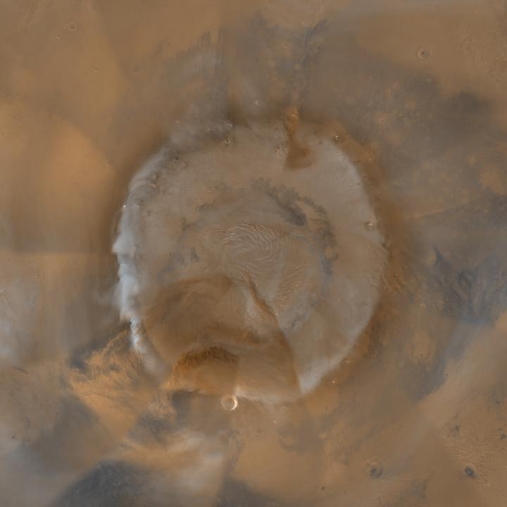
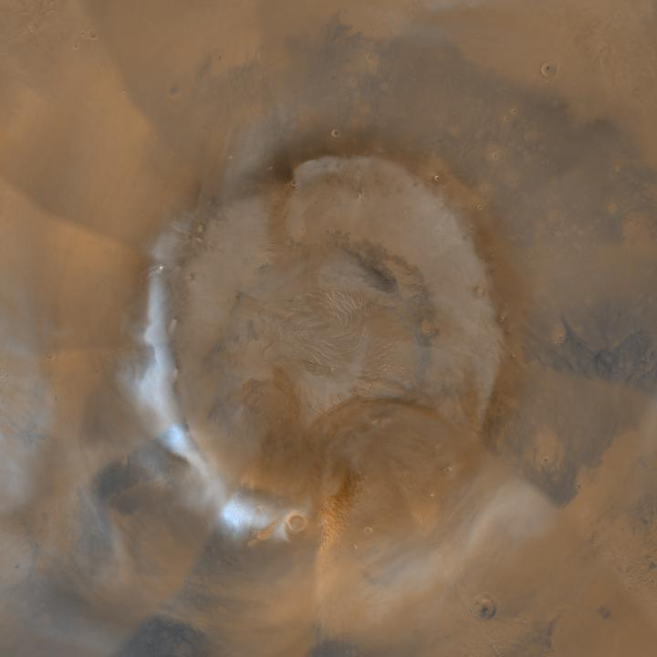
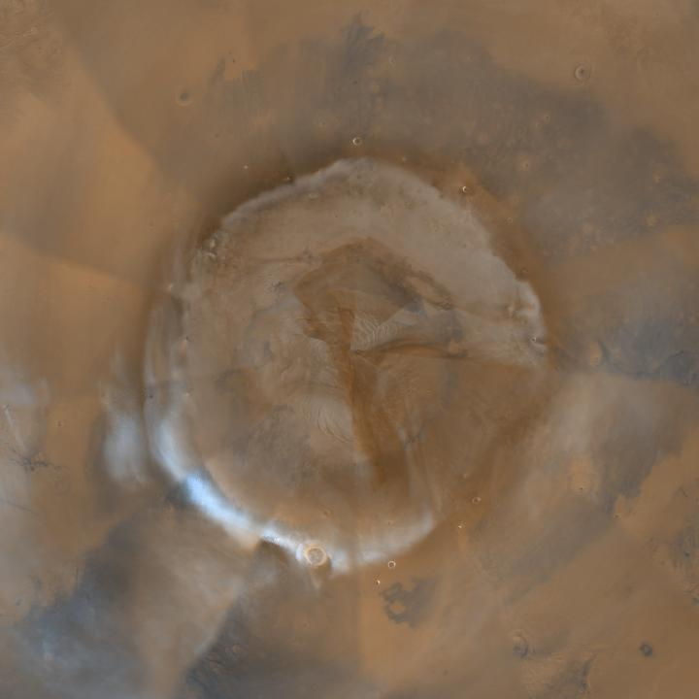
L_{S} 38.49
L_{S} 38.94
L_{S} 39.39
MY 29 (2008)
L_{S} 39.84
L_{S} 40.29
L_{S} 40.74

