Slide 1
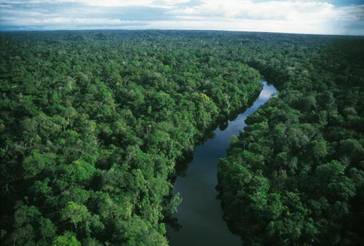
MODIS Retrievals for the Amazon Rainforest
Dan Sauceda

Slide 2
Outline
Information on the Region
Data Information
Reflectance Equations
MODIS Images
NDVI
Conclusions

Slide 3
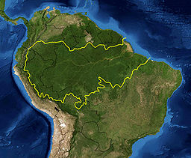
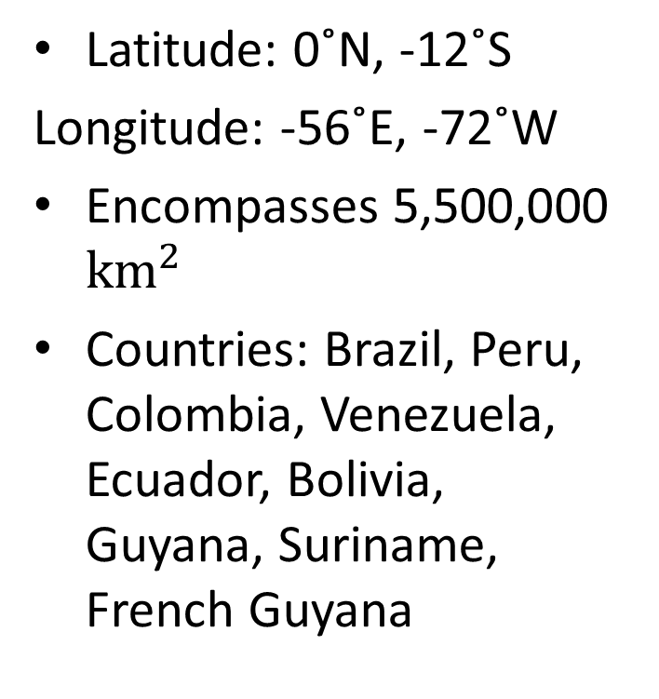
Information on the Region
Latitude: 0˚N, -12˚S
Longitude: -56˚E, -72˚W
Encompasses 5,500,000 ${km}^{2}$
Countries: Brazil, Peru, Colombia, Venezuela, Ecuador, Bolivia, Guyana, Suriname, French Guyana

Slide 4
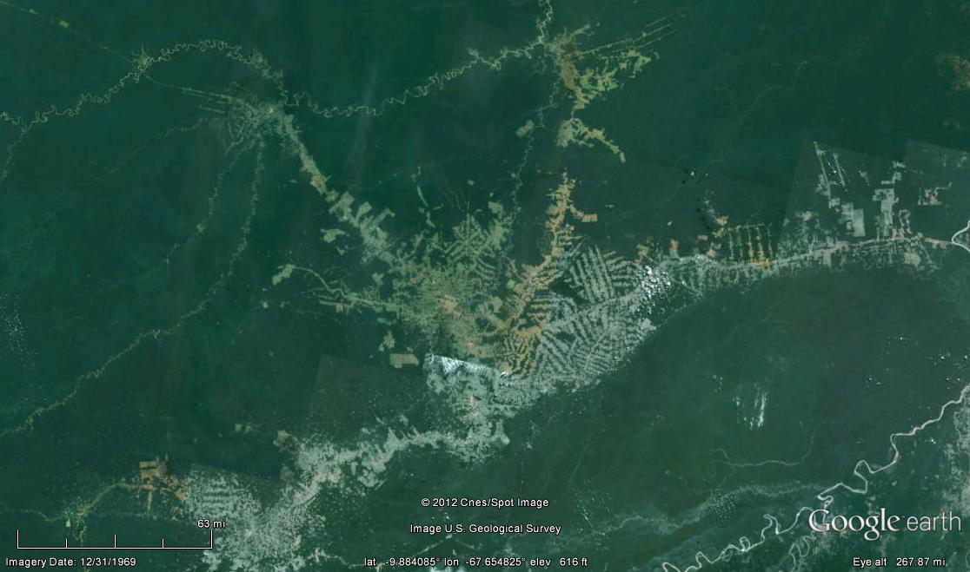
Information on the Region

Slide 5
Data Information
Dry season (July-August)
Satellite: Terra MODIS
Daytime coverage
Selected clear days:
July 27, 2000 (15:15 UTC)
August 6, 2005 (14:30 UTC)
August 2, 2012 (14:25 UTC)
Notes:
- Dry season May-Oct

Slide 6
Data Information
Level 2: Estimates surface spectral reflectance at ground level neglecting atmospheric scattering and absorption.
500 m resolution
Band 1 (620-670 nm): Red
Band 2 (780-900 nm): Near IR
Band 3 (459-479 nm): Blue
Band 4 (530-610 nm): Green
Band 7 (2105-2155 nm): Mid IR
Notes:
- Level 2 treats bands as if there were measured with no interference with scattering and adsorption.

Slide 7
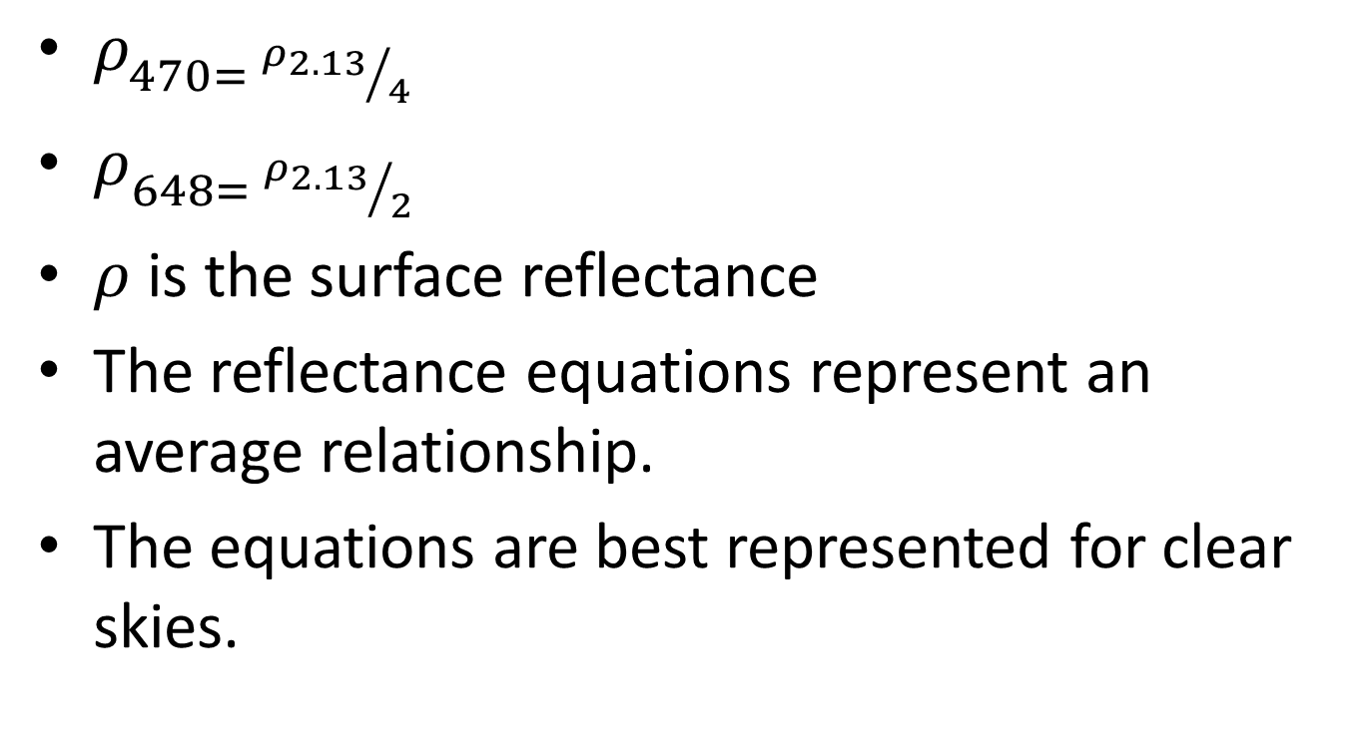
Reflectance Equations
$ρ_{470= {ρ_{2.13}}/4}$
$ρ_{648= {ρ_{2.13}}/2}$
$ρ$ is the surface reflectance
The reflectance equations represent an average relationship.
The equations are best represented for clear skies.

Slide 8
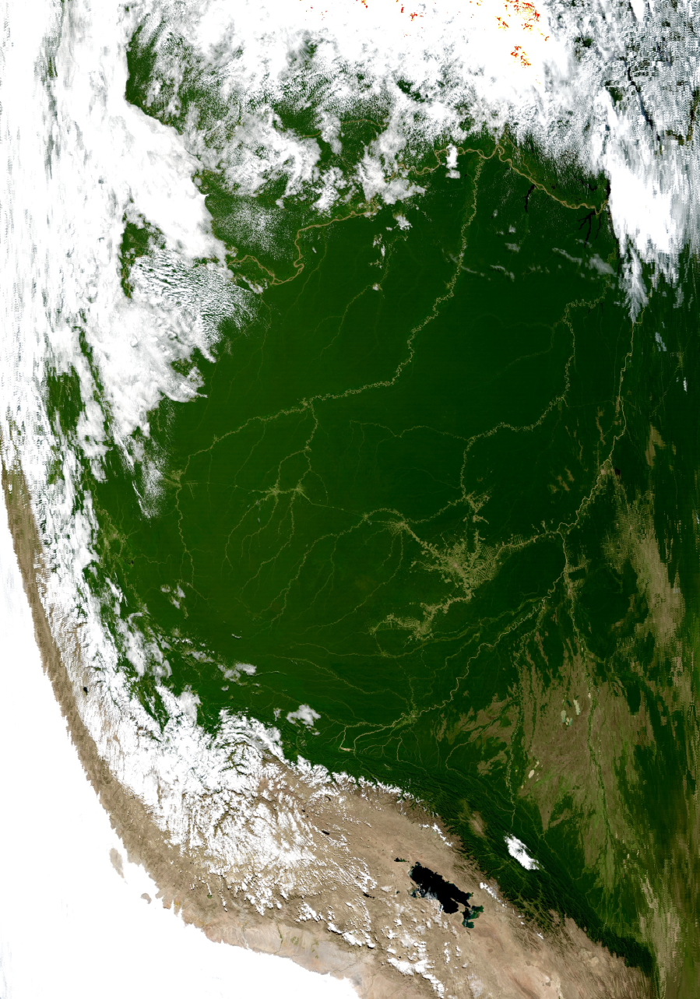
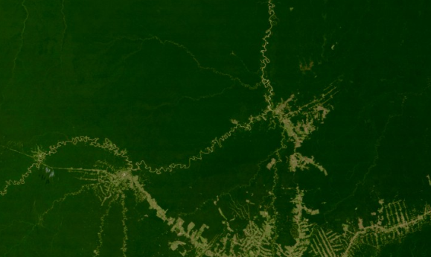
July 27, 2000 (15:15 UTC)

Slide 9
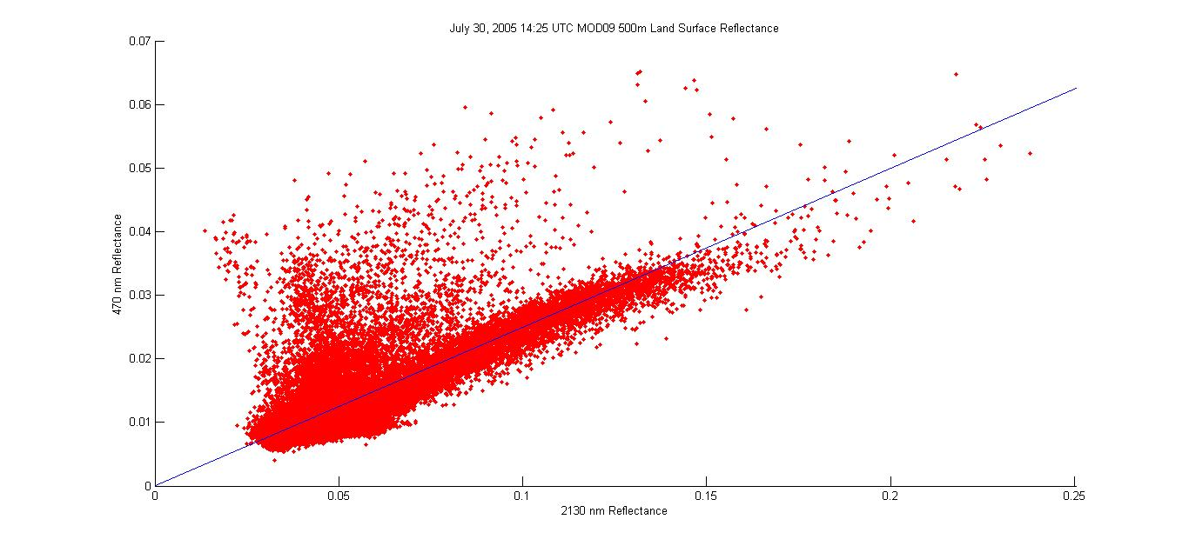
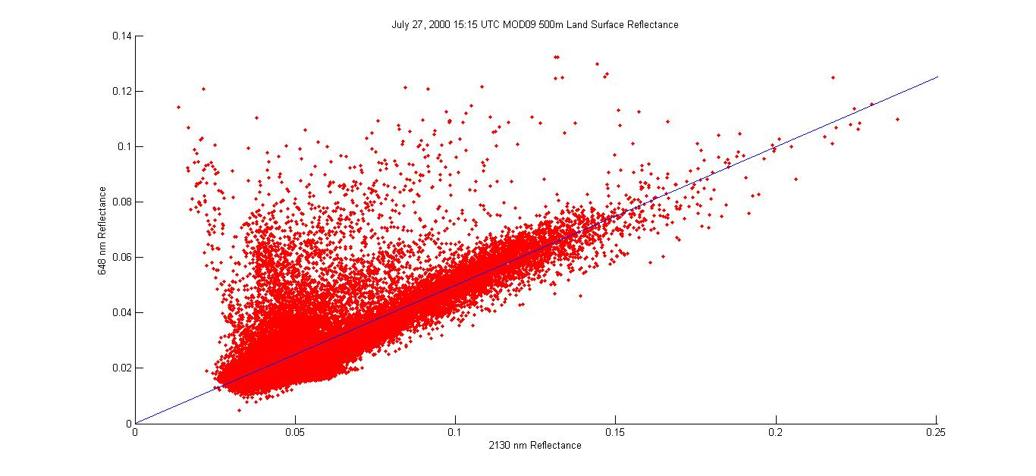
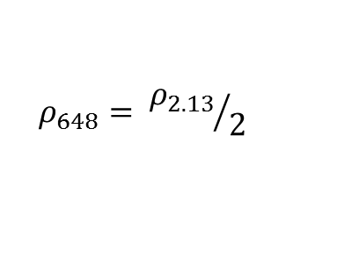
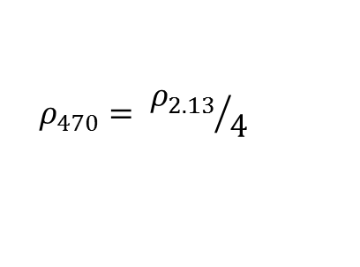
July 27, 2000 (15:15 UTC)
Clouds/Aerosols
$$ρ_{470}= {ρ_{2.13}}/4$$
Clouds/Aerosols
$$ρ_{648}= {ρ_{2.13}}/2$$

Slide 10
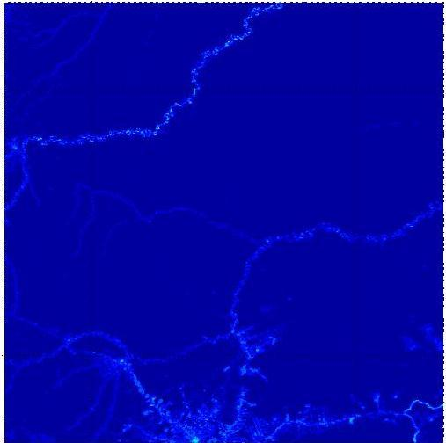
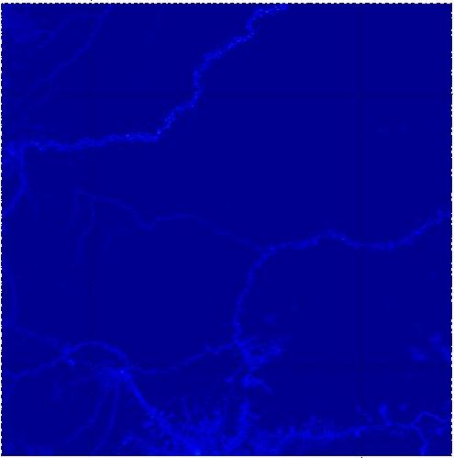

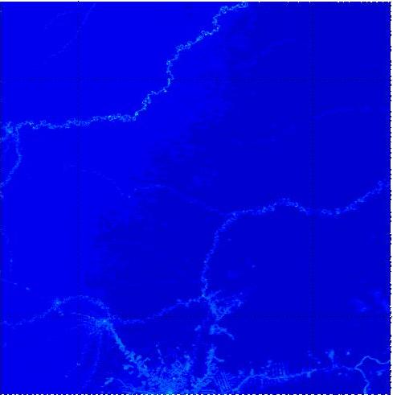
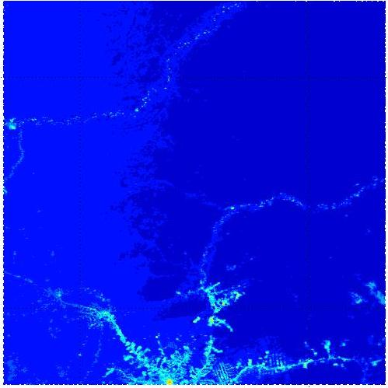
July 27, 2000 (15:15 UTC)
Band 1
Band 3
Band 4
Band 7

Slide 11
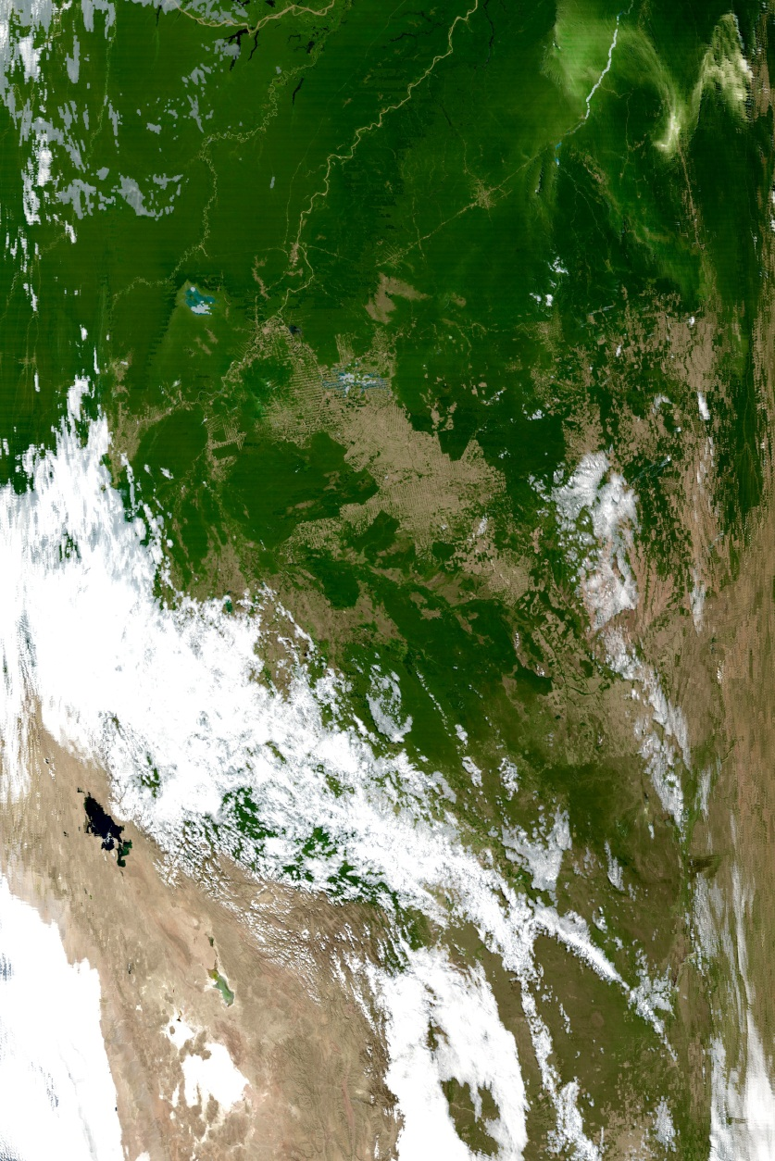
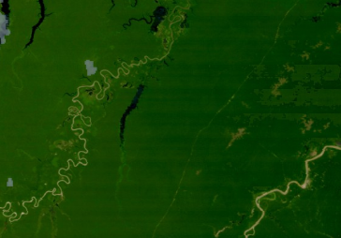
August 6, 2005 (14:30 UTC)

Slide 12
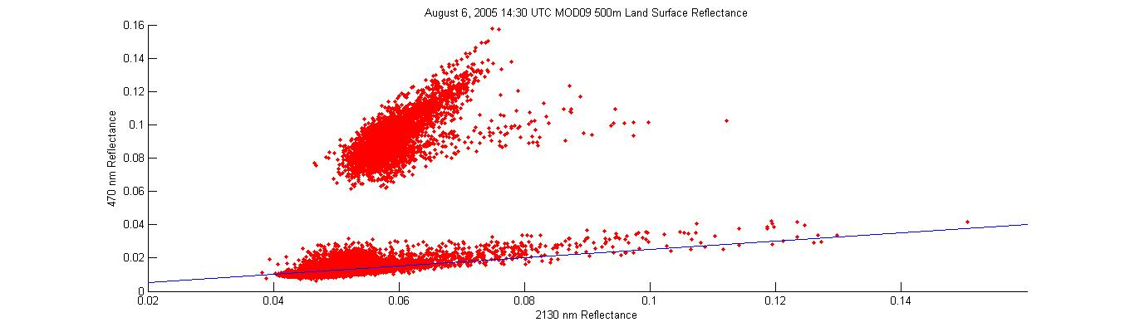
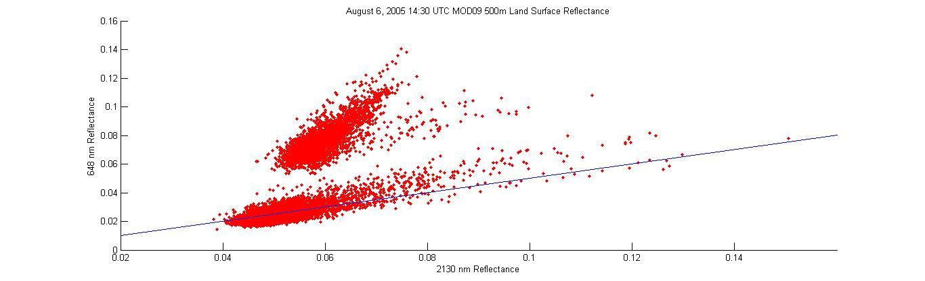
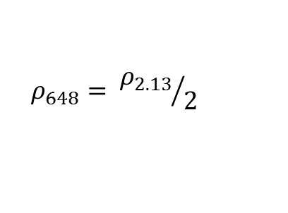
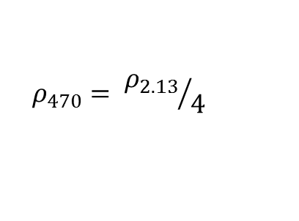
August 6, 2005 (14:30 UTC)
Aerosols
$$ρ_{470}= {ρ_{2.13}}/4$$
Aerosols
$$ρ_{648}= {ρ_{2.13}}/2$$

Slide 13
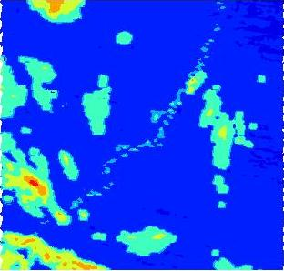
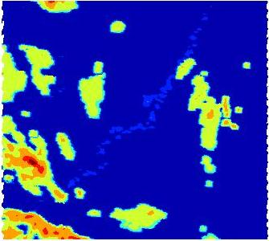

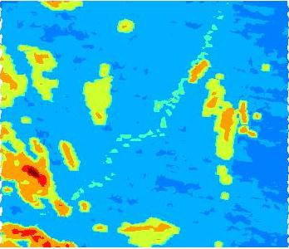
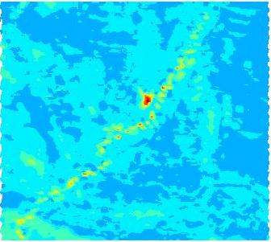
August 6, 2005 (14:30 UTC)
Band 1
Band 3
Band 4
Band 7

Slide 14
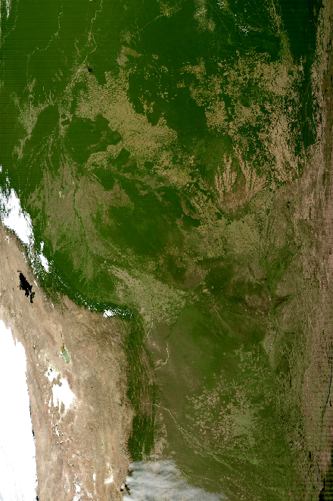
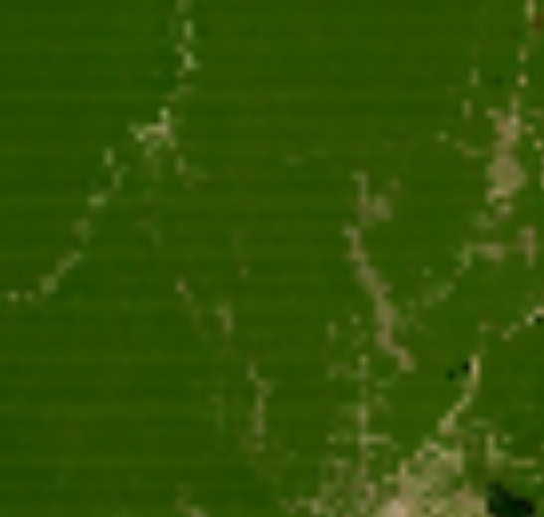
August 2, 2012 (14:25 UTC)

Slide 15
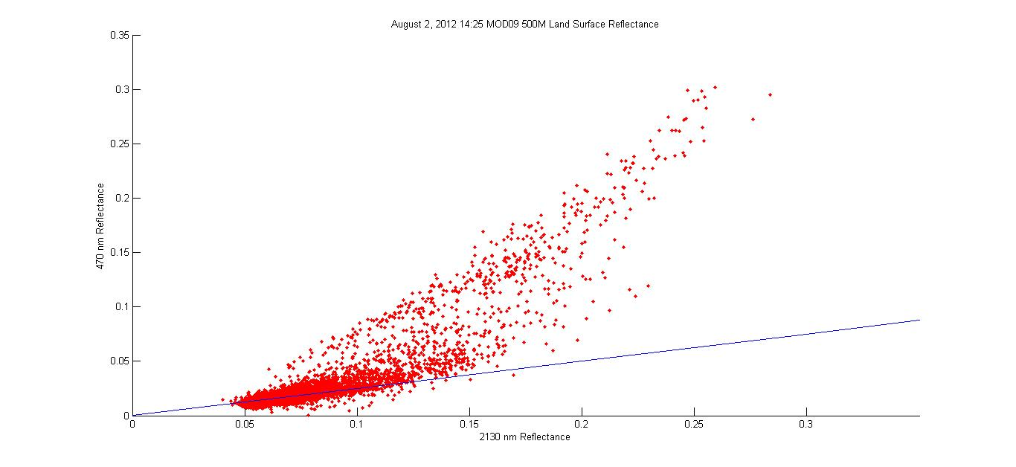
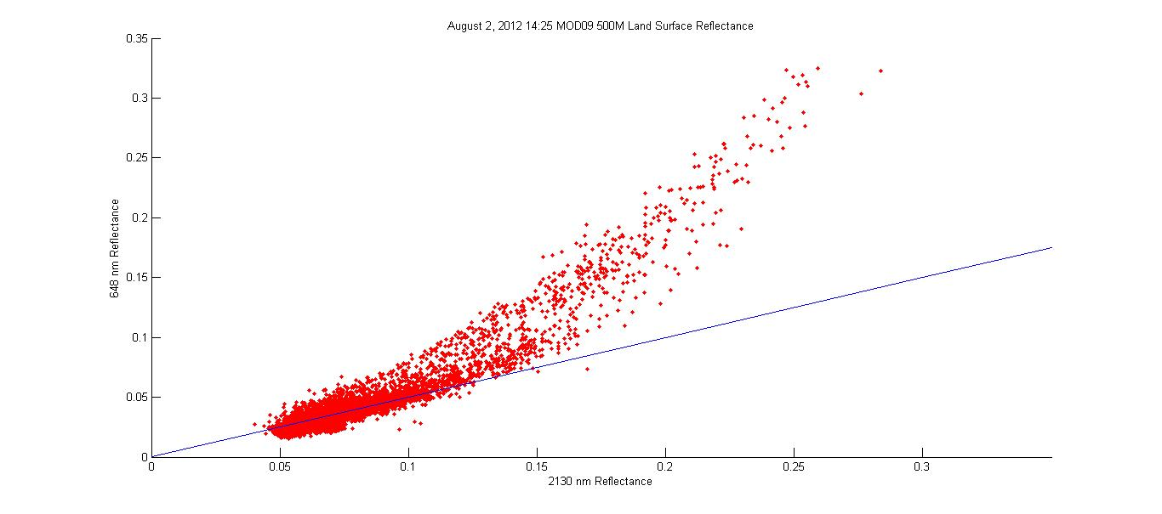
August 2, 2012 (14:25 UTC)
Clouds/Aerosols
$$ρ_{470}= {ρ_{2.13}}/4$$
Clouds/Aerosols
$$ρ_{648}= {ρ_{2.13}}/2$$

Slide 16
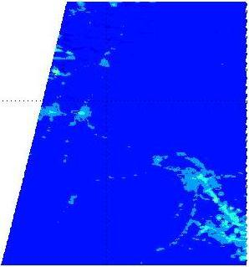
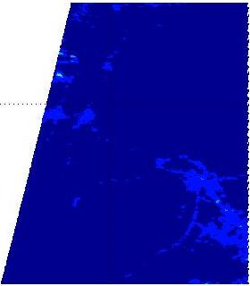

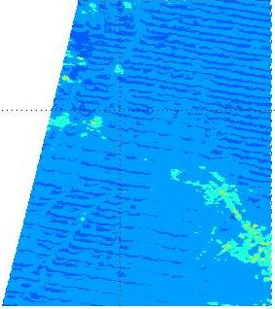
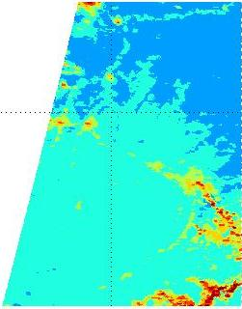
August 2, 2012 (14:25 UTC)
Band 1
Band 3
Band 4
Band 7

Slide 17
NDVI
NDVI: Normalized Difference Vegetation Index
An index to help determine live green vegetation.
Chlorophyll in plants absorbs visible light, and cell structure of leaves reflect near IR light.
The more leaves on a plant, the more effect on the wavelengths.
NDVI = (Band 2 – Band 1)/(Band 2 + Band 1)

Slide 18
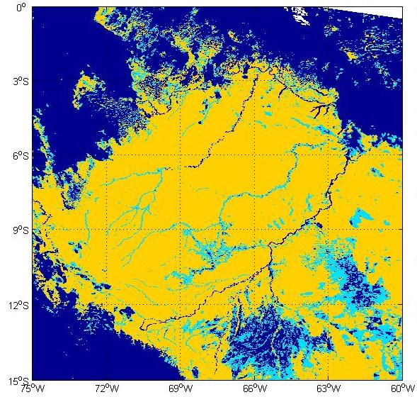
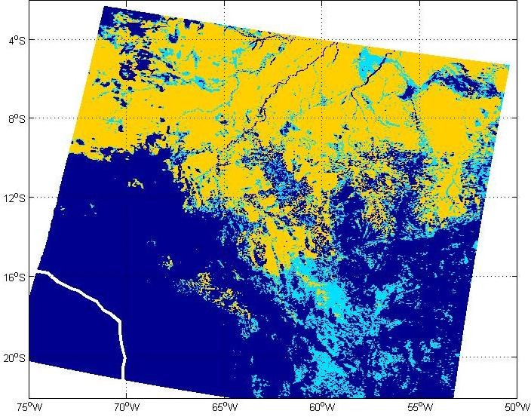
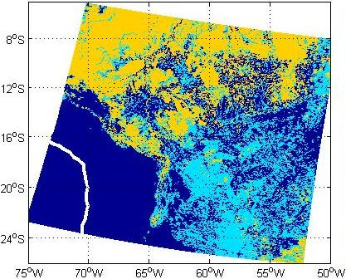

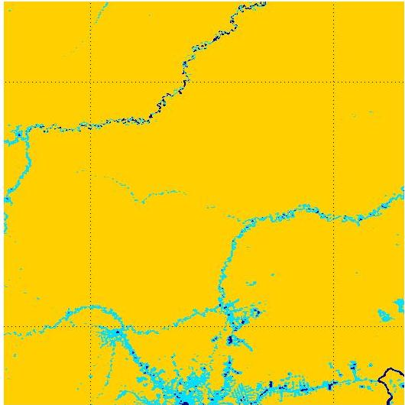
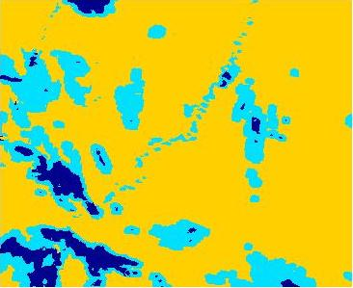
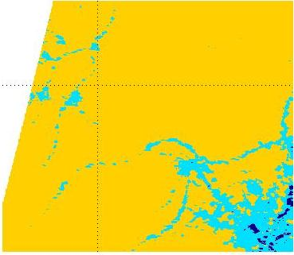
NDVI
July 27, 2000 (15:15 UTC)
August 6, 2005 (14:30 UTC)
August 2, 2012 (14:25 UTC)

Slide 19
Conclusions
Angles of the pictures can skew the image and data.
Clouds/Aerosols in the area can throw off reflective values.
Different species of trees may be responsible for some of the slight variability of reflectance values.
Health of the vegetation can play a part in reflection.

Slide 20
Conclusions
Slash and burning and wildfires during the dry season may be responsible in skewing land surface reflectance.
Farm and logging areas showed less reflectance.
Solar zenith angle may have an effect on the accuracy of surface reflection.

Slide 21
References
Kaufman, Y.J., Wald, A.E., Lorraine, A.R., Gao, B., Li, R., and L. Flynn, 1997: The MODIS 2.1-μm channel-correlation with visible reflectance for use in remote sensing of aerosol. IEEE Trans. Geosci. Remote Sensing., 35, 1286-1298.
Remer, L.A., Kaufman, Y.J., Tanre, Mattoo, S., Chu, D.A., Martins, J.V., Li, R.R., Ichoku, C., Levy, R.C., Kleidman, R.G., Eck, T.F., Vermote, E., and B.N. Holben, 2005: The MODIS aerosol algorithm, products, and validation. Amer. Meteor. Soc., 62, 947-973.

Slide 22
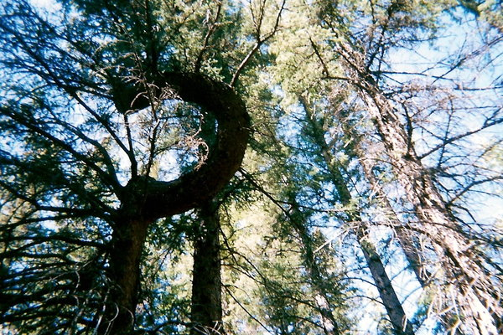
Questions

