Slide 1
OMI Aerosol Products : A tutorial
Omar Torres
Hampton University, Hampton, Va
With modifications by WP Arnott

Slide 2
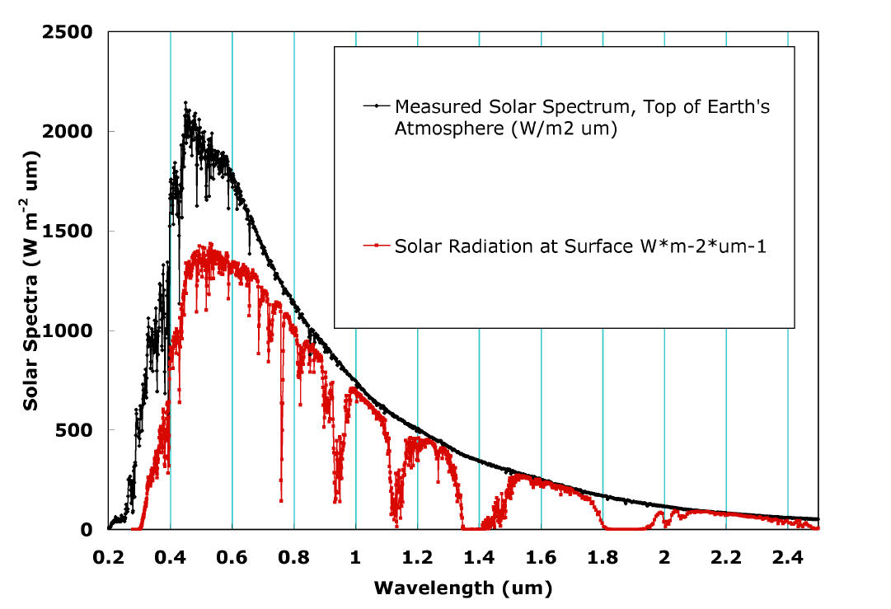
SOLAR SPECTRUM:
TOP OF THE ATMOSPHERE AND AT THE SURFACE

Slide 3
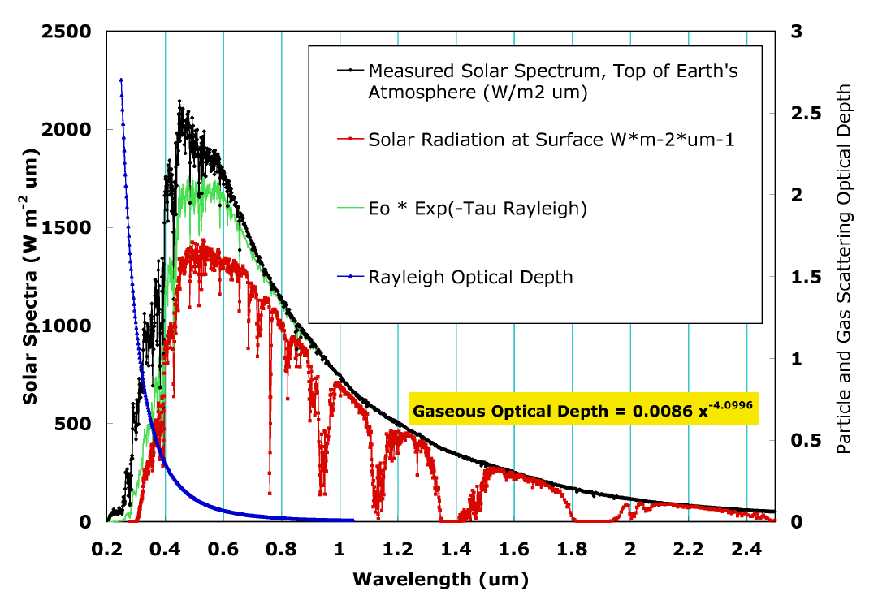
SOLAR SPECTRUM:
Effects of Rayleigh (gas) scattering, O₂ and N₂.

Slide 4
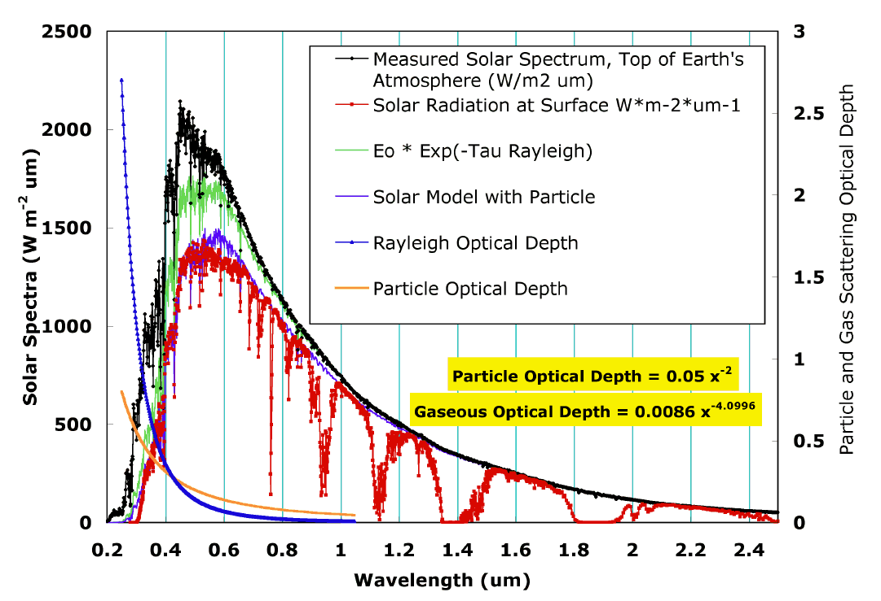
SOLAR SPECTRUM:
Effects of Rayleigh (gas) scattering, O₂ and N₂,
And effects of extinction by aerosol particles.

Slide 5
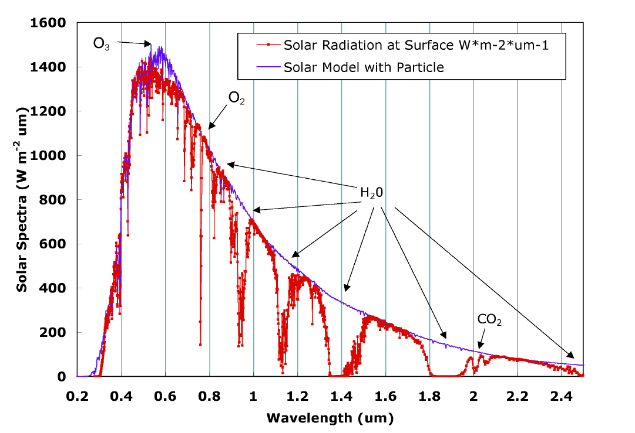
SOLAR SPECTRUM:
Effects of gaseous absorption.
(Not Shown: Many Trace Gases)

Slide 6
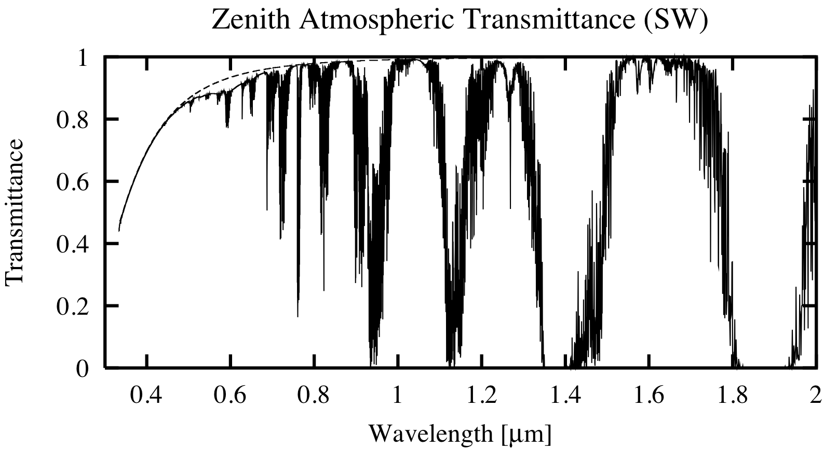
Shortwave Atmospheric Transmittance: Dashed line is Rayleigh Scattering, Solid line is Rayleigh Scattering + Gaseous Absorption.

Slide 7
Absorption by Atmospheric Gases
KEY POINTS
Visible and UV Absorption: due to electronic transitions. Monatomic - polyatomic.
IR Absorption: due to vibration and rotation transitions. Polyatomic.
Microwave Absorption: due to rotation transitions. Polyatomic.
Absorption cross sections depend on temperature and pressure.
Population of energy levels depends on temperature (thermal energy, kT). Transitions between levels therefore depend on temperature.
Temperature (Doppler) broadening of absorption lines in the mesosphere.
Pressure broadening of absorption lines (due to molecular collisions) in the troposphere.

Slide 8
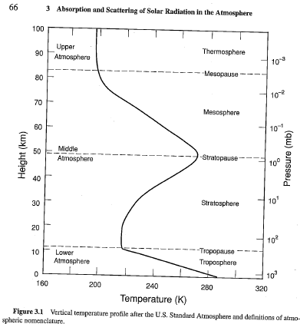
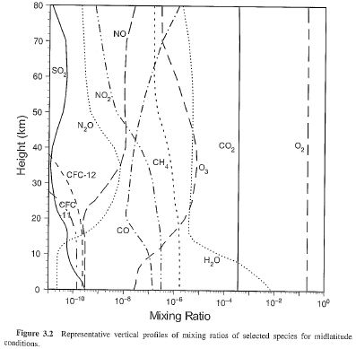
Atmospheric Temperature Profile: US “Standard” Atmosphere.
Dances of the Molecules in the Atmosphere: Which dance? Depends on temperature, available IR photons.
P(E_{ij}) ≈ exp(-hν_{ij} / kT)
From Liou

Slide 9
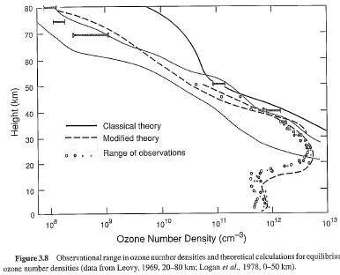
Ozone Number Density: Theory and Measurements.

Slide 10
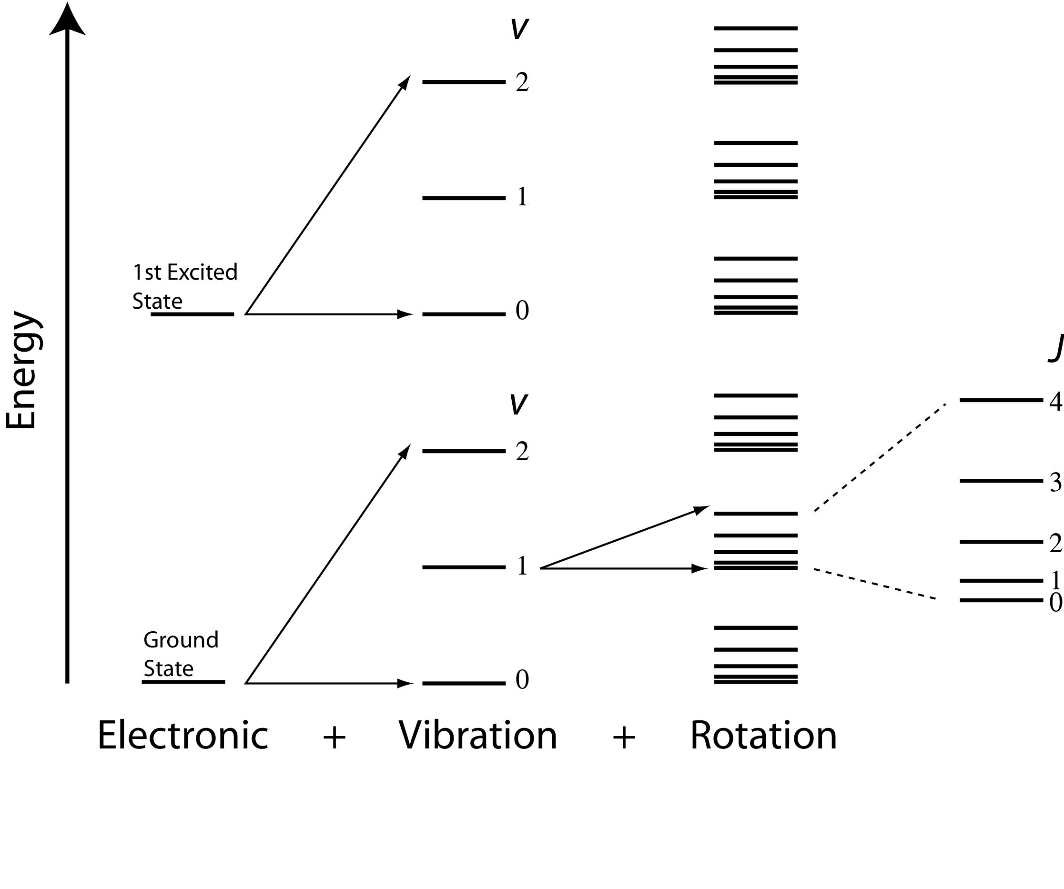


Transitions

Slide 11
Dominant Transitions
Wavelengths | Band | Dominant Transition
< 1 µm, (200 nm - 1000 nm) | Near IR, Visible, UV | Electronic
1 µm - 20 µm | Near IR, Thermal IR | Vibration
> 20 µm | Far IR, Microwave | Rotation

Slide 12


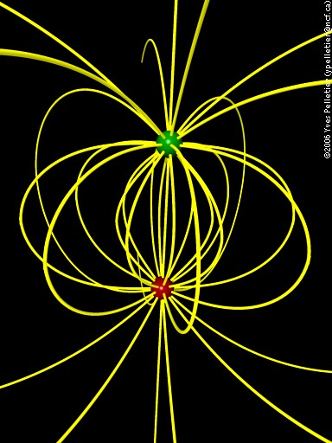
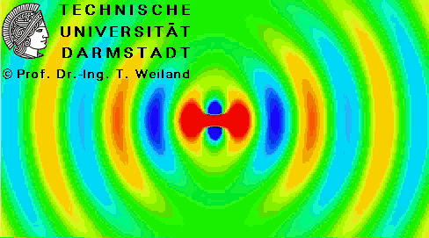
Selection Rules: Accelerated Charges are the Source, Sinks of Electromagnetic Radiation: Dipole Moment, p.
Selection rules specify the possible transitions among quantum levels due to absorption or emission of electromagnetic radiation. Incident electromagnetic radiation presents an oscillating electric field that interacts with a transition dipole p_{z}. A transition dipole moment is a transient dipolar polarization created by an interaction of electromagnetic radiation with a molecule. If p_{z} is zero then a transition is forbidden. The selection rule is a statement of when p_{z} is non-zero.
General
q
-q

Slide 13
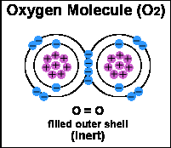
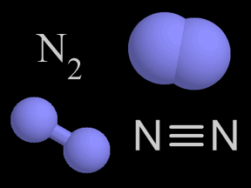
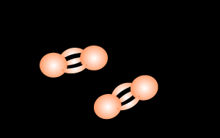
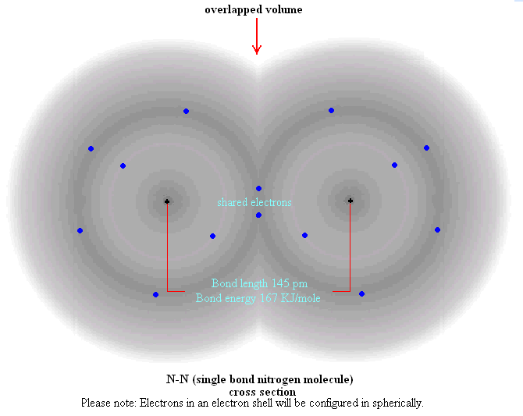
Why Don’t We Worry About Rotational and Vibrational Transitions for N₂, and worry only a little about O₂?
Homonuclear Diatomic Molecules: N₂ has no permanent electric or magnetic dipole moment due to the symmetry of positive and negative charge within the molecules. (O₂ has a permanent magnetic dipole moment, rotation bands at 60 and 118 GHz.)

Slide 14
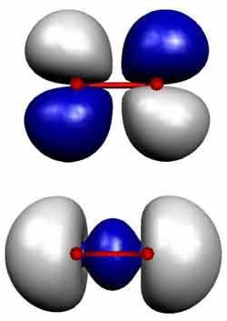
Why Don’t We Worry About Rotational and Vibrational Transitions for N₂, and worry only a little about O₂?
Bonding electron ‘clouds’ (orbitals) for O₂ and N₂ (bottom).
O₂
Homonuclear Diatomic Molecules: N₂ has no permanent electric or magnetic dipole moment due to the symmetry of positive and negative charge within the molecules. (O₂ has a permanent magnetic dipole moment, rotation bands at 60 and 118 GHz.)
N₂

Slide 15
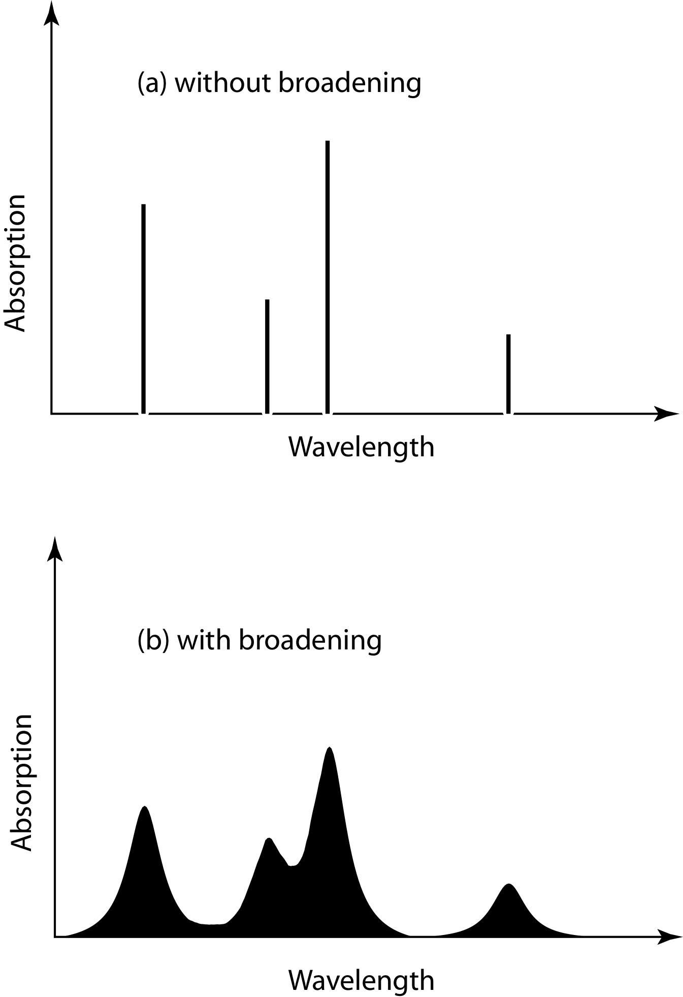
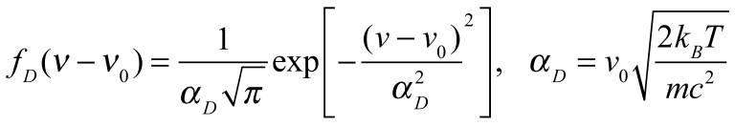
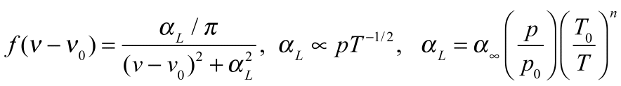
Line Broadening
Natural Broadening: Finite time, finite widths (Heisenberg is uncertain about widths, certain they are not infinitely narrow!)
Doppler Broadening:
Molecules with relative motions due to thermal energy ‘see’ doppler shifts of the light. Important in the mesosphere.
Pressure Broadening: Lorentz line shape
Molecular collisions distort energy levels for absorption and emission. Emperically determined (by measurement). Very important for the troposphere and lower stratosphere.
frequency
frequency

Slide 16
Line Strength Temperature Dependence Summary
*** Energy levels are determined from quantum mechanics, electronic, vibration, rotation etc, as related to molecular mass, charge distribution, orientation, number of atoms, etc.
*** # of molecules in each state is determined from statistical mechanics, partition function, thermal energy. Is there sufficient thermal energy to populate the energy levels above the ground state? What is the probability molecules are in a given energy state?

Slide 17
Additional Interactions
Continuum Absorption (e.g. water vapor in window region) Broad, weak absorption.
From poor model of spectral lines? From water vapor clusters of 2 or more molecules? Both? VERY IMPORTANT!!!
‘Dirties’ the window region in the thermal IR.
Photoionization (Gamma, X-ray) Continuum absorption, electrons ejected with kinetic energy. Photodissociation (UV, Vis?) e.g. NO₂ and λ < 400 nm.
Molecules are broken and leave with kinetic energy.
NO₂ + hν --> NO + O
VERY IMPORTANT FOR ATMOSPHERIC CHEMISTRY!!!

Slide 18
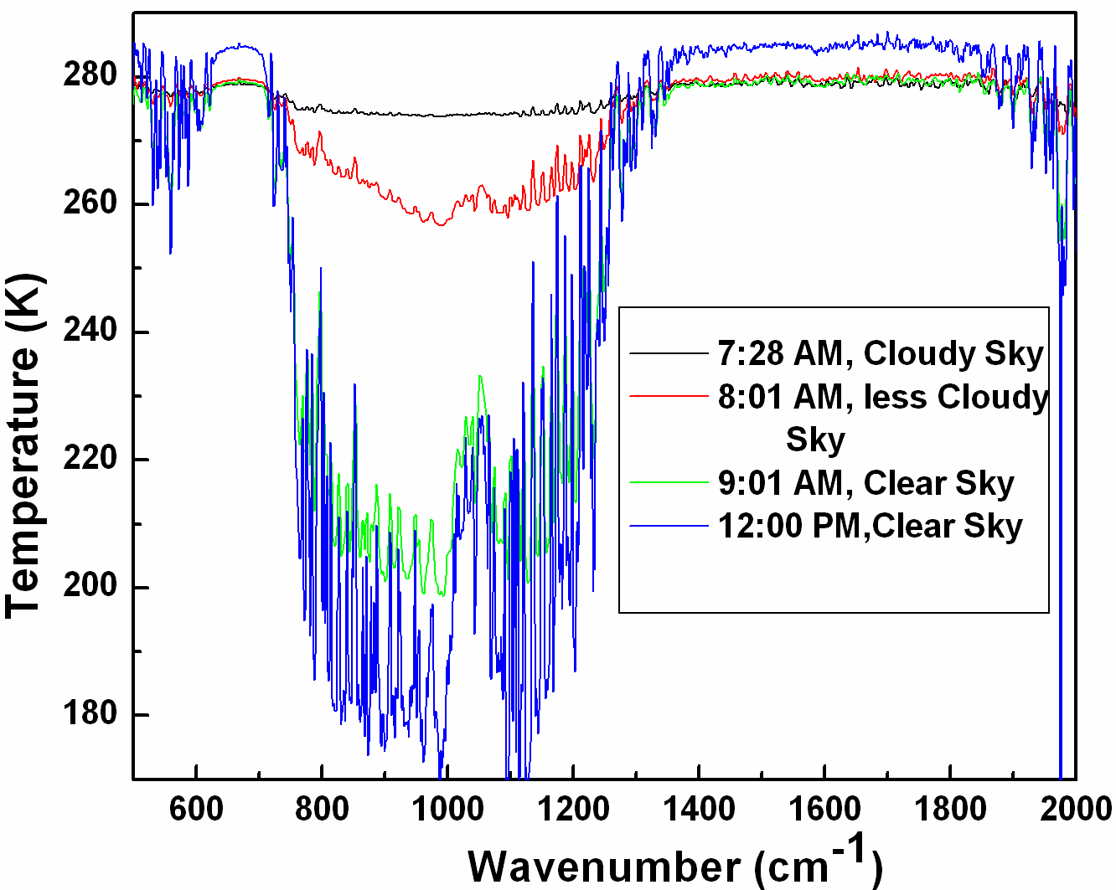
Water Vapor Continuum Absorption Very Important in Window Region!!!! (Example from 6 Nov 08 Measurements of downwelling radiance at UNR)
Weak absorption, continuum baseline with a few weak lines, easily overshadowed by the much larger emission amounts from clouds!!

Slide 19
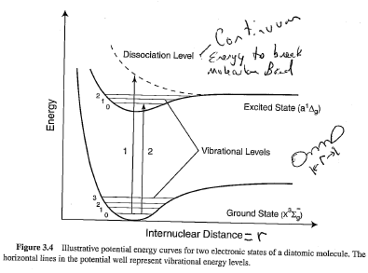
Electronic, Vibrational, energy levels and the big break up (dissociation level)
From Liou

Slide 20
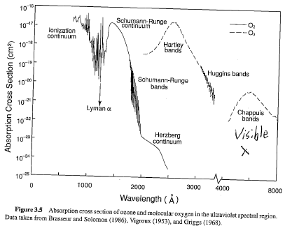
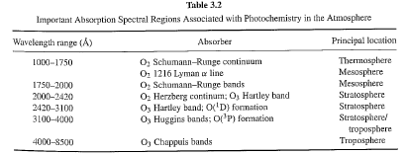
Absorption cross sections of O₃ and O₂ in the UV and Visible.
Strongly affects atmospheric chemistry, thermal structure, and amount of deadly UV that doesn’t make it to the surface.

Slide 21
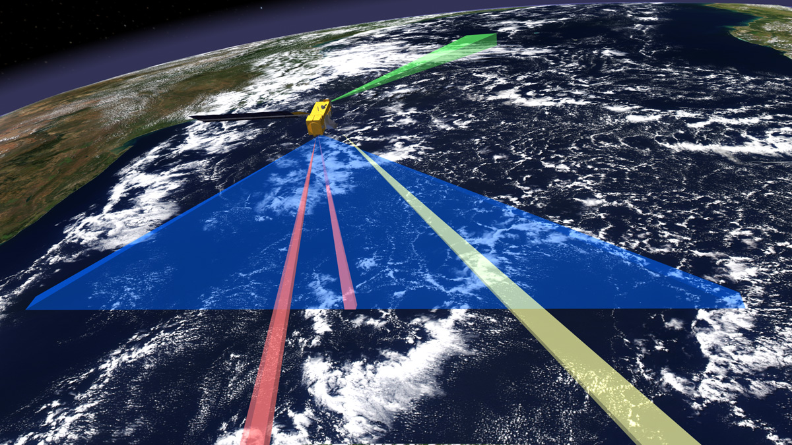
Ozone Monitoring Instrument (OMI)
One of four sensors on the EOS-Aura platform (OMI, MLS, TES, HIRDLS)
An international project: Holland, USA, Finland
Launched on 07-15-04
Instrument Characteristics
-Nadir solar backscatter spectrometer
-Spectral range 270-500 nm (resolution~1nm )
Spatial resolution: 13X24 km footprint
Swath width: 2600 km (global daily coverage)
Retrieval Products
Column Amounts
-Ozone (O₃)
-Nitrogen Dioxide (NO₂)
-Sulfur Dioxide: (SO₂)
-Others
Aerosols

Slide 22
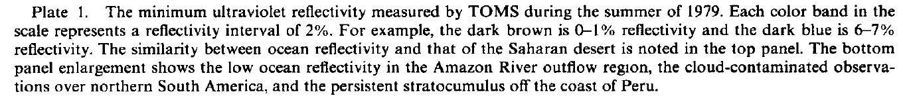
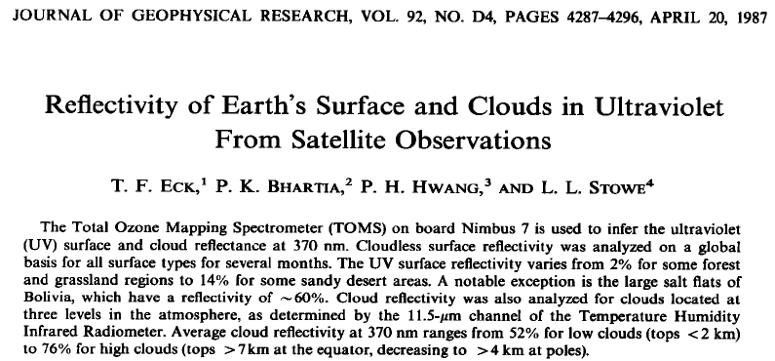
History: Total Ozone Measurement Satellite Instrument flew on the Nimbus Satellite in the 80’s.
Key idea and method we use for monitoring our ozone layer.
Next two slides show UV reflectivity of the Earth and clouds at 370 nm.

Slide 23
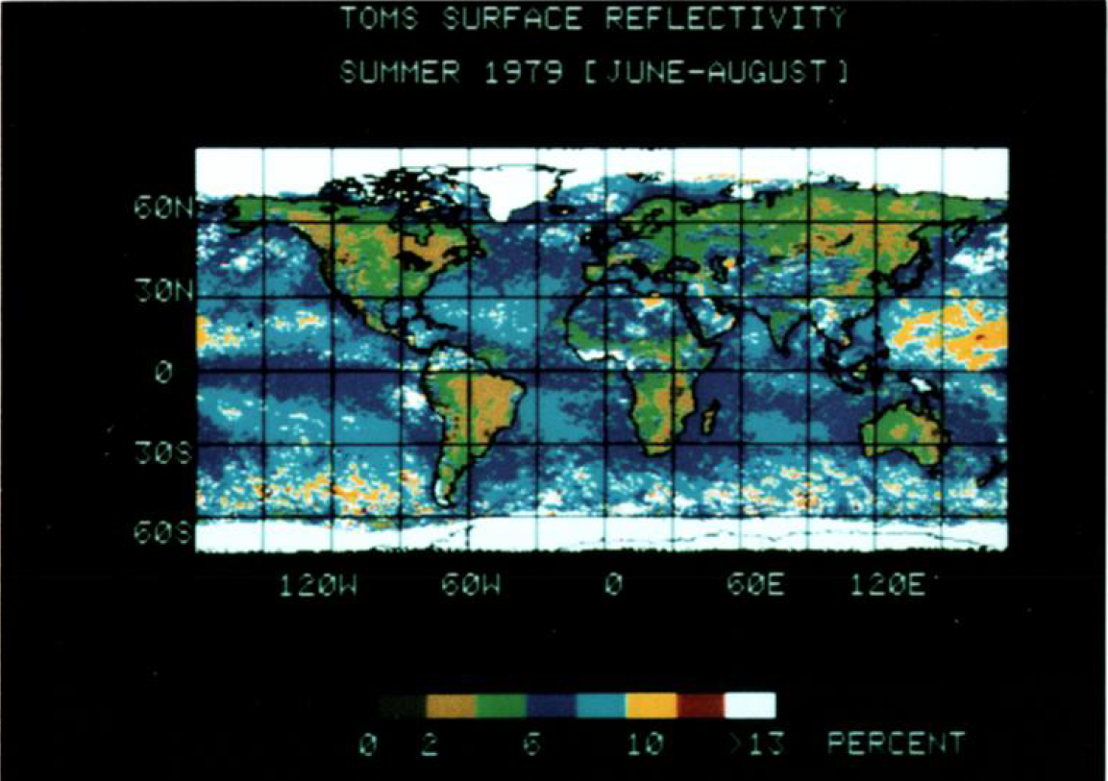

Slide 24
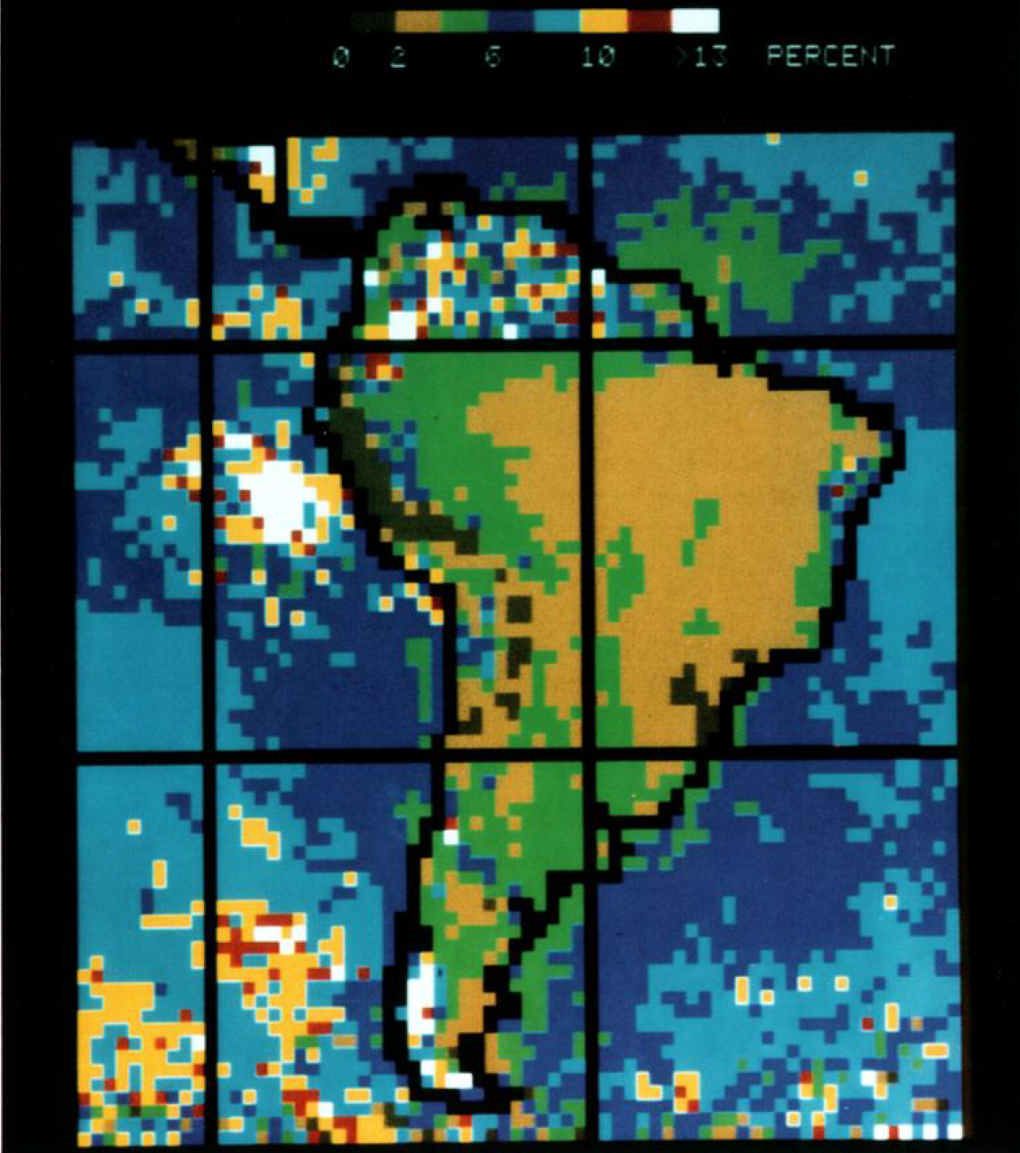

Slide 25
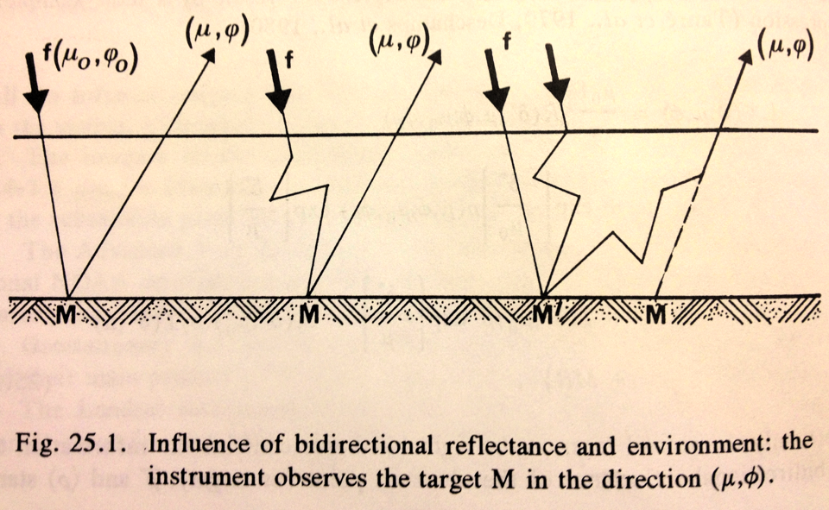
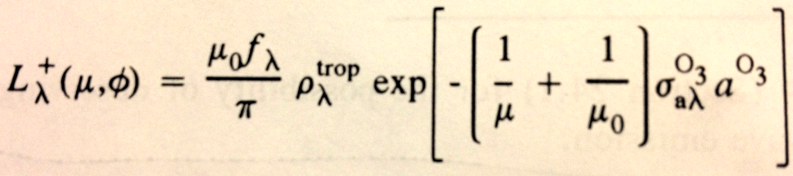
Simple Ozone Retrieval Idea:
SUN
Satellite
From Lenoble, chapter 25
Column
Ozone
Amount
Absorption
Cross section
Tropospheric
reflectivity
SUN

Slide 26
Satellite Aerosol Products
InInI | MODIS | MISR | OMI | PARASOL
Strengths | Coverage Resolution Calibration Accuracy | Calibration Accuracy Particle shape Aerosol height for thick layer or plume | Indication of absorbing or scattering particles | Calibration Accuracy Particle shape*
Weaknesses | Bright Surfaces* Ocean glint Non-spherical particles | Coverage | Resolution Cloud contamination | Cloud contamination No coarse aerosol over land
Main Products | AOD Ocean – 5 wavelengths Land – 3 wavelengths Fine Fraction* *Ocean only | AOD 4 wavelengths Spherical/ Non-spherical ratio Particle Size (3 Bins) | AOD AAOD Aerosol Index | AOD over ocean Fine AOD over land Non-spherical fraction over ocean Angstrom exponent
Product Resolution (level 2 and at Nadir) | 10 Km 3 Km (Collection 6) | 17.6 Km | 13 X 24 Km | 20 Km
Product Levels | 2 | 2 | 2 | 2
Global Level 3 Aggregates | Daily 8 Day 30 Day | Monthly 3 Month Annual | Daily Monthly | Monthly
Notes:
This comparison chart is mainly for level 2 products – Most of the level 3 products are in much coarser resolution – like 0.25, 0.5, or 1 deg

Slide 27
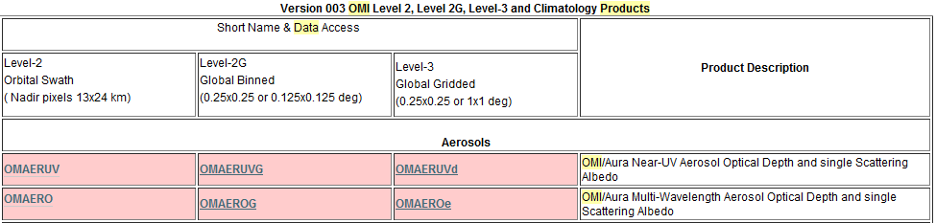
OMI data site
http://disc.sci.gsfc.nasa.gov/Aura/data-holdings/OMI
OMI-Aura_L2-OMAERUV_2011m1024t0521-o38692_v003-2011m1024t115317.he5
Product name
YYYYmMMDDtHHMM

Slide 28
OMI Products
Product Level | Product Name | Product Contains | Spatial Resolution
1 | OML1BRUG | 716 bands (264-383nm) | 13x24, 13x48 km
2 | OMAERUV | Aerosol Product | 13x24 km
2 | OMNO2 | NO2 product | 13x24 km
2 | OMSO2 | SO2 product | 13x24 km
2 | OMTO3 | Ozone Product | 13x24 km
2 | OMCLDRR OMCLDO2 | Cloud Product | 13x24 km
3 | OMAERUVd OMNO2e OMSO2e OMTO3e | Global products | 0.25 to1 degree
OMI L1 and L2 data comes in hourly files and L3 data comes in daily and monthly means global data files

Slide 29
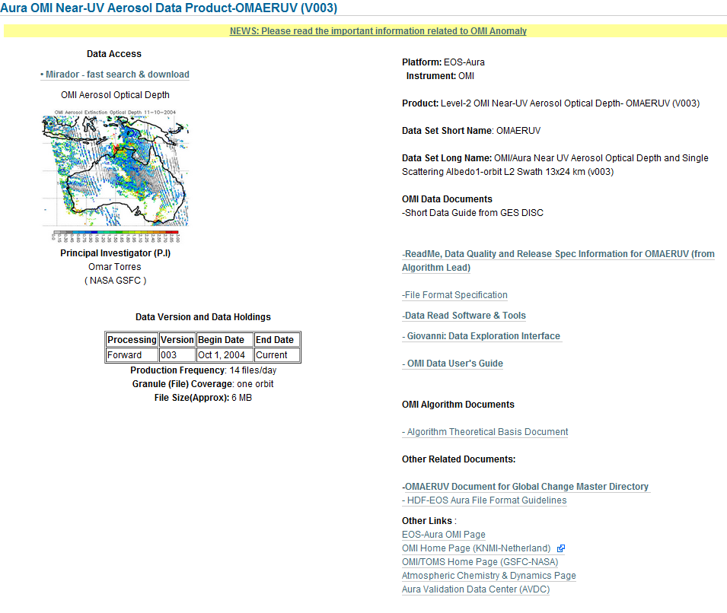
OMAERUV

Slide 30
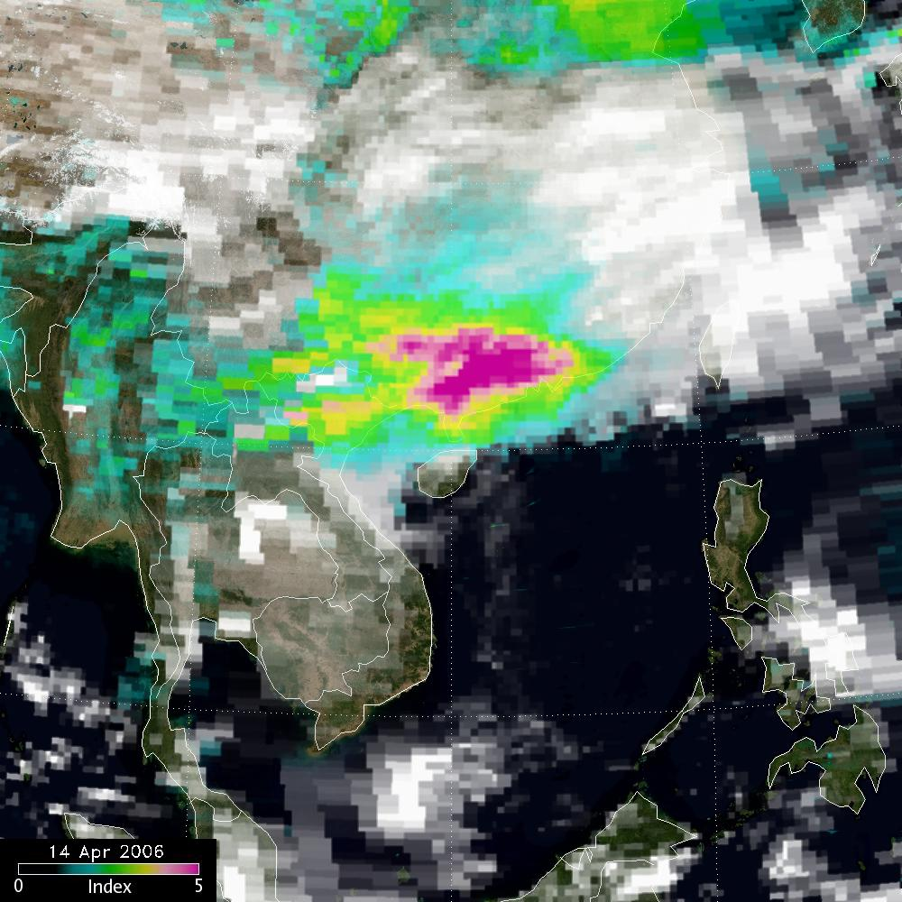
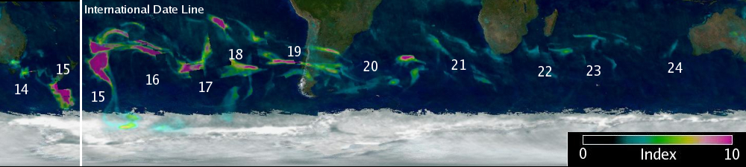
Applications of the Aerosol Index
Validation tool for transport models
Separation of carbonaceous from sulfate aerosols
Identification of aerosols above PBL (i.e., PBL aerosols are not detectable by AI)
Tracking of aerosol plumes above clouds and over ice/snow
Aerosol s over clouds:
April 14, 2006
Transport around the globe of a high altitude smoke layer generated by the
Australian fires in December 2006. Numbers indicate the day of the month.

Slide 31
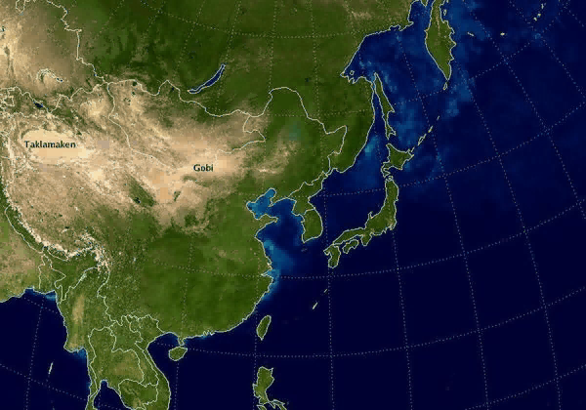

Trans-oceanic Aerosol Transport as seen by OMI Aerosol Index

Slide 32
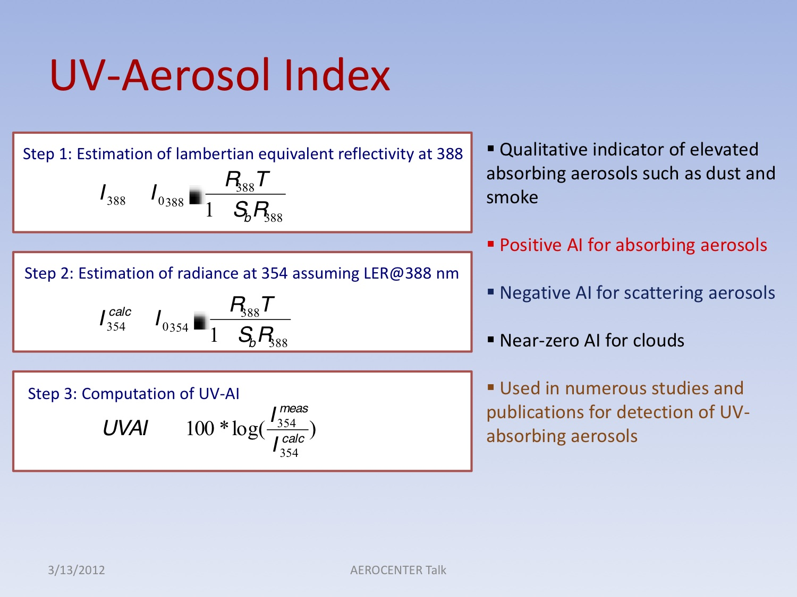
OMI Near UV Aerosol Products (388 nm)

Slide 33
Properties of the Aerosol Index
Positive values for UV-absorbing particles
- desert dust, smoke, volcanic ash
Aerosol Index signal meaningful for values larger than 0.5
Magnitude of positive AI depends mainly on
- aerosol absorption optical depth
- height of aerosol layer
Negative values for small size (less than 0.2 microns) non-absorbing particles. In practice, it is difficult to separate aerosol effects from other non-aerosol effects that also produce negative AI values.
Detects absorbing aerosols over all surface types: ocean, vegetated surfaces, deserts, snow/ice, etc
-Aerosol Index is insensitive to carbonaceous aerosols (smoke) below ~ 2km
-Larger sensitivity to low altitude desert aerosols (~ 0.5 km)
Notes:
-Direct conversion of AI to any physically meaningful parameter is not possible because of multiple dependecies (AOD, SSA, height, etc).

Slide 34
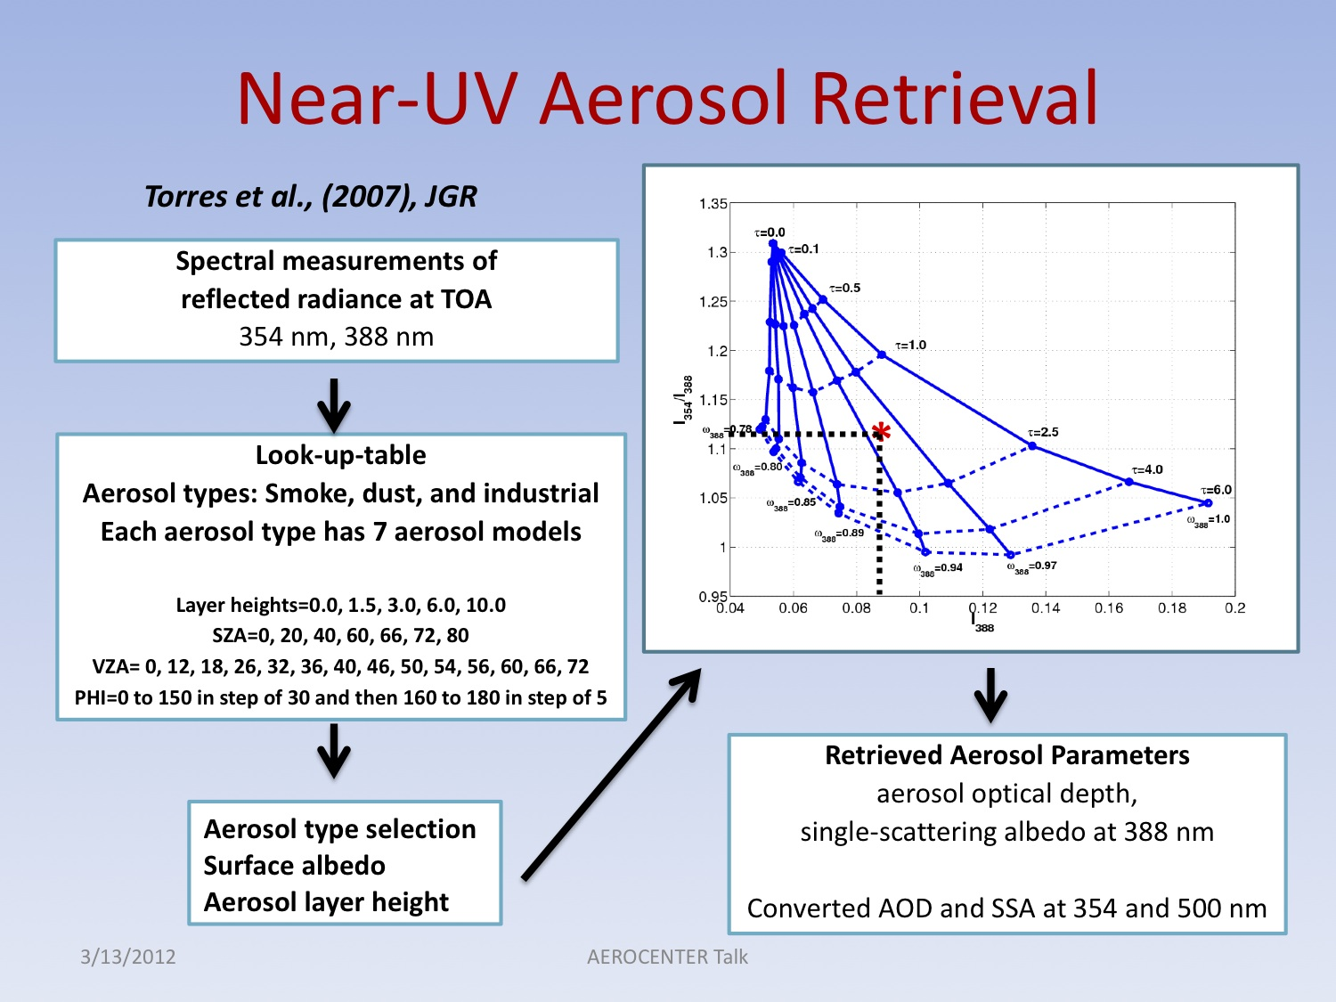

Slide 35
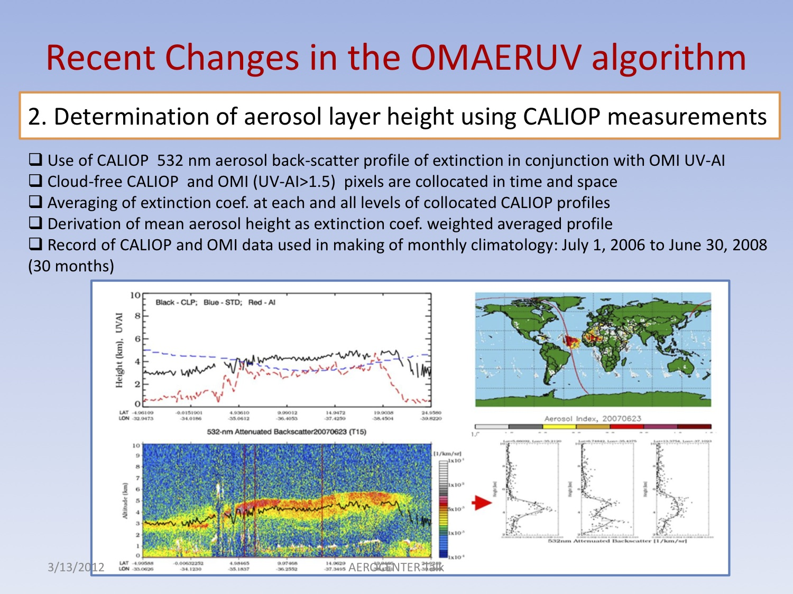

Slide 36
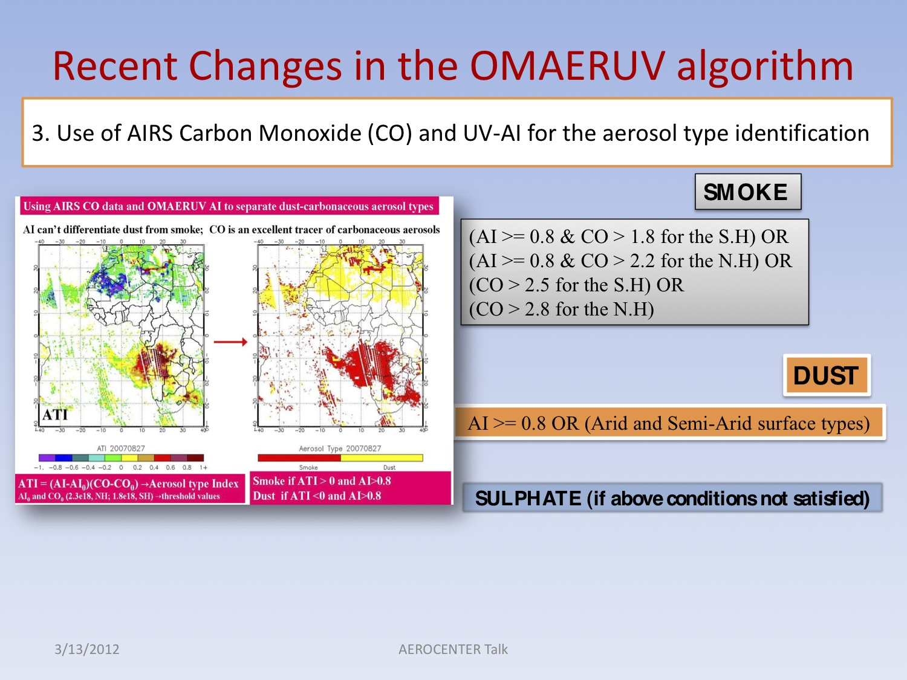

Slide 37
OMI Near UV Aerosol Products (388 nm)
Extinction Optical Depth, AOD
A measure of the aerosol capacity to extinguish radiation by scattering and absorption.
It is related to the total column amount of aerosol particles in the atmosphere.
-Single Scattering Albedo, SSA
A measure of the fractional extinction due to scattering of incident solar radiation.
Varies between 0 (all absorption, no scattering) and 1 (all scattering, no absorption)
Typical variability range (0.6 to 1.0)
-Absorption Optical Depth, AAOD
The actual optical depth resulting from the absorption process. It is easily calculated as
AAOD = AODx(1.0 – SSA)

Slide 38
Inversion Procedure
Observations
Measured radiances at 354 and 388 nm
Aerosol Models
Ancillary Input
Retrieval
Algorithm
Three aerosol types:
-Desert dust aerosols
-Carbonaceous aerosols
-Non absorbing aerosols
Assumed properties:
-Particle size distribution
-Refractive index
-Surface Albedo
-Aerosol Type
-Vertical Distribution
Extinction optical depth, AOD
Single Scattering Albedo, SSA
Absorption optical depth, AAOD
(354, 388)
Derived Parameters

Slide 39
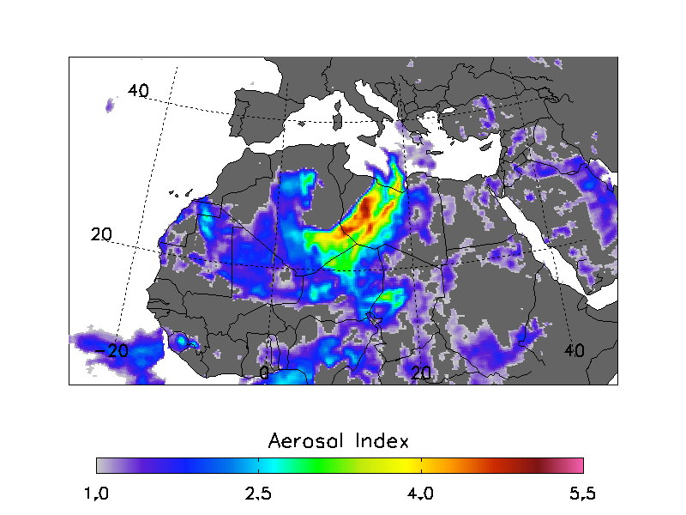
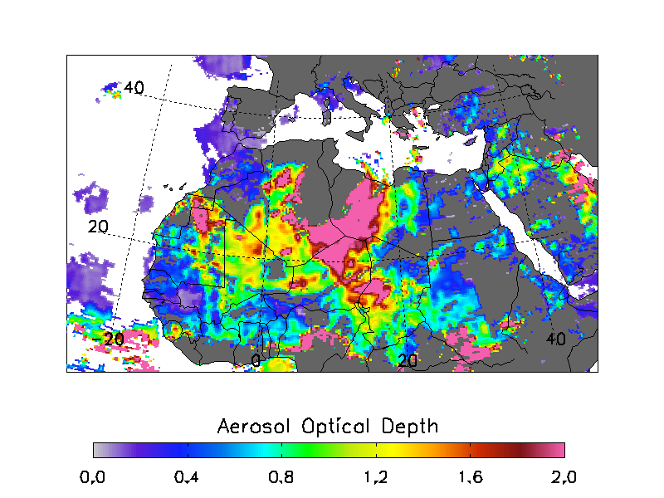
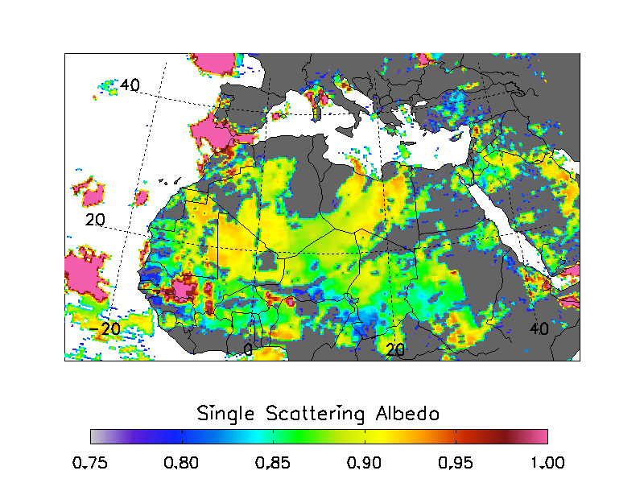
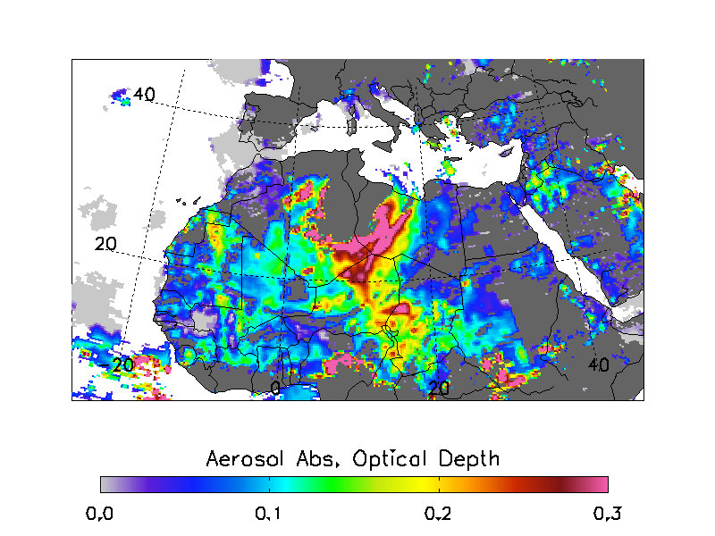
OMI Retrieved Dust Properties (March 9-2007)

Slide 40
Advantages of near UV retrieved products (AOD/SSA)
Retrieval capability over deserts where traditional visible and near IR methods fail.
-Retrieval capability of aerosol single scattering albedo.
Current Limitations
-Sensitivity to aerosol layer height
-Sub-pixel cloud contamination associated with large footprint (instrument limitation)
Works best under conditions of minimum cloud contamination and large scale aerosol events (desert dust and smoke plumes)
Small horizontal scale events (non-absorbing aerosols) are difficult to detect because of sub-pixel cloud contamination.

Slide 41
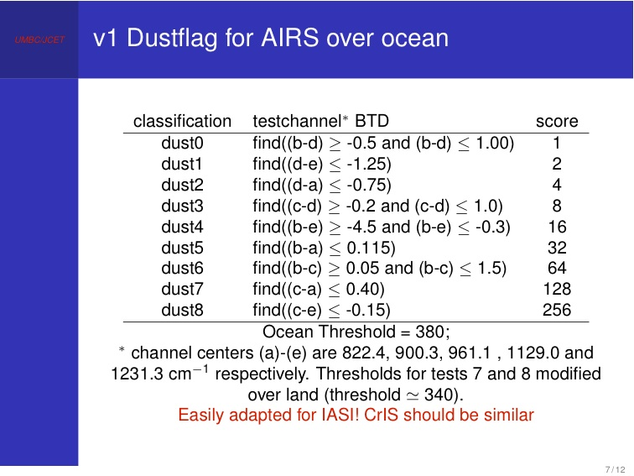

Slide 42
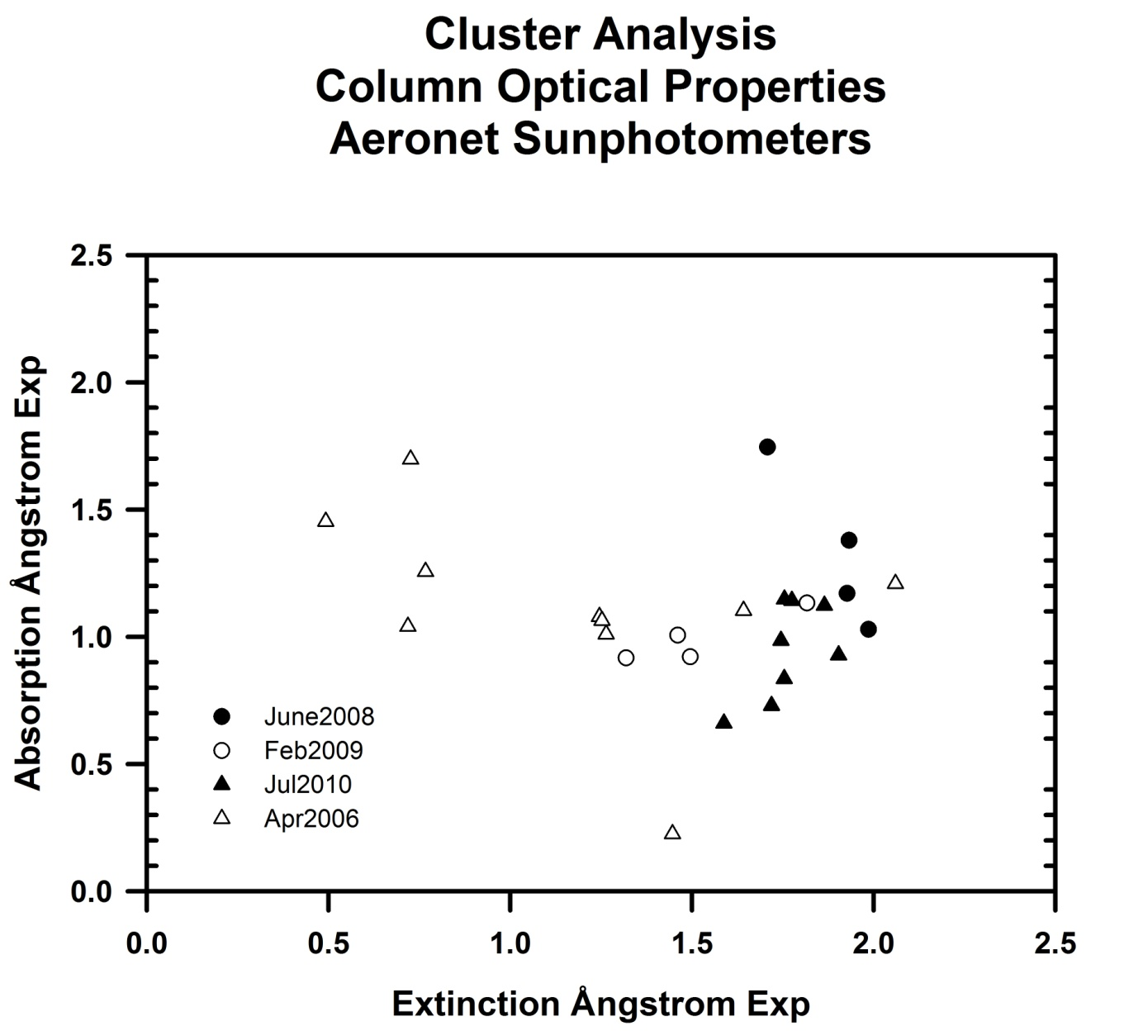
Forest fires
June 14, 2008
Dust
April 17-20, 2006
Urban
Aerosols
P.B. Russell et al., Atmos. Chem. Phys., 10, 1155-1169, 2010.

Slide 43
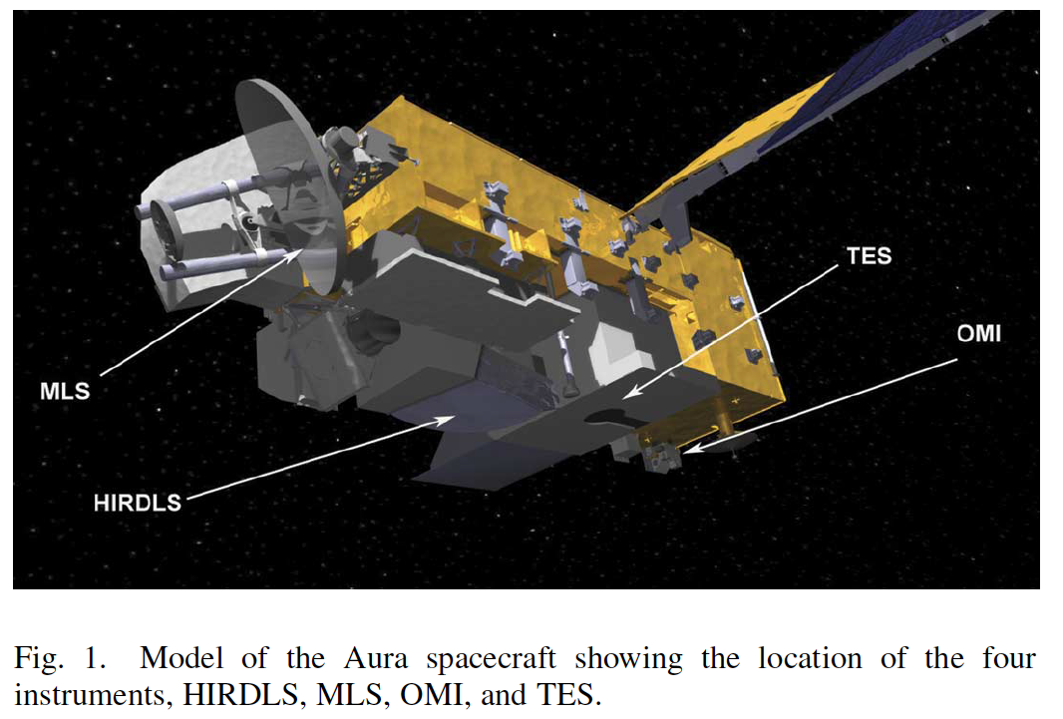
AURA SATELLITE
HIRDLS High resolution dynamics limb sounder: Limb IR filter radiometer from 6.2 µ to 17.8 µ 1.2 km resolution up to 50 km.
MLS Microwave limb sounder: 118 GHz to 2.5 THz, 1.5-3 km vertical resolution.
OMI Ozone monitoring instrument: Spectrometer, 270-500 nm, 13x24 km footprint.
TES Tropospheric Emissions Spectrometer: Limb (to 34 km) and nadir IR Fourier transform infrared spectrometer (FTIR) 3.2 um to 15.4 µ. Nadir 5.3x8.5 km, limb 2.3 km.

Slide 44
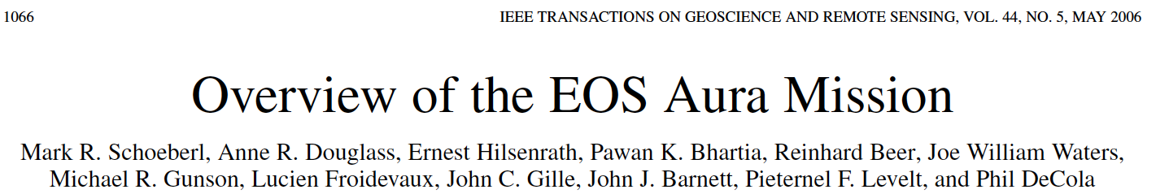
AURA PRODUCTS EXAMPLES FROM THIS SOURCE

Slide 45
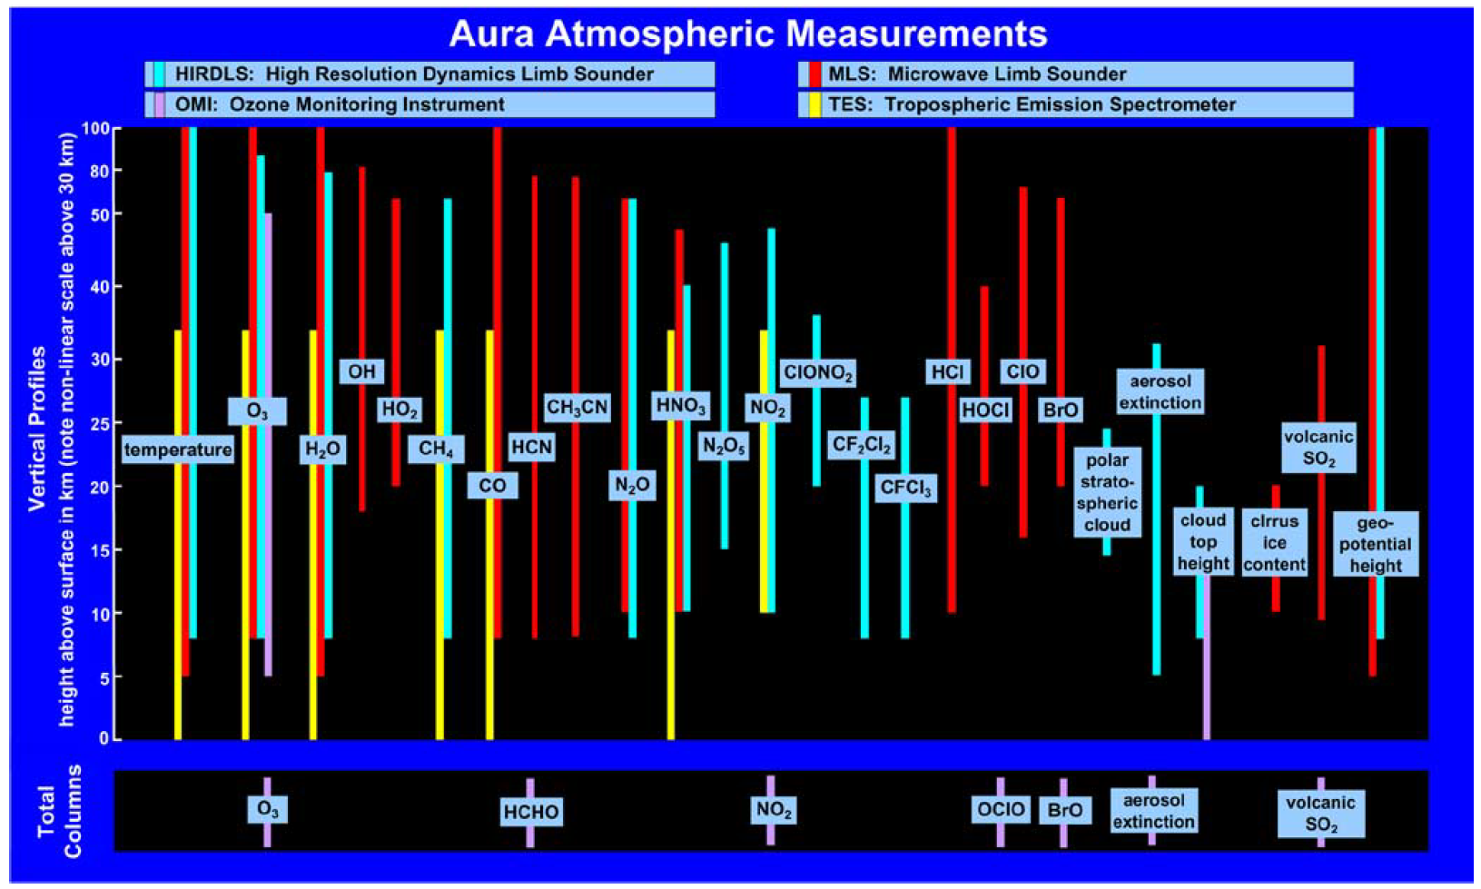
AURA PRODUCTS

Slide 46
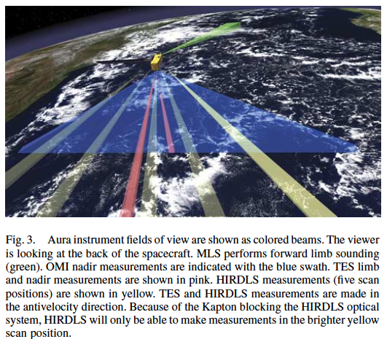
AURA SENSING DIRECTIONS

Slide 47
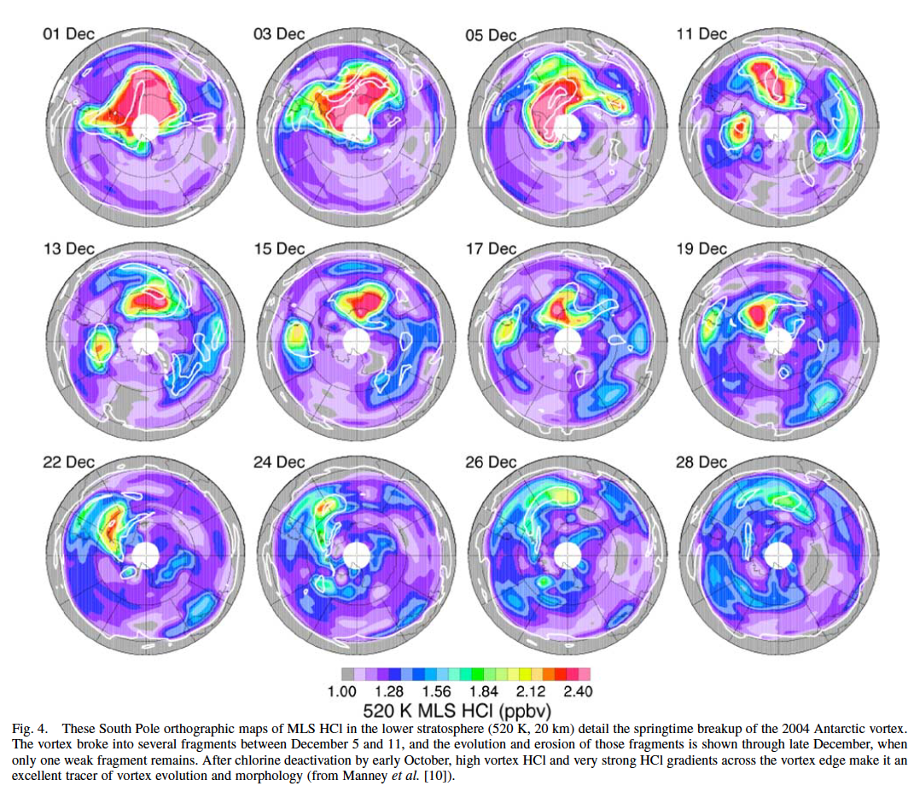
Chlorine Related Concentration in the Antarctic Vortex

Slide 48

OMI NO2

Slide 49

TES CO example

