Slide 1
Monte Carlo Multiple Scattering Idea to Understand Interaction of Solar Radiation at Visible Wavelengths with Cloud Hydrometeors (cloud droplets, drizzle, rain, hail, ice crystals).

Slide 2
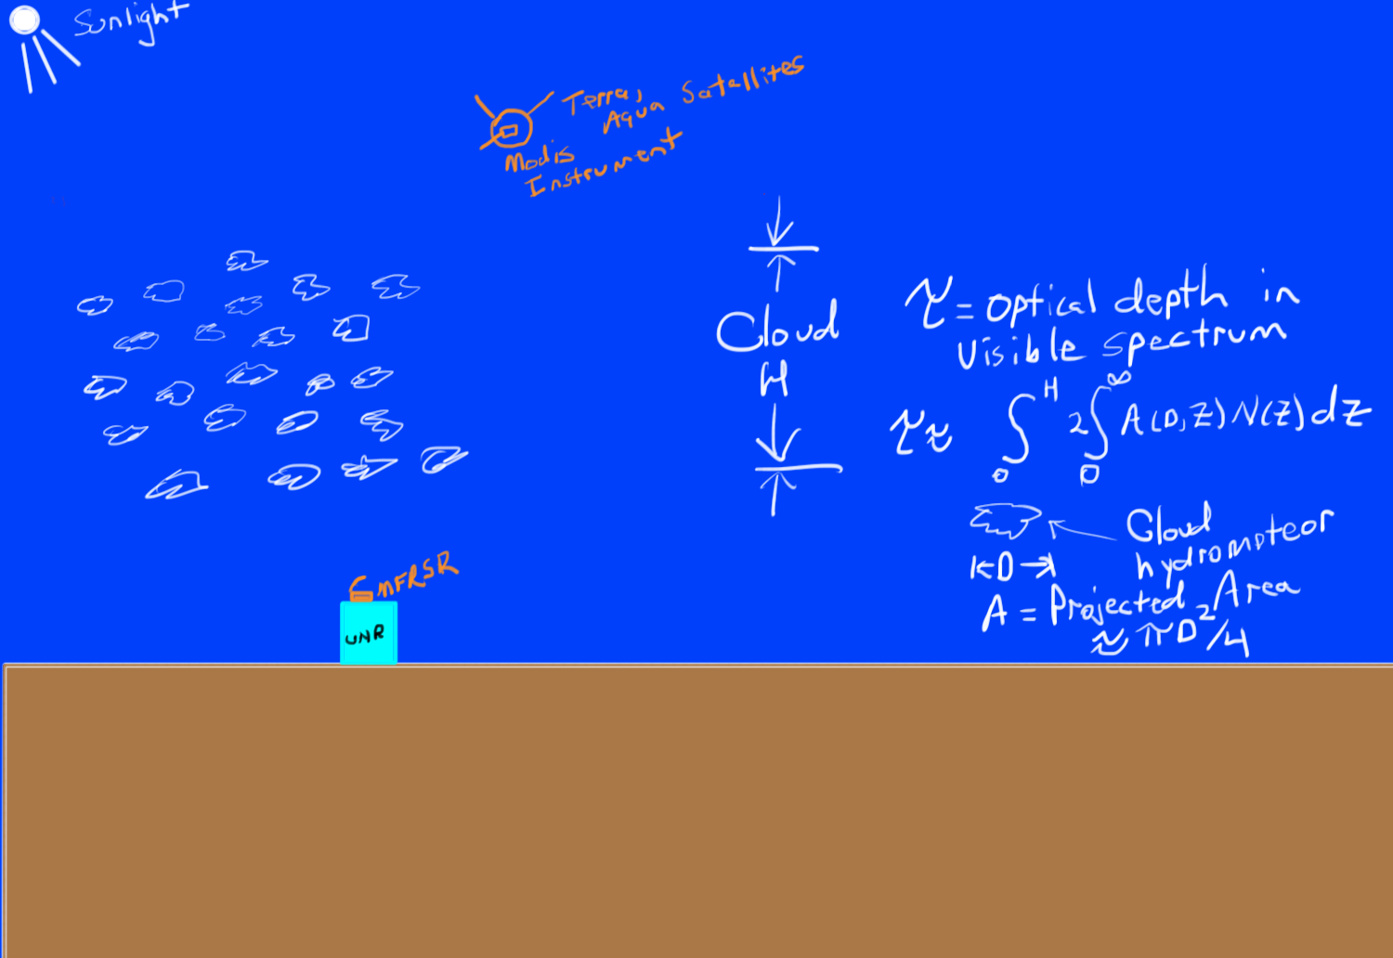

Slide 3
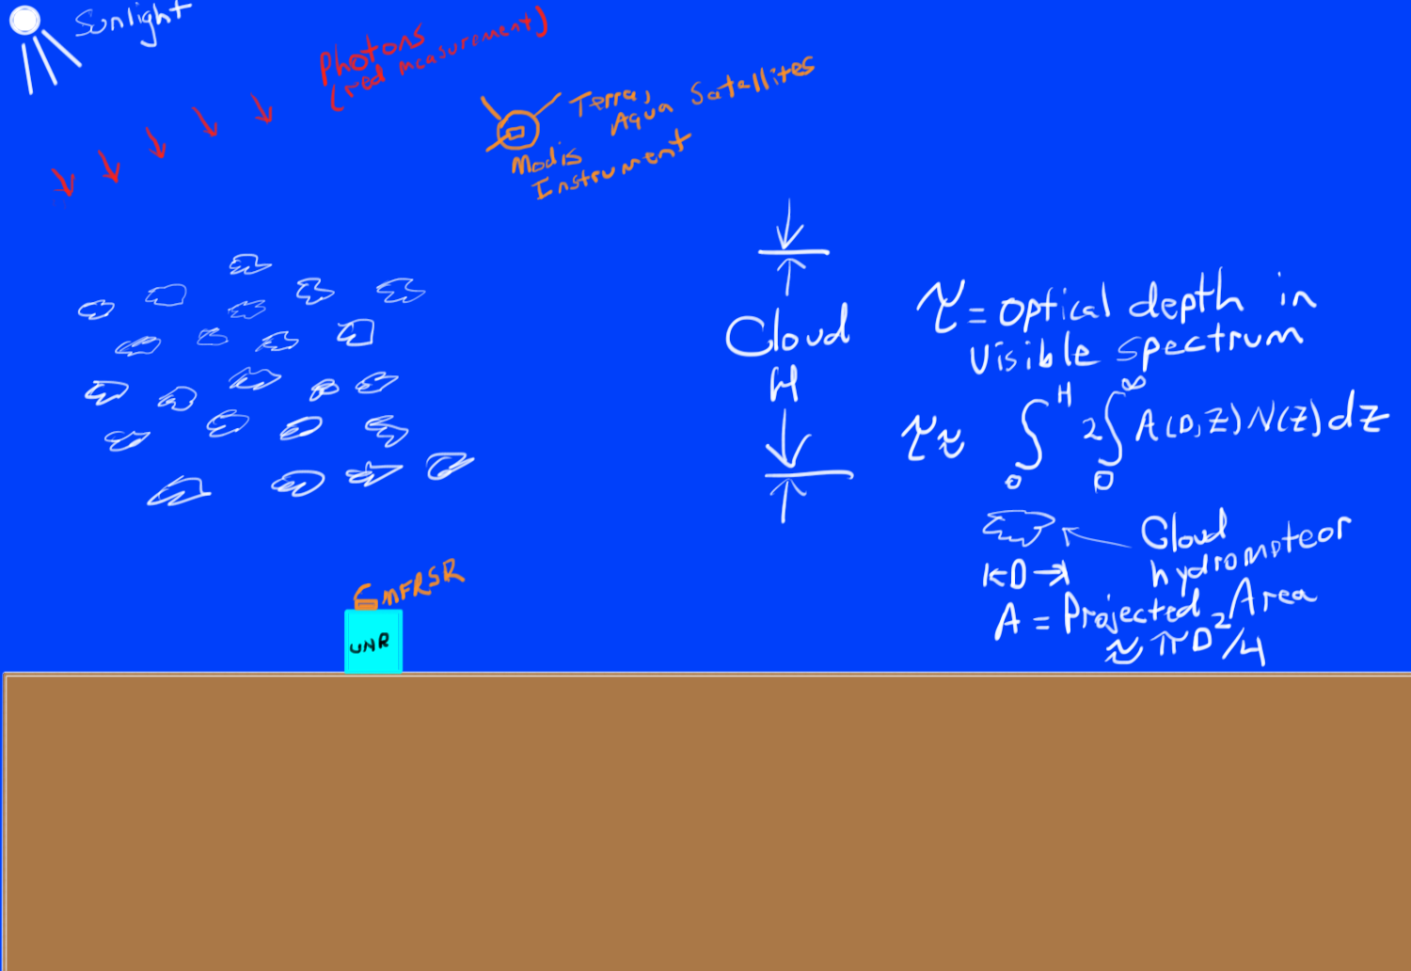

Slide 4
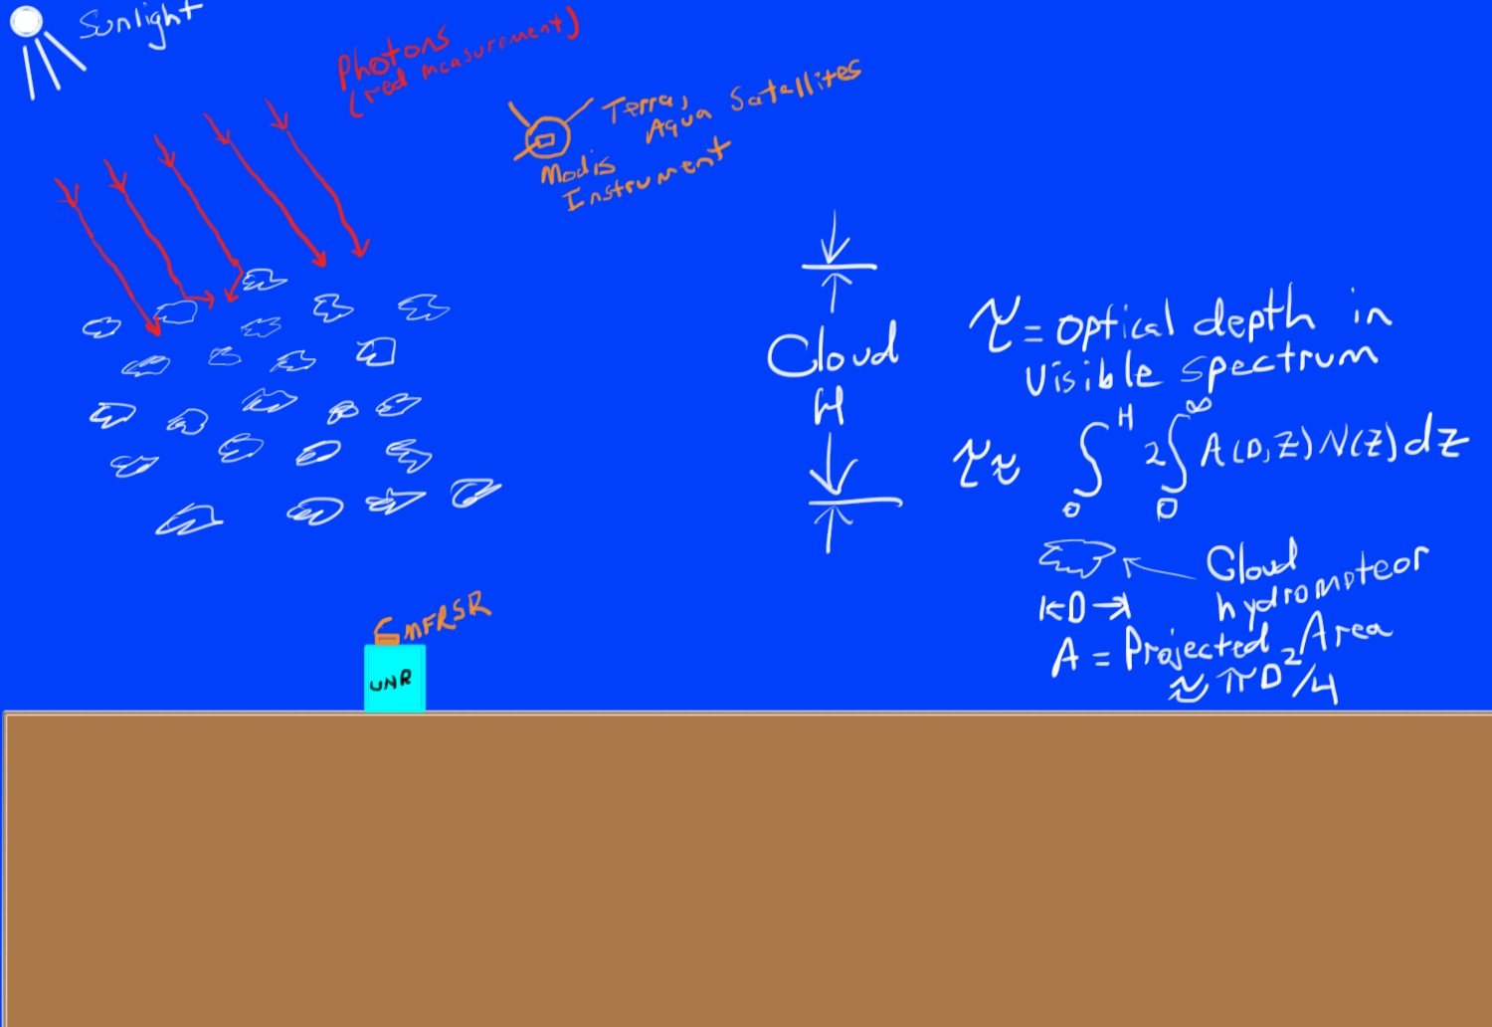

Slide 5
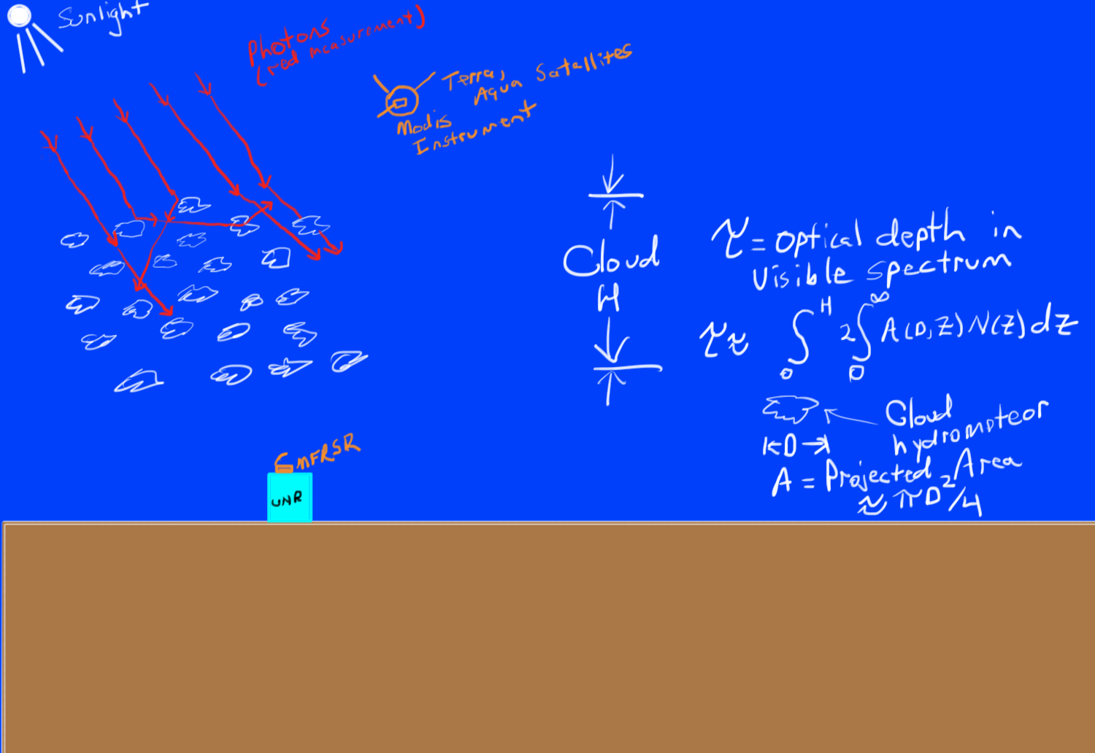

Slide 6
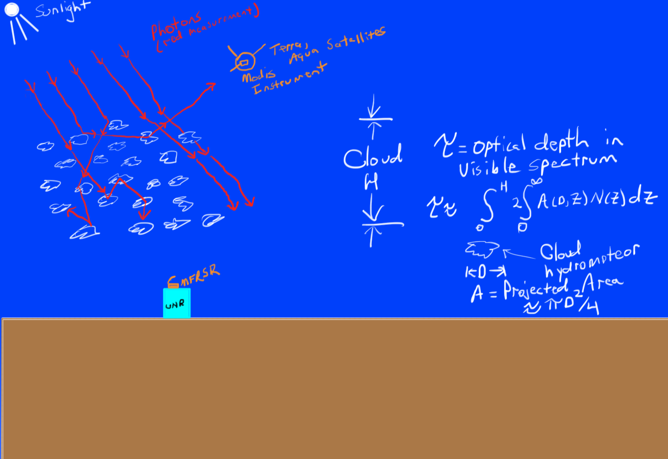

Slide 7
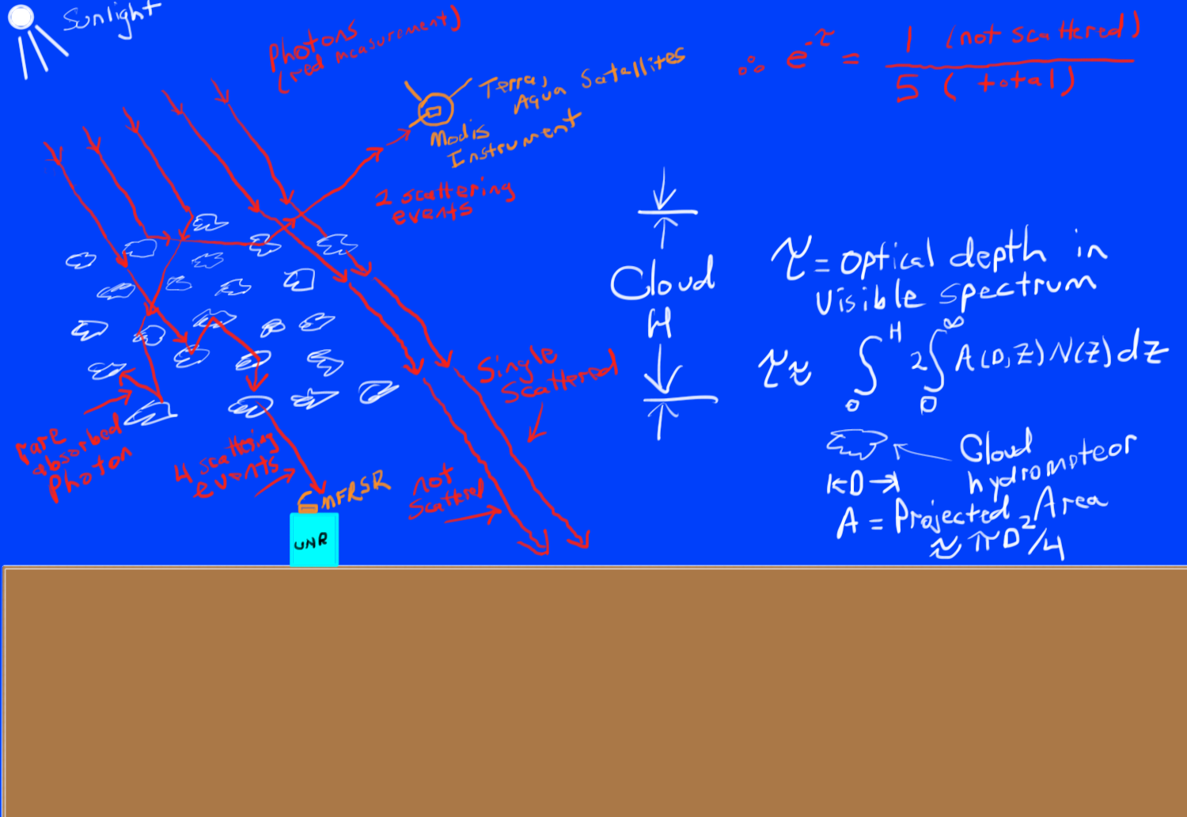
(not absorbed)

Slide 8
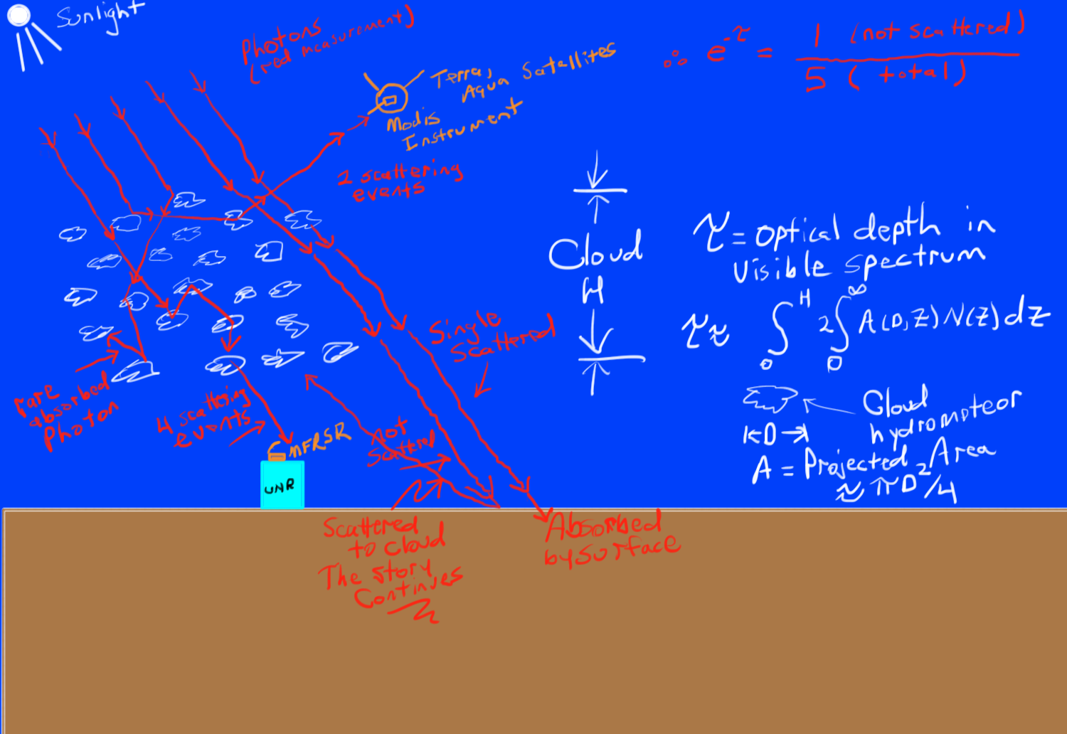
(not absorbed)

