Slide 1
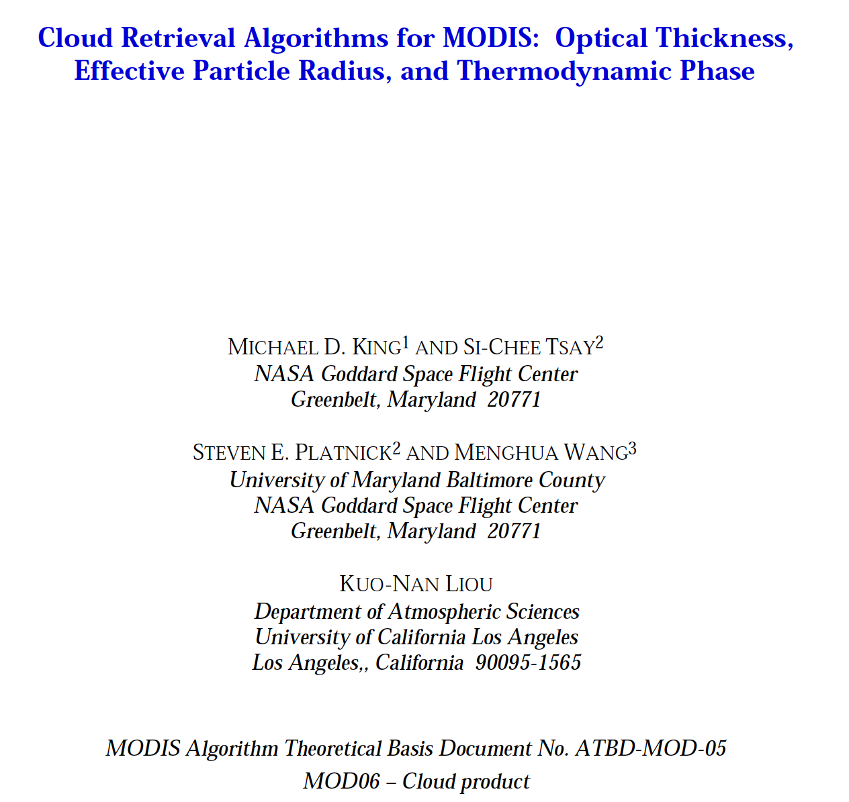
MODIS CLOUD RETRIEVAL: A presentation based on this document.

Slide 2
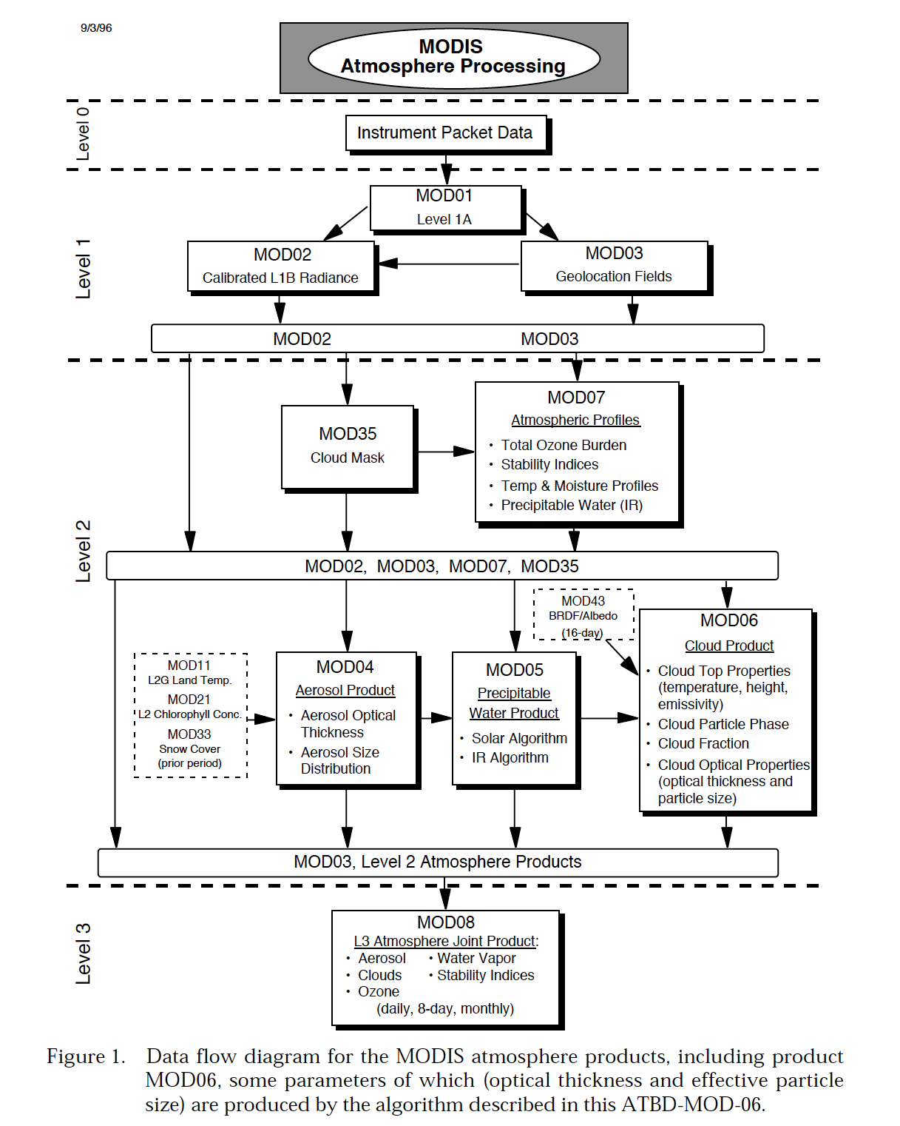
MODIS ATMOSPHERE PRODUCTS

Slide 3
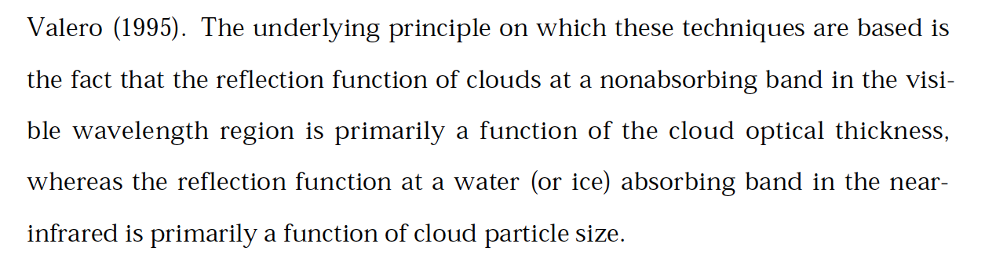
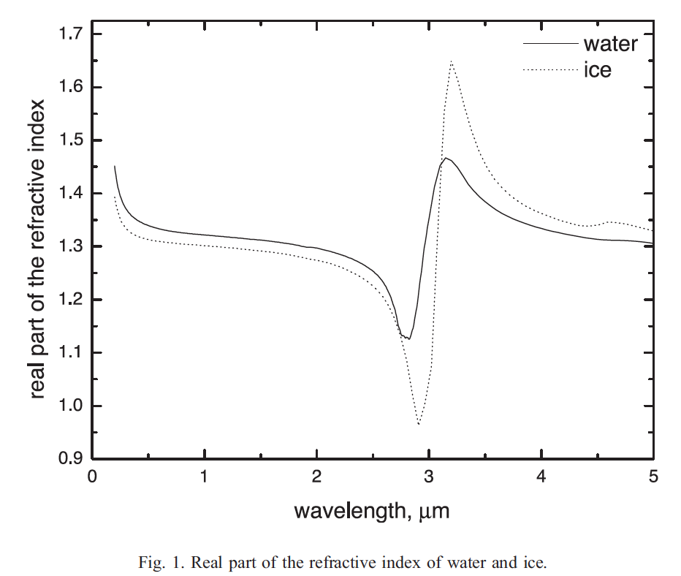
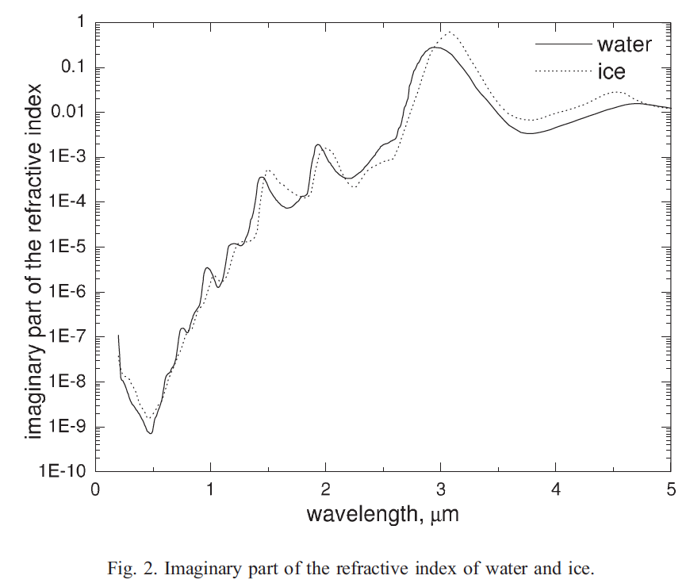
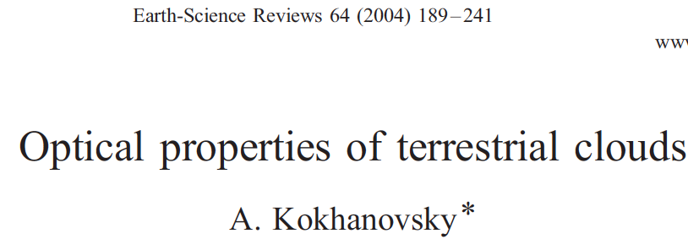
Basic Idea Behind Cloud (and Snow) Retrievals
Pg 9

Slide 4
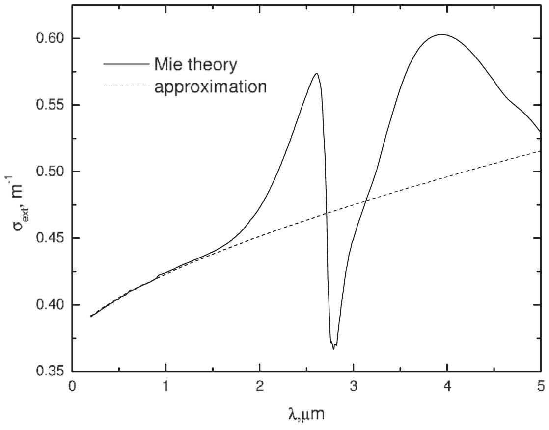
Spectral Extinction Coefficient for Water Droplet Cloud: Refractive Index Effects

Slide 5
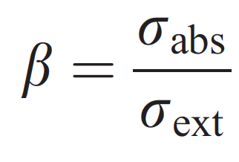
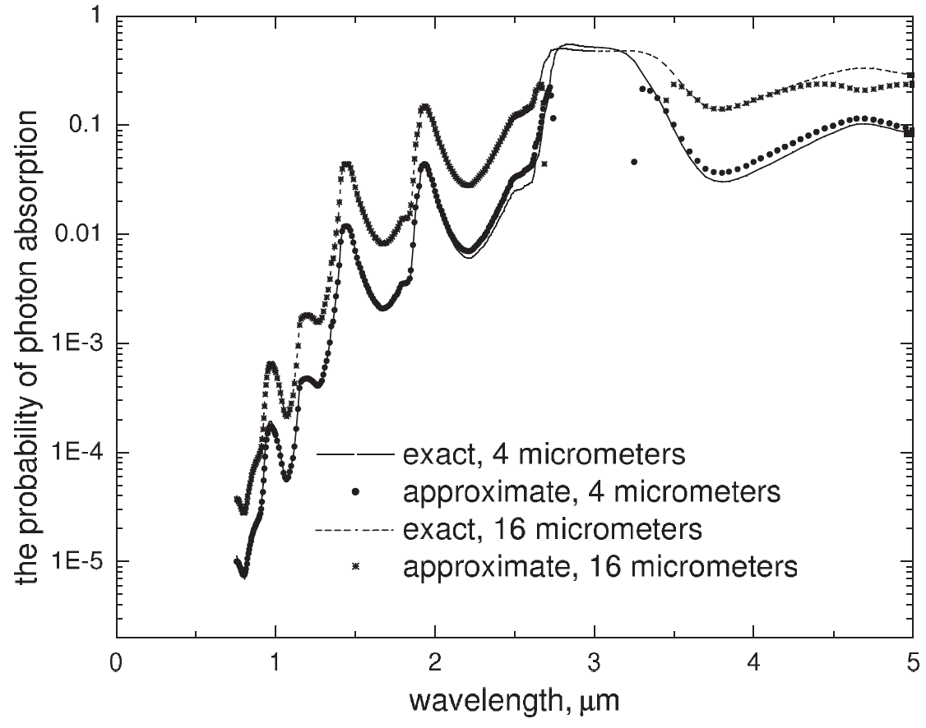
Probability of Photon Absorption for the same cloud as the last slide

Slide 6
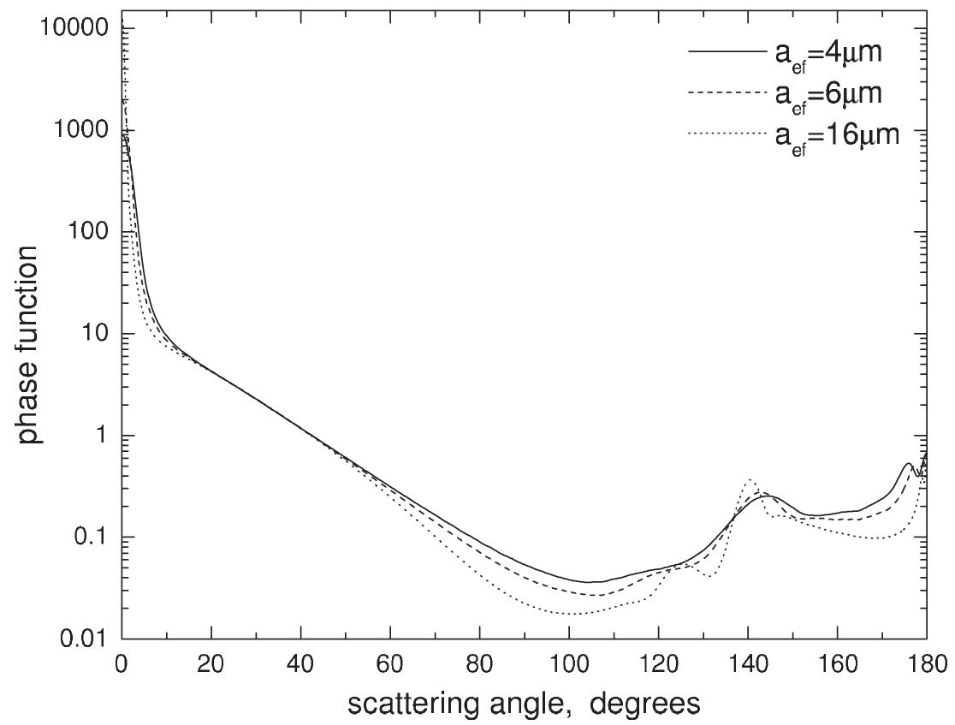
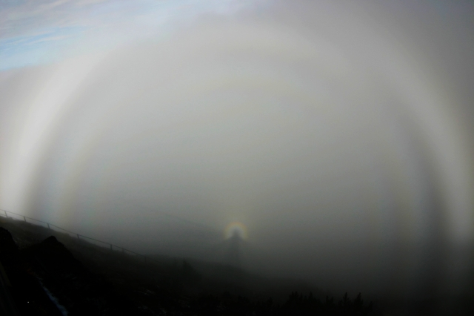
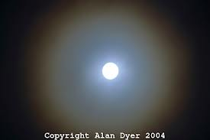
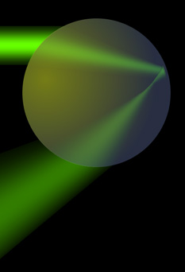
Phase Function for Water Clouds as a function of Droplet Size
forward
diffraction
peak and
corona
http://atmospherical.blogspot.com/2006/05/bright-fogbow-with-serveral.html
fogbows
glory

Slide 7
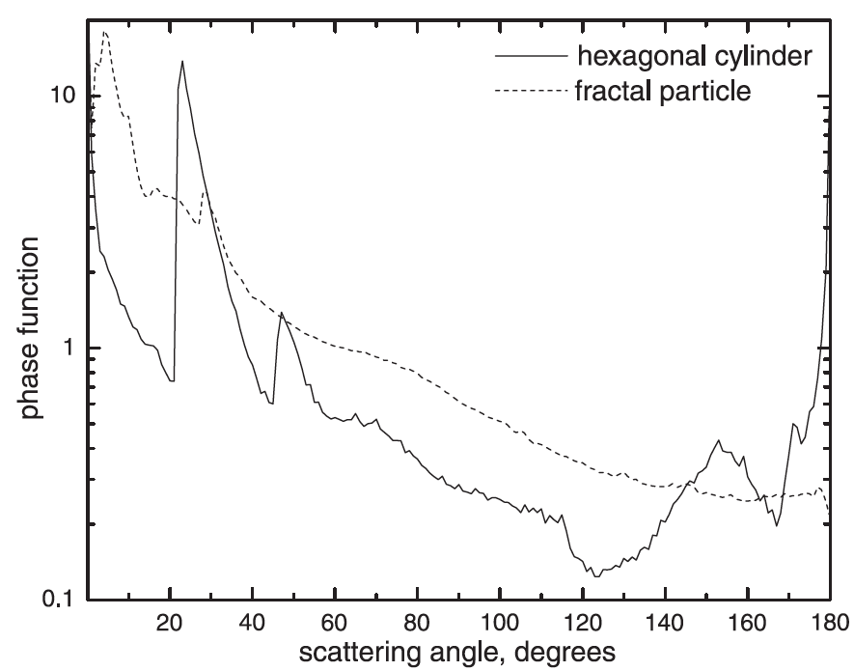
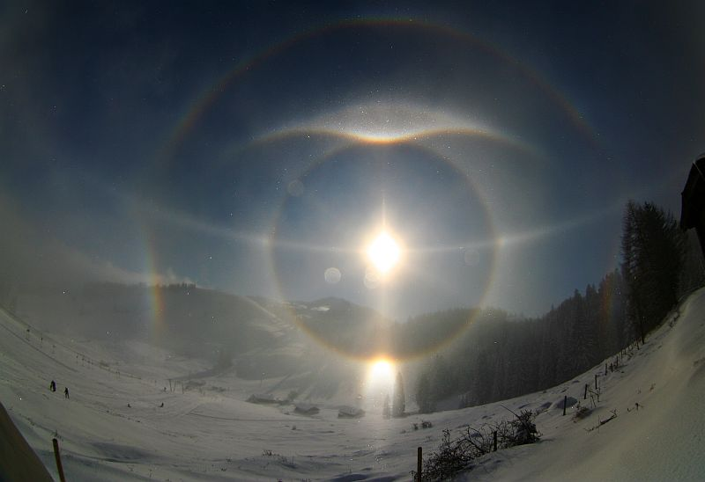
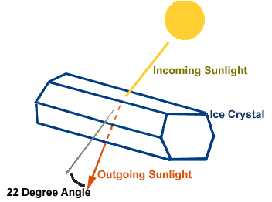
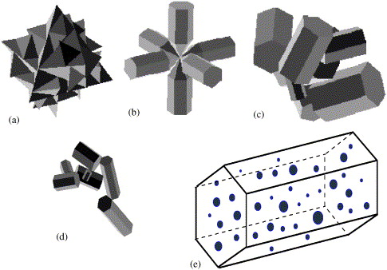
Geometical Optics Portion of the Phase function for Cirrus Clouds (no forward diffraction shown)
enhanced
specular
backscatter
https://www.ursa.fi/blogit/ice_crystal_halos/index.php/halo_display_from_upper_bavaria
halos

Slide 8
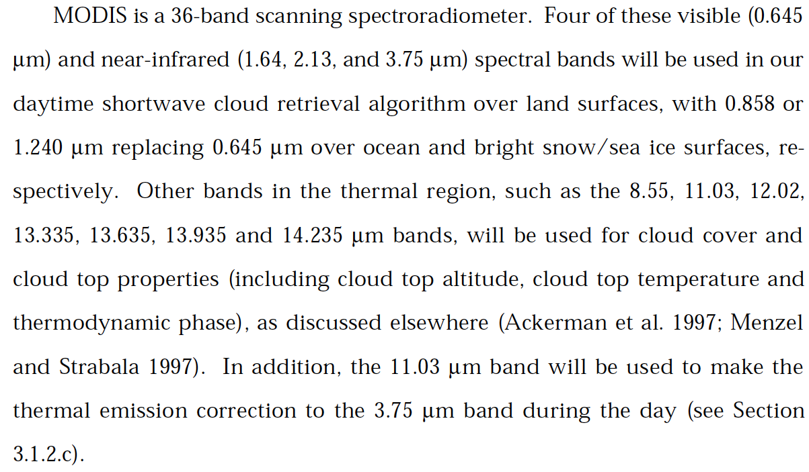
How Modis is used for Clouds
solar
thermal
infrared

Slide 9
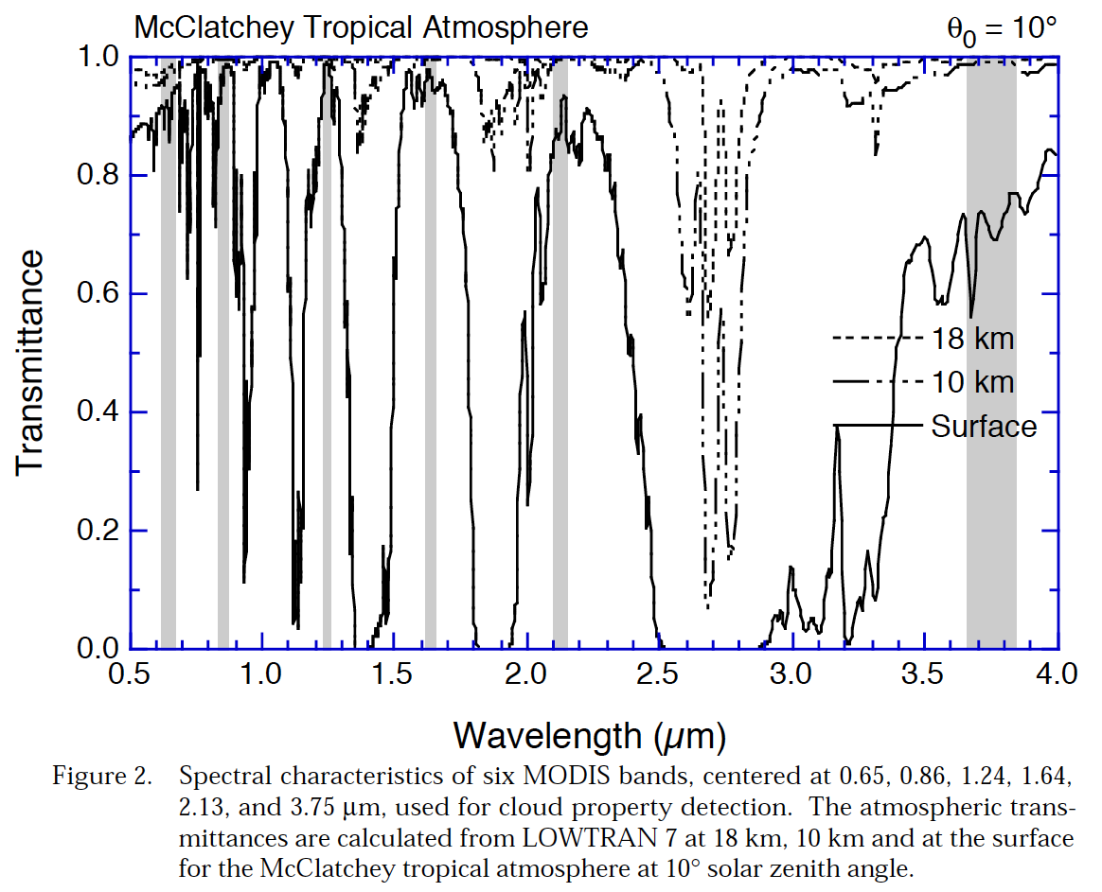
MODIS spectral bands and atmospheric transmittance for clear sky conditions

Slide 10
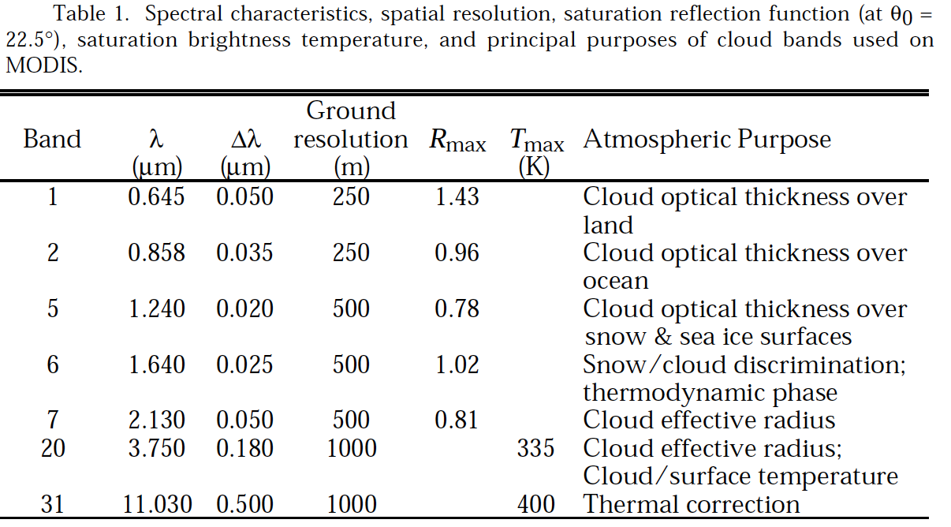
Summary of MODIS Bands Used

Slide 11
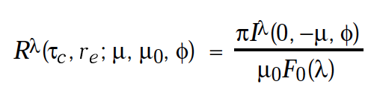
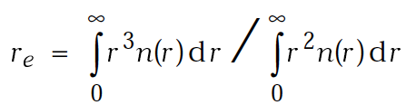

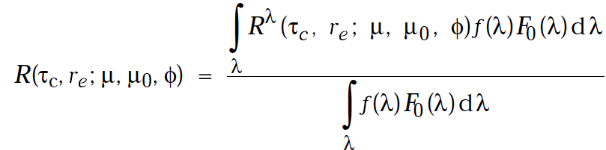
Basic Physics of the Reflectance Function

Slide 12
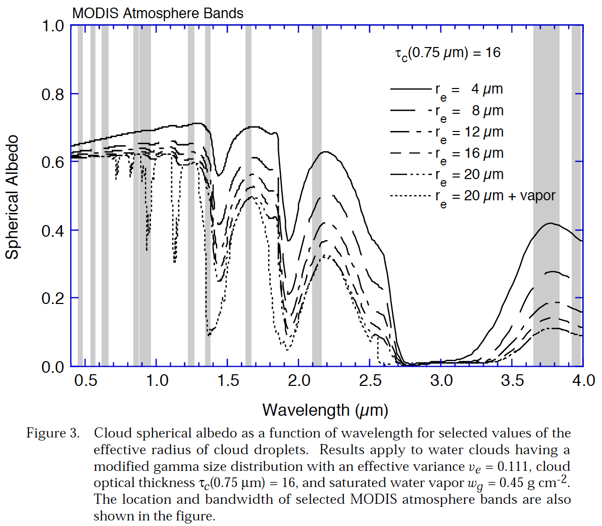
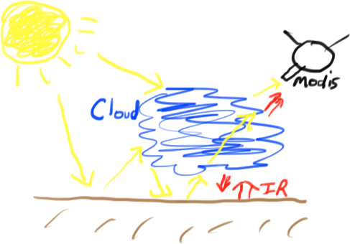
Cloud Albedo as a function of Water Droplet Size

Slide 13
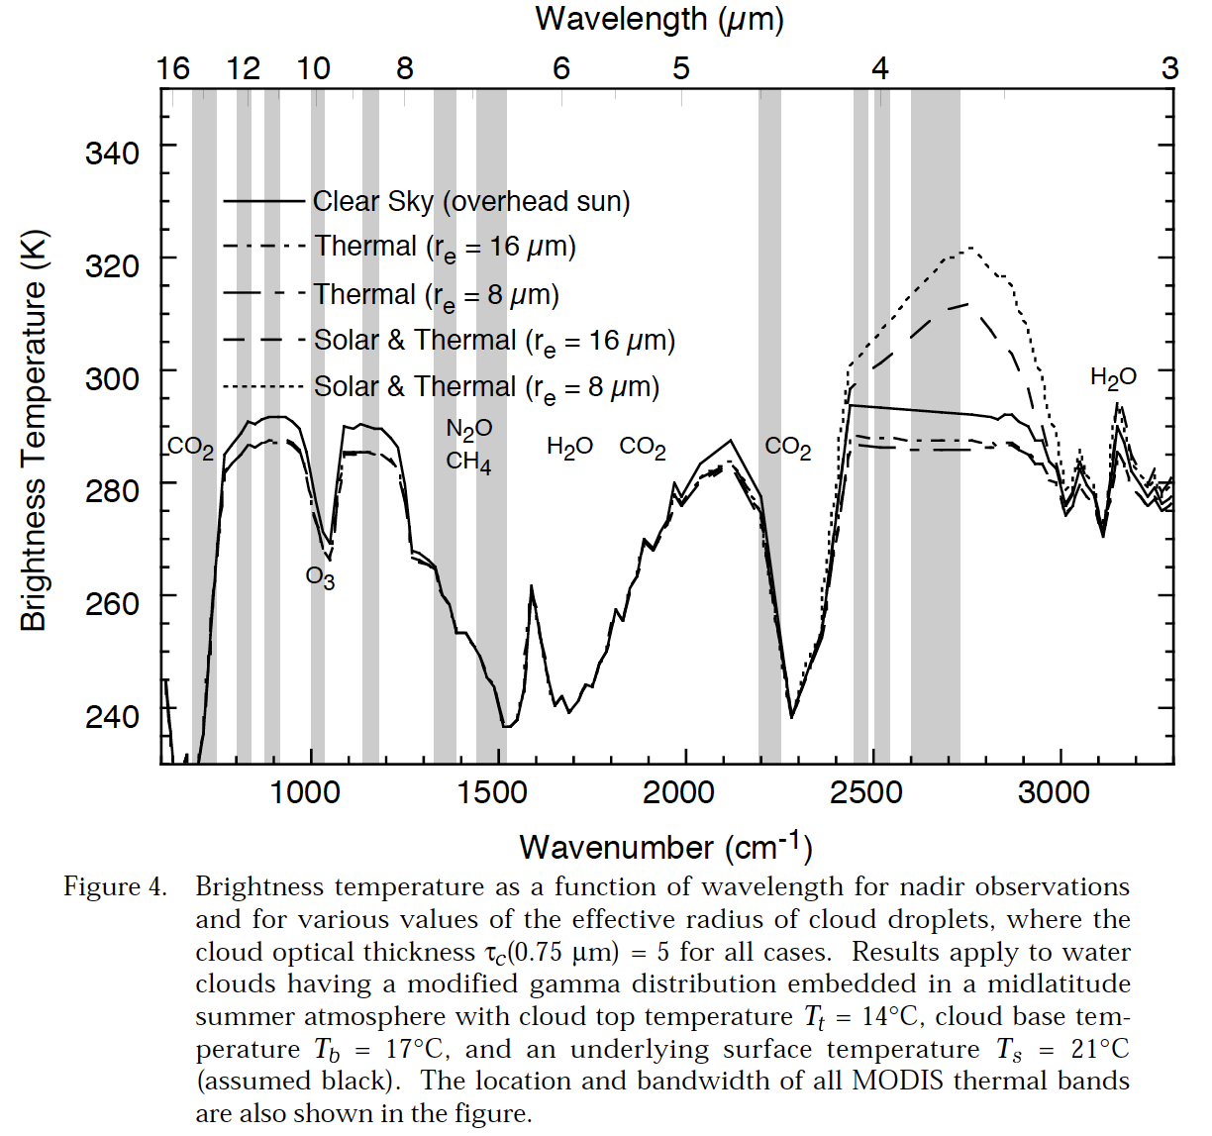
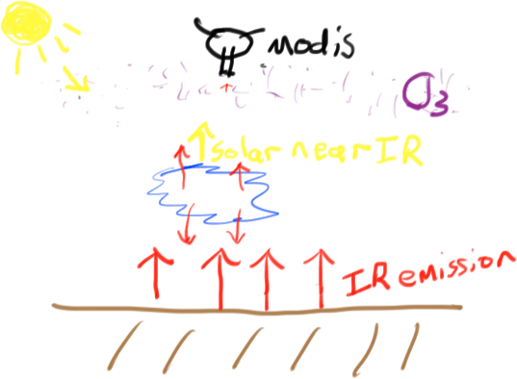
Cloud Properties from Thermal Bands and near IR, including solar
window region

Slide 14
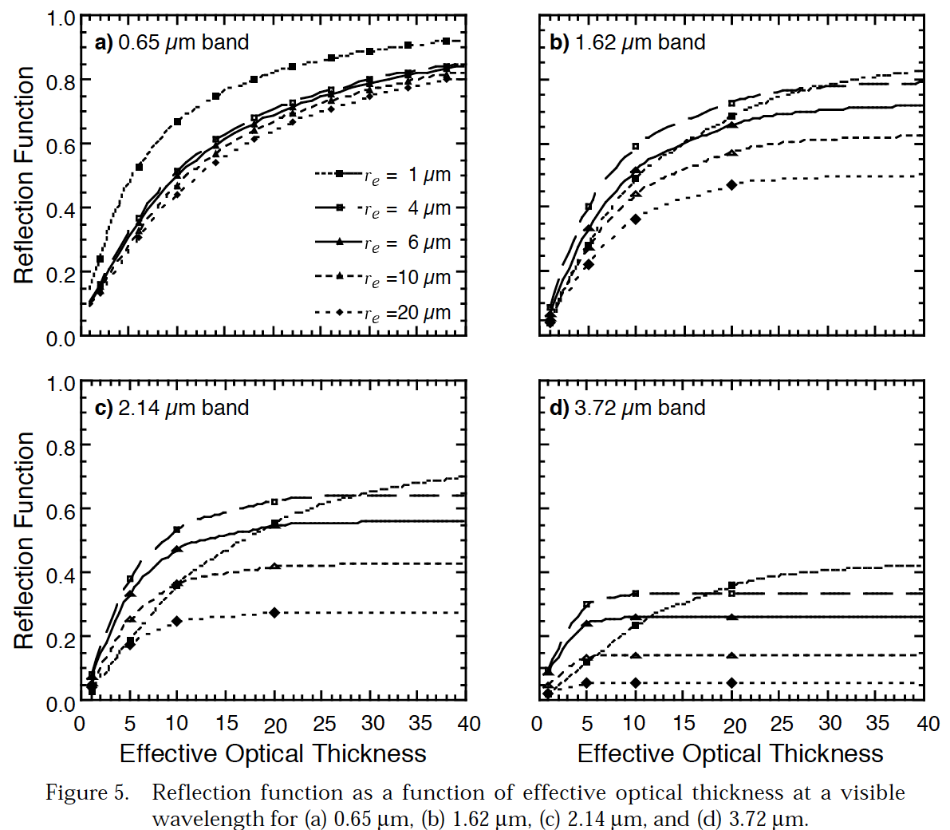
Spectral Reflectance as a function of optical depth

Slide 15
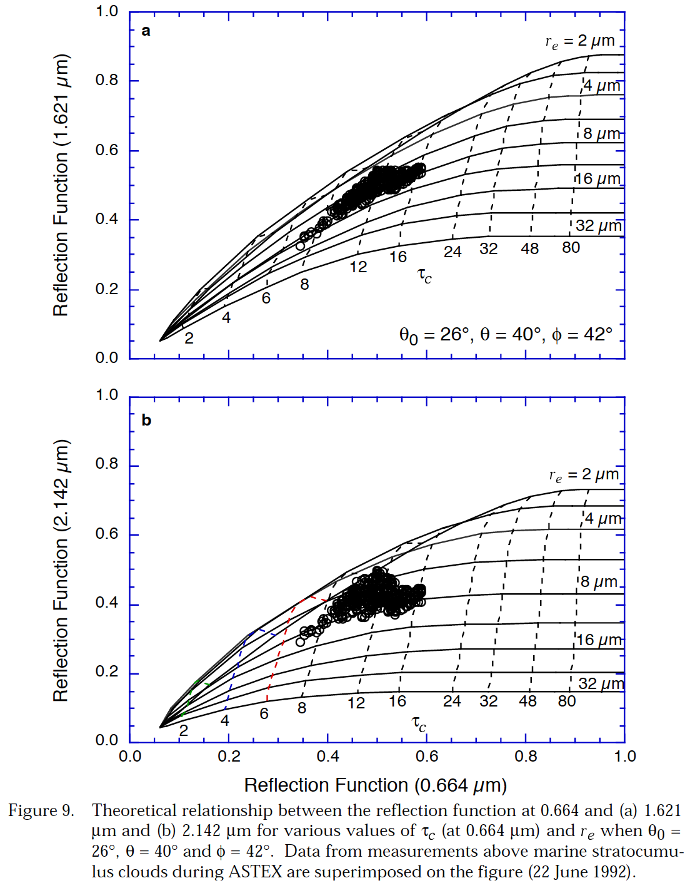
Basis of retrieval of optical depth and effective radius from MODIS: Model and measurement comparison for water droplets
Marine stratocumulus clouds near the Azores, 22 June 1992.

Slide 16
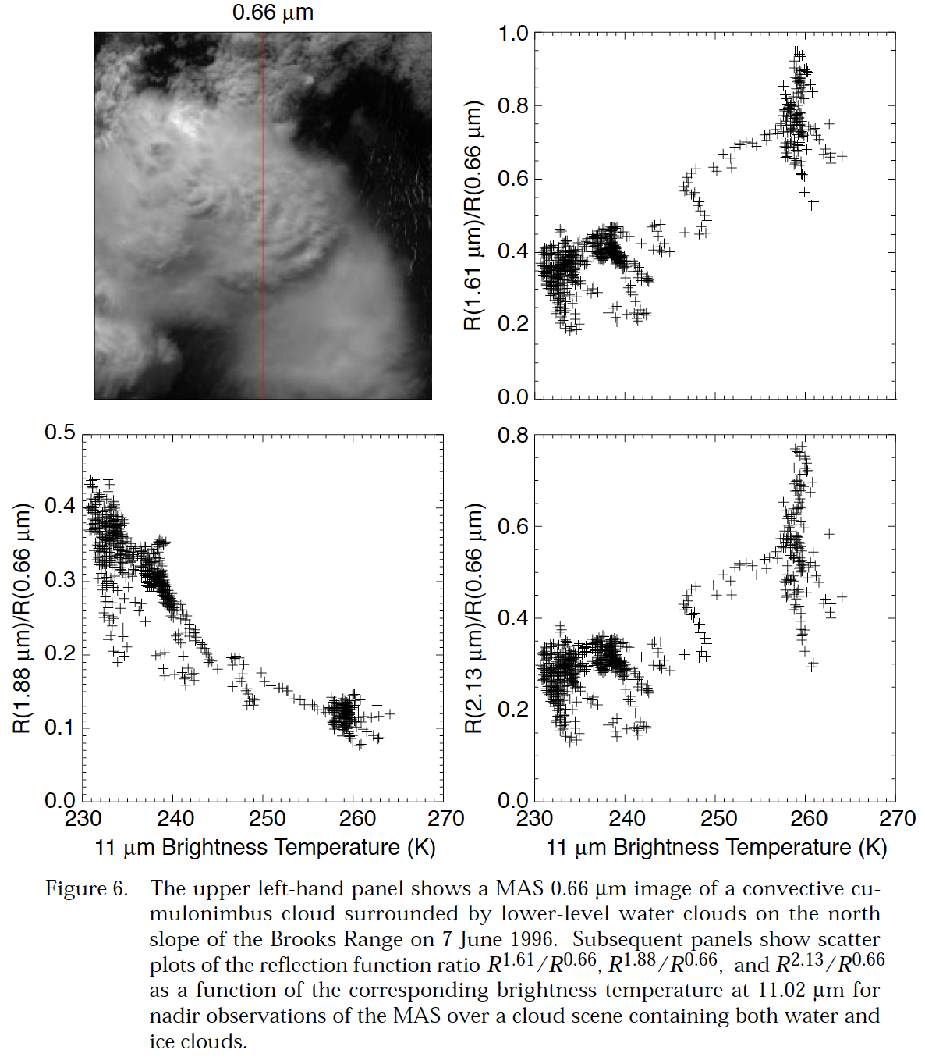
Cloud Screening: Convective Cumulonimbus Cloud
Ice phase has lower reflectivity
at 1.61 um and 2.13 microns
than does equivalent water
droplet cloud, due to the
difference in refractive index of
water and ice. These regions
also have low brightness
temperature and therefore are
associated with cold cloud tops.
1.88 um has water vapor
absorption. Less wv is above the cold clouds than the warm water droplet clouds.

Slide 17
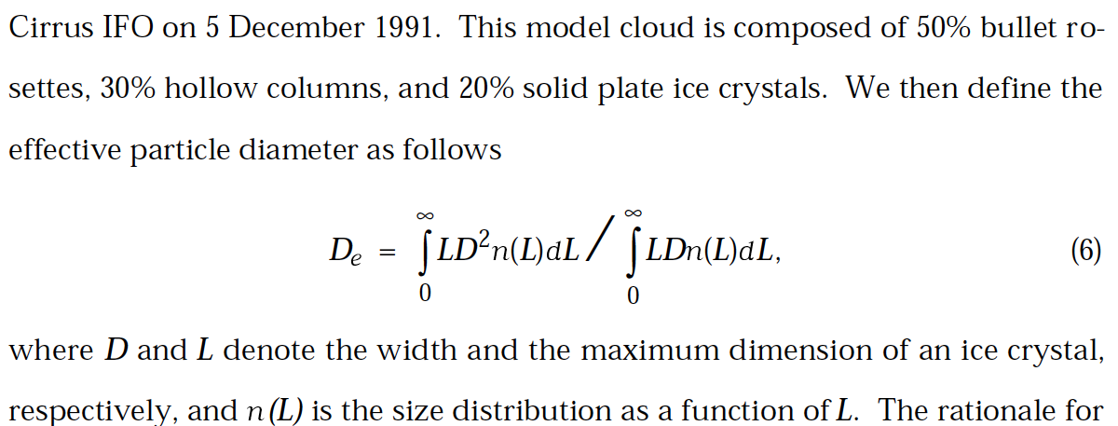
Ice Cloud Retrieval: Effective Diameter

Slide 18
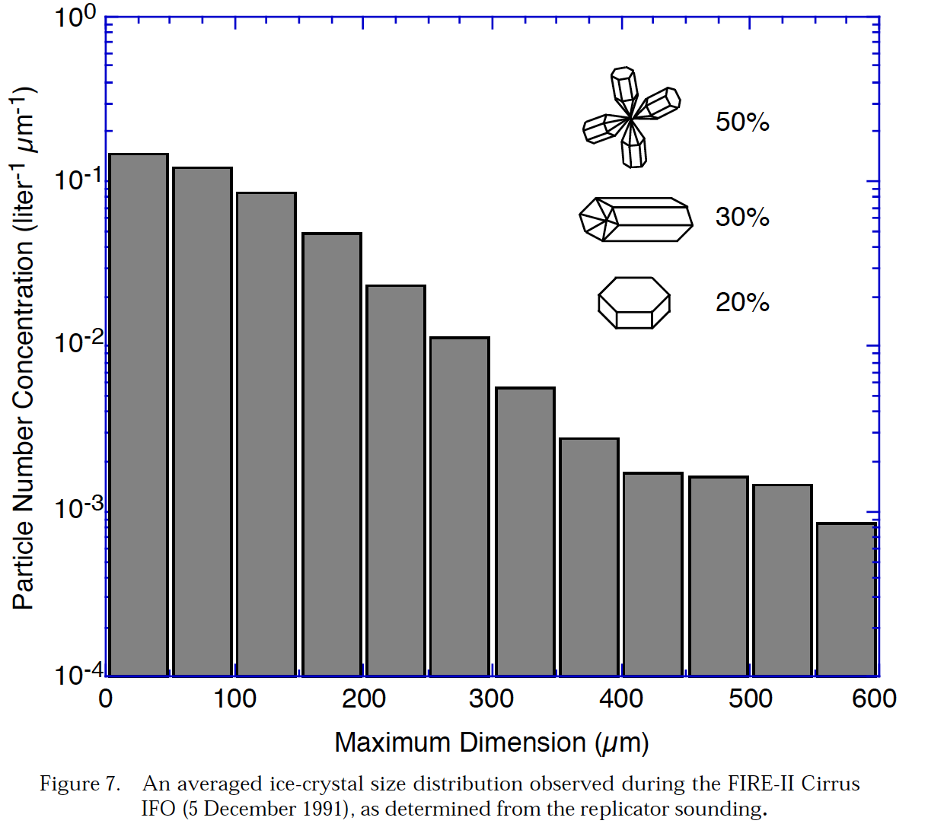
Ice Cloud Microphysics

Slide 19
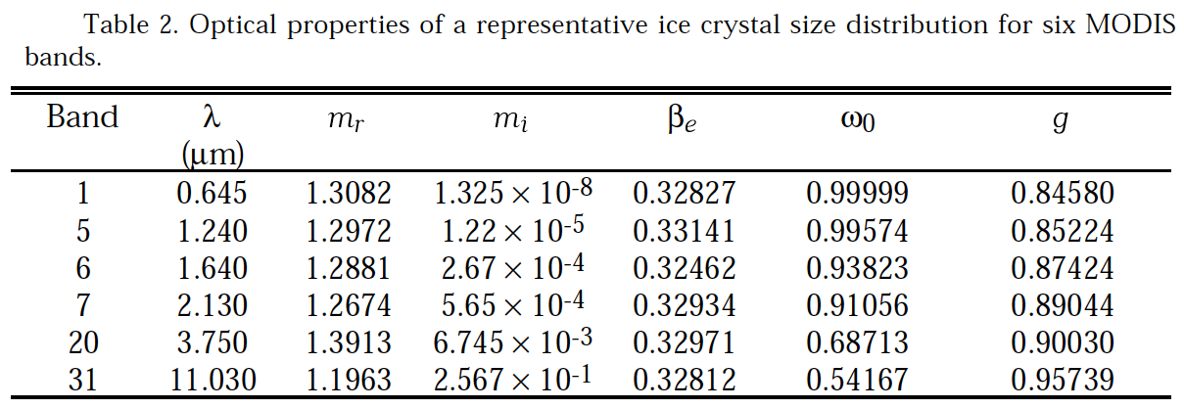
Representative Ice Optics for 6 MODIS Bands: for the Distribution of the Previous Page

Slide 20
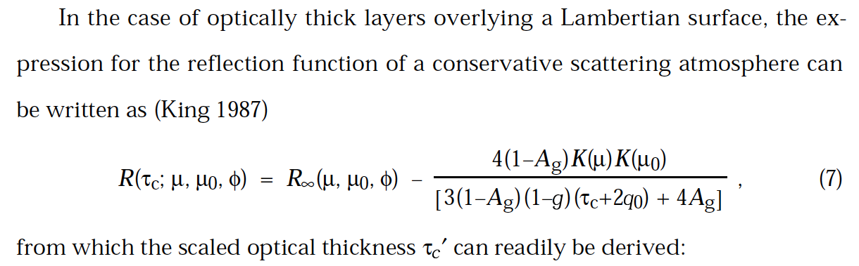
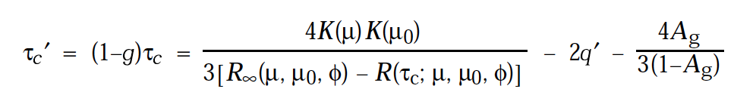
Optical Model For Surface Reflectivity

Slide 21
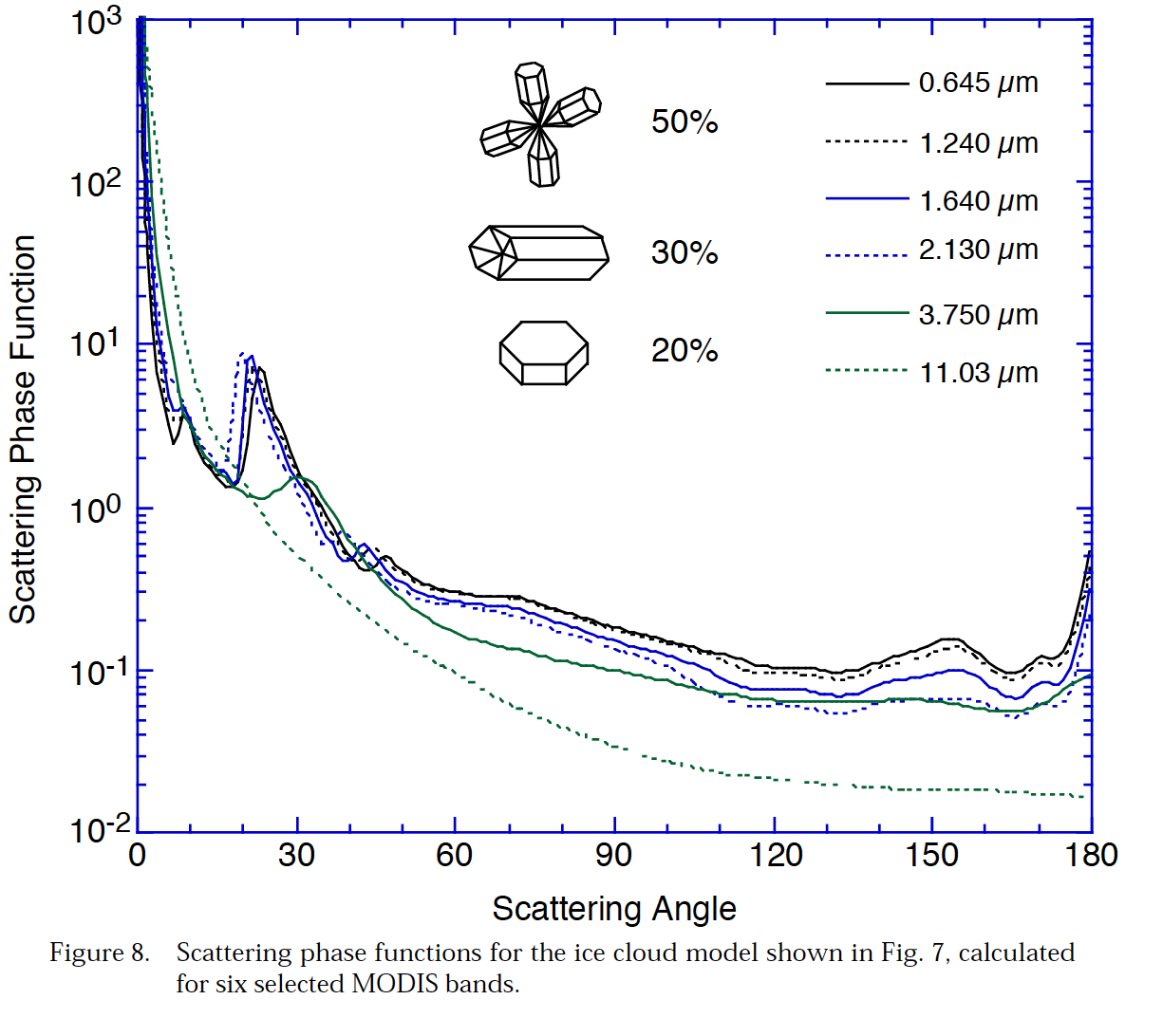
Ice Crystal Phase Function for 6 MODIS Bands

