Slide 1
MODIS Aerosol Retrievals
Outline
Overview
Aerosol retrievals over land
Aerosol retrievals over water
MODIS – Moderate resolution imaging spectroradiometer aboard
NASA’s Terra and Aqua satellites.
Measures: Calibrated radiance, sunlight reflected from the Earth’s surface and atmosphere system.
Reference for Presentation:
The MODIS Aerosol Algorithm, Products, and Validation.
Remer, L. A.; Kaufman, Y. J.; Tanré, D.; Mattoo, S.; Chu, D. A.; Martins, J. V.; Li, R.-R.; Ichoku, C.; Levy, R. C.; Kleidman, R. G.; Eck, T. F.; Vermote, E.; Holben, B. N.
Journal of Atmospheric Sciences, vol. 62, Issue 4, pp. 947-973.

Slide 2
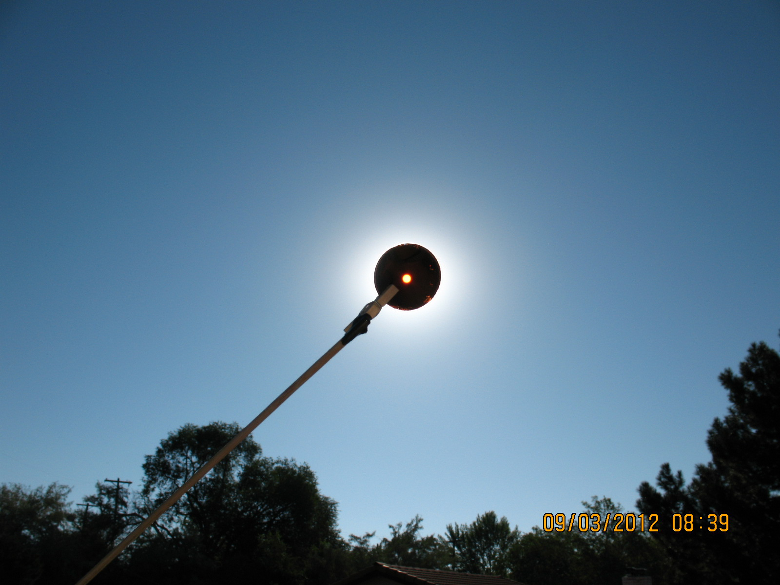
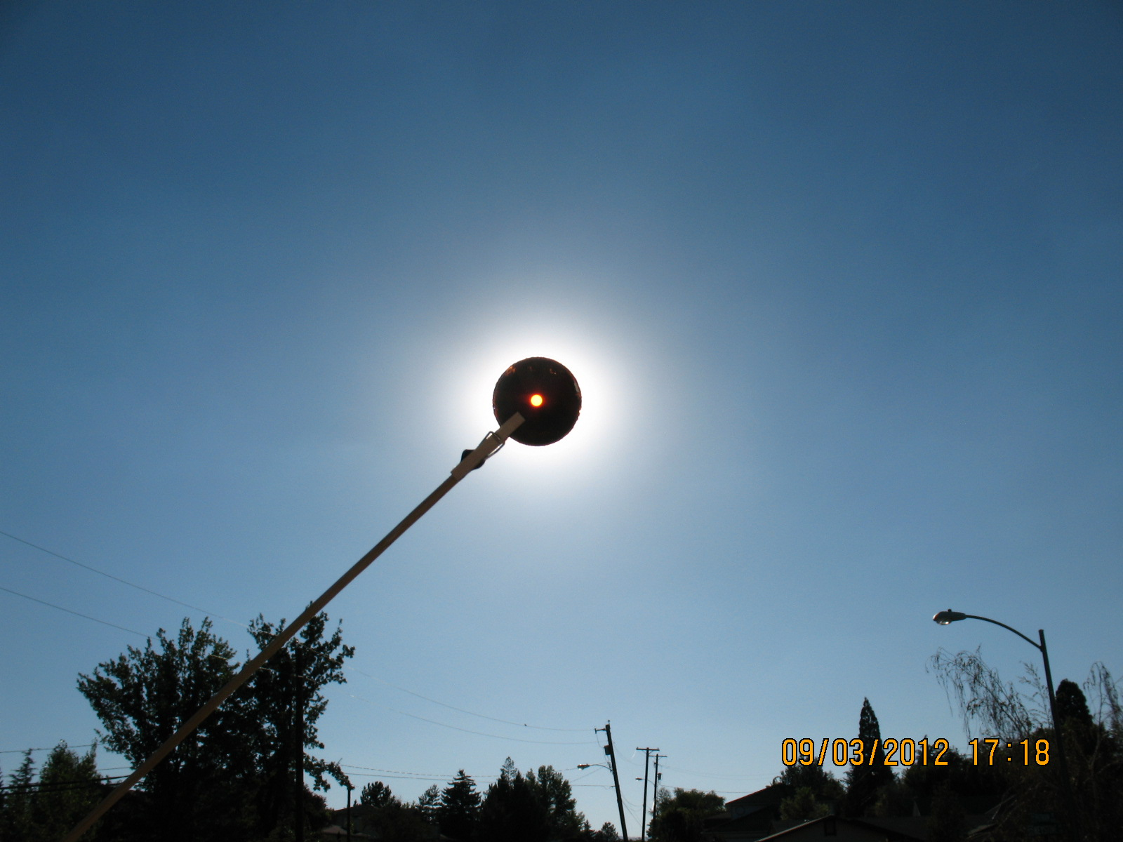
Here is What a Sky With Aerosol Looks Like
morning
evening
Two photographs where the solar zenith angle is about the same; one in the morning, and one in the afternoon, Reno NV, 9/3/2012. Aerosol size and/or concentration are different at these times. The Washoe Zephyr wind can draw air pollution from California late in the day (Marce’s research topic).

Slide 3
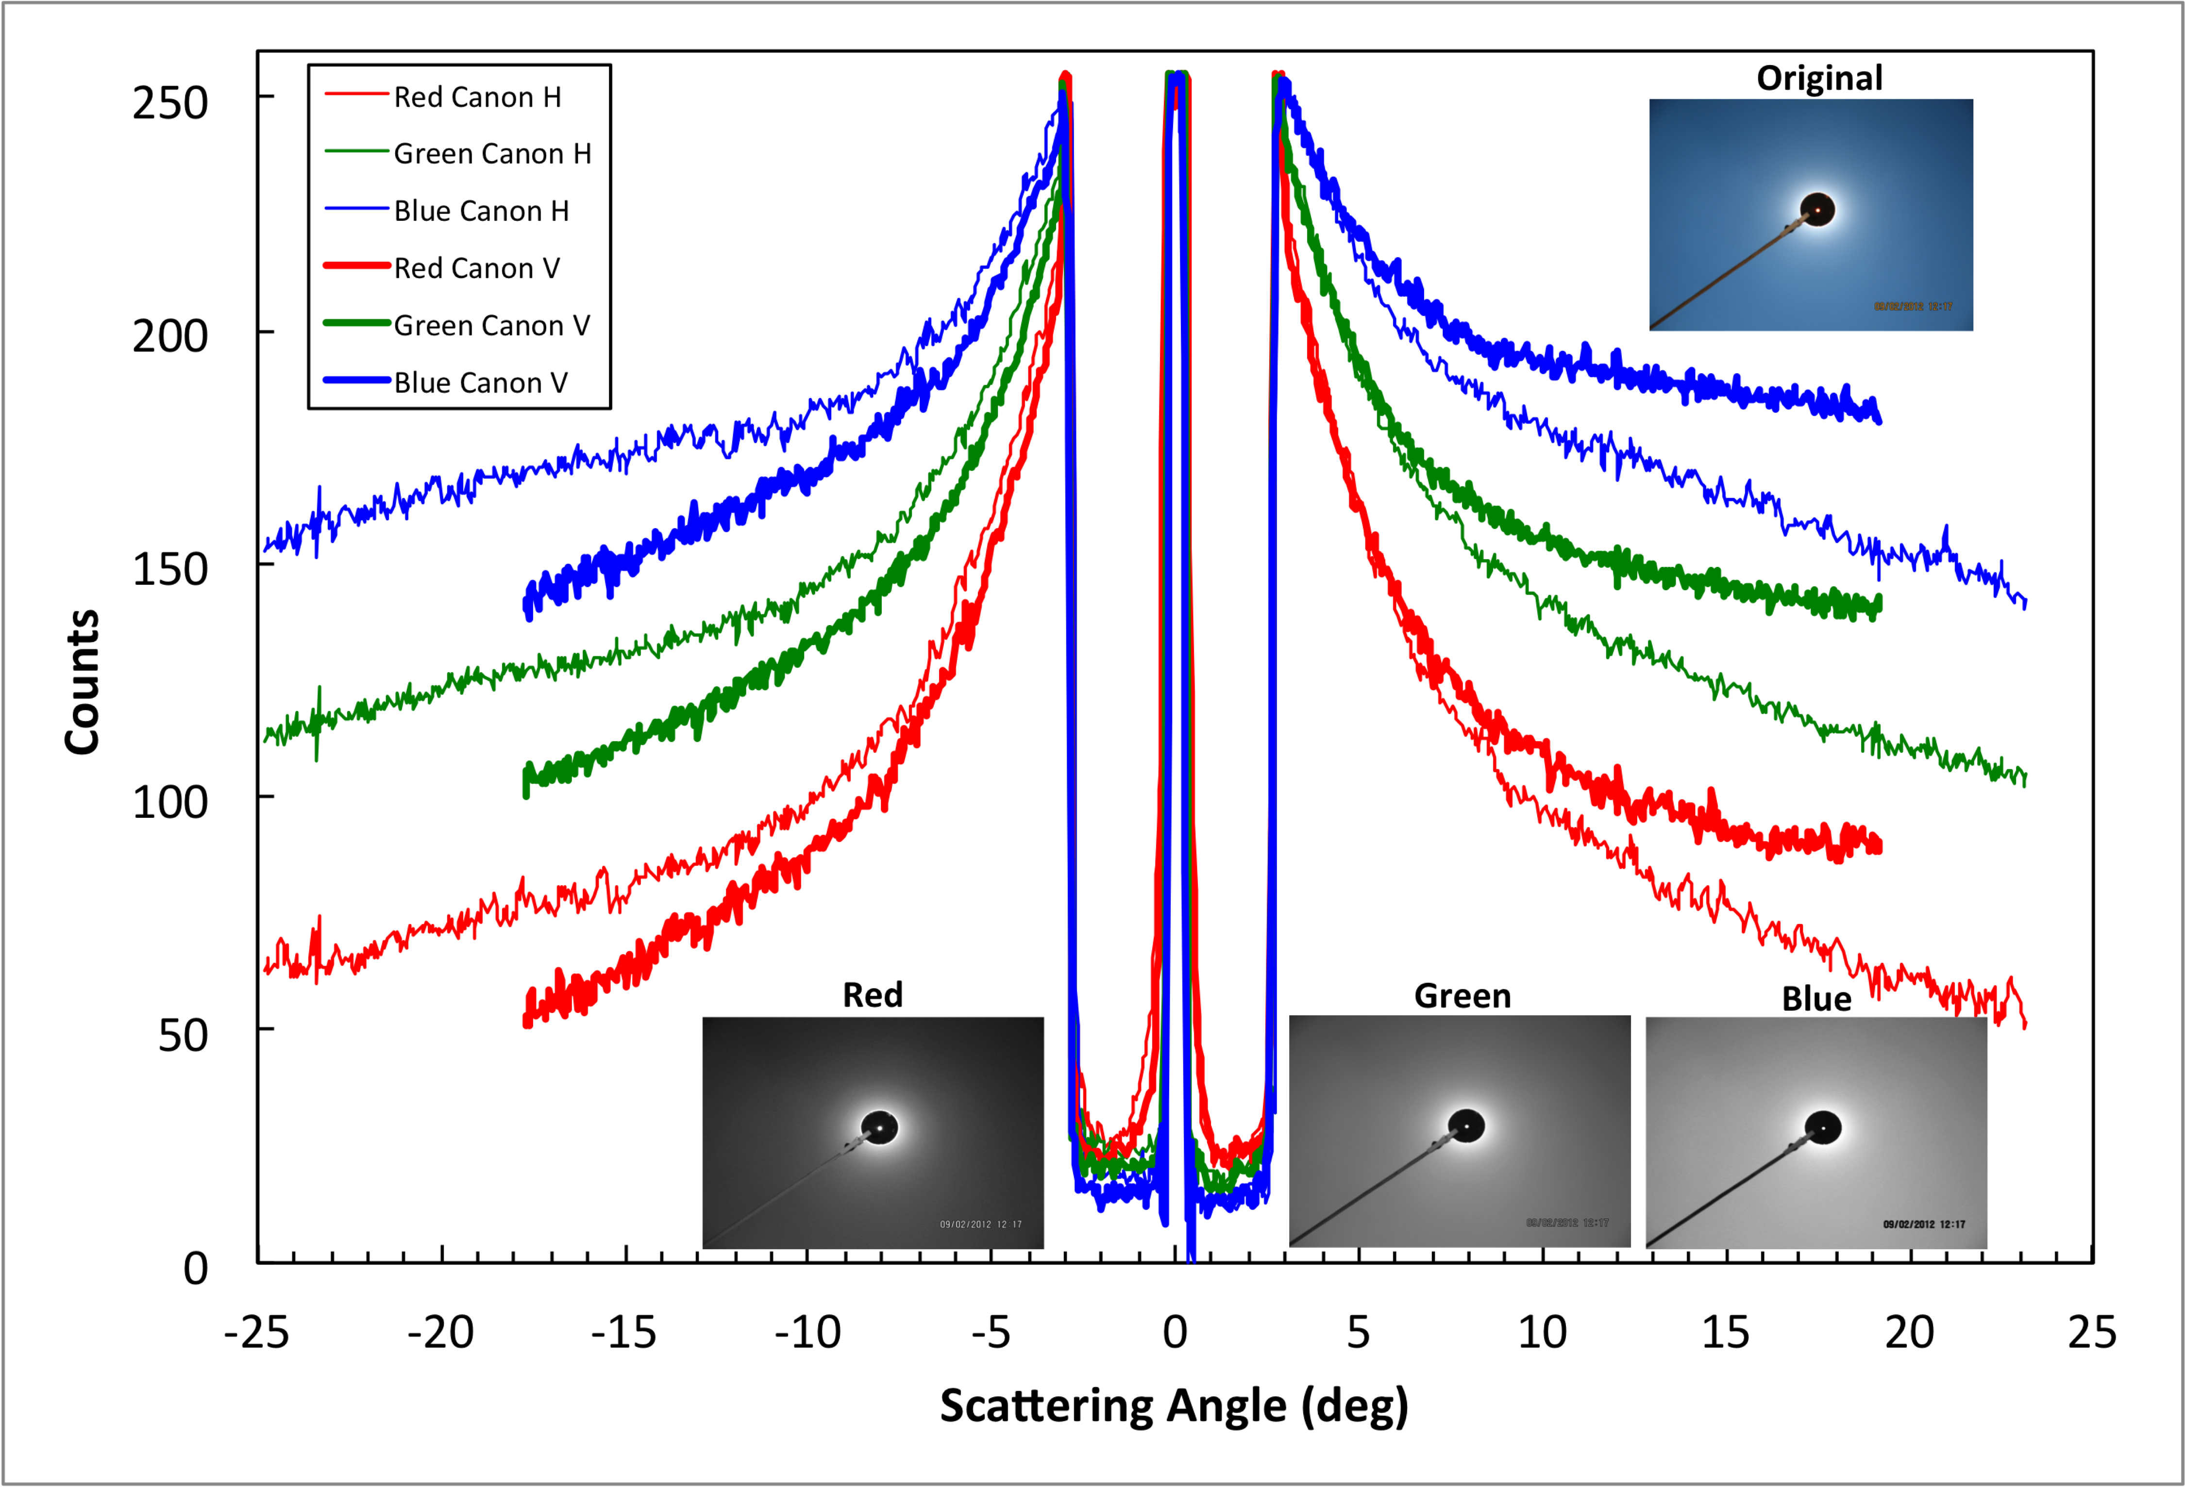
Example Analysis of ‘Bishop Rings’ Data

Slide 4
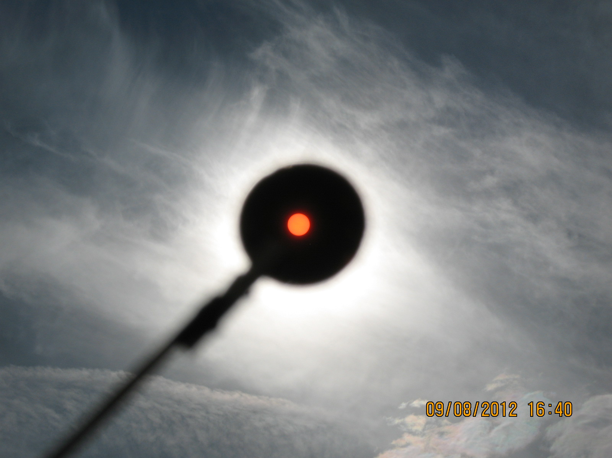
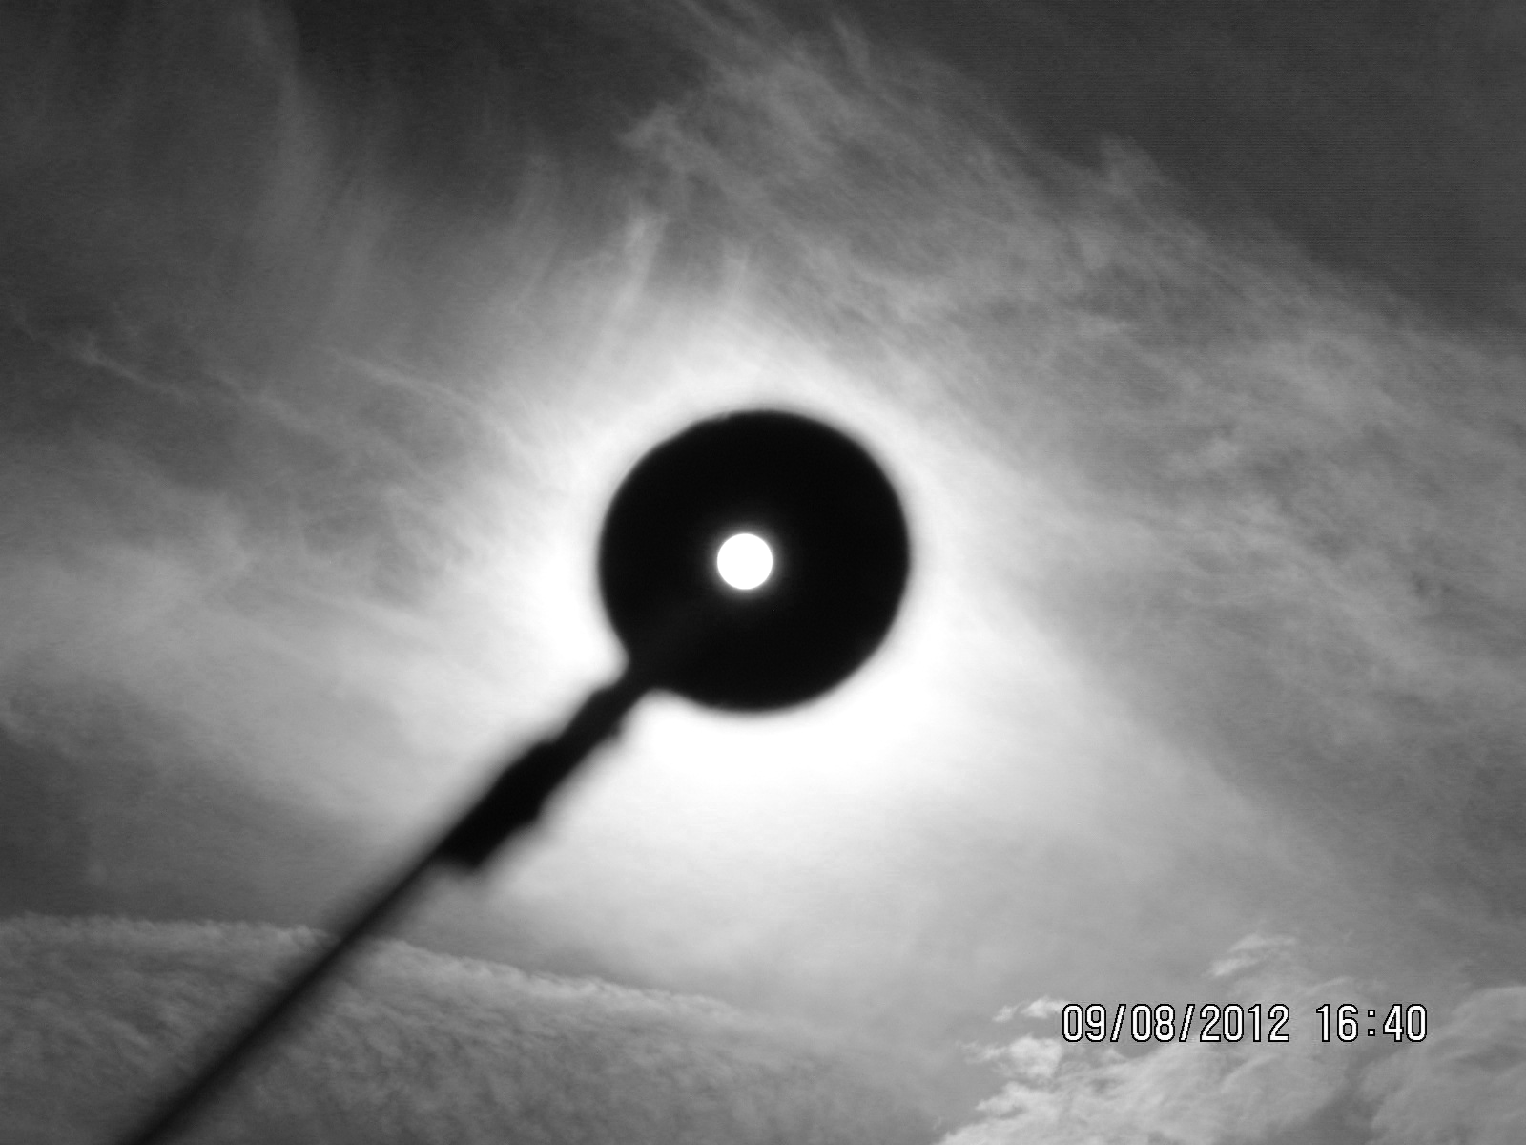
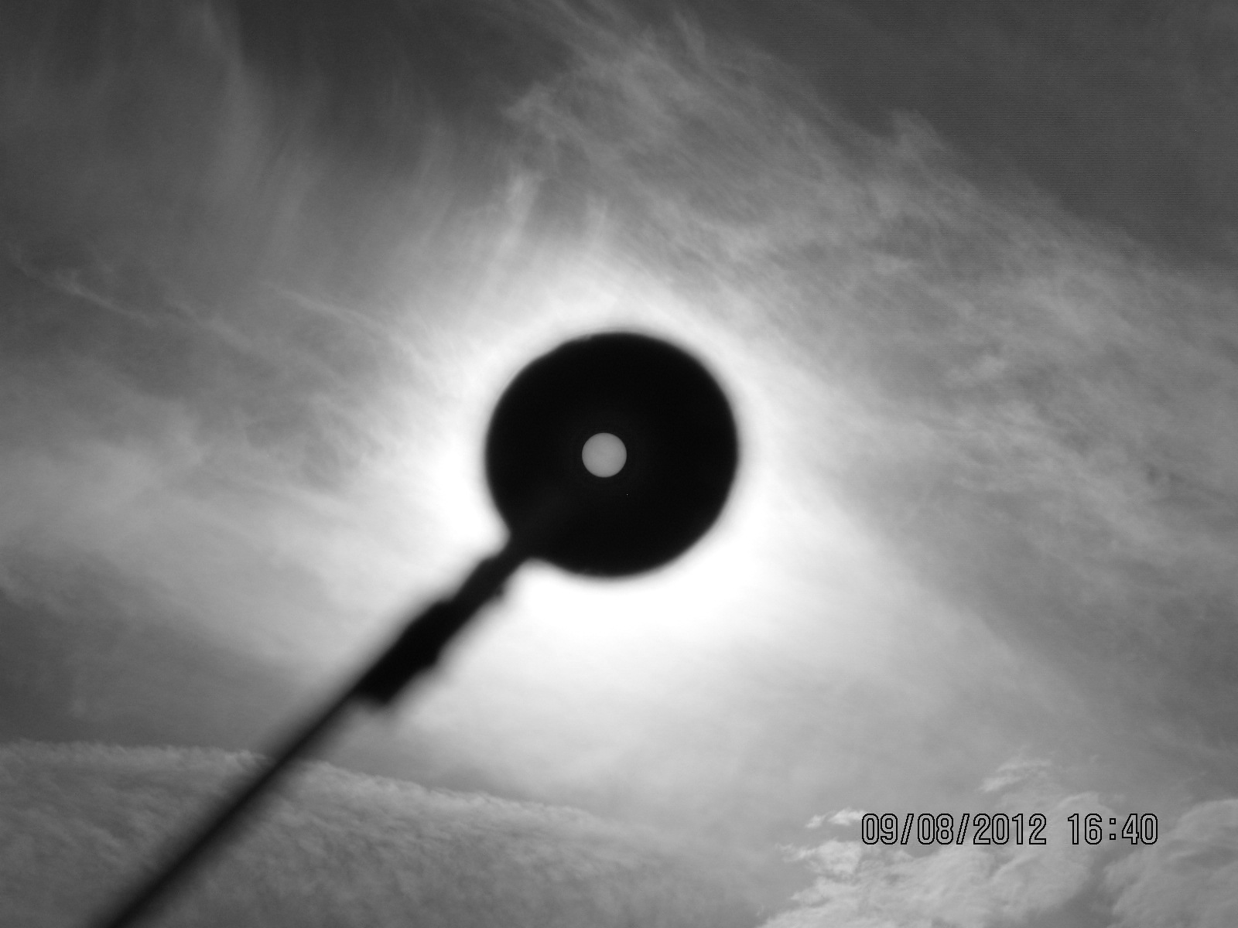
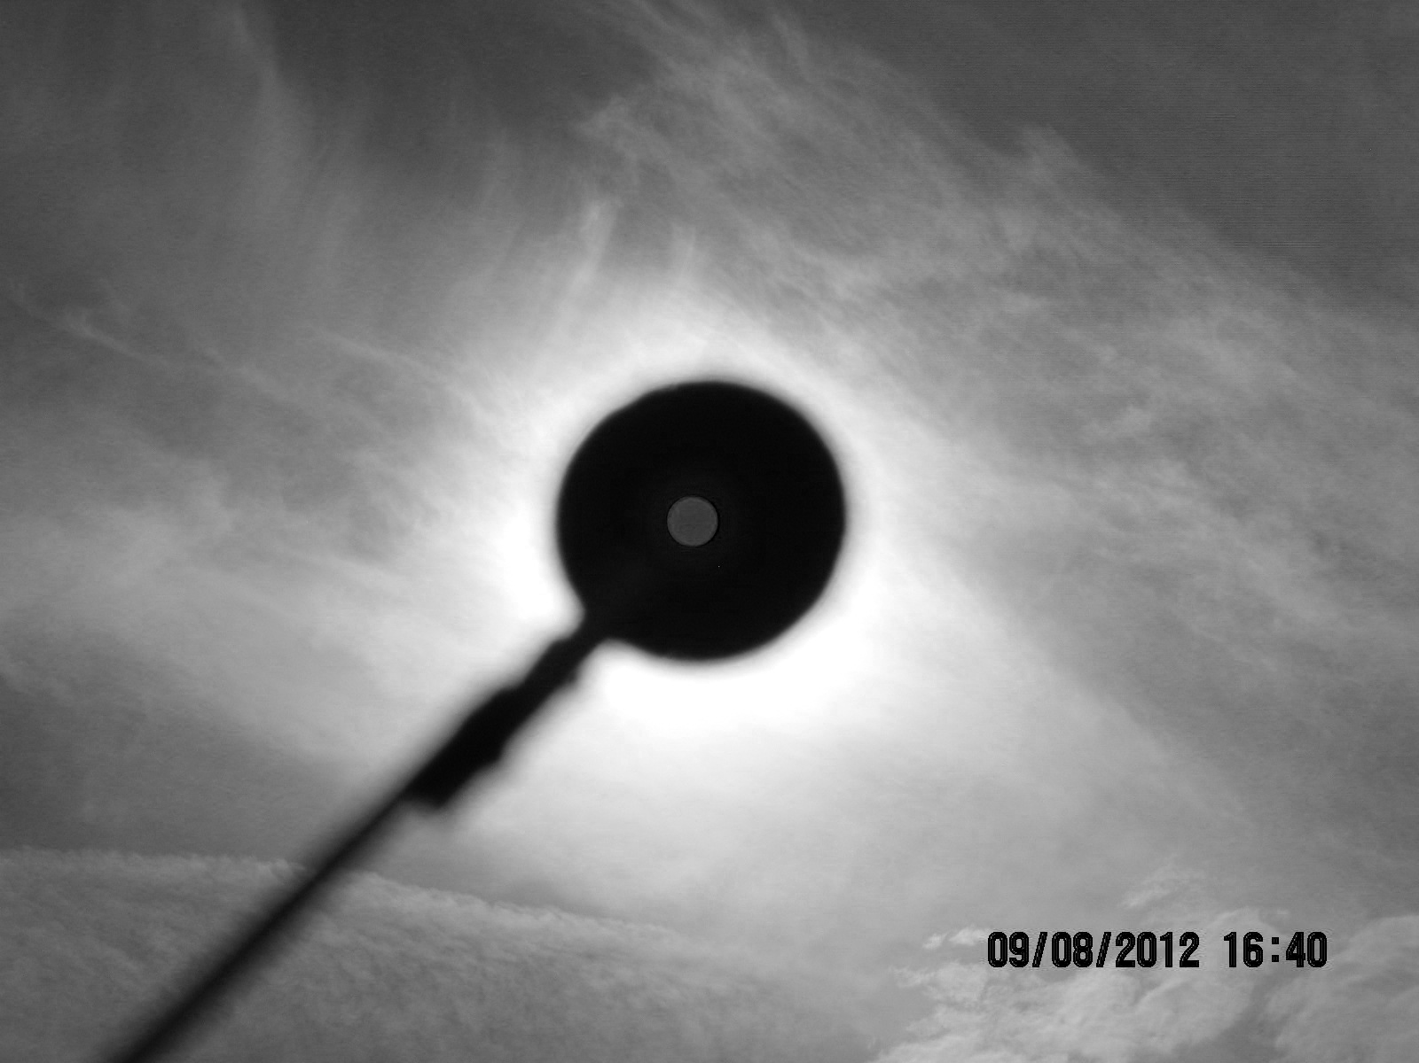
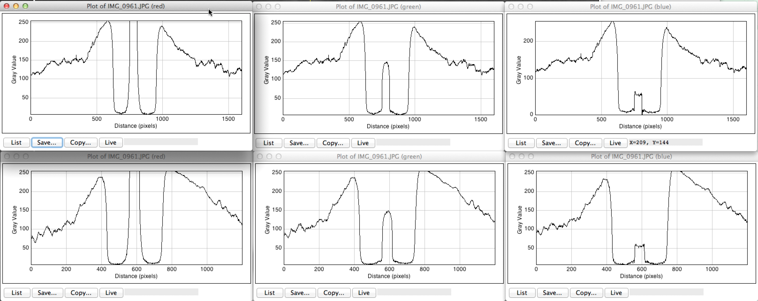
Cloud Case 8 September 2012
Original Photo
RED
GREEN
BLUE
RED SLICES
GREEN SLICES
BLUE SLICES

Slide 5
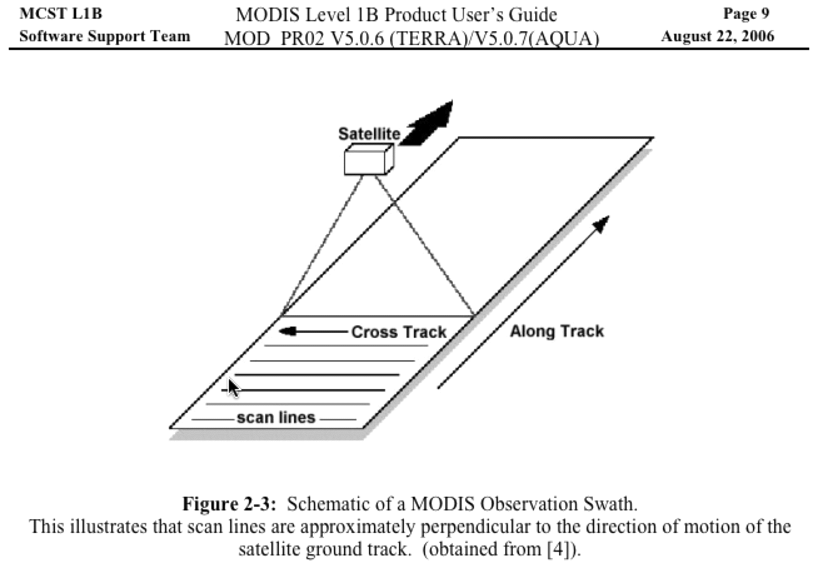
How MODIS Acquires Images

Slide 6
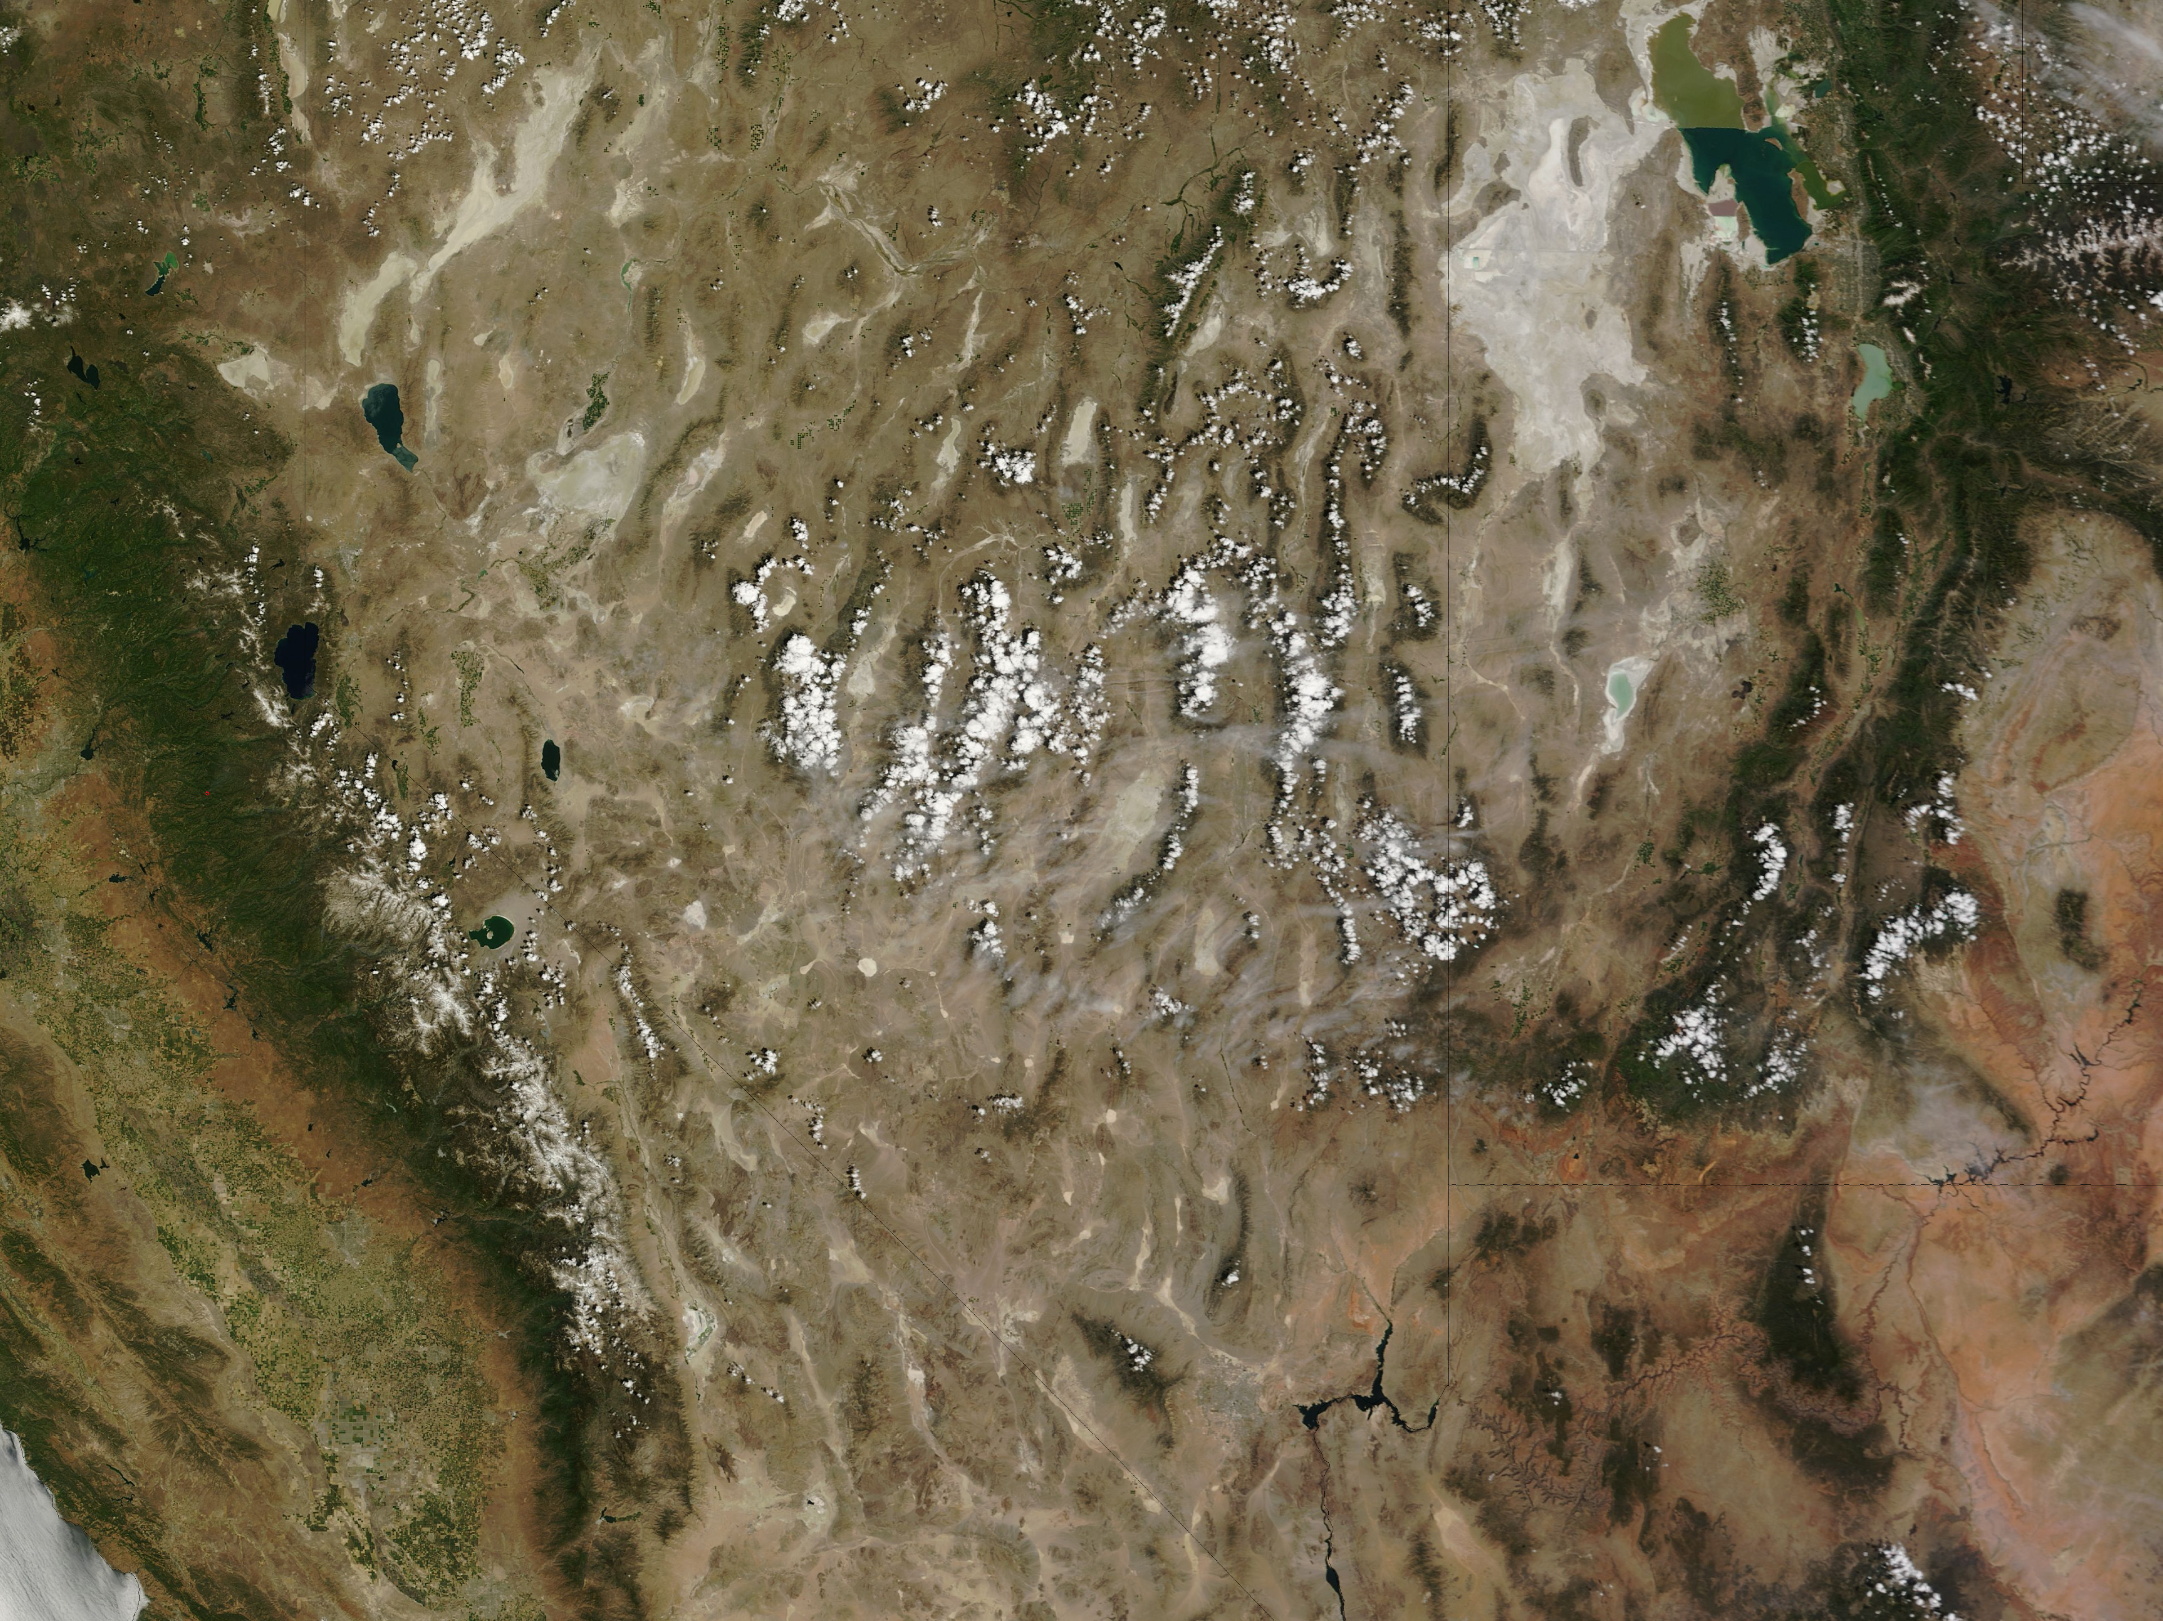
MODIS TERRA TRUE COLOR IMAGE 1 JUNE 12 18:55UTC

Slide 7
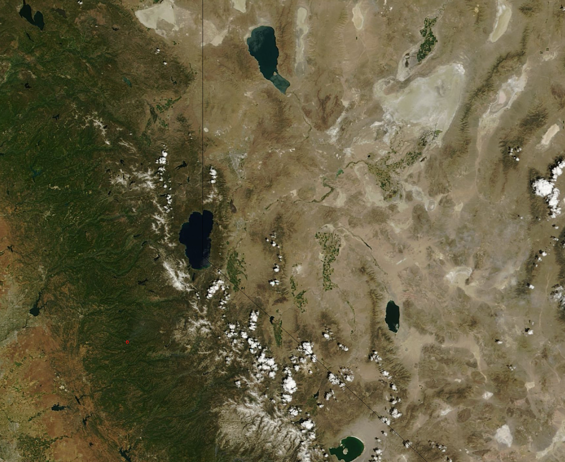
Image Subset Showing a Fire and Smoke over Lake Tahoe

Slide 8
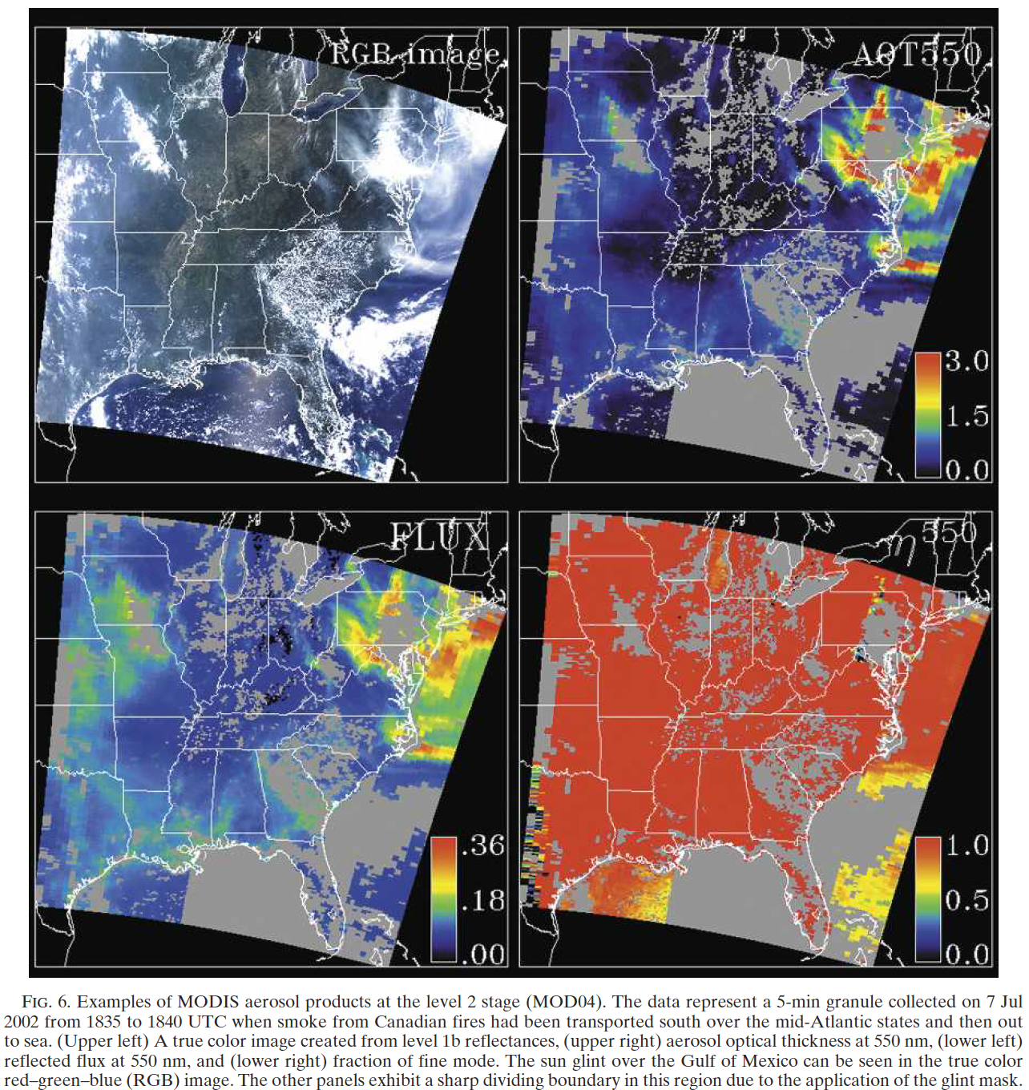
Example of Regional MODIS Aerosol Products
(Land and Ocean)

Slide 9
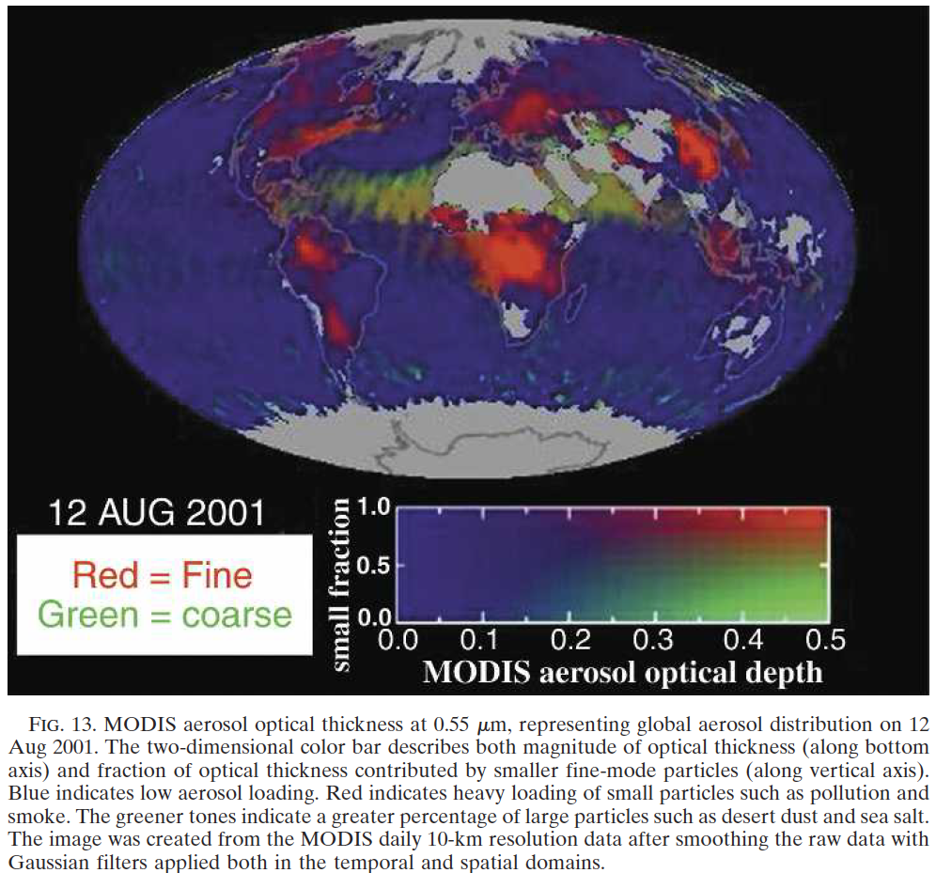
Global MODIS AOD Example

Slide 10
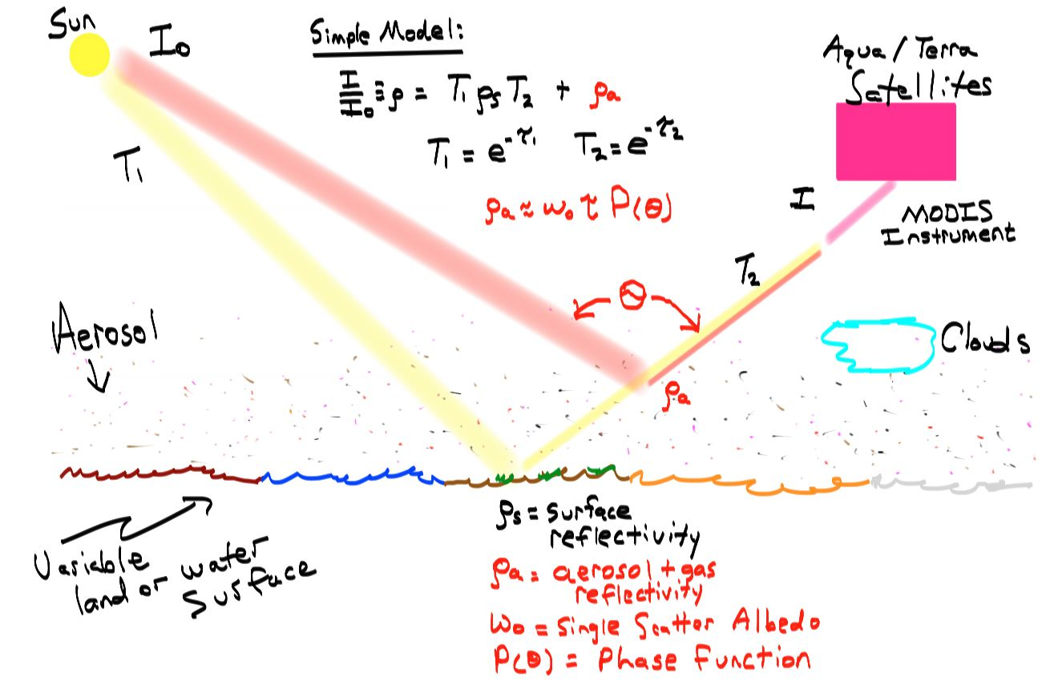
Overview: Two pathways for light to MODIS

Slide 11
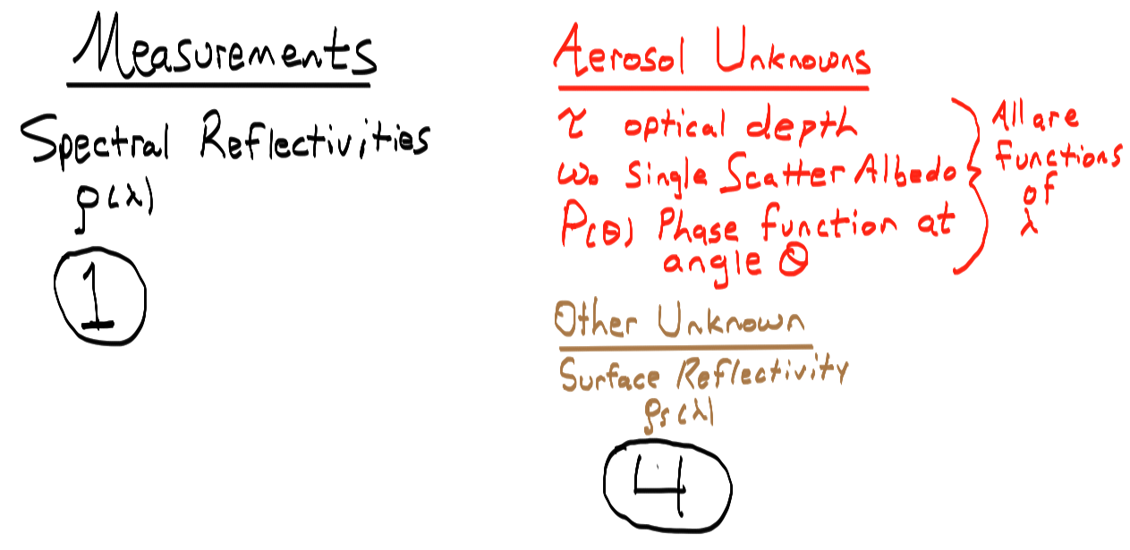
Overview: Measurements and Unknowns

Slide 12
MODIS Aerosol Retrievals Over Land
In brief:
Cloud screen (look only at clear sky).
Surface screen (look only at dark enough surfaces, no snow or bright sand.)
Determine surface reflectance at 470 nm and 660 nm.
Use geographical location and an aerosol model look up table (LUT) with inputs from MODIS measured reflectances and surface reflectances to obtain aerosol retrieval (information about atmospheric aerosol from satellite).
Bright surface algorithm extends data: uses 470 nm data where aerosol are bright and surfaces are darker, and slant paths where aerosol dominate the signal over surface reflection.

Slide 13
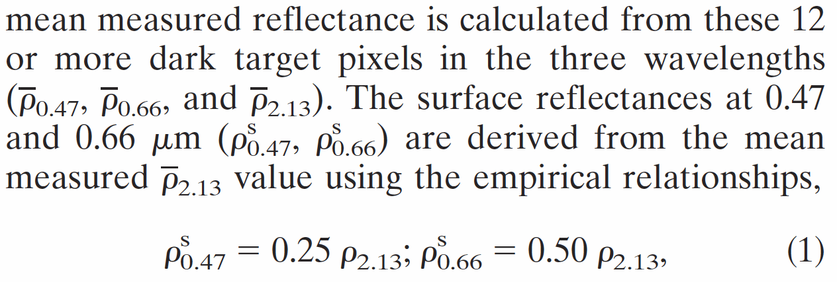
MODIS Aerosol Retrievals Over Land
In brief:
3. Determine surface reflectance at 470 nm and 660 nm.

Slide 14
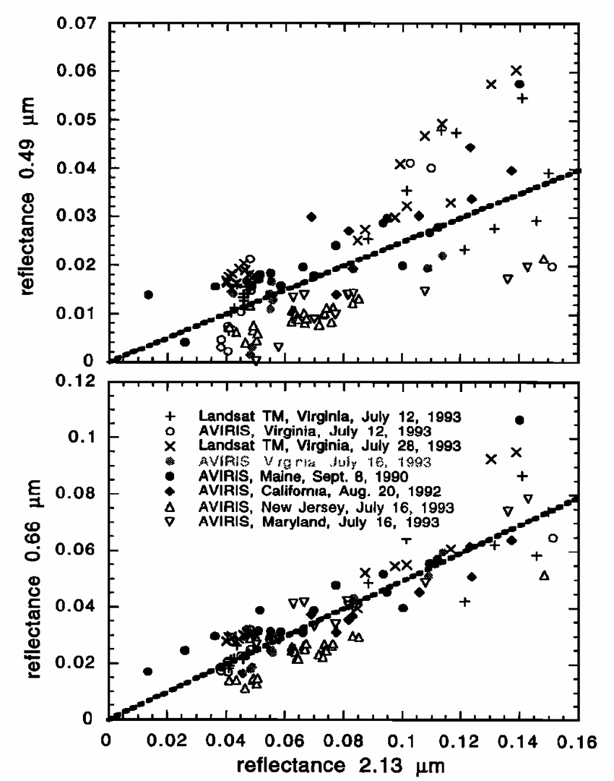
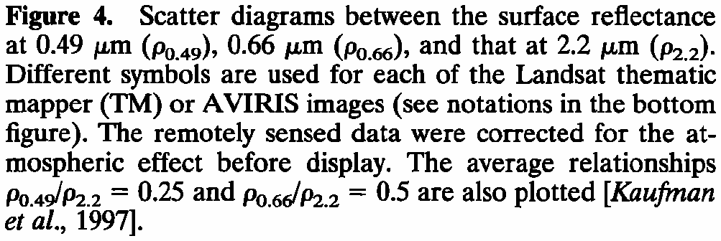
Motivation for Surface Reflectance Relationship
Kaufman, et al, 1997, The MODIS 2.1-μm channel-correlation with visible reflectance for use in remote sensing of aerosol. IEEE Transactions on Geoscience and Remote Sensing Vol 35, 1286-1298.

Slide 15
MODIS Aerosol Retrievals Over Land
In brief:
4. Use geographical location and an aerosol model look up table (LUT) with inputs from MODIS measured reflectances and surface reflectances to obtain aerosol retrieval (information about atmospheric aerosol from satellite).
Model(surface reflectance; assumed single scatter albedo; measured TOA reflectance)

Slide 16
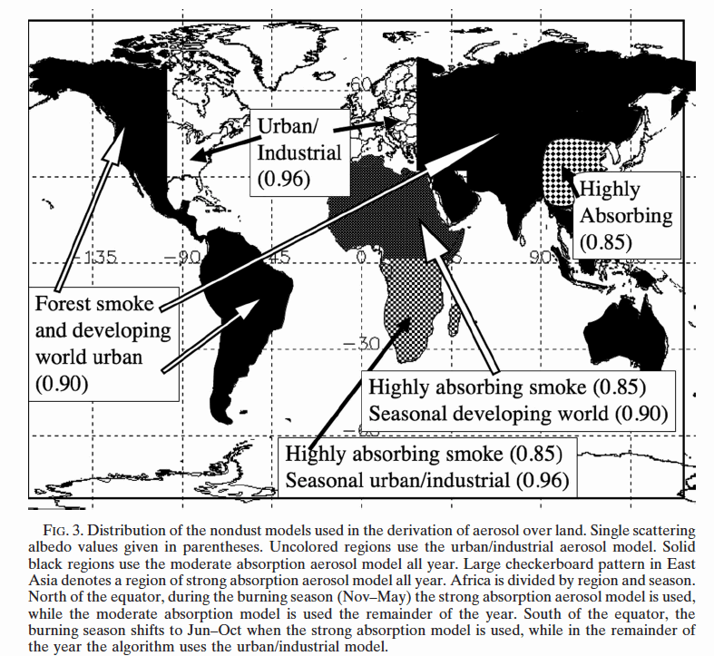
MODIS Aerosol Retrievals Over Land

Slide 17
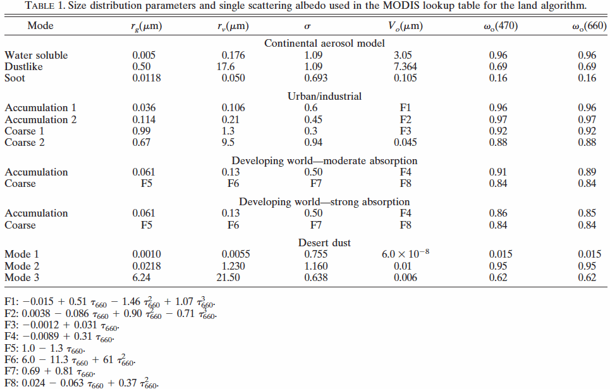
Look up table obtained from radiative transfer calculations: Used to infer aerosol properties.

Slide 18
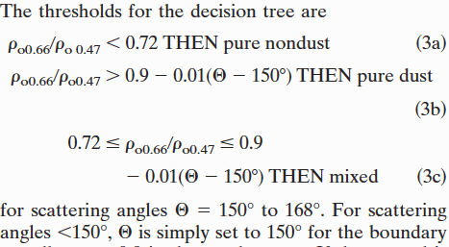
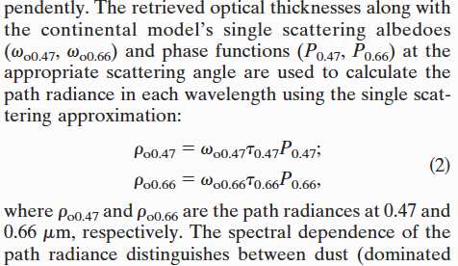
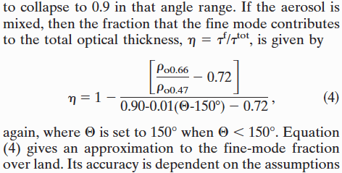
Aerosol Fine Fraction, η, Estimate
η=100%
η=0%
η=

Slide 19
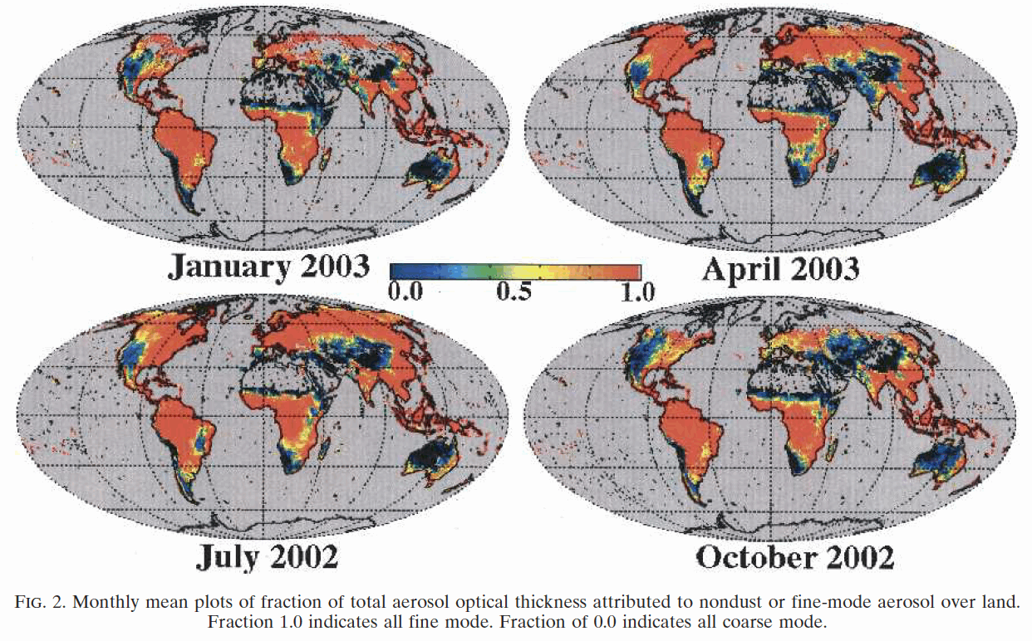
Fine Fraction Example

Slide 20
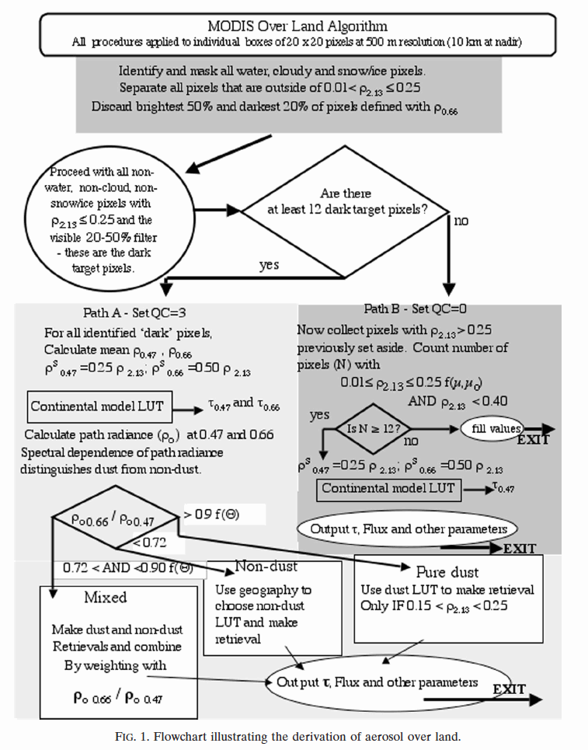
MODIS Aerosol Retrievals Over Land Algorithm

Slide 21
MODIS Aerosol Retrievals Over Ocean
In brief:
Cloud screen (look only at clear sky).
Surface screen (look only at dark water, not near shore.)
Uses level 1B reflectances at 550 nm, 660 nm, 860 nm, 1240 nm, 1600 nm, and 2130 nm.
Assume surface reflectances are negligible except for 550 nm.
Use an aerosol model look up table (LUT) with inputs from MODIS measured reflectances retrieval (information about atmospheric aerosol from satellite).
Take care of ocean glint.

Slide 22
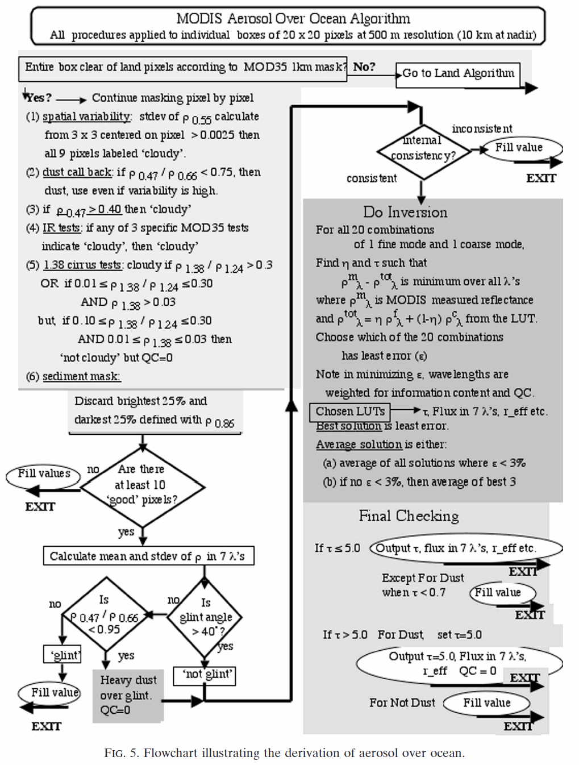
Aerosol Retrieval Over Ocean Algorithm

Slide 23
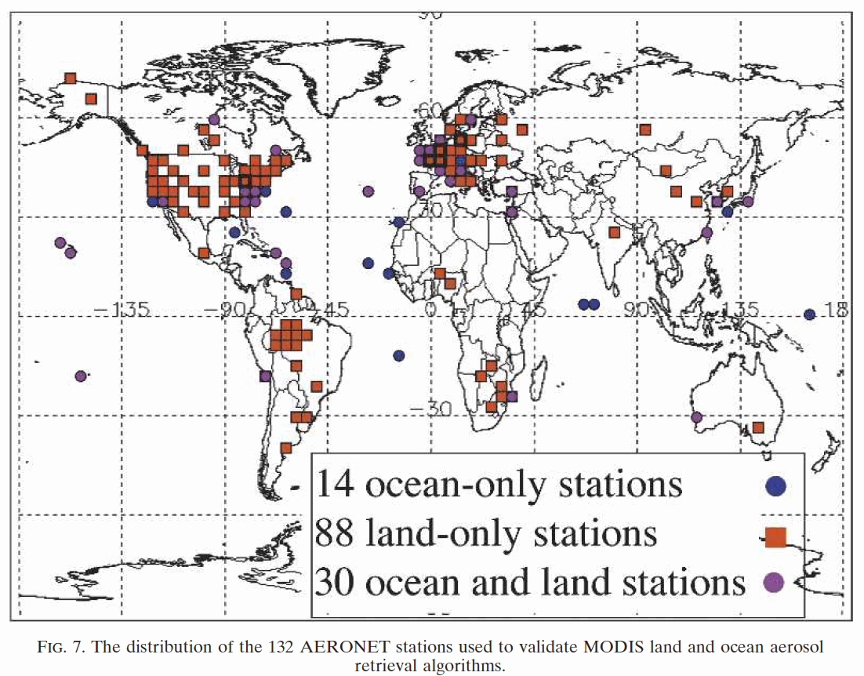
AERONET Ground Based Stations Used For Evaluation

Slide 24
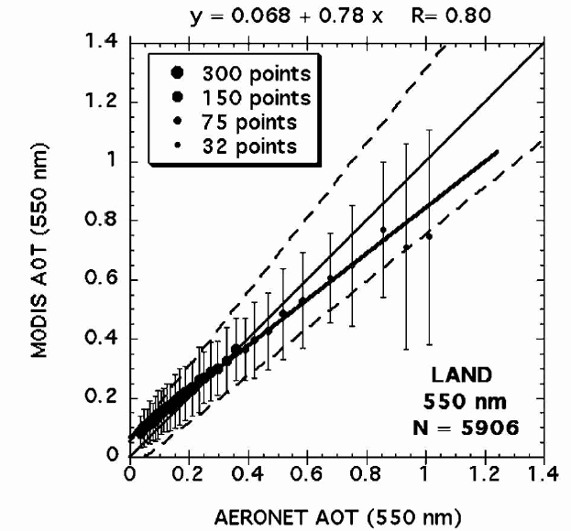
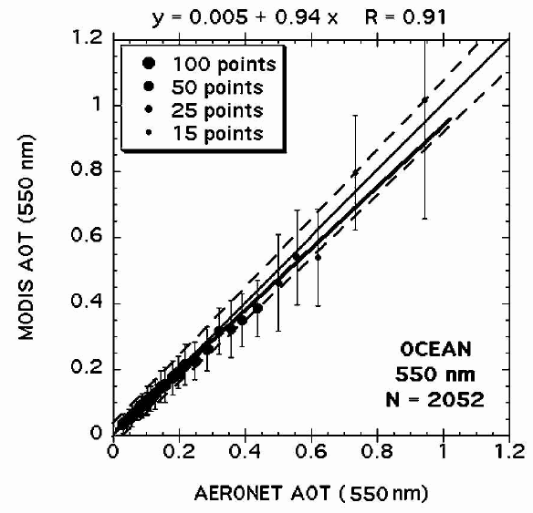
AERONET and MODIS AOD Comparisons at 550 nm

Slide 25
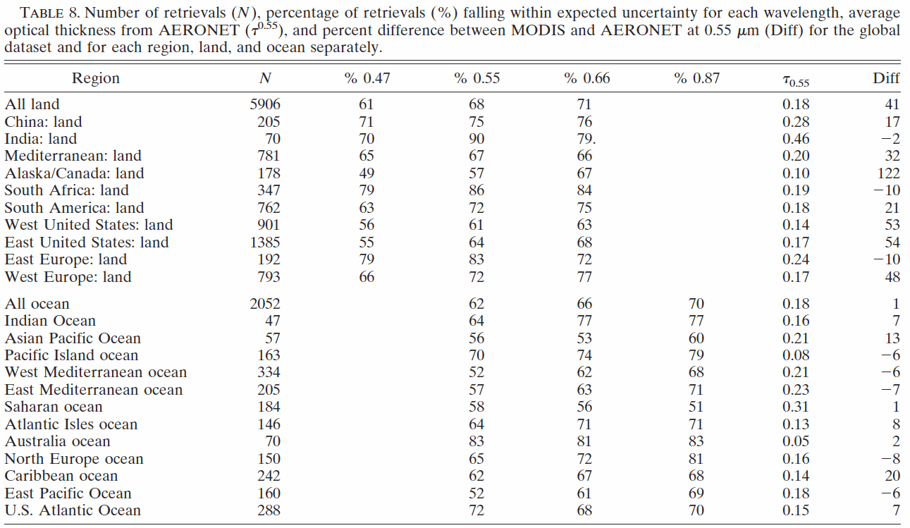
Table of Values Comparing AERONET and MODIS AOD

Slide 26
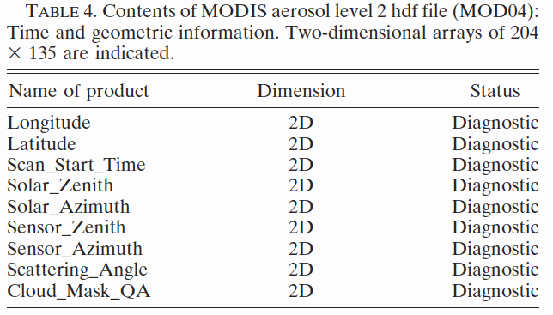
MODIS Aerosol PRODUCTS: Basic Information

Slide 27
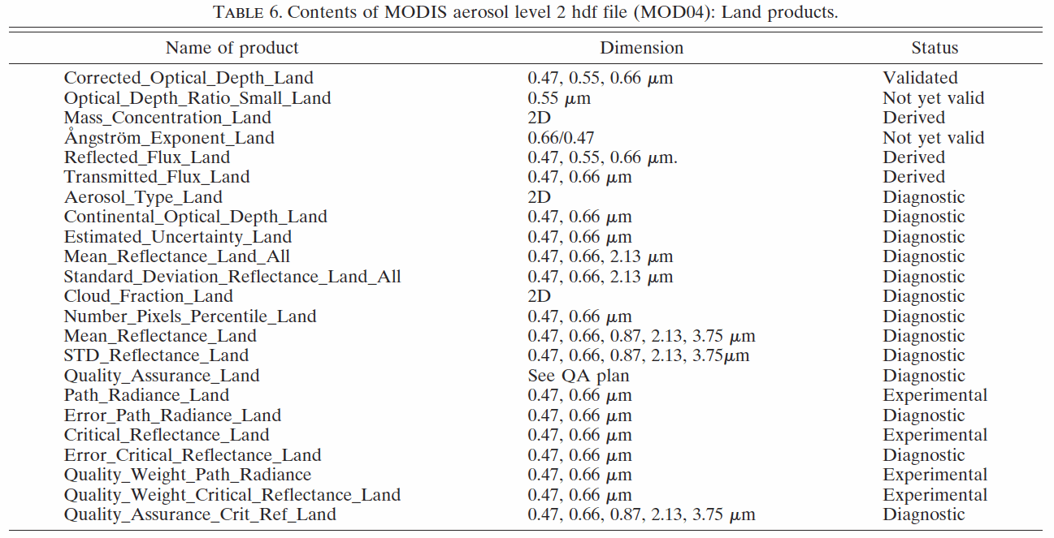
MODIS Aerosol PRODUCTS: Over Land Products
Especially recommended to use the Corrected Optical Depth Land

Slide 28
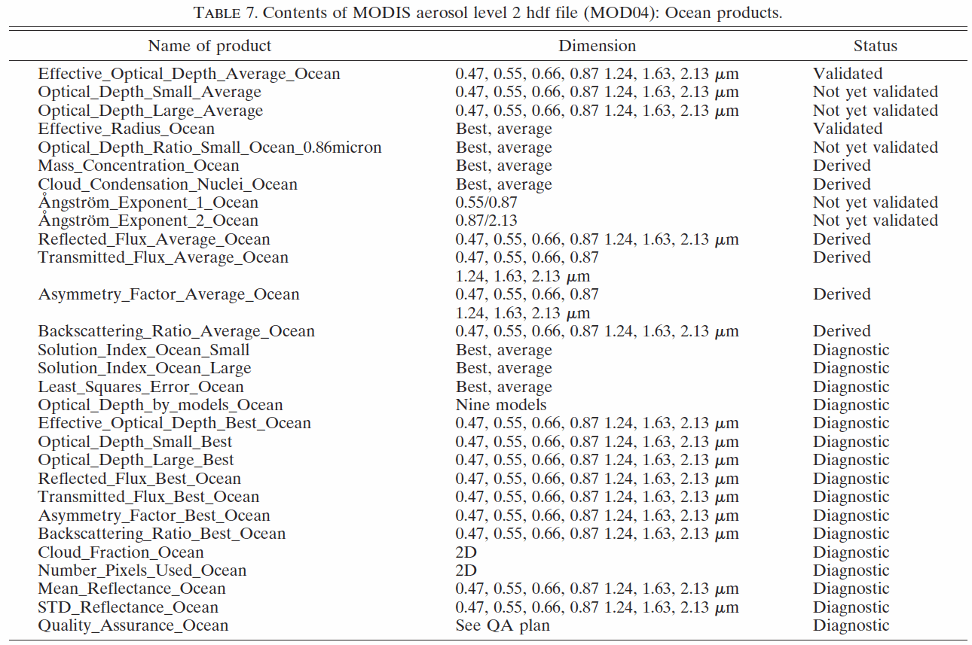
MODIS Aerosol PRODUCTS: Over Water Products
Especially recommended to use the Effective Optical Depth Average Ocean

Slide 29
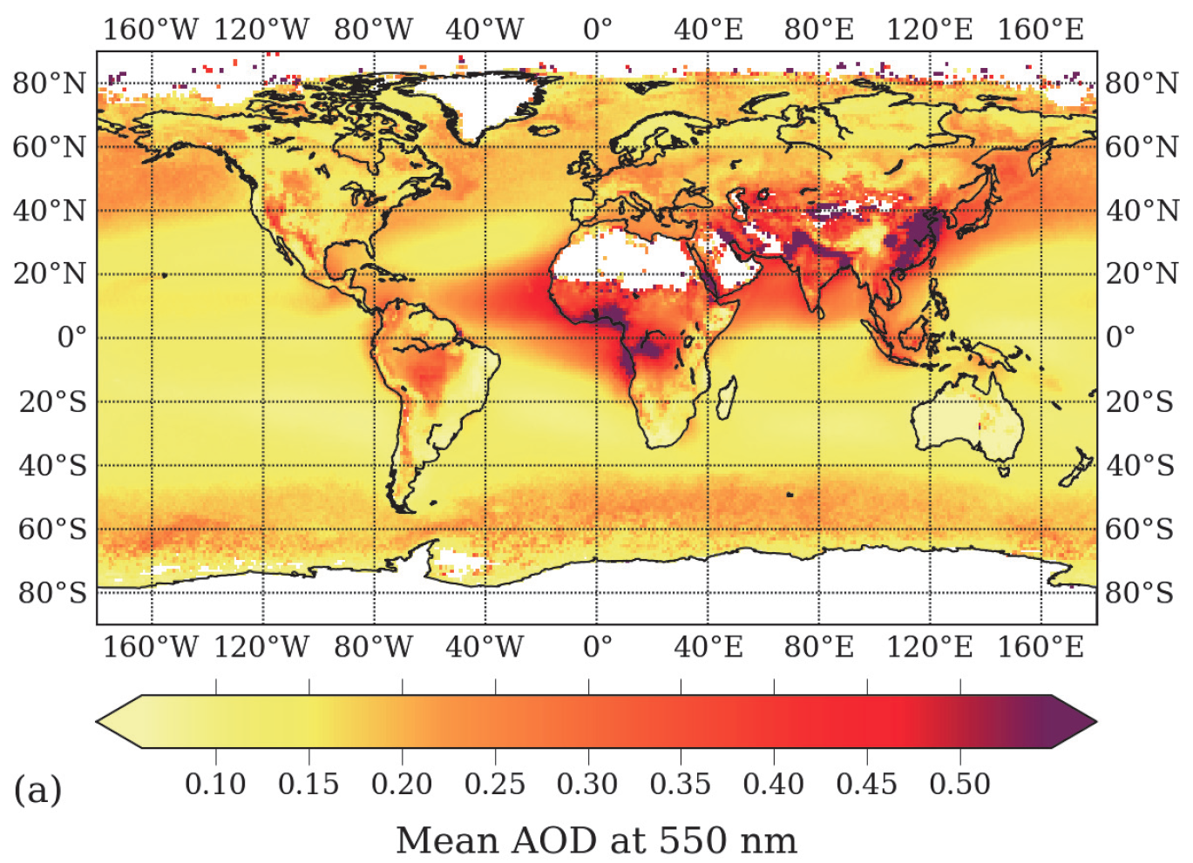
MODIS 550 nm AOD LEVEL 3 Collection 5.1, 1 deg x 1 deg
February 2000 through December 2011, Terra satellite.
Ruiz-Arias, J. A., Dudhia, J., Gueymard, C. A., and Pozo-Vázquez, D.: Assessment of the Level-3 MODIS daily aerosol optical depth in the context of surface solar radiation and numerical weather modeling, Atmos. Chem. Phys. Discuss., 12, 23219-23260, doi:10.5194/acpd-12-23219-2012, 2012.

Slide 30
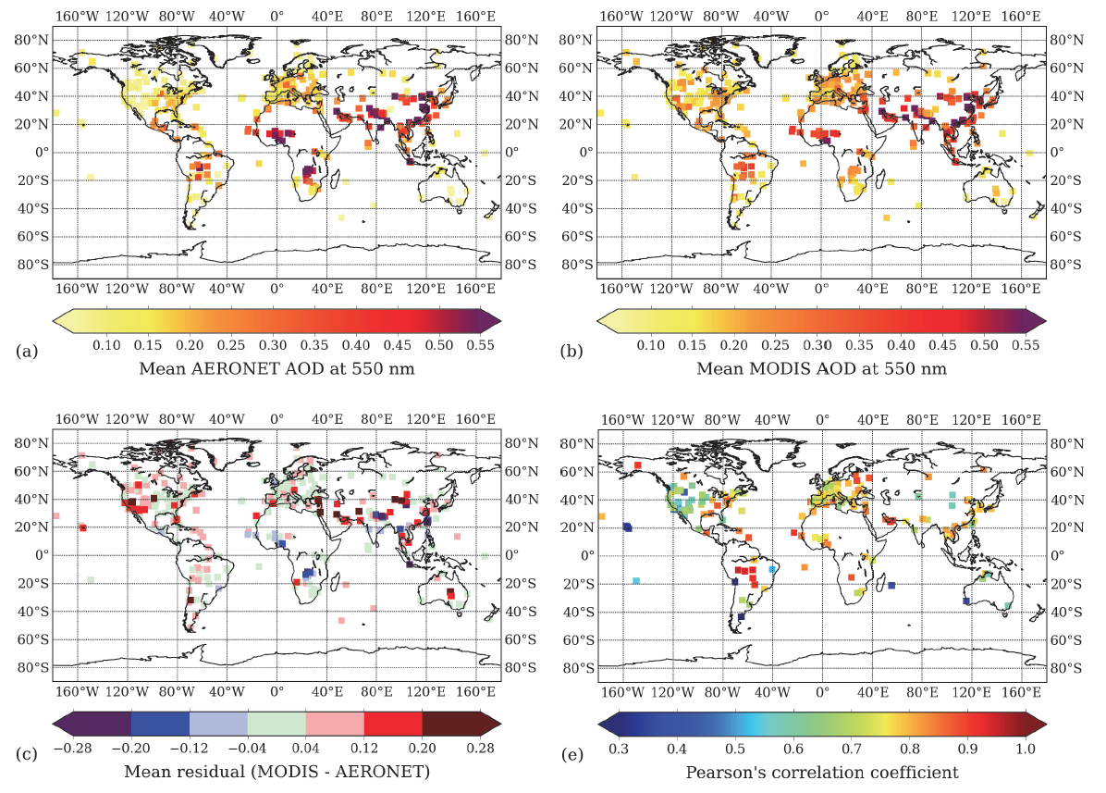
MODIS 550 nm AOD LEVEL 3 Col. 5.1, 1 x 1 deg: Comparison with Aeronet Ground Based Measurements
Ruiz-Arias, J. A., Dudhia, J., Gueymard, C. A., and Pozo-Vázquez, D.: Assessment of the Level-3 MODIS daily aerosol optical depth in the context of surface solar radiation and numerical weather modeling, Atmos. Chem. Phys. Discuss., 12, 23219-23260, doi:10.5194/acpd-12-23219-2012, 2012. (time period: February 2000 through December 2011, Terra satellite.)

Slide 31
MODIS 550 nm AOD LEVEL 3 Col. 5.1, 1 x 1 deg: Comparison with Aeronet Ground Based Measurements
Summary of conclusions from the paper referenced below.
In parts of Northern and Southern Africa and Asia, the L3 AOD is too low.
Too large values are found over Central Asia, Middle East and (most particularly) Western North America.
The regional root mean square error is always larger than 50 %, with specially high values for Western North America (151 %), South America (123 %), Central Asia (82 %) and Australia (88 %).
Ruiz-Arias, J. A., Dudhia, J., Gueymard, C. A., and Pozo-Vázquez, D.: Assessment of the Level-3 MODIS daily aerosol optical depth in the context of surface solar radiation and numerical weather modeling, Atmos. Chem. Phys. Discuss., 12, 23219-23260, doi:10.5194/acpd-12-23219-2012, 2012. (time period: February 2000 through December 2011, Terra satellite.)

Slide 32
MODIS 550 nm AOD LEVEL 3 Col. 5.1, 1 x 1 deg: Comparison with Aeronet Ground Based Measurements
Summary of conclusions from the paper referenced below with regard to errors and fitness for applications.
Under this same condition, the relative uncertainty induced in Global Horizontal Irradiance (GHI) is always below 5 %.
At regional scale, the L3 AOD is therefore of sufficient overall quality to produce good-enough GHI estimates.
Conversely, this is not generally the case for direct normal irradiance (DNI). In spite of this significant AOD-induced uncertainty in DNI, we consider the daily L3 AOD dataset very valuable because it has the advantage to generate a correct daily variability in DNI, which is important in solar energy applications.
Ruiz-Arias, J. A., Dudhia, J., Gueymard, C. A., and Pozo-Vázquez, D.: Assessment of the Level-3 MODIS daily aerosol optical depth in the context of surface solar radiation and numerical weather modeling, Atmos. Chem. Phys. Discuss., 12, 23219-23260, doi:10.5194/acpd-12-23219-2012, 2012. (time period: February 2000 through December 2011, Terra satellite.)

Slide 33
Case Study

Slide 34
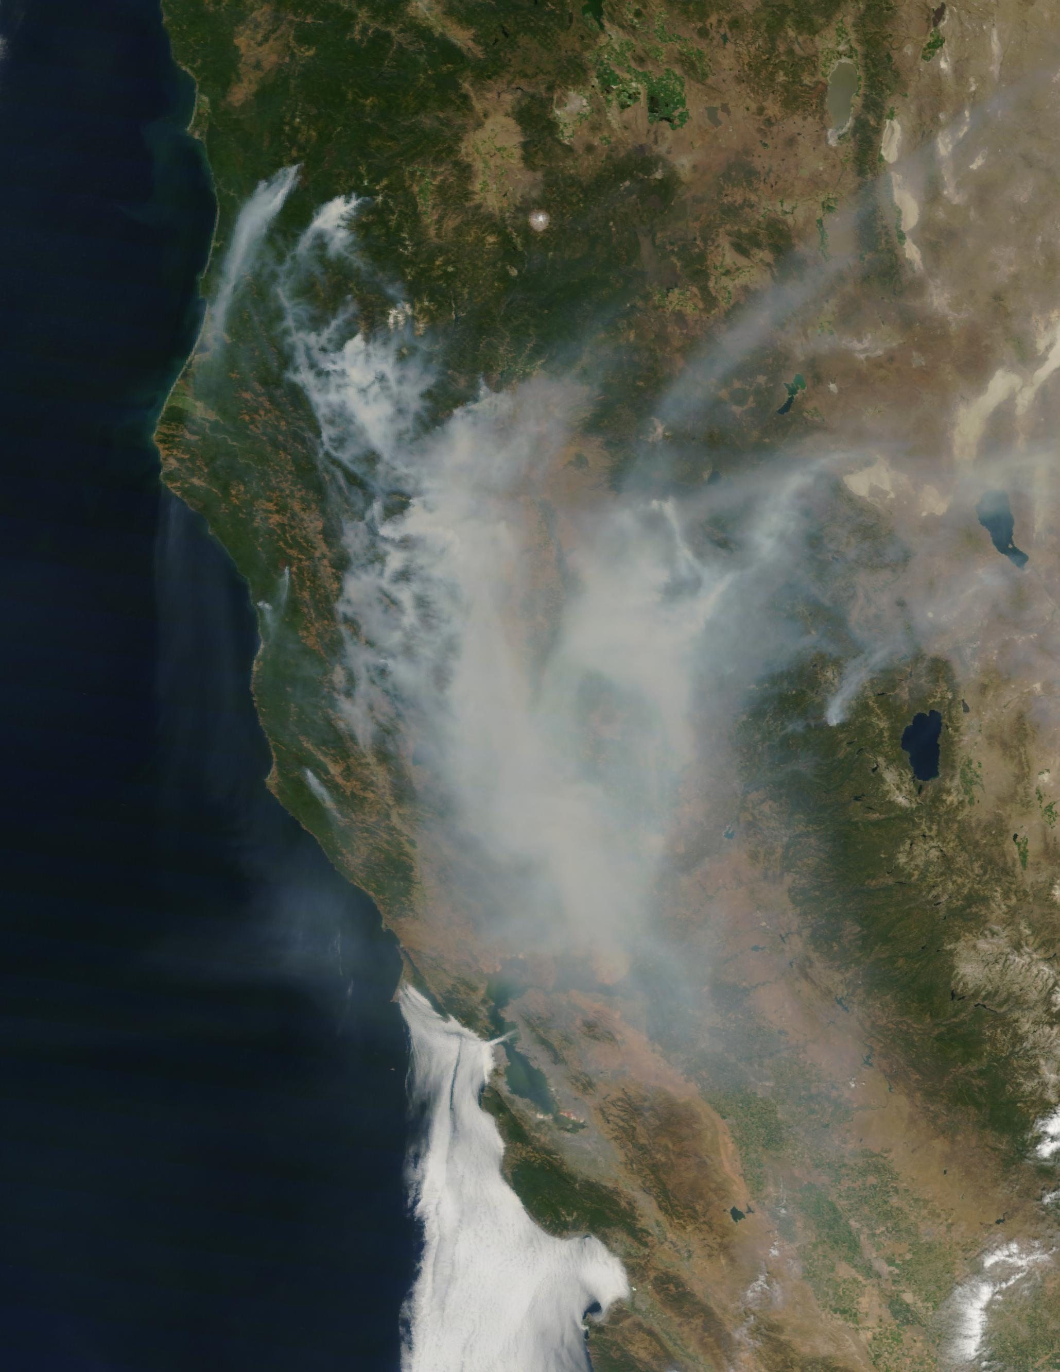
1,000 Fires, Northern CA, Summer 2008: Peak Smoke in Reno around local noon, July 10th.
Summer wild Fires
-Over 1,000
-Most sparked by lightning
-Dry and windy
-Covering 680 Sq miles of central and northern California
Source: NASA California Wild Fires 2008
34
Notes:
34

Slide 35
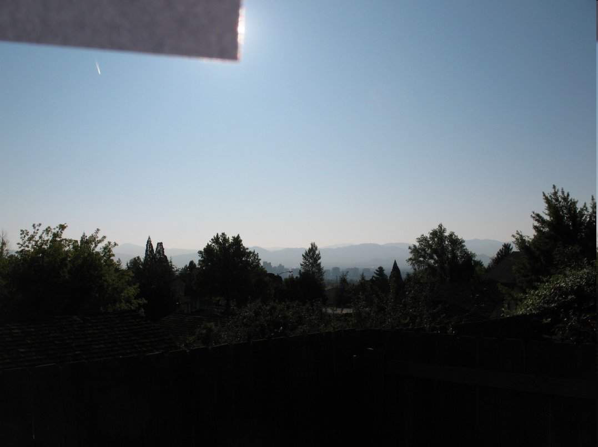
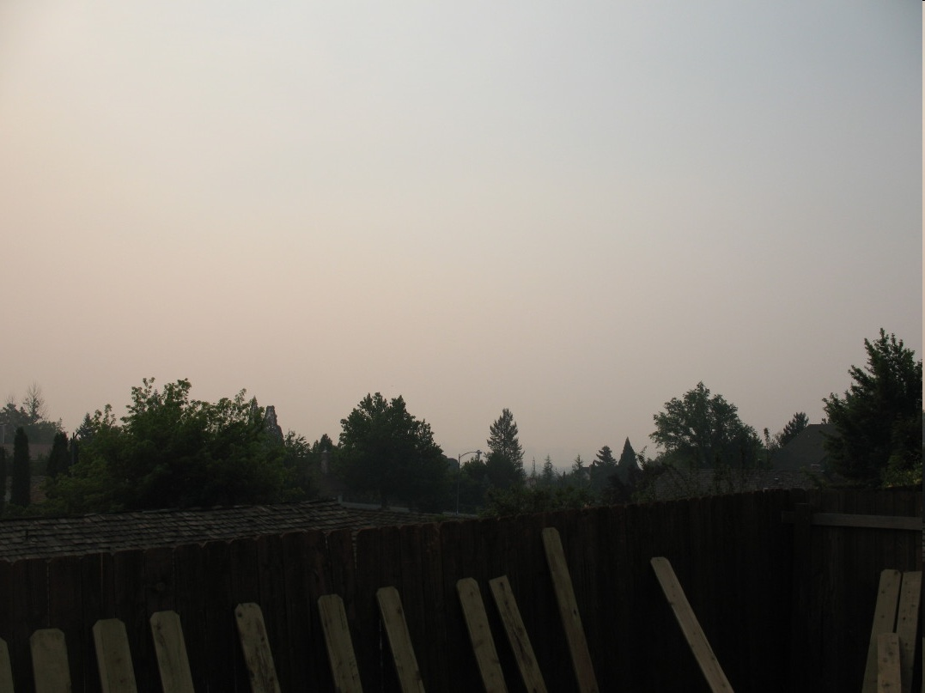
Reno Days in Photographs:
Similar Location and Sun Angle
SEPT-22, 2008
JULY-10, 2008

Slide 36
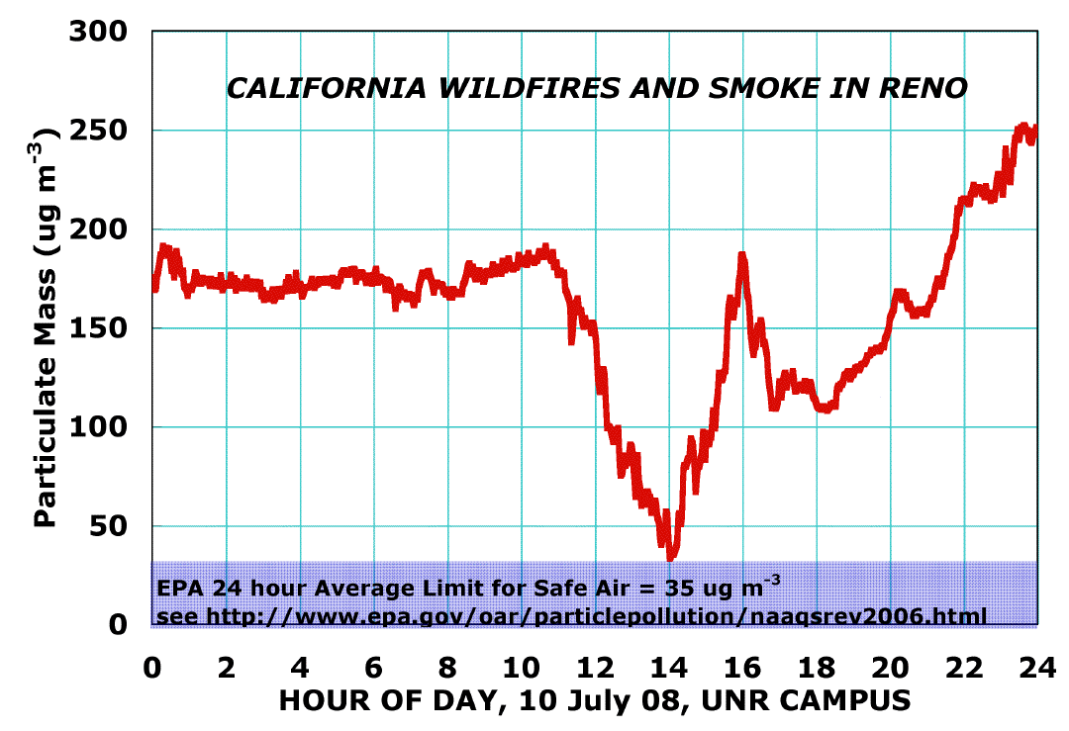
One Not So Fine Day in Reno

Slide 37
Comparison With Lab Data
37

Slide 38
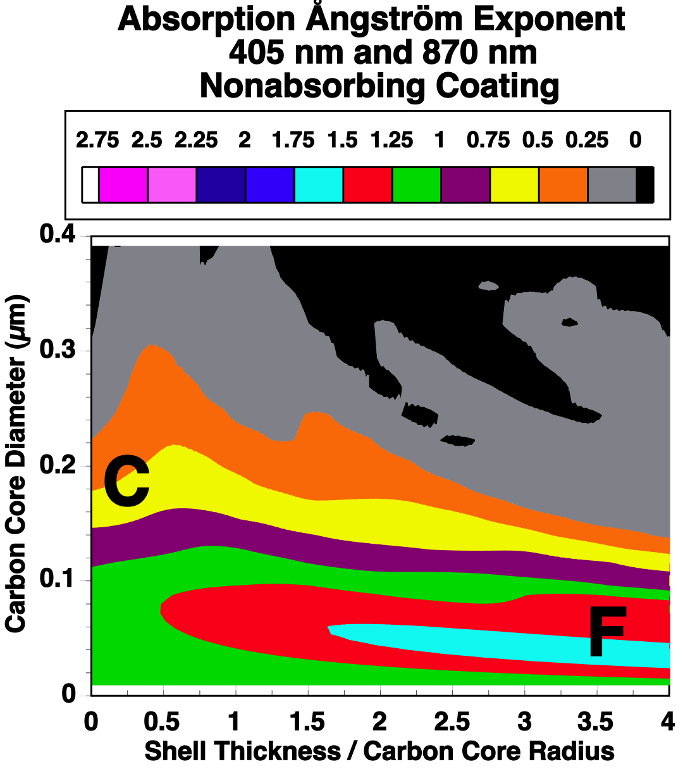
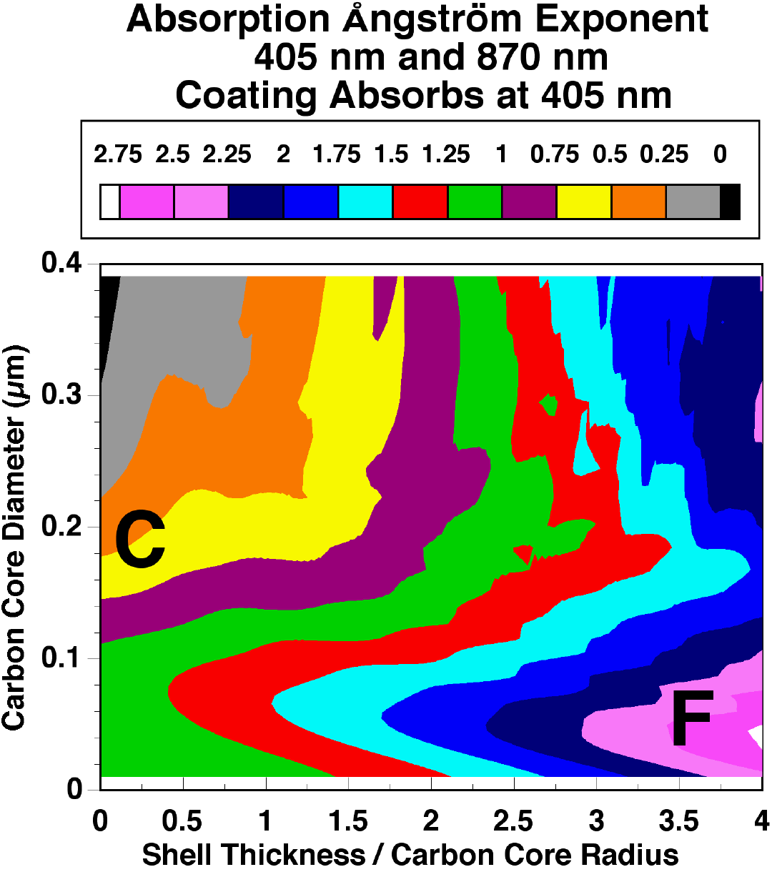
Single Particle Optics of Coated Cores

