Slide 1
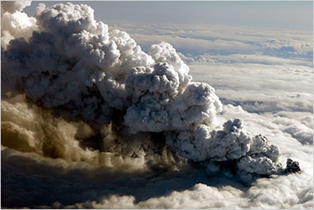
Using Remote Sensing to Track the 2010 Eruptions of Eyjafjallajökull (Icelandic Volcano) Nick Nauslar KC King
http://topics.nytimes.com/top/news/international/countriesandterritories/iceland/eyjafjallajokull/index.html

Slide 2
Overview
About the Eyjafjallajökull Volcano
Meteorology: HYSPLIT
MODIS – Visible and AOD
CALIPSO LIDAR
AERONET
Conclusions

Slide 3
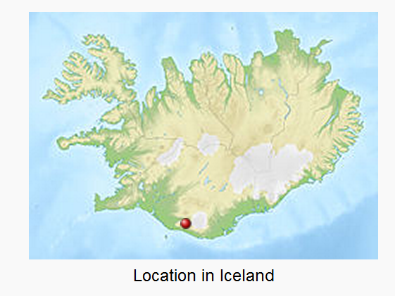
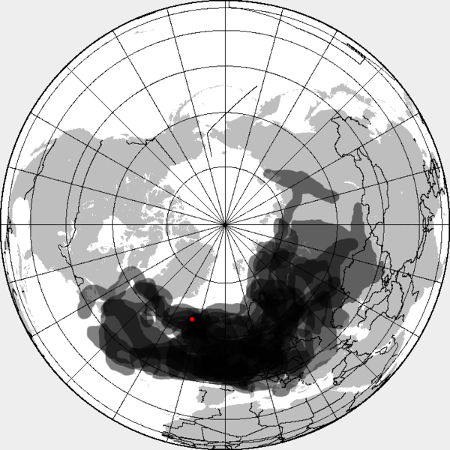
About Eyjafjallajökull
Can’t be pronounced correctly
First eruption: March 20, 2010 ranked a 1 on the Volcanic Explosivity Index (VEI)
Continuing eruptions: April 14-20 – ranked 4 on the VEI scale
~250 million cubic meters of ejected material
Ash plume rose to a height of ~9 km (30,000 ft)
From April 15-20 the ash cloud caused airport closures all over Europe
Declared over in October 2010
Extent of the ash cloud
http://en.wikipedia.org/wiki/Eyjafjallaj%C3%B6kull

Slide 4
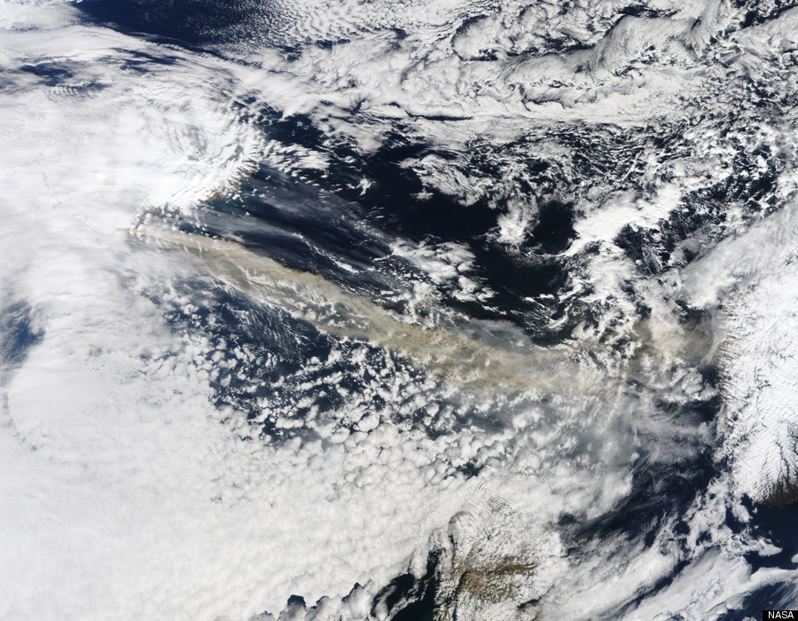
Videos to Keep You Awake
Helicopter View
Time Lapse

Slide 5
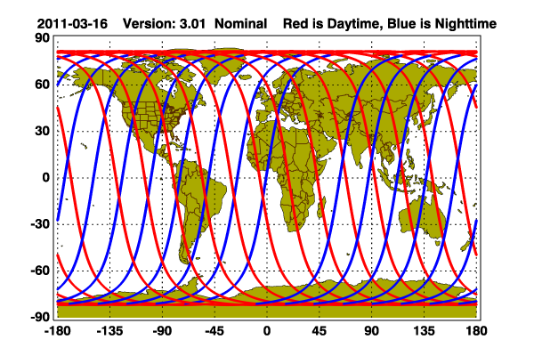
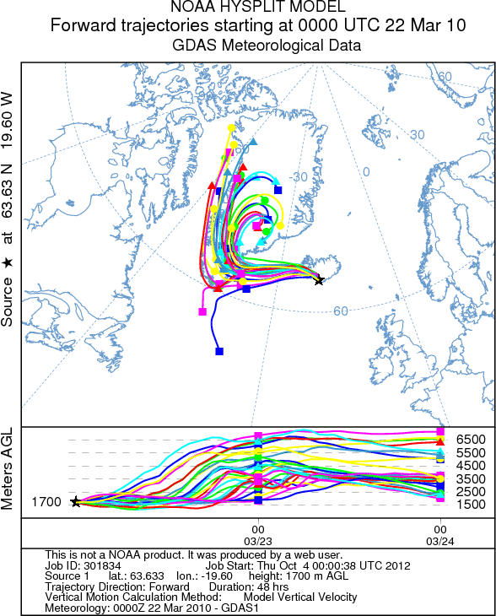
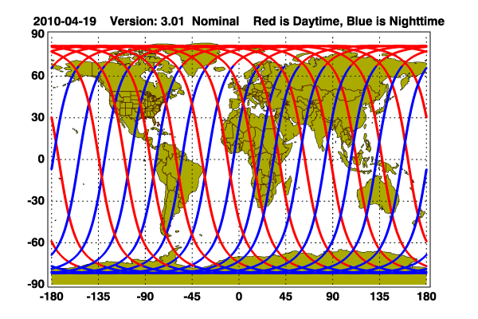
HYSPLIT

Slide 6
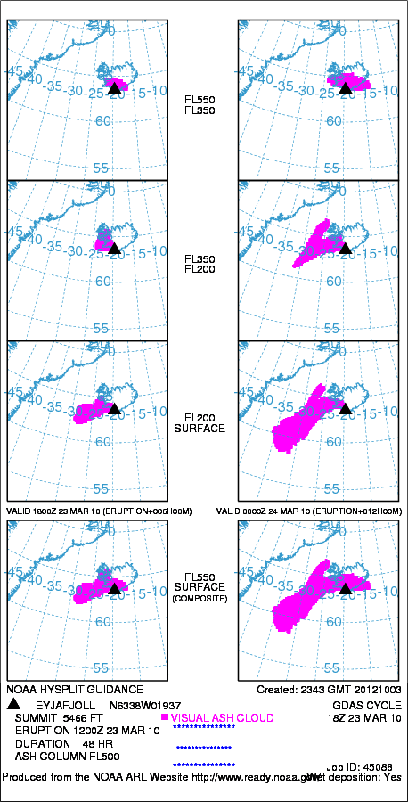
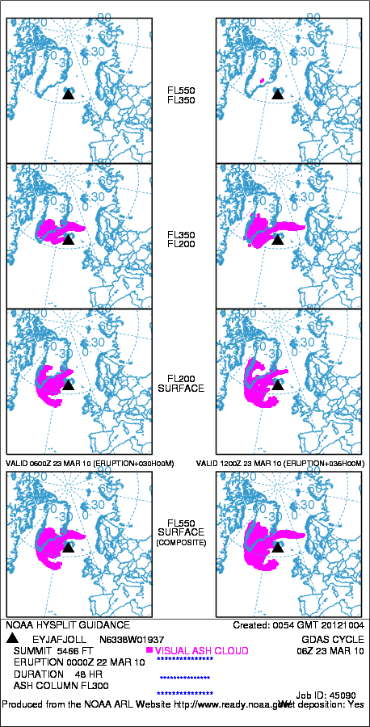
HYSPLIT Volcanic Ash

Slide 7
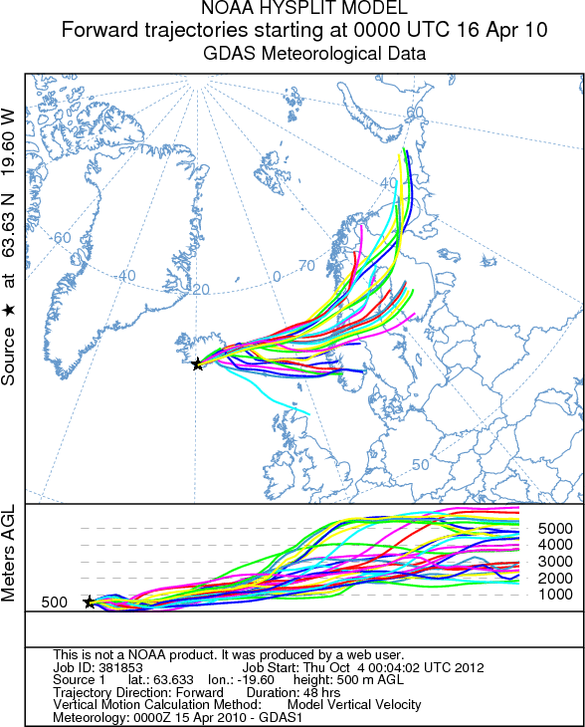
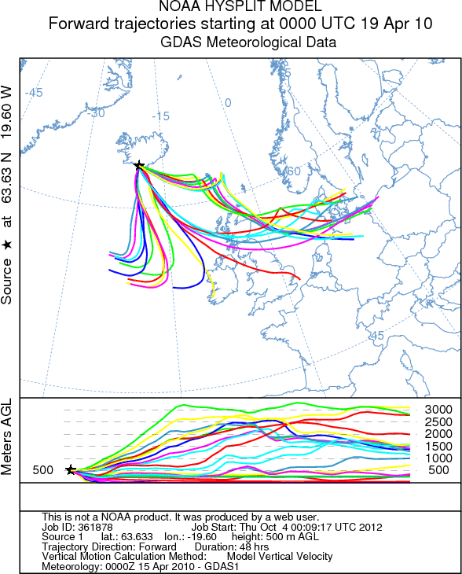
HYSPLIT

Slide 8
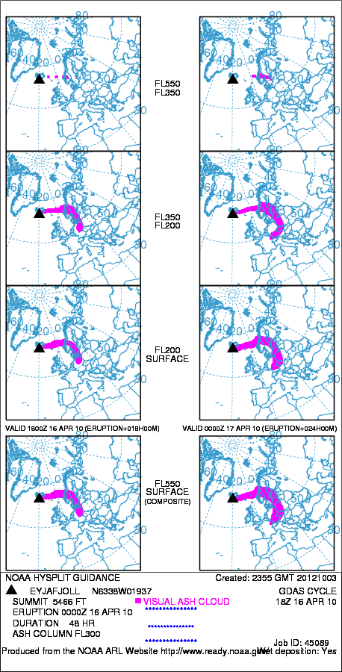
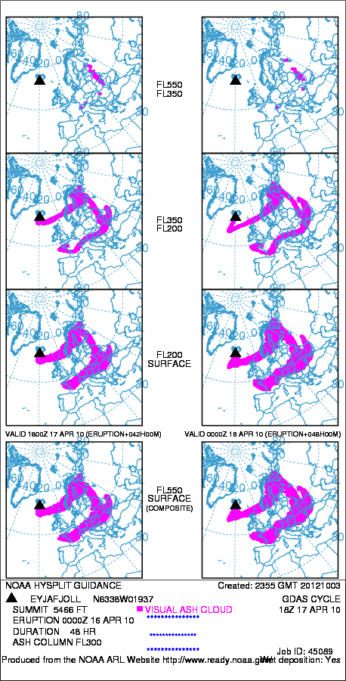
HYSPLIT Volcanic Ash

Slide 9
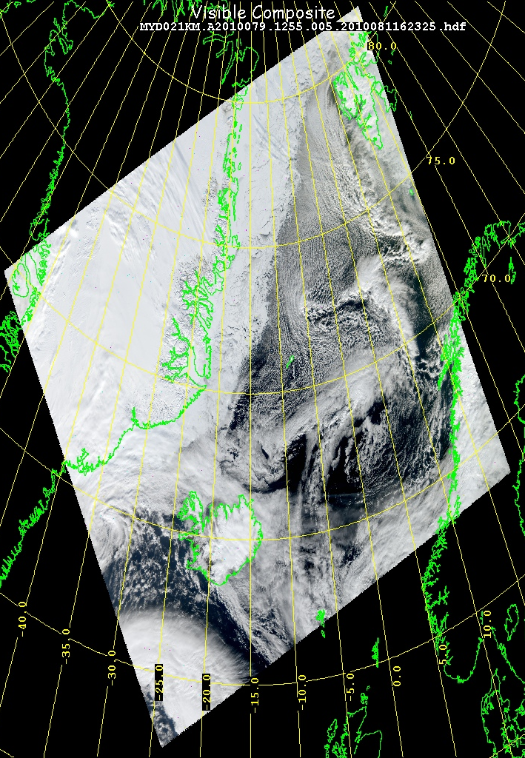
First Eruption Phase MODIS Visible
March 20 – First eruption
Aqua – 12:55 GMT
Too many clouds to see the eruption or get useful AOD information
Greenland
Iceland

Slide 10
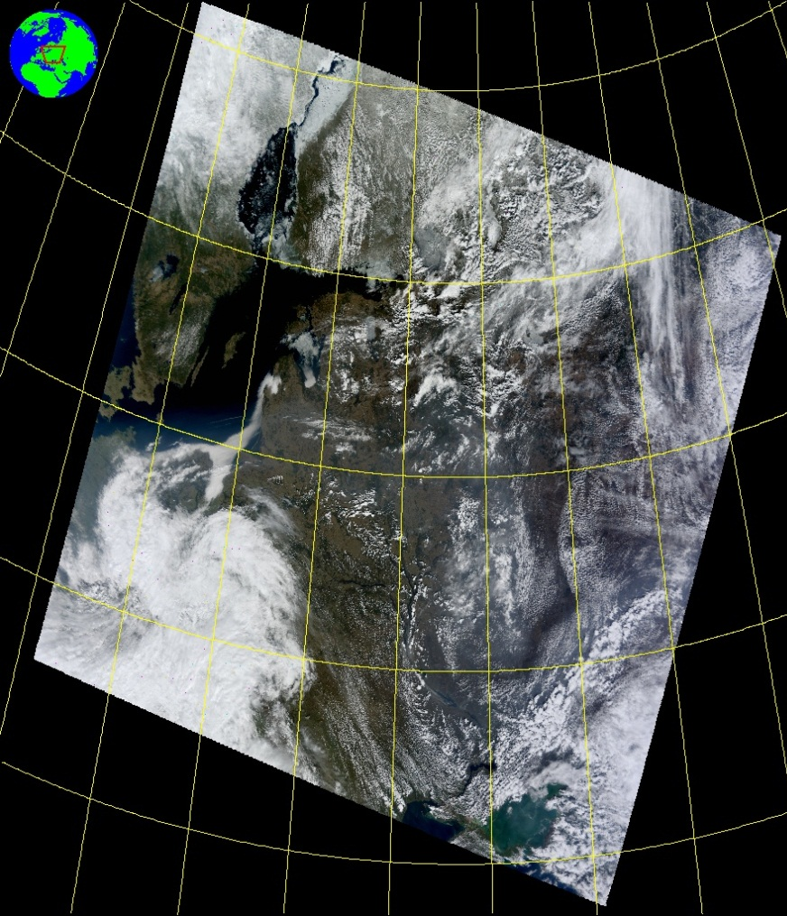
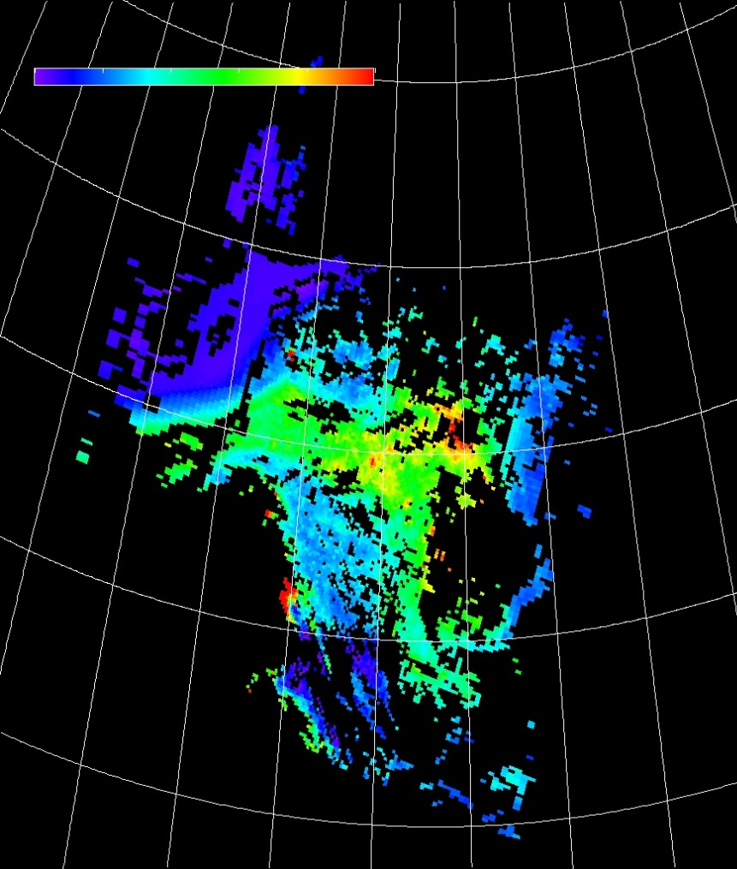
Second Eruption Phase – April 14 MODIS - Terra
Visible
AOD
Sweeden
Poland

Slide 11
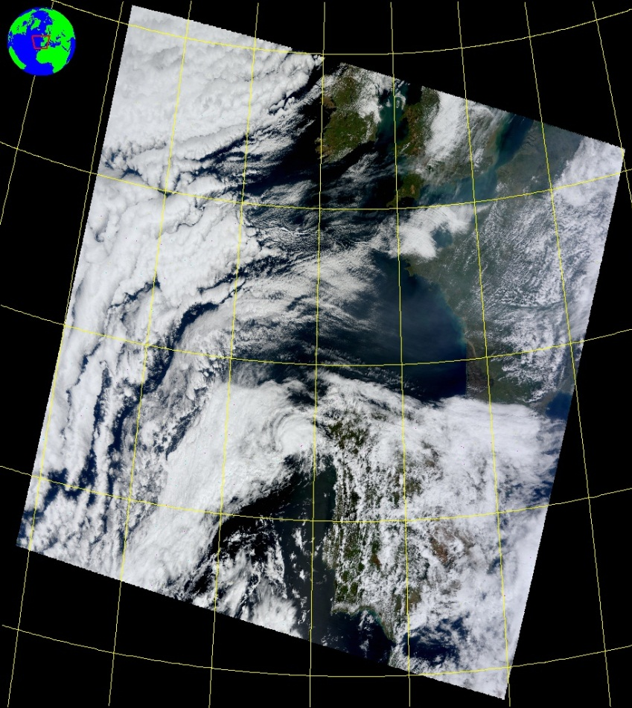
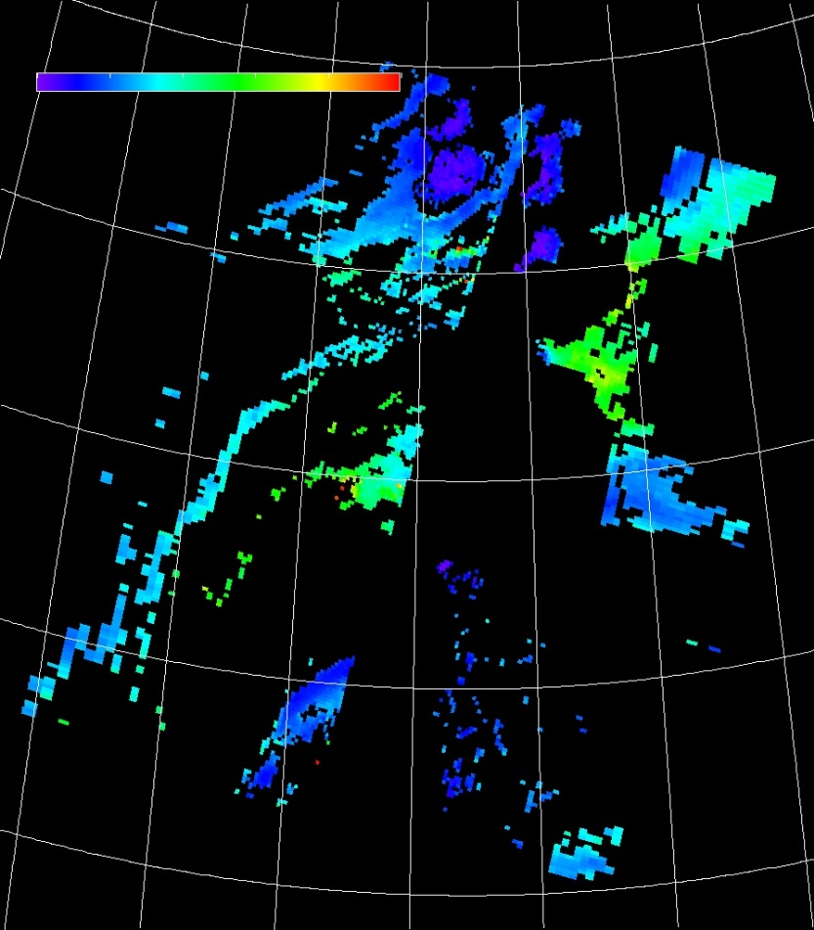
Second Eruption Phase – April 15 MODIS - Terra
Visible
AOD
UK
France
Spain

Slide 12
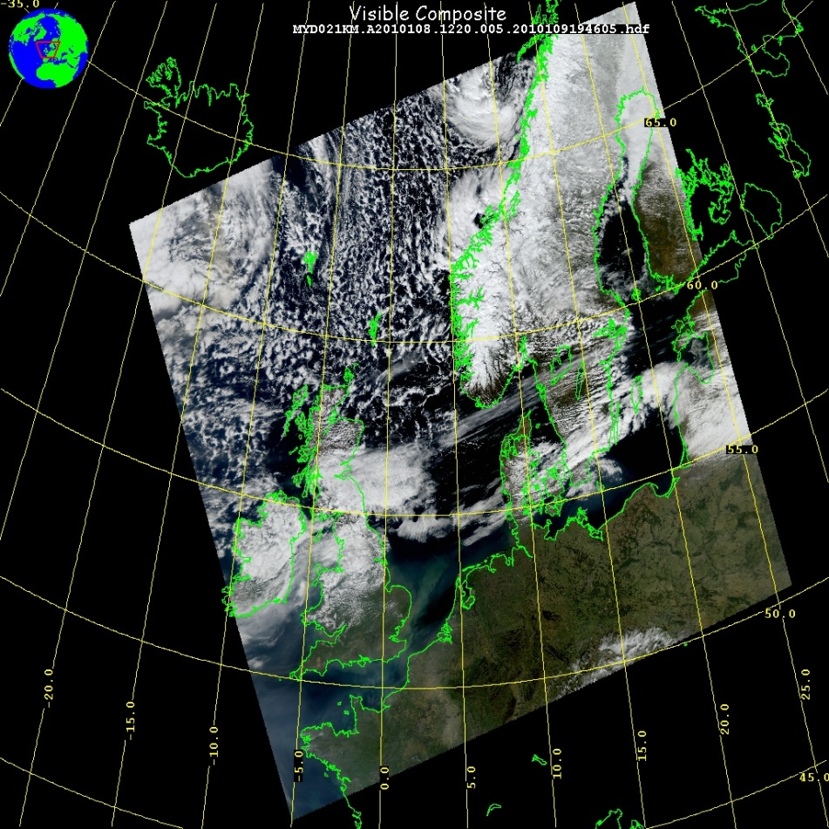
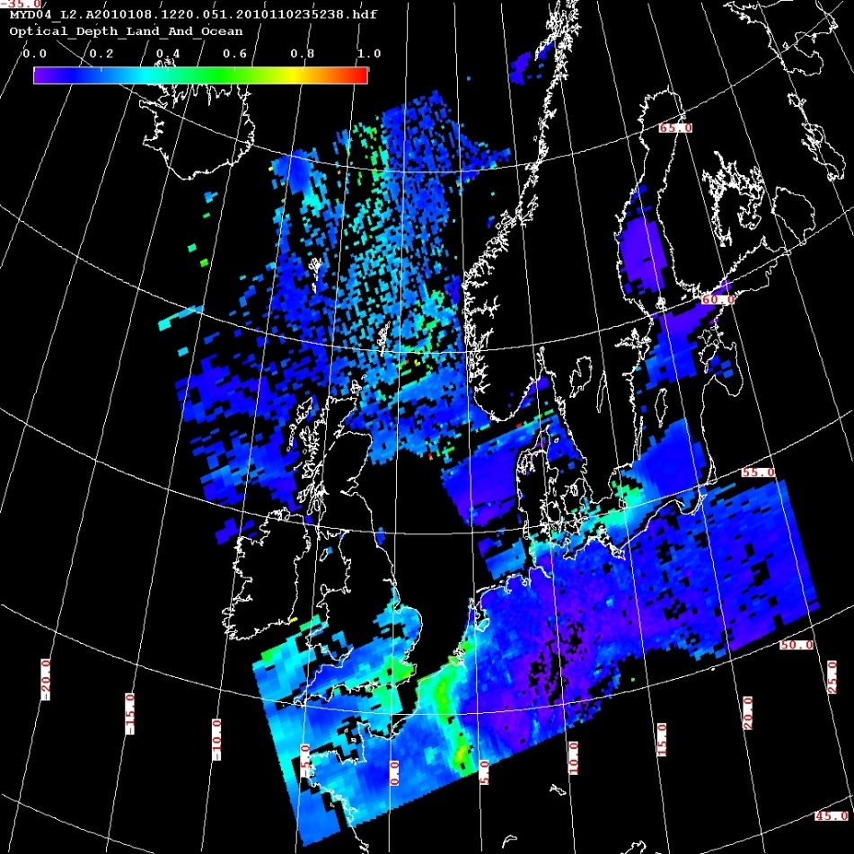
Second Eruption Phase – April 18 MODIS - Aqua
Visible
AOD
Norway
UK
France

Slide 13
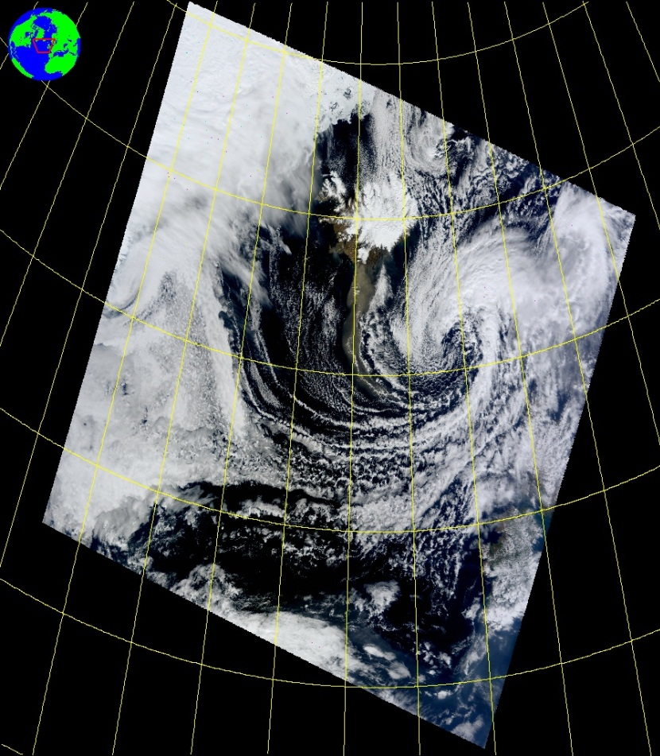
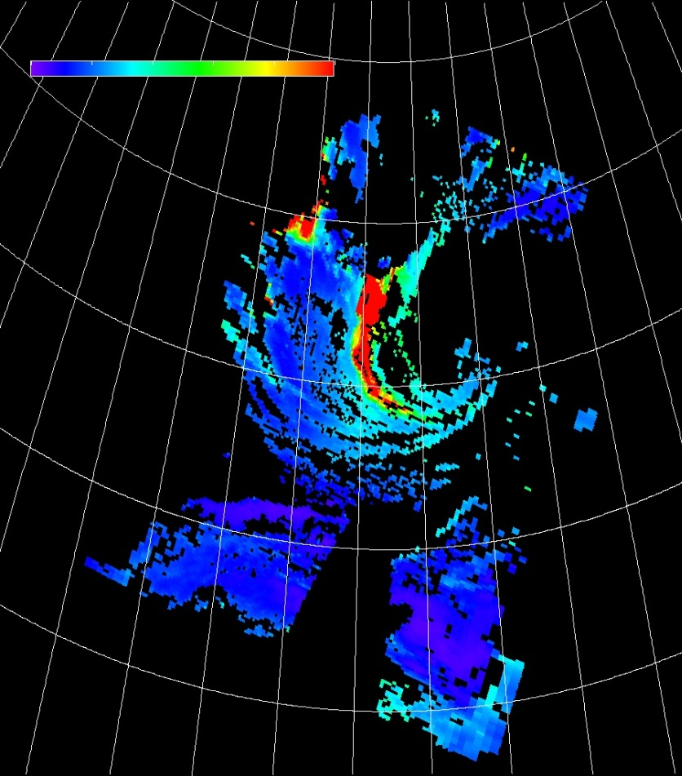
Second Eruption Phase – April 19 MODIS – Terra (12:50 GMT)
Visible
AOD
Iceland

Slide 14
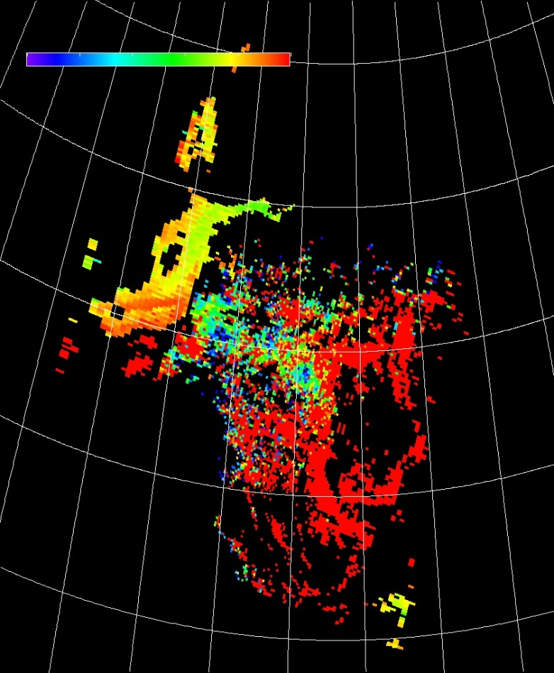
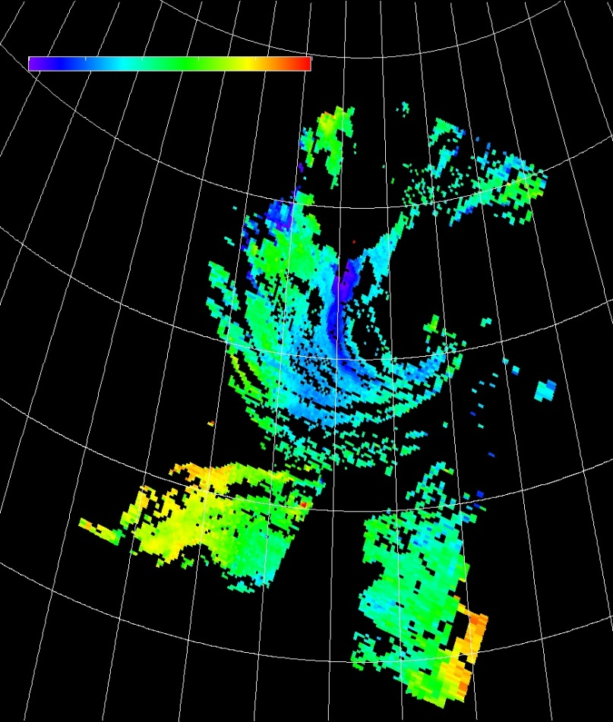
AOD Small Fraction
April 14
April 19
Sweeden
Iceland
Poland
Larger particles in swath of high AOD

Slide 15
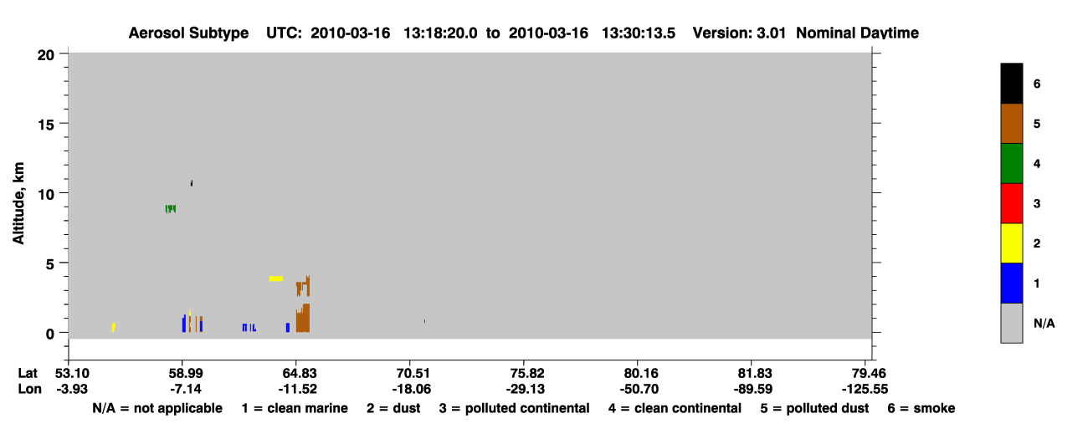
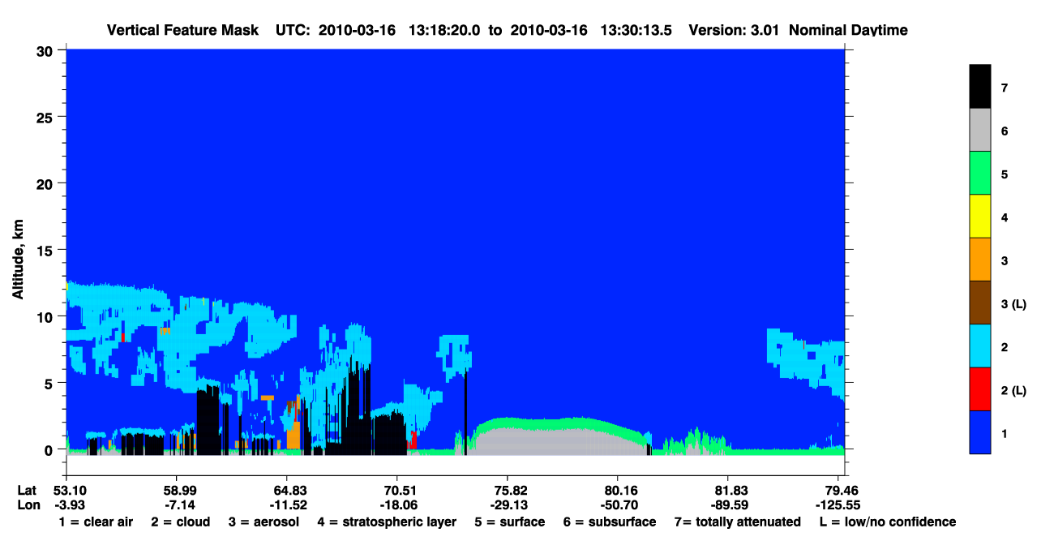
CALIPSO LIDAR: March 16

Slide 16
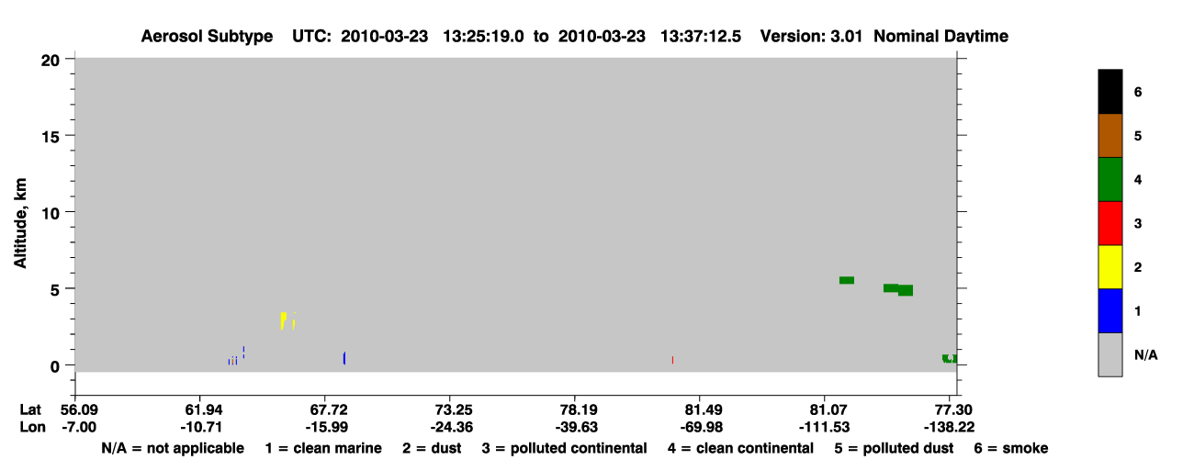
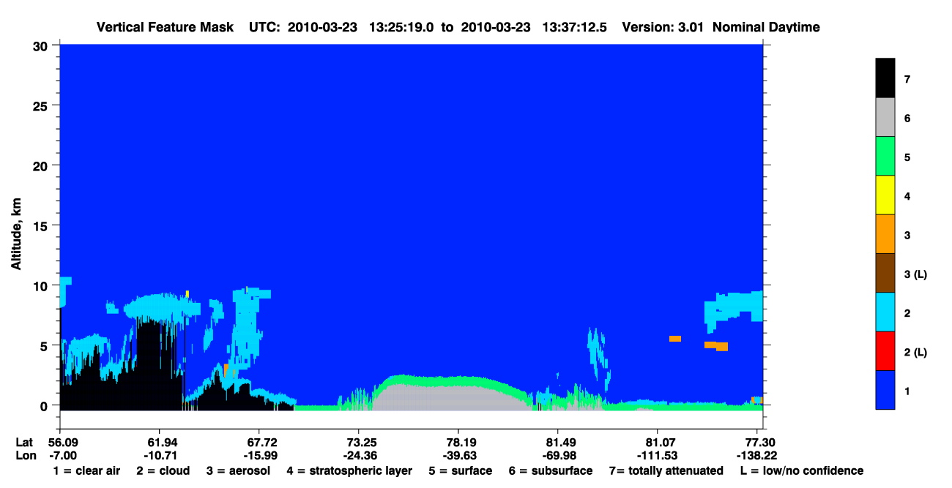
CALIPSO LIDAR: March 23

Slide 17
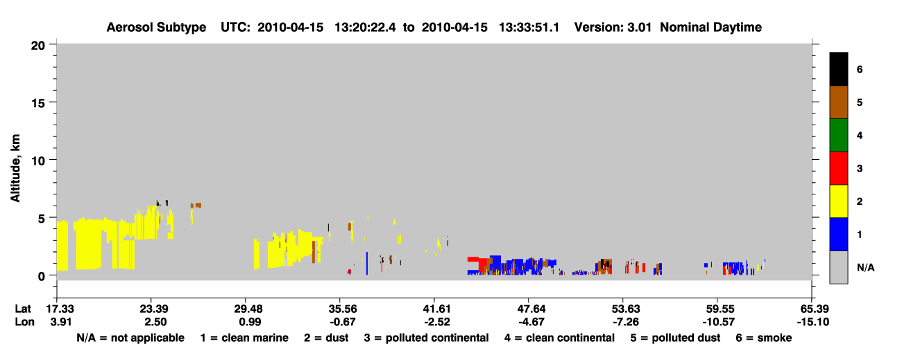
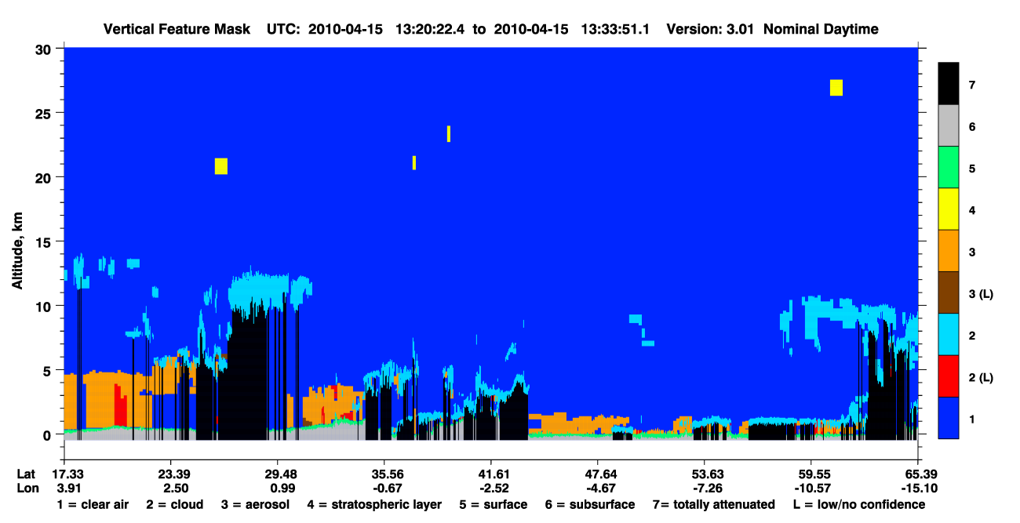
CALIPSO LIDAR: April 15

Slide 18
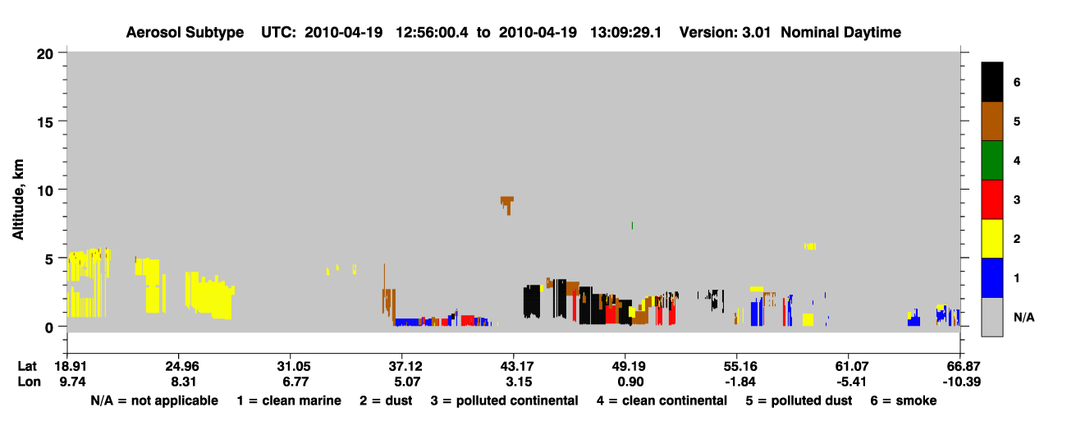
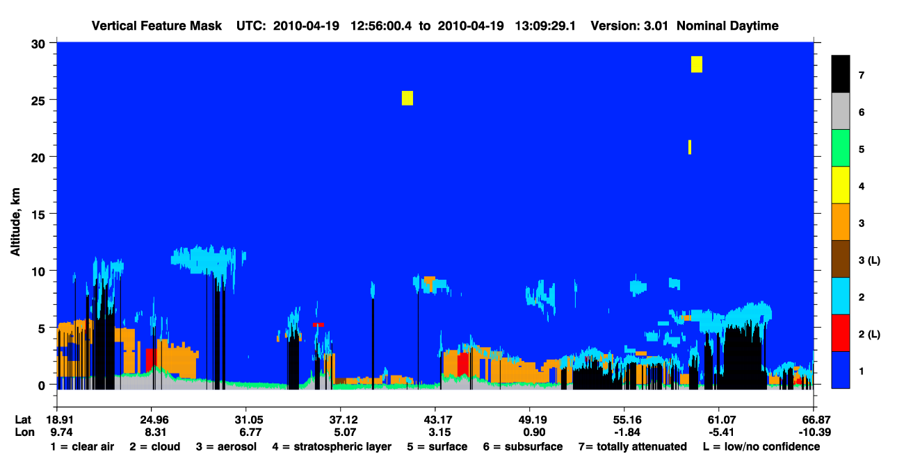
CALIPSO LIDAR: April 19

Slide 19
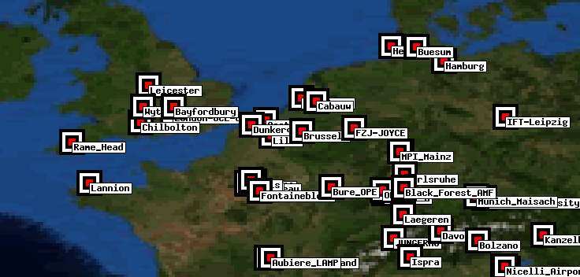
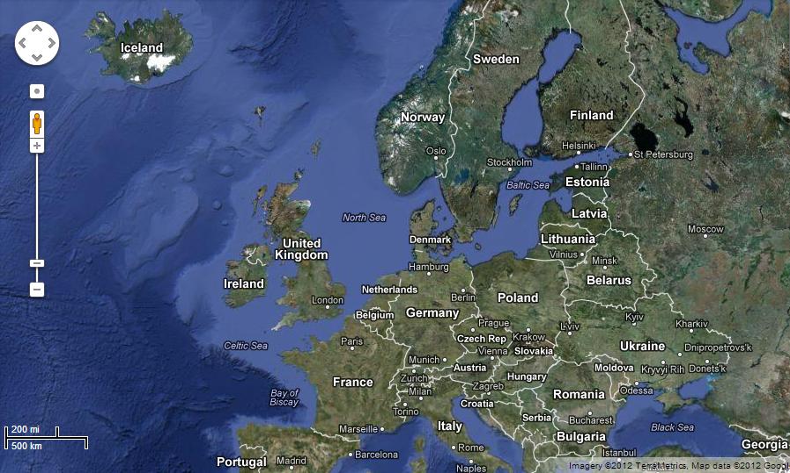

Aeronet Stations
Helgoland
Liepzig
Wytham Woods

Slide 20
Wytham Woods, UK
AOD
Julian Day

Slide 21
Liepzig, Germany
AOD
Julian Day

Slide 22
Helgoland, Denmark
AOD
Julian Day

Slide 23
Conclusions
HYSPLIT shows ash cloud over good portion of Europe
Trajectories of parcels from volcanic eruption over northern Europe
CALIPSO LIDAR shows the aerosols over parts of northern Europe. Most of it shows up as dust (volcanic ash -> larger particles)
Thought more pollution would show up due to amount of gases emitted

Slide 24
Conclusions Continued
MODIS shows a visible and AOD signal from Iceland and across Europe over the period April 14-20
The fine fraction from MODIS points to relatively large particles
Individual AERONET stations across Europe also contain the signatures of the volcanic ash cloud in increased AOD

Slide 25
References
Air Resources Laboratory - HYSPLIT
NASA – LADSWEB
AERONET
YouTube
Wikipedia: http://en.wikipedia.org/wiki/Eyjafjallaj%C3%B6kull http://en.wikipedia.org/wiki/2010_eruptions_of_Eyjafjallaj%C3%B6kull
Huffington Post: http://www.huffingtonpost.com/2010/04/16/iceland-volcano-satellite_n_540449.html

