Slide 1
HW2 Problem 1

Slide 2
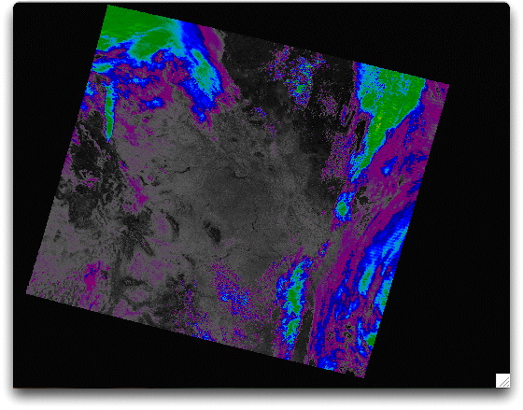
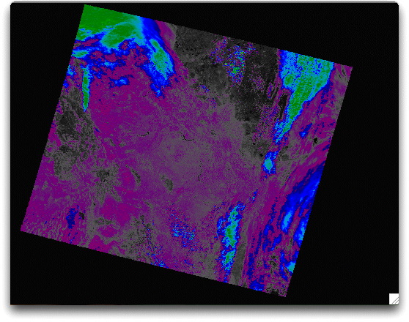
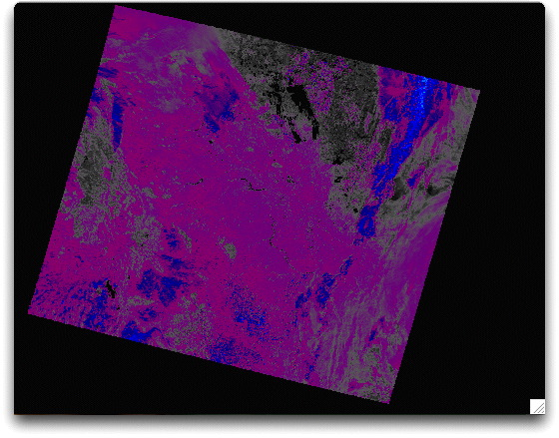
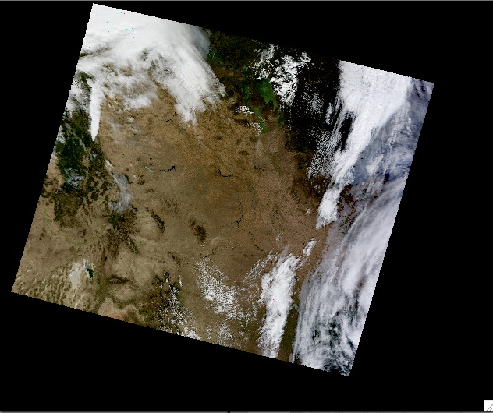
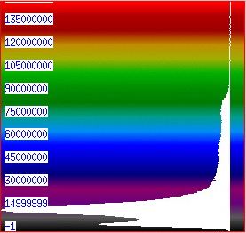
440 nm, 660 nm, and 2130 nm:
MODIS Bands 3, 1, and 7
Testing Hypothesis:
Band3 = Band7 / 4
Band1 = Band7 / 2
(assuming clear sky).
MOD09.A2012275.1750.005.2012277031427.hdf

Slide 3
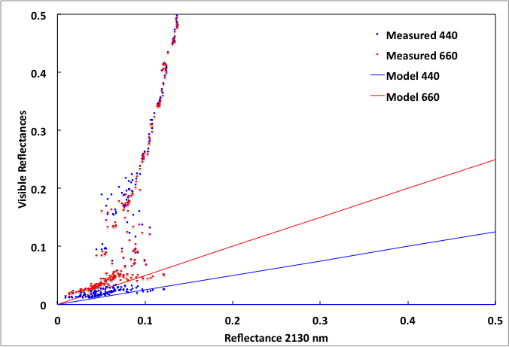
Hypothesis test for a small data subset
Clouds

