Slide 1
Great Basin Ozone Problem
Measurements indicate high ozone concentrations in the Great Basin.
Back trajectory analysis and satellite remote sensing will be used to shed light on the causes.
Great Basin National Park: 39.005 N 114.216 W.
South Fork Recreation Area: 40.677 N 115.745 W.

Slide 2
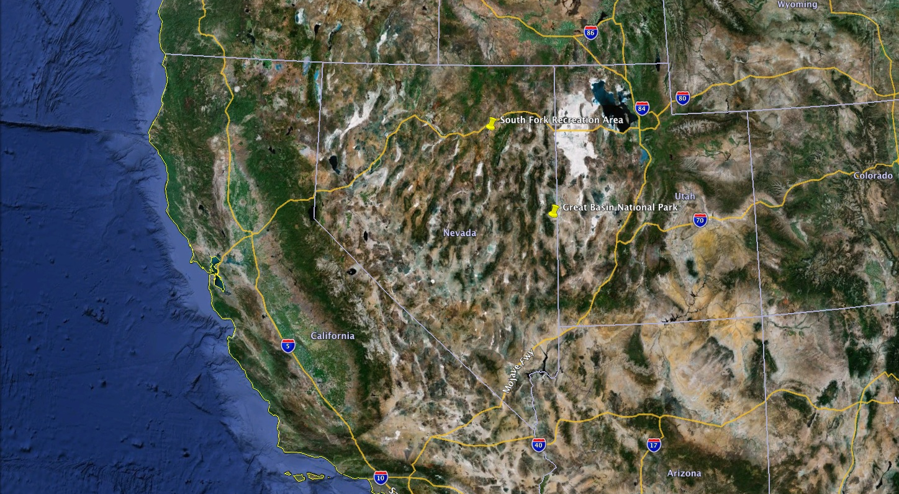
Ground Based Ozone Measurements at Two Remote Sites in Nevada
Notes:
Surface ozone measurements in Northeast Nevada (South Fork Recreation Area) and Great Basin National Park (Central, Eastern Nevada) will be compared and discussed in this presentation.

Slide 3
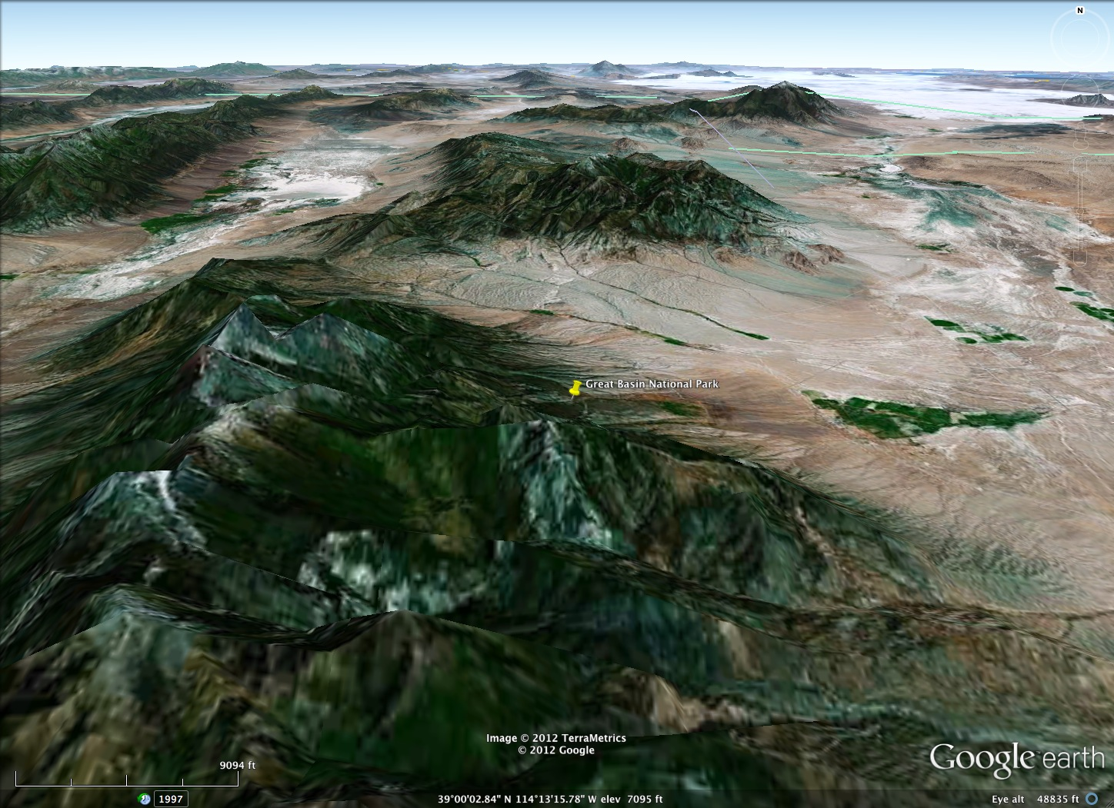
Great Basin National Park Site
Notes:
The site is located on the Eastern boundary of the Great Basin National Park, East of Wheeler Peak.

Slide 4
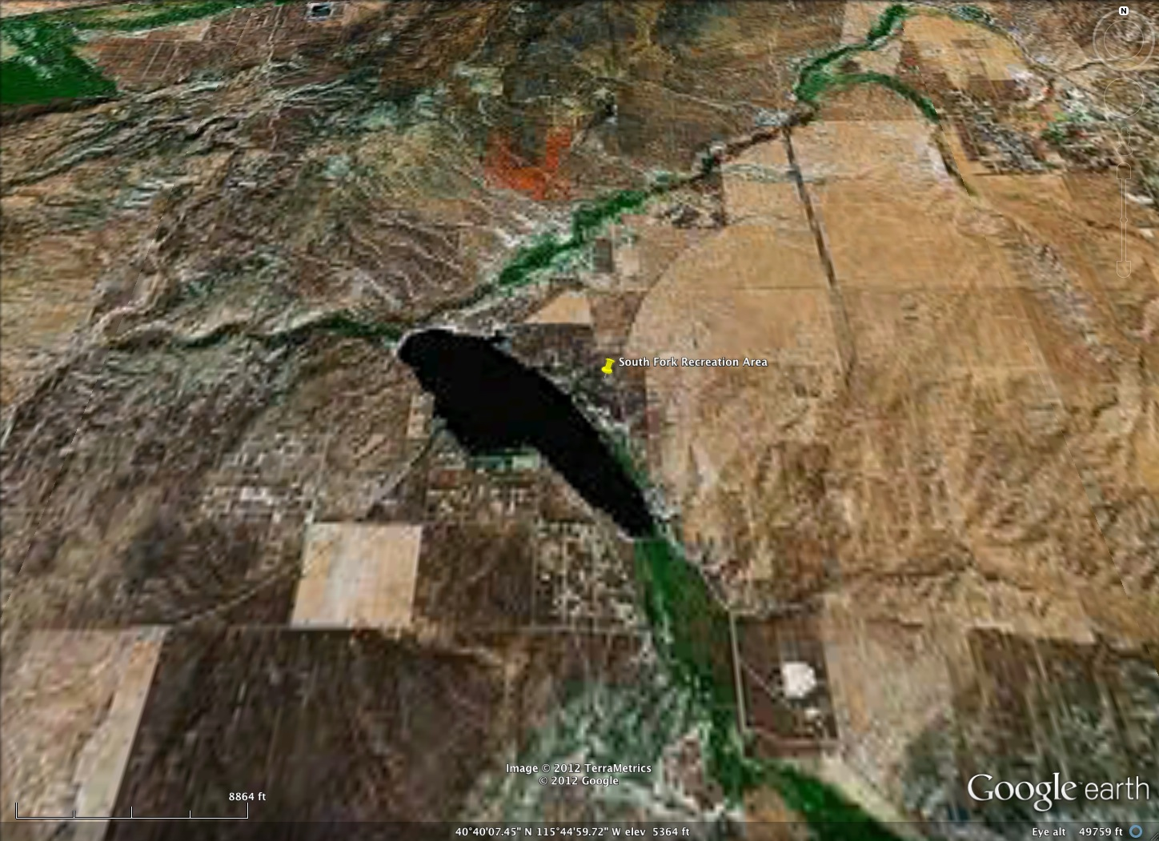
South Fork Recreation Site Near Elko
Notes:
South Fork recreation area is located in a relatively flat region southwest of Elko Nevada.

Slide 5
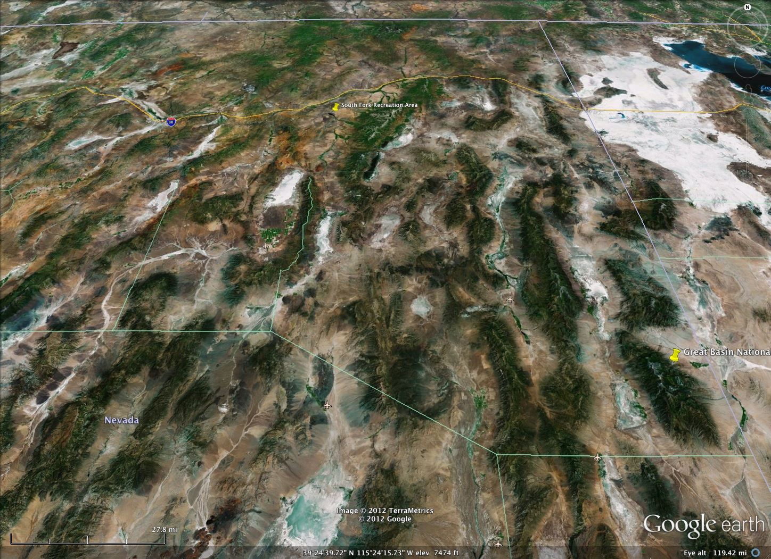
Medium View of the Two Sites

Slide 6
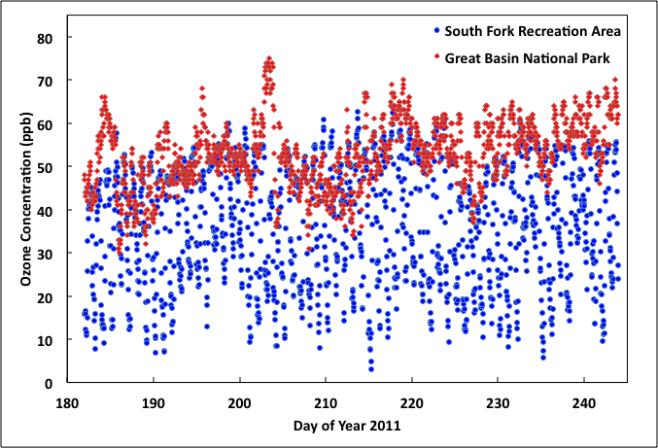
Ozone Time Series July – August 2011
July 22, 10 a.m.
July 1
Aug 31
Notes:
Peak values of ozone at the Great Basin National Park are probably due to transport of ozone from Las Vegas and Los Angeles. The South Fork Recreation Area has much more diurnal variation.

Slide 7
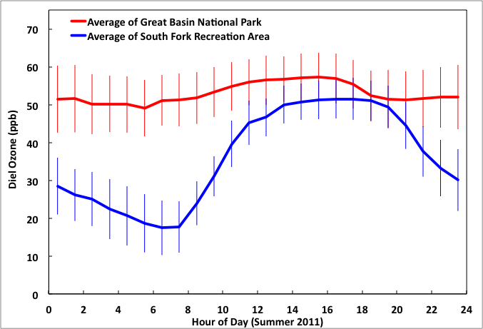
Diel Ozone Concentration: July through August 2011
Notes:
Great Basin ozone seems to be transported in. South Fork Recreation Area ozone seems to have a much stronger diurnal cycle, suggesting that the ozone is like locally produced, maybe from the Nox emissions from the Valmy power plant (see later).

Slide 8
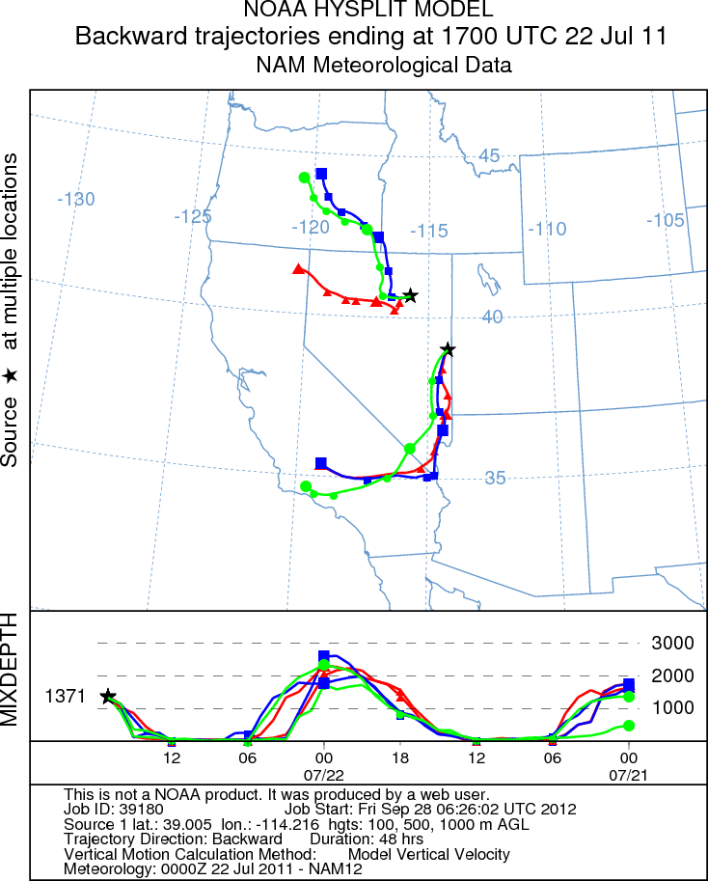
Back Trajectory Analysis for 22 July 2011
The ozone peak on this day at the Great Basin National Park is likely due to the air earlier passing over Las Vegas Nevada. It is likely that the green trajectory extends to Los Angeles as well.
The air at the South Fork Recreation Area arrives from the north and west, and travels for awhile near the I80 corridor.
Notes:
Back trajectory analysis shows the Great Basin National Park site impacted by air that had traveled through both Los Angeles and Las Vegas Nevada, giving rise to high ozone levels. The planetary boundary layer height (mixing depth) is given in the lower figure; it is lowest at night.

Slide 9
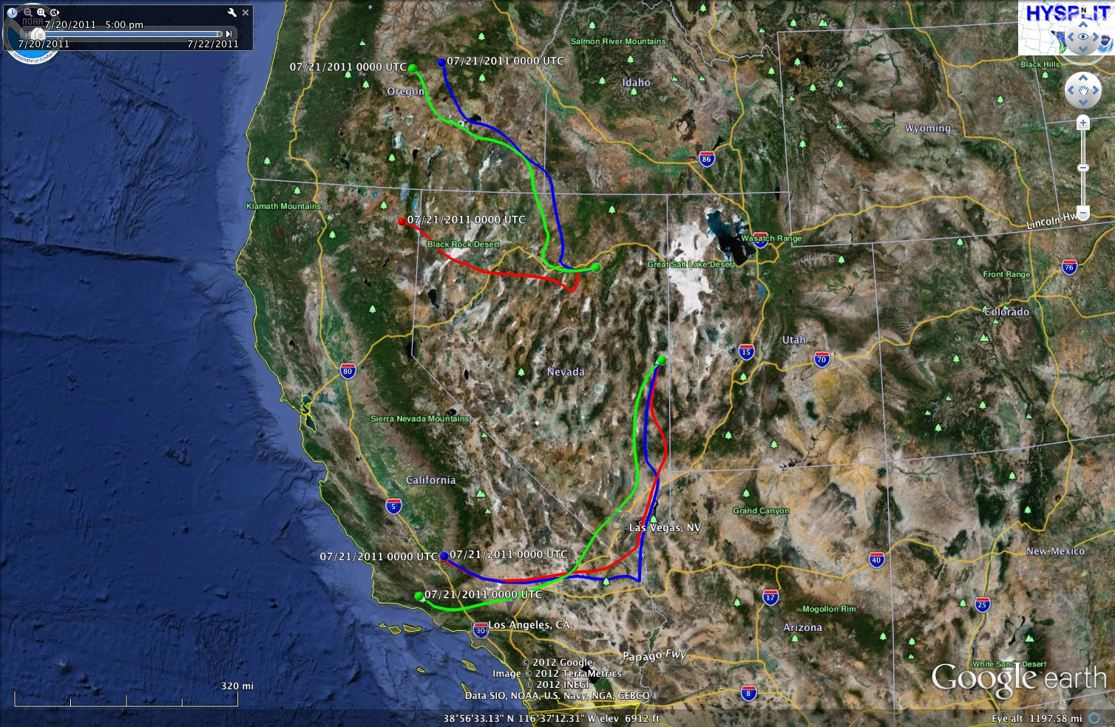
Back Trajectories Viewed with Google Earth
Notes:
Same backtrajectories from the last slide, now viewed through Google Earth.

Slide 10
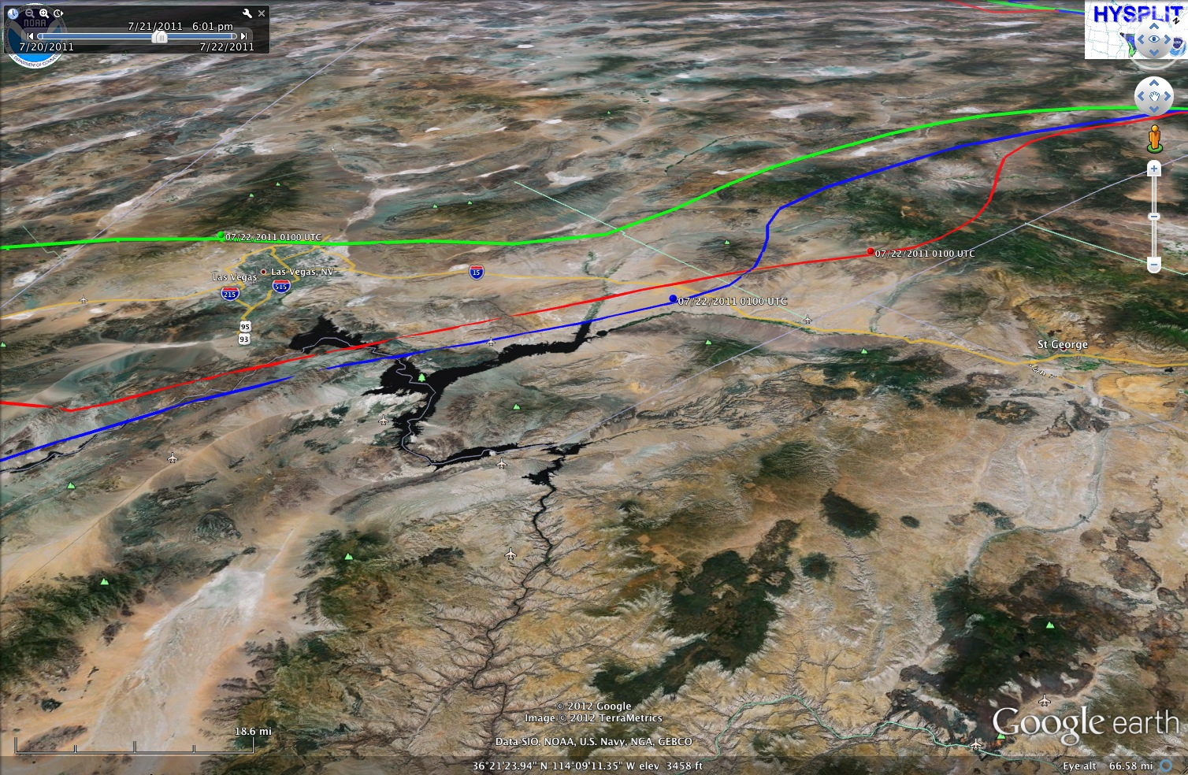
Detailed View of Trajectories Near Las Vegas
LAS VEGAS
Notes:
The green trajectory is the 1000 m trajectory at the Great Basin National Park. It passes right over Las Vegas Nevada at a time when the mixing height is greater than the trajectory height, facilitating injection of Vegas pollution into the air that eventually goes over the GBNP.

Slide 11
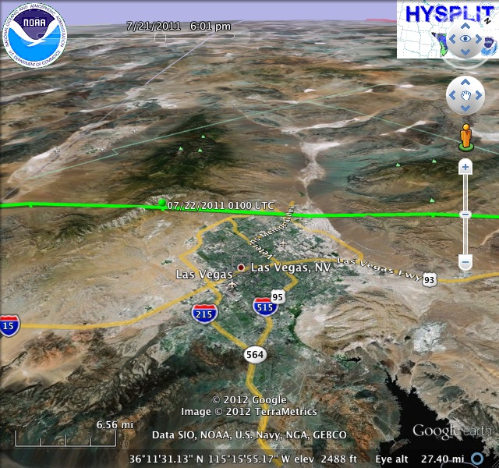
Detailed View of Trajectories Near Las Vegas
Notes:
Same as last slide, only showing more details of the trajectory over Las Vegas.

Slide 12
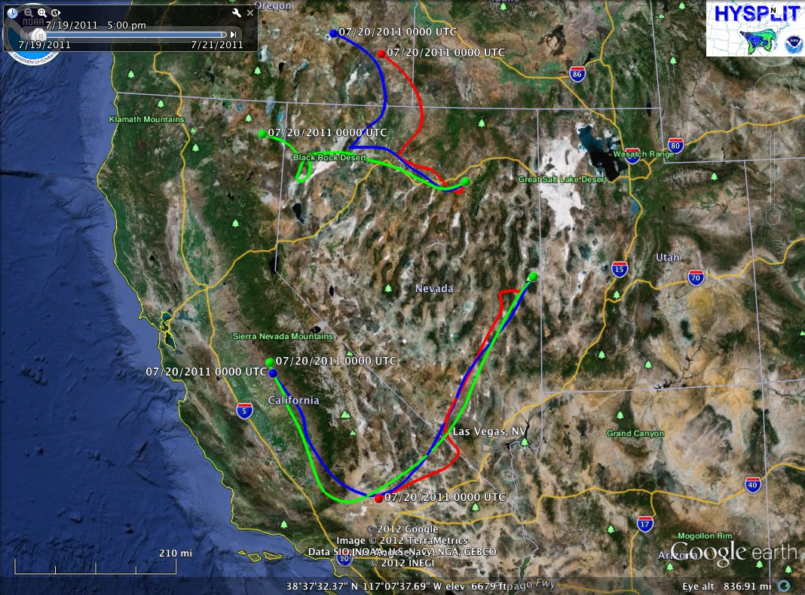
One Day Earlier: 21 July 2012 at 10:00 am local time
Notes:
The trajectories to the Great Basin National Park miss Las Vegas and Los Angeles for the 10:00 am local time arrival of the air on the 21st of July 2011.

Slide 13
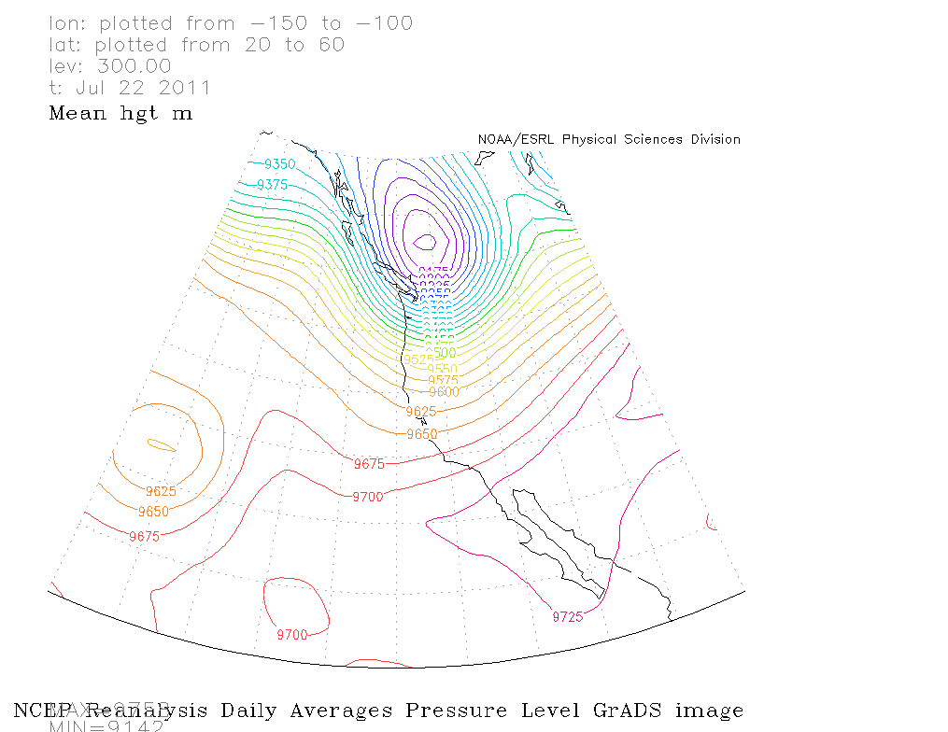
300mb Surface for 22 July 2011
Notes:
Low pressure in Canada and a trough with axis extending south of the low; Nearly zonal flow in northern NV and SW flow in southern CA and southern NV.

Slide 14
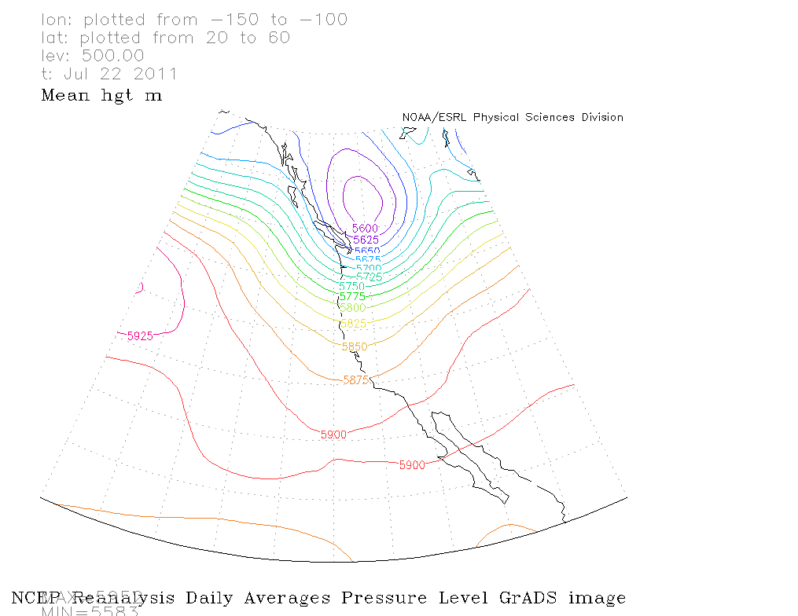
500 mb Surface for 22 July 2011
Notes:
Low pressure in Canada and a trough with axis extending south of the low; Nearly zonal flow in northern NV and SW flow in southern CA and southern NV.

Slide 15
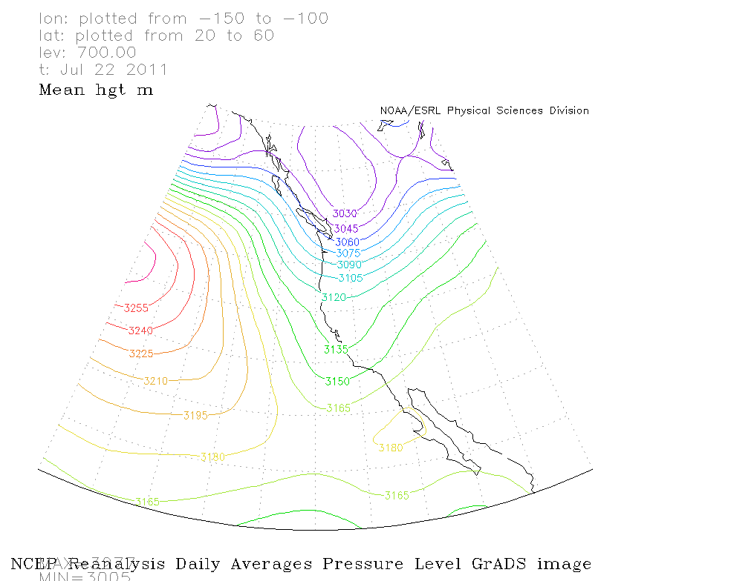
700mb Surface for 22 July 2011
Notes:
Low pressure in Canada and a trough with axis extending south of the low; Nearly zonal flow in northern NV and SW flow in southern CA and southern NV.

Slide 16
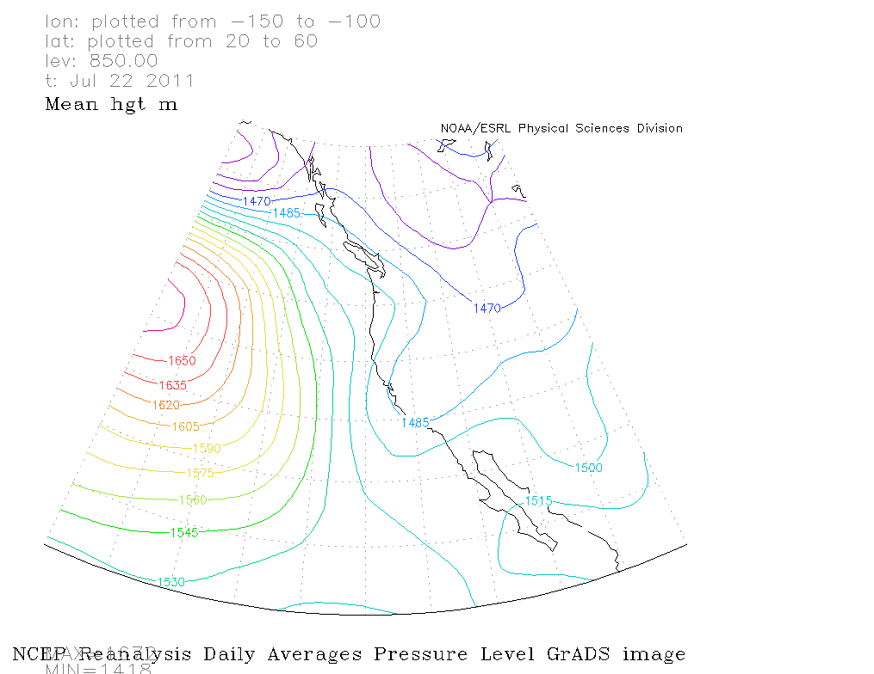
850mb Surface for 22 July 2011
Notes:
Low pressure in Canada and a trough with axis extending south of the low; Nearly zonal flow in northern NV and SW flow in southern CA and southern NV.

Slide 17
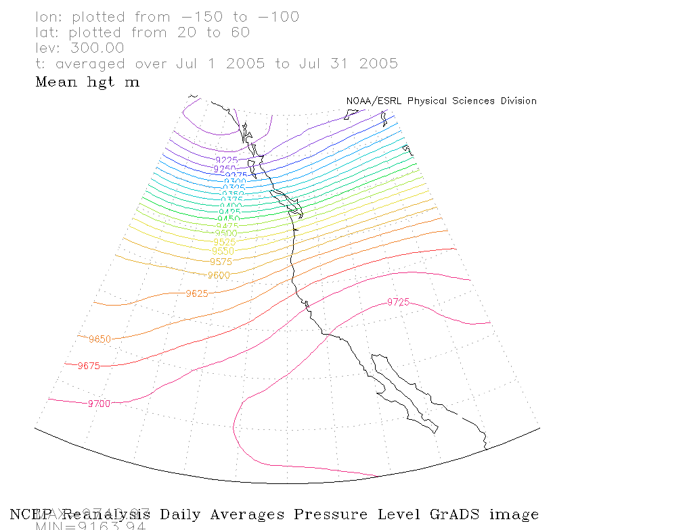
300 mb level averages by year

Slide 18
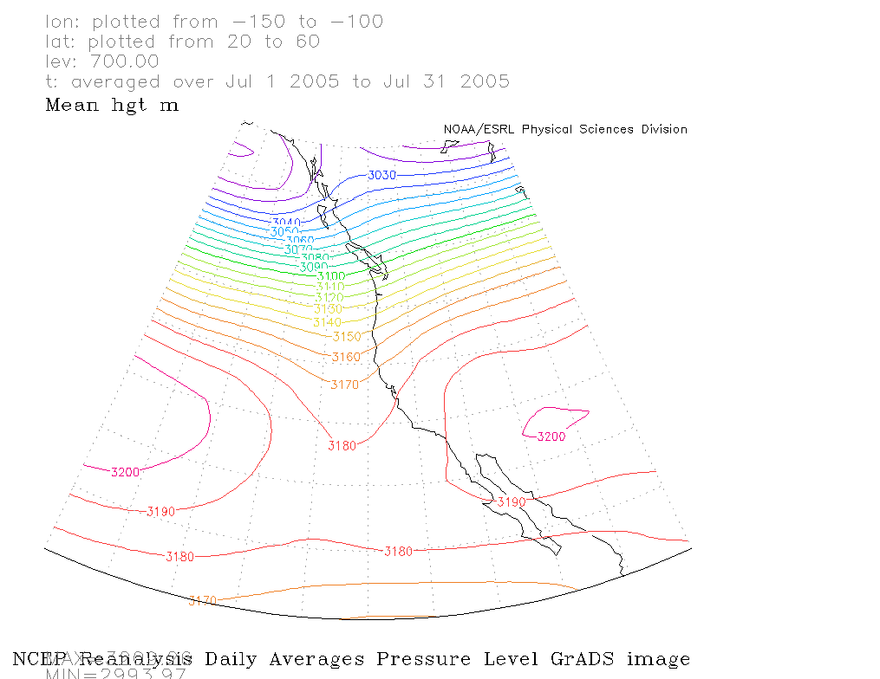
700 mb level averages by year

Slide 19
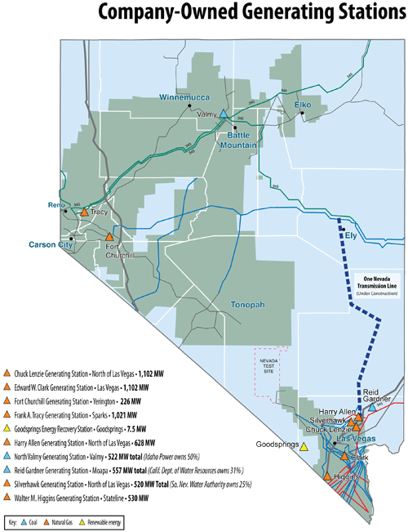
Valmy Power Plant may be the source of NOx for the South Fork Recreation Area ozone.
From www.nvenergy.com
Notes:
There are plenty of power plants that might provide NOX emissions for ozone formation in the Great Basin, both in the north (Valmy) and the south.

Slide 20
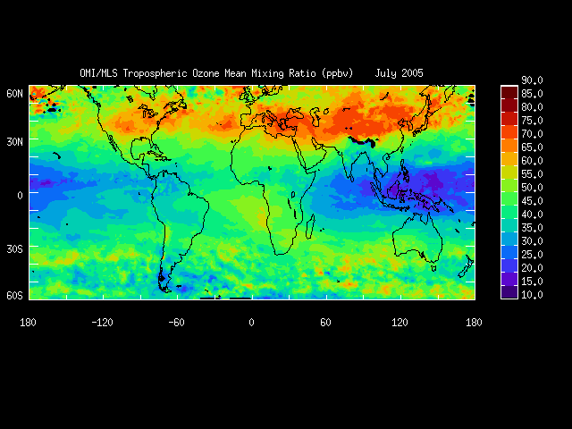
2005 Average July Tropospheric Ozone
From NASA: http://acd-ext.gsfc.nasa.gov/Data_services/cloud_slice/#nd

Slide 21
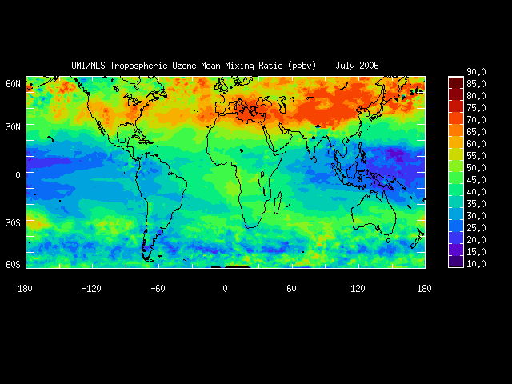
2006 Average July Tropospheric Ozone
From NASA: http://acd-ext.gsfc.nasa.gov/Data_services/cloud_slice/#nd

Slide 22
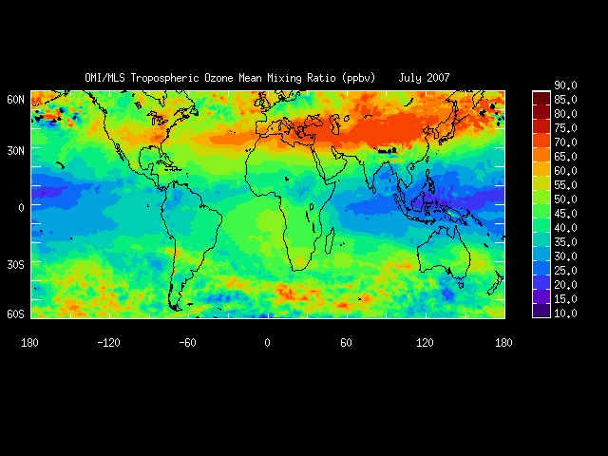
2007 Average July Tropospheric Ozone
From NASA: http://acd-ext.gsfc.nasa.gov/Data_services/cloud_slice/#nd

Slide 23
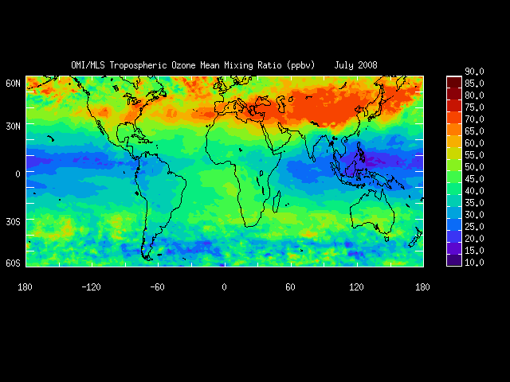
2008 Average July Tropospheric Ozone
From NASA: http://acd-ext.gsfc.nasa.gov/Data_services/cloud_slice/#nd

Slide 24
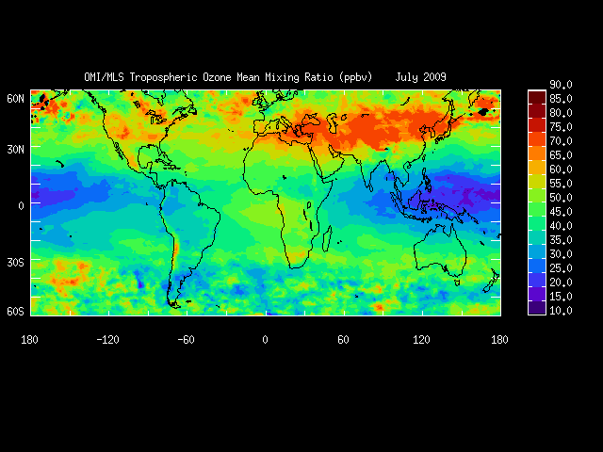
2009 Average July Tropospheric Ozone
From NASA: http://acd-ext.gsfc.nasa.gov/Data_services/cloud_slice/#nd

Slide 25
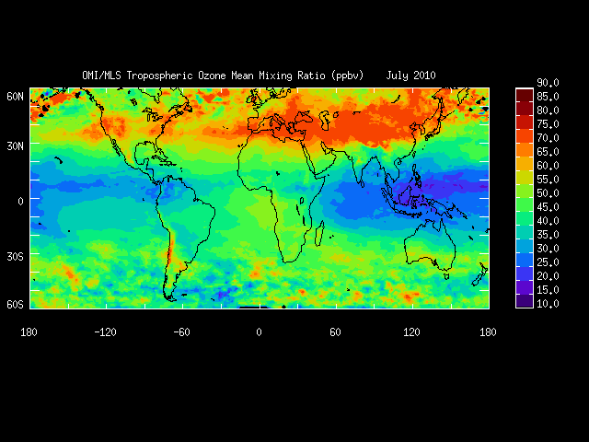
2010 Average July Tropospheric Ozone
From NASA: http://acd-ext.gsfc.nasa.gov/Data_services/cloud_slice/#nd

Slide 26
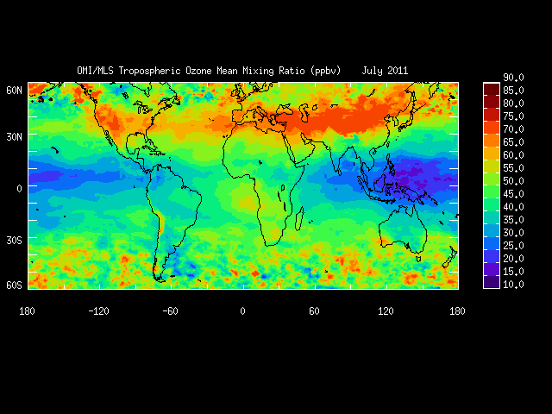
2011 Average July Tropospheric Ozone
From NASA: http://acd-ext.gsfc.nasa.gov/Data_services/cloud_slice/#nd
Notes:
Compared with other years, 2011 had considerably more tropospheric ozone in the Great Basin, likely due to meteorological conditions and transport.

Slide 27
Are we seeing a trend to higher global concentrations of ozone?
Ozone is a very reactive, short lived gas.
Ozone precursors include products of anthropogenic pollution and biomass
burning.

Slide 28
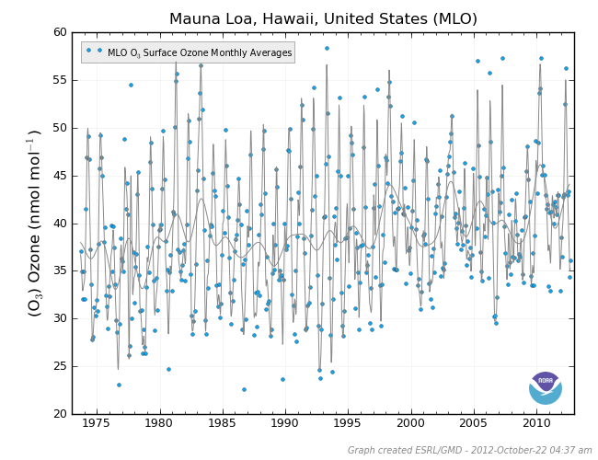
Long Term Trend of Ozone At Mauna Loa Observatory High in the Hawaiian Islands.
http://www.esrl.noaa.gov/gmd/dv/iadv/index.php?code=mlo

Slide 29
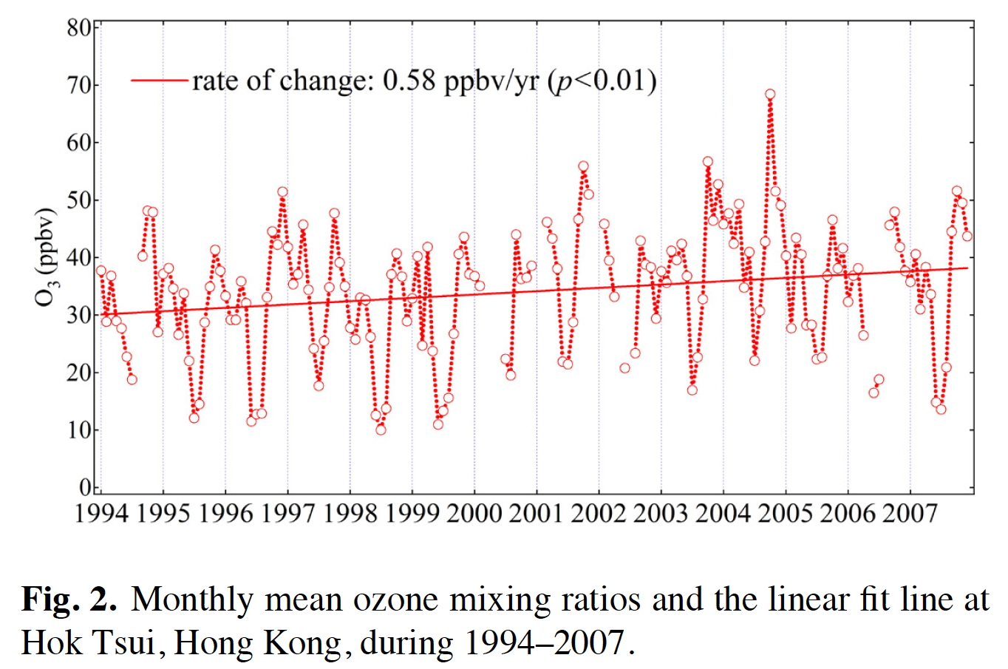
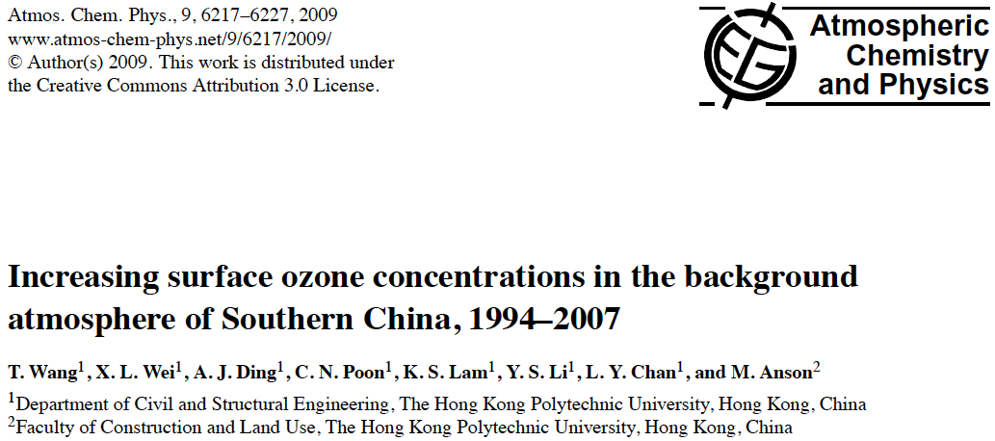
Ozone: Remote Site in Southern China

Slide 30
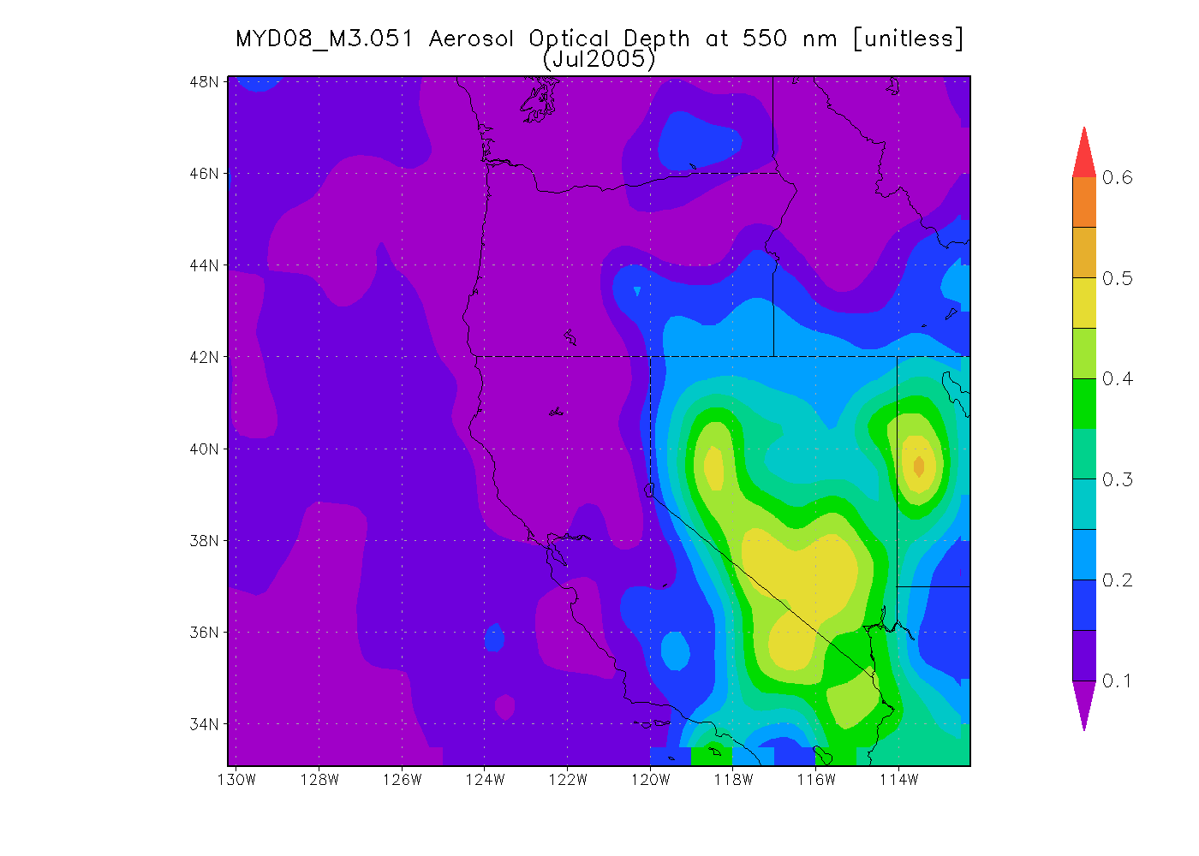
MODIS Aerosol Optical Depth Averaged For July 2005 - 2011
Diagnosis 2008 as a ‘fire year’ in Northern CA and NV. Great Basin values are likely biased
high due to surface brightness and algorithm assumptions (dark target retrieval).
Notes:
This is a gif animation, so it’s best to look at the presentation rather than just the slides. It should animate as a slide show. Modis AOD seems to be able to diagnose the fire year, 2008, for Northern NV and CA. However, the general result of the apparent large aerosol optical depth in the Great Basin is likely an artifact due to the surface brightness and the assumptions in the dark target model used to retrieve aerosol optical depth. The ‘dark target’ model was designed to work well on vegetated surfaces.

Slide 31
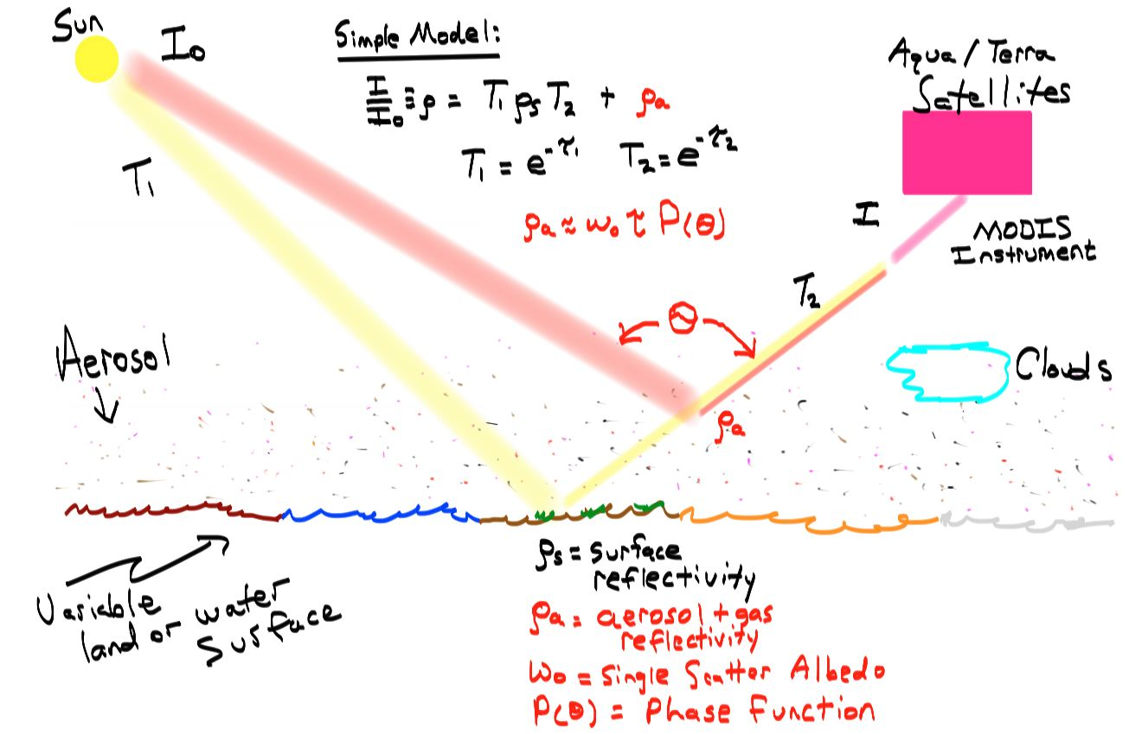
Review: Two pathways for light to MODIS

Slide 32
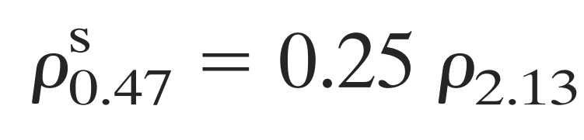
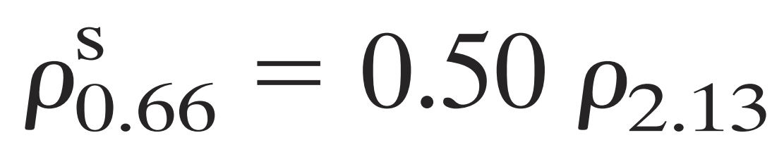
Recall the standard ‘Dark Target’ method for obtaining surface reflectivity and AOD.

Slide 33
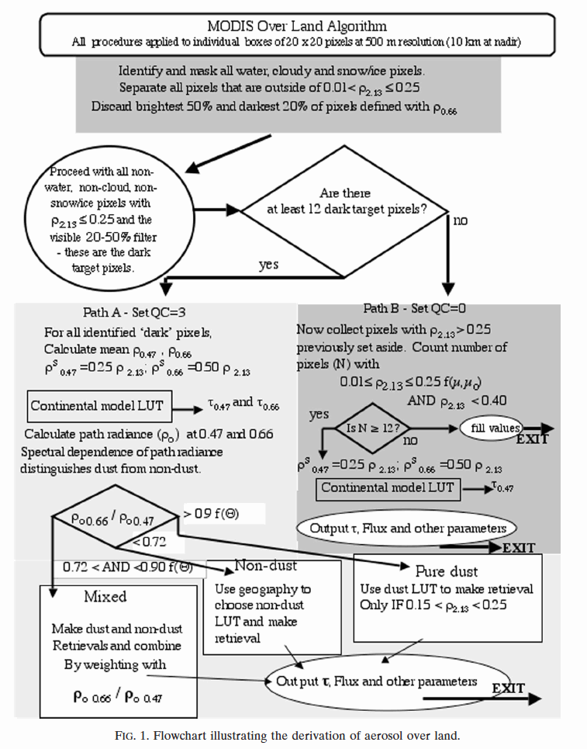
Review: MODIS ‘Dark Target’ Aerosol Retrievals Over Land Algorithm

Slide 34
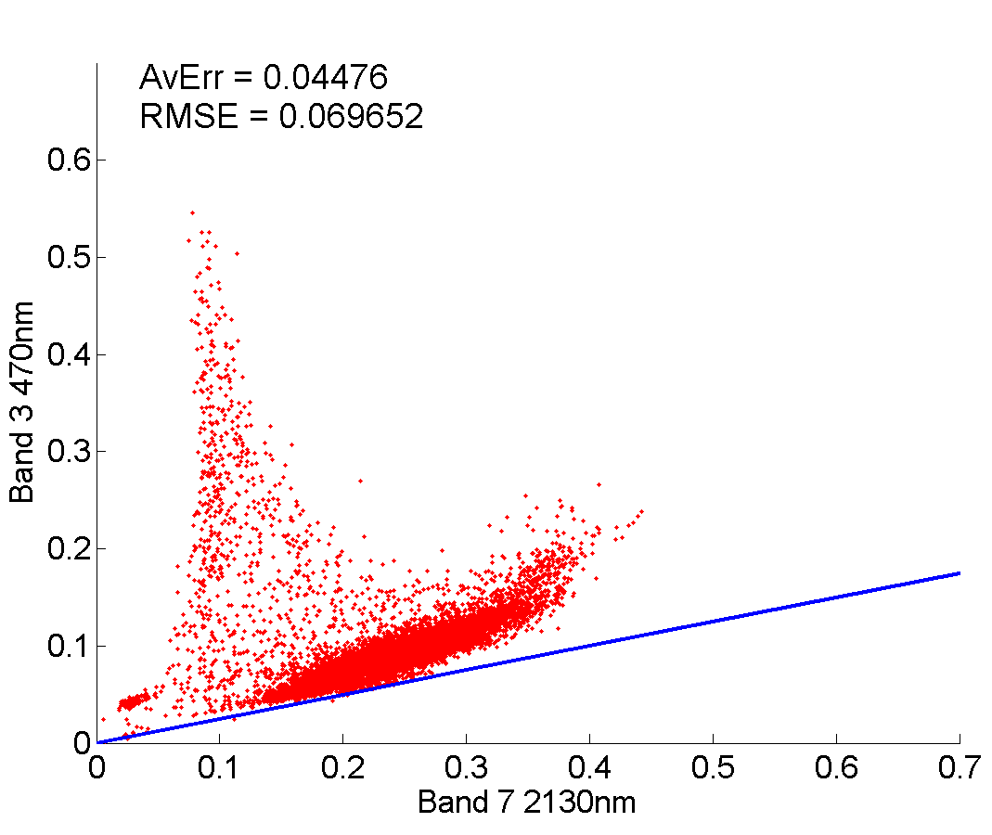
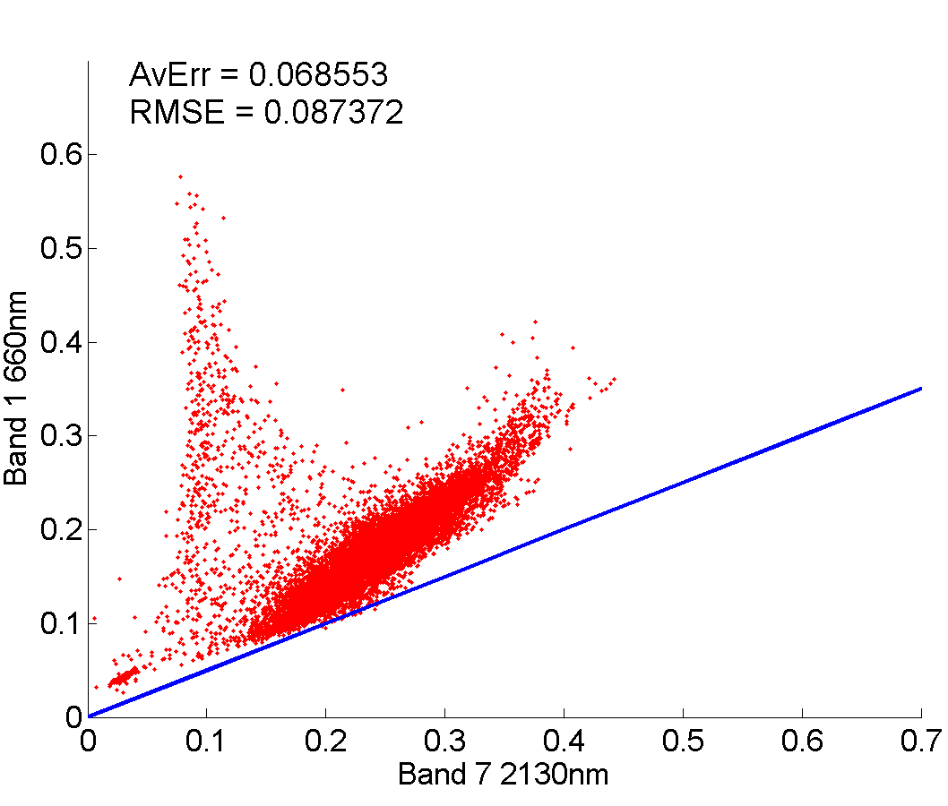
How does the surface reflectance model perform?
(Andrew Joros results for the Great Basin)
8 July 2011 – Dry Regime
470nm Scatterplot
660nm Scatterplot
Y=.25x
Y=. 5x
470 nm has lower reflectivity than 660 nm. Model and measurements match at only a few points. Green shaded region used in the ‘safe’ part of the ‘Dark Target’ algorithm. Red shaded region used for the alternate ‘Dark Target’ algorithm (note model disagreement).
Notes:
This is the surface reflectance for points near and in the Great Basin. The blue curve represents the model that is used to convert 2130 nm surface reflectance to 412 nm and 660 nm reflectance. Some points (maybe ultra clear sky) follow the model; especially when the 2130 nm reflectance is below 0.25. However, it looks like it would be better to use a different parameterization for surface reflectance for larger values.

Slide 35
How does the surface reflectance model perform?
(Andrew Joros results for the Great Basin)
8 July 2011 – Dry Regime
470nm Scatterplot
660nm Scatterplot
PROPOSE Y=x -1/8
when x > 0.25
PROPOSE Y=x/2 – 1/16
when x > 0.25
Y=x/2
Y=x/4
The black curve fits the lowest surface reflectance values much better for 2130 nm reflectance
larger than 0.25, likely representing desert surfaces rather than vegetated surfaces.
Notes:
This is the surface reflectance for points near and in the Great Basin. The blue curve represents the model that is used to convert 2130 nm surface reflectance to 412 nm and 660 nm reflectance. Some points (maybe ultra clear sky) follow the model; especially when the 2130 nm reflectance is below 0.25. However, it looks like it would be better to use a different parameterization for surface reflectance for larger values. T

Slide 36
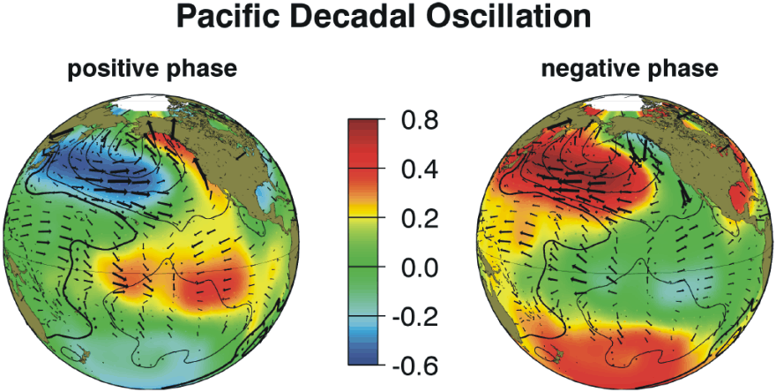
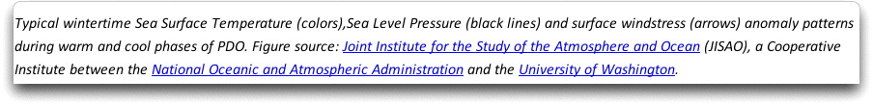
Pacific Decadal Oscillation: Link with Western US Meteorology and Pollution Transport?
http://www.climate4you.com/SeaTemperatures.htm

Slide 37
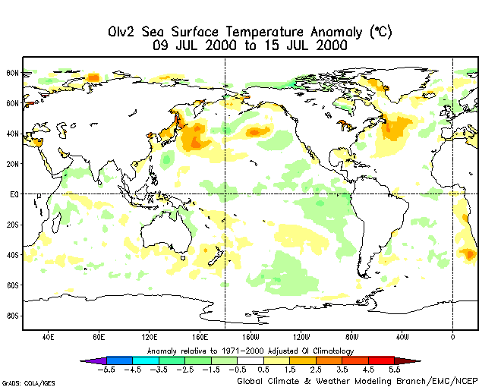
July Sea Surface Temperature Anomalies

Slide 38
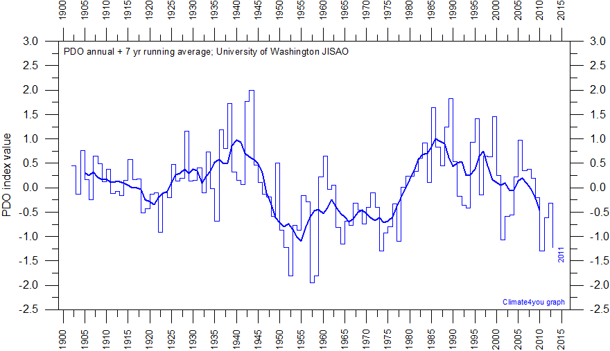
PDO Index Time Series
From http://www.climate4you.com/SeaTemperatures.htm

