Slide 1
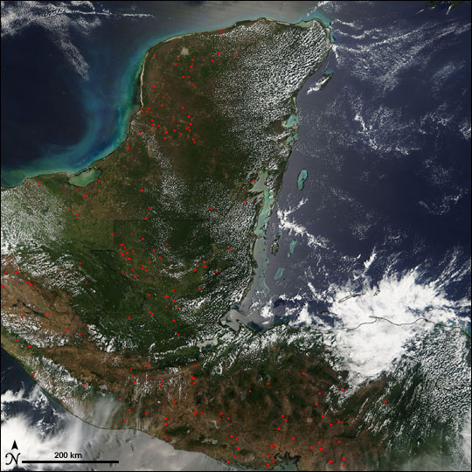
A Brief Survey of Fires in Central South America
By Remote Sensing
David Karr Satellite Remote Sensing, UNR, Fall 2012

Slide 2
Purpose
Get acquainted with satellite products.
Compare satellite products to AEROnet data in the same area.
Compare meteorological products and try to make connections with other products.
Cloud and Aerosol interactions?

Slide 3
Tools
Imagery
- MODIS subsets
- NASA Earth Observatory
Aerosol Data
- AEROnet CIMEL AOD
- Giovanni MODIS AOD
- CALIPSO aerosol verification and height
Meteorological Data
- NCEP/NCAR Reanalysis vector winds
- AEROnet Back trajectories
- HYSPLIT modeling
- Giovanni MERRA Cloud products
Websites in occurring order:
http://lance-modis.eosdis.nasa.gov/imagery/subsets/?project=fas
http://earthobservatory.nasa.gov/GlobalMaps/
http://www.esrl.noaa.gov/psd/data/composites/day/
http://aeronet.gsfc.nasa.gov/cgi-bin/bamgomas_interactive
http://ready.arl.noaa.gov/HYSPLIT.php
http://disc.sci.gsfc.nasa.gov/giovanni/overview/index.html#maincontent
http://www-calipso.larc.nasa.gov/products/lidar/browse_images/production/

Slide 4
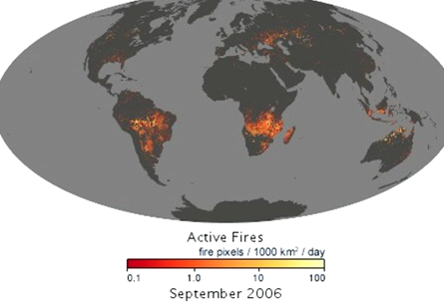
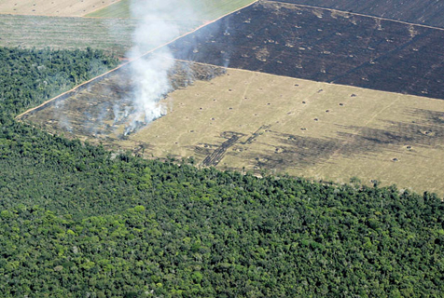
Fires in South America
Wildfires
  Southerly in woodland areas
Slash and Burn Agriculture
  Farmlands stemming into Amazon Rainforest
Dry Season: August – October is fire season for Central South America!

Slide 5
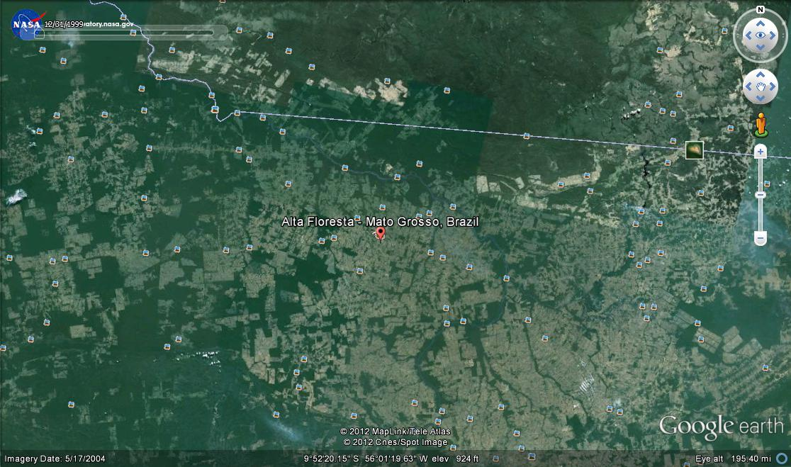

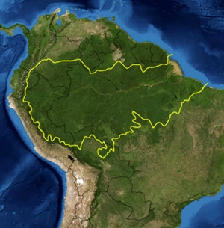
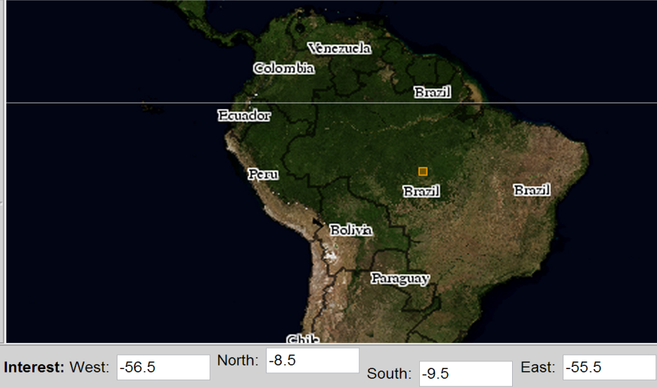
Alta Floresta, Brazil (9 S, 56 W)
Altitude: 283 m
Population: 49,233
Economy: agriculture and livestock
Brazil summer/winter: UTC -2/-3

Slide 6
Overview
Look at data from 2006 with emphasis on the dry season and September
  Verify wind patterns are characteristic of the area
  Compare ground and satellite AOD
  Analyze Sept. 1st and Sept. 17th in depth
  Imagery
  LIDAR
  Cloud and aerosol relations

Slide 7
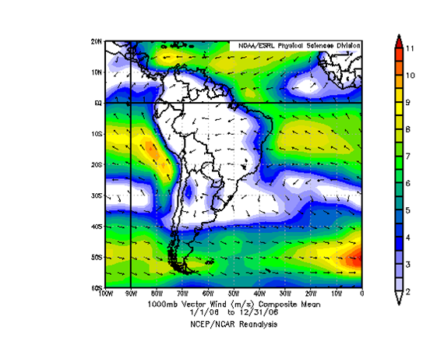
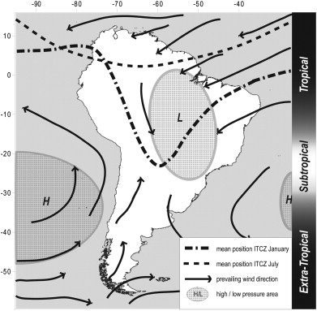
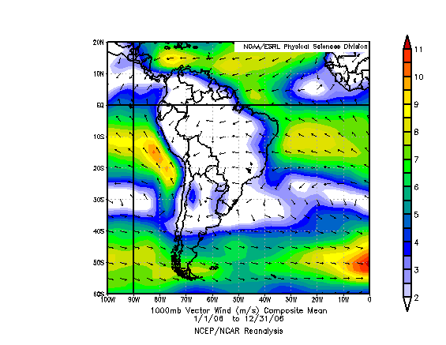
Wind Patterns Long Term vs. 2006
Climatic domains and major wind tendencies in South America (Maslin, Burns, 2000)
(top)NOAA Wind vectors and speed for 2006. (bottom) Anomalies for 1000 mb
Notes:
Seem fairly noraml

Slide 8
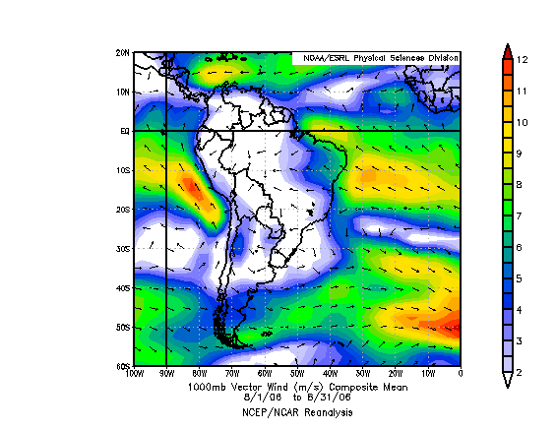
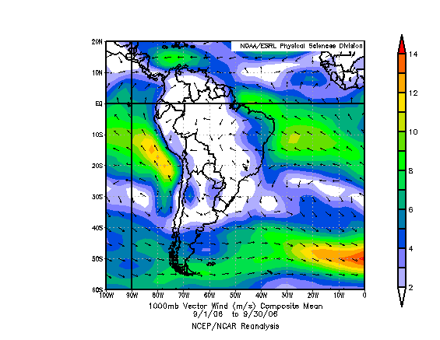
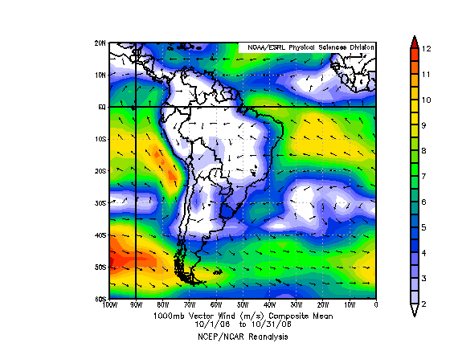
Surface Wind Patterns for Dry Season 2006
August
September
October

Slide 9
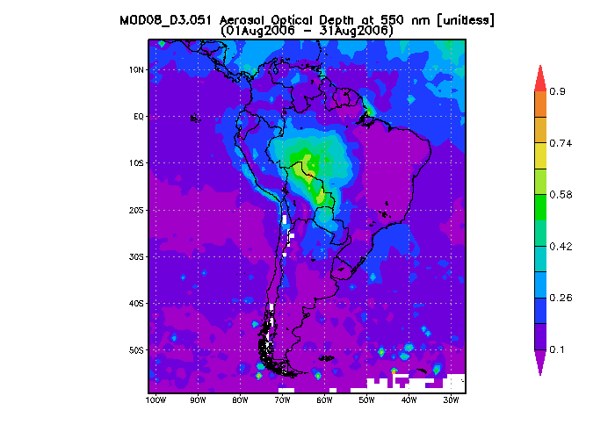
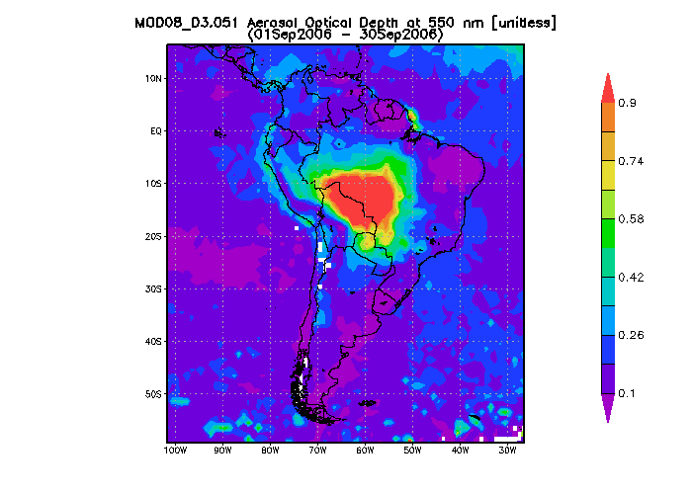

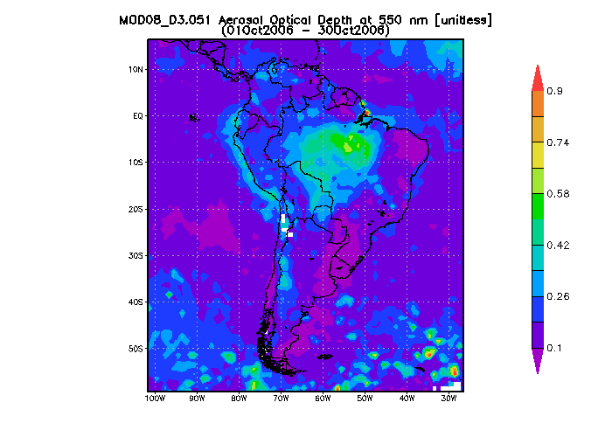
Similarity Btw Low Pressure System and AOD in C. S. America Dry Season 2006
August
September
October

Slide 10
Wind Pattern Analysis
2006 year and dry season wind patterns agree with characteristic wind patterns.
Low wind speeds and the low pressure system in C. South America suggests that the smoke is confined to the center of the continent, which is in agreement with AOD patterns.

Slide 11
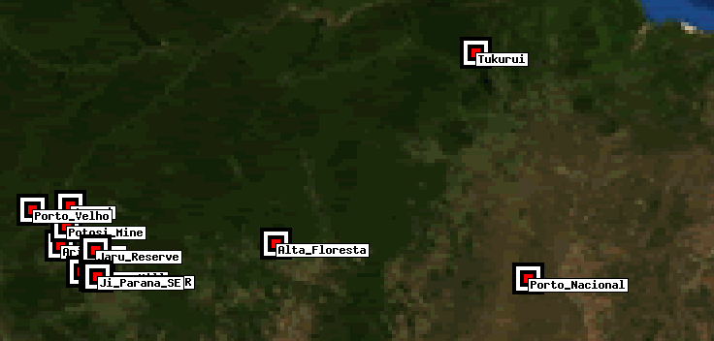
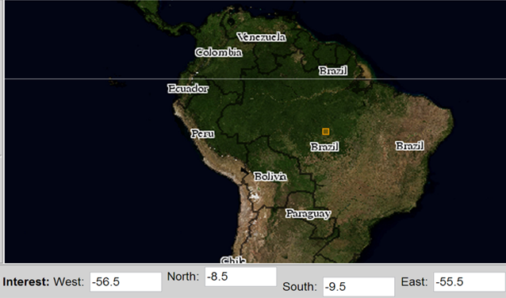
AOD Comparison
Alta_Floresta AEROnet site ‘a point’
Notes:
We will compare the AOD values for 2006 for ground and satellite remote sensing. 1 deg. long. = ? Mi. 1 deg. Lat. = ? Mi.

Slide 12
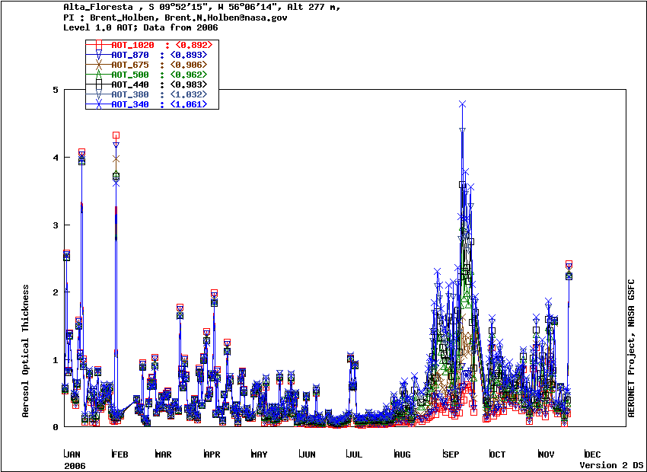
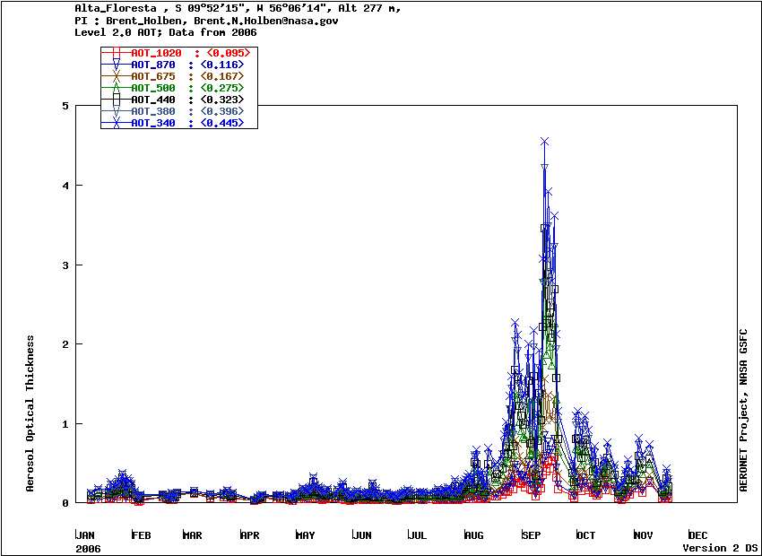
Alta_Floresta AEROnet: 2006
Notes:
High levels!!!!!! Could it just be because it is level 1 data? Apparently not, but the level 2 data is much cleaner.

Slide 13
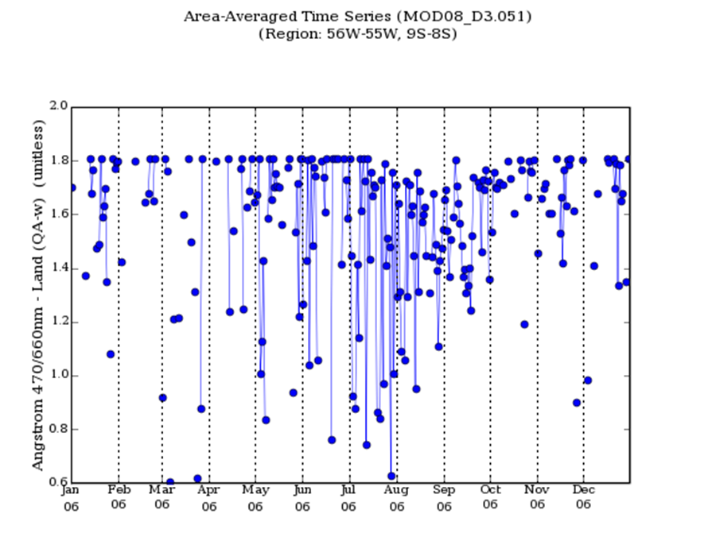
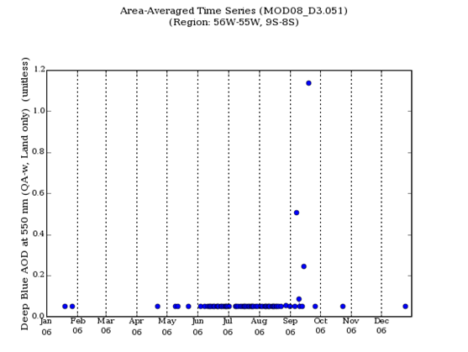
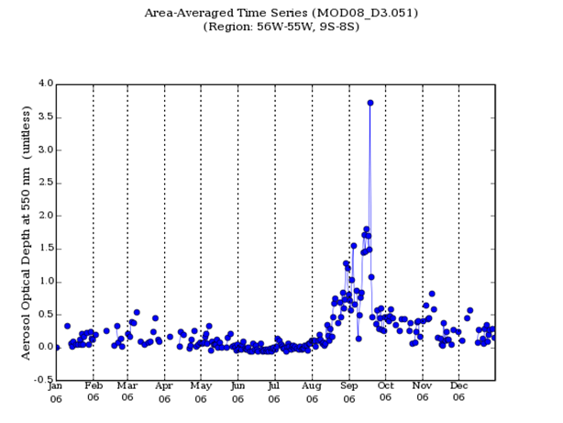
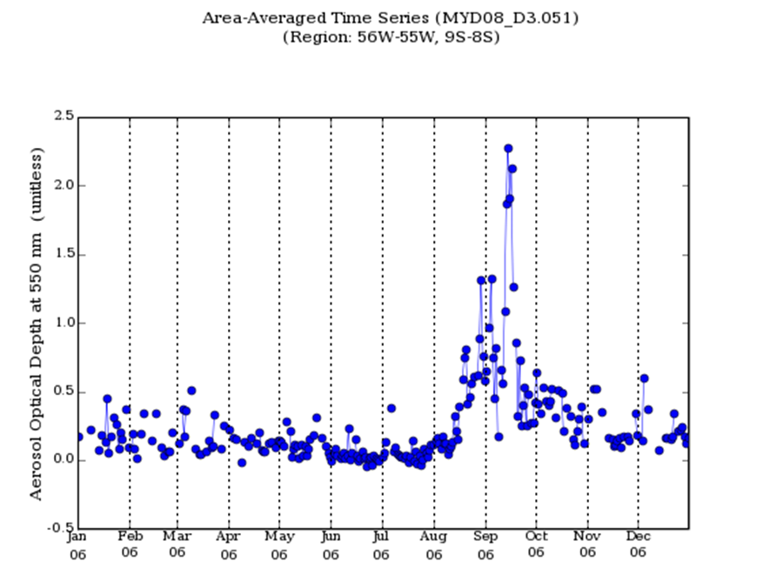
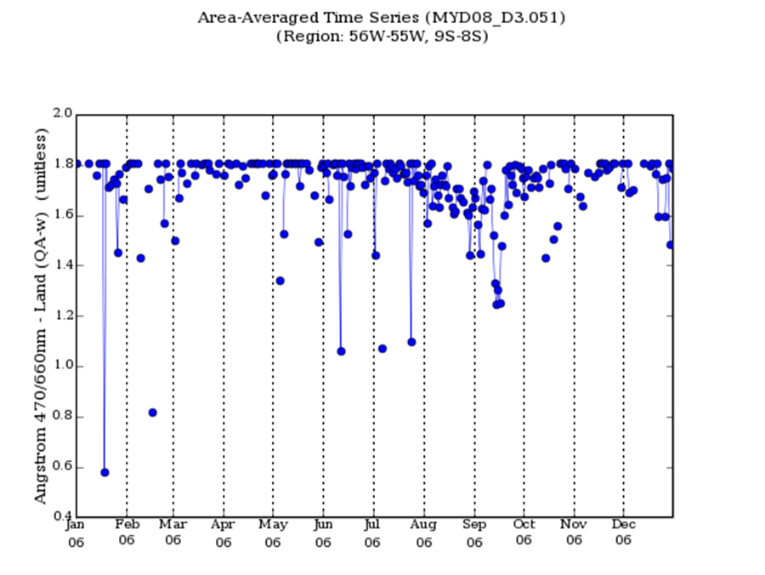
MODIS 550nm AOD: 2006
Notes:
Deep blue no good. The fires in the dry season are very pronounced. Also, there are slightly larger particles during the dry season.

Slide 14

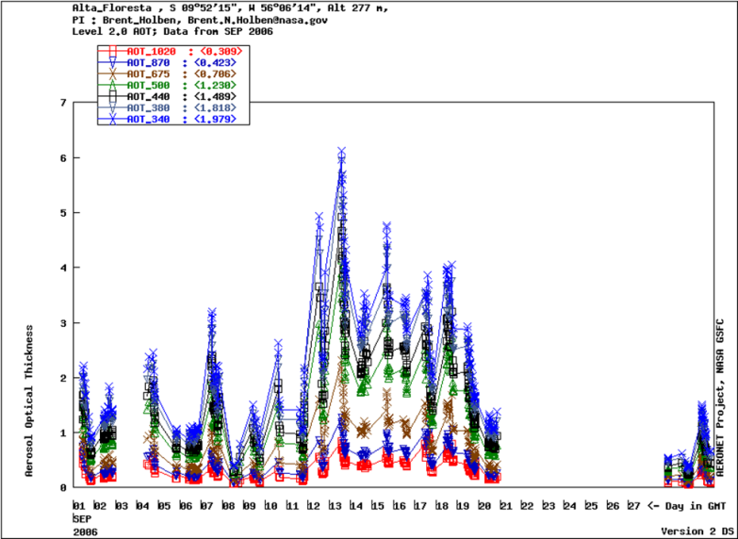

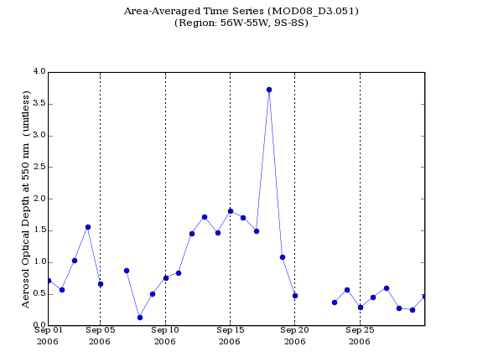
Side by Side
Ground and Satellite Remote Sensing
2006
September 2006
Notes:
Shape is the same. CIMEL AOD is ~ 1 unit higher. The monthly product doesn’t seem to agree on the maximum AOD value. This could be because AERONET is continually taking measurements while Terra receives only one data point per day.

Slide 15
AOD Product Analysis
High levels of AOD in the dry/burn season!
Ground and Satellite products show similar trends! Good verification of satellite data.
Ground AOD ~ 1 unit higher and probably more reliable as it is taking consistent measurements.
Angstrom Exponent slightly lower in dry season => larger particles.
MODIS Deep Blue Retrieval no good.

Slide 16
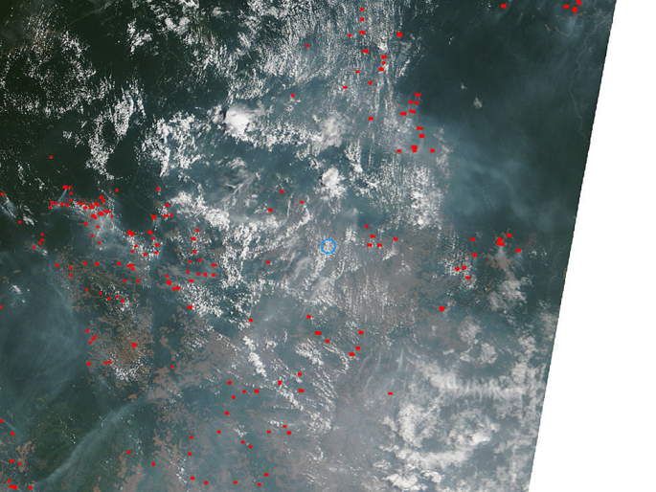
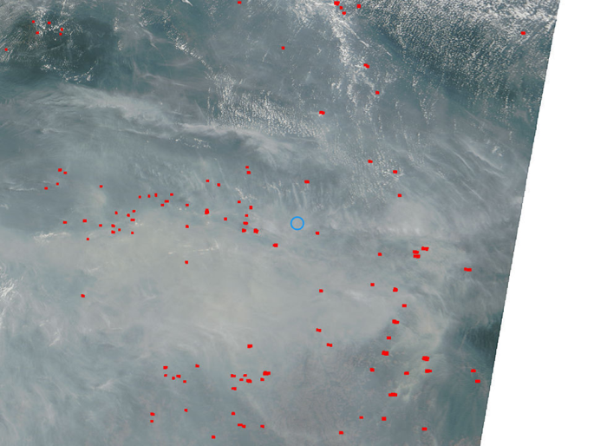
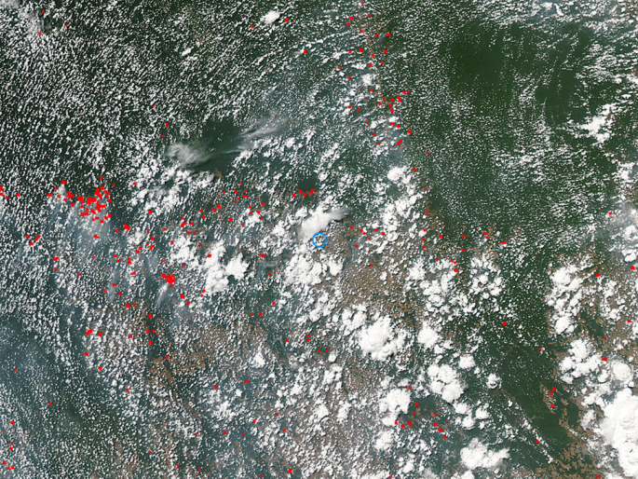
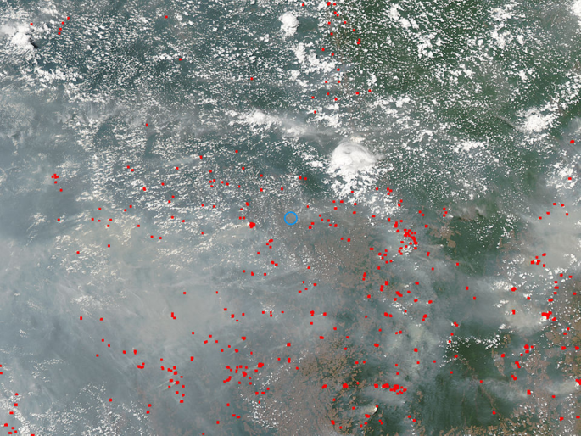
A Closer look at two days: September 1st and 17th , 2006
September 1st
September 17st
Terra
Aqua
Notes:
September 1st being a data while the AOD was still relatively low and Sept. 17th being around the peak AOD. These dates were selected also because lidar data ran closest to Alta Floresta ( 9 S, 56 W), lidar being very intriguing for cloud/aerosol analysis. Smoke seems to be travelling north easterly!

Slide 17
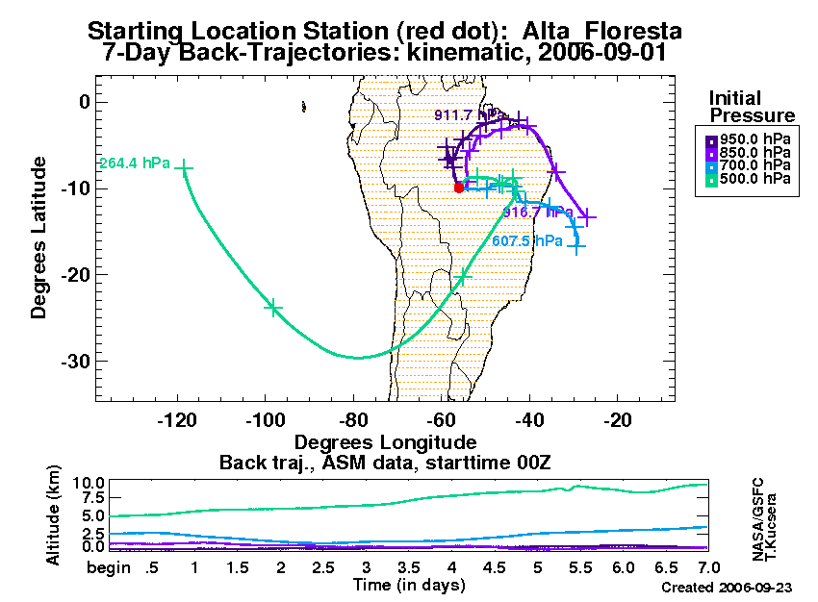
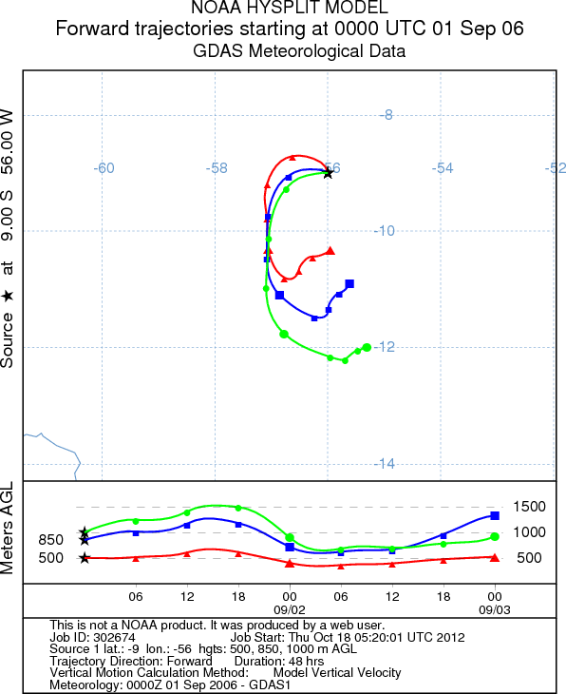
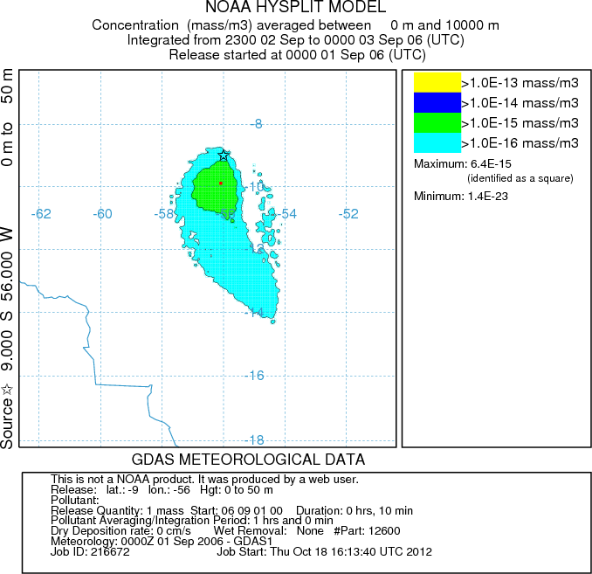
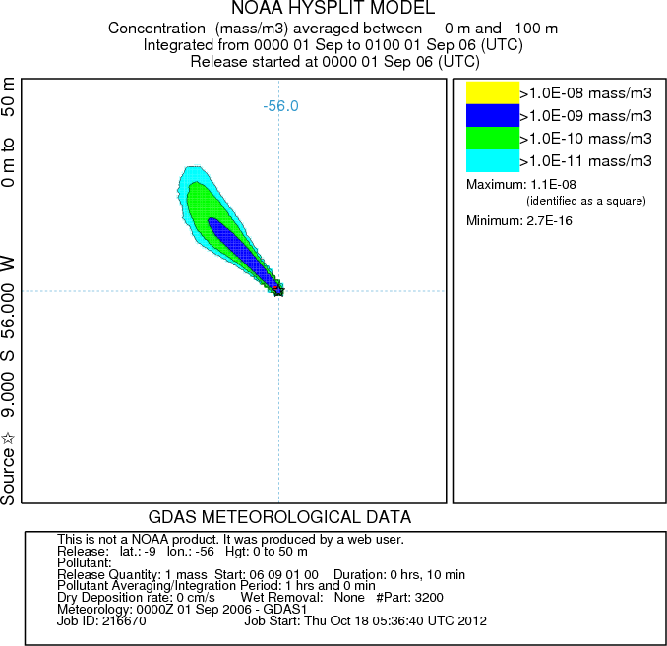
Trajectory Models Sept. 1st
Notes:
Trajectory models coincide with wind patterns! But dispersion model agrees with imagery

Slide 18
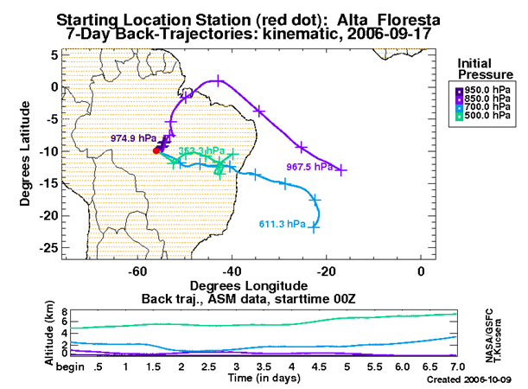
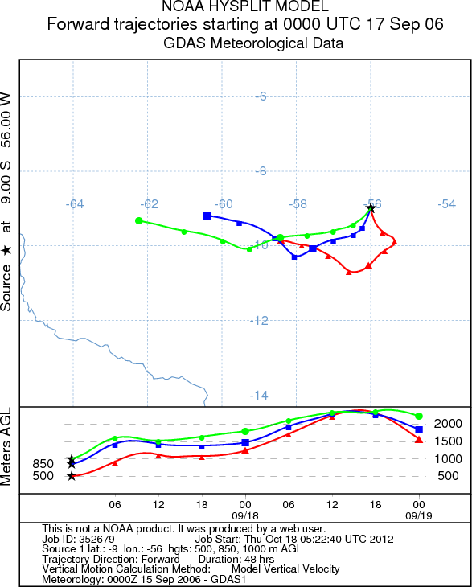
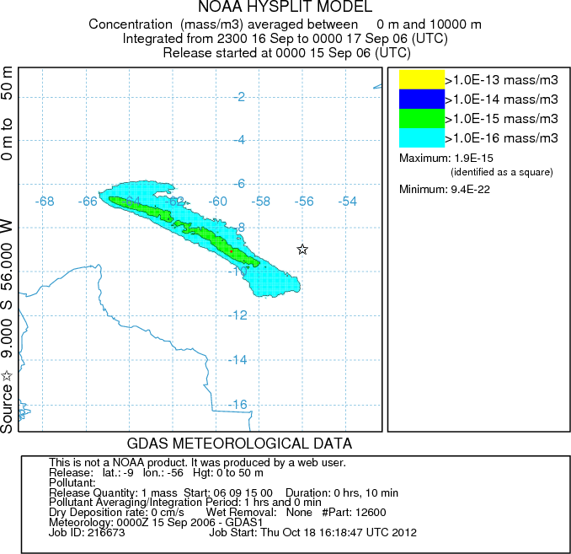
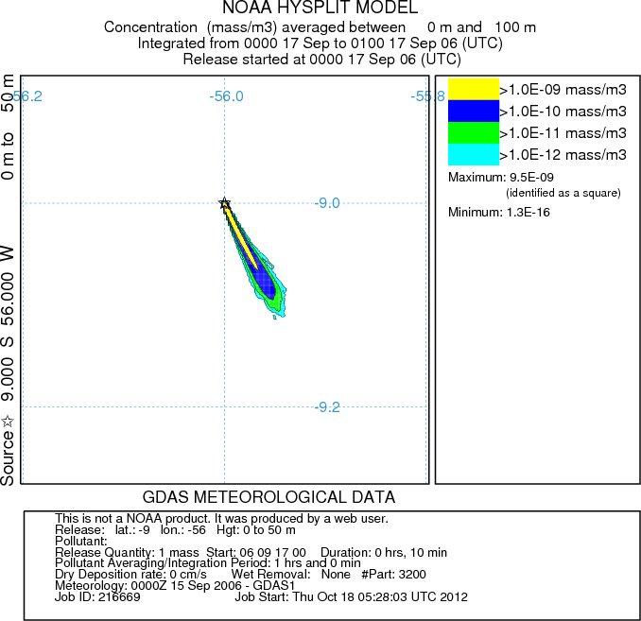
Trajectory Models Sept. 17th

Slide 19
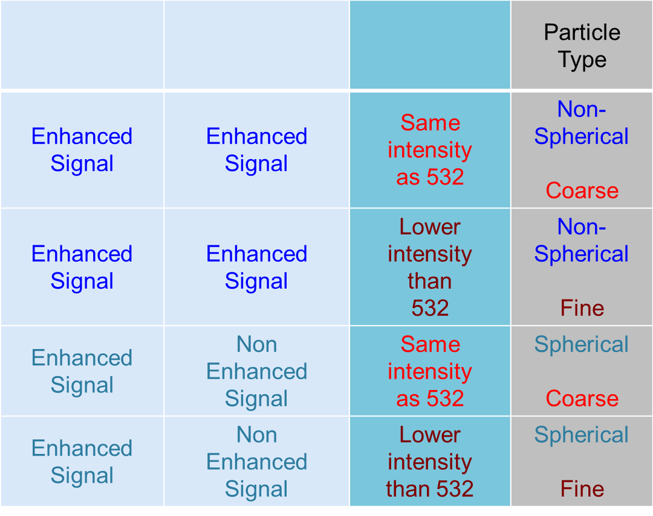



LIDAR RemindAR
Notes:
Courtesy of Dr. W. Arnott – patarnott.com Thank you!

Slide 20
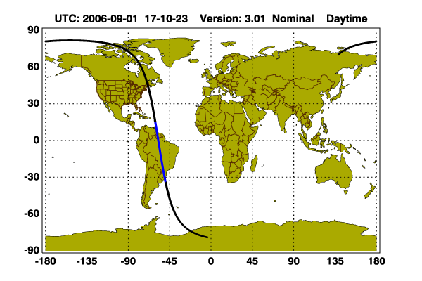
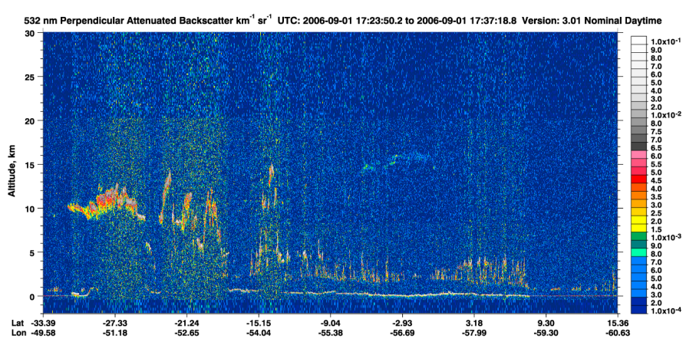
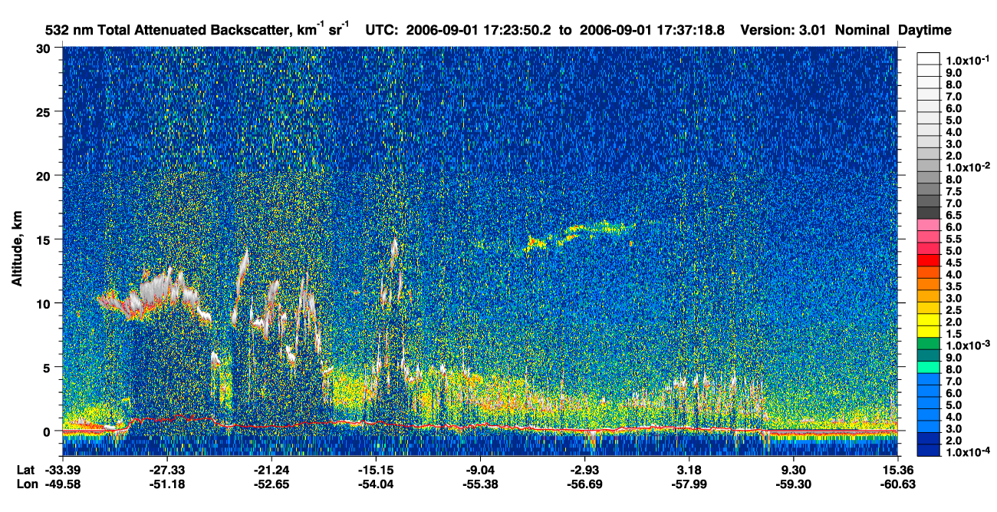
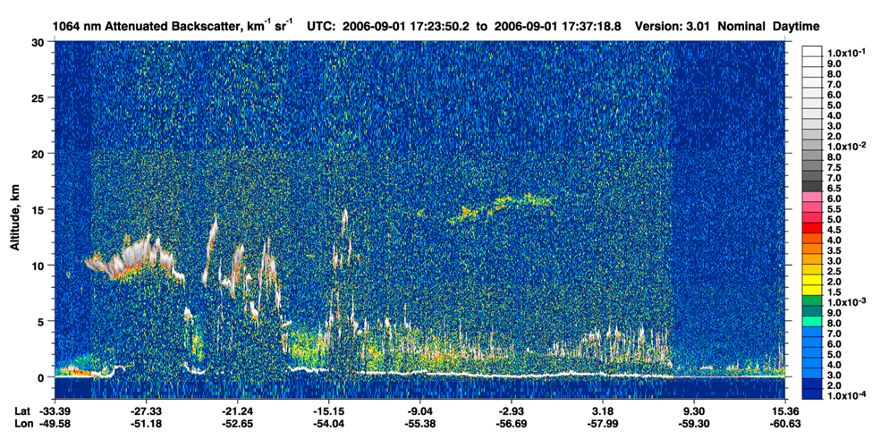
LIDAR Sept. 1st
β532 perp. non-enhanced
β532 Enhanced
β1062 < β532
Fine Sphere Particles!
Notes:
Observe the 0 – 5 km region. B532 enhanced -> B532 perp. non enhanced -> B1064 lower than B532 => fine spherical particles!!!!!!!!! Perhaps the aerosols are spherical when they are fresh

Slide 21
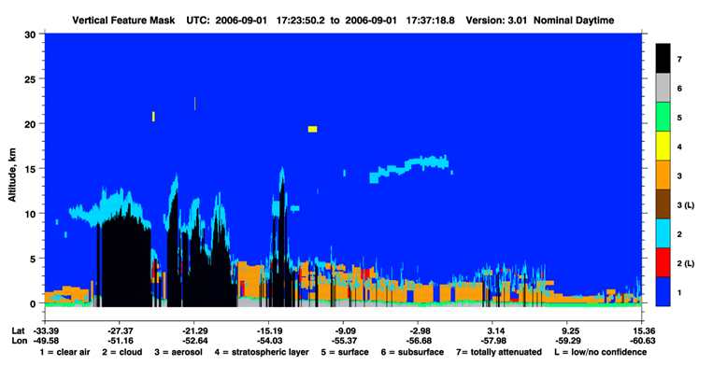
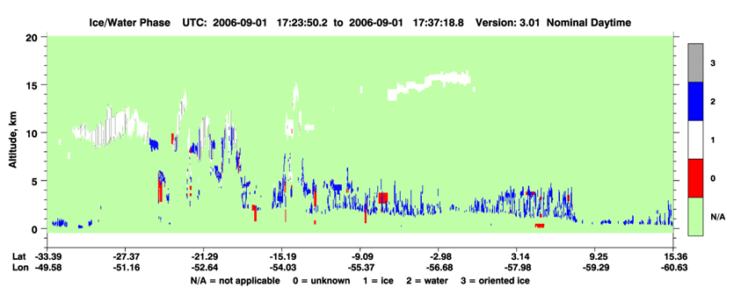
LIDAR Sept. 1st
Partial cloudy skies. Low level clouds (0-5km) interacting with smoke??
High clouds in ice phase.

Slide 22
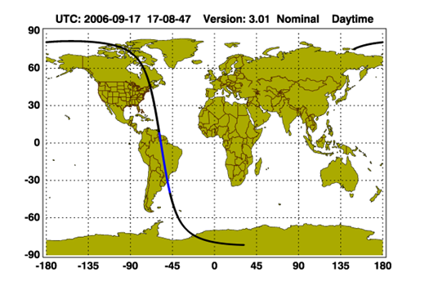
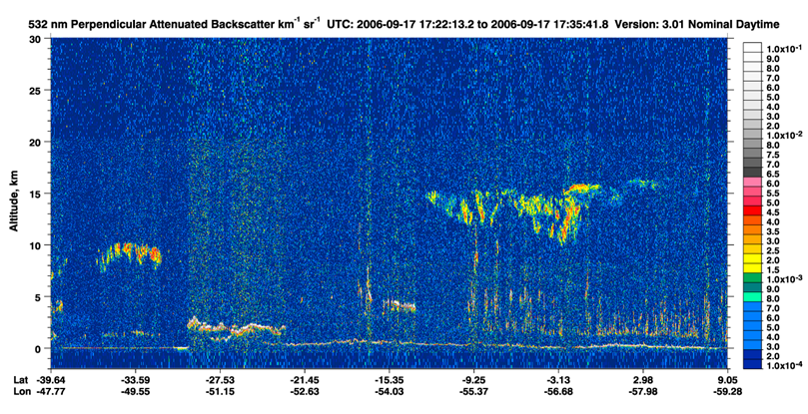
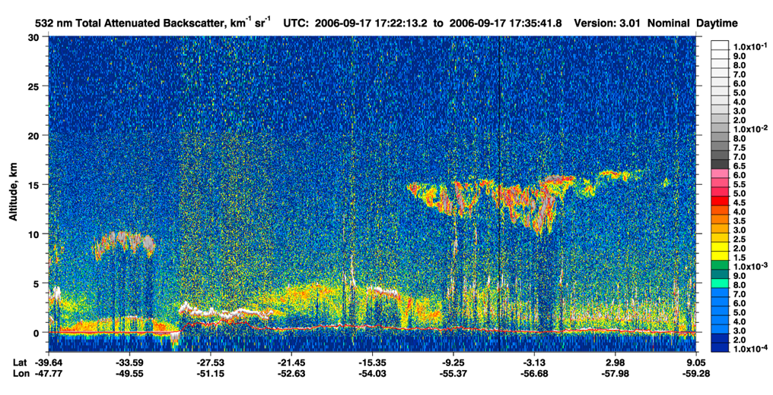
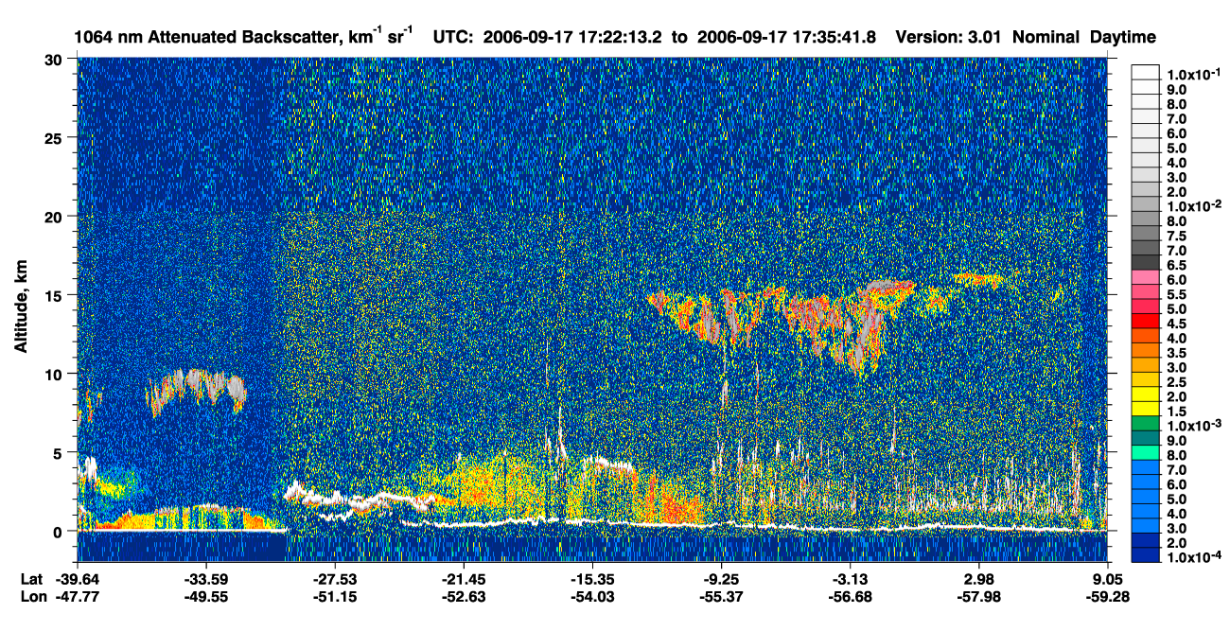
LIDAR Sept. 17th
β532 perp. non-enhanced
β532 Enhanced
Β1064 < Β532 ?
Notes:
Should be similar to Sept. 1st but B1064 seems to be the same intensity as B532, hinting at spherical coarse??

Slide 23
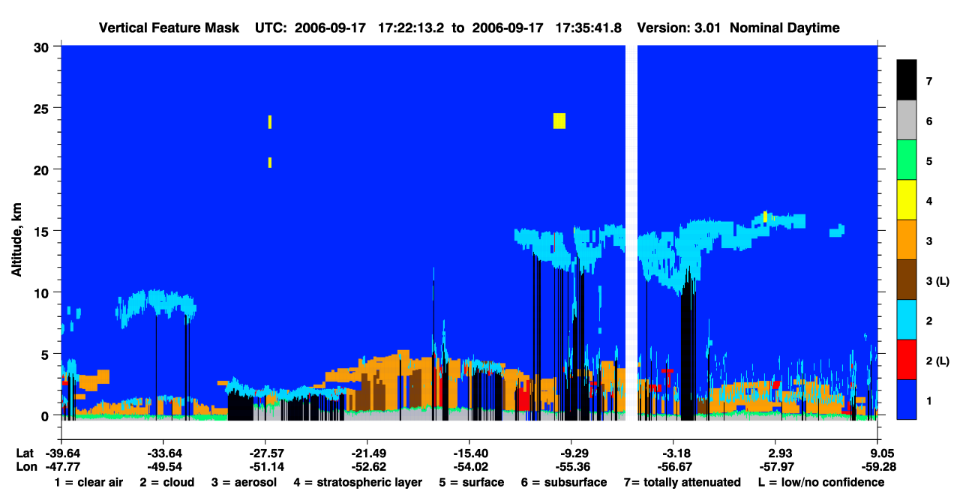

LIDAR Sept. 17th
High level clouds
(9-15 km)

Slide 24


Curiosity: Planetary Boundary Increases During Dry Season
Notes:
This presents more questions than answers. If we could look at the lidar data in depth could this problem be solved?

Slide 25

Curiosity: LIDAR Characterizes Dust in the Air
Possibilities:
Bad retrieval
Dust transport from Africa
Dust from Amazon deforestation

Slide 26

Aerosol and Cloud Interactions
It has been found that smoke reduces cloudiness over the Amazon by providing an over-abundance of condensation sites for water vapor.
Let’s see if we can find any evidence of this with our new found tools!
Reference and image:
Effect of Amazon Smoke on Inhibition of Cloud Formation; Llan, Yoram, Lorraine, Martins 2004 and Fig. 3

Slide 27




Cloud Fraction and Ground AOD: 2006
1000-700 mb
above 400 mb
700-400 mb
Notes:
Definite pattern in cloud fractions, but the max AOD doesn’t correspond to min cloud fraction. Lets also remember that during the dry season the plants are greenest! (from less cloud cover and they get more sun) This isn’t convincing….

Slide 28




Cloud Fraction and Satellite AOD
Aug. 1st – Oct. 30th
High Cloud
Low Cloud
AOD
Mid Cloud

Slide 29






Cloud Optical Depths for Sept. 1st and 17th

Slide 30

Aerosol/Cloud Analysis
?
Notes:
Need more data. Daily cloud information (MERRA only does monthly as far as I found) and a rigorous analysis of daily imagery using LAADSWEB/HDFLook for high quality/user specific data

Slide 31
Warning
Steer clear from data overload! Have a clear objective when using these products as to not get overwhelmed.

Slide 32
Thank You for Listening!
Questions and comments?

