Slide 1

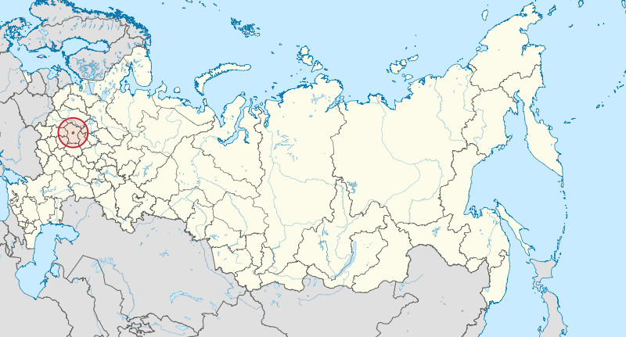
Measurement of the Aerosol Optical
Depth in Moscow city, Russia during
the wildfire in summer 2010
DAMBAR AIR

Slide 2
Outline
Introduction
  Study location (Moscow city)
  Russian Wildfire in summer 2010
  Effect of Biomass burning
AERONET and MODIS AOD of Moscow city in year 2010
Comparison of the AERONET AOD in August 2009 and 2010.
Comparison of AERONET and MODIS AOD during the wildfire
Back Trajectory during the wildfire
Comparison of AERONET and MODIS Angstrom during the wildfire.
Conclusion
1

Slide 3
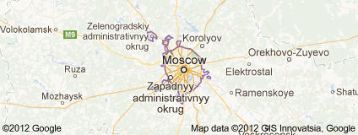

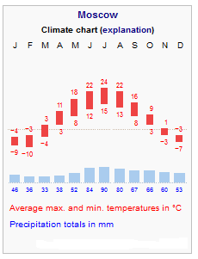
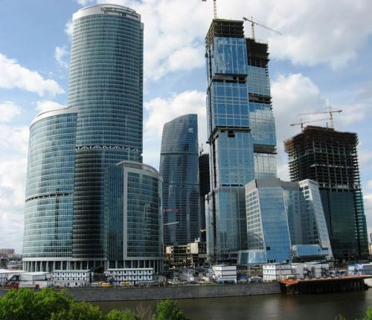



Moscow City
Capital city of Russia
Area =2,510 km² (969.1 sq mi)
population = 11,503,330 (2010)
Population density = 4,583.07 /km² (11,870.1 /sq mi )
Moscow seasons
Winter
Spring
Summer
Fall
AERONET sites of Moscow city
Latitude = 55.7
Longitude = 37.51
Altitude = 130m
2

Slide 4
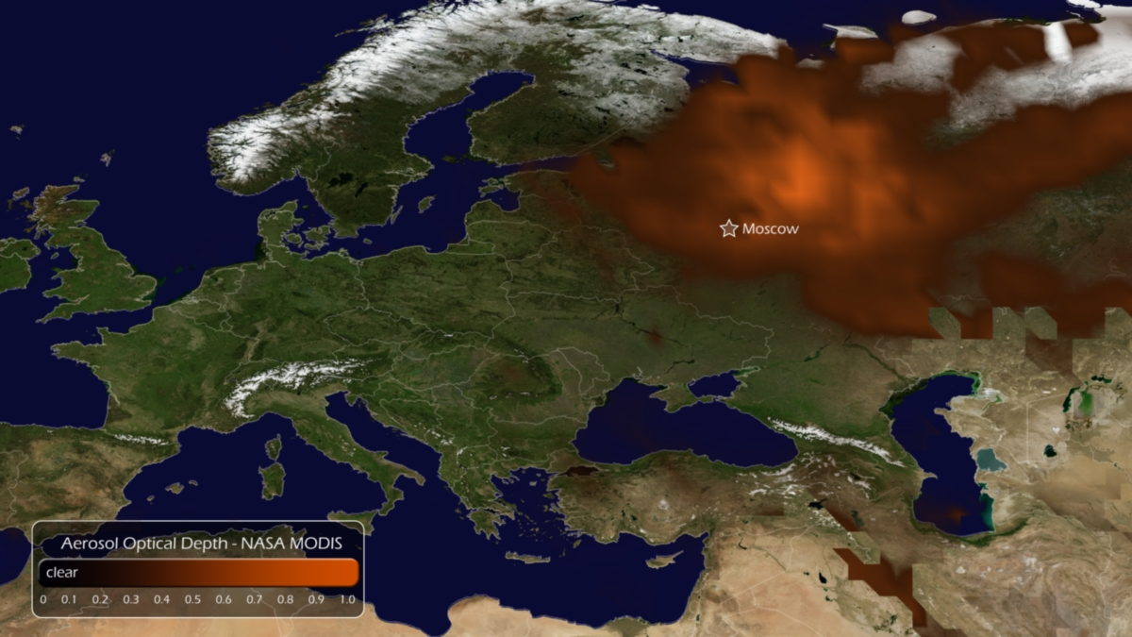
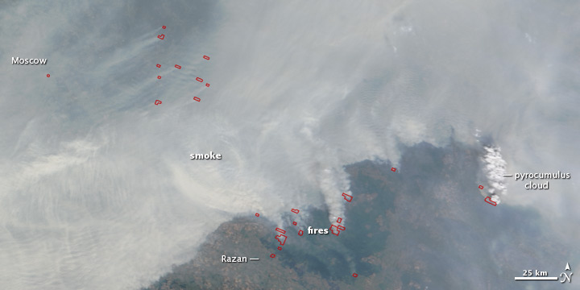
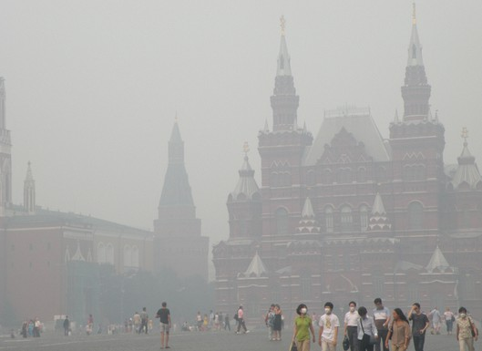
2010 Russian Wildfires
State of emergency - 35 regions
Fires cost $ 15 billions in damages
Building destroyed = 2000
Fatalities = 55,736
The visibility in Moscow city was low.
3

Slide 5
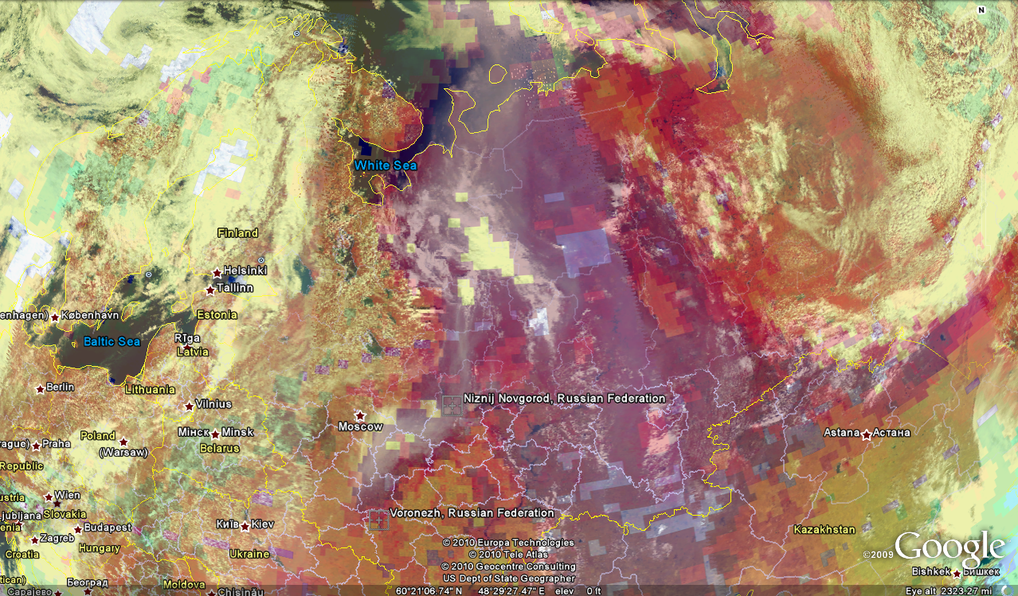
Figure 1: Image of AIRS (Atmospheric Infrared Sounder) visible wavelength radiance data (foreground), showing clouds and smoke from Russian wildfires, overlying CO concentrations (background). Dark red indicates CO concentrations higher than 120 ppb. The "sawtooth" pattern in this image is characteristic of the way the fields-of-view of the AIRS visible band detectors are projected onto the Earth's surface at the edges of the scanning swath. This pattern can also usually be seen where the swaths of the visible band detectors overlap.
Large amount of smoke, CO and other toxic gases were released during the fire.
The Dark red color indicates the higher concentration of CO .
4

Slide 6
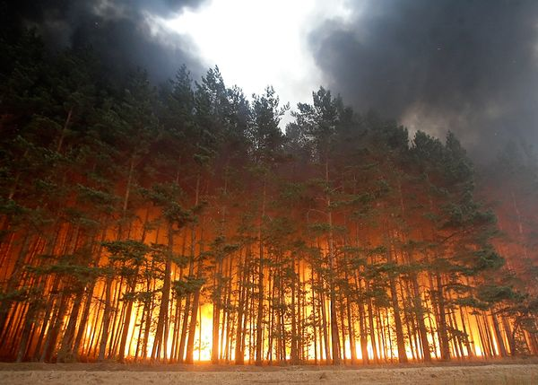
Effects of Biomass Burning
Direct influence on atmospheric environment
Decreasing evapotranspiration
Increasing concentration of several greenhouse gases and particulates matter
Increasing the aerosols amount
Change the aerosol optical depth
Change the surface temperature
Influencing on atmospheric chemistry
Effect on Human health
5

Slide 7
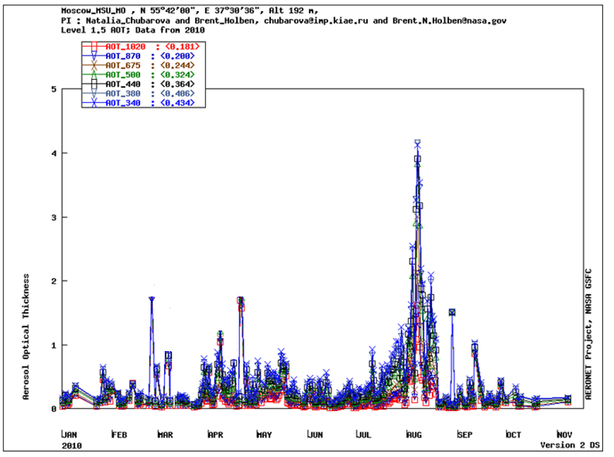
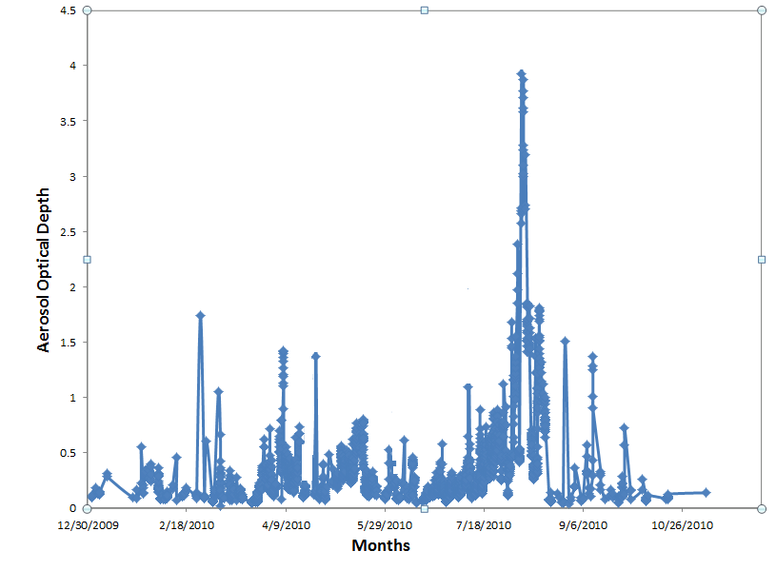
AERONET AOD in Year 2010
Aerosol Optical Depth for 500nm
6

Slide 8
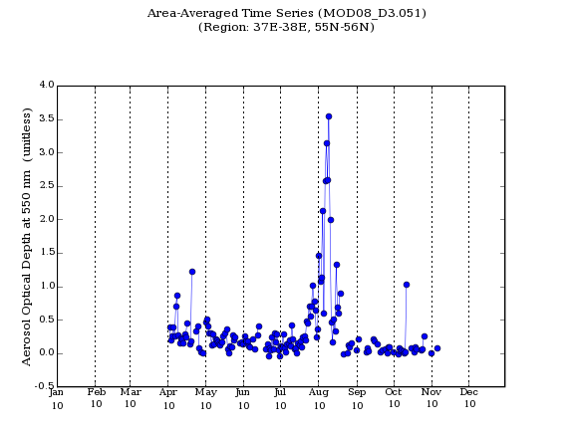
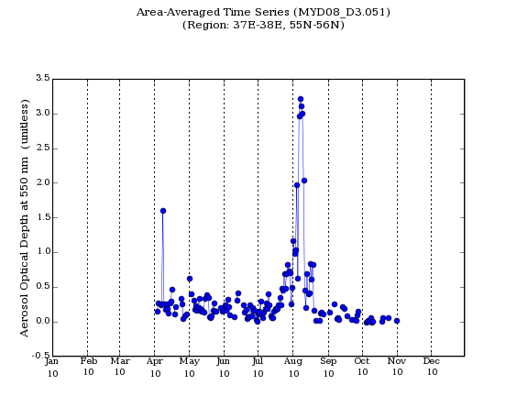
MODIS AOD (550nm) in Year 2010
TERRA - MODIS AOD (550nm)
AQUA - MODIS AOD (550nm)
7

Slide 9
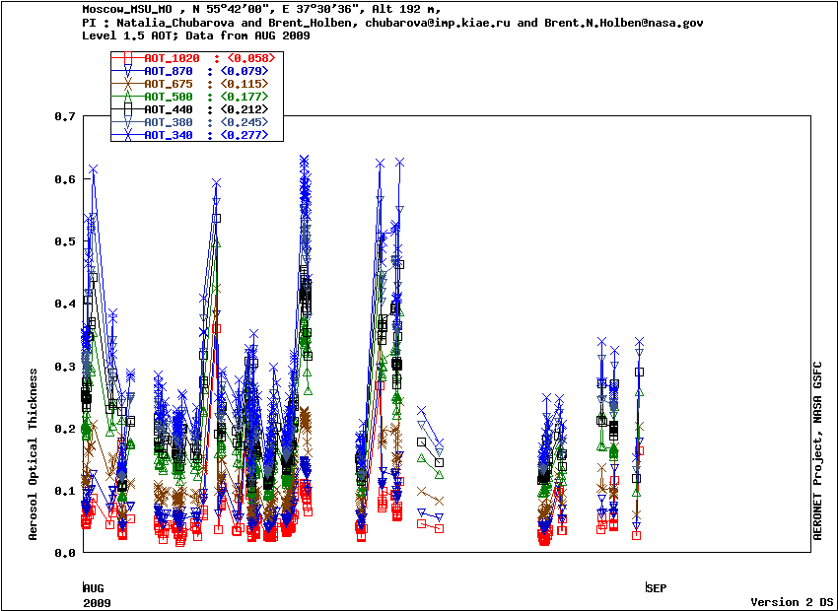
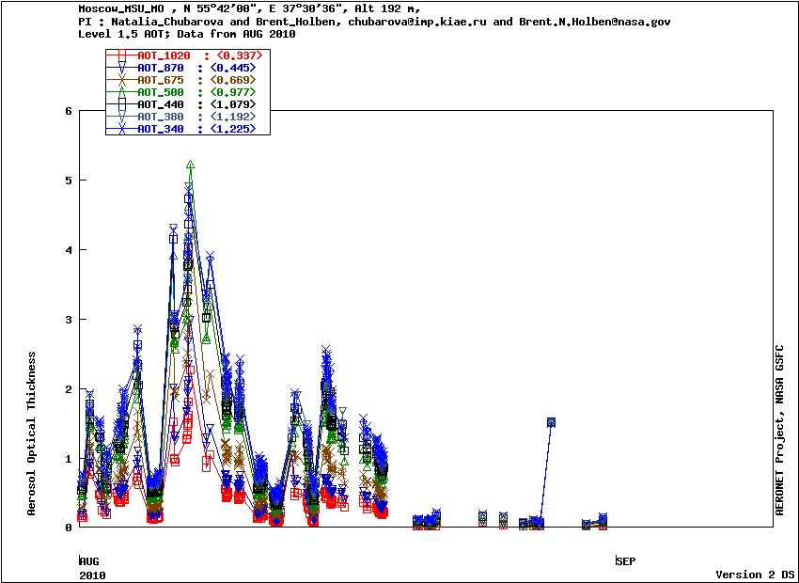
AERONET AOD in August 2009 and 2010
AERONET AOD in August 2009
AERONET AOD in August 2010
8

Slide 10
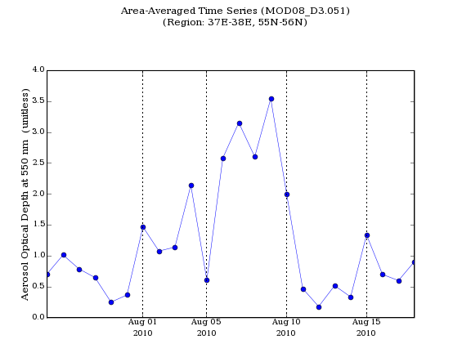
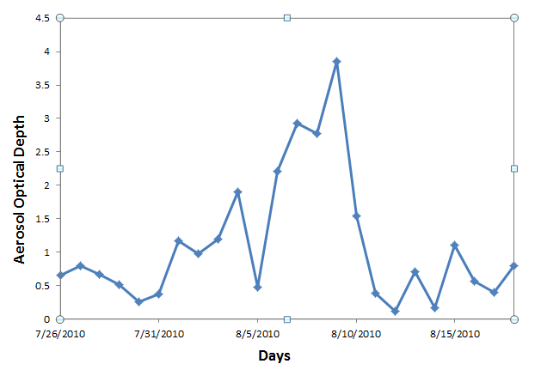
AOD during Fire in 2010
Area- Average Time series (Aeronet )
Moscow city
TERRA MODIS AOD (550nm)
AERONET AOD (500nm)
9

Slide 11
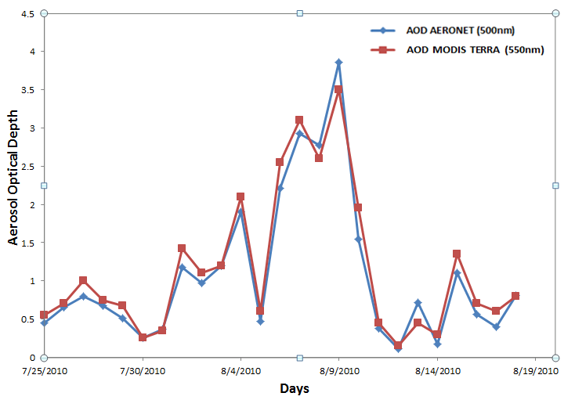
Comparison of AOD during Fire in 2010
10

Slide 12
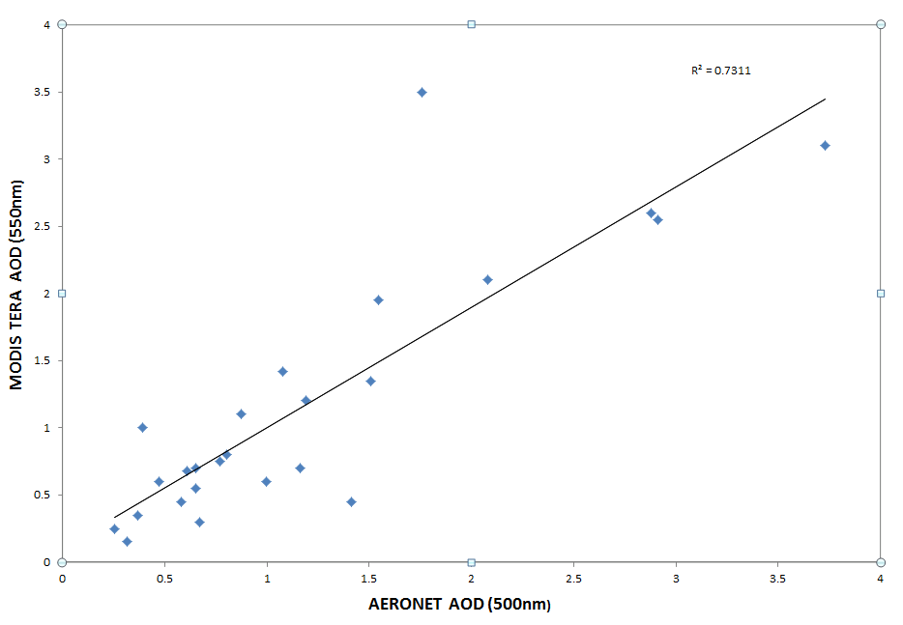
Scattering Plot of MODIS and AERONER
during the Wildfire Summer 2010 (MOSCOW)
11

Slide 13
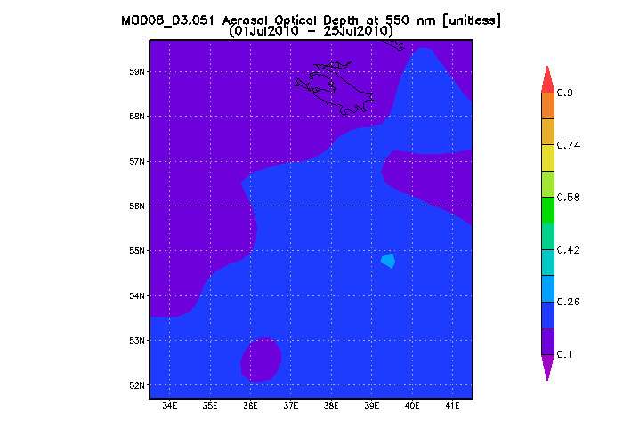
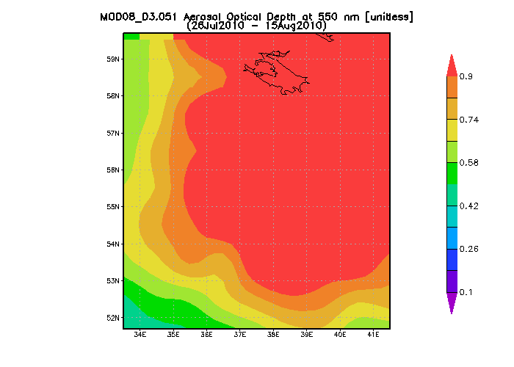
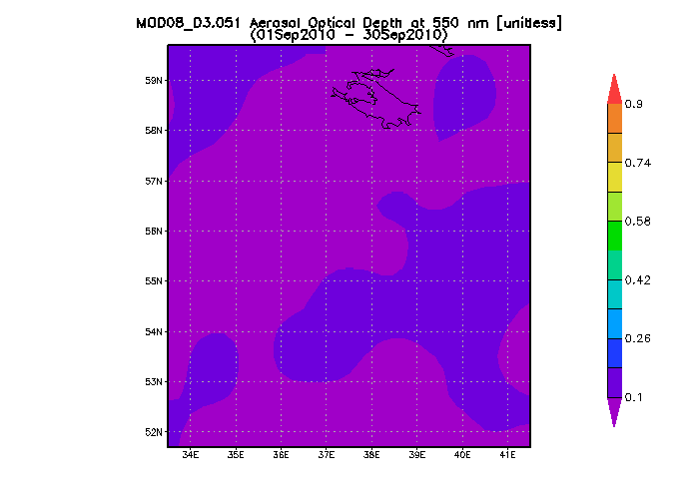
Comparison of MODIS TERRA AOD
12

Slide 14
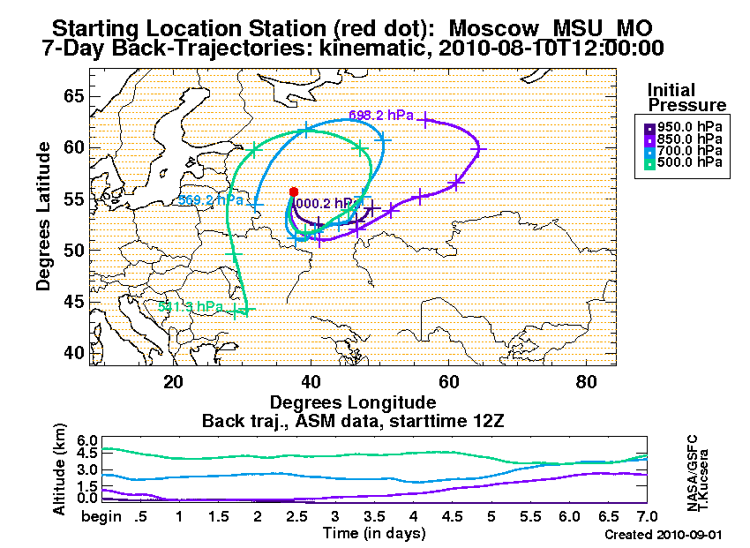
Back- Trajectories during the Fire
13

Slide 15
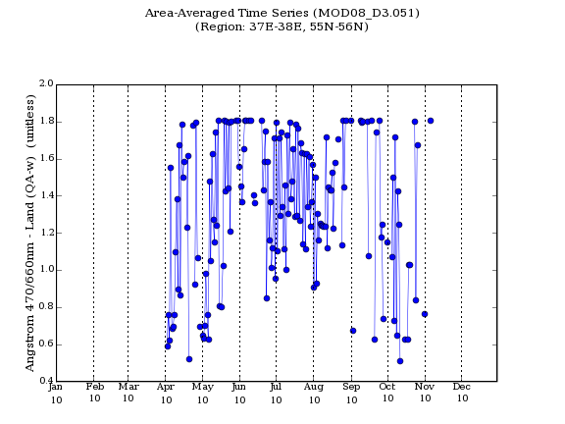
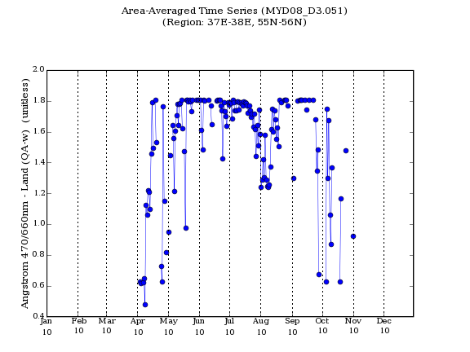
MODIS Angstrom in Year 2010
TERRA - MODIS Angstrom (470/660nm)
AQUA - MODIS Angstrom (470/660nm)
14

Slide 16
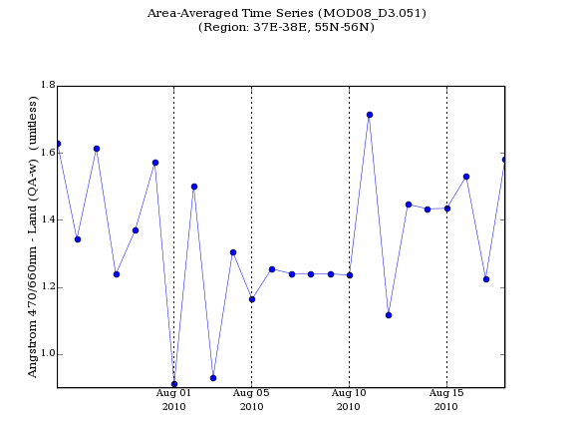
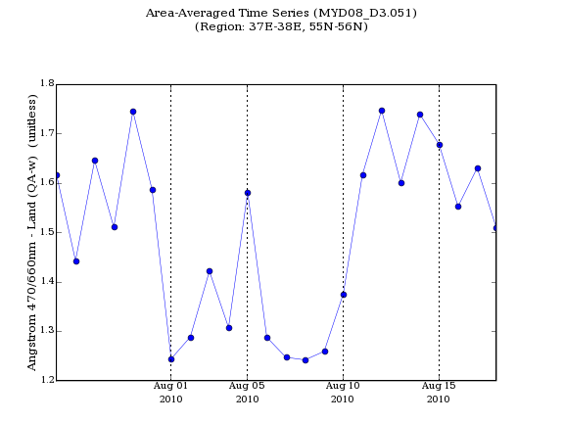
MODIS Angstrom during Fire in 2010
TERRA - MODIS Angstrom (470/660nm)
AQUA - MODIS Angstrom (470/660nm)
15

Slide 17
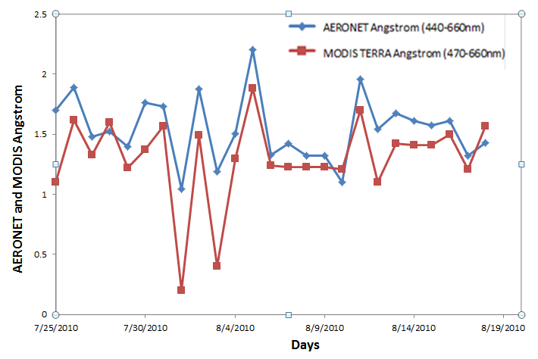
Comparison MODIS and AERONET
Angstrom during Fire in 2010
16

Slide 18
Conclusion
The Moscow city was strongly effected by wildire in August 2010.
The Moscow city was seriously influenced by wildfire from 31st July to 15th August 2010.
The AOD values of Moscow city during 6th to 9th August were very high more than 4.
The visibility of many parts of Moscow city was lass than 100 meters.
The Angstrom values during the 6th to 9th August were very low.
17

