Slide 1
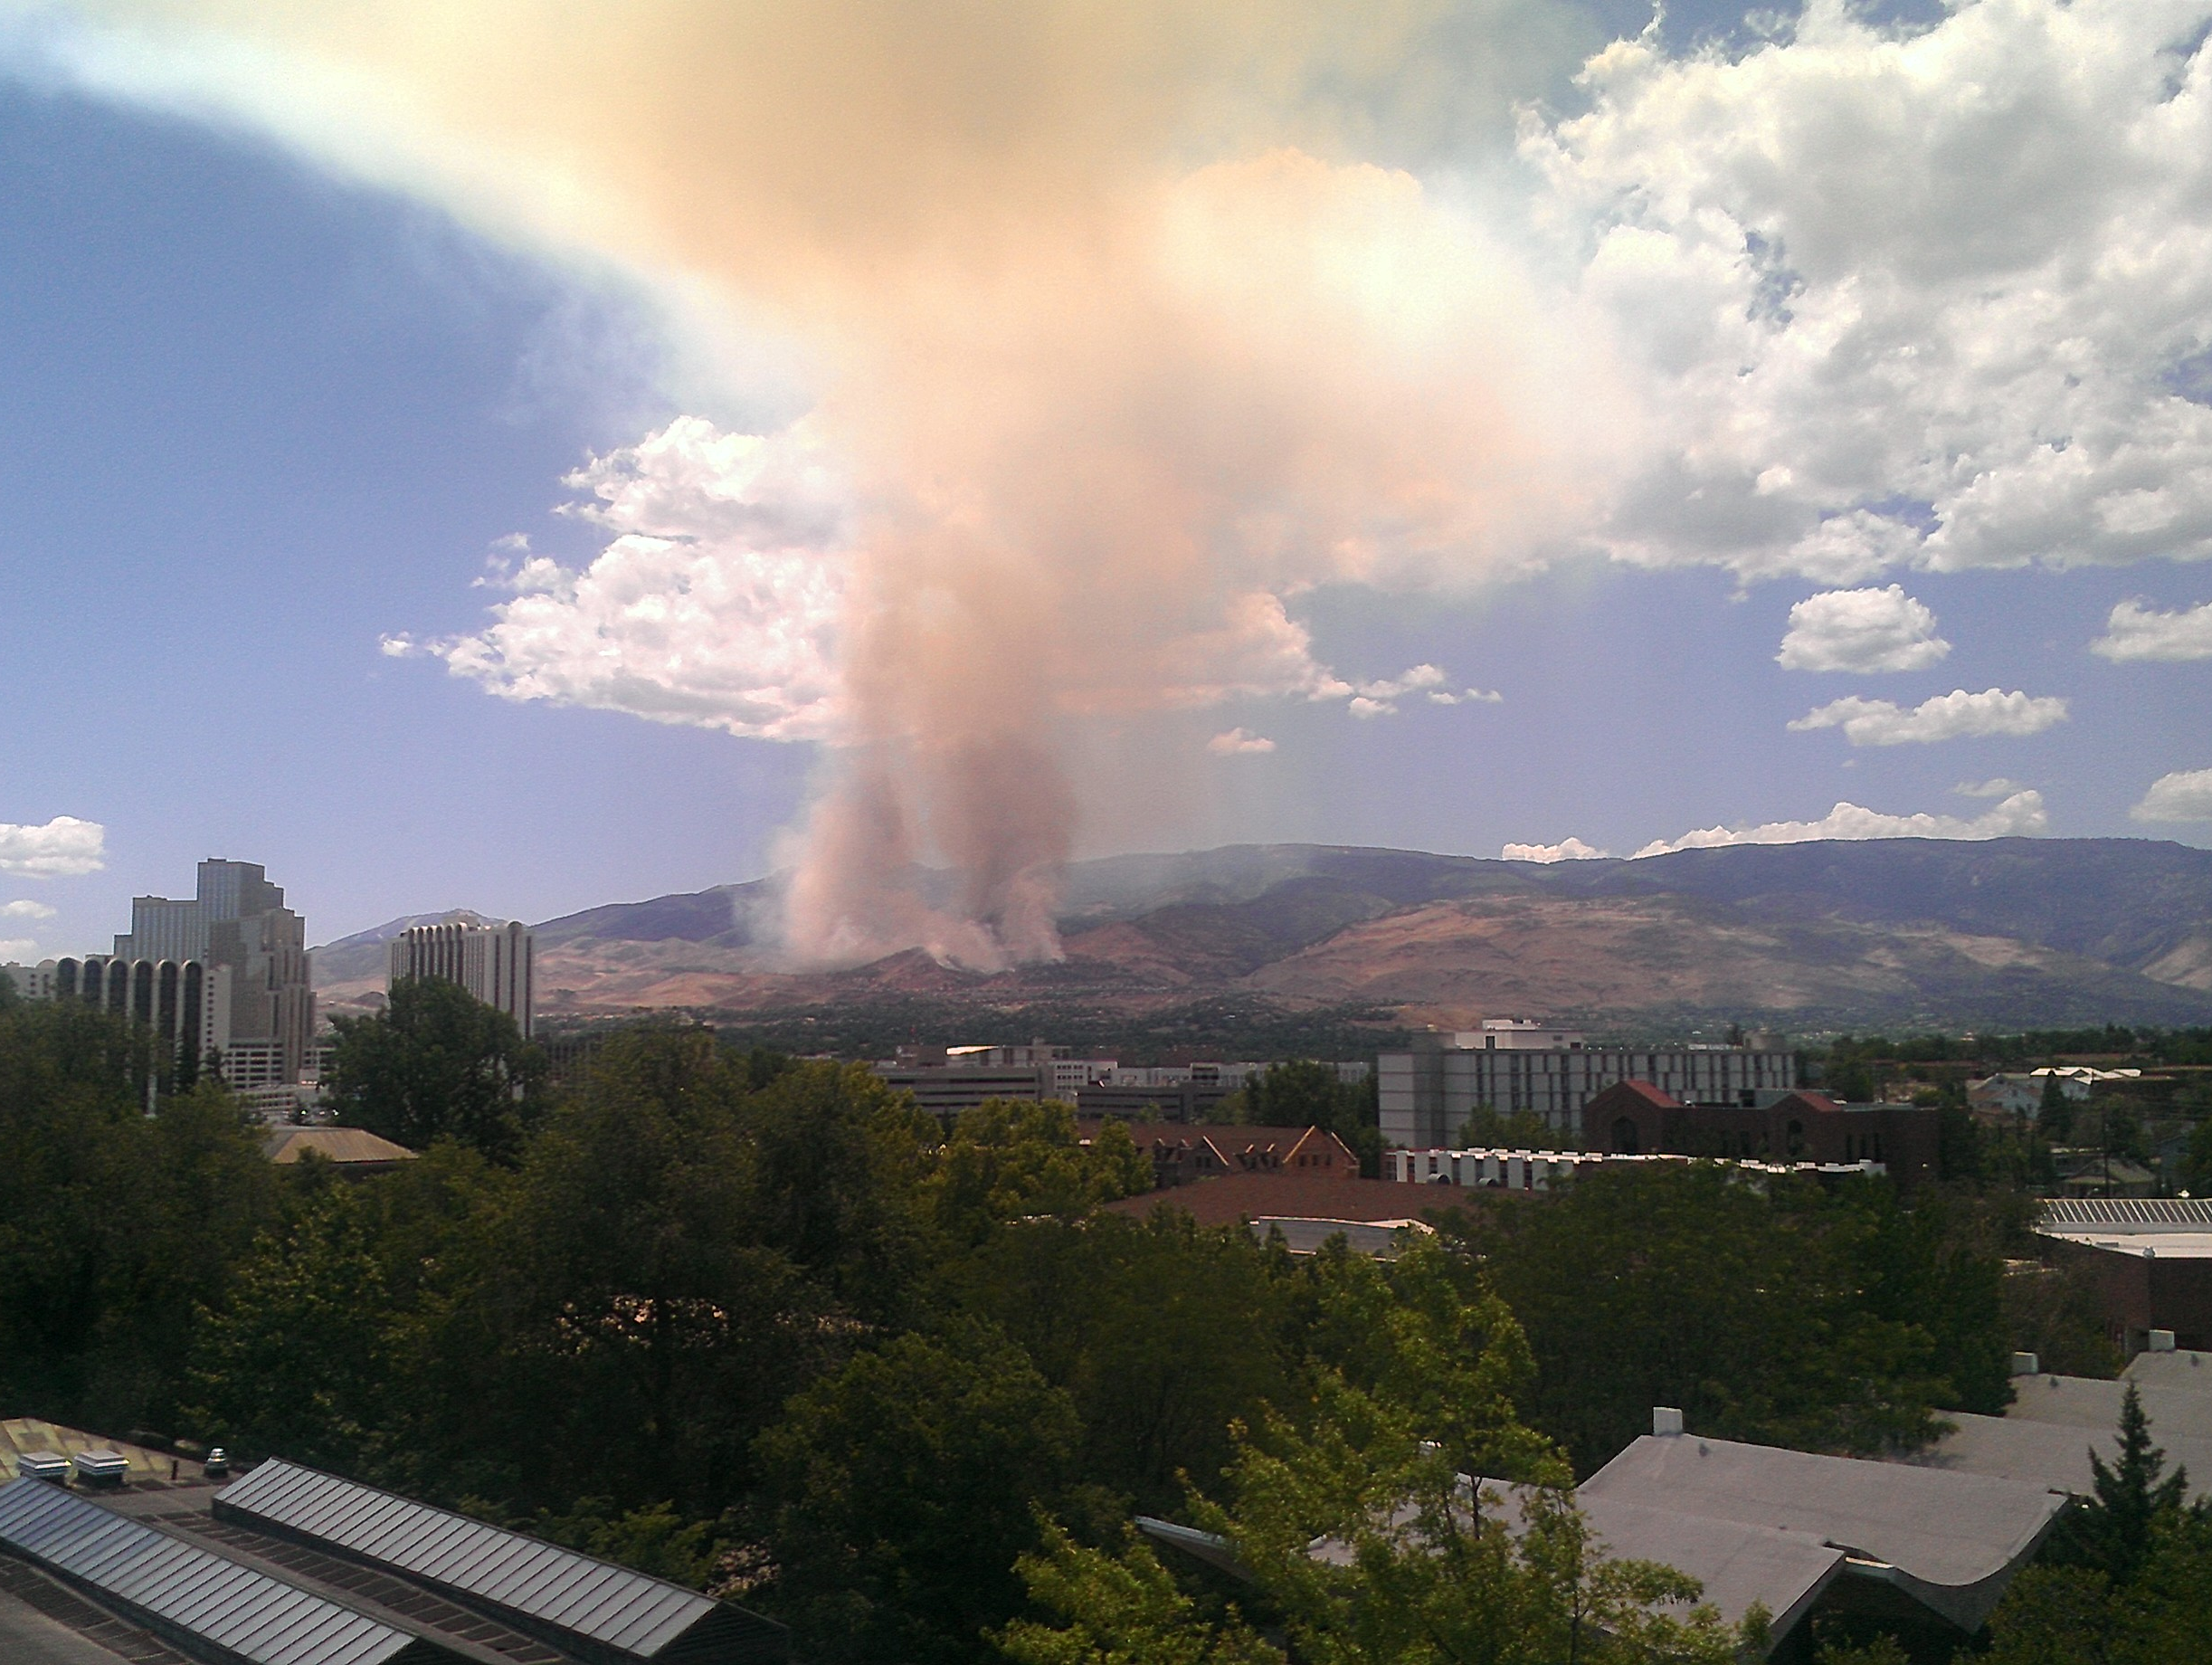
Pinehaven/Caughlin Ranch Fire July 2, 2012
Bryan Rainwater
David Colucci
July 2, 2012 1:30PM (20:30UTC)

Slide 2
Objectives
Observe the Pinehaven/Caughlin Ranch Fire beginning on July 2, 2012 at about 1PM local time.
Analyze the University of Nevada AERONET data that intersects the smoke plume.
Acquire and analyze MODIS and CALIPSO data.
Acquire dispersion characteristics from the HYSPLIT model with the NAM12K meteorological data and verify accuracy using on site LIDAR and CIMEL readings.

Slide 3
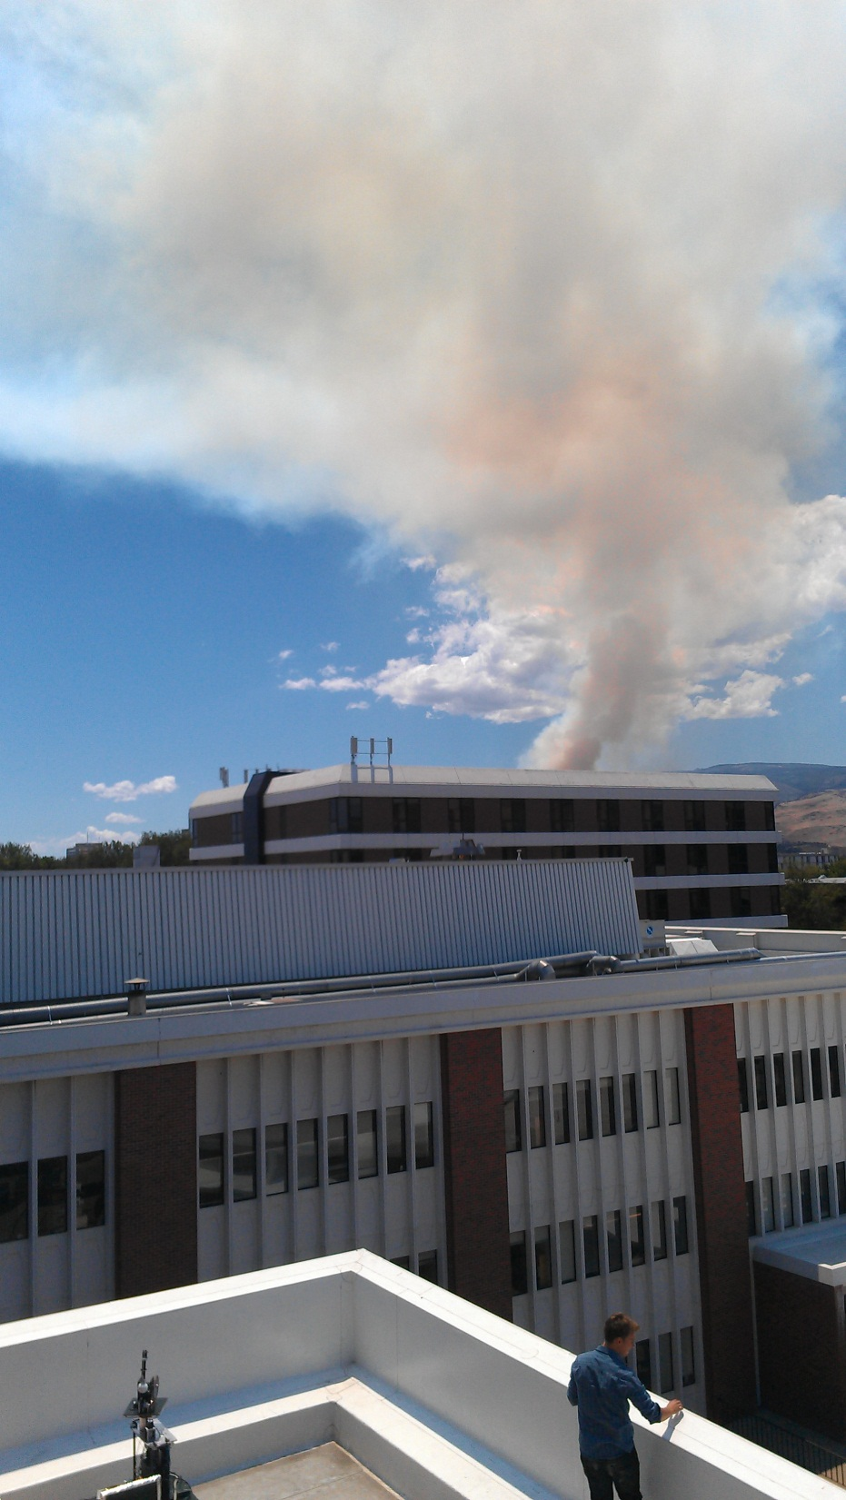
Pinehaven/Caughlin Ranch Fire
July 2, 1:00PM
fire started from suspected arson according to fire officials.
July 2, 1:30PM
Fire crews arrived on site with under 100 acres burning
July 2, 4:30PM
containment had been mostly achieved, with an estimated 200 acres burned.
July 3, 9:15AM
fire crews achieved 90 percent containment.
July 3, 1:30PM
fire had been fully contained having burned 206 acres.
July 2, 2012 1:22PM
*Photo Courtesy of Ben Sumlin
Notes:
Coordinates 39.466153
-119.867217

Slide 4
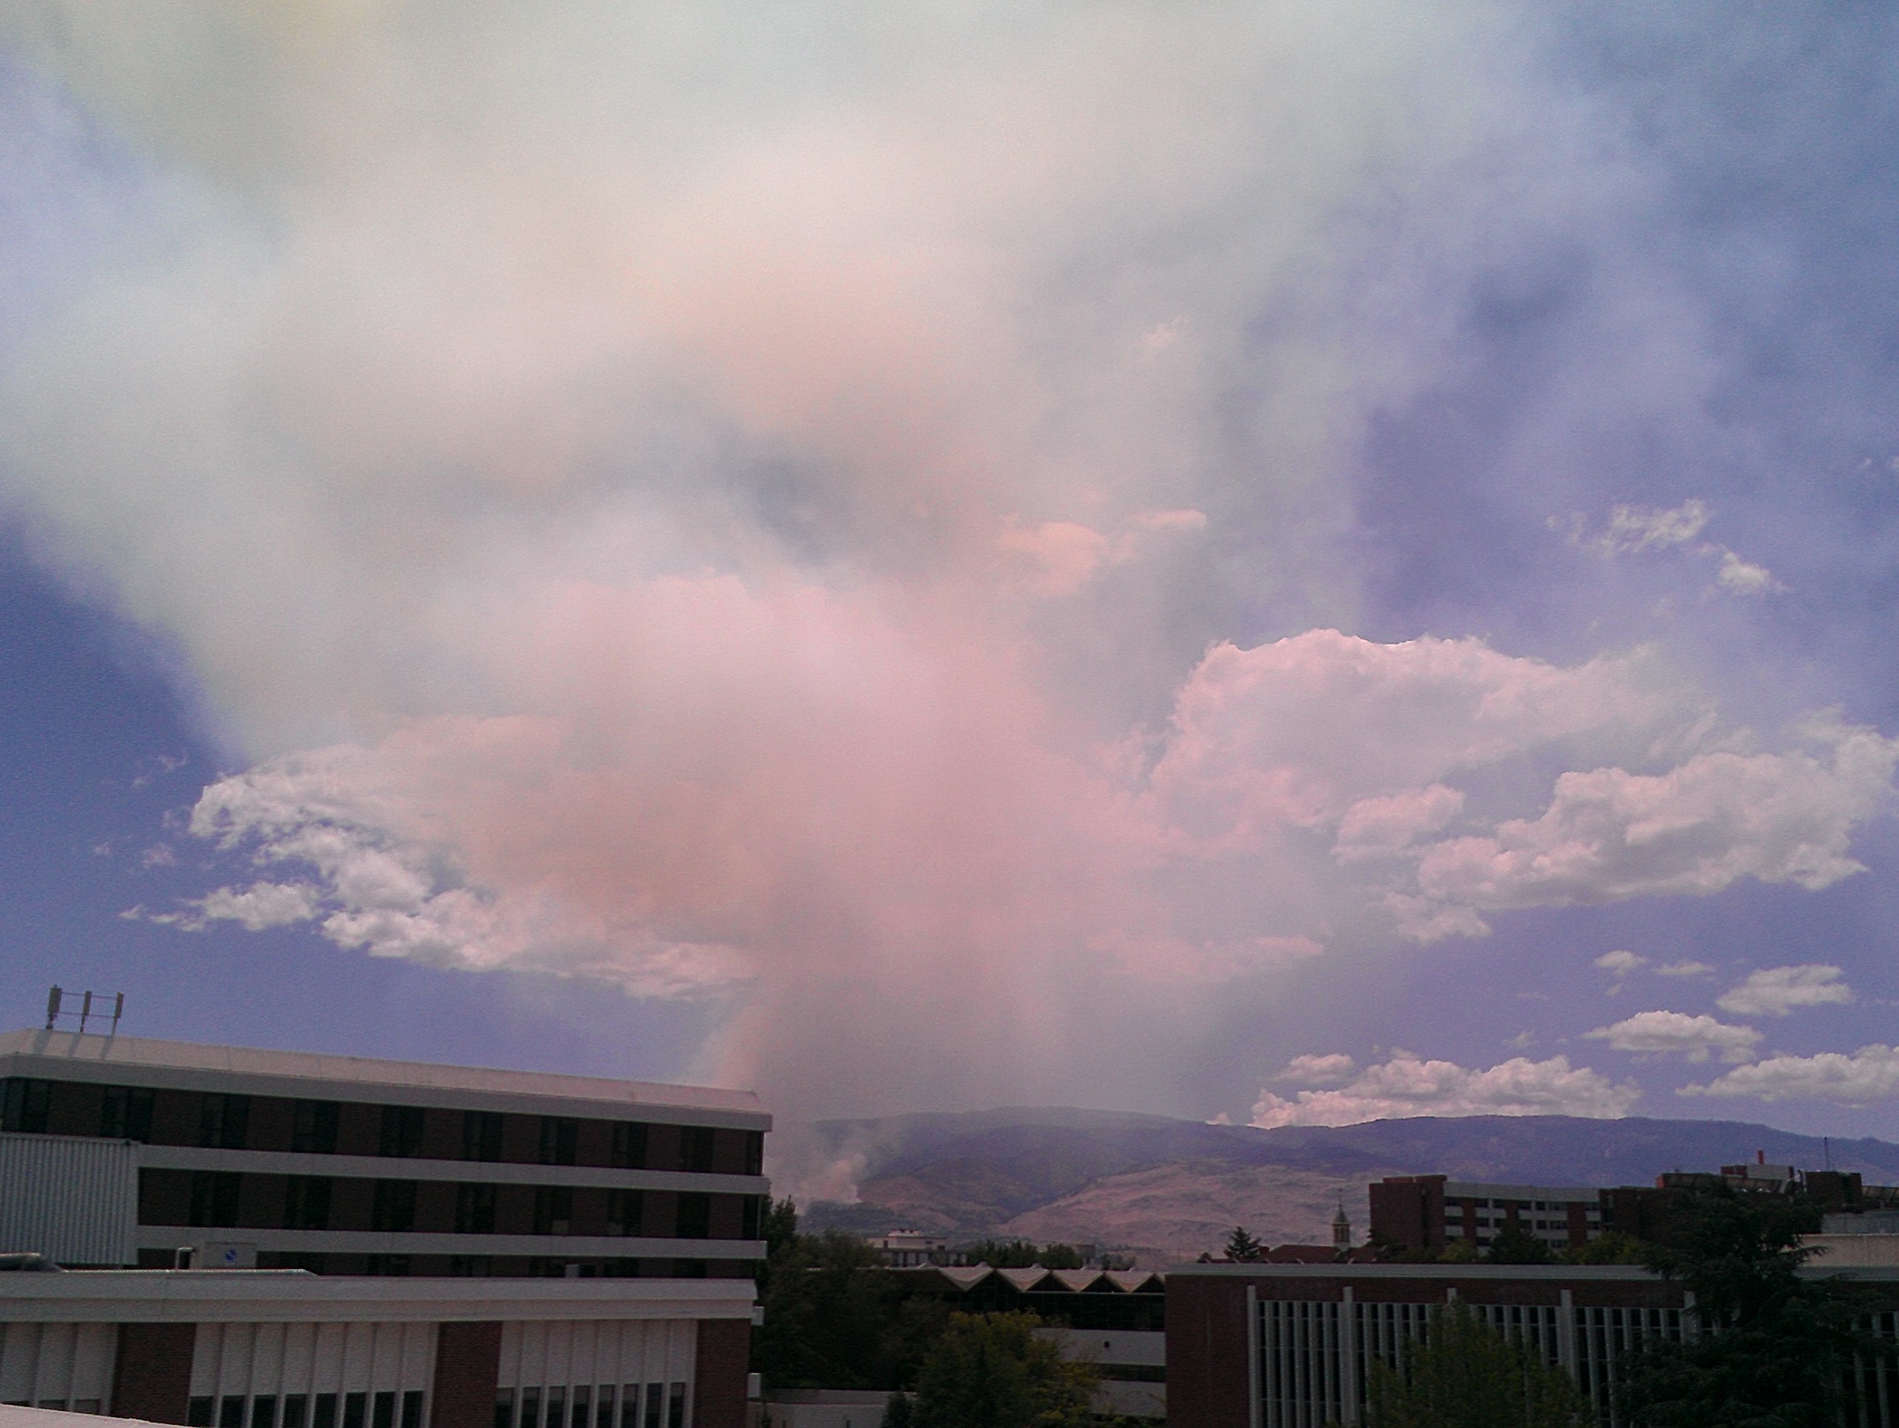
July 2, 2012 1:46PM

Slide 5
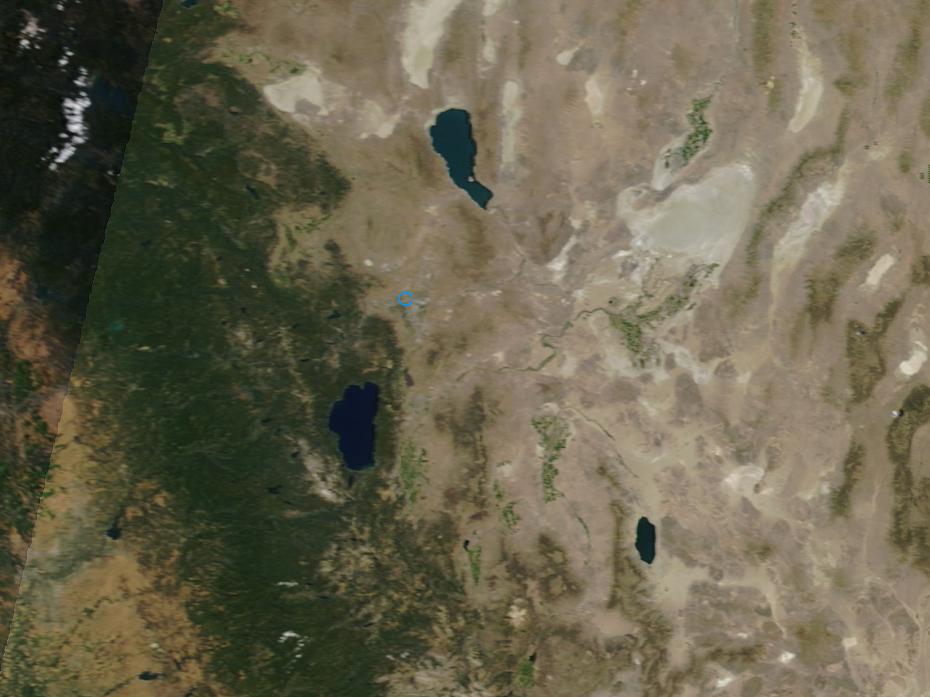
Satellite Imagery of the Fire
Terra Sensor

Slide 6
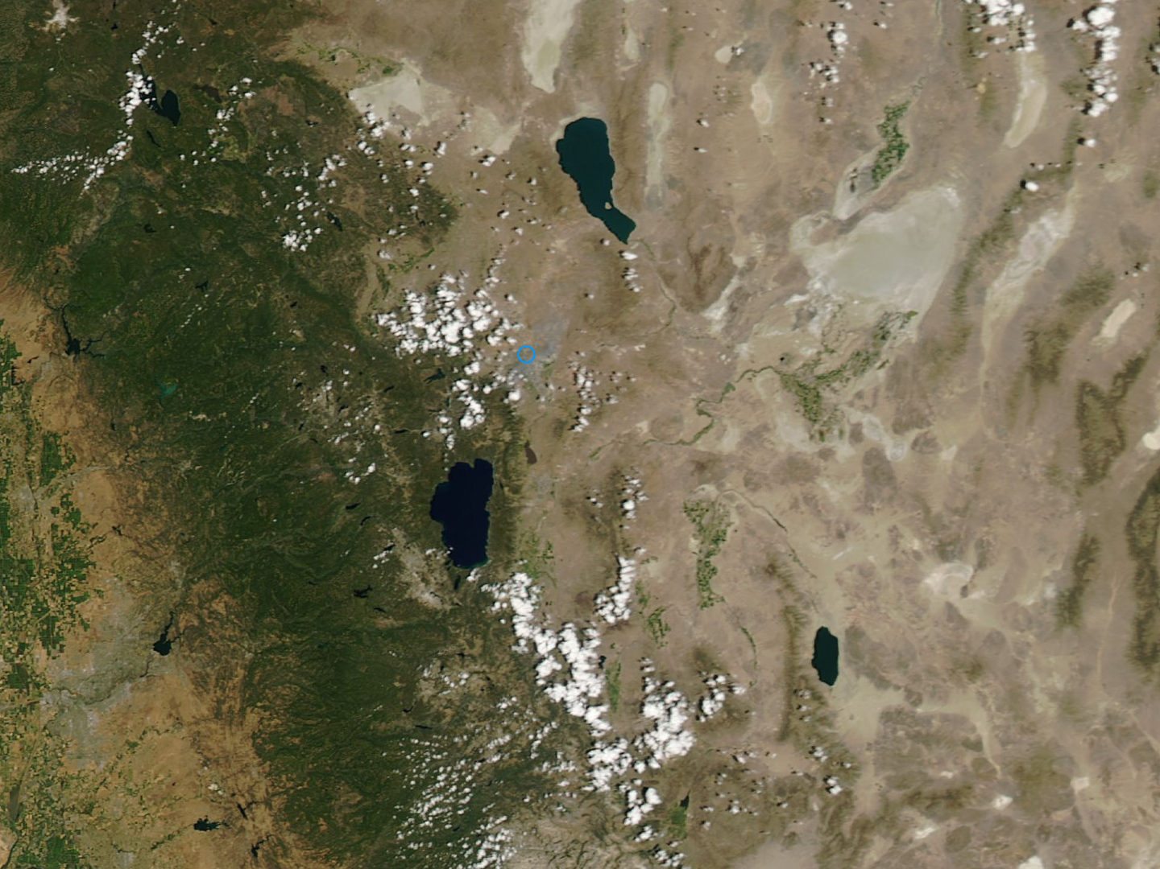
Aqua Sensor

Slide 7
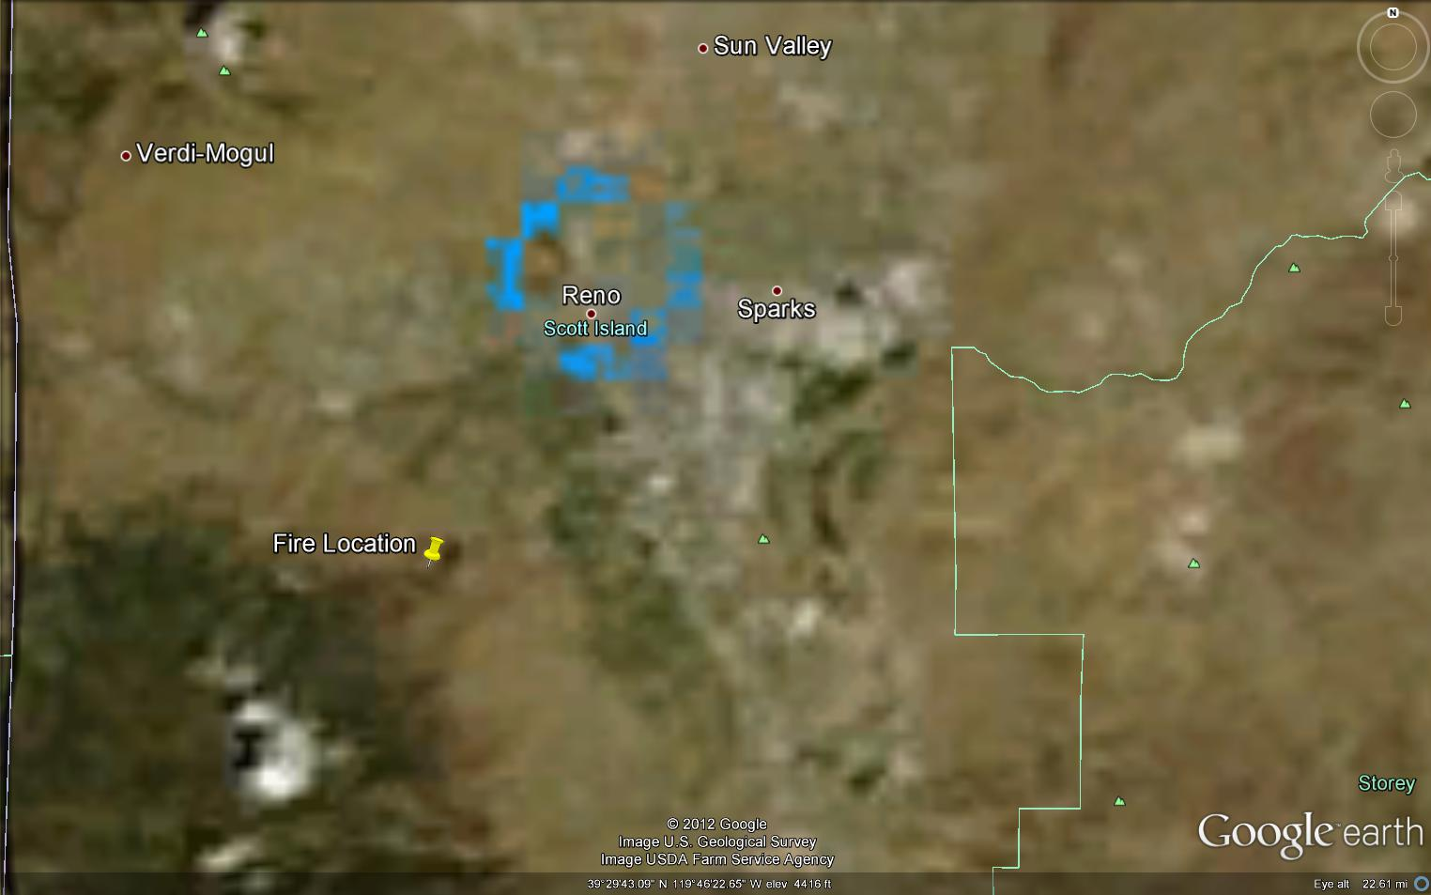
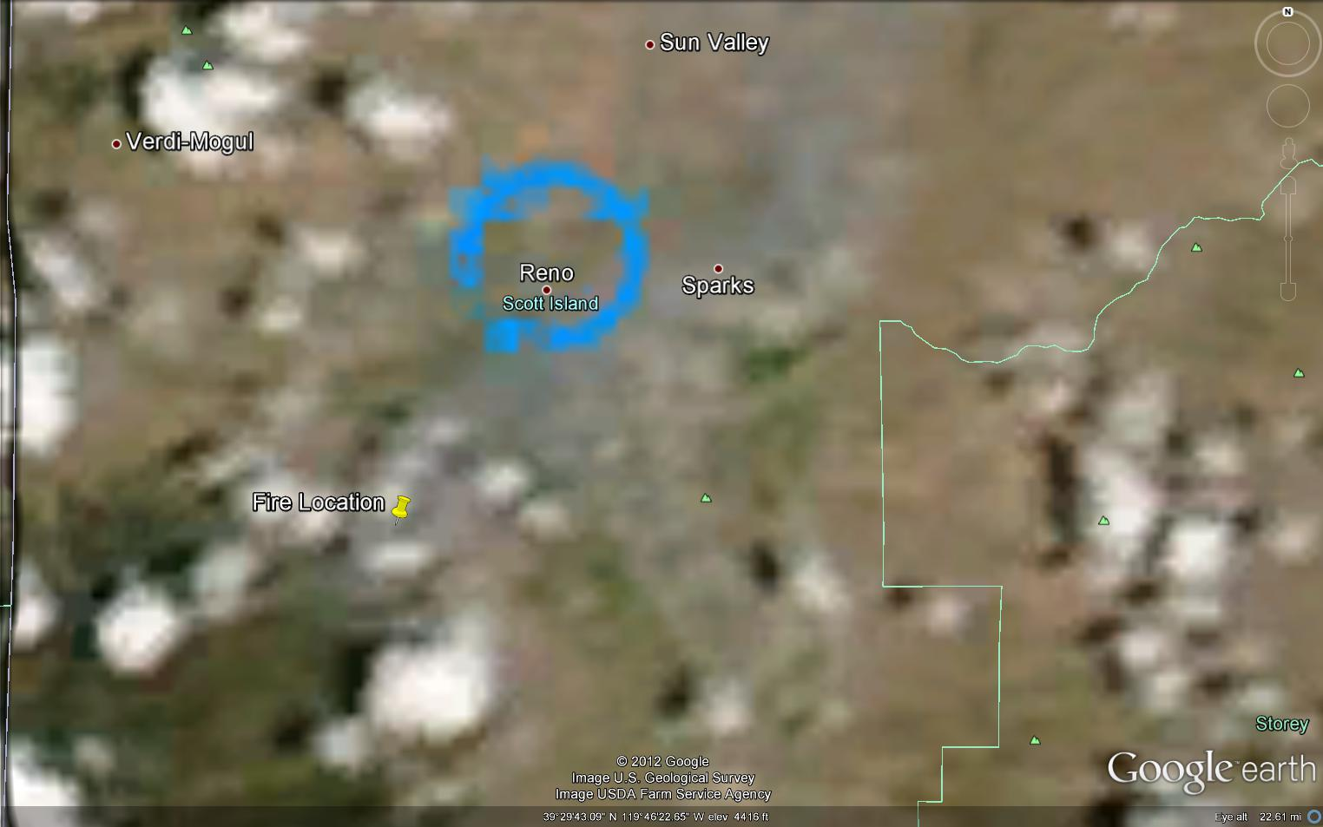
Modis Terra Satellite Image
July 2, 2012 (11:10AM)
Modis Aqua Satellite Image
July 2, 2012 (2:30PM)

Slide 8
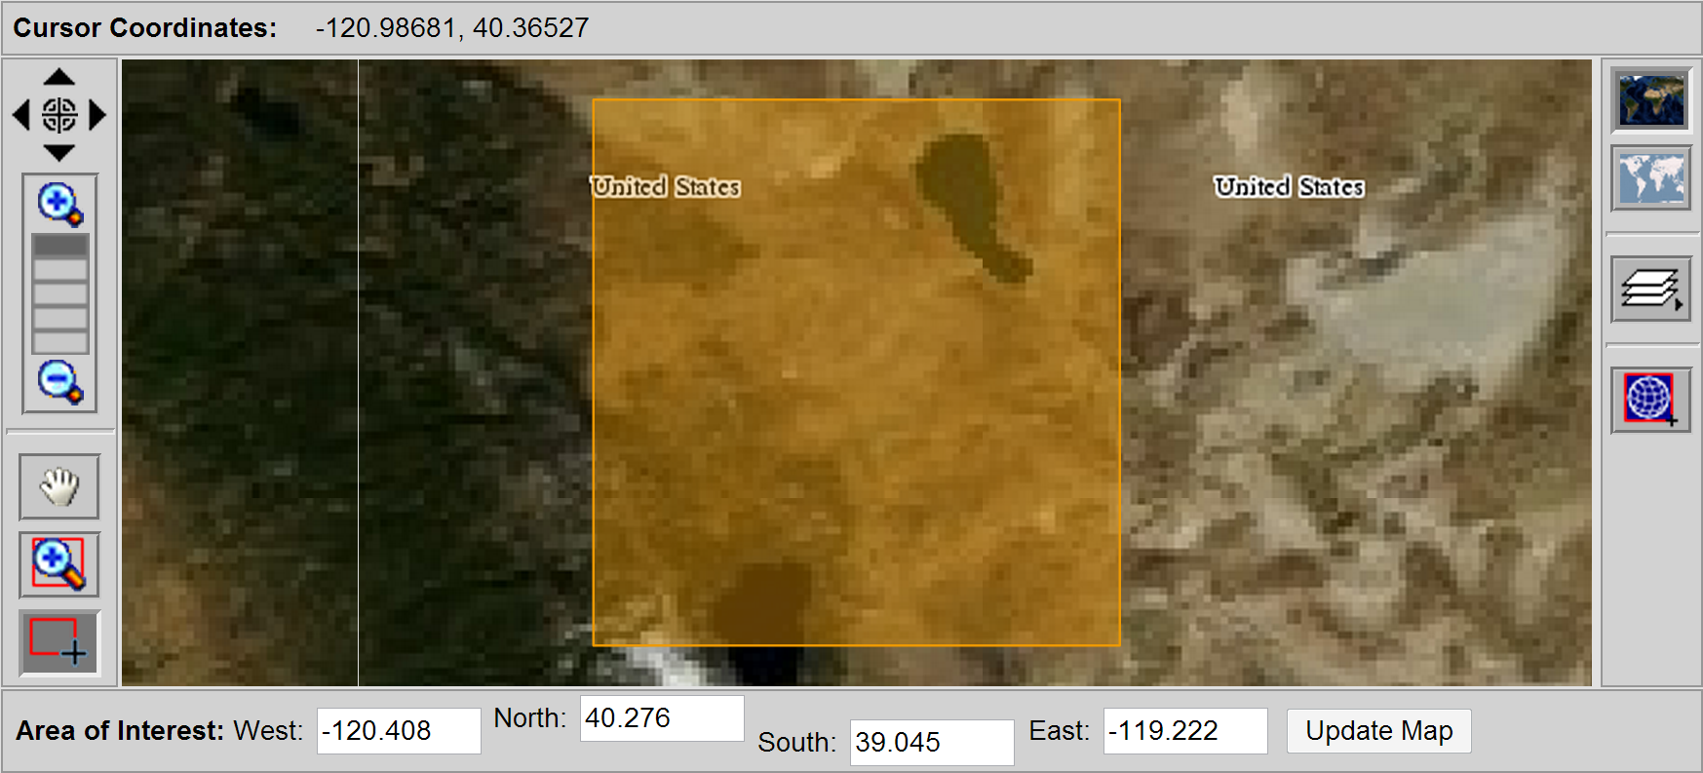
MODIS Data Boundaries

Slide 9
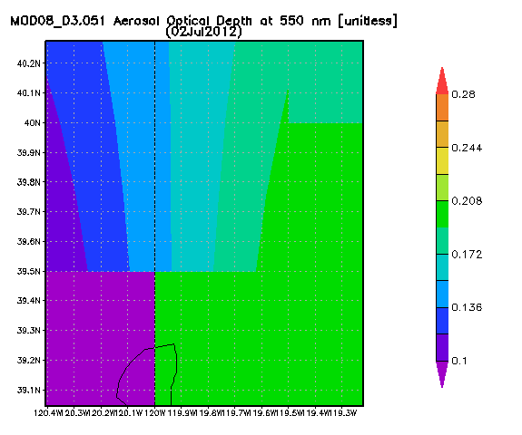
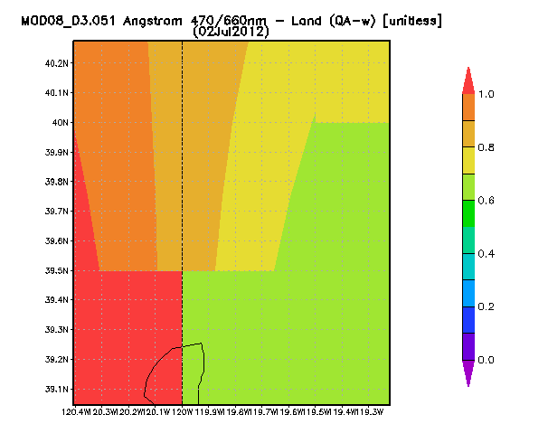
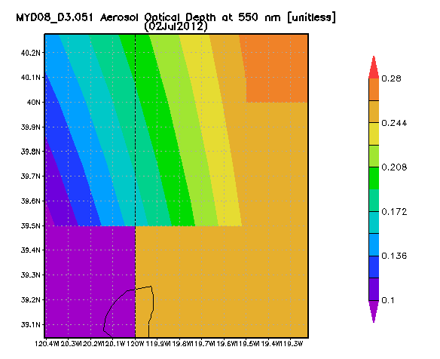
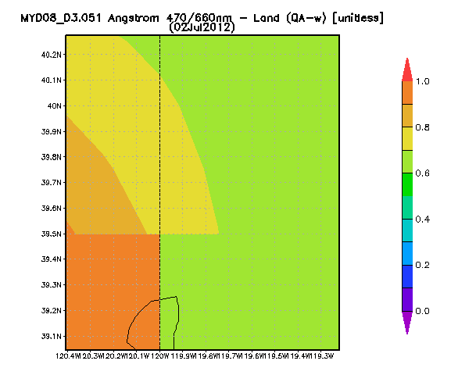
MODIS

Slide 10
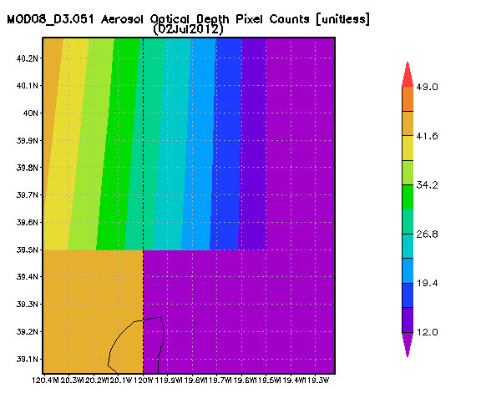
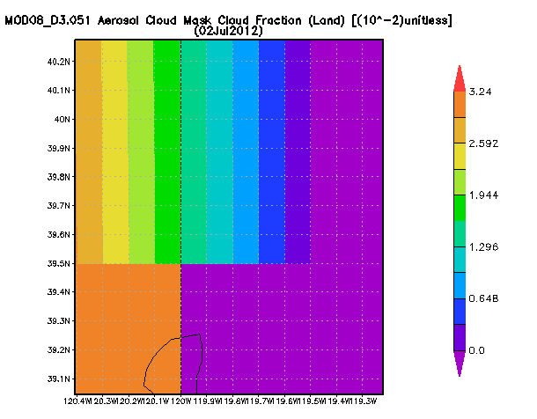
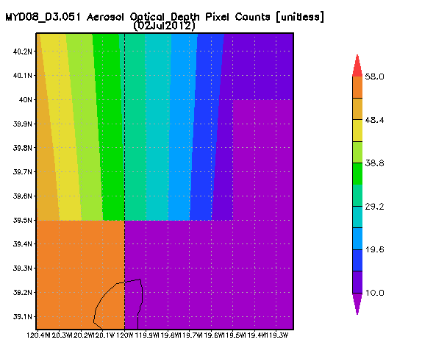
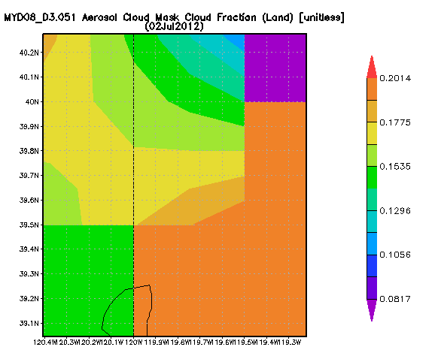

Slide 11
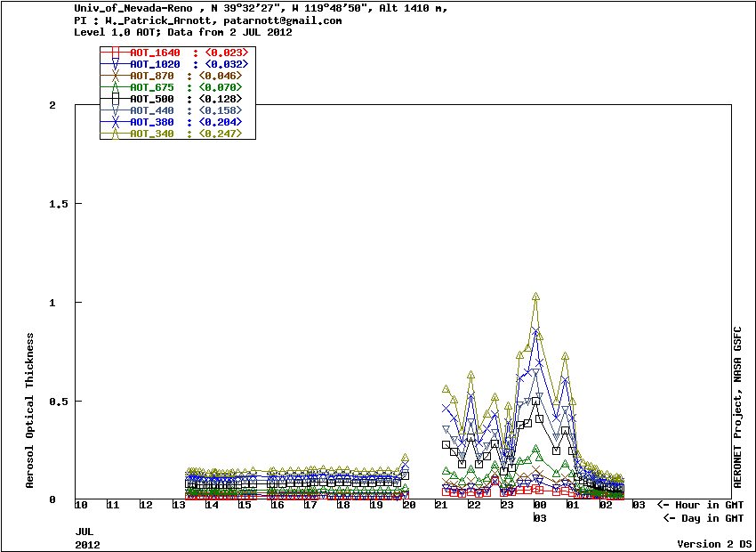
CIMEL Data (UNR Aeronet Station)

Slide 12
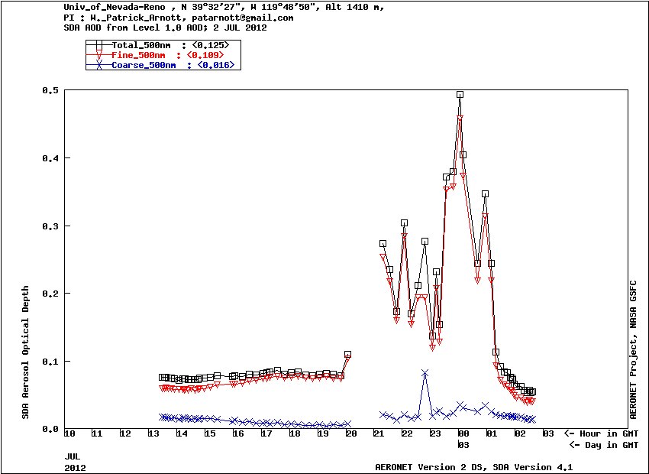
Normalized Fine Mode Fraction

Slide 13

July 2, 2012 at 1:00PM

Slide 14

July 2, 2012 at 1:22PM

Slide 15

July 2, 2012 at 1:46PM

Slide 16
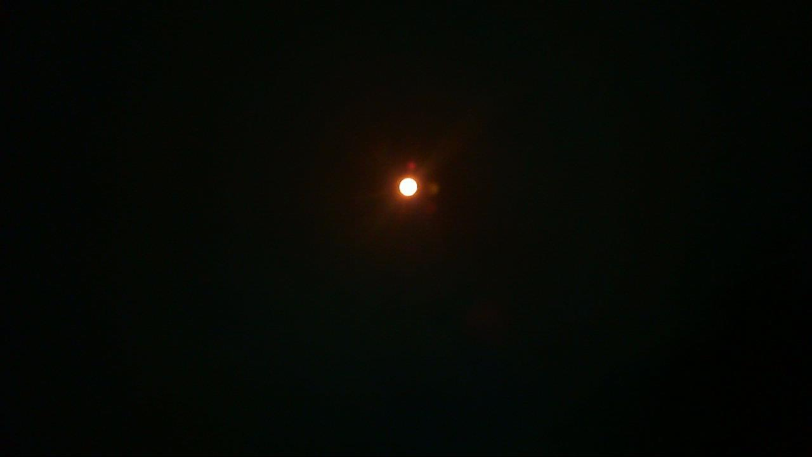
July 2, 2012 at 1:54PM

Slide 17
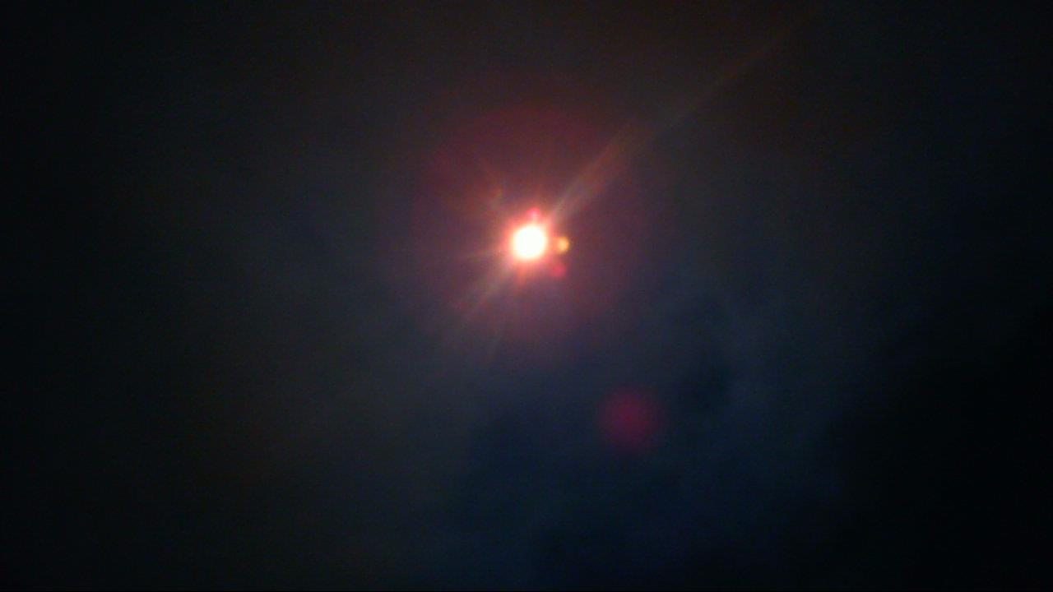
July 2, 2012 at 1:58PM

Slide 18

July 2, 2012 at 2:00PM

Slide 19

July 2, 2012 at 2:02PM

Slide 20

July 2, 2012 at 3:20PM

Slide 21

July 2, 2012 at 3:28PM

Slide 22

July 2, 2012 at 4:26PM

Slide 23
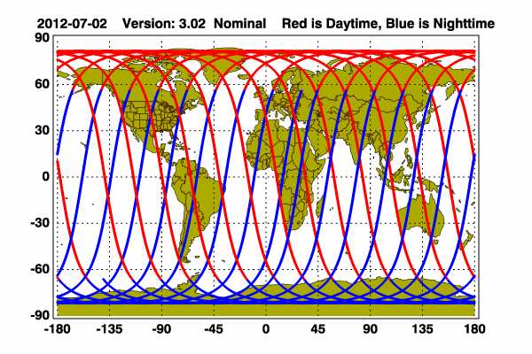
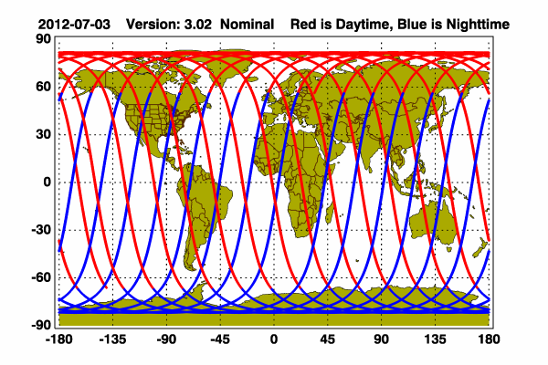

CALIPSO LIDAR Orbital Path
July 3, 2012
July 2, 2012

Slide 24
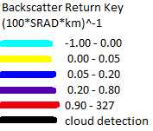
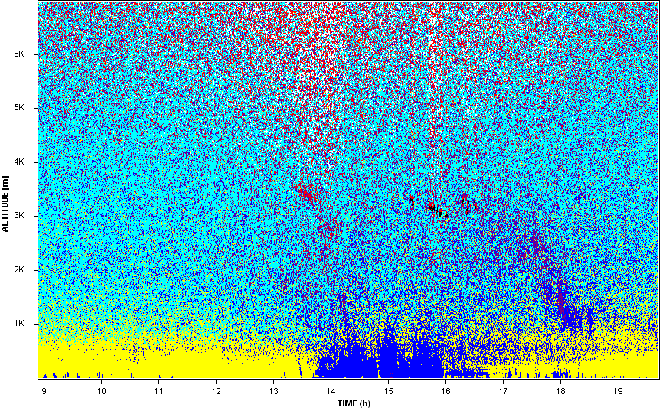
University of Nevada, Reno Vaisala CL31 Ceilometer

Slide 25


Slide 26
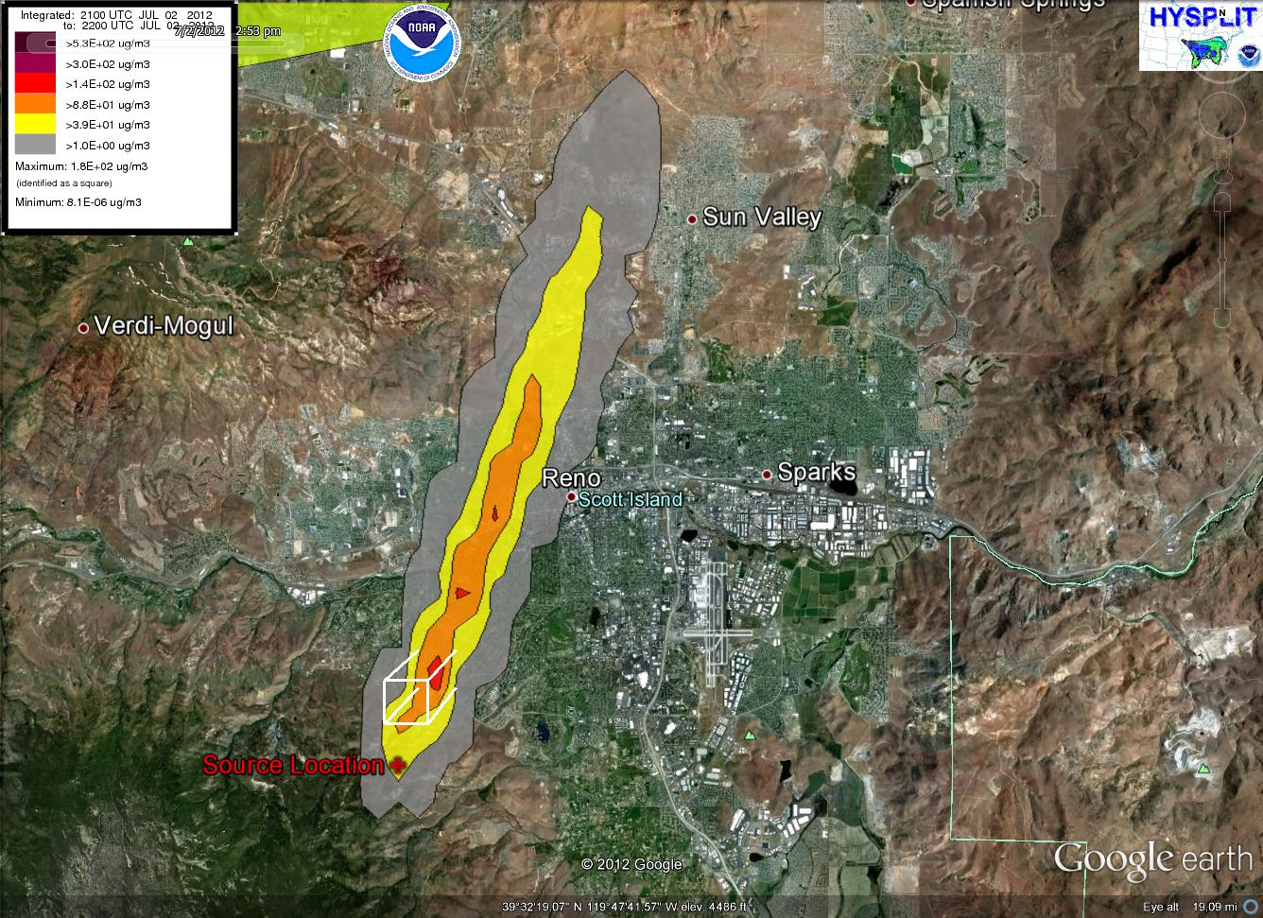
Smoke Plume Intersecting the UNR AERONET site

Slide 28
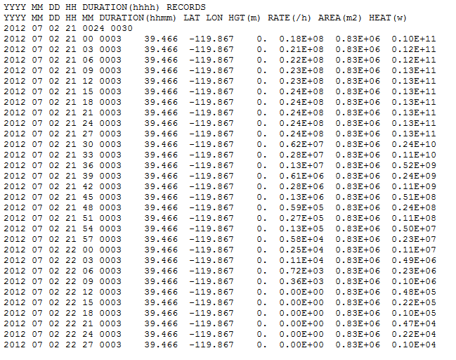
Prescribed Burn Calculation Assumptions

Slide 29
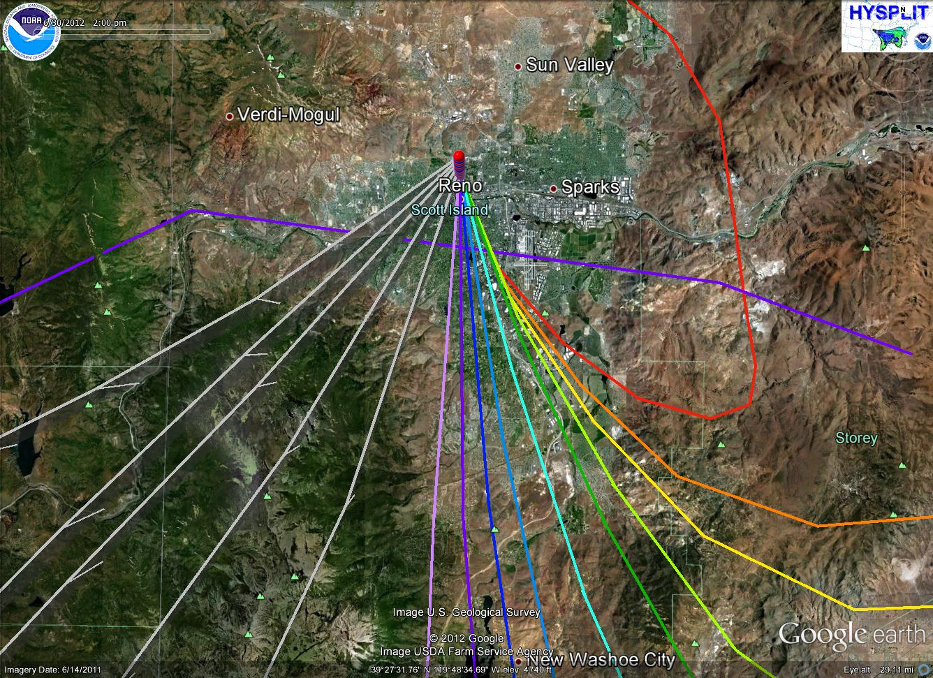
Back Trajectories from the UNR AERONET site

Slide 30
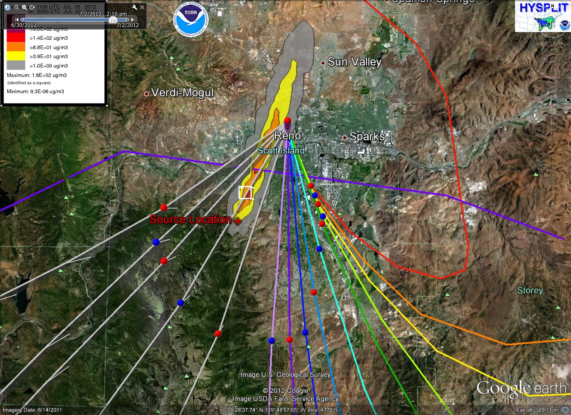
Back Trajectories and Plume Overlay

Slide 31
Satellite Remote Sensing Limitations (in sight of recent developments)
Lack of necessary pixels, appropriate resolution, or swath size.
Algorithm Errors that lead to problematic data.
Inability to continuously correct for surface and ocean albedo, elevation gradients, ocean glint
Vertical resolution needs improvement on current sensors.
Inability to identify vertical distribution of atmospheric components (unless intersected by CALIPSO)
Several sensors are far past their predicted lifetime and working (but for how long?)
Sensors are experiencing losses of data (OMI)
Sensors will fall out of orbit eventually though some sooner than others (PARASOL)

Slide 32
Future Improvements
Numerous scientific programs and teams are working on independent algorithm corrections and model improvements.
Computer processing limitations are being overcome
Remote sensing understanding is constantly improving
Algorithms for pixel “smoothing” are being worked on
Help in understanding vertical resolution is being worked on
Levels of data processing are constantly improving to allow for additional land, ocean, atmosphere, climate, etc. products.
Correlating ground and satellite based sensors data
Incorporating local meteorological data
More sensors will be lunched for additional and improved satellite data

Slide 33
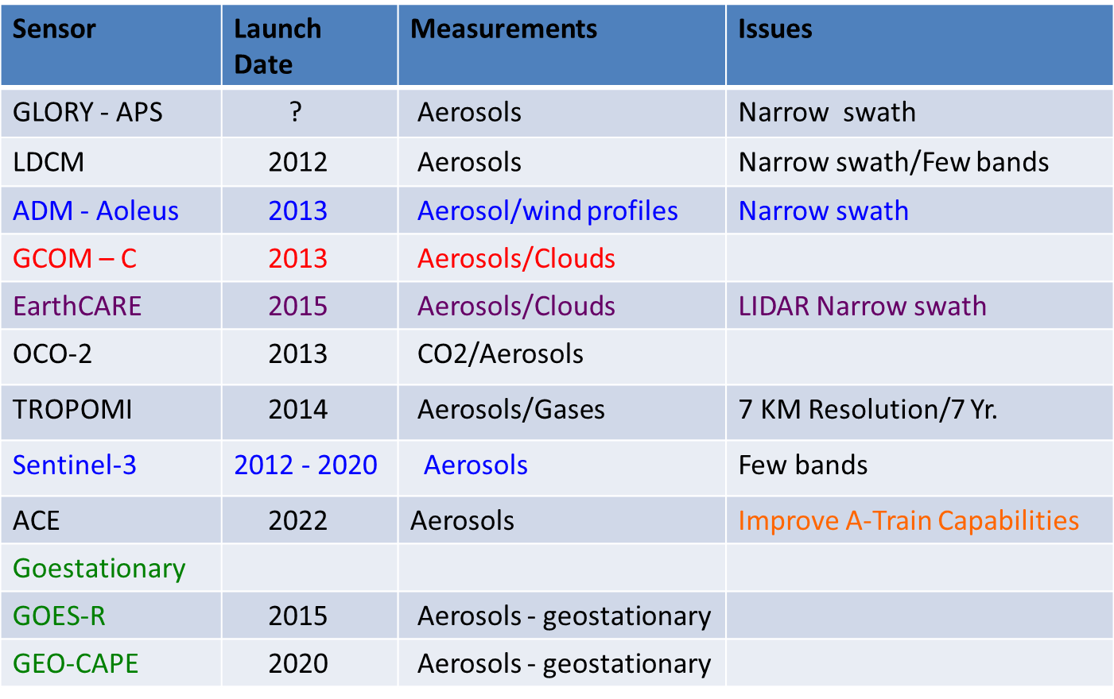
Future Improvements/Missions
Blue – ESA sensors Red – Japanese sensor Green – Geostationary
Taken from NASA ARSET Webinar Series Presentations

Slide 34
Conclusions
CIMEL level 1 data proved to be reliable to study the smoke plume passing through the column
Limitations of Remote Sensing
Lack of CALIPSO data
Smear of AOD data across a large area via MODIS
Lack of reliable AOD pixels
Inability to recognize smoke on both CIMEL data and on MODIS imagery
Lack of resolution for relatively small scale burn events (206 acre fire)
HYSPLIT’s Dispersion Model passed over the University for the time in which we physically observed smoke
The Smoke Verification Tool is very rough when compared with the HYSPLIT Dispersion Model

