Slide 1
Aerosol Optical Depth during the Northern CA Fires of 2008
In situ aerosol light scattering and absorption measurements in Reno Nevada,
2008, indicated that July was heavily impacted by smoke transported from
wildland fires in Northern California, while August was more of a typical month.
This case study seeks to compare the regional character of aerosol optical depth
for these two months to evaluate the extent and magnitude of the wildland fires
at source and downwind areas.
An in-class project, 18 September 2012.

Slide 2
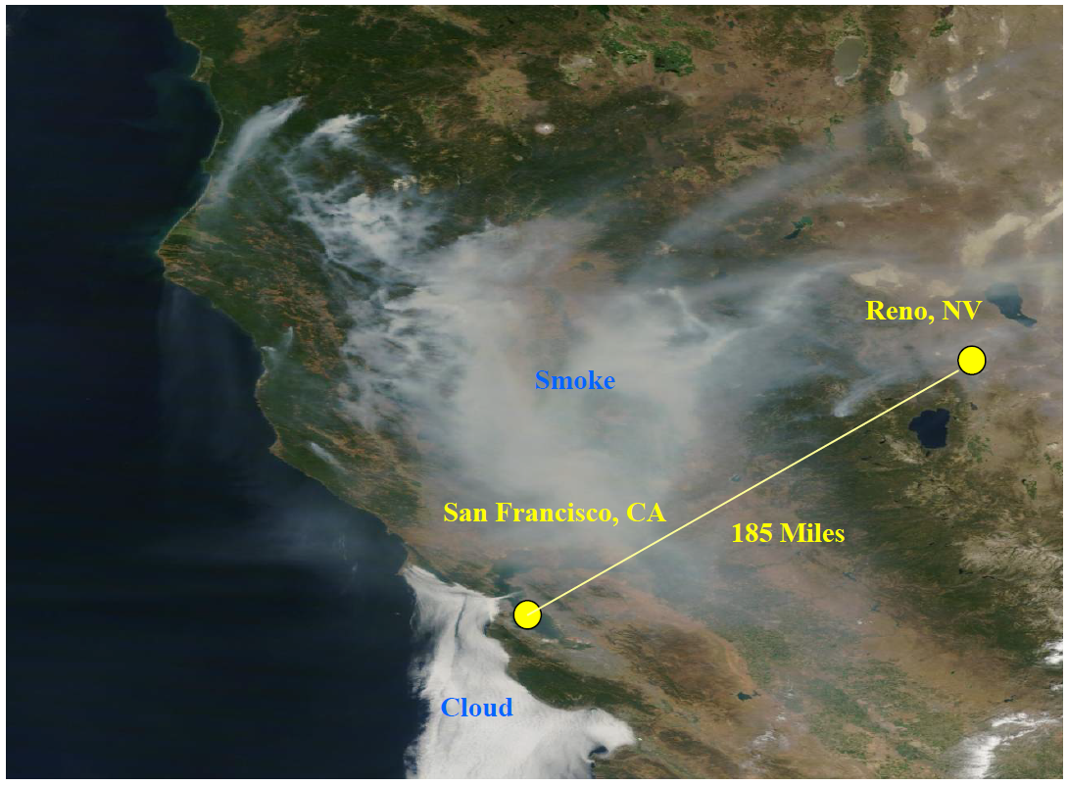
Satellite Image from July 10th 2008
From Gyawali, et al 2009

Slide 3
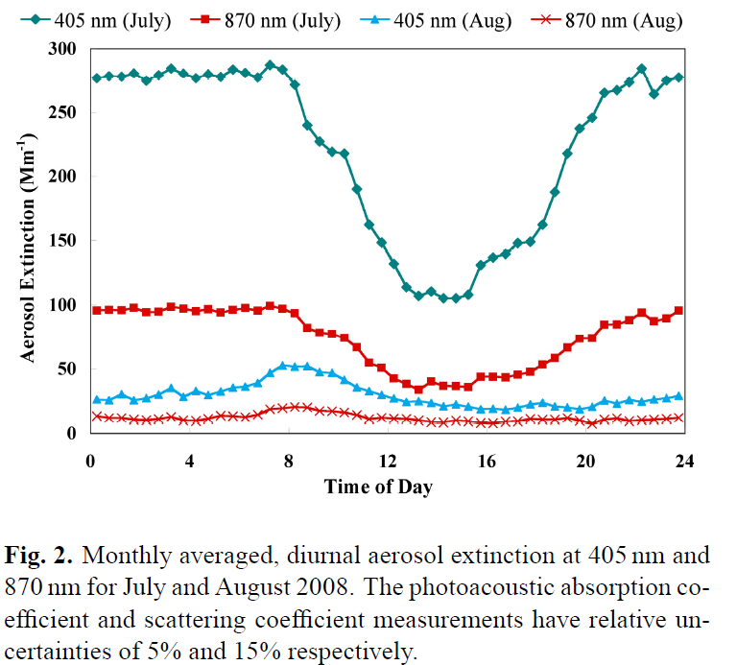
In Situ Aerosol Extinction Coefficient for July and August 2008

Slide 4
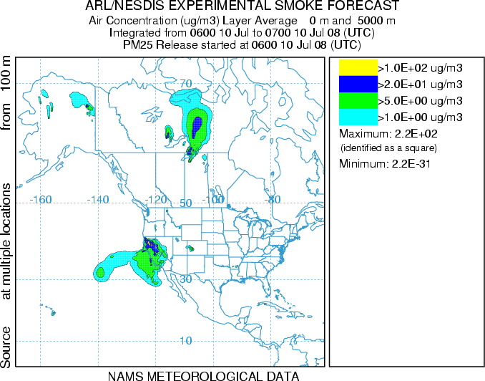
Smoke Analysis for July 2008
From http://ready.arl.noaa.gov

Slide 5
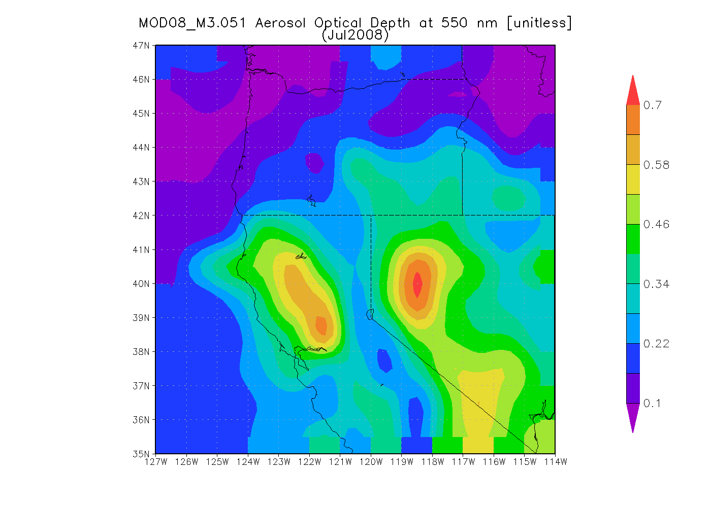
MODIS TERRA 550 nm for July 2008

Slide 6
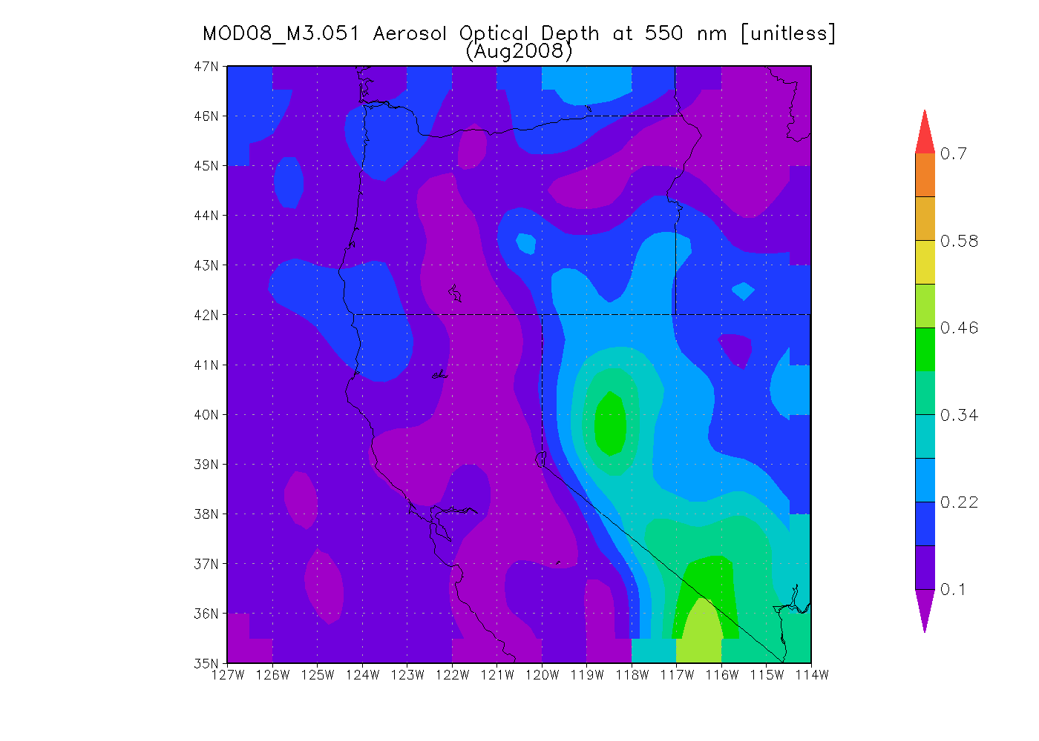
MODIS TERRA 550 nm for August 2008

Slide 7
MODIS TERRA 550 nm for August 2008
JULY 2008
August 2008

Slide 8
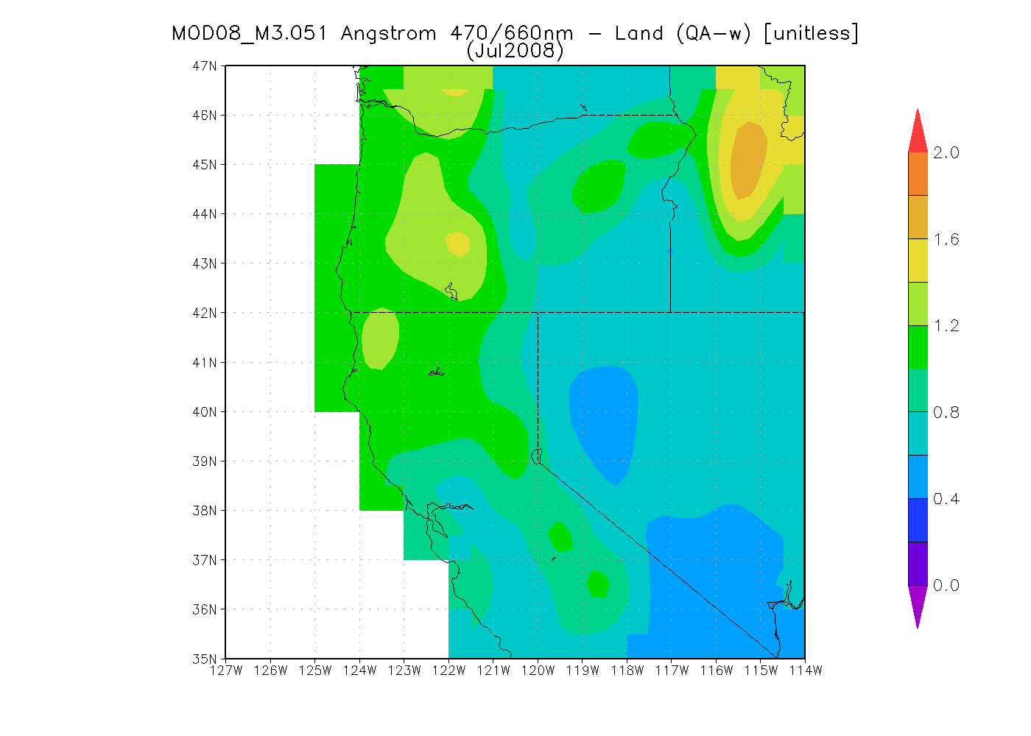
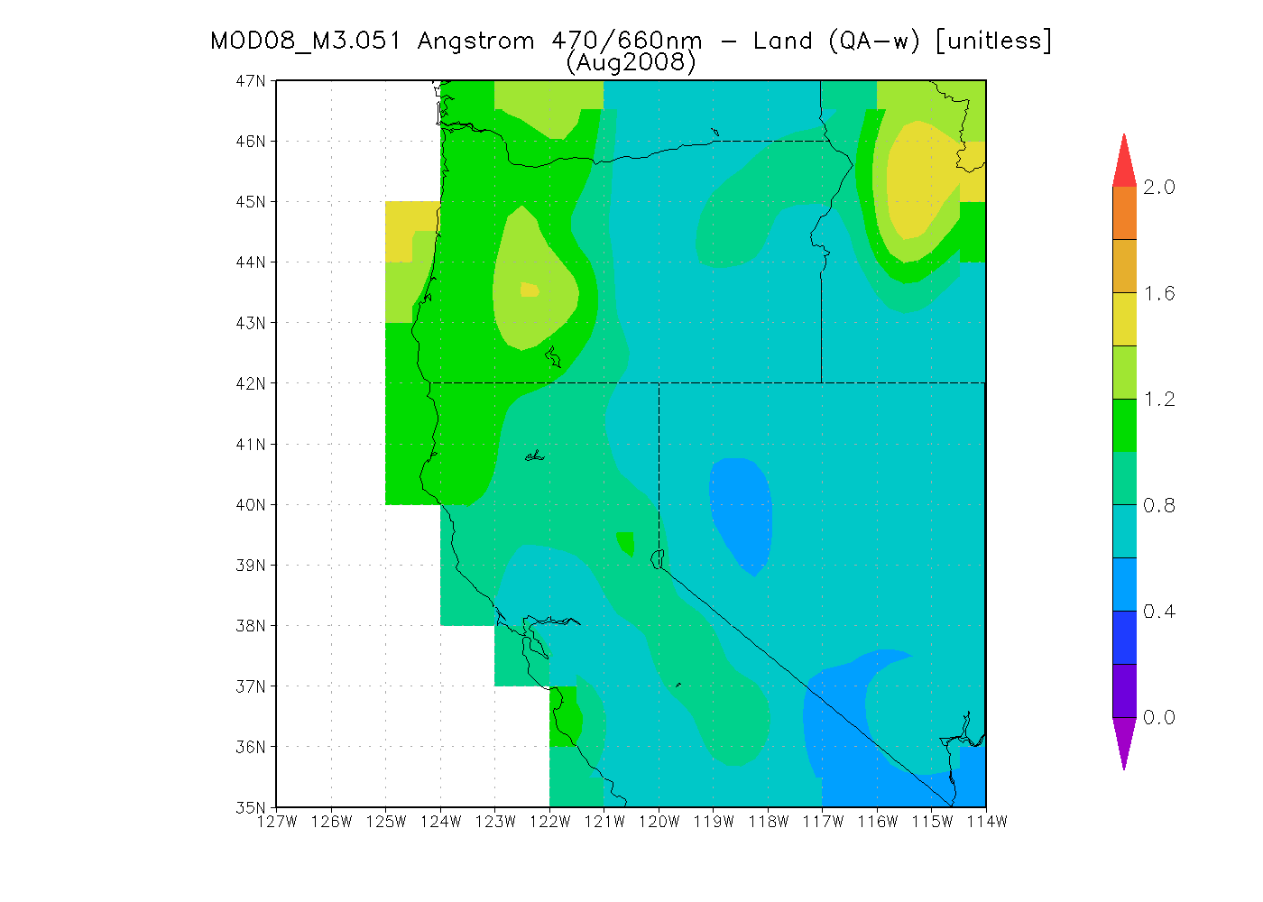
MODIS TERRA Angstrom Exponent for July and August 2008
Smaller Angstrom exponents correspond to larger particles, suggesting
that Northern CA is associated with submicron aerosols while the area
near Reno NV in the Great Basin is additionally affected by dust aerosol.
The Great Basin result may be an artifact of the retrieval algorithm since
the surface in this area is mostly of a bright, desert nature, and the algorithm
works best for dark surfaces.

Slide 9
Conclusions
Large values of aerosol optical depth were noted, on average, for the month of July 2008, in the Northern California and western Great Basin area due to wildland fires in July. August 2008 was a ‘typical’ month for both areas as the fires were out by then.
The Great Basin area has significantly higher optical depth in August 2008 when compared with the Bay area and Northern CA in general. Angstrom exponents indicated the Great Basin aerosol is larger than the Bay area aerosol, suggesting significant contributions from dust aerosol to AOD in the Great Basin.
Further work could look at the ‘Deep Blue’ retrieval for bright surfaces, could look at broader areas, and could use the observed AOD to investigate aerosol radiative forcing.

