Slide 1
Aerosol Optical Depth during the fires of Amazon Rainforest in Mato Grosso state of Brazil in September, 2007

Slide 2
Outline
Importance of the Aerosol study
Geography, demography, and ecosystem of the state
Vegetation in the Amazon
Image of fires on the southern Amazon
Backtrajcetories
Comparison between MODIS TERRA and AERONET AOT and Angstrom values
Summary

Slide 3
Importance of Aerosols study
Health
  Heart disease
  Respiratory ailments
  Environmental
  Visibility reduction
  Clouds formation and rainfall
  Radiation balance

Slide 4
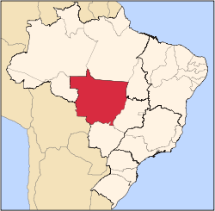
Geography, Demography, and Ecosystem of the study site
Mato Grosso state (Midwestern Brazil )
Located at 11⁰47’ S 57⁰ 06’ W, 334 m
Urbanization (76.6 %) (2006) and Population growth (2.4%) (1991-2000)
Agriculture is 40.8% of GDP
Climate: Hot and humid at low land and hot and dry at highlands. Average temperature is 26⁰ C and average annual rainfall 1500 mm. Distinct dry season from May to September.
Three different ecosystems: Amazon Rainforest, Savana Tableland, and Pantanal
Fires area

Slide 5
Vegetations in Amazon Rainforest in Brazil
Orchids
Bromeliads
Ferns
Bougainvillea
Ficus
Rattan palms
Peeper
Philodendrons

Slide 6
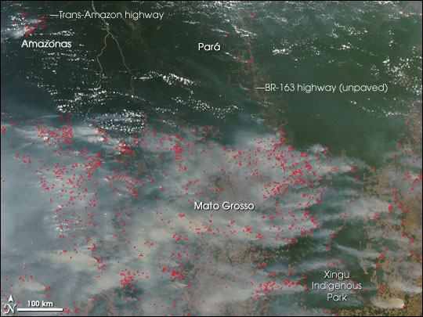
Fires on the southern Amazon in the state of Mato Grosso Brazil of September 29, 2007
MODIS, NASA

Slide 7
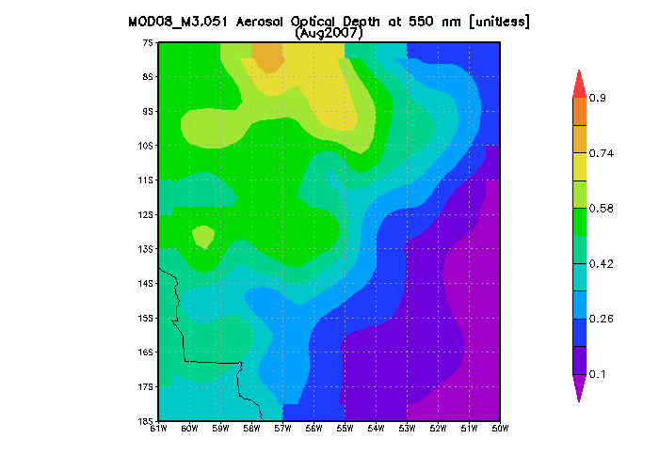
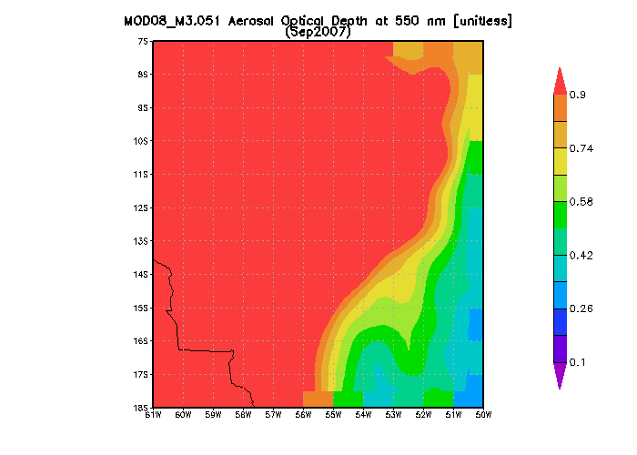
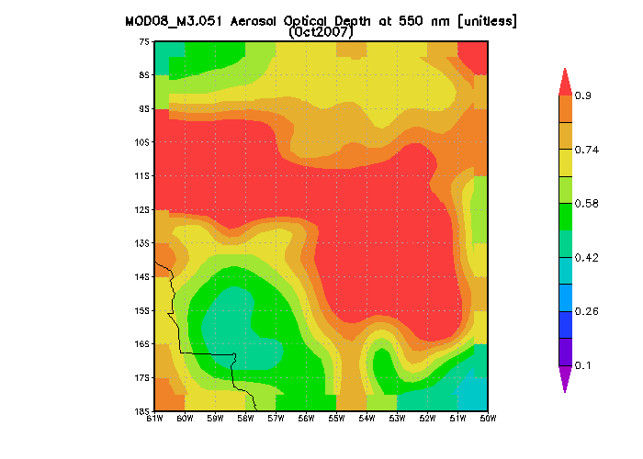
Comparison of MODIS TERRA (AOD) for Aug., Sept.,and Oct. 2007
Aug.
Sep.
Oct.

Slide 8
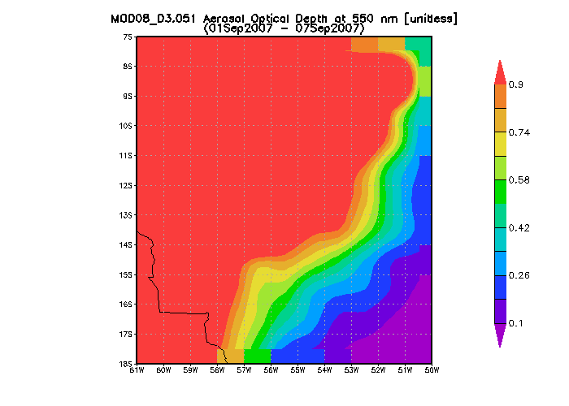
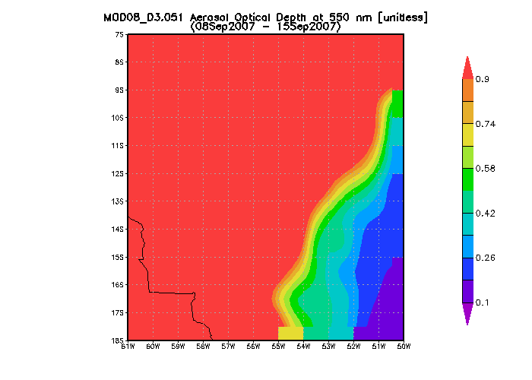
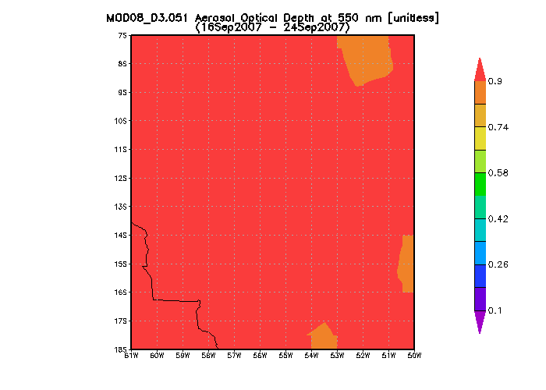
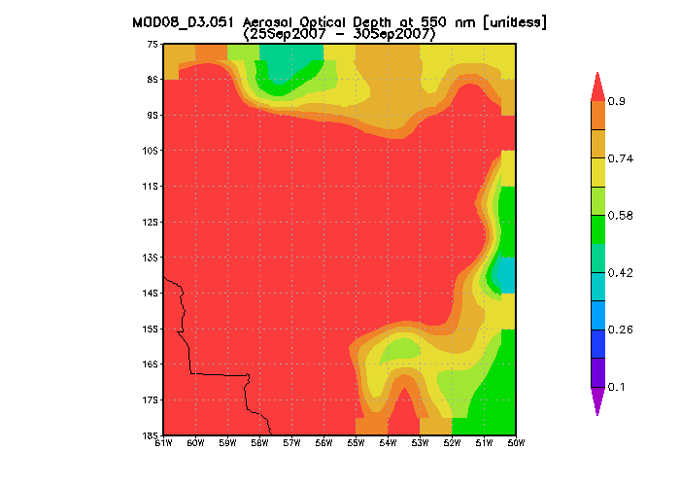
MODIS TERRA 550 nm (AOT) for Weekly Comparison: September 2007
1.
2.
3.
4.

Slide 9
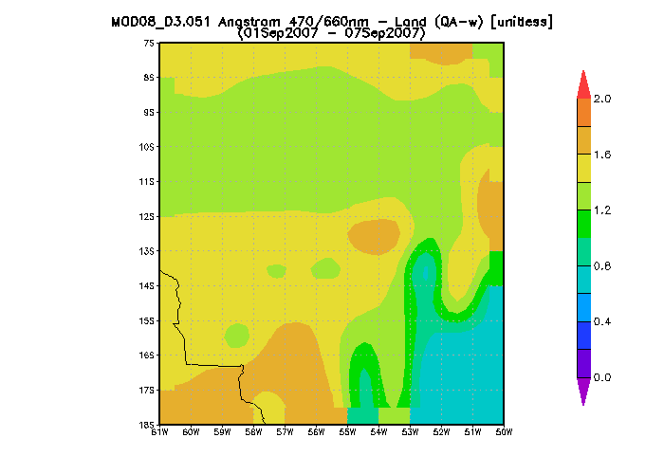
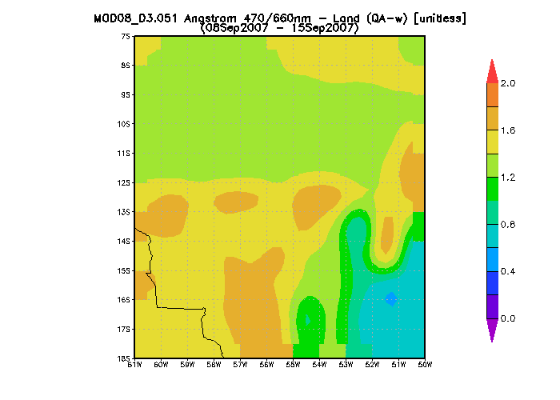
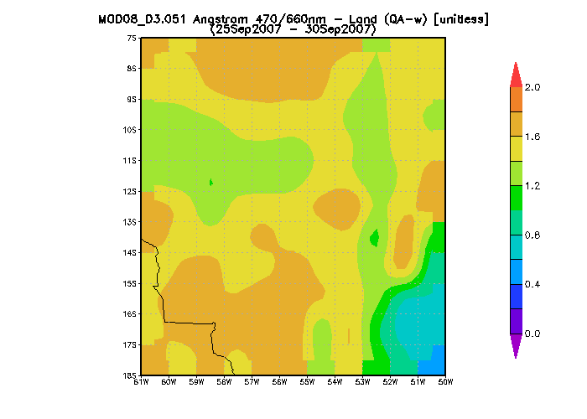
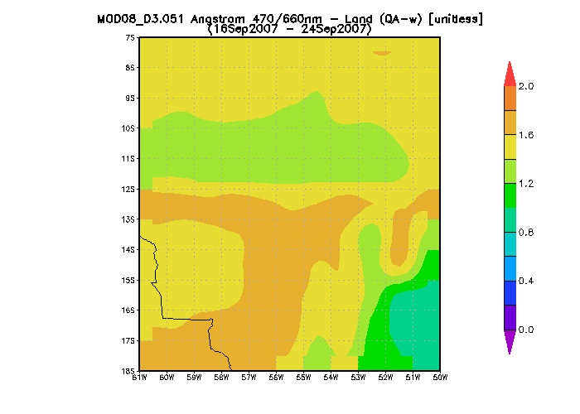
MODIS TERRA 470/660 nm Angstrom exponent for weekly comparision: September 2007
1.
2.
3.
4.

Slide 10
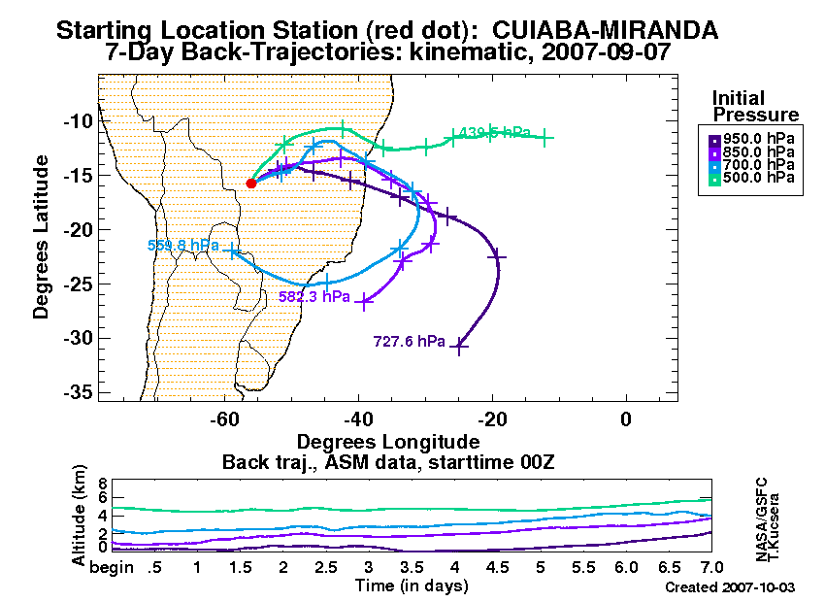
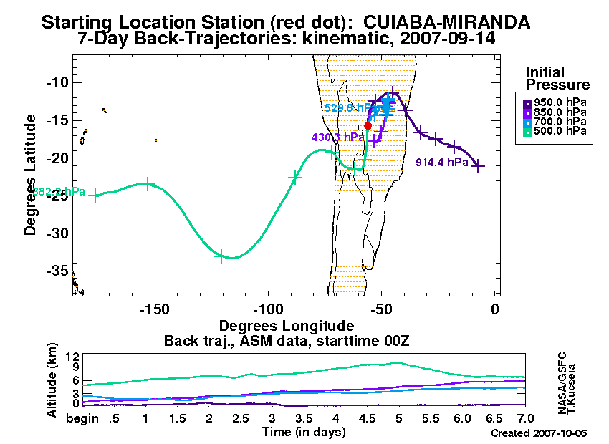
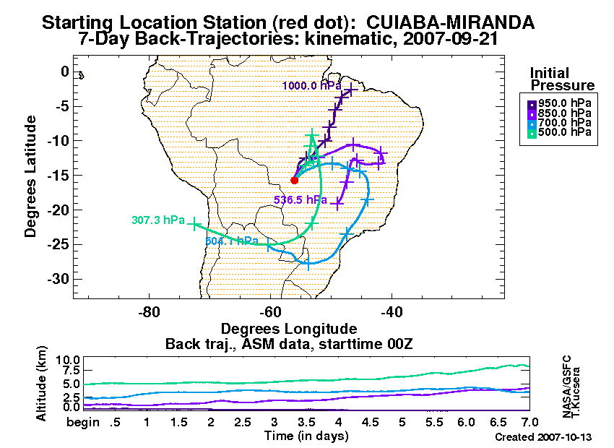
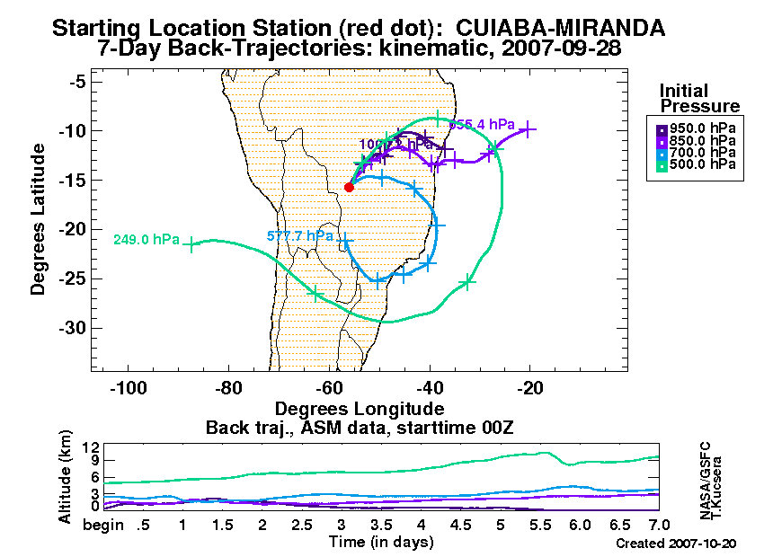
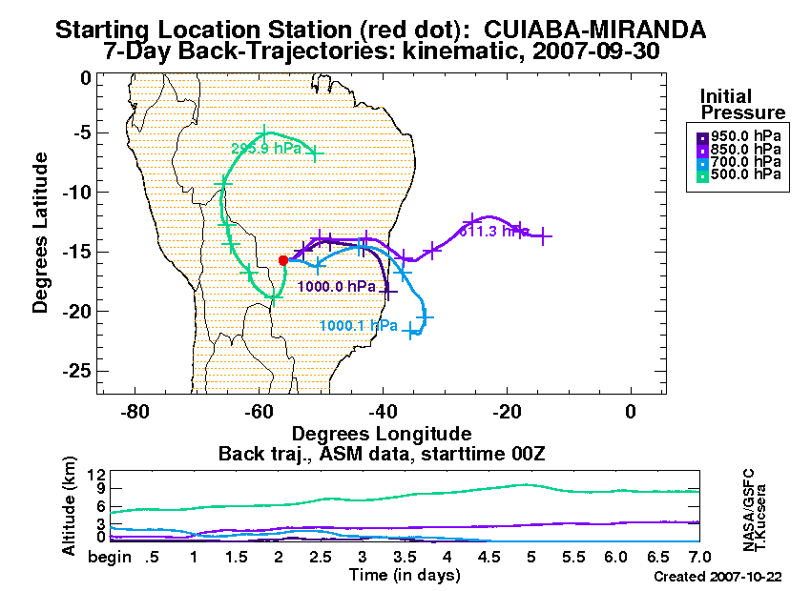
Backtrajcetories

Slide 11
Comparision between AERONET AOT and MODIS TERRA AOT

Slide 12
AERONET (AOT) vs MODIS TERRA (AOT)

Slide 13
Comparision between AERONET AOT and MODIS TERRA Angstrom

Slide 14
Summary
An optical depth is increasing continuoulsy from first week of September to the end of September. This variation on two sides of the region might be due to mountain barrier.
MODIS TERRA (AOT) values were generally higher than those of AERONET AOT values.
AOT is as high as 3.25 observed from the MODIS TERRA during 3rd week of September.
Angstrom values are always >1, which indicates the presence of fine aerosols particles in the atmosphere during the fires period.

