Slide 1

Seasonal Biomass Burning in Africa and its effects on air quality: a study of AOD in 2008-2010 with some comments on long-range transport
The Zambezi River Valley and surrounding areas, July, 2011.

Slide 2
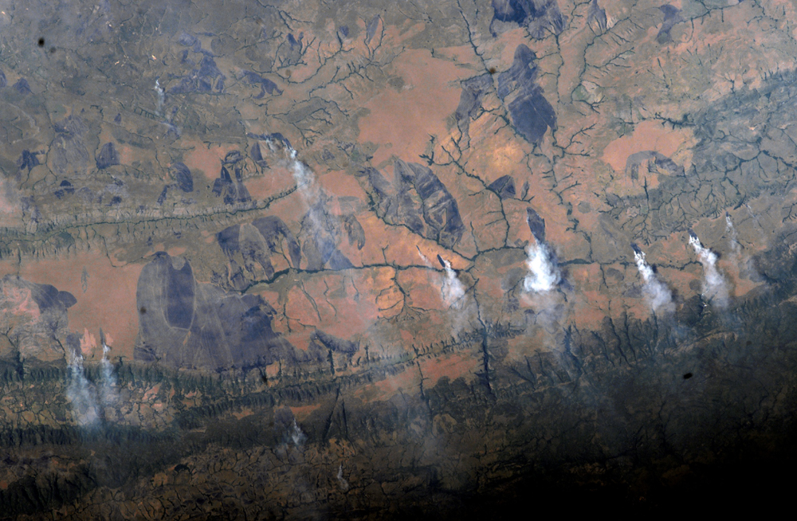
MODIS above the Democratic Republic of Congo, May 16, 2002.
with
Ben Sumlin

Slide 3
Biomass Burning in Africa
Divided in to two regions
Northern burns occur January-April
Southern burns occur May-August
No reliable Aeronet data for southern regions
Agricultural Reasons
Clear fields for new crops
Fertilize soil
Consequences
Long-range transport

Slide 4
Motivation for this Case Study
Compare satellite data against ground-based data to determine assess validity of both
Explore yearly trends and anomalies at Ilorin, Africa, located in the heart of the northern burn areas
Ascension Island

Slide 5
Two Aeronet Stations
Ilorin, Africa
8N, 4E
Right in the heart of burn country
Ascension Island
15S, 23W
Monitor offshore transport
Largely incomplete data set

Slide 6
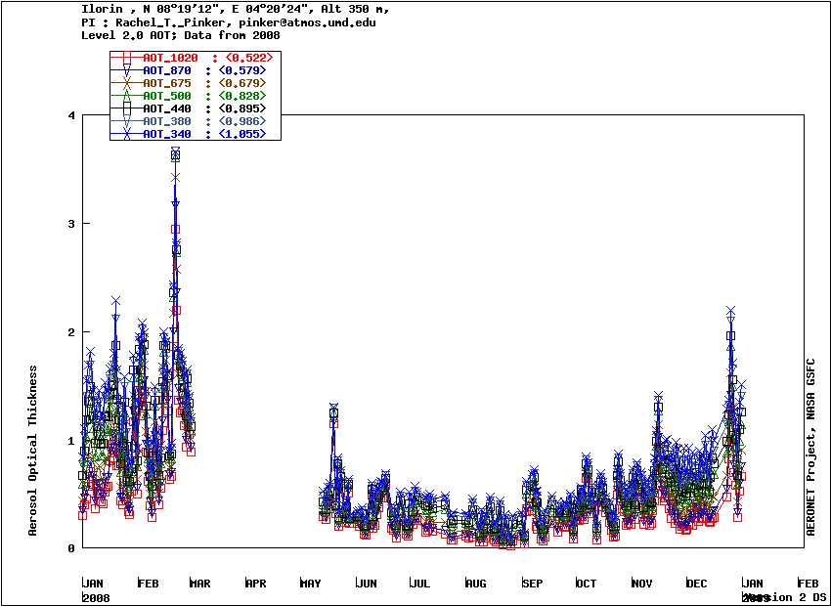
Ilorin, Africa – Aeronet Time Series of 2008

Slide 7
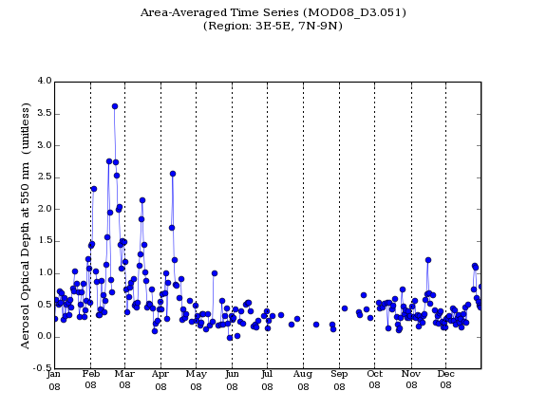
Ilorin, Africa – MODIS area-averaged time series of 2008

Slide 8
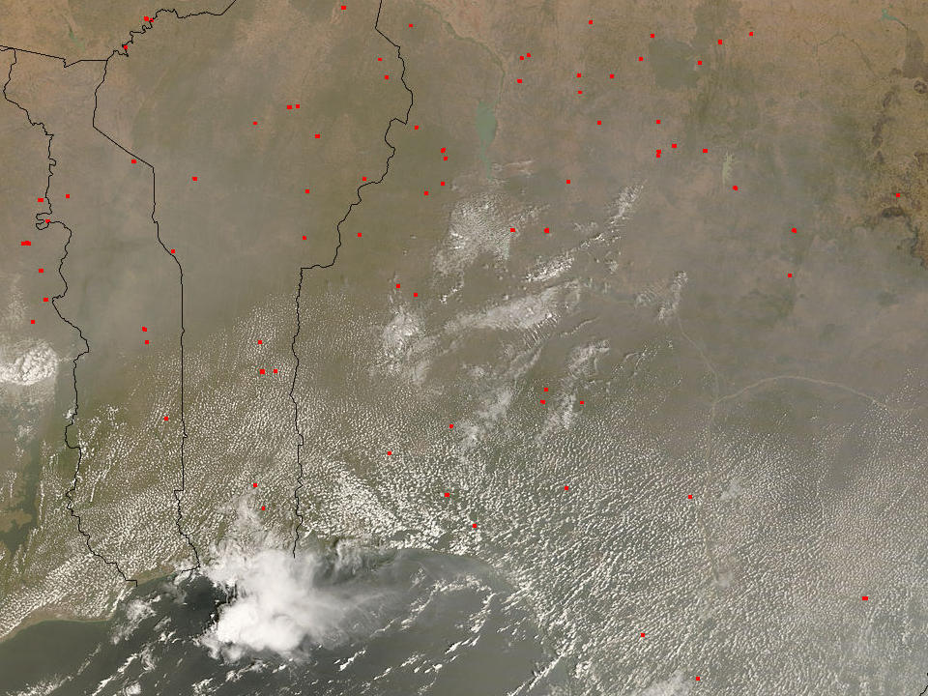
Ilorin, Africa – February 28, 2008

Slide 9
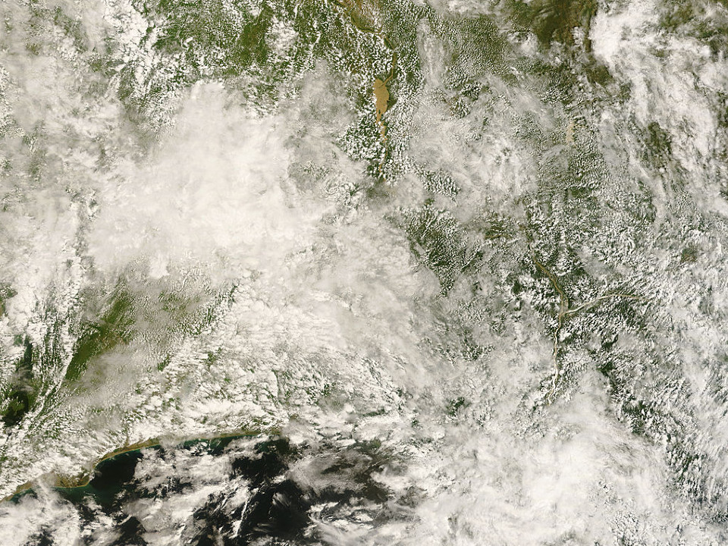
Ilorin – September 16, 2008

Slide 10
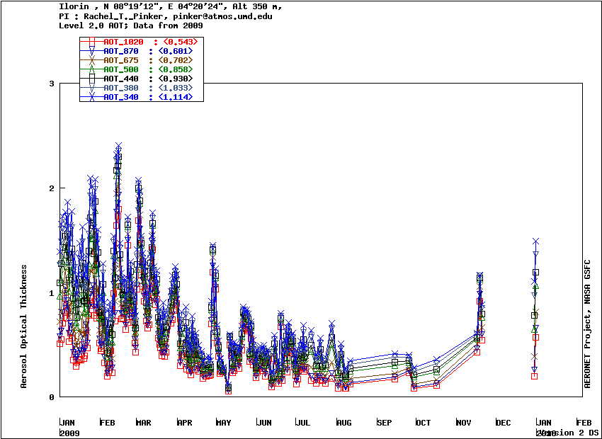
Ilorin, Africa – Aeronet 2009

Slide 11
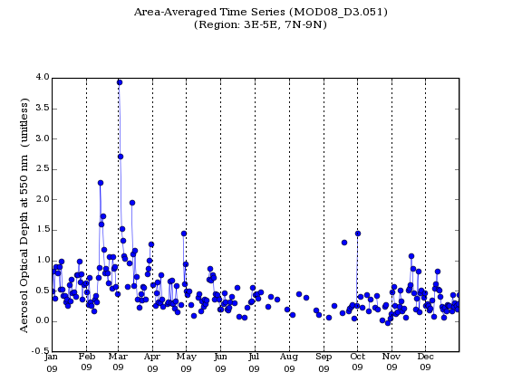
Ilorin, Africa – MODIS, 2009

Slide 12
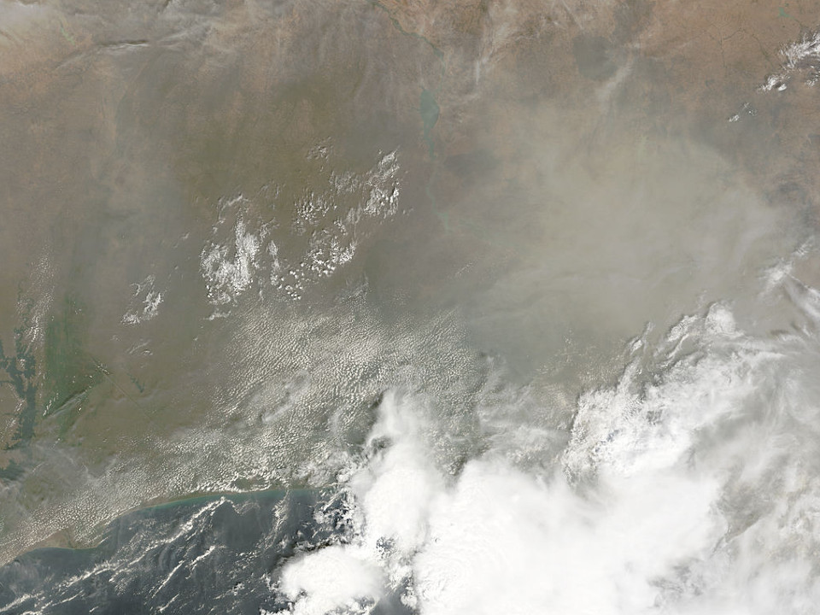
Ilorin, Africa – February 14, 2009

Slide 13
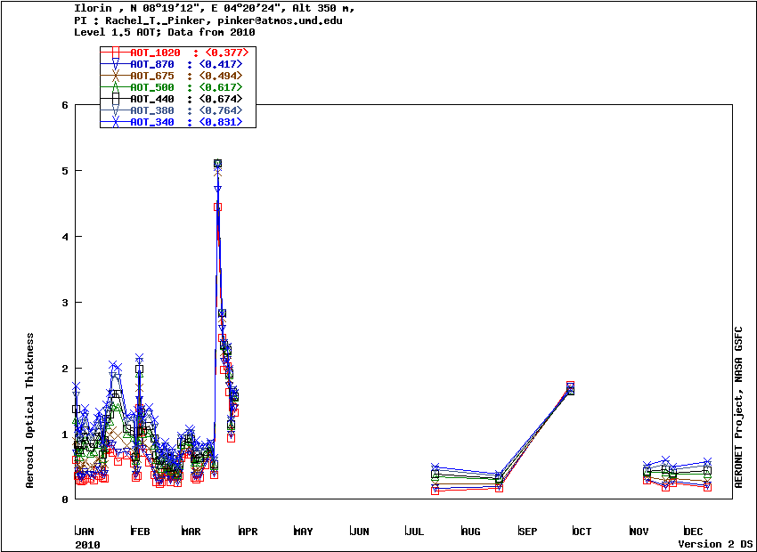
Ilorin, Africa – Aeronet 2010

Slide 14
Ilorin, Africa – MODIS, 2010

Slide 15
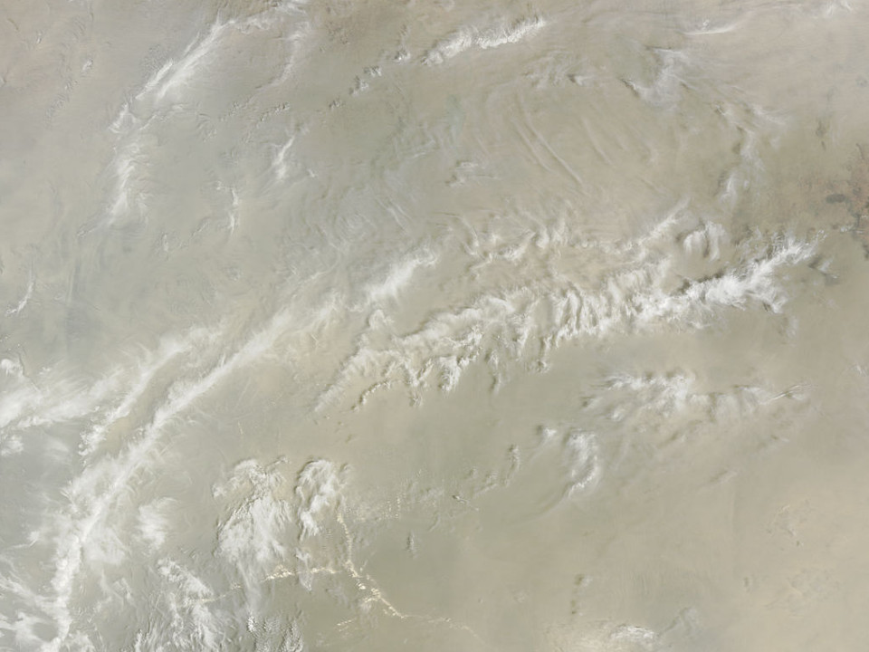
Ilorin, Africa – March 21, 2010
On this day, MODIS measured a peak OD of >5.0,
while AERONET measured just under 4.0.

Slide 16
MODIS vs. Aeronet at Ilorin
2008
Reasonable correlation, even during anomalies
2009
AOD spike on February 14
MODIS: 4.0
AERONET: 2.5.
2010
AOD spike on March 21
MODIS: >5.0
AERONET: <4.0

Slide 17
Seasonal Trends
AOD trends were identified consistent with the burning seasons

Slide 18
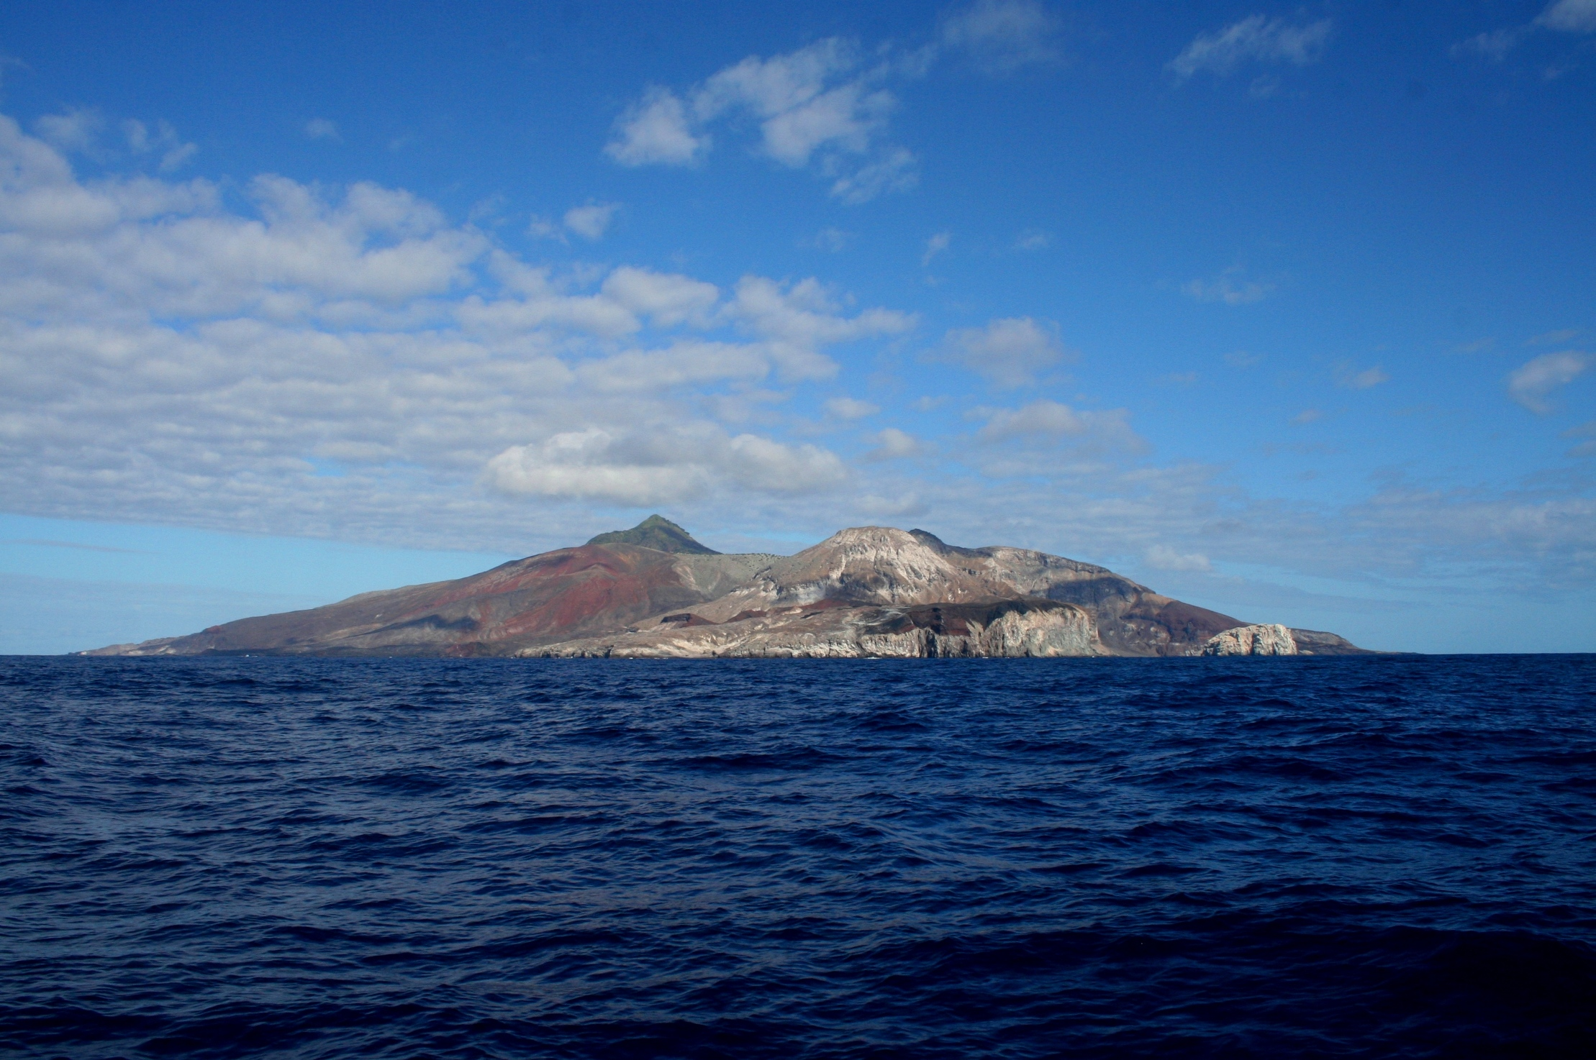
Offshore transport: Ascension Island

Slide 19
Ascension Island: ~7S, 14W
Small volcanic island in the Pacific Ocean
Under the jurisdiction of the UK
Communications hub
AERONET site
Sparse dataset
We expect to see AOD spikes over Ascension Island during the southern burn months.
More pronounced transport over the island; Northern burn emissions pass to the North of the island.

Slide 20
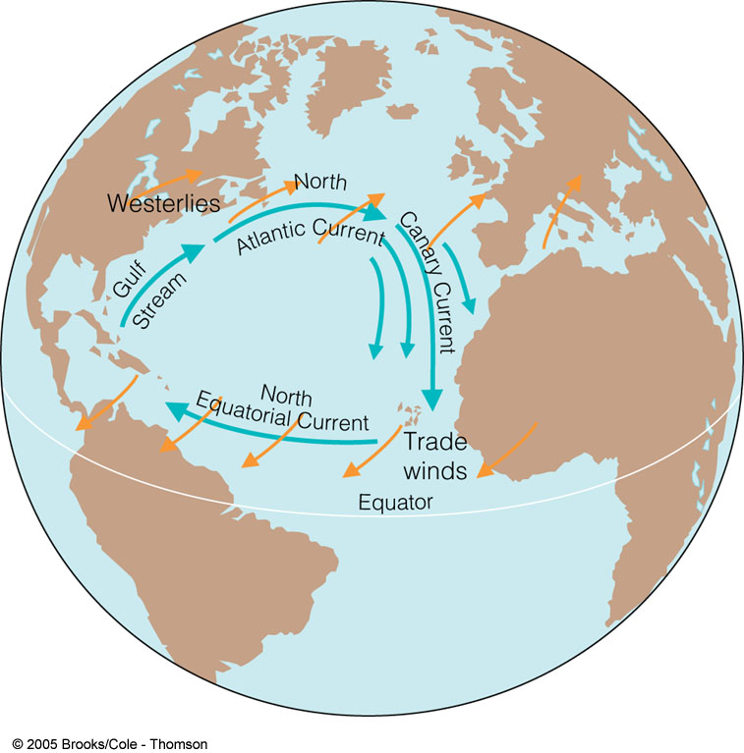
Prevailing Wind Patterns off Africa

Slide 21
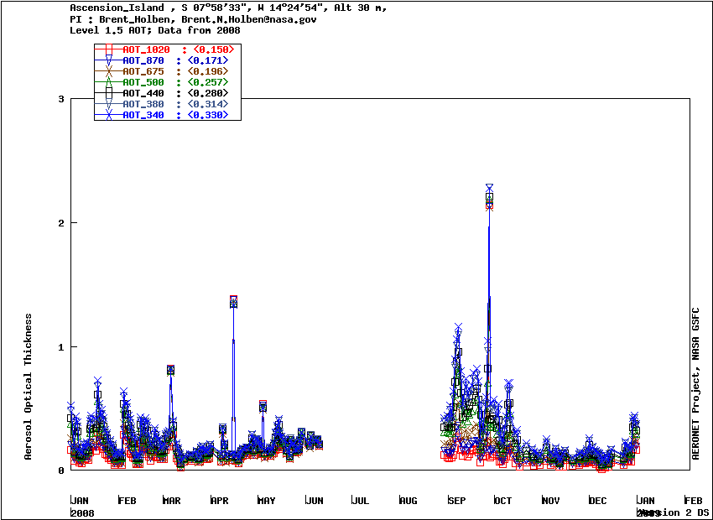
Ascension Island – Aeronet time series for 2008

Slide 22
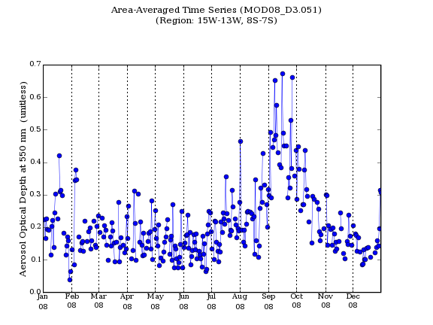
Ascension Island – MODIS area-averaged time series for 2008

Slide 23
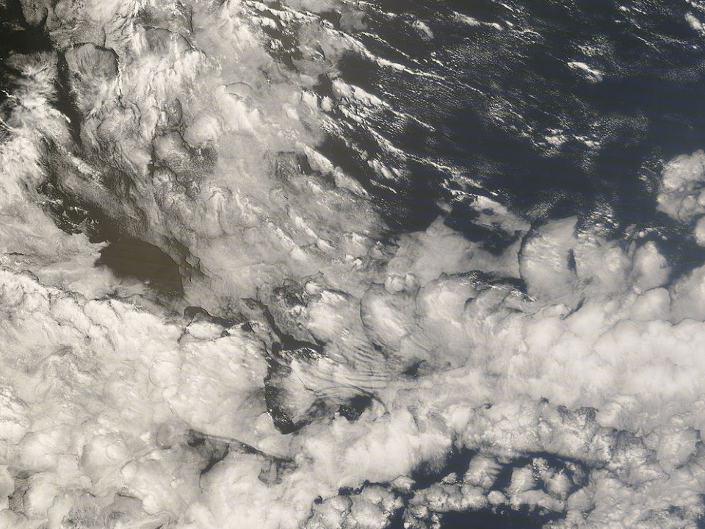
Ascension Island – September 27, 2008

Slide 24
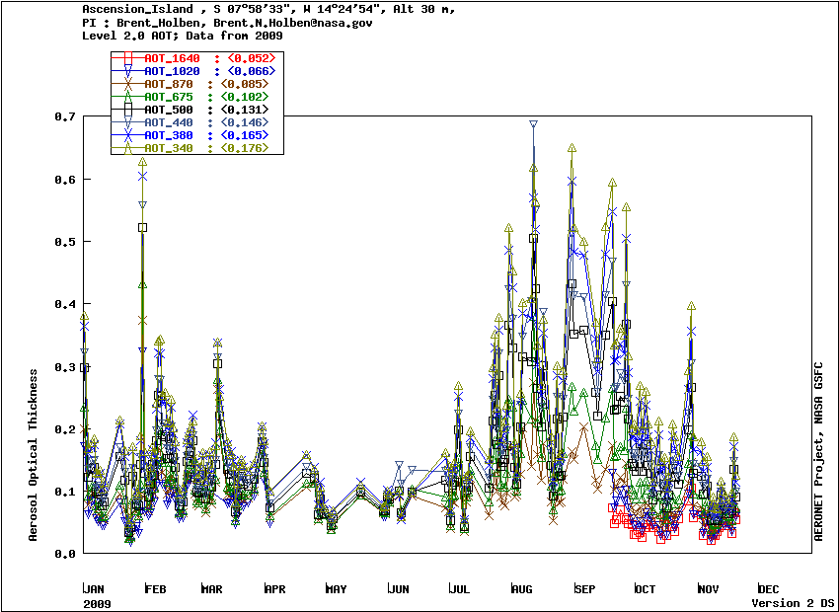
Ascension Island – Aeronet, 2009

Slide 25
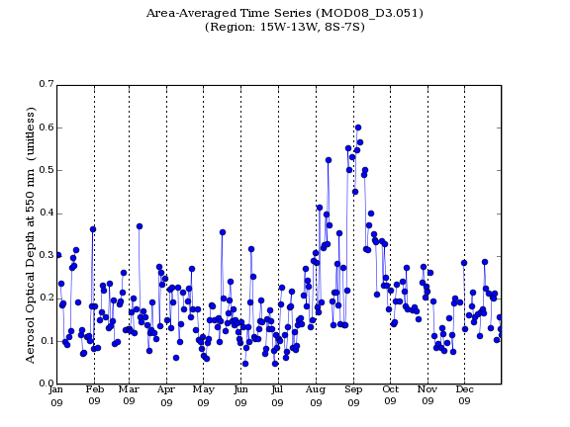
Ascension Island – MODIS, 2009

Slide 26
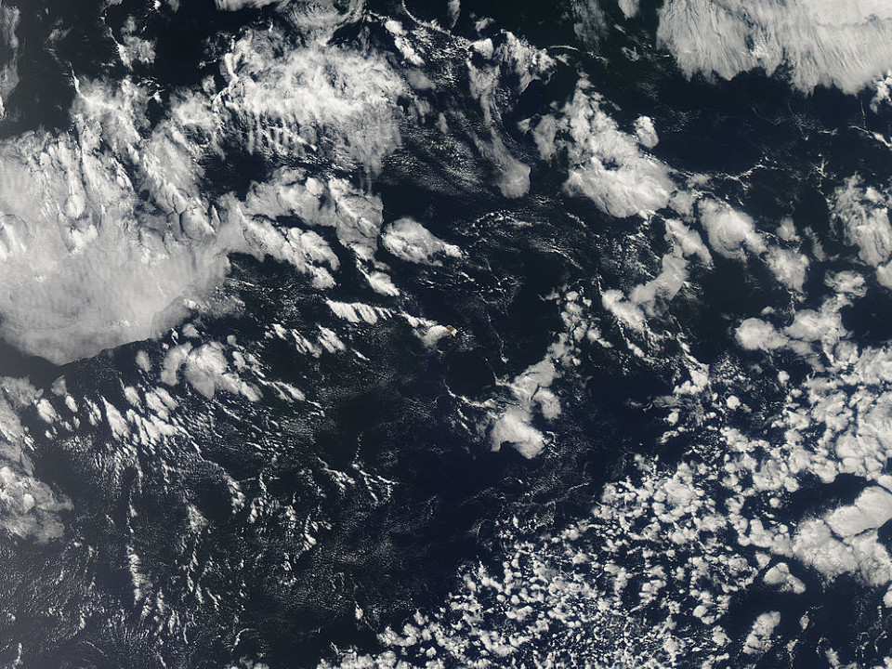
Ascension Island – September 19, 2009

Slide 27
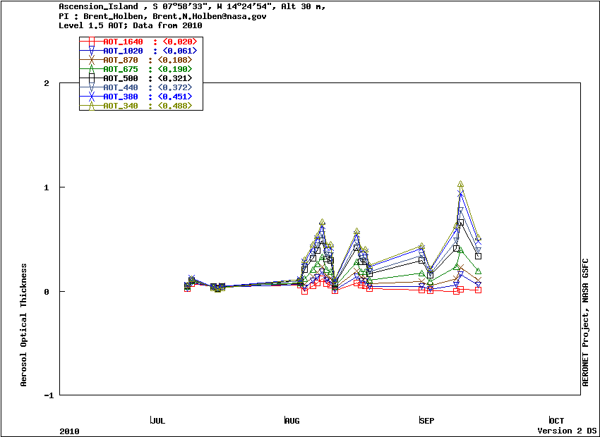
Ascension Island – Aeronet, 2010

Slide 28
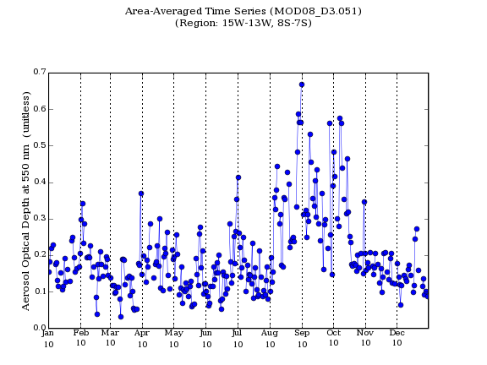
Ascension Island – MODIS, 2010

Slide 29
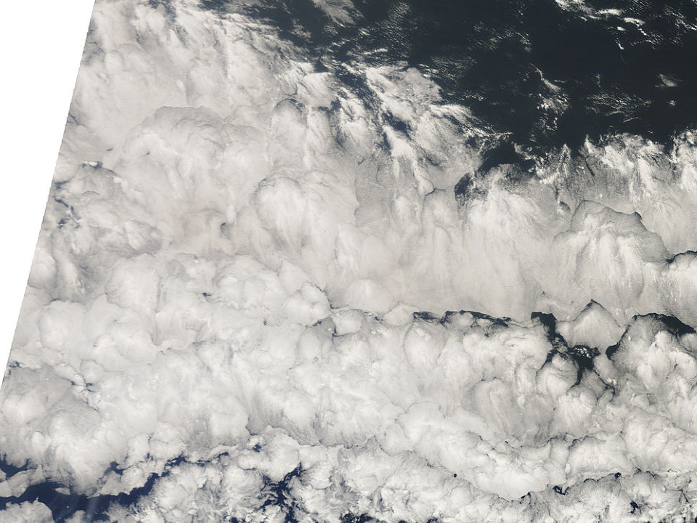
Ascension Island – August 31, 2010

Slide 30
MODIS vs. Aeronet at Ascension Island
Sparse 1.5 and 2.0 Aeronet datasets make comparisons difficult
Cloud cover
Some transport possibly identified
Inconsistencies in datasets
Level 1.5 vs. level 2.0

Slide 31
Comments on discrepancies
Sources of error
Area-averaging
Single column integrated measurement vs. area-averaged measurement
Algorithms
Discarded data
Ascension Island enjoys cloudy weather
Cloud readings are rejected by CIMEL stations.

