Slide 1
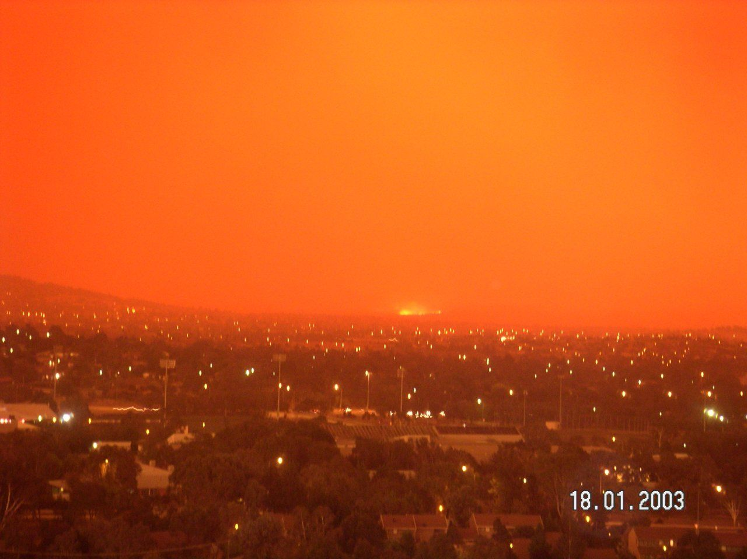
Australian Brush Fires
Canberra, Australian Capital Territory
January 2003
Daniel McEvoy & Nicholas D Beres

Slide 2
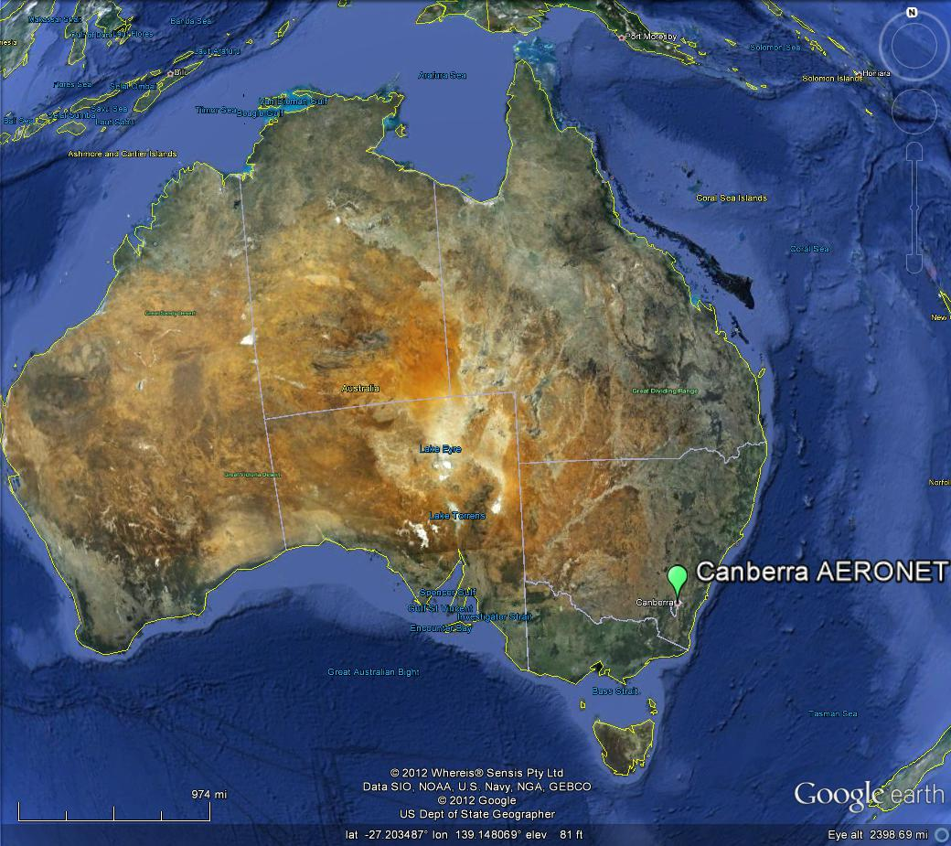

Slide 3
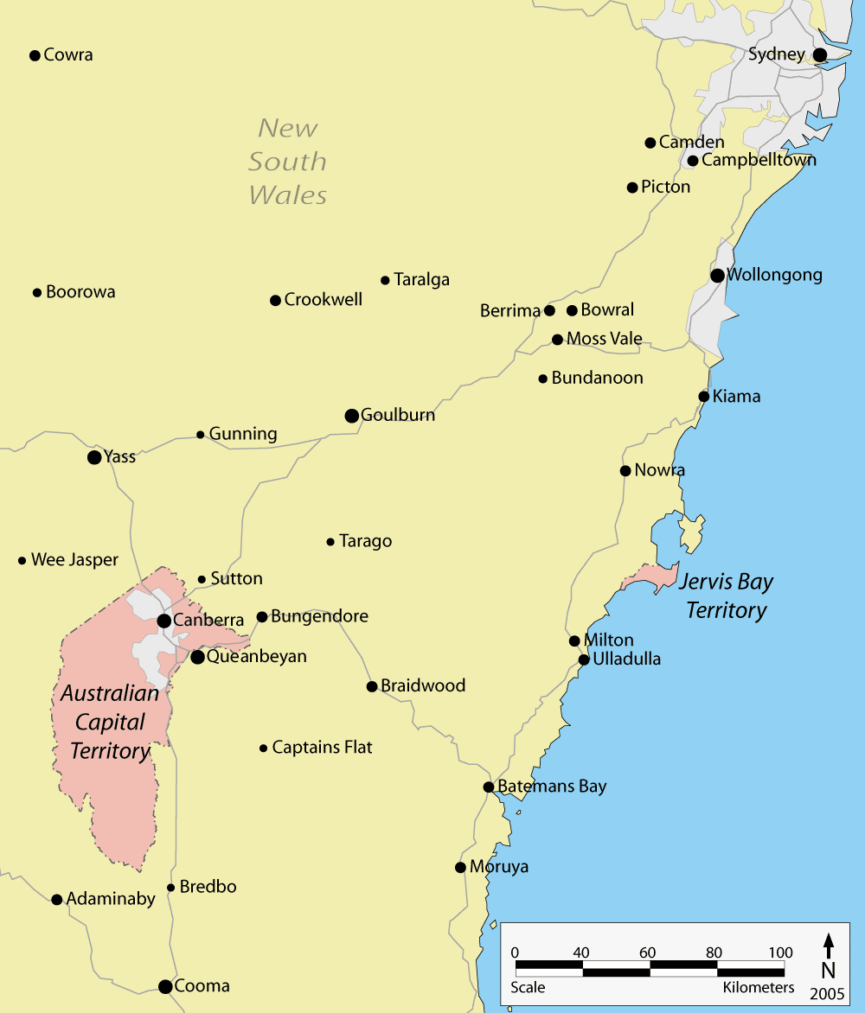
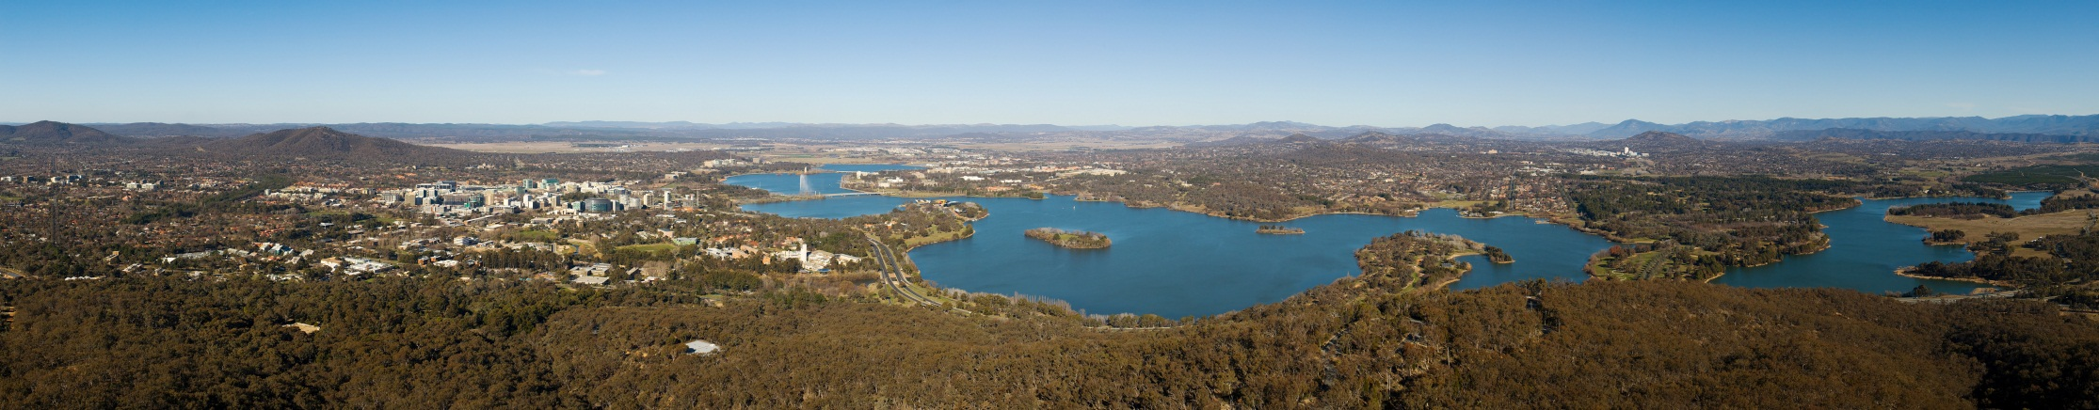
Geographical Background
Canberra = Australian
Capital City
350,000+ Population
Surrounded by
Dense forest
Mountain range to the west

Slide 4
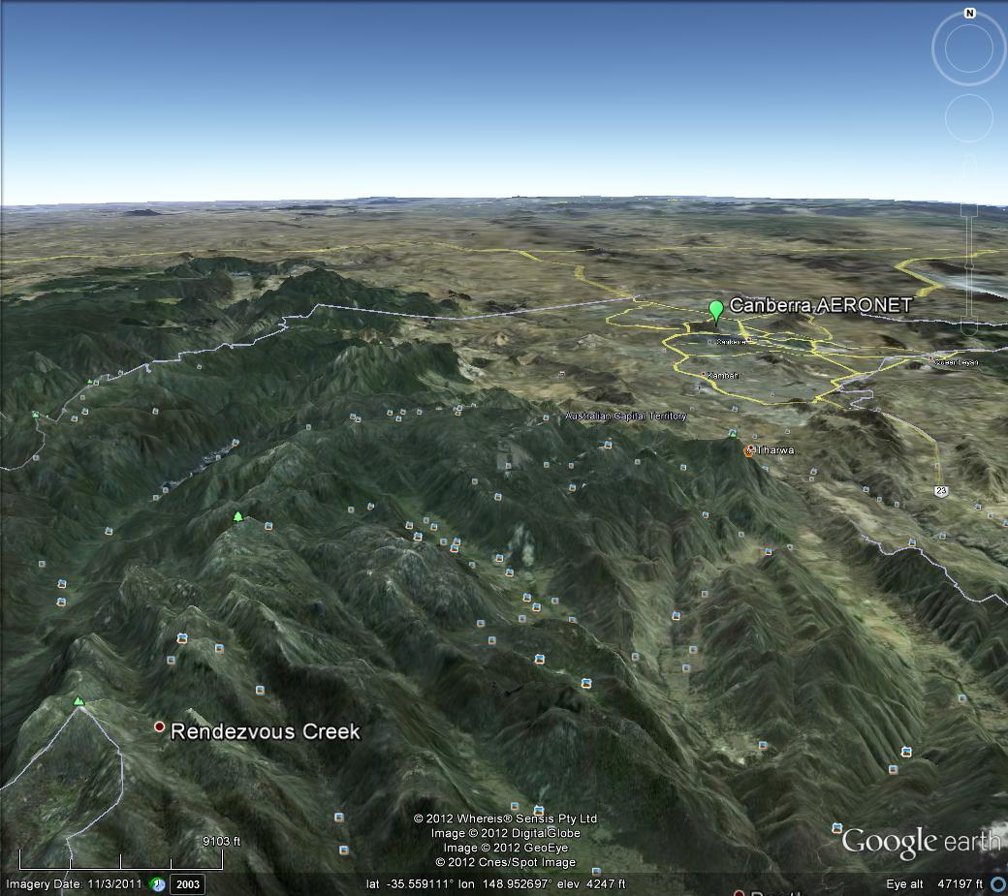

Slide 5
Motivation
Summer weather is hot and dry
Seasonal fire situation throughout Australia
AERONET station in city
Showing high AOD during fire event
= GREAT CASE STUDY!

Slide 6
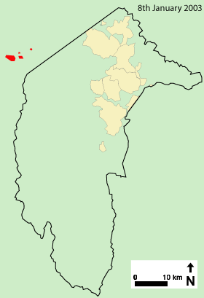
Fire
Ignition source
Lightning strike on January 8th, 2003
Small fires around territory = NBD
No sign of authorities taking control
January 18th
High temps & winds, Low RH
Fire exploded and began to engulf
city
4 deaths
500 homes destroyed

Slide 7
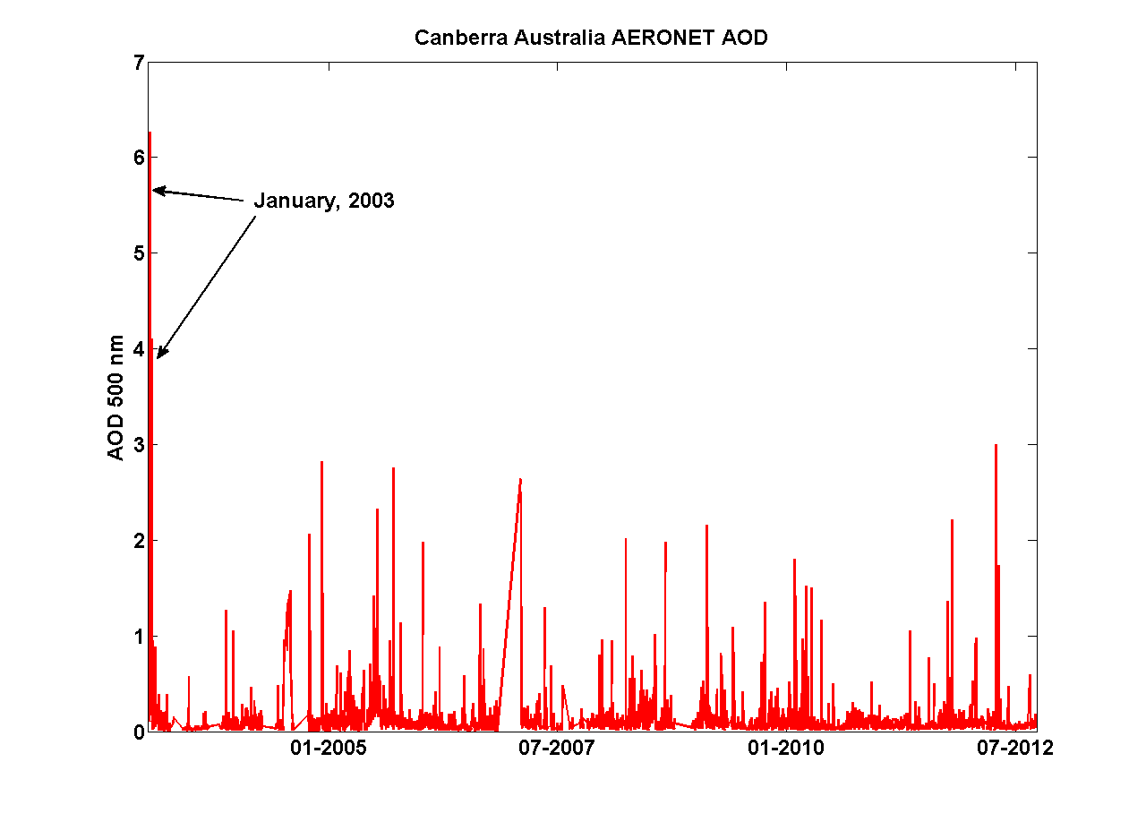
AERONET Overview

Slide 8
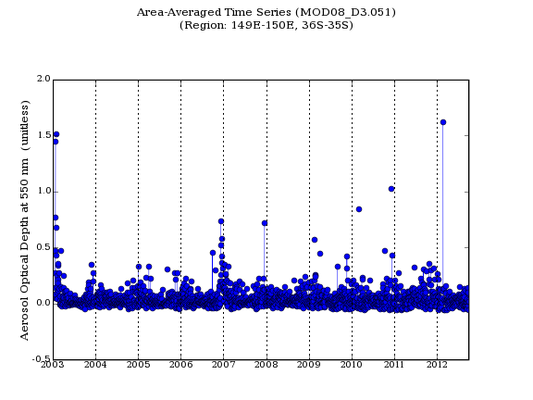

Slide 9
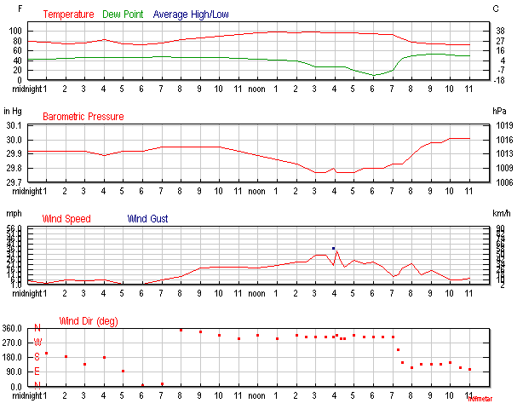
Meteorology – Jan 18th
(Weather Underground)

Slide 10
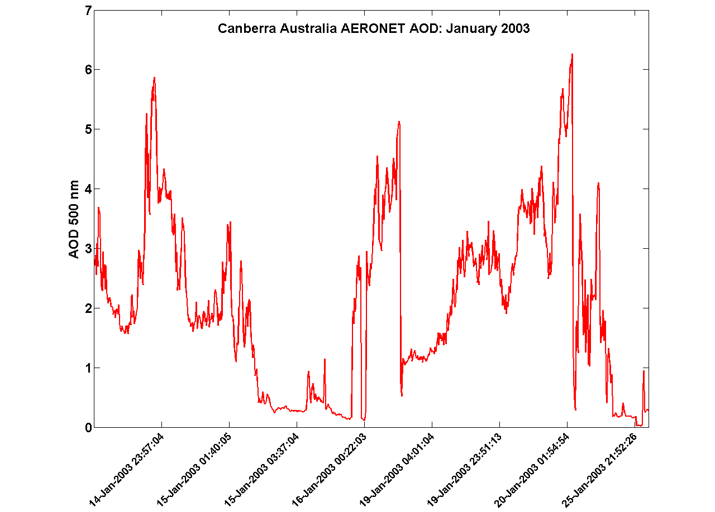
AERONET Fire Event

Slide 11
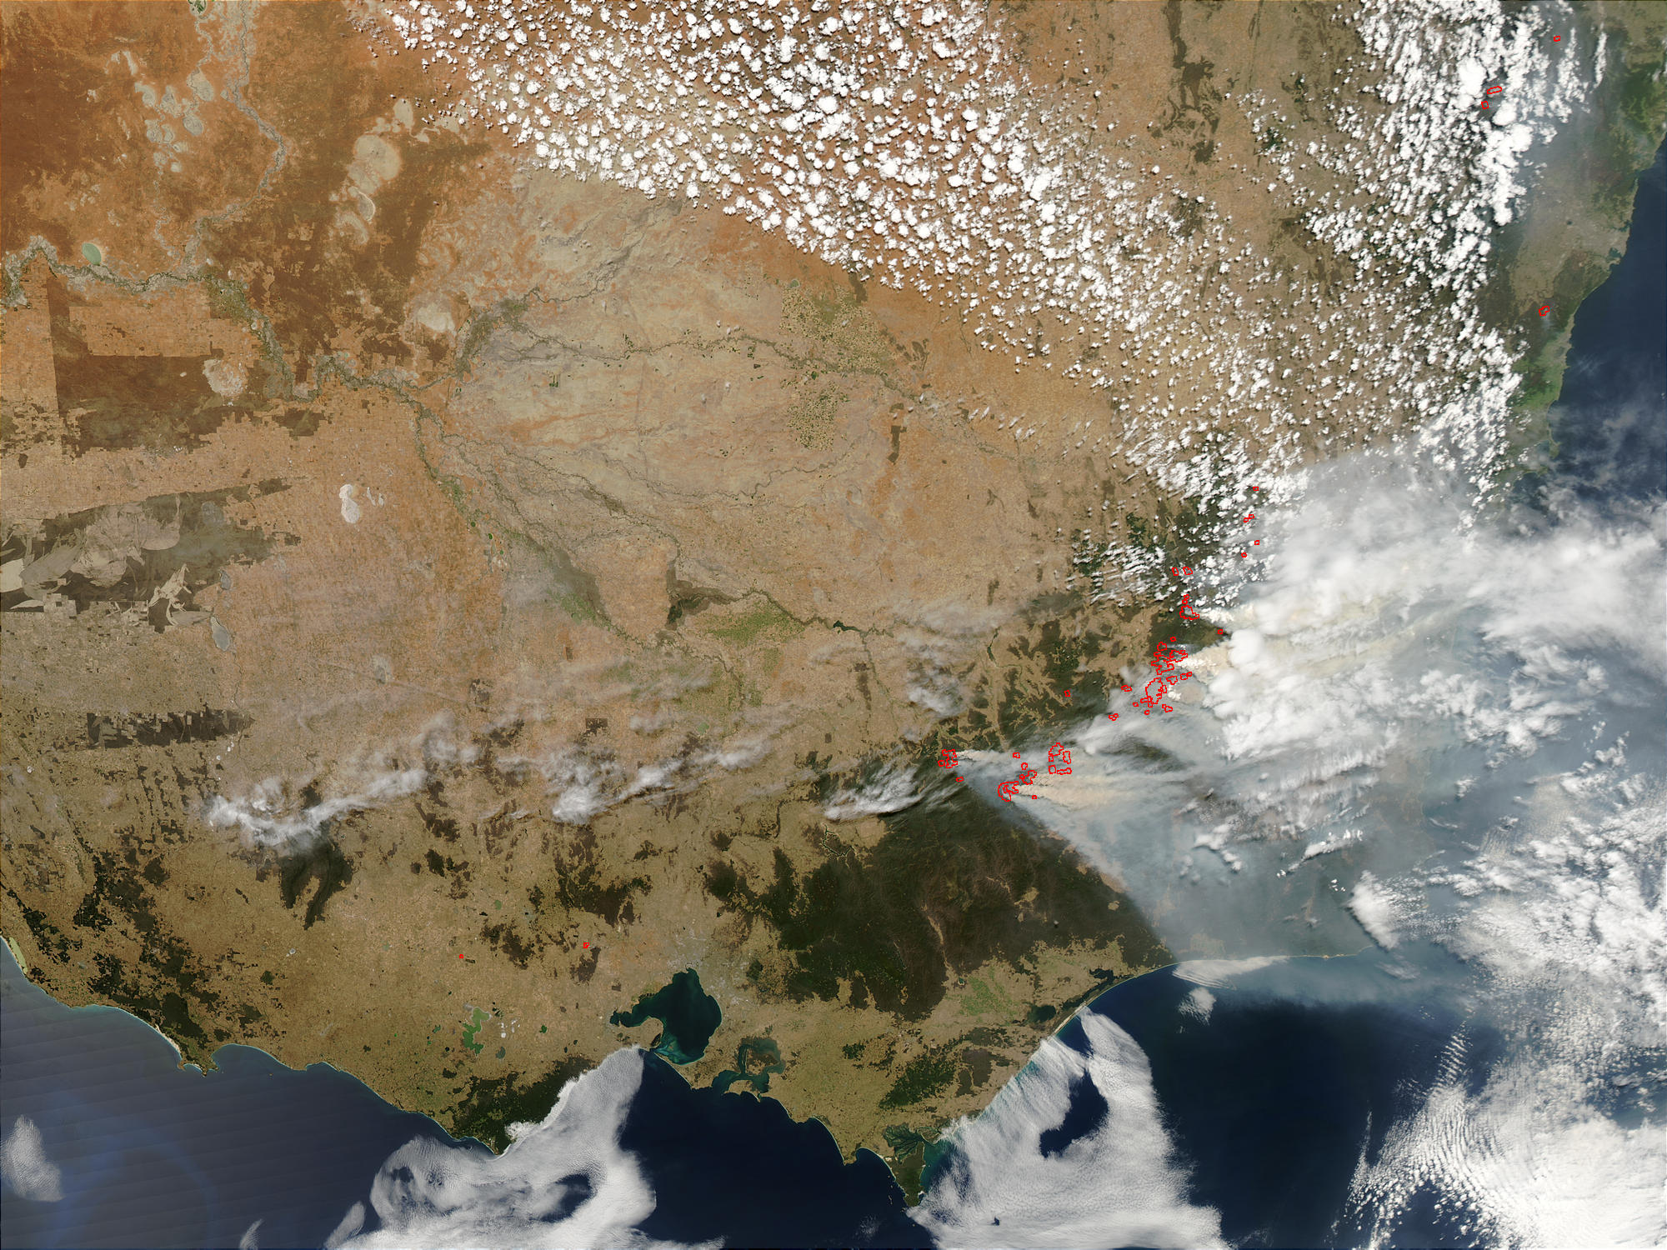
January 17th

Slide 12
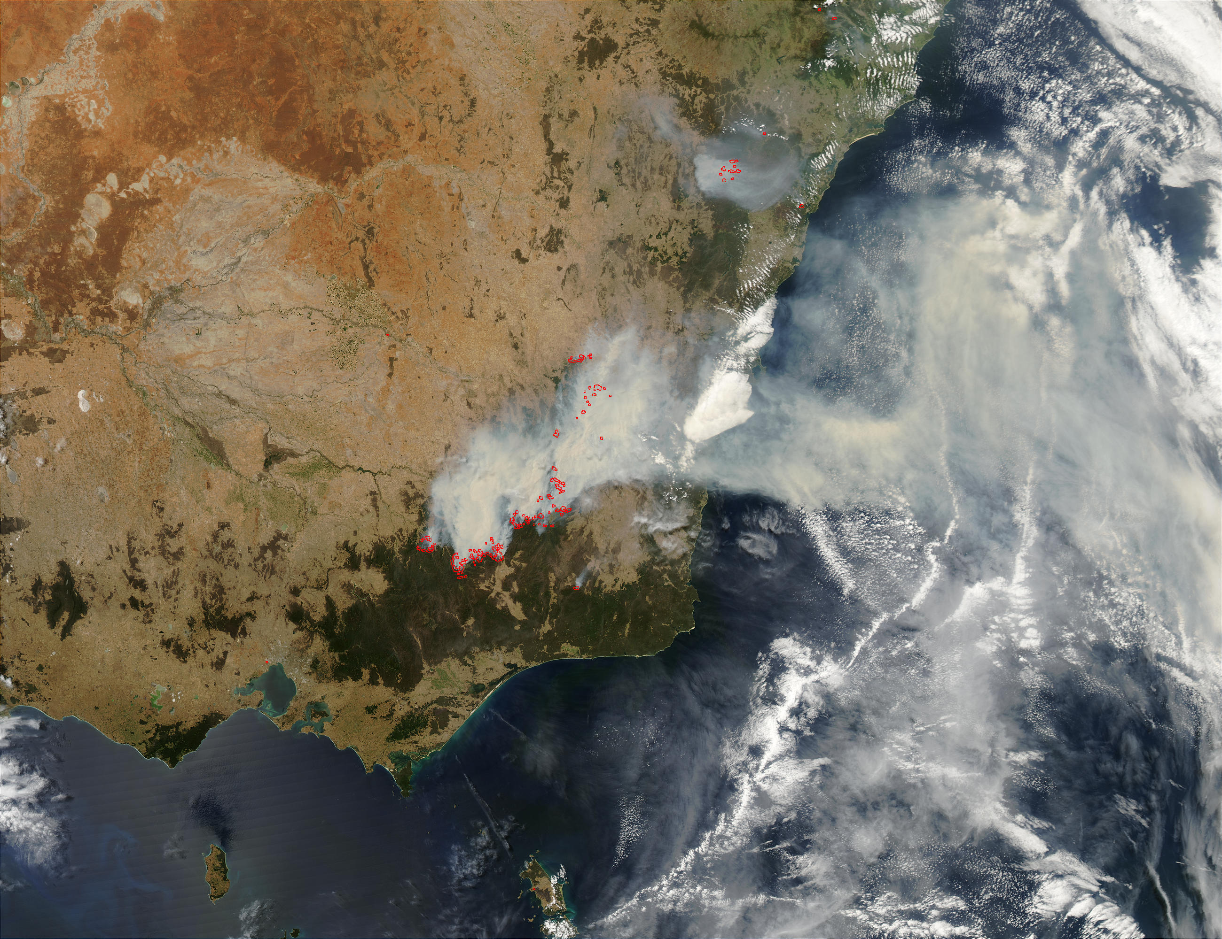
January 17th
January 19th

Slide 13
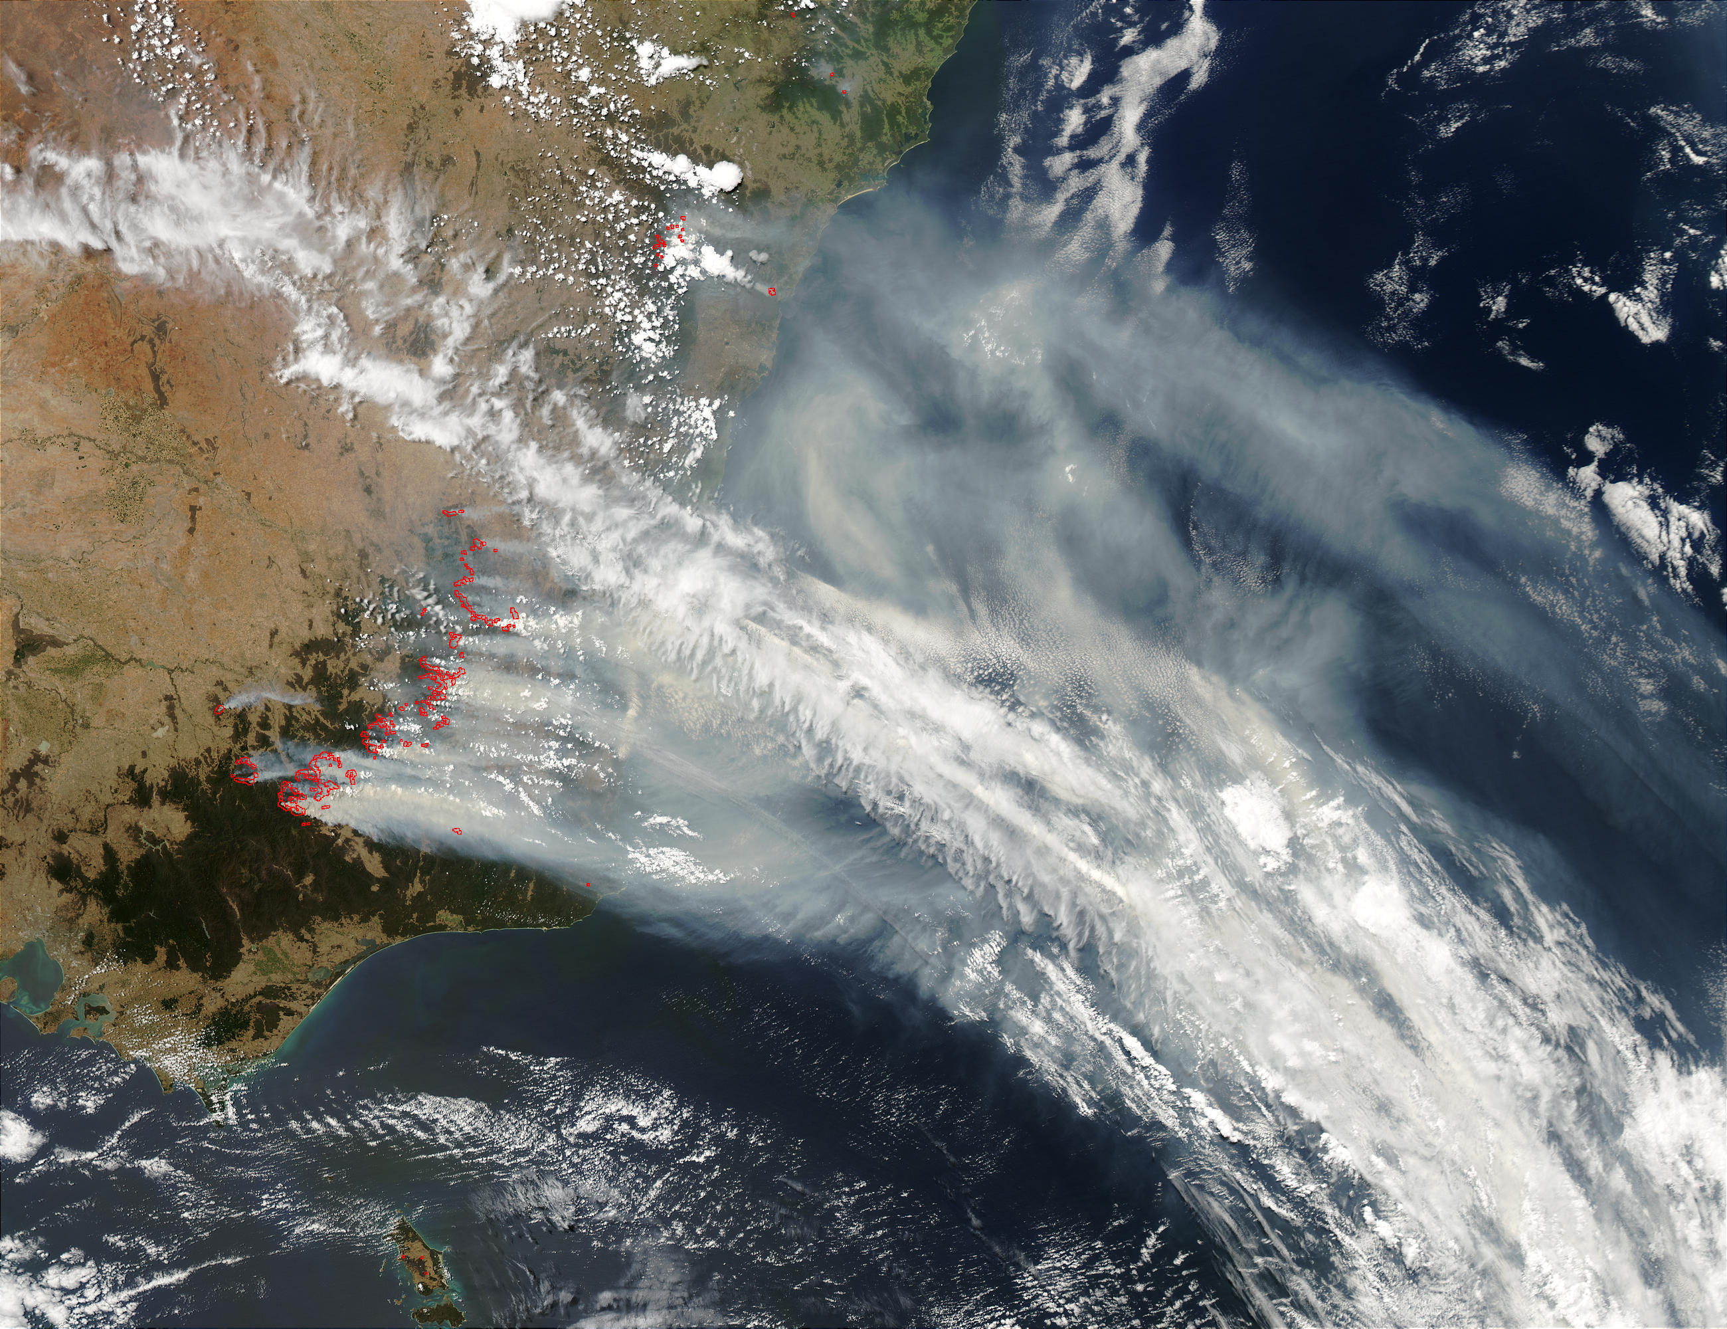
January 21th

Slide 14
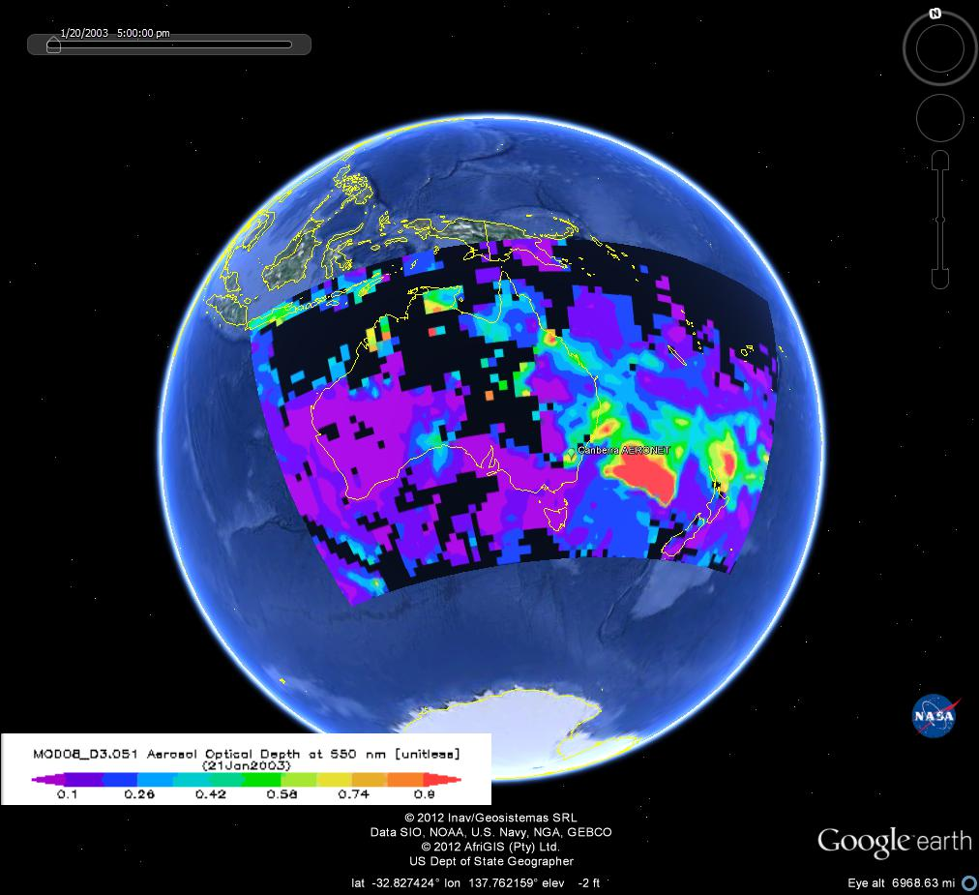

Slide 15
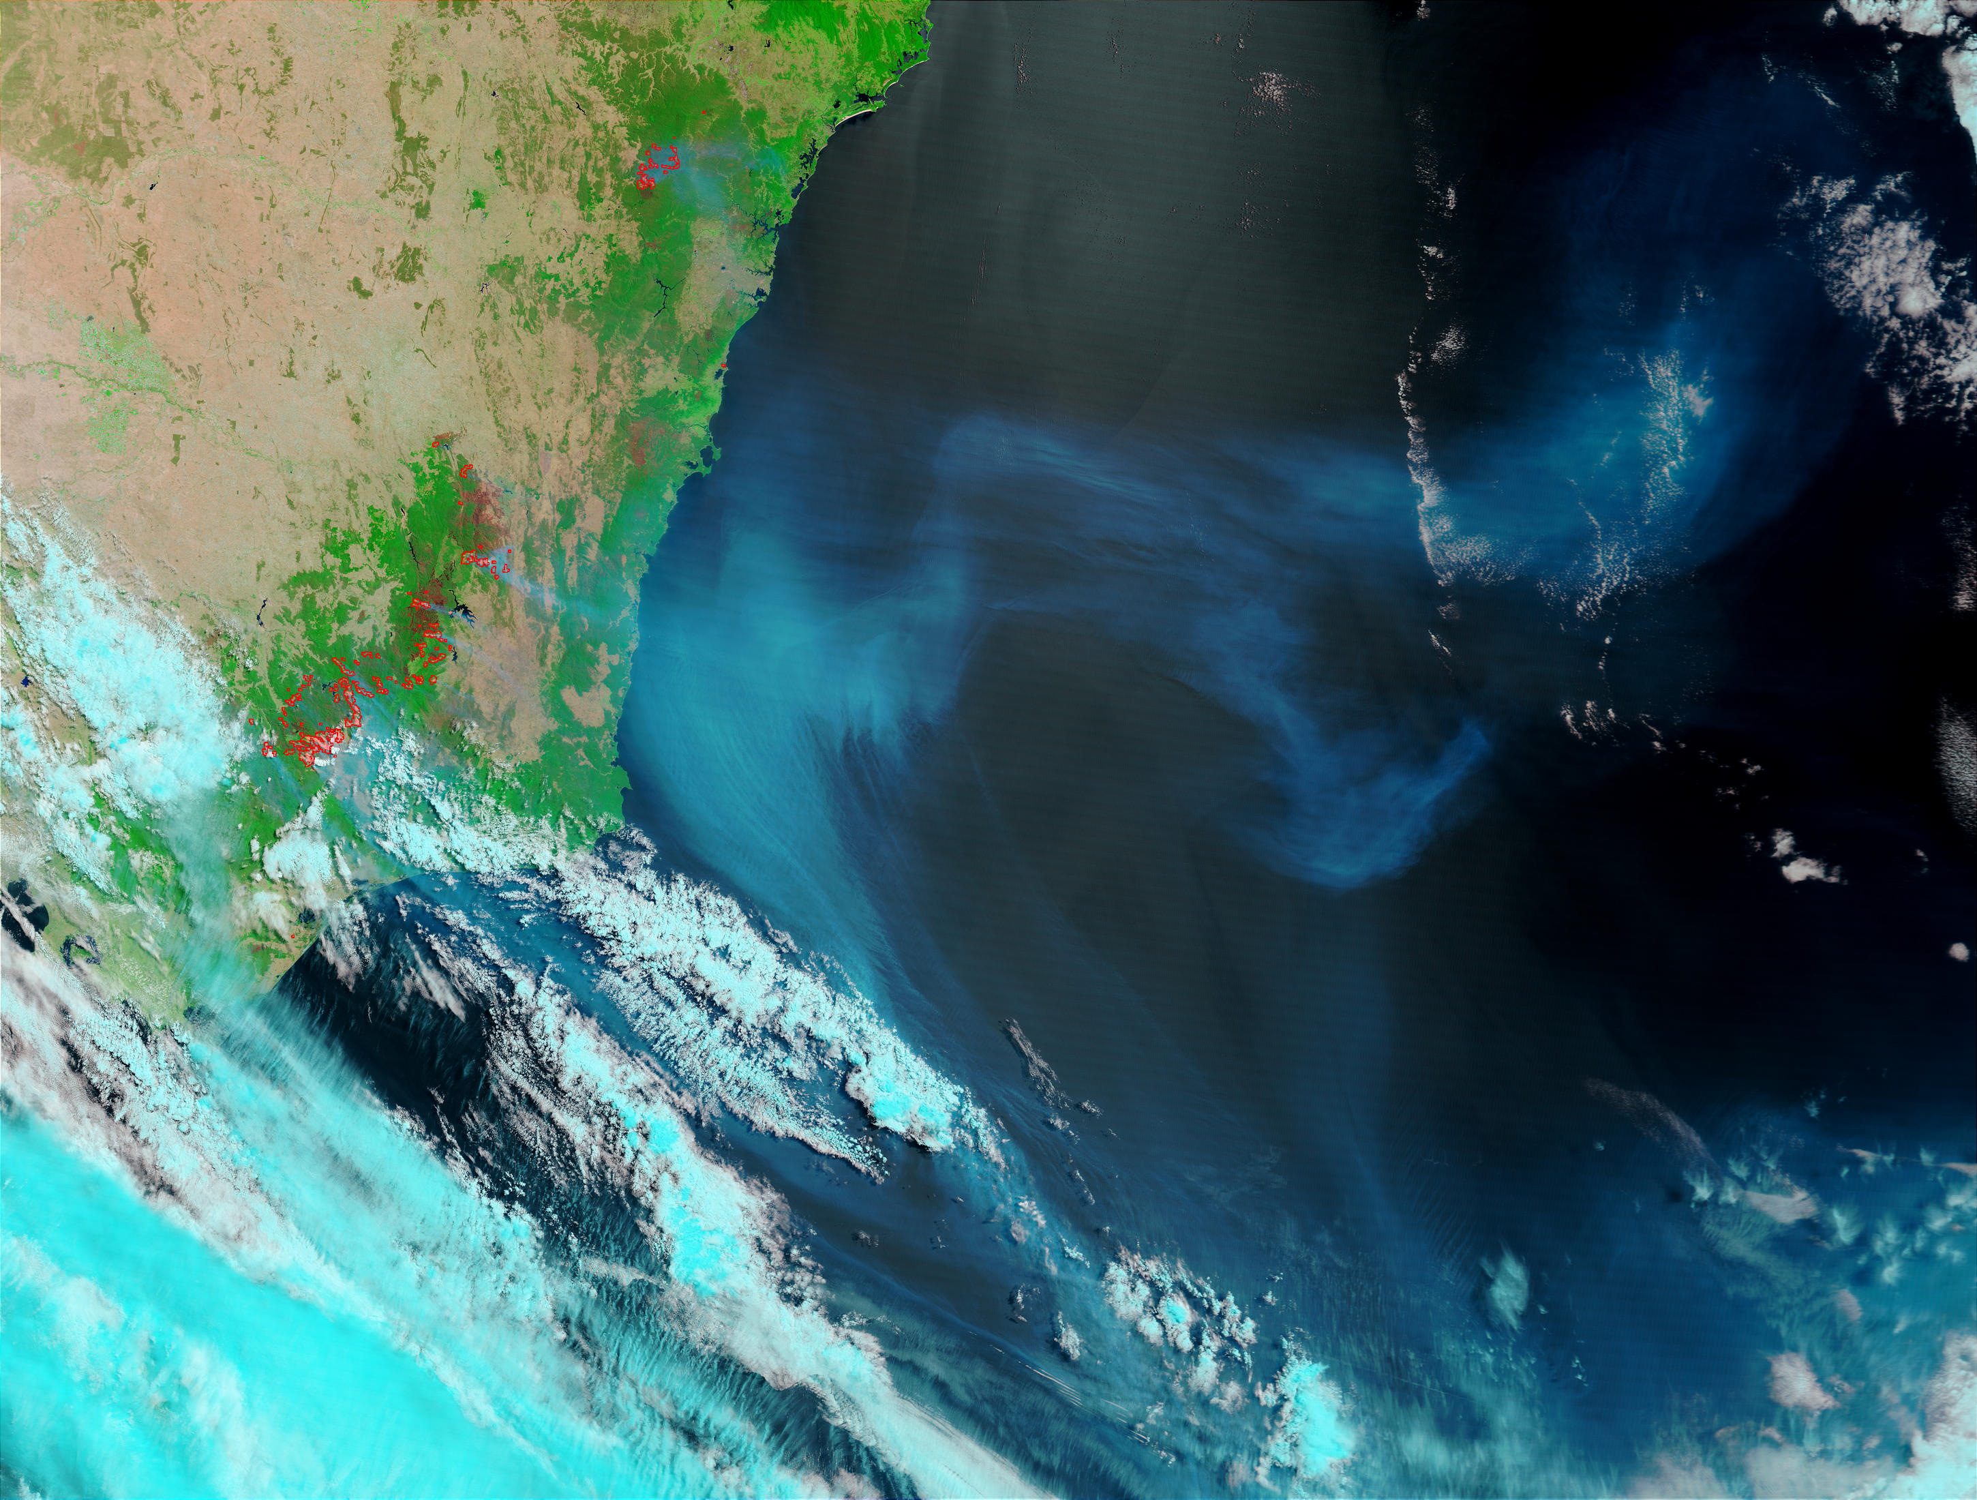
January 26th

Slide 16
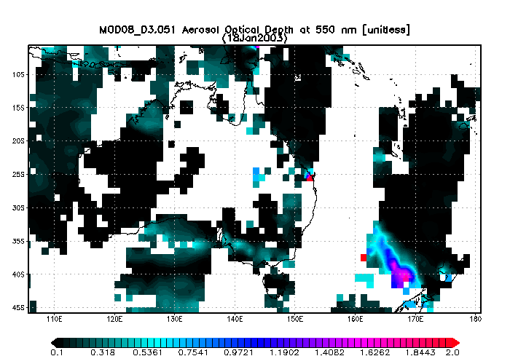
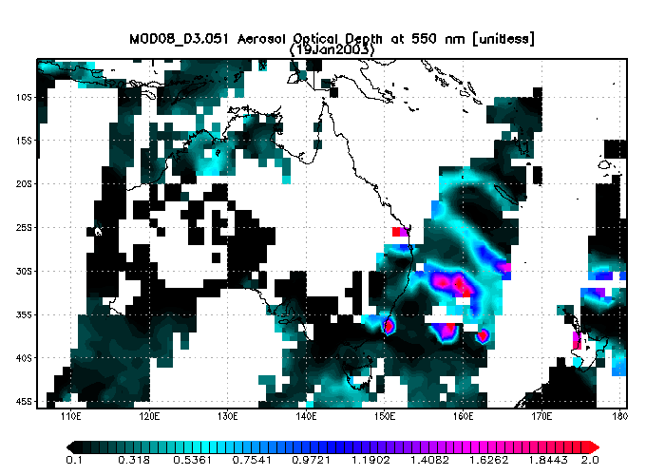
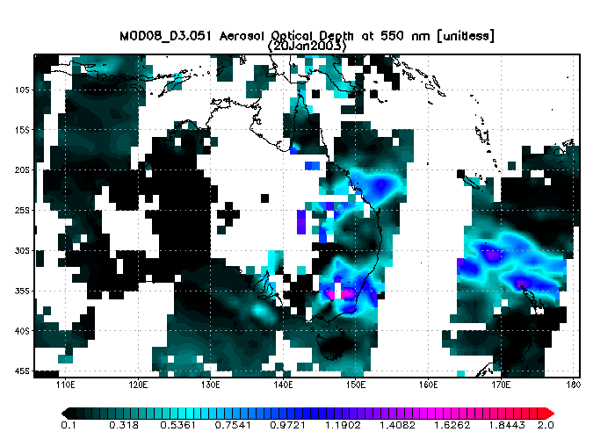
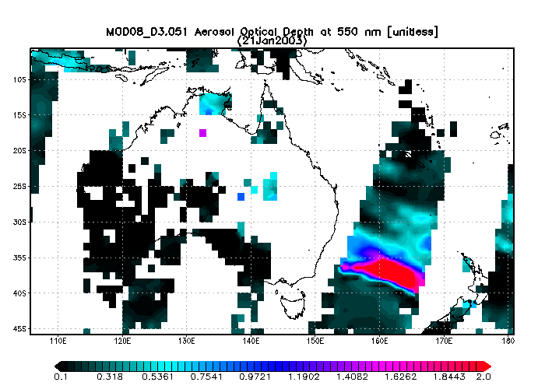

Slide 17
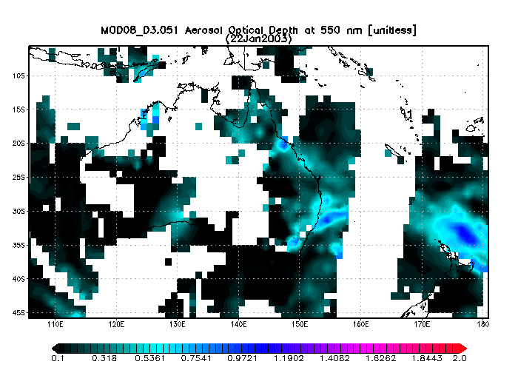
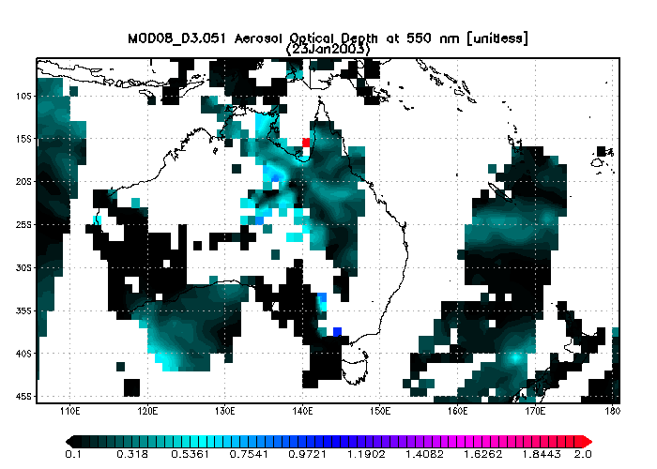
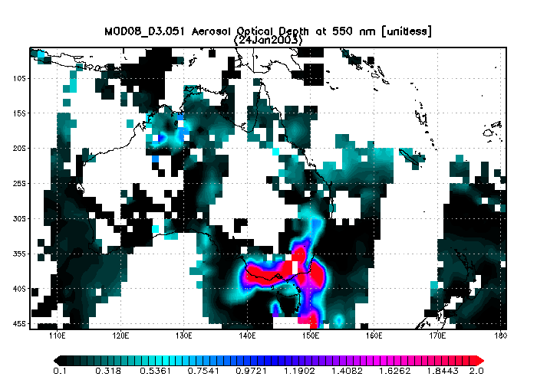
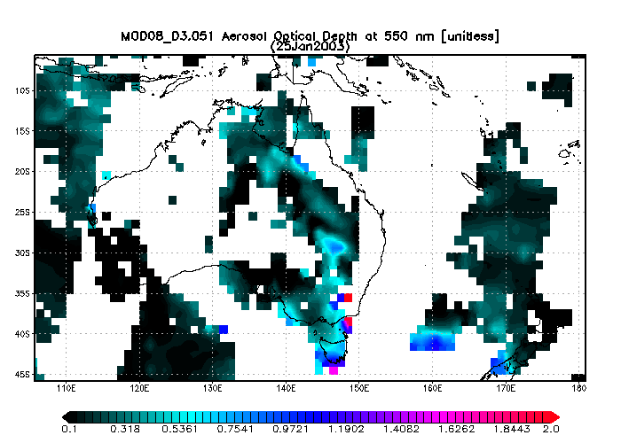

Slide 18
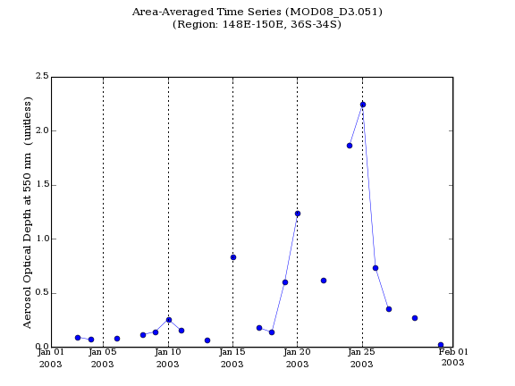
MODIS (Terra)

Slide 19
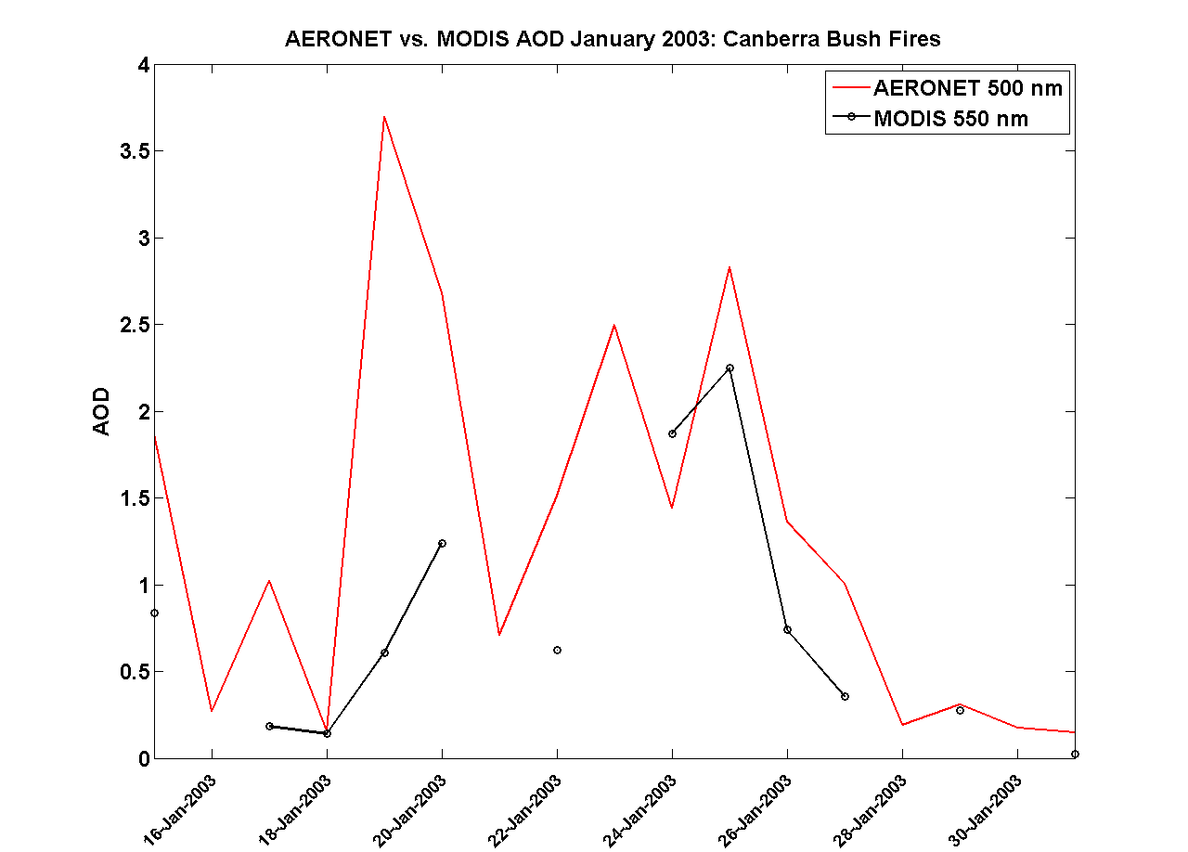

Slide 20
