Slide 1
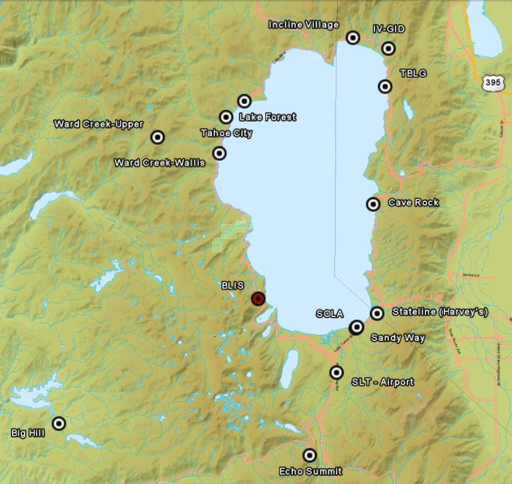
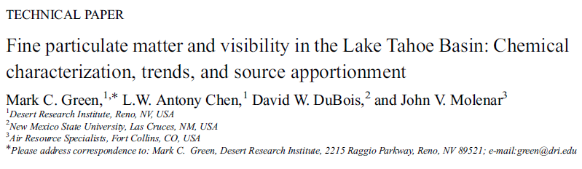
Figure 2. Trend of chemical b_{ext} at (a) BLIS1 and (b) SOLA1. The whiskers and boxes indicate 90th, 80th, 20th, and 10th percentile of b_{ext} for each year. Small bars indicate the median values. Linear regressions for the 90th and 10th percentile data are calculated and presented. Red lines indicate the current 90% and 50% standards for (a) regional and (b) sub-regional visibility. The mean natural background level is also indicated.

Slide 2
Spatial Variation Assessed By Satellite
AOD- column-total aerosol light extinction:
AOD = ∫b_{ext}(dz) If all aerosol is in boundary layer AOD approximated by b_{ext}·L (L=boundary layer depth)
NASA MODIS AOD (Level II) data from Satellites Terra and Aqua
10 km × 10 km resolution at nadir view
Twice daily scans during day time (about 11:00 AM and 1:00 PM
Less valid AOD data available in winter due to frequent cloudy skies over the Lake Tahoe basin
Spatial distribution of AOD is calculated based on valid AOD data points

Slide 3
Assumptions for surface/satellite comparability
Spatial homogeneity across pixels and within mixed layers
Cloudless sky
Temporal correspondence between surface and satellite estimates
Constant aerosol extinction properties (e.g., size, composition, and shape)

Slide 4
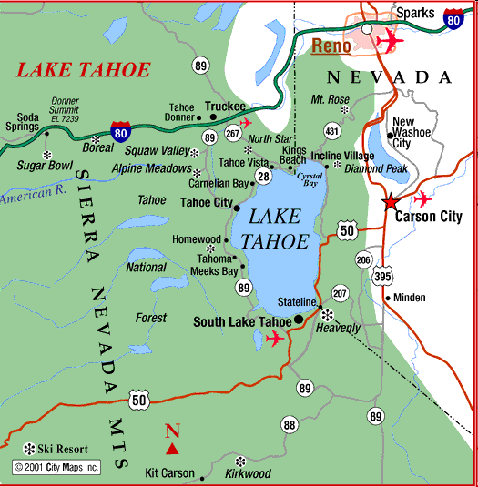
Domain of Study
11 × 11 points in the domain of interest
Surface chemical visibility measurements were made at BLIS and SOLA

Slide 5
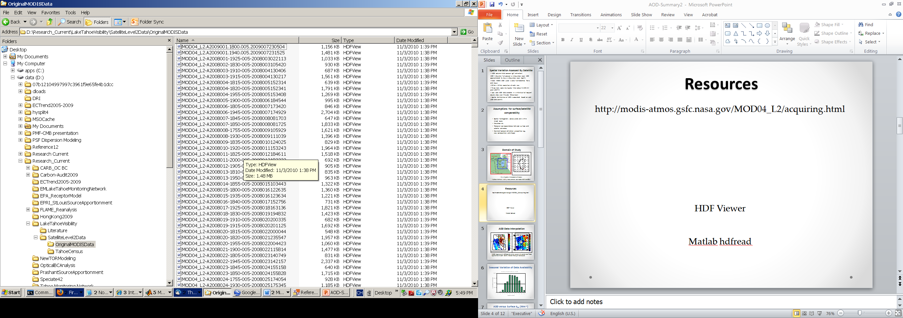
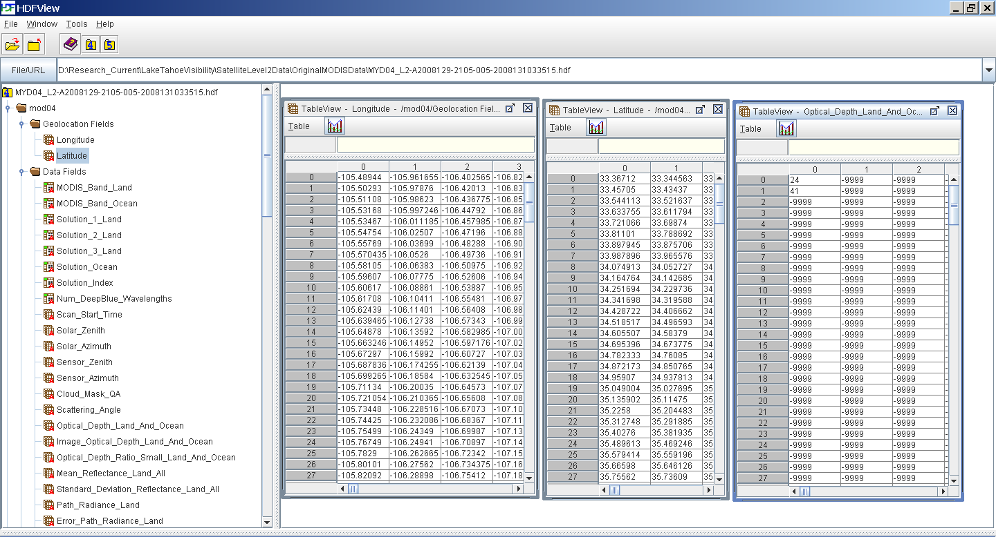
Resources
http://modis-atmos.gsfc.nasa.gov/MOD04_L2/acquiring.html
HDF Viewer
Matlab hdfread

Slide 6
AOD Data Interpolation
MODIS (Aqua Level 2) AOD data for (a) the western U.S. and (b) Lake Tahoe region on 6/27/2007. Blanks indicate missing or invalid pixels

Slide 7
Seasonal Variation of Data Availability

Slide 8
AOD versus Surface b_{ext} (Mm⁻¹)
All concurrent data for BLIS from 2007 to 2009

Slide 9
How many % differs from BLIS?
So BLIS represents a very large area (for July 2007)

Slide 10
Average July AOD
2007
2008
2009

Slide 11
Average October AOD
2007
2008
2009

Slide 12
Episodic Aerosol Optical Depth
AOD map during the Angora Fire event
Notes:
How abourt special events

Slide 13
Spatial Analysis suggests that:
1) background PM and b_{ext} levels are pretty uniform across the Tahoe basin, except during severe wildfire events,
2) influences such as traffic and residential wood combustion are confined in urban “neighborhoods” (sub-pixel), and
3) visibility within the basin would be well bounded by BLIS1 (background) and SOLA1 (maximum) measurements

