Slide 1
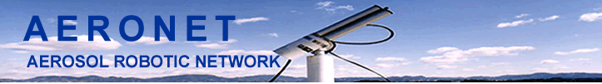
AErosol RObotic NEtwork
CIMEL CE-318
S. Marcela Loria-Salazar
Research assistant
marce.marcelaloria@gmail.com

Slide 2
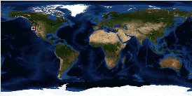
Outline
Sunphotometer
Cimel CE-318
2.1. Instrument parts and how it works
2.2. Cimel scans
2.3. Sensitivity of the instrument to the offset
3. AERONET
3.1. Direct measurement and calculations
3.2. Dubovik and King 2000
3.3. Dubovik 2006
3.4. Inversion products

Slide 3
Outline
Sunphotometer
Cimel CE-318
2.1. Instrument parts and how it works
2.2. Cimel scans
2.3. Sensitivity of the instrument to the offset
3. AERONET
3.1. Direct measurement and calculations
3.2. Dubovik and King 2000
3.3. Dubovik 2006
3.4. Inversion products

Slide 4
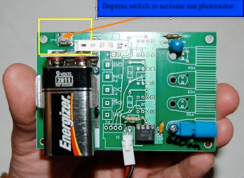
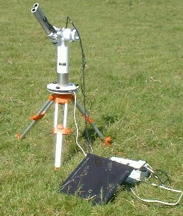
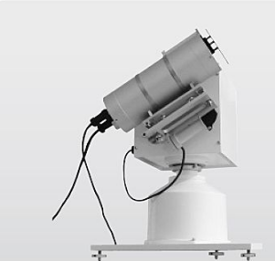
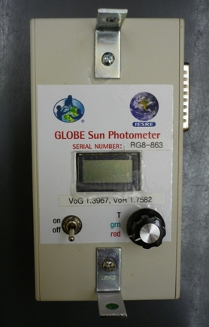
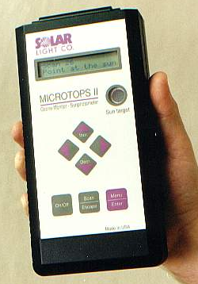
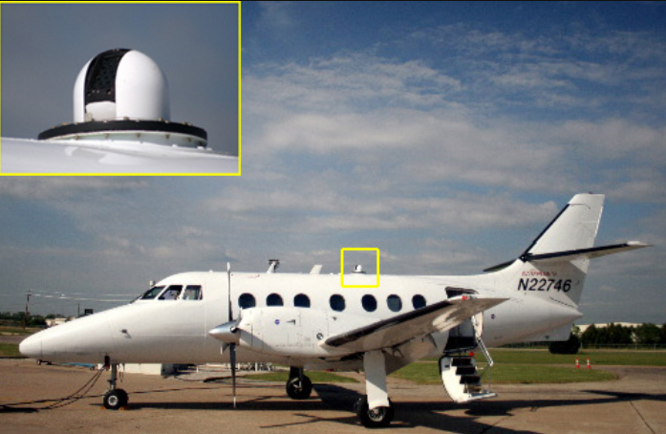
Sun-photometer
Sun-photometers are specialized narrow field-of-view radiometers designed to measure solar irradiance.

Slide 5
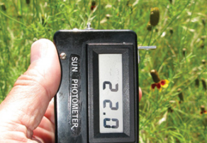
Sun-photometer
Sun-photometers were first developed during the early part of the 20th century taking advantage of the new electrical thermopile devices and developments in the glass industry, which led to cut-off filters.
The Voltz hand-held
Developed in 1959.
Two narrow spectral bands
Measure atmospheric turbidity
Precursor of modern sun-photometers.
Notes:
These instruments were primarily designed to measure the solar constant using the spectral extinction method developed by S. P. Langley. This ‘long method’ is based on measurements of the solar flux in narrow wavelength bands at varying solar zenith angles and yields as a by-product the atmospheric transmissivity (Deirmendjian, 1980).

Slide 6
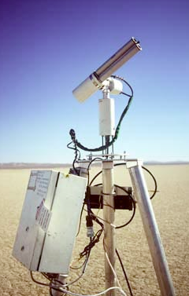
Sun-photometer
Modern instruments are electronically controlled, have on-board data storage capability and incorporate an automated tracking system for accurate positioning and pointing.
Spectral aerosol optical depth
Aerosol volume and size distribution
Radiance distributions
Ozone amount
Precipitable water
Notes:
Aerosol volume and size distribution are retrievable by inversion modelling from the spectral aerosol optical depth.

Slide 7
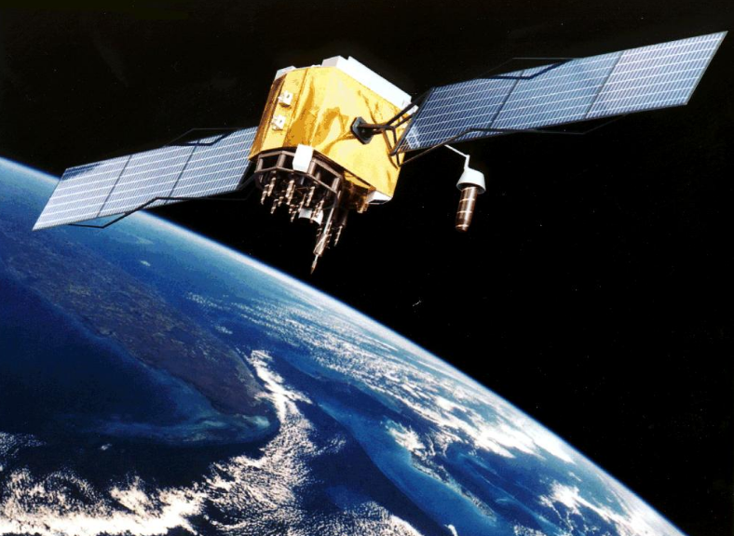
Sun-photometer
The atmospheric data retrievable from sun-photometers are primarily of use for meteorological and atmospheric applications (Schmid et al., 1998)
However, the same data are also of potential value to remote sensing, especially for the atmospheric correction of remotely sensed imagery.
Notes:
Aerosol volume and size distribution are retrievable by inversion modelling from the spectral aerosol optical depth.

Slide 8
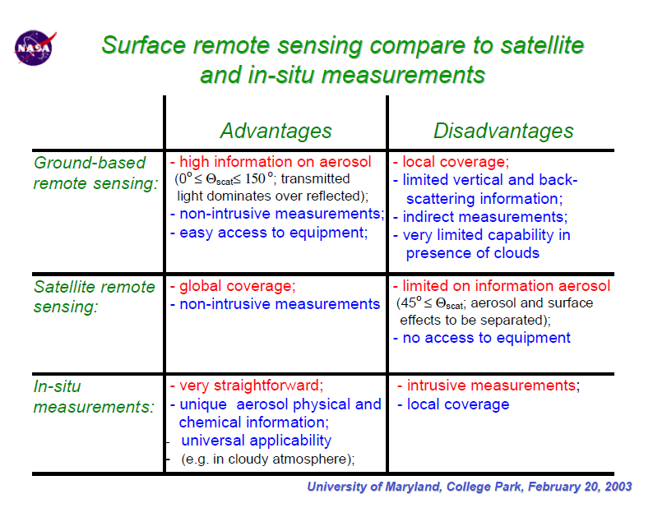
Inversion of Sun and Sky Radiance to Derive Aerosol Properties from AERONET. (Holben et al., 2003)
Notes:
Aerosol volume and size distribution are retrievable by inversion modelling from the spectral aerosol optical depth.

Slide 9
Outline
Sunphotometer
Cimel CE-318
2.1. Instrument parts and how it works
2.2. Cimel scans
2.3. Sensitivity of the instrument to the offset
3. AERONET
3.1. Direct measurement and calculations
3.2. Dubovik and King 2000
3.3. Dubovik 2006
3.4. Inversion products

Slide 10
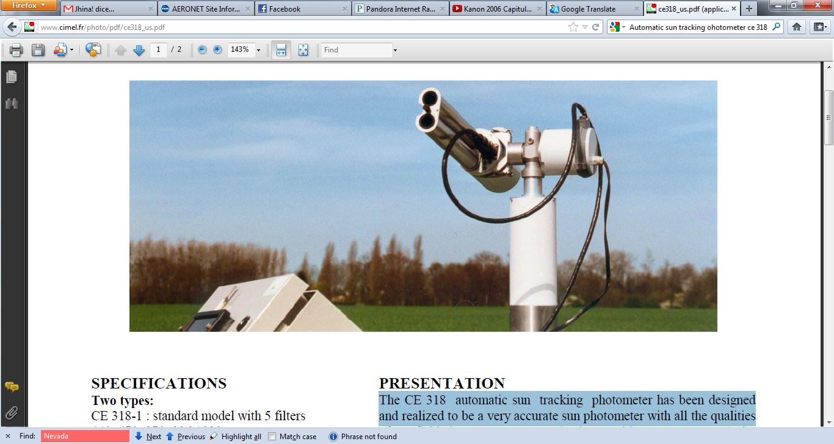
CIMEL CE-318
Main purpose
Measure
Sun and sky irradiance
Derive
Ozone and aerosol properties
Total column water
The CE 318 is an automatic sun tracking
photometer.
Very accurate
Motorized
Portable
Autonomous (solar powered)

Slide 11
Outline
Sunphotometer
Cimel CE-318
2.1. Instrument parts and how it works
2.2. Cimel scans
2.3. Sensitivity of the instrument to the offset
3. AERONET
3.1. Direct measurement and calculations
3.2. Dubovik and King 2000
3.3. Dubovik 2006
3.4. Inversion products

Slide 12
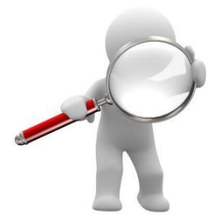
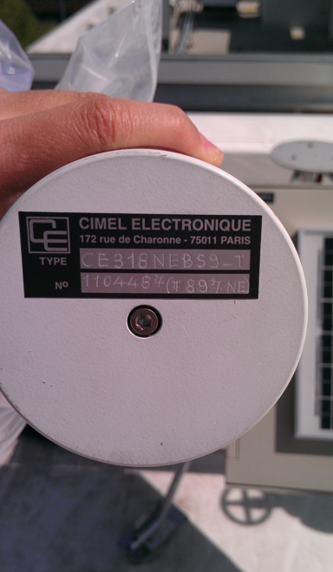
CIMEL CE-318

Slide 13
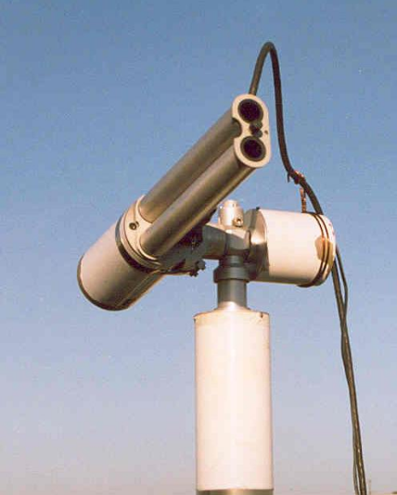
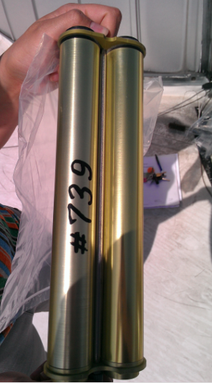
CIMEL CE-318: Collimator
The 33 cm collimetors were designed for 10⁻⁵ straylight rejection for measurements
of the aureole 3º from the sun.

Slide 14
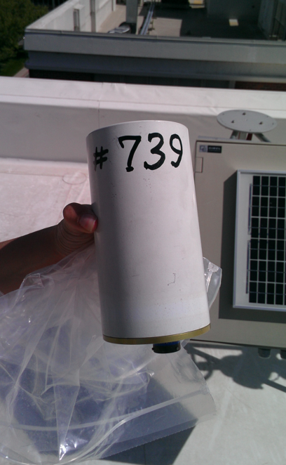
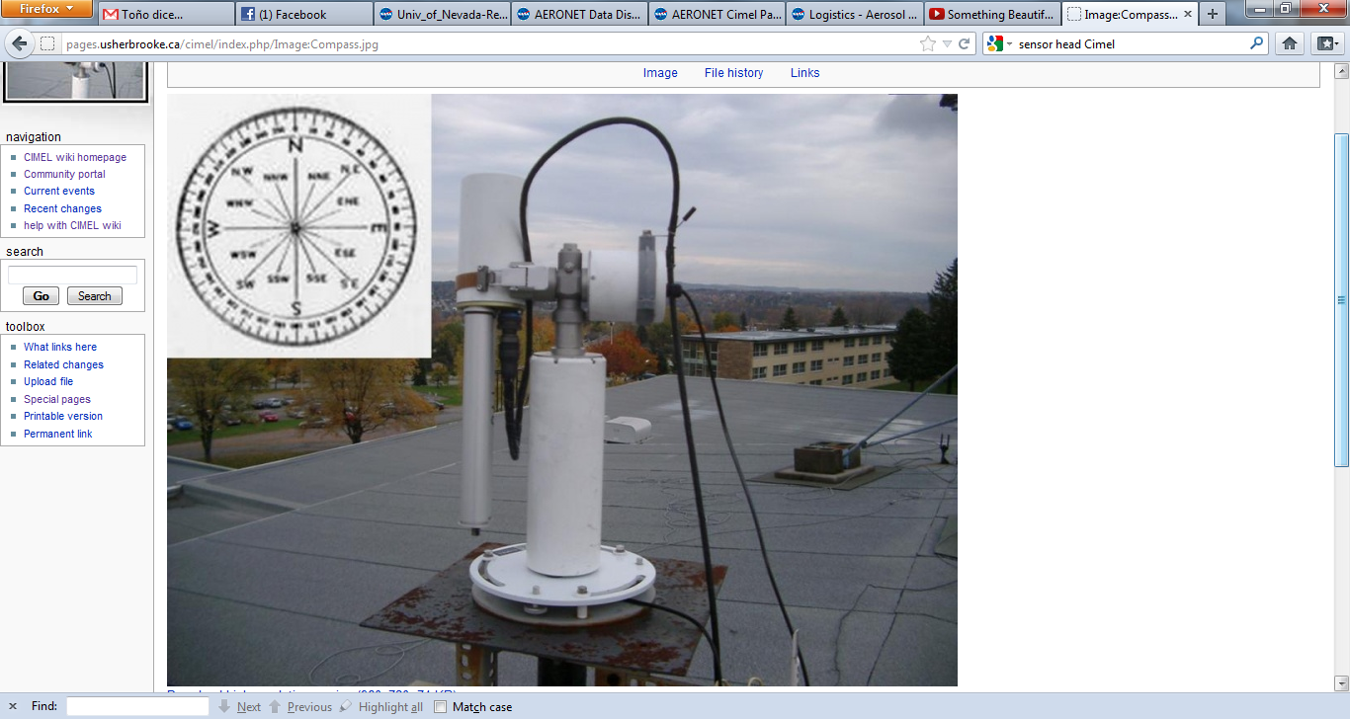
CIMEL CE-318: Sensor head
The sensor head is parked pointed very close to nadir when idle to prevent contamination of the optical windows from rain and foreign particles.

Slide 15
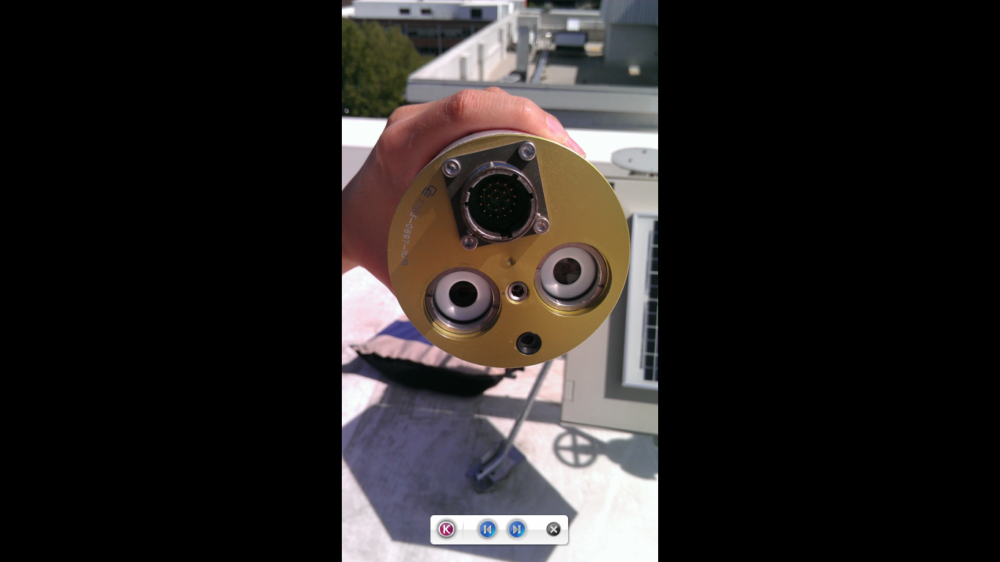
CIMEL CE-318: Sensor head
The Sun and sky collimators
Protected by a quartz window
Allowing observation
at UV
Silicon and InGaAs detectors
Spectrum between 300 nm and 1640 nm.
Notes:
The components of the sensor head are sealed from moisture and desiccated to prevent damage to the electrical components and interference filters

Slide 16
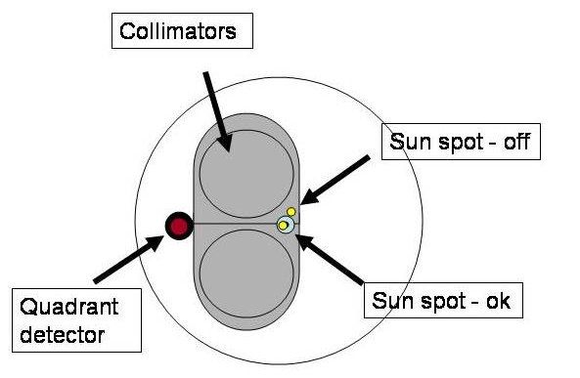
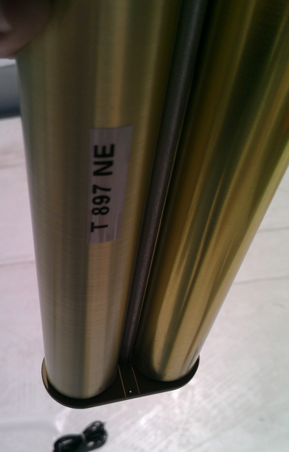
CIMEL CE-318: Sensor head

Slide 17
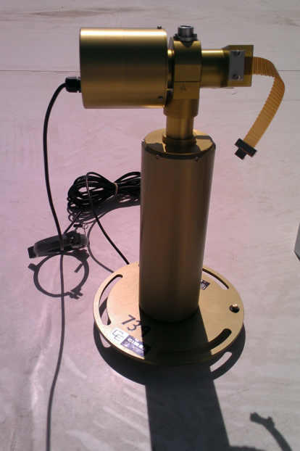
CIMEL CE-318: Zenith motor

Slide 18
CIMEL CE-318: Azimuth motor

Slide 19
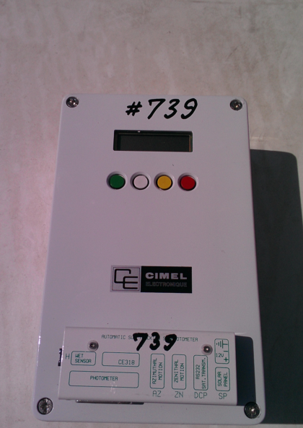
CIMEL CE-318: Electronic box
Four bottoms
Screen
Different type
of ports

Slide 20
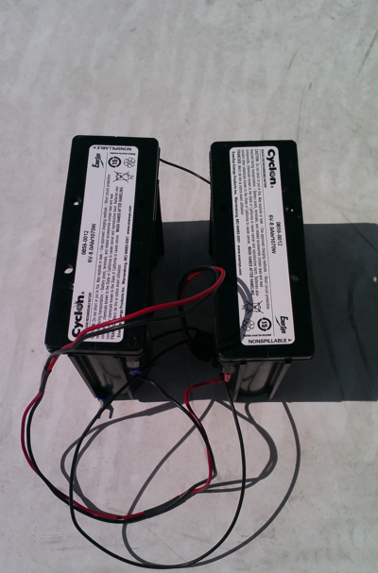
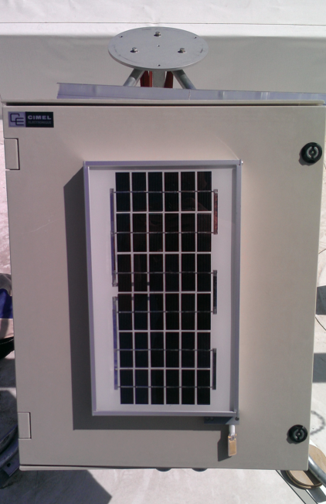
CIMEL CE-318: Box
12 V
external battery
Solar panel
5 V
internal battery

Slide 21
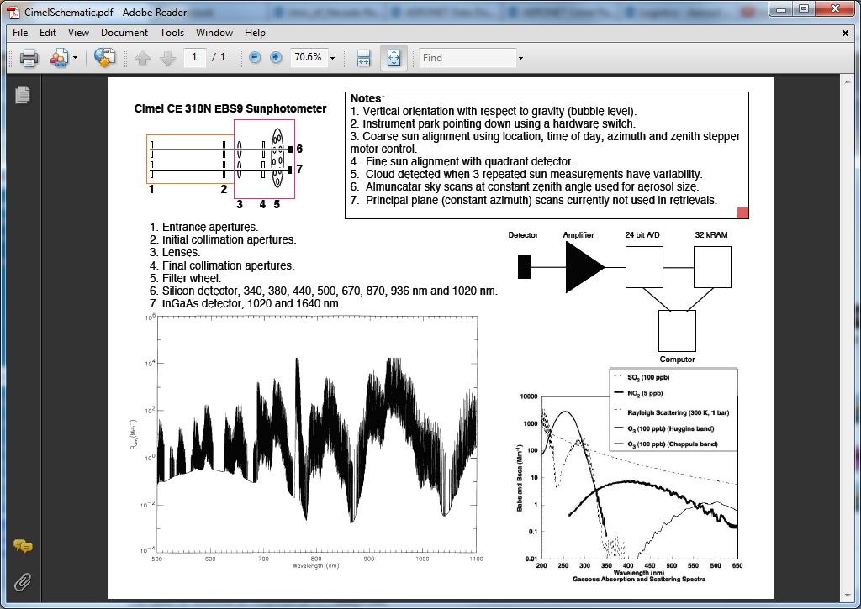
CIMEL CE-318

Slide 22
Outline
Sunphotometer
Cimel CE-318
2.1. Instrument parts and how it works
2.2. Cimel CE-318 scans
2.3. Sensitivity of the instrument to the offset
3. AERONET
3.1. Direct measurement and calculations
3.2. Dubovik and King 2000
3.3. Dubovik 2006
3.4. Inversion products

Slide 23
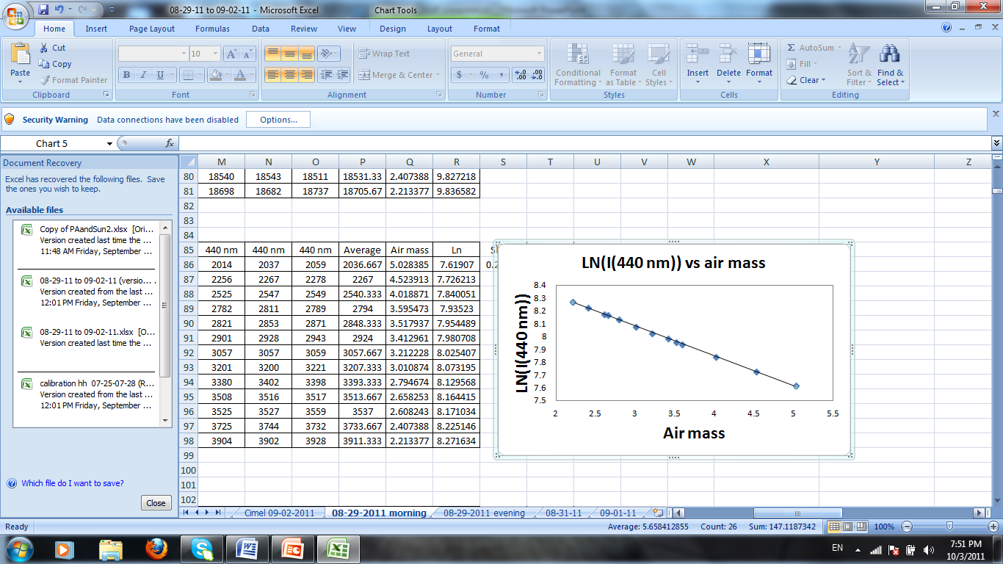
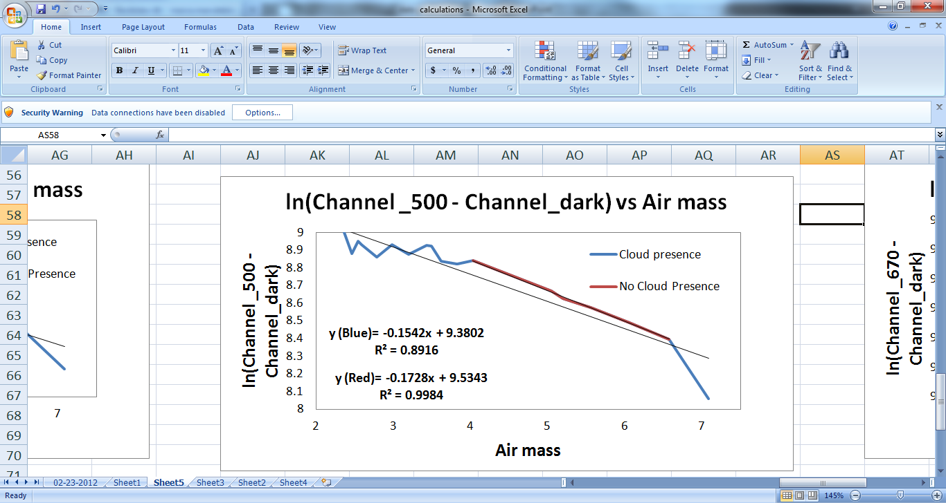
CIMEL CE-318 scans: Direct sun
-slope=TOD
Direct Sun measurements
Eight spectral bands
Approximately 10 s
Morning and afternoon
Langley calibration sequences
15-min intervals
Cloud screen
Direct sun measurement at 440 nm. Slope obtained by the Langley plot method in absence of clouds.
Direct sun measurement at 500 nm. February, 23th 2012 at 16:00 in Reno, Nevada. Presence of thin cirrus clouds.

Slide 24
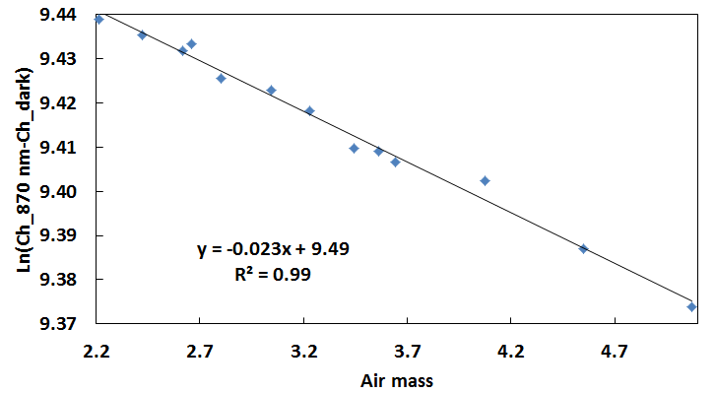
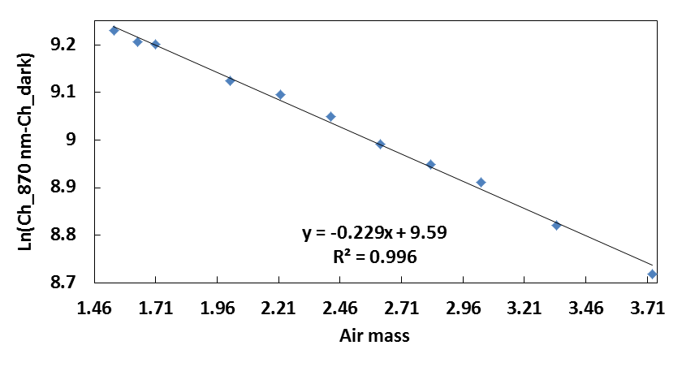
CIMEL CE-318 scans: Direct sun
Direct sun measurement at 870nm. August 9th 2011 at 7:00. Atmosphere aerosol dominated by air molecules.
Direct sun measurement at 870nm. July 28th 2011 at 17:00. Atmosphere aerosol dominated by submicron particles due to a natural fire.

Slide 25
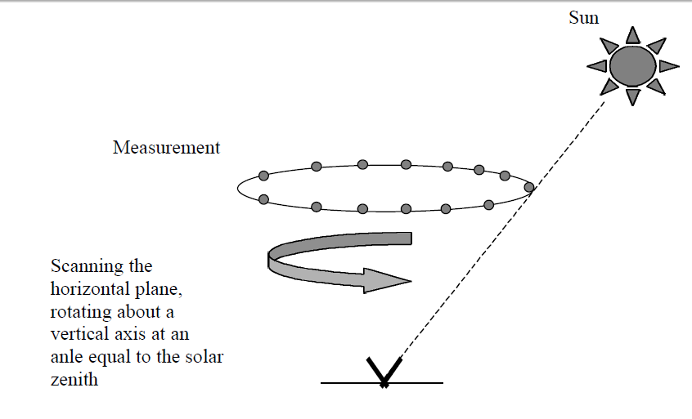
CIMEL CE-318 scans: Almucantar
Almucantar
Horizontal plane at the solar zenith angle
Specified azimuths relative to the Sun
Typically made at an airmass of 2 or less
Maintain large scattering angles
-180° to 180° of
azimuth
Almucantar
Measures
Radiance at azimuthal angles relative to the sun
Single-scattering approximation
Sky radiances in the almucantar
Not sensitive to aerosol vertical variation.

Slide 26
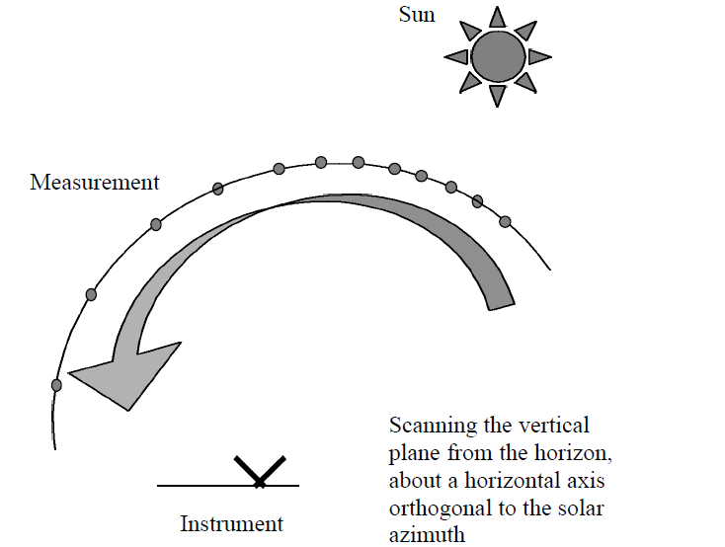
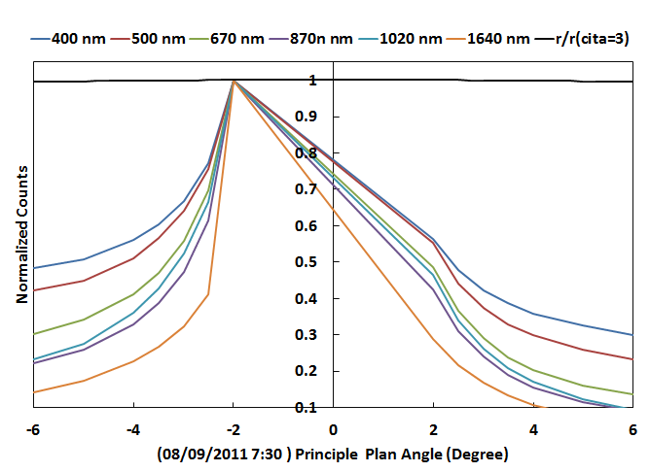
Principal plane
Measures
Radiance at scattering angles
Combination
AOD measurements
Estimation of land and water reflectance
CIMEL CE-318 scans: Principle plane
Principal plane scan taken 08-09-2011. Atmospheric aerosols dominated by Rayleigh particles.

Slide 27
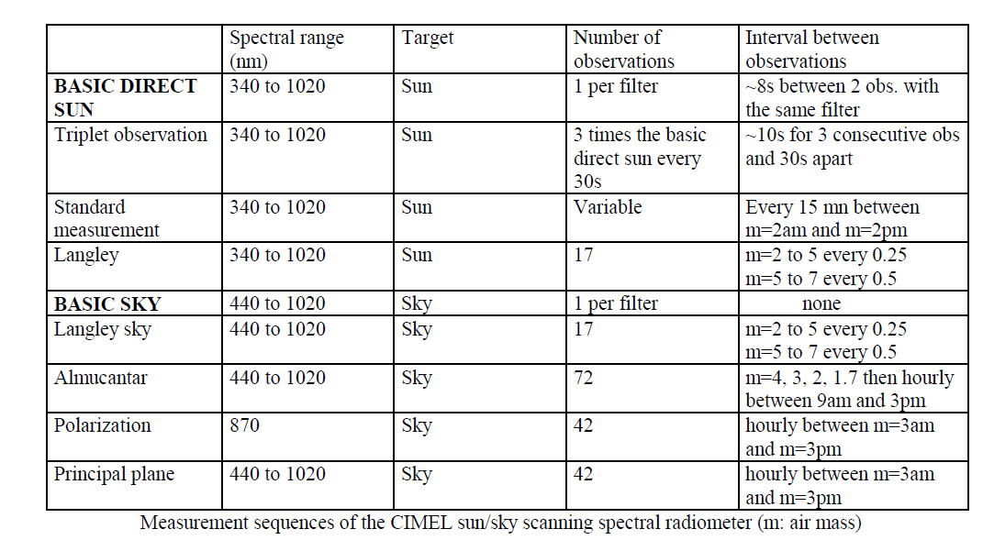
CIMEL CE-318
University of Nevada-Reno AERONET station does not count with a polarization sensor.

Slide 28
Outline
Sunphotometer
Cimel CE-318
2.1. Instrument parts and how it works
2.2. Cimel scans
2.3. Sensitivity of the instrument to the offset
3. AERONET
3.1. Direct measurement and calculations
3.2. Dubovik and King 2000
3.3. Dubovik 2006
3.4. Inversion products

Slide 29
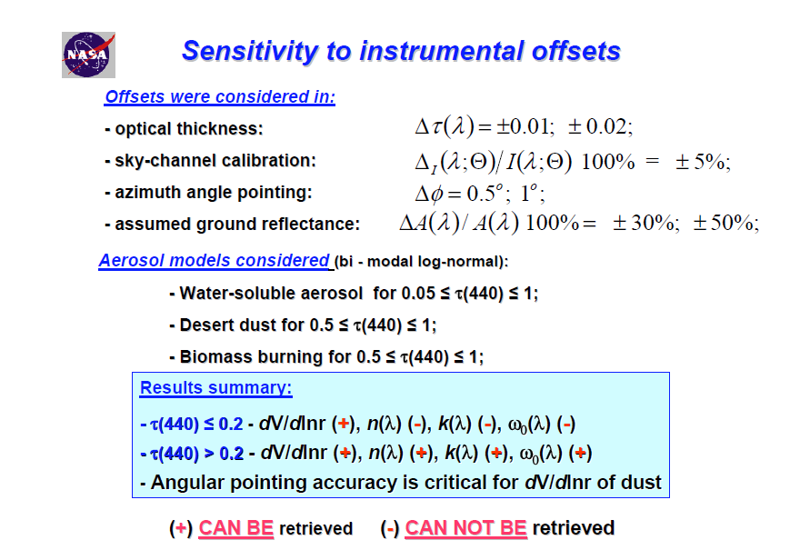
CIMEL CE-318: Sensitivity to instrument noise
Inversion of Sun and Sky Radiance to Derive Aerosol Properties from AERONET. (Holben et al., 2003)

Slide 30
Outline
Sunphotometer
Cimel CE-318
2.1. Instrument parts and how it works
2.2. Cimel scans
2.3. Sensitivity of the instrument to the offset
3. AERONET
3.1. Direct measurement and calculations
3.2. Dubovik and King 2000
3.3. Dubovik 2006
3.4. Inversion products

Slide 31
Cimel Sun-photometers

Slide 32
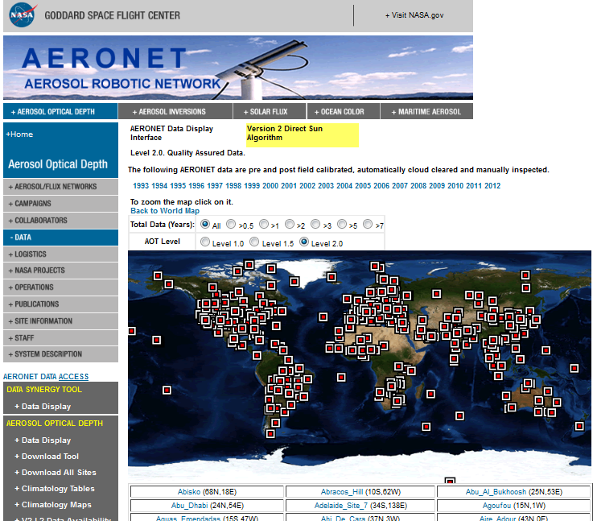
AERONET
AERONET
Ground-based remote sensing aerosol networks
The network imposes standardization of instruments, calibration, processing and distribution
Aerosol optical, microphysical and radiative properties
Agencies
Institutes
Universities
The program provides a long-term, continuous and accessible public database
Established by NASA and PHOTONS
Validation of satellite retrievals

Slide 33
AERONET
Level 1:
unscreened
Level 2.0:
Quality-assured
Level 1.5
Cloud-screened
AERONET
Globally distribution of AOD products
Inversion products
Precipitable water
Different data level treatment

Slide 34
AERONET

Slide 35
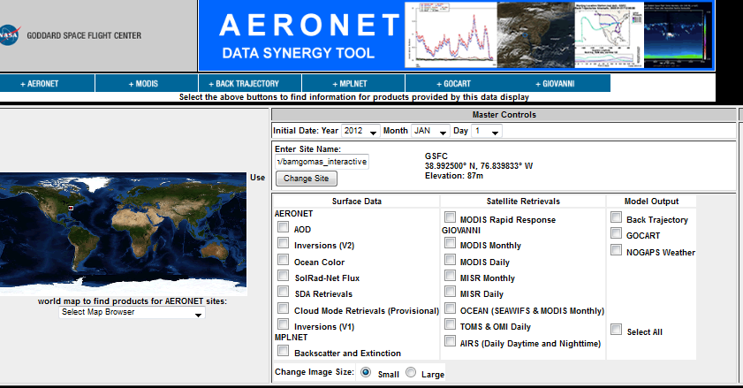
AERONET
http://aeronet.gsfc.nasa.gov/cgi-bin/bamgomas_interactive

Slide 36
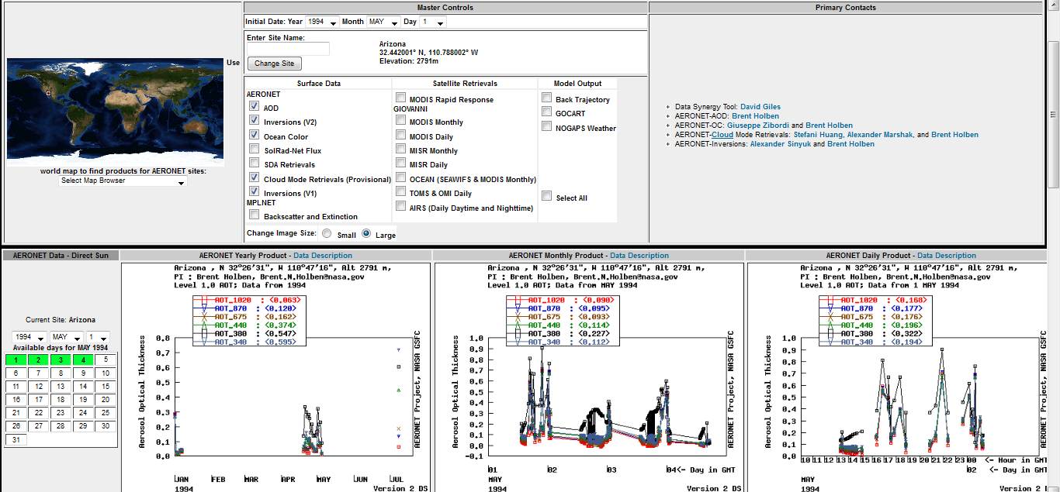
AERONET

Slide 37
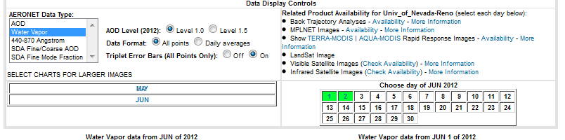
AERONET: Data controls

Slide 38
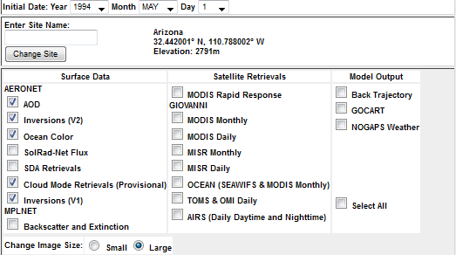
AERONET: Master Controls

Slide 39
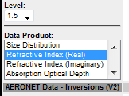
AERONET: Inversion Data Controls
Size distribution
Refractive index (Real)
Refractive index (Imaginary)
Absorption optical depth
Extinction optical depth
Single scattering albedo
Asymmetry factor
Phase functions (440 nm)
Phase functions (670 nm)
Phase functions (870 nm)
Phase functions (1020 nm)

Slide 40
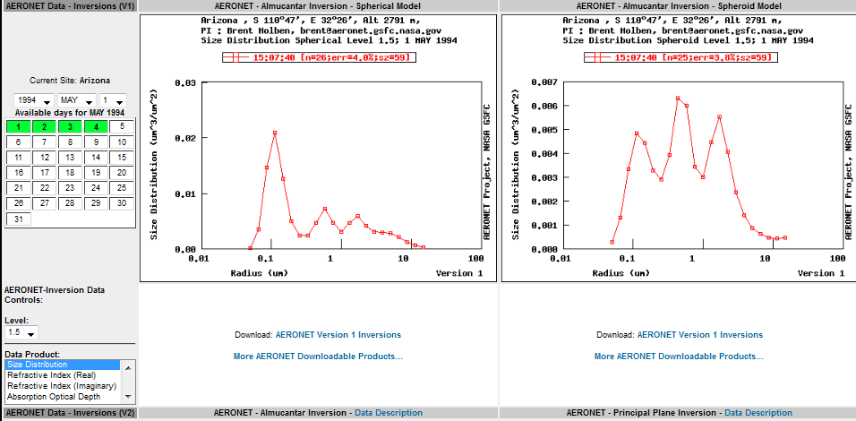
AERONET: Master Controls

Slide 41
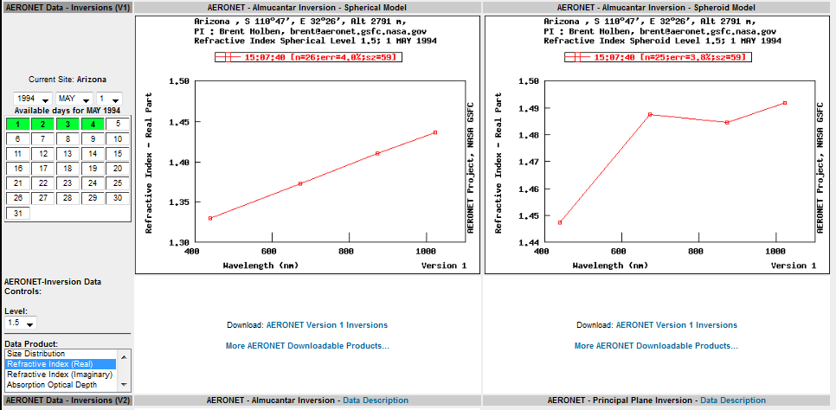
AERONET: Master Controls

Slide 42
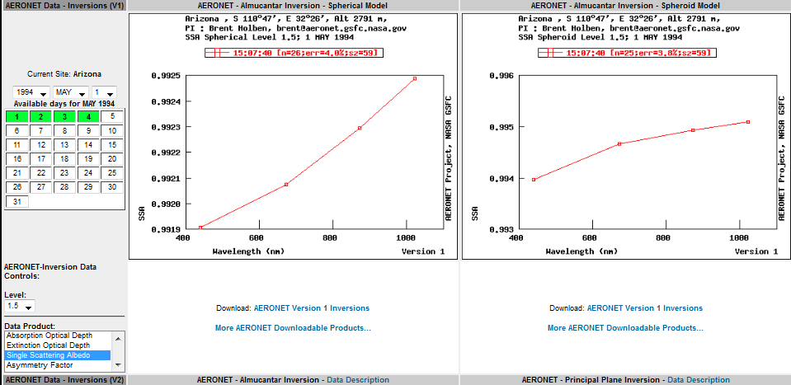
AERONET: Master Controls
Notes:
Tiempo para hablar de todo lo que se puede hacer con AERONET

Slide 43
AERONET
Error bars
Size distribution
SDA Fine/Coarse AOD
Single scattering albedo
Asymmetry factor
Different levels (1.0, 1.5, 2.0)
Extinction optical depth
Water vapor
Satellite retrievals
Refractive index (Real)
AOD
Refractive index (Imaginary)
Daily averages
Phase functions (440 nm)
Solar radiation net flux
Back scattering and extinction
Absorption optical depth
SDA Fine mode traction
440-870 Anstron
Phase functions (670 nm)
Phase functions (1020 nm)
All points
Cloud mode
Phase functions (870 nm)
Back trajectory
Notes:
Tiempo para hablar de todo lo que se puede hacer con AERONET

Slide 44
Outline
Sunphotometer
Cimel CE-318
2.1. Instrument parts and how it works
2.2. Cimel scans
2.3. Sensitivity of the instrument to the offset
3. AERONET
3.1. Direct measurement and calculations
3.2. Dubovik and King 2000
3.3. Dubovik 2006
3.4. Inversion products

Slide 45
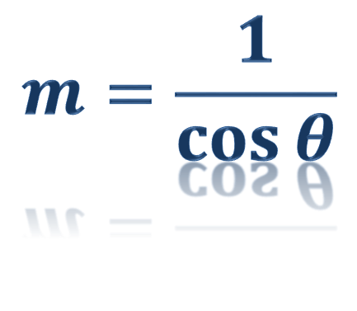
AERONET: Optical air mass calculation
h= altitude angle
ϴ= Sun zenith angle
$$m=\frac{1}{\cos{θ}}$$
ϴ
h
Ground

Slide 46
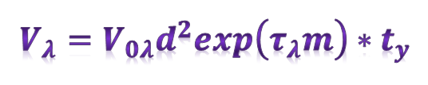
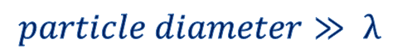
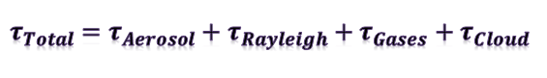
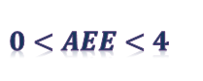


AERONET: Direct measurements and calculations
V= digital voltage
V₀= extraterrestrial voltage
m=optical air mass
τ= total optical depth
λ=wavelength
d= ratio of the average to the actual Earth-Sun distance
t_{y}= transmission of absorbing gases
a= coefficient
AEE= Angstrom extinction exponent
Beer-Lambert-Bouguer Law

Slide 47


AERONET: Precipitable water
Precipitable water
Uses of three channels
675, 870 and 940 nm
Transmission is computed for 675 and 870 nm
using ROD and TOD
The total transmission at 940 nm is determinate by extrapolation
The extrapolated transmission at 940nm is subtracted from the measured transmission at 940nm
Providing the transmission only due to water vapor (Tw).
Therefore, the precipitable water (in cm) can be determined using the following equations:

Slide 48
AERONET: Instrument precision
Calibration refers to the determination of the calibration coefficients needed to convert the instrument output (DN) to a desired output, in this case aerosol optical thickness (AOT) and radiance (W/m²/sr/μm). (Holben et al. 1998)
Instrument precision
Ability
to accurately reproduce results
From multiple measurements
Constant conditions
Standardized
techniques
2-m-diameter integrating sphere
Determine the gain and offset calibrations of the sky radiance channels using a light source
Mauna Loa Observatory
Evaluate the sun channels.
Examination of dark current values taken during each sky radiance measurement
Methods
Notes:
We define the precision of the instrument as its ability to accurately reproduce results from multiple measurements under constant conditions using standardized techniques. Holben et al.1998

Slide 49
AERONET: Calibration Assessment
The direct Sun calibration coefficient
Langley plot method
Intercomparison method
Obtain the V₀ for each wavelength
Langley calibration in the morning and in the afternoon
Optical air mass of 2 and 7
The water vapor calibration coefficient
Modification of the Langley method
The water vapor transmittance is modeled from each 940 nm.

Slide 50

AERONET: Inversion products
AERONET inversion code provides aerosol optical properties in the total atmospheric column derived from the direct and diffuse radiation measured by AERONET Cimel sun/sky-radiometers.
AERONET inversion development and research activities are described in the papers by Dubovik and King, [2000]
Sun photometers measure the radiance at four or more wavelengths using almucantar and principal plane scenarios.
Products of radiance inversion
Forward modeling of atmospheric radiance
Numerical inversion
Bimodal volume distribution of aerosol particles in Aug 3rd 2012, Reno Nevada.

Slide 51
Outline
Sunphotometer
Cimel CE-318
2.1. Instrument parts and how it works
2.2. Cimel scans
2.3. Sensitivity of the instrument to the offset
3. AERONET
3.1. Direct measurement and calculations
3.2. Dubovik and King 2000
3.3. Dubovik 2006
3.4. Inversion products

Slide 52
AERONET: Forward Model (Dubovik and King 2000)
Assumptions
Plane and parallel atmosphere
Homogeneous atmosphere. No polarization effects or angular independent ground reflectance
Cloud free conditions
Radiance measured at the
ground are influenced by the whole atmospheric column
It’s not expected to be strongly dependent on the vertical
distribution of aerosol.
Aerosol particles are spherical
Radiative transfer modeling
Lambertian approximation

Slide 53

AERONET: Forward Model (Dubovik and King 2000)
I(Θ,λ) = Spectral sky radiance
Θ = Scattering angle
F_{o} =Exoatmospheric flux
ϴ=Solar zenith angle
m= optical air mass (m₀ = l/cos ϴ₀, m ₁ = 1 /cos ϴ)
τ = Spectral extinction optical thickness
ω₀= Single-scattering albedo; and
P(0; A) = Phase function
G( . . . ) = describes multiple scattering from ground

Slide 54


AERONET: Forward Model (Dubovik and King 2000)
Modeling of τ(λ), ω₀(λ), P(Θ,λ)
Requires
Cloud free conditions
Molecular scattering
Aerosol scattering and absorption
τ _{ext}^{total} = Aerosol optical thickness of the layer
ω₀^{total} = Aerosol single scattering albedo
P(Θ,λ)= Aerosol phase function

Slide 55



AERONET: Forward Model (Dubovik and King 2000)
Aerosol optical parameters (phase function (optical thickness of aerosol extinction, scattering and absorption) can be modeled from microstructure. (Dubovik and King 2000)
r= Radius
n(r)= dN(r)/dr →Particle size distribution in the atm. column
K_{sca}= Scattering cross section
K_{τ} = Extinction cross section
Note: K_{sca} and K_{τ} are approximated by Mie functions derived for spherical and homogeneous particles characterized by a complex refractive index.

Slide 56
AERONET: Forward Model (Dubovik and King 2000)
This Equation summarizes the modeling concept that relates optical properties of the atmosphere with the size distribution and complex refractive index of the aerosol particles, which are assumed to be homogeneous spheres.
The retrieval of the particle size distribution from the measurements of light scattered by polydispersions of spheres is a well-developed optical application. (Dubovik and King et al., 2000)

Slide 57

AERONET: Forward Model (Dubovik and King 2000)
Approximation
Approximation

Slide 58



AERONET: Forward Model (Dubovik and King 2000)
Types of distributions
Kernel functions

Slide 59

AERONET: Forward Model (Dubovik and King 2000)
Aerosol optical thickness → τ(λ)
Single scattering albedo → ω(λ)
Phase function → P(Θ,λ)

Slide 60

AERONET data flows
Inversion of Sun and Sky Radiance to Derive Aerosol Properties from AERONET. (Holben et al., 2003)

Slide 61

AERONET Forward Model (Dubovik and King 2000)
Inversion of Sun and Sky Radiance to Derive Aerosol Properties from AERONET. (Holben et al., 2003)

Slide 62
Outline
Sunphotometer
Cimel CE-318
2.1. Instrument parts and how it works
2.2. Cimel scans
2.3. Sensitivity of the instrument to the offset
3. AERONET
3.1. Direct measurement and calculations
3.2. Dubovik and King 2000
3.3. Dubovik 2006
3.4. Inversion products

Slide 63
AERONET Forward Model (Dubovik 2006)
Assumptions
Plane parallel multilayered atmosphere
Some polarization
Cloud free conditions
Aerosol shape: mix ( spherical, non spherical and mixed)
Spheroid randomly oriented
Polydisperse aerosol with variable size distribution
Note: As a consequence, the simulation of light scattering by spheroids that requires integrating spheroid extinction and scattering cross sections over both a wide range of sizes and aspect ratios is computationally much more demanding than simulations of light scattering by spherical particles
Spheroid
A spheroid is the simplest nonspherical shape that
can generalize the spherical shape (a sphere is a spheroid
with an axis ratio e = 1).
The scattering of electromagnetic radiation by spheroids can be accurately simulated.
The observations of scattering by desert dust show a considerable degree of contributions from individual particles with different orientations, shapes, and compositions

Slide 64

AERONET Forward Model (Dubovik 2006)
Scattering matrix model
Photometric and polarization parameters of the atmosphere
Plane parallel multilayered atmosphere
Each layer is characterized by
Aerosol optical thickness, single scattering albedo and phase function
The phase function describes the angular polarizing properties of a single scattering
event in the layer
Mishchenko et al. (2002)
Stokes parameter

Slide 65





AERONET Forward Model (Dubovik 2006)
Polydispersion model

Slide 66



AERONET Forward Model (Dubovik 2006)
New Kernel function
Spherical
Spheroid approximation
Dubovik and King 2000
Dubovik 2006

Slide 67


AERONET Forward Model (Dubovik 2006)
Application of spheroid models to account for aerosol particle nonsphericity in remote sensing of desert dust (Dubovik et al. 2006)
The previous sections describe a new approach where the aerosol particle nonsphericity is retrieved together with other aerosol parameters. However, such approach can only be useful when the measured radiances are sensitive to particle shape, i.e., if the measurement geometry provides coverage of wide range of scattering angles and if the aerosol size distribution has significant coarse mode. (Dubovik et al. 2006)

Slide 68

AERONET Forward Model (Dubovik 2006)
The use of the spheroid model allows for more accurate fitting of observations and more robust retrievals for desert dust observations. For maritime aerosol, the assumption of spherical particles performs better since the coarse mode particles in this case (hydrated sea salt) are in fact nearly spherical. For the situation of fine mode dominated aerosol (e.g., biomass burning) both assumptions produce equivalent retrievals of high quality. (Dubovik et al. 2006)
As expected, the intensity observations of fine mode aerosols, such as biomass burning (Zambia), do not show sensitivity to particle shape (since the scattering by small particles is expected to be independent of particle shape). (Dubovik et al. 2006)
Application of spheroid models to account for aerosol particle nonsphericity in remote sensing of desert dust (Dubovik et al. 2006)

Slide 69

AERONET Forward Model (Dubovik 2006)
Better approximation to the real part of the refractive index
Elimination of an non existent fine mode
Application of spheroid models to account for aerosol particle nonsphericity in remote sensing of desert dust (Dubovik et al. 2006)

Slide 70

AERONET Forward Model (Dubovik 2006)
“At present, there is no single established approach to account for aerosol particle shape, and the methods utilized in different satellite retrieval algorithms are rather diverse.” (Dubovik et al. 2006)
“The MODIS and SeaWiFS groups are exploring the possibility of using an empirical phase function that
does not require any assumption of particle shape”. (Dubovik et al. 2006)
Application of spheroid models to account for aerosol particle nonsphericity in remote sensing of desert dust (Dubovik et al. 2006)

Slide 71
Outline
Sunphotometer
Cimel CE-318
2.1. Instrument parts and how it works
2.2. Cimel scans
2.3. Sensitivity of the instrument to the offset
3. AERONET
3.1. Direct measurement and calculations
3.2. Dubovik and King 2000
3.3. Dubovik 2006
3.4. Inversion products

Slide 72

AERONET Inversion products
Inversion of Sun and Sky Radiance to Derive Aerosol Properties from AERONET. (Holben et al., 2003)

Slide 73
AERONET: Inversion assumptions 2012…
Atmosphere is assumed plane-parallel.
Aerosol particles are assumed to be partitioned into two components: spherical and non-spherical.
The spherical component is modeled by an ensemble of polydisperse, homogeneous spheres (complex index of refraction is the same for particles of all sizes).
The non-spherical component is a mixture of polydisperse, randomly-oriented homogeneous spheroids
Vertical distribution of aerosol is assumed homogeneous in the almucantar inversion and bi-layered for the principal plane inversion.

Slide 74



AERONET: Volume particle size distribution
The volume particle size distribution
dV(r)/dlnr (μm3/μm2)
22 logarithmically equidistant bins
Complex refractive index
The real n(λ)
(1.33 ≤ n(λ) ≤ 1.6)
The imaginary k(λ) (0.0005 ≤ k(λ) ≤ 0.5)
0.05μm ≤ r ≤ 15 μm.

Slide 75

AERONET: Fine / coarse mode separation
Inversion code
This minimum is a separation point between fine and coarse mode particles
Simulates optical thickness, phase function and single scattering albedo of fine and coarse mode separately.
Minimum within the size interval from 0.439 to 0.992 μm.
Fine and coarse modes of aerosol particles in Aug 3rd 2012, Reno Nevada.
NOTE: The fine and coarse modes of single scattering albedo are technically estimated, however, it is not advised to use these values for the physical interpretation because the retrieval is implemented under assumption that complex refractive index is the same for all particle sizes.

Slide 76
AERONET: Univ_of_Nev-Reno

Slide 77

AERONET: Univ_of_Nev-Reno

Slide 78

AERONET:Univ_of_Nev-Reno

Slide 79
References
Holben B.N., T.F.Eck, I.Slutsker, D.Tanre, J.P.Buis, A.Setzer, E.Vermote, J.A.Reagan, Y.Kaufman, T.Nakajima, F.Lavenu, I.Jankowiak, and A.Smirnov, 1998: AERONET - A federated instrument network and data archive for aerosol characterization, Rem. Sens. Environ., 66, 1-16.
Dubovik, O., King, David et al. (2000). A flexible inversion algorithm for retrieval of aerosol optical properties from Sun and sky radiance measurements. Journal of geophysical research, 105, 673-696.
Dubovik, O., et al. (2006). Application of spheroid models to account for aerosol particle nonspherical in remote sensing of desert dust . Journal of geophysical research, 111.
Rollin E.M. An introduction to use of Sun-photometry for the atmospheric correction of airborne sensor data. Department of Geography, University of Southampton.
Cimel CE-318 User Manual

Slide 80
References
Holben B.N,. Et al. AERONET-A federated Instrument Network and Data Achieve for Aerosol characterization. Remote sense environment. 1996
Moosmüller, H., R. K. Chakrabarty, and W. P. Arnott (2009) Aerosol light absorption and its measurement: A review, Journal of Quantitative Spectroscopy & Radiative Transfer, 110, 844–878.
Ratnayke, R. 2008. Spectral Sun Photometry: It’s History, Purpose, and Applications. University of Nevada, Reno.
Arnott, P. Sun Photometry. University of Nevada, Reno
Arnold, I. Measuring Spectral Response of LEDs for Sun Photometry.
Turner, D. National Severe Storms Center, NOAA. Data from the DOE ARM Site, North Central Oklahoma.

