Slide 1
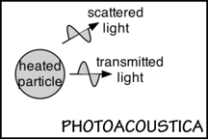
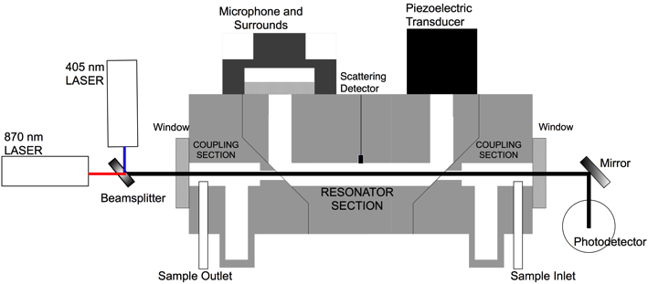
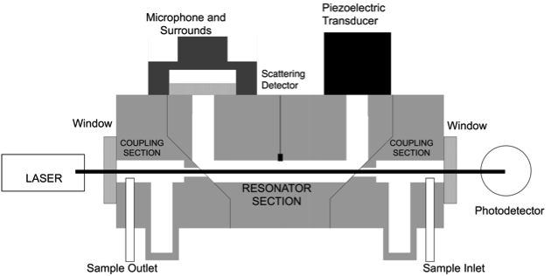
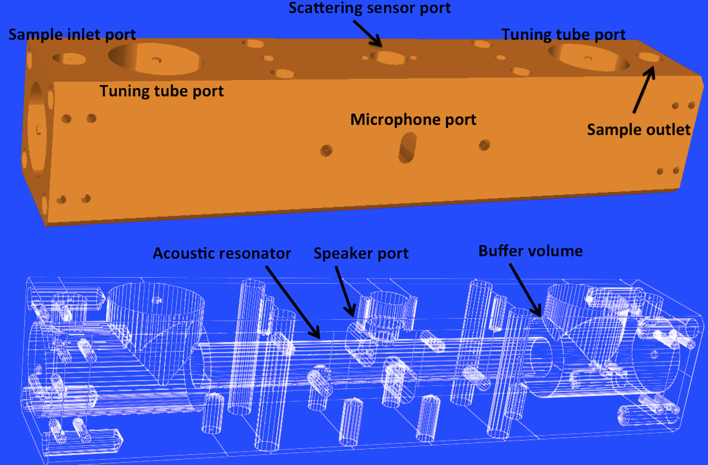
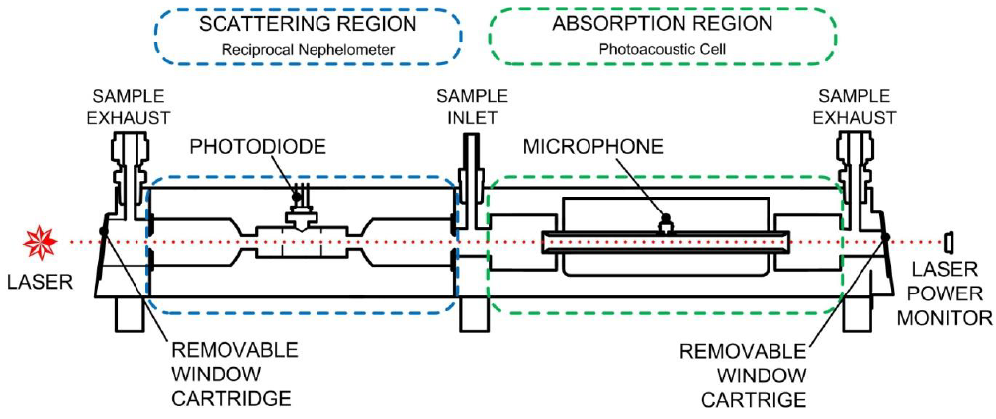
Aerosol Light Absorption and Scattering
W. P. Arnott and Guadalupe Paredes Miranda
Atmospheric Science Program
Department of Physics
University of Nevada Reno

Slide 2
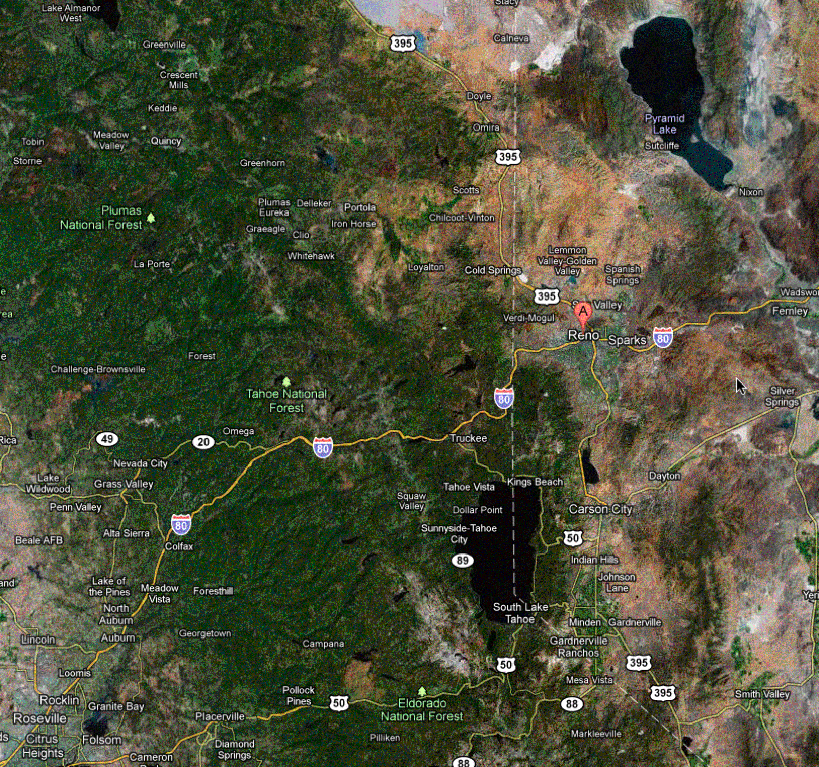
UNR Is Also A Land Grant University: Morrill Act of 1862.

Slide 3
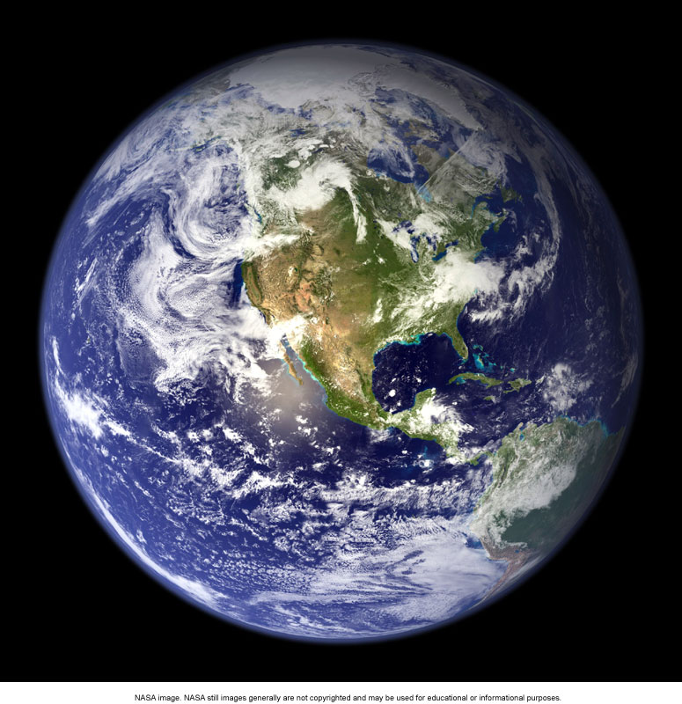
Earth
UNR/DRI Atmospheric Science
UNR
DRI
desert
research
institute
2 faculty
member (physics).
2 affiliated faculty
Members
(geography and
envir. science).
Undergrad Program:
Since 2005.
Part of Physics.
Small program, lots of
personal attention.
Student Chapter
of the American
Meteorological
Society.
DRI has 400 employees. Division of Atmospheric Sciences has 20 faculty members that teach and mentor UNR Atmospheric Science students. Students gain practical experience in climate, modeling, mountain meteorology, atmospheric chemistry,
and instrumentation.
Grad Program:
Since 1965.
Originally part
of Physics. Now
one of UNR’s
interdisciplinary
programs.
Graduates at:
National Center for
Atmospheric Research.
Brookhaven National Lab.
Lovelace Laboratory.
Oakridge National Lab.
University of Utah.
University of Alaska.
University of Maryland.
Texas A&M.
Raytheon. NASA… and more.
UNR and DRI are part of the Nevada System of Higher Education (NSHE)

Slide 4
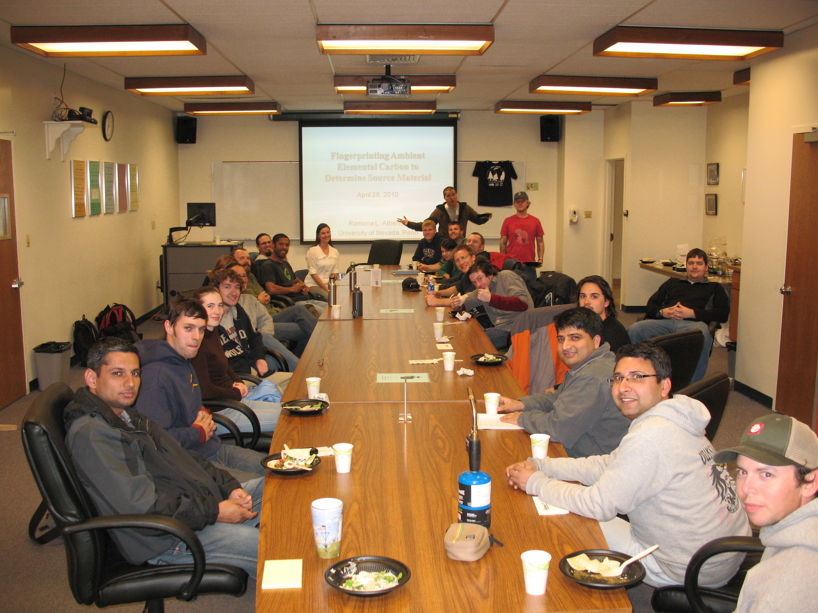
UNR Student Chapter of the American Meteorological Society

Slide 5
OUTLINE
Overview: Aerosol optics microphysics.
Aerosol Optical Coefficients of an Air Parcel:
Absorption B_{abs} (death of photons, light energy goes to heat)
Scattering B_{sca} (second life for photons, redirection)
Extinction B_{ext} (the bottom line, how much power is removed from a beam of light by B_{ext} = B_{sca} + B_{abs})
How we measure B_{ext} , B_{sca} , B_{abs}
Applications of these coefficients and science insights

Slide 6
Connections
Aerosol Optics =
Societal Activity +
Nature in Action +
Photochemical Transformation +
Meteorology

Slide 7
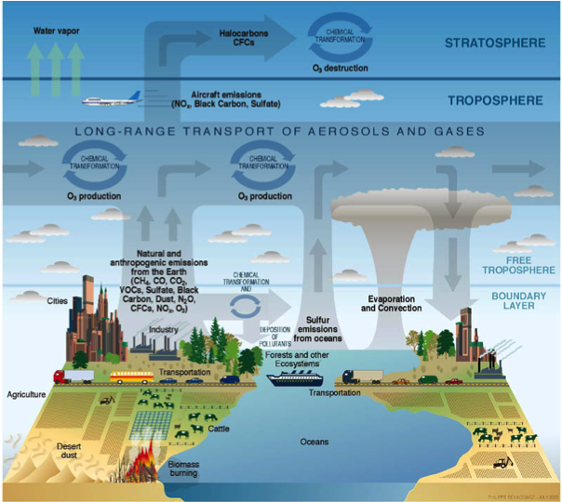
Connections

Slide 8
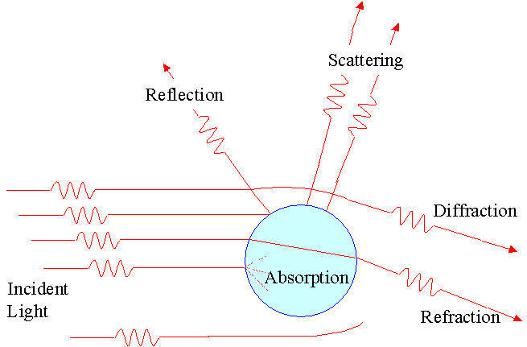
Optical Aerosol Properties
I_{o}
I
L
Direct Beam of Light:
Beer’s Law
σ_{sca}
σ_{abs}
σ_{abs,sca,ext} depend on aerosol size, shape, and composition.

Slide 9
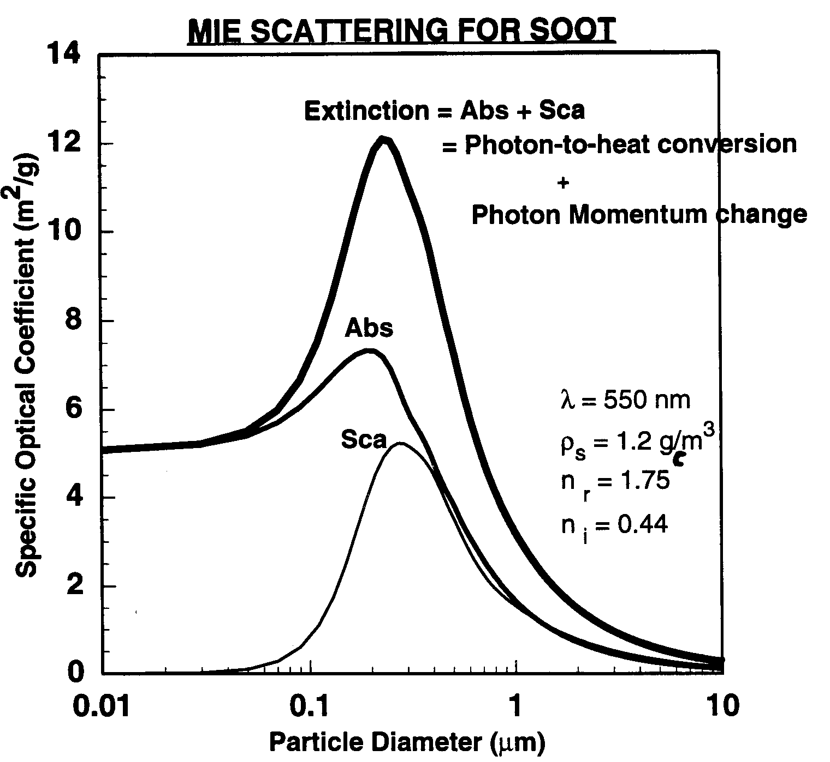
Aerosol Optical Properties: Absorbing particles
Optical power removed by ext=abs+sca.
F₀ (W/m²)
P_{ext} (W) = F₀ σ_{ext}
P_{abs} (W) = F₀ σ_{abs}
P_{sca} (W) = F₀ σ_{sca}
Absorption dominates for D < 0.1 µm (Rayleigh scattering).
Note the strong dependence of the scattering coefficient on diameter.
Mie scattering is not a great model to use for fresh soot with small fractal dimension.
For non-absorbers, Extinction=Scattering.
σ
particle
mass
1/r
Rayleigh

Slide 10
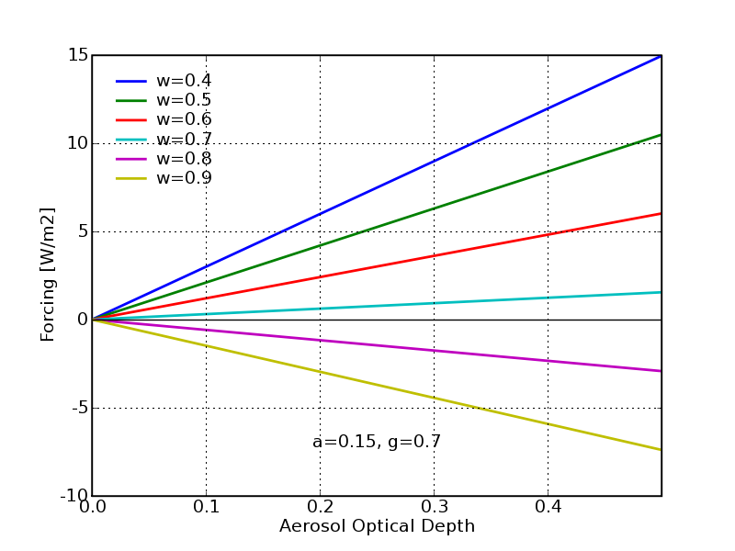
Aerosol Radiative Forcing: Top of Atmosphere
Scattering
Absorption
Warming
B_{abs} dominates
Single scattering approximation
S = Solar constant (1386 [W/m²])
T = Atmospheric transmission (0.8)
N = Cloudiness (0.5)
g = Asymmetry parameter (0.7)
ω = Single scattering albedo (0.75)
a = Surface albedo (MODIS)
= Aerosol optical depth
Chylek and Wong, GRL, 1995
Strong Impacts on Boundary Layer Meteorology and Surface Radiative Forcing.
Cooling
B_{sca} dominates
Modified from Dr. Seth Olsen’s AGU Presentation 2006. Globally averaged linear model for small optical depth.
Notes:
Delta F is the Aerosol Radiative Forcing. In words, it is the the difference in outgoing flux without and with the causative agent. In this case, the causative agent is aerosol. The negative sign for scattering means that the scattering property of aerosol has the effect of scattering more sunlight back to space than the planet would without aerosol. The positive sign for absorption means that aerosol absorption reduces the amount of sunlight going to space; therefore, the atmosphere heats.
NOTES:
If the surface albedo a=0, the scattering by aerosol is most important, and since the surface is perfectly absorbing in this case, aerosol absorption doesn’t matter.
If the surface albedo a=1, the surface scatters much more than the aerosol, so only absorption matters. And the impact of absorption is greatest when the surface albedo is greatest.
This equation can easily be derived by allowing for multiple reflections between the aerosol layer and the surface.
This expression says NOTHING about what happens to the surface forcing! Surface forcing is vitally important for boundary layer dynamics.

Slide 11
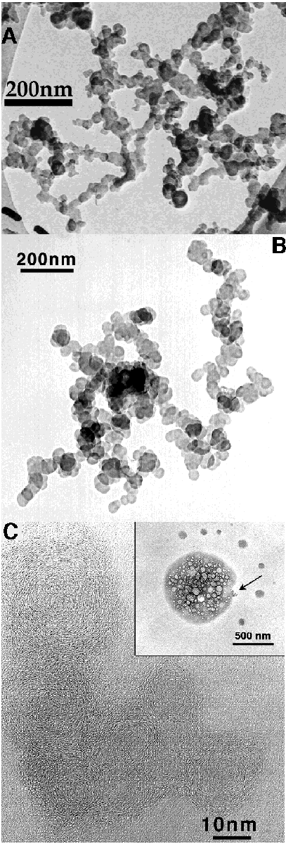
Black Carbon ≈ Soot:
10 - 50 nm monomers chained together to form larger aggregates. ‘Onion Shell’ structure of the monomers.
IMAGE CREDIT:
http://7starm.asu.edu/Buseck2000%20/figure_10.htm
TEM images of soot.
A, B. Chain-like soot aggregates. (A--Phoenix, after Katrinak et al., 1993; B--Sagres, Portugal, ACE-2).
C. High-resolution TEM image of the arrowed soot aggregate showing the onion-like structure of soot spheres. (Southern Ocean, ACE-1; after Pósfai et al, 1999).

Slide 12
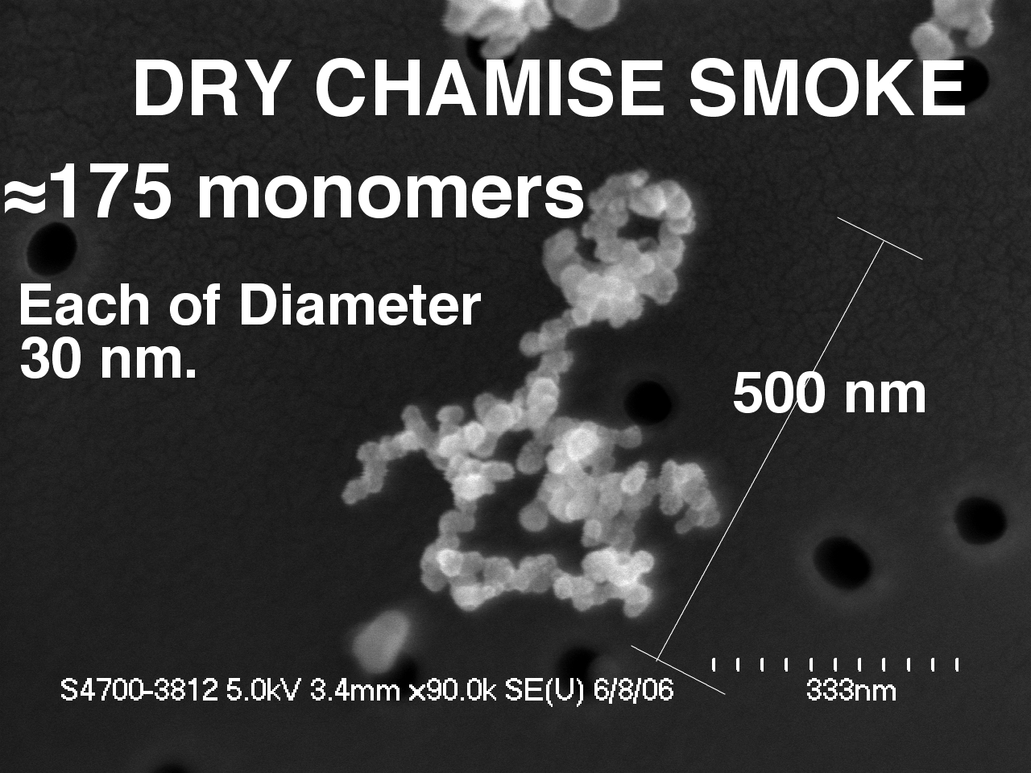
Example of Dry Chamise Particle SEM Image
`
K. A. Lewis, W. P. Arnott, H. Moosmüller, R. K. Chakrabarty, C. M. Carrico, S. M. Kreidenweis, D. E. Day, W. C. Malm, A. Laskin, J. L. Jimenez, I. M. Ulbrich, J. A. Huffman, T. B. Onasch, A. Trimborn, L. Liu, and M. I. Mishchenko (2009) Reduction in biomass burning aerosol light absorption upon humidification: roles of inorganically-induced hygroscopicity, particle collapse, and photoacoustic heat and mass transfer. Atmos. Chem. Phys., 9, 8949-8966.

Slide 13
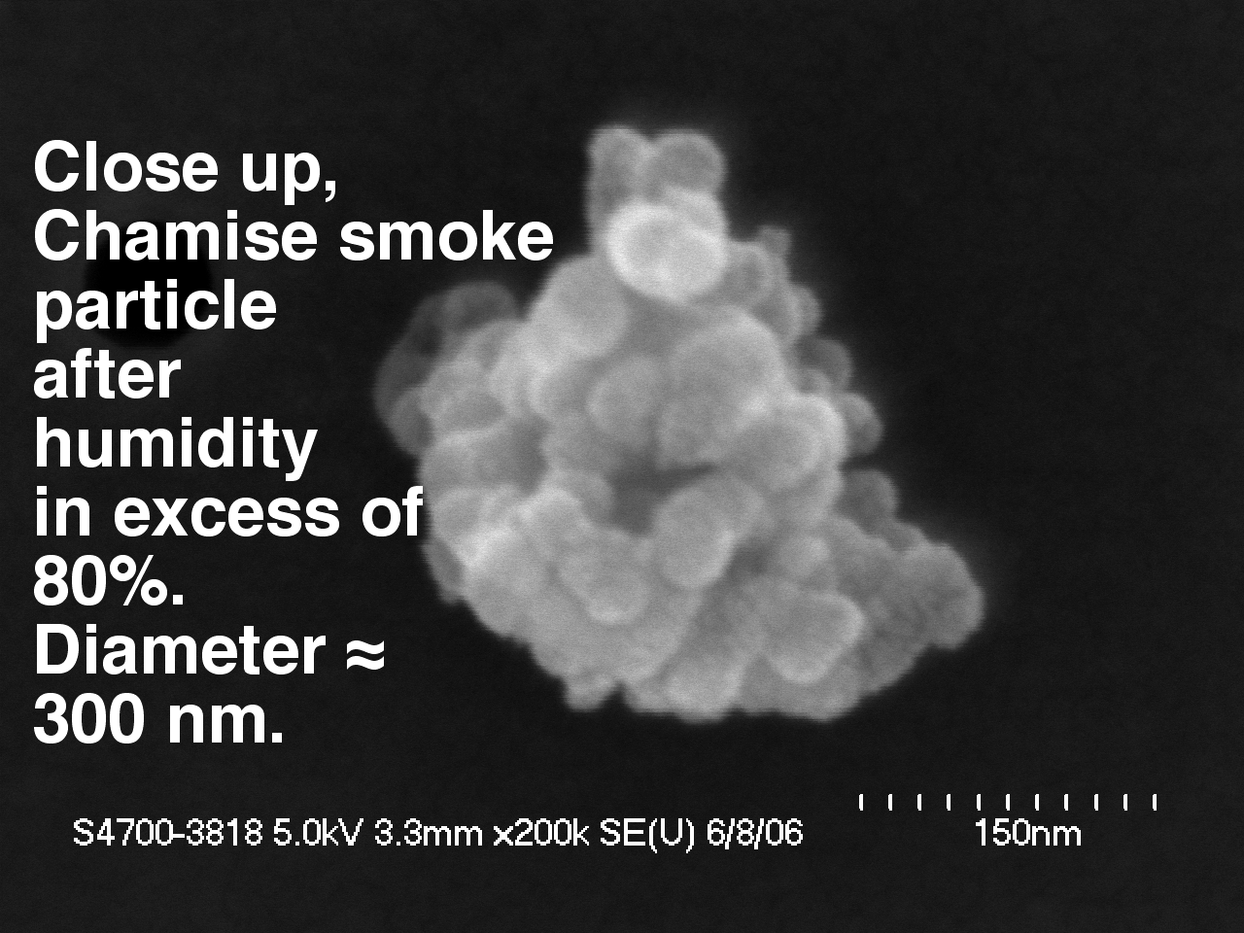
Example of Chamise Particle SEM Image After H₂0 Vapor Applied at RH=85%
`

Slide 14
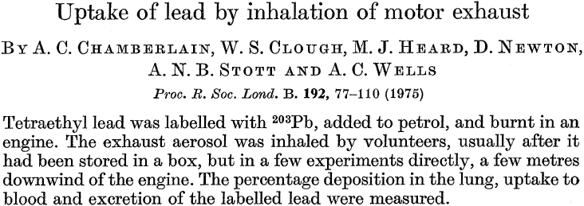
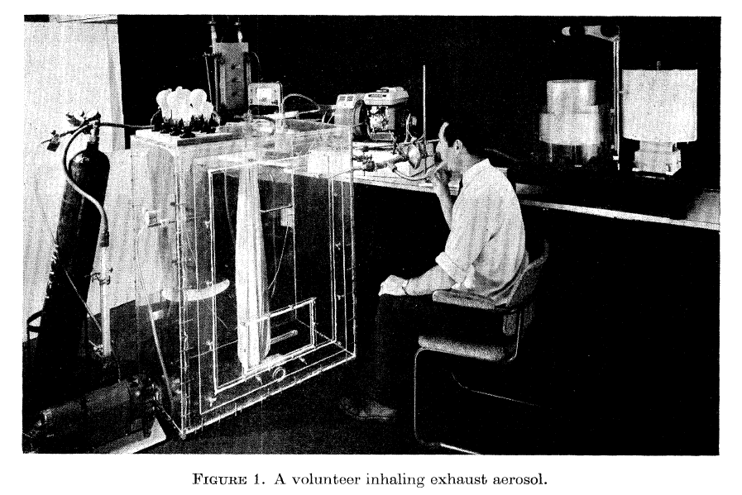
Lead Experiments on People!
Circa 1975!

Slide 15
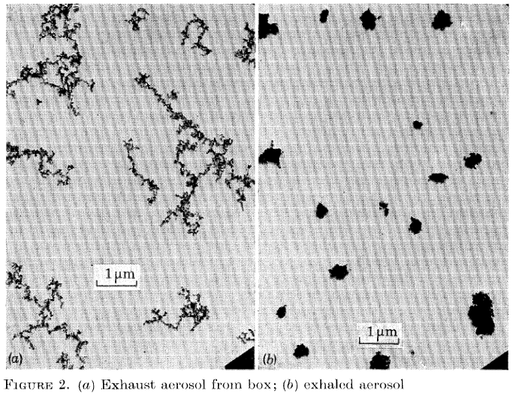
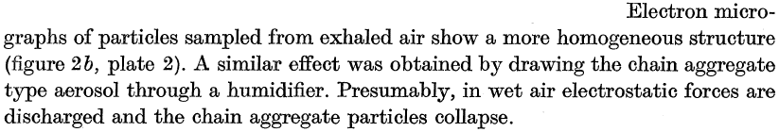
Particle Collapse Upon Humidification in the Lungs!
Chamberlain, A. C., W. S. Clough, M. J. Heard, D. Newton, A. N. B. Stott, and A. C. Wells (1975), Uptake of lead by inhalation of motor exhaust, Proceedings of the Royal Society of London. Series B, Biological Sciences, 192, 77-110.

Slide 16
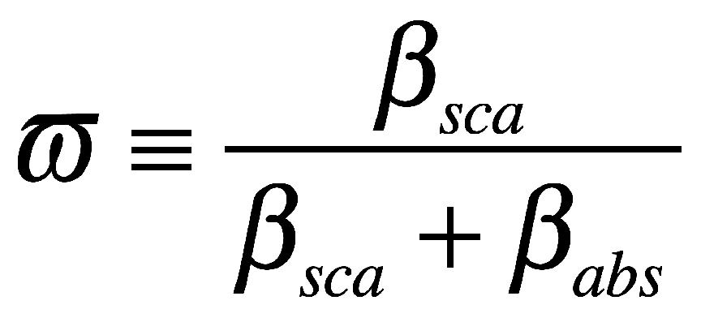
Aerosol Single Scattering Albedo
Fraction of total light extinction (β_{abs}+β_{sca}) due to
scattering
Completely scattering ,e.g. sulphate ω ∼1
Strongly absorbing diesel soot, freshly emitted BC, ω ∼ 0.3
Depends on chemical composition, particle size, morphology and wavelength
Notes:
16

Slide 17
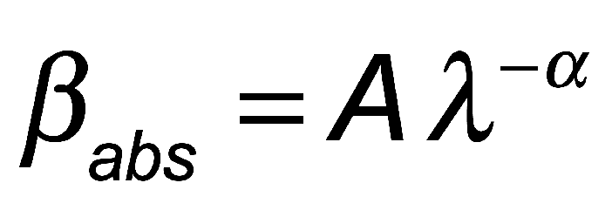
Wavelength Dependence of Absorption
α = Angström Exponent for Absorption.
We often use measurements at 405 nm and 870 nm to determine α.
α ≈ 1 for motor vehicle emission generated BC.
Biomass burning aerosols has α as high as 3.5, due to absorption by the organic aerosol fraction known as brown carbon (BrC)
Dust has α ≈ 3 due to UV and near UV absorption by SiO₂.
Notes:
17

Slide 18
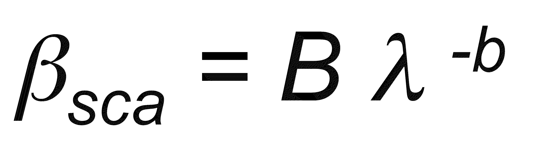
Wavelength Dependence of Scattering
b = Angström Exponent for scattering.
Typically use 405, 532, and 870 nm to determine b. 870 nm is less sensitive to fine mode; more to coarse mode.
b ≈ 1.6, but varies during the day as aerosol size changes.
Rayleigh scattering by gases has b ≈ 4.
Coarse mode dust has b < 1 due to large aerosol size compared with the wavelength. b OO b OO
Notes:
18

Slide 19
How Can We Obtain Aerosol Absorption?
Calculation of Light Absorption (Complex Refractive Index, Size Distribution, Morphology)
In Situ Measurements
(Filter Based and Photoacoustic)
Remote Sensing
Bond, T. and R. Bergstrom (2006). “Light Absorption by Carbonaceous Particles: An Investigative Review.” Aerosol Sci. Tech. 40, 1-41.
Moosmüller, H., R. K. Chakrabarty, and W. P. Arnott (2009) Aerosol light absorption and its measurement: A review, Journal of Quantitative Spectroscopy & Radiative Transfer, 110, 844–878.

Slide 20
Filter Based Measurement of B_{abs}
Challenges:
Interference between absorption by particles and scattering by particles in the filter medium.
Partial Solution: Either correct for through additional measurements and/or radiative transfer approach (Petzold et al., 2002; Arnott et al., 2005) or eliminate scattering with index matching (Ballach et al., 2001).
Limited dynamic range.
Partial Solution: Variable filter change interval or variable dilution .
Petzold, A., H. Kramer, and M. Schönlinner (2002). “Continuous Measurement of Atmospheric Black Carbon Using a Multi-Angle Absorption Photometer.” Environmental Science and Pollution Research 4, 78-82.
Ballach, J., R. Hitzenberger, E. Schultz, and W. Jaeschke (2001). “Development of an Improved Optical Transmission Technique for Black Carbon (BC) Analysis.” Atmos. Environ. 35, 2089-2100.
Arnott, W. P., K. Hamasha, H. Moosmüller, P. J. Sheridan, and J. A. Ogren (2005). “Towards Aerosol Light-Absorption Measurements with a 7-Wavelength Aethalometer: Evaluation with a Photoacoustic Instrument and 3-Wavelength Nephelometer.” Aerosol Sci. Tech. 39, 17-29.

Slide 21
Simplified description of filter methods for light absorption. PSAP and AETHALOMETER
Aerosol are deposited on the light-diffusing filter, multiple scattering substrate.
Light absorbing aerosol reduce the light power at the photodetector.
Light scattering aerosol don't reduce power in principle.
Calibration and effects of aerosol loading (blocking)??
We have noted large RH induced artifacts (PSAP).

Slide 22
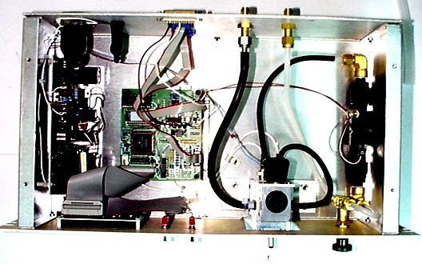
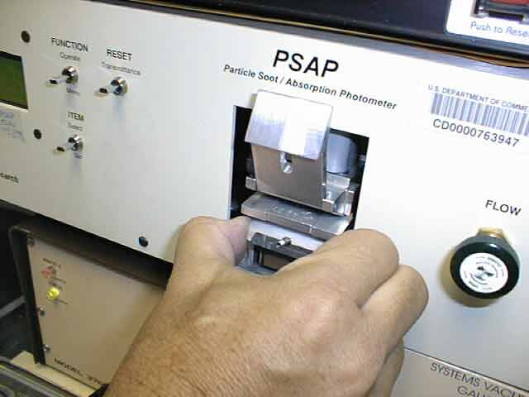
Particle Soot Absorption Photometer
Single Wavelength Unit: 565 nm
3 Wavelength Unit: 467 nm, 530 nm, 660 nm.
Virkkula, A., N. C. Ahlquist, D. S. Covert, W. P. Arnott, P. J. Sheridan, P. K. Quinn and D. J. Coffman (2005). "Modification, calibration and a field test of an instrument for measuring light absorption by particles." Aerosol Science and Technology 39: 68-83.
Bond, T. C., T. L. Anderson and D. Campbell (1999). "Calibration and Intercomparison of Filter-Based Measurements of Visible Light Absorption by Aerosols." Aerosol Science and Technology 30(6): 582-600.
Image from http://www.mlo.noaa.gov/programs/esrl/aero/img/img_psap_filter.JPG

Slide 23
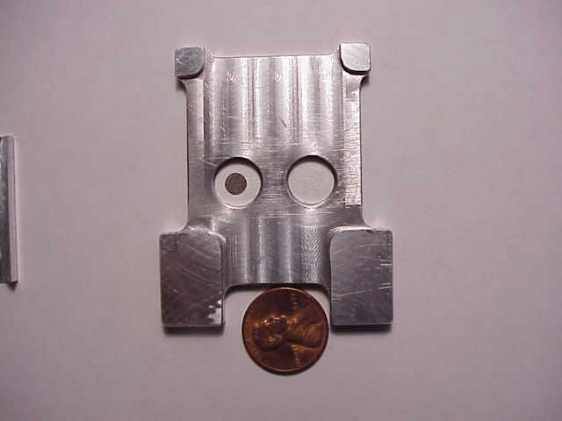
PSAP: Particle Soot Absorption Photometer A filter-based measure of light absorption. Person needed to change filter.
Reference filter on the right. Aerosol-loaded filter on the left. Compare light transmission through these filters as a measure of light absorption.
Major advantage: Noise decreases as 1/(measurement time) since aerosol accumulates on the filter. Helps in clean locations. See Stephen R. Springston & Arthur J. Sedlacek III (2007) Noise Characteristics of an Instrumental Particle Absorbance Technique, Aerosol Science and Technology, 41:12, 1110-1116, DOI: 10.1080/02786820701777457

Slide 24
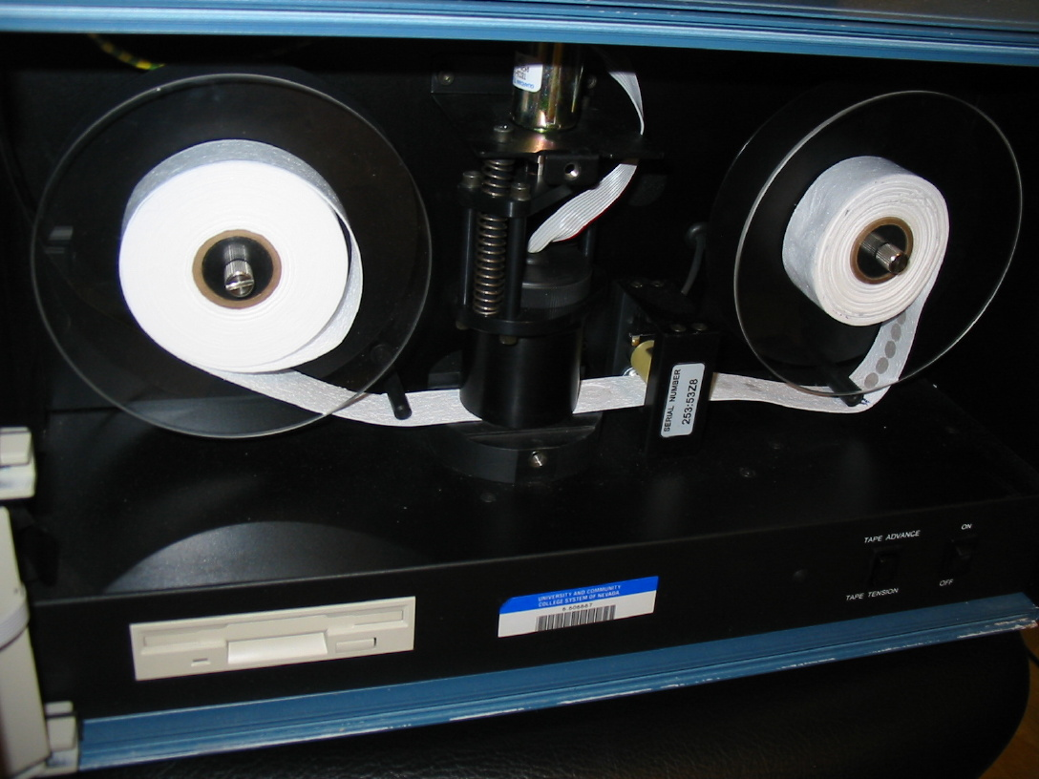
Aethalometer: Automatic filter changes
AE-31 (‘Spectrum Aethalometer’):
Measurement at 7 wavelengths.
370, 470, 520, 590, 660, 880 and 950 nm.
Sensitivity: Proportional to flow rate, inversely to time resolution, about 0.1 ug/m³ @ 1 min resolution and 3 LPM flow rate.

Slide 25
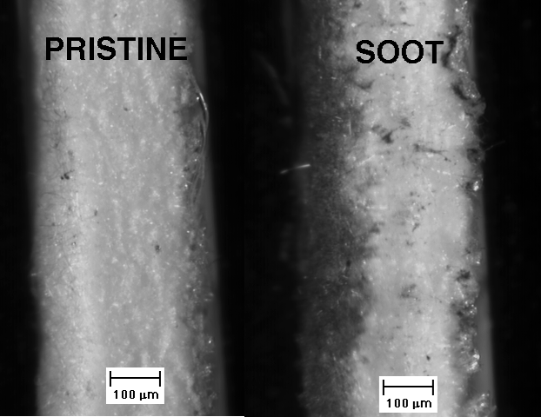
Aethalometer Glass Fiber Filter Details: Side view.
Aerosol deposits from the left. Somewhat non uniform distribution.

Slide 26
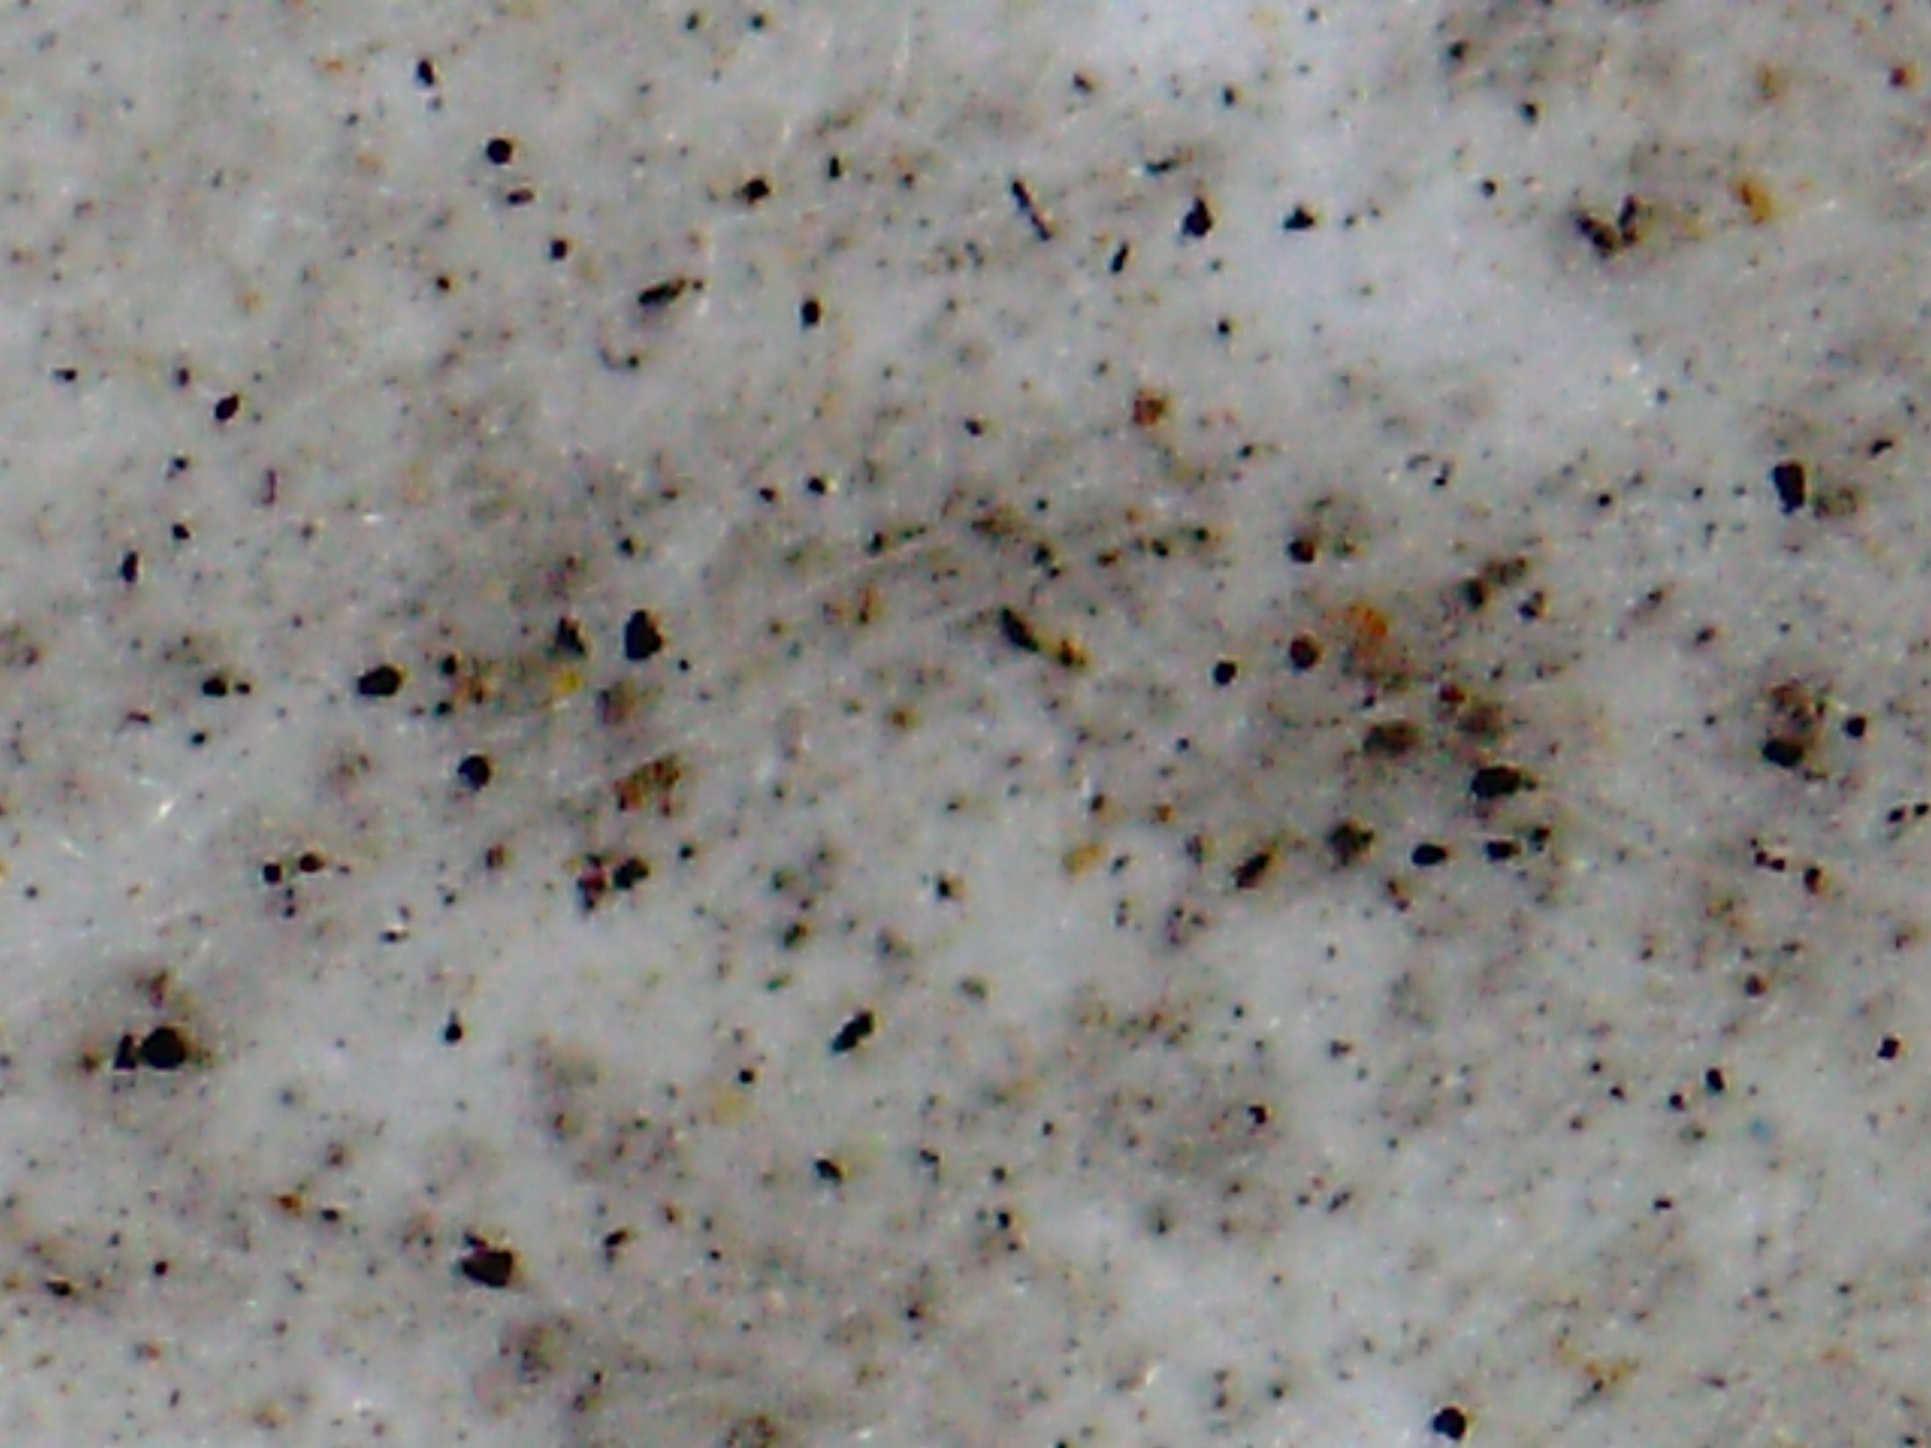
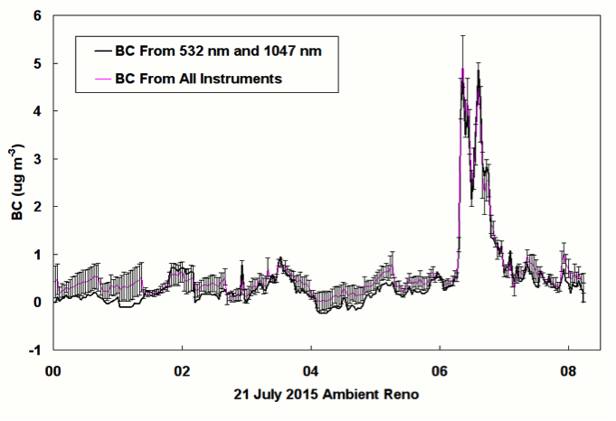
Top Surface Teflon Filter: Reno Ambient
Aerosol agglomerates on the filter surface
so that interior volume is no longer available
for absorption (from Rick DeFreez)
Reno BC
20 μm

Slide 27
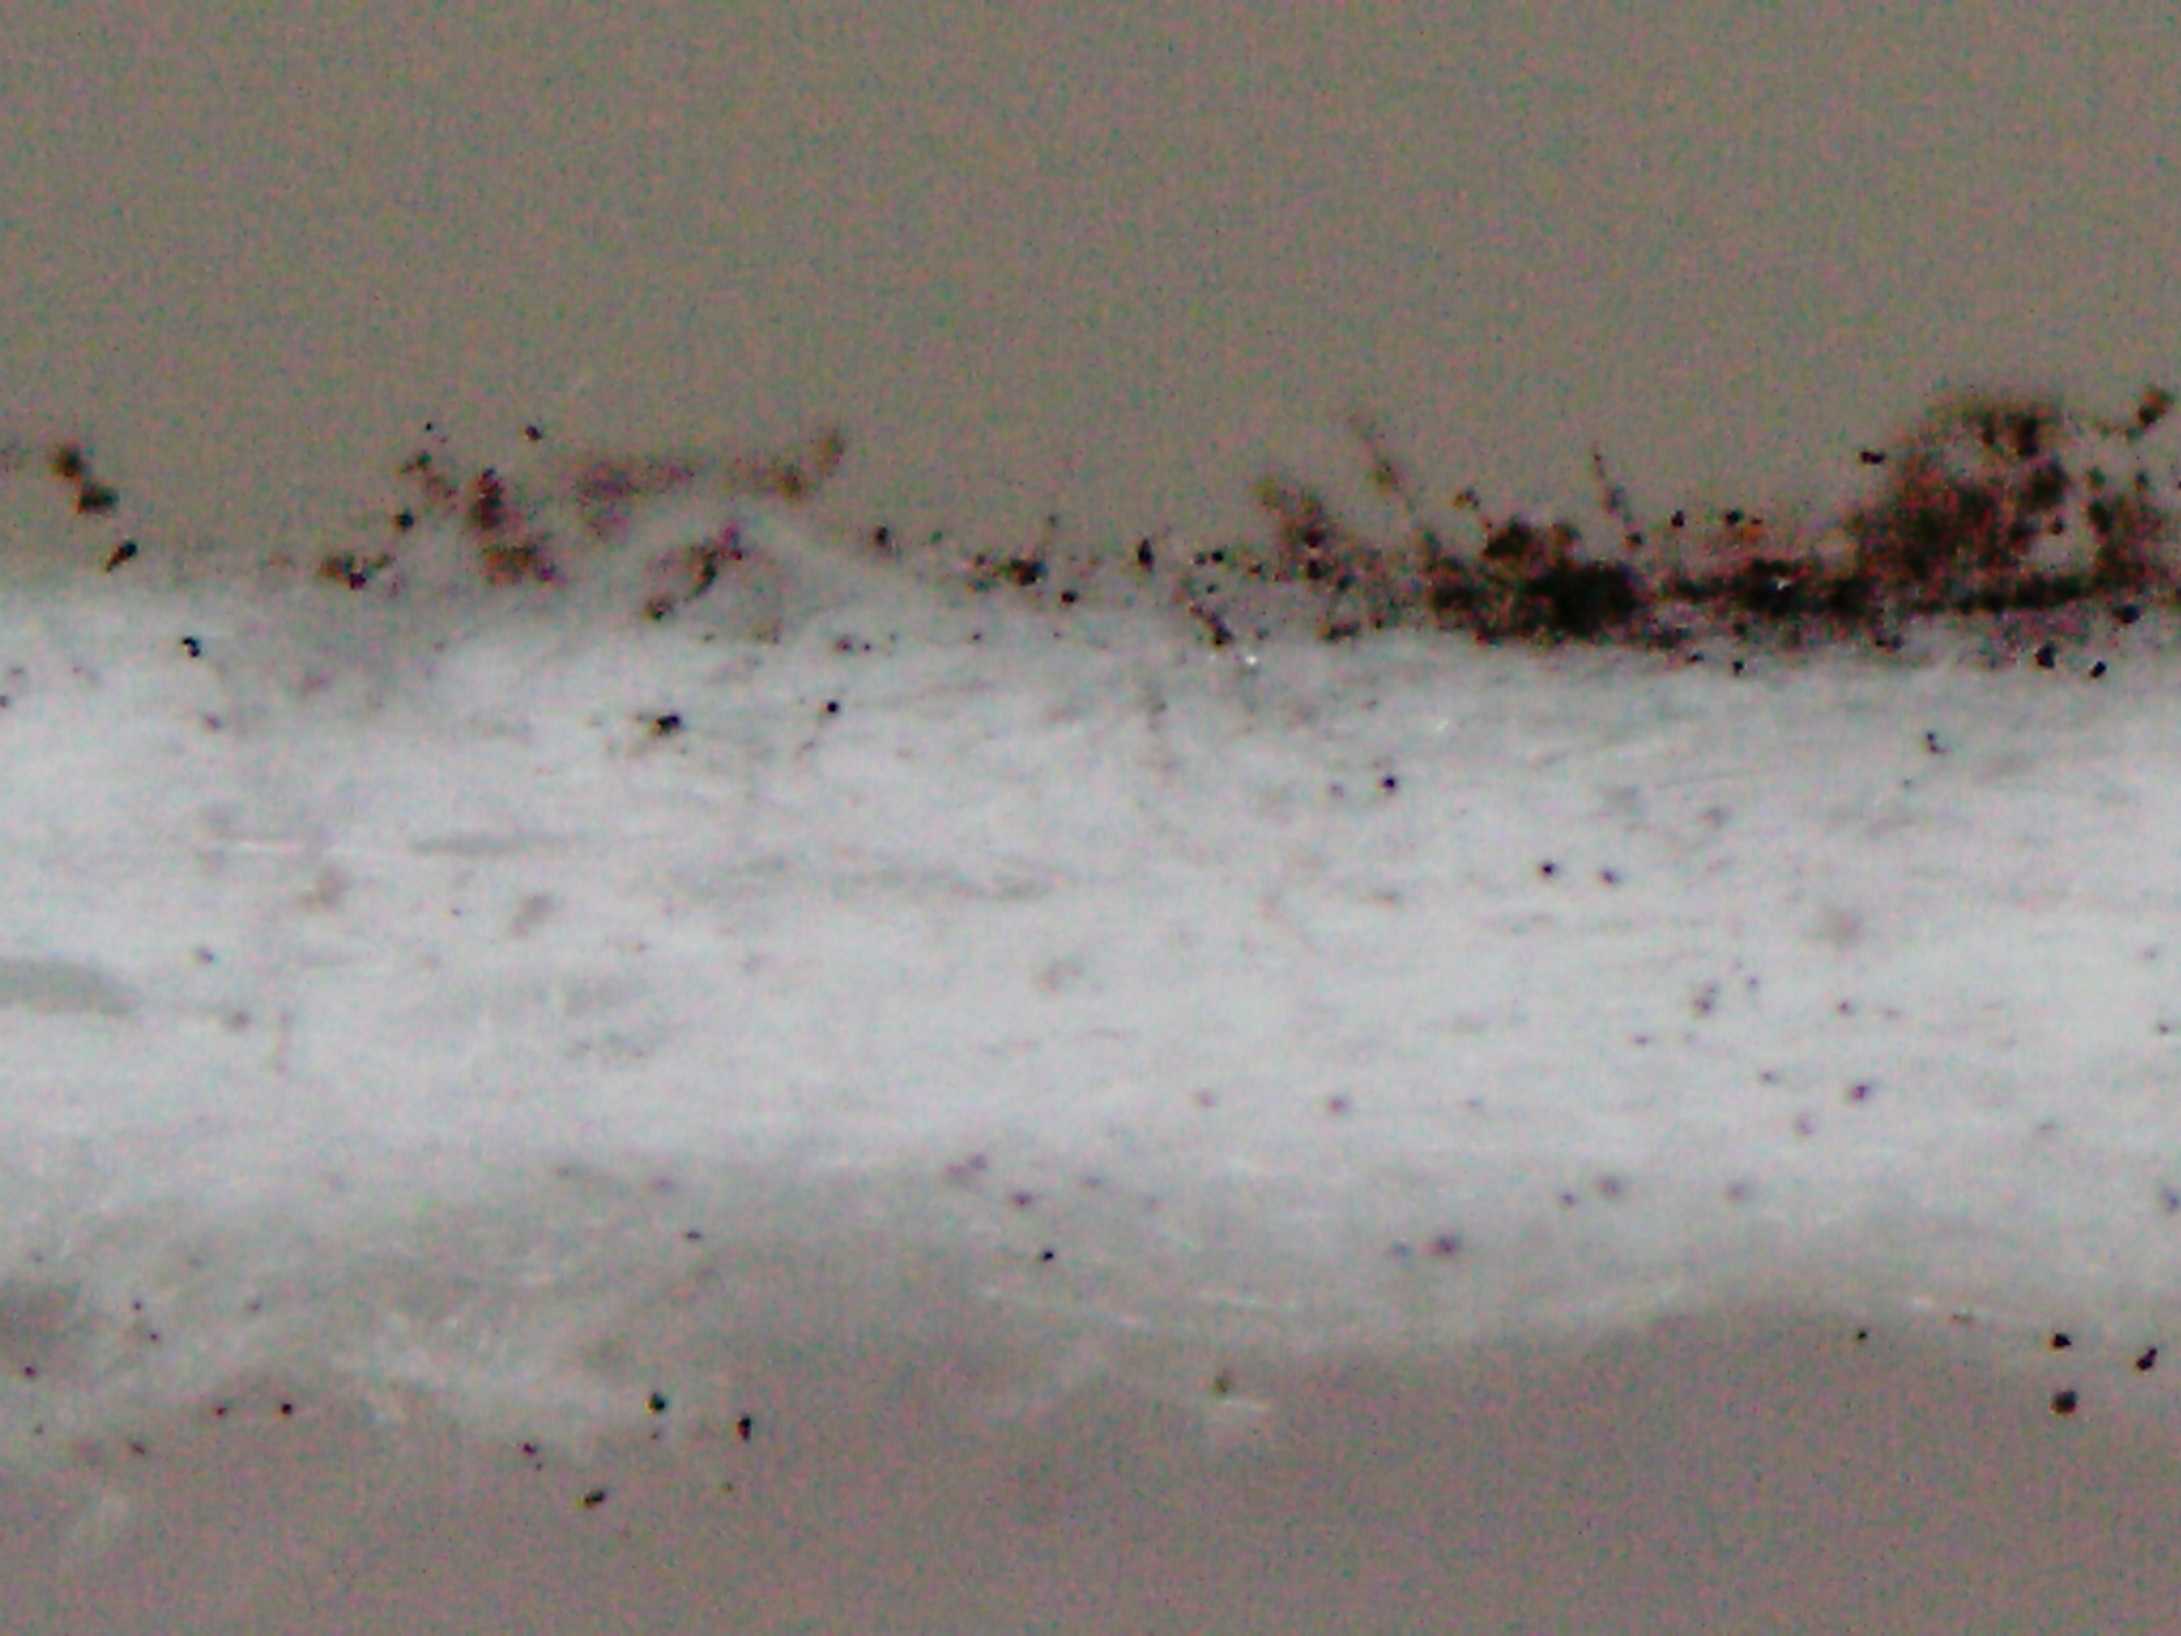
Cross-Section Teflon Filter: Kerosene Soot Test
(from Rick DeFreez)
500 μm
100 μm

Slide 28
Photoacoustic Instrument
Based on and calibrated with first principles.
High time resolution (up to 1 s).
Large (10⁶) dynamic range (ambient to sources).
Sensitivity (≈ 0.5 Mm⁻¹ ≅ 50 ng/m³ of EC), depends on laser power.
Compact (19” rack mount) and rugged (aircraft operation).
Arnott, W. P., H. Moosmüller, C. F. Rogers, T. Jin, and R. Bruch (1999). “Photoacoustic Spectrometer for Measuring Light Absorption by Aerosol: Instrument Description.” Atmos. Environ. 33, 2845-2852.
Arnott, W. P., H. Moosmüller, and J. W. Walker (2000). “Nitrogen Dioxide and Kerosene-Flame Soot Calibration of Photoacoustic Instruments for Measurement of Light Absorption by Aerosols.” Rev. Sci. Instrum. 71, 4545-4552.
Arnott, W. P., H. Moosmüller and J. W. Walker (2003). Photoacoustic instrument for measuring particles in a gas. USA Patent 6,662,627, Desert Research Institute, Reno NV.
Arnott, W. P., B. Zielinska, C. F. Rogers, J. Sagebiel, K. E. Kelly, D. A. Wagner, A. F. Sarofim and J. S. Lighty (2005). "Evaluation of 1047 nm photoacoustic instruments and photoelectric aerosol sensors in source-sampling of black carbon aerosol and particle bound PAH's from gasoline and diesel powered vehicles." Environ. Sci. Technol 39(14); 5398-5406. DOI: 10.1021/es049595e
Lewis, K., W. P. Arnott, H. Moosmüller, and C. E. Wold (2008), Strong spectral variation of biomass smoke light absorption and single scattering albedo observed with a novel dual-wavelength photoacoustic instrument, J. Geophys. Res., 113, D16203, doi:10.1029/2007JD009699.

Slide 29
Photoacoustic Instruments For Light Absorption Measurements
Basic principles:
Laser light is power modulated by the chopper.
Light absorbing aerosols convert light to heat - a sound wave is produced.
Microphone signal is a measure of the light absorption.
Light scattering aerosols don't generate heat.

Slide 30
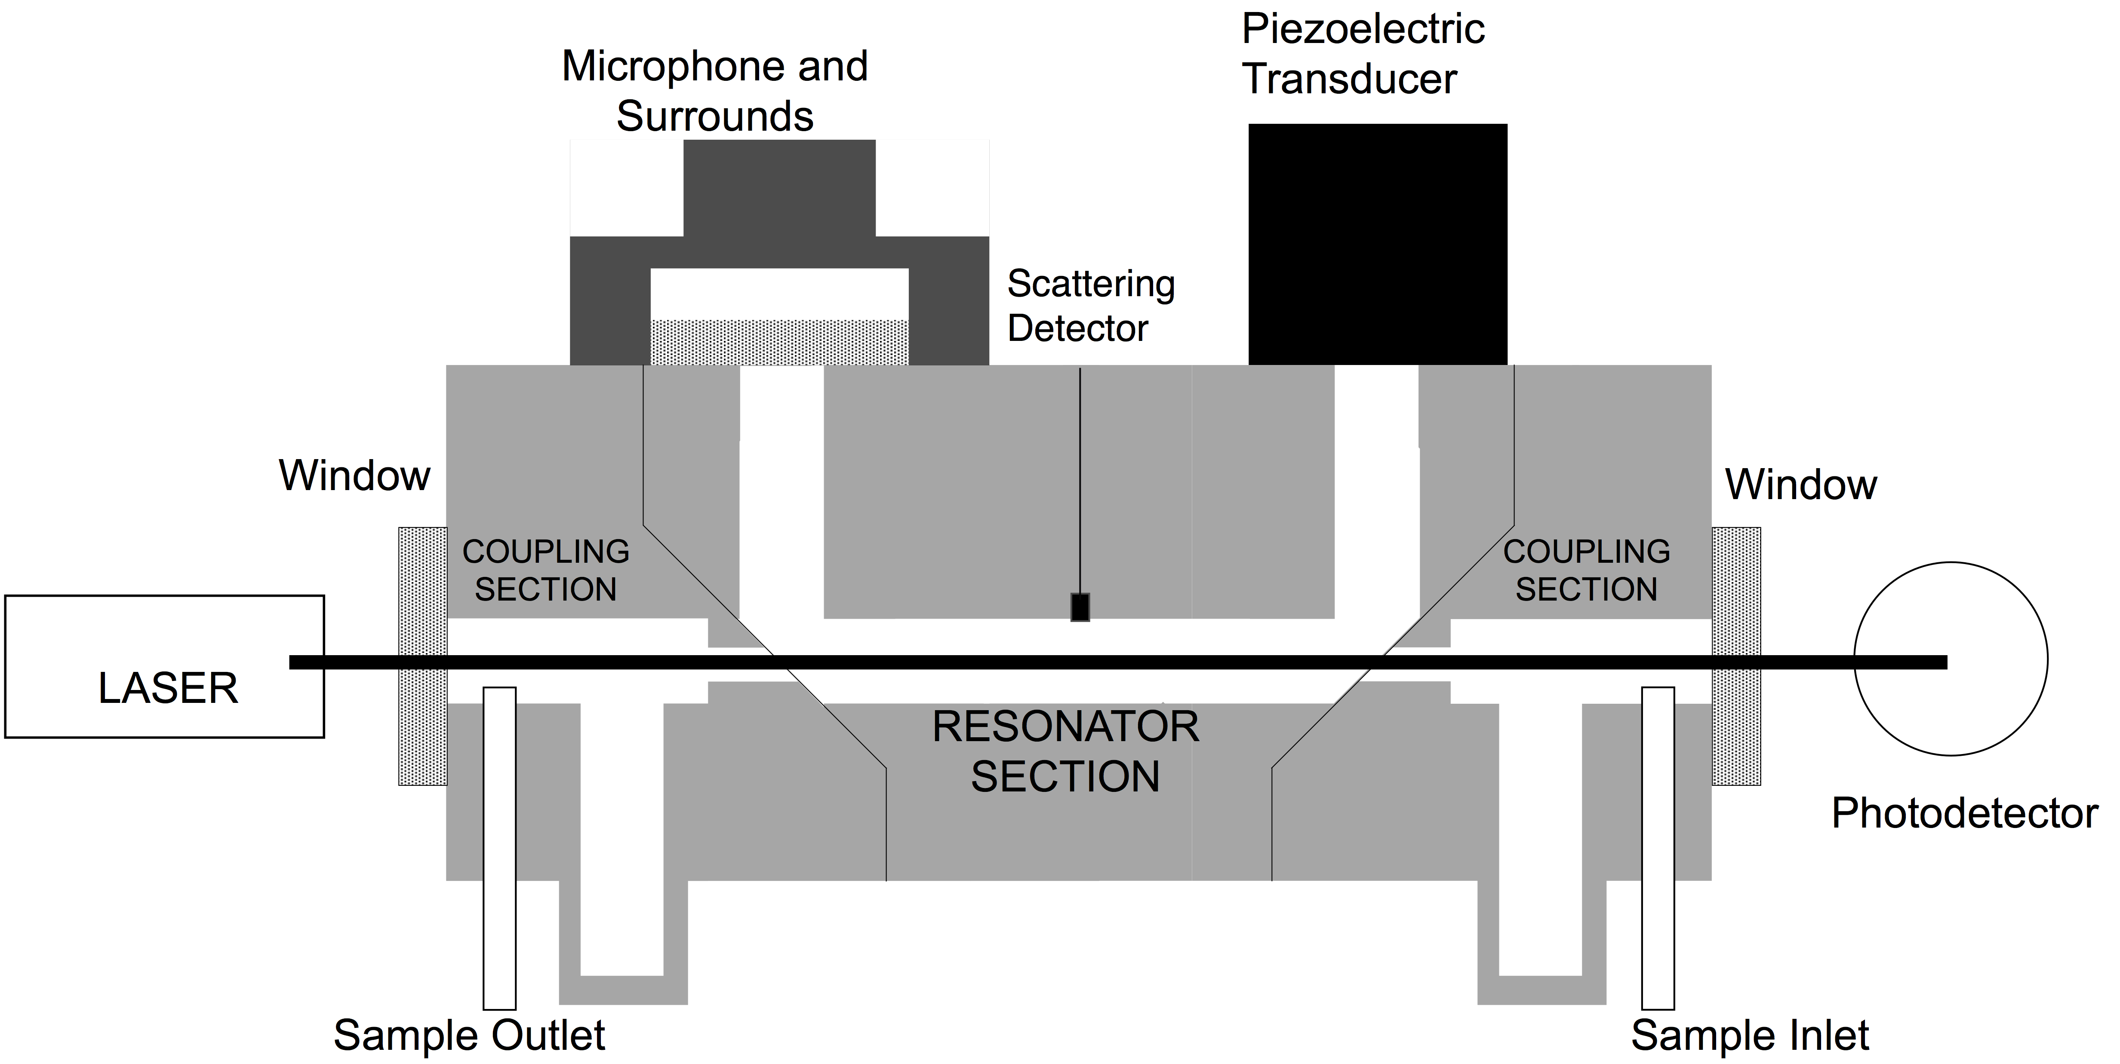
Measurement of Light Absorption, Scattering, and Extinction
in situ measurement
  PHOTOACOUSTIC INSTRUMENT

Slide 31
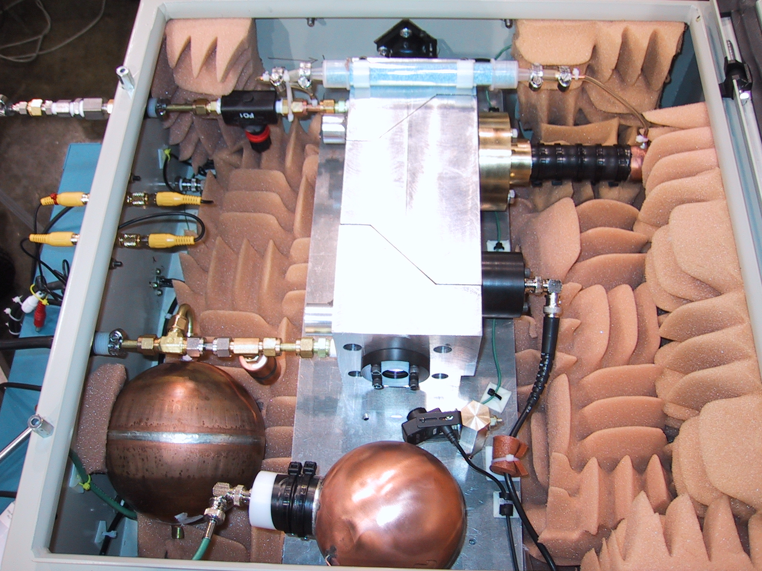
PAS version 1 serial # 1, to the University of Utah: 1047 nm for Black Carbon Mass Concentration Measurement

Slide 32
Photoacoustic Instrument Details: Equation to Obtain Light Absorption Coefficient.

Slide 33
Very Weakly Absorbing Aerosol:
Scattering offset of filter measurement methods

Slide 34
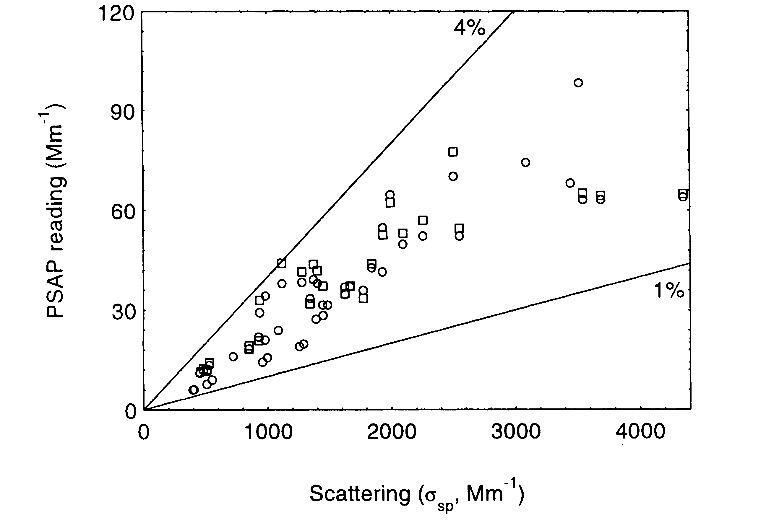
PSAP Response to Scattering:
Source: Bond et al. (1999) also provides parameterization to reduce effects of scattering.
B_{abs}^{True} = B_{abs}^{PSAP} - 0.025*B_{sca}
Notes:
Trend up to 1991 published by Bodhaine & Dutton. They attributed likely cause of 1982-1991 decrease to changes in emissions from FSU.
Subsequent flattening out of “trend” illustrates need to continue monitoring to follow up apparent trends. Could it just be that 1982-1987 were anomalies?
Followup analysis being done as part of NOAA Arctic Research Initiative.
No other obvious trends at baseline stations..
Aerosol properties at baseline sites show clear seasonality, reflecting seasonal changes in sources and sinks.

Slide 35
Strongly Absorbing Aerosol Response:
Filter loading effect anomalously reduces response as light absorbing aerosol accumulates

Slide 36
Photoacoustic Measurements of Black Carbon Mass Concentration for Source Measurements for Emission Inventory Development And Urban Air Quality

Slide 37
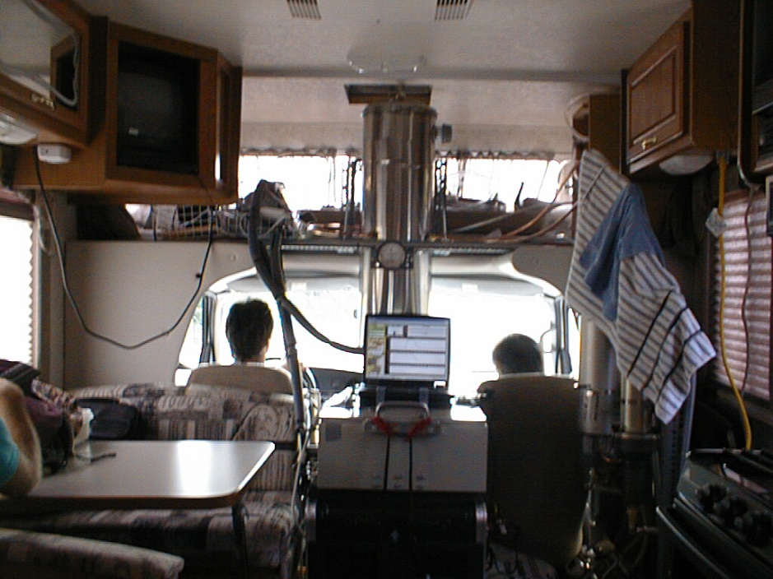
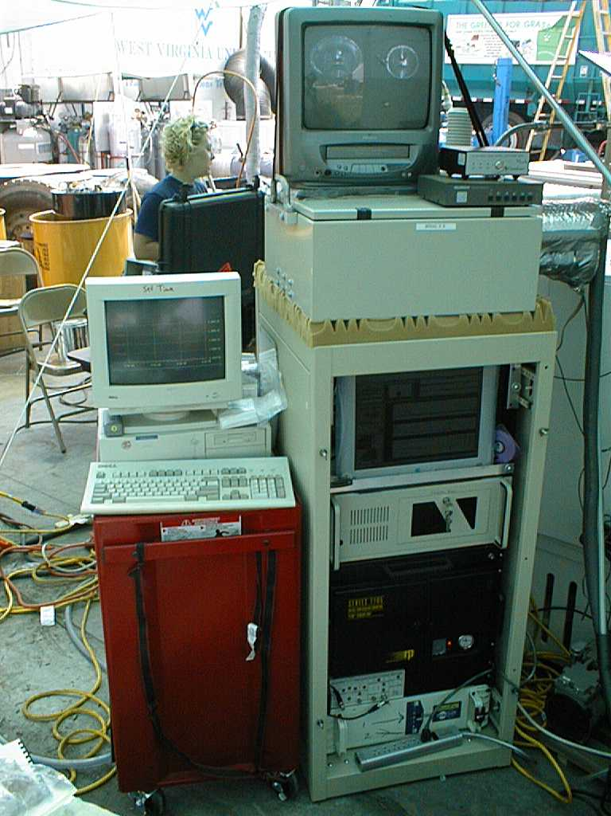
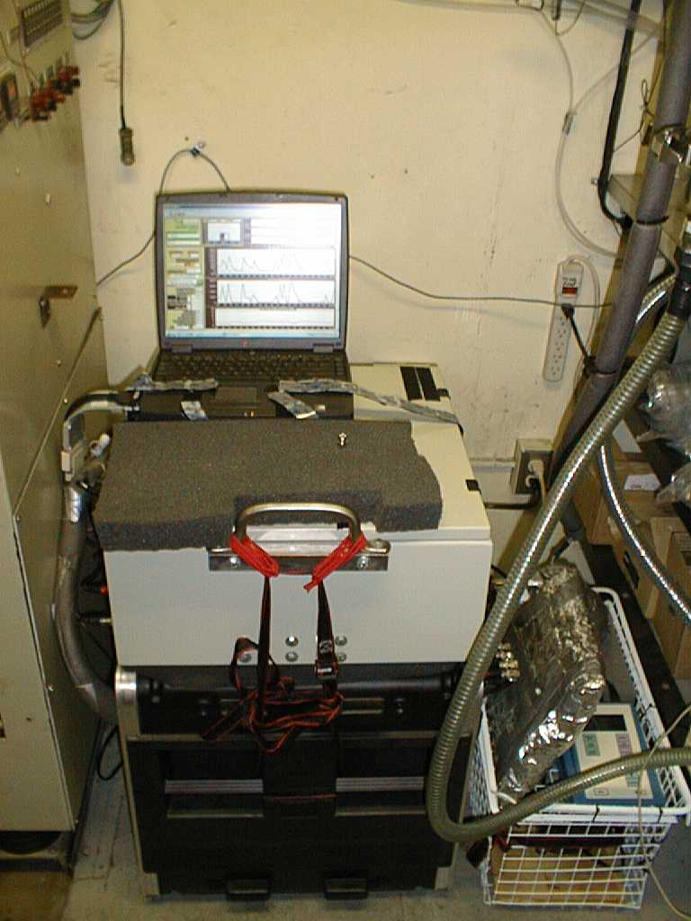
Some Images of the Photoacoustic Instrument in Operation
Mobile sampling from an RV. (Dave Campbell left, and Eric Fujita right.)
Sampling a vehicle (dyno) during a ‘unified’ driving cycle.
PA and dusttrak installed in the Univ. West Virginia trailer for sampling from their dilution tunnel.

Slide 38
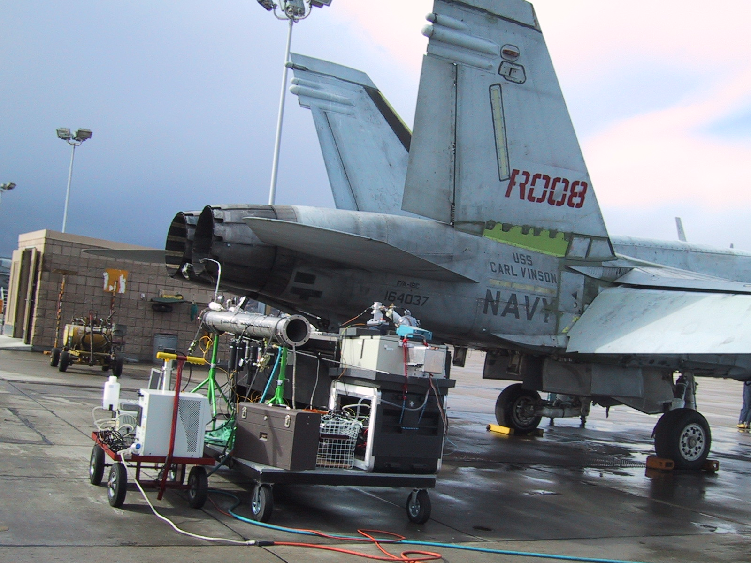
Jet Exhaust: SERDP 2002, North Island CA
Rogers, F., W. P. Arnott, B. Zielinska, J. Sagebiel, K. E. Kelly, D. Wagner, J. S. Lighty, and A. F. Sarofim, (2005). Real-time measurements of jet aircract engine exhaust. Journal of Air and Waste Management 55, 583-593.

Slide 39
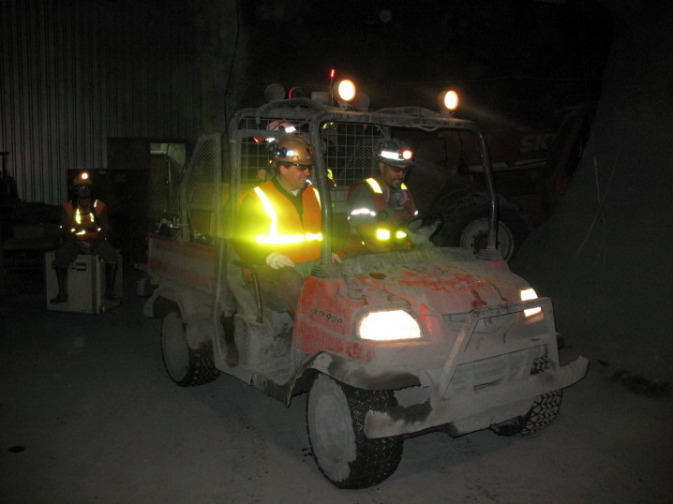
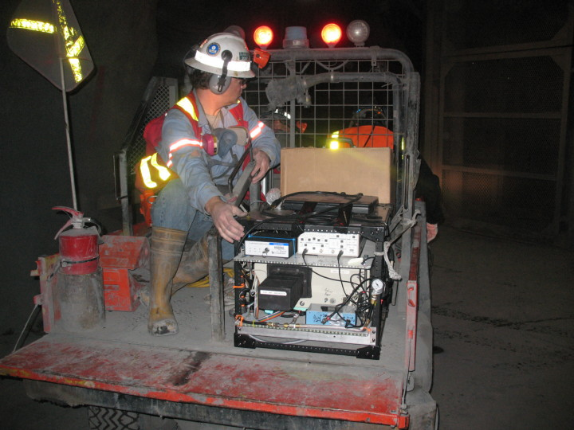
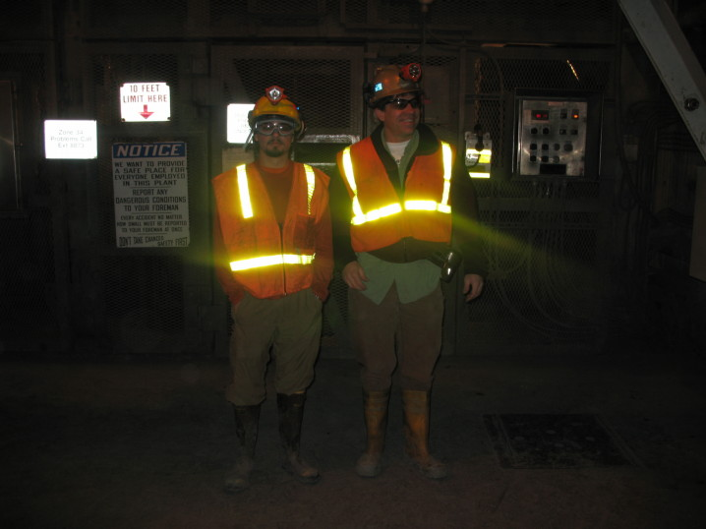
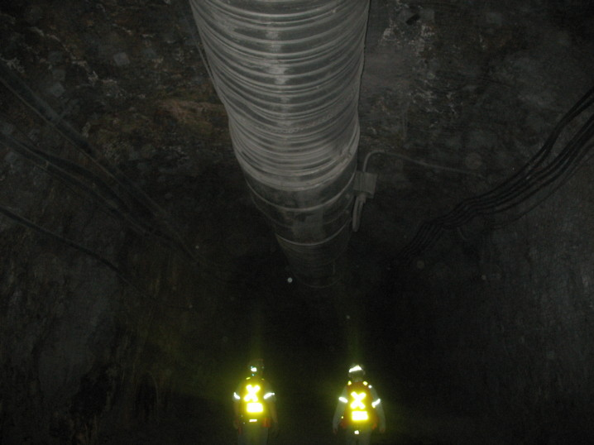
The Crew In Action…

Slide 40
Vehicle Used for the Tests
Arnott, W. P., I. J. Arnold, P. Mousset-Jones, K. Kins, and S. Shaff (2008). Real-time Measurements of Diesel EC and TC in a Nevada Gold Mine With Photoacoustic and Dusttrak Instruments: Comparison With NIOSH 5040 Filter Results To be published, Proceedings of the 12th US/North American Mine Ventilation Symposium, Reno, NV June 9-11.
Photograph showing the haul truck in operation along with the air quality samplers. The photoacoustic EC instrument is housed in the vanilla colored box on the equipment rack and the Dustrak nephelometers are in blue. The filter samplers are up on the wall immediately to the right of the blue writing on the wall. The sample inlet for the photoacoustic instrument can be seen draped over the top of the laptop computer.

Slide 41
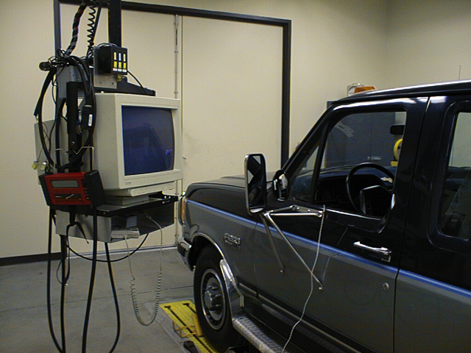
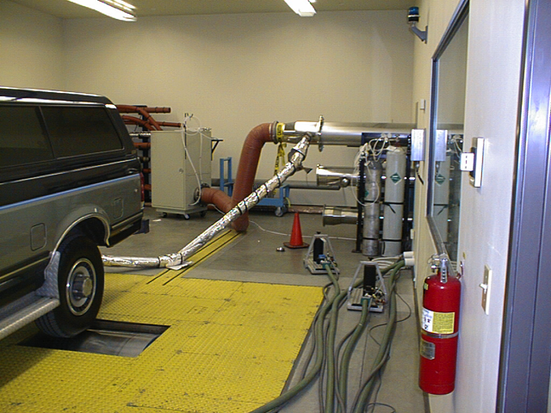
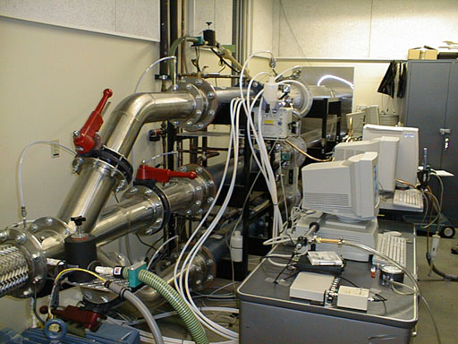
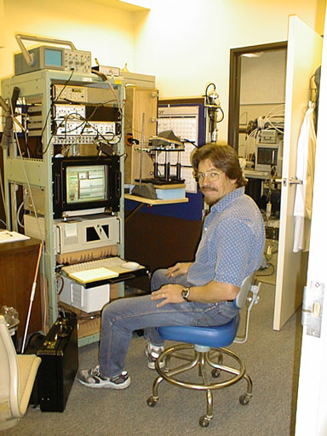
Dynamometer Test Facility at UC CE-CERT
H. Moosmüller, W. P. Arnott, C. F. Rogers, J. L. Bowen, J. A. Gillies, W. R. Pierson,, J. F. Collins, T. D. Durbin, and J. M. Norbeck, 2001: Time Resolved Characterization of Diesel Particulate Emissions: 1. Instruments for Particle Mass Measurements Environ. Sci. Technol. 35 , 781-781.
H. Moosmüller, W. P. Arnott, C. F. Rogers, J. L. Bowen, J. A. Gillies, W. R. Pierson,, J. F. Collins, T. D. Durbin, and J. M. Norbeck, 2001: Time Resolved Characterization of Diesel Particulate Emissions: 2. Instruments for Elemental and Organic Carbon Measurements Environ. Sci. Technol. 35 , 1935-1942.

Slide 42
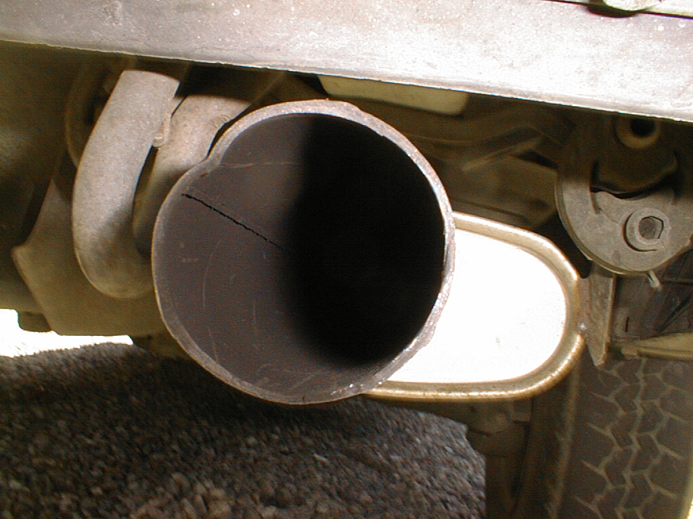
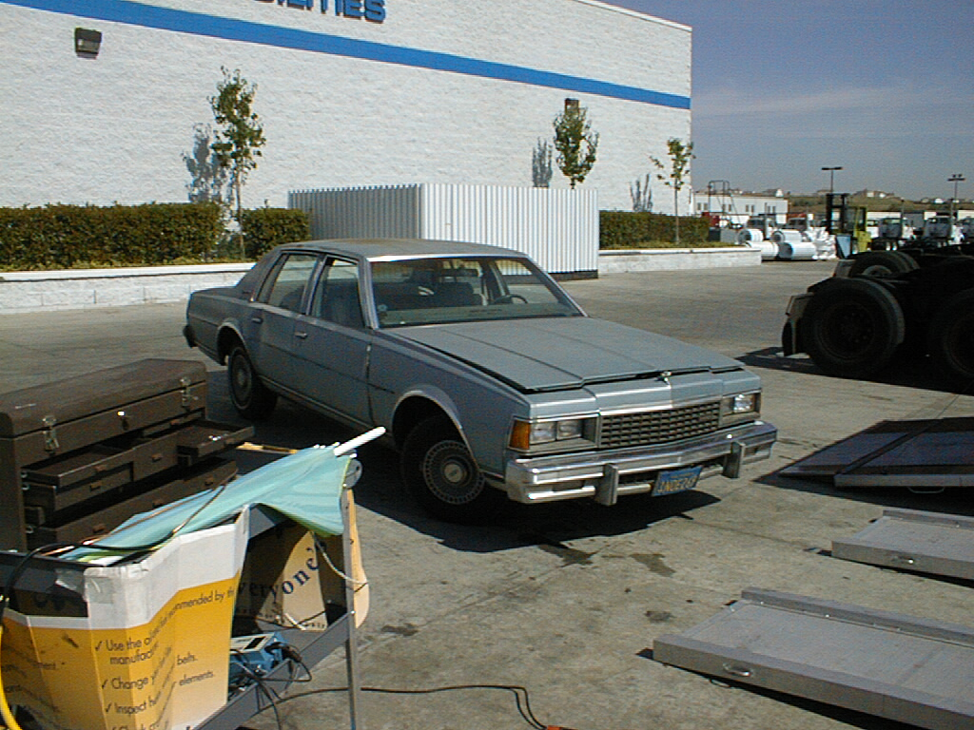
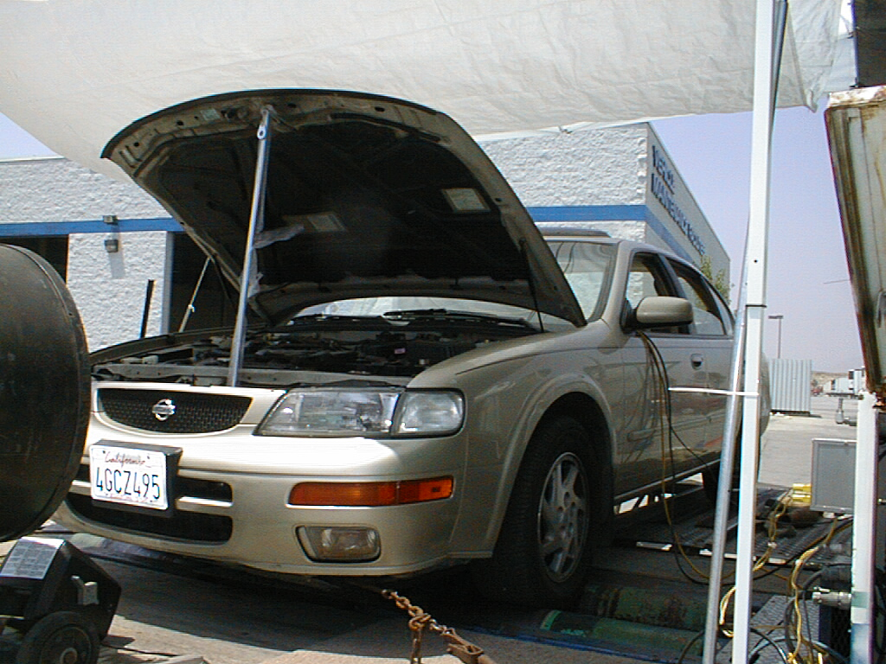
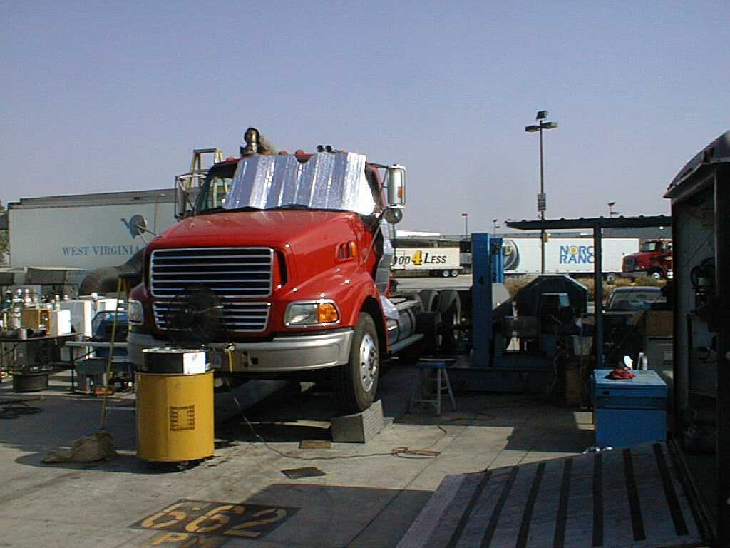
Dynamometer Vehicle Tests
Fujita, E. M., B. Zielinska, D. E. Campbell, W. P. Arnott, J. C. Sagebiel, L. Mazzoleni, J. C. Chow, P. A. Gabele, W. Crews, R. Snow, N. N. Clark, W. S. Wayne, D. R. Lawson (2007). Variations in speciated emissions from spark-ignition and compression ignition motor vehicles in California's south coast air basin. J. Air & Waste Manage. Assoc. 57, 705-720.
Eric M. Fujita, David E. Campbell, W. Patrick Arnott, Ted Johnson & Will Ollison (2014) Concentrations of mobile source air pollutants in urban microenvironments, Journal of the Air & Waste Management Association, 64:7, 743-758.

Slide 43
BC [μg/m³] = B_{abs}(1047 nm) / 4.4 m²/g During the Modified UC Test of Vehicles on Electrodynamic Rollers
Notes:
Great for emission inventory determination.

Slide 44
Aerosol Light Scattering Measurement Methods in General
Nephelometer
Reciprocal Nephelometer*
Polar Nephelometer
Single Particle Light Scattering Measurement
* We use this method; especially good for laser light sources.

Slide 45
Scattering Coefficient, B_{sca}
Ideal Nephelometer:
Gives a direct measurement of total scattering by suspended particles, after calibration.
Independent of aerosol properties such as size, composition and physical composition.
Beuttell, R. G. and A. W. Brewer (1949). “Instruments for the Measurement of the Visual Range.” J. Sci. Instrum. 26, 357-359.
Heintzenberg, J. and R. J. Charlson (1996). “Design and Application of the Integrating Nephelometer: A Review.” J. Atmos. Ocean. Technol. 13, 987-1000.

Slide 46
Real Nephelometer => Real Problems
Truncation errors (e.g. light scattered at < 7⁰ and
> 170⁰ is not detected)
=> Does not detect the near-forward scattering from large particle (50%)
=> 25% cutoff at 2.5 µm.
Imperfect aerosol sampling
=> Large particles may not be sampled
Imperfect wavelength response (50 nm bandwidth)
=> Measures only effective scattering
Heating from light sources (thermal or laser).
Moosmüller, H. and W. P. Arnott (2003). “Angular Truncation Errors in Integrating Nephelometry.” Rev. Sci. Instrum. 74, 3492-3501.

Slide 47

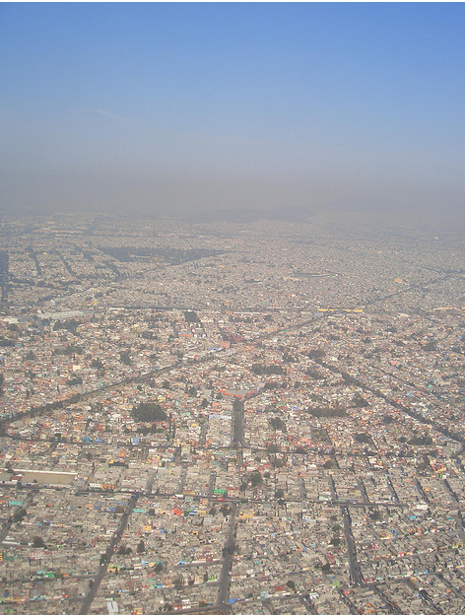
Aerosol primary and secondary contributions in Mexico City
Paredes-Miranda, G., Arnott, W. P., Jimenez, J. L., Aiken, A. C., Gaffney, J. S., and Marley, N. A.:(2009) Primary and secondary contributions to aerosol light scattering and absorption in Mexico City during the MILAGRO 2006 campaign, Atmos. Chem. Phys. 9, 3721-3730.
Paredes-Miranda, G., W. P. Arnott, H. Moosmüller, M. C. Green, M. Gyawali, 2013: Black carbon aerosol concentration in five cities and its scaling with city population. Bull. Amer. Meteor. Soc., 94, 41–50.

Slide 48

Sampling Locations In Mexico City (March 2006)

Slide 49

Primary and Secondary Aerosol
Secondary OC, BrC?

Slide 50


Aerosol Optics at 532 nm 2006 T0
Secondary formation.
Scattering.
Paredes et al 2009
Primary emissions.
Absorption.
Paredes et al 2009

Slide 51

Aerosol Optics and Chemistry
Secondary formation.
Scattering.
Paredes et al 2009
Primary emissions.
Absorption.
Paredes et al 2009

Slide 52

Use of PAS Scattering to Estimate PM Concentration
PM₁ ≈ B_{sca} / 3.8
Paredes et al 2009

Slide 53
Comparison of TO Circa NE DF in 2006 with CCA at UNAM 2015
Preliminary work with Rafael Liñan
and the group of Dr. Telma Castro and Dr. Oscar Peralta

Slide 54




Aerosol Optics at 532 nm: T0 in 2006 and CCA UNAM in 2015

Slide 55
CCA 2015
UNAM
Few days look
like the average day

Slide 56
CCA 2015
UNAM
Few days look
like the average day

Slide 57
Use PAS to Evaluate Accuracy of Satellite PM2.5 Determination
Aerosol properties techniques
Ground-based
Sunphotometry
NASA AERONET
and MFRSR
For column AOD
In-situ Photoacoustic and reciprocal nephelometer
for in situ extinction
coefficients
Satellite remote sensing for column AOD
Beta attenuation monitoring PM_{2.5}

Slide 58


Assumption of Satellite PM2.5 Determination
If all aerosol are in the atmospheric boundary layer, and it has RH < 65%, column measurements of AOD could be used to obtain surface extinction coefficient, with knowledge of the boundary layer height H.
Does AOD[Cimel]=AOD[MODIS]?
Does AOH = H? If so, ok to use MODIS …
MODIS Instrument, Terra and Aqua Satellites
H = boundary layer height
aerosol in
boundary layer
Cimel
PAS
ground
AOH = Apparent Optical Height
of boundary layer.
= AOD[Cimel] / B_{ext}[PAS]
AOD=Aerosol Optical Depth

Slide 59

Results of AOH Comparison with H
For Reno, 405 nm AOH > H probably due to secondary aerosol formation aloft. 870 nm AOH ≈ H probably due to influence of coarse mode aerosol mostly in the boundary layer. Therefore would expect MODIS AOD to overestimate B_{ext} and PM2.5 at the surface (MODIS AOD uses wavelengths < 870 nm).
See Loría-Salazar, S. M., W. P. Arnott, and H. Moosmüller (2014), Accuracy of near surface aerosol extinction determined from columnar aerosol optical depth measurements in Reno, NV, USA, J. Geophys. Res. Atmos., 119, doi:10.1002/2014JD022138.

Slide 60


Profile 27 May 2003: Pancaked Layers of Russian Forest Fire Smoke Observed over North Central Oklahoma, USA, costly aircraft sampling of vertical distribution.
Significant layers of light absorbing aerosol near 650 mb and 550 mb, with a clean layer in between at 600 mb.
PHOTOACOUSTIC LIGHT ABS.
Arnott, W. P., J. W. Walker, H. Moosmüller, R. A. Elleman, H. H. Jonsson, G. Buzorius, W. C. Conant, R. C. Flagan, and J. H. Seinfeld, (2006). Photoacoustic insight for aerosol light absorption aloft from meteorological aircraft and comparison with particle soot absorption photometer measurements: DOE Southern Great Plains climate research facility and coastal stratocumulus imposed perturbation experiments. Journal of Geophysical Research 111, D05S02, doi:10.1029/2005JD005964.

Slide 61


In Situ Measurements of Aerosol Vertical Distribution
UNAM Tethered Balloon equipped with particle sensors. (Wilfrido Gutiérrez López.; García Espinosa, M.; Robles Roldan M.A.)
Raman Lidar Picture of the Convective Mixed Layer at the DOE ARM site in North Central Oklahoma.
(Courtesy of Dr. David Turner)

Slide 62
Biomass Burning Case Study
Lewis, K., W. P. Arnott, H. Moosmüller, and C. E. Wold (2008), Strong spectral variation of biomass smoke light absorption and single scattering albedo observed with a novel dual-wavelength photoacoustic instrument, J. Geophys. Res., 113, D16203, doi:10.1029/2007JD009699.
Gyawali, M., W. P. Arnott, K. Lewis, and H. Moosmüller (2009). In situ aerosol optics in Reno, NV, USA during and after the summer 2008 California wildfires and the influence of absorbing and non-absorbing coatings on spectral light absorption . Atmos. Chem. Phys, 9, 8007-8015.

Slide 63

Aerosol Optics Instrument
355 nm
405 nm,870 nm
532 nm
671 nm, 676 nm
1047 nm
Aerosol Absorption and
Scattering Coefficients
f₀
f₀ + df
Notes:
63

Slide 64

Biomass Smoke Example of Dual Wavelength Photoacoustic Measurements (Fire Science Lab, FLAME experiment, Missoula Montana, 2006, 2007).
Chemistry

Slide 65


Fire Science Laboratory: Biomass Burning Study
Photoacoustic instruments
Instrumentation sampling wood smoke during FLAME Chamber burns

Slide 66



Fuels Tested at the Fire Science Laboratory
Chamise
Rice Straw
Ponderosa Pine
66
Notes:
66

Slide 67

1,000 Fires, Northern CA, Summer 2008: Peak Smoke in Reno around local noon, July 10th.
Summer wild Fires
-Over 1,000
-Most sparked by lightning
-Dry and windy
-Covering 680 Sq miles of central and northern California
Source: NASA California Wild Fires 2008
67
Notes:
67

Slide 68


Reno Days in Photographs:
Similar Location and Sun Angle
SEPT-22, 2008
JULY-10, 2008

Slide 69

One Not So Fine Day in Reno

Slide 70
Comparison With Lab Data
70

Slide 71
Trends, Needs, and Conclusions
Filter based measurements (Aethalometer, PSAP) need to be processed with algorithms to reduce aerosol scattering and filter loading affects
Much current work is on the chemical and optical properties of brown carbon aerosol, and the impacts of coatings and aerosol aggregation on aerosol light absorption and scattering
We have a continued need to evaluate satellite remote sensing of surface PM2.5, especially with vertical distribution of aerosol physical and chemical properties measurements
Get the most out of aerosol optics measurements, e.g. black carbon mass concentration from B_{abs}, PM2.5 mass concentration from B_{sca}, especially in networks with limited measurements

Slide 72
Thanks to …
Collaborators: Hans Moosmüller, Fred Rogers, John Walker, Barbara Zielinska, John Sagebiel, Eric Fujita, Dave Campbell, Rick Purcell, Dan Wermers, Sebastian Upallalli (DRI), Rich Raspet, Willie Slaton (Univ. Miss.), James Mehl, Rob Abbott, Mike Ossosfsky, Khadeejeh Hamasha, Ali Rahmah, Kristin Lewis, Lupita Paredes, Madhu Gyawali, Dambar Air, Narayan Adhikari, Jim Barnard, Heather Holmes, Marcela Loria, Adel Sarofim, Kerry Kelly, Dave Wagner, Joanne Lighty (Univ. Utah CFE), Otmar Schmid, Meinrat Andreae (Max Planck Institute for Chemistry), John Ogren and Pat Sheridan (NOAA CMDL), John Seinfeld, Rick Flagan, Haf Jonsson (CAL TECH), Anthony Strawa, Beat Schmid, Rich Ferrare (NASA) Manvendra Dubey, Rahul Zaveri (LANL and PNNL) Claudio Mazzoleni (MTU) and Rajan Chakrabarty (WUSL) Ian Arnold (UA) Darrel Baumgardner, Greg Kok, John Walker, and Gavin McMeeking (DMT) and others … It’s been a wonderful adventure … hopefully continues …
Funding over the Years: EPA, NPS, ONR, NSF, DOE, DOD-SERDP, DRI, UNR

Slide 73
Additional Information:
My publications:
http://www.patarnott.com/pubsDescription/dri.htm
Selected presentations, including this one:
http://www.patarnott.com/pubsDescription/invitedPresentations.htm
Real time air quality measurements in Reno from PAS:
http://www.patarnott.com/pas532/

Slide 74




Thanks for your attention…

Slide 75
Calibration

Slide 76
Instrument Calibration
CO₂ and Refrigerants for gaseous light (Rayleigh) scattering.
NO₂ gas for gaseous light absorption. (Photoacoustic).
NaCl or ammonium sulfate aerosol for aerosol light scattering.
Kerosene-flame soot primarily for light absorption, but also a check for closure.
Calculate scattering and absorption for monodispersions of spherical particles (measure particle number, compare with measured aerosol optics).
Extinction, β_{ext,} is compared to measured absorption, β_{abs,} and scattering, β_{sca,}
  Beers Law: T = I/I_{o} = exp(-Lβ_{ext})
I_{o}
I
L

Slide 77
Example of Calibration Methods
NO₂ gas
  Extinction = Absorption + Scattering
Scattering Aerosol
  Extinction = Scattering + Absorption
Kerosene Soot
  Extinction = Absorption + Scattering
check

Slide 78

Scattering Calibration Experimental Set-up
Production and delivery of salt aerosol for scattering calibration

