Slide 1
History of the DMT Photoacoustic Instruments
By W. Patrick Arnott, University of Nevada Reno
Collaborators: Hans Moosmüller, Fred Rogers, John Walker, Barbara Zielinska, John Sagebiel, Eric Fujita, Dave Campbell, Rick Purcell, Dan Wermers, Sebastian Upallalli (DRI), Rich Raspet, Willie Slaton (Univ. Miss.), James Mehl, Rob Abbott, Mike Ossosfsky, Khadeejeh Hamasha, Ali Rahmah, Kristin Lewis, Lupita Paredes, Adel Sarofim, Kerry Kelly, Dave Wagner, Joanne Lighty (Univ. Utah CFE), Otmar Schmid, Meinrat Andreae (Max Planck Institute for Chemistry), John Ogren and Pat Sheridan (NOAA CMDL), John Seinfeld, Rick Flagan, Haf Jonsson (CAL TECH), Anthony Strawa, Beat Schmid, Rich Ferrare (NASA) Manvendra Dubey, Rahul Zaveri (LANL and PNNL) Claudio Mazzoleni (MTU) and Rajan Chakrabarty (WUSL) Ian Arnold (UNR) Darrel Baumgardner, Greg Kok, John Walker, and Gavin McMeeking (DMT) and others … It’s been a wonderful adventure … hopefully continues …
Funding over the Years: EPA, NPS, ONR, NSF, DOE, DOD-SERDP, DRI, UNR

Slide 2
Introduction
We are not the first to use photoacoustic methods for aerosol light absorption measurement;
(Petzold, Niessner, Adams, Pierson, Japar, Terhune, Anderson, Foot, Truex, Pinnick)
going back to Alexander Graham Bell.
We were at a convergence in history of …
A. Strong need for a practical instrument for aerosol light absorption measurement that improves upon filter-based methods.
B. Technological breakthroughs in lasers to get high power in small, efficient packages.
C. A great opportunity for people interested in aerosol instrumentation development.

Slide 3
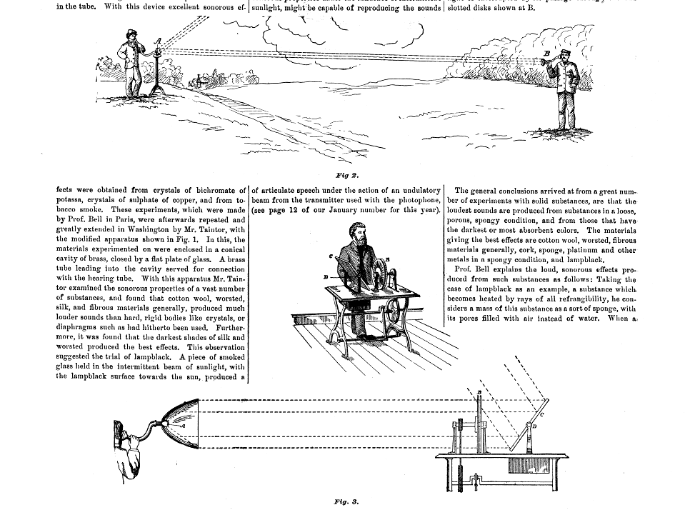
Photoacoustics and Alexander Graham Bell Observations and usefulness of sound from light, Circa 1880

Slide 4
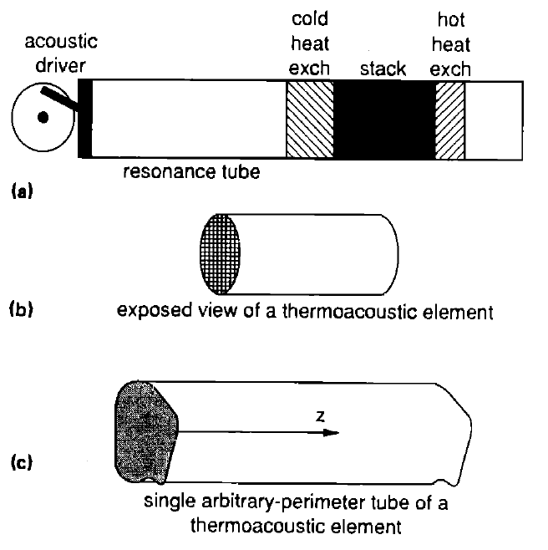
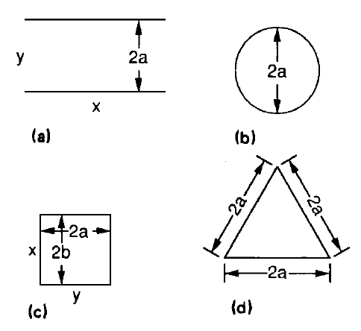
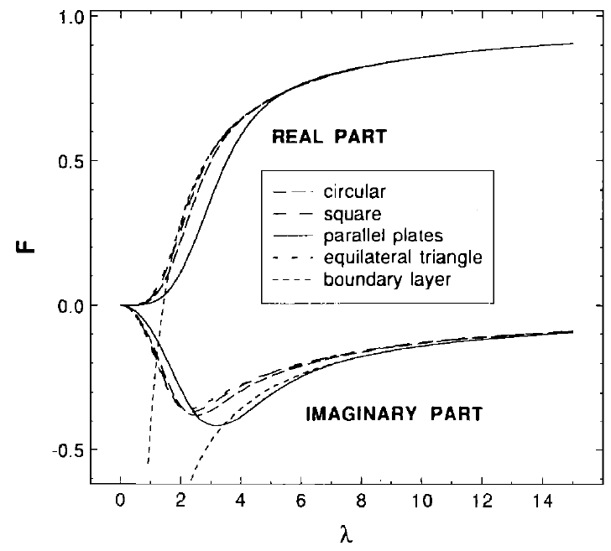
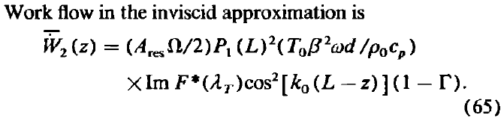
Arnott’s Postdoc National Center for Physical Acoustics, University of Mississippi: 1988-2001: Study of ThermoAcoustic Heat Engines
Arnott, W.P. H.E. Bass and R. Raspet, 1991: General formulation of thermoacoustics for stacks having arbitrarily-shaped pore cross-sections. J. Acoust. Soc. Am., 90 , 3228-3237. (A key paper for me, and one that was particularly useful to others). Some of the ideas coming out of this time have been realized in a well-used software package for design of acoustic refrigerators and prime movers (sounds sources).

Slide 5
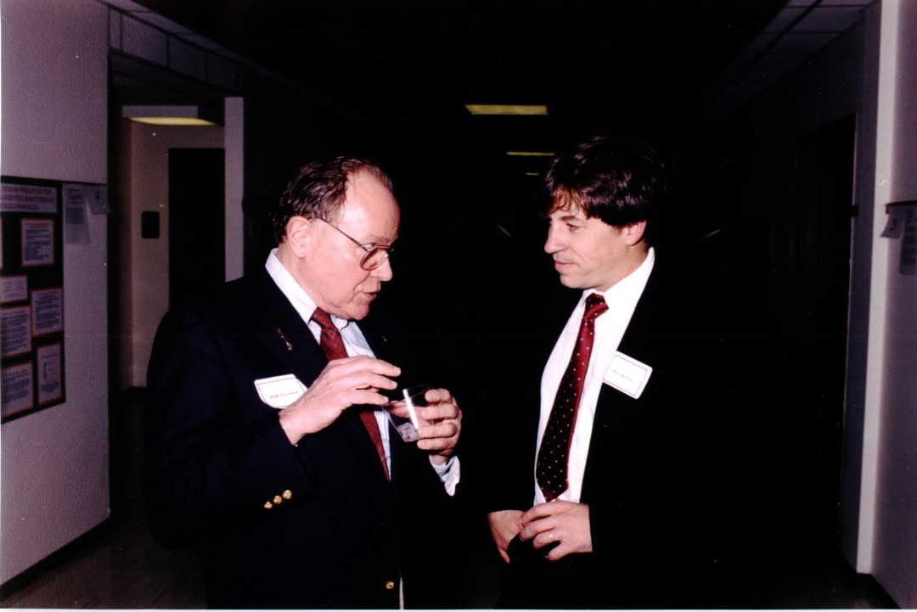
1992: Bill Pierson, Director of the Energy and Environmental Engineering Center at the Desert Research Institute
Pierson
Arnott
Former Ford Motor Company researcher: Had worked with trailer size photoacoustic instruments.
Strongly advocated for development of practical photoacoustic instruments.
Mentored our EPA Exploratory Proposal submitted (and funded) by Arnott (PI), Moosmüller, and Rogers, 1993-1997.

Slide 6
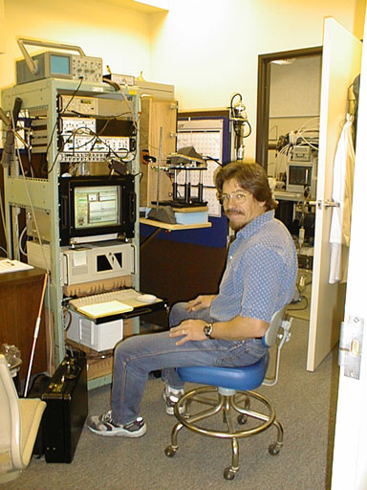
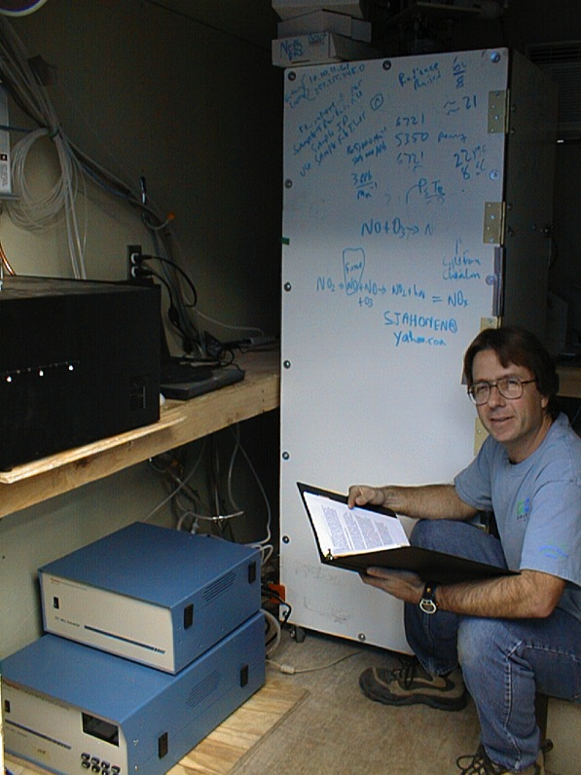
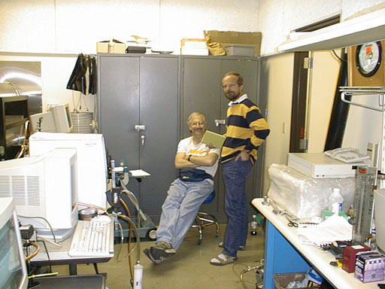
Assembled a team at DRI to pursue Aerosol Light Absorption, Scattering, and Extinction Instrumentation Development
Pat Arnott,
Acoustics and instrumentation
Also …
Rick Purcell, DRI Mechanical Engineer
Dan Wermers, DRI Electrical Engineer
John Walker
Machinist and
instrumentation
Hans Moosmüller
Optics and instrumentation
Fred Rogers
Aerosol expert

Slide 7
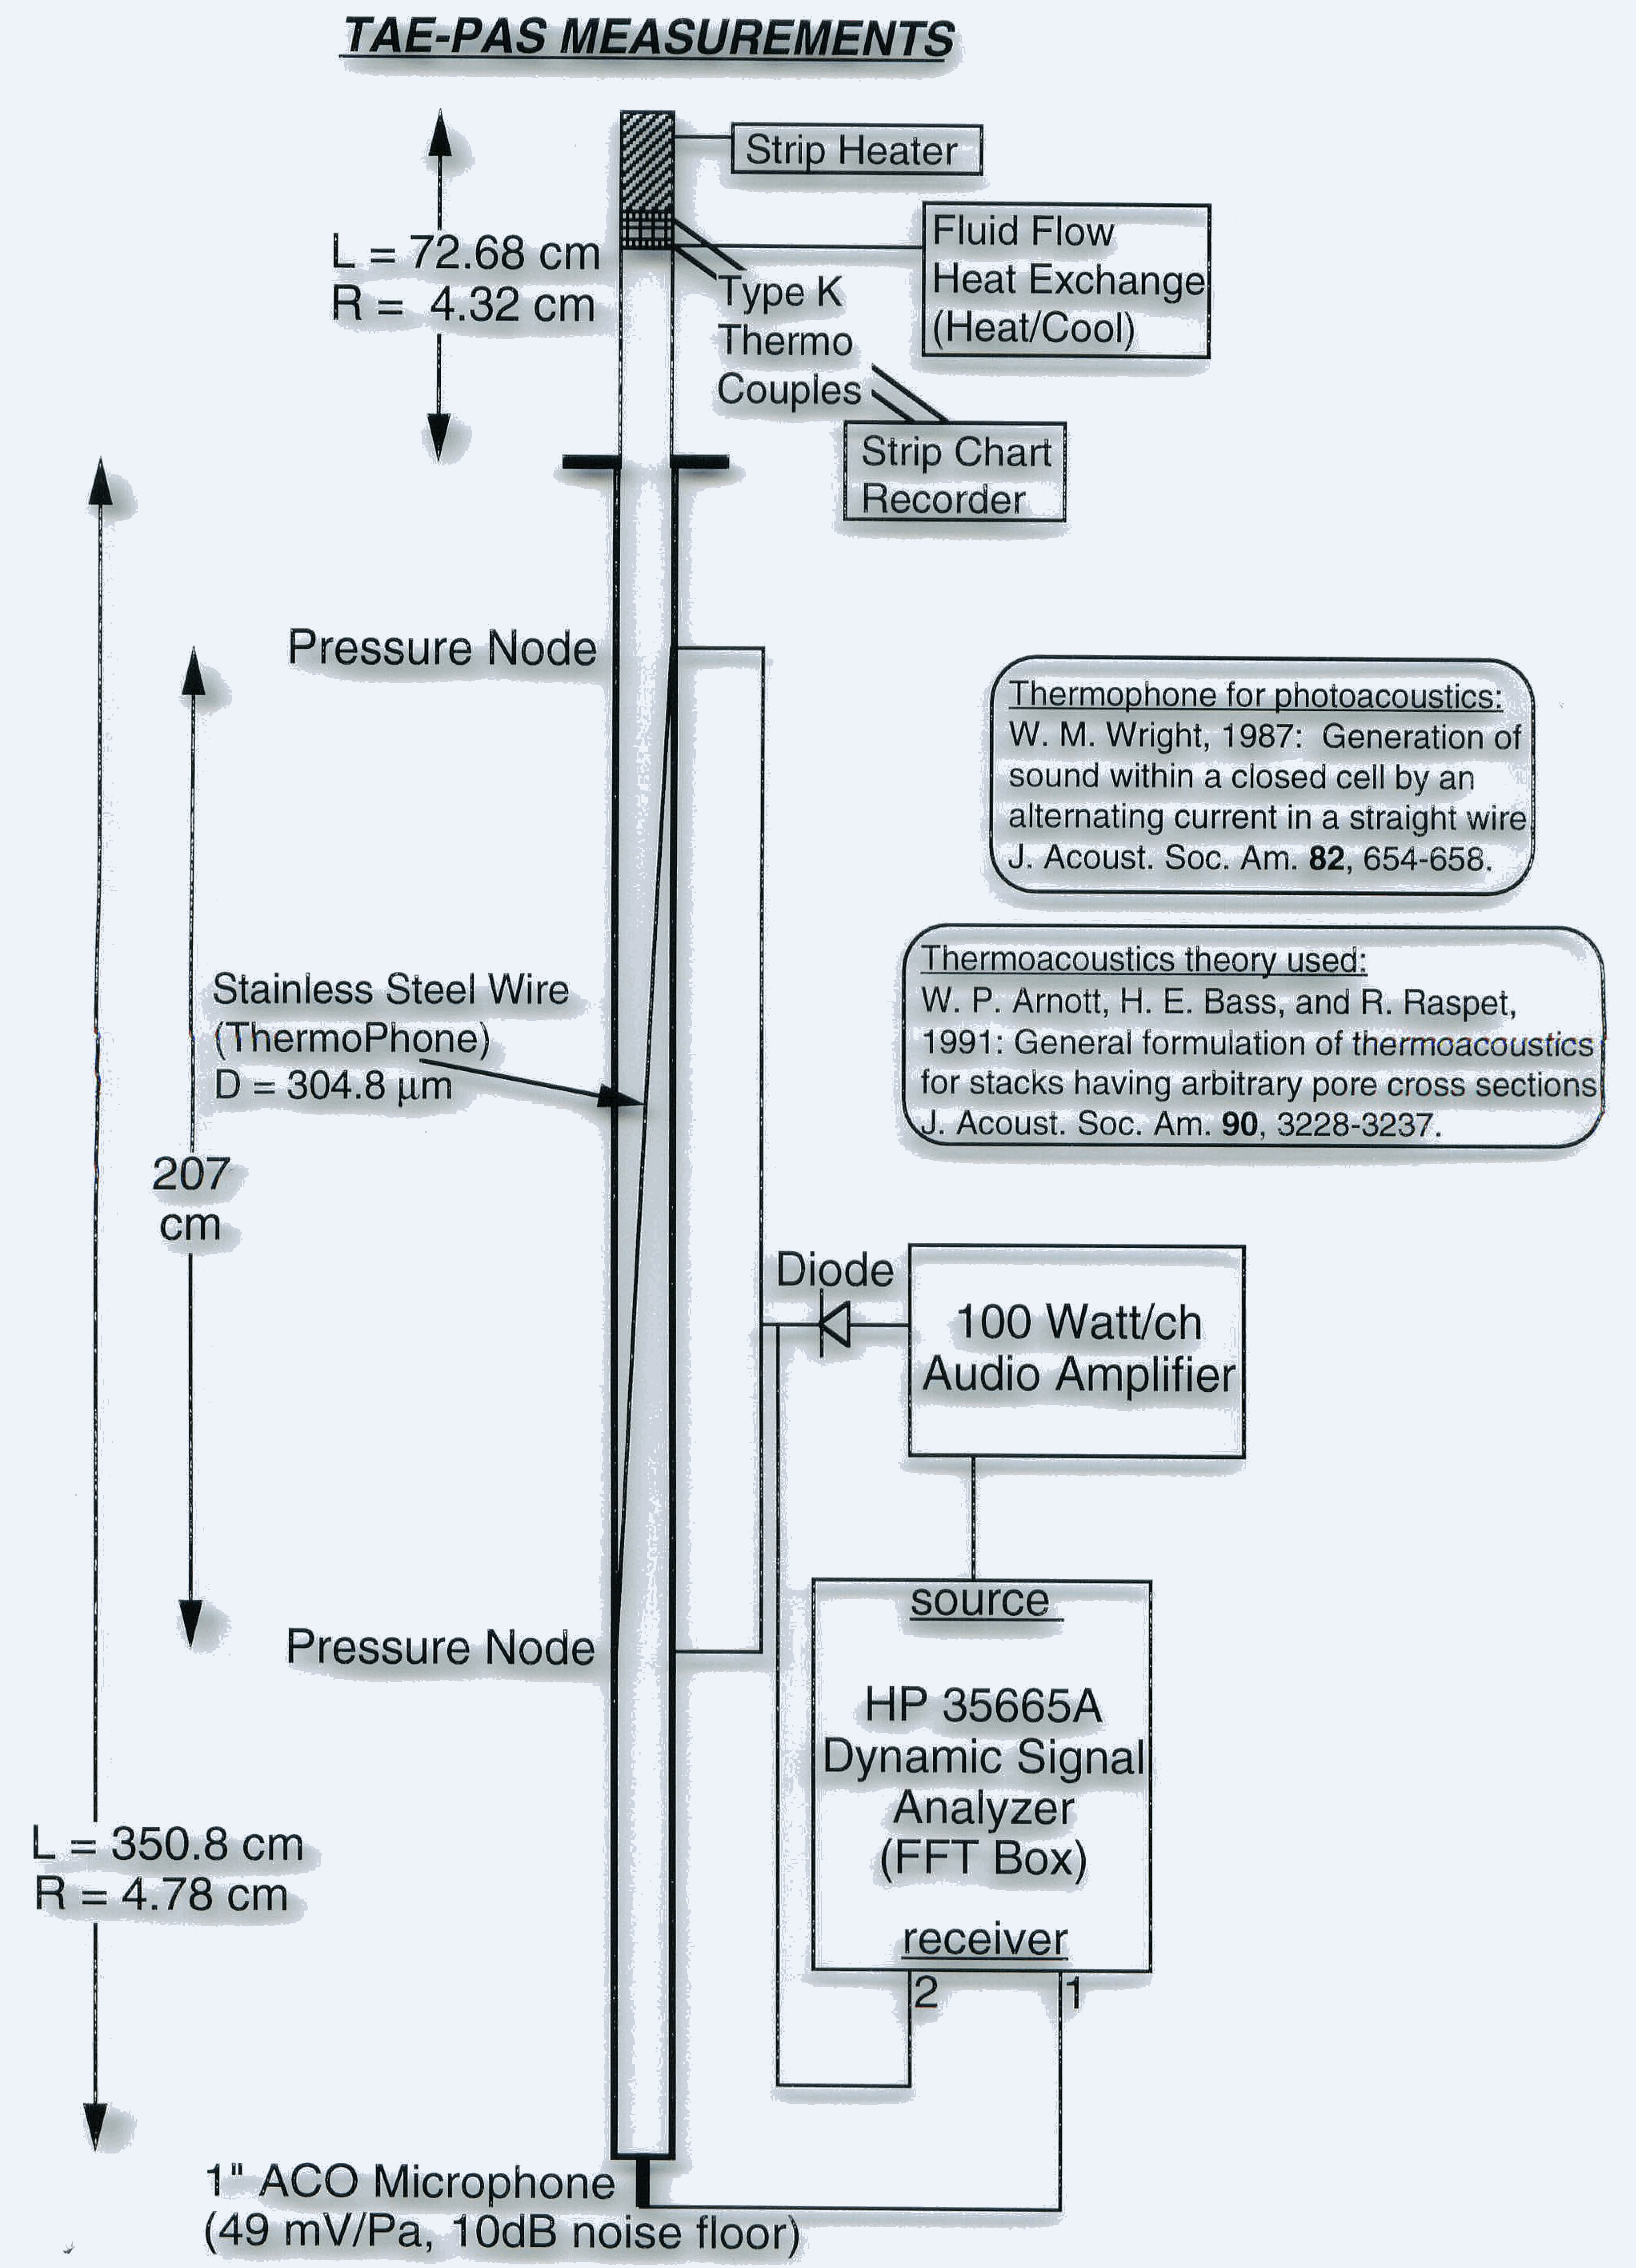
Circa 1992-1993: Learned how to amplify thermally generated sounds with thermoacoustic heat engines

Slide 8
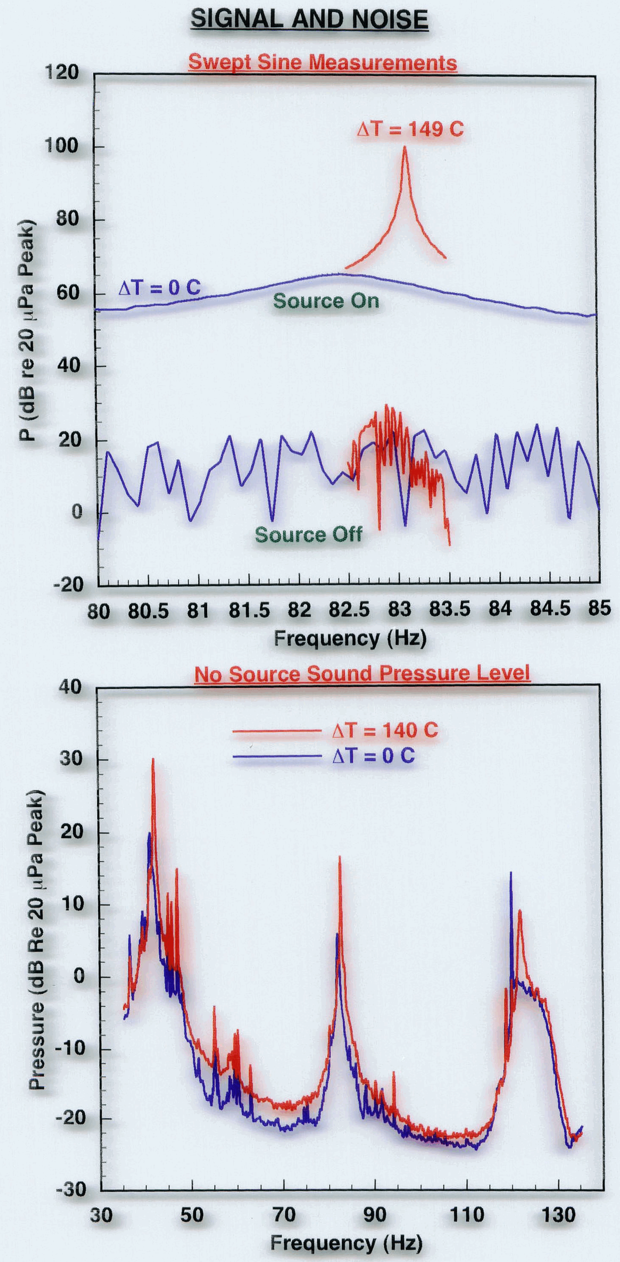
Obtained enormous signal to noise ratios by thermoacoustic control (very high quality factor for the resonator) Great for pulsed lasers. Needed also to develop a simple system.

Slide 9
Why photoacoustic instruments? Filter based measurement systems are simple, but much work is needed to interpret results. Realization by the community that alternatives to filter methods were needed.
Aerosol are deposited on the light-diffusing filter, multiple scattering substrate.
Light absorbing aerosol reduce the light power at the photodetector.
Light scattering aerosol don't reduce power in principle.
Calibration and effects of aerosol loading (blocking)??
We have noted large RH induced artifacts (PSAP).
Filter-based systems have low dynamic range because the filters fill up quickly at high concentration.

Slide 10
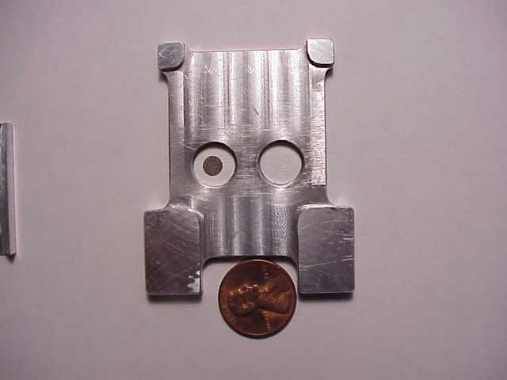
PSAP: Particle Soot Absorption Photometer A filter-based measure of light absorption.
Reference filter on the right. Aerosol-loaded filter on the left. Compare light transmission through these filters as a measure of light absorption.

Slide 11
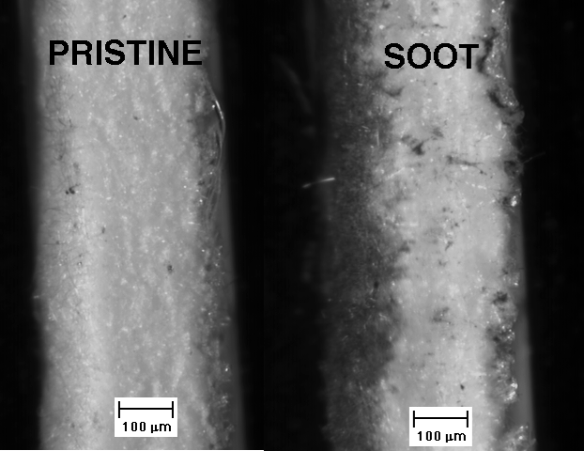
Aethalometer Filter Details: Side view.

Slide 12
Photoacoustic Instruments For Light Absorption Measurements
Basic principles:
Laser light is power modulated by the chopper.
Light absorbing aerosols convert light to heat - a sound wave is produced.
Microphone signal is a measure of the light absorption.
Light scattering aerosols don't generate heat.

Slide 13
Photoacoustic Instrument Details: Equation to Obtain Light Absorption Coefficient.

Slide 14
Strongly Absorbing Aerosol Response: Note the Ski Slope Response of the Filter Sampler as the Filter Darkens From the Reno Aerosol Optics Study

Slide 15
Our First Fieldable Photoacoustic Instrument Details: Combined elements of the Sigrist ‘Banana’ Resonator with use of Acoustic Notch Filters to allow windows to largely decouple from the resonator
1” very sensitive microphone
System calibration

Slide 16
Our First Field Deployment of the Photoacoustic Instrument: North Front Range Air Quality Study (NFRAQS) Winter 1997

Slide 17
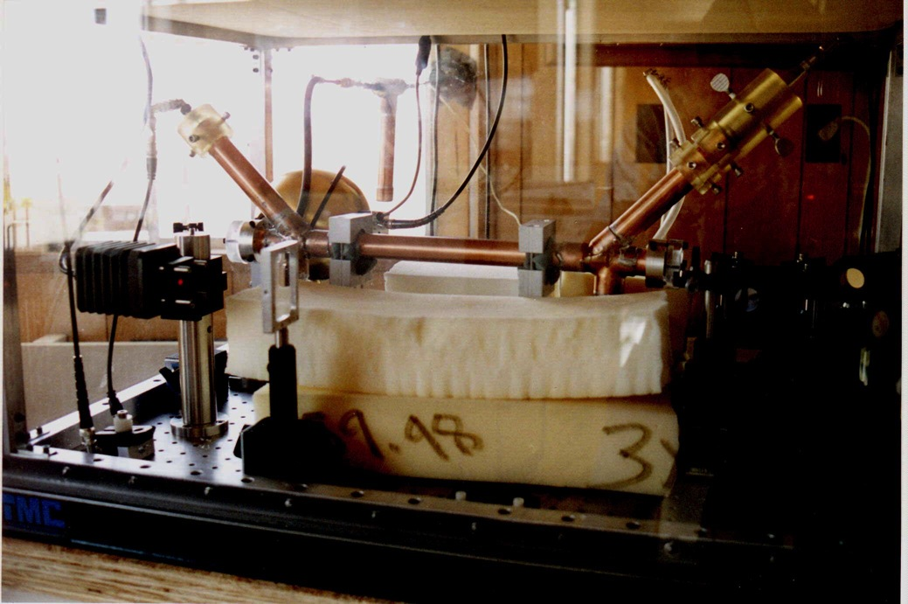
Photoacoustic Instrument at NFRAQS (1997)

Slide 18
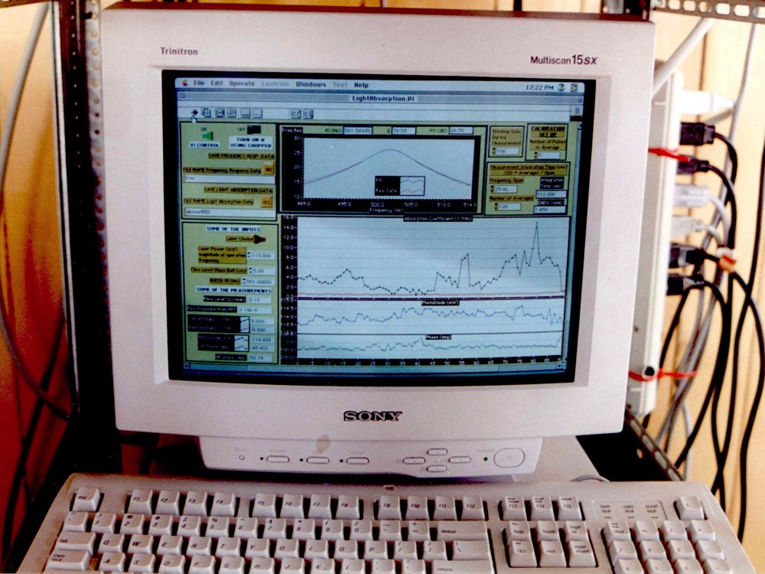
Photoacoustic Data Acquisition (National Instruments Labview).

Slide 19
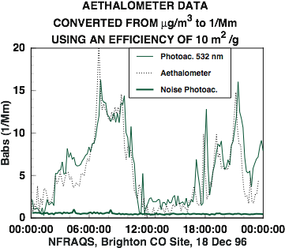
Some Results from NFRAQS: 532 nm Laser
Measurements agree at times… time offset, 10 m²/g?
Comparison allows evaluation (calibration?) of filter method for aerosol light absorption measurement.

Slide 20
1998 – 2002 NSF Major Research Instrumentation Project Moosmüller PI, Arnott CO PI 1. Further Development of the Photoacoustic Instrument 2. Development of a Low Truncation Angle Nephelometer 3. Development of a Cavity Ring Down Instrument for Aerosol Extinction Measurement

Slide 21
DOE CARAT PROJECT Simple Particulate Emissions Measuring System
CARAT Cooperative Automotive Research for Advance Technology. (Highly efficient, low-polluting vehicles of the future - from diesel to fuel cell technologies.)
Purpose: Evaluate methods for fast time response measurements (< 5 sec) of aerosol mass from diesel engines.
Background: Vehicles are evaluated using dynamometer test facilities. The EPA standard protocol for aerosol mass measurement use filter samples acquired over many minutes. Instruments and methods for determining aerosol mass at high time resolution should provide automotive, engine, and exhaust system manufactures with valuable insight.
UC Riverside College of Engineering Center for Environmental Research and Technology (CE-CERT) provided the dynamometer test facility.
DRI provided the instruments for measuring high time resolution mass measurements.
Notes:
Diesel Engines
Simple Particulate Emissions Measuring System
Current methods for measuring particulate matter emissions in diesel and other internal combustion engines require expensive, complex equipment and are difficult to use. Funded organizations are working to develop a simple, accurate, and user-friendly sensor to directly or indirectly measure particulate matter emissions from internal combustion engines. The goal is to develop a measuring system that is just as accurate but significantly simpler, less expensive, and easier to use than current dilution-tunnel, filtration-based systems. The improved system should be able to measure the most common types of particulates (carbon particles, liquid droplets, sulfate particles) as small as 1 micrometer. A system capable of making continuous (transient) measurements (with updates every 5 seconds, minimum) would be particularly attractive to industry.
CARAT is sponsored by the U.S. Department of Energy through its Office of Advanced Automotive Technologies (OAAT). Unlike other federally funded programs, the three phases of the CARAT Program have been designed to foster and support the development of a technology from proving its feasibility, through prototype development, and on to partnering with a manufacturer for validation of the technology and demonstration of production feasilibity. The program has been established to research, develop, and validate advanced automotive technologies that will enable the production of highly fuel-efficient, low-emission, and fuel-flexible cars and trucks.
For more information on the role of the CARAT Program within OAAT's R&D Plan, click here.

Slide 22
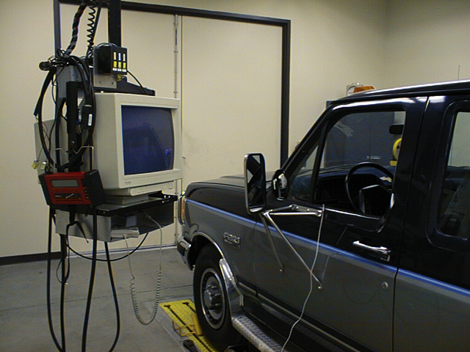
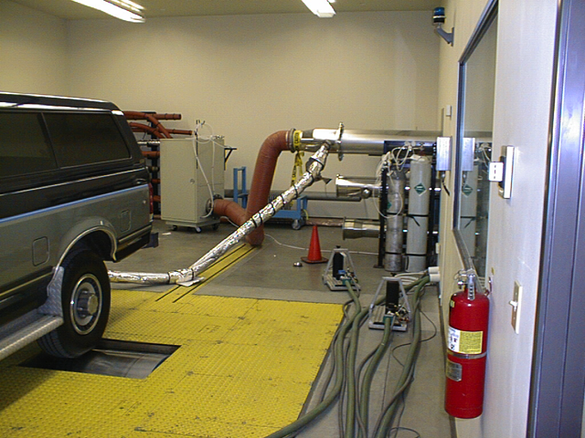
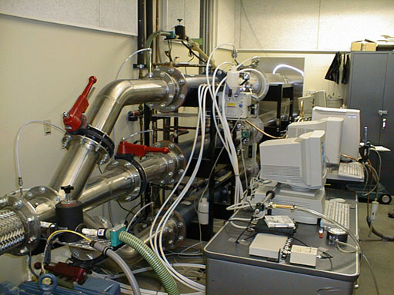
Dynamometer Test Facility at UC CE-CERT

Slide 23
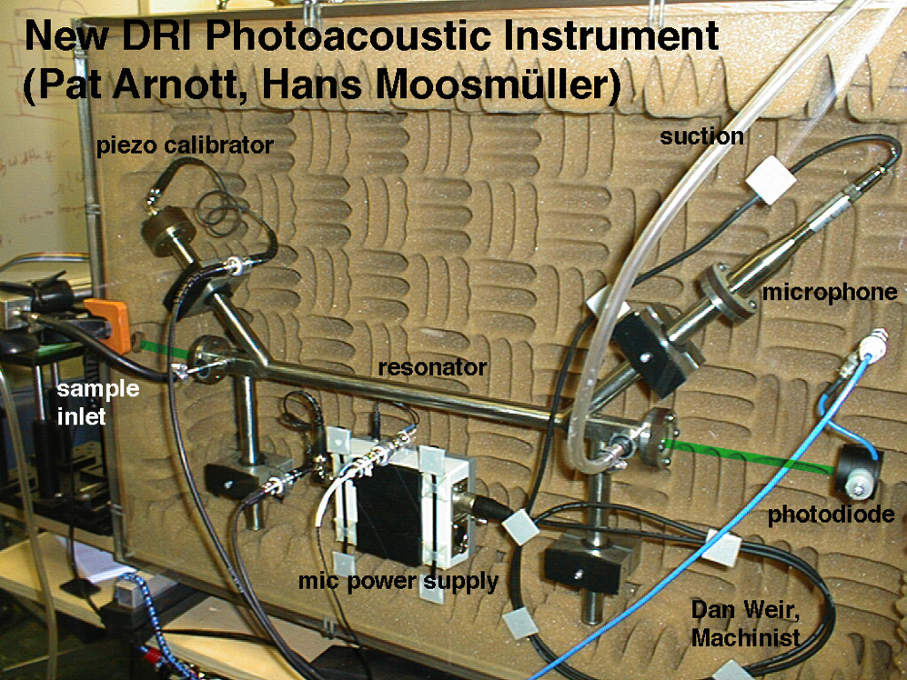
Photoacoustic Instrument, 1999, resonator.
Stainless steel resonator, small acoustic enclosure, cleaner design.

Slide 24
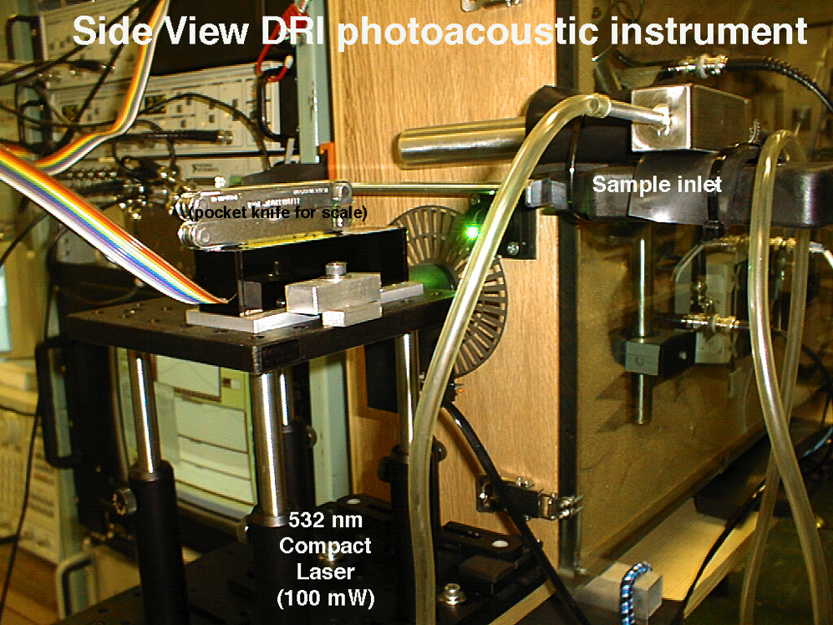
Photoacoustic Instrument, 1999, Laser.
Crystalaser (company in Reno) 532 nm Nd-YAG laser diode-pumped solid state laser. Chopper wheel provides laser power modulation.

Slide 25
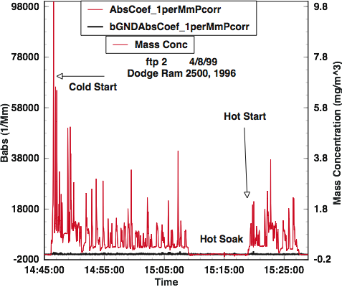
DOE-CARAT Photoacoustic Results (Dodge) Shows the great utility of photoacoustic instruments for black carbon measurements from vehicles.

Slide 26
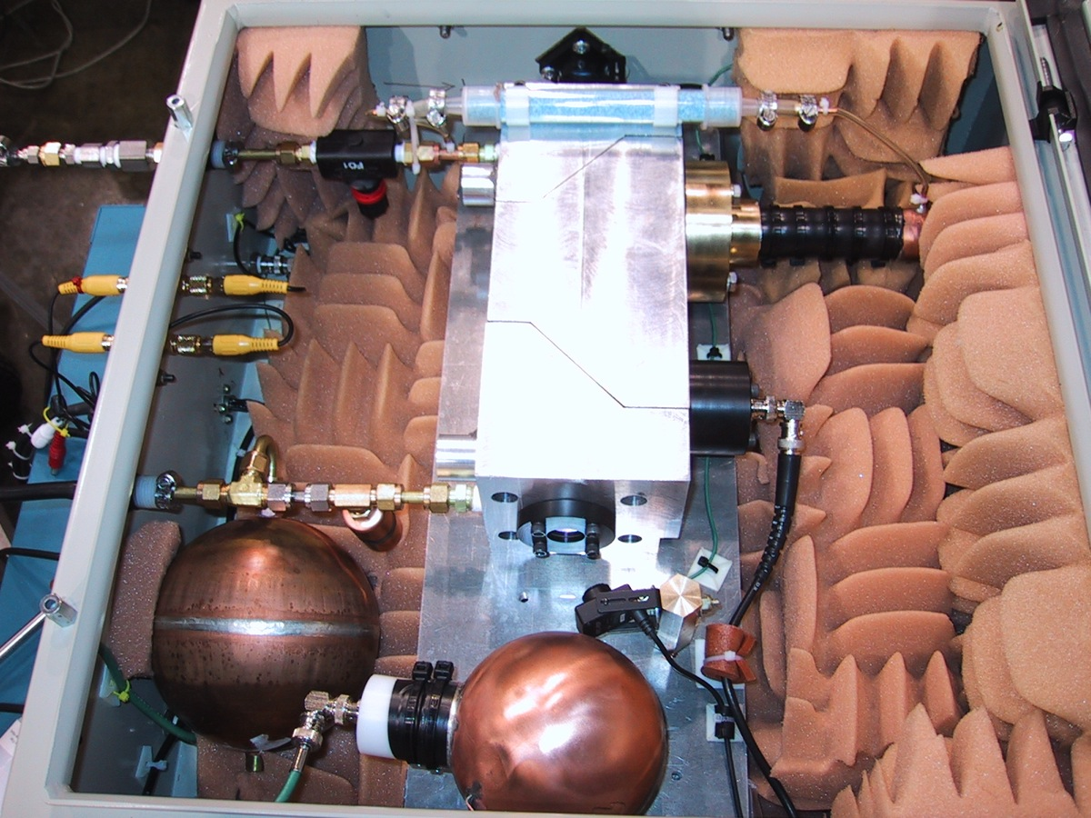
PA serial # 1... Built for Adel Sarofim, University of Utah, for Black Carbon Mass Concentration Measurements by Vehicles Designed by Pat Arnott, Machined by John Walker After a Demonstration Project at Hill Air Force Base

Slide 27
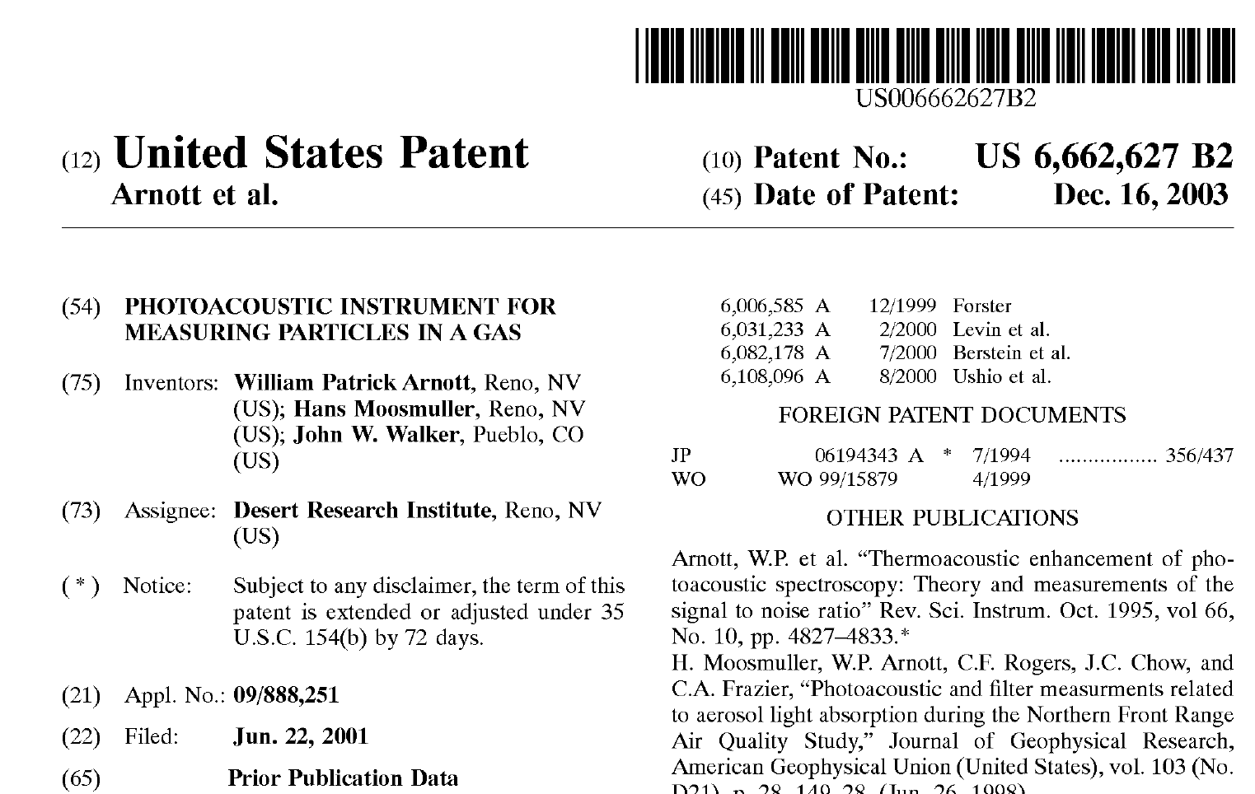
Patent for the PAS 1 Instrument: Single Wavelength Photoacoustic Instrument

Slide 28
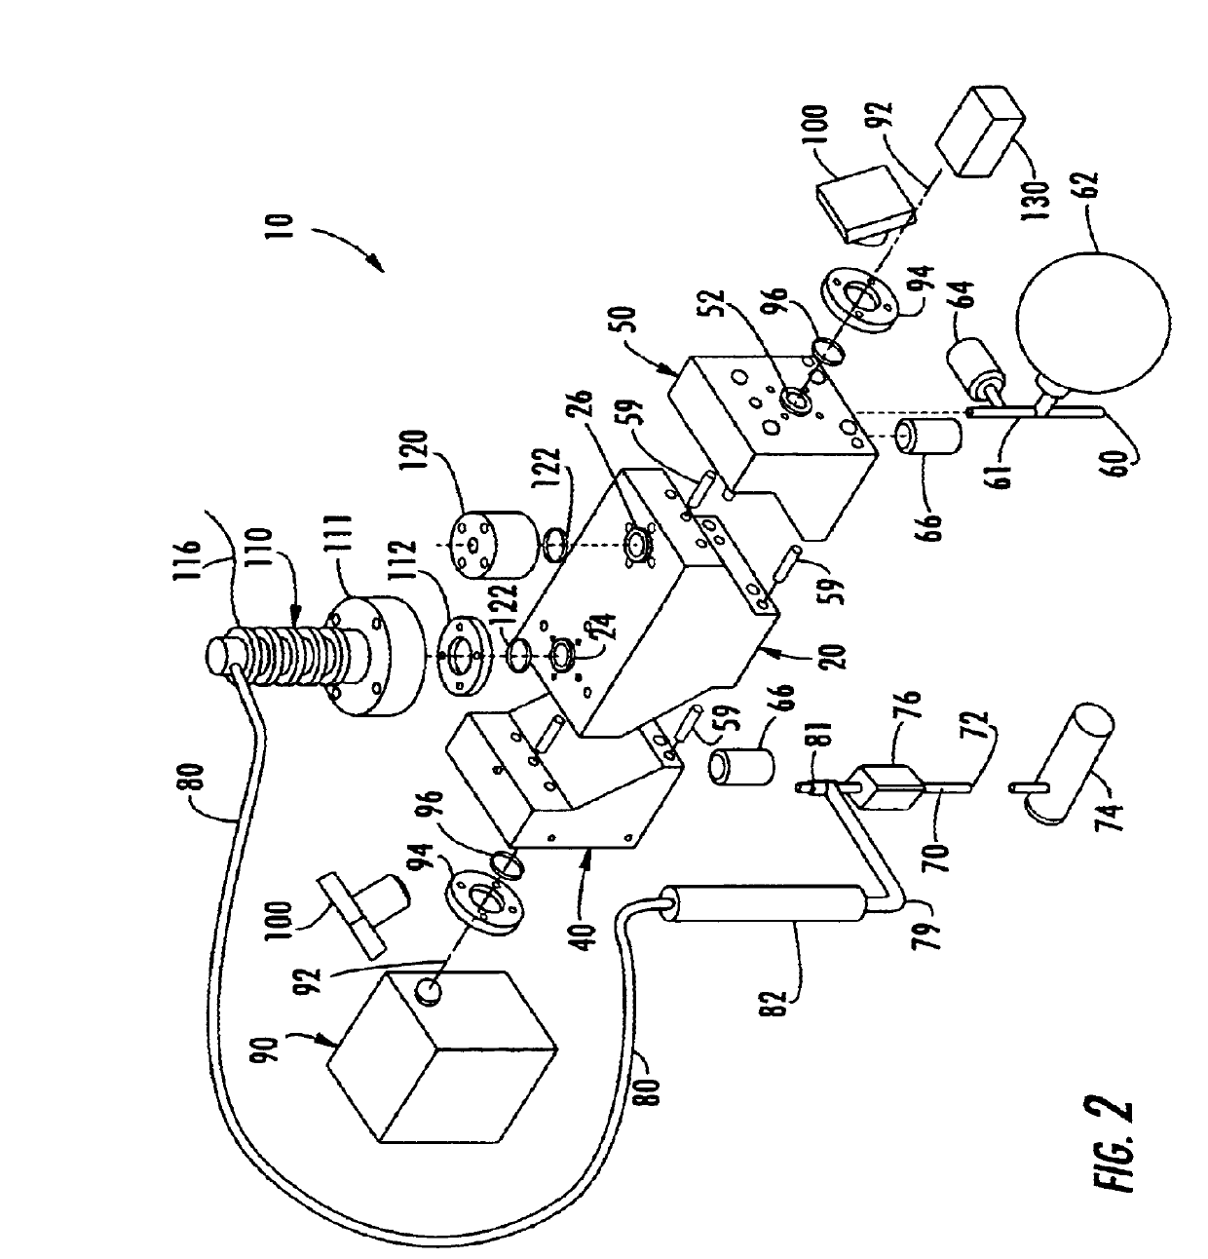
Instrument Description in the Patent

Slide 29
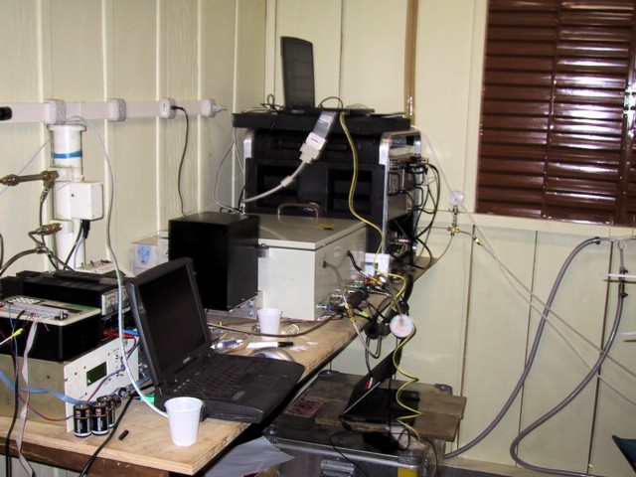
Site Details: Instrument built for the Max Planck Institute for Chemistry

Slide 30
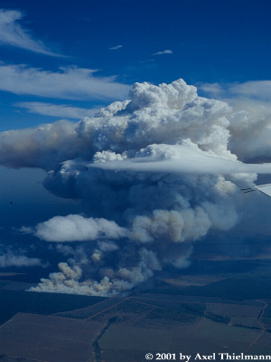
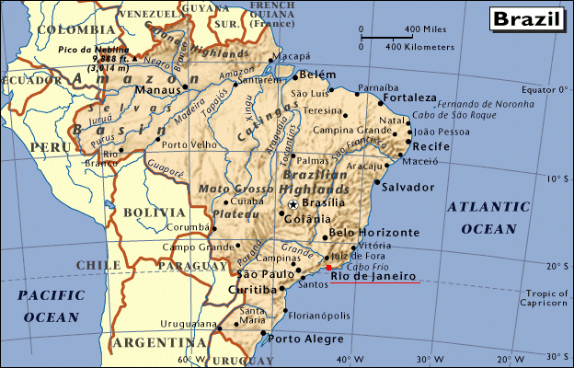
SMOCC
Smoke Aerosols, Clouds, Rainfall and Climate:
Aerosols from Biomass Burning Perturb Regional
and Global Climate
S M O C C
http://dionysos.mpch-mainz.mpg.de/smocc/
Notes:
S M O C C
Objectives
The overall goal of SMOCC is to investigate the connection between the composition and abundance of biomass burning aerosol, the lowering of the size of cloud droplets formed on this aerosol, and the climatic consequences of the resulting perturbation of cloud physics. To achieve this goal, we will:
(1) Make field measurements of aerosol and supporting parameters in the Amazon Basin;
(2) chemically characterise the aerosols produced by biomass burning, with particular attention to the organic fraction;
(3) determine the link between the aerosol chemical/physical properties and the aerosol hygroscopic and cloud-nucleating properties;
(4) model the effect of biomass burning aerosol on cloud microphysics at the cloud and regional level; (5) investigate the effect of smoke aerosols on climate dynamics and the resulting large-scale climate effects;
(6) use satellite data to detect, validate and quantify the effect of smoke aerosol on cloud properties and precipitation processes.

Slide 31
NSF MRI Project, Arnott PI 2002 – 2006 and Navy SBIR
Develop Multiple Wavelength Photoacoustic Instrument and Add Scattering Measurement
Navy Issues SBIR For Multiple Wavelength Photoacoustic Instrument Arnott Discusses SBIR with Sunset Labs, Rupprecht and Patashnik, Aerodyne, Spec Inc, and DMT
DMT Agrees to Commercialize Single Wavelength Instrument and Work on SBIR for 3 Wavelength Instrument Photoacoustic Instruments Complement the DMT SP2 Instrument

Slide 32

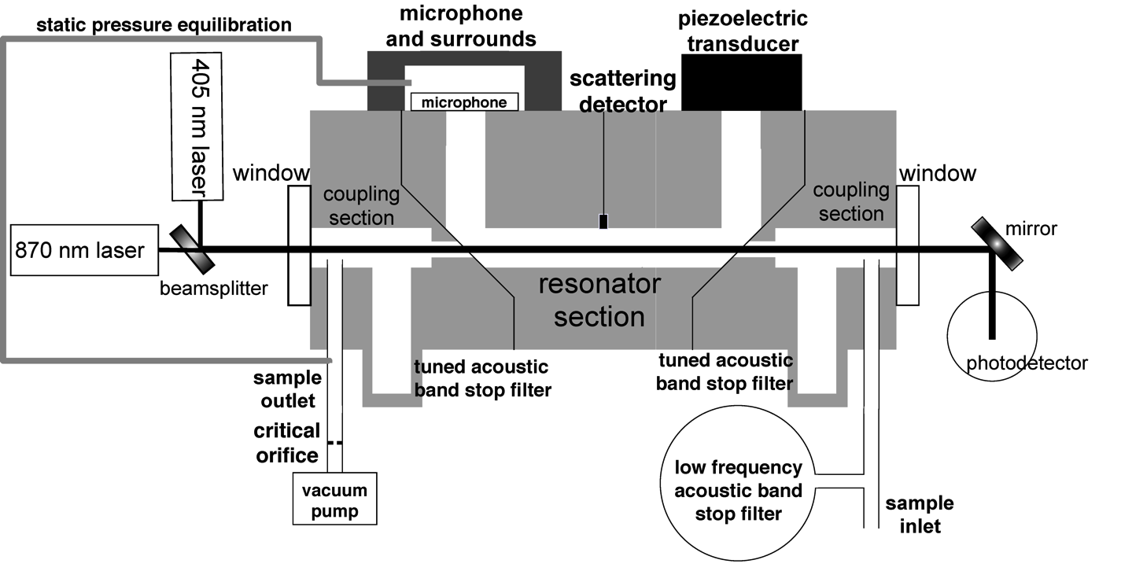
Aerosol Optics Instrument
355 nm
405 nm,870 nm
532 nm
671 nm, 676 nm
1047 nm
Aerosol Absorption and
Scattering Coefficients
f₀
f₀ + df
Notes:
32

Slide 33
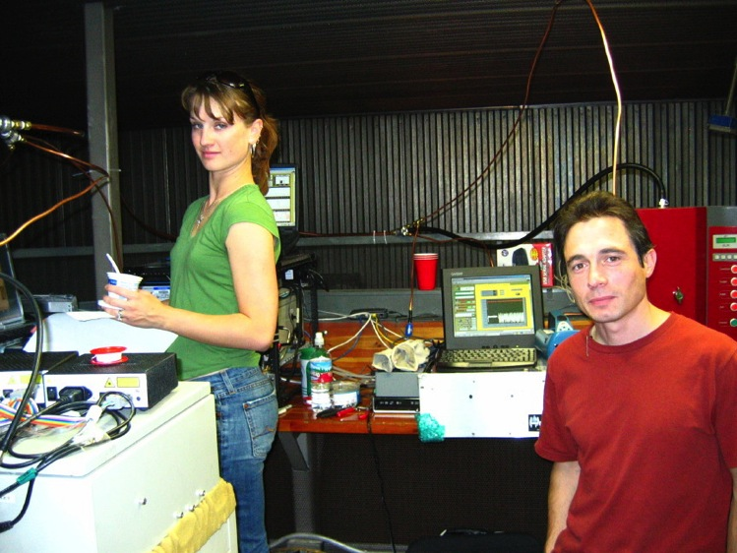
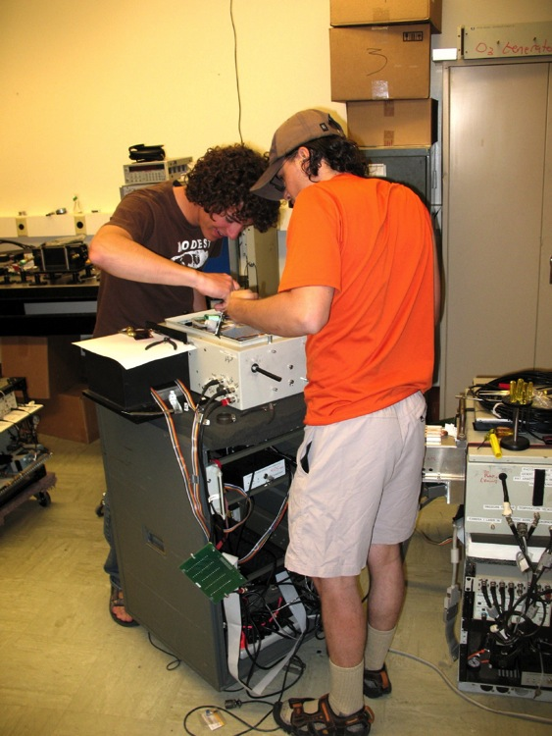
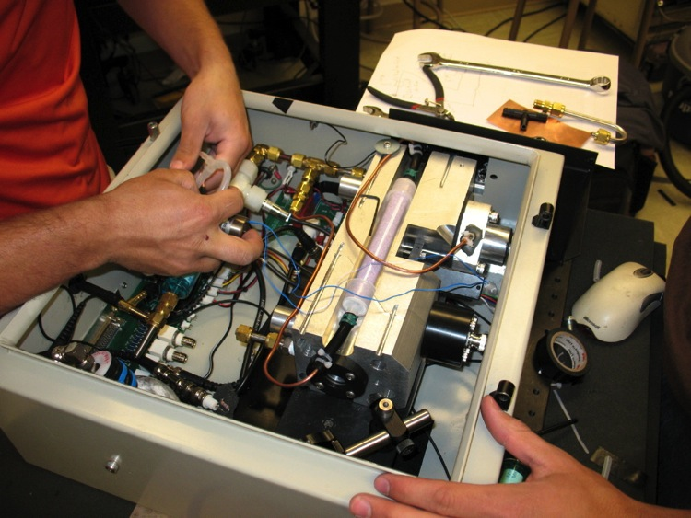
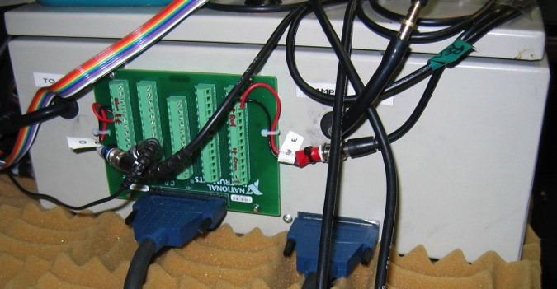
Images of the Dual Wavelength Instrument

Slide 34
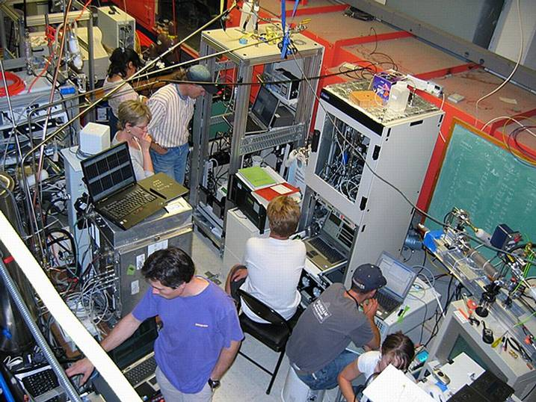
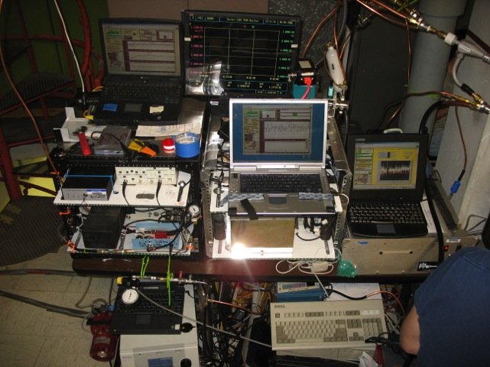
Fire Science Laboratory: Biomass Burning Study
Photoacoustic instruments
Instrumentation sampling wood smoke during FLAME Chamber burns

Slide 35
Comparison of Smoky July With Lab Data
35

Slide 36
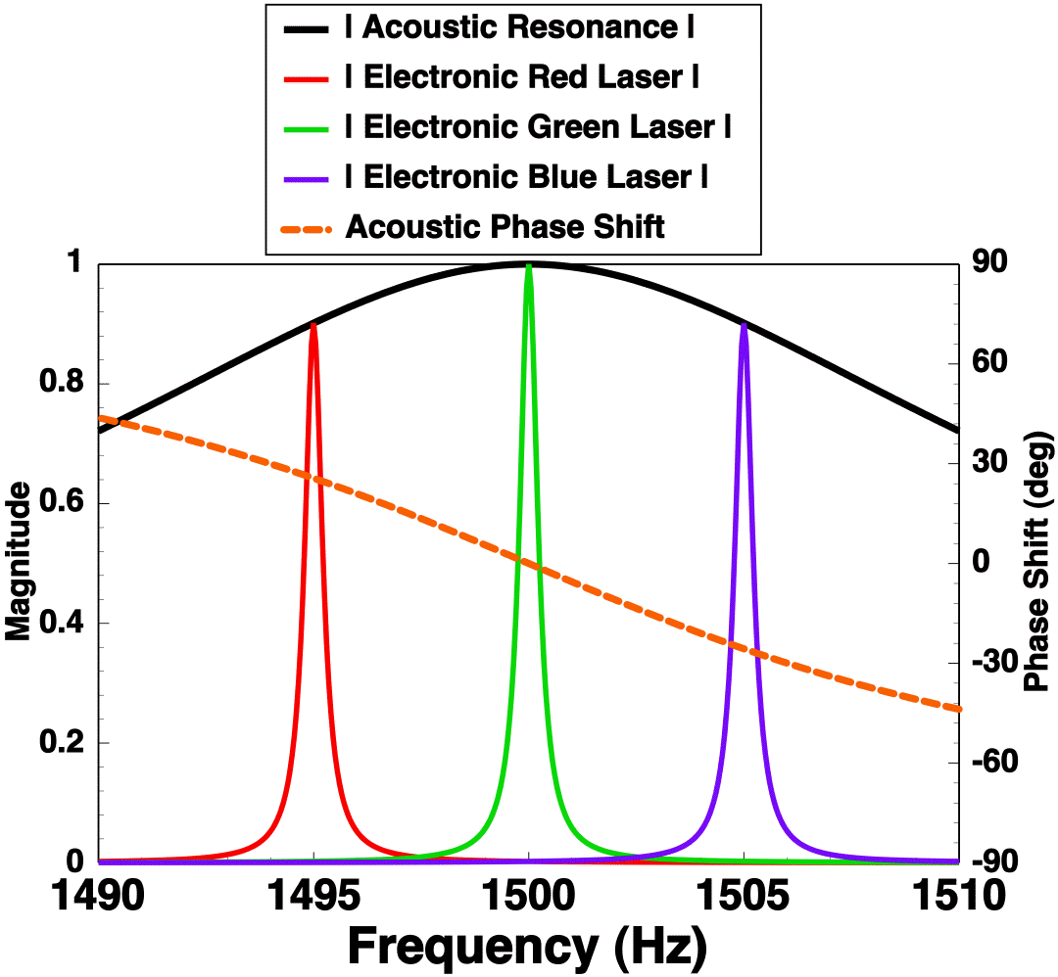
Multiple Wavelength Instrument
Idealized
Response
Need to translate response of red and blue lasers to f₀ = 1500 Hz.

Slide 37
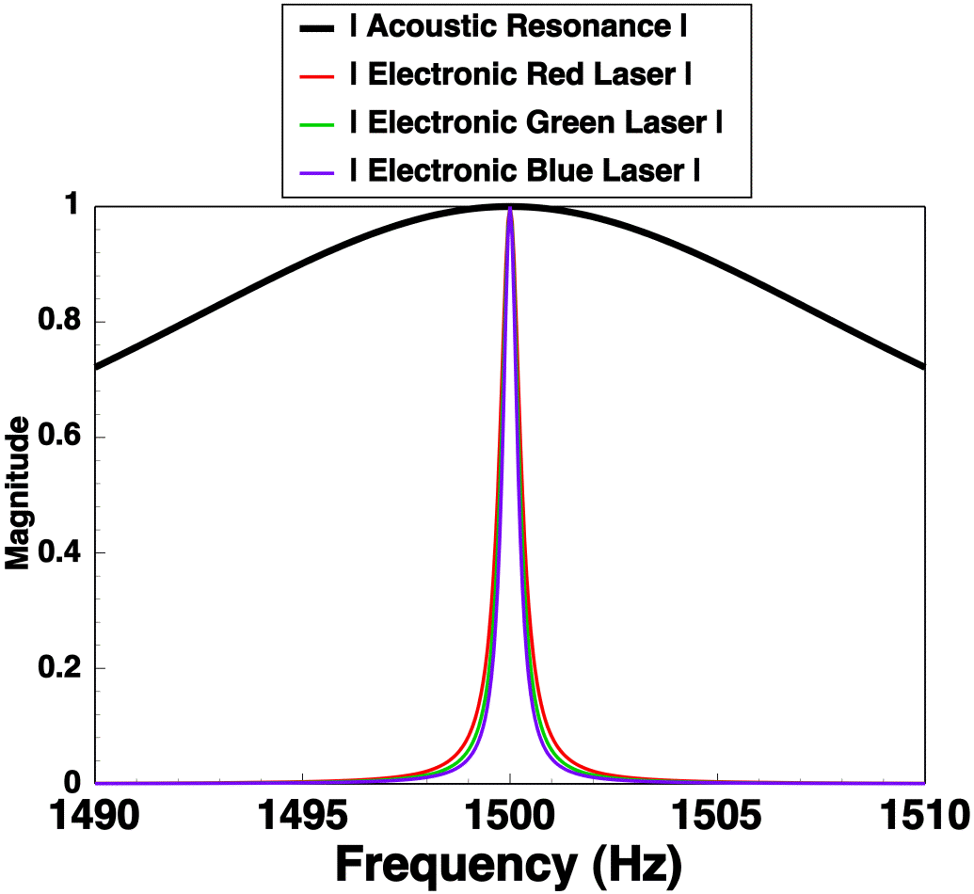
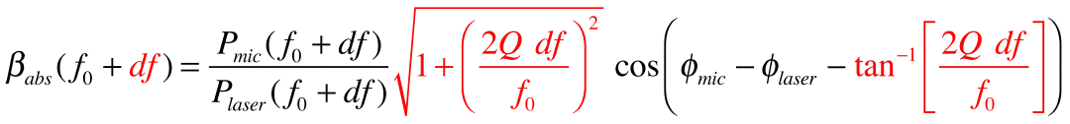
Multi Wavelength Analysis Like Single Wavelength

Slide 38
Schematic of 3 wavelength Photoacoustic instrument with scattering sensor

Slide 39
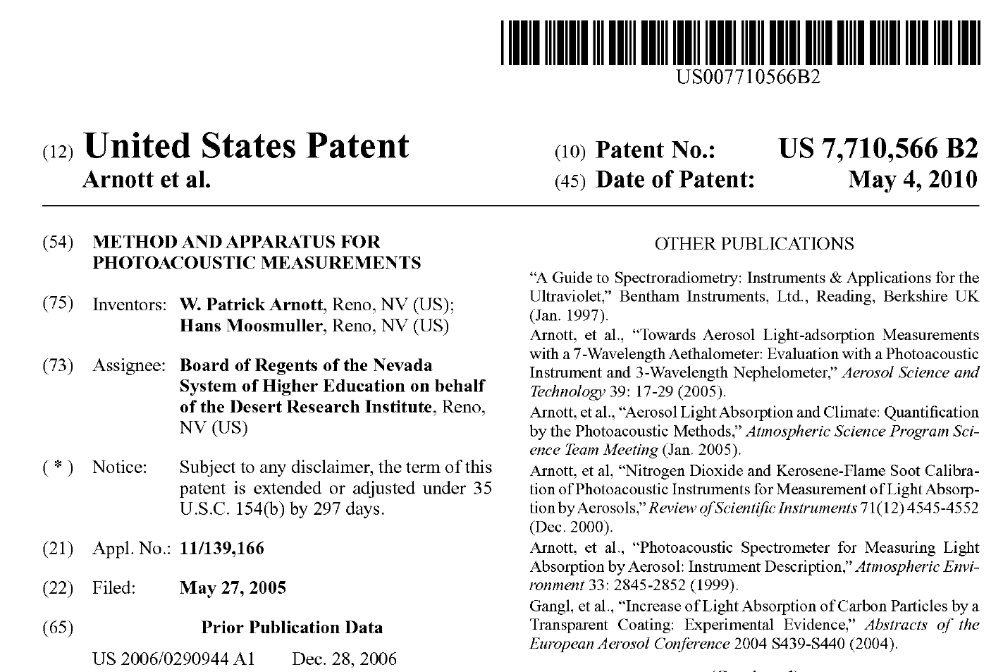
3 Wavelength Instrument Patent

Slide 40
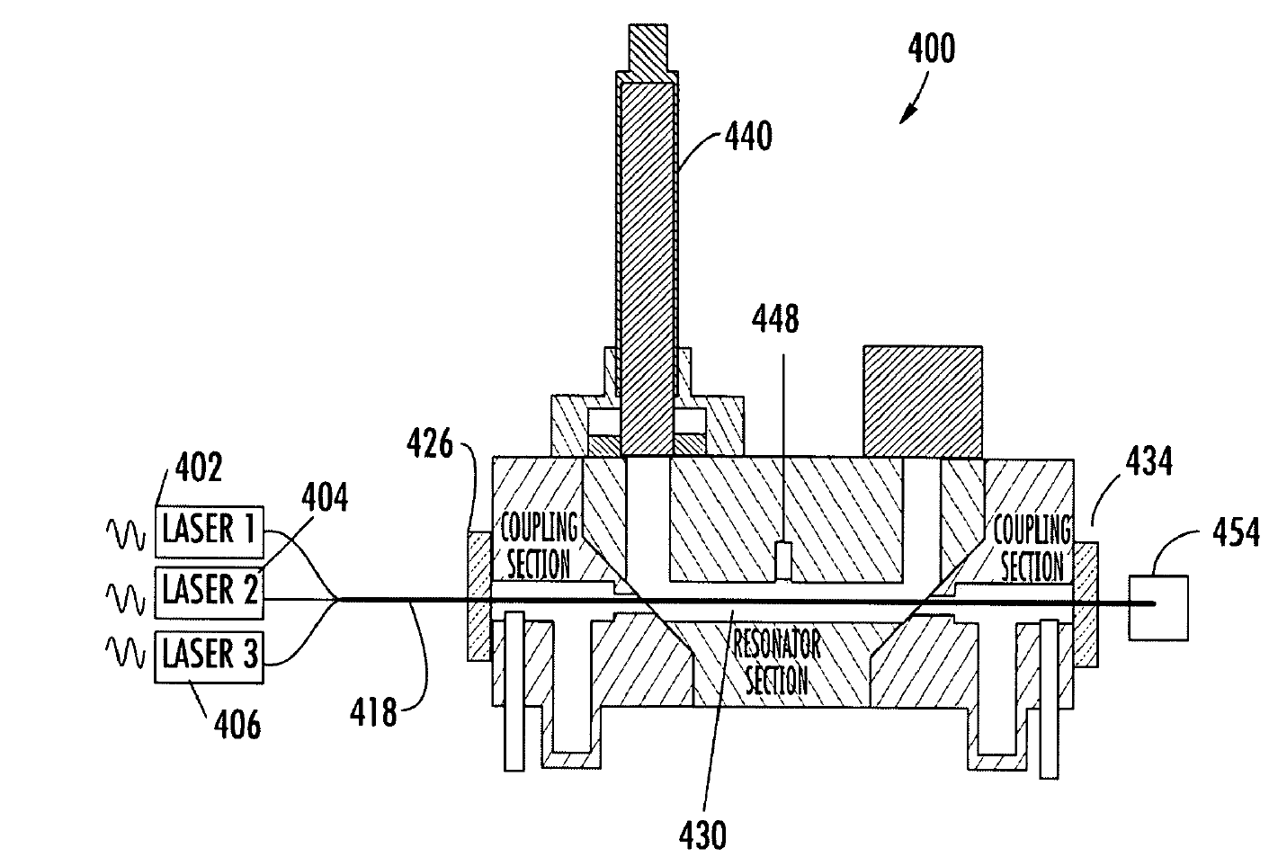
3 Wavelength Instrument Patent

Slide 41
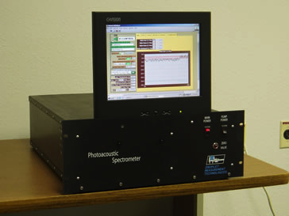
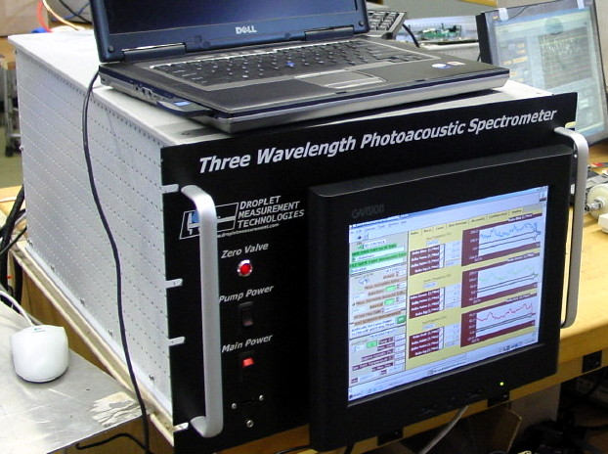
Single and 3 Wavelength Instruments made by Droplet Measurement Technology of Boulder Colorado.
PAS 1 Phased out in favor of the PAX instrument

Slide 42
PAX is Born: Circa 2007
Developed to reduce component costs and expand capabilities of scattering measurements.
DMT and UNR have a joint NSF SBIR Phase 1 in 2009 to further develop the PAX.
Created 3 mobile lab versions, 2 for DRI and 1 for the Bay Area Air Quality Management District.

Slide 43
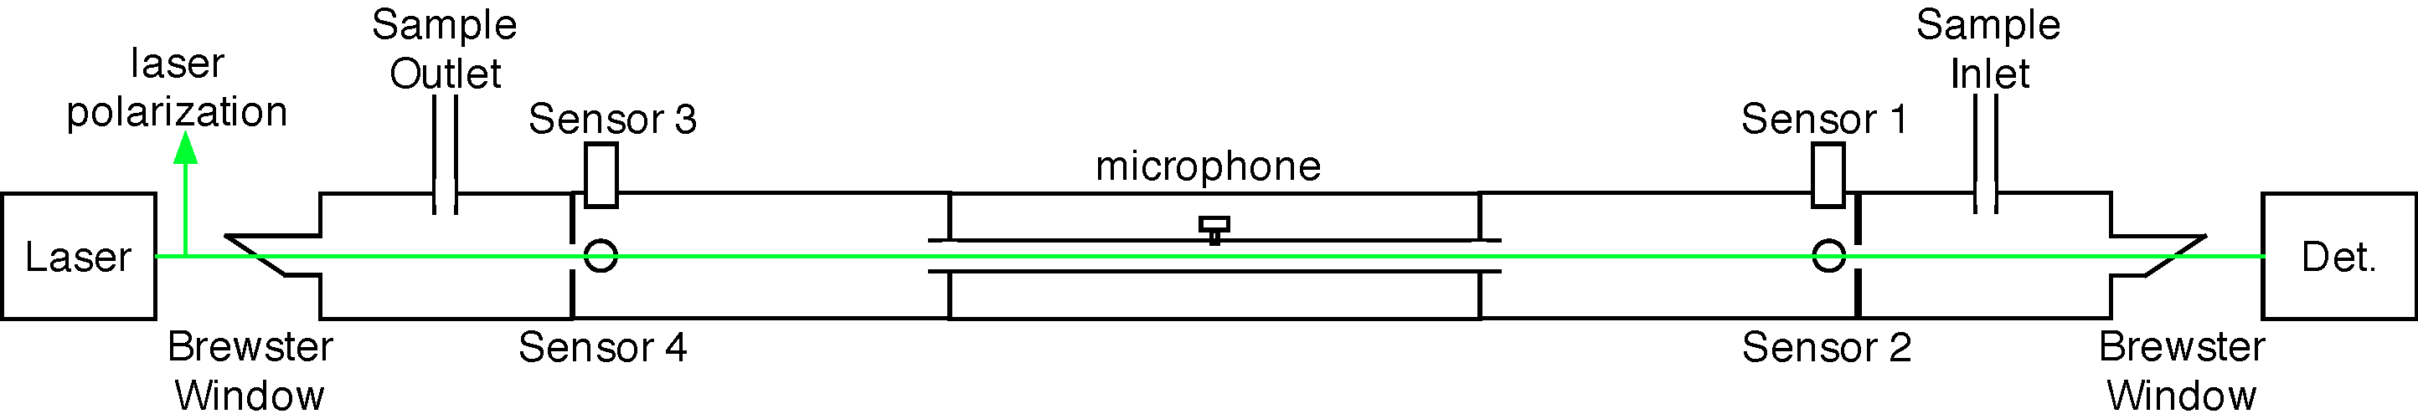
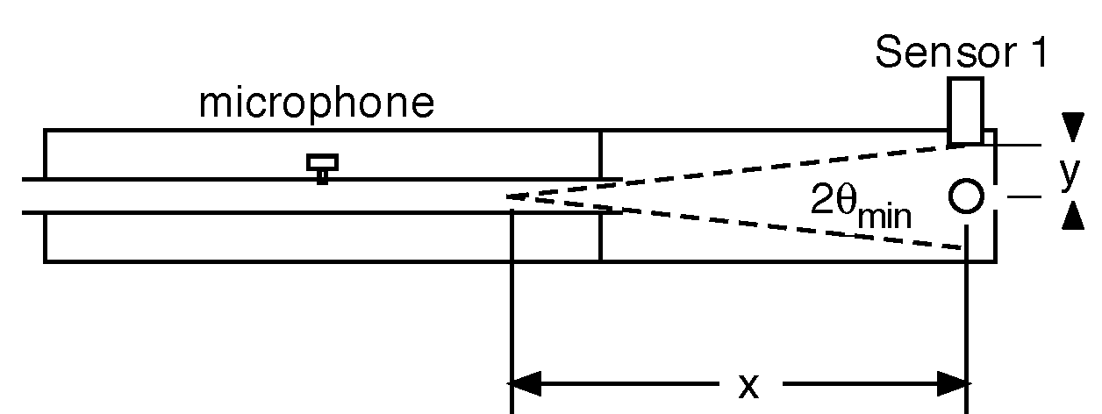
Schematics of the then new SUPER MINI PAS

Slide 44
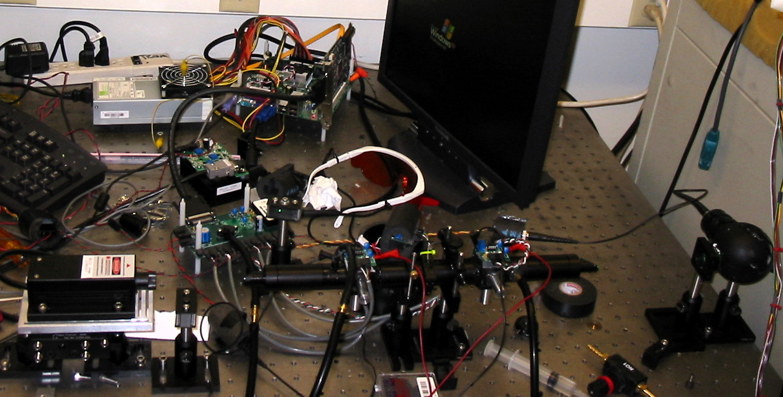
Photograph of the then new SUPER MINI PAS
Later to become the PAX

Slide 45
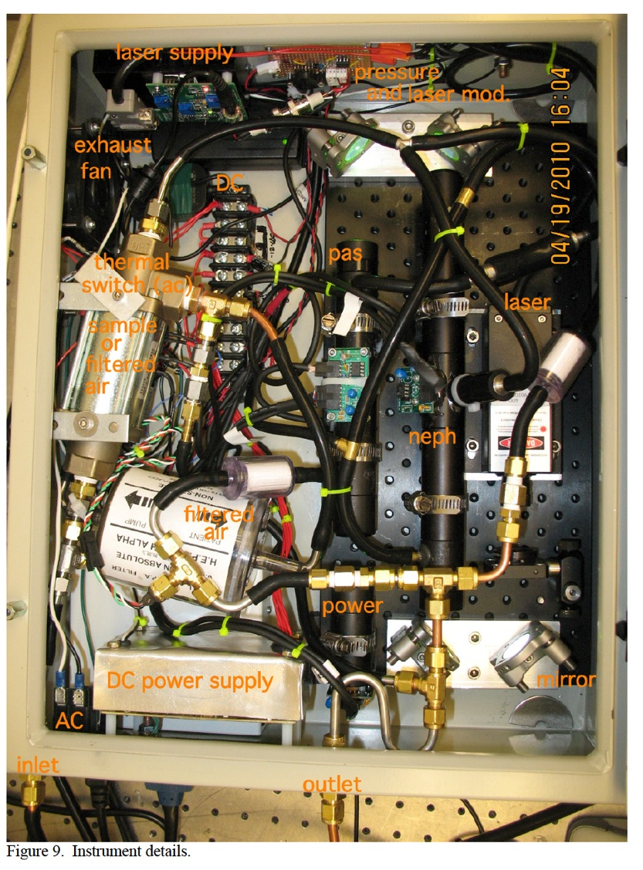
Mini PAS, now known as the PAX, Prepared for the Kirchstetter lab at LBL

Slide 46
Licensing Agreements with DMT and UNR/DRI
PAS 1 single wavelength photoacoustic instrument
June 3, 2005 (DMT and DRI agreement)
PAX single wavelength instrument
PAS 3 triple wavelength instrument
January 7, 2011
Many field deployments and associated publications:
Mexico City, Sacramento, Vancouver, Reno, Las Vegas, Oklahoma, Washington
Monterey, Riverside, Los Angeles, San Francisco, Oakland, Nevada Gold Mines
…

