Slide 1
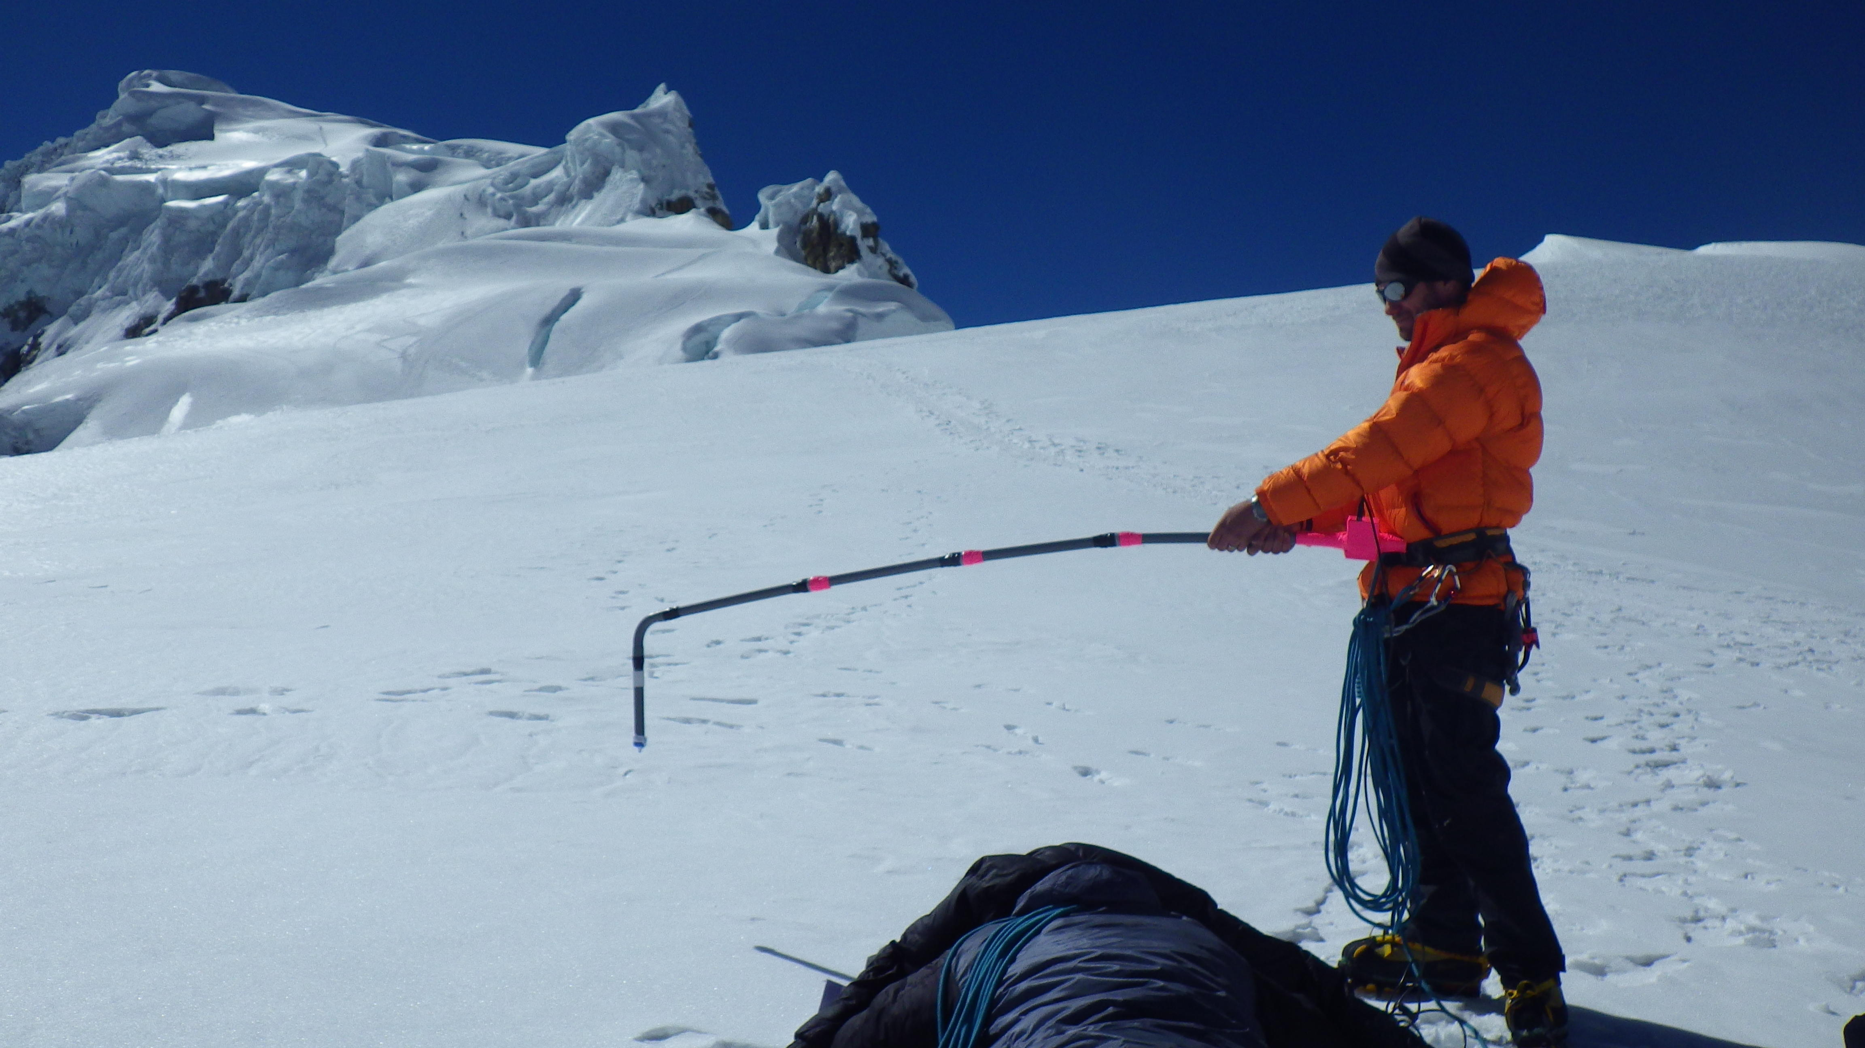
Integrative High Alpine Research through Collaborative Partnerships
John All¹, Pat Arnott², Carl Schmitt³, Rebecca Cole⁴, Ruth Sofield⁵, Ellen Lapham, Benny Bach²
American Climber Science Program, USA
¹ Dept Geography, Western Kentucky University
² Atmospheric Science Program, University of Nevada Reno
³ National Center for Atmospheric Research, Boulder Colorado
⁴ University of Hawaii at Manoa
⁵ Dept Environmental Science, Western Washington University

Slide 2
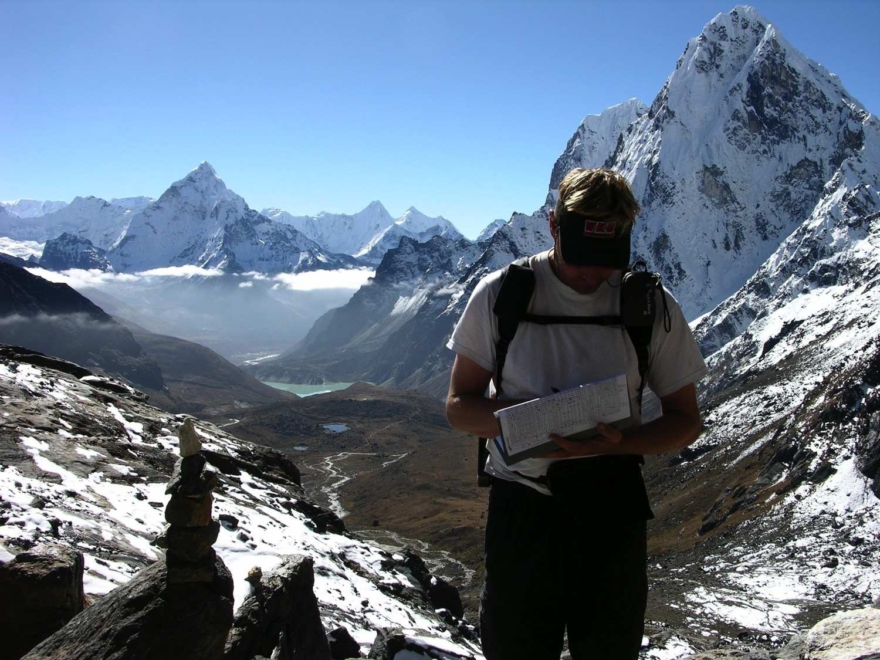
OUTLINE
American Climber Science Program
Project Example: Black Carbon Aerosol in the Cordillera Blanca of Peru
Local Example: Snow Albedo and Chemistry at Tahoe Meadows (poster to be presented by UNR student Kyle Swanson at the exhibition on Wednesday)
Summary

Slide 3
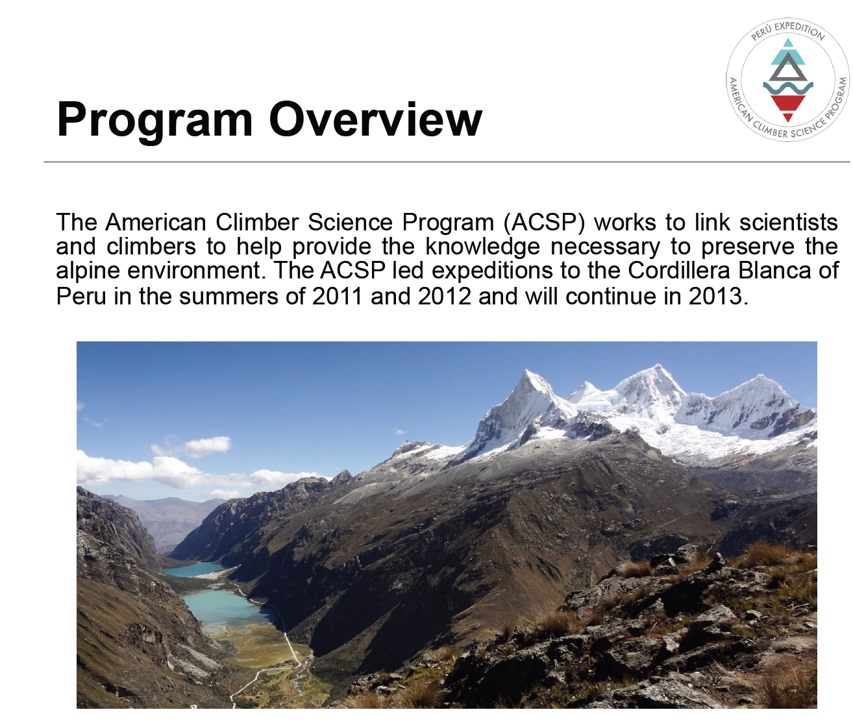
Program Overview

Slide 4
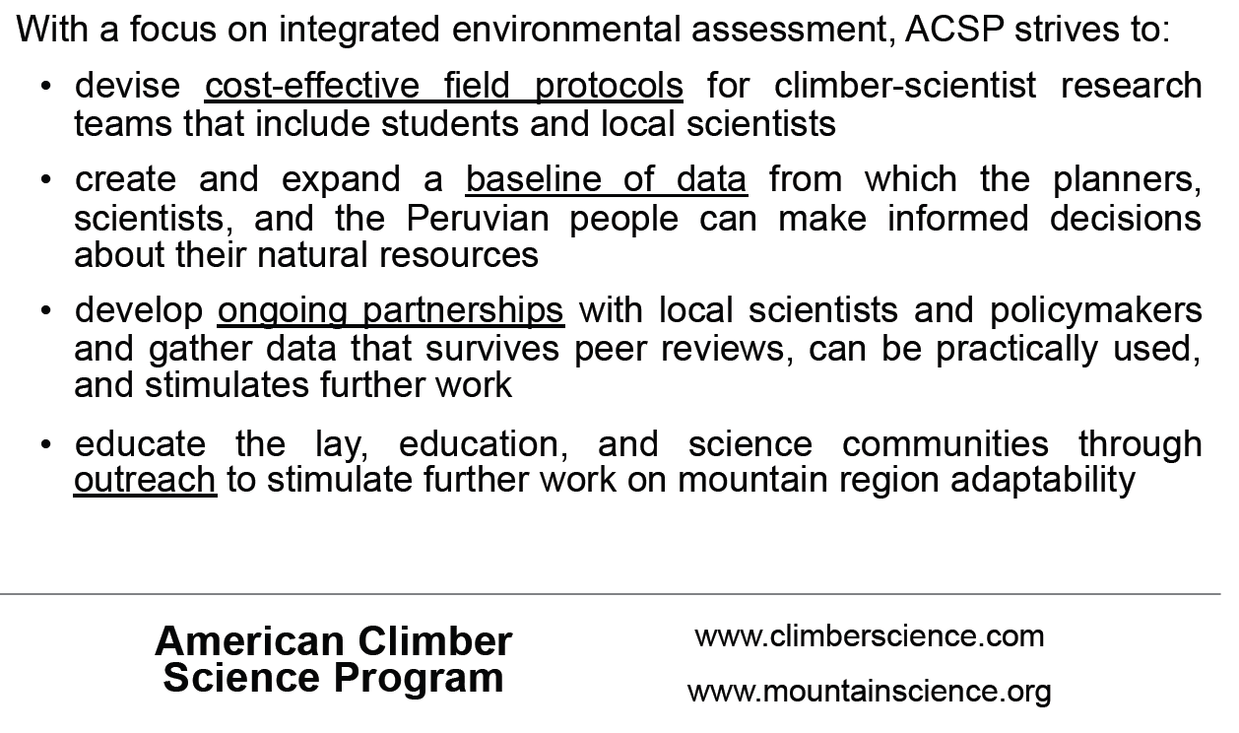
Program Focus

Slide 5
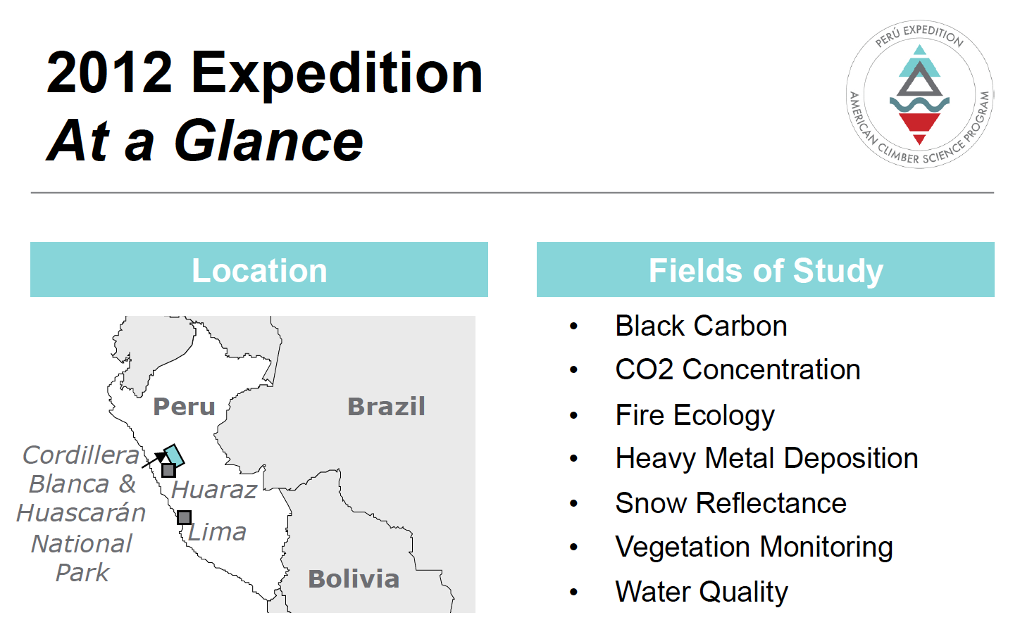
2012 Expedition to Peru

Slide 6
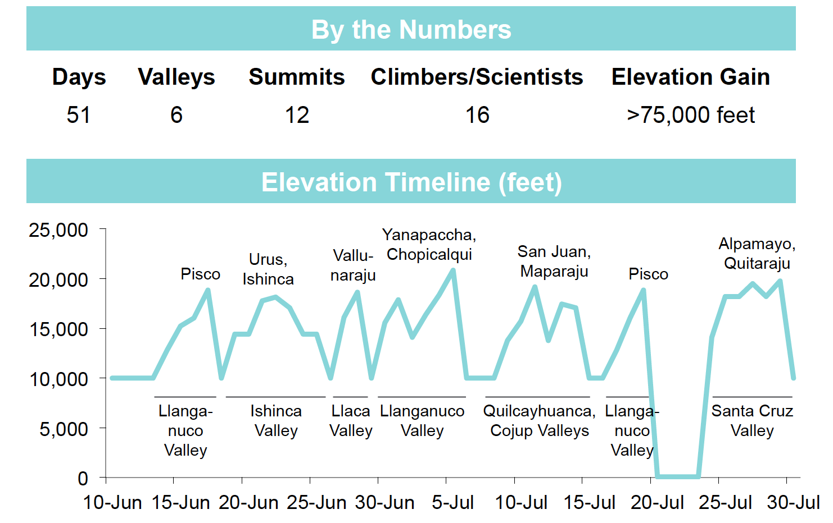
By the numbers

Slide 7
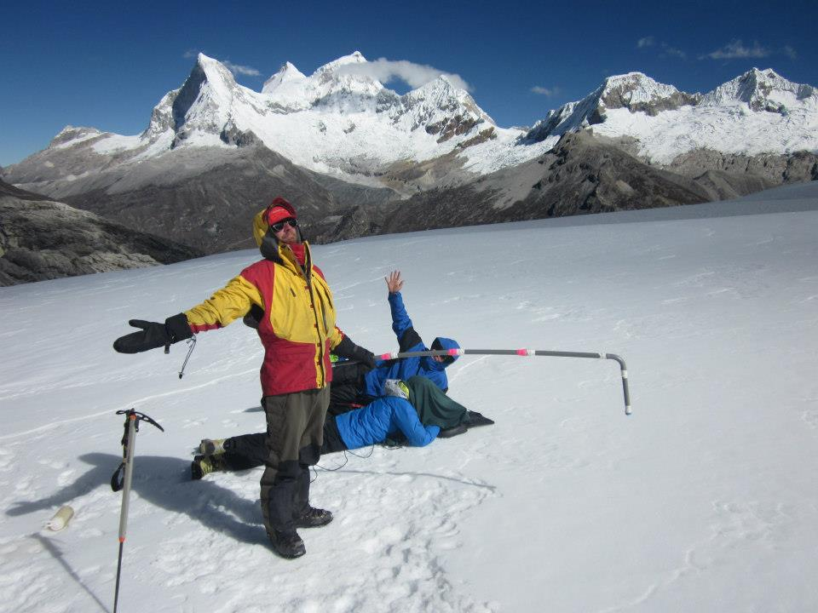
Spectrajeros: Workers Committed to Studying the Hydrological and Energy Budget of Glaciers.
Benny Bach
Pat Arnott
Spectrometer →
Irradiance sensor head
Kate operating computer

Slide 8
Idea
Glaciers as ‘organisms’ grow under favorable meteorological and climate conditions.
They are an important water source for many of the people in Peru and Nepal, for example.
Glaciers are a governor for the pace of climate change due to their high reflectivity (albedo), and the great amount of heat needed to melt them from ice, to water, to water vapor in the atmosphere.
Glaciers may directly sublimate to the atmosphere when their surface albedo is reduced by deposition of light absorbing material like rock, dust, and soot on the surfaces. This water vapor is likely not directly available to serve the water needs of people and ecosystems downstream.
In situ, on the ground measurements of the spectra of light reflected by glaciers is needed to provide ground-truthing for satellite remote sensing algorithm development.

Slide 9
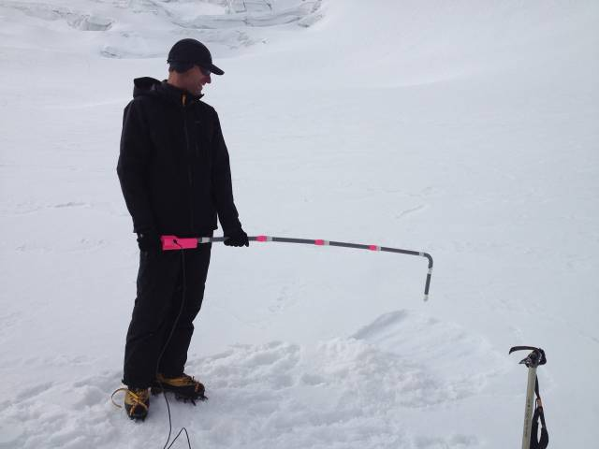
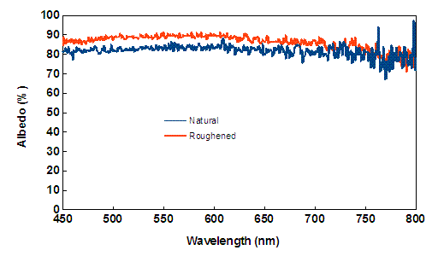
Yana Pacha Glacier Albedo
Carl Schmitt measuring albedo over
Roughened surface, 2 July 2012.
Sky conditions: Fairly uniform altocumulus clouds.

Slide 10
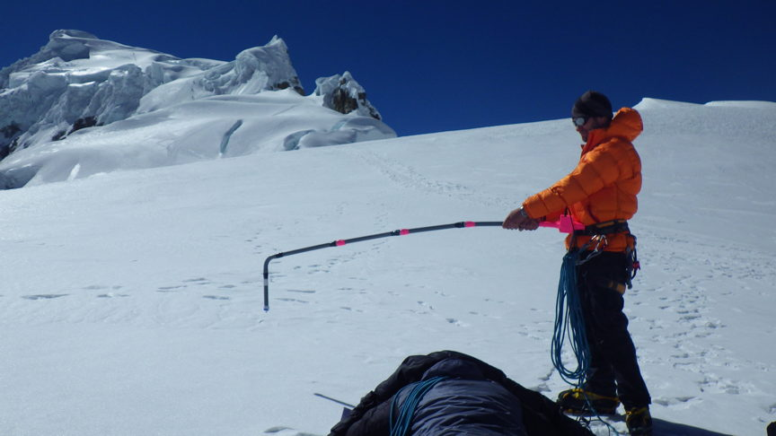
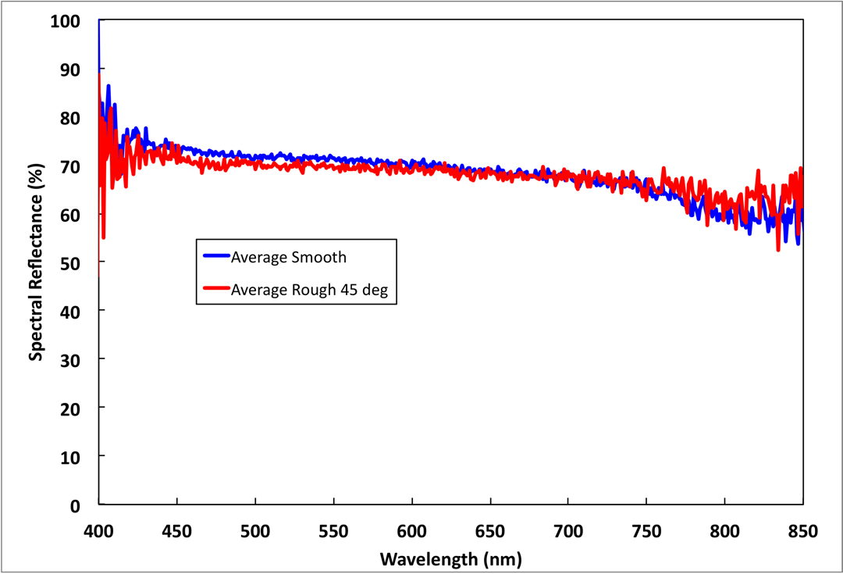
Pisco Glacier Albedo
John All and Ed measuring late July 2012.
Sky conditions: clear.

Slide 11
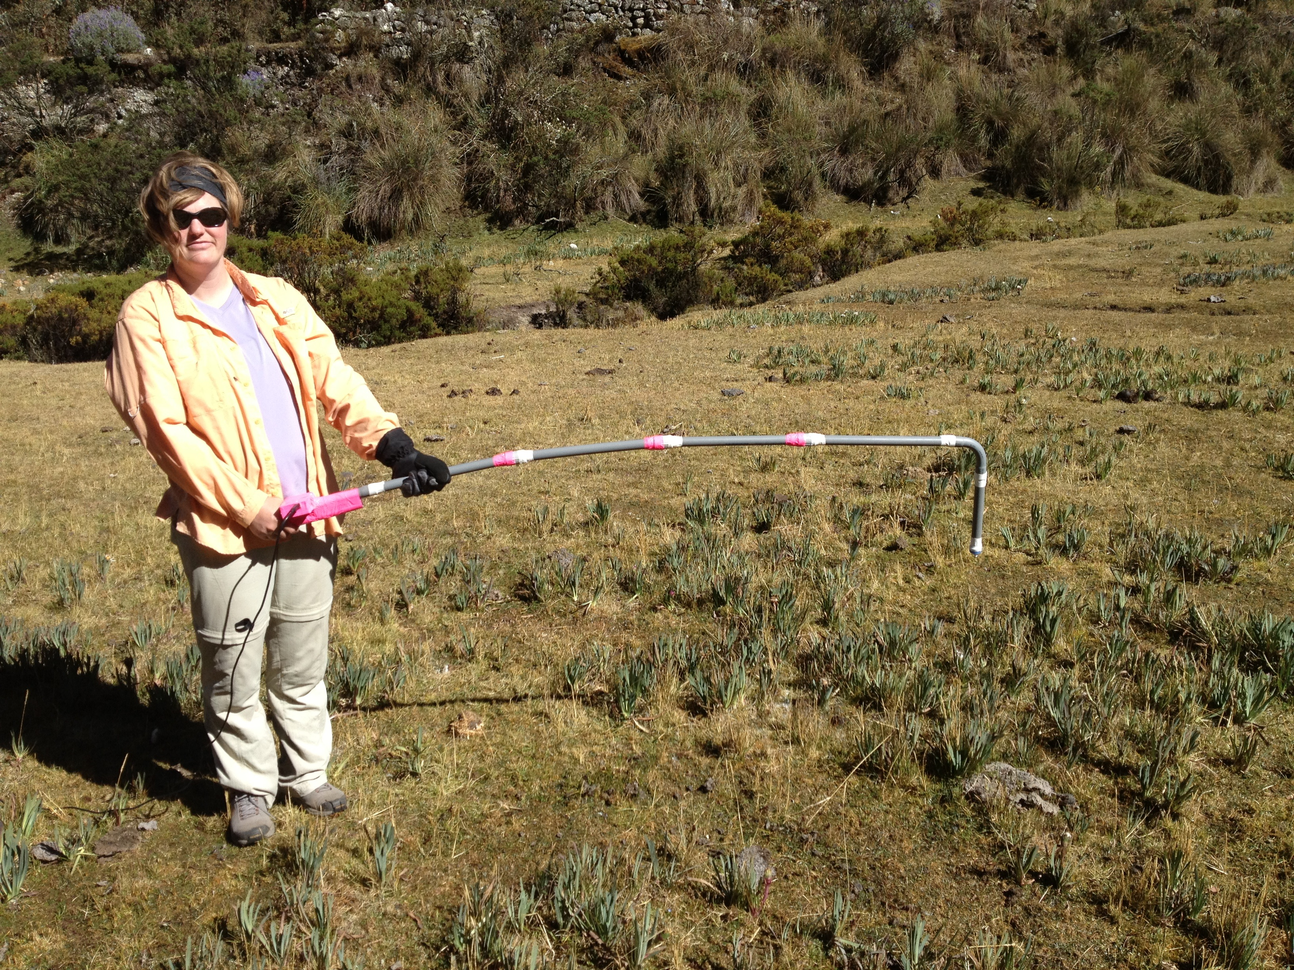
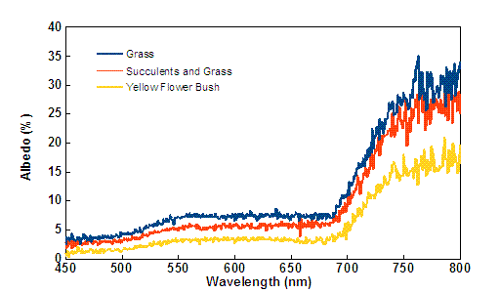
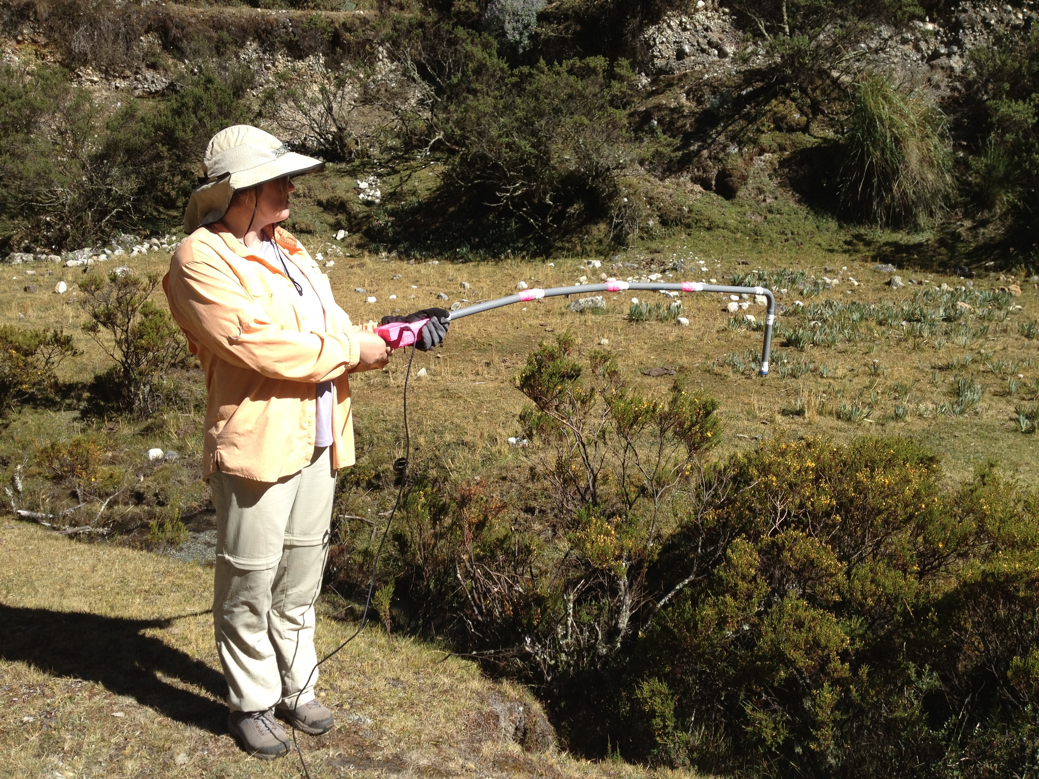
Grass and Mixed Surface Albedo
Darby measuring albedo over mixed grass, succulent, and dirt surface, clear sky conditions.

Slide 12
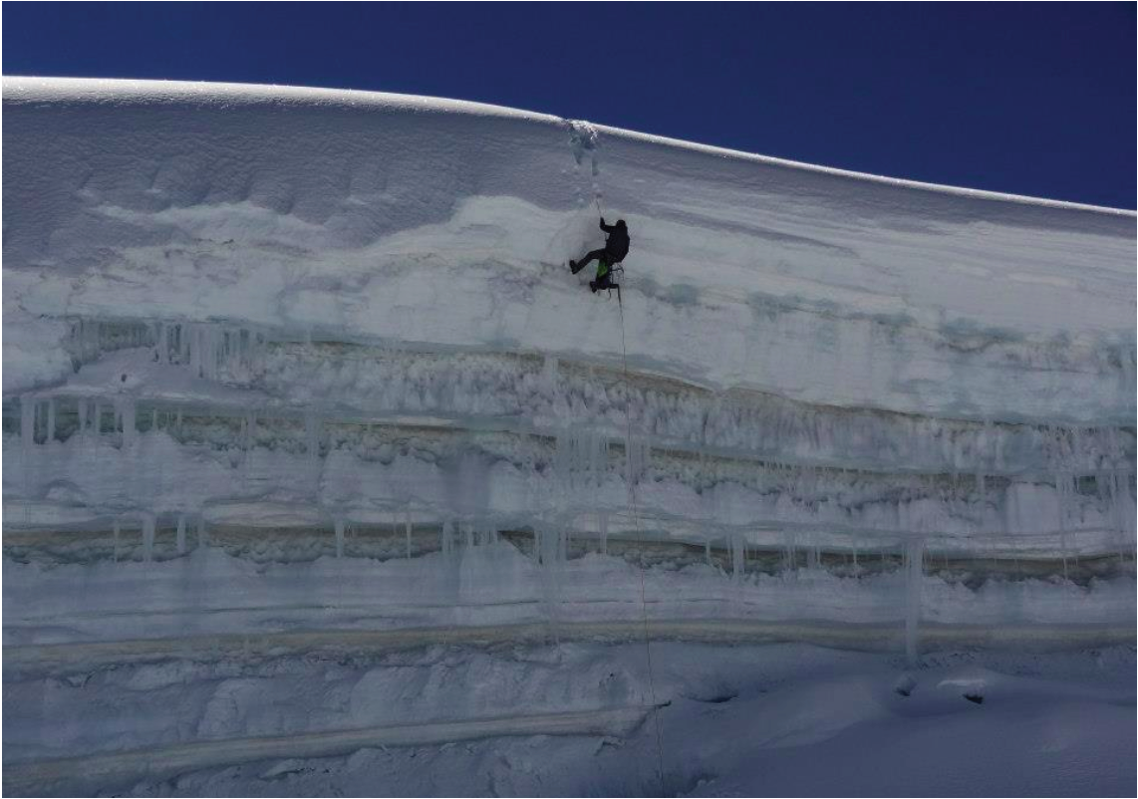
Black Carbon Aerosol Concentration on Glaciers in Peru

Slide 13
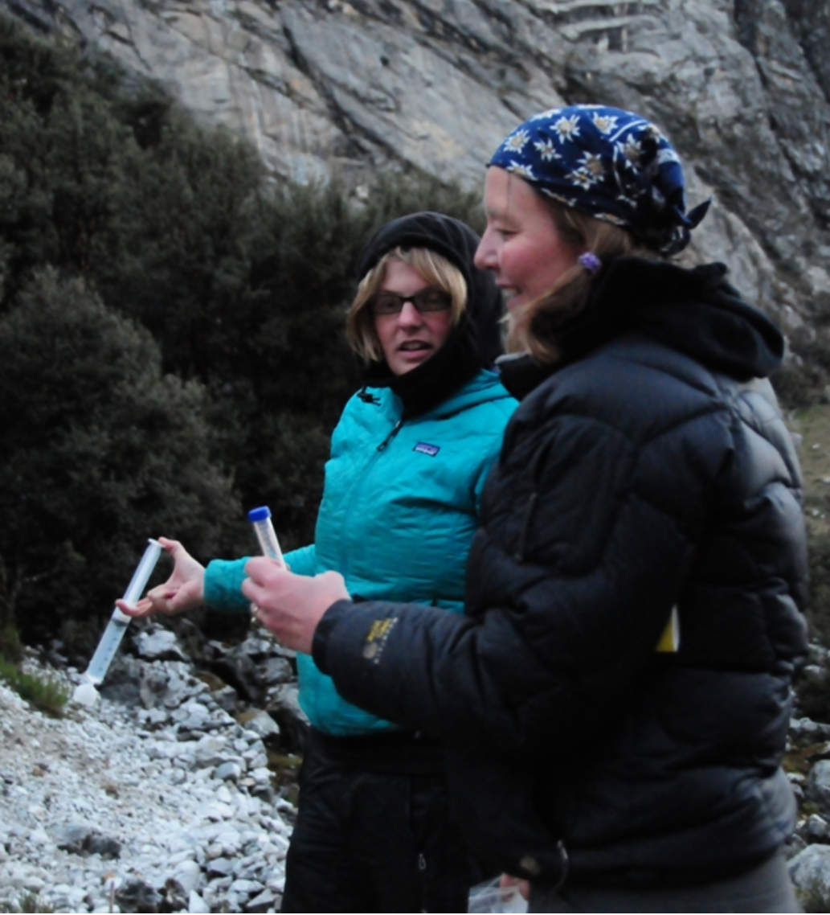
Glacier Melt and Water Quality

Slide 14
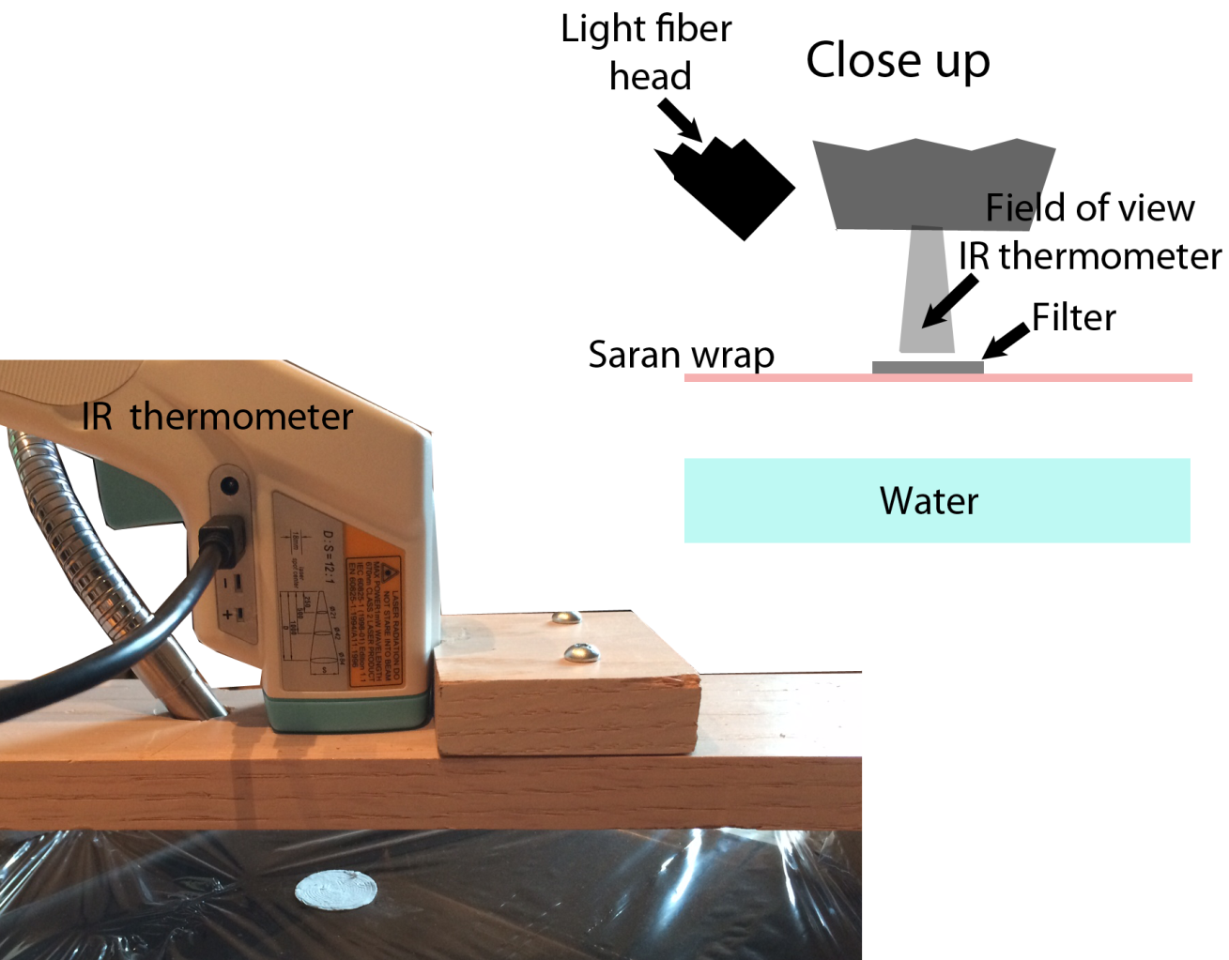
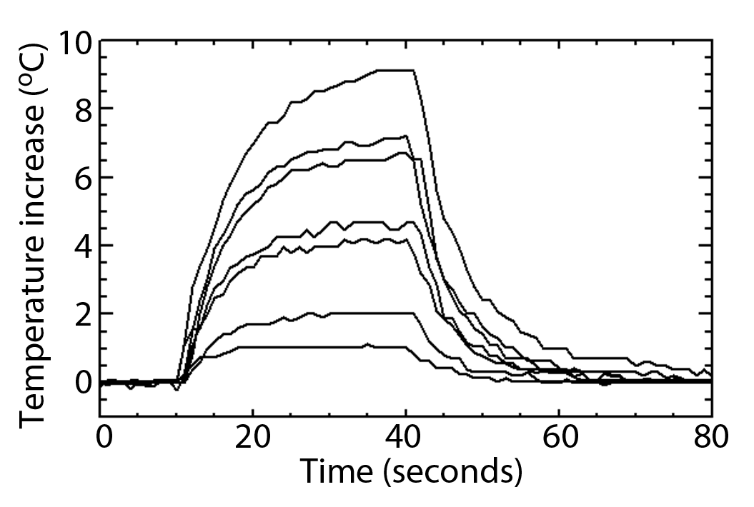
Simple, Inexpensive, Quantitative Measure of Black Carbon
Data for 7 Samples
High BC
Low BC
Observations of black carbon and dust on the glaciers of the Cordillera Blanca, Peru
C. G. Schmitt^{1,2}, J. All^{3,2}, J. P. Schwarz^{4,5}, W. P. Arnott⁶, R. J. Cole^{7,2,*}, E. Lapham², K. Froyd^{4,5}, J. Liao^{4,5}, A. Celestian³, J. Gomez⁸ [to be submitted, The Cryosphere journal, this week]

Slide 15
Summary
ACSP
Serious Science
Serious fun
Seeking participants and sponsorship
Outreach to local people

Slide 16
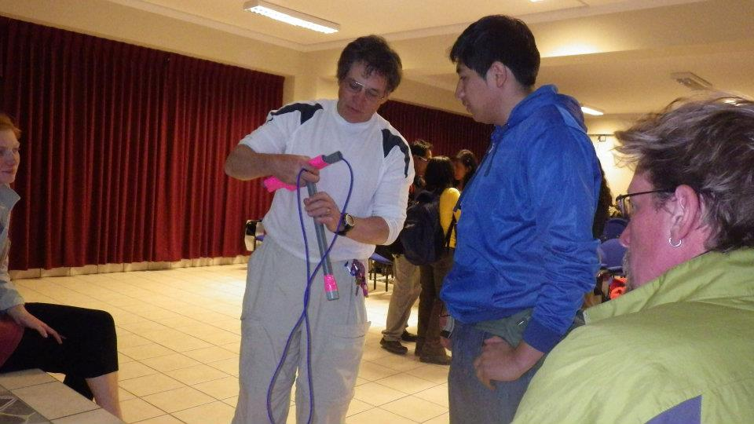
Discussing Albedo Meter with Student after Presentation at the College in Huaraz, Peru

Slide 17
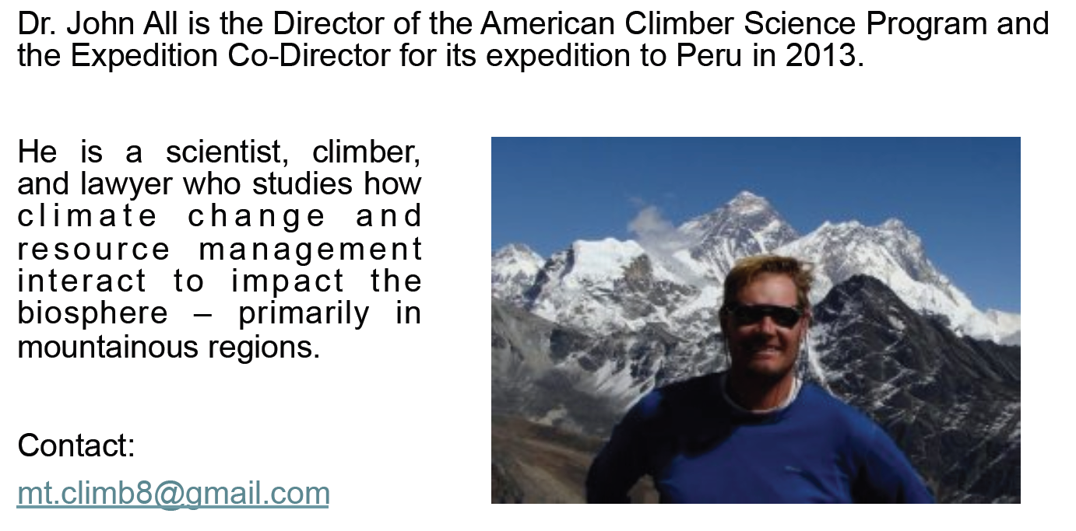

Further Information

Slide 18
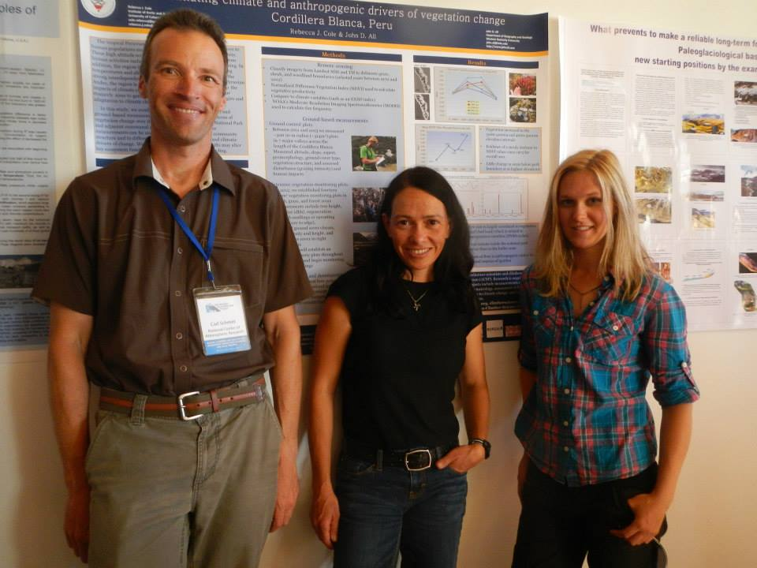
UNR Graduates Out in the World Making a Difference
Carl Schmitt, Physics BS UNR
Atmospheric Science MS UNR
Atmospheric Science PhD CU
Rebecca Cole
Biology BS UNR
Ecology PhD UC Santa Cruz

Slide 19
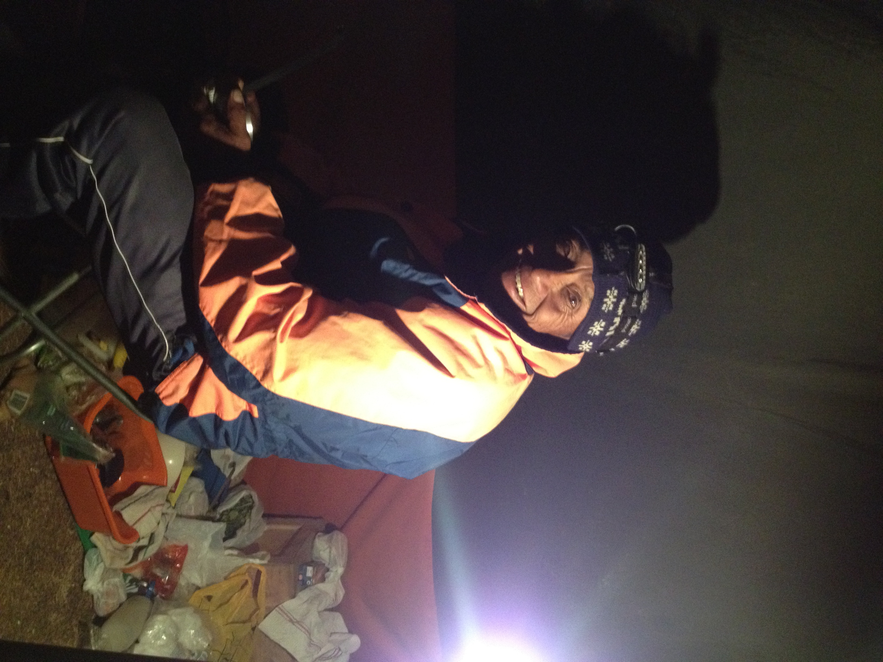
Best Part of Peru: The People.
Joachim, cook and friend, at age 62.
Lore: Climbed Huascaran 126 times (21,000’) as a guide. Carried a bicycle to the top for the first mountain bike descent by a Frenchman.

Slide 20
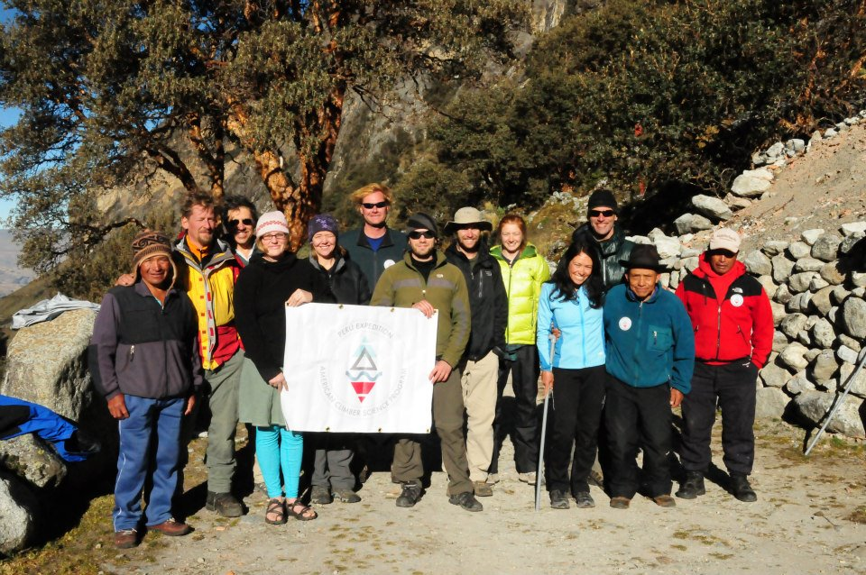
Thanks Everyone for a Great Experience

Slide 21
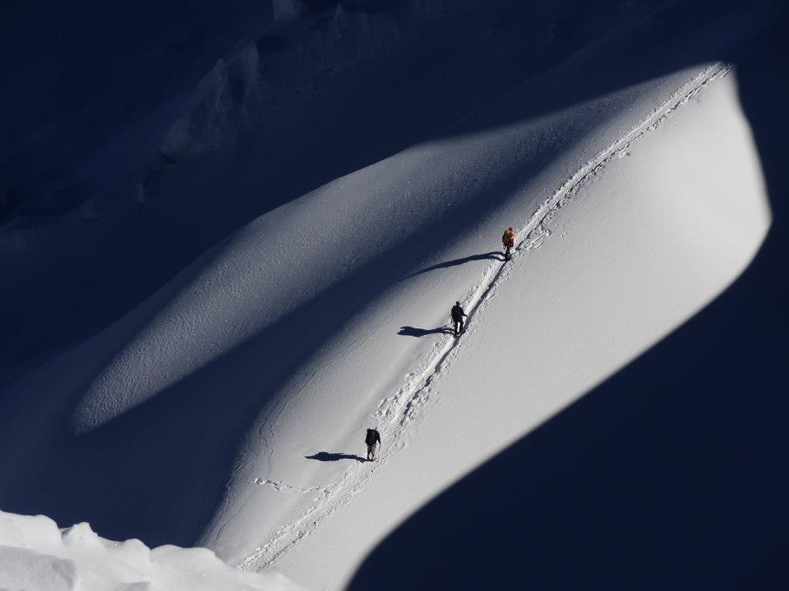
Thanks for Your Attention ☺
Benny Bach
Colin Steiner
Pat Arnott
Photo by John All

