Slide 1
Session

Slide 2
1pPA4. POSTDOC AT NCPA: Explosive Growth and Entertainment 1988-1991
W. Patrick Arnott
Department of Physics
Atmospheric Science Programs
University of Nevada Reno, MS 220
Reno, NV 89557 patarnott@gmail.com arnottw@unr.edu
Outline
1. Brief history leading up to my postdoc.
2. Being quite unprepared ...
3. Some of the research projects ...
4. Hank Bass, Richard Raspet, and James Sabatier as a mentors, colleagues, statesmen, entrepreneurs, and friends.
5. What I ended up doing afterwards: Influence of NCPA
6. Entertainment

Slide 3
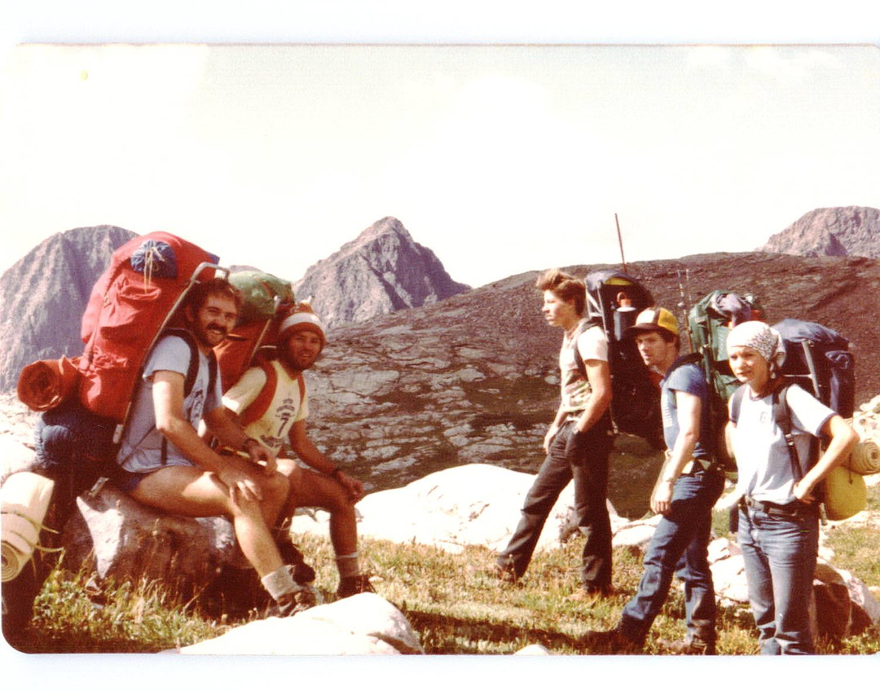
Born a tree hugger; enjoy practical problems

Slide 4

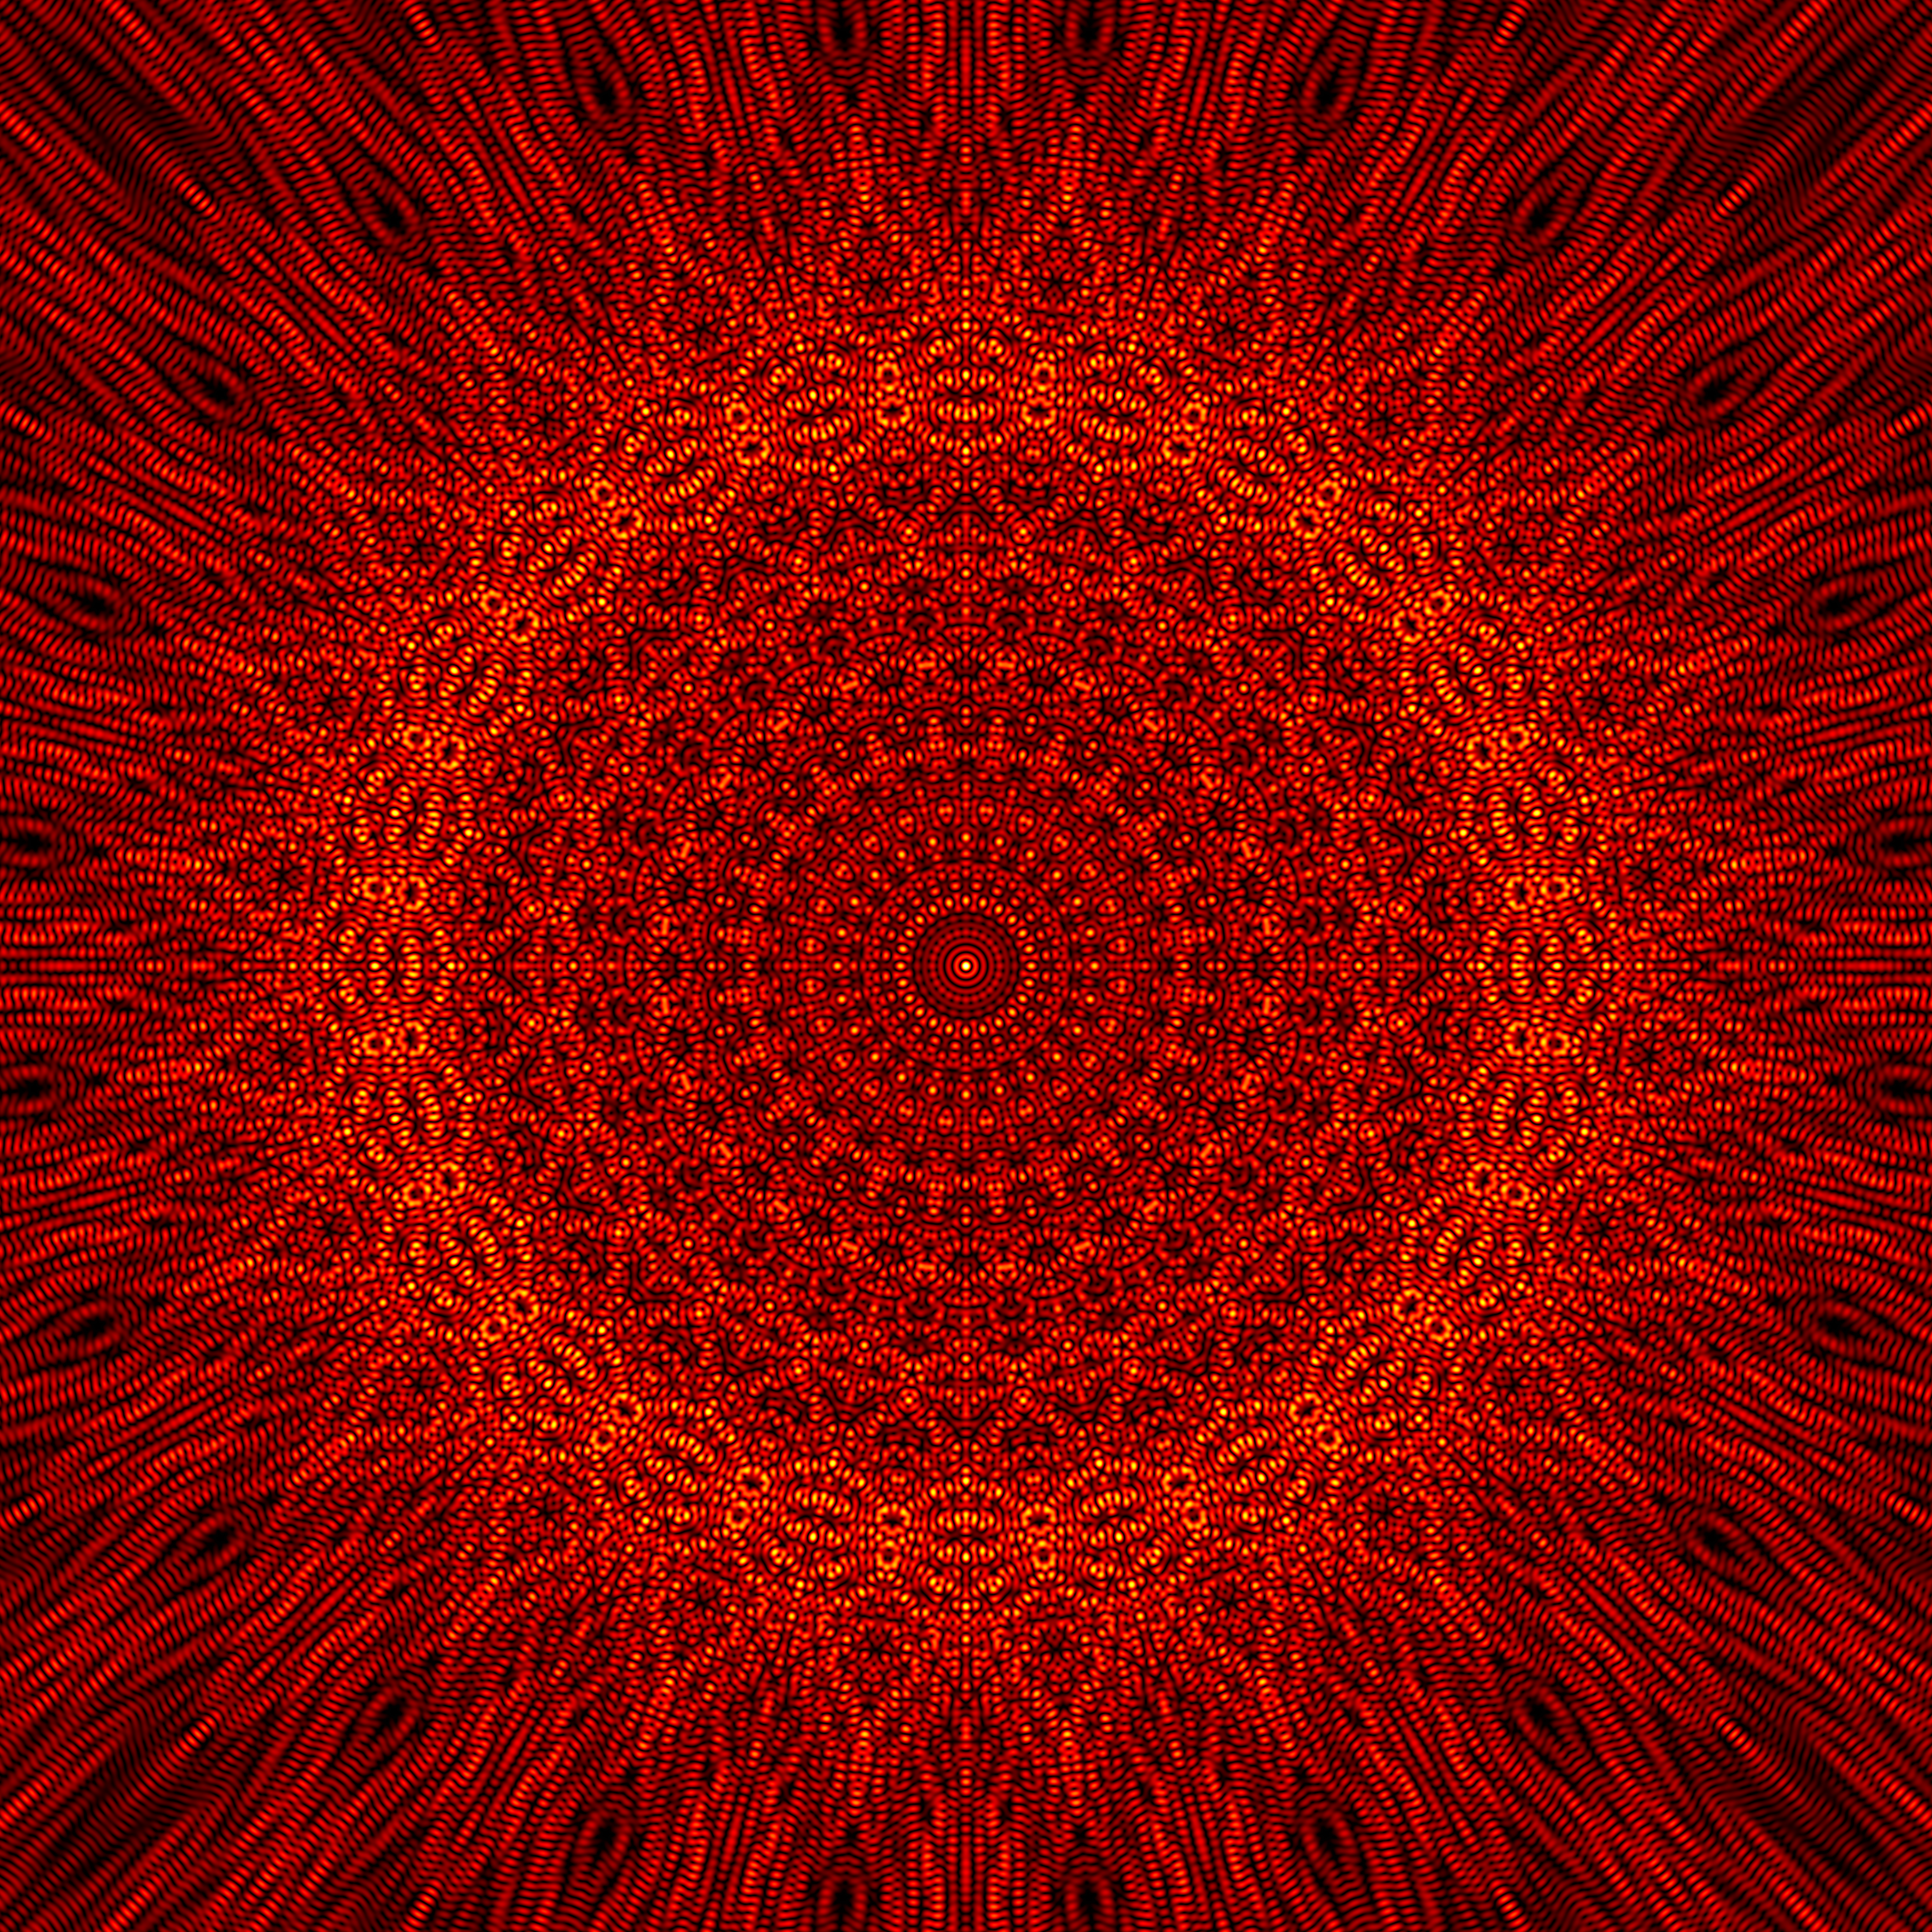
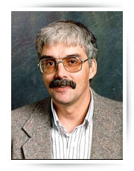
1984-1988 Physics Grad School, Washington State Univ.
Geometrical aspects of backscattered wavefields in electromagnetic and acoustic scattering by objects
Thanks Professor and Advisor
Dr. Philip Marston

Slide 5
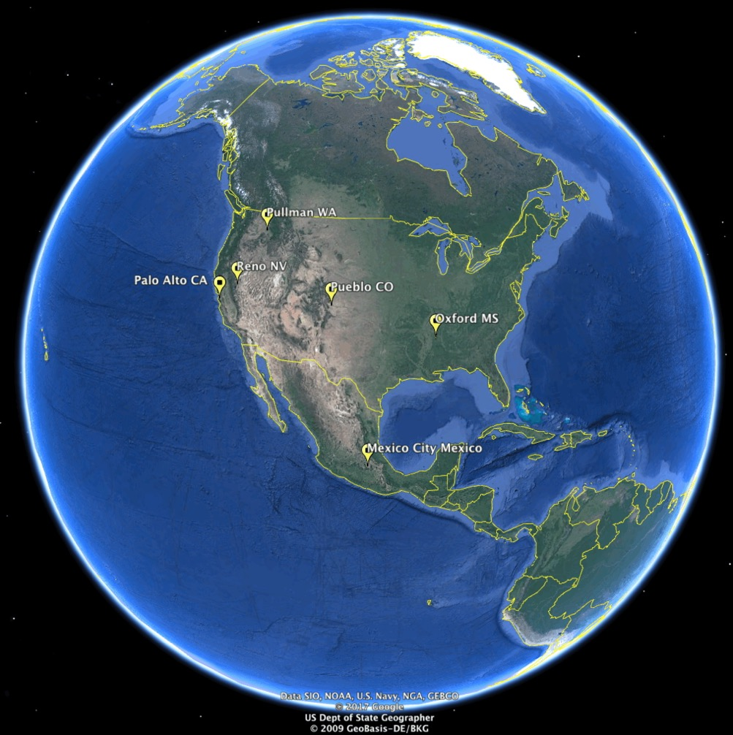
Quite Unprepared for NCPA and Oxford MS ...

Slide 6
Why So Unprepared?
Was it the food? No, great food, gained 15 lbs eating catfish and hush puppies at Starnes Restaurant.
Was it the weather? No, great cumulonimbus clouds, humidity, rain, colorful seasons, plenty of trees to hug.
Was it the language? No sir, just learn a credible y’all, and order your tea sweet or unsweet
Was it the people? No met many fine people both at work and as neighbors, fellow citizens
It was NCPA, National Center for Physical Acoustics.
For every problem in the world there is a Physical Acoustics solution ...

Slide 7
Problems and Physical Acoustics Solutions
Suspect nuclear explosions? Listen in on them using long range propagation of infrasound in the atmosphere.
Suspect your crickets of being amorous? Listen for their love songs at night.
Need to measure global warming? Use the speed of sound going between ocean basins.
Need a very regular, flashy point source of light? Put a bubble in water within an acoustical resonator and vibrate it so that light comes out.
Got a kidney stone? Shock wave it away.
Need to maybe measure global precipitation? Listen in the oceans for the sound that rain makes.
Need to test your scotch? Shine light on it and listen for the sounds of quality.
Need to find out if fruit fly larvae are in your imported oranges? Listen for them chewing.
Suspect your ceramic of being superconducting? Send in ultrasound to find out.

Slide 8
Actually the science and applications developed by everyone at NCPA, and elsewhere at the time, were profound and very humbling, and I tried to soak it all up.

Slide 9
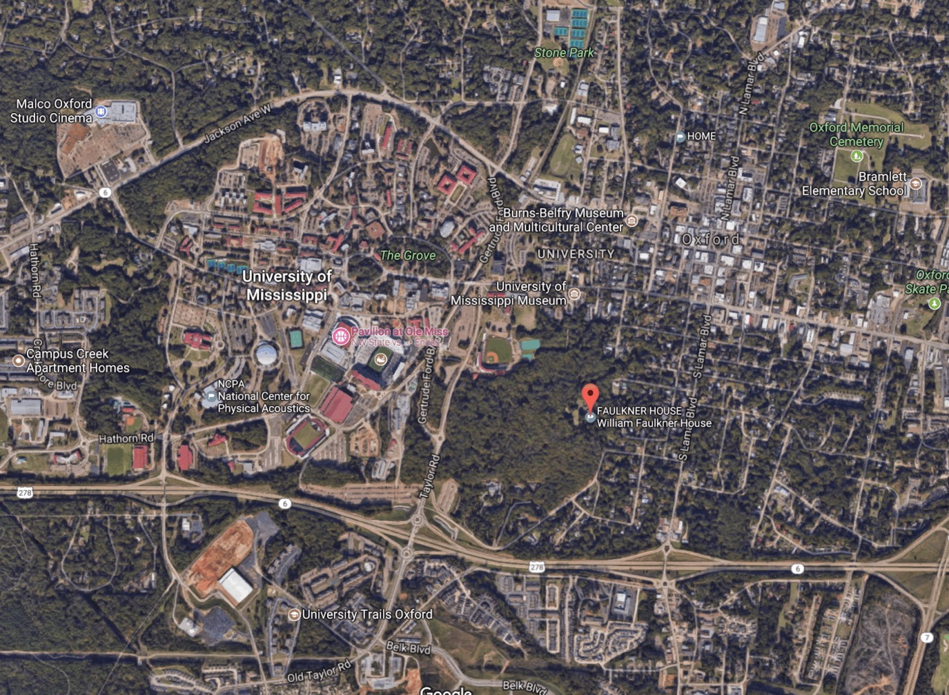
Oxford Mississippi and Ole Miss

Slide 10
National Center for Physical Acoustics

Slide 11
Jaime Whitten

Slide 12
As a postdoc I was expected to help solve some of the world’s problems using sound
Test land for crop worthiness by reflecting sound off of it in a Lloyd’s mirror arrangement to measure surface porosity and tortuosity.
Do fundamental studies of model porous materials for informing ground albedo for sound sources and for testing thermoacoustic heat engines.
Use low frequency sound sources in the atmosphere to shake the ground to measure near-surface layering, sound speed, attenuation, and to detect buried land mines. Use Doppler shifted laser light to measure ground motion. Sound sources included a propane cannon and an enormous speaker hoisted up through 100’ of scaffolding --- Acoustic to seismic coupling.
Use heat to create large amplitude sound, and large amplitude sound to create environmentally friendly refrigeration --- Thermoacoustics Heat Engines and Refrigerators.

Slide 13
Soils Work

Slide 14
Level Difference Example
Theory
Observation
Transfer Function (dB)
Frequency (Hz)
Dip depends on
Soil porosity, flow resistivity, and tortuosity

Slide 15
Sound Propagation In Ideal Porous Material: Ceramic Celcor Catalyst Support
Walls are porous too (wall photo)
Thermoviscous Dissipation Function

Slide 16
Measurements of Specific Acoustic Impedance
T_{hot}
T_{ambient}

Slide 17
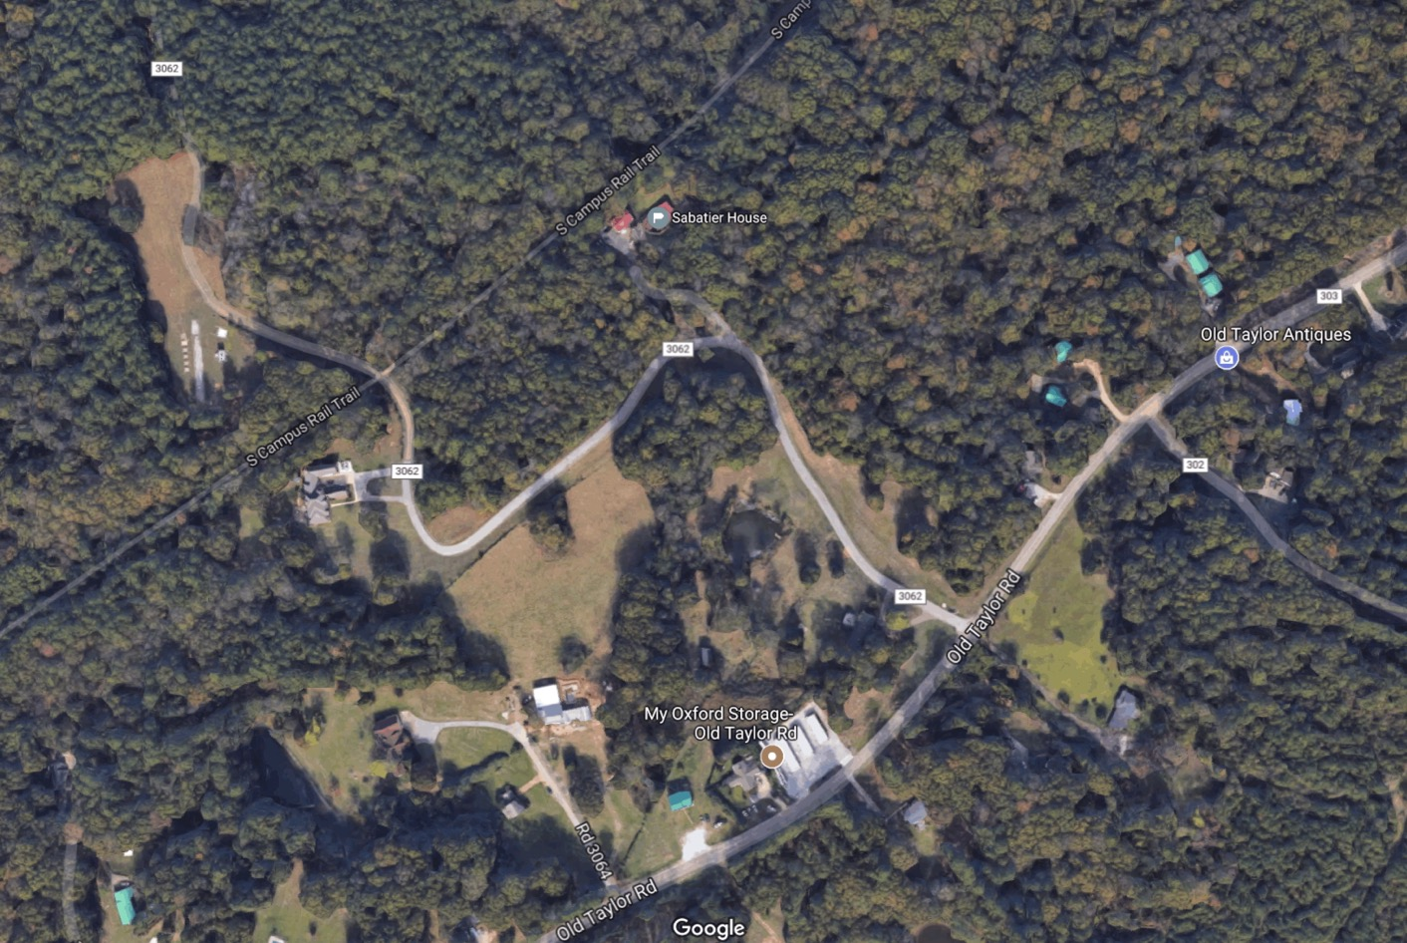
Audi Acres: Field Site for Outdoor Acoustics Experiments

Slide 18
Laser Doppler Vibrometer Measurements of Acoustic To Seismic Coupling
Propane
Cannon
LDV
GEOPHONE
Unburied
Land Mine

Slide 19
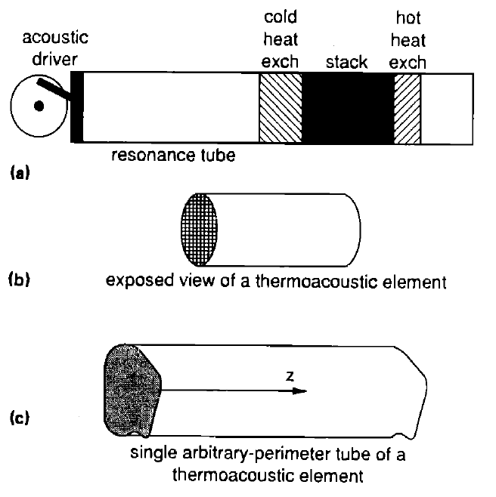
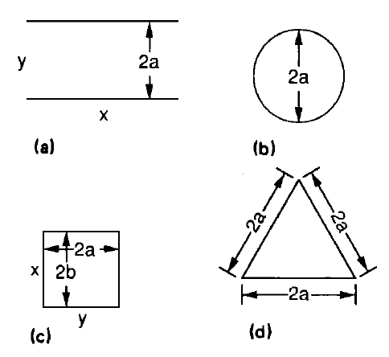
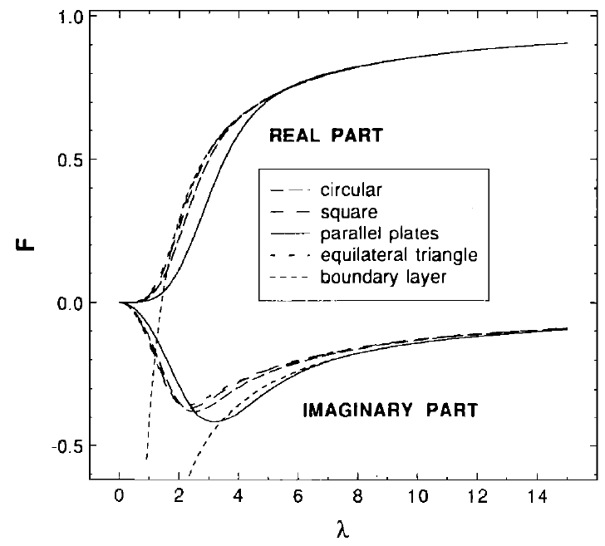
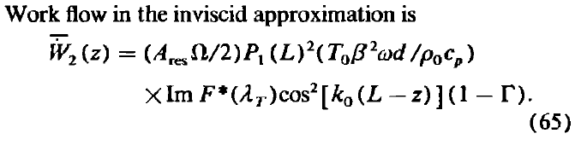
Thermoacoustic Heat Engines: Strong Sound from Heat and Acoustically Driven Environmentally Friendly Refrigeration
Arnott, W.P. H.E. Bass and R. Raspet, 1991: General formulation of thermoacoustics for stacks having arbitrarily-shaped pore cross-sections. J. Acoust. Soc. Am., 90 , 3228-3237. (A key paper for me, and one that was particularly useful to others). Some of the ideas coming out of this time have been realized in a well-used software package for design of acoustic refrigerators and prime movers (sounds sources).

Slide 20
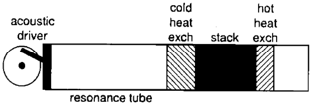
Economic Incentive for Developing Environmentally Friendly Refrigeration Technology

Slide 21
Publications
Arnott, W.P. and J.S. Sabatier, 1990: Laser-Doppler vibrometer measurements of acoustic to seismic coupling.
Applied Acoustics, 30 , 279-291.
Sabatier, J.S., H. Hess, W.P. Arnott, K. Attenborough, M. Romkens and E. Grissinger, 1990:
In situ measurements of soil physical properties by acoustical techniques. Soil Sci. Soc. Am. 54 , 658-672.
Roh, H., W. P. Arnott, J. M. Sabatier and R. Raspet, 1991:
Measurement and calculation of acoustic propagation constants in arrays of small air-filled rectangular tubes,
J. Acoust. Soc. Am., 89 , 2617-2624.
DURING POST DOC
Arnott, W.P. H.E. Bass and R. Raspet, 1991:
General formulation of thermoacoustics for stacks having arbitrarily-shaped pore cross-sections.
J. Acoust. Soc. Am., 90 , 3228-3237.
Arnott, W. P., J.M. Sabatier and R. Raspet, 1991:
Sound propagation in capillary-tube-type porous media with small pores in the capillary walls.
J. Acoust. Soc. Am., 90 , 3299-3306.
Arnott, W.P., H.E. Bass and R. Raspet, 1992:
Specific acoustic impedance measurements of an air-filled thermoacoustic prime mover. J. Acoust. Soc. Am., 92 , 3432.
Arnott, W. P., J. R. Belcher, R. Raspet and H. E. Bass, 1994:
Stability analysis of a helium filled thermoacoustic engine. J. Acoust. Soc. Am. 96 , 370-375.
AFTER POST DOC
Arnott, W. P., Jay A. Lightfoot, Richard Raspet, and Hans Moosmüller, 1996:
Radial wave thermoacoustic engines: Theory and examples for refrigerators and high-gain narrow-bandwidth
photoacoustic spectrometers. J. Acoust. Soc. Am. 99 , 734-745.
Raspet, R., J. M. Sabatier, and W. P. Arnott, 1997: Estimation of temperature gradient effects on the normalized surface impedance of soils.
J. Acoust. Soc. Am. 101 , 602-605.
Lightfoot, J. A., W. P. Arnott, H. E. Bass, and R. Raspet, 1998: Experimental study of a radial mode thermoacoustic prime mover.
J. Acoust. Soc. Am. 105 , 2652-2662.
Raspet, R., W. V. Slaton, W. P. Arnott and H. Moosmüller (2003).
"Evaporation-Condensation Effects on Resonant Photoacoustics of Volatile Aerosols."
Journal of Atmospheric and Oceanic Technology 20(5): 685-695.
Arnott, W. P., H. Moosmüller, P. J. Sheridan, J. A. Ogren, R. Raspet, W. V. Slaton, J. L. Hand, S. M. Kreidenweis and J. L. Collett (2003).
"Photoacoustic and filter-based ambient aerosol light absorption measurements: Instrument comparisons and the role of relative humidity."
Journal of Geophysical Research 108 4034.

Slide 22
Courses Taught During Postdoc
Statistical Mechanics and Thermodynamics
Optics and Optics Lab (Dan Warren TA)
Parts of Advanced Acoustics

Slide 23
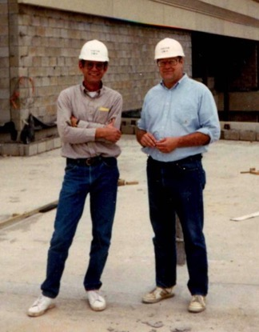
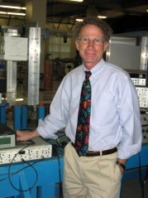
Hank Bass, Rich Raspet, and James Sabatier as Mentors and Colleagues
THANK YOU!!
“Concentrate on the physics …”
“Do a good job communicating your ideas …”
“Listen to others with keen interest …”
“Build collaborations and connections …”
“Aggressively go after money to fund research …”
“Pick those things you need to be best at and go for it ...”
“Smile, laugh, be yourself!! Enjoy life, learn from others!! Be comfortable in your skin, it is contagious, and it draws people to you …”

Slide 24
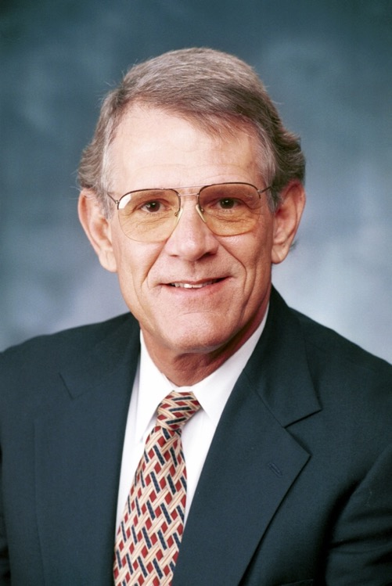
Thanks Hank for sharing your skills and life with us!
We miss you, remember you, and carry on with your life-lessons in mind.

Slide 25
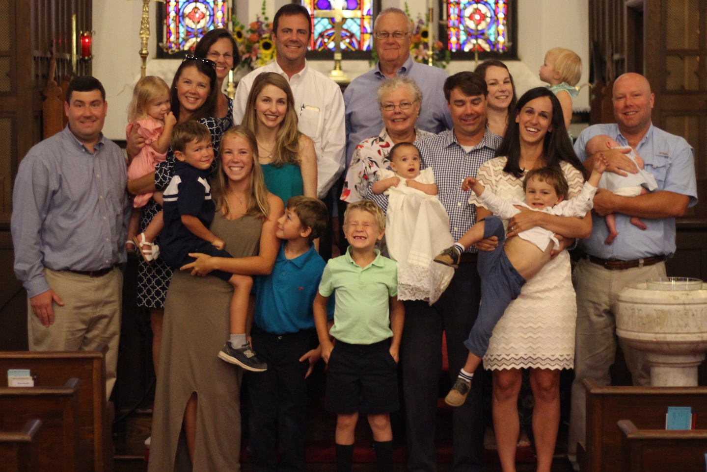
Jim Sabatier, Family Man

Slide 26
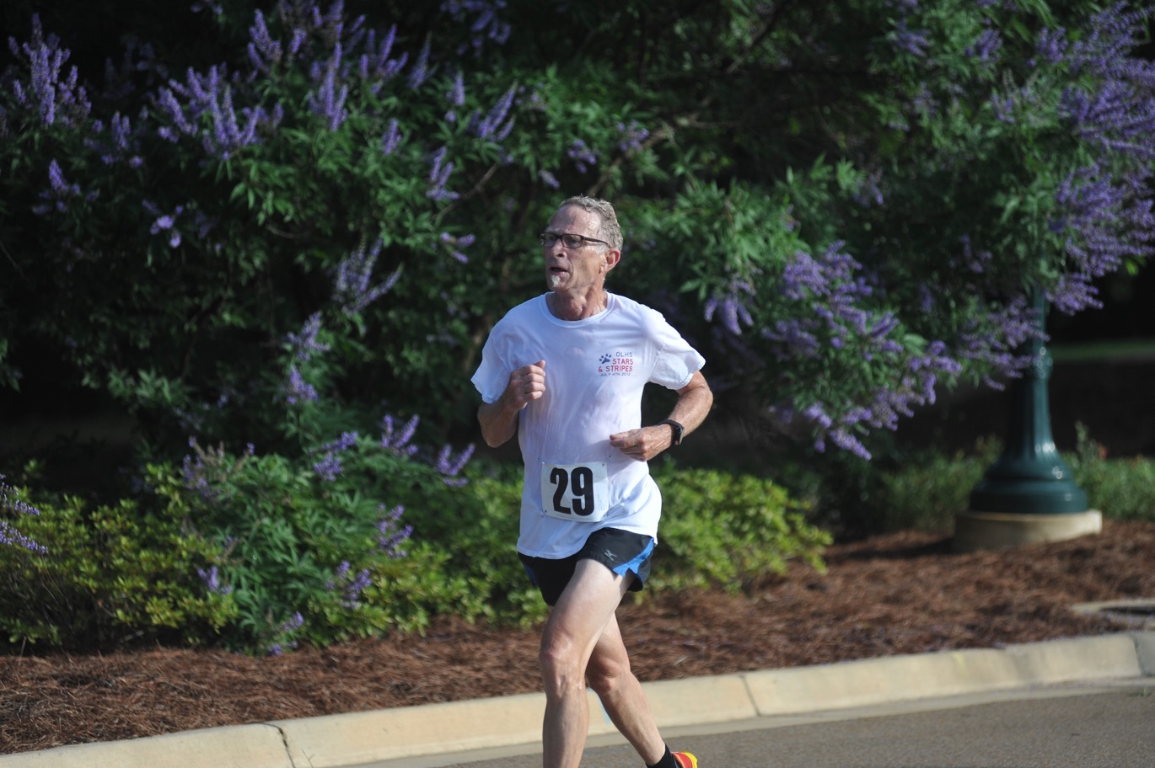
Rich Raspet: Intensity in Research, Academics, and Athletics!

Slide 27
Influence of Postdoc on my Later Life

Slide 28
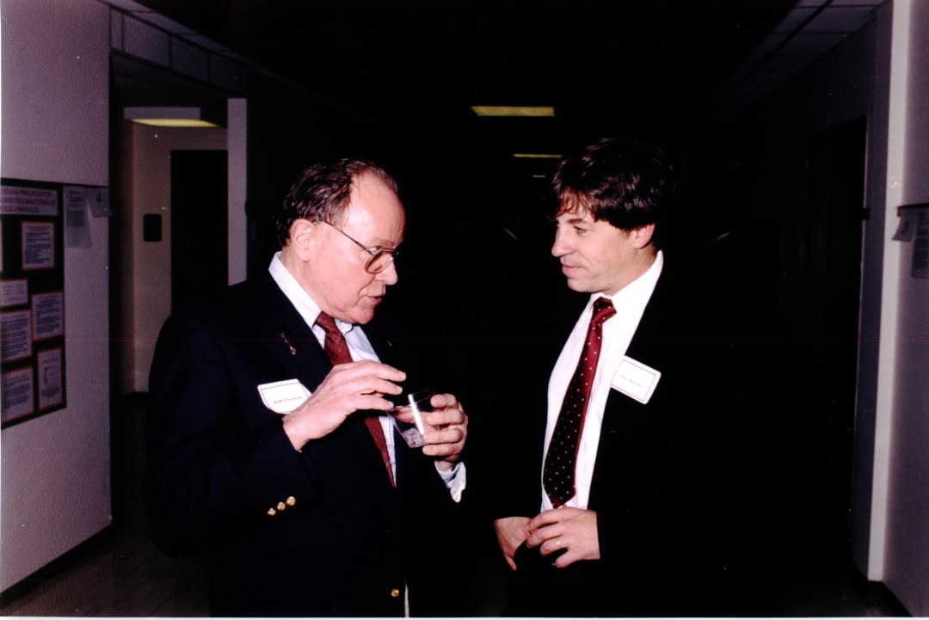
1992: Bill Pierson, Director of the Energy and Environmental Engineering Center at the Desert Research Institute, Reno NV
Pierson
Arnott
Former Ford Motor Company researcher: Had worked with trailer size photoacoustic instruments.
Strongly advocated for development of practical photoacoustic instruments.
Mentored our EPA Exploratory Proposal submitted (and funded) by Arnott (PI), Moosmüller,
and Rogers, 1993-1997.

Slide 29
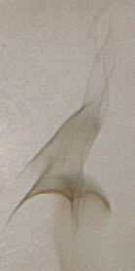
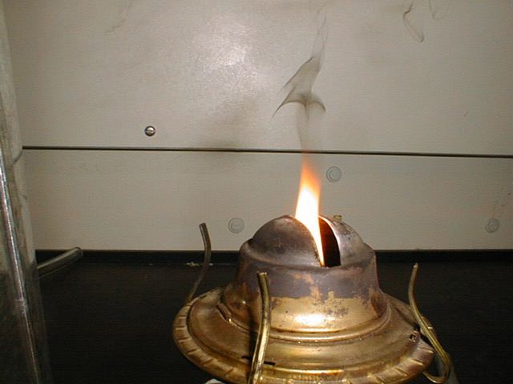
FIRE!! The Primary Source of Soot in General is Incomplete Combustion
Need to find an acoustic solution for measuring air pollution

Slide 30

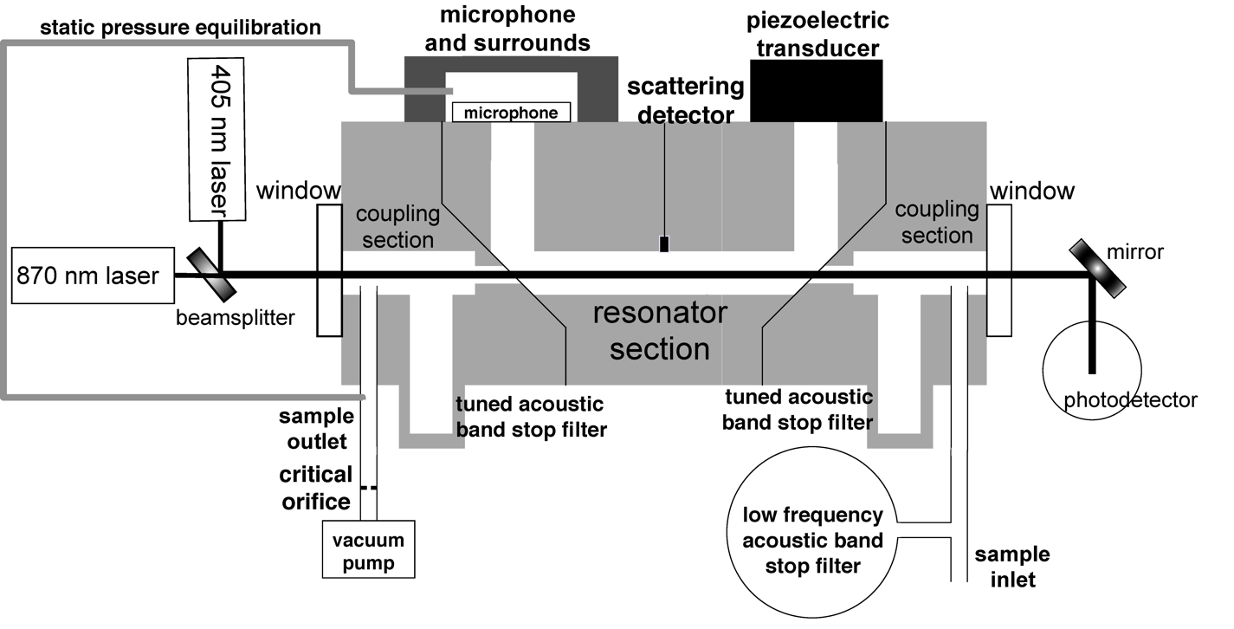
Aerosol Optics Instrument
355 nm
405 nm,870 nm
532 nm
671 nm, 676 nm
1047 nm
Aerosol Absorption and
Scattering Coefficients
f₀
f₀ + df
Notes:
30

Slide 31
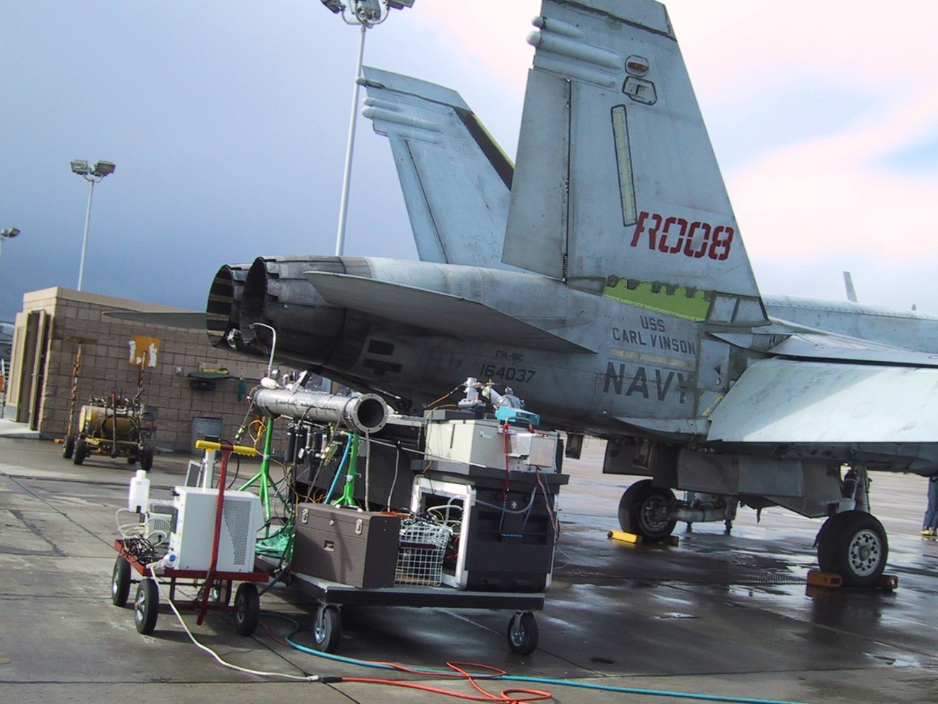
Jet Exhaust: SERDP 2002, North Island CA
Rogers, F., W. P. Arnott, B. Zielinska, J. Sagebiel, K. E. Kelly, D. Wagner, J. S. Lighty, and A. F. Sarofim, (2005). Real-time measurements of jet aircract engine exhaust. Journal of Air and Waste Management 55, 583-593.

Slide 32
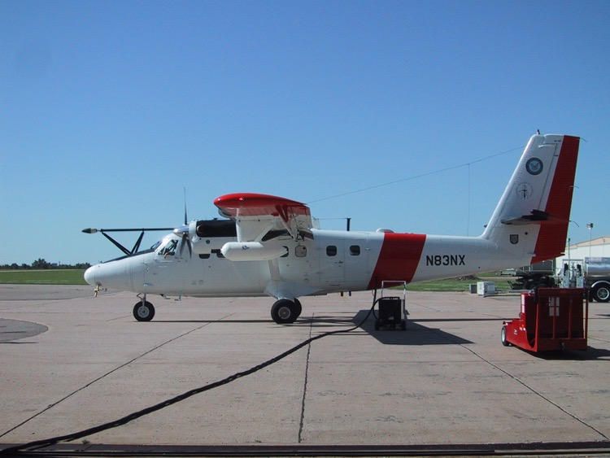
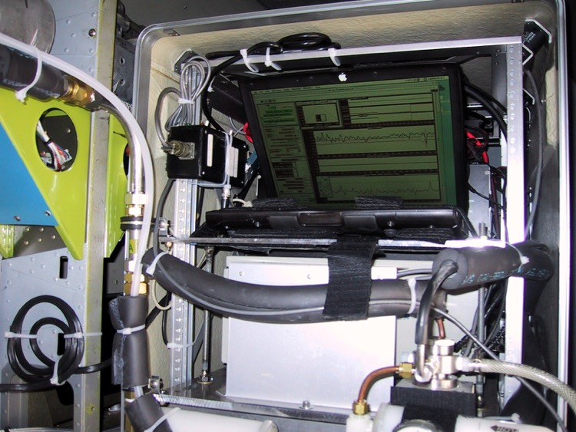
Photoacoustic Measurements from the Twin Otter

Slide 33
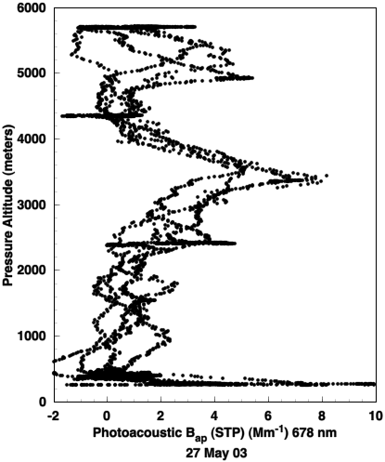
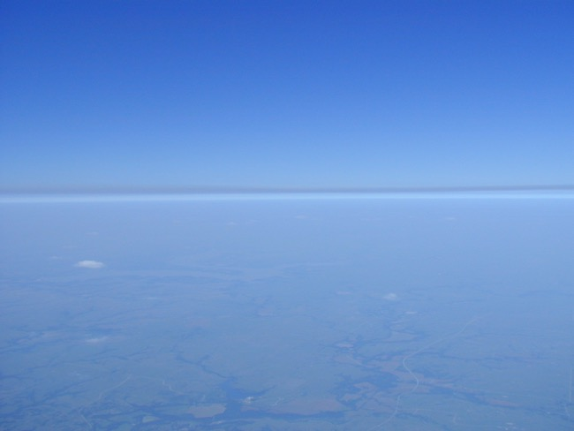
Vertical Profile 27 May 2003: Pancaked Layers of Russian Forest Fire Smoke
PHOTOACOUSTIC LIGHT ABS.
Significant layers of light absorbing aerosol near 650 mb and 550 mb, with a clean layer in between at 600 mb.
Arnott, W. P., J. W. Walker, H. Moosmüller, R. A. Elleman, H. H. Jonsson, G. Buzorius, W. C. Conant, R. C. Flagan, and J. H. Seinfeld, (2006). Photoacoustic insight for aerosol light absorption aloft from meteorological aircraft and comparison with particle soot absorption photometer measurements: DOE Southern Great Plains climate research facility and coastal stratocumulus imposed perturbation experiments. Journal of Geophysical Research 111, D05S02, doi:10.1029/2005JD005964.

Slide 34
Lonely Western Desert Serenade for the NCPA Anniversary
Sung to ‘you are my sunshine’
You are acoustics
The sound and science
You make me happy
When lights are out
You’ll never know dear
How much I love you
Please don’t take my funding away ...

Slide 35
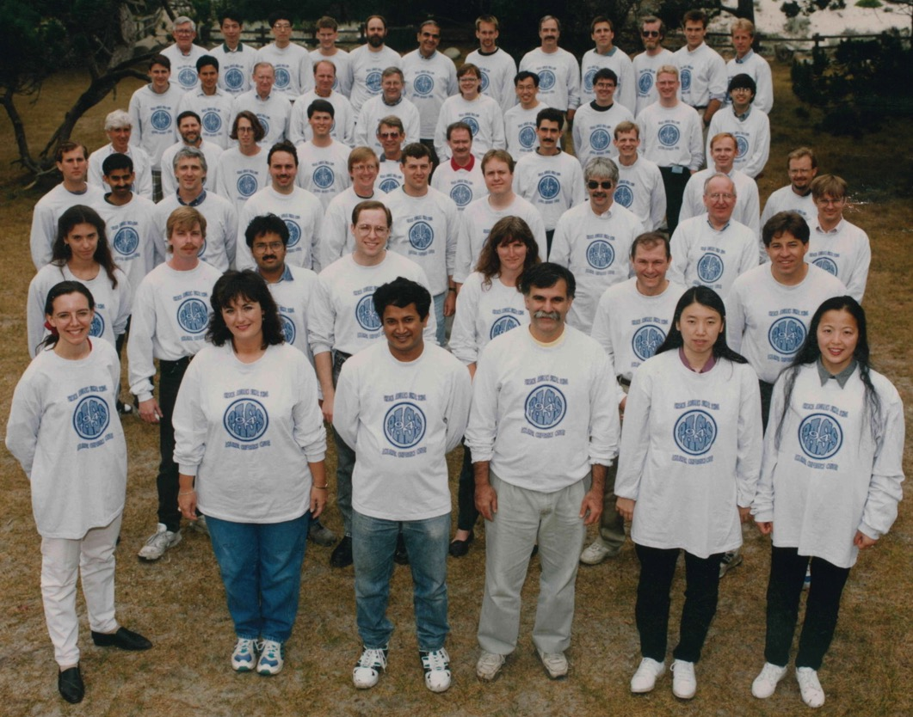
Thanks for your attention!
Physical Acoustics Summer School 1994

