Slide 1
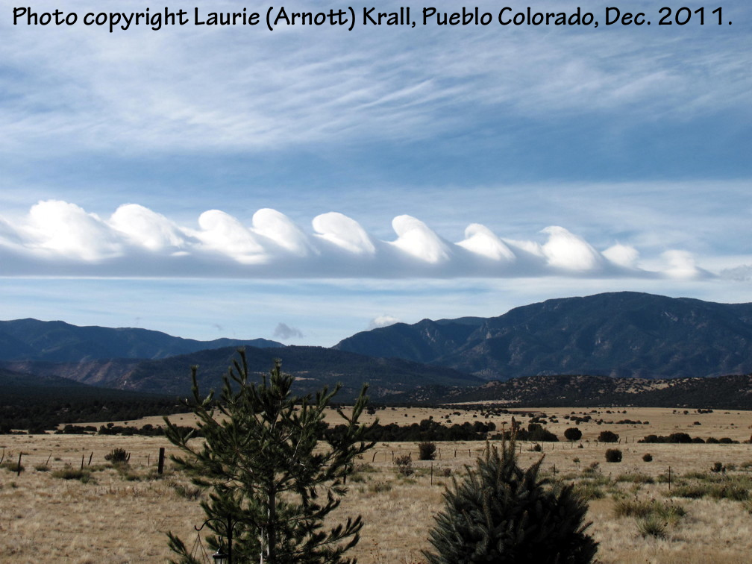
Atmospheric Science: Brief Personal Trajectory and Jobs
By W. Patrick Arnott
Atmospheric Science Program
Department of Physics
University of Nevada Reno
Desert Research Institute, Reno

Slide 2
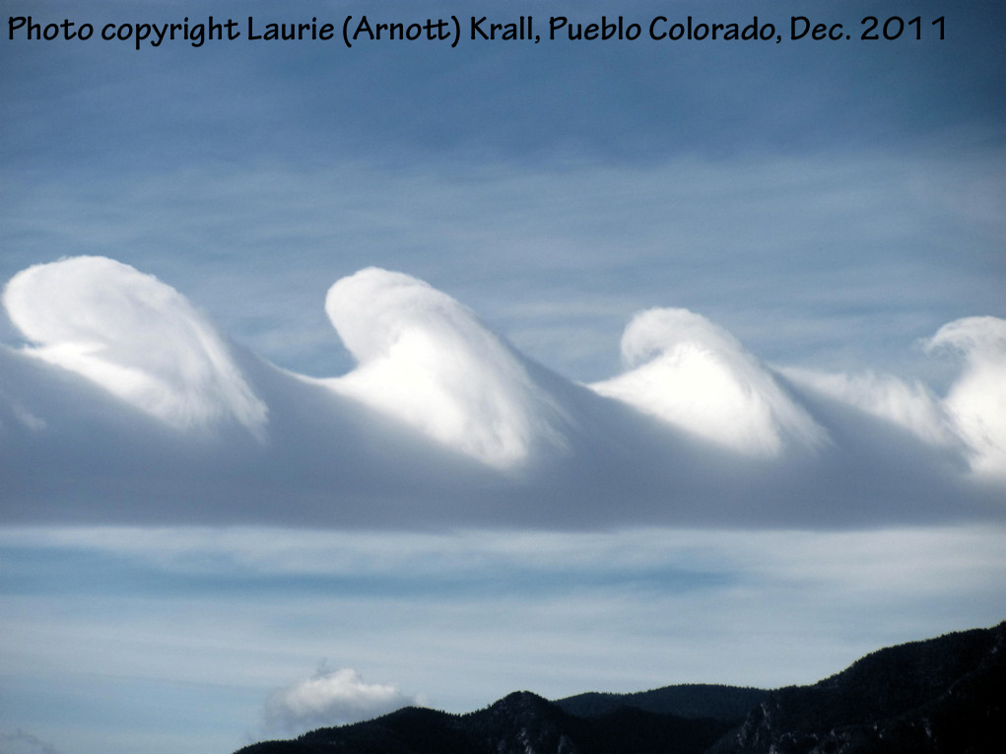
Atmospheric Science: Brief Personal Trajectory and Jobs
By W. Patrick Arnott
Atmospheric Science Program
Department of Physics
University of Nevada Reno
Desert Research Institute, Reno

Slide 3
Grew up in Pueblo Colorado
Two things ….

Slide 4
1. Fantastic high school teacher in an otherwise ‘ok’ high school. Thank you Mr. Gonzalez!
3 year high school program in digital electronics; placed kids in industry right out of high school.
I aimed at EE as an undergrad,
But …. Was bitten by the Physics bug as an undergraduate at the University of Southern Colorado.

Slide 5
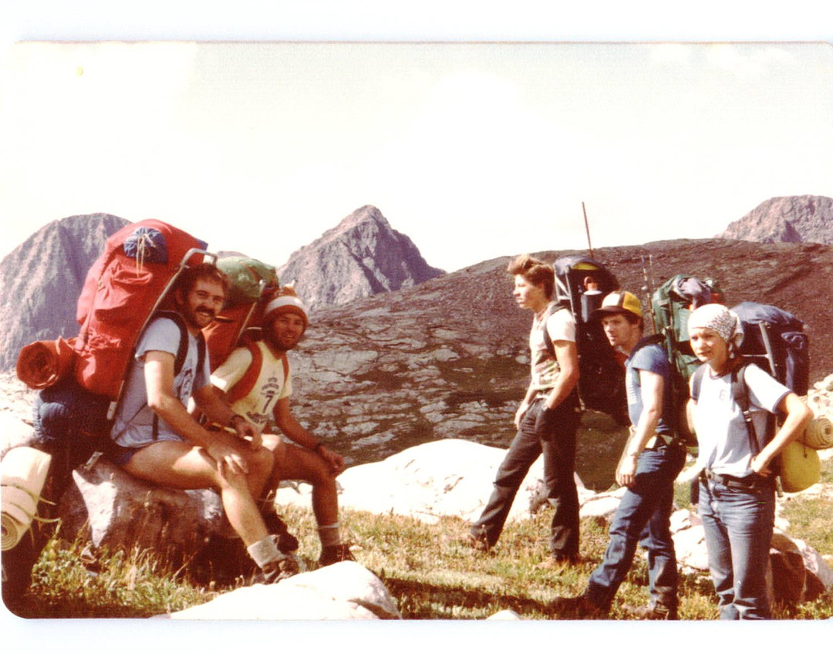
2. I’m a tree hugger; enjoy practical problems
Finding trees to hug in Nevada is a challenge … it’s like being above timberline

Slide 6
1984: Finally landed an internship after my senior year
Xerox PARC
Paoli, T.L., W.P. Arnott, William Streiffer and Robert D. Burnham, 1985: Optical model for radiation patterns of phase-locked diode laser arrays. Digest of Technical Papers, Conference on Lasers and Electro-Optics (CLEO), 21-24 May.
Fantastic opportunity ….
DON’T BE SHY, APPLY!!!

Slide 7


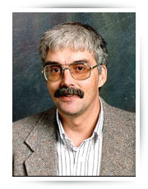
1984-1988 Phys Grad School, Washington State Univ. Geometrical aspects of backscattered wavefields
Thanks Professor and Advisor
Philip Marston

Slide 8
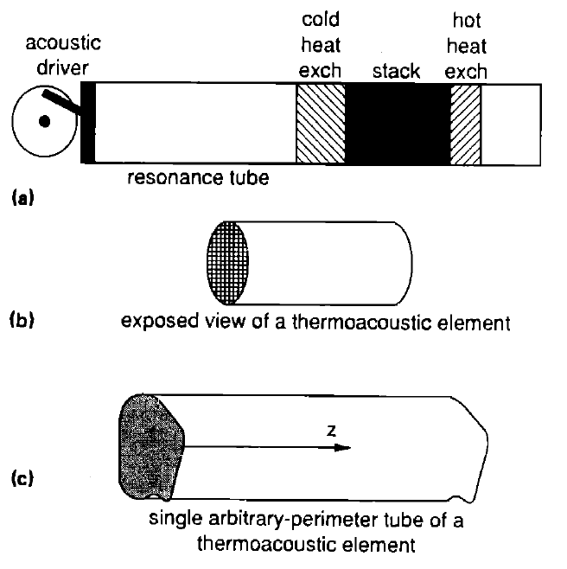
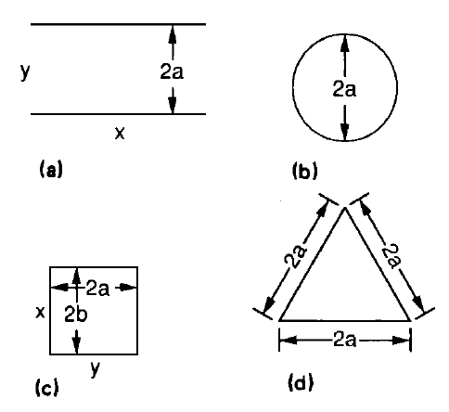
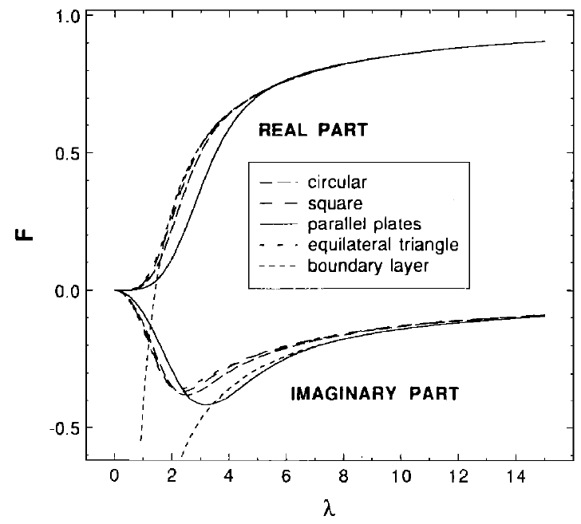
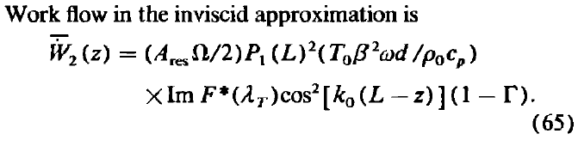
Postdoc National Center for Physical Acoustics, University of Mississippi: 1988-2001
Arnott, W.P. H.E. Bass and R. Raspet, 1991: General formulation of thermoacoustics for stacks having arbitrarily-shaped pore cross-sections. J. Acoust. Soc. Am., 90 , 3228-3237. (A key paper for me, and one that was particularly useful to others). Some of the ideas coming out of this time have been realized in a well-used software package for design of acoustic refrigerators and prime movers (sounds sources).

Slide 9
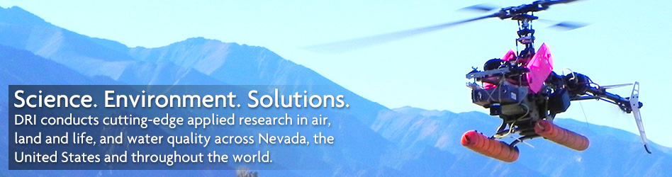
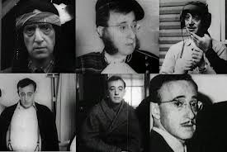
Desert Research Institute, Reno: Atmospheric Science Center 1992-2005 A ‘billed’ scientist for hire --- Grants and Contracts EPA, NSF, NASA, DOE, DSWA, ONR UNR Atmospheric Science Grad Program: UNR Physics Contract Instructor
Felt like Woody Allen’s Zelig character:
Took on the role of an Atmospheric Physicist in the NASA TOGA COARE project 6 months after starting at DRI
Formal Preparation: Read an Atmospheric Physics text book by Iribarne on a backpacking trip
Thanks Dr. John Hallett for mentoring my early years at DRI.

Slide 10
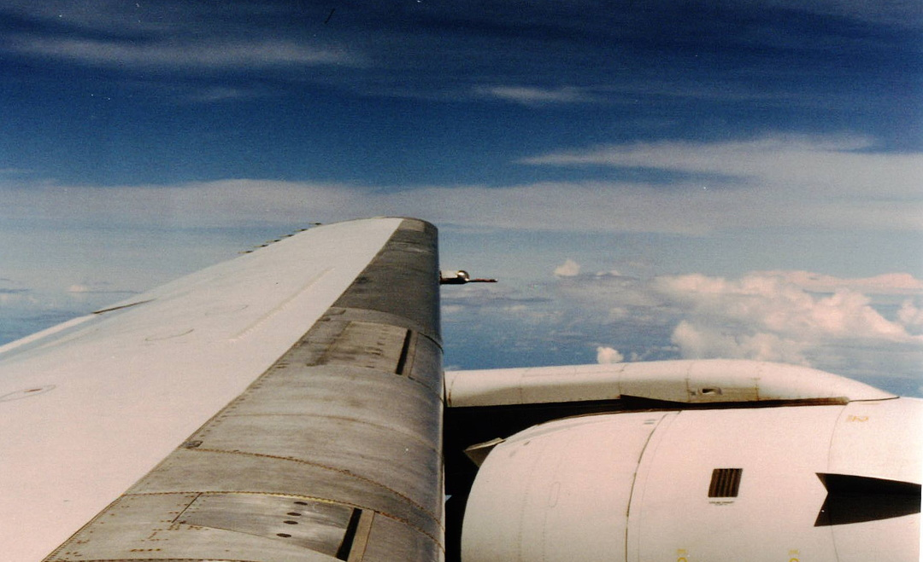
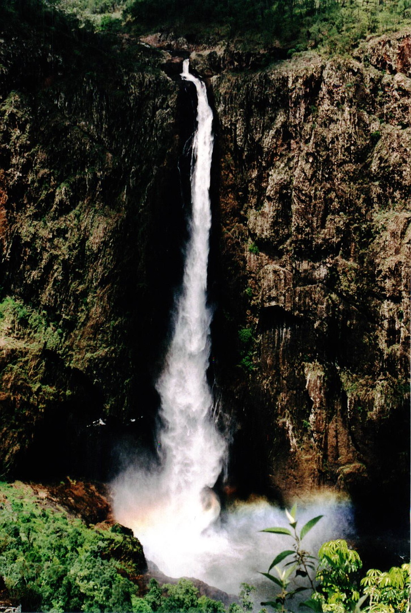
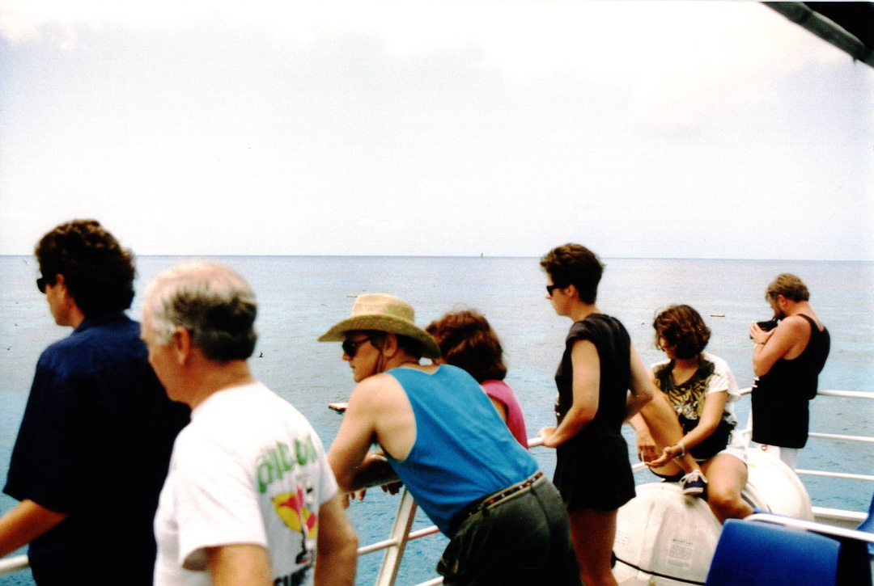
Tropical Ocean Global Atmosphere Coupled Ocean Atmosphere Response Experiment 1992-1993 NASA DC8 Out of Townsville Australia

Slide 11
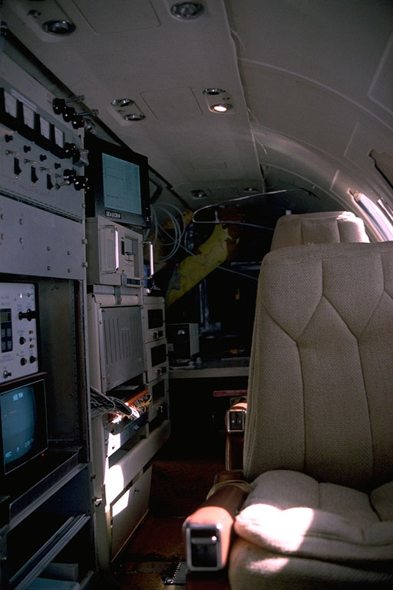
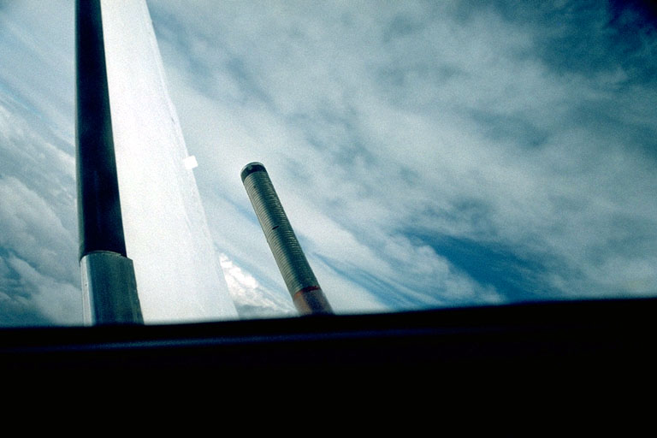
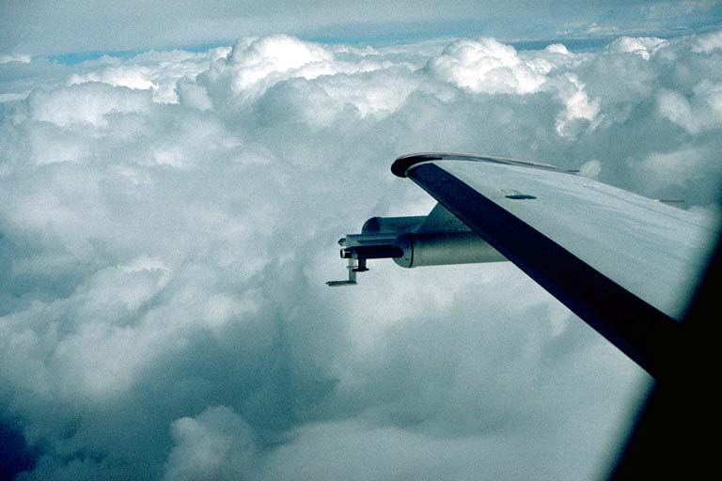
Sampling Cirrus Cloud Microphysics Using Meteorological Aircraft

Slide 12
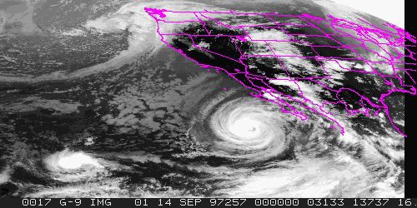
Hurricane Nora Cirrus Outflow: 1997

Slide 13
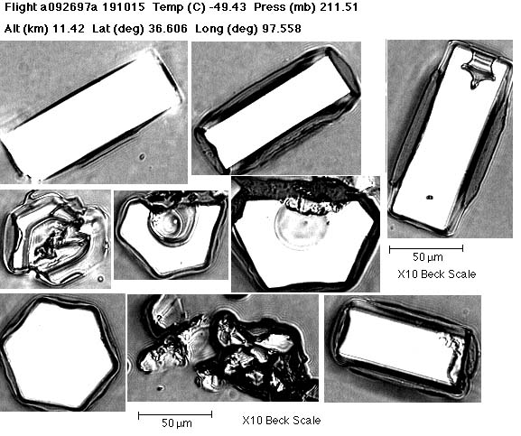
Ice Crystals Observed in Hurricane Nora Outflow, 1997: Diatom Nuclei?

Slide 14
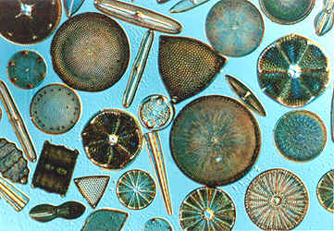
Diatoms: Ice Crystal Nuclei in Cirrus Clouds?? 20 to 200 microns
http://www.daviddarling.info/encyclopedia/D/diatom.html

Slide 15
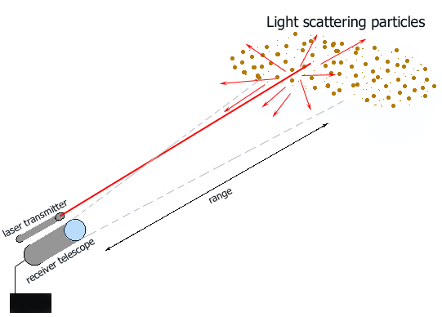
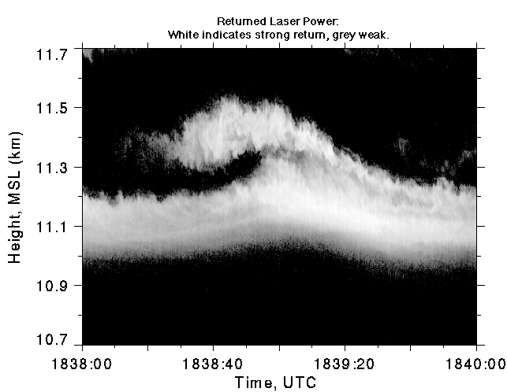
LIDAR (Laser light Detection and Ranging) for Hurricane Nora Outflow
Backscattered Power
by cirrus cloud with shear,
breaking like an ocean wave.

Slide 16
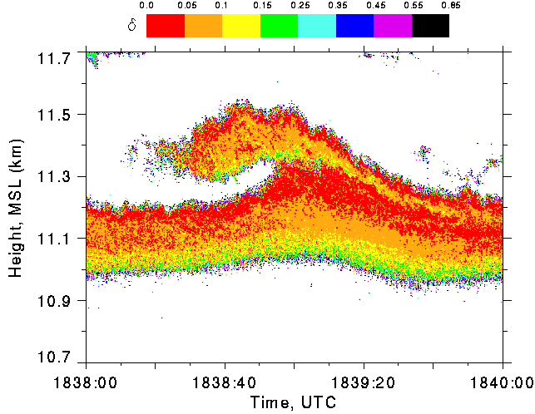
LIDAR (Laser light Detection and Ranging) for Hurricane Nora Outflow
Linear depolarization ratio:
cross polarized power /
copolarized power.
d small implies oriented pristine crystals.
d large implies randomly tumbling crystals or polycrystals.

Slide 17
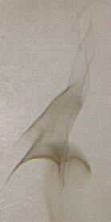
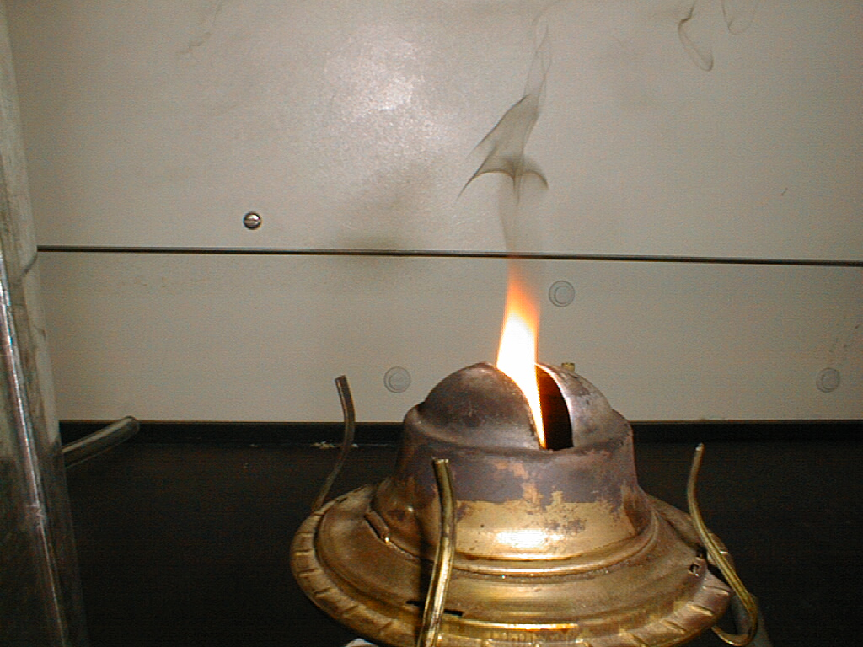
FIRE!! The Primary Source of Soot in General is Incomplete Combustion

Slide 18
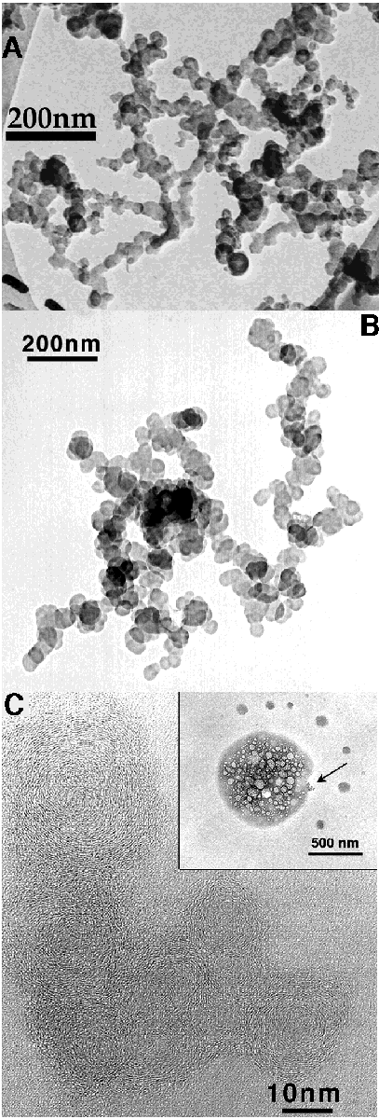
Soot: 10 - 50 nm monomers chained together to form larger aggregates. ‘Onion Shell’ structure of the monomers.
IMAGE CREDIT:
http://7starm.asu.edu/Buseck2000%20/figure_10.htm
TEM images of soot.
A, B. Chain-like soot aggregates. (A--Phoenix, after Katrinak et al., 1993; B--Sagres, Portugal, ACE-2).
C. High-resolution TEM image of the arrowed soot aggregate showing the onion-like structure of soot spheres. (Southern Ocean, ACE-1; after Pósfai et al, 1999).

Slide 19
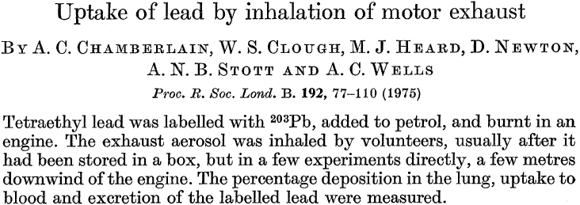
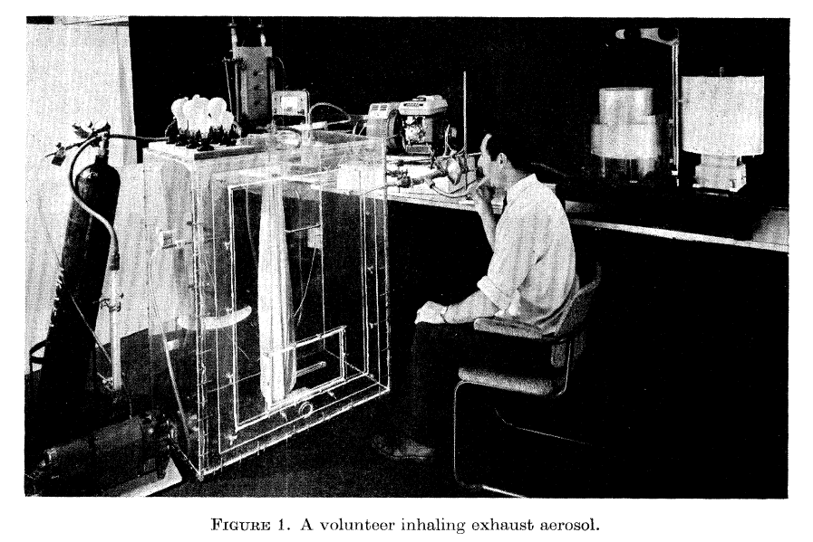
Lead Experiments on People!
Circa 1975!

Slide 20

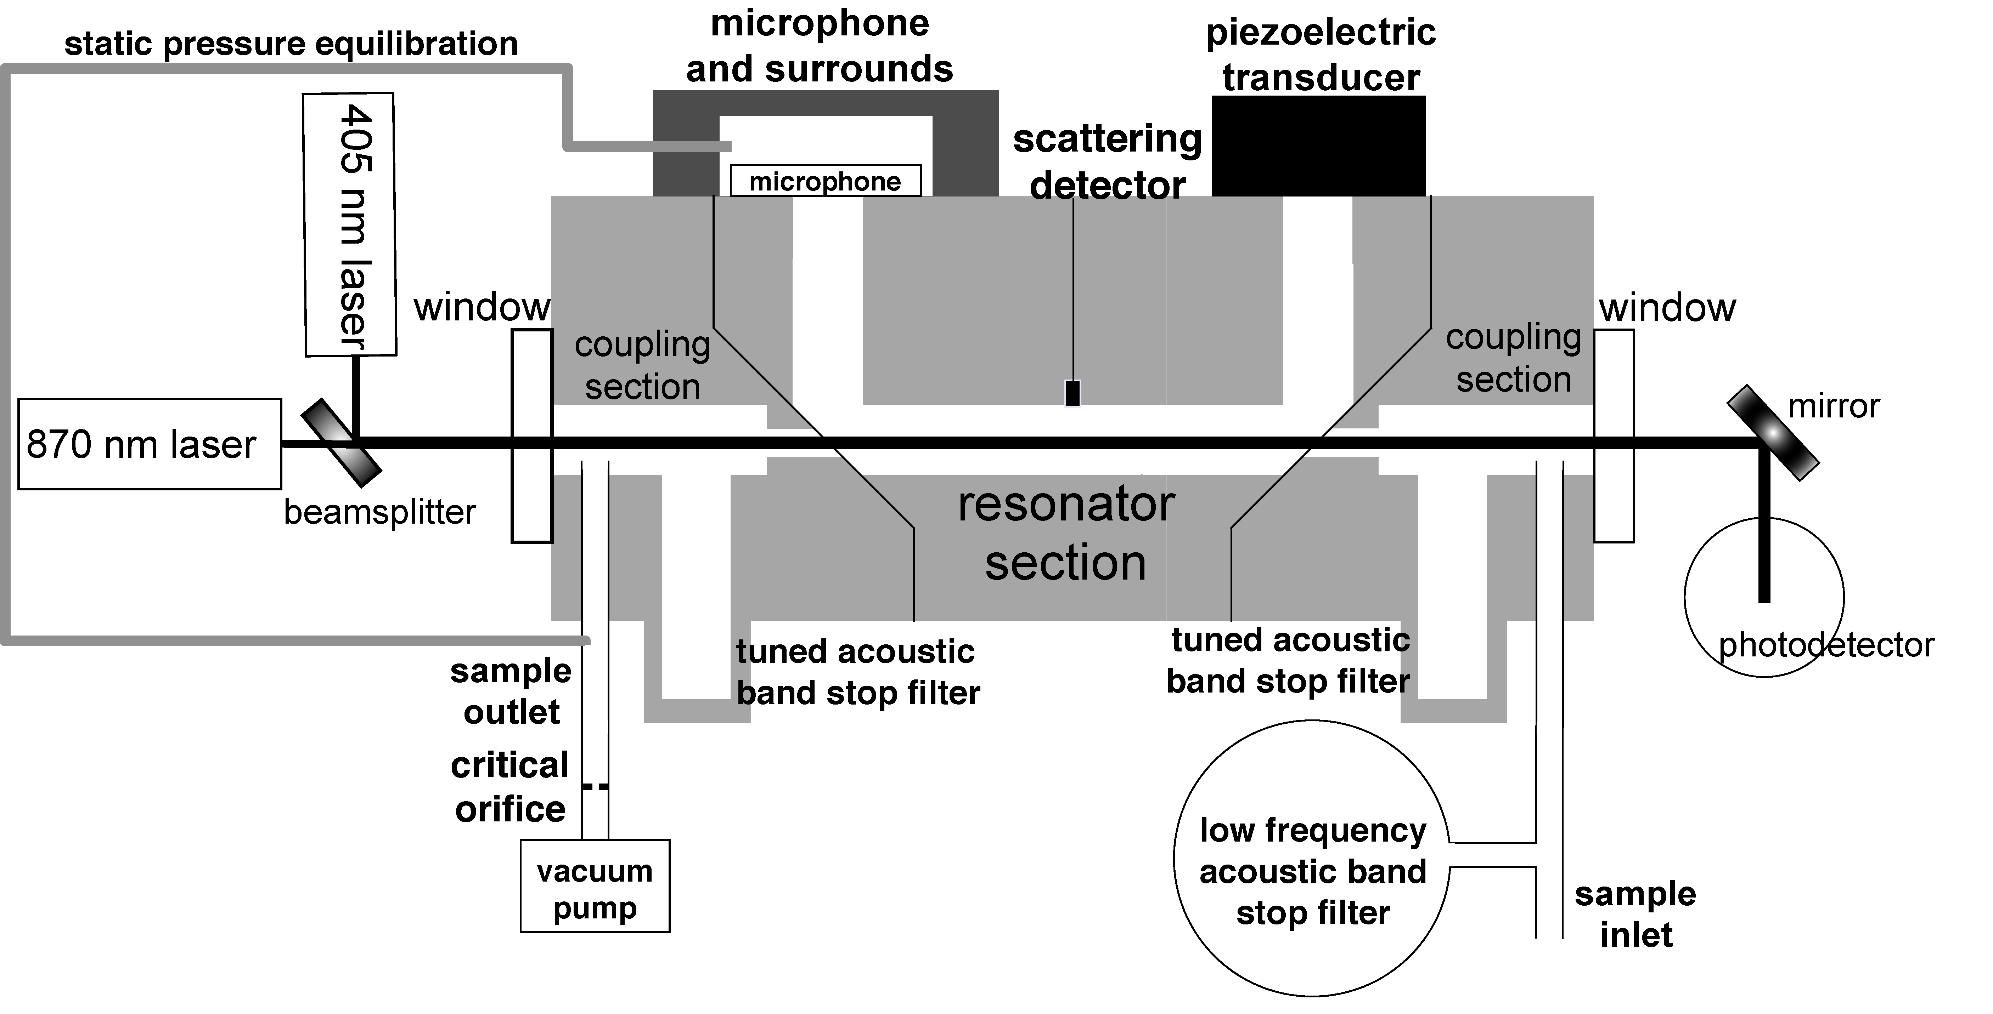
Aerosol Optics Instrument
355 nm
405 nm,870 nm
532 nm
671 nm, 676 nm
1047 nm
Aerosol Absorption and
Scattering Coefficients
f₀
f₀ + df
Notes:
20

Slide 21

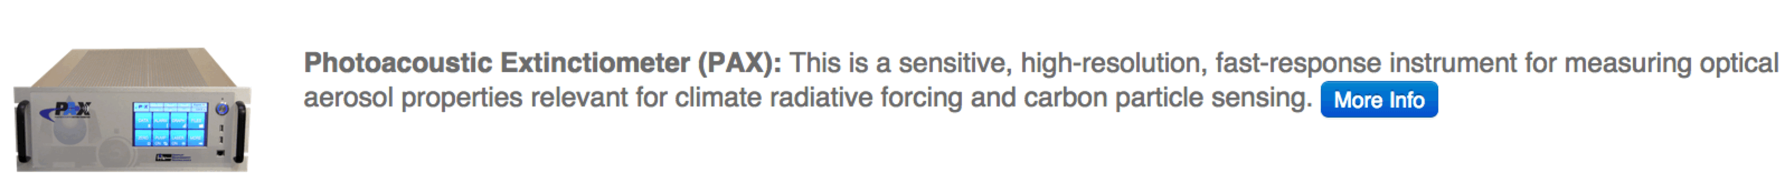
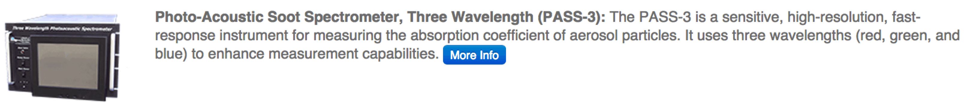
5 Patents and 2 ‘Commercialized’ Instruments: Royalties and Connections

Slide 22
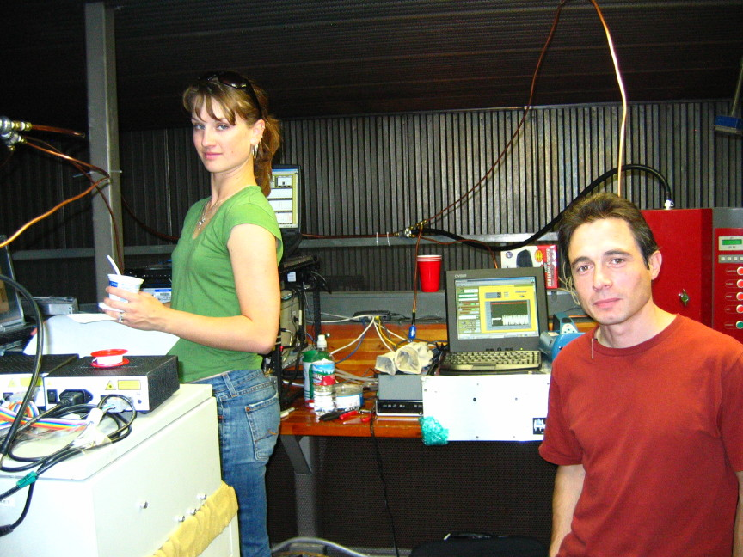
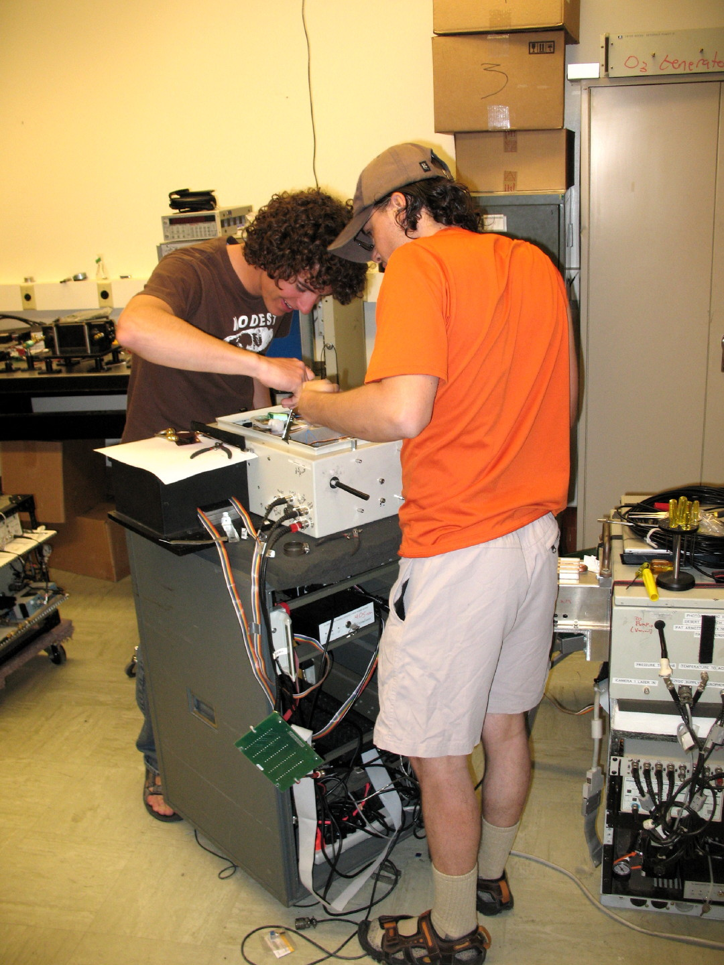
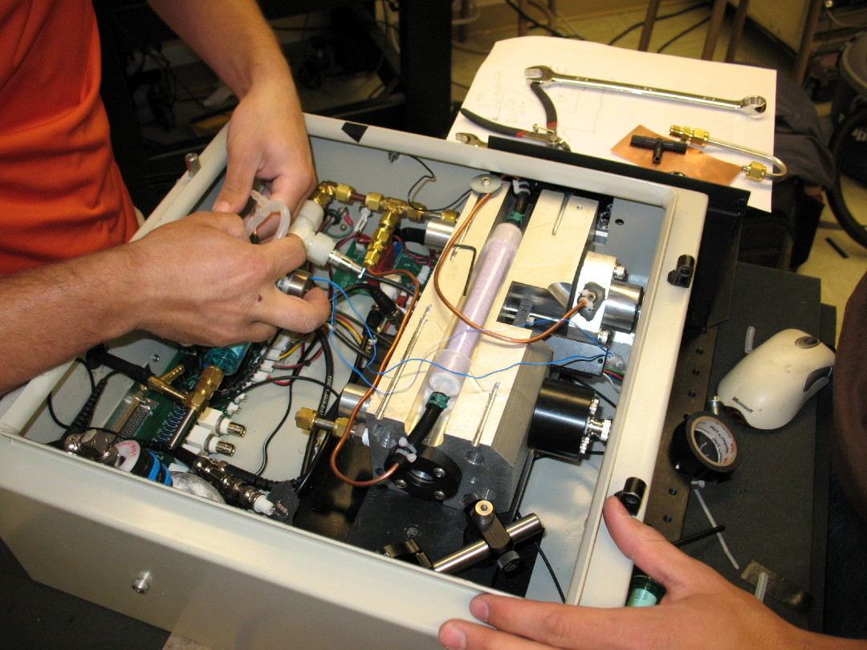
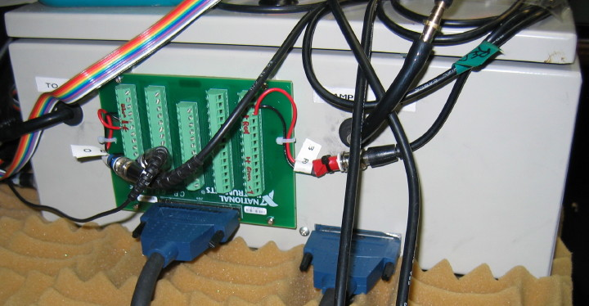
Images of the Dual Wavelength Instrument

Slide 23
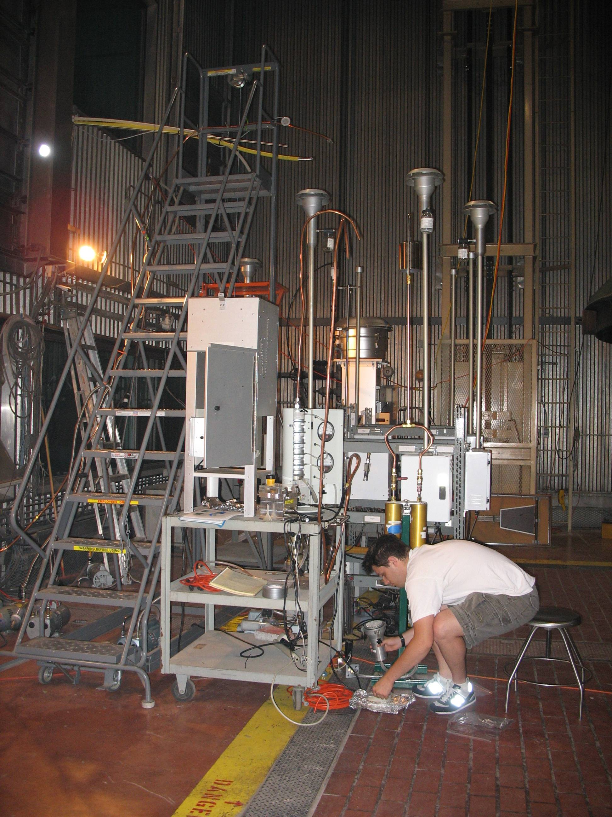
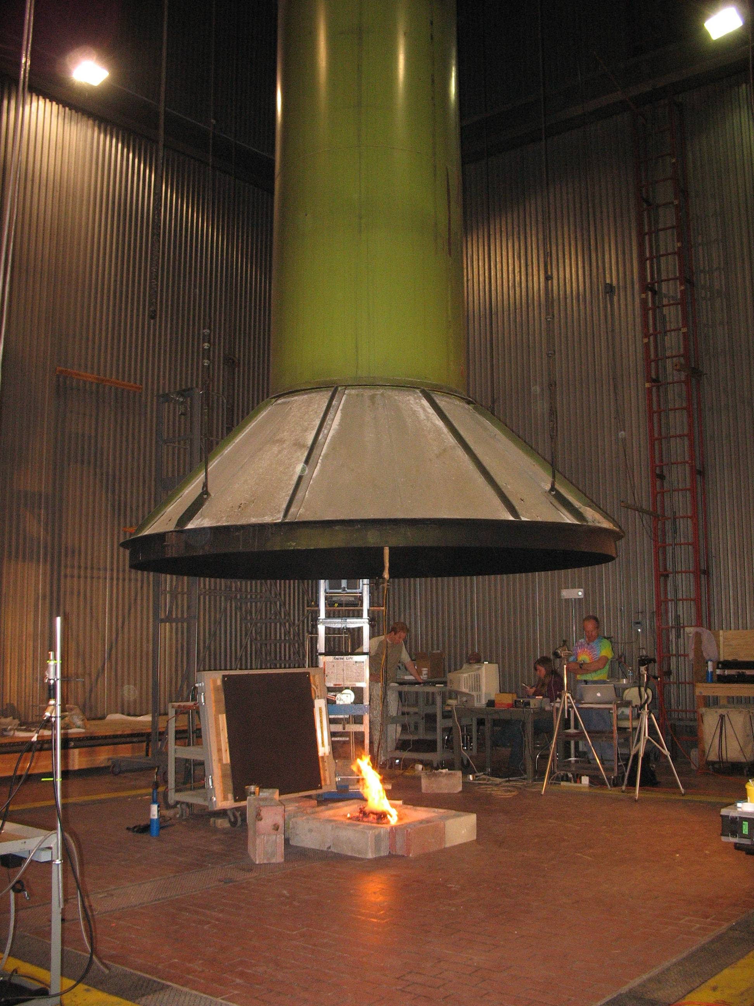
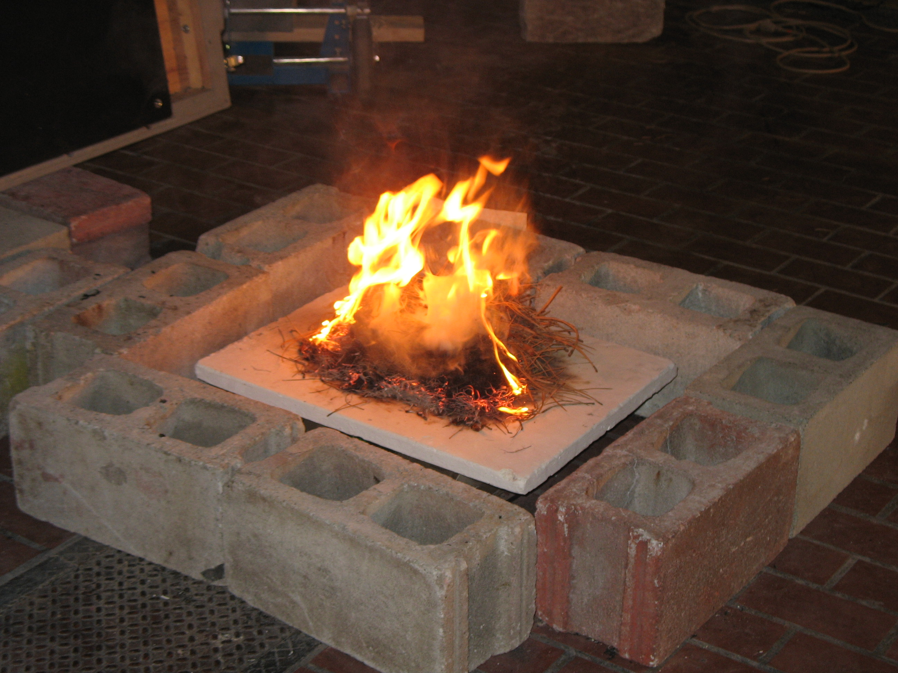
Fire Science Laboratory in Missoula Montana

Slide 24
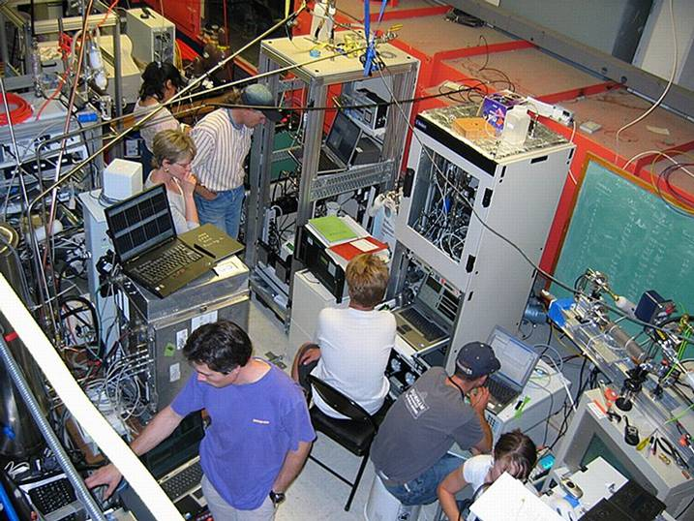
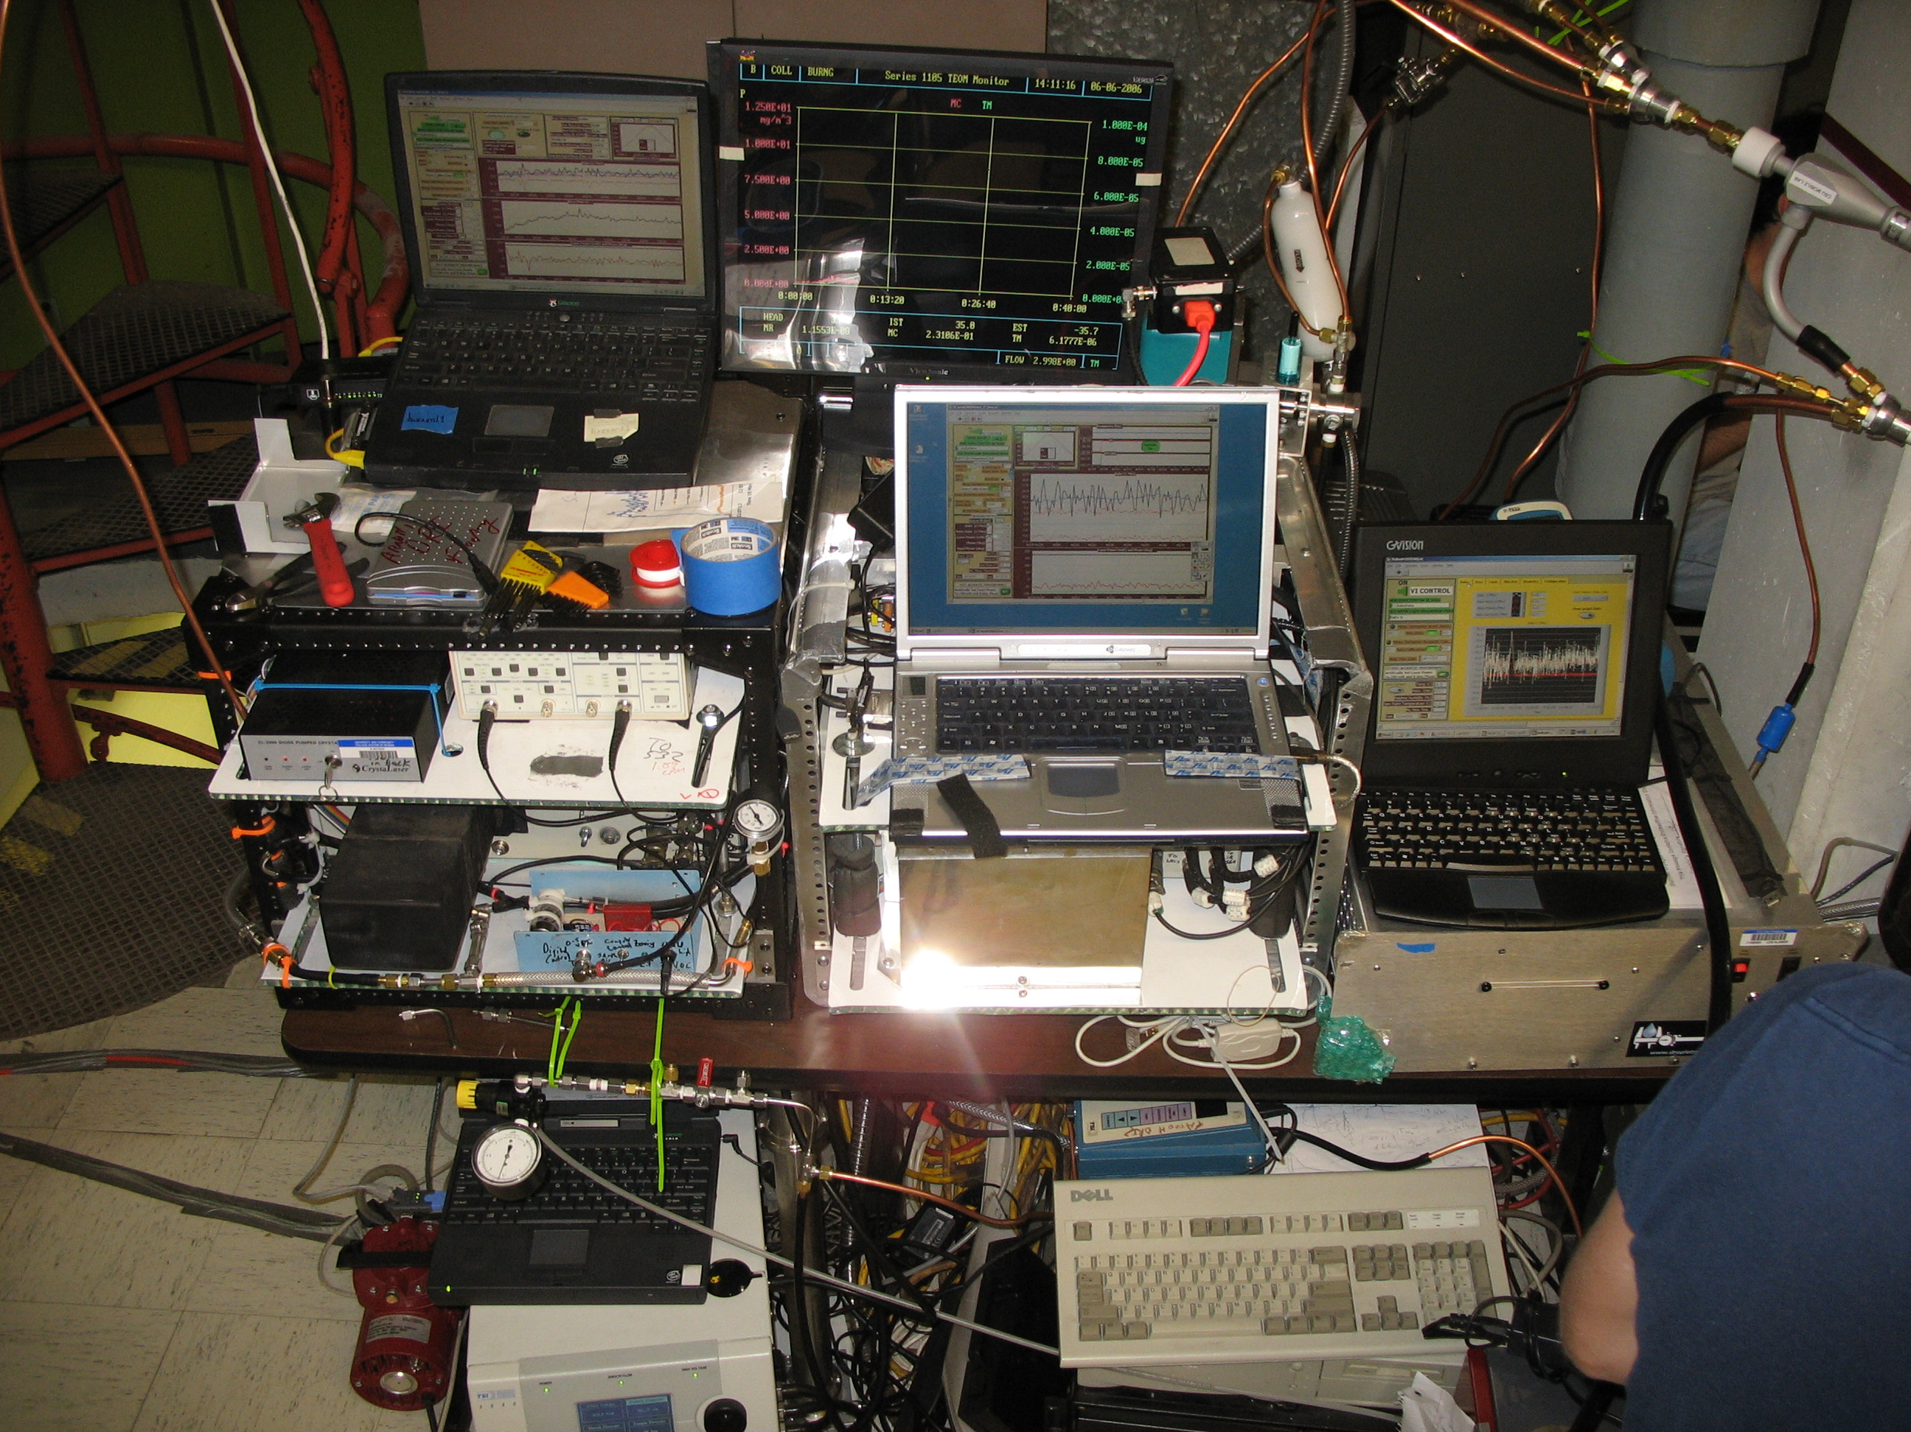
Fire Science Laboratory
Photoacoustic instruments
Instrumentation sampling wood smoke during FLAME Chamber burns

Slide 25
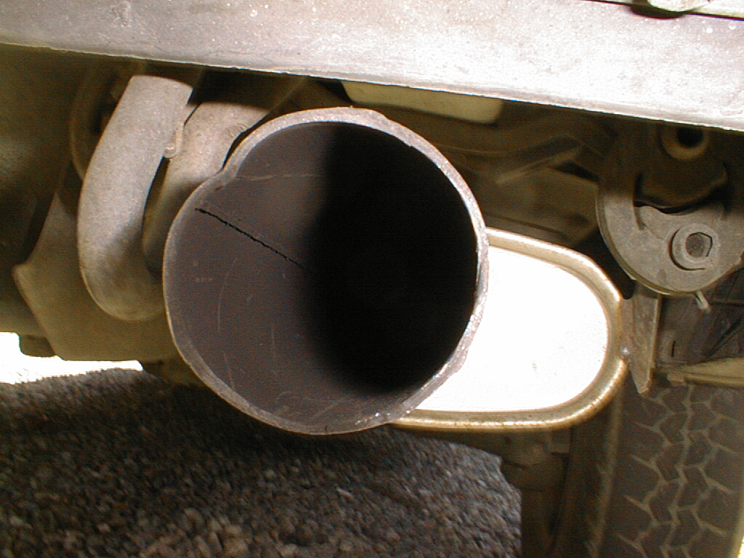
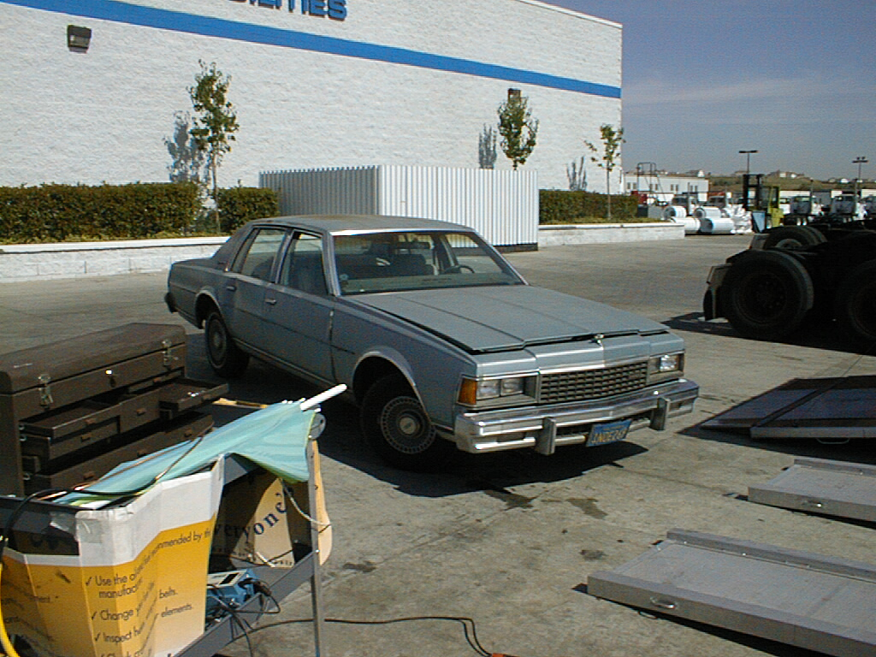
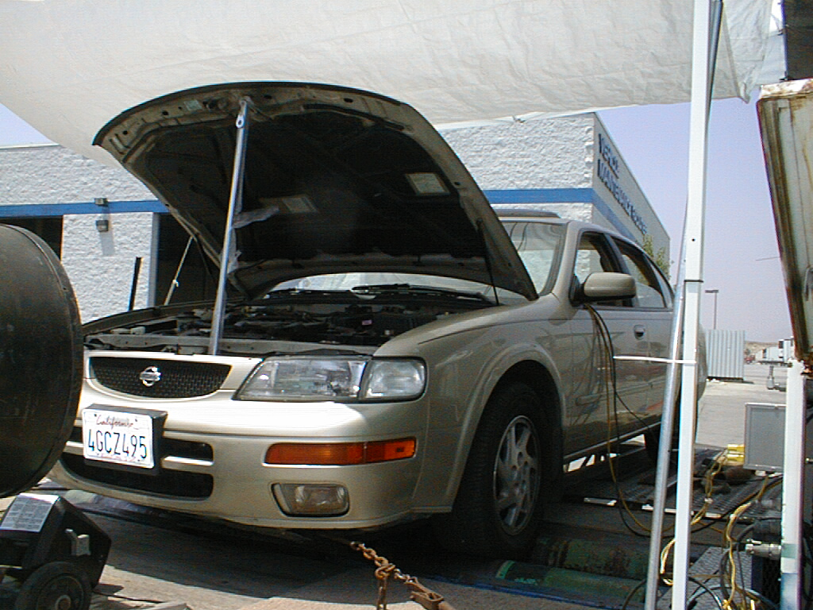
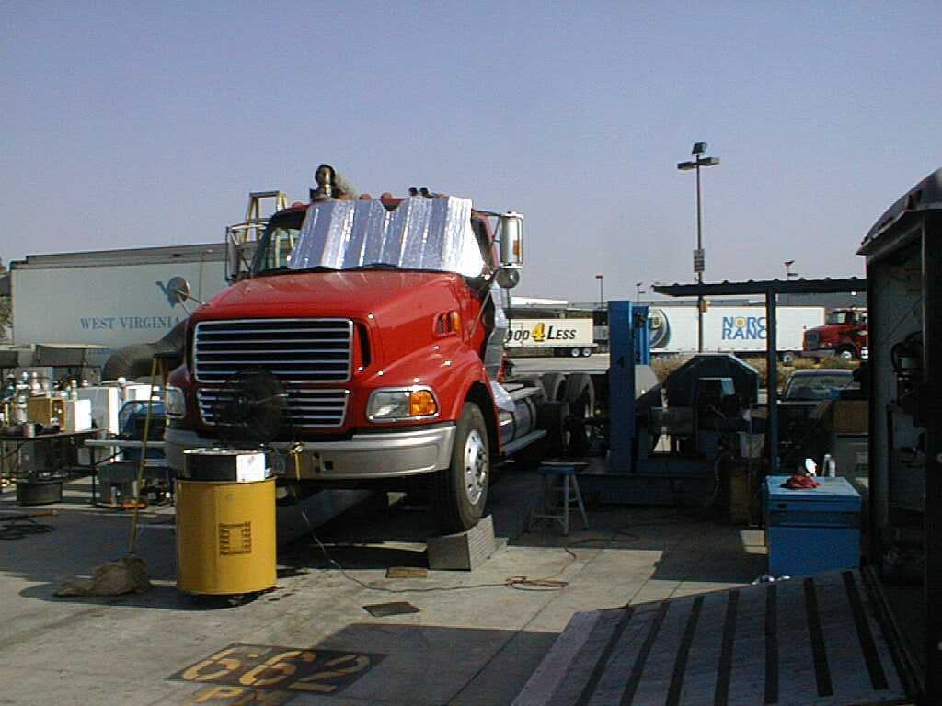
Dynamometer Vehicle Tests

Slide 26
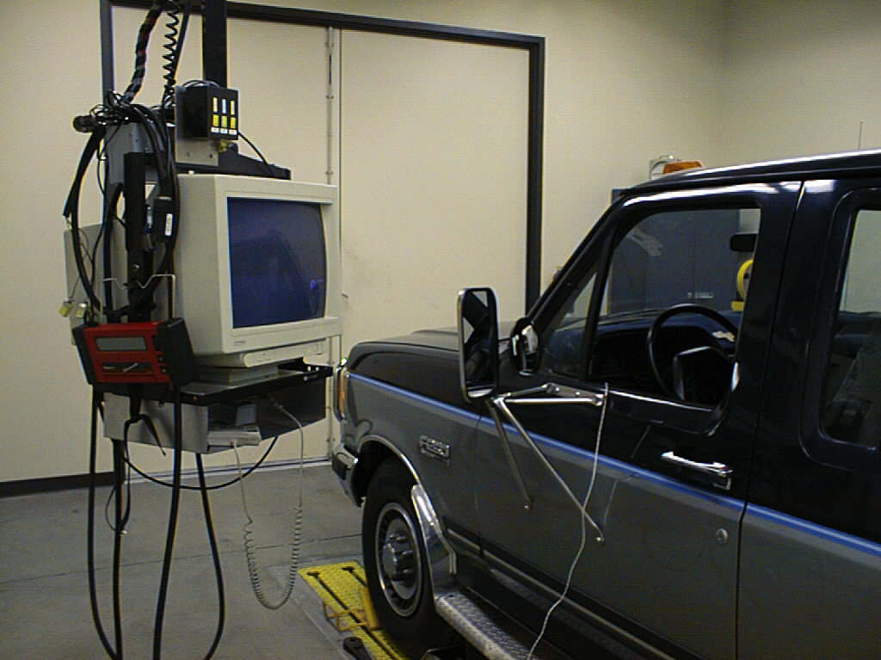
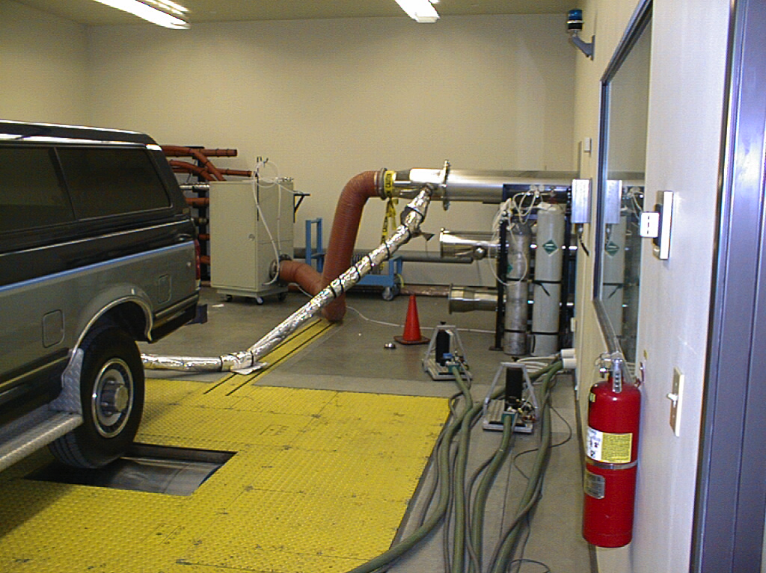
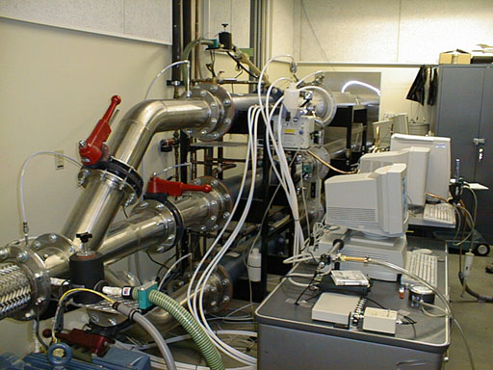
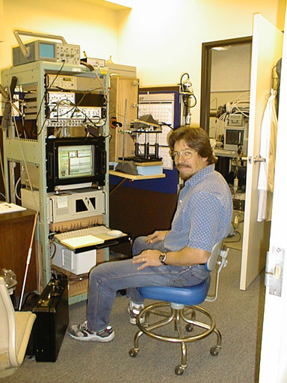
Dynamometer Test of Compression Ignition Vehicles at UC CE-CERT

Slide 27
BC During the Modified UC Test Photoacoustic Measurements

Slide 28
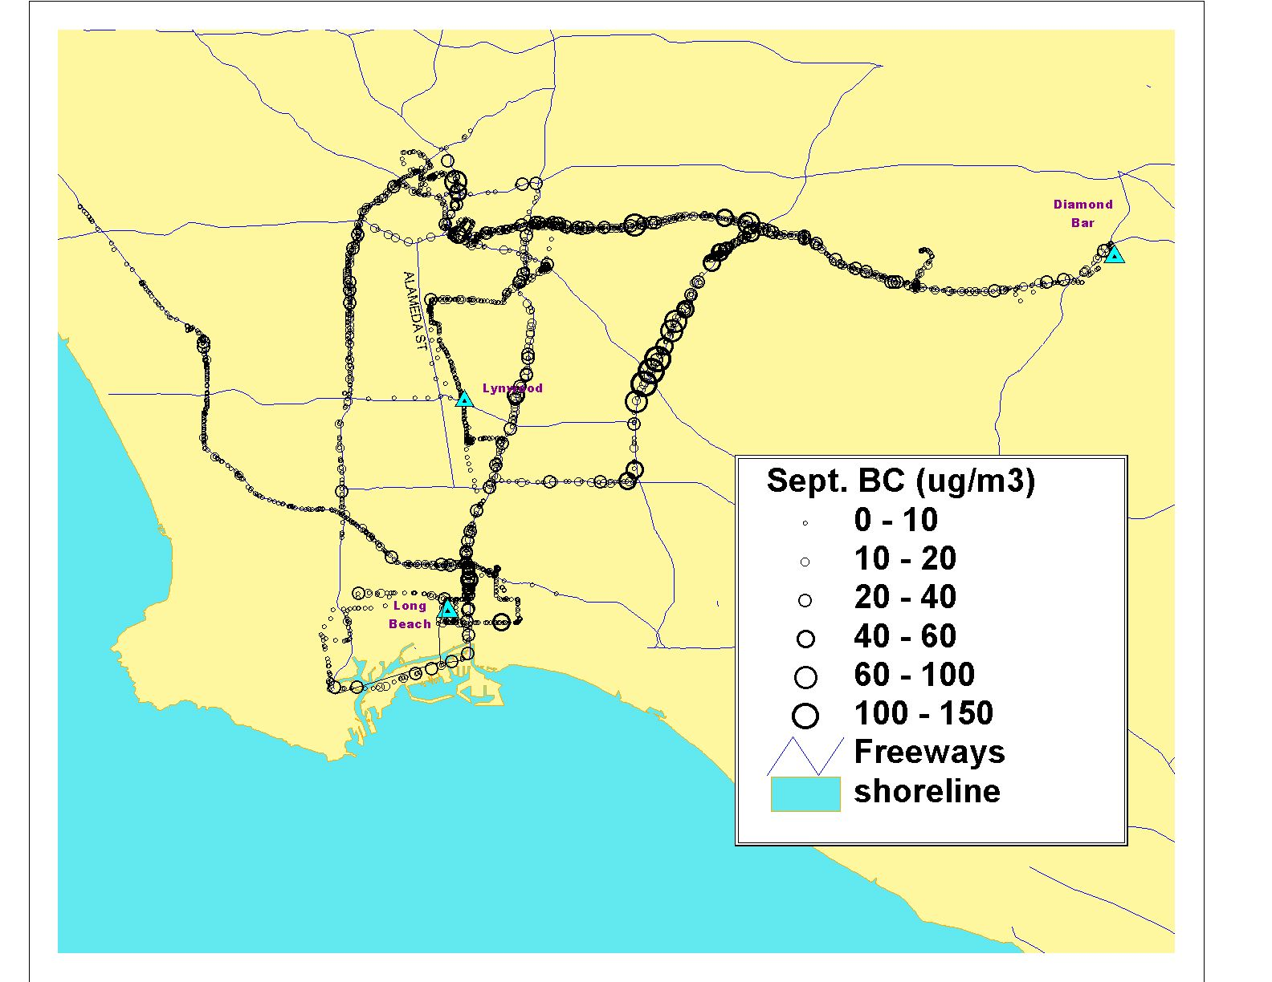
Photoacoustic Black Carbon Map of Los Angeles Freeways
Health Effects Institute Project RFA03-1

Slide 29
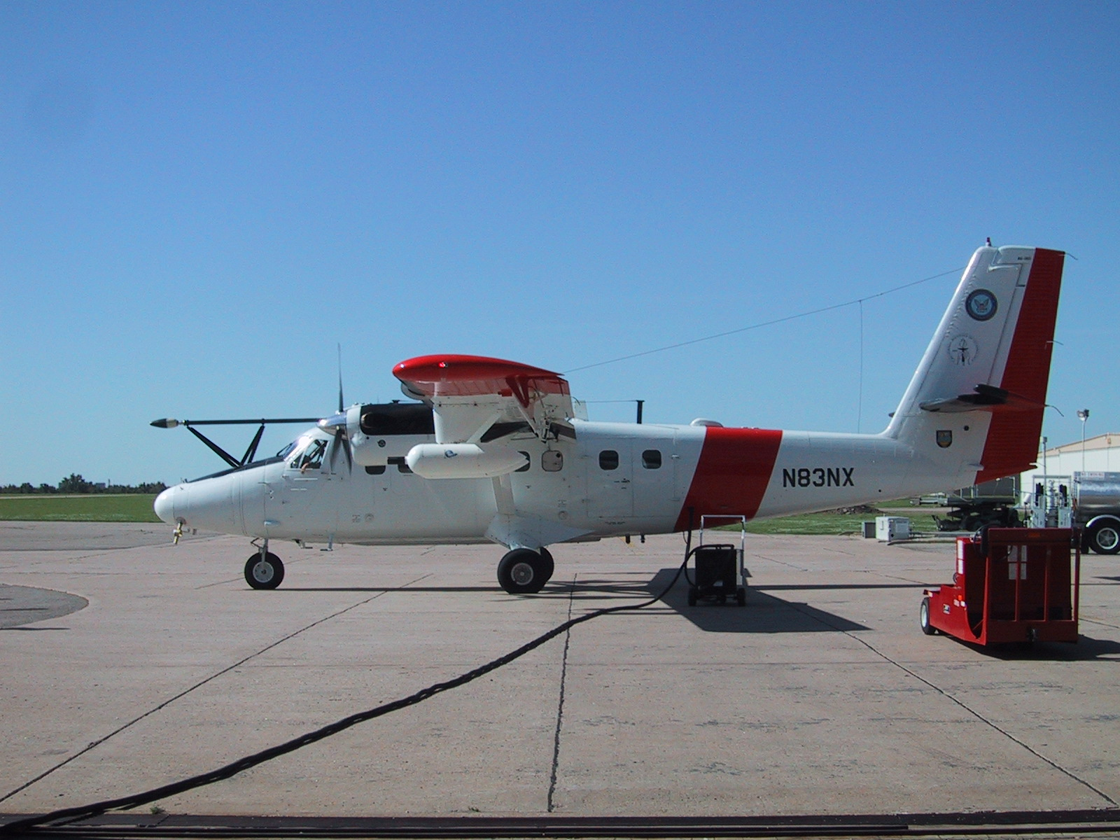
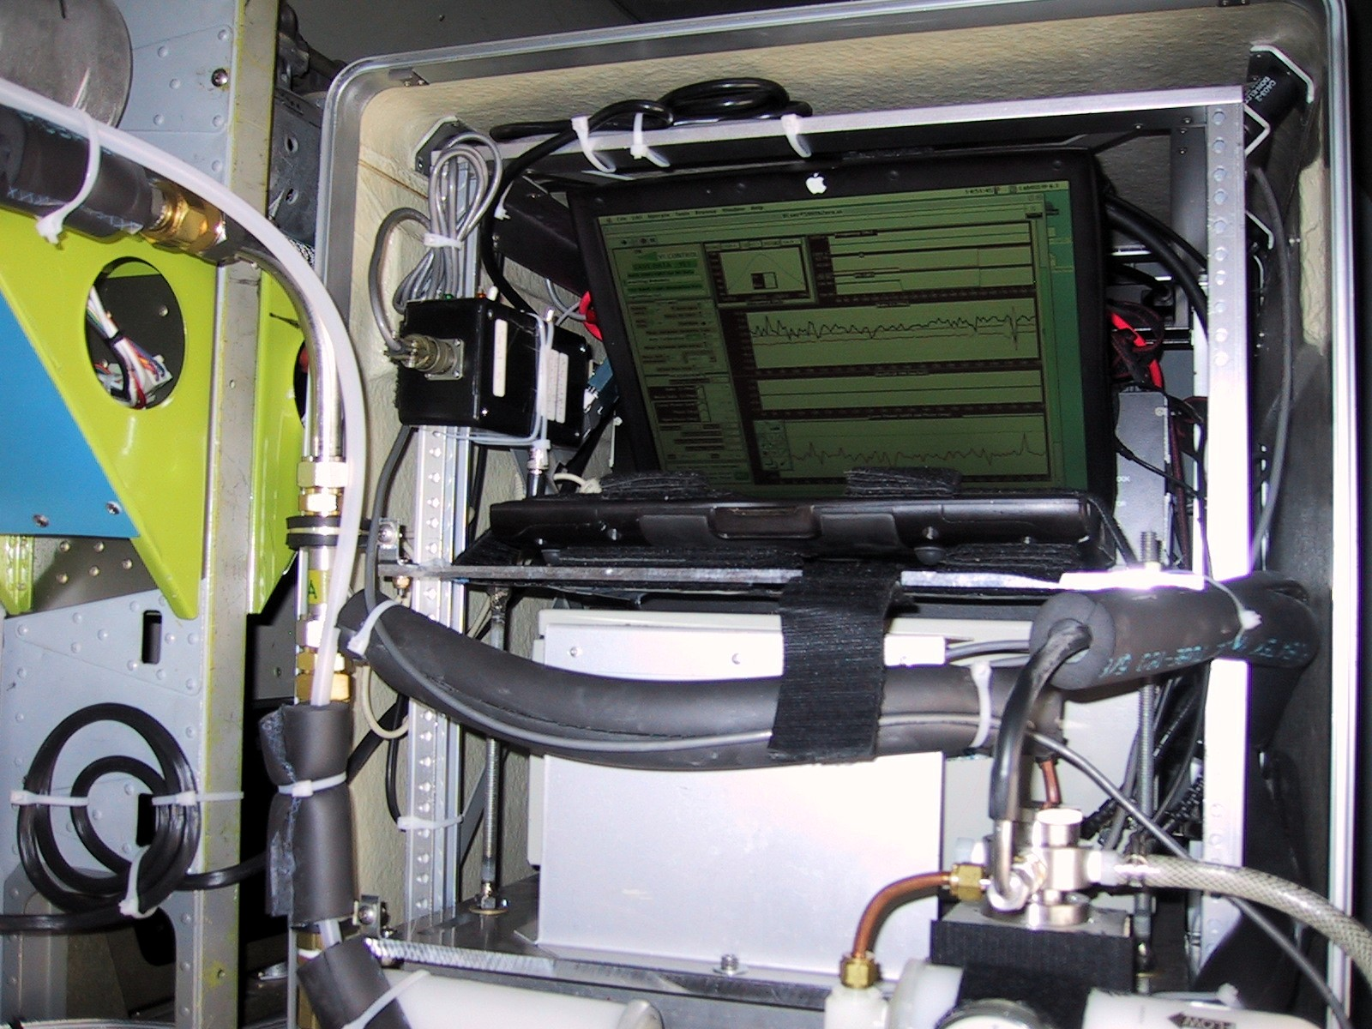
Photoacoustic Measurements from the Twin Otter

Slide 30


Vertical Profile 27 May 2003: Pancaked Layers of Russian Forest Fire Smoke
PHOTOACOUSTIC LIGHT ABS.
Significant layers of light absorbing aerosol near 650 mb and 550 mb, with a clean layer in between at 600 mb.

Slide 31

1,000 Fires, Northern CA, Summer 2008: Peak Smoke in Reno around local noon, July 10th.
Summer wild Fires
-Over 1,000
-Most sparked by lightning
-Dry and windy
-Covering 680 Sq miles of central and northern California
Source: NASA California Wild Fires 2008
31
Notes:
31

Slide 32


Example of a morning when the Mexico City Plume Goes South to Popocatepetl Volcano.
near forward scattering by particles θ_{sca} = 30 degrees
r << λ r ~ λ r >> λ
32
Notes:
32

Slide 33

Comparison of Aerosol Light Absorption in 2 Major Cities
Vegas:
Jan thru Feb
Mexico City:
March 10-30
Sunrise: 6:45 am
Sunset: 6:45 pm
33
Notes:
33

Slide 34

Aerosol Optics and Chemistry in Mexico City

Slide 35


Real Time Aerosol Chemistry and Optics
of the aerosol
mass and
scattering is
due to secondary
aerosol formation!!!

Slide 36




The Crew In Action…
We Went to a Gold Mine to Find Soot!!

Slide 37
Vehicle Used for the Tests
Photograph showing the haul truck in operation along with the air quality samplers. The photoacoustic EC instrument is housed in the vanilla colored box on the equipment rack and the Dustrak nephelometers are in blue. The filter samplers are up on the wall immediately to the right of the blue writing on the wall. The sample inlet for the photoacoustic instrument can be seen draped over the top of the laptop computer.

Slide 38
Banshee Drift: Site of the Measurements
Uphill
DD site
Key Points:
2 sites were used for the continuous measurements.
The grade is around 12%. The truck turned around and repeatedly drove between the endpoints of the drift.
The hauler truck was fully loaded in test 1, and was empty in test 2.
MLC site

Slide 39

Real Time Measurements of TC and EC: Vehicle Loaded, MLC Site

Slide 40





Slide 41


Number of Degrees Per Year
Gray - Engineering
Green - Biology
Blue - Chemistry
Yellow - Physics
Black - Geosciences
*Data from National Science Foundation/Division of Science Resources Statistics and the American Geological Institute

Slide 42



Preferences of Geoscience Graduates
Actual Employment of Geoscience Graduates
Black – Master’s
Gray - Doctoral
*Data American Geological Institute

Slide 43
Some Advice …

Slide 44

Plenty of People will Shoot Down Your Ideas …
Strongly believe in yourself even if others don’t

Slide 45

Beware of Going Nowhere Fast …

Slide 46

Maintain Perseverance and Hope

Slide 47

Thanks for Your Attention ☺
Benny Bach
Colin Steiner
Pat Arnott
Photo by John All

