Slide 1
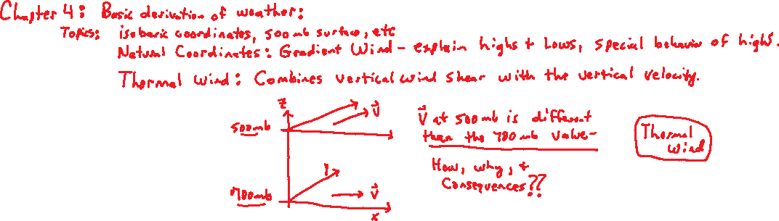
Chapter 4: Applications of the Equations of Motion.

Slide 2
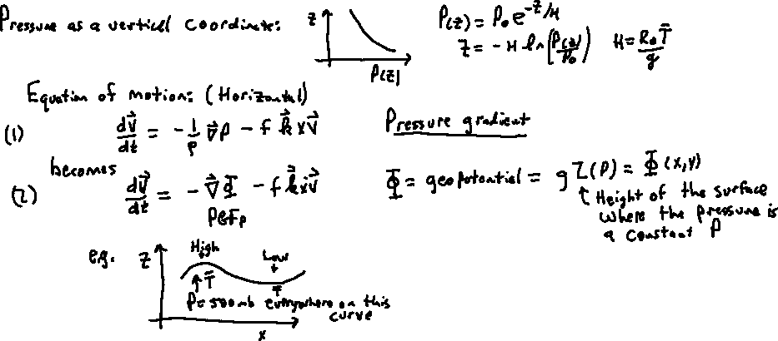
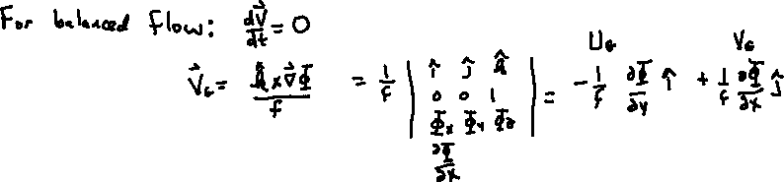
Pressure as a vertical coordinate: Note the density simplification

Slide 3

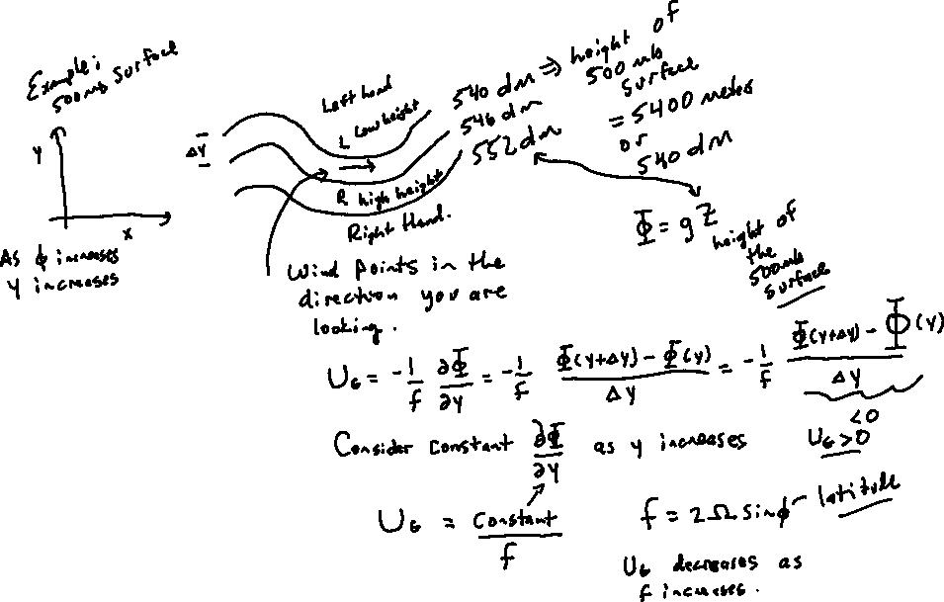
For constant derivative. V_{g} will decrease with,
But f is increasing with y since f=2Ω sinφ and dφ=dy/R_{e}. So V_{g} is not divergenceless.

Slide 4
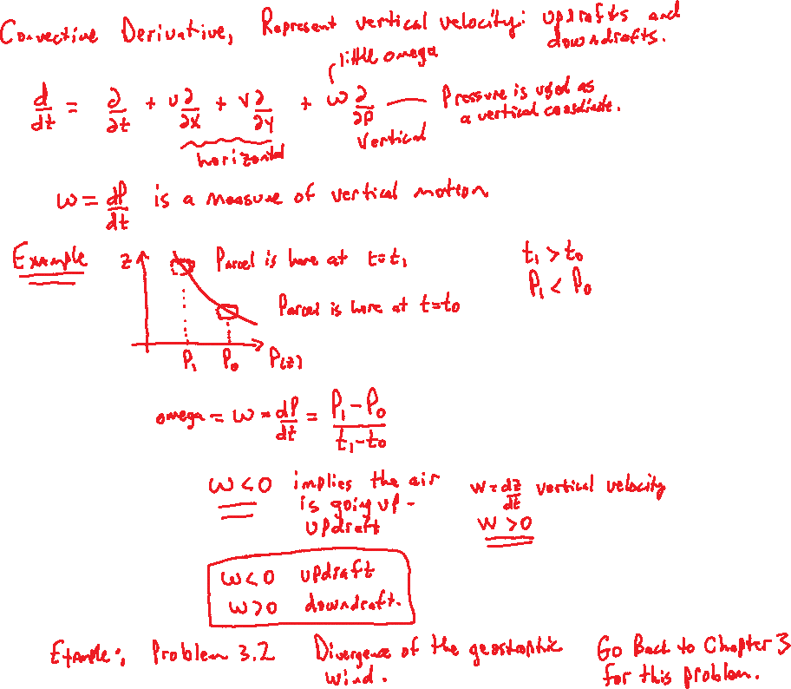
dP = - ρg dz
w = dz/dt = -ω/ρg Approximately. The denominator is about r=0.5 kg/m3 and g=10m/s2, about 20 Pa/m.

Slide 5
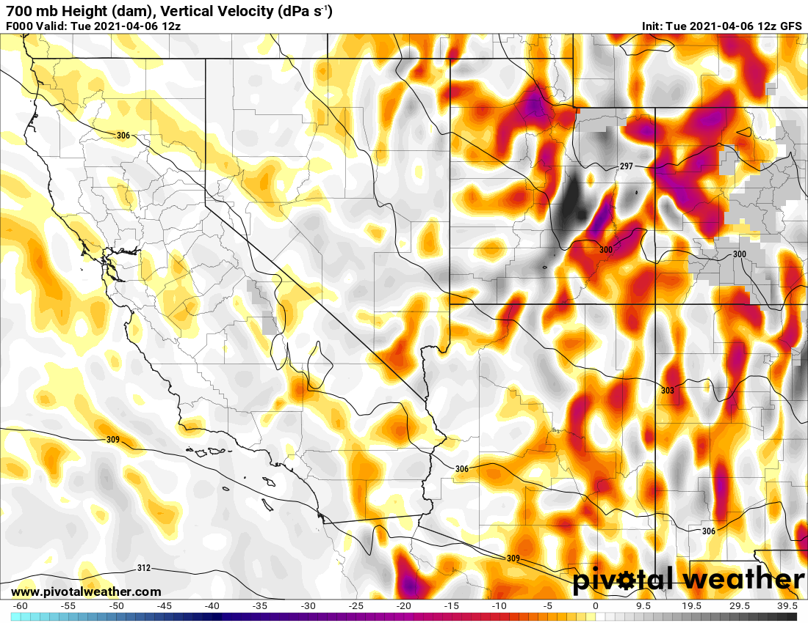
Example from Pivotal Weather
1 dPa/s = deciPa/s = 0.1 Pa/s = 1 microbar/s $≈$1 cm/s (about)

Slide 6
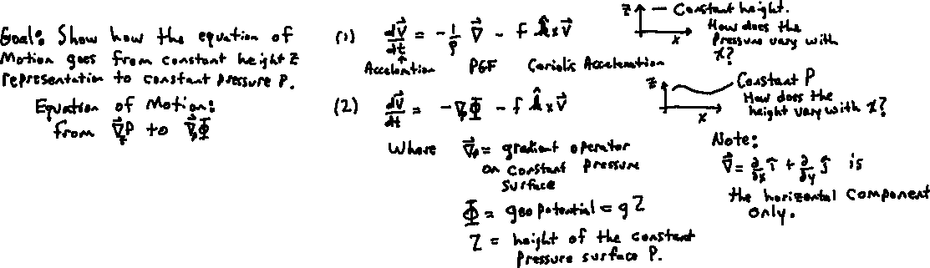
Equation of Motion in Pressure Coords
Constant z and P

Slide 7
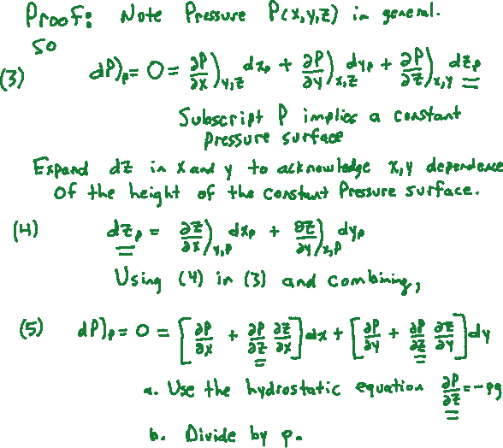

Slide 8
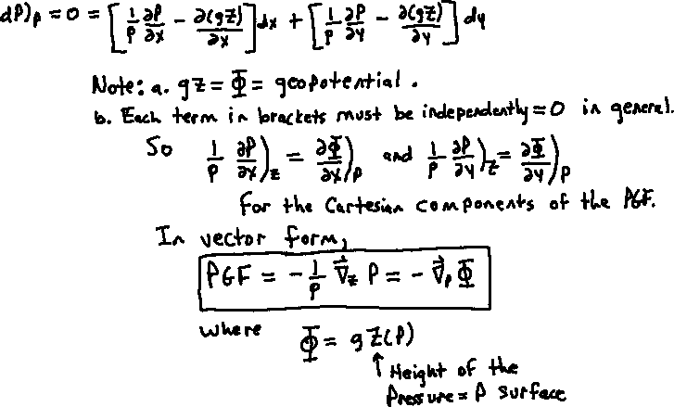
Proof continued

Slide 9
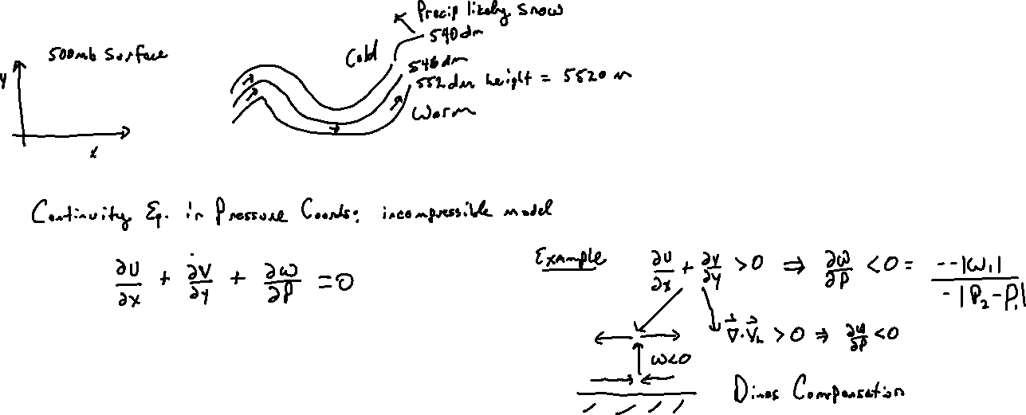
Thermal Wind 1

Slide 10
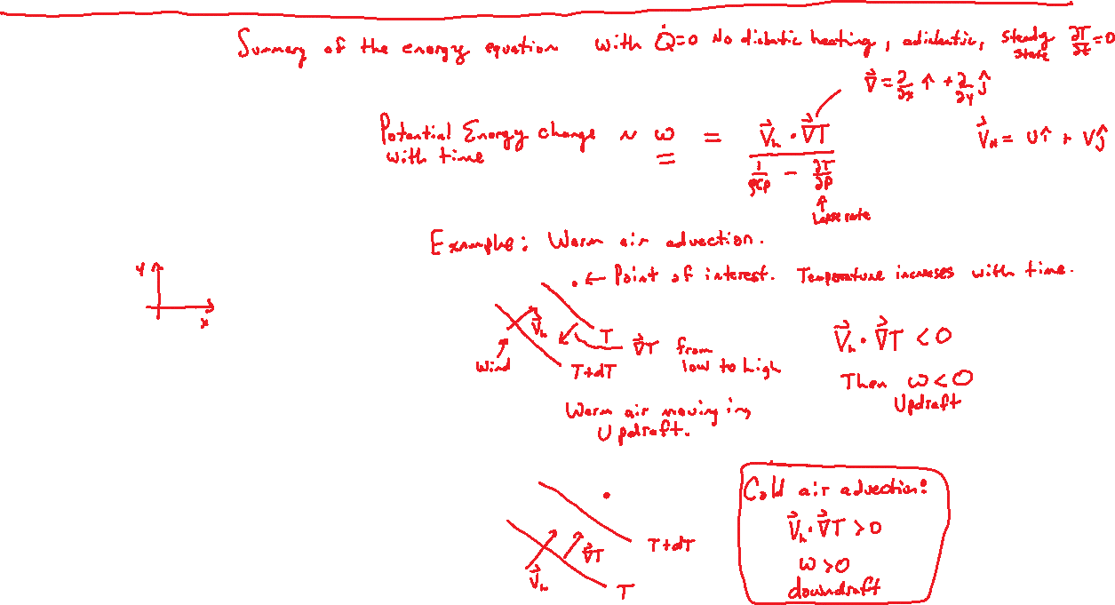
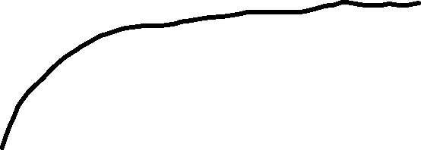
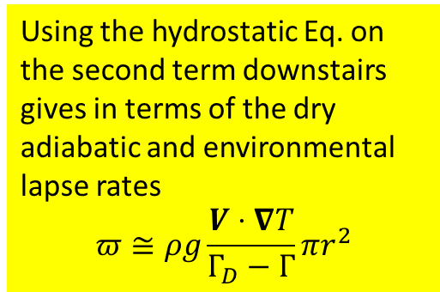
dT/dP < 0 most of the time.
Using the hydrostatic Eq. on the second term downstairs gives in terms of the dry adiabatic and environmental lapse rates
$$π≅ρg\frac{V⋅∇T}{Γ_{D}−Γ}πr^{2}$$

Slide 11
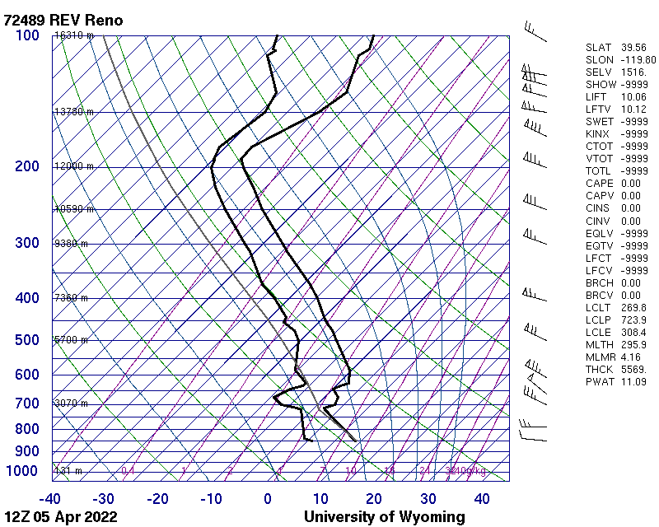
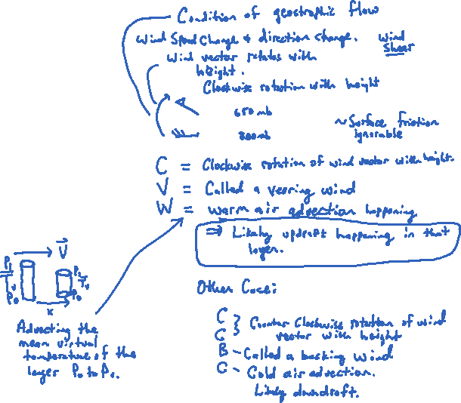
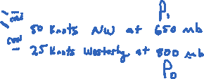
Thermal Wind 2

Slide 12
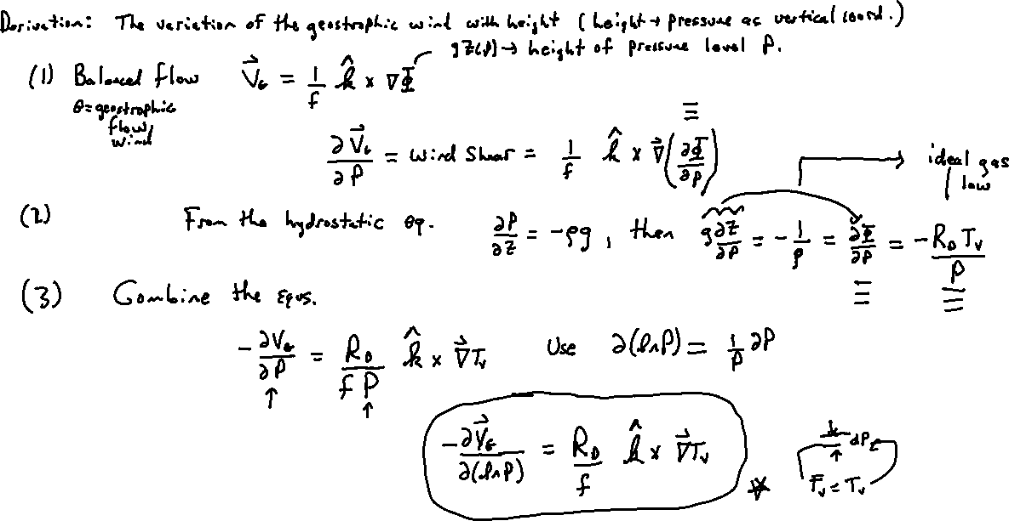
Thermal Wind 3
Vertical

Slide 13
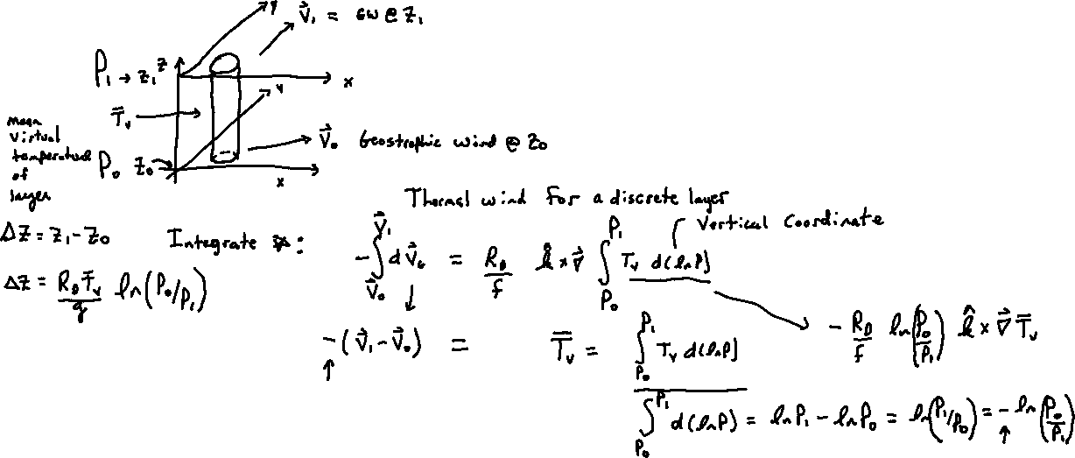
Derivation of the discrete form on this and next page.

Slide 14

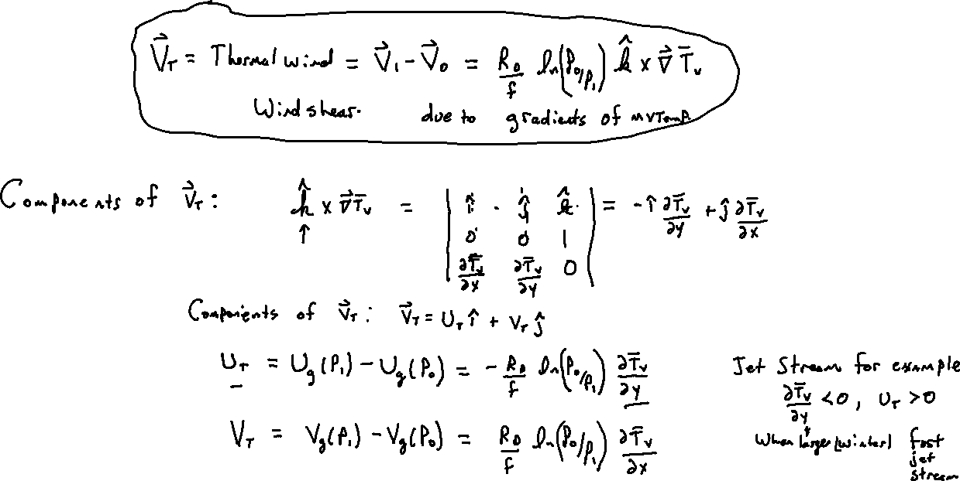
Compare:

Slide 15
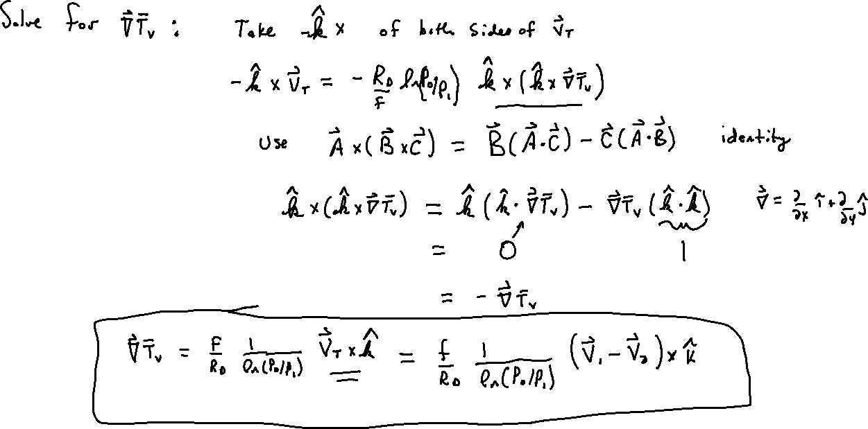
0

Slide 16
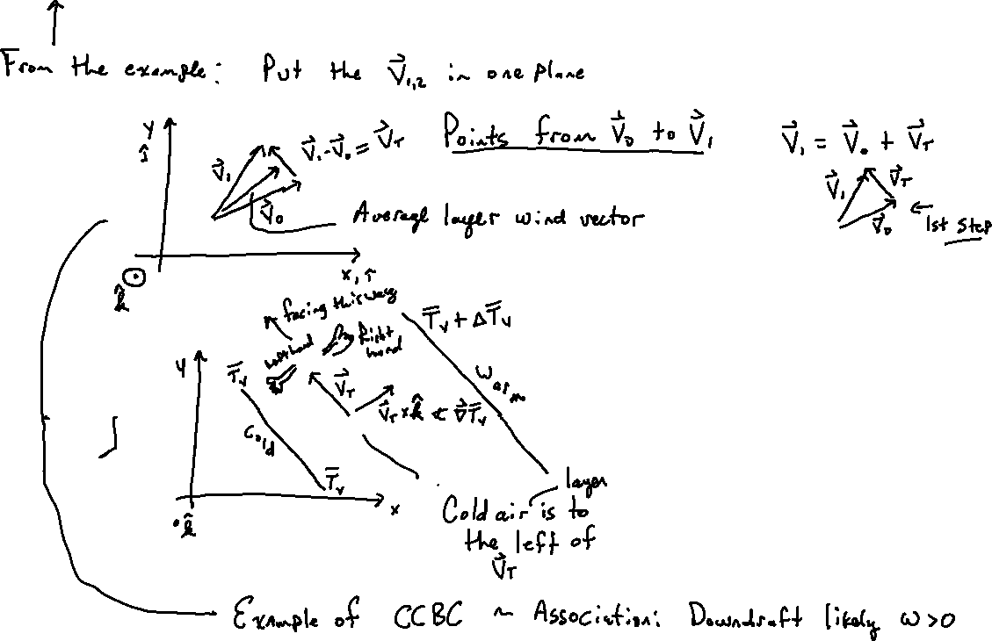

Slide 17
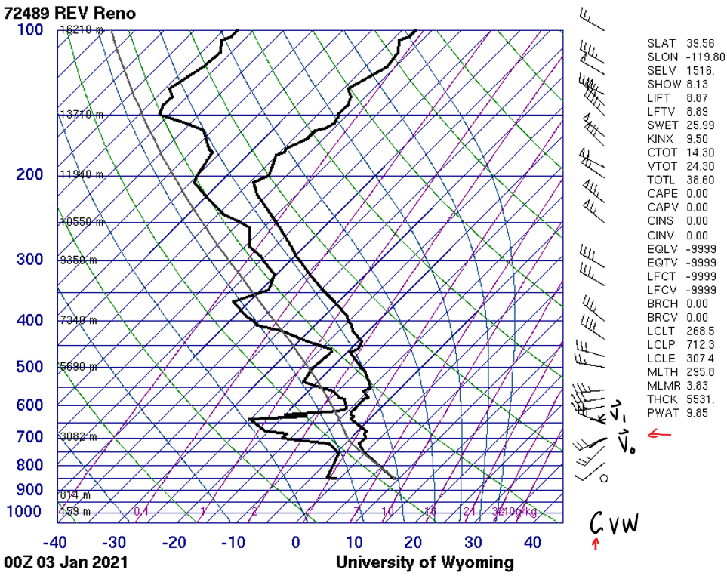
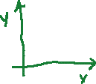
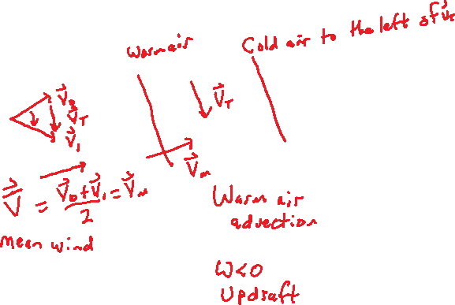
Thermal Wind 3 example sounding

Slide 18
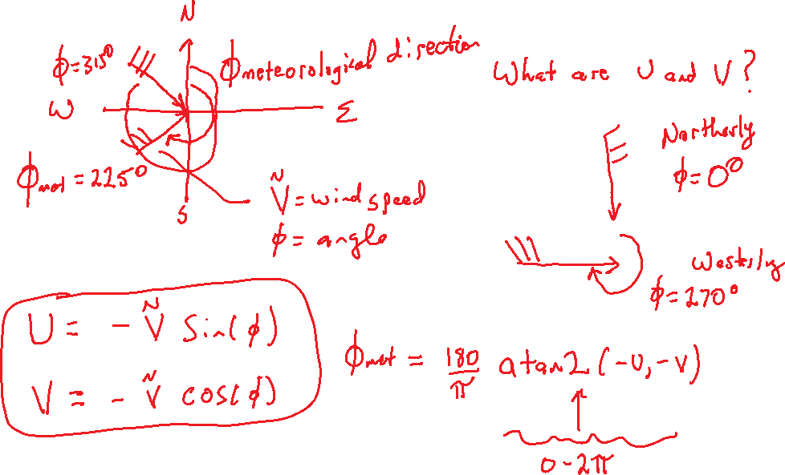
How to get U and V from wind barbs

Slide 19
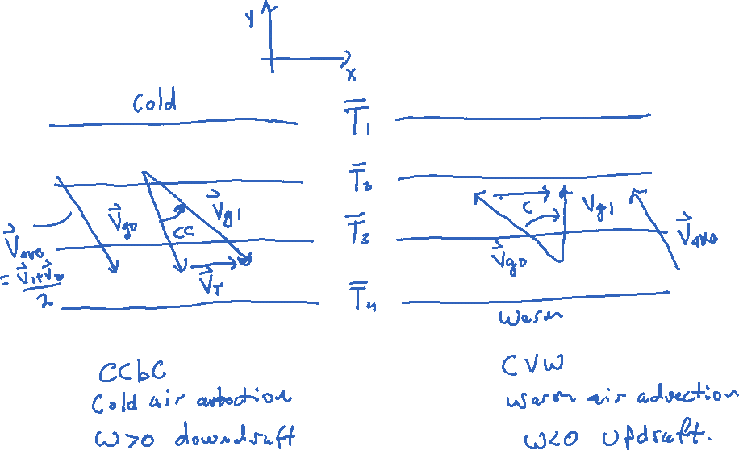
Thermal Wind Summary

Slide 20
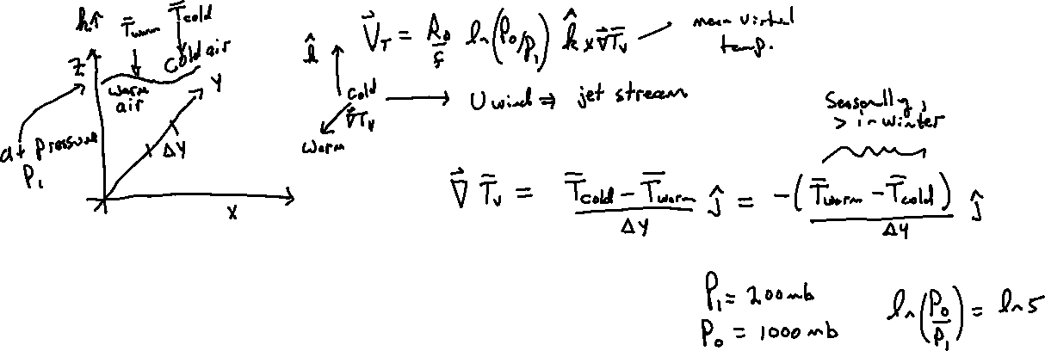
Thermal wind Jet Stream

Slide 21
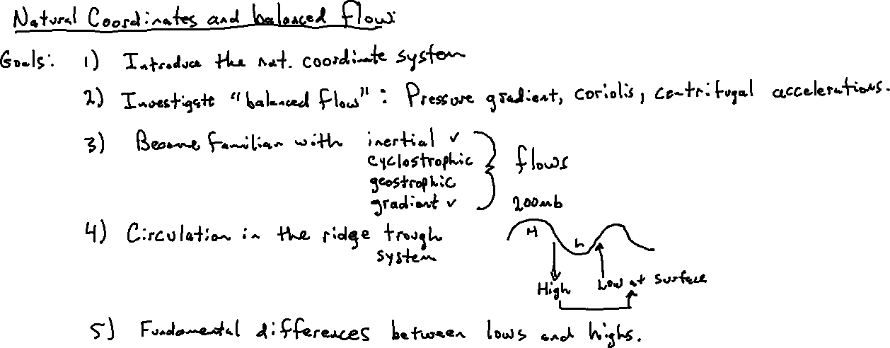
Gradient Wind Part 1

Slide 22

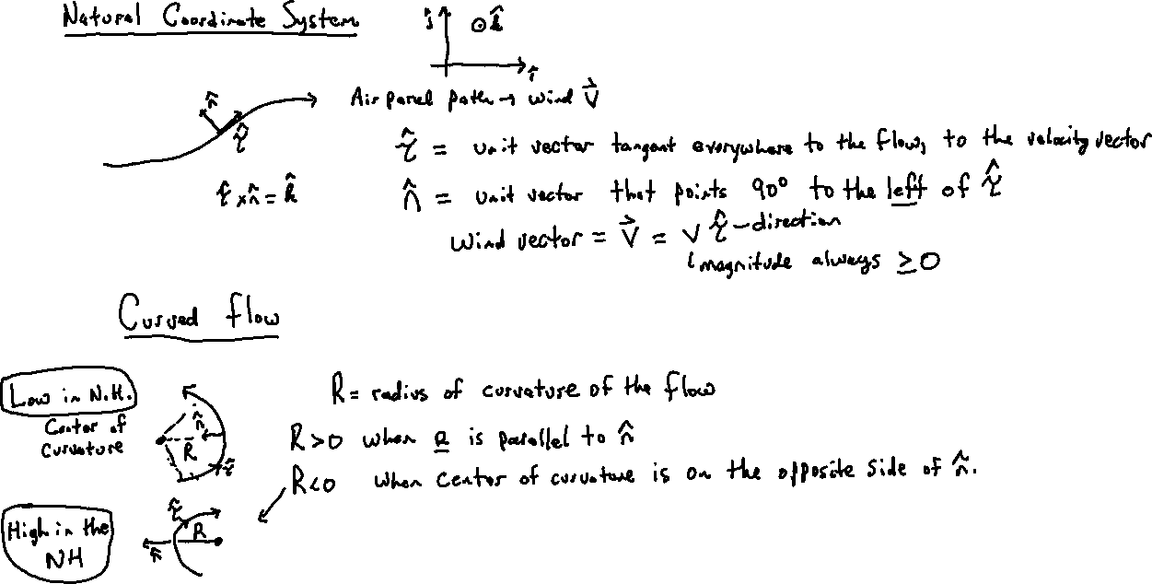



Slide 23
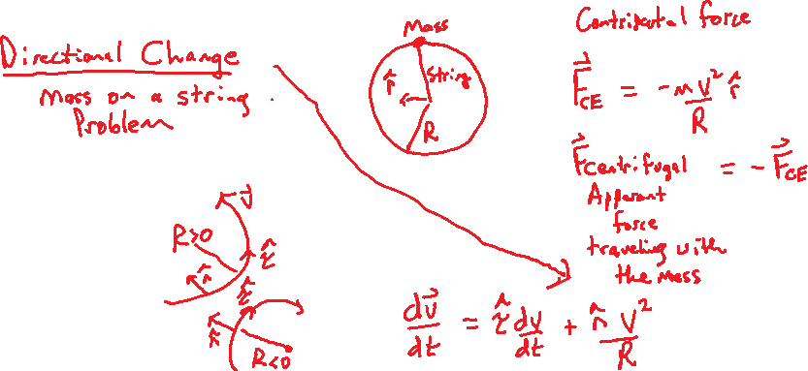

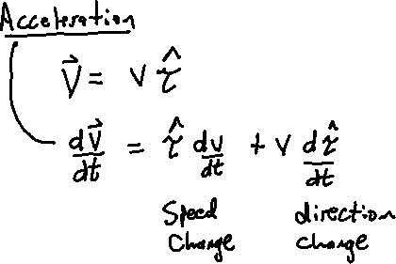
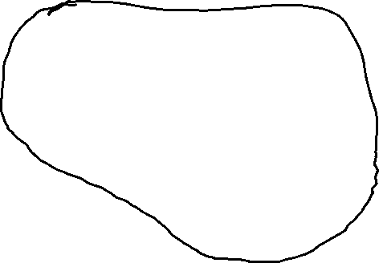

Gradient Wind Part 2: Setting up the equation of motion

Slide 24


Slide 25
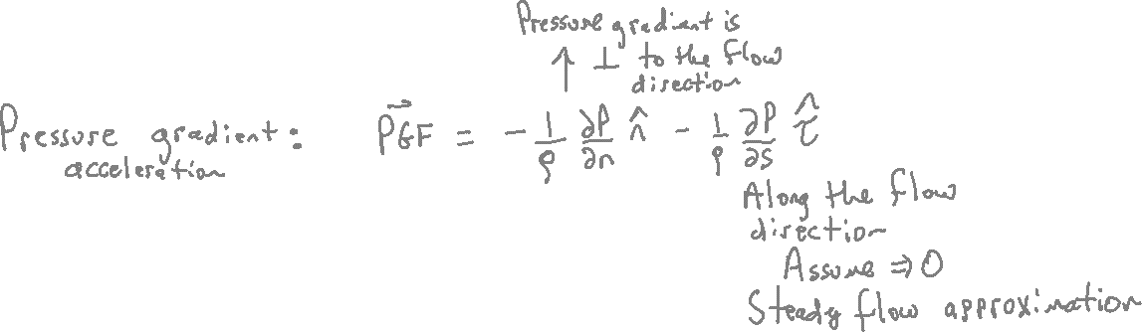

Slide 26
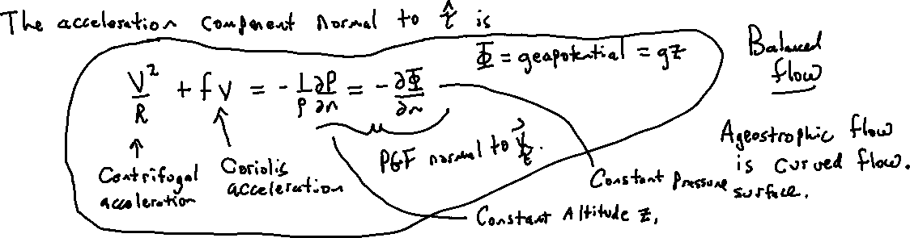
Acceleration component normal to tau is…

Slide 27
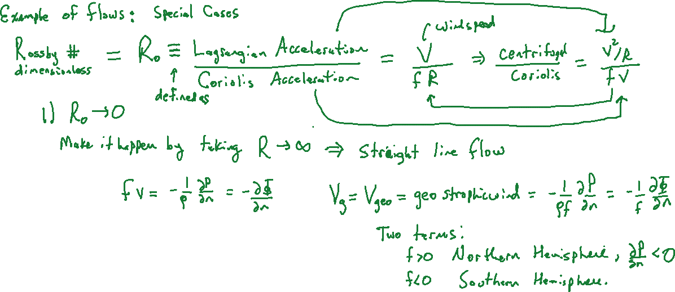

Slide 28
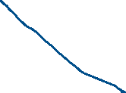



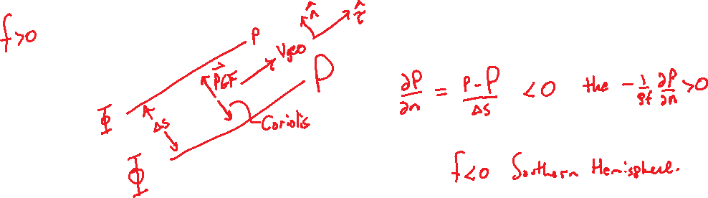
n + dn
n + dn
dn
n
dn
n
n
n points from lower to higher n values
dn
n + dn
dn
n

Slide 29
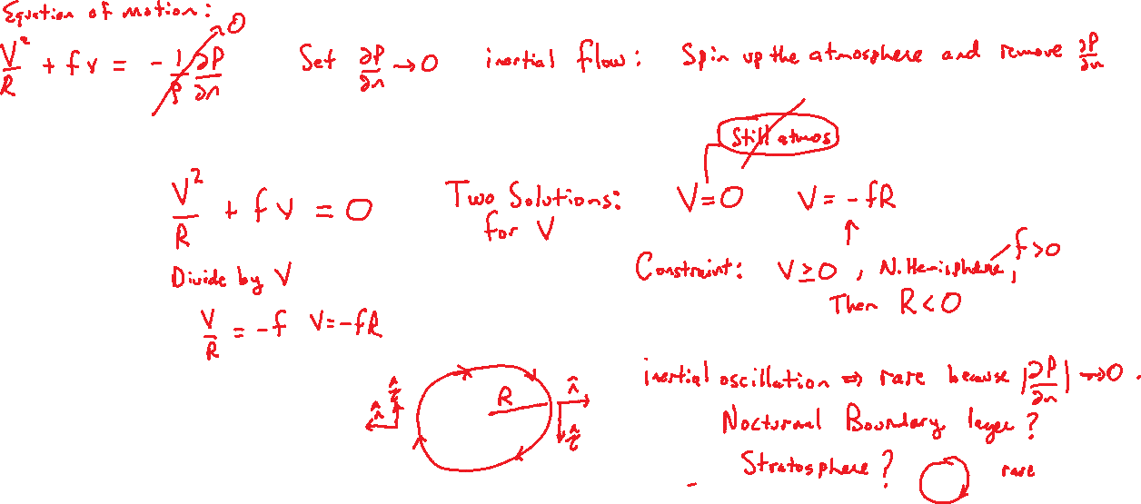
Gradient Wind Part 3 Inertial Flow

Slide 30
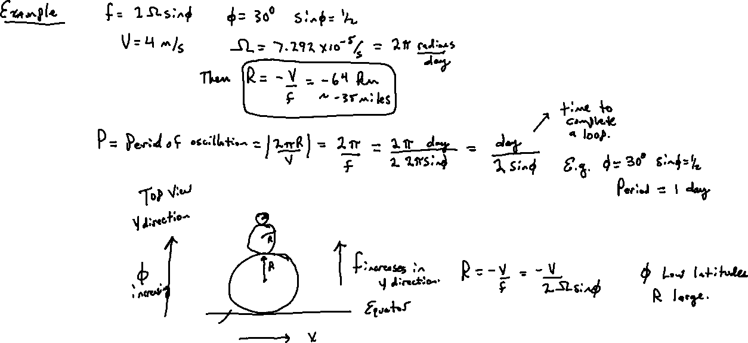

Slide 31
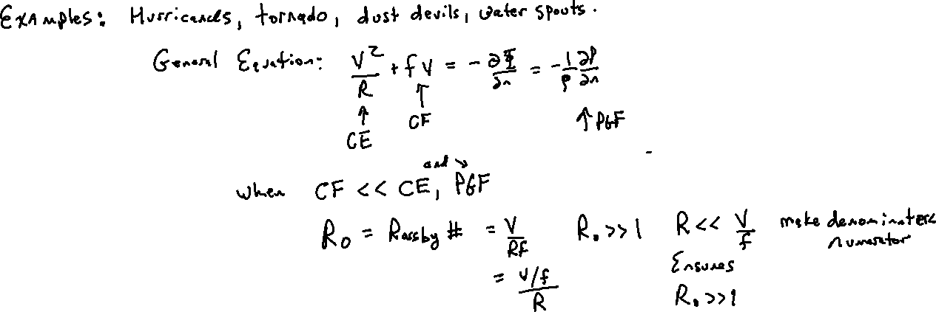

Gradient wind 4 Cyclostrophic flow

Slide 32
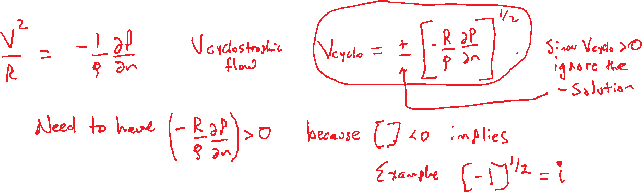

Slide 33
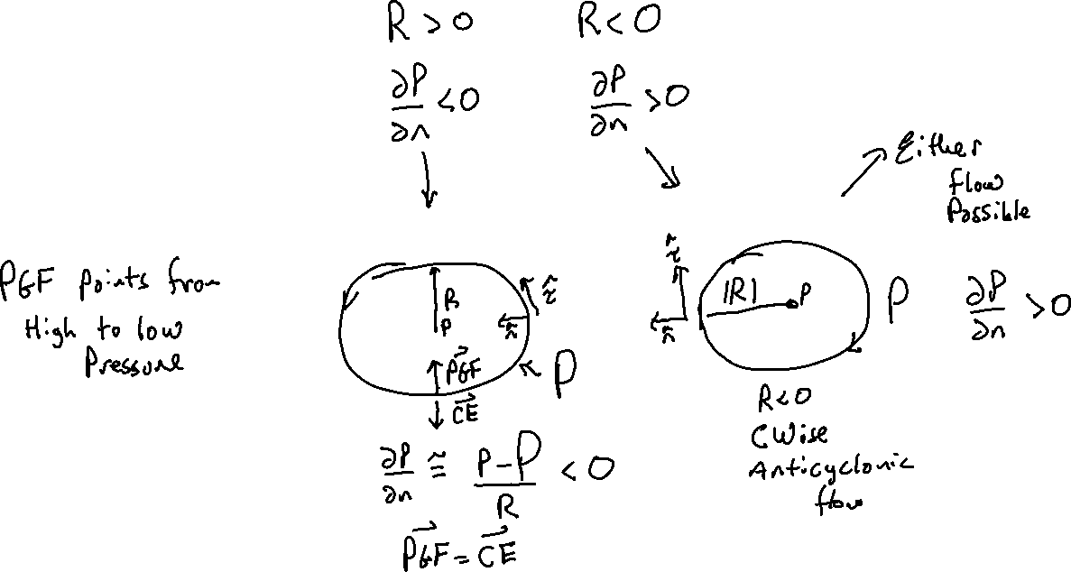

Slide 34
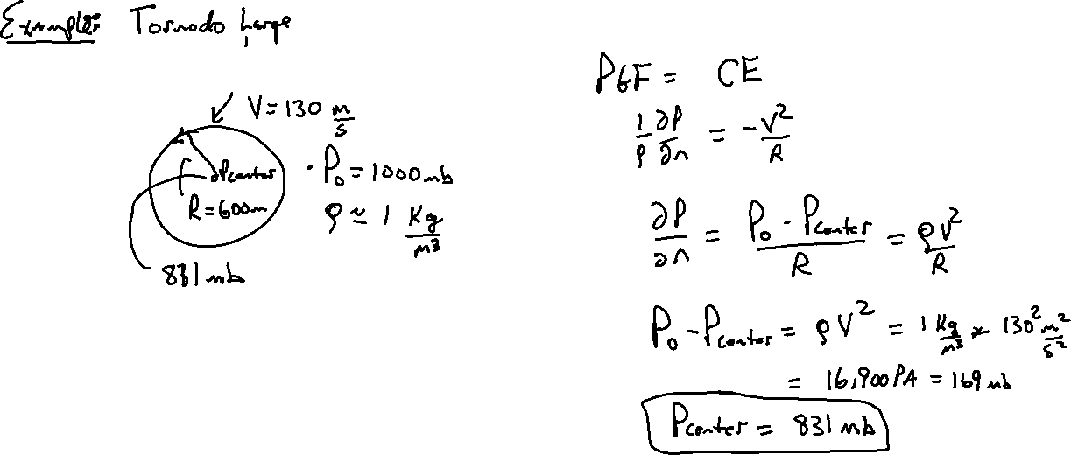
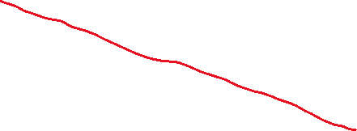

Slide 35
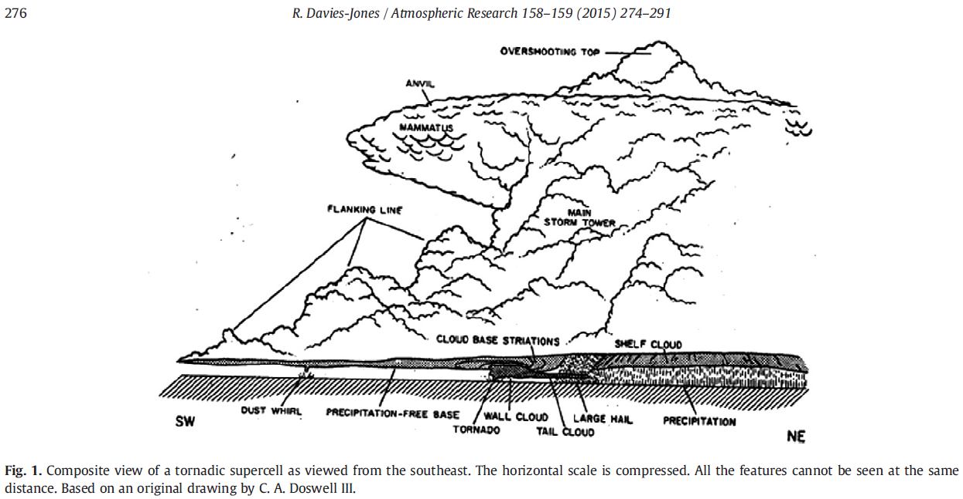



Slide 36



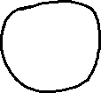



Slide 37
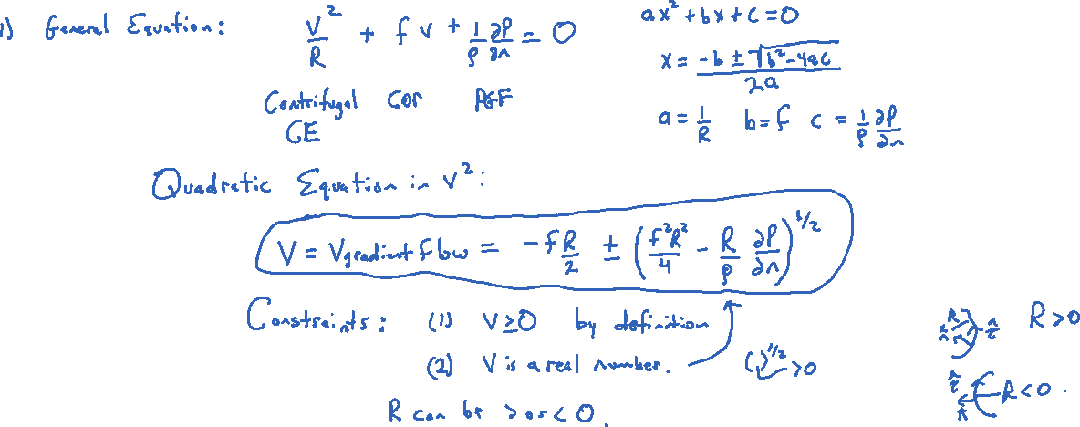
Gradient Wind 5 General Case

Slide 38
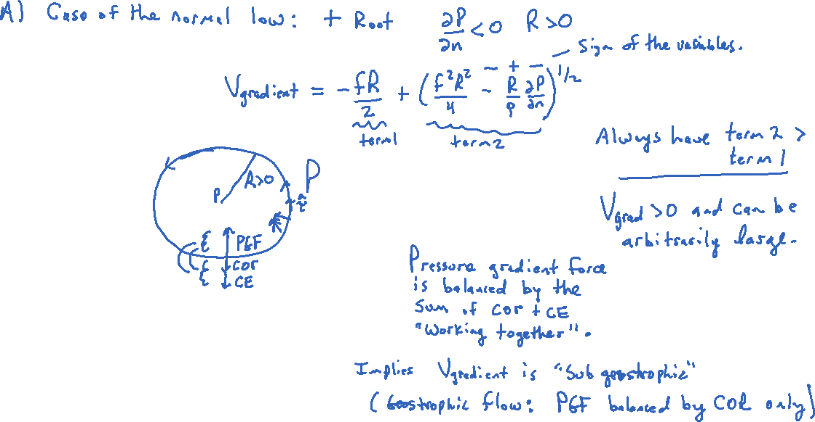

Slide 39
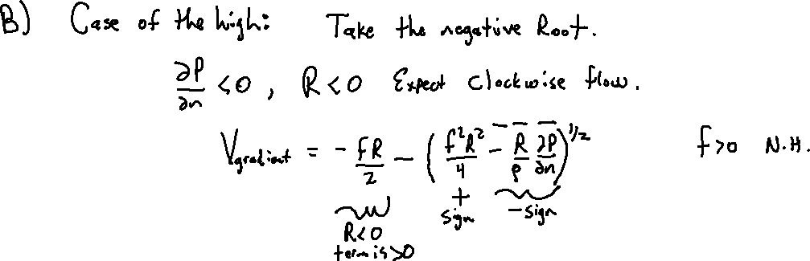

Slide 40
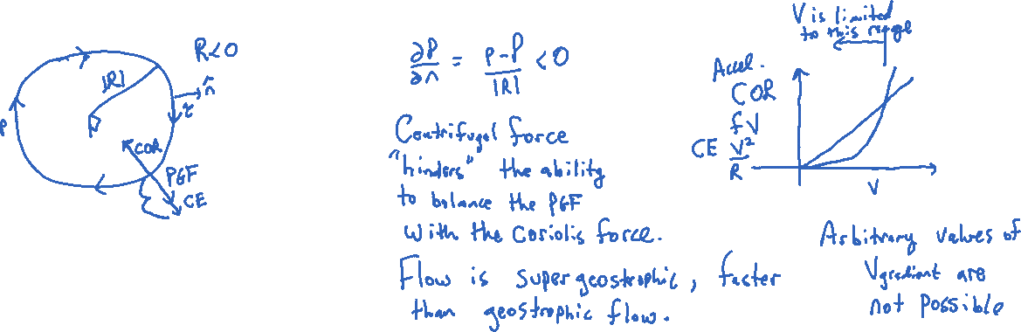

Slide 41


Slide 42


Slide 43

Surface Map
View the highs and lows.

Slide 44

Gradient Wind 6 Ageostrophic Flow

Slide 45


Slide 46


Slide 47


Slide 48


Gradient wind 7: Trough-Ridge System

Slide 49

Gradient Wind 8: Hurricane Problem

Slide 50


Slide 51


Slide 52


Slide 53


