Slide 1
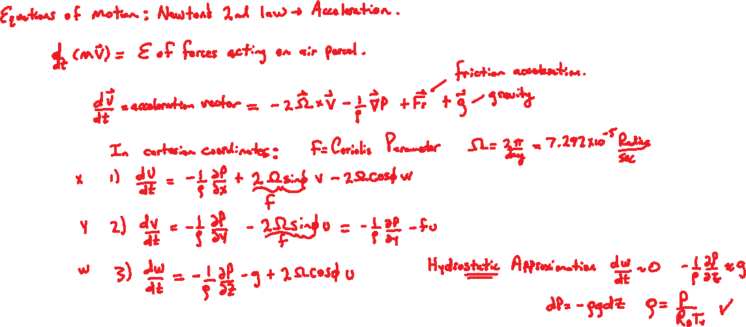
Equation of Motion and Rossby Number

Slide 2
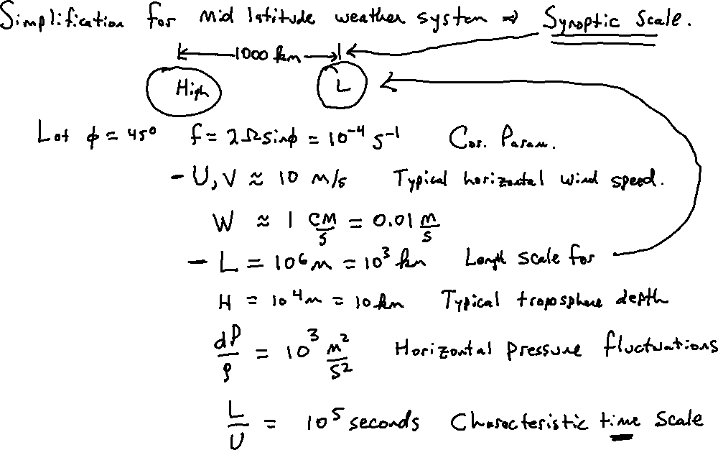

Slide 3
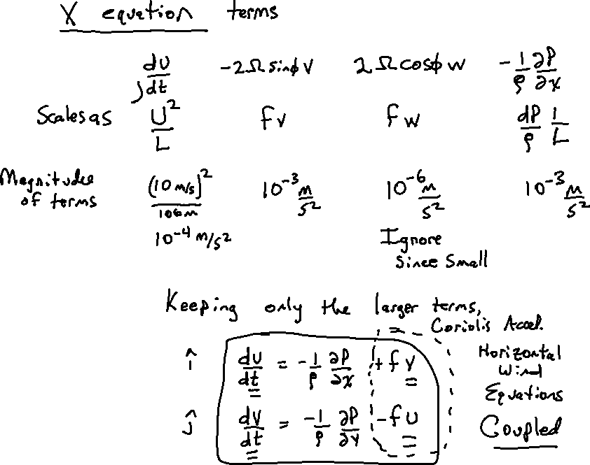

Write a vector form: Subscript H means horizontal. V_{H}=(U,V).
$$\frac{dV_{H}}{dt}=−\frac{1}{ρ}∇_{H}P−fk×V_{H}$$

Slide 4
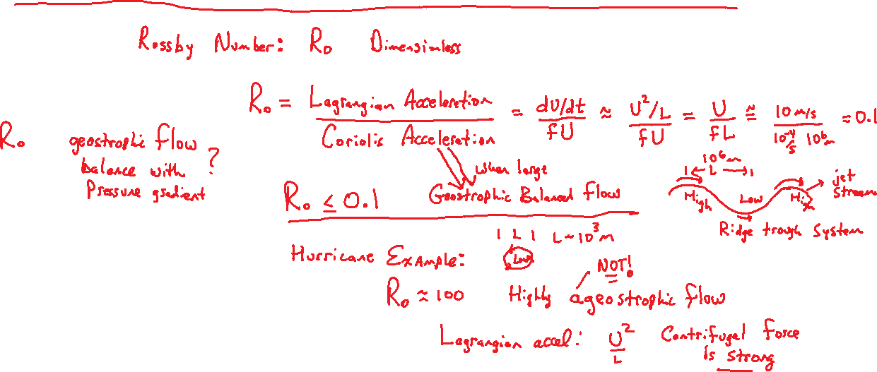

Slide 5
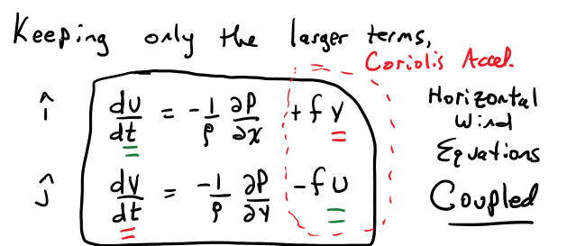
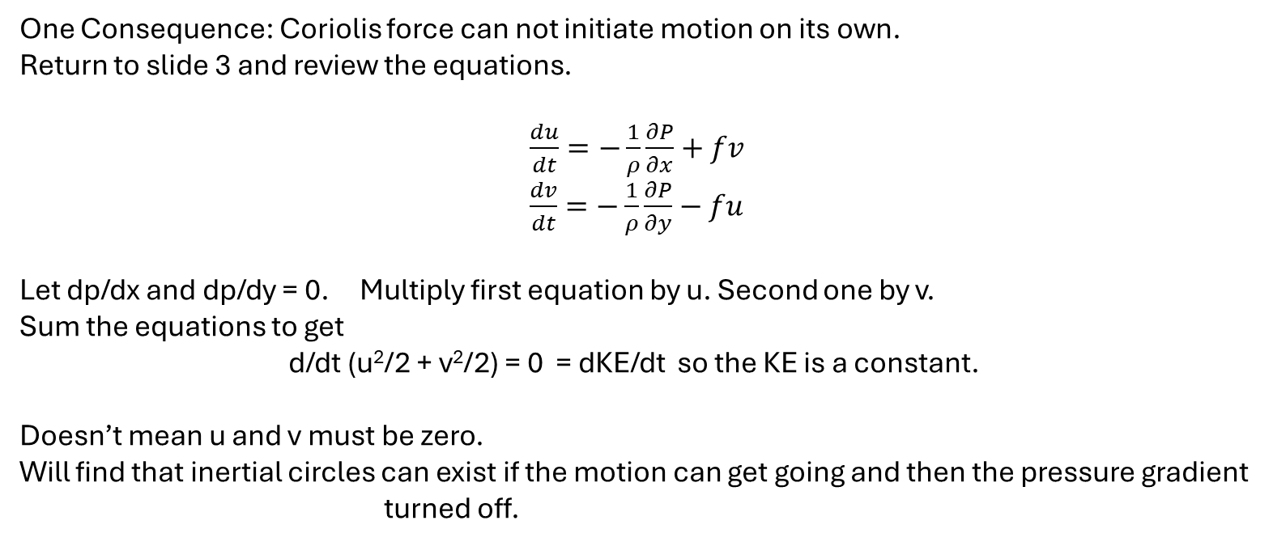
One Consequence: Coriolis force can not initiate motion on its own.
Return to slide 3 and review the equations.
$\frac{du}{dt}=−\frac{1}{ρ}\frac{∂P}{∂x}+fv$
$\frac{dv}{dt}=−\frac{1}{ρ}\frac{∂P}{∂y}−fu$
Let dp/dx and dp/dy = 0. Multiply first equation by u. Second one by v.
Sum the equations to get
d/dt (u²/2 + v²/2) = 0 = dKE/dt so the KE is a constant.
Doesn’t mean u and v must be zero.
Will find that inertial circles can exist if the motion can get going and then the pressure gradient turned off.

Slide 6
Thermal Wind Homework Problem
Calculate the geostrophic wind in m/s and knots at an altitude of 9.5 km and a latitude of 40 degrees north for:
(a) Winter conditions with a surface temperature of 20 C at 30 degrees north and -10 C at 50 degrees north.
(b) Summer conditions with a surface temperature of 30 C at 30 degrees north and 20 C at 50 degrees north.
Assume a sea level pressure of 1000 mb, and a lapse rate of 6 C / km. Show your work. Make a table of values leading up to the wind calculation.

Slide 7

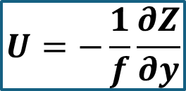
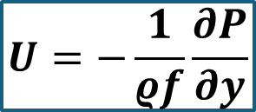


Thermal Wind Homework Problem: Two ways of looking at it.
$$U=−\frac{1}{ρf}\frac{∂P}{∂y}$$
$$U=−\frac{1}{f}\frac{∂Z}{∂y}$$
Z=250 mb height
Z(y)

Slide 8
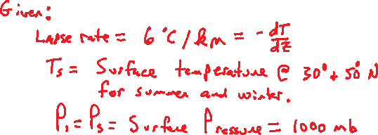

Slide 9



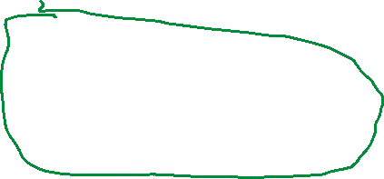


The problem boils down to obtaining T2 and P2, the temperature and pressure at the 9.5 km altitude.

Slide 10


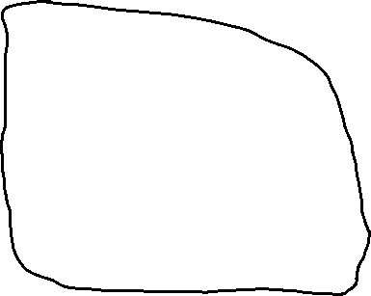






The problem boils down to obtaining T2 and P2, the temperature and pressure at the 9.5 km altitude.

Slide 11













Aside: Need to get T₂ for ρ₂ and P₂ .

Slide 12

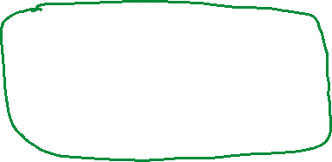





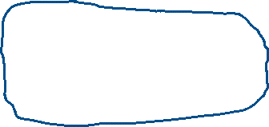







Use T₂ to get ρ₂ and P₂ .

Slide 13
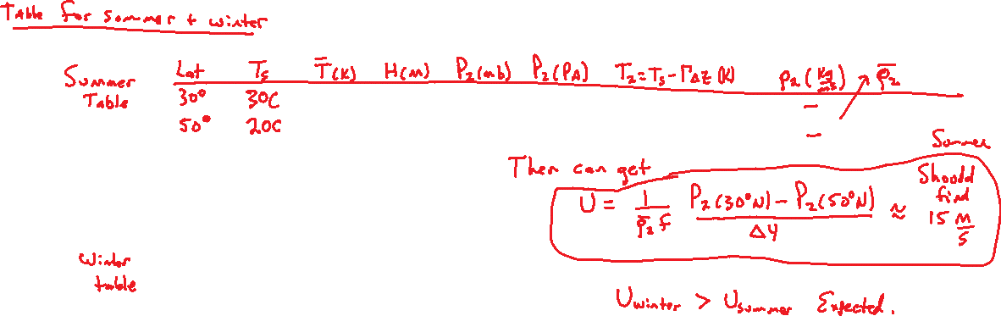
Need to put together tables for summer and winter conditions.
May just do the calculations in python or excel and include them in the assignment. Really look at he numbers in the table for each quantity. They are typical.

Slide 14
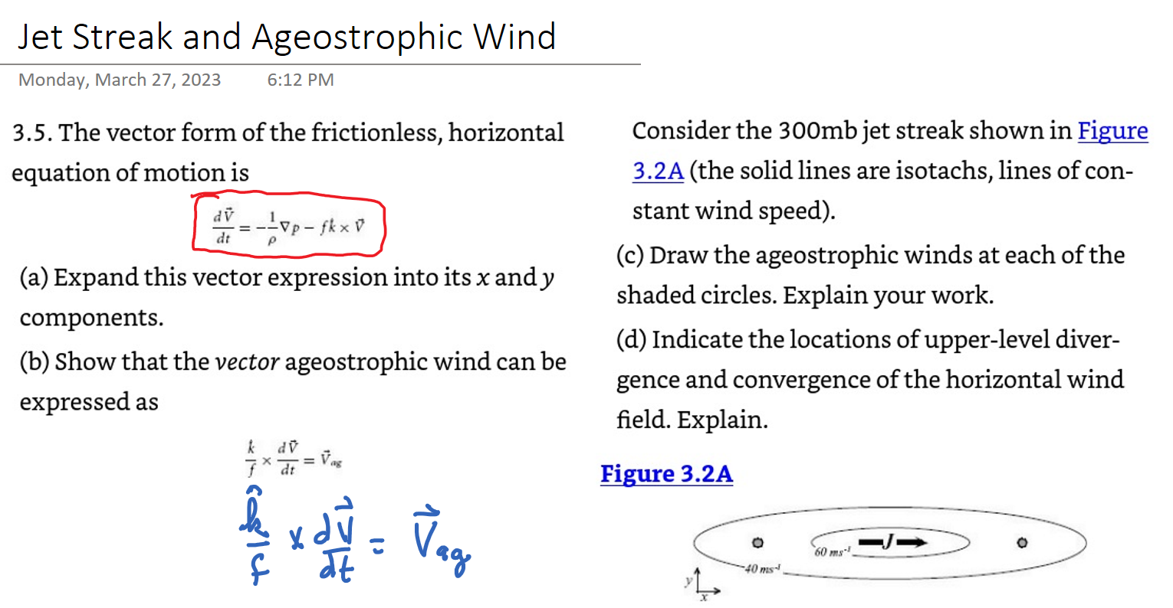
Jet Streak and Ageostrophic Wind: Problem 3.5

Slide 15
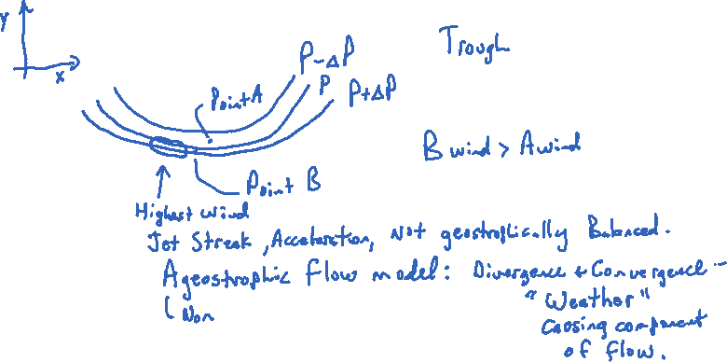
Typical Dimensions:
200-1000 km long
50-200 km wide
Around 2 km thick

Slide 16

Part (a) Balanced flow: Demonstrate the PGF x k = V_{g} on the next page
Balanced: PGF + C = 0 PGF = -C, where C=-fk x V_{H}
PGF = fk x V_{H} . PGF = -(1/ρ) Del_{H}P
Take k x of both sides.
Use A x (B x C) = B(A.C) – C(A.B).
k x PGF = f k x (k x V) = k * 0 –f V k.k so
V = -(1/f) k x PGF
Reverse the order of cross product to change the sign and add g at the end.
V_{g} = (1/f) PGF x k
where
PGF = -(1/ρ) DelP
Write a vector form: Subscript H means horizontal. V_{H}=(U,V).
$$\frac{dV_{H}}{dt}=−\frac{1}{ρ}∇_{H}P−fk×V_{H}$$

Slide 17
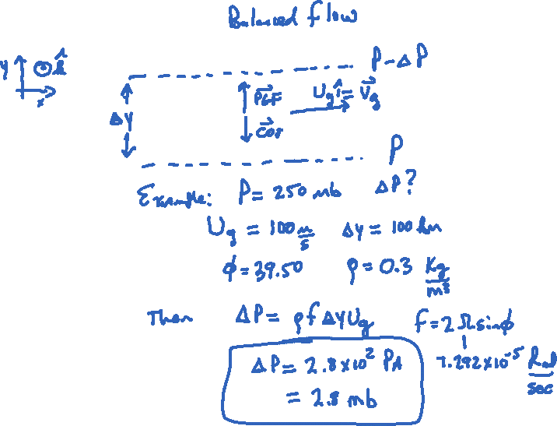

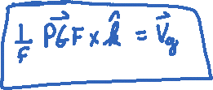
Example of the pressure difference over 100 km for a fast upper-level westerly wind assuming balanced flow.

Slide 18
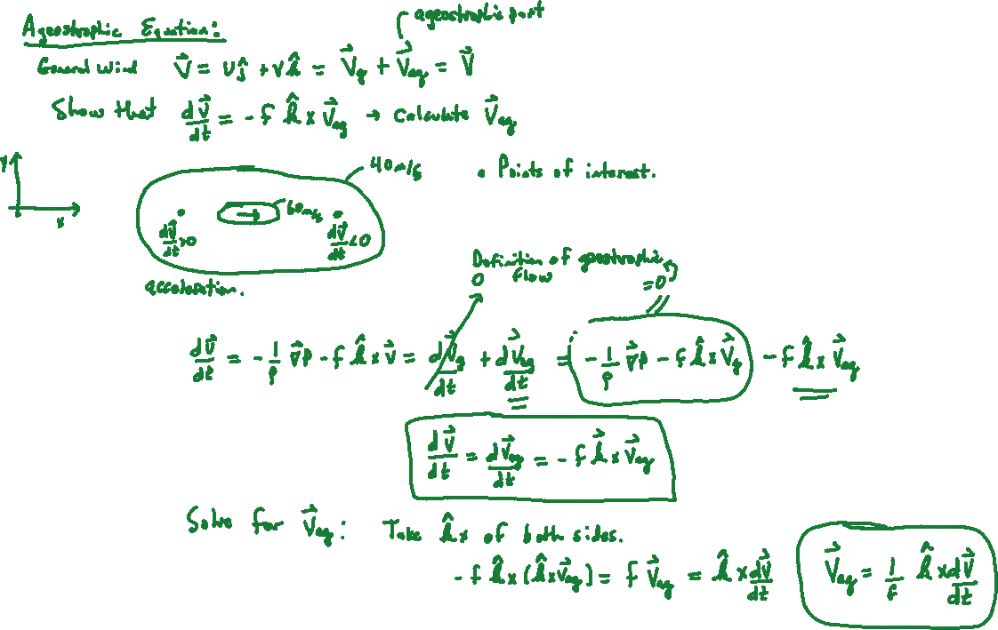
The vector triple product at the bottom can be simplified by the BAC-CAB rule: A×(B×C)=B(A⋅C)−C(A⋅B). Note that V_{ag} is in the horizontal i, j direction.

Slide 19
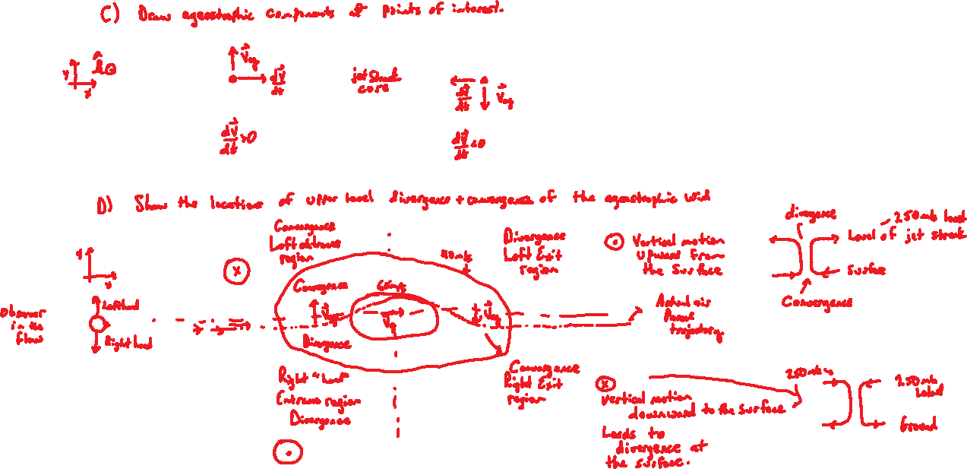
Low surface pressure
High surface pressure

Slide 20
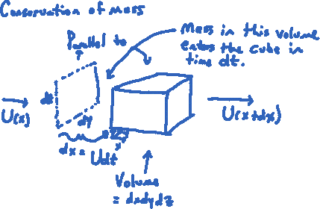
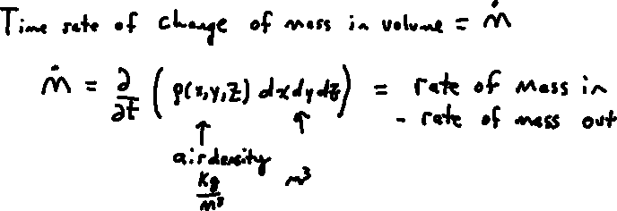
Continuity Equation
At a fixed location, look at the x direction and generalize to y and z. Eularian view.
General strategy: Will calculate rate of mass in – rate of mass out for x, y, and z.

Slide 21
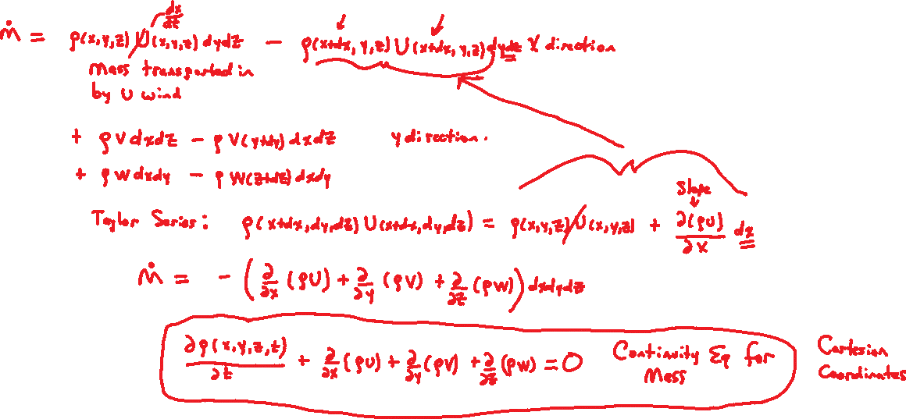
Expand the second term out, notice the cancellations given in green. Generalize for the y and z direction. Get a Cartesian coordinate form of the density change.

Slide 22
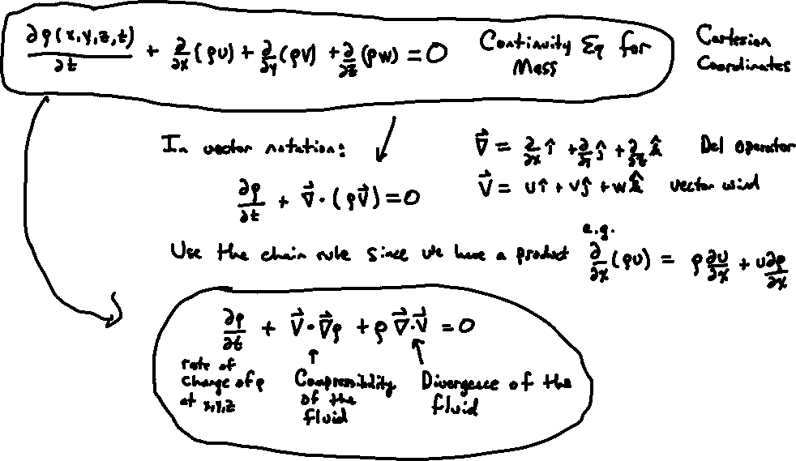
Carry over the equation from the previous slide: Write it in vector notation. Use the chain rule for the product to get another form of the Continuity equation.

Slide 23
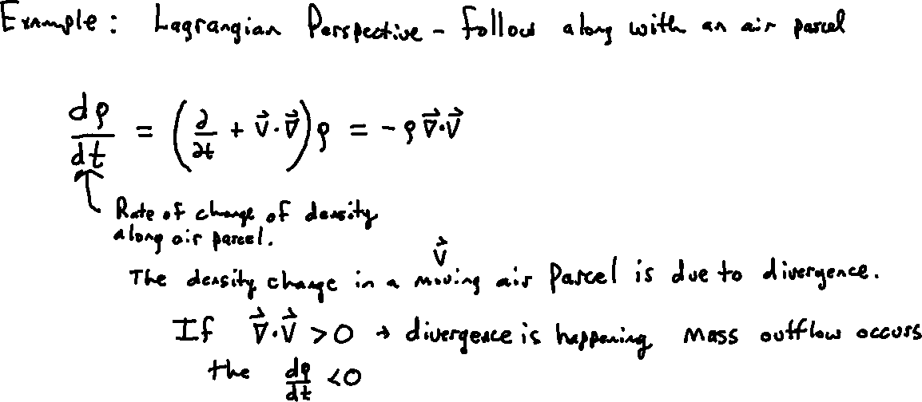
The ‘total’ time derivative of the density for an air parcel moving along a Lagrangian trajectory that arrives at the fixed Eularian location x,y,z,t

Slide 24
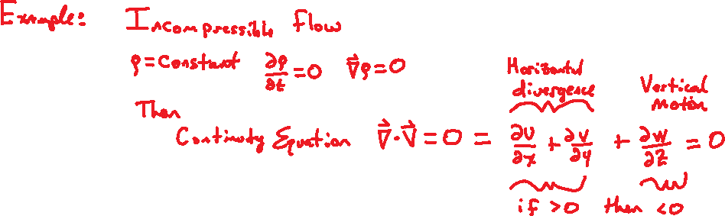
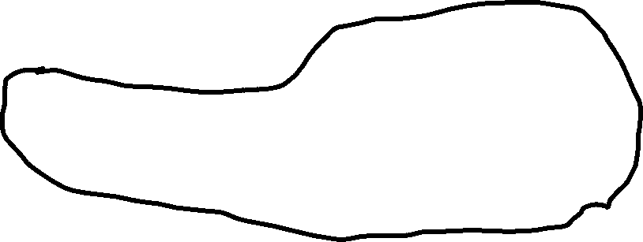

Slide 25
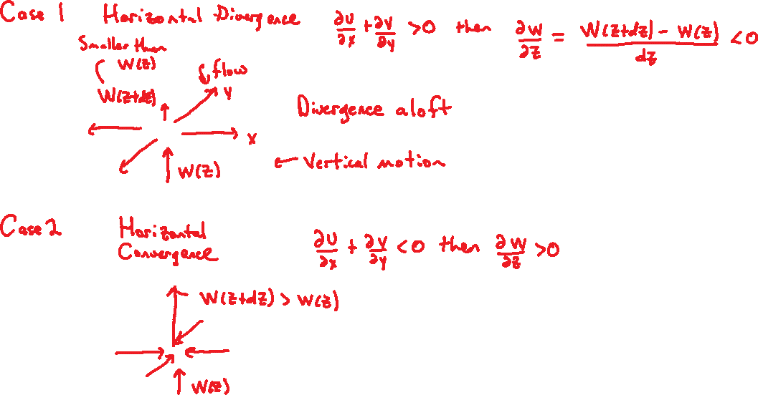

Slide 26
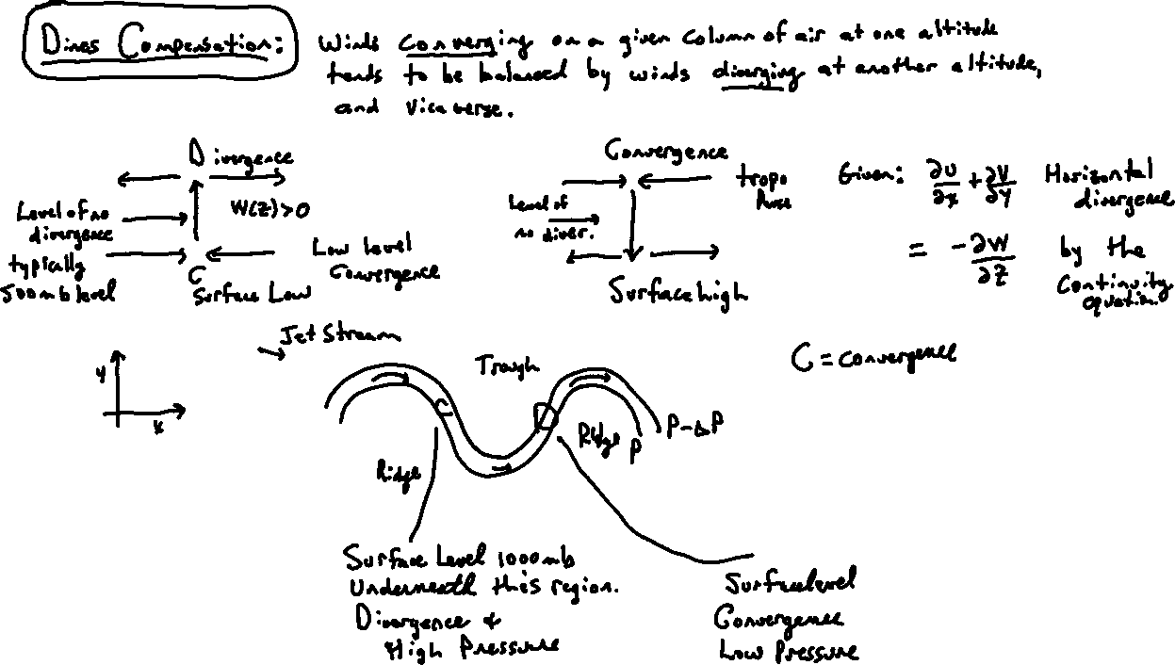

Slide 27
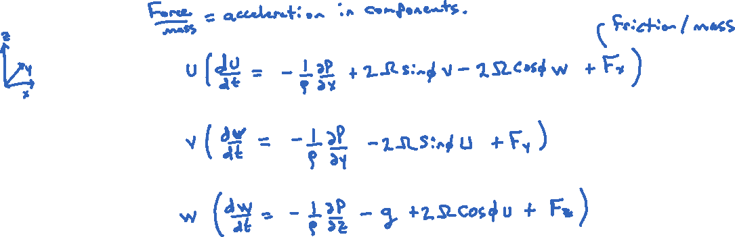
Energy Equation: Conservation of Energy
Start by multiplying both sides by U, V, and W.

Slide 28
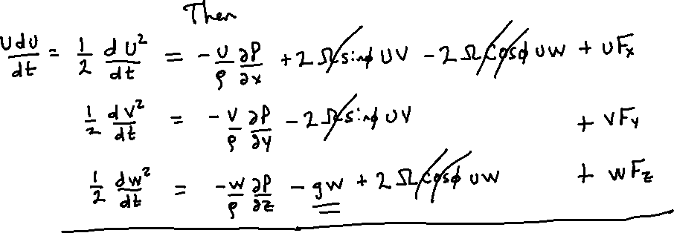
Note the nifty rearrangement of du/dt. Note also the cancellation of the Coriolis terms when a sum of all terms is made.

Slide 29

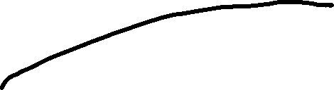
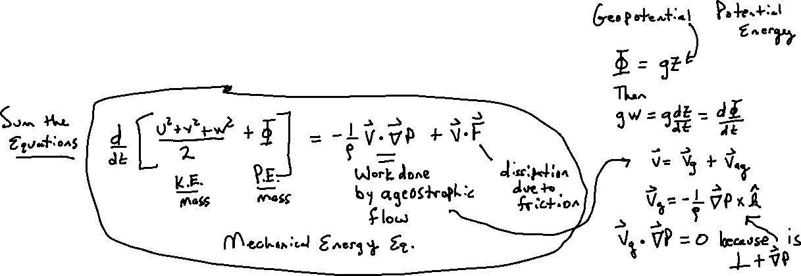

Obtain the mechanical energy equation. Notes: “work done per second by ageostrophic flow” is better, and prove that on the right.

Slide 30
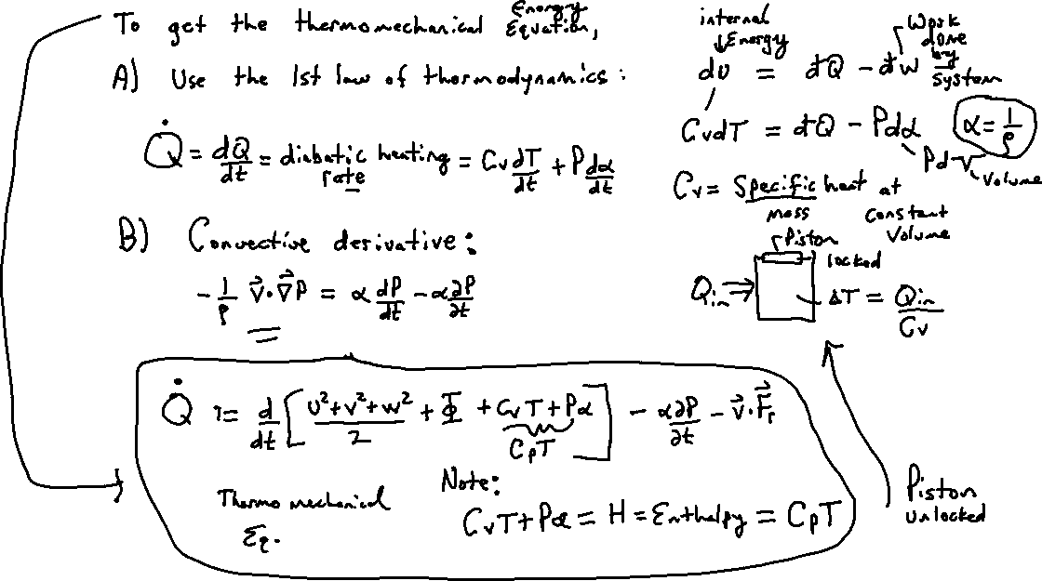
Thermo-mechanical energy equation: Note the d (P α)/dt term in the brackets gets expanded by the chain rule.

Slide 31
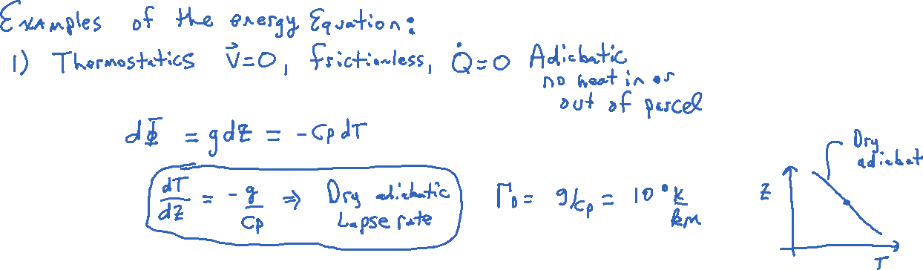
Derive the dry adiabatic lapse rate from thermostatics. See the assumptions that are needed for it.

Slide 32
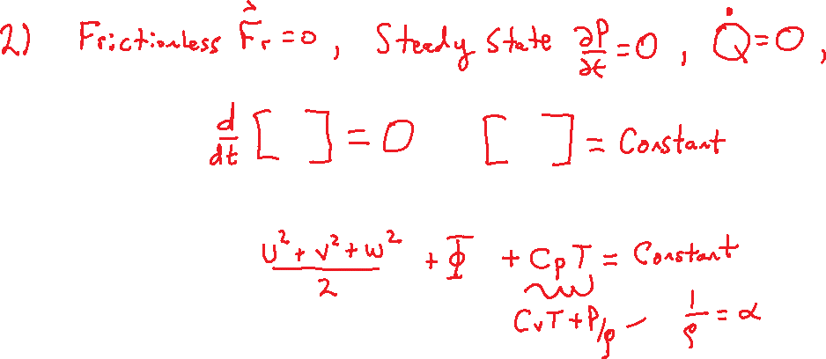
Step on the way to the incompressible form where C_{v}T = constant, just added to the other side.

Slide 33
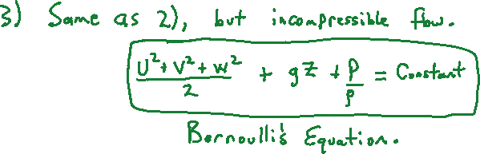
Bernoulli’s Equation

Slide 34
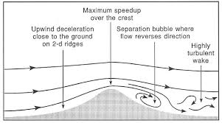
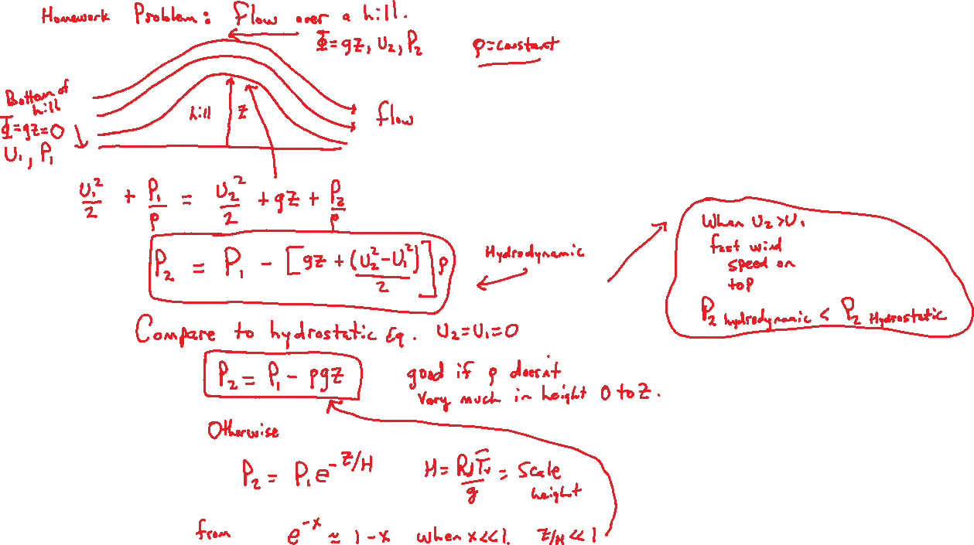

Slide 35
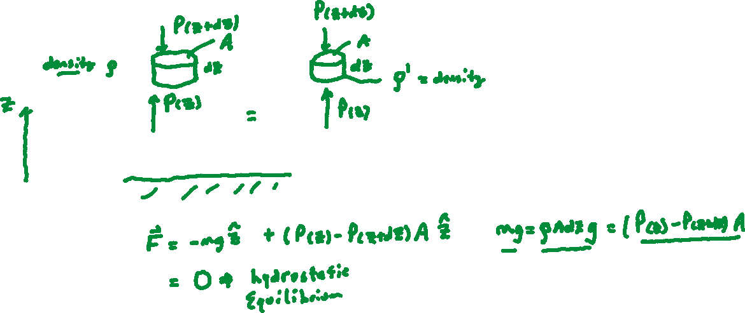
Buoyant Force and Archimedes Principle Are Central In Atmospheric Science
First
Second

Slide 36
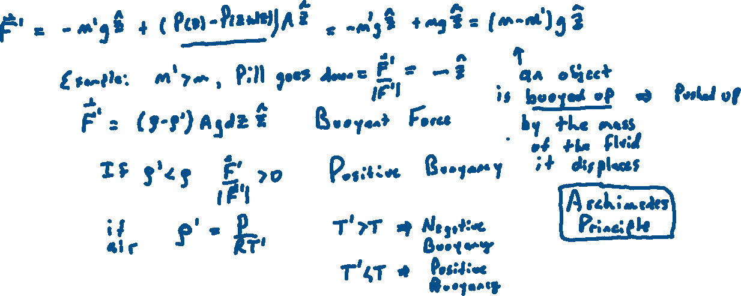

Slide 37
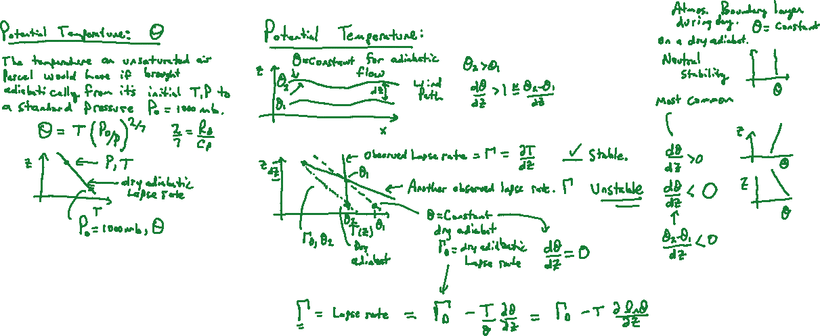
Potential Temperature, Gravity Waves, Stability
Draw two separate graphs.

Slide 38
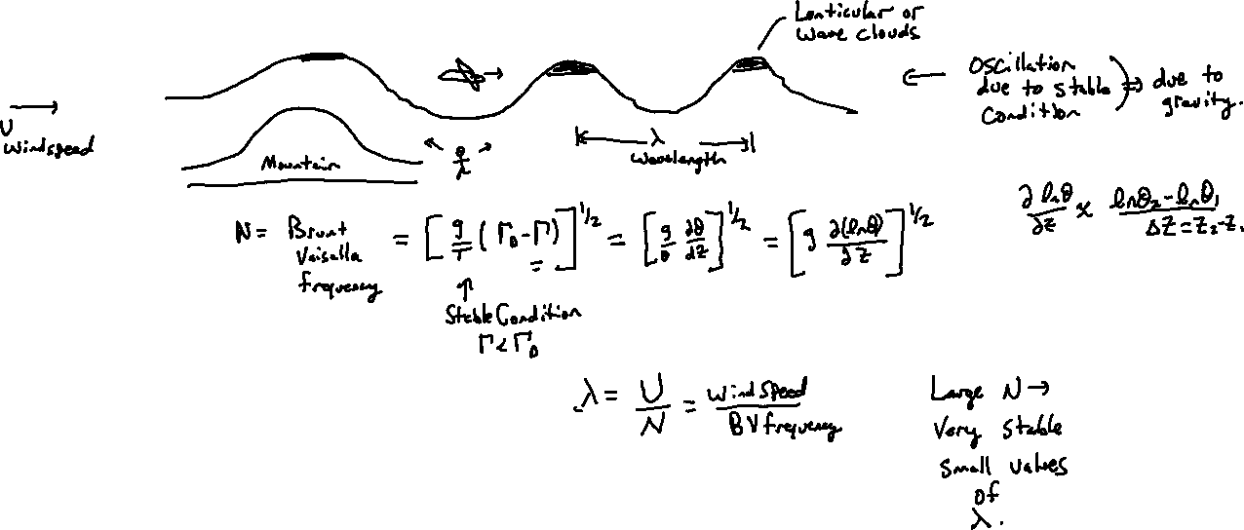
Gravity wave clouds and homework problem: Derived in the ATMS411 atmospheric physics class.

Slide 39
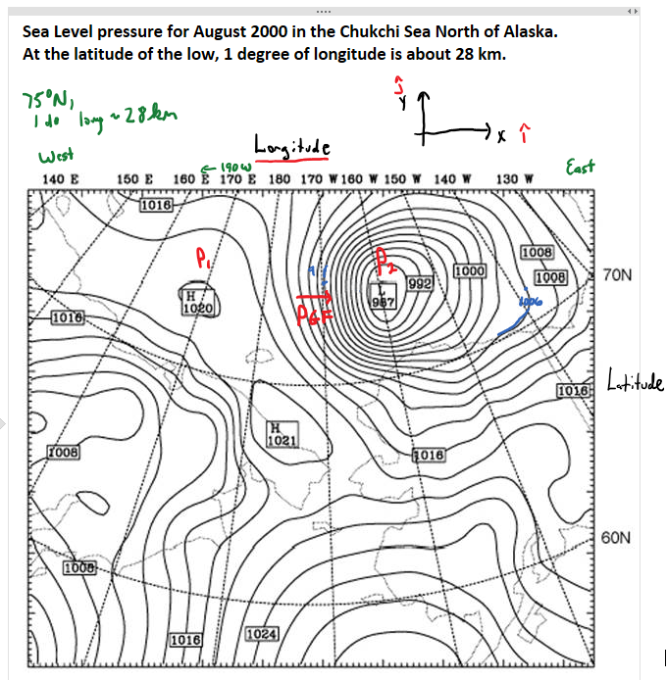
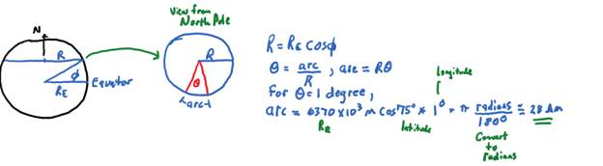
Chukchi Sea Prob 3
Calculate the pressure gradient force / mass between the center of the low and the center of the high to the west, assuming an air density of 1 kg/m3.
An air parcel starts from rest at 175 degrees West, 75 degrees North. What direction would it be accelerated assuming only the pressure gradient? How many hours does it take to reach a speed of 35 m/s?
If the high pressure was 50 km further to the West, would the air parcel take more or less time to reach 35 m/s?
Calculate the geostrophic wind speed at 170 W, 75 N using part a) for the PGF and assuming negligible friction.
Calculate the wind speed at 170 W, 75 N assuming that the pressure gradient is balanced by the centrifugal force.

Slide 40
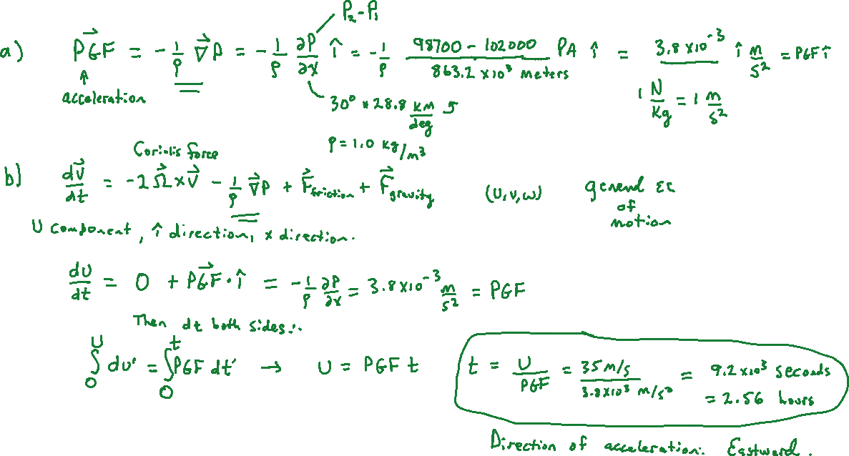
160 deg!

Slide 41
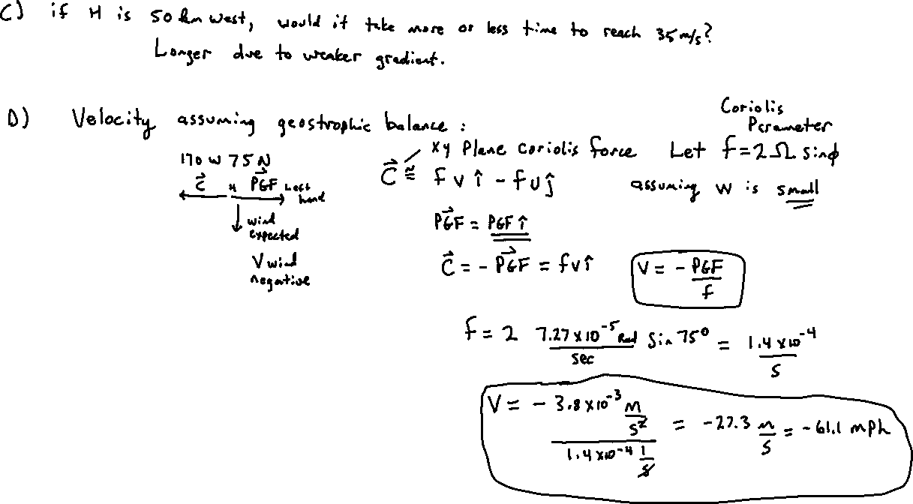

Slide 42
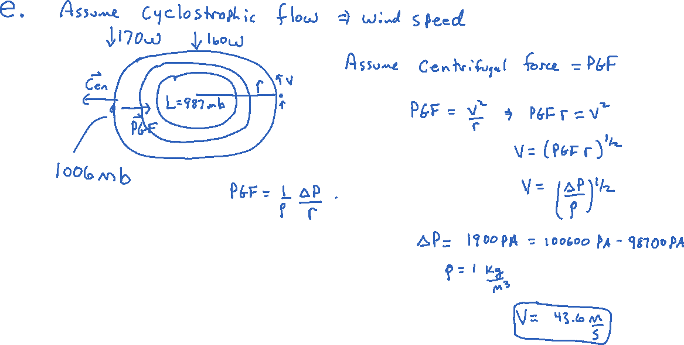

Slide 43
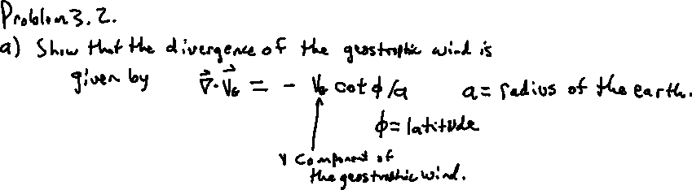
Problem 3.2 Divergence of the geostrophic wind
Explain with a diagram what makes this happen.
Work an example to see how large it is.

Slide 44
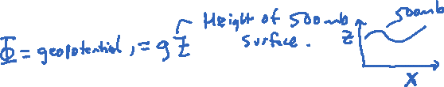

INTRODUCE: the geopotential and way of writing the force balance with it, expressing the Coriolis force using it.

Slide 45

First draw a ridge-trough system identifying where the upper level divergence and convergence is doing to happen, and set up this problem as being to the right of the trough. SEE THE NEXT PAGE!

Slide 46

Part a) Derive the relationship in this and next page.

Slide 47


Slide 48

DRAW GRADIENT WIND FIRST WITH ULD and ULConvergence
Divergence aloft -> updraft Convergence aloft -> downdraft by Dines compensation.

Slide 49


Slide 50
Long Waves and Short Waves
In part, adapted from:
https://www.youtube.com/watch?v=byzFKuXYjfU
&
https://www.youtube.com/watch?v=WLP4nKzxliA&t=201s

Slide 51

Example of 5 planetary wave pattern for Rossby waves, aka longwaves
wavelength
From <https://www.noaa.gov/jetstream/upper-air-charts/longwaves-and-shortwaves>

Slide 52

500 mb chart example
Height contours are in black. Brown arrows indicate direction of airflow. Large red dashed lines represent the location of the long wave troughs.
Shorter blue dashed lines represent the location of the of the more prominent shortwaves (There are more short waves than indicated.) Green areas represent precipitation totals. The areas of precipitation are mainly associated with shortwaves as they pass through longwaves. Like railroad cars on a train track, shortwaves will generally follow height contours.
From <https://www.noaa.gov/jetstream/upper-air-charts/longwaves-and-shortwaves>

Slide 53
Example 500 mb height chart (recent) (look at an animation with more detailed map to hunt for shortwaves in the longwave pattern.)

Slide 54




Baroclinic and Barotropic Examples

Slide 55


Slide 56



Long Waves: Rossby Waves

Slide 57

IMPORTANT EXAMPLE.

Slide 58




Comparison of Short and Long Waves

Slide 59

Short waves

Slide 60



Slide 61


Slide 62

Ridge (red) trough orange dashed

Slide 63


Slide 64





Slide 65



Slide 66



Slide 67


BOTTOM LINE: Hard to find in height charts

Slide 68



Slide 69



Slide 70



