Slide 1
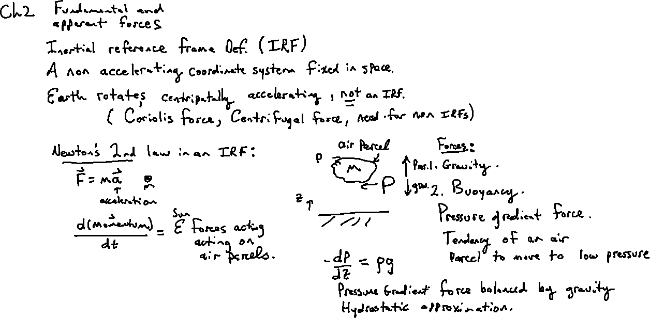
Pressure Gradient Force

Slide 2
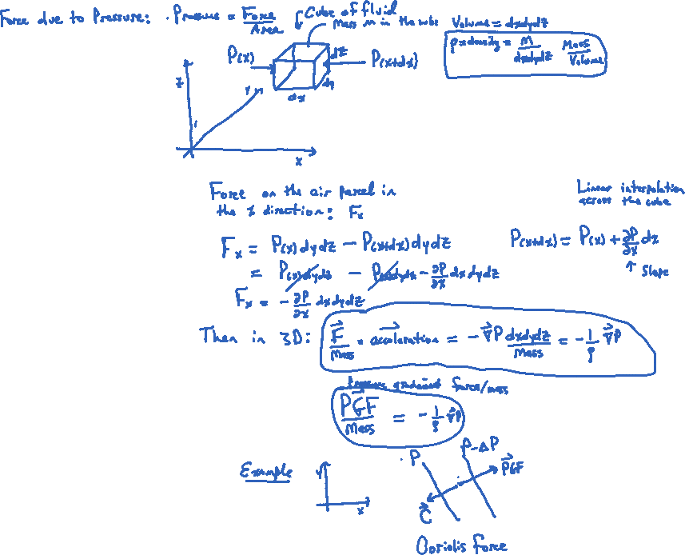

Slide 3
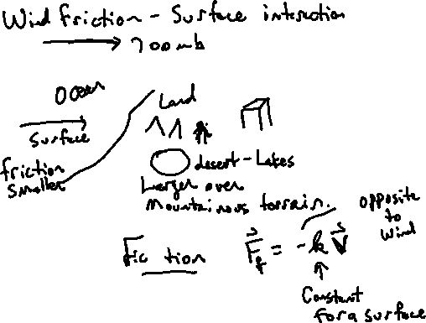
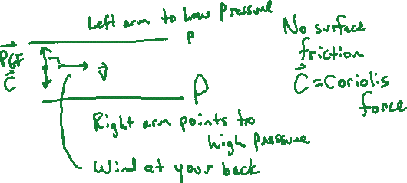
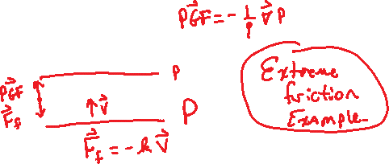

Slide 4
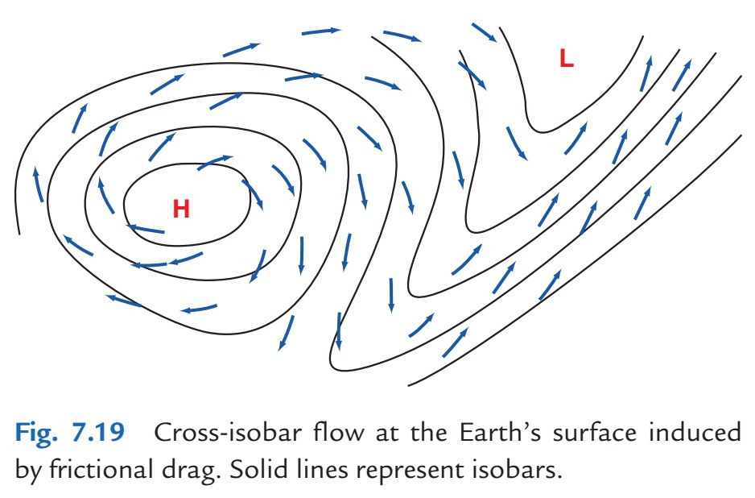
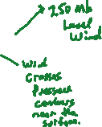
Draw the high and Low and pressure contours. Or put the image in OneNote also.

Slide 5
Example problem associated with the force balance between pressure gradient, friction, and Coriolis force (all per unit mass).
2.10. At a certain station the surface wind has a speed of 15m s−1 and is directed across the isobars from high to low pressure at an angle α = 25°. Assuming the flow is balanced, calculate the magnitude of the horizontal pressure gradient and the frictional forces per unit mass. Assume the station is located at 40°N.
Martin, Jonathan E.. Mid-Latitude Atmospheric Dynamics: A First Course (p. 41). Wiley. Kindle Edition.

Slide 6
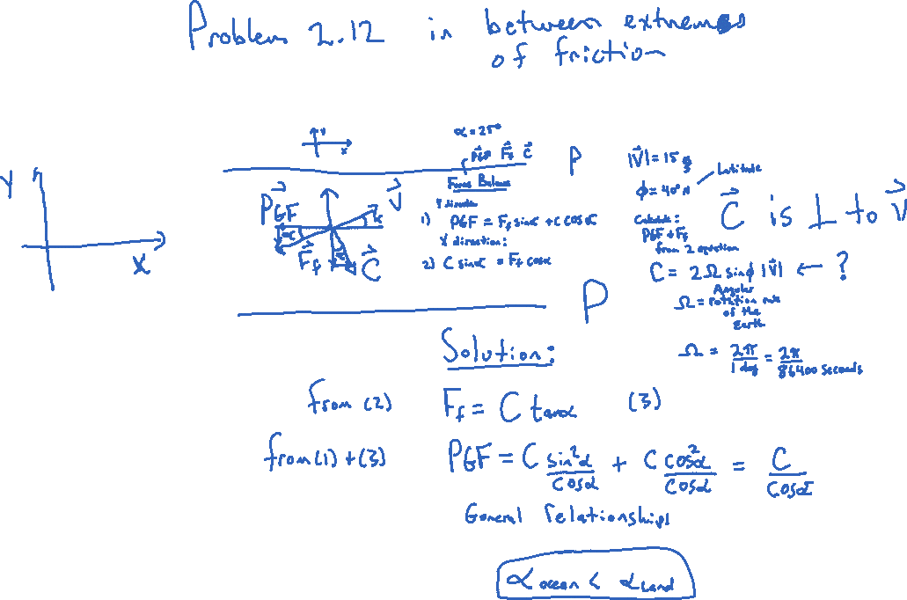

Slide 7
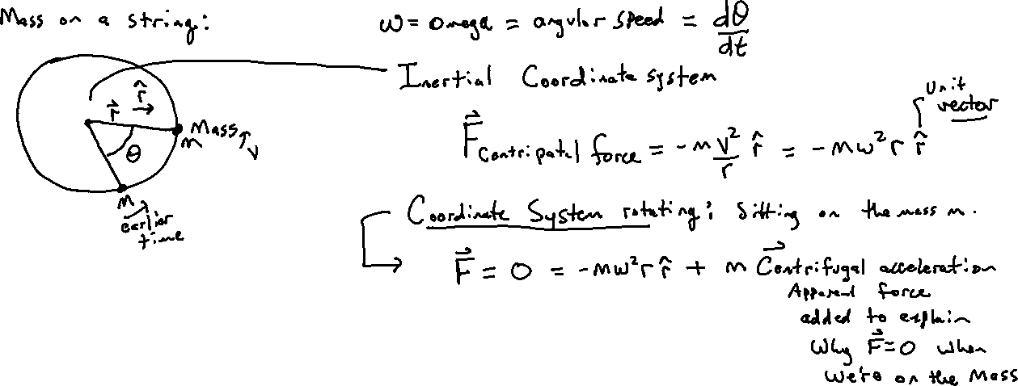
Rotating Coordinate System: Introducing apparent forces.

Slide 8
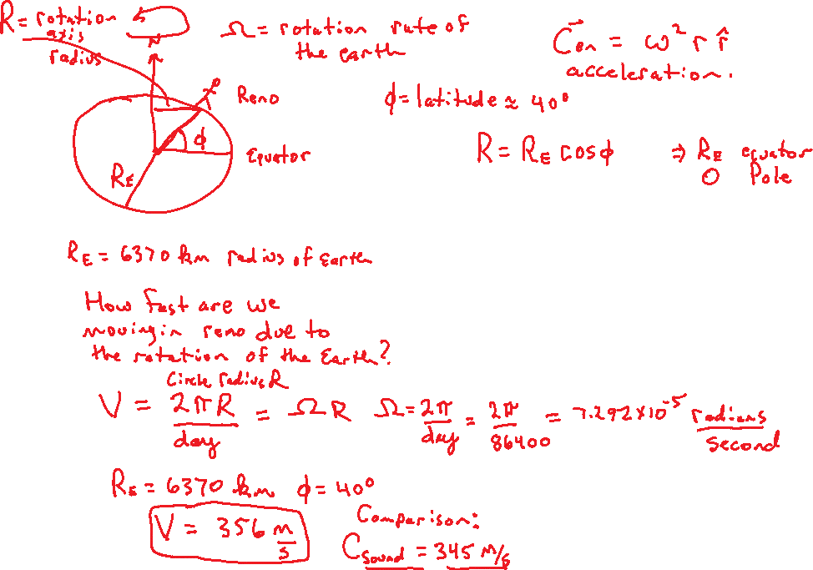

Slide 9
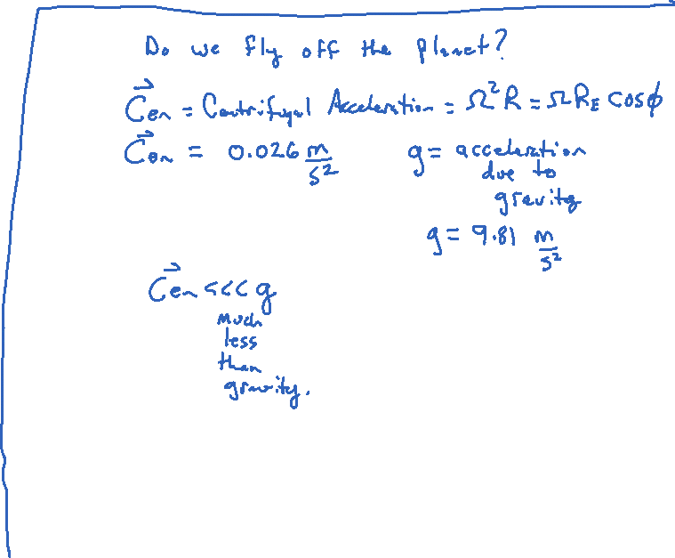
2
The Earth would have to rotate 17 times faster for the Centrifugal acceleration to be equal to the gravitational acceleration.

Slide 10
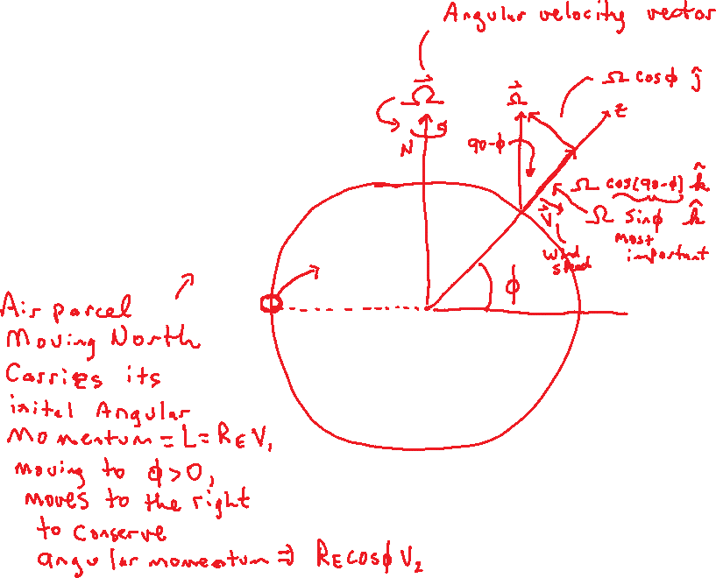
Coriolis Force
U
U₂

Slide 11
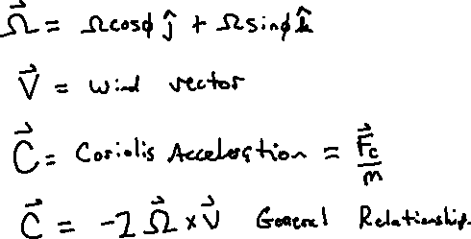
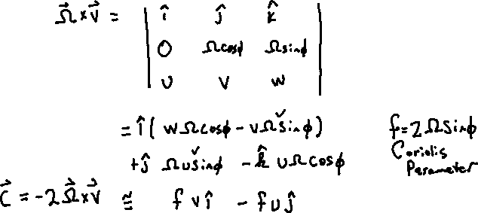
General Relations
Will find this

Slide 12
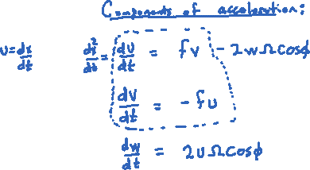

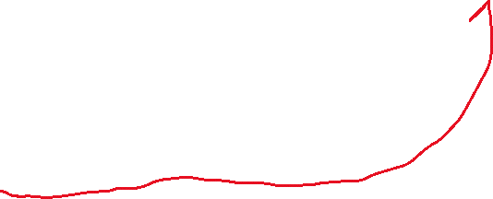
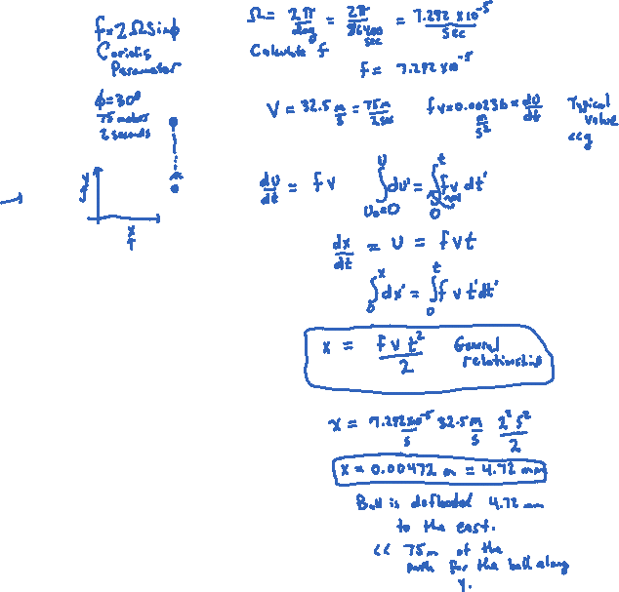

Example: Pitcher throws the ball at latitude 30N, 75 meter in the due north direction in two seconds. What is the deflection due to the Coriolis force?
This term is small because w usually small for large scale synoptics, about 3 cm compared with 50 m/s for U and V.
Sin(30)=1/2
37.5
This term is very small compared with g.
General Note: A positive v makes du/dt > 0, to the east, a westerly tendency. A positive u makes dv/dt < 0, to the south, a northerly tendency.
CAST THE PROBLEM DIFFERENTLY: Have the pitching to the east rather than to the north. Use symbols rather than values. Throws the ball x meters due east in tau seconds. u=x/tau, y=-fu tau^2/2,
so y = -fx tau / 2. Leave it in notation.
37.5

Slide 13
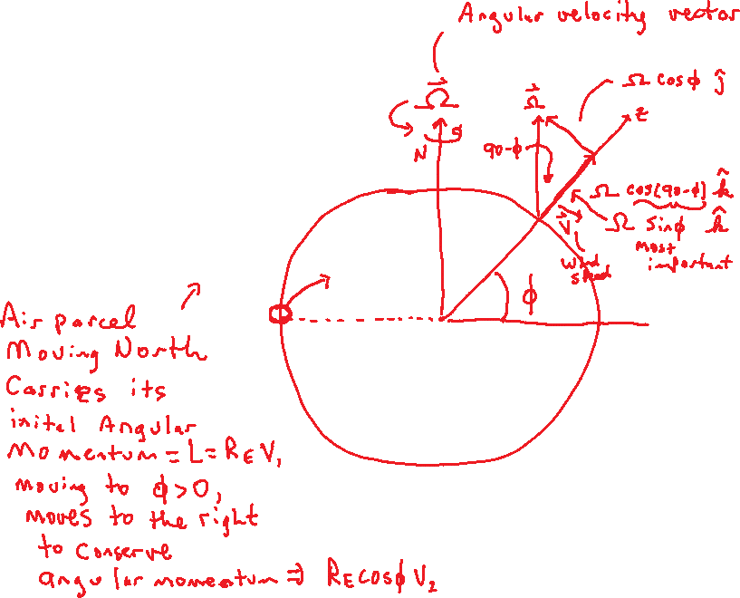
Summary
U
U₂

Slide 14
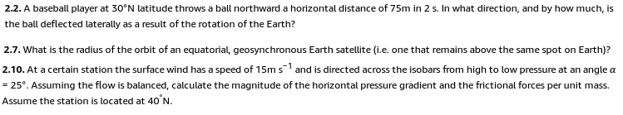

Problems for Chapter 2
Assignment 3

Slide 15
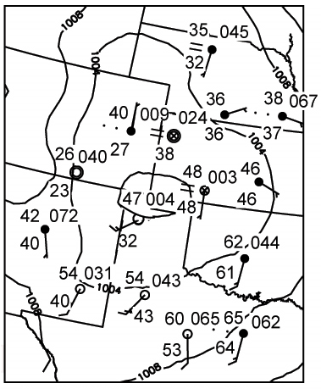
Example PGF and Coriolis Force: Copy image to OneNote. SKIP

Slide 16
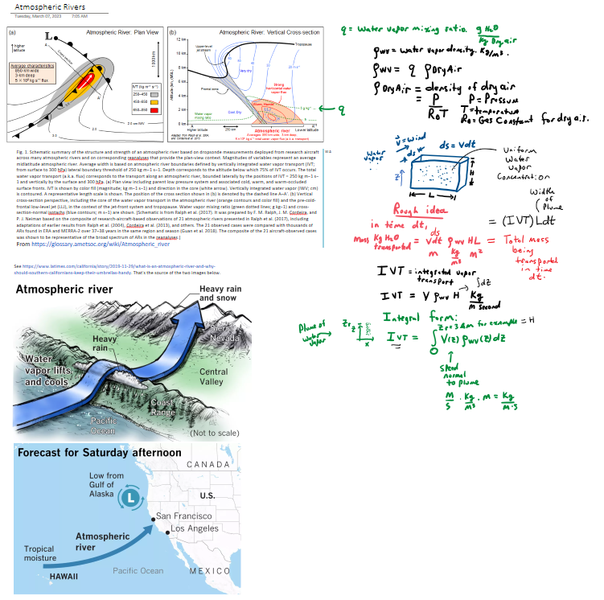
Atmospheric Rivers: Copy to OneNote from other OneNotebook.

Slide 17
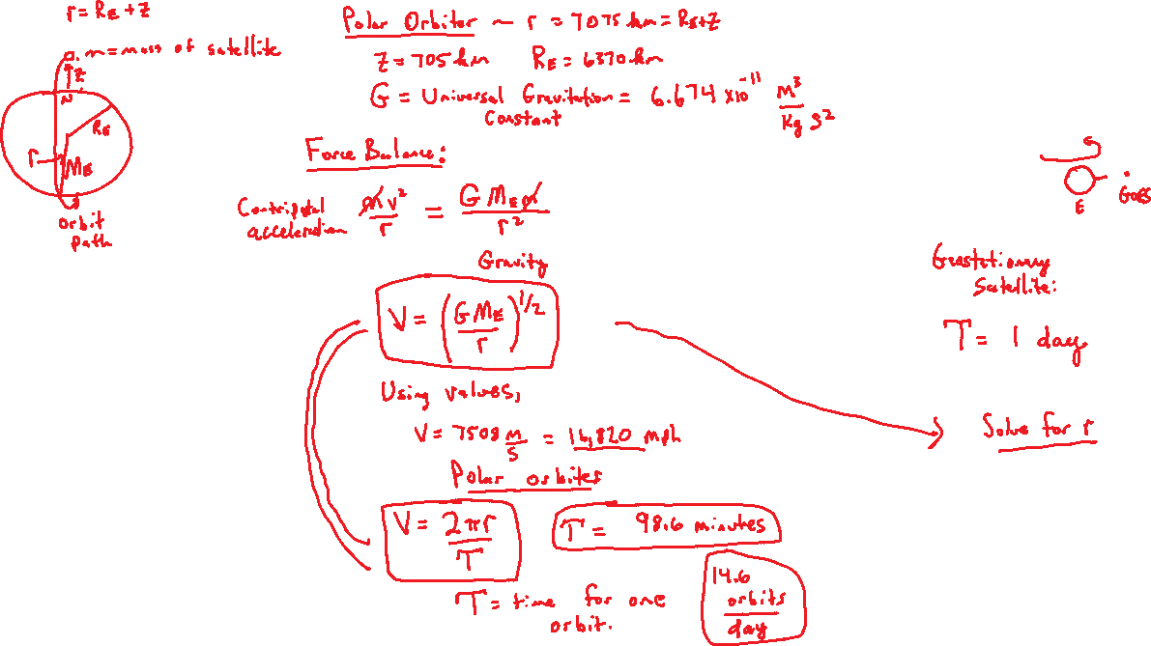
Satellite Problem: First solve for NASA Aqua and Terra Polar Orbiters and set up GOES.

