Slide 1

Severe Fire Danger Index
Sarah Jakober
Graduate Research Assistant
Western Regional Climate Center

Slide 2
The Journal article
Jolly, W. M., Freeborn, P. H., Page, W. G., & Butler, B. W. (2019). Severe Fire Danger Index: A Forecastable Metric to Inform Firefighter and Community Wildfire Risk Management. Fire, 2(3), 47. Retrieved from https://www.mdpi.com/25716255/2/3/47

Slide 3
Introduction
Wildfires have been increasing in severity over the last four decades
Wildfires pose significant threats to communities
Notes:
BULLET ONE:
- research from the lead author and others shows that wildfires burn longer and spread faster
- firefighters are exposed to more and more risk
- a decision support tool would help reduce exposure and help firefighters better manage risk
BULLET TWO:
- the WUI (wildland urban interface) is facing increasing consequences from more dangerous fires
- An early warning system that could predict severe fire danger would be beneficial here as well

Slide 4
introduction
Fire danger can be estimated using fire danger rating systems, which can operate with numerical weather predictions
The SFDI (Severe Fire Danger Index) proposes utilizing Energy Release Component (ERC) and Burning Index (BI), from the US fire danger rating system.

Slide 5
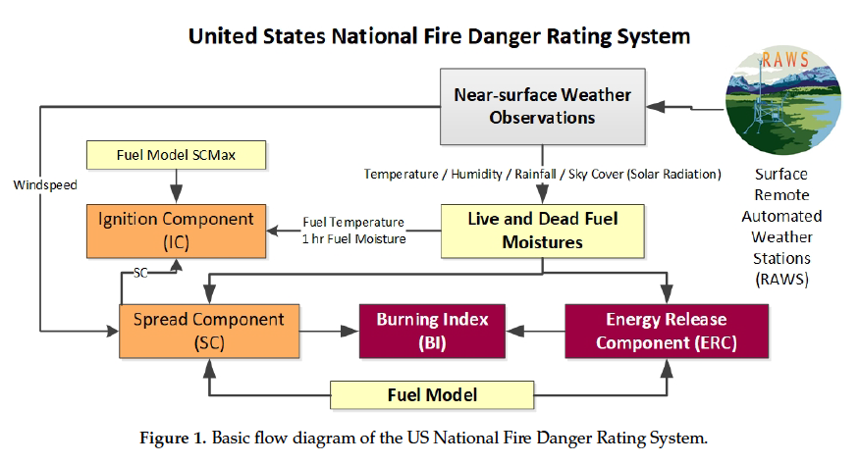

Slide 6
Materials and methods
Abatzoglou, J.T. Development of gridded surface meteorological data for ecological applications and modelling. Int. J. Climatol. 2013, 33, 121–131.
http://www.climatologylab.org/gridmet.html

Slide 7
Materials and methods
ERC and BI are calculated (using gridded data) and normalized relative to their site-specific climatology
…compared against reported fire activity
…and ongoing fire activity as measured by MODIS (moderate resolution image spectroradiometer)

Slide 8
Materials and methods
ERC = the amount of heat per area released during flaming
BI = flame length (feet)
p’ = ERC’ x BI’

Slide 9
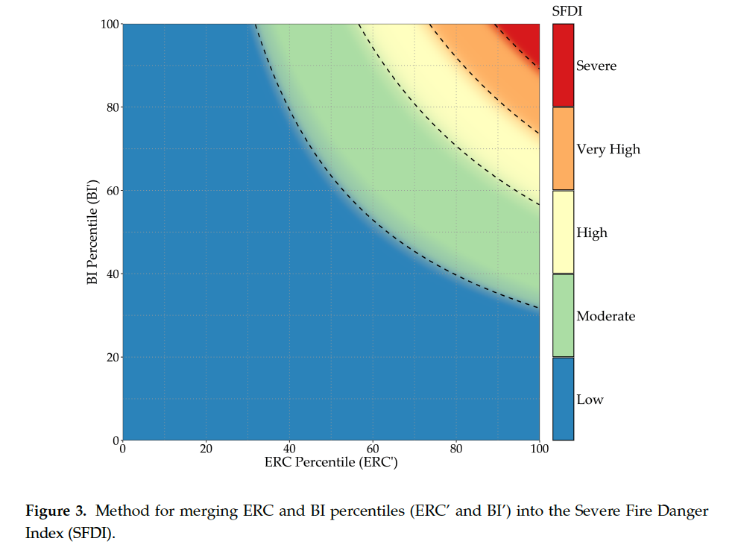
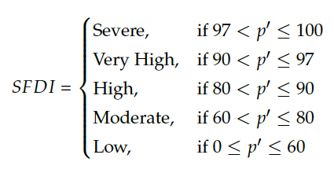
Materials and methods

Slide 10
COMPARISONS
Two datasets:
Recorded fire information (Fire Occurrence Database)
Remote sensed fire information (MODIS active fire product)

Slide 11
EVALUATIONS
ERC’ and BI’ verses…
- total number of new fires discovered
- total burned area on discovery date AND after discovery date
- total number of active fire pixels discovered
- total sum of fire radiative power (FRP)

Slide 12
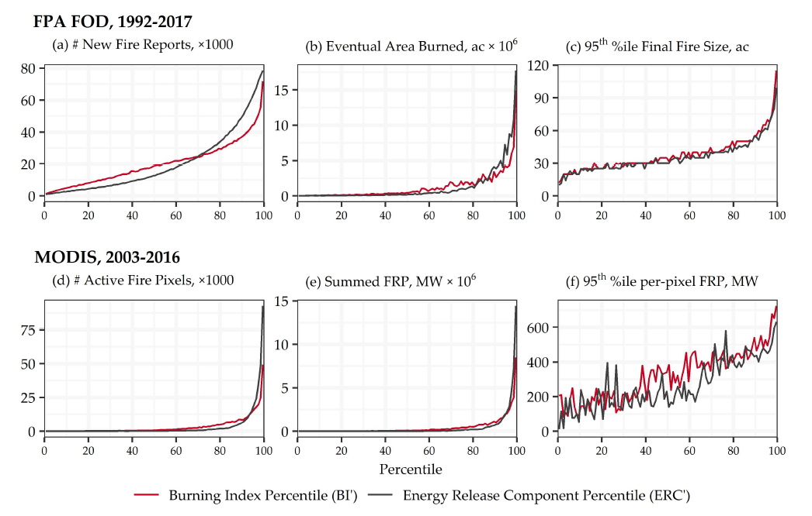

Slide 13
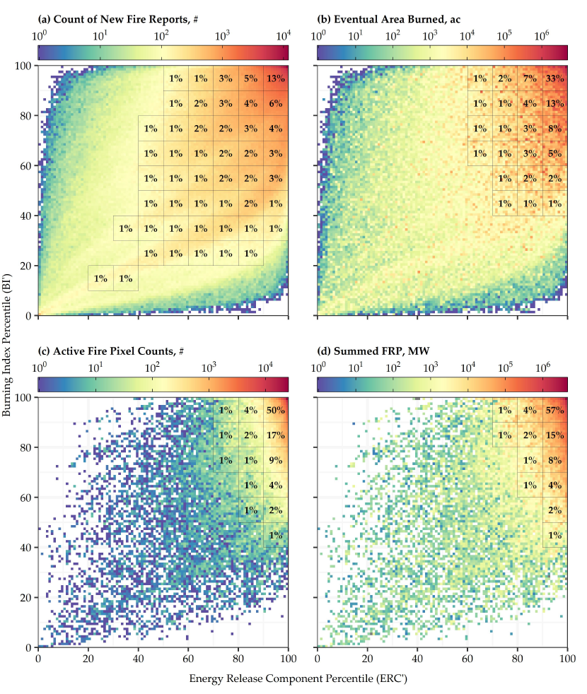
Results

Slide 14
Case study
Significant California wildfires in 2017 and 2018…
- Atlas
- Nuns
- Redwood Valley
- Tubbs
- Thomas
- Carr
- Mendocino Complex
- Camp
- Woolsey

Slide 15
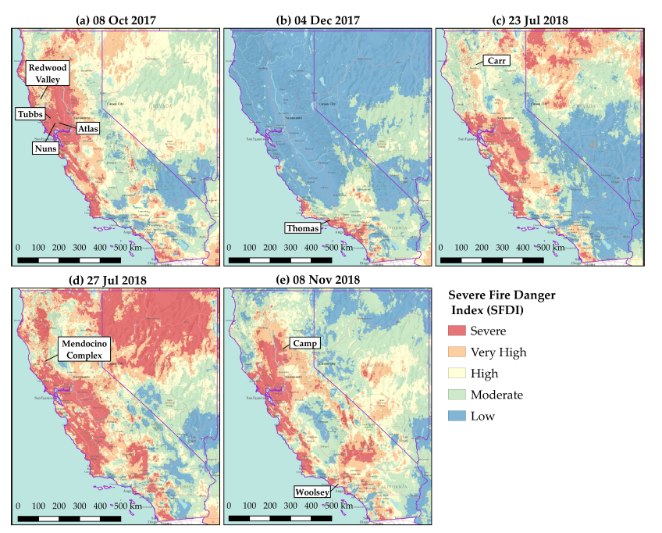
Case study

Slide 16
discussion
New index provides rapid decision support to wildland fire management
By using percentiles as a means of comparison, the local climatology is considered

Slide 17
Conclusion
How do you see fire danger forecasts being integrated into future community preparedness?
What is missing from the public (common) understanding of fire danger?
As fire danger becomes a more salient issue, who is responsible for developing tools to inform and forecast?

