Slide 1
Dust Impact of Rapid Agricultural Expansion on the Great Plains
Lambert et al. (2020), Geophysical Research Letters
ATMS 790, Spring 2021
Presenter: Saroj Dhital
March-1, 2021

Slide 2
Introduction
Agricultural expansion in Great Plain rapidly increased in the late 2000s due to biofuel boom
Replaced soil-stabilizing grasslands with drought-sensitive crops
2006-2011, ~ 530,000 ha of grassland was lost due to new cropland in North Dakota, Nebraska, Minnesota & Iowa
In the 20th century U.S. southwest, south and southern Great Plains drought duration and severity increased
Threaten to the increase in dust loading

Slide 3
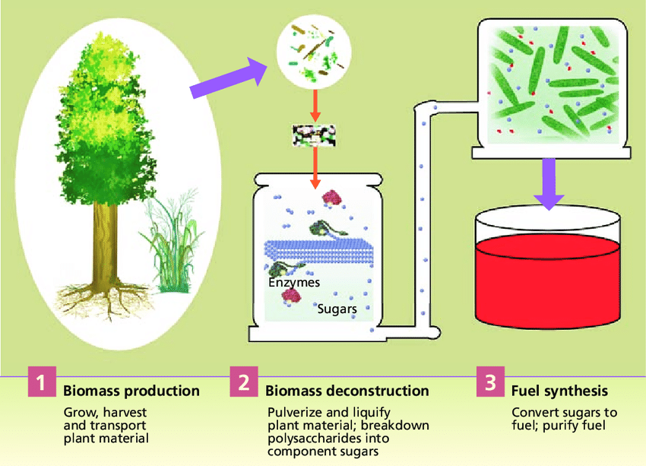
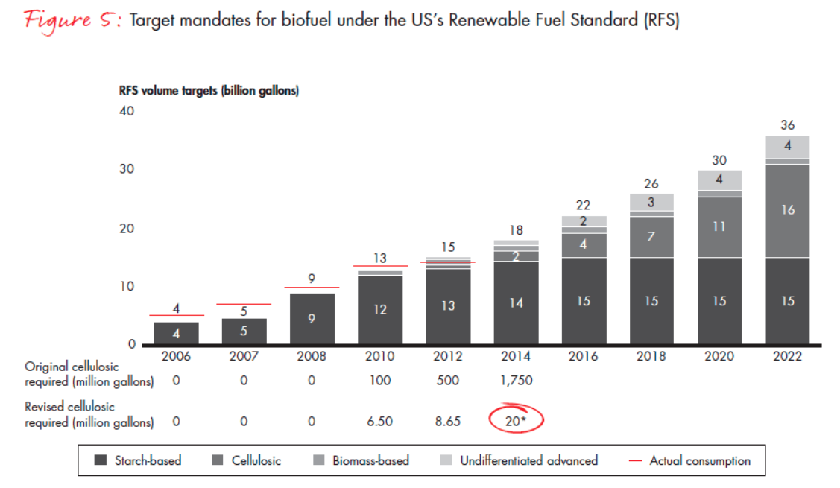
Introduction (biofuel boom)
Biofuel: Biomass conversion into liquid fuels (ethanol and biodiesel)
[source: http://genomics.energy.gov]
[Source: https://www.bain.com/insights/biofuels-from-boom-to-bust/]

Slide 4
Introduction
Coupled Model Intercomparison Project Phase 5 (CMIP5) projected 50-200% increasing summertime drought risk in the Great Plains in response to warming of 1-4°C
This could lead to Dust bowl situation
What is the Dust Bowl situation?

Slide 5
Dust Bowl
Driest region of the Plains – southeastern Colorado, southwest Kansas and the panhandles of Oklahoma and Texas in 1930s
Large amount of topsoil was blown from the barren lands
Damaged the ecology and agriculture of the American and Canadian Prairies
Drought and failure to apply drylands farming methods increased aeolian processes
[source: https://livinghistoryfarm.org/farminginthe30s/water_02.html]

Slide 6
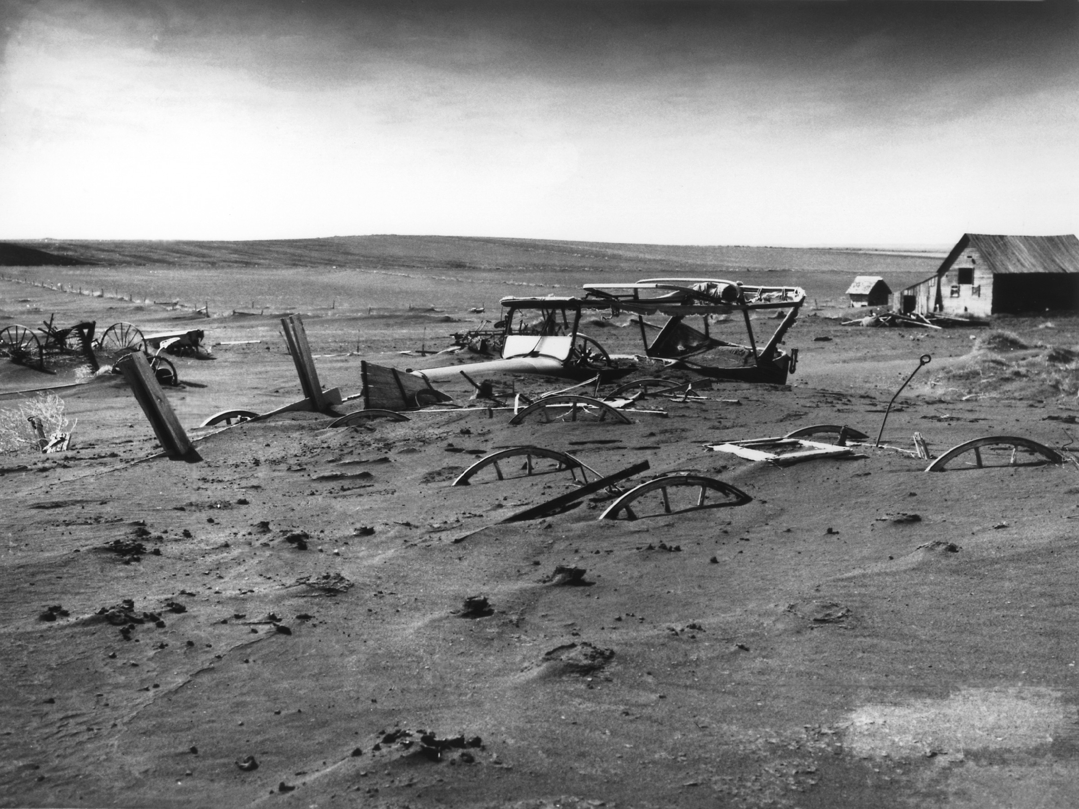
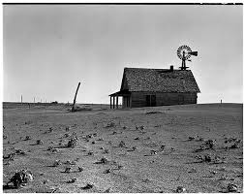
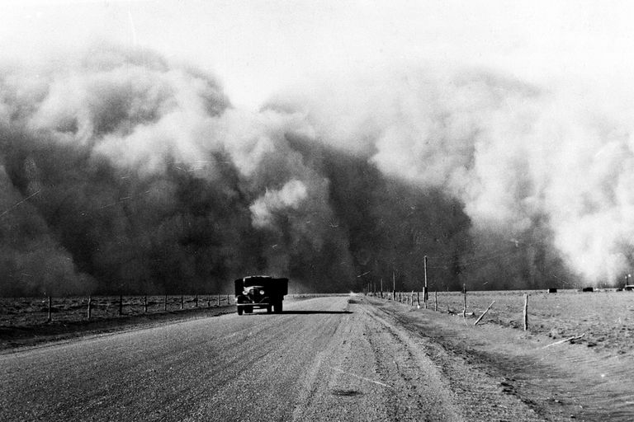
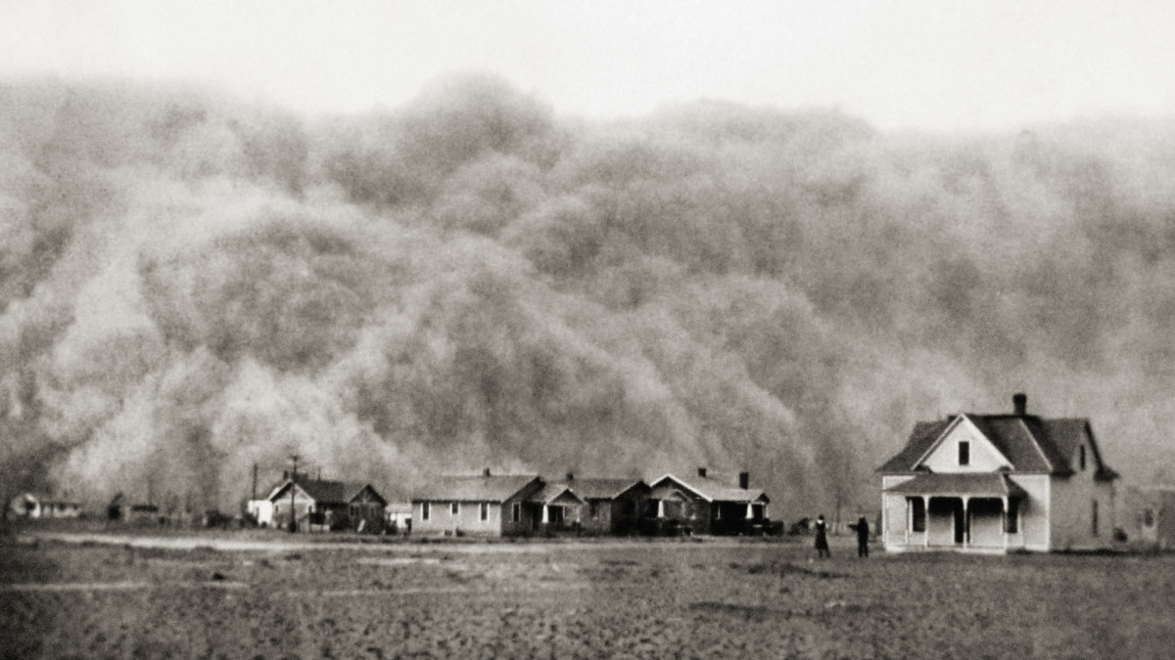
Dust Bowl (1930s)
[source: University of Chicago News]
[source: Texas highways.com]
[source: thoughtco.com]
[source: history.com]

Slide 7
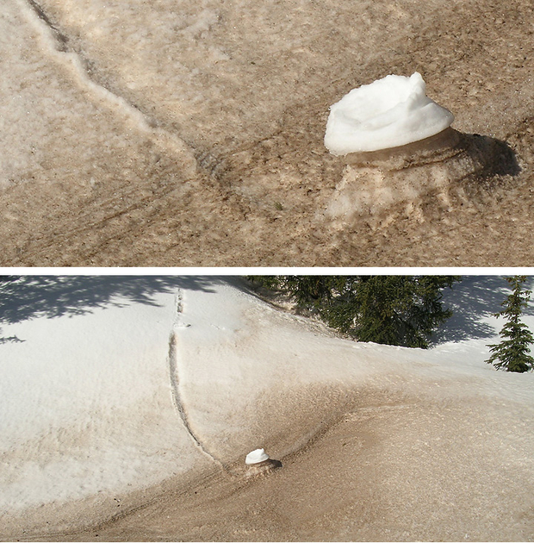
Importance of dust
Large uncertainty in radiative forcing
Deposition on snow results in fast melting of snowpack due to reduction in snow albedo
Impacts on water resources
[source: NOAA climate.gov]

Slide 8
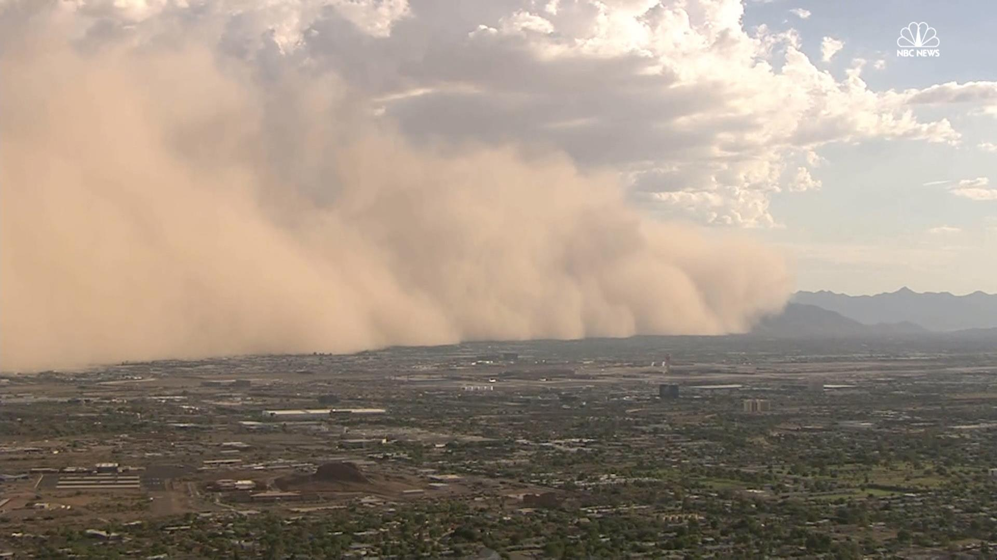
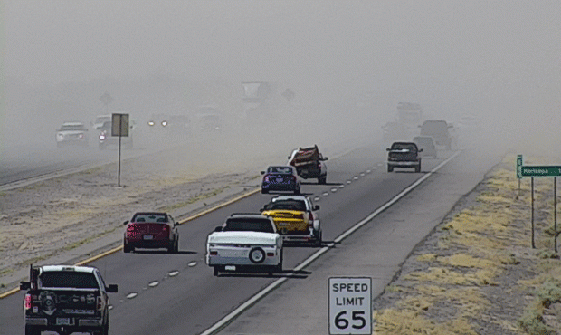
Importance of dust
Respiratory complications, fever, meningococcal meningitis
Impacts road and aviation traffic through reduction in visibility
Mineral dust is beneficial to the soil as it carries nutrients
[source: nbcnews.com
[source: ktar.com]

Slide 9
Research objectives
How agricultural expansion has changed the dust loading over the U.S. Great Plains
Understanding future possibility of the 1930s Dust Bowl situation and properly mitigate the possible future risks

Slide 10
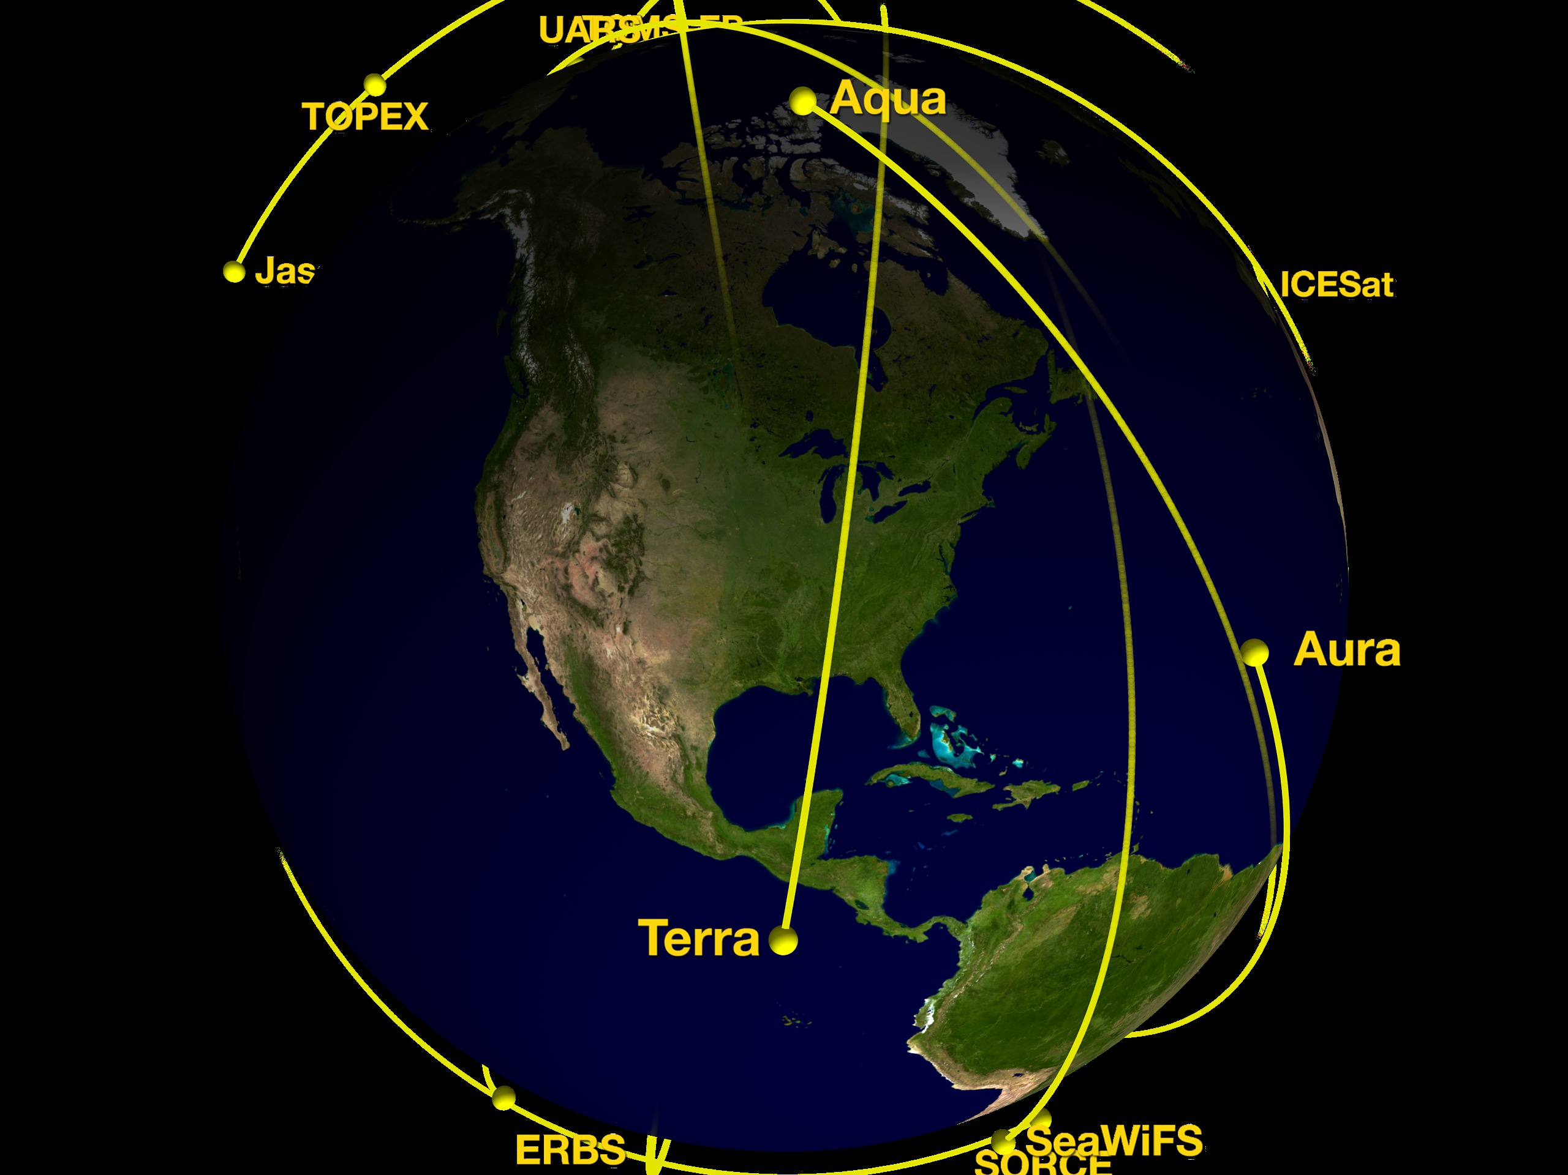
Data
MODIS (Terra) Level 3 (1°x1° ) daily average of aerosol optical depth (AOD) for 2000-2018
AOD: Measure of extinction of solar beam by dust or haze
AOD over land: Dark Target aerosol retrieval algorithm for bands centered at 470, 550, and 660 nm
AOD at 550 nm is used in this study
Temporal resolution: ~2 days
MODIS: Moderate Resolution Imaging Spectroradiometer
[Source: NASA.gov]

Slide 11
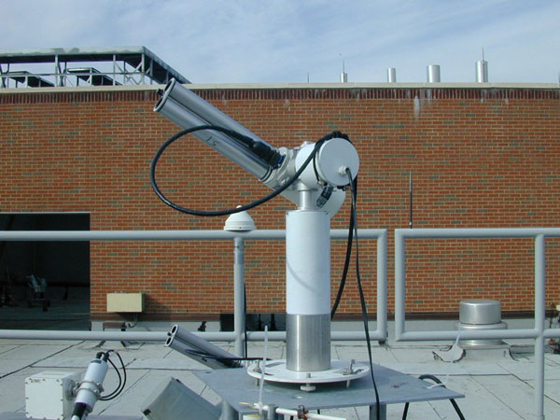
Data (AERONET)
Ground based AOD: AERONET
Cimel Sun photometer
Sky radiances and Sun irradiance between 340 and 1640 nm
AERONET: AErosol RObotic NETwork
UNR AERONET station
[Source: nasa.gov]

Slide 12
Data (AERONET)
Ground based AOD: AERONET (4 sites)
AOD temporal resolution: 3 or 15 min during daytime clear sky
550 nm band results for AOD
15 min resolution data were used
Dust signal: Coarse mode AOD parameter, Spectral Deconvolution Algorithm

Slide 13
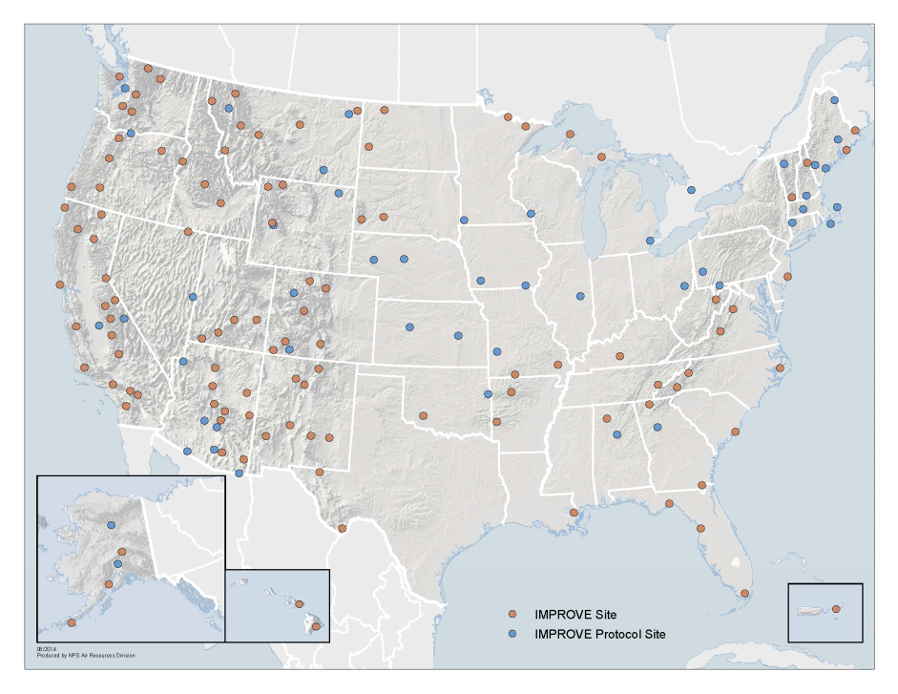
Data (IMPROVE)
IMPROVE network: visibility and aerosol condition
PM₁₀ and PM_{2.5}
24 hours aerosol filters are collected every third day (3-day temporal resolution)
IMPROVE: Interagency Monitoring of Protected Visual Environments
[source: http://vista.cira.colostate.edu/Improve/improve-program/]

Slide 14
Data (IMPROVE)
23 sites within the study area
IMPROVE’s PM_{10-2.5} : Difference between PM₁₀ and PM_{2.5}, change in dust
Soil is the largest contributor to PM_{10-2.5} in majority of the U.S.

Slide 15
Data (cropland)
Cropland change: U.S. Department of Agriculture’s Cropland Data layer (CDL)
Uses satellite imagery to classify cropland annually at the 30 cm resolution (2008-2018)
Classification
All crop features: crop
All non crop features: noncrop
% change in cropland coverage: 2000-2018 at 1°x1° to match MODIS data

Slide 16
Data analysis
Trend analysis of AERONET and IMPROVE dataset (Theil-Sen Estimator method)
Quantile regression of the 90th percentile of AERONET and IMPROVE coarse mode observations
Lagged correlation between cropland change and MODIS AOD_{dust}

Slide 17
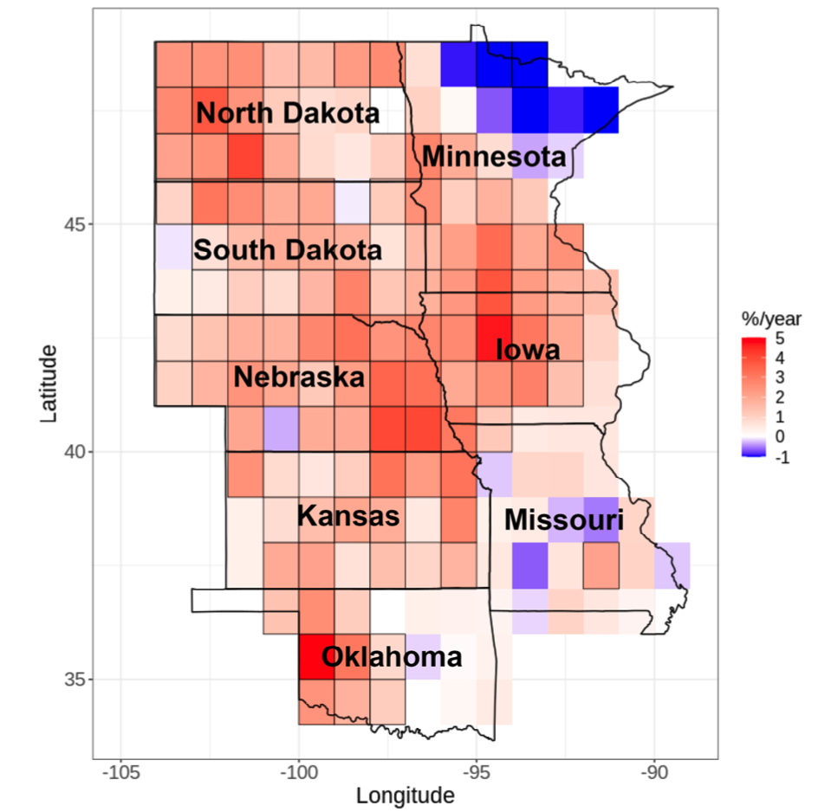
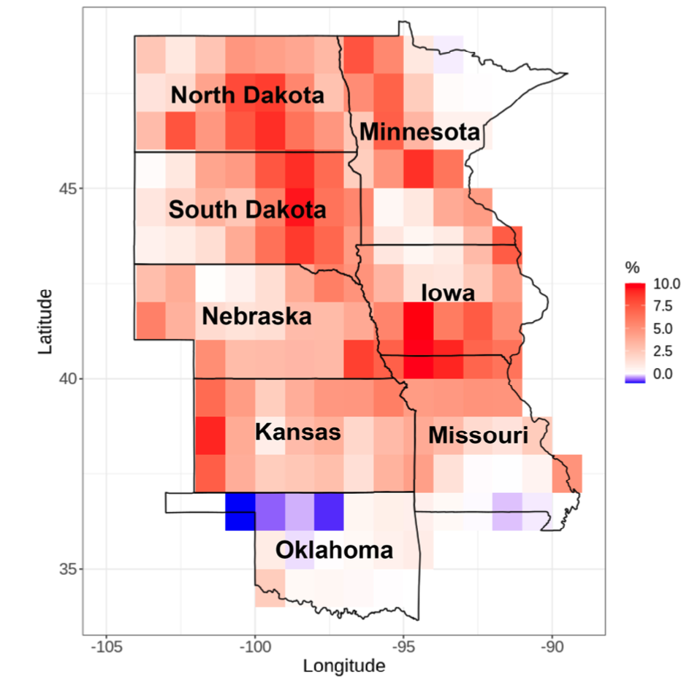
Results (trend in MODIS AOD_{dust} , cropland change)
MODIS AOD_{dust} increased by 3-5%/year during 2000-2018
Cropland area increased by 7.5-10% during 2008-2018
Figure: Trend in MODIS AOD_{dust} for 2000-2018
Figure: Percent change in cropland coverage for 2008-2018

Slide 18
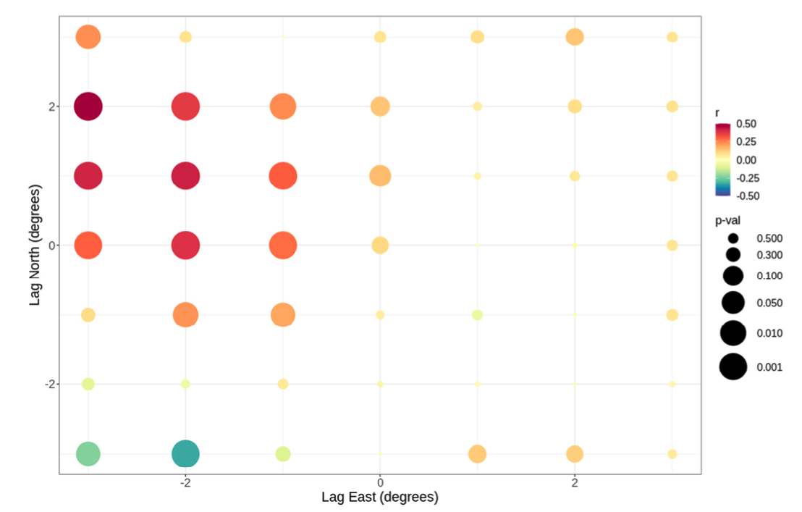
MODIS AOD_{dust} vs. cropland change
Strongest and most significant correlations: 2° to the west and 1° degree to the north
Cropland expansion is contributing dust load to the northwest
Consistent with the wind speed and direction climatologies
Figure: Lag correlation coefficient between MODIS AOD_{dust} trends (2000-2018) and CDL cropland change (2008-2018)

Slide 19
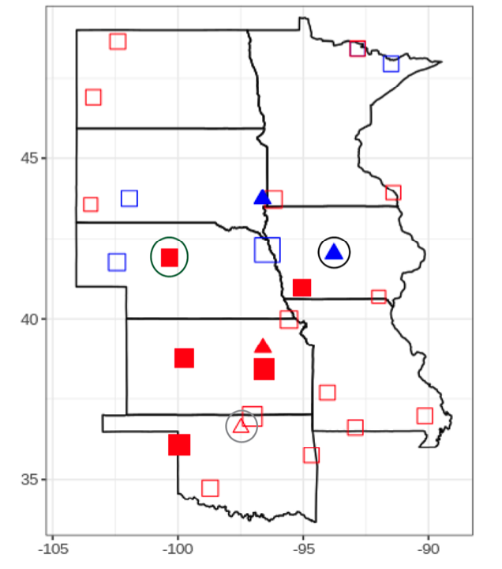
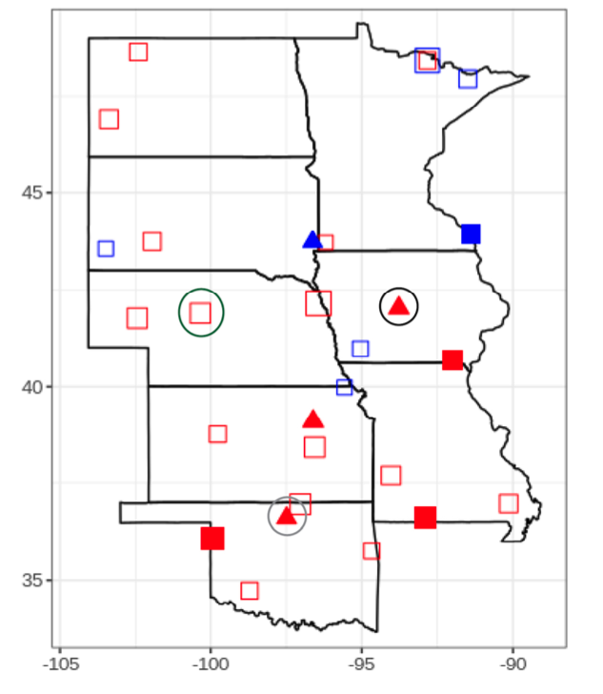
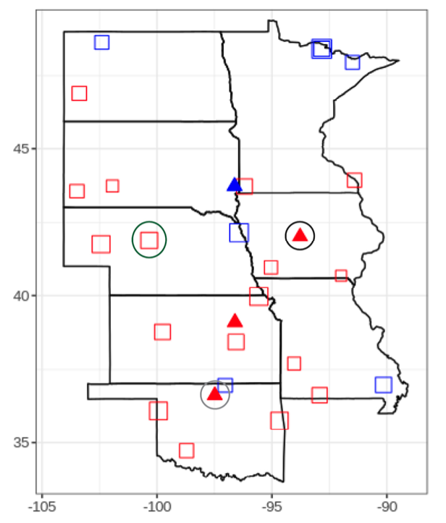
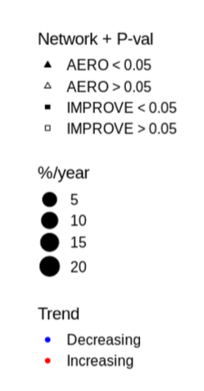
Planting and harvesting season’s dust trend
March June October
Figure: Monthly trend in 90th percentile AERONET AOD (1995-2018) and IMPROVE PM_{10-2.5} (1988-2018)
Positive trend are observed during planting and harvesting season
March: Corn planting, June: Soybean planting, October: Corn and soybean harvesting

Slide 20
Summary
Dust AOD increased by ~5% per year across the Great Plains for 2000-2018
Cropland area expanded by 5-10% during the 2008-2018
The increase in cropland is correlated with MODIS dust AOD to the west and northwest
The observed positive trend in dust AOD increase is consistent with the planting and harvesting season

Slide 21
Conclusions
Desertification is increasing risk in the Great Plains due to drought severity associated with climate change
Could lead to economic and human impact as in the case of 1930s Dust Bowl

Slide 22
Thank you very much
Questions?

