Slide 1
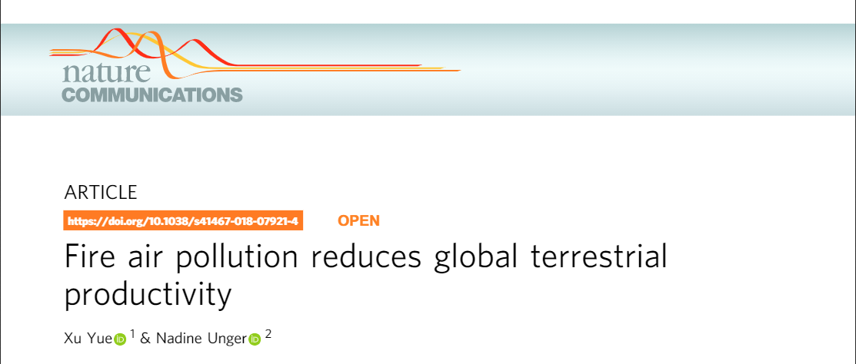
Mona Farnisa

Slide 2
Outline
O₃, PM and Plants
Methods
Figures
Hemp 2020
2020 Air Quality
Conclusions

Slide 3
Abbreviations
O₃ – ozone
PM – particulate matter
GPP – gross primary productivity
DFE – Diffuse fertilization effects
PAR – Photosynthetically active radiation
AOD – aerosol optical depth

Slide 4
Why is it so hard to quantify wildfire smoke effects on agriculture?
O₃ and PM have inverse effects on plant productivity

Slide 5
Ozone (O3)
O₃ formed by oxidation of CO and VOCs in presence of NOx and sunlight
O₃ inflicts phytotoxic damage to the plant tissue in the stomata
Oxidizes and burns the plant tissue during respiration
Reductions in gas exchange, photosynthesis and biomass
Necrosis of leaf tissue

Slide 6
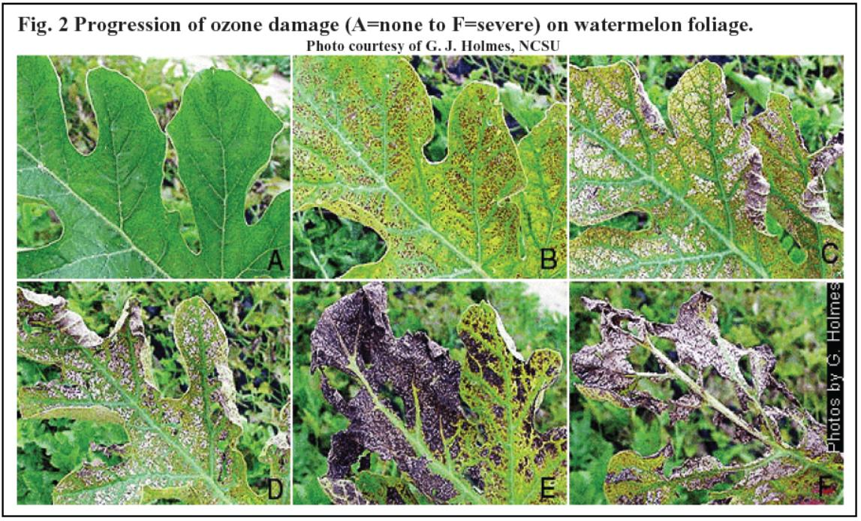
Van Dingenen et al. (2009) find year 2000 RY losses due to ozone to be 3–5 %for maize, 7–12 % for wheat, and 3–4 % for rice, with ranges due to variation in exposure metric

Slide 7
Particulate Matter (PM)
PM can be directly emitted or chemically formed in the atmosphere
Dependent on region and source
PM aerosols promote photosynthesis by enhancing diffuse radiation
PM scatters light reducing light that reaches surface
Increased light scattering allows increased radiation to reach lower canopy
Overall, some plants (C3 plants) may photosynthesize more because of the increased light scattering on shaded leaves
Termed: Aerosol diffuse fertilization effects (DFE)

Slide 8
C3 and C4 plants
Different photosynthetic pathway classifies plants as either C3 or C4
C4 plants would decrease photosynthetic productivity due to a decrease in surface level sunlight
C4 plants (maize, grasses, sugarcane)
C3 plants would increase photosynthetic productivity because of more diffuse light towards shaded leaves
C3 plants (wheat, rice, potato, hemp, most crop plants)

Slide 9
Why is it so hard to quantify wildfire smoke effects on agriculture?
O₃ and PM have inverse effects on plants
Crops have different threshold sensitivities to O₃
PM effect on plant physiology/productivity is still relatively understudied
C3 and C4 plants react differently to light scattering
Relatively short fire season
Smoke exposure length vs concentration of pollutants
Many agricultural crops are annual
Notes:
Weather, cloud cover

Slide 10
Models Used
GEOS-Chem – predicts fire induced changes in aerosols and surface O3
Column Radiation Model (CRM) – quantifies perturbations in diffuse and direct solar radiation caused by fire aerosols
Yale Interactive terrestrial Biosphere (YIBs) – global vegetation model used to quantify changes in ecosystem gross primary productivity (GPP) due to O3 inhibition and aerosol diffuse fertilization effects (DFE)

Slide 11
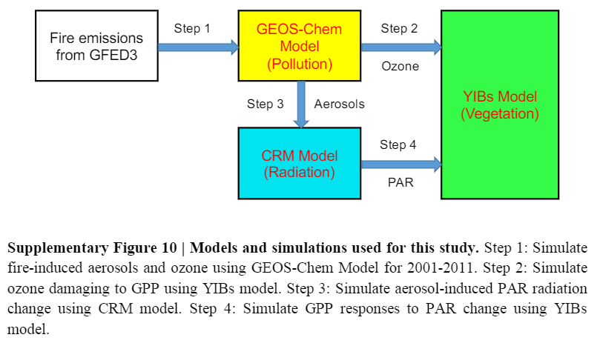
Methods
2001 – 2011 period
Multiple sensitivity models run
Wildfire emissions taken from Global Fire Emission Database (GFED)

Slide 12
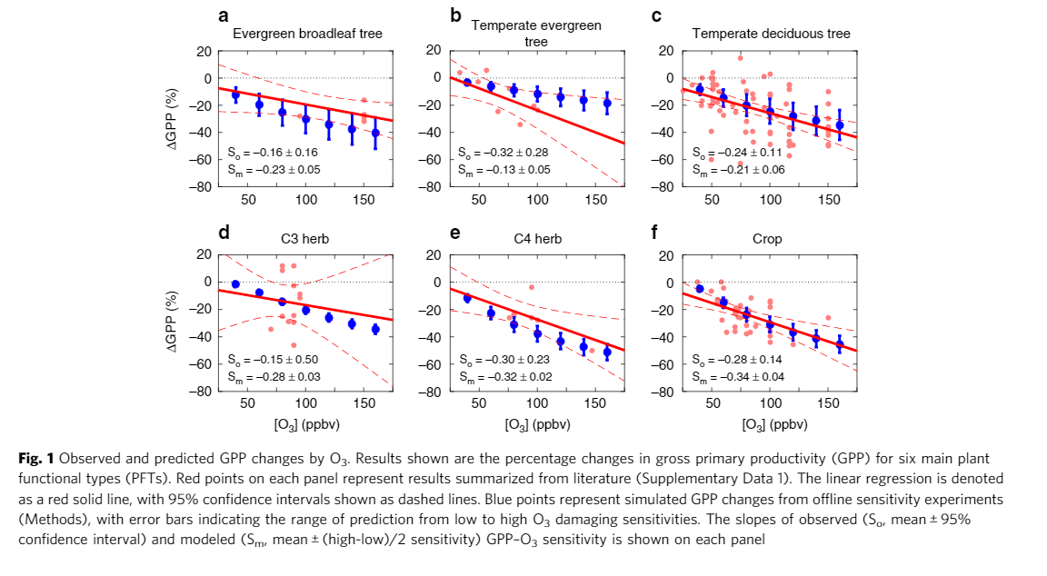
Gross Primary Productivity ~ O₃
Notes:
GPP and O3 calculated as a function of stomatal O3 flux.

Slide 13
Gross Primary Productivity ~ O₃
GPP decreases by 0.24-0.30% for 1 ppbv O₃ increase
For C3 herb not enough O₃ data measurements for accurate simulation
Notes:
GPP and O3 calculated as a function of stomatal O3 flux.
OZONE DECRESES GPP

Slide 14
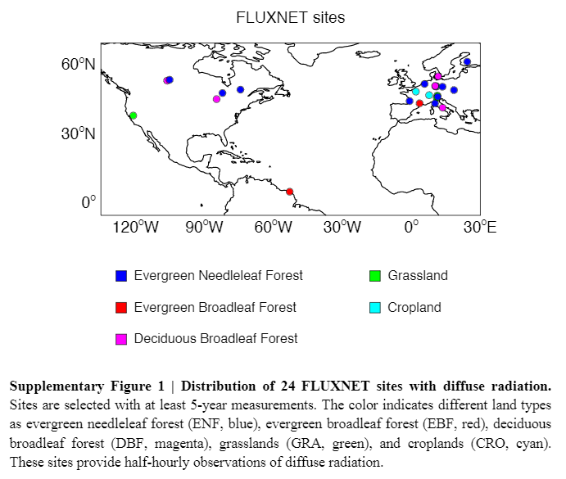
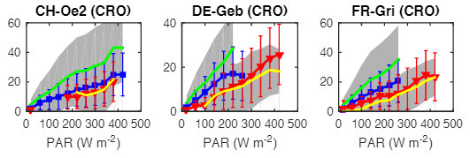

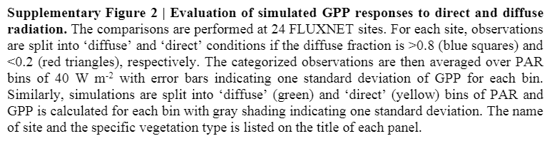
Gross Primary Productivity ~ Photosynthetically Active Radiation

Slide 15
Gross Primary Productivity ~ Photosynthetically Active Radiation
GPP increases with PAR at different rates for diffuse and direct light
GPP grows faster when light is diffusive

Slide 16
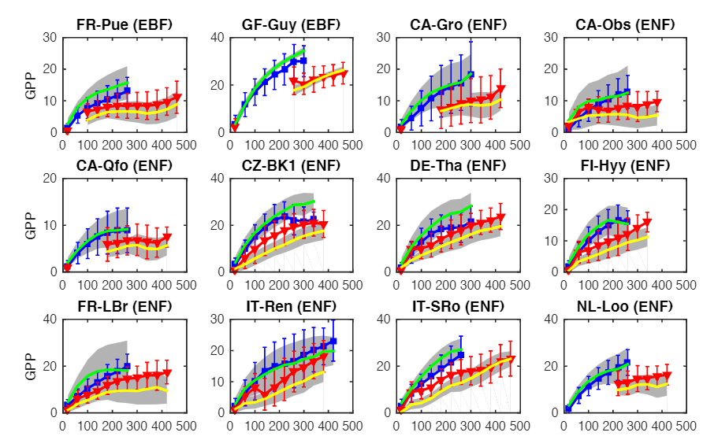
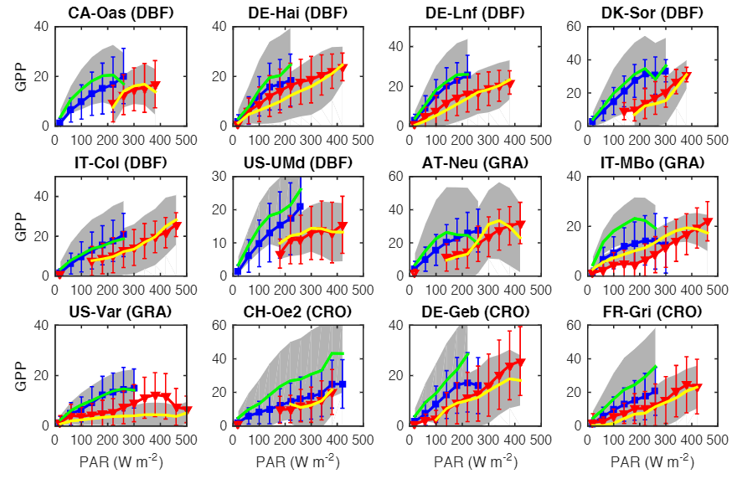
Gross Primary Productivity ~ Photosynthetically Active Radiation
EBF - Evergreen Broadleaf Forest
ENF - Evergreen Needle Forest
DBF - Deciduous Broadleaf Forest
GRA – Grassland
CRO – Cropland

Slide 17
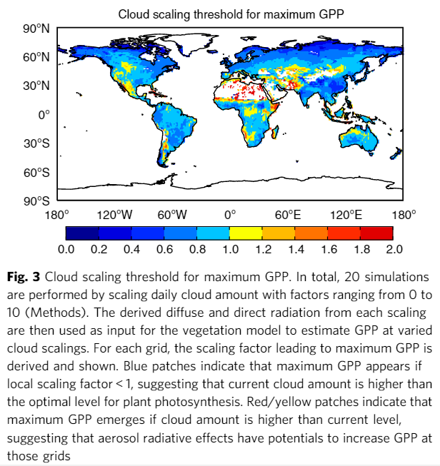
Cloud diffuse effects on Gross Primary Production
Notes:
The reason modelling aerosols and understanding the effect of PM can be difficult is because of cloud cover.
There has to be the right amount of cloud cover because if you have too much than you’re actually shading the plant = no photosynthesis.
Too little also doesn’t really activate the effects of diffuse radiation events.

Slide 18
Cloud diffuse effects on Gross Primary Production
- Over arid and semi-arid regions cloud scaling is >1
Not many clouds
Atmospheric aerosol increases in red/yellow areas can result in increases in plant photosynthesis

Slide 19
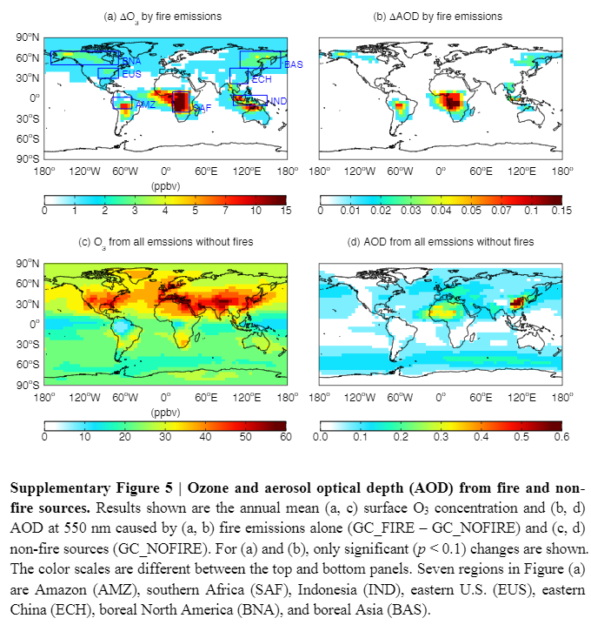
Fire effects on O3 and aerosols
Fire emissions cause increases in surface O₃ and aerosols
From 2002-2011 fires increase global O₃ by 5.4 ± 0.6% and global aerosols by 9.6 ± 1.9 %
Notes:
Here we see the net effect of ozone and aerosols from fire emissions.
Western US severely underrepresented

Slide 20
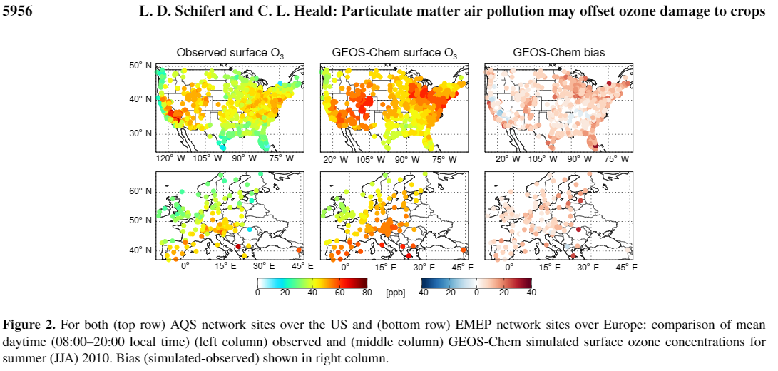
Fire effects on O₃ and aerosols
Fire emissions cause increases in surface O3 and aerosols
From 2002-2011 fires increase global O3 by 5.4 ± 0.6% and global aerosols by 9.6 ± 1.9 %
Notes:
A zoom in on our area. And our ozone levels in summer months (fire season)

Slide 21
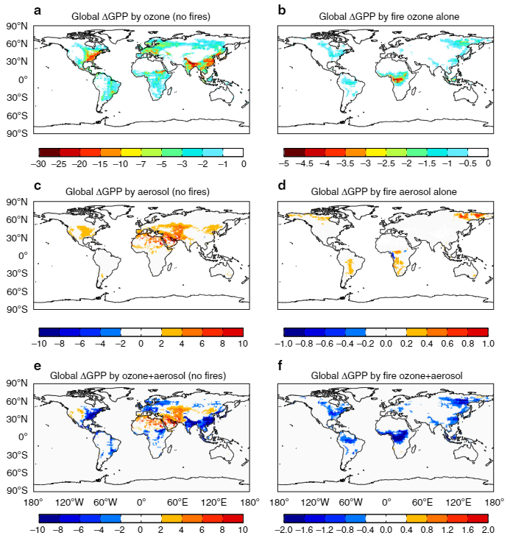
Gross Primary production ~ O₃ & Aerosols
Global GPP is reduced by 4.0 ± 1. Pg C year
Fire ozone further causes reduction of 0.92 ± 0.44 Pg C year
Notes:
One of the big figures that this paper culminates in.
PETRAGRAM CARBON YEAR

Slide 22
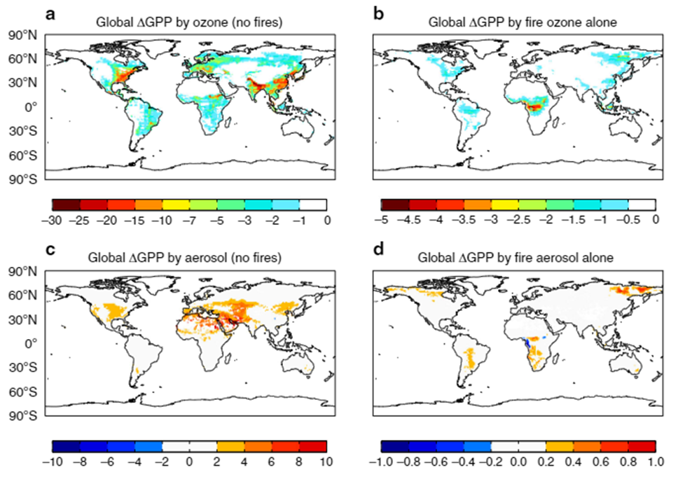
Gross Primary production ~ O₃ & Aerosols
Global GPP is reduced by 4.0 ± 1. Pg C year
Fire ozone further causes reduction of 0.92 ± 0.44 Pg C year
Net increase due to aerosols very small
Heavily dependent on cloud cover and weather patters locally
Notes:
One of the big figures that this paper culminates in.
PETRAGRAM CARBON YEAR

Slide 23
Gross Primary production ~ O₃ & Aerosols
Global GPP is reduced by 4.0 ± 1. Pg C year
Fire ozone further causes reduction of 0.92 ± 0.44 Pg C year
Globally net increase due to aerosols very small mostly concentrated in arid/semi arid regions
Higher latitudes increase GPP due to fire aerosols
Aerosol radiation fertilization effects more dominant in arid/semi arid areas
Ozone effect is greater on GPP. Reductions of 0.6% in GPP
Notes:
One of the big figures that this paper culminates in.

Slide 24
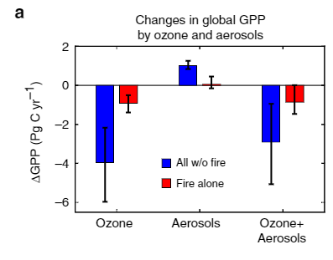
Gross Primary production ~ O₃ & Aerosols
Notes:
One of the big figures that this paper culminates in.

Slide 25
Conclusions
Net impact is estimated at 0.6% loss/year in GPP
Regionally, fire pollution causes ~ 3.6 % GPP losses/year during large fire years
O₃ damage is more severe than aerosols at the global scale
Variation in fire aerosols and its effect on photosynthesis cause uncertainties in net impact on GPP

Slide 26
Limitations
Most data is for forested land
Cropland and grassland mostly unaccounted for
Very little visualization and modelling of Western US/Mountain region
O₃ effects likely overestimated in Eastern US
Aerosols alter meteorology and cloud cover which influence plant photosynthesis
Fire aerosols may alter physiological (stomatal) and biogeochemical effects in plants

Slide 27
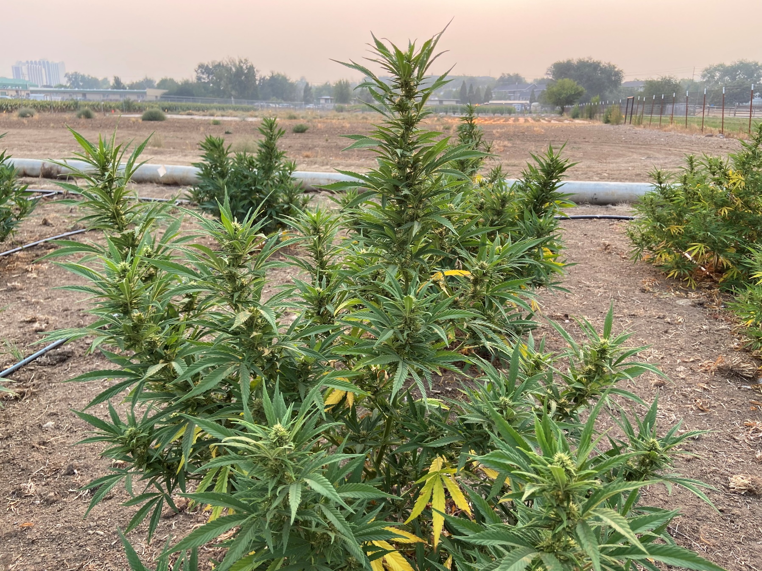
Cannabis sativa L. – Hemp 9/7/2020

Slide 28
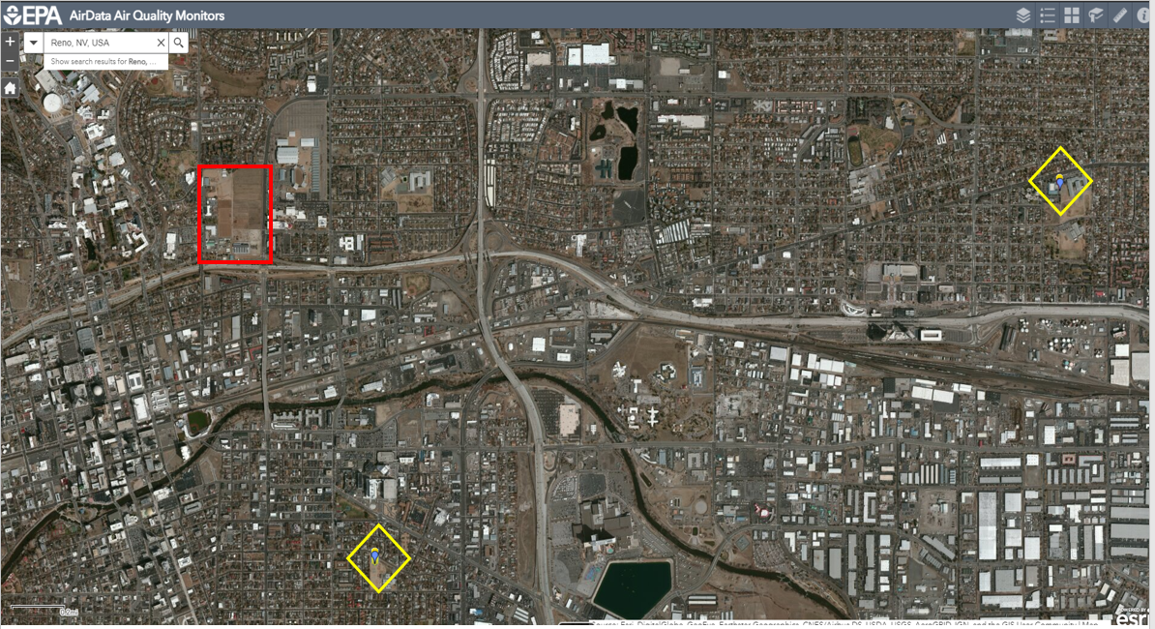
EPA Air Quality Sensors

Slide 29
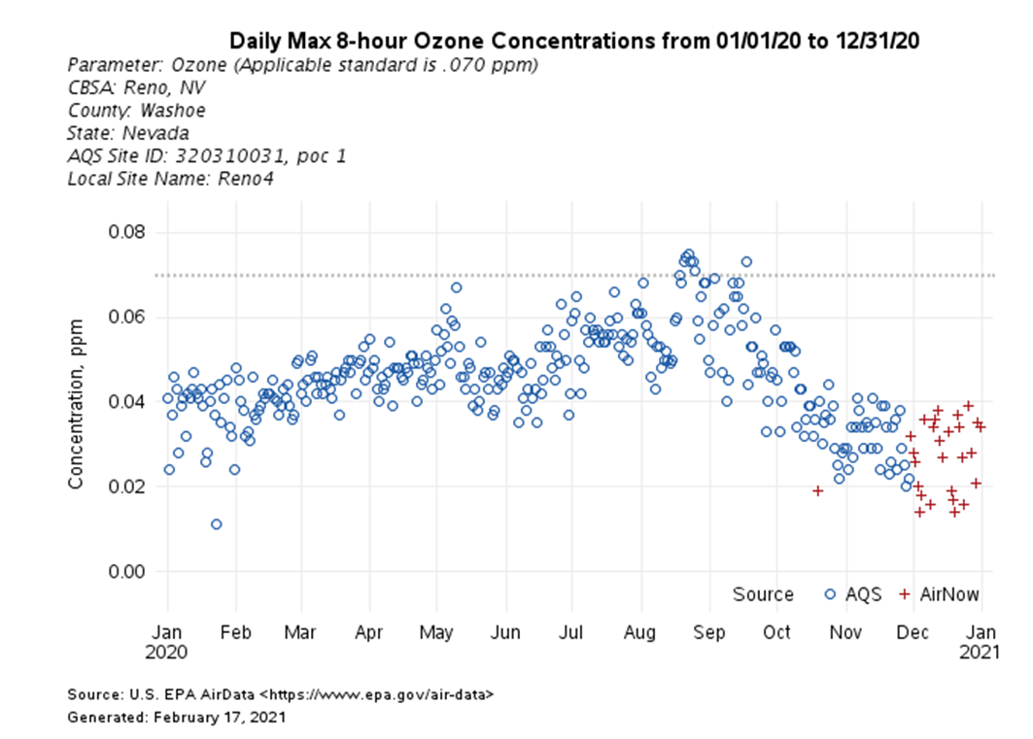
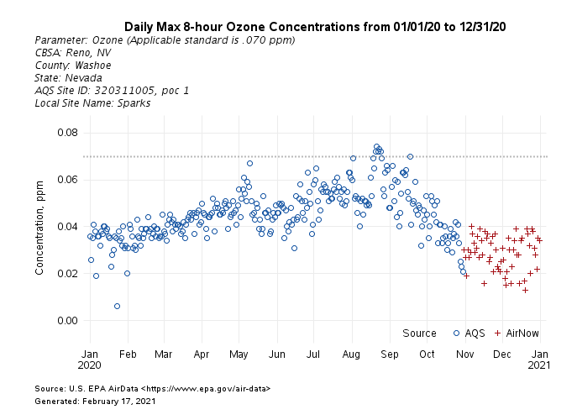
O₃ Concentrations - 2020

Slide 30
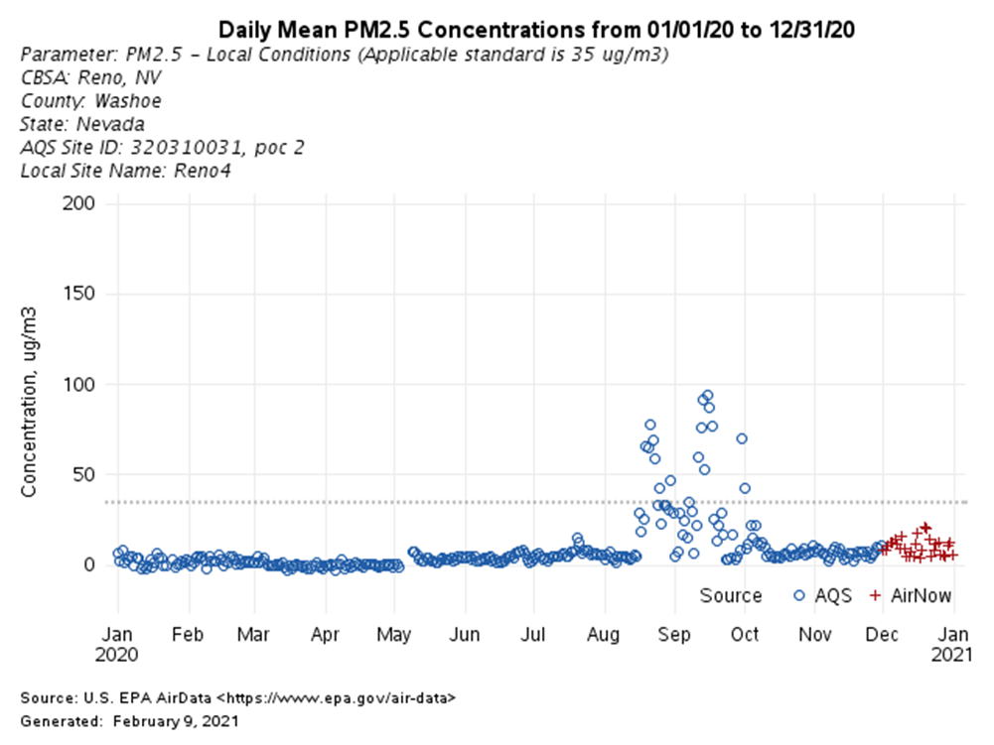
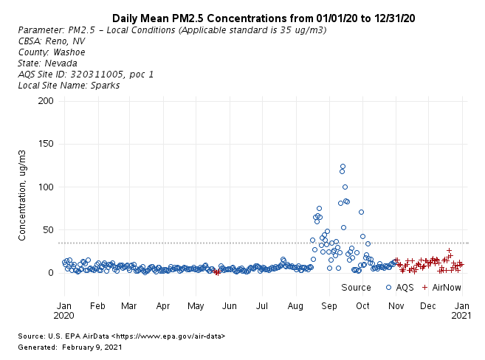
PM 2.5 Concentrations - 2020

Slide 31
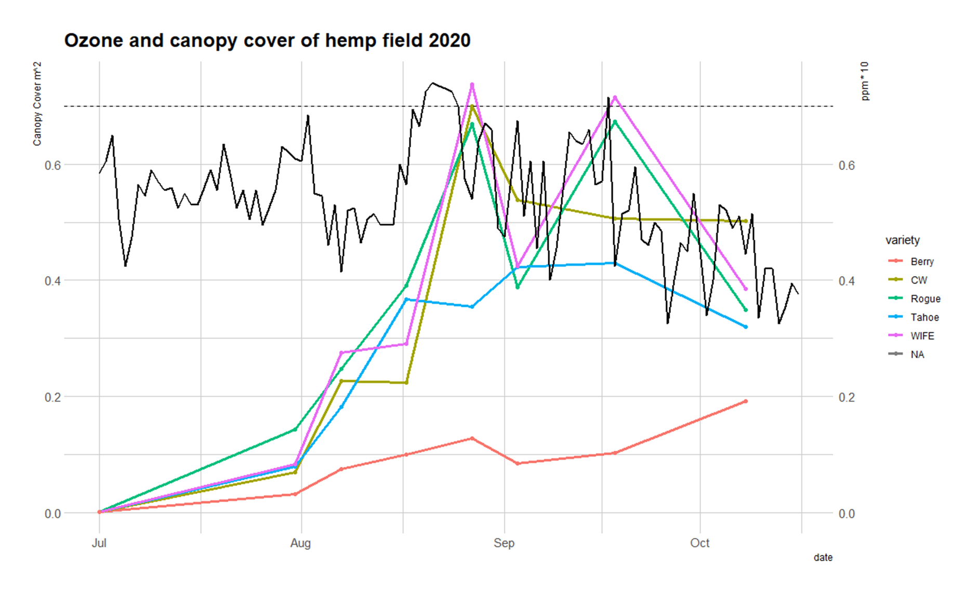

Slide 32
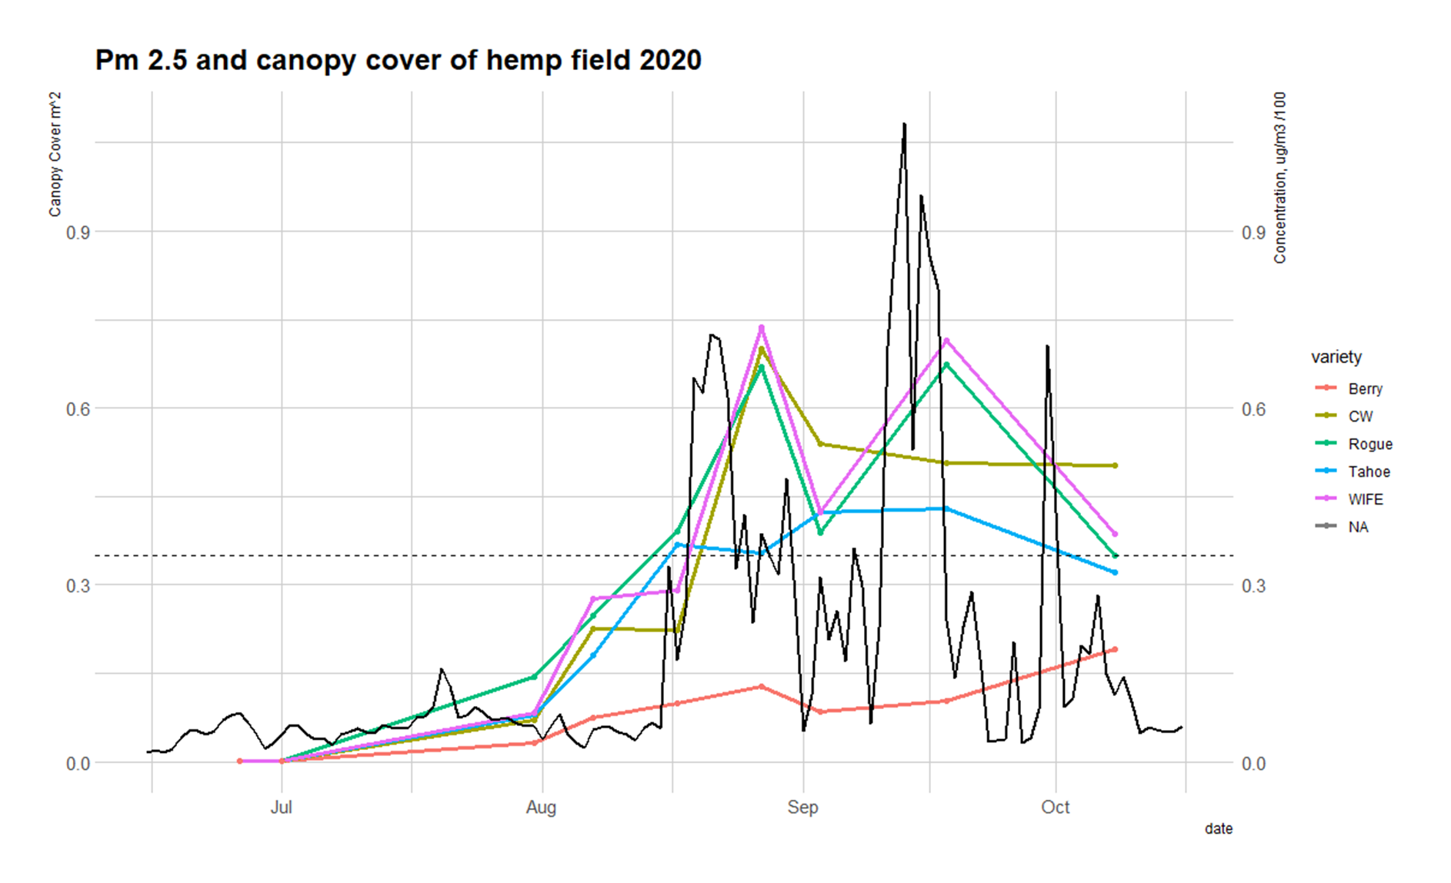

Slide 33
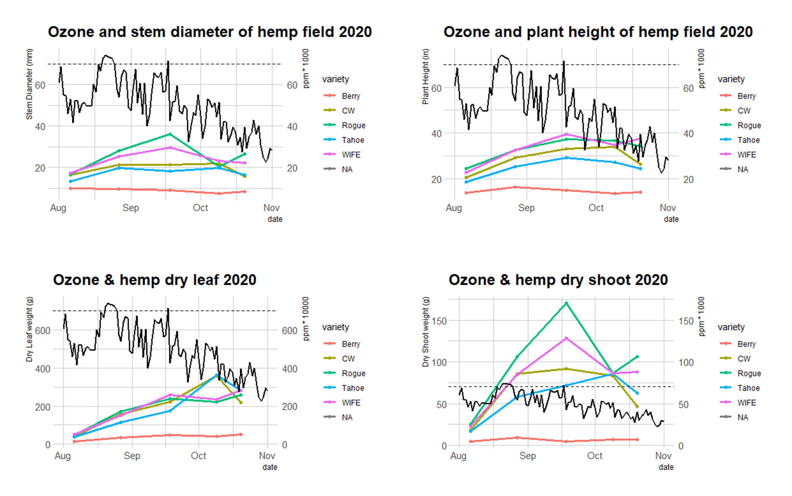

Slide 34
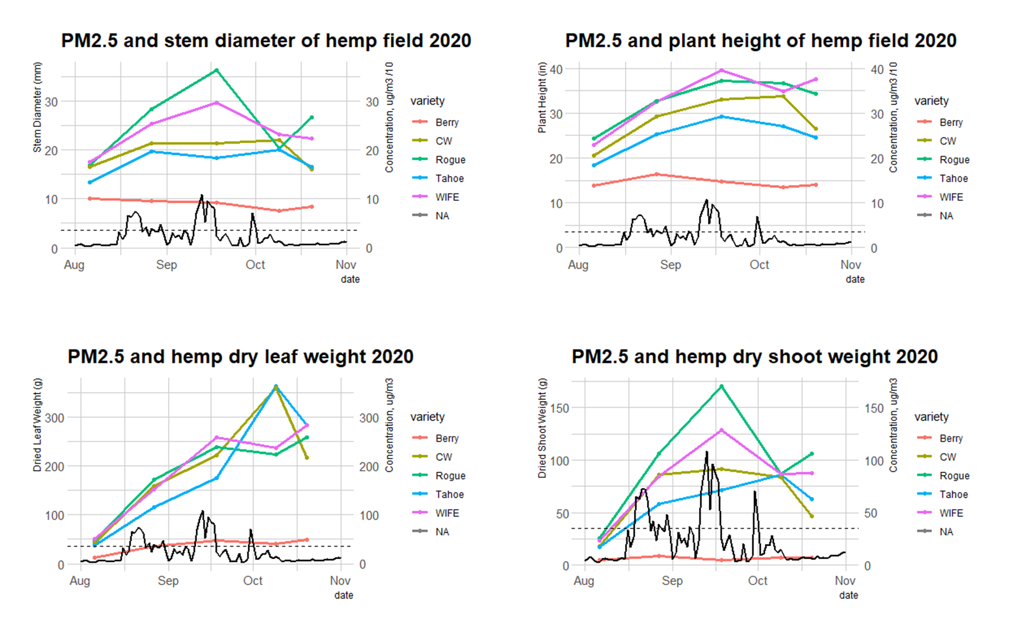

Slide 35
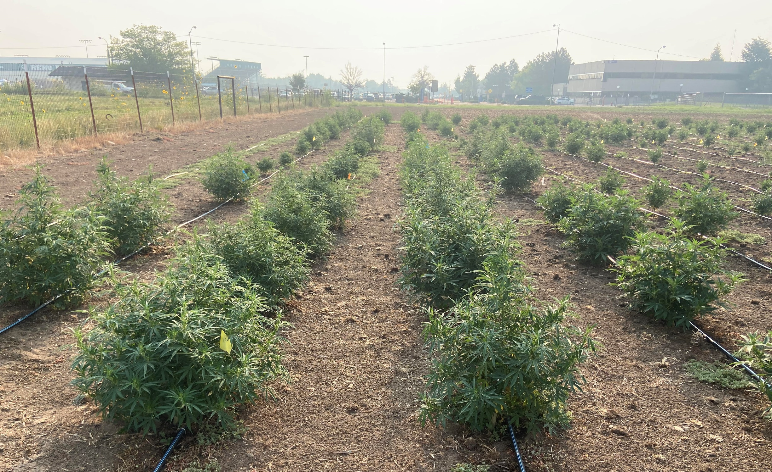
Questions ?

