Slide 1

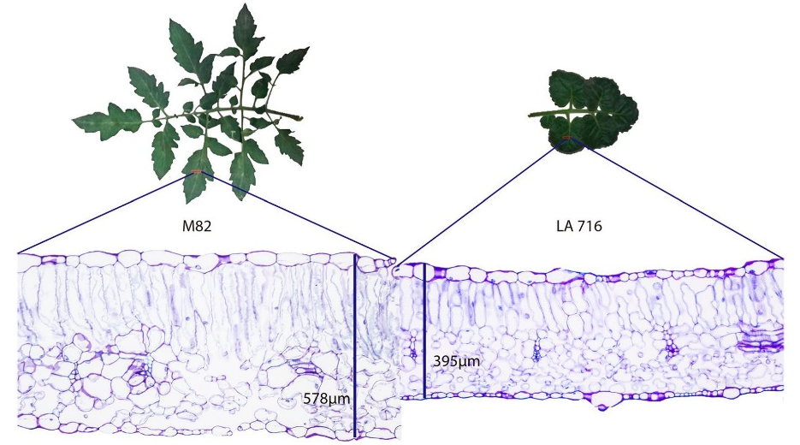
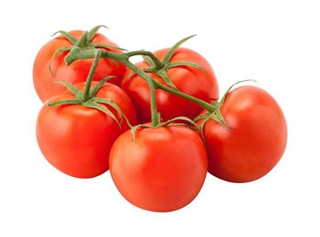
Scientific Reports Vol. 10, Art. No. 16052, Published: 29 September 2020 Evaluation of anatomical and physiological traits of Solanum pennellii Cor. associated with plant yield in tomato plants under water‑limited conditions Françoise Dalprá Dariva, Mariane Gonçalves Ferreira Copati , Herika Paula Pessoa , Flávia Maria Alves , Felipe de Oliveira Dias , Edgard Augusto de Toledo Picoli, Fernando França da Cunha & Carlos Nick
Maria Sole Bonarota, PhD student
E-mail: mbonarota@unr.edu
Department of Agriculture, Veterinary and Rangeland Sciences

Slide 2
Overview
Agricultural drought
Background information
Breeding tomato for drought tolerance
Advances
Tomato responses
The use of introgression lines
Presentation of the paper
Aim
Materials and methods
Results
Discussion of the results

Slide 3
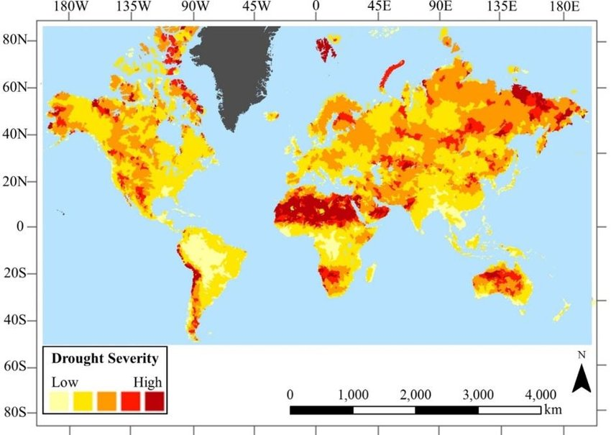
Background information
Agricultural drought
Caused yield losses of the value of ~$30 billion in the decade 2010-2020
(Gupta et al., 2020)
Solutions
Irrigation
Accentuated by climate change: rising T and prolonged droughts
(IPCC, 2019)
Plant breeding
→ Not a long term solution!
Unsustainability
Ecological
Economic
Social
From Hazaymeh and Hassan et al., 2016
Poor-quality water leads to soil degradation
Lower net income for farmers
Water is a scarce resource in many countries of the world
→ Long term solution!
In corn (C4 plant) crop breeders have increased yield under drought up to 80 kg ha⁻¹ year⁻¹
In wheat (polyploid) crop breeders have increased yield under drought up to 19 kg ha⁻¹ year⁻¹

Slide 4
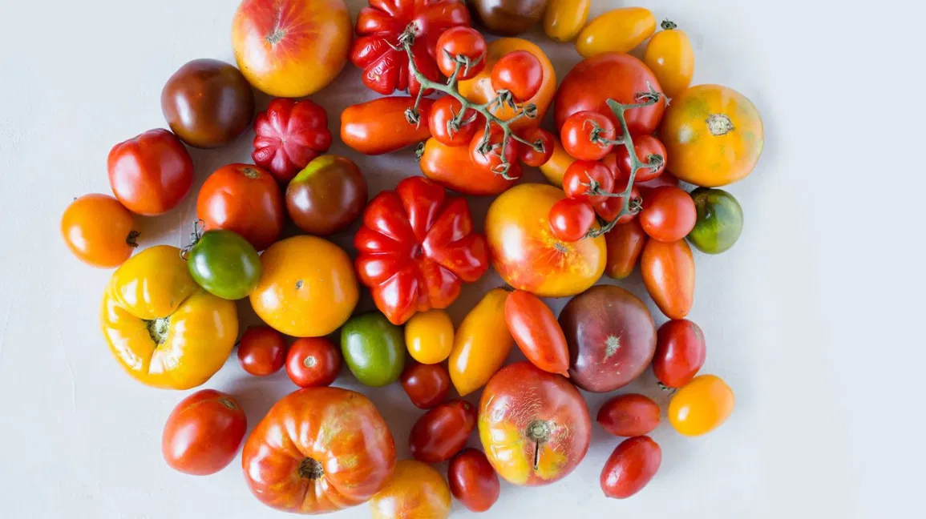
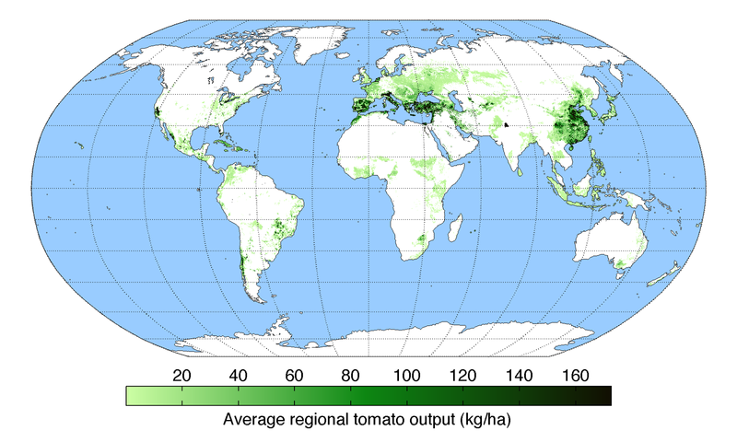
Tomato (Solanum lycopersicum L.)
Second most important vegetable in the world after potato;
Production: 181 million tonnes, 5 million hectars in 2018 (FAOSTAT);
Grown in open field or greenhouses;
Requires irrigation for high yields.
From: Monfreda et al., 2008

Slide 5
Tomato drought responses
First days
First hours
TRADEOFFS
PROS
CONS
Less leaf turgor
Less leaf water potential
Less work for water to come up
(in terms of difference in potential energy between the soil and the leaf)
Higher leaf osmotic potential
Less leaf growth and cell expansion
Leaf senescence (auto-pruning)
Higher leaf thickness
Less photosynthetic rate
Impaired source to sink relationship
Less epidermal conductance
Deposition of cuticle in the leaves
Higher concentration of chloroplasts per unit leaf area
Nutrient imbalance
Stomatal closure
Oxidative stress
Lipid peroxidation
Water saving, maintenance of leaf turgor
Less carbon assimilation
Less growth
Less yield
Membrane damages
Less enzyme activity
Altered phytohormonal profile
Higher number of root cortex cells
Better management of soil water availability
Deposition of suberin and lignin in root exodermis and endodermis
Aquaporin downregulation
Less incidence of hydraulic failure
Less water and nutrient flow to the shoot
Low soil water potential
Increased root-to-shoot ratio
Higher water and nutrient uptake
Less biomass allocation to the shoot (yield)

Slide 6
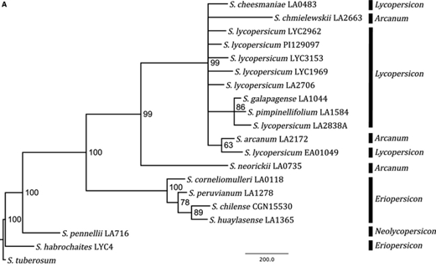
How do we target drought tolerance in tomato?
Solanum sect. Lycopersicon (From latin= “wolfpeach”)
Genetic engineering
Traditional breeding
Trait introgression from drought tolerant wild relatives
From Dodsworth et al., 2016

Slide 7
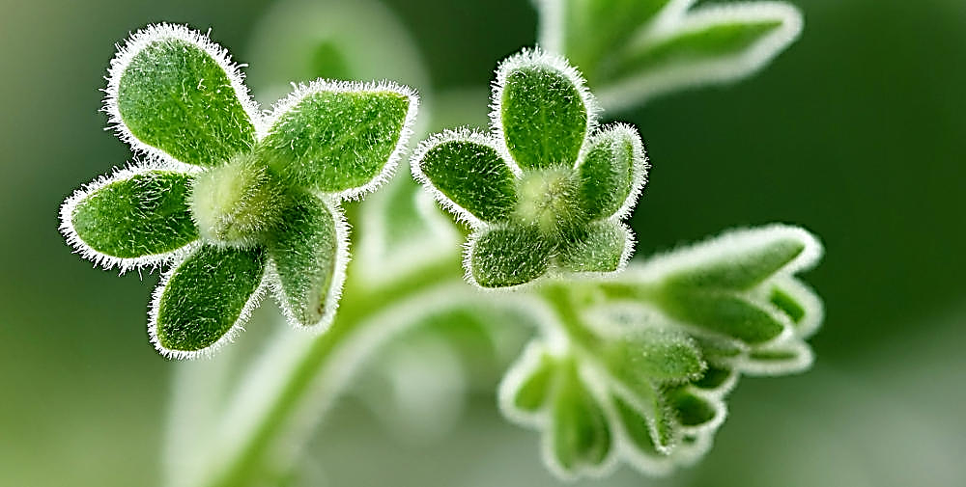
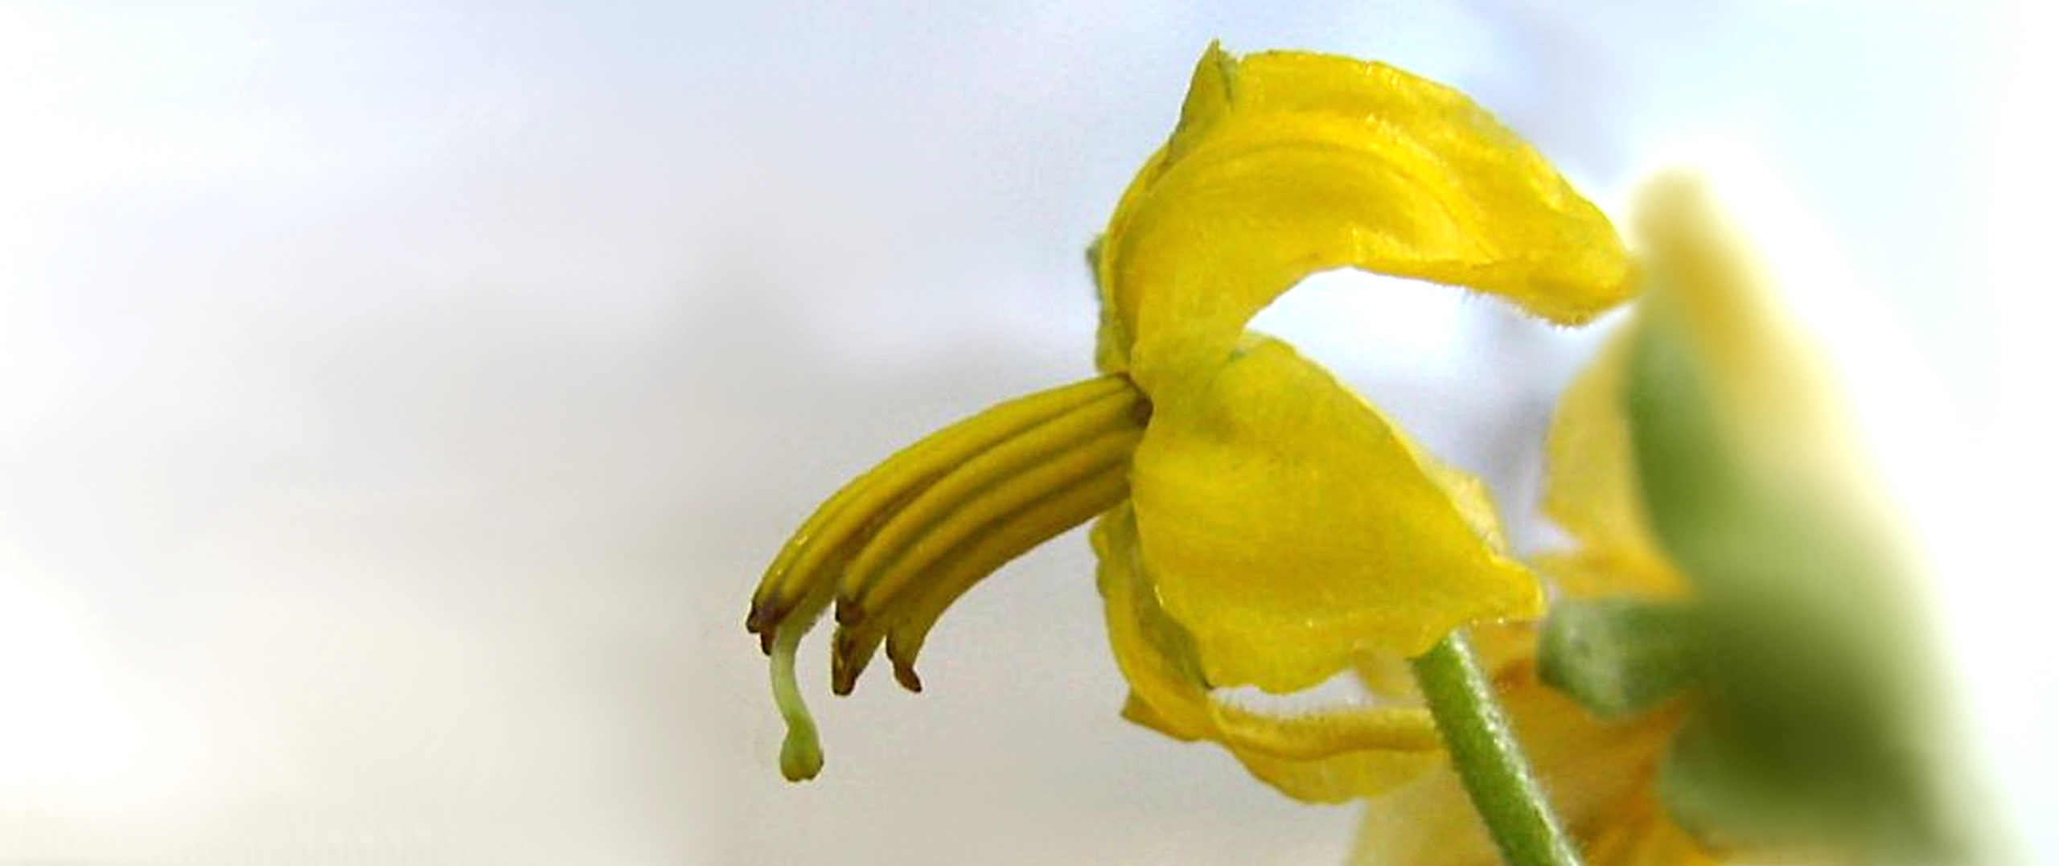
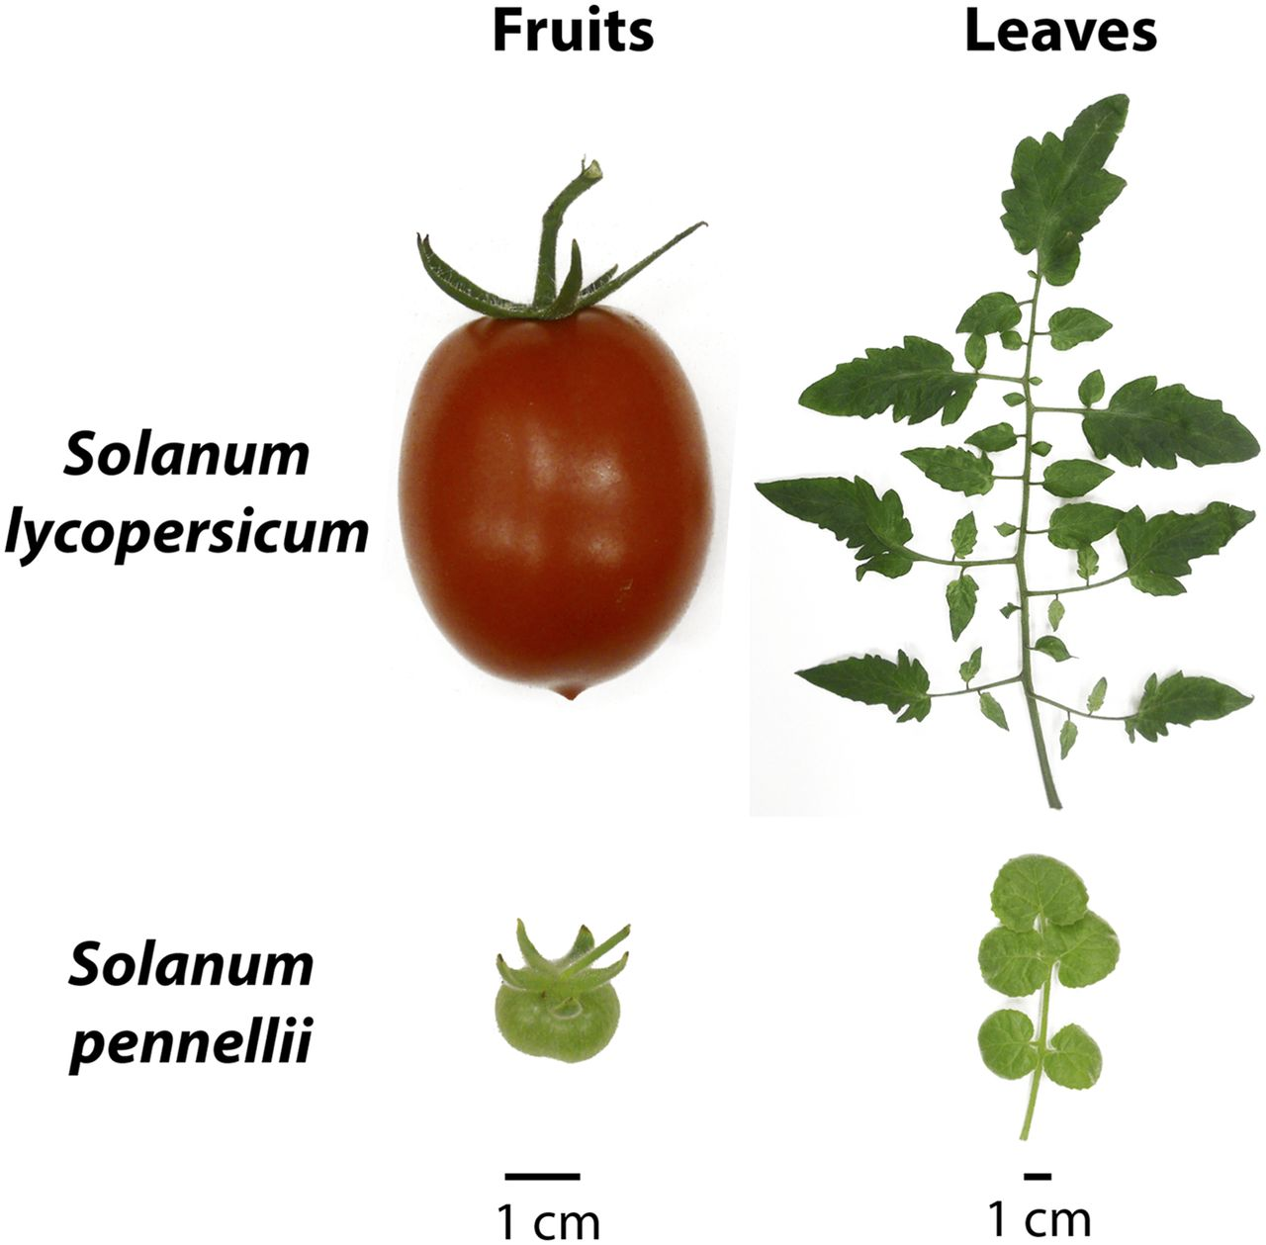
Solanum pennellii Cor.
Habitat: Dry rocky hillsides and sandy areas; sea level to 2300 m.
Traits: Salt/Alkali tolerant, drought tolerance; resistance to bacterial spot (Xanthomonas campestris pv. vesicatoria T3), Alternaria stem canker (Alternaria alternata f.sp. lycopersici), and Fusarium.
Ref.: TGRC Accession details (ucdavis.edu)
From Lockhart, 2013
The Introgression line population S. pennellii x M82 was firstly created to investigate QTL involved in fruit total soluble content and for fruit mass (Eshed and Zamir, 1995).

Slide 8
Aim of the study
Scientific Reports Vol. 10, Art. No. 16052, Published: 29 September 2020 Evaluation of anatomical and physiological traits of Solanum pennellii Cor. associated with plant yield in tomato plants under water‑limited conditions Françoise Dalprá Dariva, Mariane Gonçalves Ferreira Copati , Herika Paula Pessoa , Flávia Maria Alves , Felipe de Oliveira Dias , Edgard Augusto de Toledo Picoli, Fernando França da Cunha & Carlos Nick
Determine whether the ILs from S. pennellii x M82 can maintain high fruit yield under drought stress.
Materials
Methods
FOUR INTROGRESSION LINES PRE-SCREENED FOR DROUGHT TOLERANCE
IL 2-5 DROUGHT-SENSITIVE (DS)
IL 3-5 DROUGHT-TOLERANT (DT)
IL 7-1 DROUGHT-SENSITIVE (DS)
IL 10-1 DROUGHT-TOLERANT (DT)
PARENTAL LINES
M82
LA716
Treatments
50% available soil water (ASW)
100% available soil water (ASW)
Measurements
Start at 60 days after treatment (fruit setting stage)
Leaf water relations
Photosynthetic rate
Leaf thickness
Plant yield
60 days
Selected through phenotypic characterization at germination and seedling stages. A multi-trait index (FAI-BLUP index) was used to rank 50 ILs according to drought-tolerance.

Slide 9
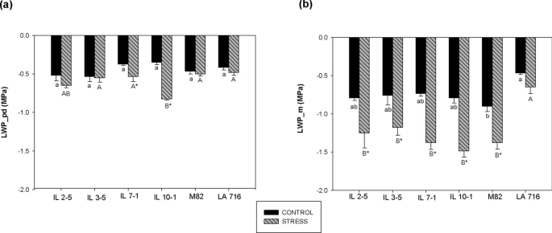
Results – leaf water relations
Leaf water potential at pre-dawn
Leaf water potential at midday
All genotypes showed no differences between treatments in leaf water potential at pre-dawn, except for the IL 10-1 (DT).
S. pennellii showed better leaf water status at noon under drought, but none of the ILs showed the same behavior.

Slide 10
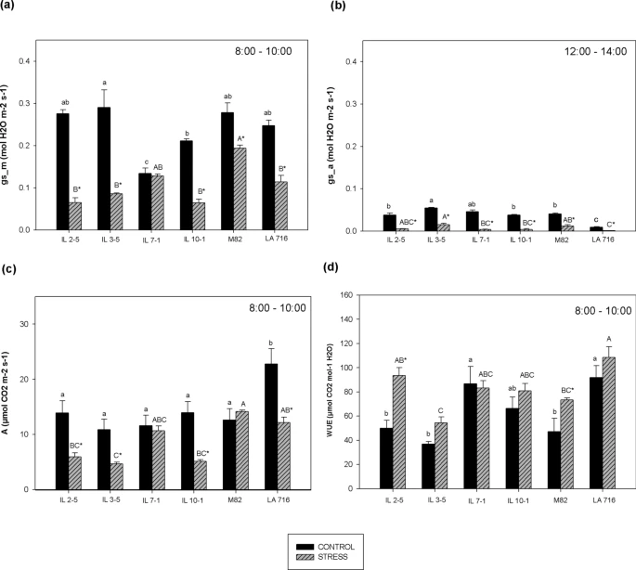
Results – leaf physiology
M82 showed higher g_{s} and A in the morning under drought compared to all ILs (except for the DS IL7-1-) and S. pennellii.
Stomatal conductance in the morning
Stomatal conductance in the afternoon
In the afternoon, g_{s} was higher in M82 and all ILs compared to S. pennellii at 100 % ASW and in M82 and the DS IL3-5 under 50%ASW
Photosynthetic rate in the morning
Water use efficiency
S. pennellii and the DT IL 10-1, and the DS ILs 7-1 and 2-5 showed higher water use efficiency under drought compared to M82.

Slide 11
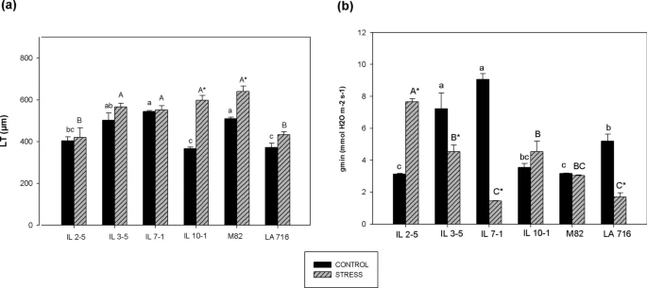
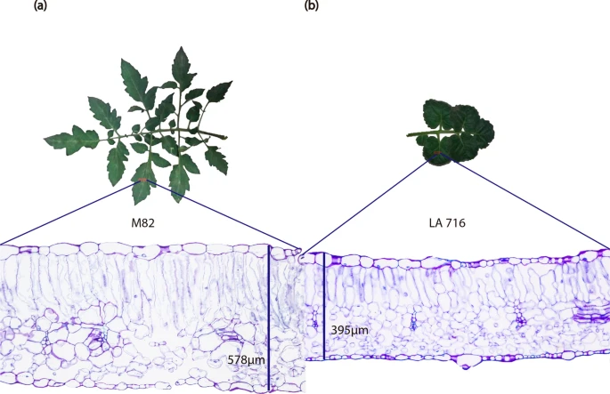
Results – leaf anatomy
Leaf thickness
Minimum epidermal conductance
M82 and IL 10-1 increased leaf thickness under drought at the fruit setting stage. This increase was due to larger cells in the spongy and palisade parenchyma.
Results from the minimum epidermal conductance are complex: LA716, IL 3-5 and IL 7-1 decreased g_{min}.
M82 and IL 10-1 maintined g_{min}.
The DS IL 2-5 increased g_{min} under drought.

Slide 12
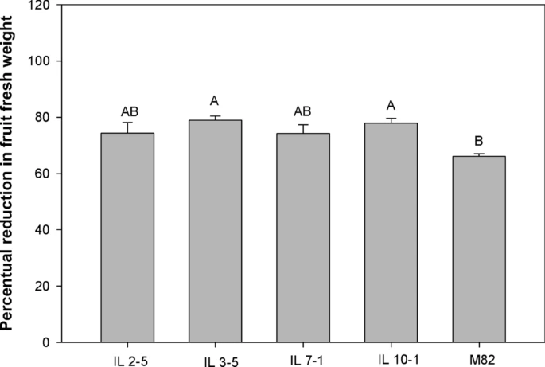
Results – plant yield
Mean and standard error followed by same lower case letter within treatment, and with the same upper case letter within genotype indicate no statistical significance (p>0.05, Tukey’s test).
All ILs showed the same number of fruits, but lower fruit diameter compared to M82 under drought.
M82 showed the lowest percent decrease in fruit fresh weight.
Fruit length was higher was higher in M82 under drought compared to ILs 10-1 and ILs 2-5.
There was no statistical difference in fruit yield between M82 and the ILs under drought.

Slide 13
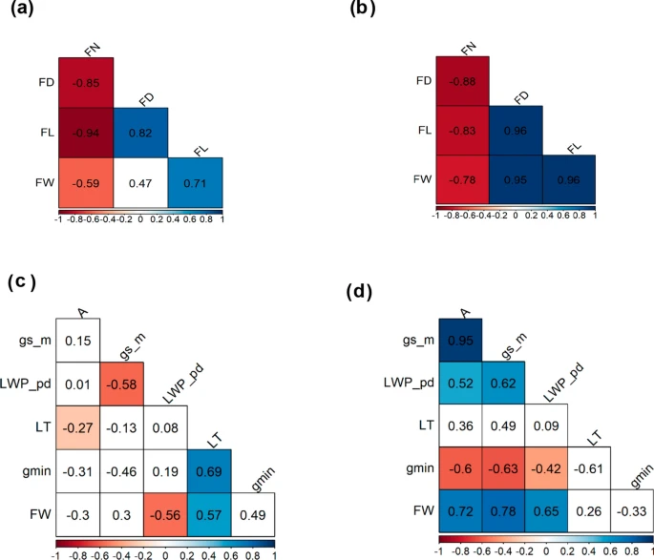
Results – correlation analysis
Fruit weight (FW) under drought was correlated with both fruit diameter (FD) and fruit length (FL), but under 100%ASW only with FL.
100%ASW
50%ASW
Leaf thickness (LT) was negatively correlated photosynthetic rate under 100%ASW, but not under 50%ASW.
Leaf thickness was correlated with fruit weight only under 100% ASW, but not under 50%ASW.
Cuticolar conductance was positively correlated with LT under 100%ASW, but not under drought. Under drought it was negatively correlated with Photosynthetic rate (A), stomatal conductance in the morning (gs_m), and LWP at pre-dawn (LWP_pd).
Fruit weight was correlated with A, gs_m, and LWP_pd under drought.

Slide 14
Conclusion
S. pennellii showed higher capacity to preserve water, as demonstrated by lower leaf water potential;
This characteristic was associated with less stomatal conductance in the critical hours of the day;
In tomato, C3 plant, a less g_{s} results in lower photosynthetic rate and carbon assimilation, which is not interesting for drought-tolerant breeding;
None of the introgression lines showed higher yield under drought, showing that drought tolerance at early vegetative stage was not correlated to higher yield under drought;
In conclusion, this paper offers new insights on breeding for high yield under drought conditions.
However, one limitation is that they did not investigate the root system physiology, which is important as a long-term drought response.
Root acclimation sustains canopy water demand, and thus growth and yield under drought.

Slide 15
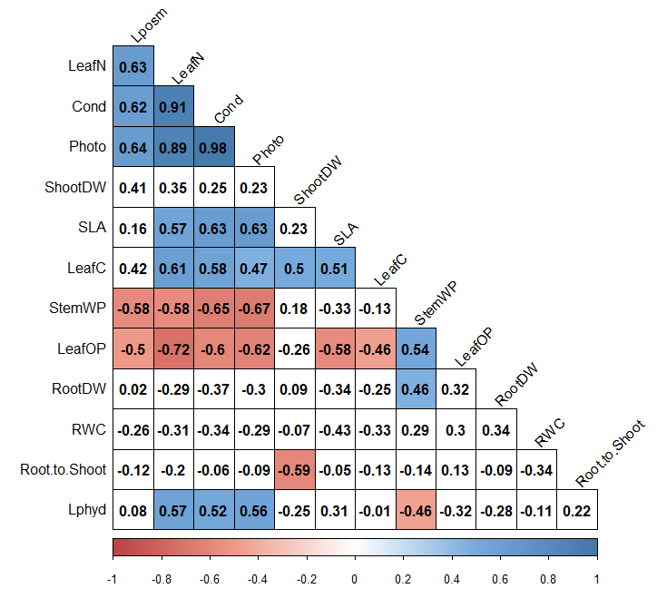
Three grapevine rootstocks with different response to drought (tolerant, intermediate and sensitive).
Grafted with the same scion.
Correlation analysis – how root features influence whole plant water relations and growth.

Slide 16

Questions Comments
Thank you for your attention!

