Slide 1
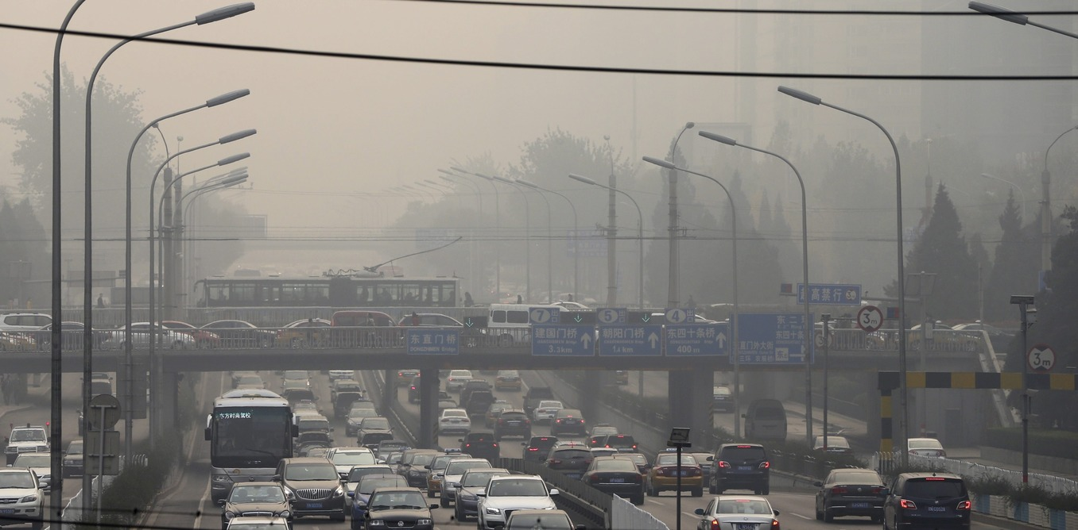
Taxi Drivers’ Exposure to Black Carbon and Nitrogen Dioxide in Electric and Diesel Vehicles: A Case Study in London (Brendan Bos, Shanon Lim, Michael Hedges, Nick Molden, Sam Boyle, Dr. Ian Mudway, Dr. Benjamin Barratt)
Christopher Atkinson
ATMS 790
5/10/2021

Slide 2
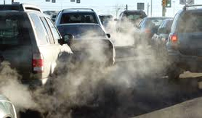
Introduction
How does fuel contribute to air pollution?
What is the impact of fuel and cabin design on driver's exposure to air pollution?
Why black carbon and nitrogen dioxide is being studied compared to other aerosols?
Does type of car matter concerning air pollution?
Notes:
The fuel contains toxic substance called black carbon (BC), which is made up of fine Particulate matter (PM_{2.5}) and nitrogen dioxide (NO₂).
Unlike other pollutants, vehicle engines have no ability to combust Black carbon making it released into the air fully.
Black carbon is chemically stable easily traced from vehicle emissions.
Again, black carbon has been proved to cause increased adverse health effects. For instance, a short duration exposure to BC has been proved to cause increased respiratory and cardiovascular diseases leading to increased respiratory fatalities.
People who spend more hours inside cars like Taxicabs are exposed to more hours of inhaling contaminated air.
The less the car space, the higher the concentration of these air pollutants. Thus, the concentration of these gases inside a small car is higher than in vehicles with large surface areas.
Regular exposure to these particulate matters and gasses for an extended period contributes to health problems like the respiratory system and vascular system.
Therefore, the study's primary goal entails investigating the effect of the cabin modification and fuel on London taxicab drivers based on exposure levels based on electric TXe City and TX4 Diesel taxis.

Slide 3
Background
Previous researches on NO₂ and BC pollutants.
Impact of diesel fuel on concentration of NO₂
Effect of filters in controlling pollutants entry into the car cabin.
Role of opening car windows in regulating pollutants.
Health effects of pollutants.
Notes:
Few types of research have tried to categorize pollution relate to NO₂ and that caused by BC.
However, research has shown that diesel fuel contributes to higher percentages of NO₂ concentration than is the case for petrol fuel according to the in-cabin concentration.
When filters are fixed on the vehicle's air intake sections, they help lower the concentration of particulate matter inside the cabin. However, the concentration varies of vehicle air intake mechanical condition, with new cars exhibiting more air purification than old cars.
Air conditioning inside a car can be regulated by either opening windows or operating a HEPA filter.
Research on Los Angeles taxicabs experience with PM_{2.5} and Ultra-fine particles (UFP) showed that when divers leave their car windows open and switch on HEPA filters, the indoor-outdoor ratio of pollutants is decreased and vice versa.
Diesel cars contributed to an increasing concentration of BCs, UFPs, and PM_{2.5} in the air. This is according to research performed on different types of vehicles in-cabin air concentration in Barcelona and Canada.
Therefore, the impact of air pollution on human health is determined by exposure level, type of car, and cabin design.

Slide 4
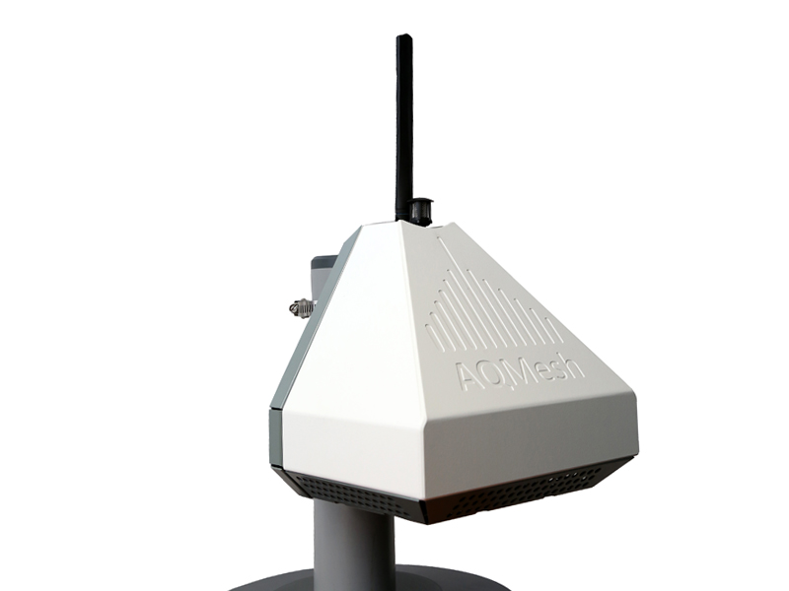
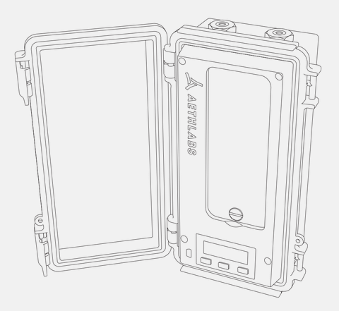
Methods
https://www.aqmesh.com/products/aqmesh/
Selection of sample involving ten taxi drivers
Fitting taxi drivers with monitoring gadgets
Regulating operation areas
Interval of recording data based on exposure
https://aethlabs.com/microaeth/ma350/overview
Notes:
The study design involved two investigations entailing taxicab driver exposure and evaluating the rates through which air exchange between different vehicle types.
To ascertain how taxicab driver exposure, ten professional taxicab drivers got recruited by the London Electric Vehicles Company (LEVC).
The drivers got equipped with GPS-Linked BC monitors, micro aethalometers, and AQmesh pods calibrated to measure only NO₂.
AQMesh is a small-sensor air quality monitoring system for measuring outdoor and indoor air quality, offering real-time localised air quality information and data analysis. AQMesh can be specified to monitor a single gas or up to 6 gases, as well as PM, noise and wind speed & direction all from a single unit, with seamless data delivery: Measures gases Nitrogen Oxide (NO), nitrogen Dioxide (NO2), Ozone (O3), Carbon Monoxide (CO), Sulfur Dioxide (SO2) and Hydrogen Sulfide (H2S) using the latest generation of electrochemical sensors Carbon Dioxide (CO2) monitoring with a NDIR sensor Measures particulates PM1, PM2.5, PM10, (Total Particulate Carbon TPC and Total Suspended Particulate Matter TSP (up to 30 microns) with a light-scattering optical particle counter Noise monitoring with an omnidirectional microphone Meteorological sensor for wind speed and direction measurement Measures relative humidity, pod temperature, atmospheric pressure as standard
AQmesh pods are advantageous because they are small and not bulky, making them portable.
The AQmesh pod was installed in the vehicle cabin and stayed there during the whole research study. On the other hand, drivers carried the MA350 while not at work and only could keep it aside at night to charge. This enabled the BCs to record deviation based on exposure.
MA350 is a real-time 5-wavelength Ultraviolet-Infrared UV-IR Black Carbon monitor housed in an outdoor-rated case with an 85 sampling location automatic filter tape advance system which allows for 3-12 months of continuous measurements. The device is a self-contained instrument with built-in pump, flow control, data storage, and 4X the battery capacity of the MA200. The MA350 also features onboard GPS, satellite time synchronization, accelerometer, altimeter/barometer, and sensors for relative humidity and temperature. Wireless communication interfaces are under development to provide future network or mobile smart device integration. The spectrum measurement provides insight into the composition of light absorbing carbonaceous particles and helps to distinguish among the different optical signatures of various combustion sources such as diesel, woodsmoke, biomass, and tobacco.
To establish impact based on the type of car, five of the ten drivers drove diesel fuel injected cars that the company between 2008 and 2016 had developed.
The remaining five drivers drove plug-in hybrid range-extender electric vehicles model LEVC TXe City developed in 2018.

Slide 5
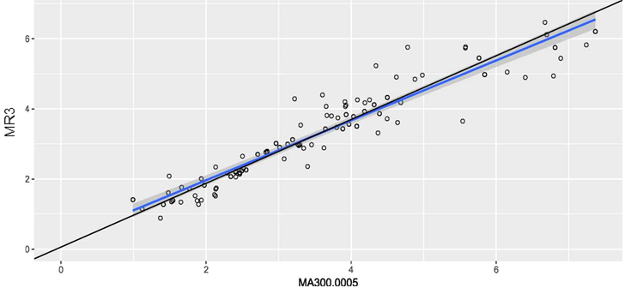
Continuation
Figure A1: Chart showing the standard major axis regression performed for each monitoring device and the resulting R². In this case, MR3 denotes Marylebone Road BC concentrations compared with what the MA unit measured.
SMA (black line): intercept= 0.06119 slope= 0.9089
OLS (blue line): intercept= 0.2542 slope= 0.8544 adj.r2= 0.882
Notes:
Colocation and Standardization process
The AQmesh pods were collocated at Marylebone Road monitoring station both prior to and after the sampling period, whereas the aethalometers were solely collocated after sampling due to time restrictions.
SMA, Standard Major Axis (black line): intercept= 0.06119 slope= 0.9089
OLS, Ordinary Least Squares (blue line): intercept= 0.2542 slope= 0.8544 adj.r2= 0.882
To standardize all the results, all the taxis came from the same company LTC and got rebranded to LEVC in 2017; all the drivers were non-smokers, and all measuring gadgets should be kept away from smokers.
Results were recorded after three weeks between 21st May, and 8th June with each driver filled the questionnaire on shift details after each shift.
Exposure data got recorded after four working days per driver. Also, to get a variation on outdoor and indoor air ratio, the drivers got advised to close their car windows on the first two days. The other two days required the driver to observe a regular ventilation routine.
This amounted to 1100 hours of exposure whose data got recorded. However, three drivers failed to record BC data of the four work shifts because of the failure of the monitors.
As a result, 36 entire work shifts were analyzed for BC, and 40 out of the 40 days were analyzed for NO₂. All collected data involved weekdays, except one single shift that operated on a weekend, and working hours extended from 8 am to 10 pm with all drivers operating within London.

Slide 6
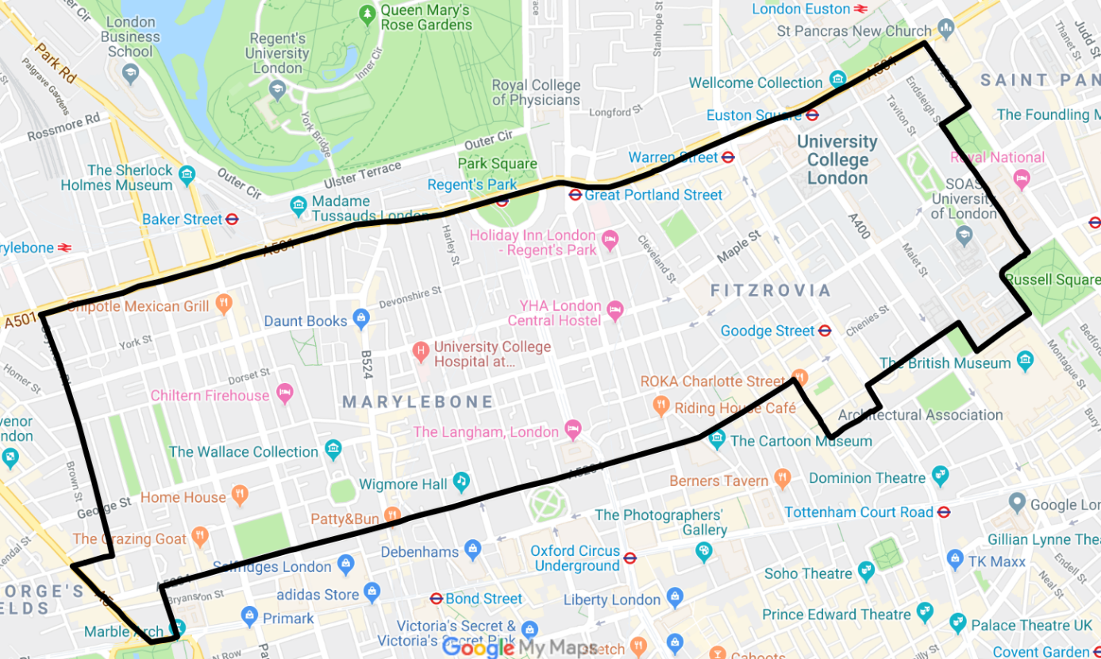
Assessing Air Exchange Rates Between Vehicle Types
In cabin exposure experiences
Analysis using TXe City and TX4 Euro 5 diesel Taxi
Accuracy maintenance
Figure 2: Map of the test route travelling in an anticlockwise direction in Central London starting and finishing at Russell Square.
Notes:
The variation between in-cabin exposure experiences depended on measuring the concentration of black carbon inside and outside the car using MA350s in a 1-min resolution within central London.
The analysis used one TXe City and one TX4 Euro 5 diesel taxi, both well licensed.
A specific circular route spanning 7.1km was selected within central London. Each taxi traveled in the route four rounds, twice with ventilation set to recirculate and twice with recirculating off.
The fan speed got regulated to medium speed while windows remained closed
Another four rounds involved electric cars with pollen filters removed got driven with recirculating on and off to investigate the effectiveness of the pollen filter in reducing in-cabin concentrations.
The test runs for two days between 13th and 14th May 2019, and electric and diesel cars got involved in the test.
The total runs were twelve that lasted approximately 35 minutes each. However, two runs were discarded because the monitors failed to function as targeted, making several runs to be analyzed ten.
Instruments got calibrated differently; AQmesh got calibrated 11 days prior and seven days after the study. The MA350s got only calibrated after sampling to save time.
To maintain an accurate frequency of BC measurement, data got processed using the Optimized Noise-reduction Averaging (ONA) algorithm.

Slide 7
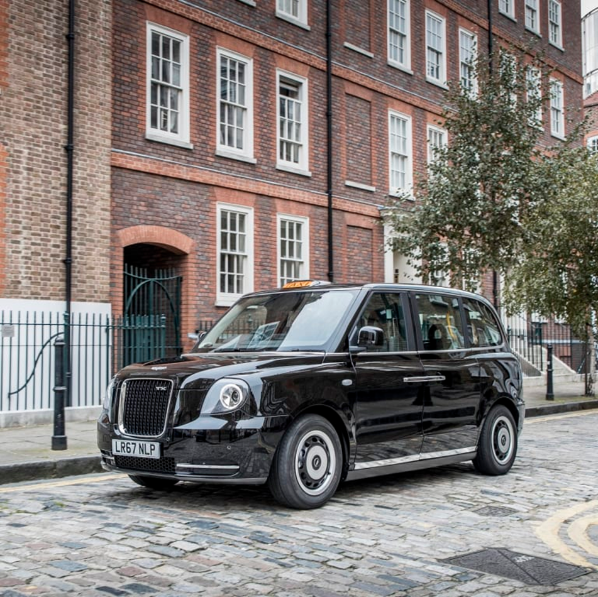
UK Taxi
https://www.levc.com/tx-electric-taxi/
Notes:
The electric TXe City taxi was built by the London Electric Vehicle Company and registered in April 2018. The taxi has been licensed as a London taxi by Transport for London since April 2019. The TXe taxi is always battery powered and a small range extender petrol engine maintains the battery level until the battery can be recharged. The taxi had recorded a mileage of 8,010 miles at the time of testing. The taxi was fitted with a pollen filter.
The TX4 diesel taxi was built by the London Taxi Corporation and registered in September 2015. The taxi has been licensed as a London taxi by Transport for London since September 2015. The taxi had recorded a mileage of 57,337 at the time of testing. The manufacturers confirmed that the taxi was not fitted with a pollen filter.

Slide 8
Statistics
To ascertain the exact differences between daily exposure and work environment.
Used Mann-Whitney-Wilcoxon test.
Verification of impact of external environmental factors like wind & temperature
Notes:
When comparing two independent samples when the outcome is not normally distributed and the samples are small, a nonparametric test is appropriate. A popular nonparametric test to compare outcomes between two independent groups is the Mann Whitney U test. The Mann Whitney U test, sometimes called the Mann Whitney Wilcoxon Test or the Wilcoxon Rank Sum Test, is used to test whether two samples are likely to derive from the same population (i.e., that the two populations have the same shape). Some investigators interpret this test as comparing the medians between the two populations. Recall that the parametric test compares the means (H₀: μ₁=μ₂) between independent groups.
The test also tested the correlation between outside exposure of diesel car drivers and electric car drivers.
To verify whether background environment concentration like wind, temperature, and vehicle type affected the cabin concentration of BC and Nitrogen Dioxide the study incorporated a mixed-effect model.

Slide 9
Results
Table A1: Full details of each driver’s vehicle and exposure to BC and NO₂ at one-minute resolution throughout all the working shifts that were recorded.
Driver | Mean (sd) nitrogen dioxide exposure (μg/m³) at work | Mean (sd) black carbon exposure (μg/m³) at work | 98th percentile NO₂ exposure (μg/m³) at work | 98th percentile BC exposure (μg/m³) at work | Vehicle type | Emission Standard | Vehicle year | Hours worked
DEM047 | 38.9 (49.5) | 4.3 (6.9) | 118.2 | 17.8 | TXe City | Zero Emission | 2018 | 48.7
DEM048 | 60.9 (43.1) | 4.2 (4.0) | 130.0 | 14.8 | TXe City | Zero Emission | 2018 | 46.2
DEM056 | 50.1 (57.0) | 2.7 (2.7) | 68.8 | 9.4 | TXe City | Zero Emission | 2018 | 45.2
DEM057 | 87.6 (67.2) | 4.4 (7.2)** | 108.6 | 19.8 | TXe City | Zero Emission | 2018 | 43.6
DEM058 | 39.2 (48.1) | 2.4 (3.9) | 149.9 | 13.6 | TXe City | Zero Emission | 2018 | 28.8
DEM049 | 104.1 (59.9) | 5.6 (4.9) | 219.6 | 20.4 | TX4 Diesel | Euro 6 | 2016 | 36.1
DEM050 | 106.1 (84.6) | 6.3 (6.7) | 200.2 | 21.4 | TX4 Diesel | Euro 4 | 2008 | 41.0
DEM051 | 64.0 (124.2) | 3.8 (5.8) | 393.6 | 13.9 | TX4 Diesel | Euro 5 | 2013 | 32.5
DEM054 | 112.2 (68.2) | 6.5 (6.1)* | 218.8 | 23.4 | TX4 Diesel | Euro 5 | 2010 | 25.6
DEM055 | 123.3 (102.2) | 11.6 (11.6)* | 194.7 | 38.9 | TX4 Diesel | Euro 4 | 2008 | 43.7
 | 78.6 (70.4) | 5.2 (6.0) |  |  |  |  |  | 39.1
Notes:
The average driver exposure per shift varied between n 2.4 and 11.6 μg/m3 for BC and 38.9–123.3 μg/m3 for NO_{2,} with the driver who showed a higher level of BC exposure concurrently showing higher levels of NO₂ and vice versa.
Again, the driver's exposure to BC while working outside was three times higher than when not working for TXe City vehicle.
On the other hand, the BC value was four times higher when the driver was working than when not working for a diesel-operated taxi.
The difference between daily average exposures at work and outside of work (Wilcoxon test; p < 0.01) was statistically significant. The average exposures to BC for all drivers at work were 5.2 (6.0) μg/m3 compared with 1.4 (2.8) μg/m3 outside of work.
The outside environment temperature concentrations had negligible but statistically impact on the cabin concentrations of both BC and NO₂ (p < 0.01 and p < 0.05, respectively). The wind speed similarly barely affected BC concentrations but had a slightly more substantial effect on NO2 concentrations (p < 0.01 and p < 0.05, respectively).
Again, the environmental concentration of NO₂ and BC had a minor but crucial impact on the concentration results (p < 0.001).
The faulty monitor contributed to only one round getting recorded with recirculating set to off for the inside-outside analysis in the diesel taxi. This run coincided with very high outside readings compared to the other runs resulted in increased values.
Most likely, the absence of this round could have caused similar results for in-cabin diesel taxi concentrations, and the results would be like the electric taxi without the filter, with the electric taxi with the filter resulting in the lowest in-cabin concentrations.
However, the type of vehicle presented a significant difference in cabin concentration for the two air pollutants.

Slide 10
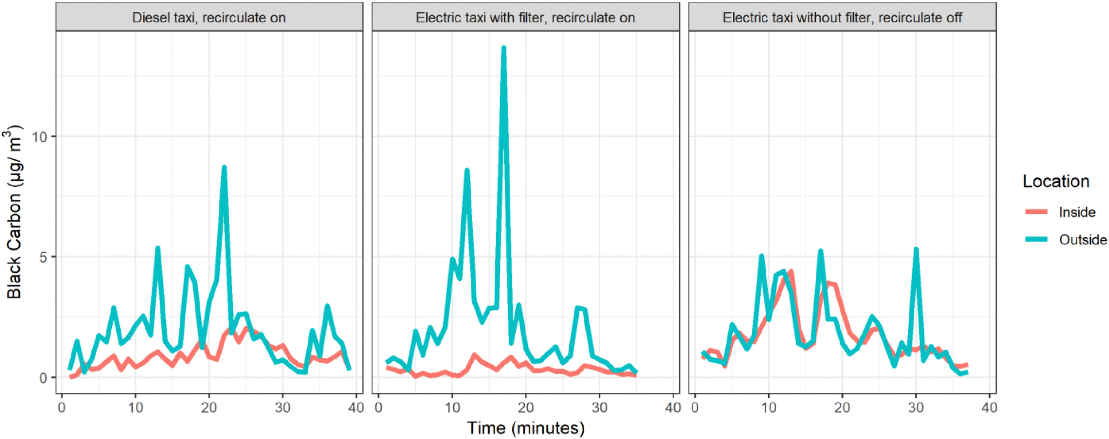
Continuation
Fig. 3. Paired inside and outside 1-min black carbon concentrations for diesel taxi with recirculate on; electric taxi with filter, recirculate on and electric taxi without filter, recirculate off.
Notes:
The I/O ratio was 0.99 in the diesel taxi with recirculating off and 0.44 with recirculating on, indicating that BC concentrations inside and outside of the taxicab were virtually the same before the recirculate setting was turned on.
In the electric vehicle, even with recirculation off, the I/O ratio was 0.63, lower than in the diesel vehicle. Turning on recirculate reduced the ratio further to 0.07, barely detecting BC concentrations inside the vehicle. Hence, the pollen filters played a significant role in regulating pollutant infiltration.
Again, while closing the windows can help regulate the concentration of pollutants inside the cabin, the increase of CO₂ exhalation of the driver can lead to the driver experiencing fatigue and concentration loss.
However, some researches have shown that there is reduced concentration of pollutants in new cars because the air-filtration system is improved.
The study showed that cabin design and air exchange rate were the same, and thus self-pollutants play a minor role in determining levels of black carbon.
The higher results from outside work exposures could be due to the taxi driver's neighborhood; probably, the areas have higher exposure to high diesel operated cars. Therefore, future research can regulate the problem with the driver keeping a diary of their daily activities.
Some of the mechanisms that have contributed to reduced disease infection caused by exposure to pollutants include the simple choice of preference the driver has on the type of car and regulating the cabin environment.
As a result, if drivers can opt to use electrically operated cars, their health gets protected and the control of environmental pollution.

Slide 11
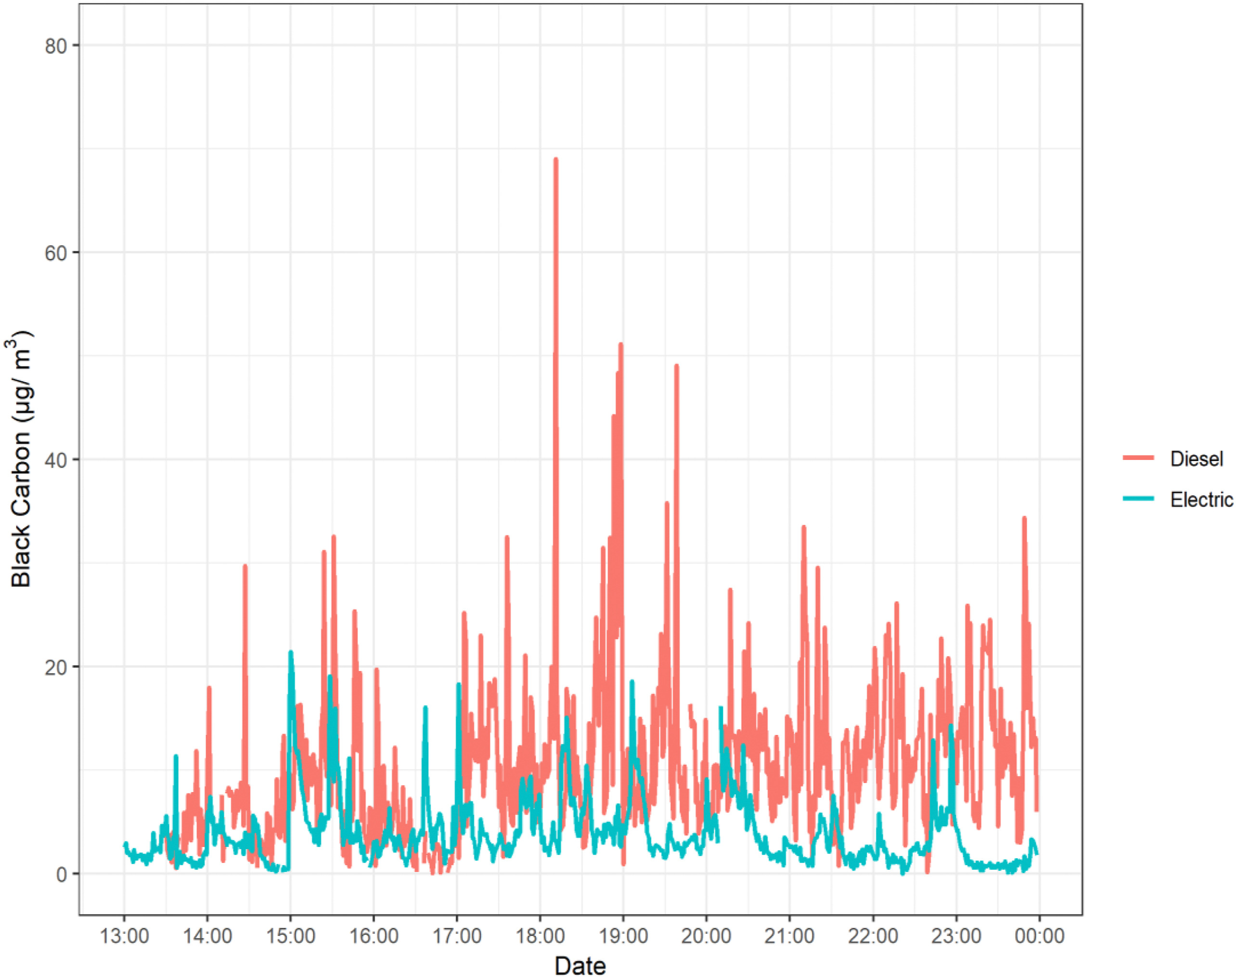
Continuation
Fig. 4. Chart showing a same-day comparison on a typical driving day of exposure to black carbon in a TX4 Diesel vehicle and a TXe City electric vehicle, 31st of May 2018.
Notes:
Mean exposure to BC at work at 1-min resolution was nearly twice as high for diesel vehicle drivers.
The results indicate that the electric-operated taxi cabin decreased the infiltration of environmental black carbon concentrations compared to the diesel-operated car cabin.

Slide 12
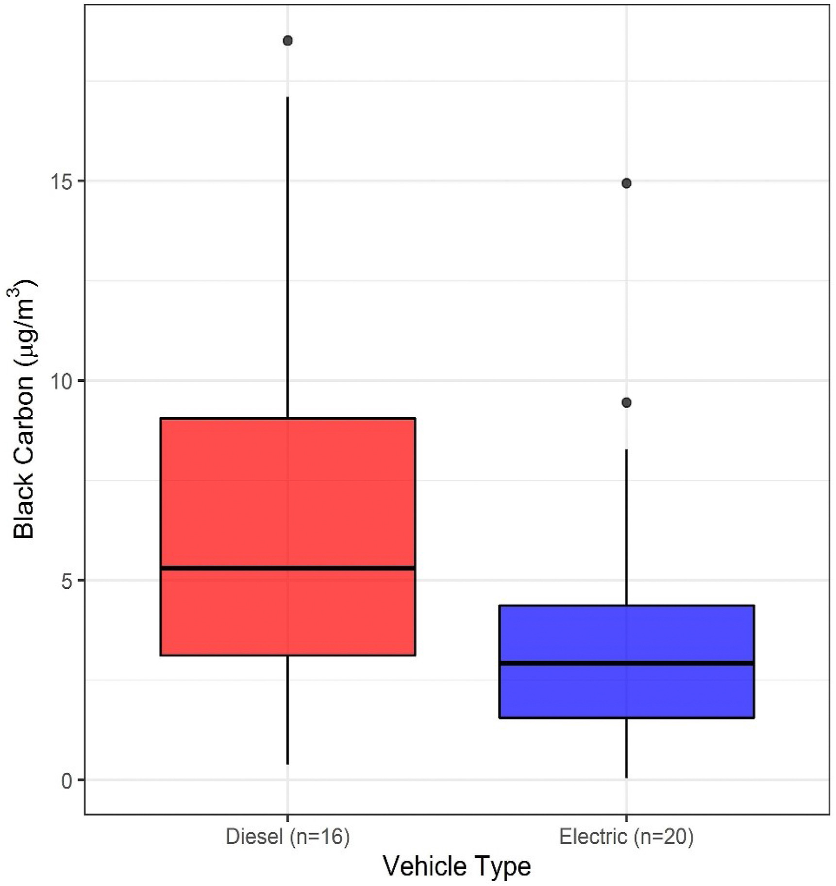
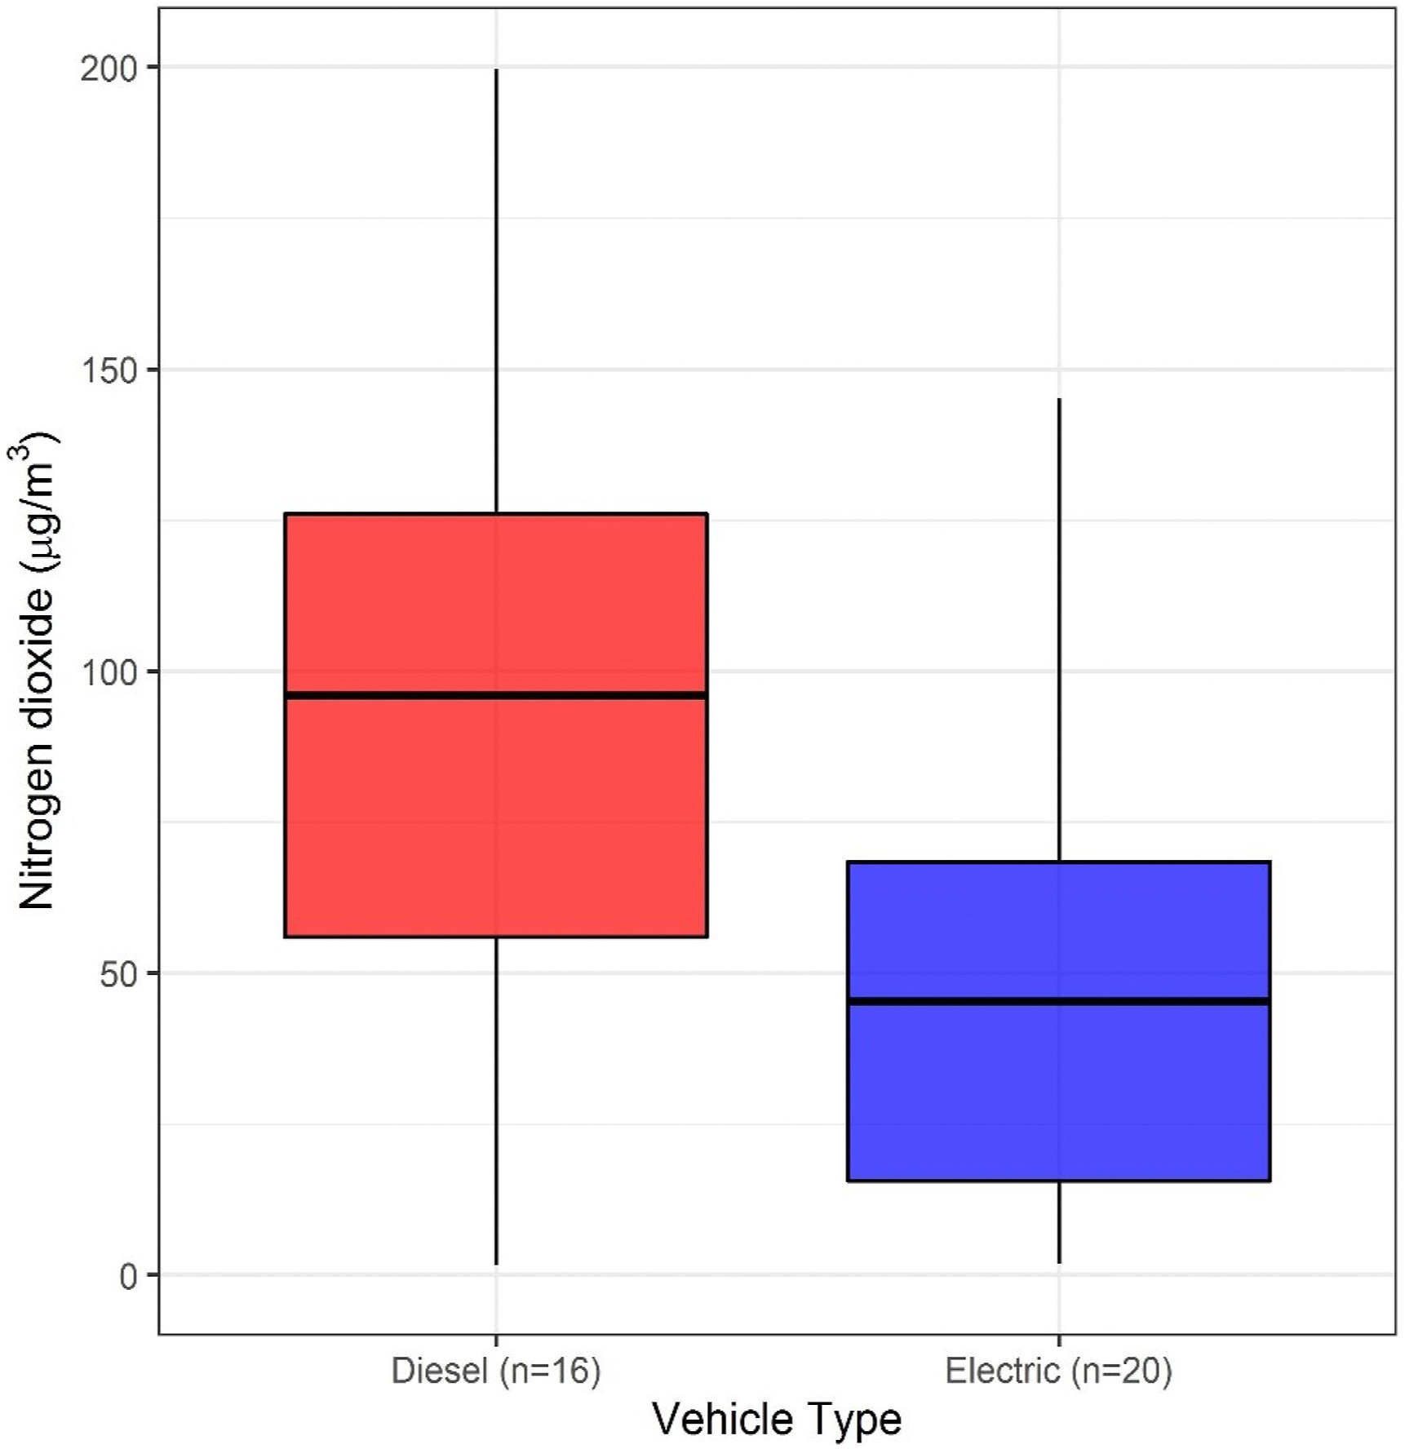
Infiltration Rate Analysis
Fig. 5. A boxplot showing the exposure to BC depending on vehicle type during 16 shifts for diesel vehicles and 20 shifts for the electric vehicles.
Fig. 6. A boxplot showing the exposure to NO2 depending on vehicle type during 16 shifts for diesel vehicles and 20 shifts for the electric vehicles.
Notes:
As indicated by table two, the average concentration was higher inside diesel taxis compared to electric taxis both with and without the filter.
The mean range exposure for the diesel-operated car for black carbon was very high compared to an electrically operated car. (2.4 μg/m3 higher than for the electric vehicle drivers (5.3 μg/m3 compared with 2.9 μg/m3 ))
The boxplots for NO2 exposure at work illustrated different exposure patterns, with a more extensive range and a higher median of 95.7 μg/m3 for TX4 Diesel taxi drivers and a smaller range lower median of 45.3 μg/m3 for TXe City electric taxi drivers.
The variation in the two types of car's exposure to NO₂ matched diesel, including the 98th percentile.
Similarly, the concentration of BC and NO₂ showed higher results outside work for diesel operated car (mean of 1.6 μg/m3 compared with 1.1 μg/m3 and 30.1 μg/m3 compared with 22.2 μg/m3, respectively (p < 0.001)). The collected data varied between two and four in comparison with mean work exposure.
Therefore, the results indicated that diesel cars expose drivers to increased concentrations of both pollutants at all points. The exposure to the two pollutants for an electric car driver was minimal. The cabin concentration primarily involved external pollutants based on the driver's environment, like congested streets.
The faulty monitor contributed to only one round getting recorded with recirculating set to off for the inside-outside analysis in the diesel taxi. This run coincided with very high outside readings compared to the other runs resulted in increased values.
Most likely, the absence of this round could have caused similar results for in-cabin diesel taxi concentrations, and the results would be like the electric taxi without the filter, with the electric taxi with the filter resulting in the lowest in-cabin concentrations.

Slide 13
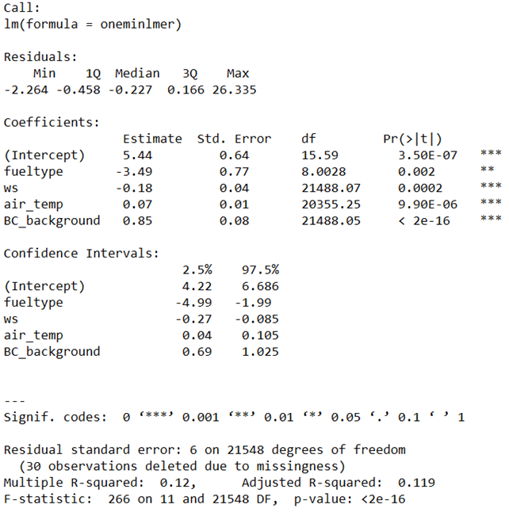
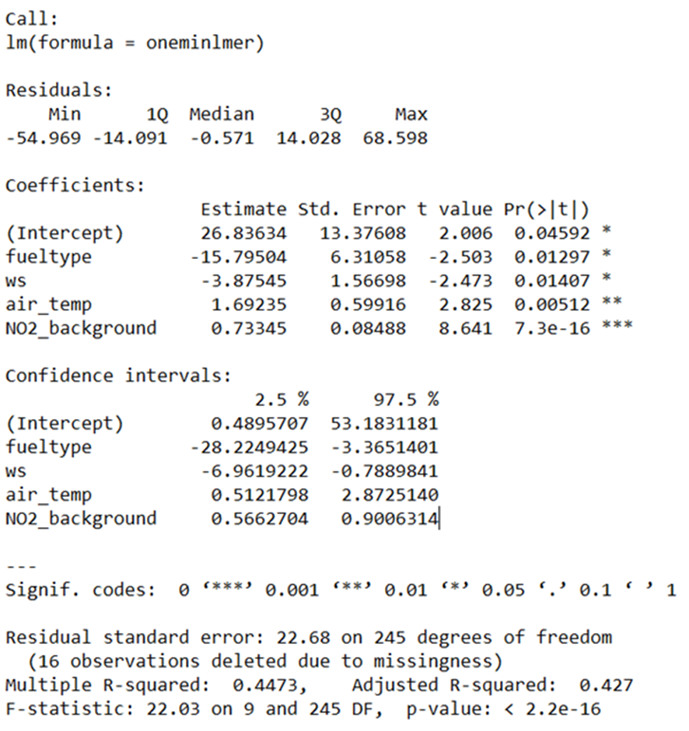
Discussion
Figure 7: Mixed-effects model result for BC concentrations
Figure 8: Mixed-effects model result for NO2 concentrations
Notes:
Figure 7: Mixed-effects model result for BC concentrations; wind speed (ws), air temperature (air_temp); background concentrations of BC (BC_background).
External environmental factors like temperature and wind concentration have no valid impact on BC and NO₂ pollutant concentrations on the vehicle cabin.
The pollen filters played a significant role in controlling the entry of pollutants from the outside environment because when they got removed, the data matched that of diesel-operated vehicles.

Slide 14
Continuation
Electric car have minimal pollutant exposure than diesel cars
High traffic areas expose taxi drivers to excess pollutants
Exposure to pollutants can be managed using different cars.
Driver exhaled cardon dioxide impact.
Petrol is less harmful than diesel
Notes:
The study hypothesized that taxi drivers operating electric cars are less likely to be exposed to air pollutants than those using diesel-operated cars.
The study also confirmed that taxi drivers get regularly exposed to air pollutants during their routine work, primarily while in high traffic areas. Average BC work exposures being 5.1 μg/m3, three to four times higher than outside of work exposures.
Different types of vehicles can help moderate the exposure percentage of the driver to pollutants.
Previous research on the comparison between cabin NO2 concentration of diesel and petrol compared to 2004 indicated less concentration of NO2 in petrol-operated taxi cars than diesel engines due to the modification of the petrol engines.

Slide 15
Limitation and Conclusion
a) Limitations
Limited data collection due to limited sample
Limitation of data recording mechanism.
b) Conclusion
Cabin design and car filters play a vital role in regulating air pollution, a health threat to drivers.
Impact of fuel type on driver exposure.
Effect of ventilation in regulating pollution exposure.
Advantage of zero tailpipe emission vehicles.
Notes:
Limitation
More accurate results could have been realized by using more samples as control.
The research could have employed a time-resolved method of data recording to increase accuracy levels. Hence, this should be automated to relive the patrician role of recording or use a proxy in-cabin CO₂ concentration.
Conclusion
Cabin design and car filters play a vital role in regulating air pollution, a health threat to drivers. Mostly, drivers who spend more hours on the road like taxi drivers and transit vehicles.
Fuel type plays a minor impact on the reduced exposure of a taxi driver. When a diesel car has similar cabin modification and filters like those of an electric car, the percentage exposure rate is similar.
The type of ventilation of a car helps in regulating pollution exposure. However, it depends on the driver's mental balance of the exhaled carbon dioxide.
The best mechanism to reduce driver exposure to pollutants involves zero tailpipe emission vehicles with airtight cabins and filters.

Slide 16
Reference
Bos, B., Lim, S., Hedges, M., Molden, N., Boyle, S., Mudway, D. I., & Barratt, D. B. (2021). Taxi drivers’ exposure to black carbon and nitrogen dioxide in electric and diesel vehicles: A case study in London. Environmental Research, 195, 110736. https://doi.org/10.1016/j.envres.2021.110736
Questions?

