Slide 1

Warm arctic episodes linked with increased frequency of extreme winter weather in the United States
(Judah Cohen, Karl Pfeiffer, and Jennifer A. Francis)
By
Eric Zubar

Slide 2
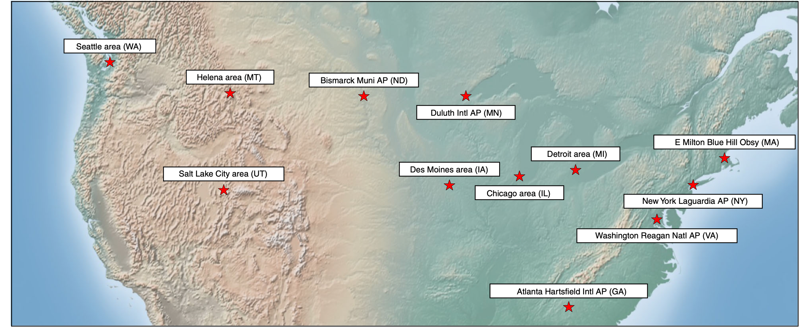
Introduction
The researchers worked to discover a correlation between the temperature of the atmosphere at the North Pole (Polar Cap Temperature (PCT)), as well as the height of the troposphere there (Polar Cap Height (PCH)), with severity of winter weather at 12 different locations in the continental United States.
A strong reverse-correlation was found in most locations; particularly in the eastern half of the U.S. The same reverse-correlation was found in Eurasia, as well.
The third metric they developed is called the Accumulated Winter Season Severity Index (AWSSI), which measures intensity of cold and snow.

Slide 3
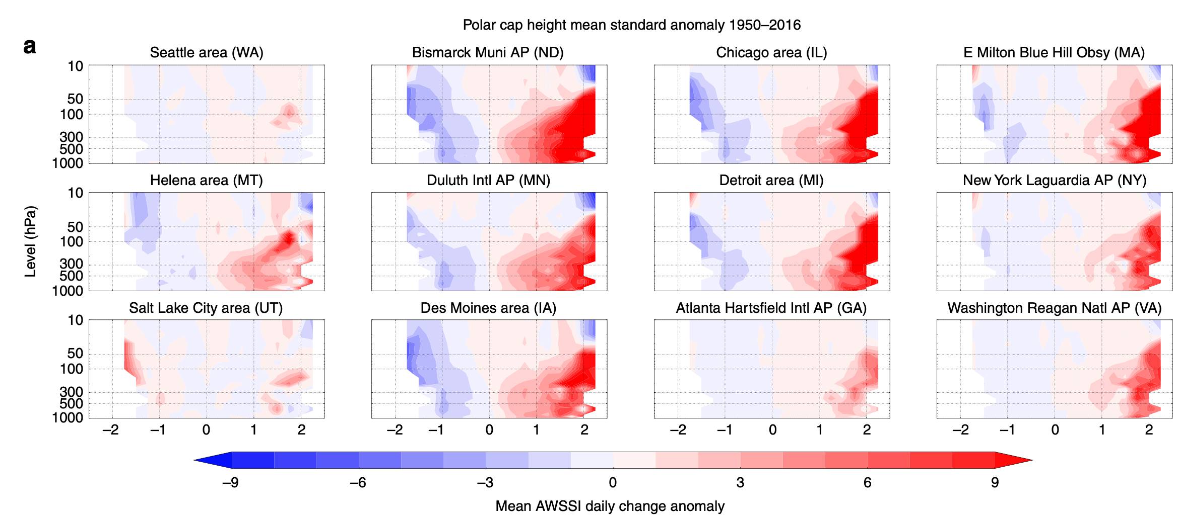
Evidence
-2 to +2 on graphs represent PCH and PCT values. Lower PCH and PCT values lead to lower AWSSI and vice versa.
Note that the more red AWSSI is, the more severe the winter weather in the U.S. locations. Colors are reversed in regard to what one might expect.

Slide 4
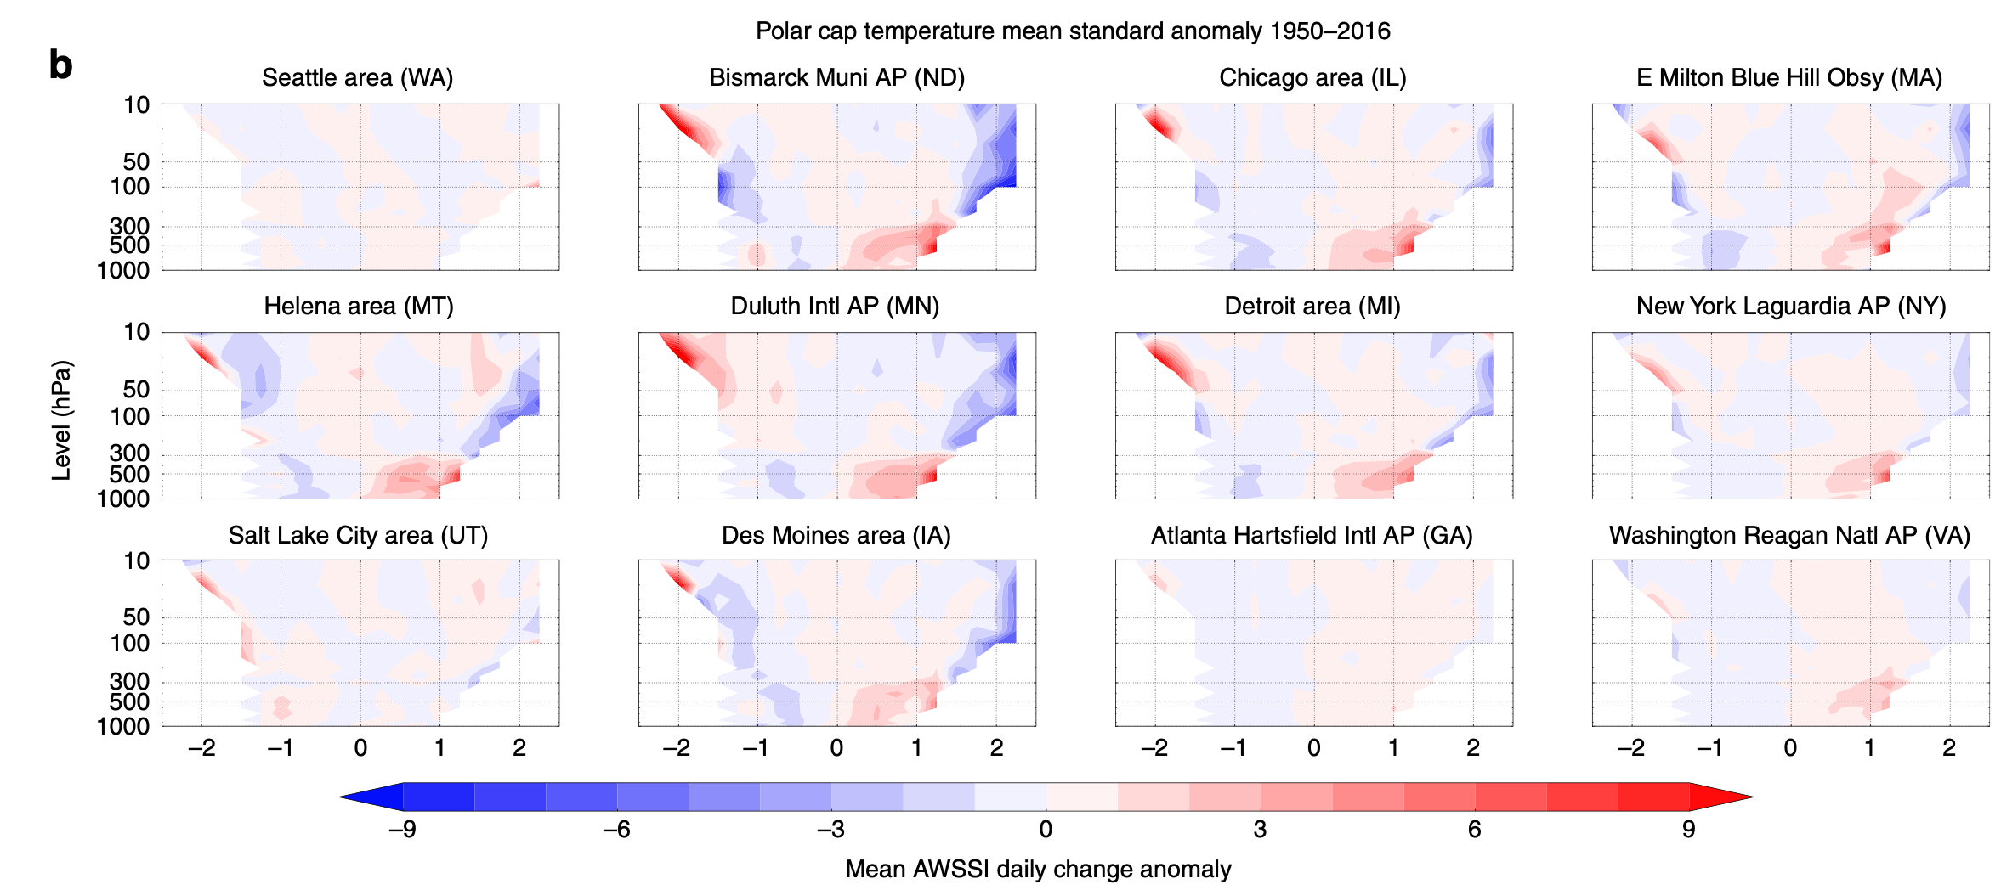
Evidence
-2 to +2 on graphs represent PCH and PCT values. Lower PCH and PCT values lead to lower AWSSI and vice versa.
Note that the more red AWSSI is, the more severe the winter weather in the U.S. locations. Colors are reversed in regard to what one might expect.

Slide 5
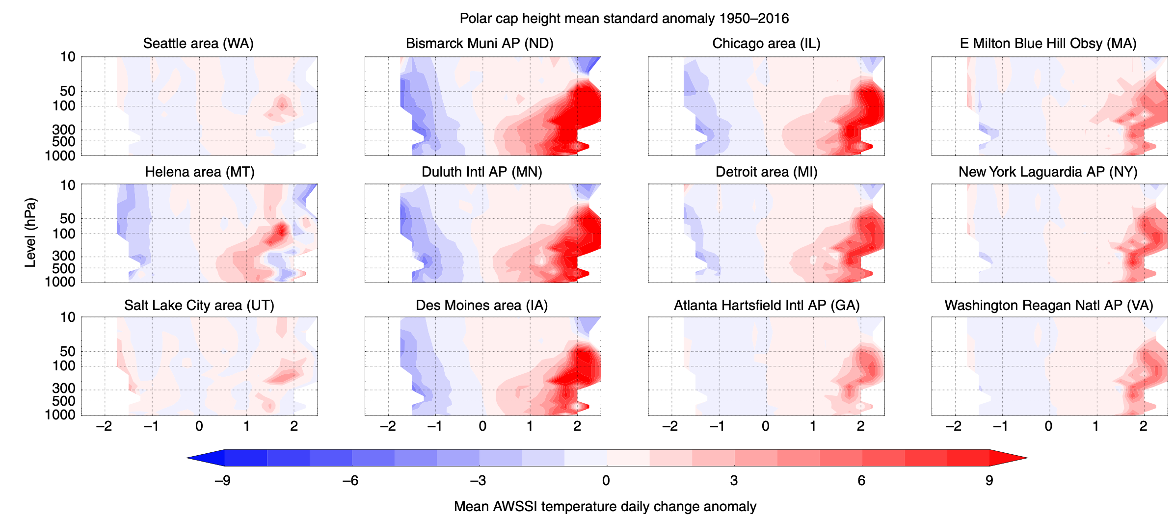
Evidence
PCH has a very similar correlation as the previous slide when looking at the temperature aspect of AWSSI.

Slide 6
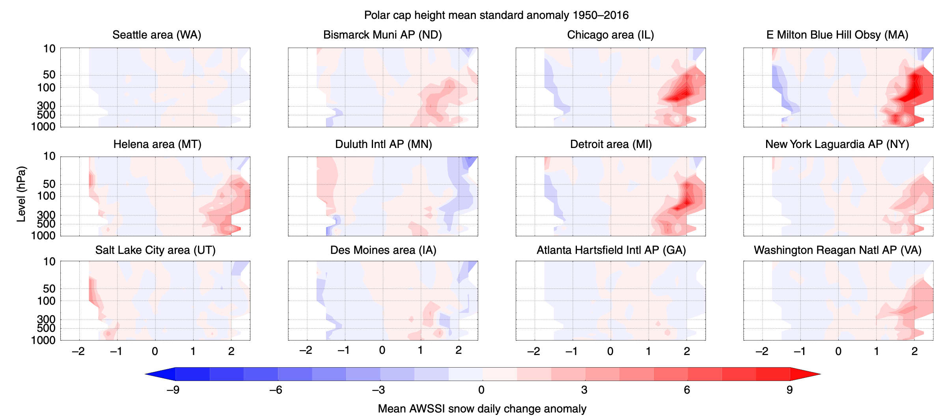
Evidence
PCH has a positive, but not as strong of a correlation with the snowfall aspect of AWSSI.

Slide 7
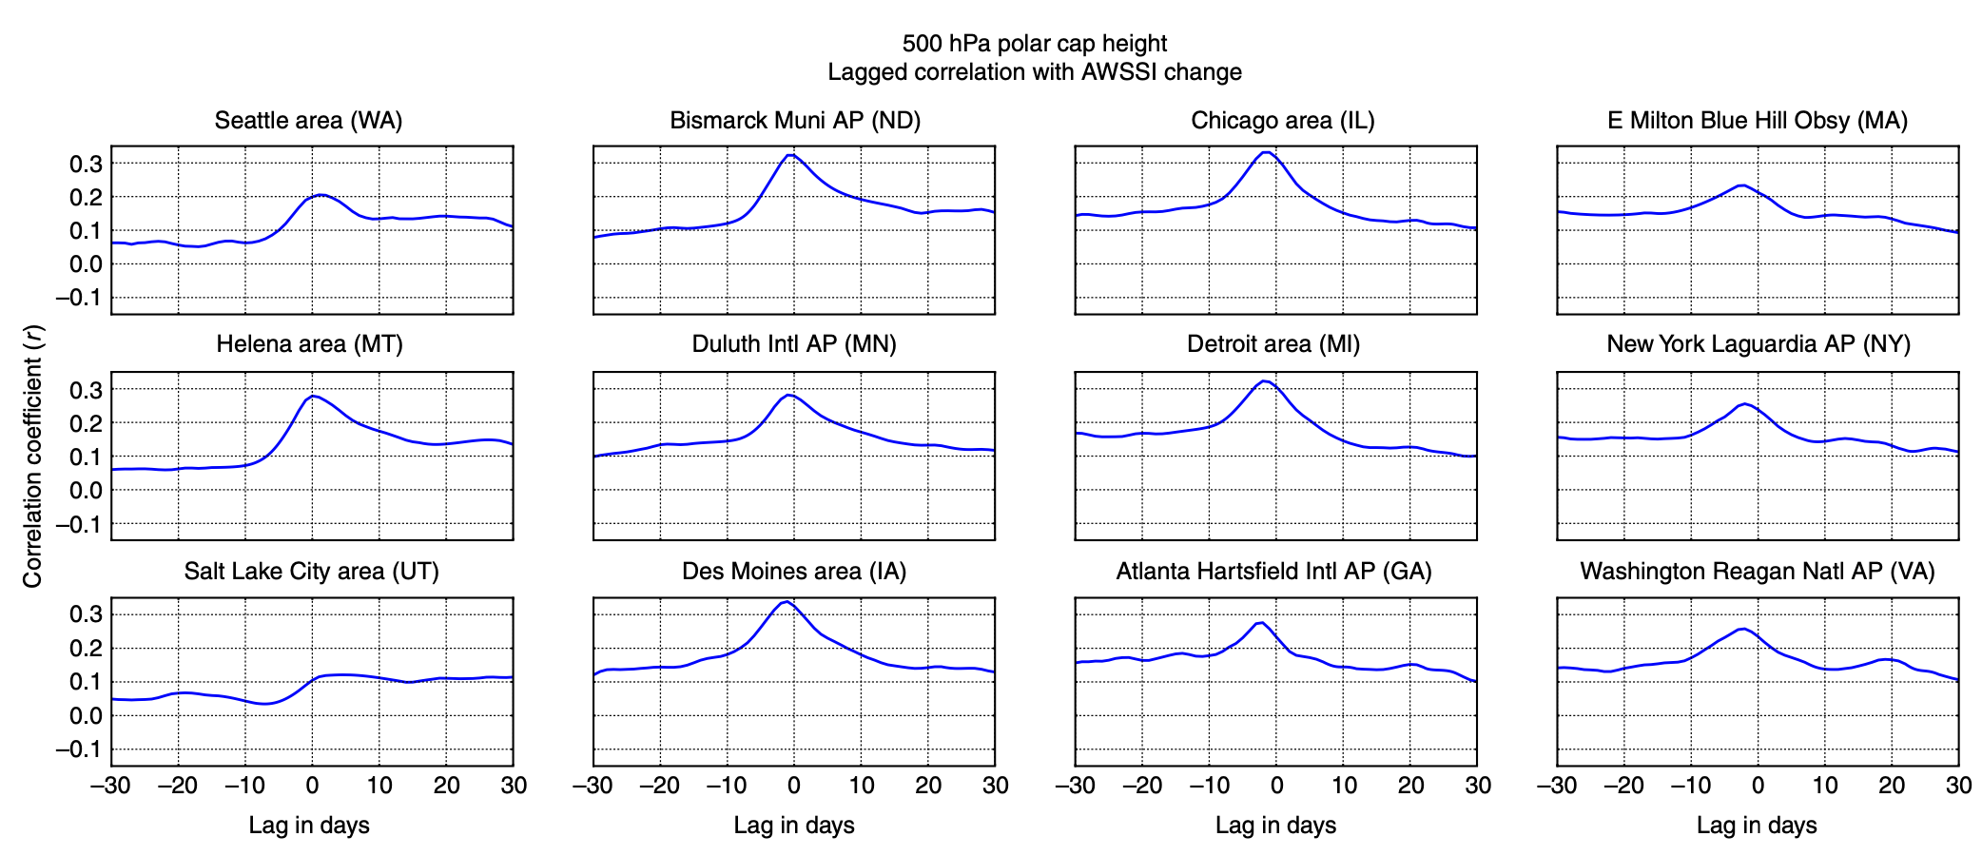
Evidence
When PCH changes, a strong uptick in correlation coefficient (r) is seen in all stations except Salt Lake City at 5 days in advance of AWSSI severe winter weather occurrences.
The strongest correlations are in the Midwest, and become stronger the further westward one goes from the East Coast.

Slide 8
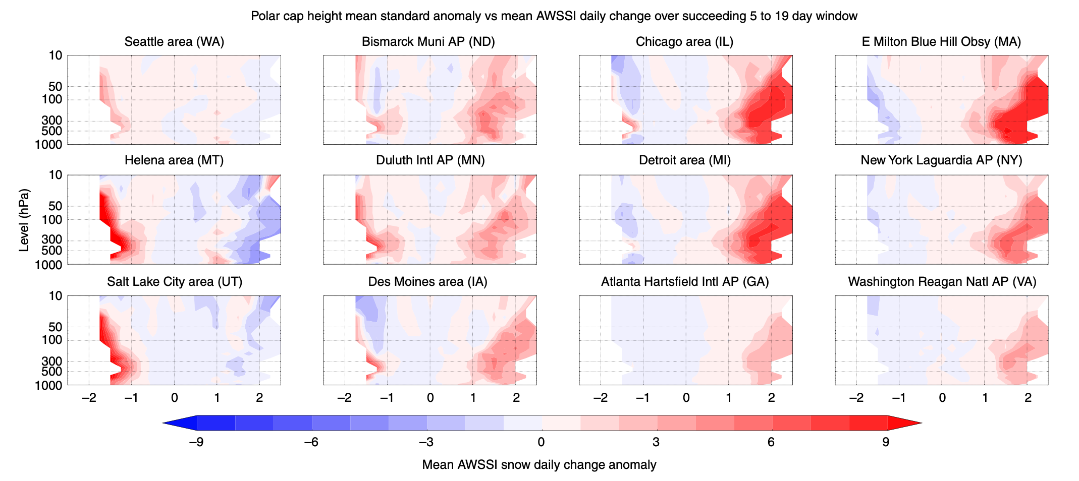
Evidence
PCH variability leads to more severe snowfall during a 5-19 day window from the time of cap height change.
Correlation is perhaps the strongest here in terms of both positive and negative correlation: Midwest to East Coast shows solid positive correlation with snowfall, whereas West shows well-defined inverse correlation.

Slide 9
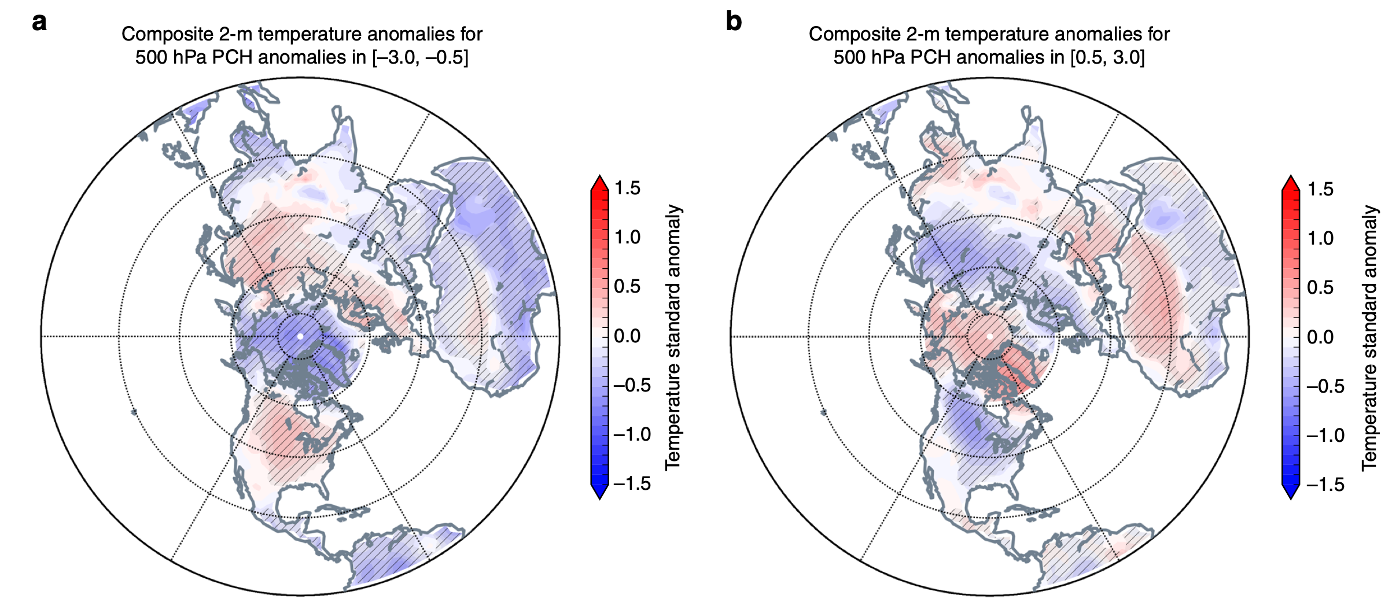
Evidence
a and b show surface temperature anomalies relative to negative and positive PCH anomalies.

Slide 10
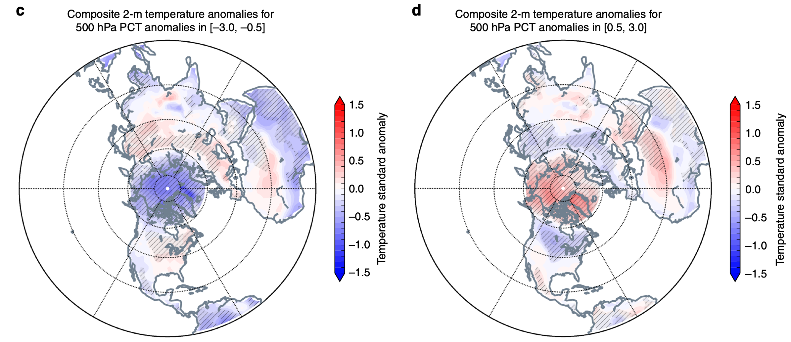
Evidence
c and d show surface temperature anomalies relative to negative and positive PCT anomalies.

Slide 11
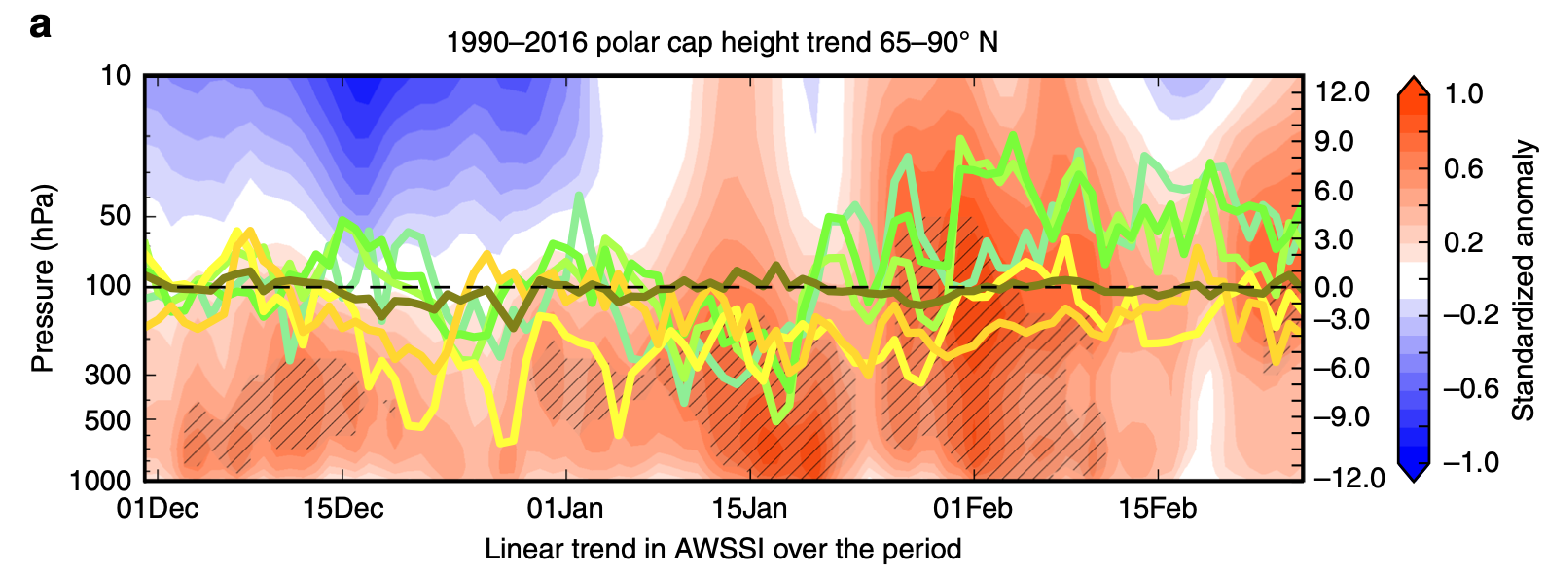
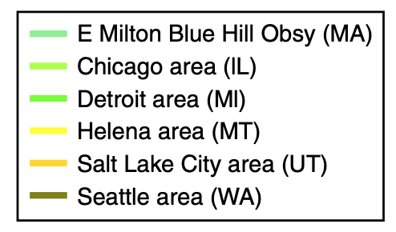
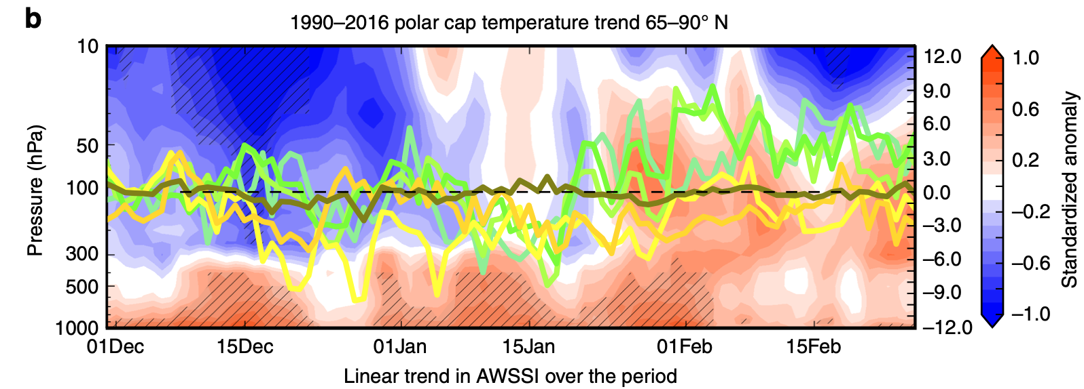
Evidence
AWSSI is stronger in most locations in late-January through February.
PCT correlates better with AWSSI in these locations than does PCH.

Slide 12
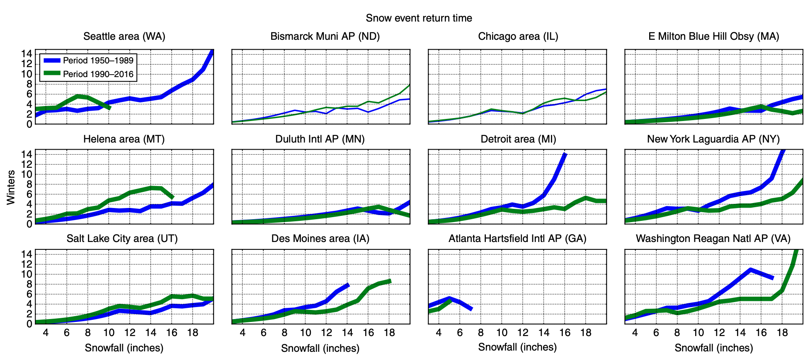
Evidence
Generally, the more eastward one goes in the U.S., the more frequent and intense snowfall events have become since 1990 when compared to 1950-1989.
The graphs drawn in bold lines represent a 95% confidence interval.

Slide 13
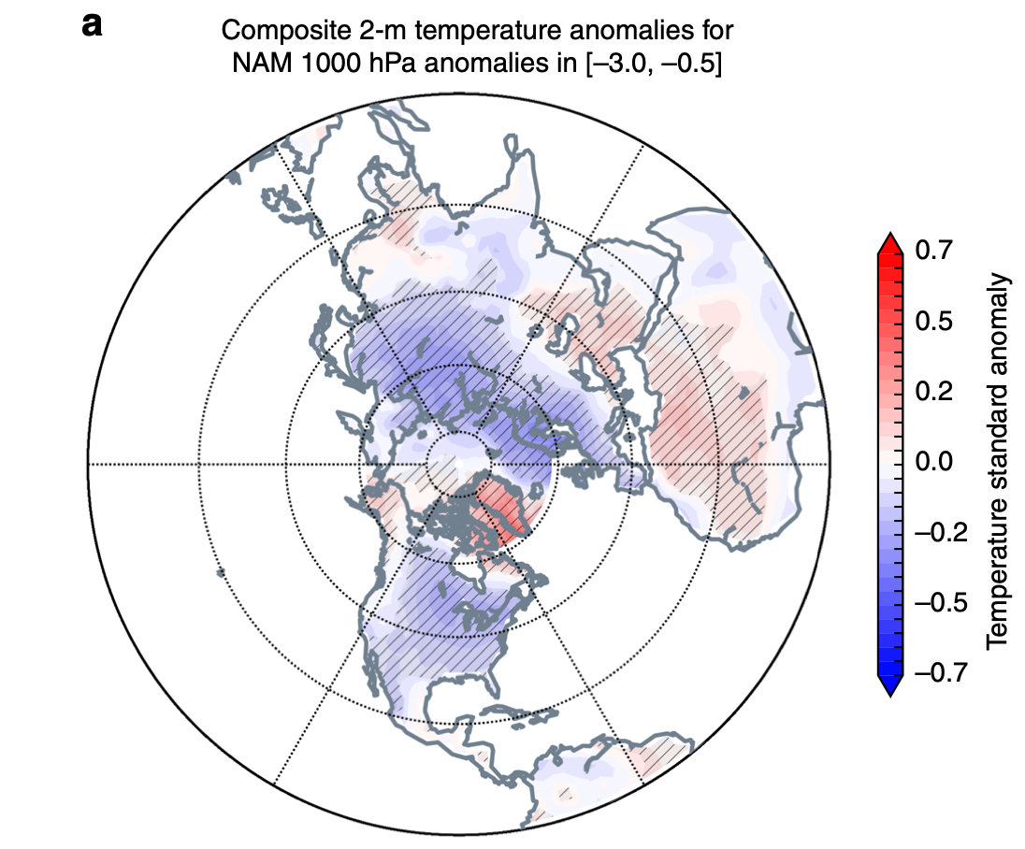
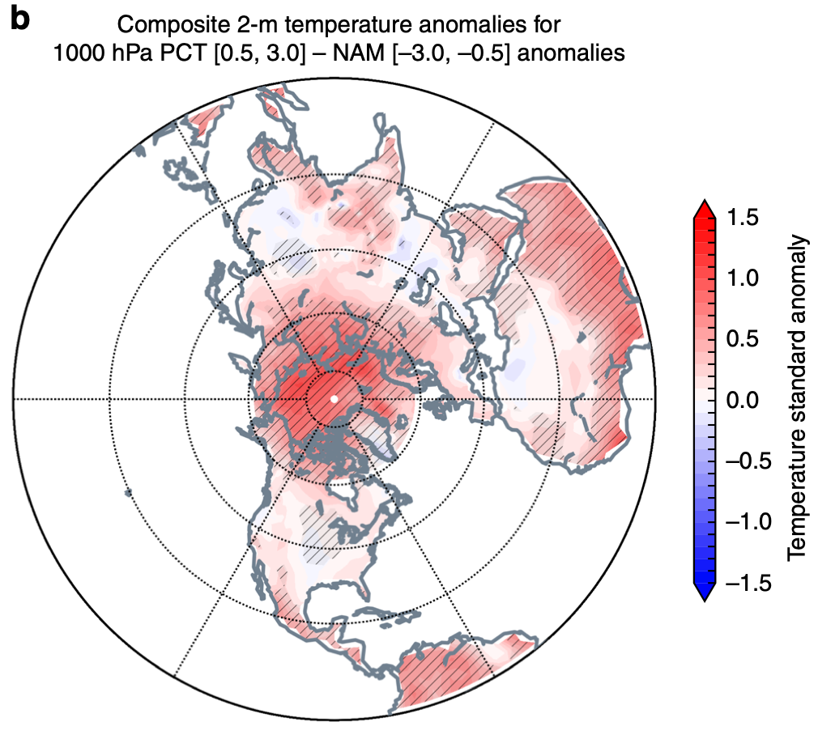
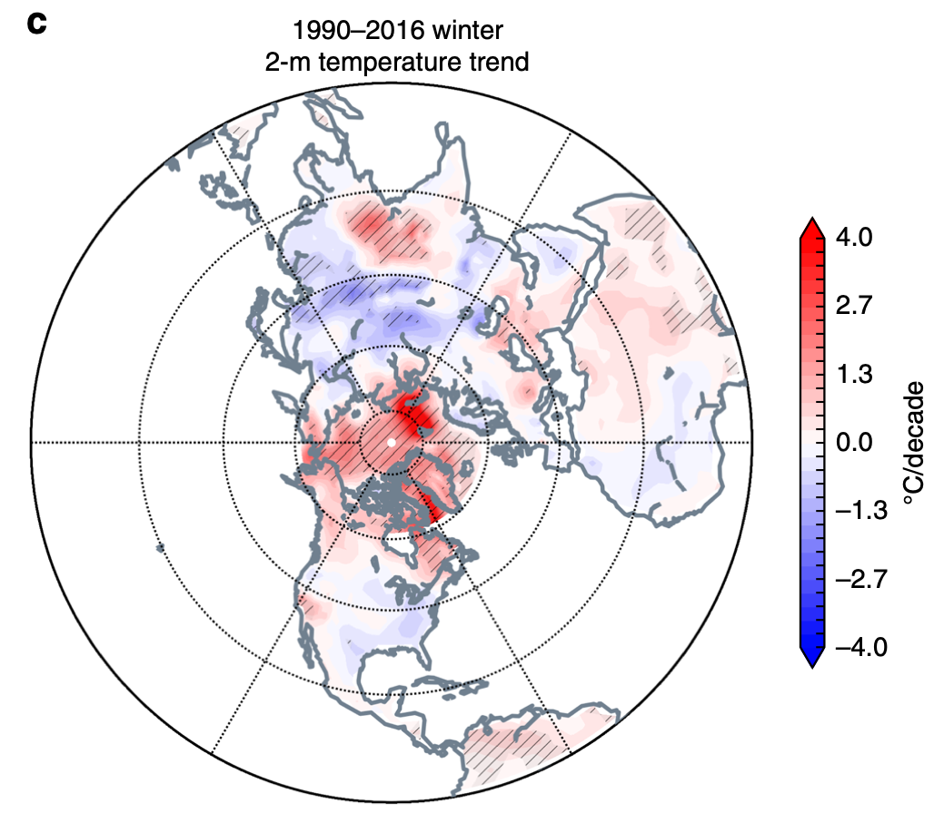
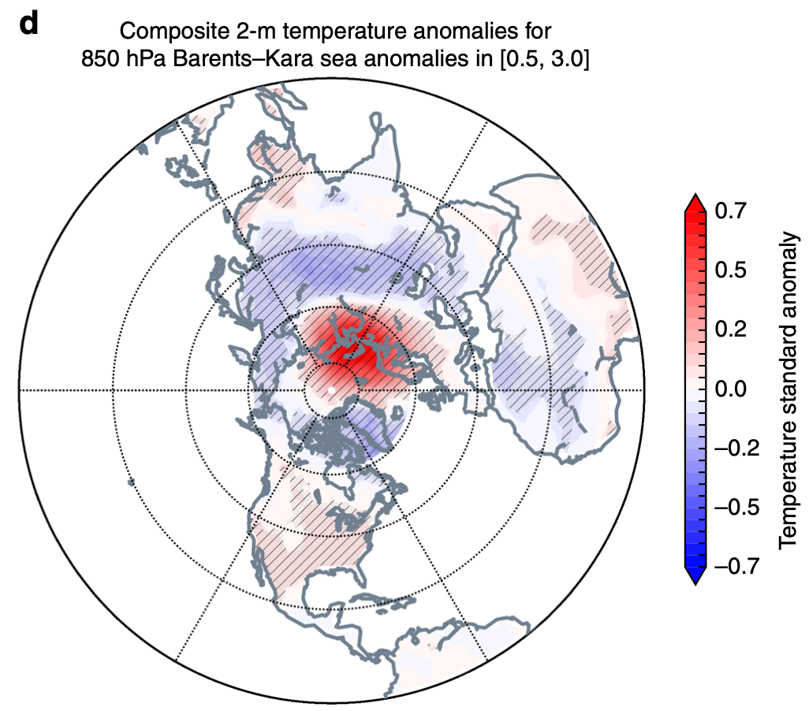
Evidence
Northern Annual Mode (NAM) is a metric that measures variability in all of the Northern Hemisphere north of 20°N, in contrast to just the polar regions like PCH and PCT do. Map “a” shows a positive correlation with NAM and temperature, and Map “b” shows NAM- subtracted from PCT+.
“c” shows the basic 1990-2016 winter temperature trend in the N.H. “d” shows the importance of the Barents-Kara Sea region to temperature anomalies in the N.H.

Slide 14
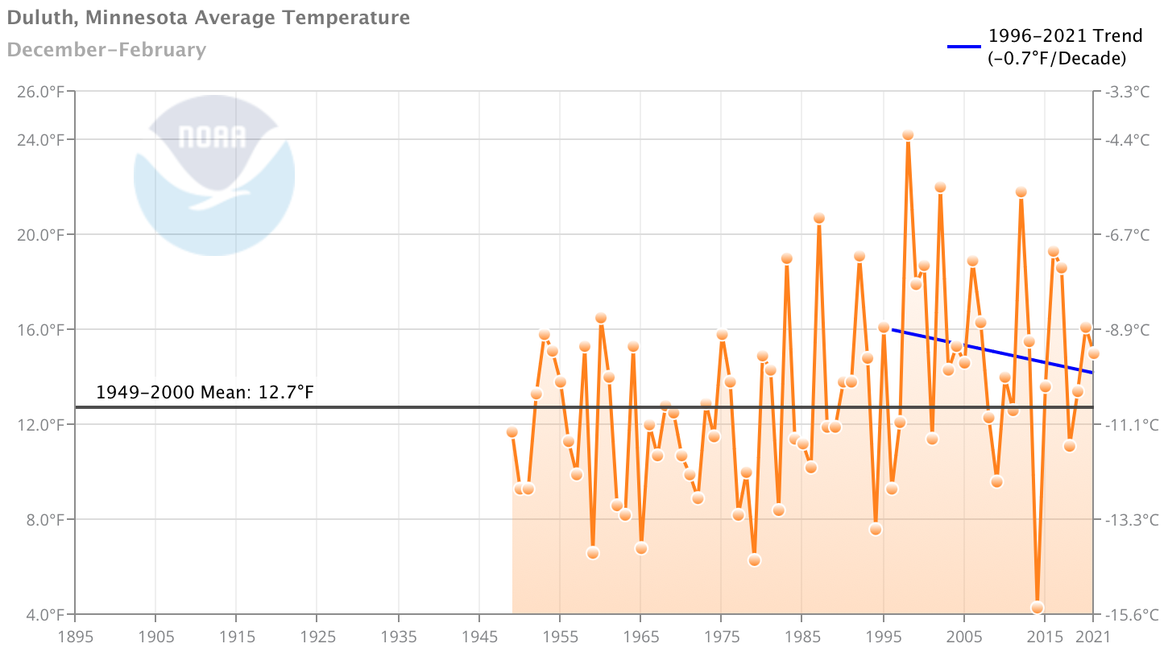
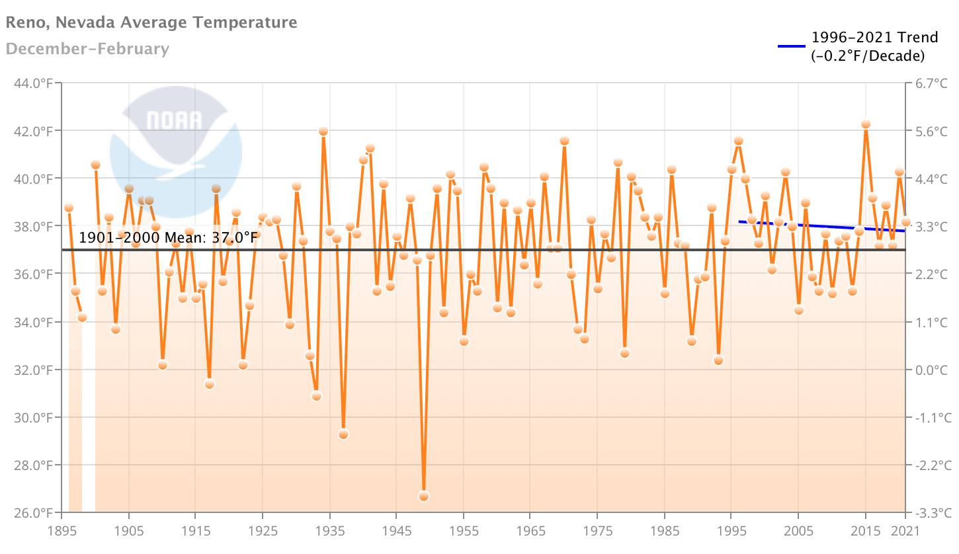
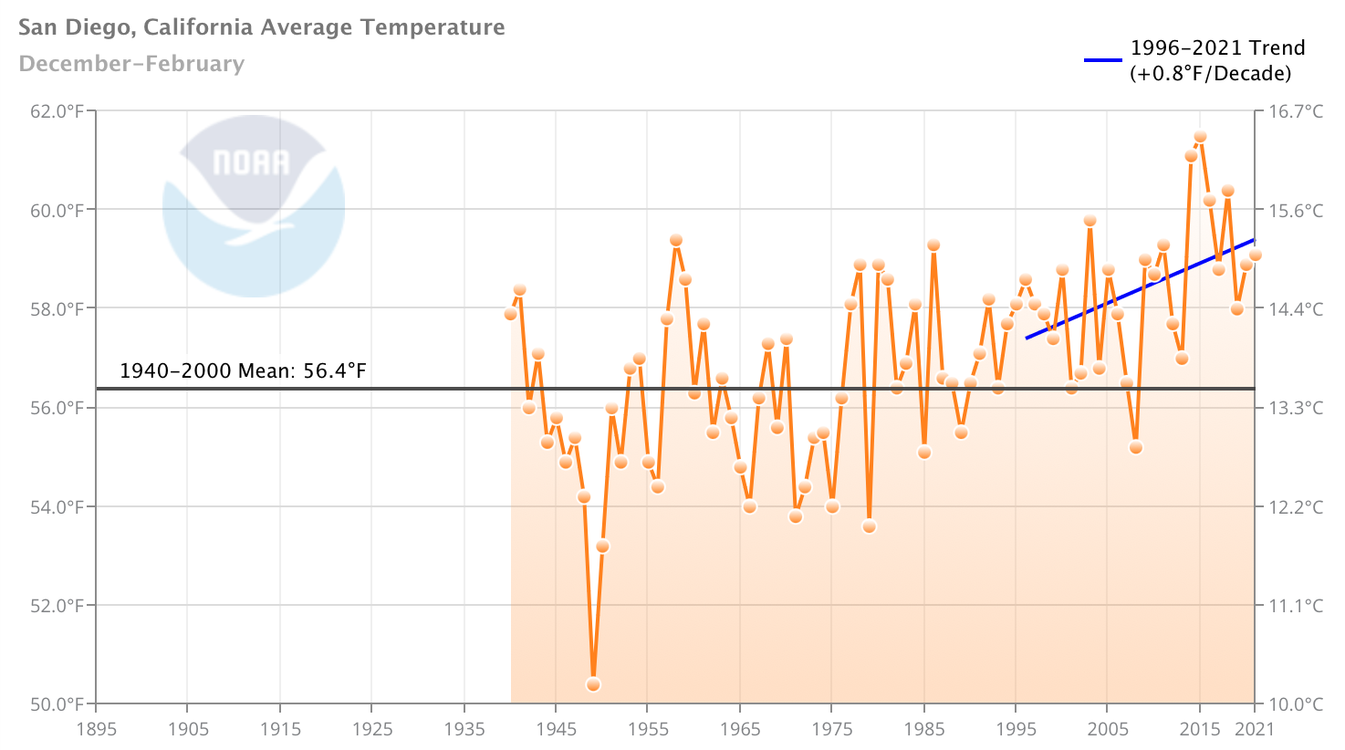
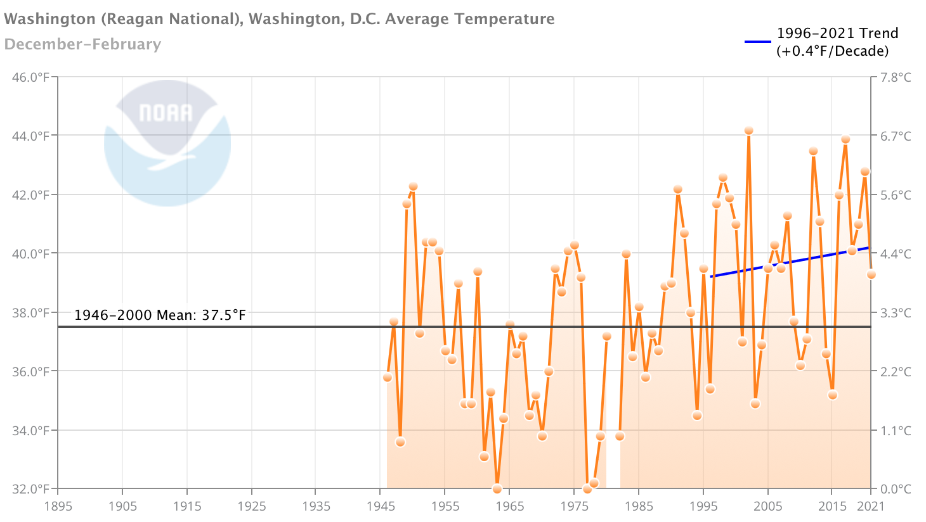
What is the trend now?
Winter temperature trends since 1996 shown in four different locations in four different regions.
The updated trends since the study was published neither help nor hurt the paper’s conclusion (Duluth’s trend aligns with findings, while Washington does not align).
NOAA National Centers for Environmental Information, Climate at a Glance: City Time Series, published March 2021, retrieved March 29, 2021 from https://www.ncdc.noaa.gov/cag/

Slide 15
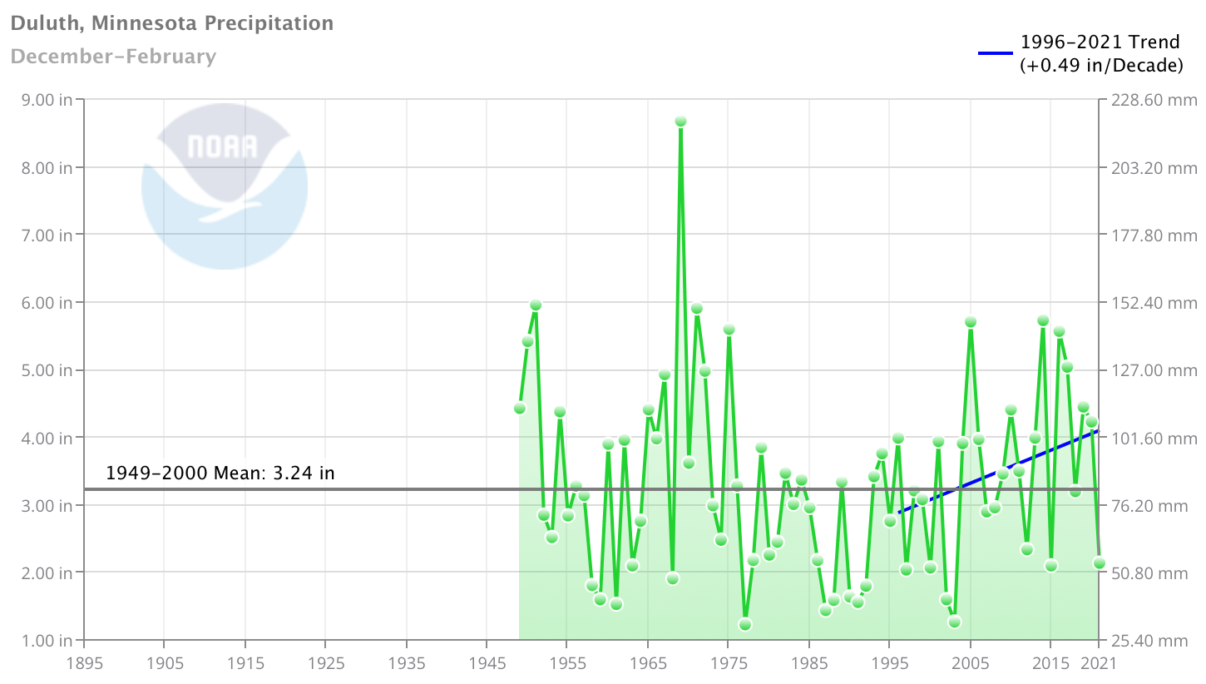
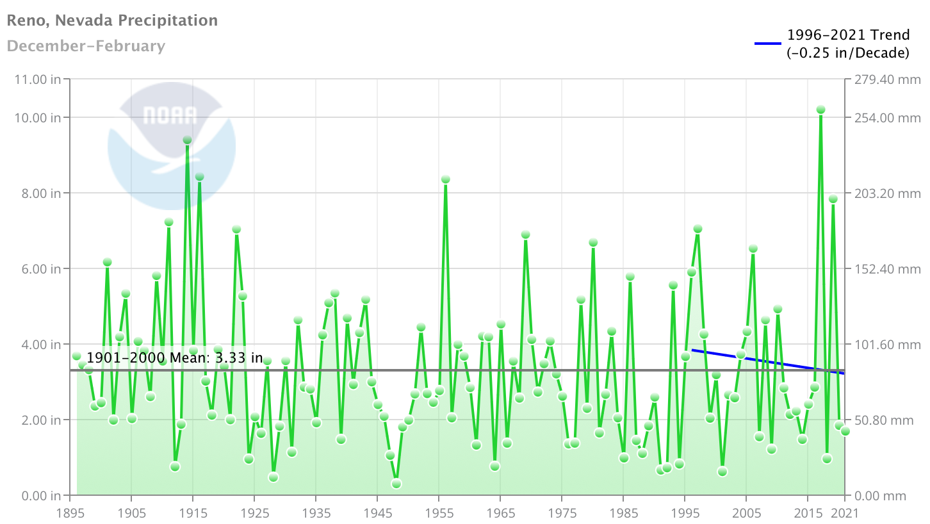
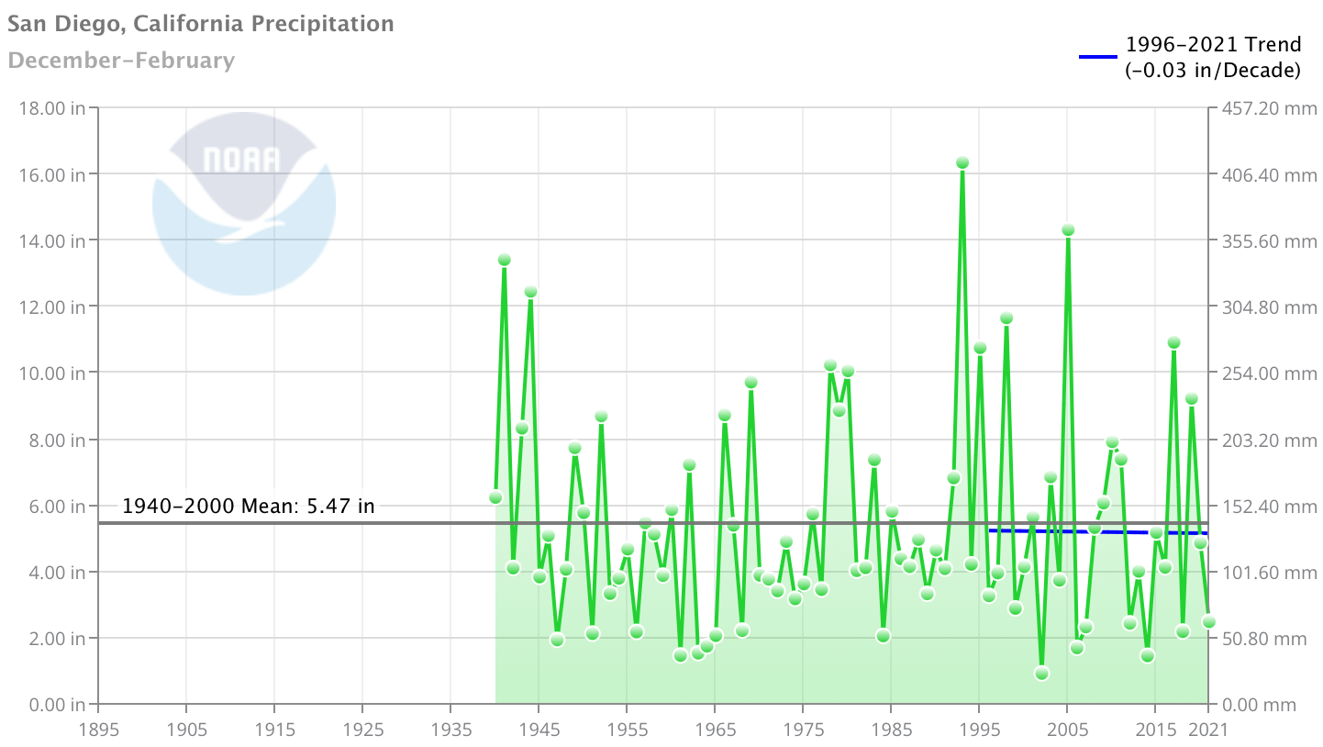
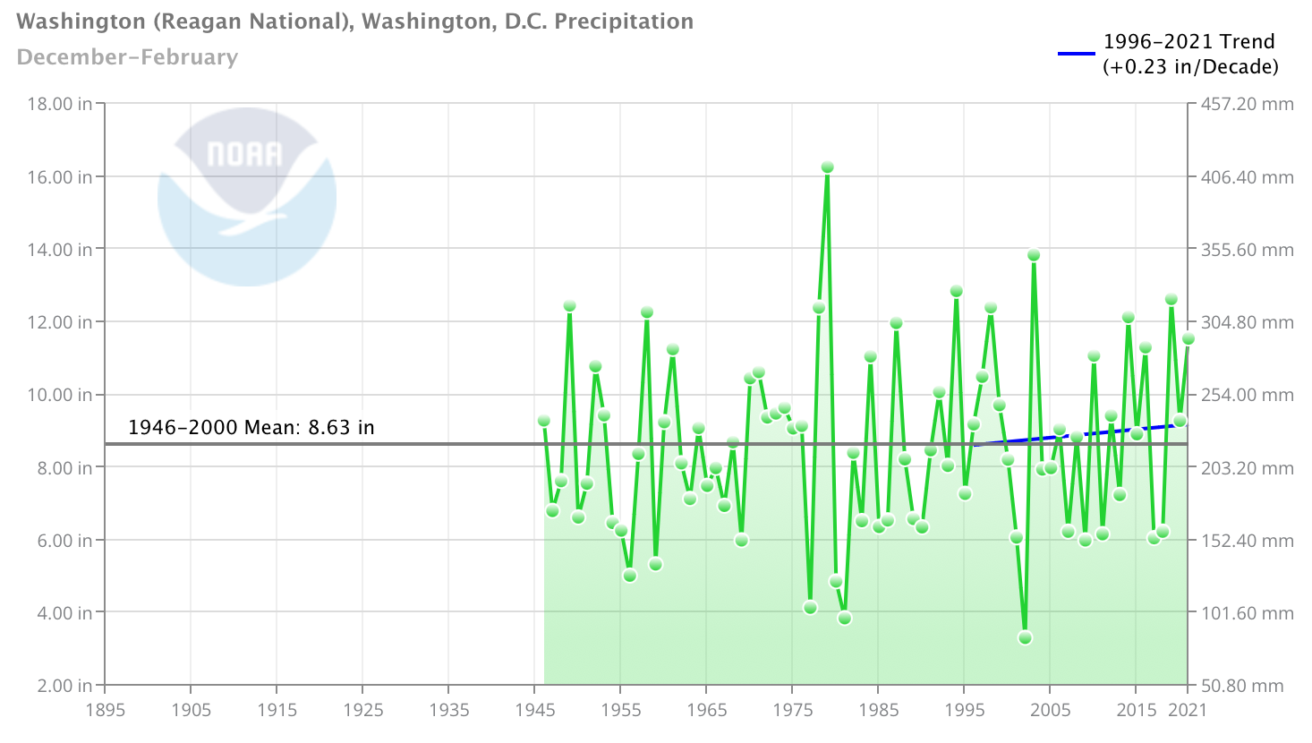
What is the trend now?
Winter precipitation trends since 1996 shown in the same four locations.
Updated trends somewhat help paper’s conclusion (positive precipitation trends in Duluth and Washington).
NOAA National Centers for Environmental information, Climate at a Glance: City Time Series, published March 2021, retrieved on March 29, 2021 from https://www.ncdc.noaa.gov/cag/

Slide 16
Conclusion
As the Earth has warmed, not all areas have warmed evenly.
As the North Pole has warmed, the eastern half of the United States and a large area of Eurasia have cooled during the winter, a phenomenon most pronounced since 1990-2016 when using the Accumulated Winter Season Severity Index (AWSSI).
The AWSSI intensifies in these areas as a result of increases in Polar Cap Temperature (PCT) and Polar Cap Height (PCH).
Since this study was published, the updated trends largely agree with its findings in four selected locations.

Slide 17
Questions? Comments?
Thank You

