Slide 1
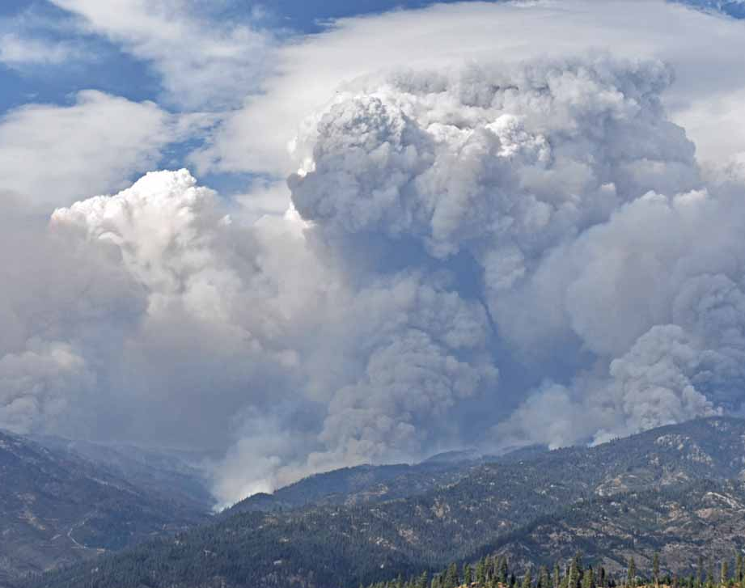
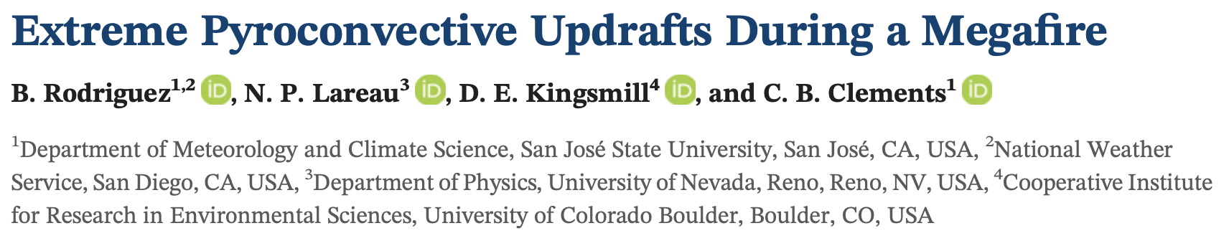
Matt Roberts
Grad Seminar Spring 2021

Slide 2
Outline
Introduction
Pyroconvection Background
Data and methods
Results
Summary/Conclusions

Slide 3
Introduction
Wildfire convective plume impacts
  Long range spotting
  PyroCb development
  Extreme (often erratic) inflow winds
  Fire generated vortices
Dynamics and structure poorly understood
  Lack of observations
How strong are wildfire updrafts?
  Pioneer Fire, Idaho (2016)

Slide 4
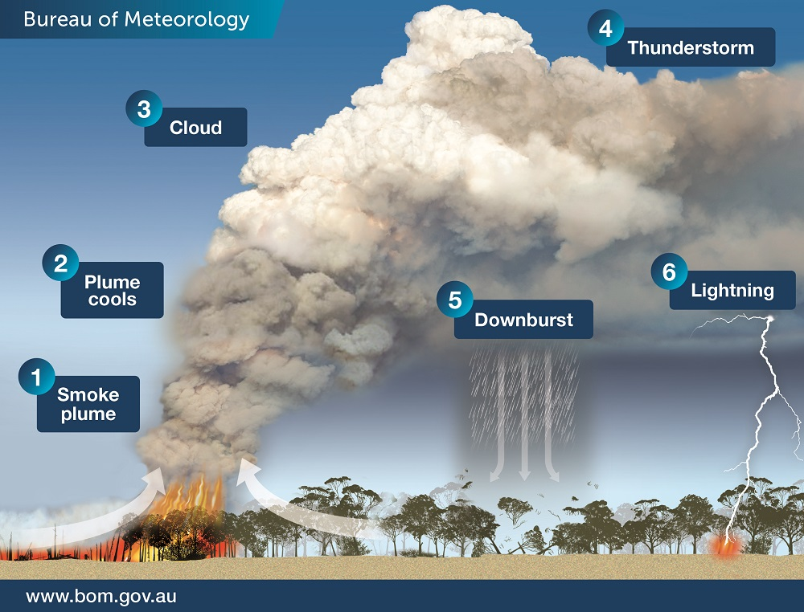
Wildfire Convective Plumes
Intense surface heating leads to rising updrafts
  Triggers convergent surface flow
Sufficiently buoyant updrafts can generate clouds (PyroCu/Cb)
  Thunder/lightning
  Downburst winds
  Precipitation
?

Slide 5
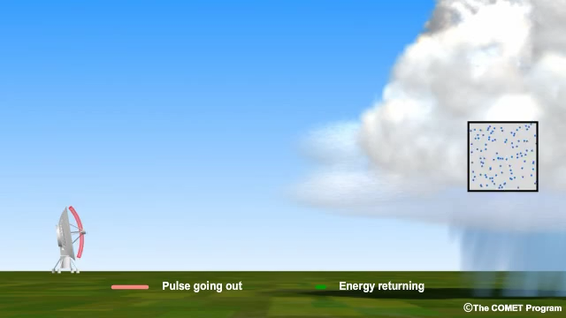
Data and Methods
Radar emits EM waves
Hydrometeors reflect energy back to radar receiver
  Droplet distribution
  Radial winds

Slide 6
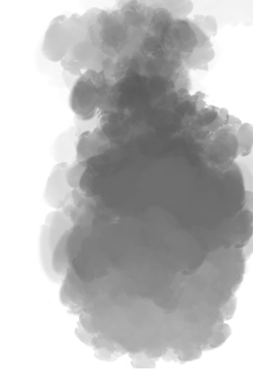

Data and Methods
Radar emits EM waves
Larger ash particles reflect energy back to radar receiver
  Ash distribution
  Radial winds

Slide 7
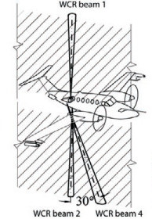
Univ. of Wyoming King Air
Wyoming Cloud Radar (WCR)
Downward pointing radar
  93 GHZ W-band (3-mm wavelength)
  Sensitive to smaller scatterers (i.e. pyrometeors)
  Reflectivity factor = ash distribution
  Radial winds = vertical velocities
Additional data used:
  In-situ aircraft measurements of temperature, wind, and moisture
  Radiosonde data
  NWS ground-based radar coverage
Wang et al. (2012)

Slide 8
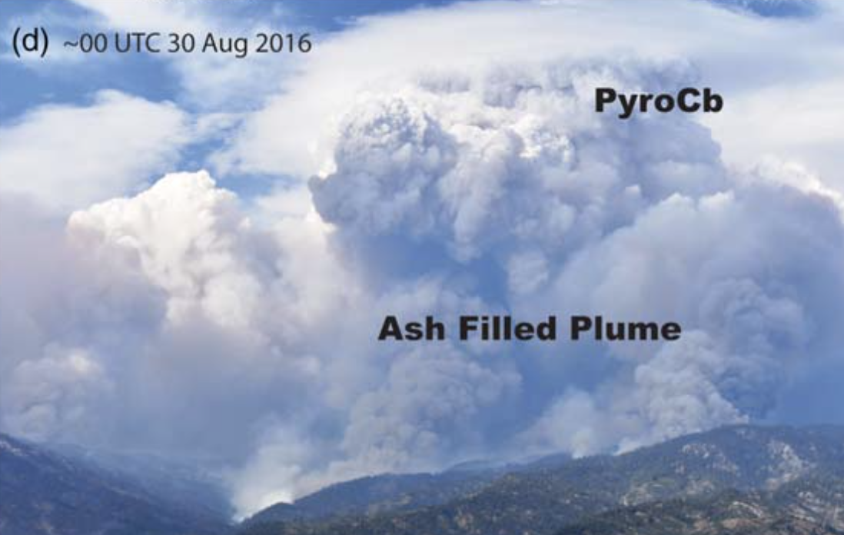
The Pioneer Fire
”Megafire” consumed 188,000 acres
  Late summer 2016
  Idaho
Generated deep pyroCb plume on afternoon of Aug 29th
Rapid spread of 29,000 acres

Slide 9
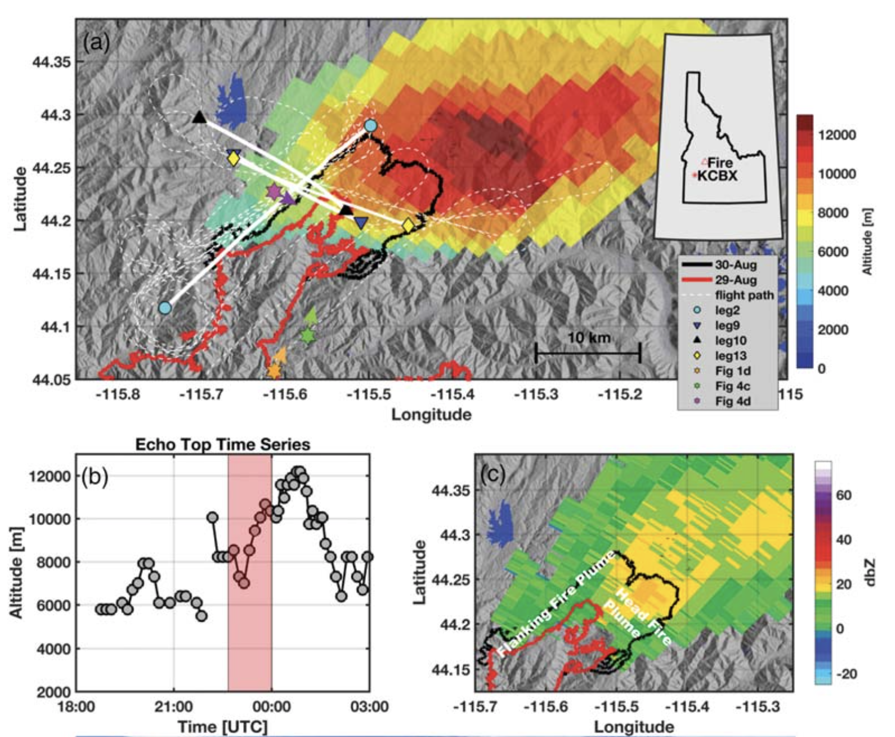
The Plume
10km deep convective plume
Plume top temps of -55˚C
  Glaciated cloud tops
UWKA flight during rapid plume deepening
  Heavy ash loading

Slide 10
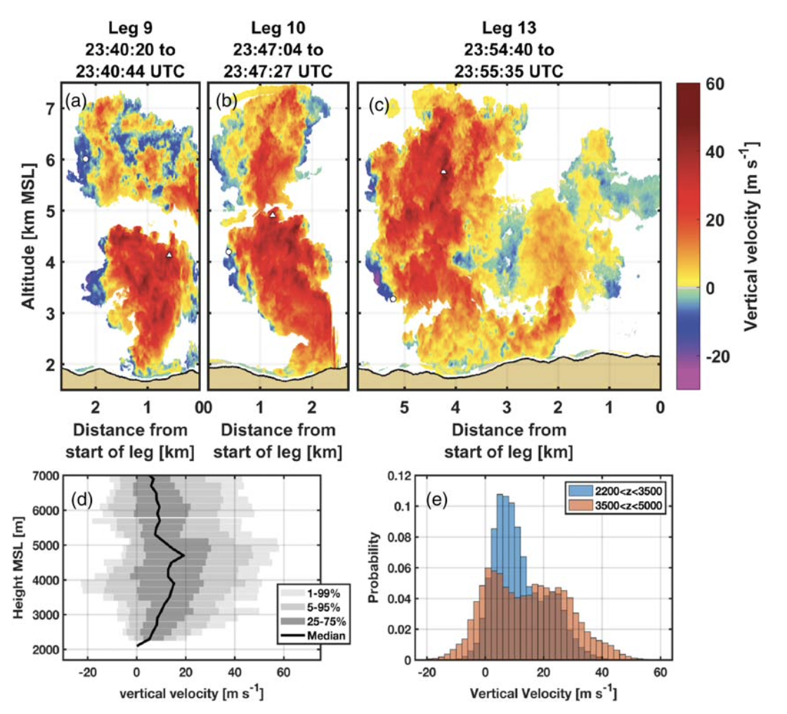
Plume Vertical Velocity
Flight Leg 9
  40 ms⁻¹ central updrafts, widening w/ height
  -18 ms⁻¹ narrow flanking downdrafts
  Residual convective element aloft
Flight Leg 10
  Updrafts and downdrafts intensify (58 ms⁻¹,-29ms⁻¹) with plume growth
Flight Leg 13
  Strong updrafts (48 ms⁻¹) persist aloft

Slide 11
Plume Vertical Velocity
Flight Leg 9
  40 ms⁻¹ central updrafts, widening w/ height
  -18 ms⁻¹ narrow flanking downdrafts
  Residual convective element aloft
Flight Leg 10
  Updrafts and downdrafts intensify (58 ms⁻¹,-29ms⁻¹) with plume growth
Flight Leg 13
  Strong updrafts (48 ms⁻¹) persist aloft
Updrafts accelerate w/ height up to ~5km
Both stronger updrafts and downdrafts w/ height
Parcels decelerate >5km

Slide 12
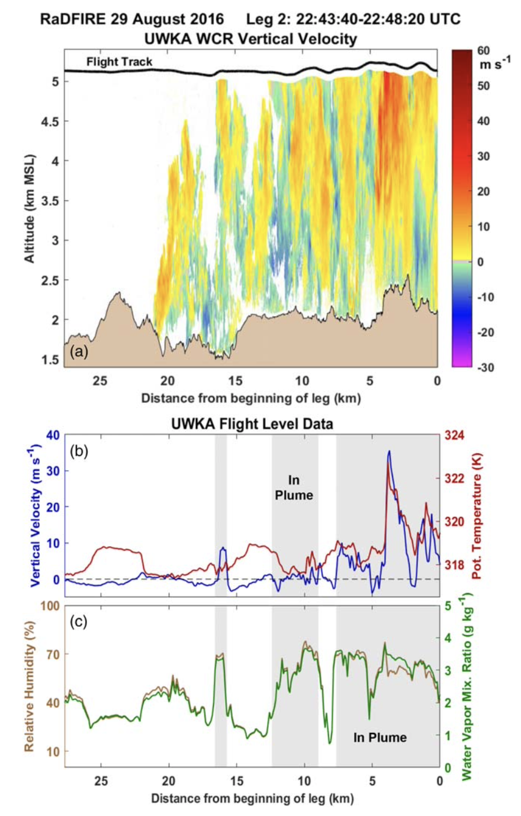
PyroCb Thermodynamics
Increased vertical velocity w/ height driven by sustained positive buoyancy
  Highest vertical velocities well correlated w/ warmer updraft core
Driven by fire sensible heat flux, not pyroCb latent heat release
Updrafts important for triggering pyroCb via vertical moisture transport

Slide 13
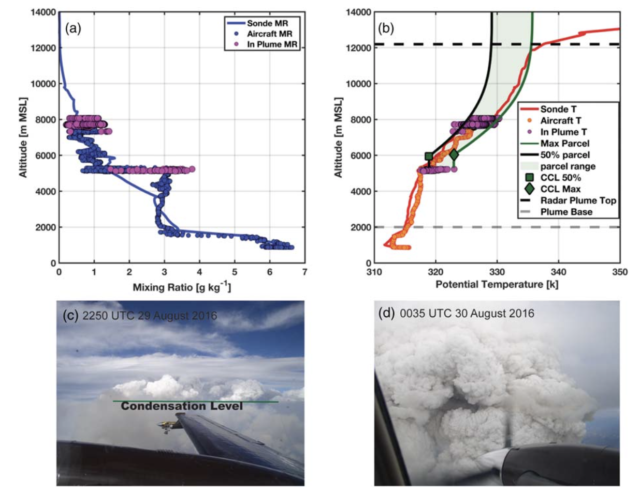
PyroCb Thermodynamics
Median plume parcels condense near 5945 m
  Quickly become negatively buoyant
Hot, moist parcels condense at 6036 m
  Remain positively buoyant to 12 km
  Triggers pyroCb

Slide 14
Summary
Wildfire convective updrafts can be extreme (at least 58 ms⁻¹)
Comparable to supercell thunderstorms (20-55 ms⁻¹)
“Hot-moist” updraft cores trigger overlying pyroCb
Updrafts of this magnitude can:
  Loft burning debris, triggering spot fires
  Stretch, tilt, twist ambient vorticity, potentially leading to tornado-strength vortices
Aviation hazard due to low reflectivity on weather avoidance radars

Slide 15
References
Rodriguez, B., Lareau, N. P., Kingsmill, D. E., & Clements, C. B. (2020). Extreme Pyroconvective Updrafts During a Megafire. Geophysical Research Letters, 47(18), e2020GL089001.
Wang, Z., French, J., Vali, G., Wechsler, P., Haimov, S., Rodi, A., et al. (2012). Single aircraft integration of remote sensing and in situ sampling for the study of cloud microphysics and dynamics. Bulletin of the American Meteorological Society, 93(5), 653-668.
When bushfires make their own weather. (2018, January). Retrieved 2021, from http://media.bom.gov.au/social/blog/1618/when-bushfires-make-their-own-weather/
Questions?

