Slide 1
Assessing Relative Humidity Dependent Photoacoustics to Retrieve Mass Accommodation Coefficients of Single Optically Trapped Aerosol Particles
Presented by Sam Taylor
Diveky, M. E., S. Roy, J. W. Cremer, G. David, and R. Signorell, 2019: Assessing relative humidity dependent photoacoustics to retrieve mass accommodation coefficients of single optically trapped aerosol particles. Physical Chemistry Chemical Physics, 21, 4721-4731.
Notes:
Introduce myself
Introduce paper – Assessing Relative Humidity Dependent Photoacoustics to Retrieve Mass Accommodation Coefficients of Single Optically Trapped Aerosol Particles
This paper requires quite a bit of background explanation, so without further ado…

Slide 2
Outline
Background
Photoacoustic Theory
Optical Tweezing
Quantum Cascade Lasers
Application of topics to paper
Results
Conclusions – Theirs and my own
Notes:
I’m going to cover some background information for the article.
The first thing that’s important to understand is photoacoustic theory. The paper kind of hinges on that concept, so I’ll spend some time going over what it is and the equations it uses.
The next thing I’ll talk about is relatively new to physics. They use something called optical tweezing in order to trap singular particles and measure them, so it’s fairly important to understand how that is working
Then I’ll talk a little bit about quantum cascade lasers and how they work.
Next, I’ll get to how all of that background applies to the paper.
I’ll go over their results, and then I’ll conclude with their findings and my own thoughts on the paper.

Slide 3
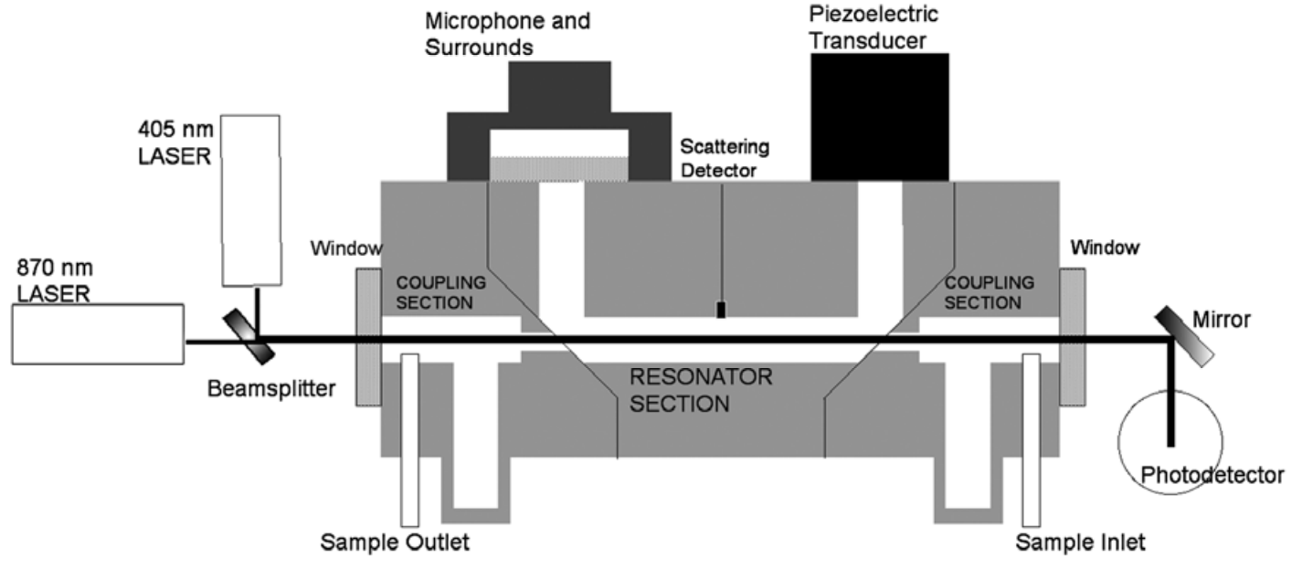
Photoacoustic Theory
Modulated laser
Acoustic resonator
Sensitive microphone
Scattering detector
Photodetector
Lewis et al, 2008
Notes:
Important notes about this image:
1 lpm through instrument
Full acoustic wavelength in U shape

Slide 4
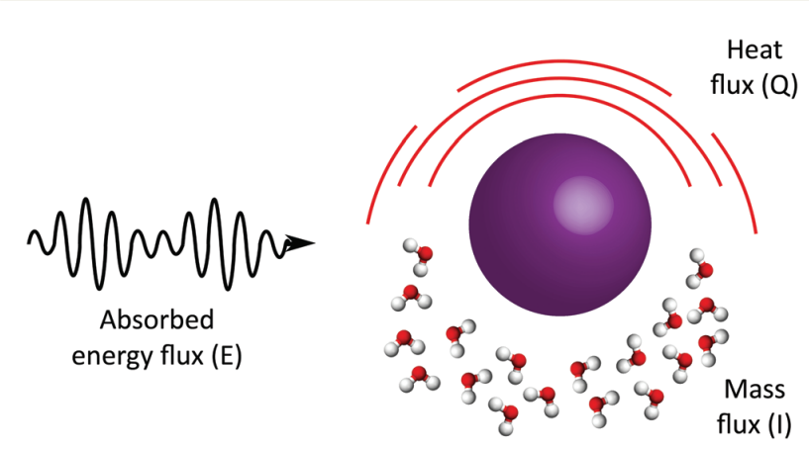
Photoacoustic Theory
Energy flux introduced by laser
Energy absorbed by particle
Energy dissipated
Heat flux –> Photoacoustic signal
Mass flux –> Evaporation
Notes:
Important notes about this image:
1 lpm through instrument
Full acoustic wavelength in U shape

Slide 5
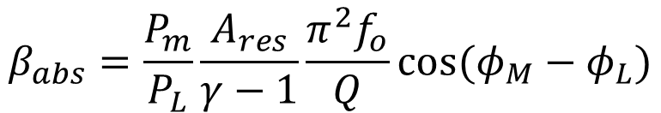
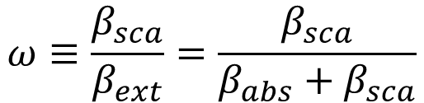
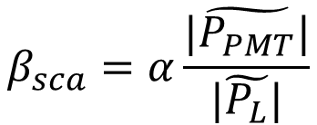
Photoacoustic Theory
$$ω≡\frac{β_{sca}}{β_{ext}}=\frac{β_{sca}}{β_{abs}+β_{sca}}$$
Single Scattering Albedo
Absorption coefficient
Scattering coefficient
$$β_{abs}=\frac{P_{m}}{P_{L}}\frac{A_{res}}{γ−1}\frac{π^{2}f_{o}}{Q}cos⁡(φ_{M}−φ_{L})$$
$$β_{sca}=α\frac{|\tilde{P_{PMT}}|}{|\tilde{P_{L}}|}$$
Lewis et al, 2008

Slide 6
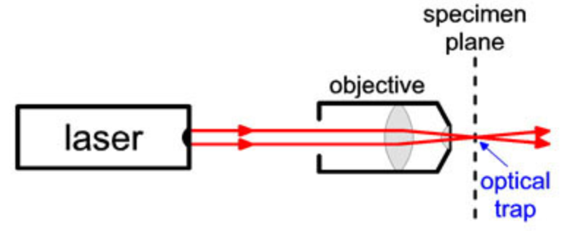
Optical Tweezing
Momentum of photon
Focused laser light
Particle is optically trapped
Block, 2019

Slide 7
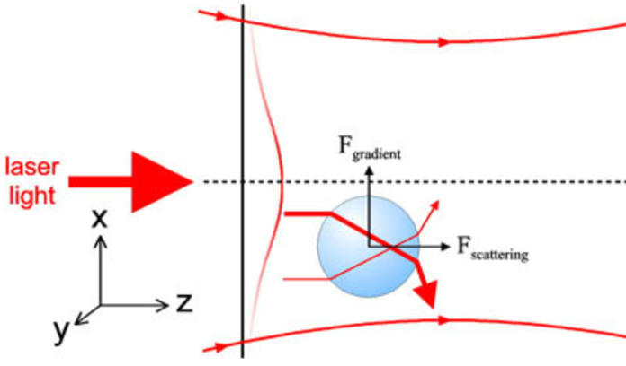

Optical Tweezing
$P=m∗v$
Block, 2019

Slide 8


Optical Tweezing
$P=m∗v$
$E^{2}={(P∗c)}^{2}+{(m∗c^{2})}^{2}$
$$P≈m∗v$$
Block, 2019

Slide 9


Optical Tweezing
$P=m∗v$
$E^{2}={(P∗c)}^{2}+{(m∗c^{2})}^{2}$
$$P≈m∗v$$
$$P=\frac{E}{c}$$
$$P=\frac{ℏ}{2π}∗\frac{2π}{λ}=ℏ∗k$$
Block, 2019
If something has energy, its momentum is non zero!

Slide 10
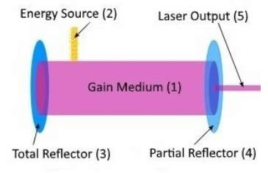
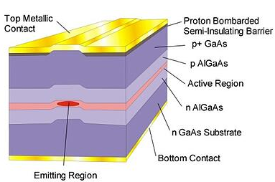
Lasers! Light Amplification by Stimulated Emission of Radiation
https://go.rpmclasers.com/lasers-101-laser-selection-guide

Slide 11
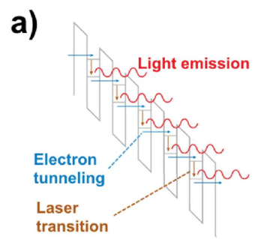
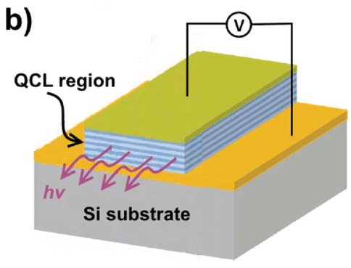
Quantum Cascade Lasers
https://www.researchgate.net/figure/Quantum-Cascade-Laser-In-part-a-a-schematic-of-the-gain-region-of-a-quantum-cascade_fig5_286085525

Slide 12
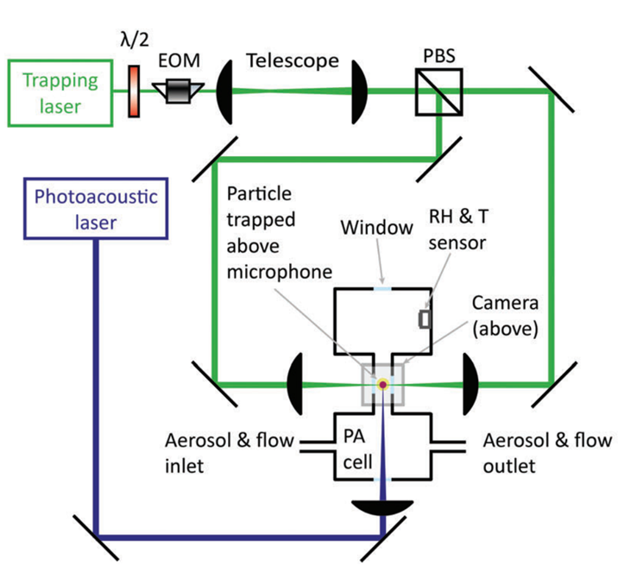
Application – Optical Tweezing
532nm trapping laser
Telescope
Polarization beam splitter
Electro-optic modulator (EOM)
Notes:
(0.02 lpm indirect flow)

Slide 13
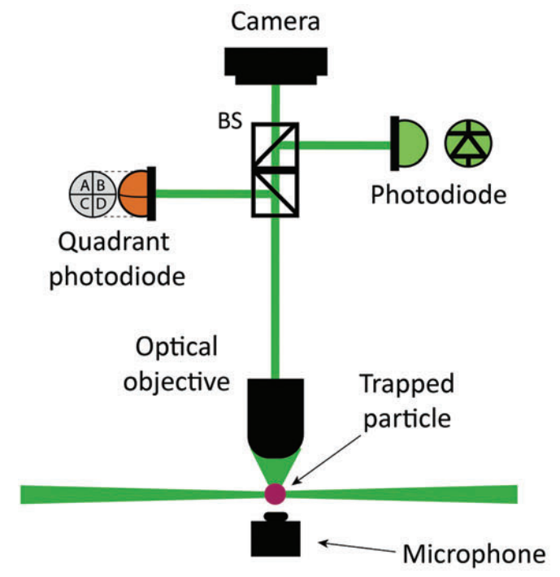
Application – Optical Tweezing
Camera
Quadrant photodiode
Beam splitter
Photodiode for scattering

Slide 14
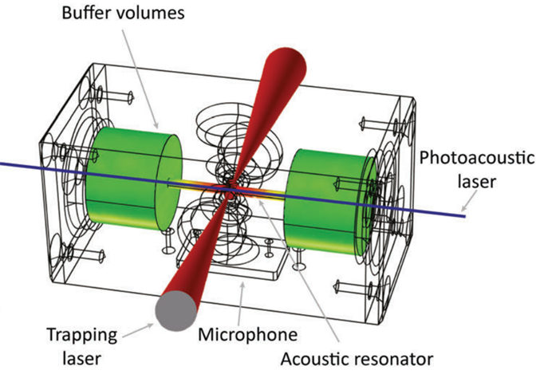
Application – Photoacoustics
532nm trapping laser
9.47 μm photoacoustic QCL
Acoustic resonator
Microphone
Scattering photodiode above
(1/2 wavelength resonator)

Slide 15

Tetraethylene Glycol
Why was this chosen over other substances?
What makes it water soluble?
Why is that desirable?
Are there drawbacks to using TEG?
https://pubchem.ncbi.nlm.nih.gov/compound/Tetraethylene-glycol
Notes:
C8 H18 O5
Vapor pressure of substance (6.2 x10^-6 kPa) is beneficial for their purposes?
Absorbance at a convenient wavelength for available QCLs?
Atmospheric relevance

Slide 16
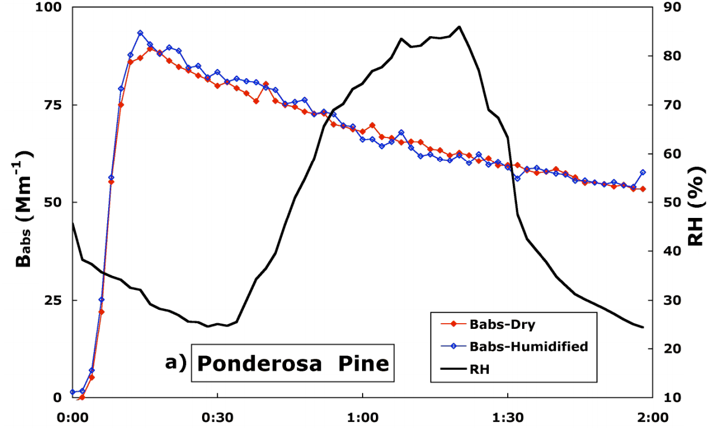
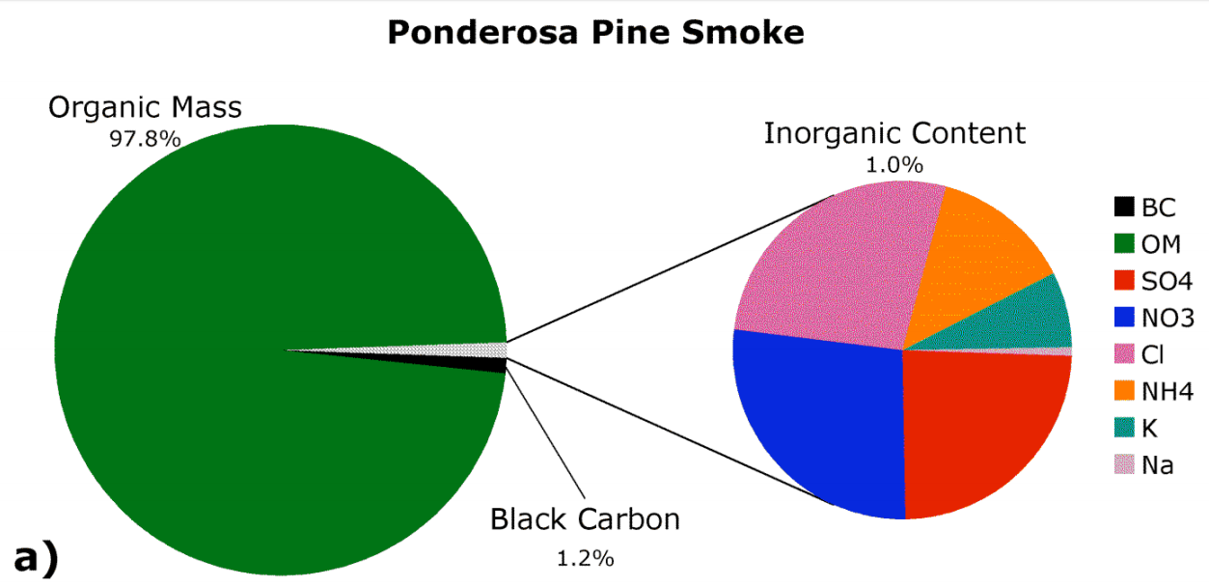
Expected Relative Humidity Effects
Lewis et al, 2009

Slide 17
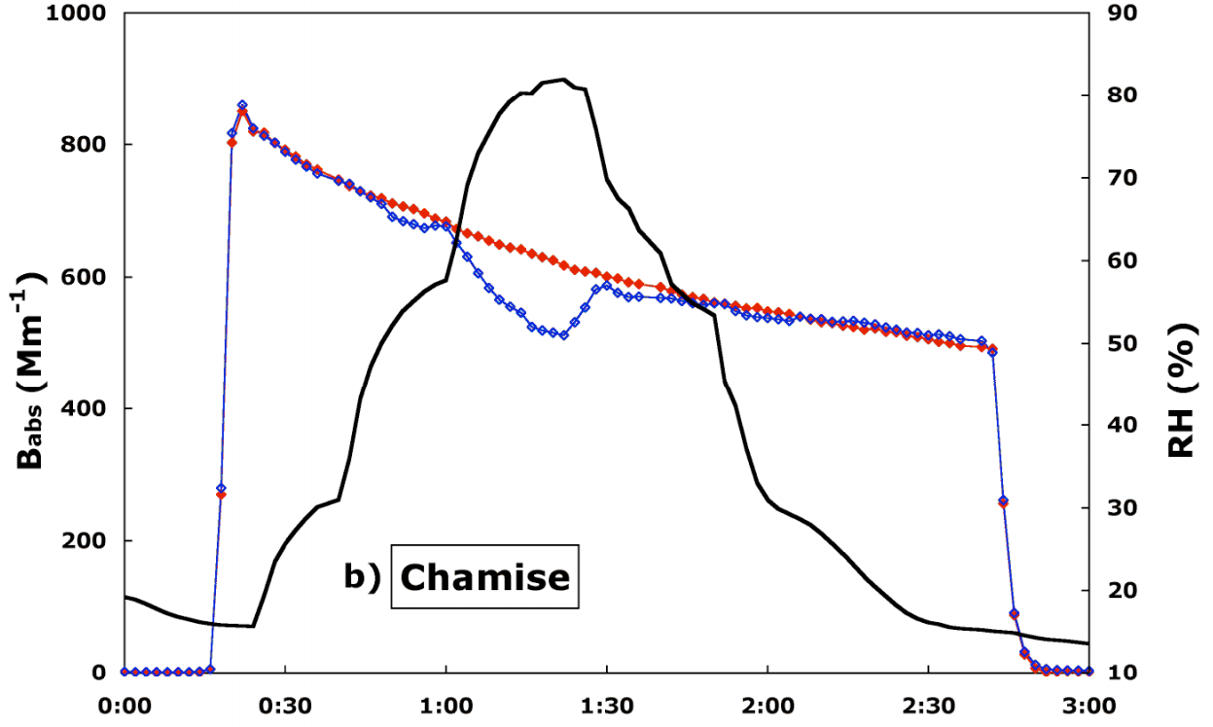
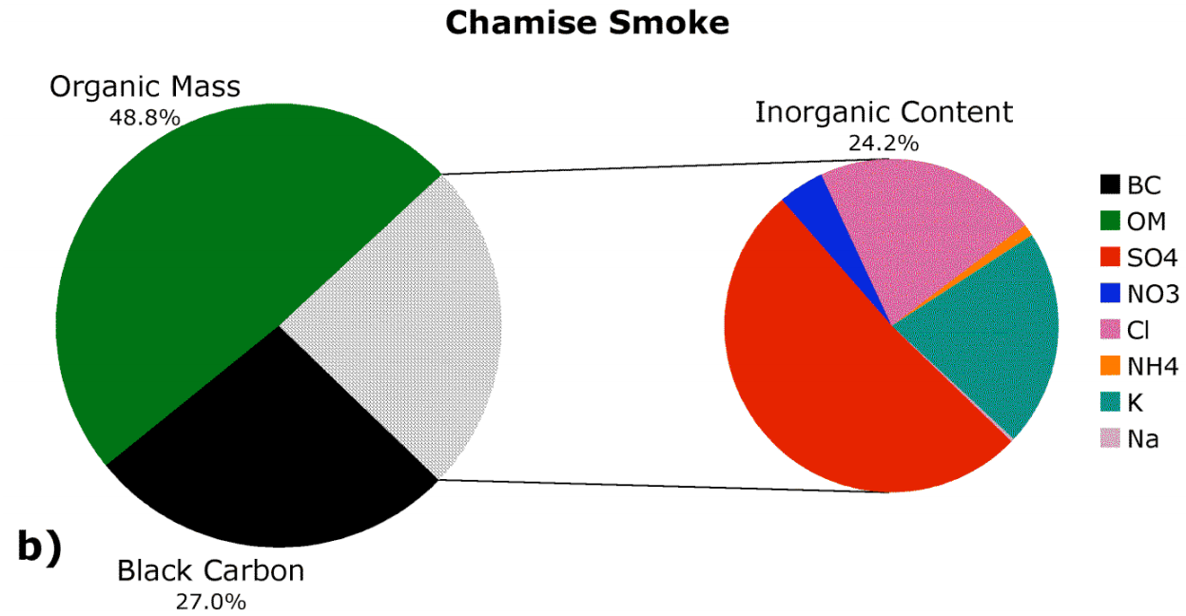

Expected Relative Humidity Effects

Slide 18
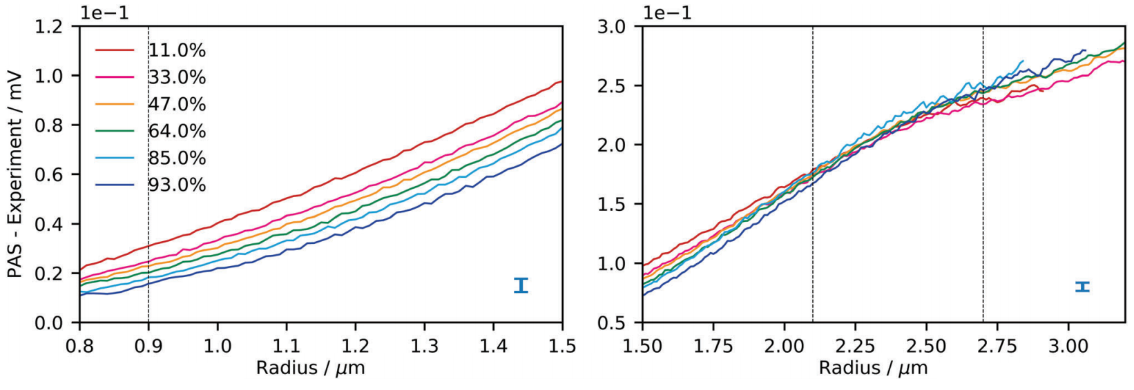
Results
Notes:
Discussion of their RH results
How do they differ from previous studies?
If there is significant difference, what could cause this and why?

Slide 19
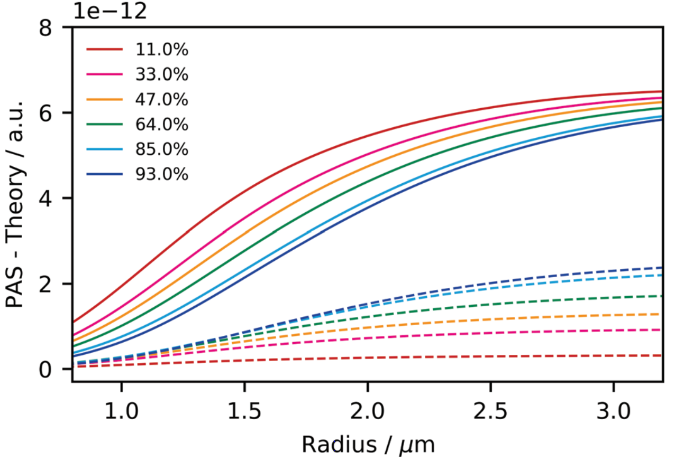
Results
Notes:
Discussion of their RH results
How do they differ from previous studies?
If there is significant difference, what could cause this and why?

Slide 20
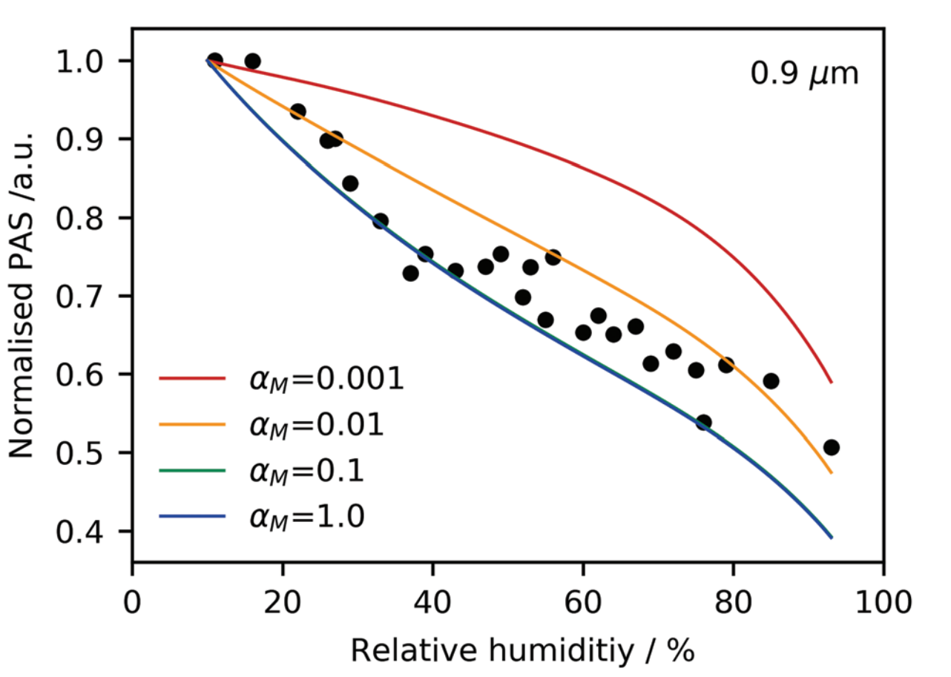
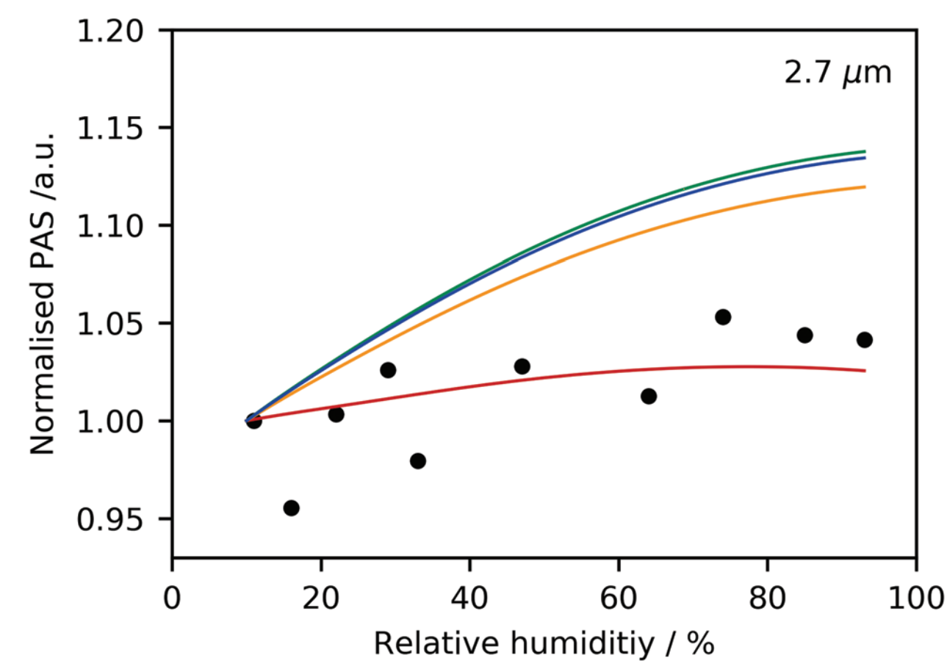
Results
Notes:
Discussion of their RH results
How do they differ from previous studies?
If there is significant difference, what could cause this and why?

Slide 21
Extraction of Mass Accommodation Coefficients
“The mass accommodation coefficient influences the kinetics of water evaporation/condensation (mass flux) on the particle’s surface.” – Diveky et al., 2019
“The mass accommodation coefficient is the probability that reversible uptake of a gas-phase species will occur upon collision of that species with a given surface (liquid or solid).” – AMS Glossary

Slide 22
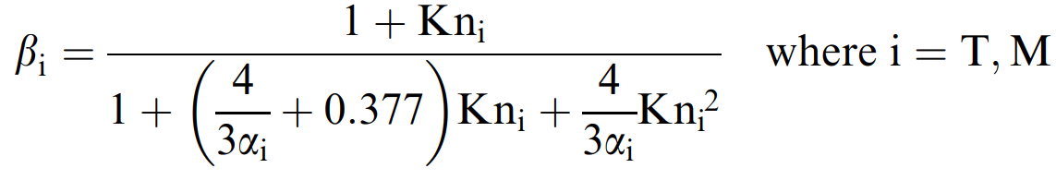
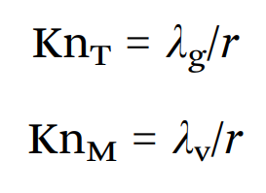
Extraction of Mass Accommodation Coefficients

Slide 23
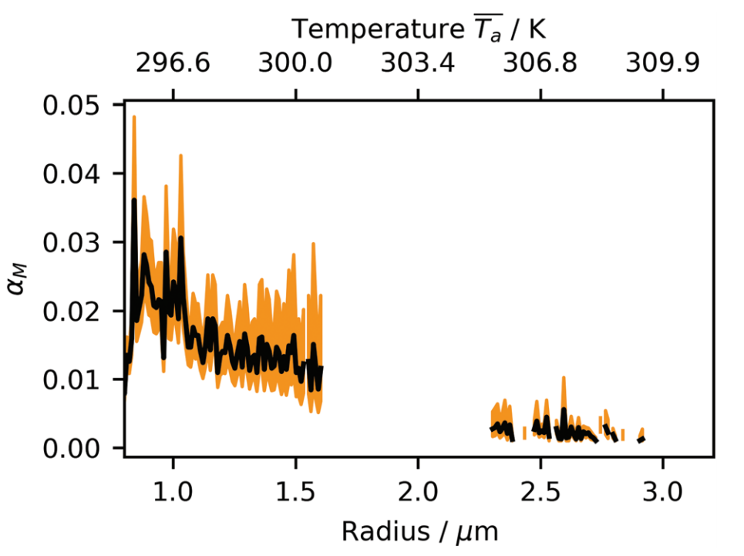
Extraction of Mass Accommodation Coefficients

Slide 24

Conclusions
RH influence on photoacoustic signal
Mass accommodation coefficient extraction
Method is useful for understanding aerosol activation and chemistry in the atmosphere
Intend further studies using a micro-tuning fork rather than a microphone
Use higher modulation frequency to prevent too much heat transfer

Slide 25
My Thoughts
The relationship they found for the effect of RH on hygroscopic particles is unexpected
Differing particle types and size distributions in previous studies could affect this
I would like to know the extent to which the trapping laser affected the particle’s temperature
Or if it did at all
The method of air sampling to trap particles by diffusion is not feasible for sampling in atmosphere
Overall, I thought it was a well written and interesting study with some question that need to be addressed.

Slide 26
References
Diveky, M. E., S. Roy, J. W. Cremer, G. David, and R. Signorell, 2019: Assessing relative humidity dependent photoacoustics to retrieve mass accommodation coefficients of single optically trapped aerosol particles. Physical Chemistry Chemical Physics, 21, 4721-4731.
Lewis, K. A., and Coauthors, 2009: Reduction in biomass burning aerosol light absorption upon humidification: roles of inorganically-induced hygroscopicity, particle collapse, and photoacoustic heat and mass transfer. Atmospheric Chemistry and Physics, 9, 8949-8966.
Lewis, K., W. P. Arnott, H. Moosmuller, and C. E. Wold, 2008: Strong spectral variation of biomass smoke light absorption and single scattering albedo observed with a novel dual-wavelength photoacoustic instrument. Journal of Geophysical Research-Atmospheres, 113, 14.
Block, S., 2019: Block lab at Stanford University. Block lab - Optical tweezers. https://blocklab.stanford.edu/optical_tweezers.html (Accessed February 7, 2020).
National Center for Biotechnology Information. PubChem Database. Tetraethylene glycol, CID=8200, https://pubchem.ncbi.nlm.nih.gov/compound/Tetraethylene-glycol (accessed on Feb. 10, 2020)

Slide 27
Thank you! Questions?

