Slide 1
Gravity waves excited during a minor sudden stratospheric warming
Presented by Stormi Noll
February 3, 2020
Dörnbrack, A., Gisinger, S., Kaifler, N., Portele, T. C., Bramberger, M., Rapp, M., . . . Jelić, D. (2018). Gravity waves excited during a minor sudden stratospheric warming. Atmospheric Chemistry and Physics, 18(17), 12915-12931. doi:http://dx.doi.org.unr.idm.oclc.org/10.5194/acp-18-12915-2018

Slide 2
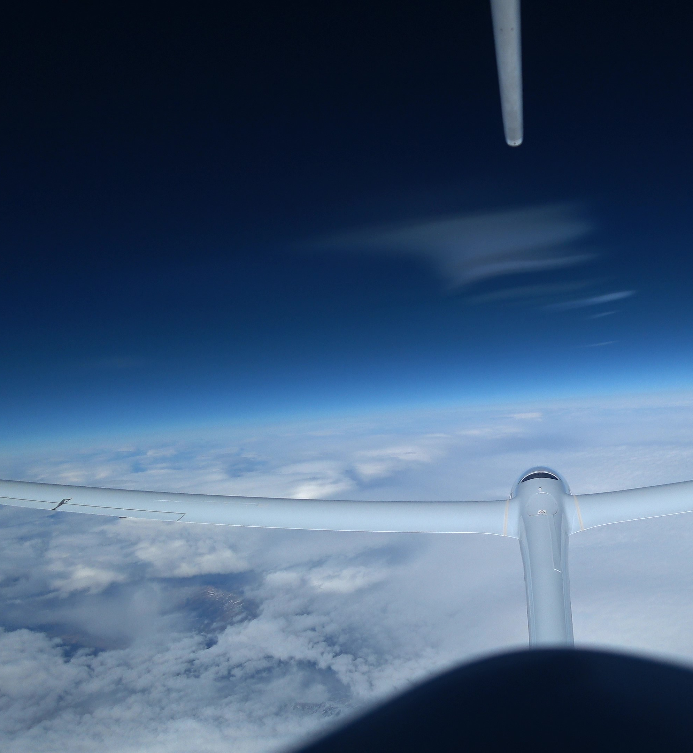
Outline
Key Concepts
Atmospheric Gravity Waves
Stratospheric Gravity Waves
Sudden Stratospheric Warming
Motivations and purpose of this study
Key Figures
Conclusion

Slide 3
Key Concept: Atmospheric Gravity Waves
Same mechanism as waves in the oceans
Combination of buoyant force and gravitational force
Requires a stable atmosphere
Referred to as internal gravity waves (IGWs)
http://www.physics.uwo.ca/~whocking/p103/grav_wav.html

Slide 4
Orographic Gravity Waves (OGW) - Gravity waves can be initiated by flow over mountains
KE per unit volume = ½ ⍴𝑣²
Gravity waves do not deposit energy into the mean flow until they break
Energy associated with atmospheric gravity waves tends to propagate upward from a tropospheric source
When waves break, energy is deposited energy into the mean flow
http://www.physics.uwo.ca/~whocking/p103/grav_wav.html

Slide 5
Effects of Stability
http://www.physics.uwo.ca/~whocking/p103/grav_wav.html

Slide 6
Visible when there is moisture present for cloud condensation
Common on the lee side of mountain ranges – Reno is a hotspot!
Interactions between waves from different sources and of different scales creates more complicated dynamical situations
Can be numerically modelled. Often parameterized based on model scale.
Experimental modelling is widely used in investigating other processes in which gravity waves initiate, propagate, and disperse
https://worldview.earthdata.nasa.gov/?v=-127.28240909985968,29.07257696581145,-97.75115909985968,45.57843634081145&t=2019-09-20-T16%3A00%3A00Z

Slide 7
Key Concepts: Stratospheric Gravity Waves
http://www.atmosp.physics.utoronto.ca/SPARC/News25/coupling.html

Slide 8
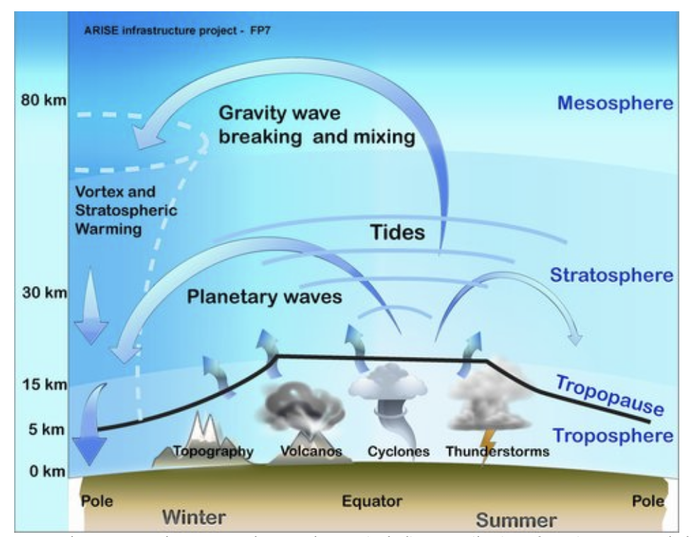
Key Concepts: Stratospheric Gravity Waves
http://arise-project.eu/atmospheric-dynamics.php

Slide 9
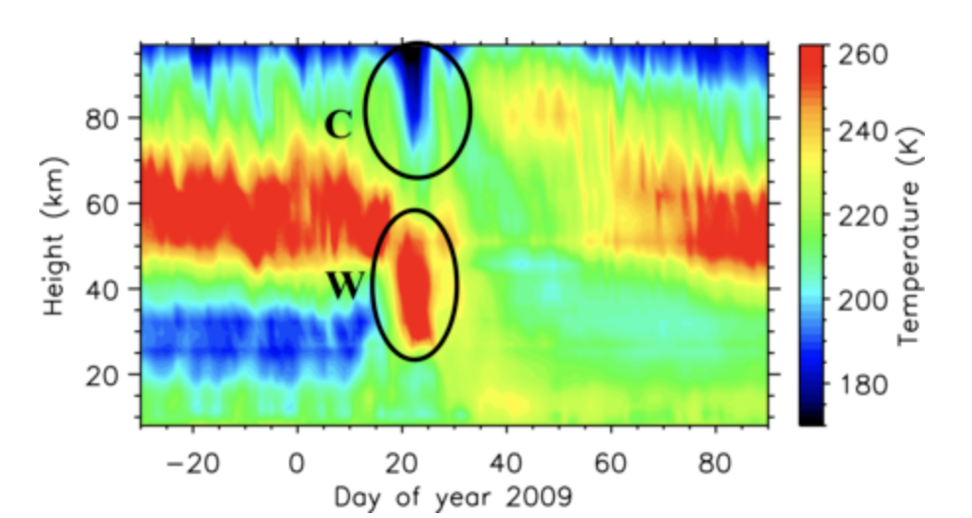
Key Concepts: Sudden Stratospheric Warming

Slide 10
Gravity waves excited during a minor sudden stratospheric warming:
Motivation and Purpose
Gravity waves observed at mid to high latitudes are sometimes attributed to spontaneous adjustment related to the polar night jet, suggesting a stratospheric source rather than a tropospheric source
Direct observations of the excitation of stratospheric gravity waves by nonlinear processes are rare
In this study, Dornbrack et al. investigate the characteristics and sources of stratospheric gravity waves observed in the Northern Hemisphere in late January 2016, arguing that SSW activity sets up the ideal scenario for inertial gravity waves with a stratospheric source

Slide 11
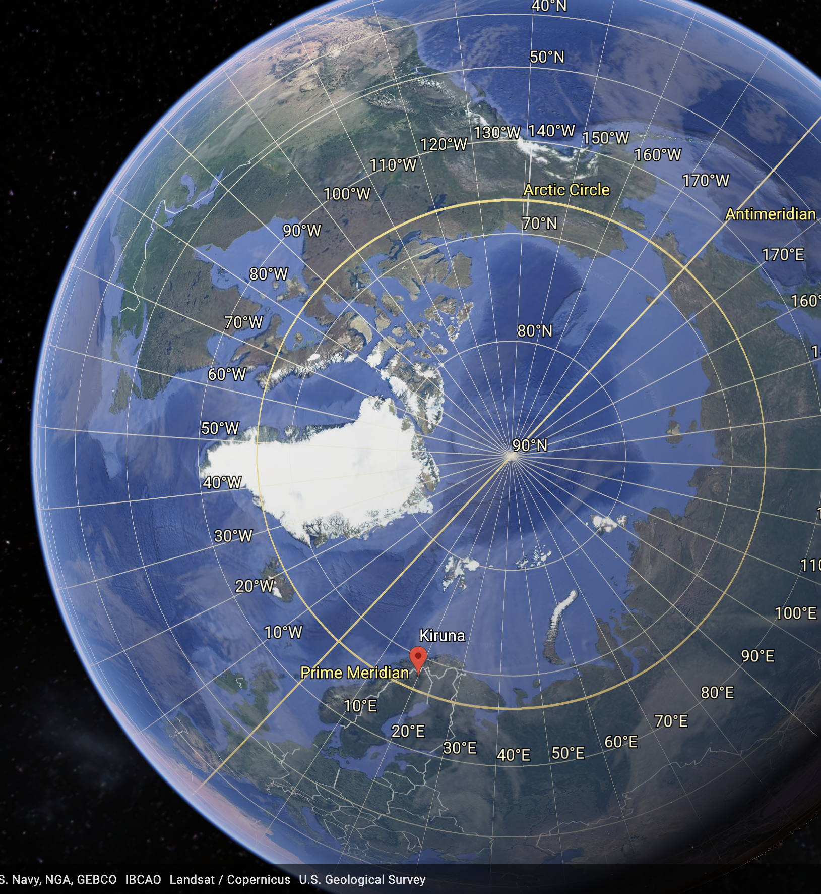
Data Sources and Analysis Methods
9 consecutive radiosondes launched from Kiruna airport 29-30 January 2016
used to determine background profiles u, v, T, and gravity wave perturbations u’, v’, T’
3000 g radiosonde balloon launched 30 January 2016, reaching an altitude of 38.1 km (23.7 mi)
National weather prediction (NWP) forecasts and analysis
1-hourly HRES forecst and 6-hourly operational analysis from ECMWF’s IFS cycle 41r2: Horizontal resolution = 9 km, vertical levels = 137, model top = 0.01 hPa
Semi-implicit time-stepping
Semi-Lagrangian advection
Used in normal mode decomposition and two-dimensional wavelet analysis

Slide 12
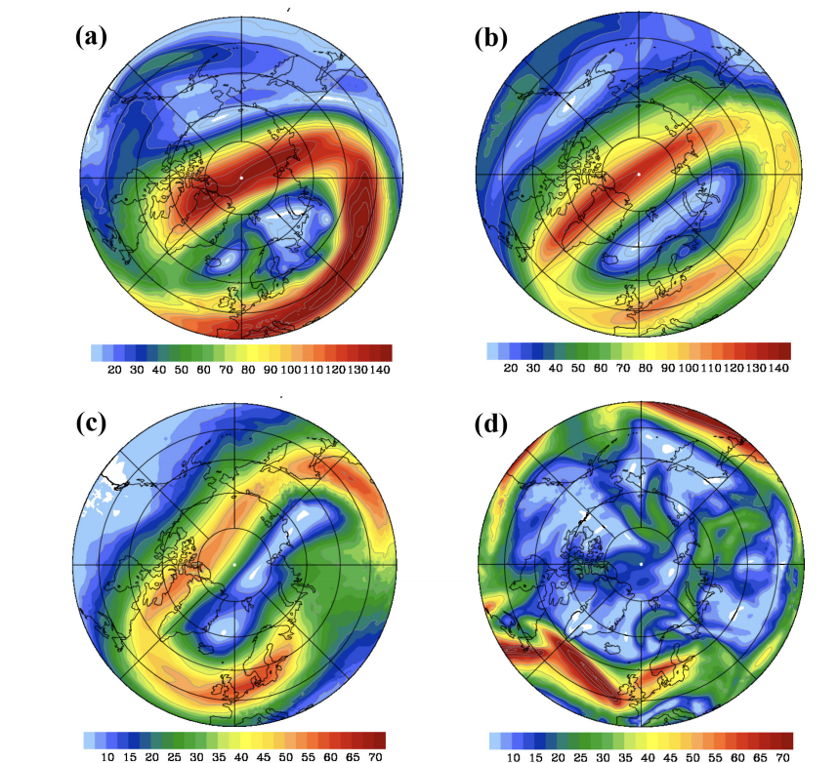
Figure 1: magnitude of the balanced wind

Slide 13
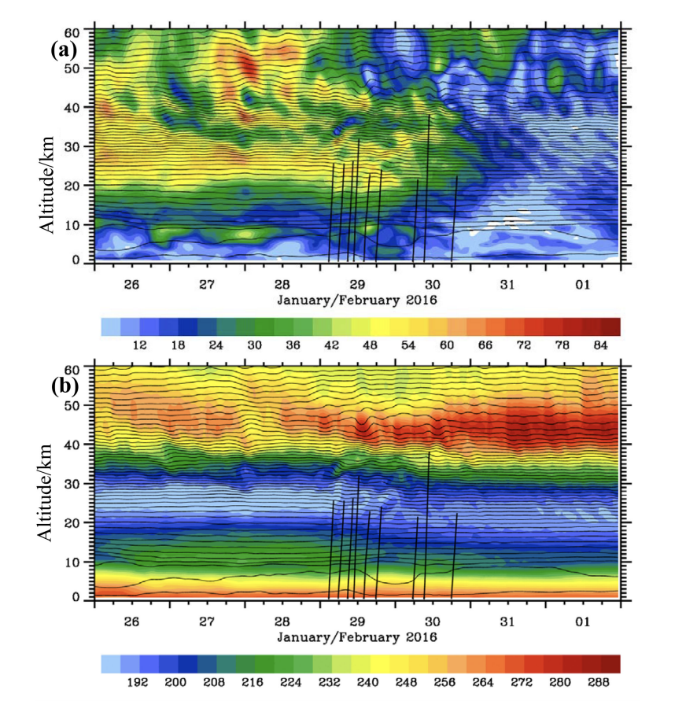
Figure 2: Potential temperature and radiosonde paths

Slide 14
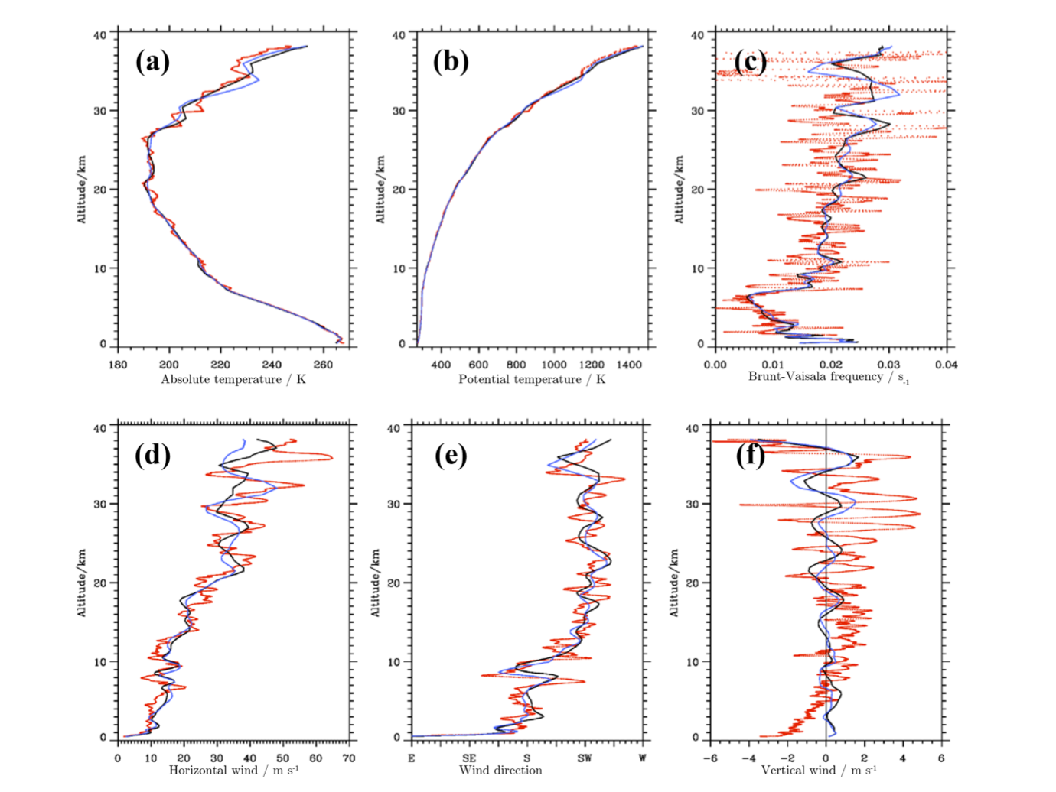
Figure 3: Vertical profiles of high-altitude radiosonde data

Slide 15
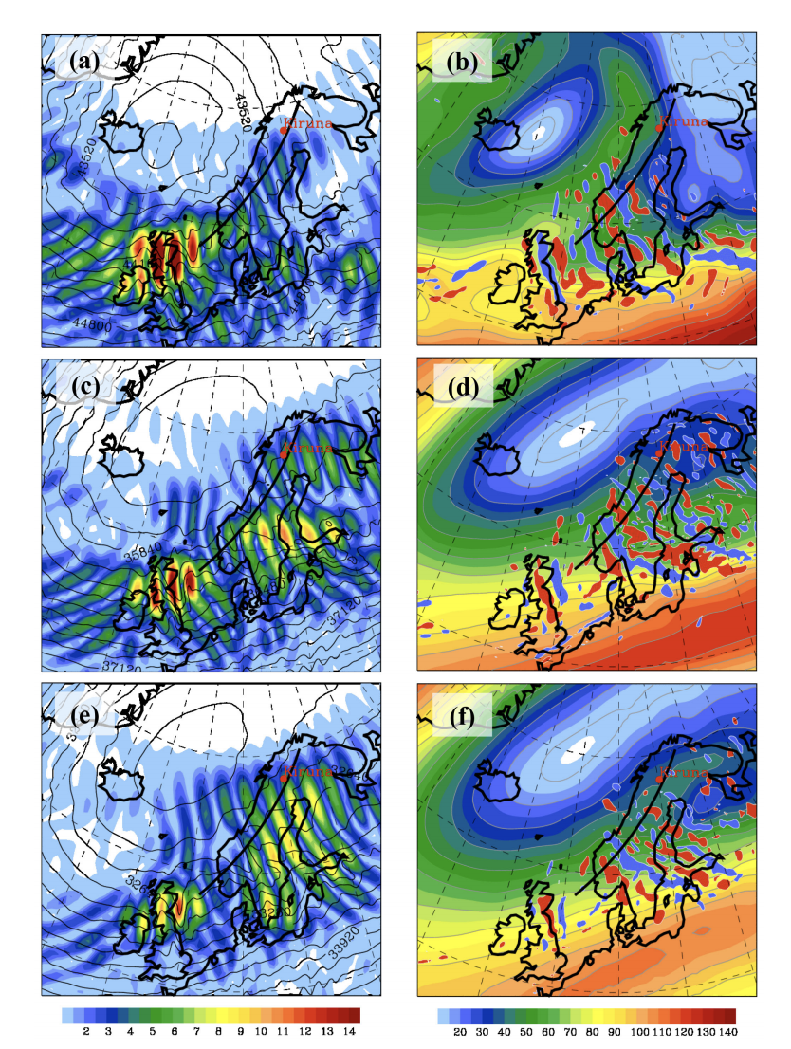
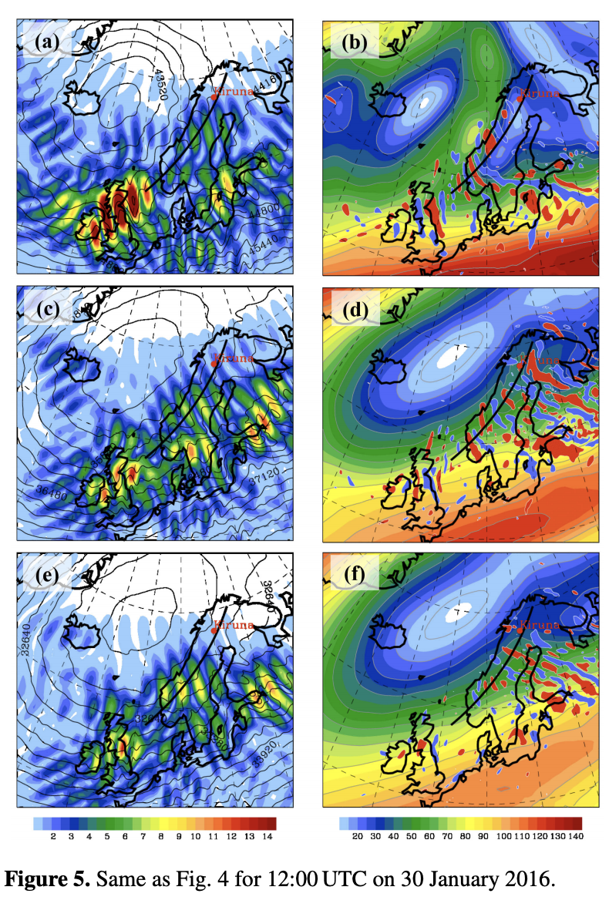
Figures 4 & 5: IGW component of the horizontal wind (a,c,e) and horizontal divergence in the balanced wind (b,d,f)

Slide 16
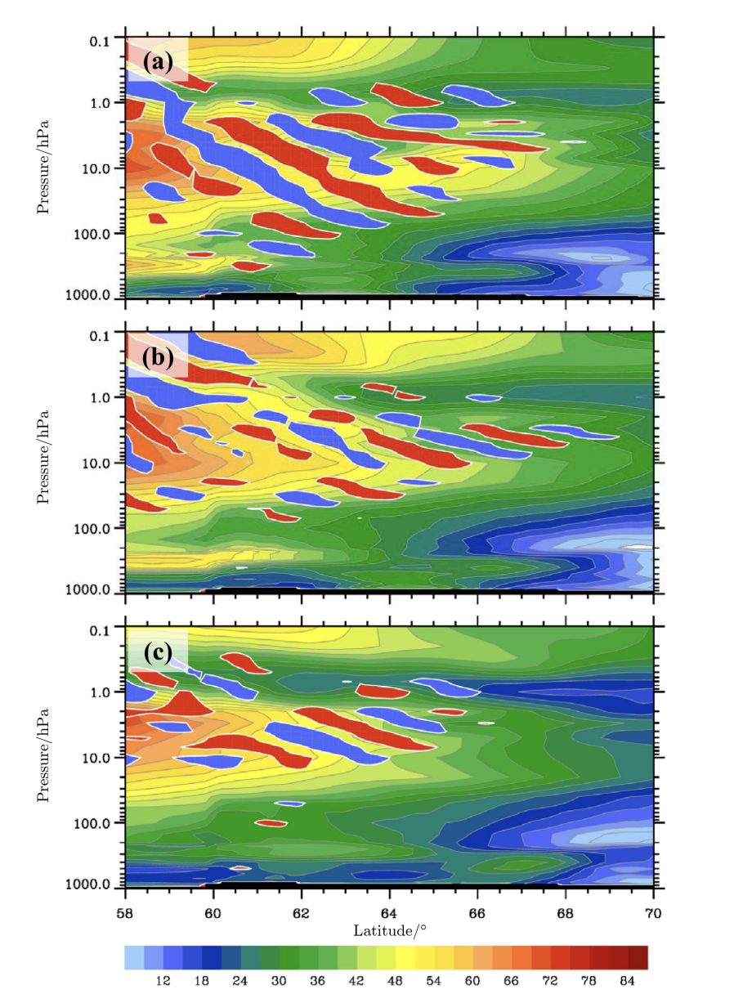
Figure 6: Magnitude of balance and unbalanced wind

Slide 17
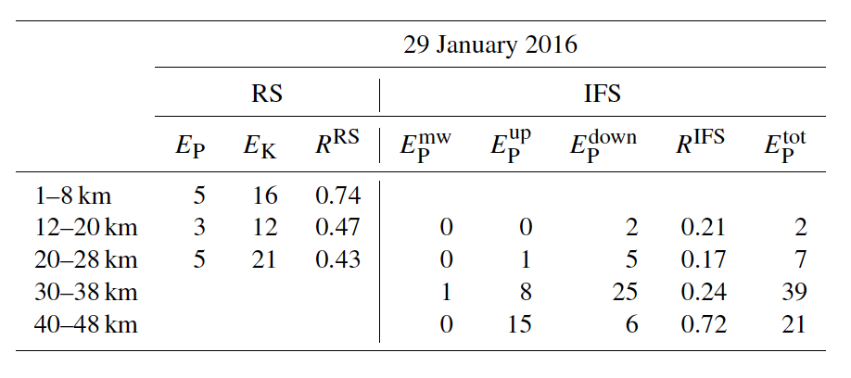
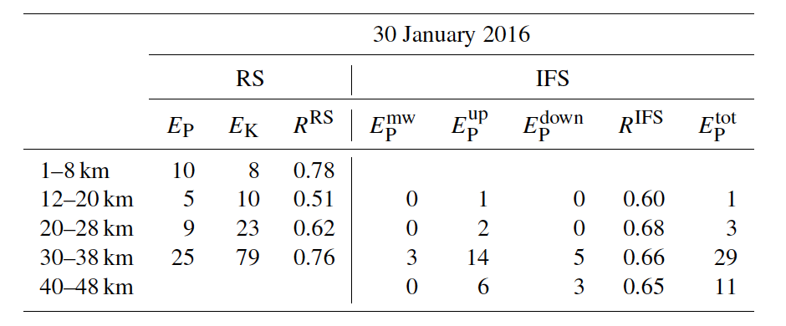
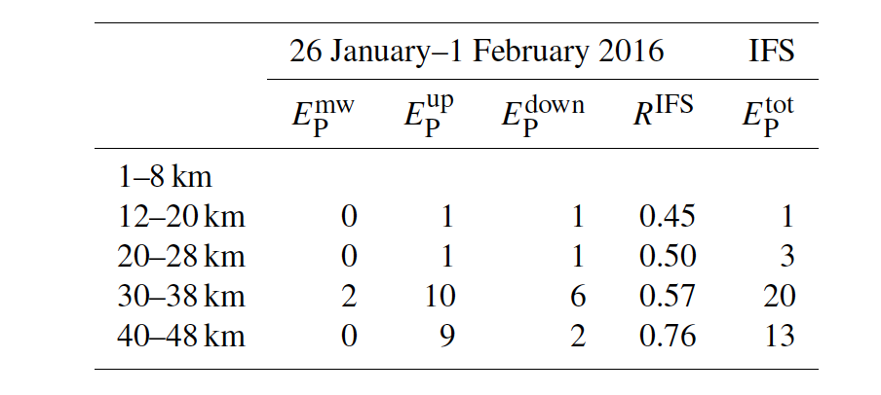
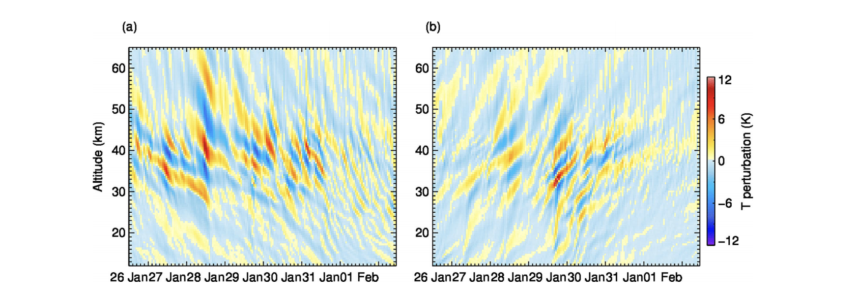
Figure 8 and Tables 1-3: Wavelet analysis

Slide 18
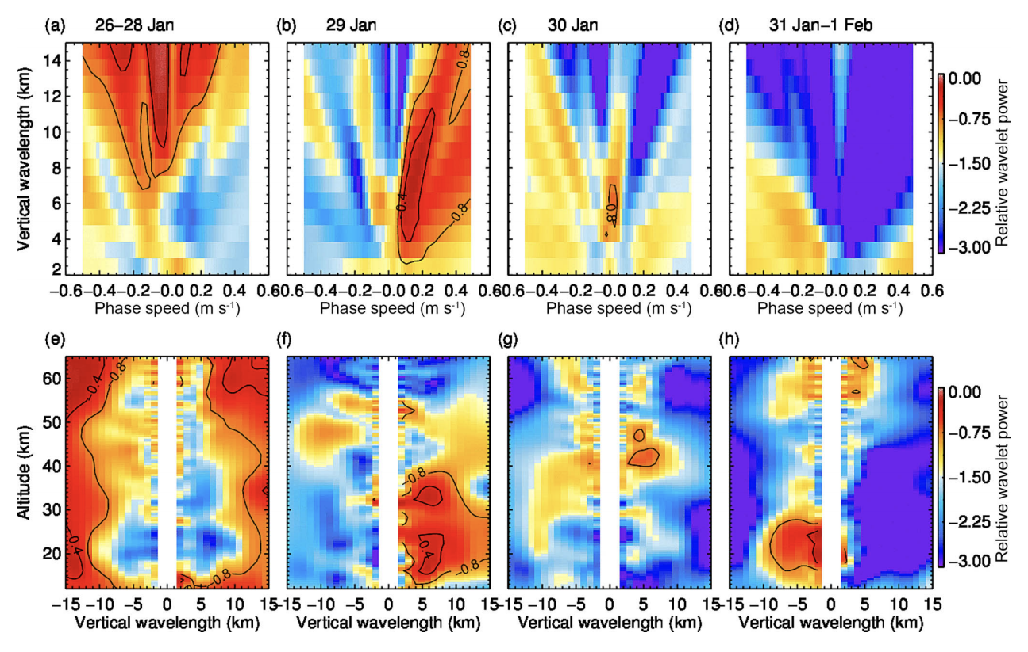
Figure 9: Distribution of gravity wave parameters

Slide 19
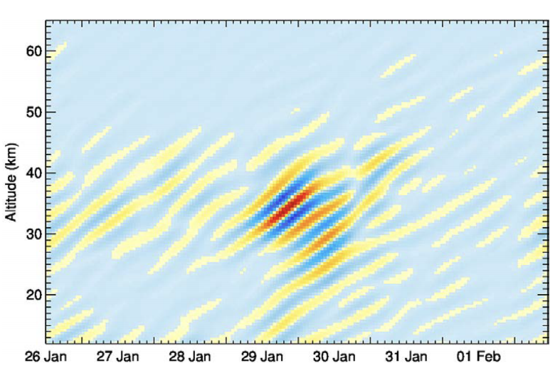
Figure 10: Reconstruction of downward propagating wave packet

Slide 20
Conclusion

