Slide 1

Global scale variability of the mineral dust long-wave refractive
index: a new dataset of in situ measurements for climate
modeling and remote sensing
Author: Claudia Di Biagio et al, 2017
Presenter: Mohammad Reza Sadrian
Spring 2020

Slide 2
Outline
Introduction
Experimental Set-up and instrumentation
Measurements:
FTIR extinction spectrum
Instruments used for measuring mineralogy
Retrieval of the LW complex refractive indices
Selection of soil samples: representation of the dust mineralogical variability at the global scale
Results

Slide 3
Outline-Cont.
Atmospheric representativity: mineralogical composition
Atmospheric representativity: size distribution
Dust LW extinction and complex refractive index spectra for the different source regions
Discussion
Comparison with the literature
Conclusions and perspectives

Slide 4
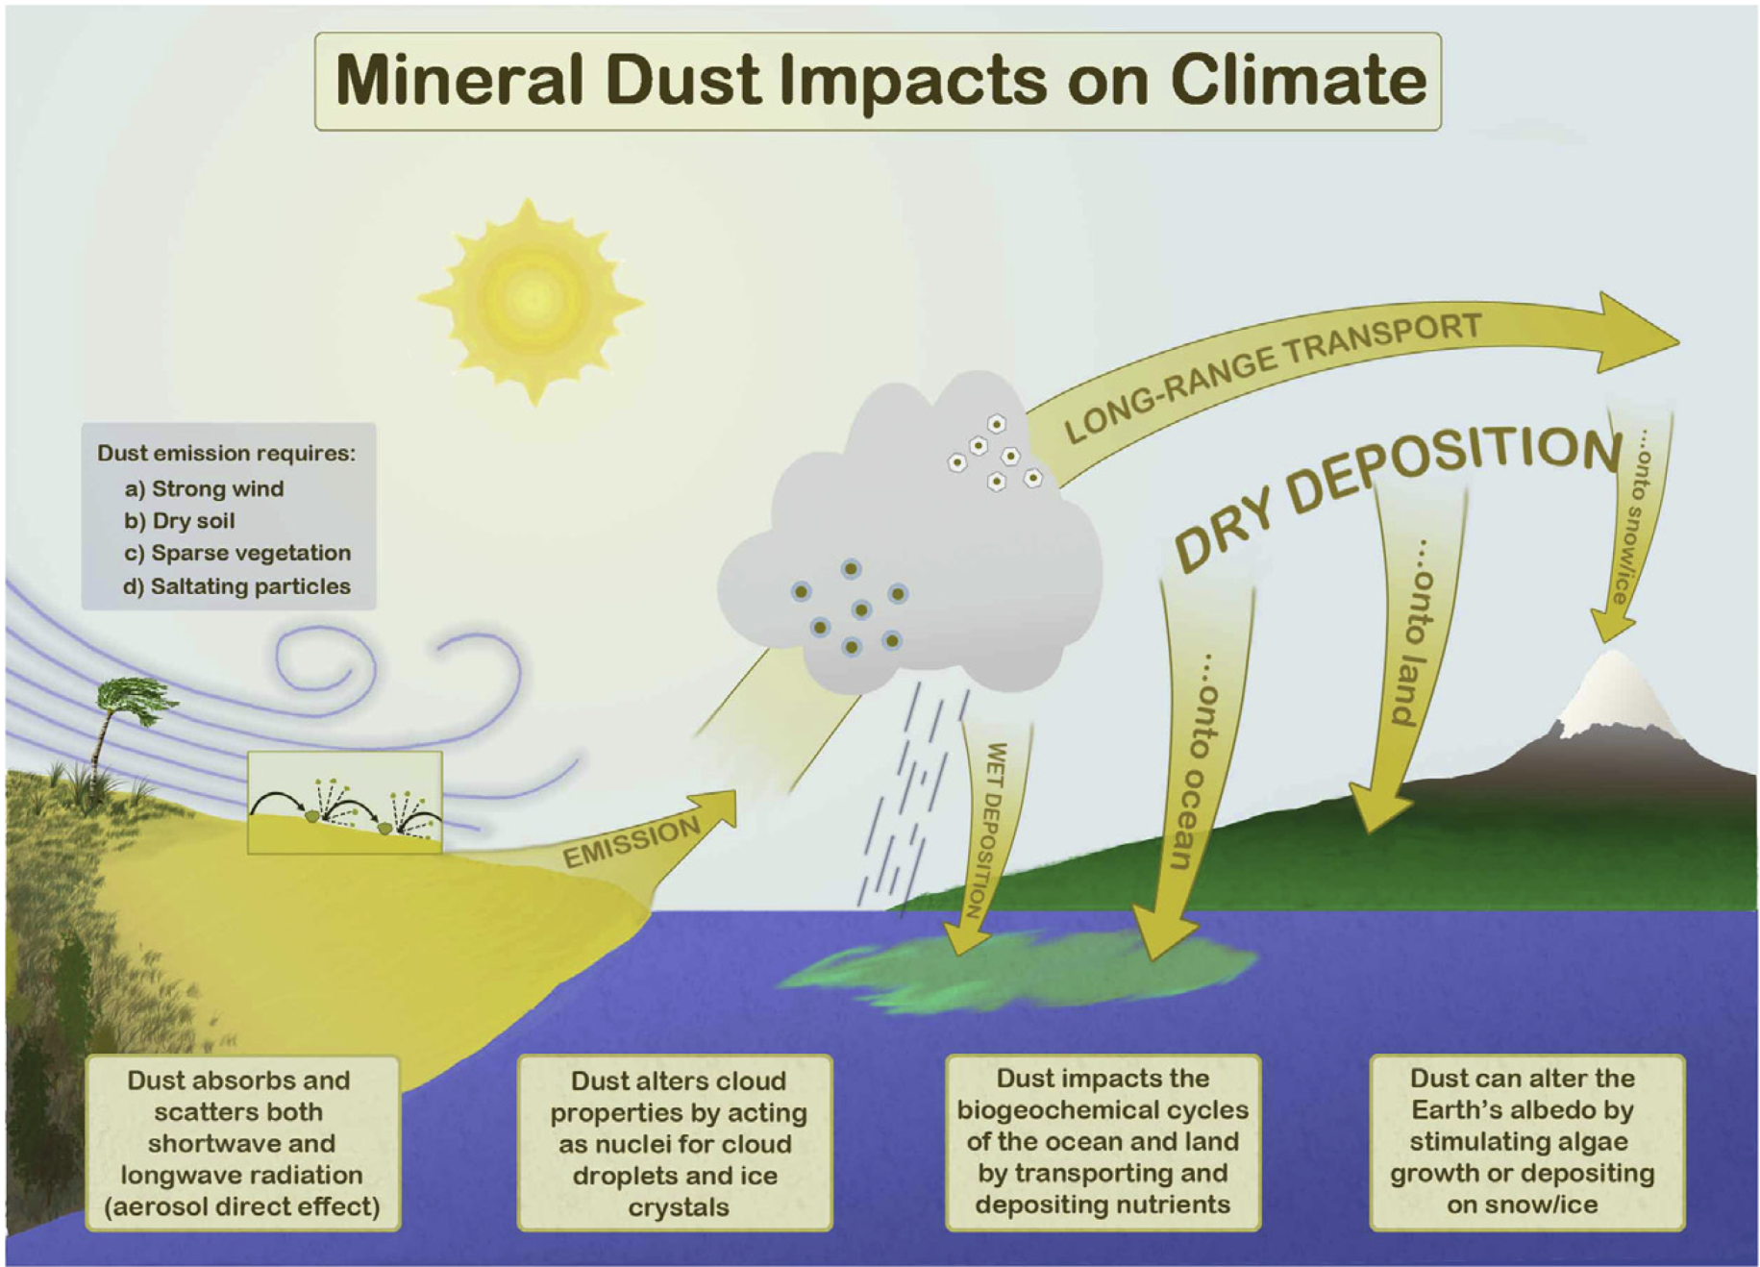
Introduction
Figure 1. Schematic of interactions between dust and climate and biogeochemistry.
*N. Mahowald et al. 2013

Slide 5
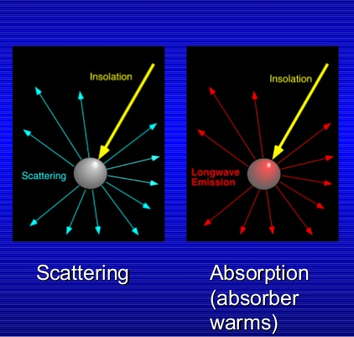
Dust aerosol on radiation
Figure 2. illustrates the interaction of mineral dust and solar and terrestrial radiation which can cause absorption, scattering.
*https://slideplayer.com/slide/5741393/

Slide 6
The paper’s goal
Produce realistic data for LW refractive indices using the smog chamber method.
interaction of dust with LW radiation over the dust cycle is important
Uncertain LW spectra results in Misinterpretation of data
Source-dependent produced data can be used in he climate models and remote sensing instruments rather than generic data.

Slide 7
Complex Index of Refraction
N = n_{r} + n_{i}i
N is complex index of refraction
n_{r} is the real part and n_{i} is the imaginary part
In some literatures:
N= n + ik
n is real part k is imaginary part
*Petty et al, 2006
Notes:
The radiative properties of dust aerosols, which are size and wavelength-dependent, are described by the spectral complex index of refraction (which is a single parameter).
n is effective phase speed of EM waves propagating through the medium while the imaginary part is the rate of the absorption.
The values might be in different letters in some other literatures.

Slide 8
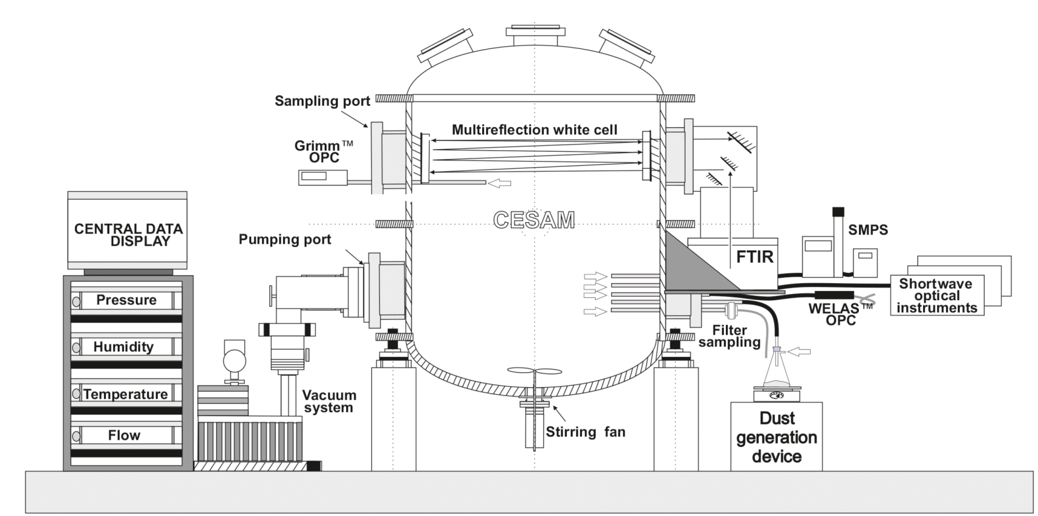
Experimental set-up and instrumentation
Inlets
Büchner flask
conductive
silicon tubing
Vibrating plate
Figure 3. Schematic configuration of the CESAM set up for the dust experiments.
CESAM (Chambre Expérimentale de Simulation Atmosphérique Multiphasique)
Translates as “multiphase atmospheric experimental simulation chamber”; Wang et al., 2011
Notes:
- Relative humidity <2%
Particle free N2-O2 (continuously injected after air being extracted)
Experiment conducted in an ambient temperature
Chamber was cleaned after each sample was analyses to be ready for the next sample.

Slide 9
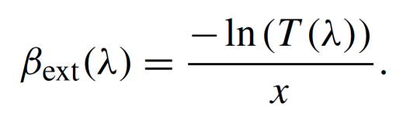

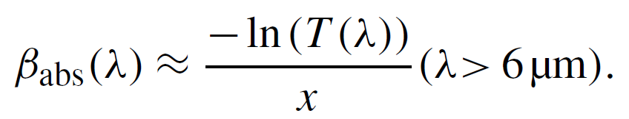
LW optical measurements: FTIR extinction spectrum
Wavelength between 2.0 to 16 µm.
The references spectra was acquired right before the injection.
Contamination with CO₂ and water vapor were subtracted.
Loss of energy between 2-3 and 15-16 µm, so data is limited to the 3-15 µm intervals.
= extinction coefficient
T = Transmission
x = path length
Scattering dominates below 6 µm
Extinction does not include scattering, Because:
Super-micron fractions dominates Forward scattering
Represent almost exclusively absorption above 6 μm
Notes:
- scattering-to-absorption ratio calculated as a function of the wavelength in the LW for one of the samples used in this study.
- The results of the calculations confirm that above 6 μm the scattering signal measured by the FTIR spectrometer accounts for less than 20% of the total LW extinction at
the peak of the injection and less than 10% after 120 min in the chamber.

Slide 10
Analysis of Mineralogical composition
X-ray Diffraction (XRD)
Mass calibration was performed to make a relationship between intensity of diffraction peak and mass concentration. *Klaver et al. (2011)
This methods works for crystalline minerals efficient
Clays have poorly outlined crystals and due to absence of appropriate calibration mass for clays, so the difference between the total dust mass and the total mass of quartz, calcium-rich species, and feldspars, estimated after XRD calibration, and iron oxides (masses estimated from XANES).
X-ray absorption near-edge structure (XANES) to retrieve the content of iron oxides.
wavelength dispersive X-ray fluorescence (WD-XRF)

Slide 11
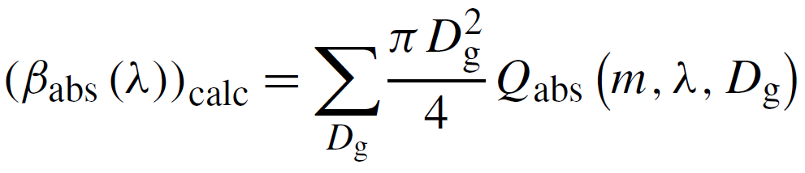
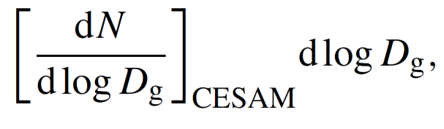

Retrieval of the LW complex refractive indices
Notes:
-An optical inversion procedure was applied to retrieve the LW complex refractive index of the dust aerosols based on the simultaneous measurements of the particle LW spectra and size.
- The surface size distribution is the quantity that determines dust optical properties.

Slide 12
Selection of soil samples
A total of 19 soil samples were selected for experiments from a collection of 137 soils from various source areas worldwide.
Criteria for choosing the soil samples:
Soils had to represent all major arid and semi-arid regions
Their mineralogy should envelope the largest possible variability

Slide 13
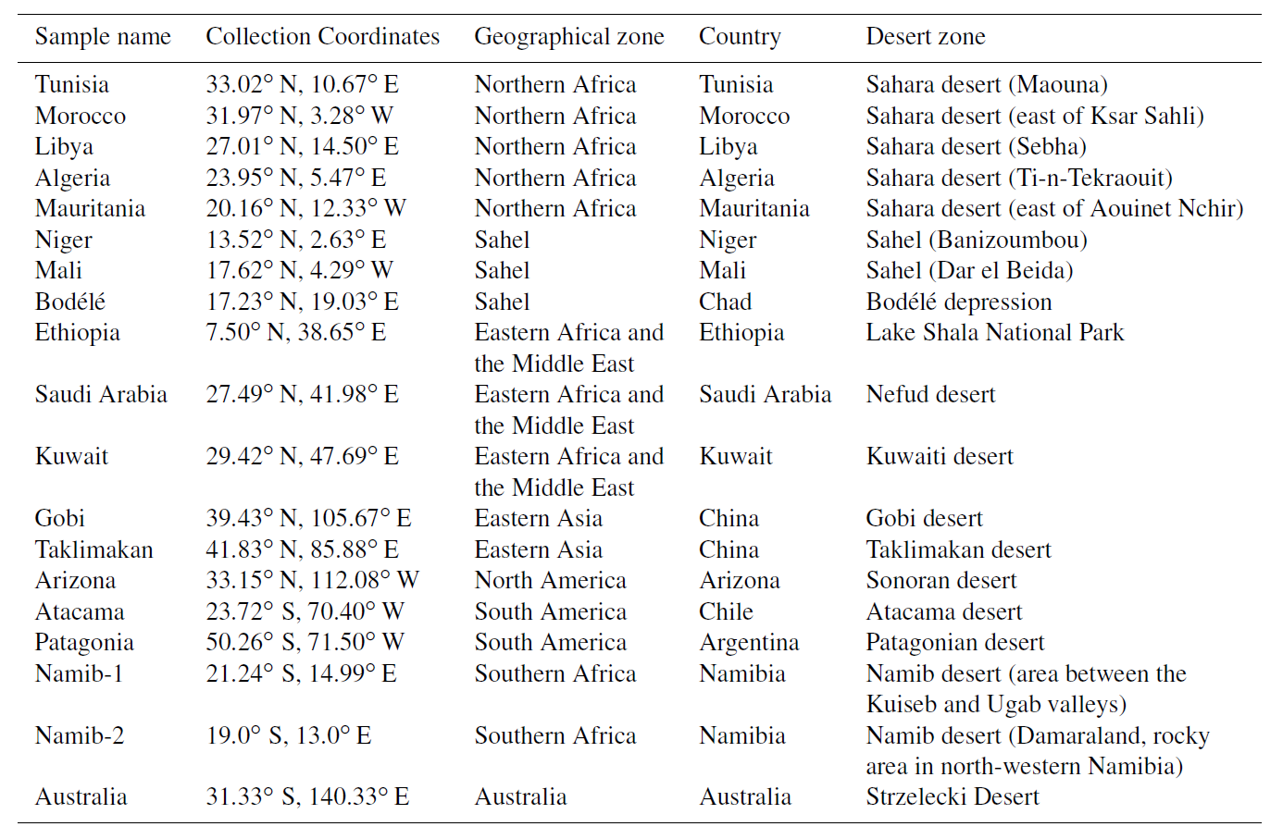
Selection of soil samples
Table 1. Summary of the sample soils used in this study.

Slide 14
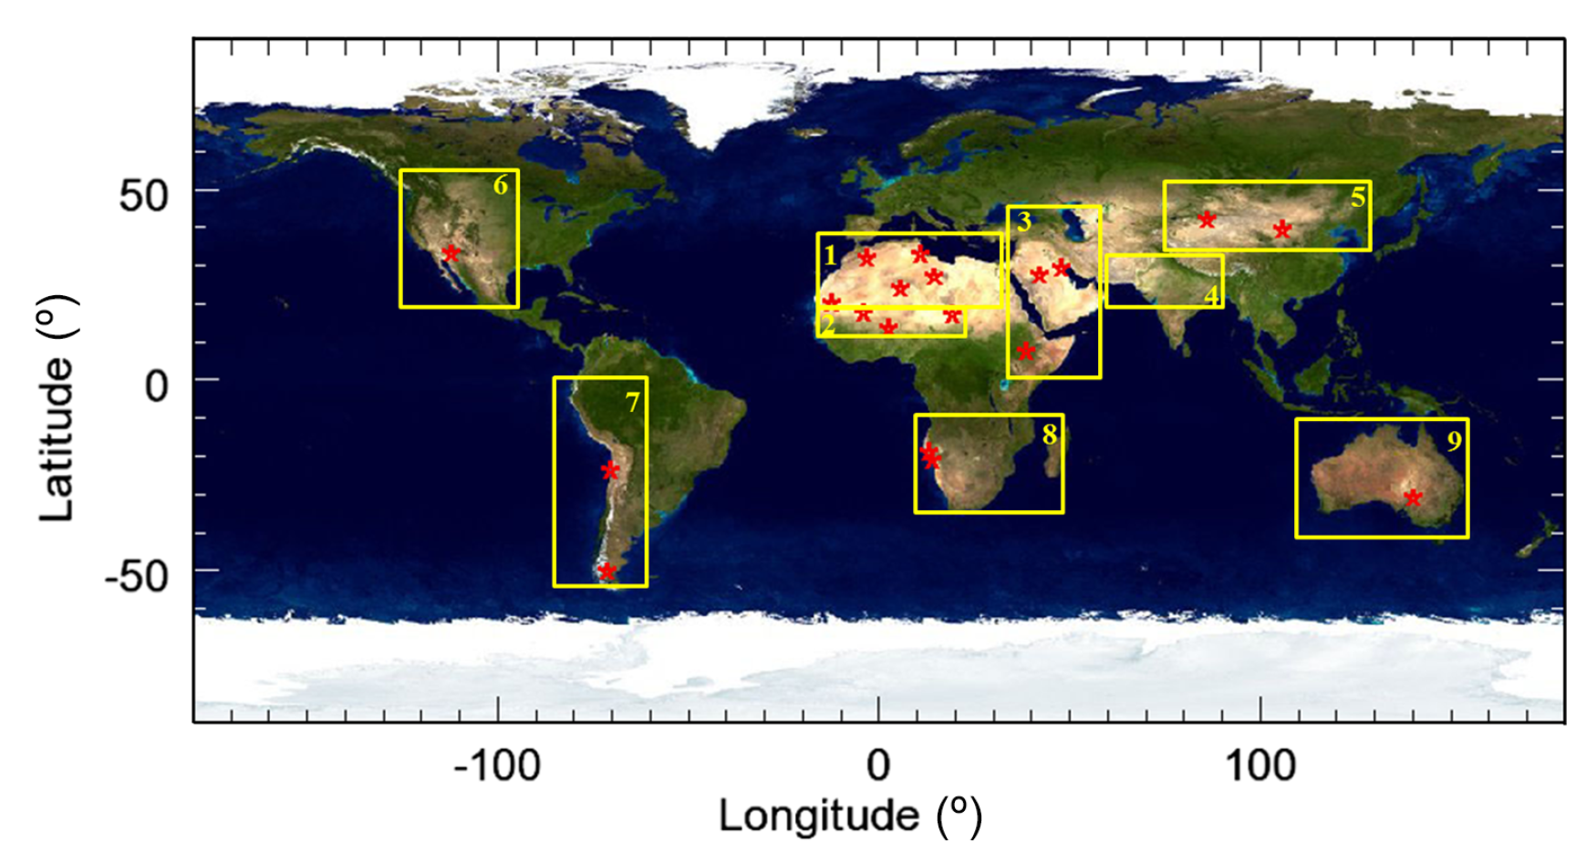
representation of the dust mineralogical variability at the global scale
Figure 4. Location (red stars) of the soil and sediment samples used to generate dust aerosols
*Ginoux et al. (2012)
Notes:
The three soils from eastern Africa and the Middle East are from Ethiopia, Saudi Arabia, and Kuwait, which are important sources of dust in the Red and Arabian seas (Prospero et al., 2002)
The selected soils from northern Africa and the Sahel represent important sources for medium- and long-range dust transport towards the Mediterranean (Israelevich et al., 2002)
The three samples from the Sahel are from Niger, Mali, and Chad (sediment from the Bodélé depression), and are enriched in quartz compared to Saharan samples.
There were no sample from central Asia
-The Sonoran Desert is a permanent source of dust in North America, the Atacama desert is the most important source of dust in South America, whilst Patagonia emissions are relevant for long-range transport towards Antarctica

Slide 15
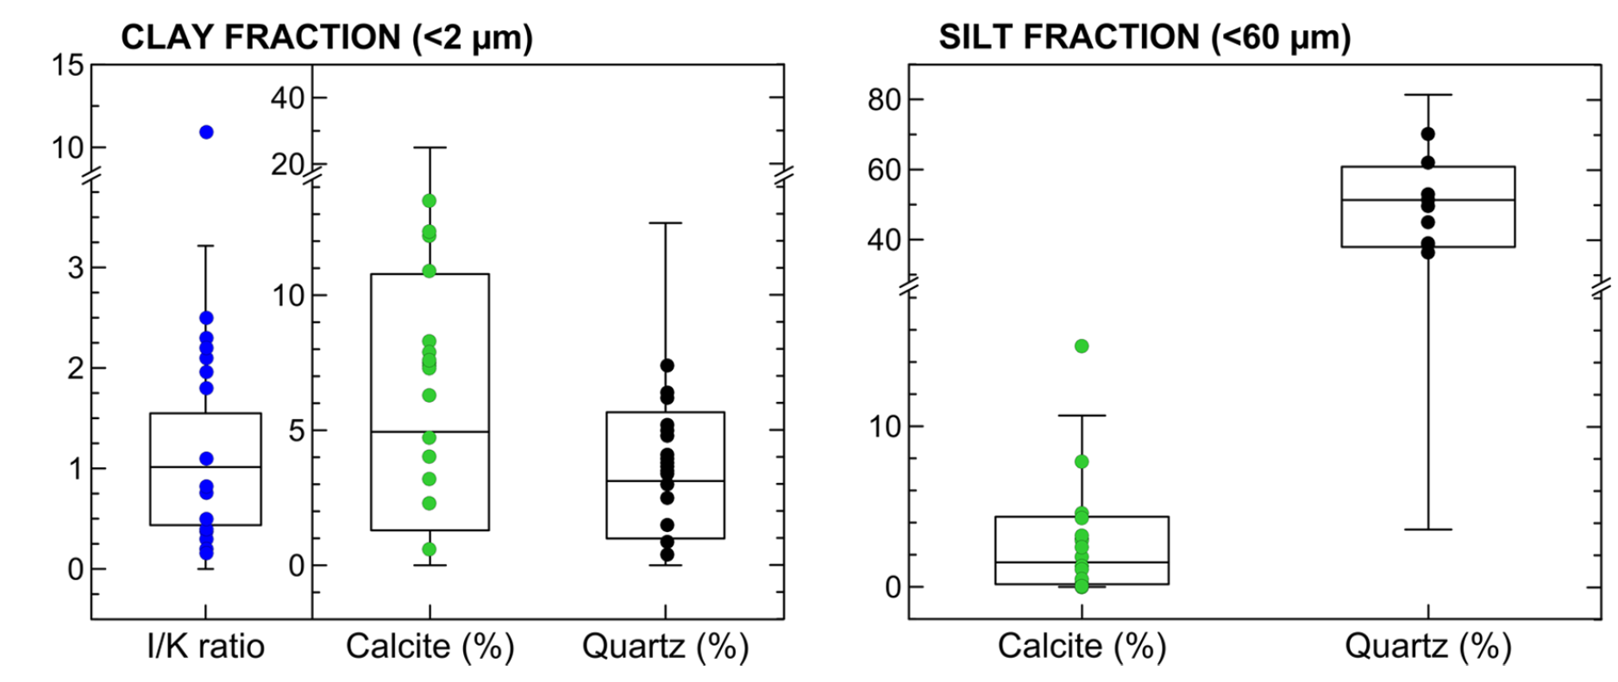
variability of the soil composition in the clay and silt fractions at the global scale
Figure 5. Box and whisker plots showing the variability of the soil composition
in the clay and silt fractions at the global scale.
*Journet et al. (2014)
Notes:
Dots represent those are more than normal or a lot less than normal (outliers) ////Dots indicate specific mineralogical characteristics (illite-to-kaolinite mass ratio (I = K), calcite and quartz contents,
Minimum = lowest observation
Maximum = biggest observation
Median = separates lower 50% from upper 50 percent
Whiskers = Tails
Calcite%(as silt) is more condensed means it varies less and it is more consistent
Calcite%(as clay) varies quit a bit shown by much larger width of the box plot.

Slide 16
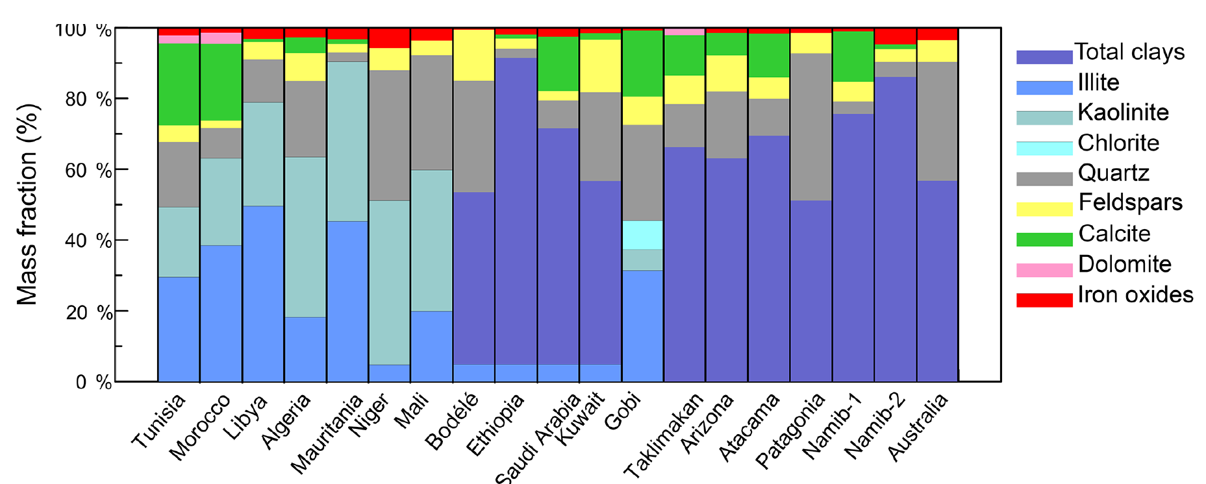
mineralogical composition
clays (≈46–92%)
Figure 6. Mineralogy of the 19 generated aerosol samples considered in this study.
Notes:
Mineral composition of different samples form different part of the world showed different variability.
-Aerosols composition dominates by clay (46-92% for different samples with variable contents of quartz, calcite, dolomite, and feldspars.
Quartz ranges from 3 to 42% by mass in the samples
Chlorite is just in china sample
Calcite Vs. minor traces of dolomite less than 3% in some of the samples
These data are in agreement with field measurements of the dust aerosols. e.g. The amount of quartz in the samples increase from northern African countries towards Sahel /detection of chlorite in china has another proof for validity of the data

Slide 17
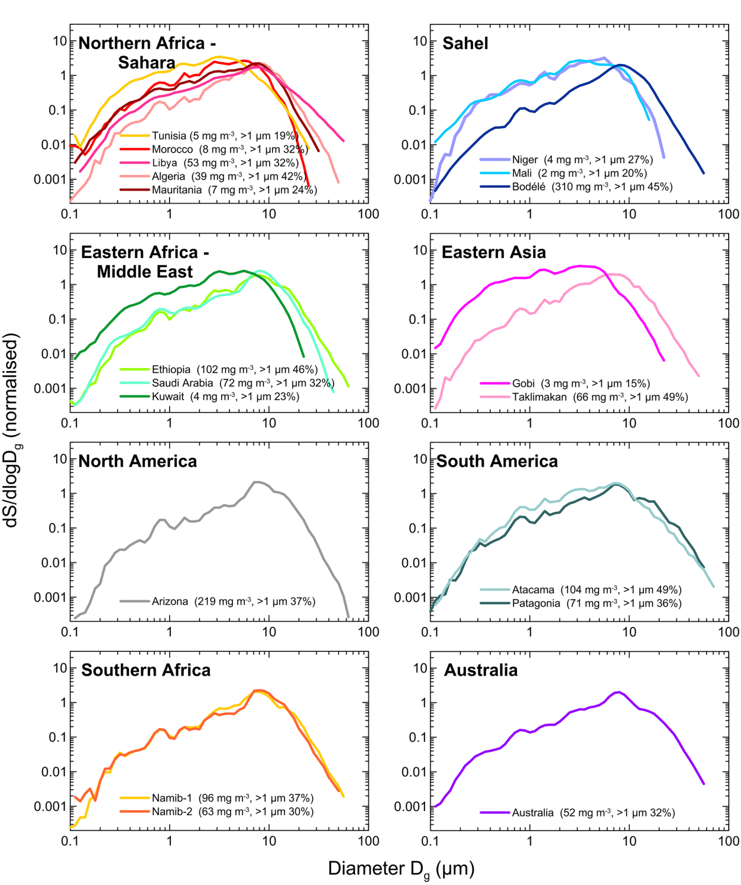
Atmospheric representativity: size distribution
Mass concentration
Percentage of the
super-micron to
sub-micron
Figure 7. Surface size distributions in the CESAM at the peak of dust injection
Notes:
The values are comparable to what has been observed close to sources in proximity to dust storms.
Mass concentration (at the peak of the injection) estimated from size distribution data varies between 2 and 310 mg/m₃. (why?).
The comparison of the chamber data with observations of the dust size distribution from several airborne campaigns in Africa is shown in Fig. This comparison suggests that the
shape of the size distribution in the chamber at the peak of the injection accurately mimics the dust distribution in the atmosphere near sources.

Slide 18
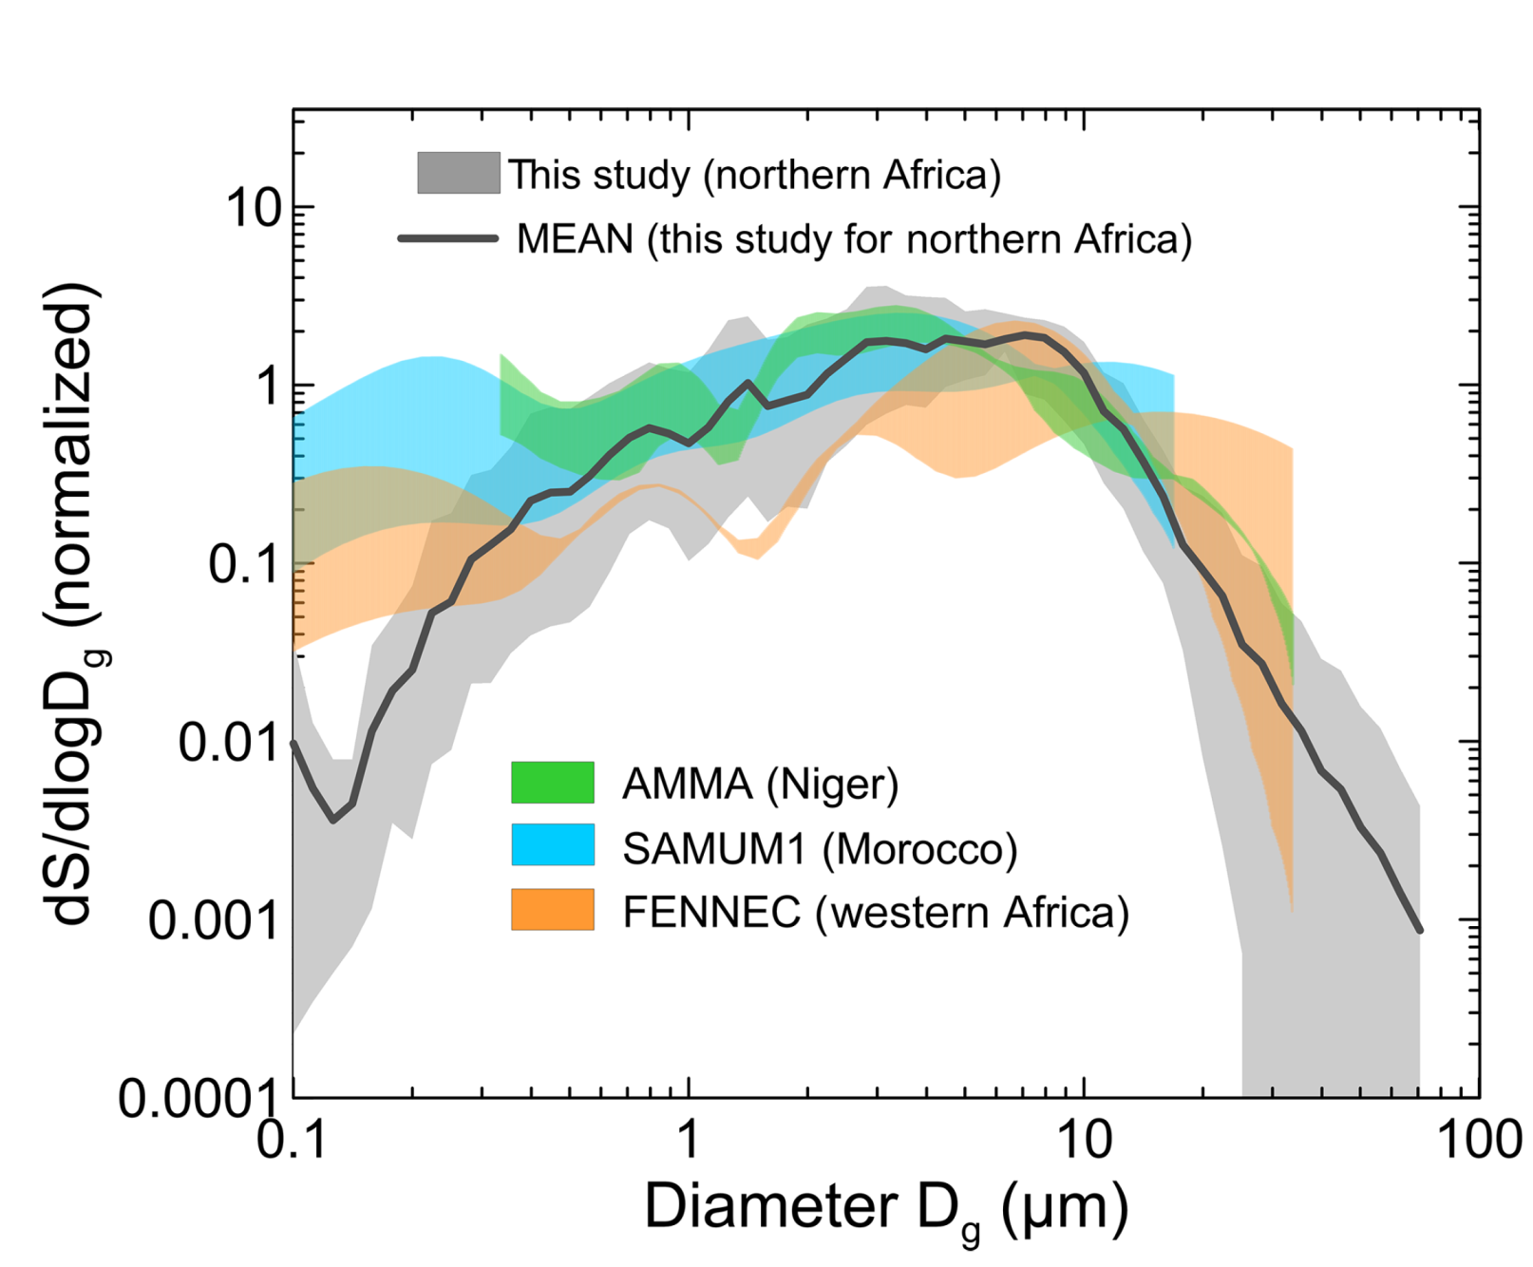
The comparison of the chamber data with observations of the dust size distribution from several airborne campaigns
Figure 8. Comparison of CESAM measurements at the peak of the injection with dust size
distributions from several airborne field campaigns in northern Africa.
Notes:
- This comparison suggests that the shape of the size distribution in the chamber at the peak of the injection accurately mimics the dust distribution in the atmosphere near sources.

Slide 19
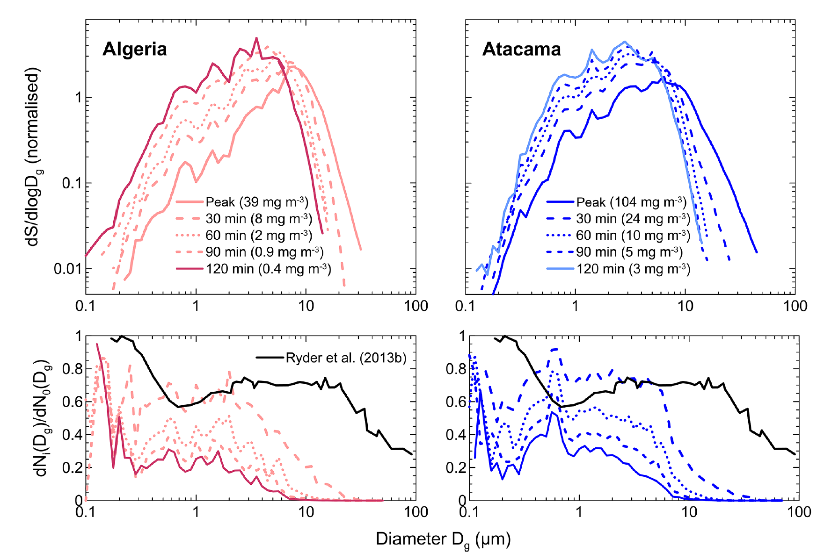


Size distribution of the normalized surface size distribution within CESAM
Rate of fall speed:
Figure 9. Upper panel: surface size distribution measured at the peak of the dust injection and at 30, 60, 90, and 120 min after injection for the Algeria and Atacama aerosols.
Notes:
- The Algeria and Atacama samples were chosen as representative of different geographic areas and different concentration levels in the chamber.
The size distribution strongly changes due to gravitational settling. coarse mode above 5 μm rapidly decreases, due to the larger fall speed
In about 2 hours chamber produced size-selective gravitational settling a process may take 1-5 days in atmosphere.
- where dNi (Dg/ is the number of particles measured by size class at time i (i corresponding to 30, 60, 90, and 120 min after injection) and
dN0(Dg/ represents the size-dependent particle number at the peak of the injection.
+Ryder: Transported from Northern Africa to Sahara, was taken 1-2 days. Altitudes between1.5 and 6 km above see level.
+comparable for particles 0.4 and 3 μm for Algeria and .4 to 8 μm for Atacama
+Depletion is faster for both larger and smaller particles
+Rate of the removal is higher in earlier stages than toward the end
1.This suggest number fraction of coarse particles depends on initial size distribution
2. Limitation of the four-blade fan in providing a vertical updraft to counterbalance the gravimetric deposition for particles larger than about 8 μm.
(it is not possible to create wide range of dynamical processes in the lab)

Slide 20
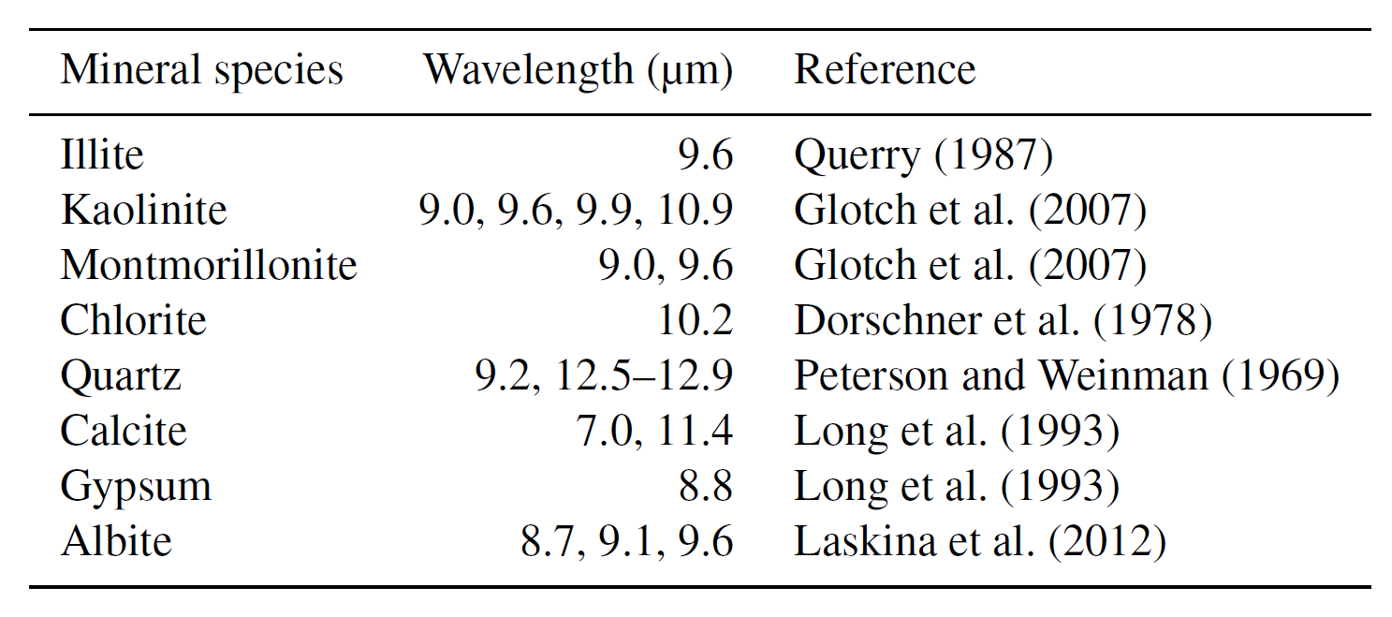
Specific minerals absorption feature
Table 3. Position of LW absorption band peaks (6–15 μm) for the main minerals composing dust.

Slide 21
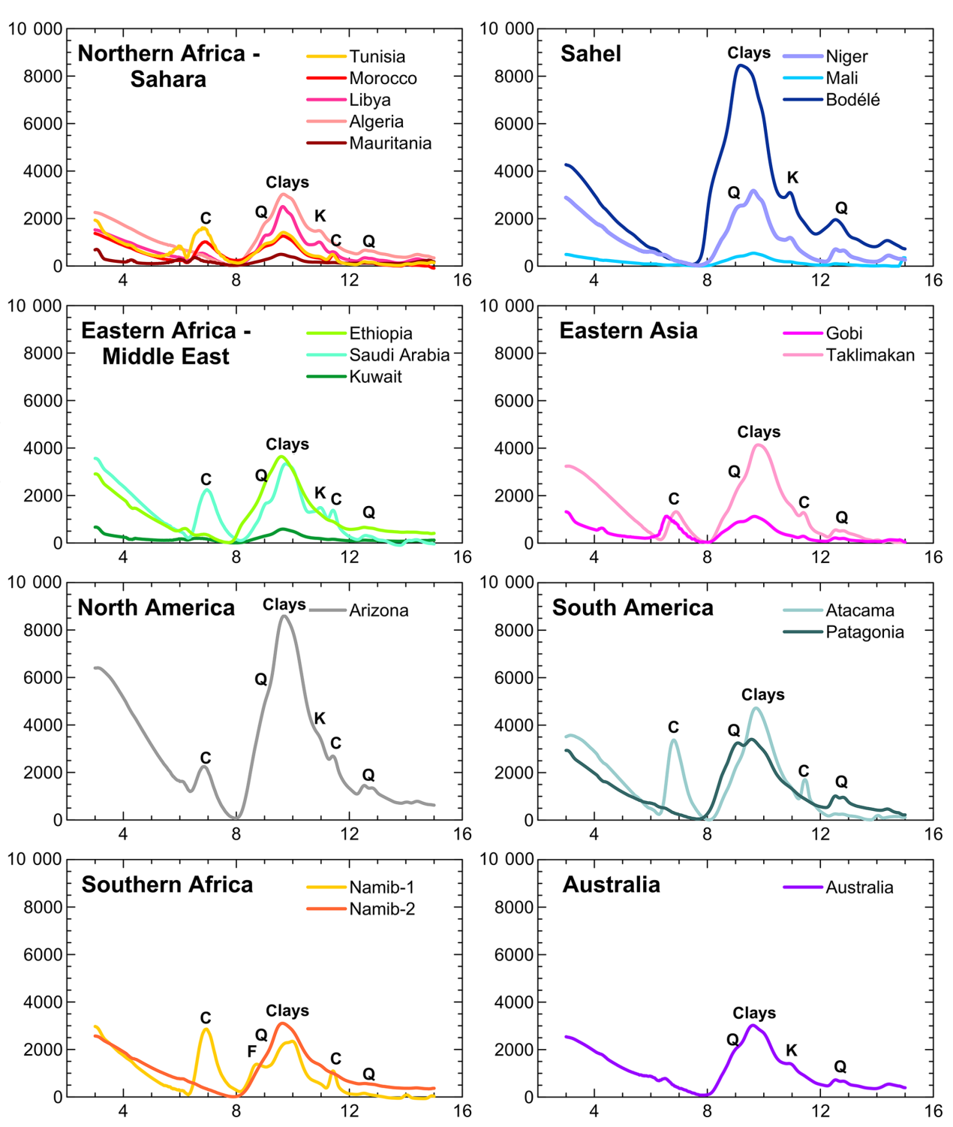



Table 3. Position of LW absorption band peaks (6–15 μm) for the main minerals composing dust.
Figure 10. Dust extinction coefficient measured in the LW spectral range for the 19 aerosol samples analyzed in this study.
Notes:
The most prominent absorption peak is found around 9.6 μm for all samples, where clays have their Si–O stretch resonance peak.
The shape around the peak differs according to the relative proportions of illite and kaolinite in the samples.
+illite and kaolinite(richer in illite): Tunisia, Morocco, Ethiopia, Kuwait, Arizona, Patagonia, Gobi, and Taklimakan
+Libya, Algeria, Mauritania, Niger, Bodélé, Saudi Arabia, and Australia samples (richer in kaolinite)
+quartz
+Calcite
- The intensity of the absorption bands depend strongly on the particle size distribution, in particular on the contribution of the aerosol super-micron fraction, as well as on the
total dust mass concentration.
+ Bodele 310 mg/m3 and 45% super-micron , so the biggest absorption feature.
+Conversely, Mauritania, Mali, Kuwait, and Gobi super-micron particle fraction and the mass concentrations are lower.

Slide 22
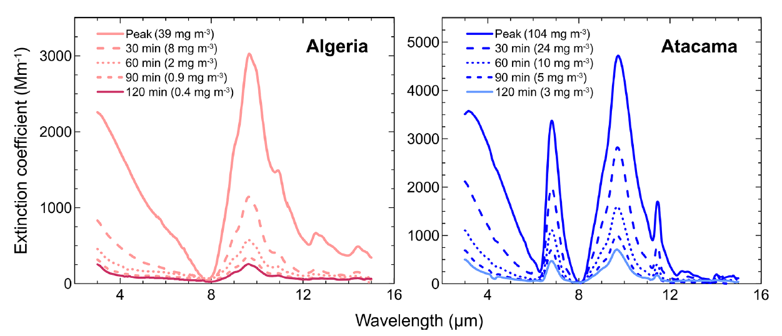
The temporal evolution of the measured extinction spectrum
Ratio of quarts to clay (for Algeria): 0.21 ± 0.03 at the peak and 0.25 ± 0.04 120 min later
Ratio of calcite to clay (for Atacama): 0.73 ± 0.10 at the peak and 0.67 ± 0.09 120 min later
60 min
modified
30 min
Figure 11. Extinction spectra measured at the peak of the dust injection and at 30, 60, 90, and 120 min after injection for the Algeria and Atacama aerosols.
Notes:
The intensity of the absorption band at 9.6 μm is about halved after 30 min and reduced to 20–30% and < 10% of its initial value after 60 and 90–120 min, respectively.
+Settling can modify spectral shape. (like quartz 12.5 in Atacama) (Changes would indicate that the time variability of the mineralogical composition is optically significant.)
++Ratio of quarts to clay (for Algeria): 0.21 ± 0.03 at the peak and 0.25 ± 0.04 120 min later
++Ratio of calcite to clay (for Atacama): 0.73 ± 0.10 at the peak and 0.67 ± 0.09 120 min later
Relative proportion of the minerals do not change, thus their contribution to LW absorption

Slide 23
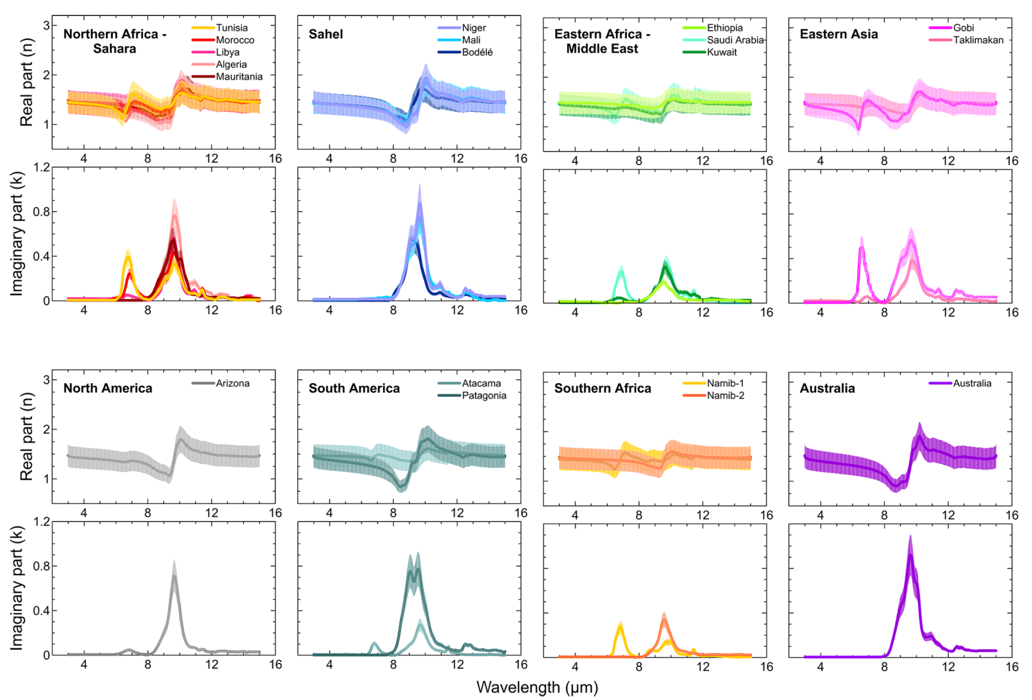
Estimated real (n) and imaginary (k)
n range is 0.84–1.94 while imaginary part k is between 0.001 and 0.92
Figure 12. Real (n) and imaginary (k) parts of the dust complex refractive index obtained for the 19 aerosol samples analyzed in this study.
Notes:
The dust refractive index widely varies both in magnitude and spectral shape from sample to sample, following the variability of the measured extinction spectra.
n span the range 0.84–1.94 while imaginary part k is between 0.001 and 0.92.
k, is observed to vary both from region to region, and also within each region.
For Northern Africa the variability for k is of a similar order of magnitude to the variability at the global scale.
Conversely, n values are in agreement within the region and region to region. (Exceptions are observed only at wavelengths where strong signatures = 7 in Suadi and Gobi)
Also Australia and Patagonia due to quartz

Slide 24
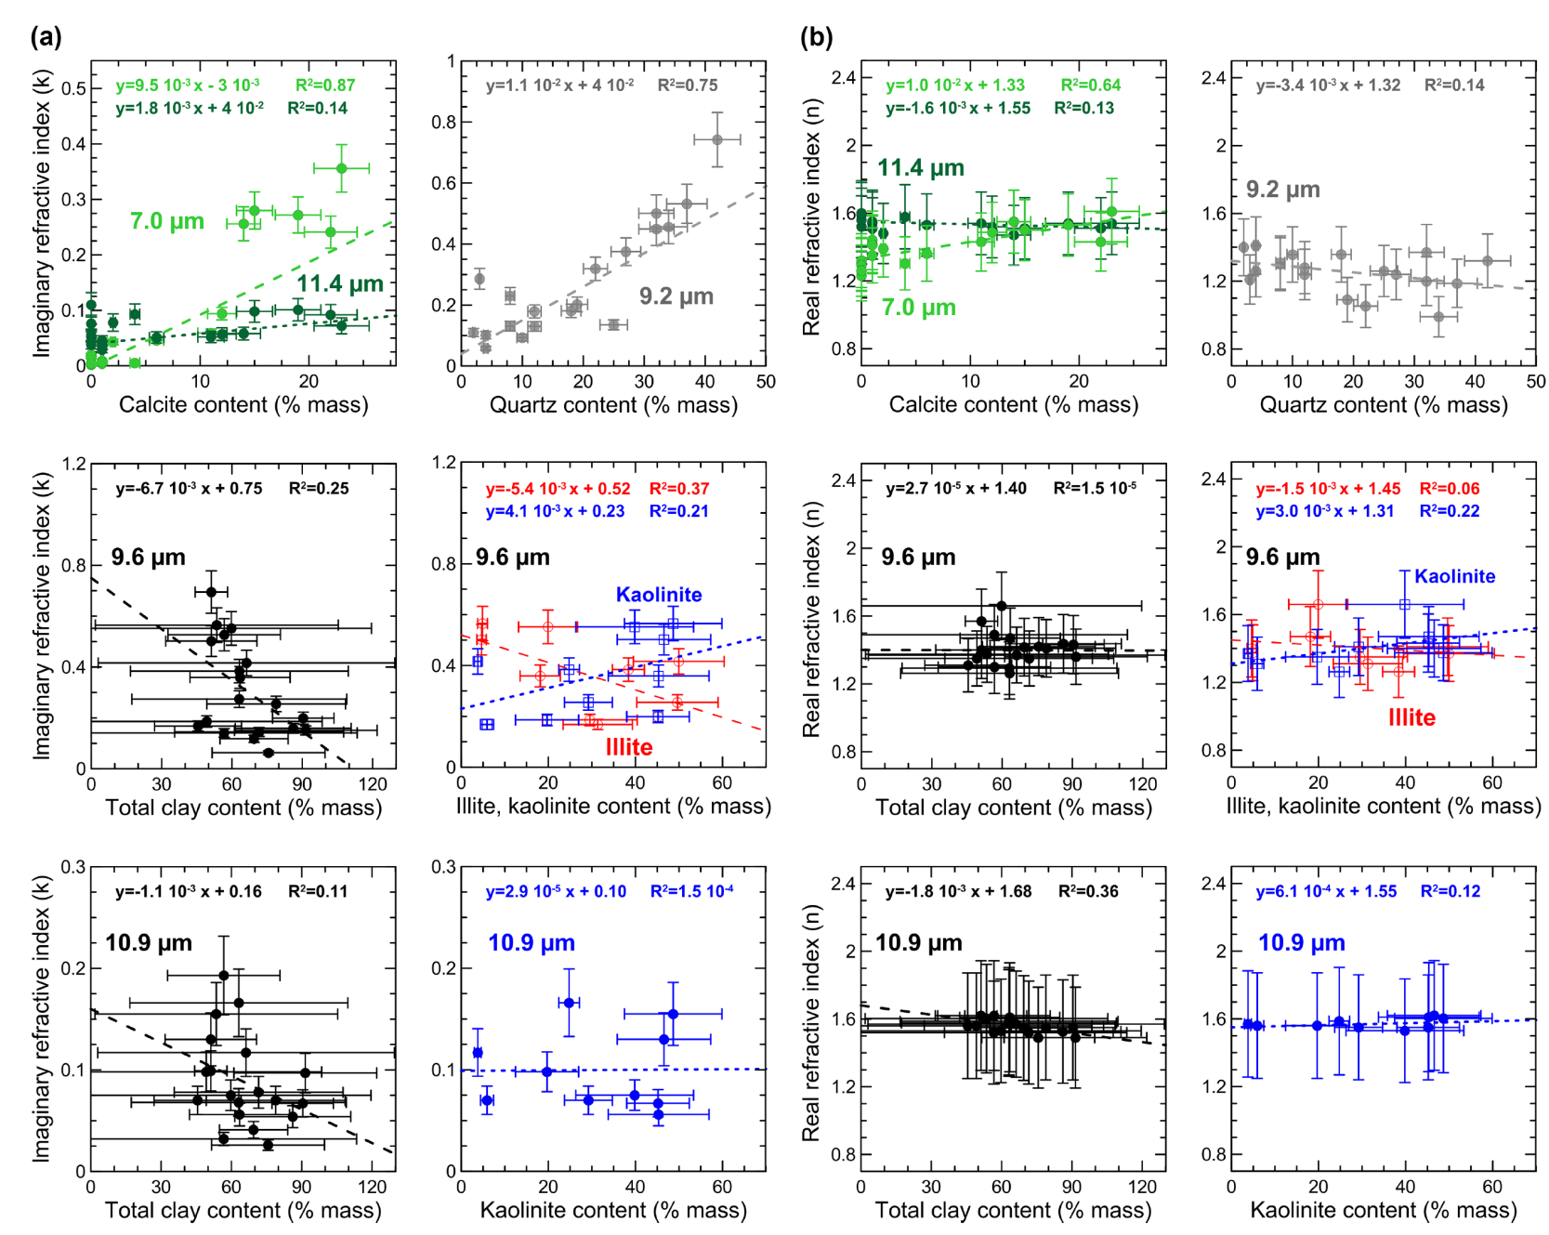
Predicting the dust refractive index based on its mineralogical composition
Figure 13. Imaginary part of the complex refractive index (k) versus the mineral content (in % mass) for the bands of calcite (7.0 and 11.4 μm), quartz (9.2 μm), and clays (9.6 and 10.9 μm).
Notes:
Mean k values were calculated as averages over the filter sampling time.
For calcite and quartz the relationship is almost linear. These minerals are commonly large in size and well-crystallized.
Calcite and quartz quantification by XRD is certain and they produce well-identified absorption peak in the LW.
Exception: (around 5 %) that gives rise to absorption at 7 μm, therefore measurable for k values.
Conversely, at 11.4 μm, non-zero k values are obtained even in the absence of calcite, due to the interference of the calcite peak and the clay resonance bands.
-Poorer or no correlation is found between k and the percent mass fraction in the absorption bands of clays at 9.6 and 10.9 μm. The reason the production conditions in the soils (weathering) and aging in the atmosphere, their physical and chemical conditions (composition, crystallinity, aggregation state) might differ from one soil to another, and from that of mineralogical standards.
+That is the reason why XRD measurements of clays in natural dust samples might be erroneous, and why we prefer to estimate the clay fraction indirectly.
(more spectral deconvolution based on the single minera lrefrence in needed to understand the shape and magnitude of imaginary index in this spectral band. )
n part: The correlation of calcite at 7 μm and n is significant. while for all other cases, very poor or no correlation is found.
(The real refractive index of dust is also almost constant at all bands)

Slide 25
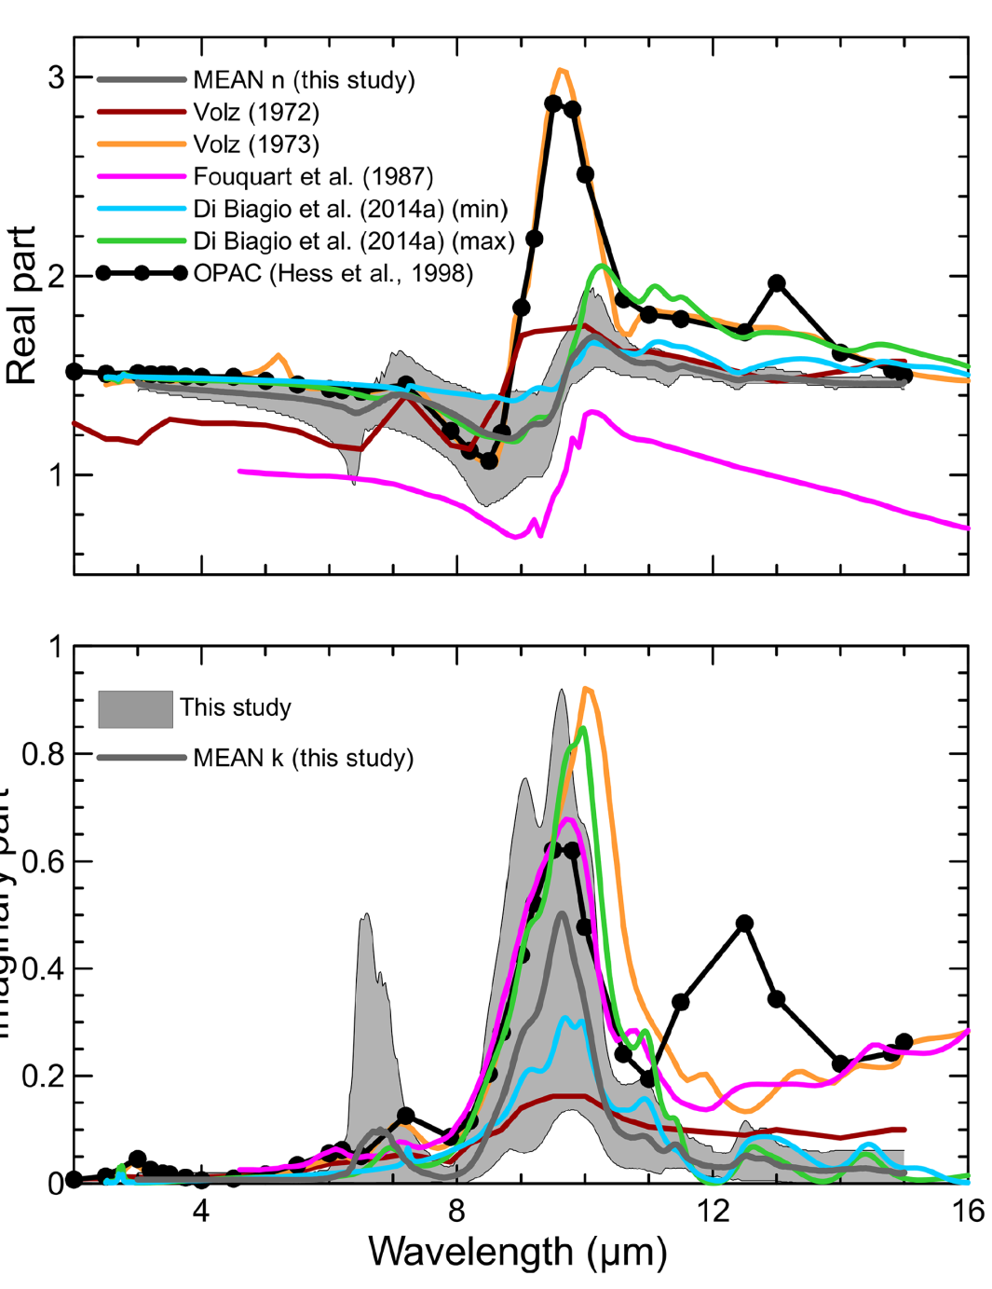
Comparison with the literature
Highwood et al. 2003 have estimated that a change of about 0.3 in k at 10 μm, may result in up to 3 k change in the Modeled sky brightness temperature.
overestimation
underestimation
overestimation
Imaginary part
Figure 14. Comparison of results obtained in this study with
literature-compiled values of the dust refractive index in the LW.
Notes:
These literature data, in particular those of OPAC and Volz (1973), are the most frequently used references in climate modeling and remote sensing applications.
Because of their limited regional span, the literature data clearly cannot do justice to the full range of magnitude and of the spectral variability of the LW complex
+In particular, clearly none of the published data represent the contribution of calcite at 7 µm.
+Some of data overestimate k above 11 where 12.5-12.9 µm quartz band is found.
+The best correspondence, especially above 10 μm, is found with Di Biagio et al. (2014a).
+A shift in 9.6 µm to the longer wavelength which is for clay minerals (in DB2014 and Volz) is probably due to using KBr pellet technique.
+The agreement is even less satisfactory for the real part of the refractive index (upper panel of Fig. 12), which is overestimated in OPAC and Volz (1973) and underestimated in Fouquart et al. (1987). (might be due to using different techniques)
+There are large enough differences in magnitude and spectral shape to impact on radiative forcing. (e.g. at 10 μm absolute difference between our retrieved
mean k and the k by OPAC and Volz (1973) is between 0.15 and 0.6…..Highwood et al. 2003 have estimated that a change of about 0.3 in k at 10 μm, may result in up to 3 k change in the
Modeled sky brightness temperature.

Slide 26
Conclusions and perspectives
1. The envelope of refractive index data obtained in this study can adequately represent the full range of variability for dust.
2. The imaginary LW refractive index, k, of dust varies strongly both in magnitude and spectral shape.
3. The available literature used nowadays in climate models and satellite retrievals do not adequately represent either magnitude or spectral shape.
SO the recommendation is the use of source-specific extinction spectra and/or imaginary refractive indices rather than generic values in models and remote sensing applications.
4. Predictive relationship between mineral mass and magnitude of K LW.
5. The spectral shape of the dust extinction spectrum does not seem to change significantly with time as a result of the loss of coarse particles by gravitational settling.
6. Therefore, models just have to reproduce the dust composition at the source, without the necessity of following its changes during transport, which could be a
challenge.
Notes:
The spectral shape of the dust extinction spectrum does not seem to change significantly with time as a result of the loss of coarse particles by gravitational settling.(so optical properties
Will not change. Also LW k will not change in medium-long range transport.

Slide 27
Conclusions and perspectives
Perspective:
Regional variability needs to be characterized further in order to better assess he influence of dust on regional climate.
More formal spectral deconvolution procedure, based on single mineral Reference spectra must be investigated.
Further experimental efforts by increasing life time should be done.
Aging process, such as heterogeneous reactions, mixing with other aerosol types, or water uptake have o be investigated for their effect on LW refractive index.
Notes:
Volz and OPAC data may introduce a systematic bias in modeling dust radiative effects at LW wavelengths.

Slide 28
References
Journet, E., Balkanski, Y., and Harrison, S. P.: A new data set of soil mineralogy for dust-cycle modeling, Atmos. Chem. Phys., 14, 3801–3816, doi:10.5194/acp-14-3801-2014, 2014.
Highwood, E. J., Haywood, J. M., Silverstone, M. D., Newman, S. M., and Taylor, J. P.: Radiative properties and direct effect of Saharan dust measured by the C-130 aircraft during Saharan Dust Experiment (SHADE): 2. Terrestrial spectrum, J. Geophys. Res., 108, 8578, doi:10.1029/2002JD002552, 2003.
Ginoux, P., Prospero, J. M., Gill, T. E., Hsu, N. C., and Zhao, M.: Global-scale attribution of anthropogenic and natural dust sources and their emission rates based on MODIS Deep Blue aerosol products, Rev. Geophys., 50, RG3005, doi:10.1029/2012RG000388, 2012.
Klaver, A., Formenti, P., Caquineau, S., Chevaillier, S., Ausset, P., Calzolai, G., Osborne, S., Johnson, B., Harrison, M., and Dubovik, O.: Physico-chemical and optical properties of Sahelian and Saharan mineral dust: in situ measurements during the GERBILS campaign, Q. J. Roy. Meteorol. Soc., 137, 1193–1210, doi:10.1002/qj.889, 2011.
von der Weiden, S.-L., Drewnick, F., and Borrmann, S.: Particle Loss Calculator – a new software tool for the assessment of the performance of aerosol inlet systems, Atmos. Meas. Tech., 2, 479–494, doi:10.5194/amt-2-479-2009, 2009.
Petty, G. W. (2006). A first course in atmospheric radiation. 2nd ed. Madison, Wis.: Sundog Pub.

Slide 29
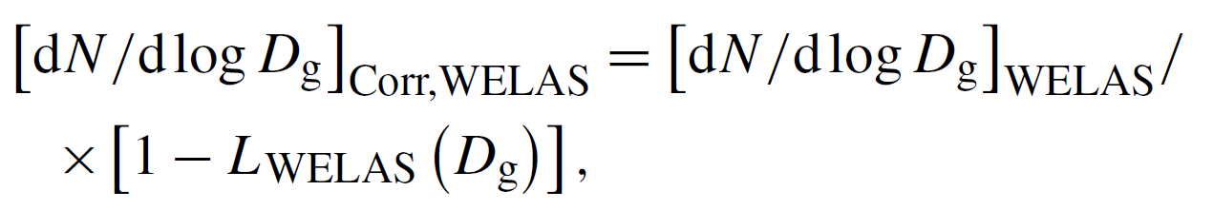
Correction for particle losses in sampling lines
Particle losses due to aspiration and transmission in the sampling lines
This loss is calculated using PLC (particle loss calculator)
*von derWeiden et al., 2009
Paticle loss D_{g}< 1µm negligible, but;
reaching 50% at D_{g} ≃ 5 μm, 75% at D_{g} ≃ 6.3 μm, and 95% at D_{g} ≃ 8 μm for the WELAS
To correct WELAS data:
Notes:
[dN/dlog D_{g}]_{WELAS} is size measured by WELAS , L_{WELAS} (D_{g})] is particle loss as a function of particle diameter.

