Slide 1

Using distributed temperature sensing to monitor field scale dynamics of ground surface temperature and related substrate heat flux
Presented by Daniel Baldassare
Phys.org
Bense, V. F., Read, T., & Verhoef, A. (2016). Using distributed temperature sensing to monitor field scale dynamics of ground surface temperature and related substrate heat flux. Agricultural and Forest Meteorology, 220, 207–215. https://doi.org/10.1016/j.agrformet.2016.01.138

Slide 2
Presentation Outline
How distributed temperature sensing (DTS) works
Surface energy budget
Study area and methodology
Spatial variability of temperature
Ground heat flux
Discussion

Slide 3
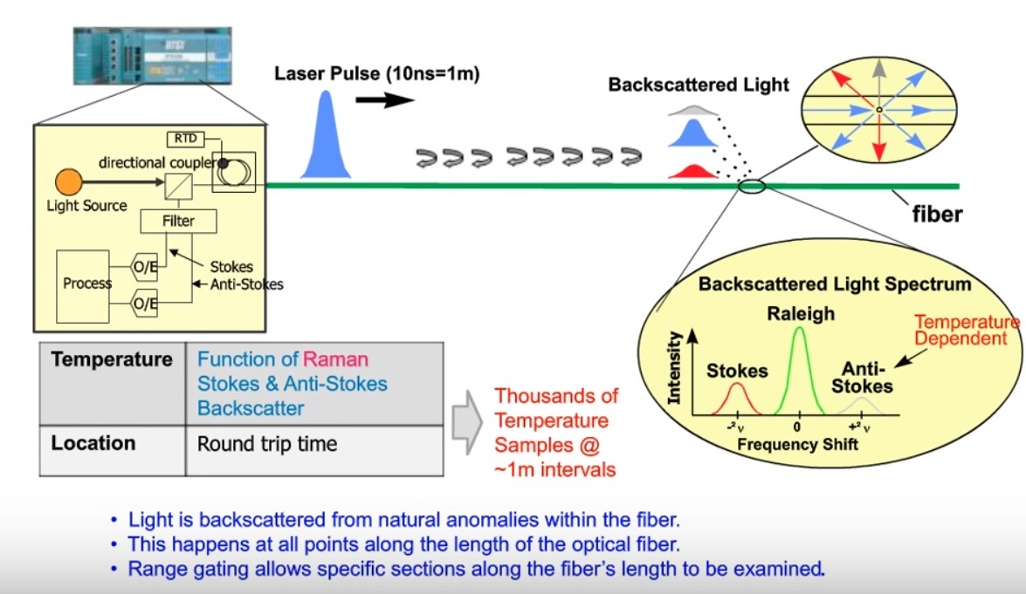
automationforum.in

Slide 4
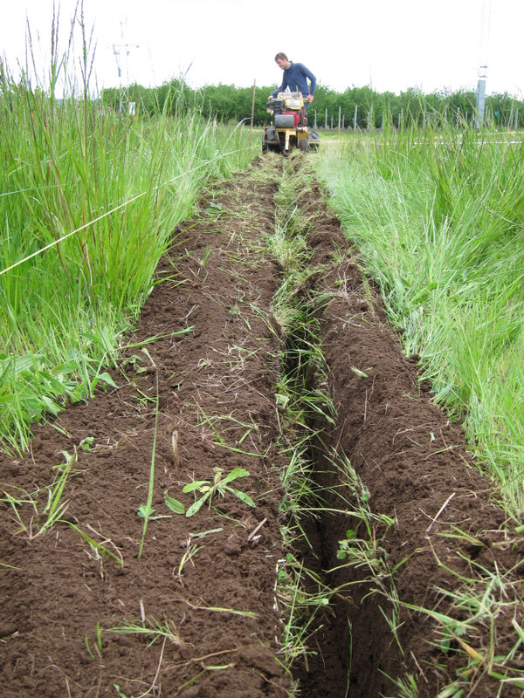
Earlier DTS studies
Krause et al. studied canopy temperatures
Lutz et al. investigated ground temperatures in varied forest
Thomas et al. measured surface layer flows
https://www.bayceer.uni-bayreuth.de/FOSES_Workshop_2019/
Notes:
Purpose of this study:

Slide 5
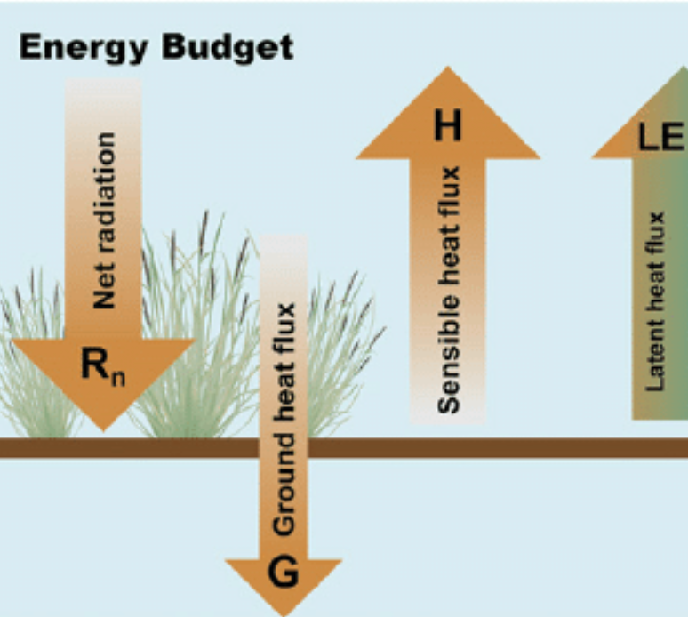

Surface energy budget
R_{n} – G = H + LE
All components relate to surface temperature
Aerial thermal IR good at finding surface temperature without canopy
Ground based thermal IR covers small area, causes closure issues
(Lofgren, 2013)

Slide 6
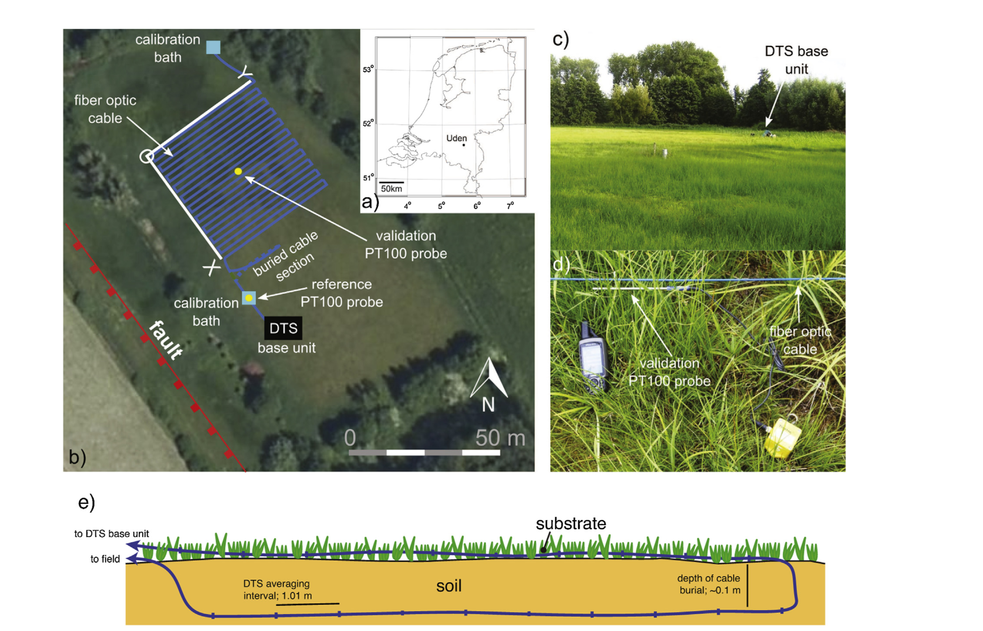
Notes:
Purpose: To demonstrate how DTS can be used to map GST in low canopies, study how temperatures are affected by canopy size and structure, and how the data can estimate the variations in time and space of heat fluxes. Field site is in southeast Netherlands SE of Uden, groundwater fed wet meadows, heterogenous ground cover and localized soil moisture and groundwater depth. Variation in plant cover based on ground heterogeneity. GST can be expected to be highly spatially organized, and be controlled by the structure (density, height and LAI) of the vegetation cover through variation in light extinction, as well as by its radiative, thermal and aerodynamic properties. 900m of fiber optic cable with blue polyamide jacket. 21 parallel sections of 40m, 2m between lines. Attached to ground every 2m, so variation in cable height 0 to 10 cm. 10m of buried cable at 10cm. Measured 48 hours Aug 25-26 2009, using Oryx DTS, 1 meter intervals averaged over 2.5 minutes, using double ended configuration. This allows for corrections of light attenuation along the cable by comparing the two measurements. 20m of cable and calibration probe were placed in a bath of water for calibration. Estimate of 1-2 C error due to solar heating of blue cable.

Slide 7
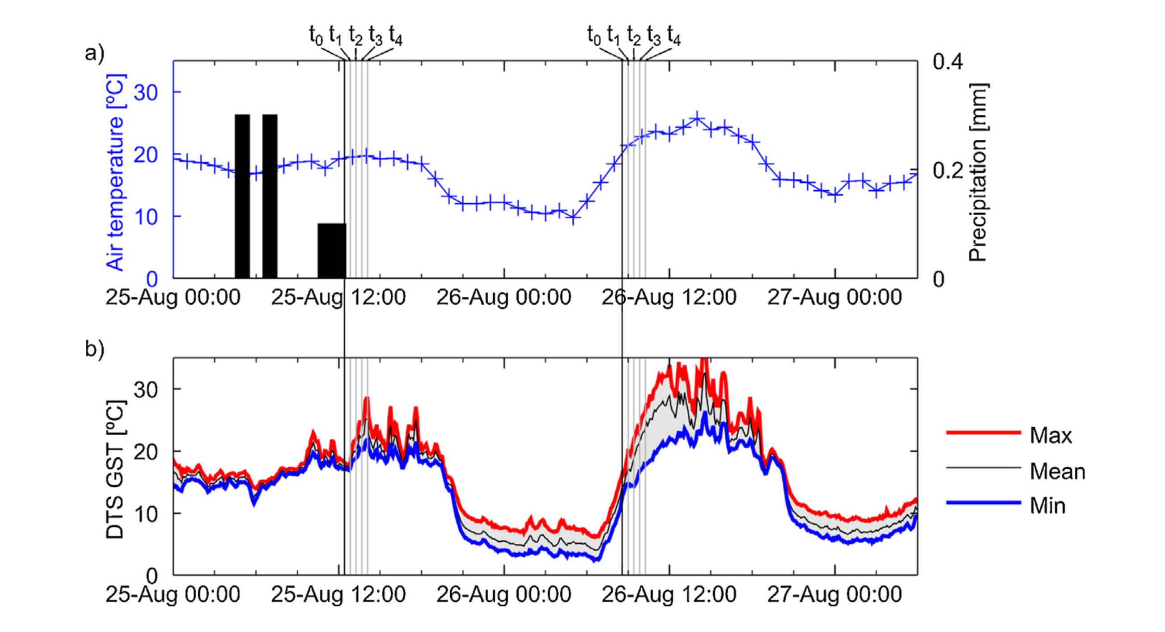
Notes:
Comparison of measured temperature at Volkel met station 6km from site and DTS ground surface temperature. Black bar indicates precip at station. GST below air during rainfall. Range shows highest to lowest along length of DTS, low variance during precip event, highest in early afternoon of sunny day. GST higher than air during day, lower at night (height of station not stated in paper)

Slide 8
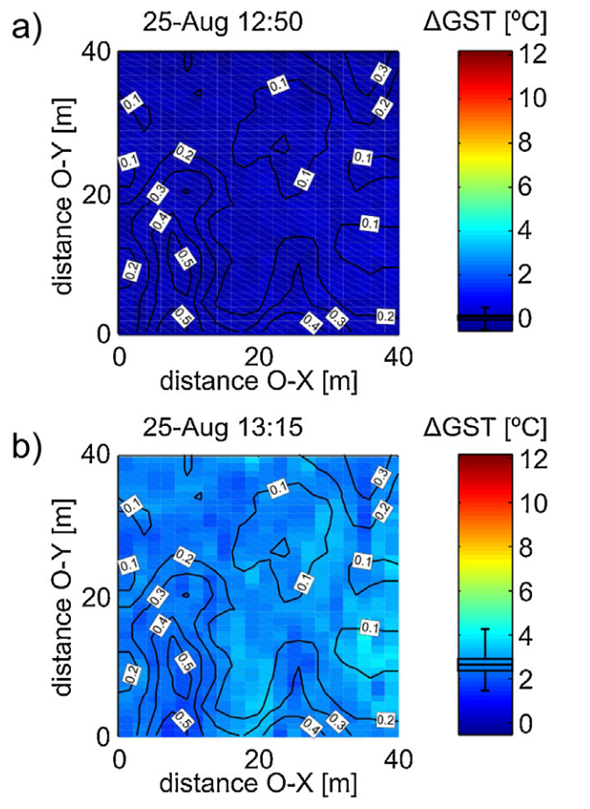
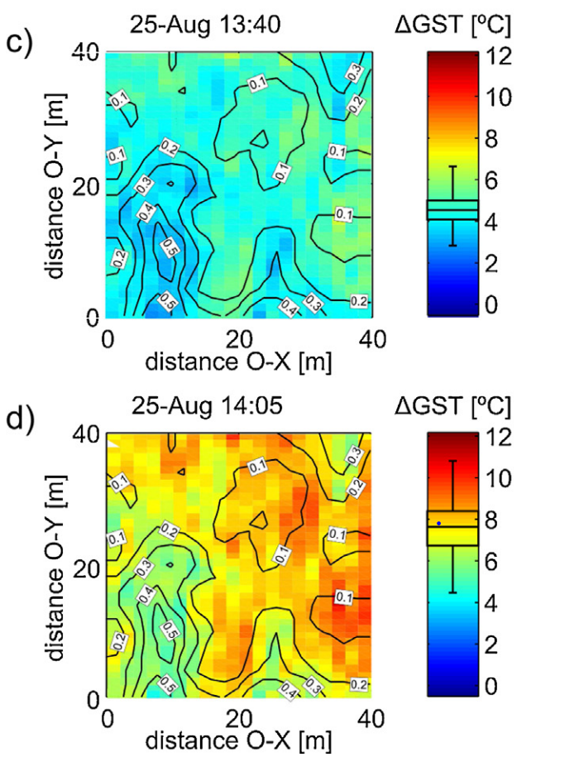
Notes:
Delta gst for first day immediately after rainfall compared to reference time of 12:25. 75 min. Contours represent veg height. 2m horizontal by 1m vertical resolution. Middle line on side shows spatial mean. Air temperature very stable (2 degrees c> variation). Increasing heterogeneity after rain passes. Lower veg height has higher GST during sunlight after clouds pass, even without warming air temp in remainder of day

Slide 9
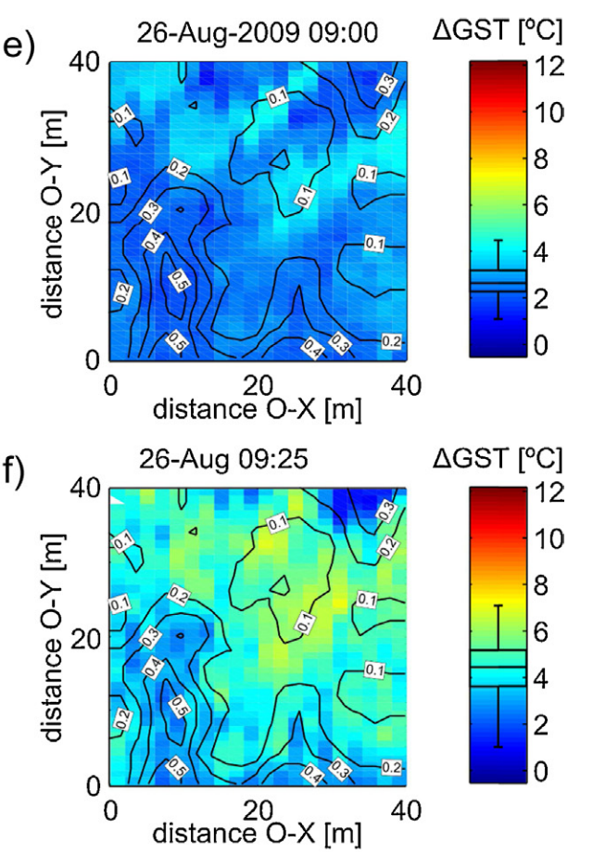
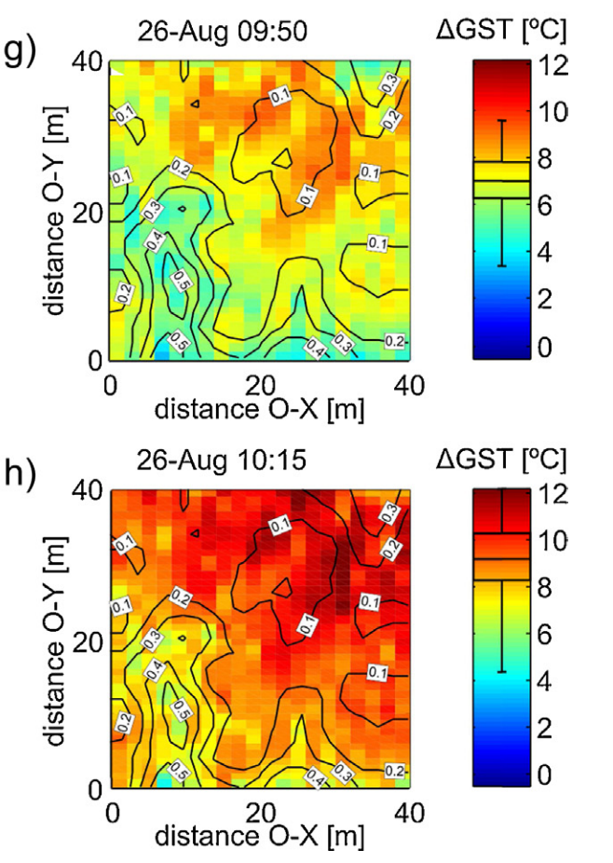
Notes:
Reference time 8:35. Same chart but next day, 75 min periodHeterogeneity increases during morning transition, air temp increasing at the same time. Lower veg is hotter. Variation within contours intriguing

Slide 10
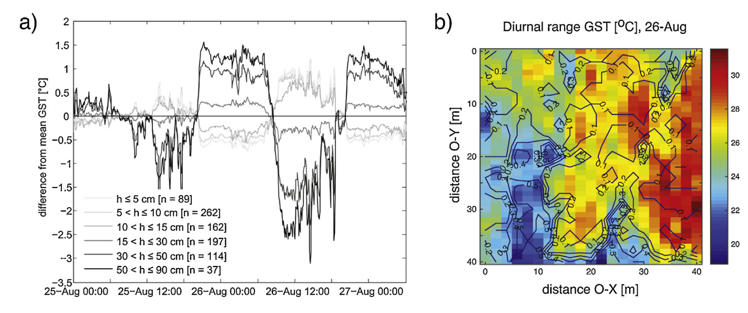
Notes:
Spatially averaged at each time step for different veg heights fig A. Higher veg warmer at night, lower warmer in day. Continuous gradient at night or day
Diurnal range for each point with contours showing veg height

Slide 11
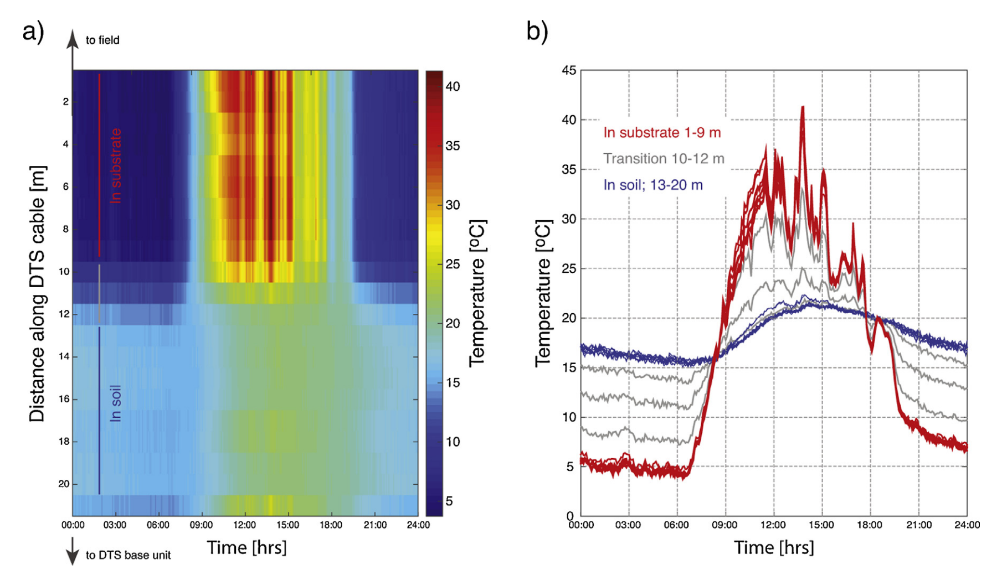
Notes:
DTS temperature along buried cable, substrate is top of soil where all dts placed, transition is part buried or shallow buried, in soil is buried 10 cm. Note lower variance with greater depth, temperature inversion at night. Also shows intensity of diurnal variability (30 C at soil surface, less than 15 at tower) Soil T has low spatial variability

Slide 12
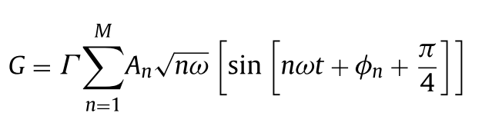
Ground heat flux
Ground heat flux calculated using harmonic analysis
Substrate thermal properties assumed to be uniform
Temperature averaged at 30 minutes for each meter
Notes:
Ground Heat flux = Gamma(Thermal intertia) (sqrt(thermal conductivity * volumetric heat capacity) and An is temperature amplitude of given harmonic

Slide 13
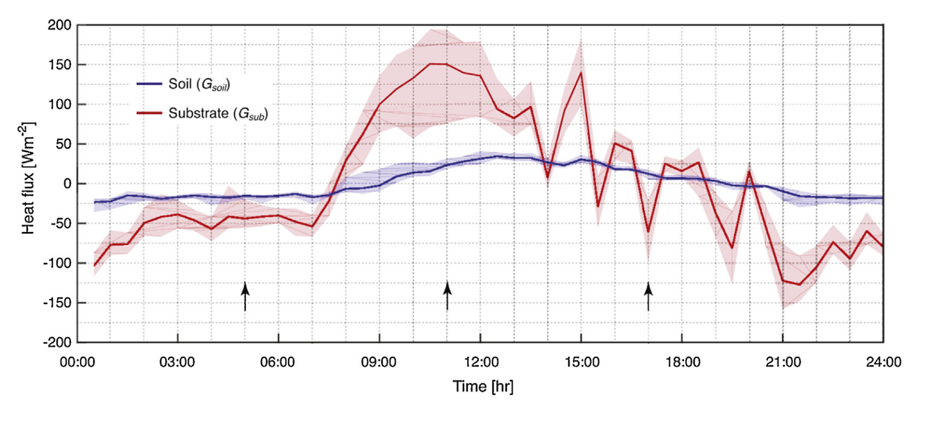
Ground Heat Flux
Notes:
shows substrate and soil heat flux, negative means upward heat flux, so a lot of energy into ground during day (solar), release heat at night
Especially high difference between gsub and gsoil due to high groundtable (high conductance)
Greater variability of Gsub
Arrows show times used in next figure

Slide 14
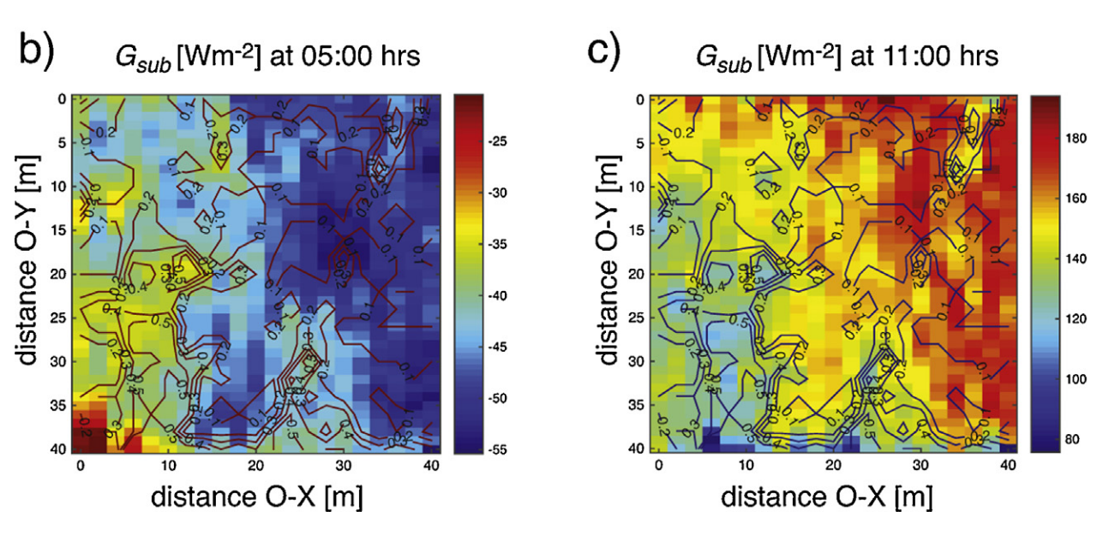
Notes:
Aug 26 only, night and late morning. Energy upwards at night, downwards during the day. More energy flux (+ and –) in low veg cover. Consistent with more solar heating and more open canopy for outgoing. Gsub at maximum at 1100 (hot sun and temp below equilibrium from night cooling)

Slide 15
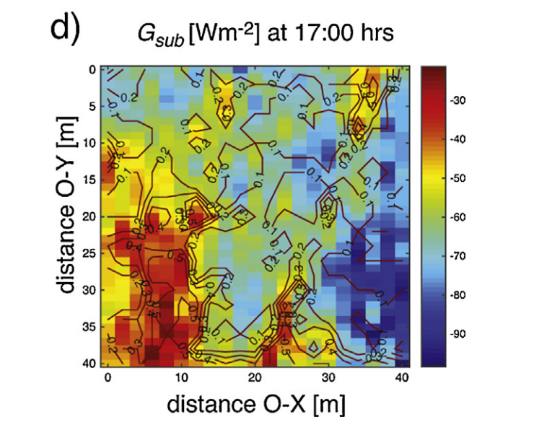

Slide 16
Further research
Comparing DTS measurements and UAV IR
Surface heterogeneity quantification
DTS methodology standardization
Varied height of DTS for canopy measurements
Notes:
#2 many factors on surface temp so further studies needed to parse effects

Slide 17
References
Bense, V. F., Read, T., & Verhoef, A. (2016). Using distributed temperature sensing to monitor field scale dynamics of ground surface temperature and related substrate heat flux. Agricultural and Forest Meteorology, 220, 207–215.
Lofgren, B. M., Gronewold, A. D., Acciaioli, A., Cherry, J., Steiner, A., & Watkins, D. (2013). Methodological approaches to projecting the hydrologic impacts of climate change. Earth Interactions, 17(22).

