Slide 1
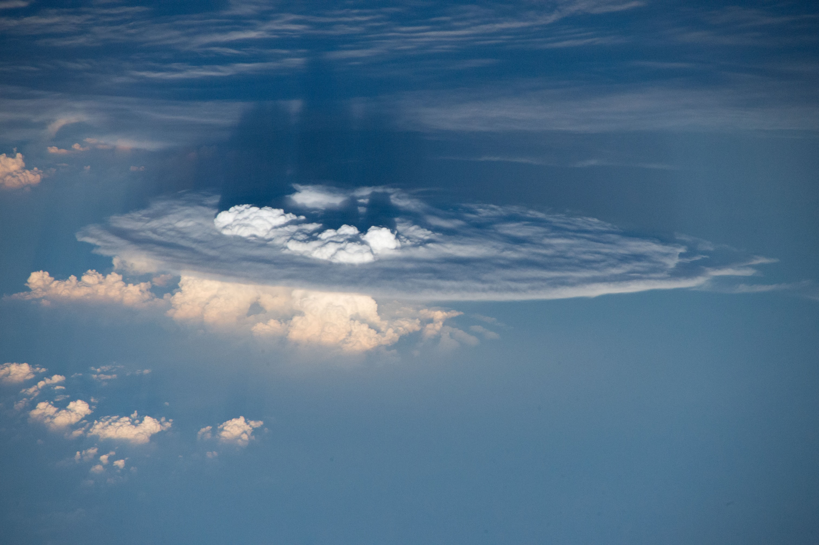
Relationships between Deep Convection Updraft Characteristics and Satellite-Based
Super Rapid Scan Mesoscale Atmospheric Motion Vector–Derived Flow
Presented by: Courtney Keene
April 22nd, 2019
Apke et al 2018

Slide 2
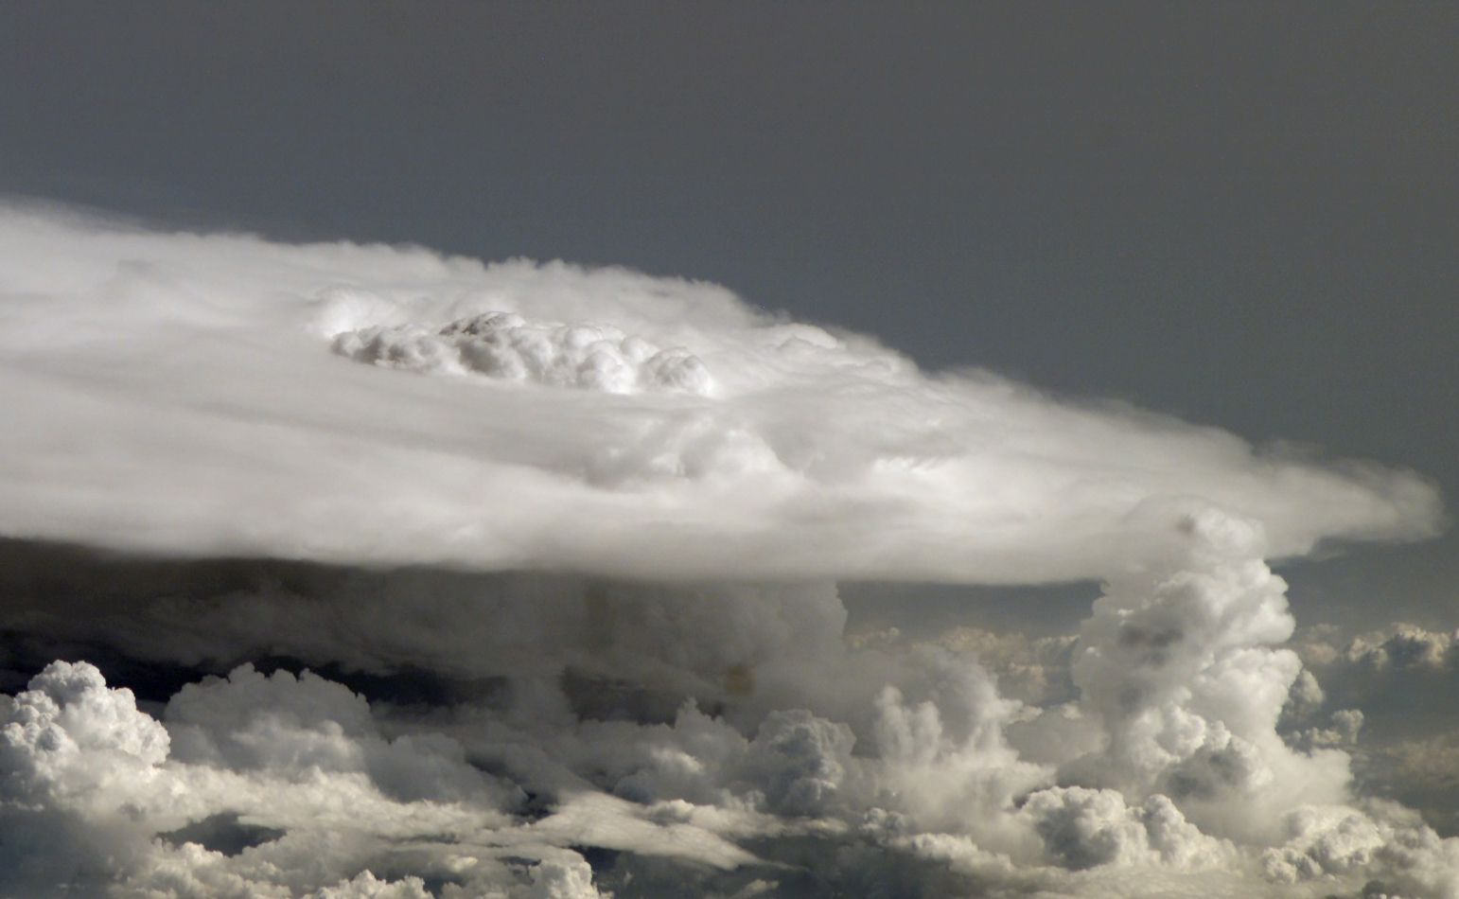
Outline
Introduction
Background
Methods
Results
Conclusions
RKW Theory
My Research
Final Conclusions
References

Slide 3
Introduction: Goals
The goals are:
  1.) To understand if SRS-based CTD products provide meaningful and temporally consistent characterizations of updrafts in DC.
  2.) To determine the relevance of updraft accelerations inferred in these multisensor products for severe weather nowcasting.
Hypothesis: Storm scale CTD should peak in space and time near OT regions depicted by GOES, and the CTD maximum will further be correlated to internal and near-cloud-top uprdraft characteristics.
  Updraft volume and magnitude.

Slide 4
Background
Mesoscale atmospheric motion vectors (mAMVs).
  Derived using a series of GOES images.
  Used with NWP to extract mesoscale flow field.
Remote sensing observations of convective updrafts.
  Ground-based multi-Doppler radar has been used to characterize 3-D updraft flow structure of severe DC. **
Radar observations of updrafts in DC have been complemented by total lightning measurements.
  Total lightning flashes observed from LMAs have been correlated to mixed-phase updraft strength and volume.
  The spatial distribution of LMA sources sometimes reveals lightning “holes” or “rings” in intense storms.
    Strongest updraft cores.

Slide 5
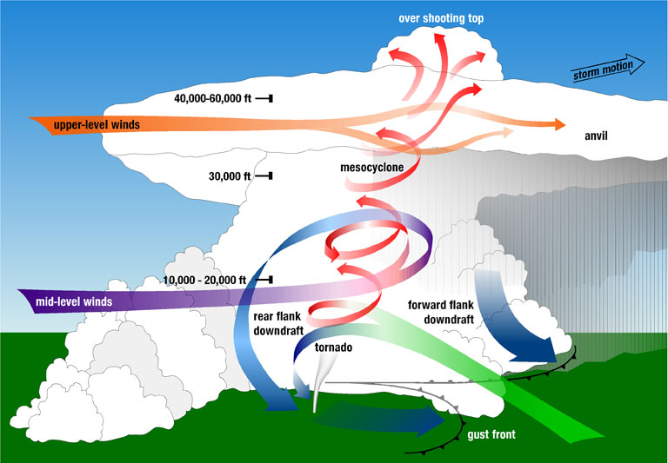
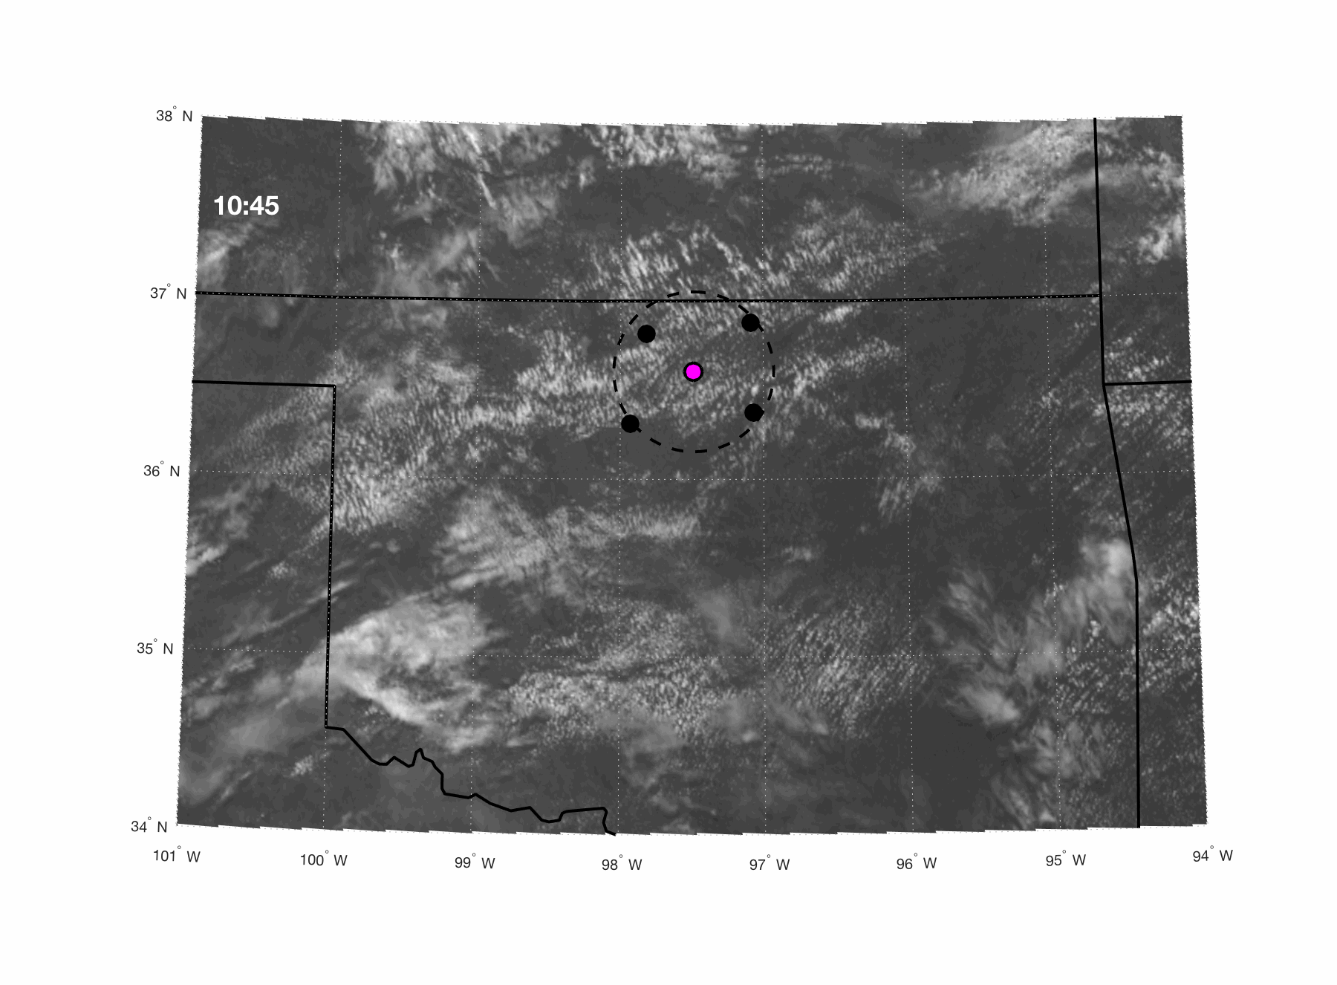
Background cont..
Updraft tracking is performed with GEO satellites that collect data over significantly larger domains.
  Updrafts tracked by identification of domelike protrusions
    Overshooting tops, aka OTs
Caveats between satellite-based OT detections and updrafts:
  OTs penetrating the stratosphere may appear warmer.
  IR temperature data may have too course a spatial distribution.
Drawbacks in subjective an objective OT identification suggest a need to combine OT observations with other datasets for optimal updraft location and intensity recognition. **

Slide 6
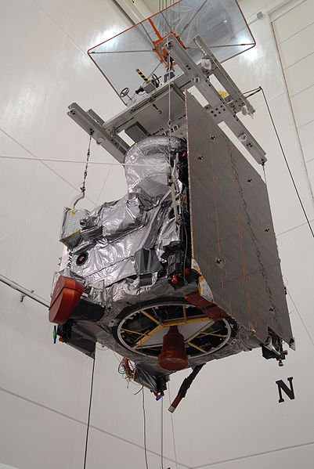
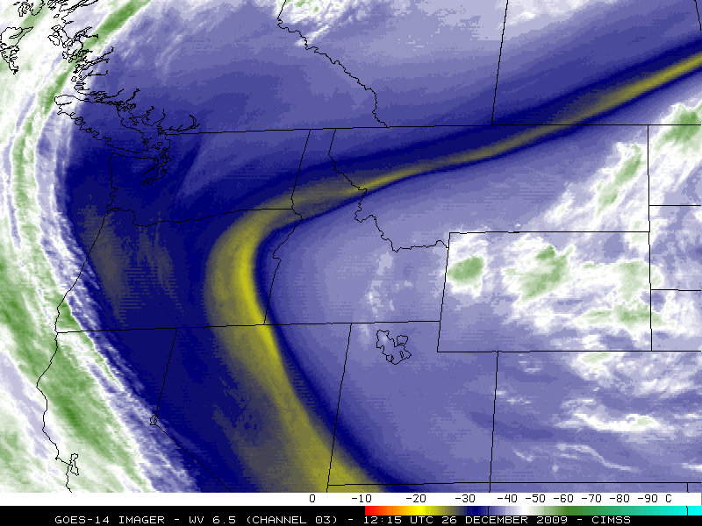
Methods: Data - Satellite
Three GOES-14 channels were used for mAMV derivation and OT observations:
  The VIS band (0.63 μm)
  The WV band (6.48 μm)
  The cloud-top temperature “window” IR band (10.7 μm)

Slide 7
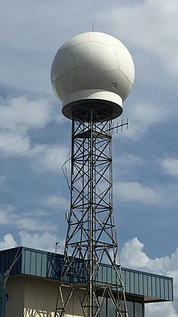
Methods: Data - Radar
Radar datasets include the Level-II Weather Surveillance Radar-1988 Doppler (WSR-88D) acquired from:
  The Level-II Weather Surveillance Radar-1988 Doppler (WSR-88D) acquired from National Climatic Data Center Archive Information Request System (NCDC AIRS).
    The Front Range, Colorado, system (KFTG)
    The Hytop, Alabama, system (KHTX)
  Northern Alabama Advanced Radar for Meteorological and Operational Research (ARMOR) located at the Huntsville, Alabama Airport.

Slide 8
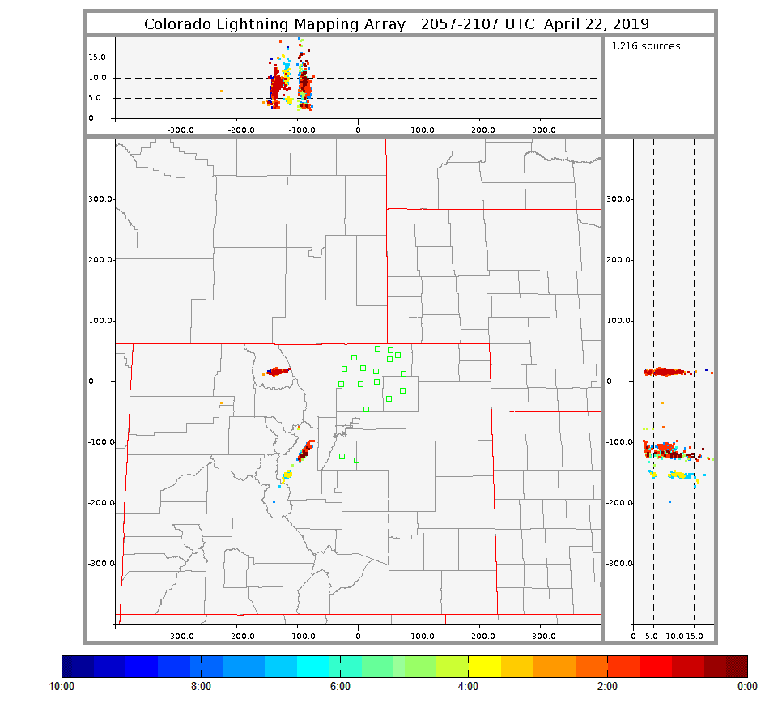
Methods: Data – Lightning Map Array (LMA)
For total lightning information:
  The Colorado Lightning Map Array (COLMA)
  West Texas LMA (WTLMA)
  Northern Alabama LMA (NALMA)
Sum of the flashes for individual cells and evolving trend in flash rates (FRs) were compared to CTD and updrafts.
http://lightning.nmt.edu/colma/

Slide 9
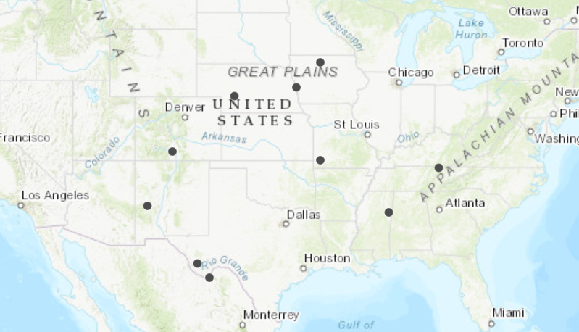
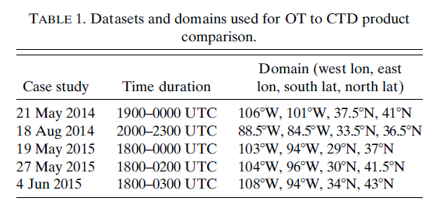
Methods: Case Studies
Four of the cases were events with widespread DC and severe weather reports.
  National Centers for Environmental Information (NCEI) storm events database.
The Adams County supercell; a tornadic supercell in central Colorado
The Hale County supercell; a hailstorm in central Texas.
The Elbert County supercell; a tornadic supercell in southern Colorado
Localized DC within the ARMOR and KHTX dual-Doppler and NALMA domain in northern Alabama

Slide 10
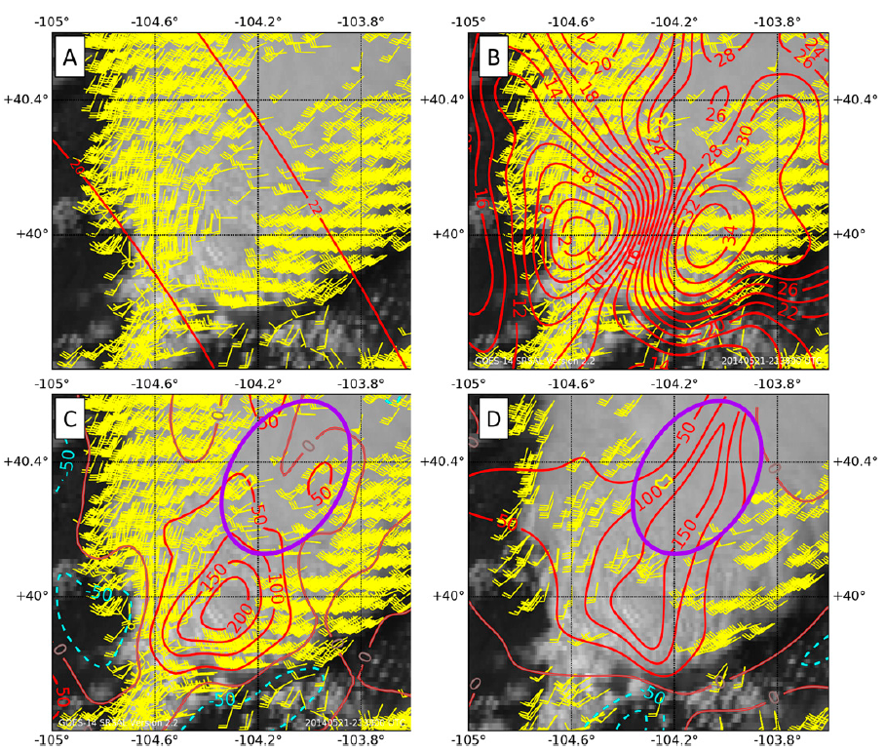
Methods: Derivation of mAMV CTD
Point source mAMVs over a 5 minute period were gridded into a flow field of u- and v- component wind using a recursive filter analysis system.
Large objective analysis CTD artifacts derived in A16 are reduced with the RF approach.
  Incorrectly interpolated u- and v- component information where few mAMVs exist.
The product developed here has been named the super rapid scan anvil level flow system (SRSAL).

Slide 11
Methods: OT and CTD Comparison
The BK16 OT detection methods are designed to mimic the human OT identification process.
Assigns OT probability based on:
  IR T_{B} vs. the anvil mean T_{B}
  Tropopause height
  Regional most unstable equilibrium level.
    Latter two defined using NWP or reanalysis data.
Texture produced by OTs and gravity waves in VIS imagery is assigned a “texture rating”
  ~5 => gravity waves
  >7 tends to isolate OTs

Slide 12
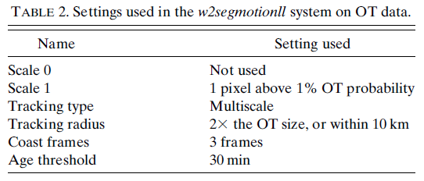
Methods: OT and CTD Comparison cont..
Warning Decision Support System-Integrated Information (WDSS-II) w2segmotionII tool.
  Settings shown in Table 2.
Determined if an OT detection was near local CTD max.
With the match rate and location differences established, time evolution of CTD was documented during the storms listed with respect to a variety of indicators of updrafts.

Slide 13
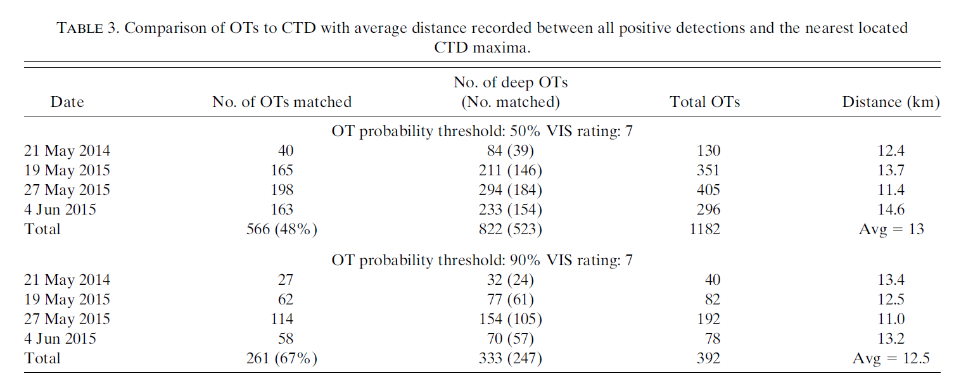
Results: OT and CTD comparison
~70%
~85%

Slide 14
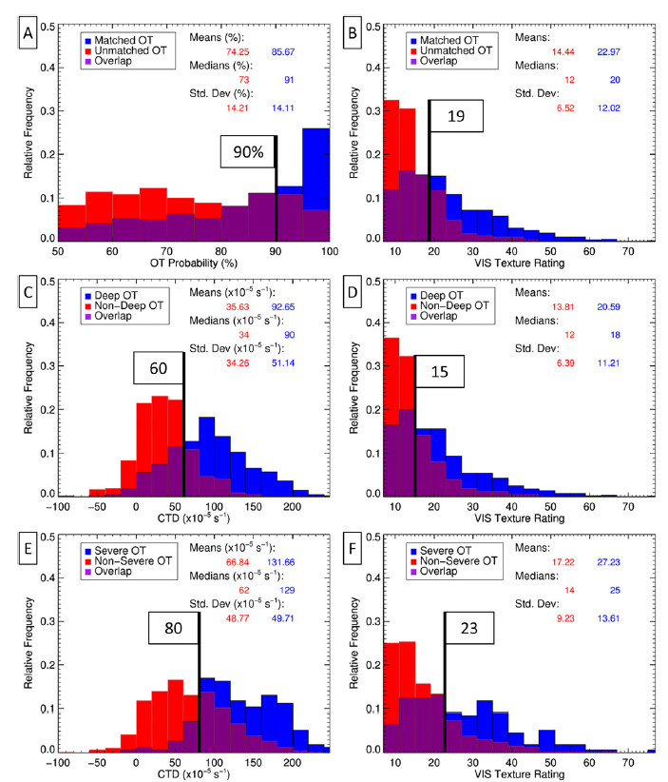
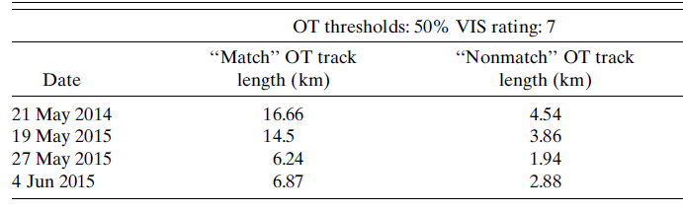
Results: OT and CTD comparison cont..
Matches had a higher-average OT probability and VIS texture rating.
CTD and average OT VIS texture rating were larger for deep OTs than nondeep OTS.
OT tracks without matching large CTD were ~1/3 of the distance length of tracks with.
  Suggests that the more an updraft protruded above the mean anvil altitude, the more likely is was to be deep and have large CTD.

Slide 15
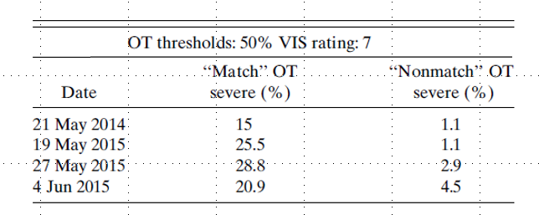
Results: OT and CTD comparison cont..
Tracks where OTs had matching CTD, ~25% met the severe criteria.
CTD and VIS texture rating was greater for severe versus nonsevere.
Median CTD was also larger for severe OTs than deep OTs.
Above a threshold value of CTD:
  A greater relative frequency of severe vs nonsevere OTs.
  A greater relative frequency of deep vs nondeep OTs.
Severe storms contain more prominent and persistent OTs that produce a stronger anvil outflow.

Slide 16
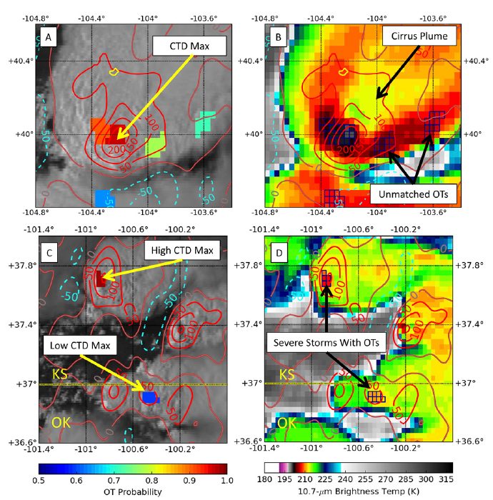
Results: OT and CTD comparison cont..
OT detections that weren’t deep nor severe were in regions:
  Of cold-anvil outflow downstream from the main updraft.
  In regions with T_{B} that look like OTs in an instantaneous view.
False OT patterns downstream of true OTs may form as a result of:
  Advection of cold cloud matter from the OT
  Collocation of cold cloud matter to the relatively warm above anvil cirrus
  Local gravity wave breaking
Missed events were frequently associated with small storms that may have been excessively smoothed using the RF system parameters.
  Example: a storm with distinctly weaker CTD maxima than a tornadic storm in Kansas, though it did produce large severe hail reports at the ground.

Slide 17
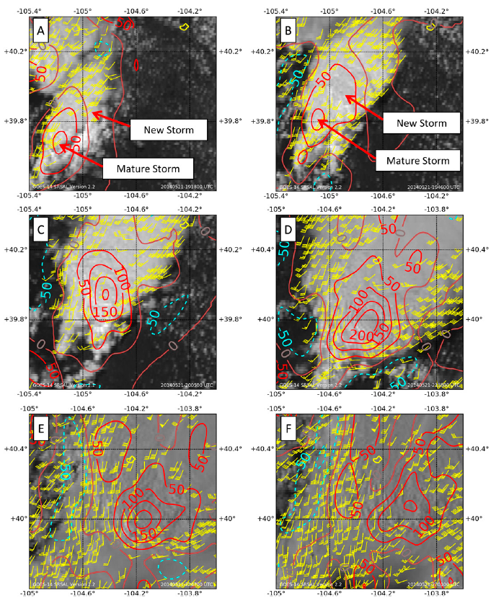
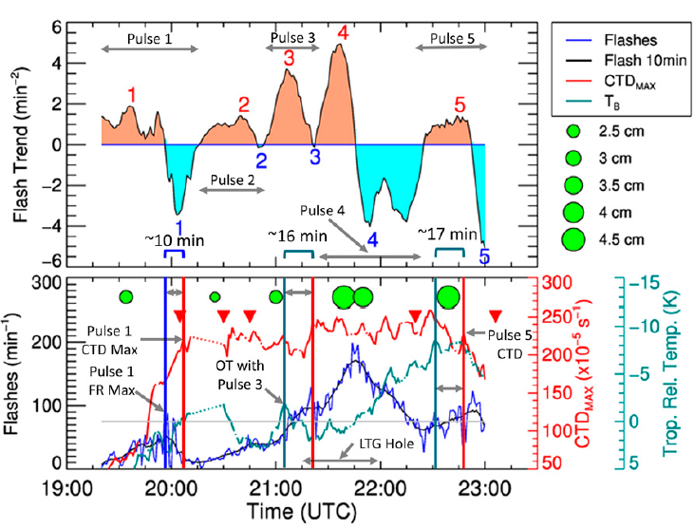
Results: The Adams County supercell analysis

Slide 18
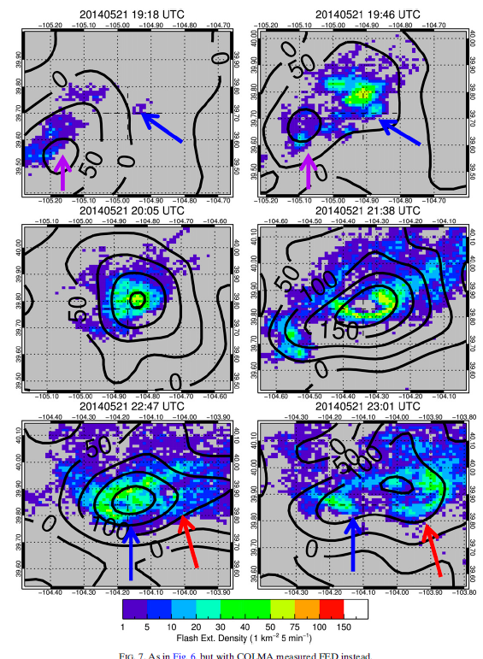
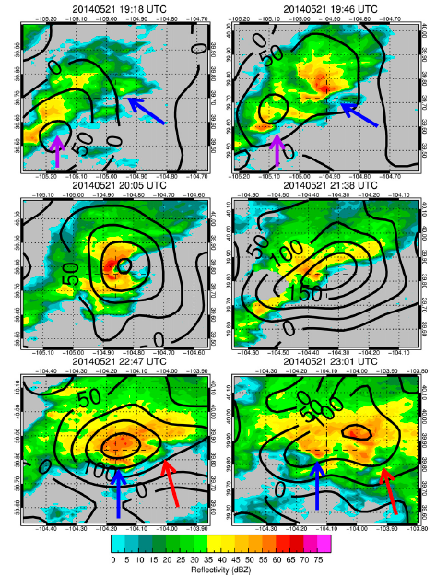

Slide 19
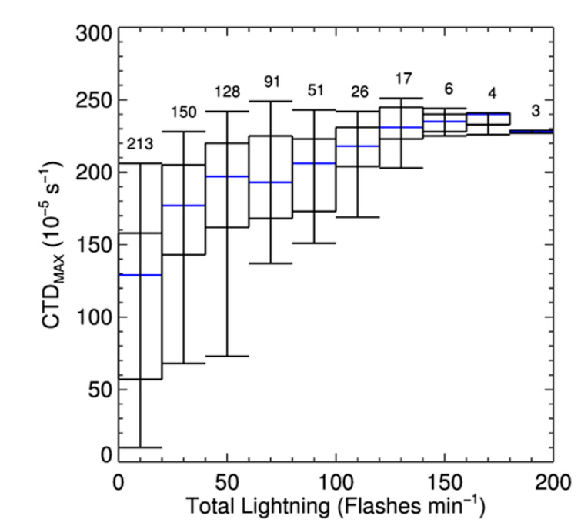
Results: All Case Studies FR ad CTD
Combining 3 of the case study’s total lightning and CTD, there is higher total lightning FRs in storms with higher CTD.
Lower FRs had higher CTD variance.
Suggests that strong updrafts with very high FRs have a higher likelihood of producing observable CTD.
  Weaker updrafts with lower FRs may not always be evident at cloud top.

Slide 20
Conclusion
The higher the OT probability, the taller (stronger) the updraft.
OTs with higher CTD and OT VIS texture ratings were indicative of updrafts from severe weather-producing storms.
This shows larger (diameter and amplitude) and persistent updrafts are more likely to produce detectable cloud-top outflow with SRSAL.
  Thus, OTs found within that detectable outflow were more likely to be severe.
The CTD median value for all deep OTs was lower that that for severe OTs.
  Implies that the severe OTs have stronger inferred updrafts than OTs that are merely deep.

Slide 21
Conclusion cont..
CTD should not be used alone to identify DC and internal updraft intensification.
  Derived CTD only identified ~2/3s of observable DC in this sample.
  It was also not correlated to total lightning FR when multiple updrafts of varying magnitude were present.
The mAMV-derived system output more than noise.
CTD used with OTs can help a forecaster identify primary updrafts.
CTD can be utilized as a separate yet complementary interest field to overcome deficiencies present in T_{B} cooling and total lightning FR detection.

Slide 22
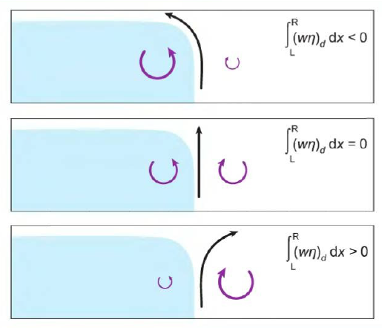
Rotunno-Klemp-Weisman (RKW)Theory
Goal: establish factors allowing a line oriented disturbance to mature into a long-lived system of precipitating cumulus convection.
They compare the Klemp-Wilhelmson Cloud model with observations.
RKW shows two factors affect the strength and orientation of the updraft that initiates the convection:
  Strong low level shear in environment (0-2.5km)
  Cold pool strength
“Balance” between the two = optimal state

Slide 23
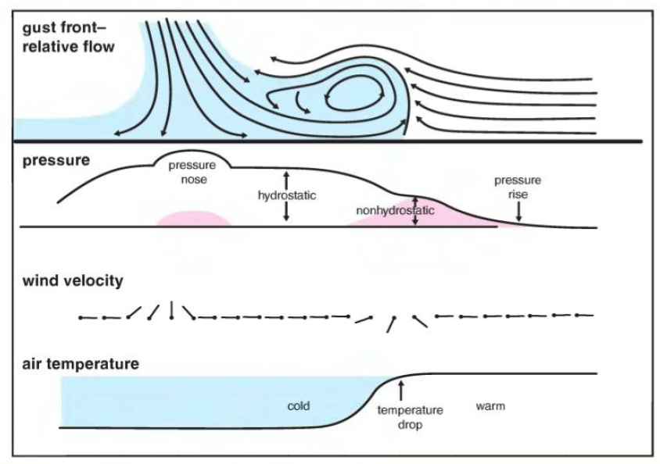
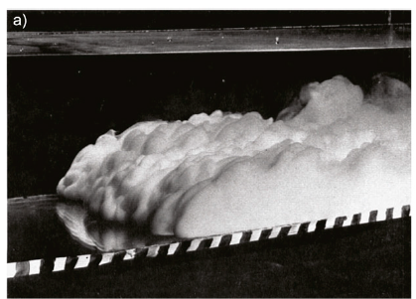
My Research: Background
Taken from Markowski and Richardson
The updrafts associated with density currents (a.k.a., gust fronts, cold pools) are important for initiating new, or sustaining existing, convective storms.
Climate models need to initiate new convection based on unresolved cold pool processes.
  Better understanding these processes will help us to parameterize climate models more accurately.
Our goal: To examine updraft sensitivity to variations in cold pool properties and environmental wind shear.
Specifically, we aim to characterize c, Δu and updraft strength (w) and orientation (𝜃).
Taken from Wilbanks et al. (2015)

Slide 24
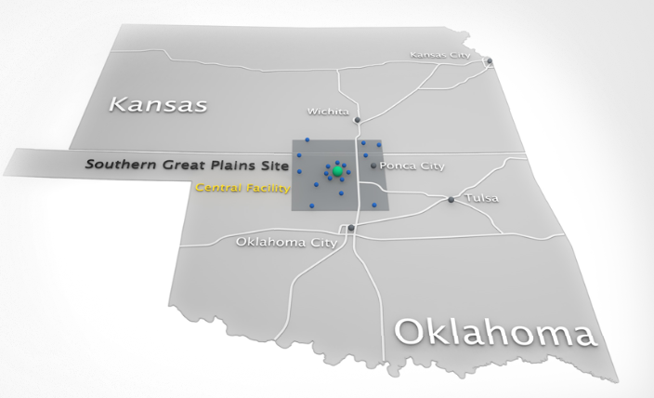
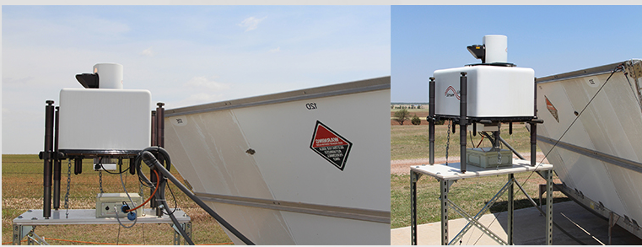
My Research: Methods
Data collected from the Southern Great Plains (SGP) atmospheric observatory in Oklahoma.
  The ARM Facility has more than 50 instrument platforms or suites.
    Lidars, Radars
    Surface meteorological instrumentation
Lots of afternoon deep convection.
Both images taken from https://www.arm.gov/capabilities/observatories/sgp

Slide 25
My Research: Methods cont..
Following Markowski and Richardson (2010) we transform observed wind profiles into a front relative coordinate:
  Vertical wind profiles are examined spanning the density current passage.
  Density current speed and direction are defined 30 minutes after the frontal passage.
  A coordinate rotation is performed based on the propagation direction.
  Frontal speed is subtracted from all observed winds.
  This allows us to:
    Examine the pre frontal wind shear (Δu).
    Diagnose the height of the density current core (h).

Slide 26
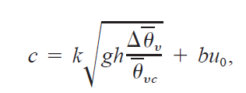
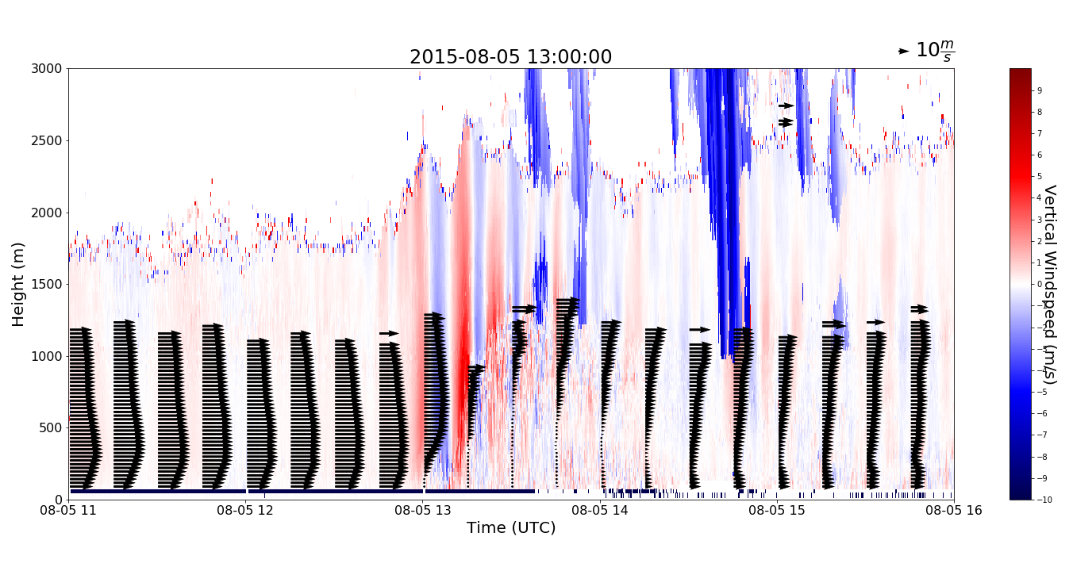
My Research: Methods cont..
Δu
Δu
h

Slide 27
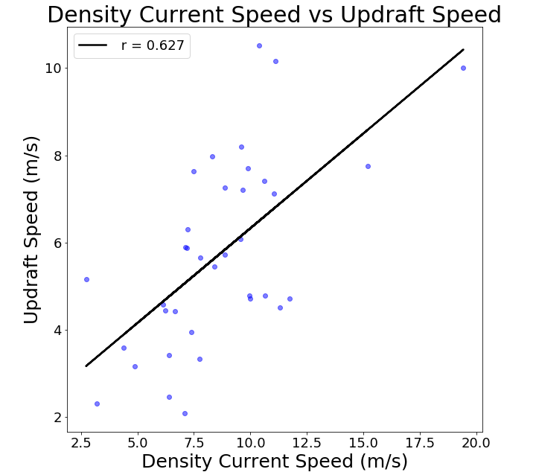
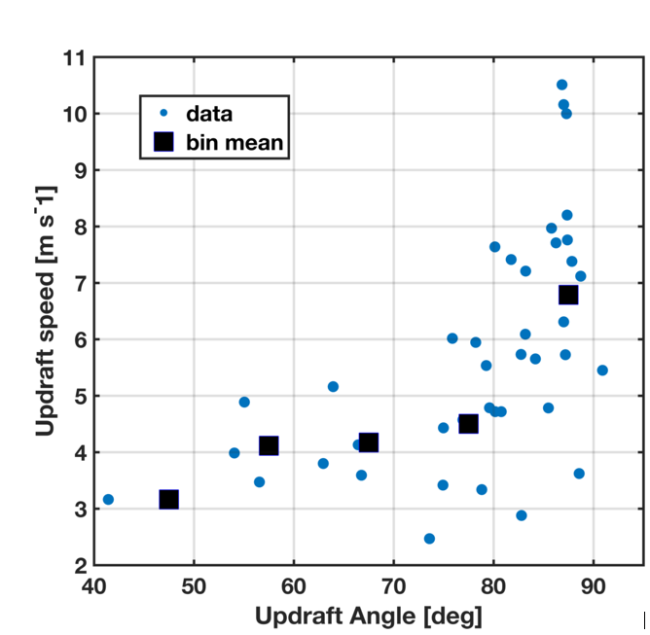
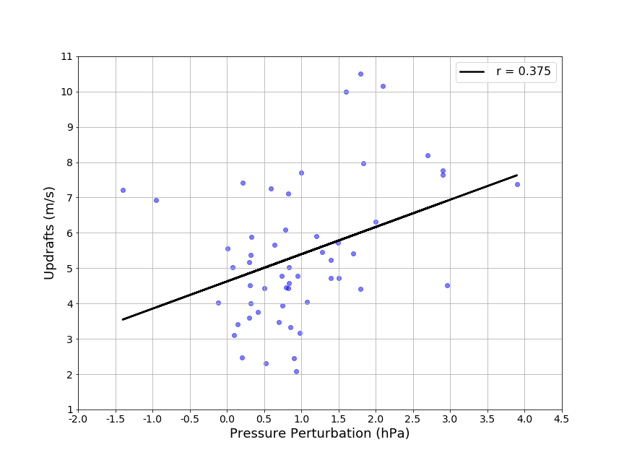
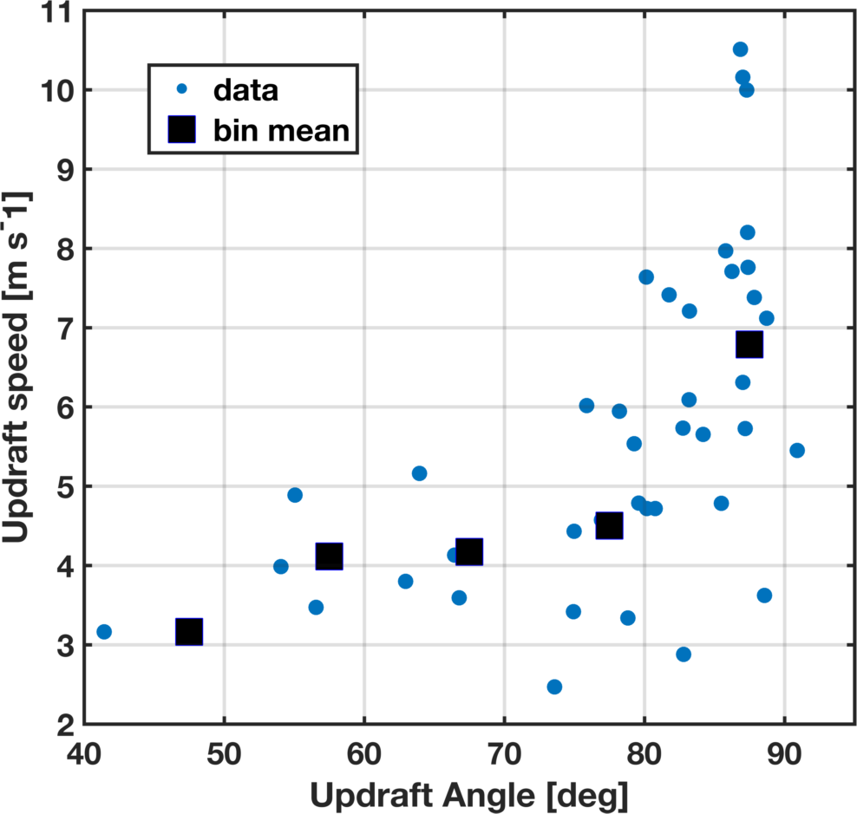
My Research: Preliminary Results
Correlations between density current properties and environmental properties with updraft characteristics were attempted.
Many problems arise when comparing observations to modeling and laboratory studies.
  Δu, p’, c etc.
We plan to physically show RKW theory as well as diagnose other physical parameters that may affect updrafts, and therefore convection.
p‘ vs Updraft Speed
Updraft Angle vs Updraft Speed

Slide 28
Final Conclusions
Climate models need to be able to initiate new convection based on cold pool processes, but climate models don’t actually resolve cold pools.
  Therefore they need to be parameterized.
  Finding basic physical processes will help us to determine updrafts.

Slide 29
References
Bedka, K. M., and J. R. Mecikalski, 2005: Application of satellite derived atmospheric motion vectors for estimating mesoscale flows. J. Appl. Meteor., 44, 1761–1772, https://doi.org/10.1175/JAM2264.1.
Bedka, K. M., and K. Khlopenkov, 2016: A probabilistic multispectral pattern recognition method for detection of overshooting cloud tops using passive satellite imager observations. J. Appl. Meteor. Climatol., 55, 1983–2005, https://doi.org/10.1175/JAMC-D-15-0249.1.
Rotunno, R. (1988). A Theory for Strong, Long-Lived Squall Lines. Journal of the Atmospheric Sciences, 45(3), 463
Apke, J. M., J. R. Mecikalski, and C. P. Jewett, 2016 : Analysis of mesoscale atmospheric flows above mature deep convection using super rapid scan geostationary satellite data. J. Appl. Meteor. Climatol., 55, 1859 – 1887, https://doi.org/10.1175/JAMC-D-15-0253.1.
Apke, J. M., J. R. Mecikalski, K. M. Bedka, E. W. McCaul, C. R. Homeyer, and C. P. Jewett, 2018 : Relationships between deep convection updraft characteristics and satellite based Super Rapid Scan mesoscale atmospheric motion vector derived flow. Mon. Wea. Rev., https://doi.org/10.1175/MWR-D-18-0119.1, in press.

