Slide 1
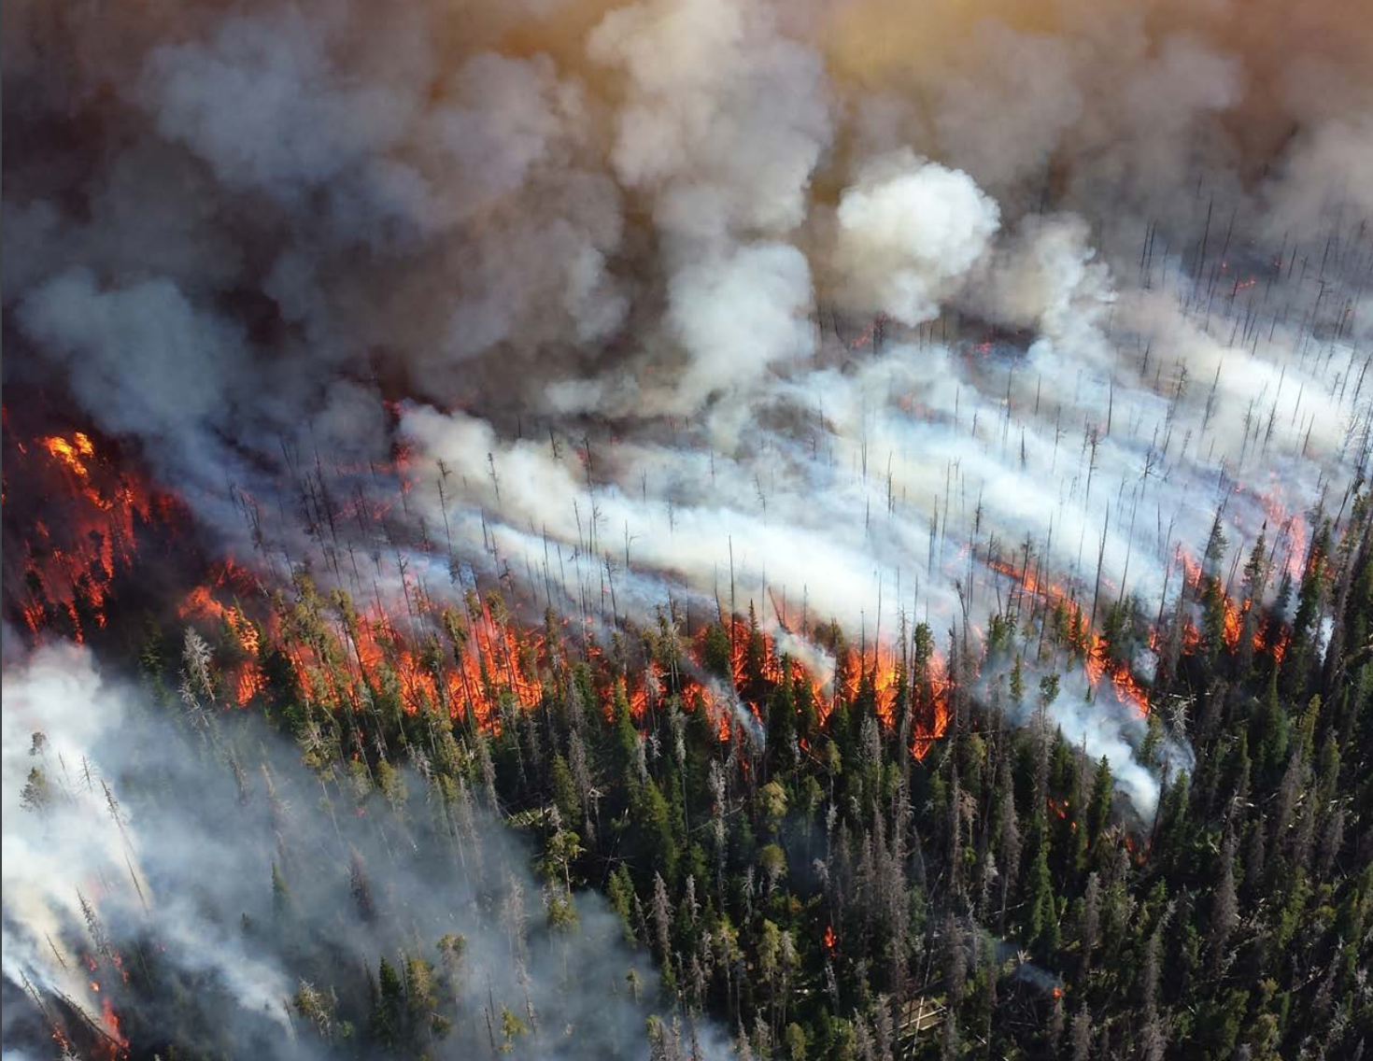
Western Wildfires A Fiery Future
Presented by: Skylar Smith

Slide 2
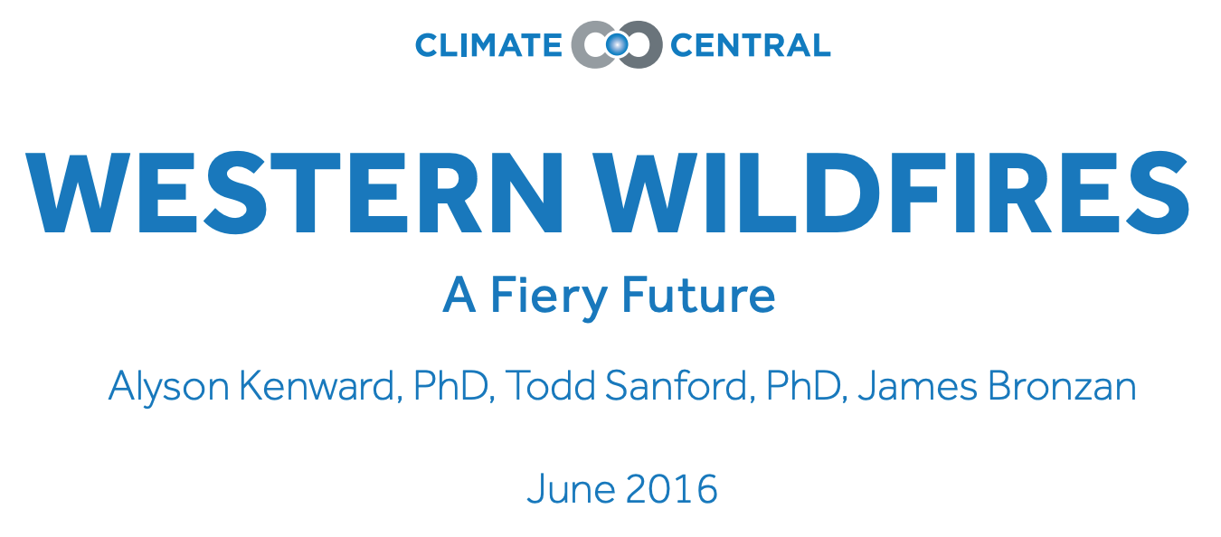

Slide 3
Outline
Who is Climate Central?
Introduction
Western Wildfire Trends
Hotter Temperatures and Changing Snowpack
Future of Western Wildfires
State Wildfire Trends
Methodology
Conclusion
References

Slide 4
Who is climate central?
Independent organization of leading scientists and journalists researching and reporting facts about our changing climate (only facts and findings)
Survey and conduct scientific research on climate change
Not an advocacy organization; do not lobby or support any specific legislation, policy, or bills
Publish peer-reviewed research
Investigate and synthesize weather, climate data, and science to help local communities and media

Slide 5
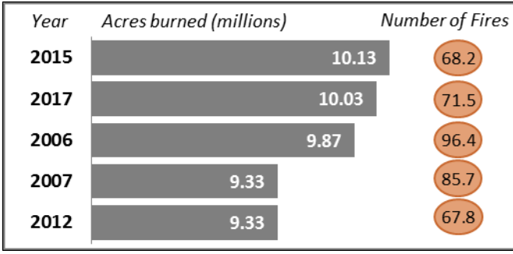
Introduction
2015 wildfire season was the worst on record with 10 million plus acres burned (2017 came in 100,00 acres short)
Alaska was over half with 5.1 million acres burned in 2015
Not just random fires but wildfires are becoming more prevalent with climate change
Since the 1970s, wildfires in the western US have dramatically increased
Snowpack melts earlier, temperature rising, snow falling as rain more, more hot days leading to grasslands drying out
NIFC

Slide 6
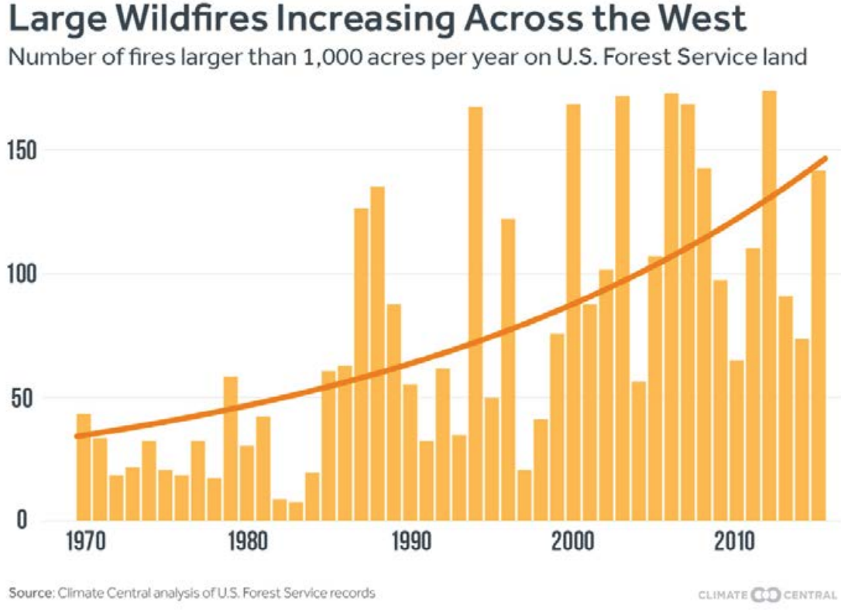
Introduction
Analysis of 45 years of U.S. Forest System Service records
Number of large fires on Forest Service land increased dramatically
Western U.S. average annual number of large fires has tripled from 1970-2015
Current fire seasons are
105 days longer compared
to in 1970 which can lead
to year round fire seasons
eventually

Slide 7
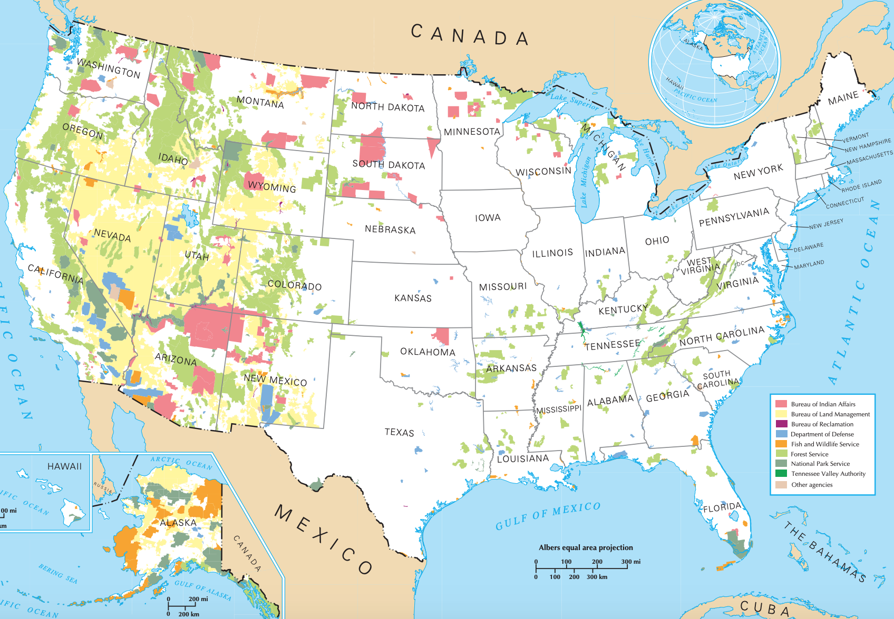
Introduction
nationalatlas.gov

Slide 8
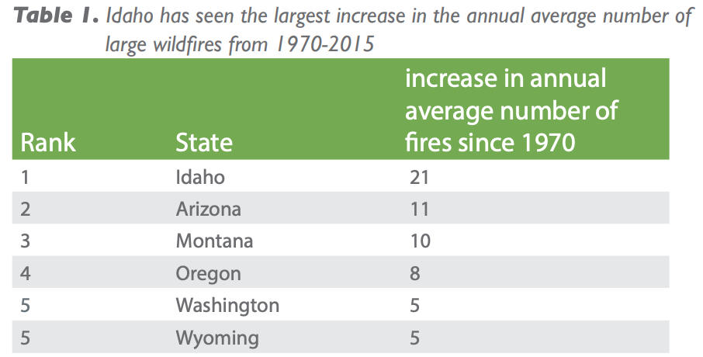
Western Wildfire trends
According to research, climate is the largest driver in the increase of areas burned by wildfires
Average number of large fires on U.S. Forest Service land has increased 10 times more in the Northern Rocky Mountain states (Wyoming, Idaho, Montana)

Slide 9
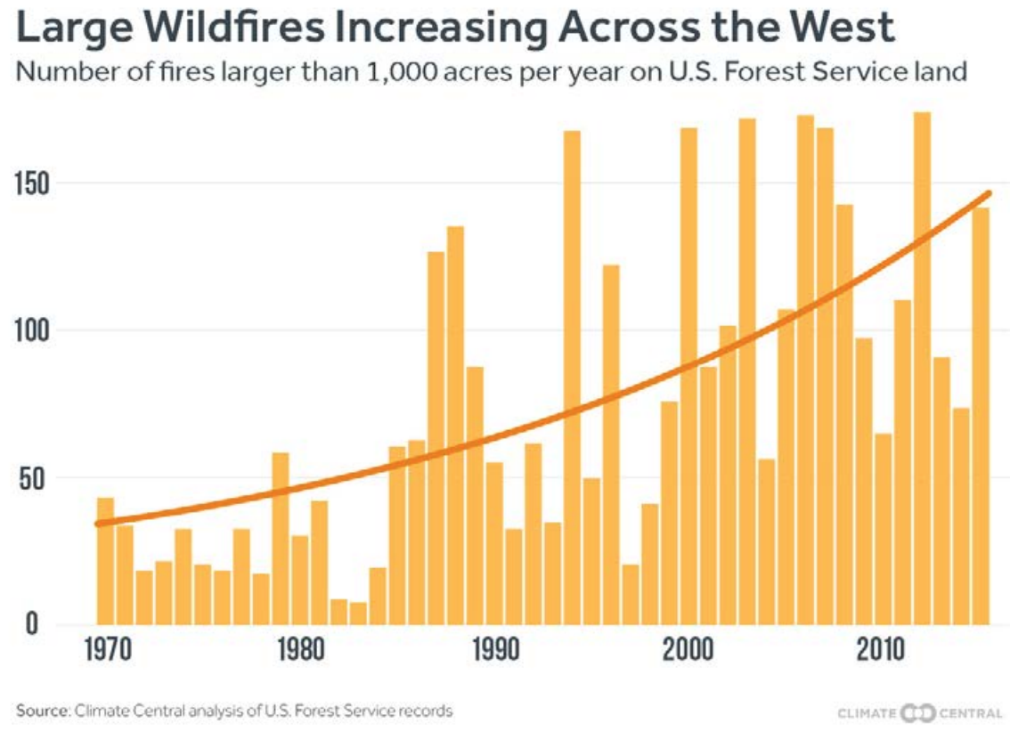
Western Wildfire Trends

Slide 10
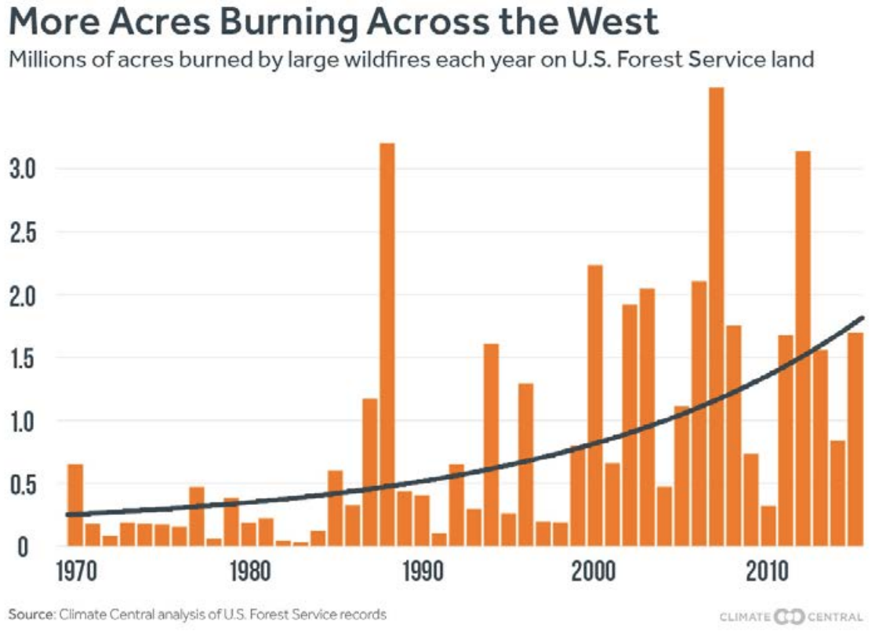
Western wildfire trends

Slide 11
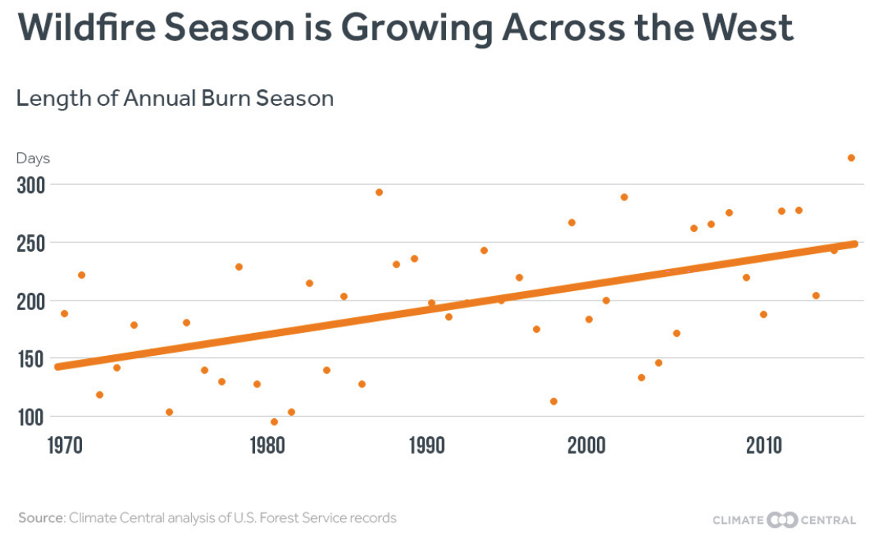
Western wildfire trends

Slide 12
Western wildfire trends
Wildfire Impacts
~1100 firefighters have died since 1910 fighting wildland fires
Granite Mountain Hotshots 19 died in 2013
2015 was the costliest wildfire season for U.S. Forest Service ($1.7 billion)
2017 is now the highest with an estimated $2.7 billion and 2018 could be even higher (both have not come out with exact numbers)
Smoke can lead to respiratory and cardiovascular issues

Slide 13
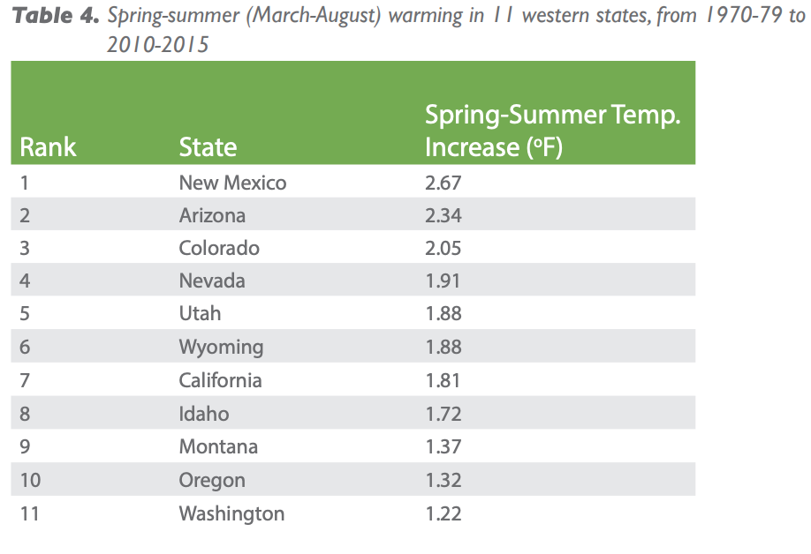
Hotter temperatures and changing snowpack
Western U.S. Temperature Trends
In the West, summer temps have gone up 2.1 degrees F (~half a degree per decade) since 1970
New Mexico, Arizona, and Colorado have had the fastest warming rates

Slide 14
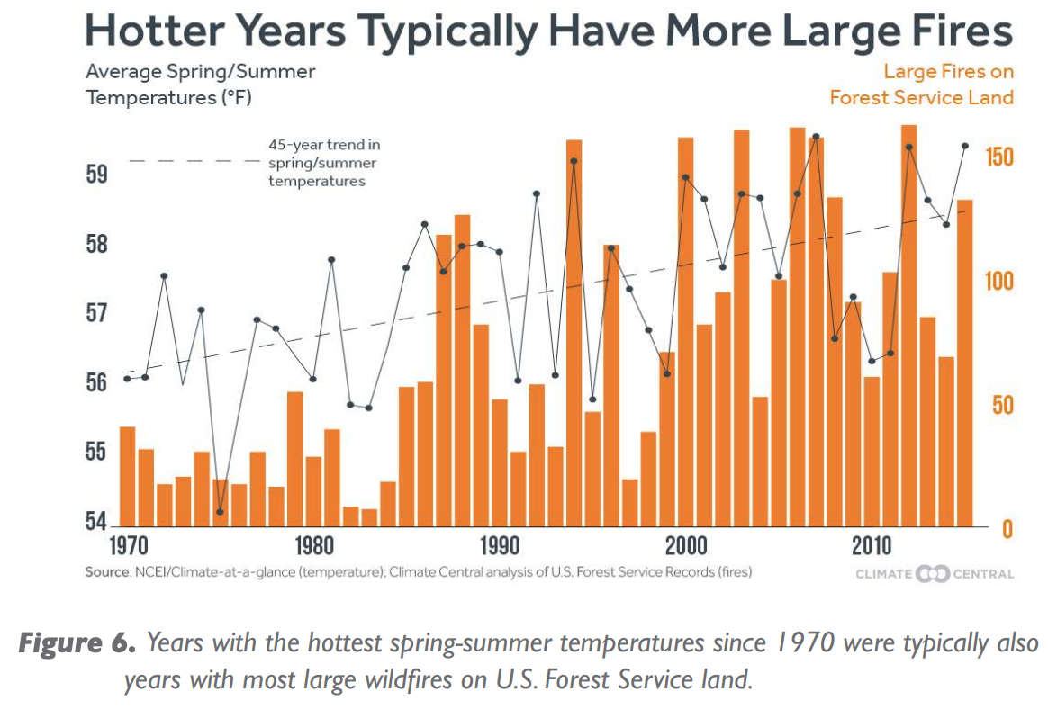
Hotter temperatures and changing snowpack

Slide 15
Hotter temperatures and changing snowpack
Changing Snowpack Trends
Increasing percentage of winter precip is falling as rain across much of the West
Less snowpack means ground dries out sooner
Years with higher wildfire frequency were also years with low snowpack especially in the Northern Rockies
77% of Oregon’s mountain weather stations have reported a decrease in precip falling as snow

Slide 16
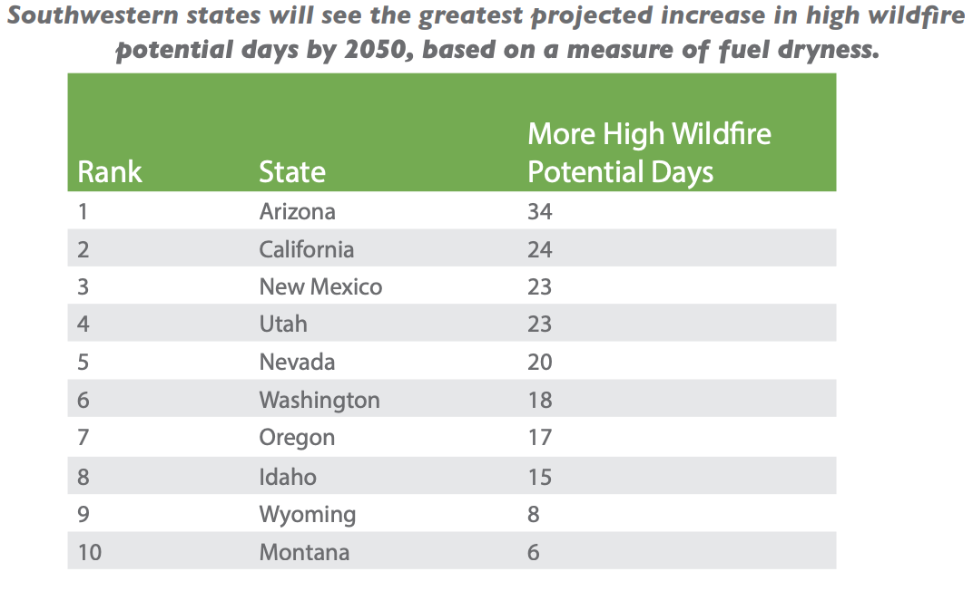
Future of western wildfires
Analysis relies on Keetch-Bryam Drought Index (KBDI)
Measures dryness for the top 8 inches of forest floor
Used as indicator for wildfire potential and to predict fire danger
Scale 0-800
Days with KBDI above 600 will significantly increase from
now until 2050 in
the 10 western states
examined if greenhouse
emissions continue
without significant
decrease (potentially
up to 46% increase)

Slide 17
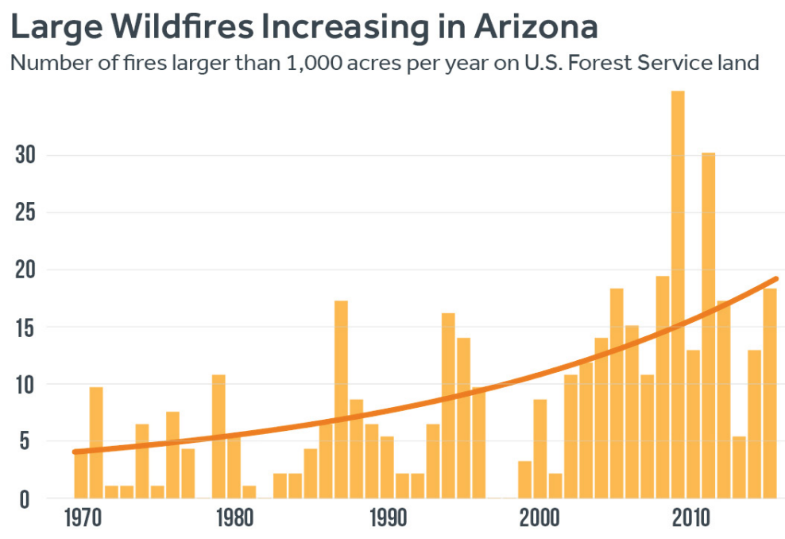
Arizona
Largest increase in number of large fires and area burned
2010-2015 average of 11 more large wildfires a year compared to 1970

Slide 18
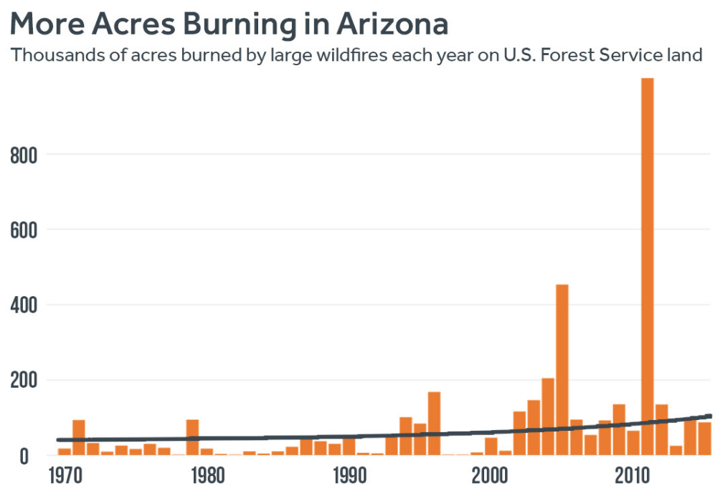
Arizona
2.3 degrees F increase for average spring and summer temperatures
Second largest increase among western states
Projected to see largest increase among western states in days with high wildfire potential

Slide 19
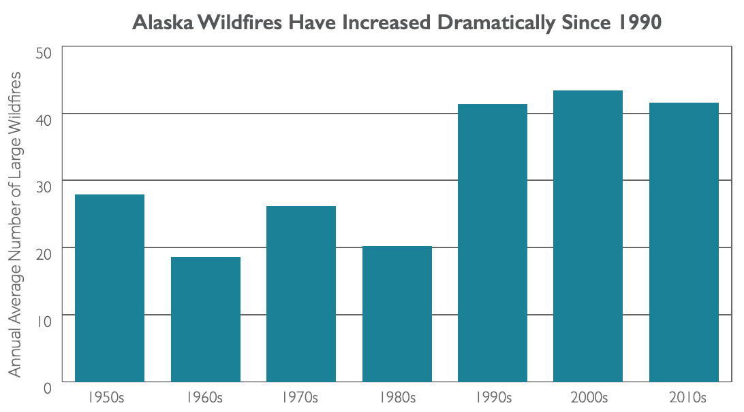
Alaska
More area burning in wildfires than any other state
42 more large wildfires each year on federal land since 1950s
~350,000 more acres burn in Alaska each year on average
Double the number of acres burning since 1950s

Slide 20
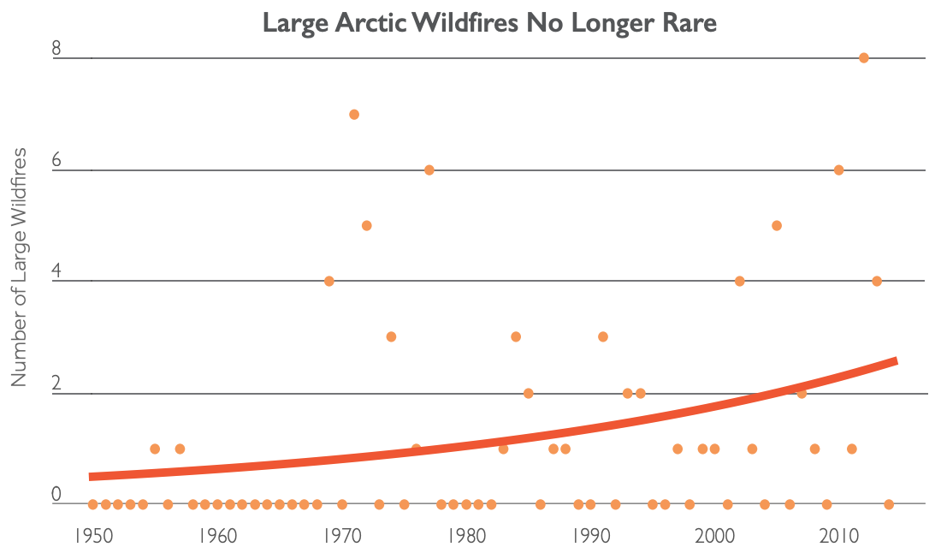
Alaska
Large artic wildfires are not rare anymore
Potentially putting large stores of carbon in permafrost and tundra soils at risk

Slide 21
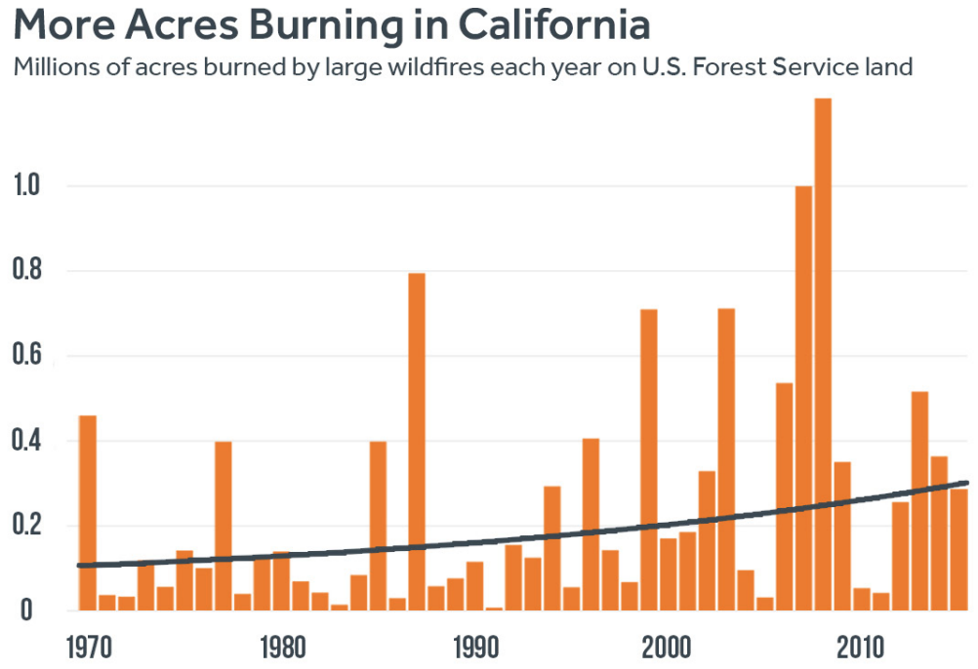
California
Average of 94,000 acres more burn in large wildfires on U.S. Forest Service land since 1970s
~3 more large wildfires since 2010 every year

Slide 22
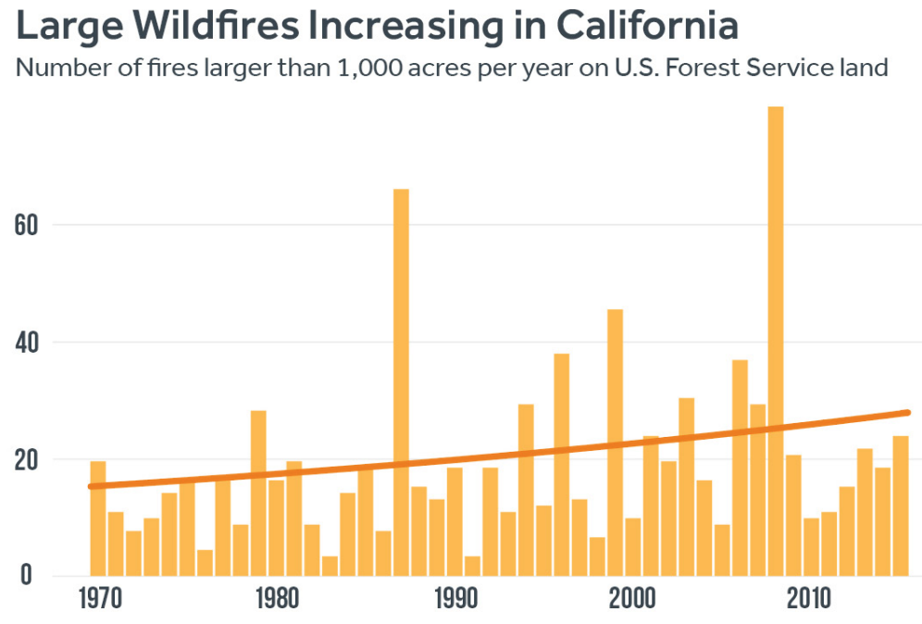
California
Spring and summer temps have increased by 1.8 degrees F since 1970s
By 2050, projected to have 24 more days with high wildfire potential compared to in 2000

Slide 23
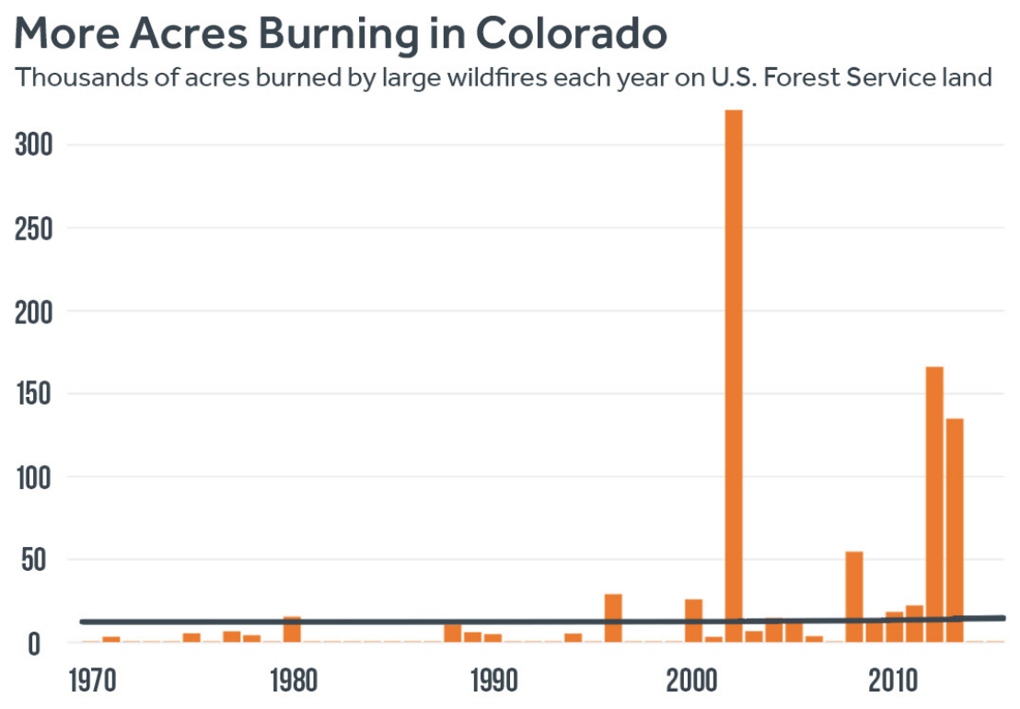
Colorado
Largest increase in number of large fires and acreage burned since 1970s
Spring and summer temps increased by 2.05 degrees F since 1970s (3rd largest increase among western states)
2010-2015: 30 times more acres burned by large wildfires compared to 1970s

Slide 24
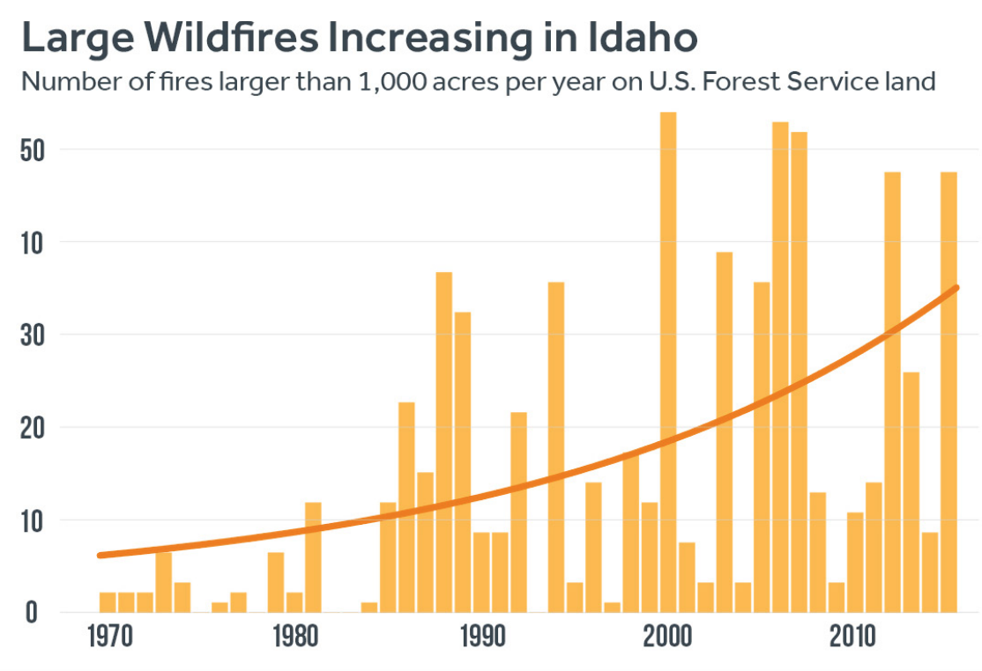
Idaho
~21 more large fires compared to 1970
Largest increase among western states
Ranks first in increase of area burned, 305,000 more acres compared to 1970s
Number of high wildfire days projected to quadruple by 2050

Slide 25
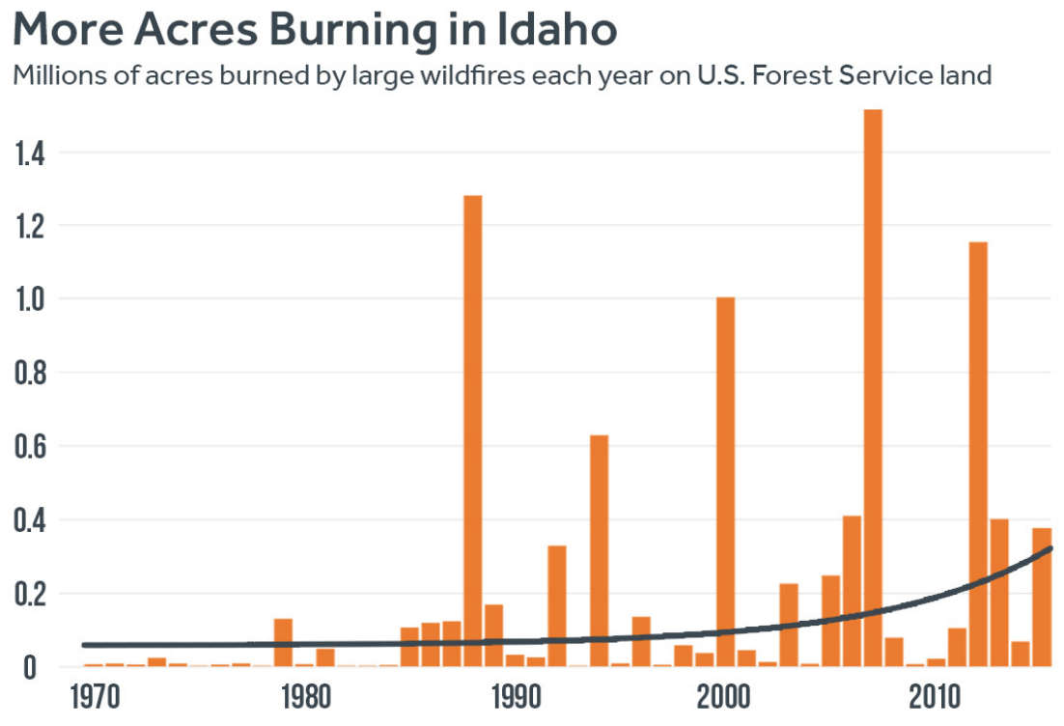
Idaho
Fires impact timber industry most
Spring and summer temps have increased by 1.72 degrees F since 1970s

Slide 26
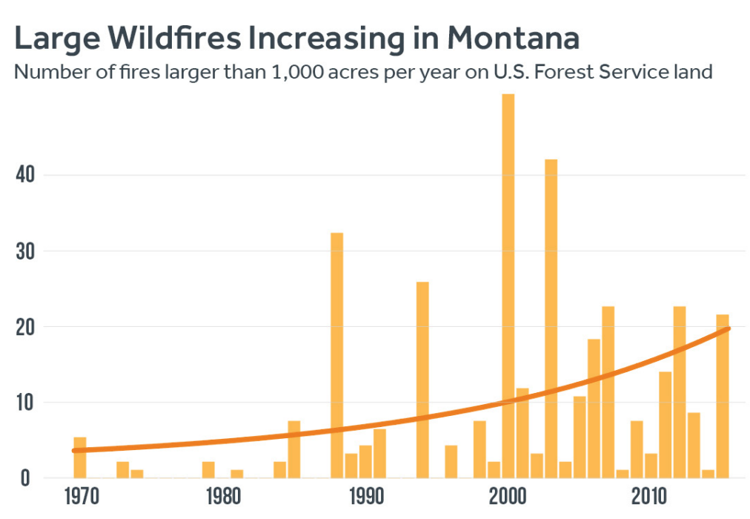
Montana
Larger percentage increase in number of large wildfires compared to any other western state
Over past 5 years, ~10 more large wildfires burning each year since 1970s

Slide 27
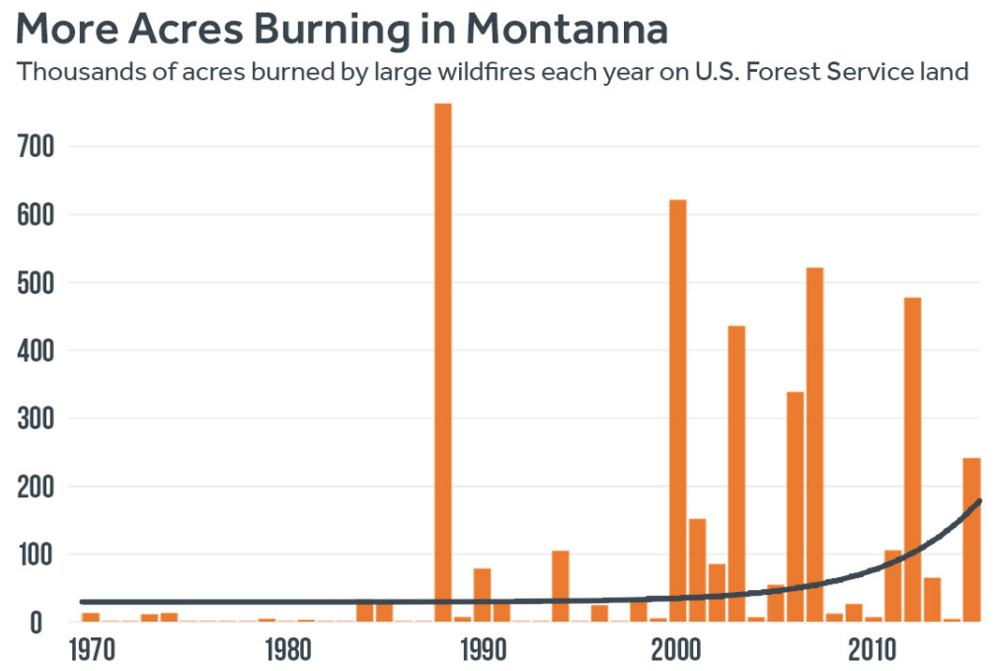
Montana
~134,000 more acres burn compared to 1970s
Spring and summer temps increased by 1.37 degrees F since 1970s

Slide 28
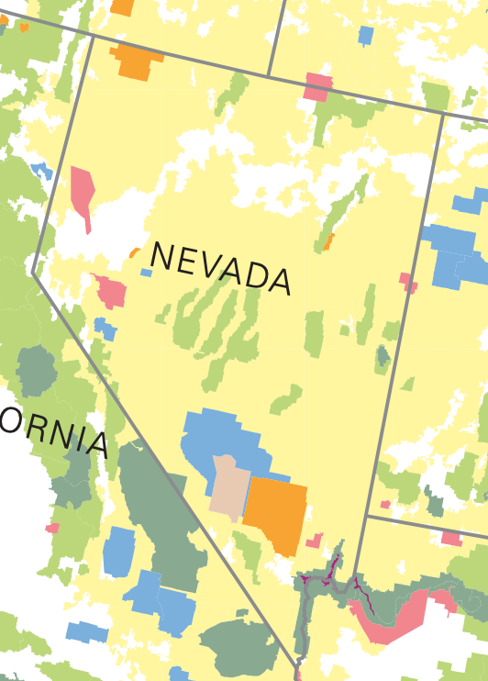
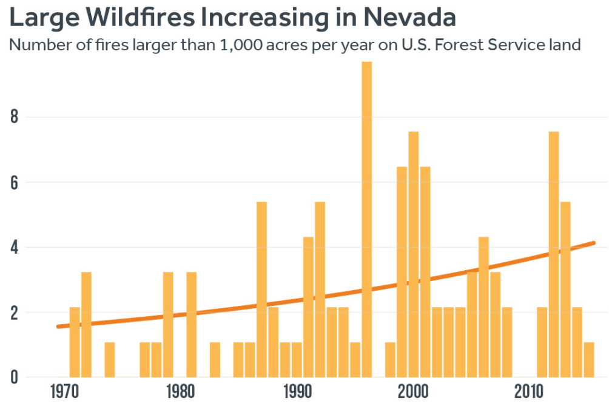
Nevada
Projected to see ~20 more days of high wildfire potential by 2050
From 2010-2015 there was an increase of 2 more large wildfires each year since 1970s

Slide 29
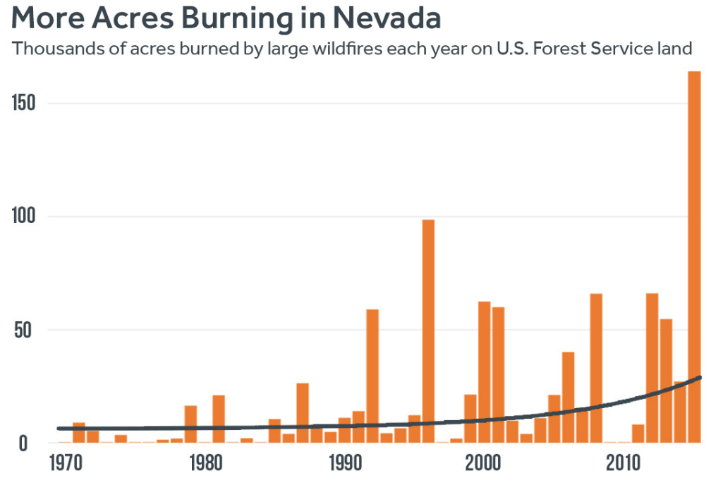
nevada
Spring and Summer temps have increased by 1.91 degrees F since 1970s
~45,000 more acres burn compared to 1970s

Slide 30
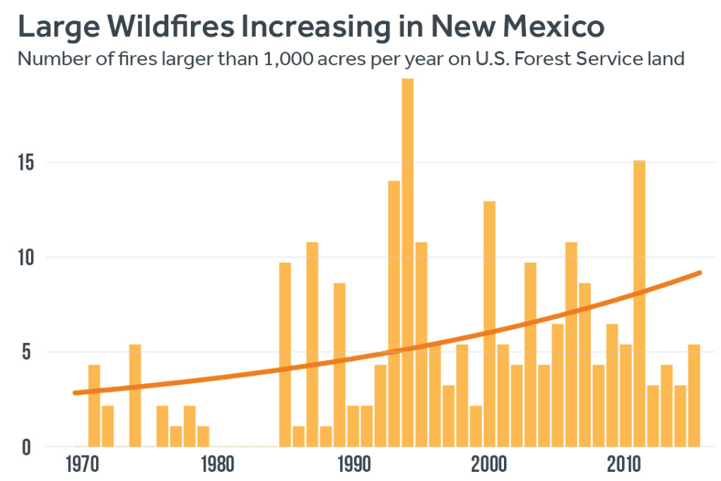
New Mexico
Projected to see 23 more high wildfire days by 2050
From 2010-2015, ~4 more large wildfires each year since 1970s

Slide 31
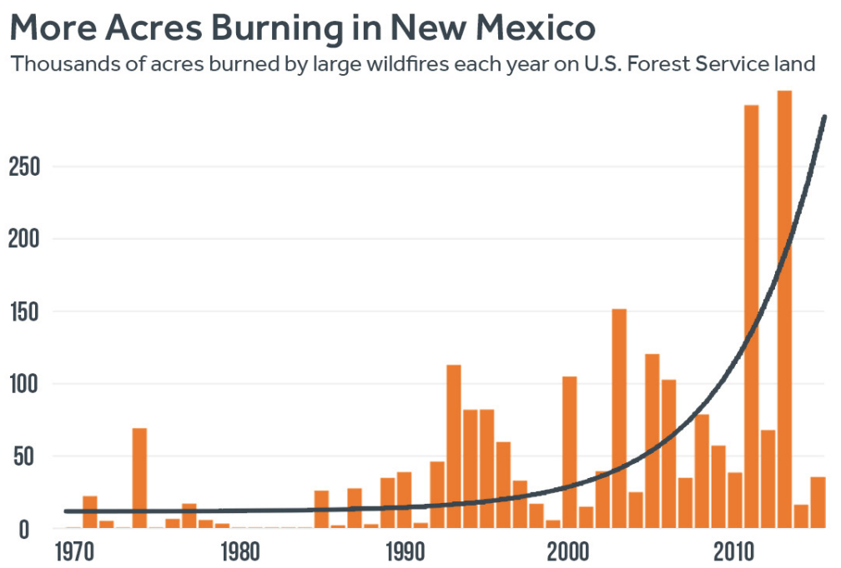
New mexico
Spring and summer temps increased by 2.67 degrees F since 1970s
Largest increase among western states
~104,000 more acres burn each year in large wildfires

Slide 32
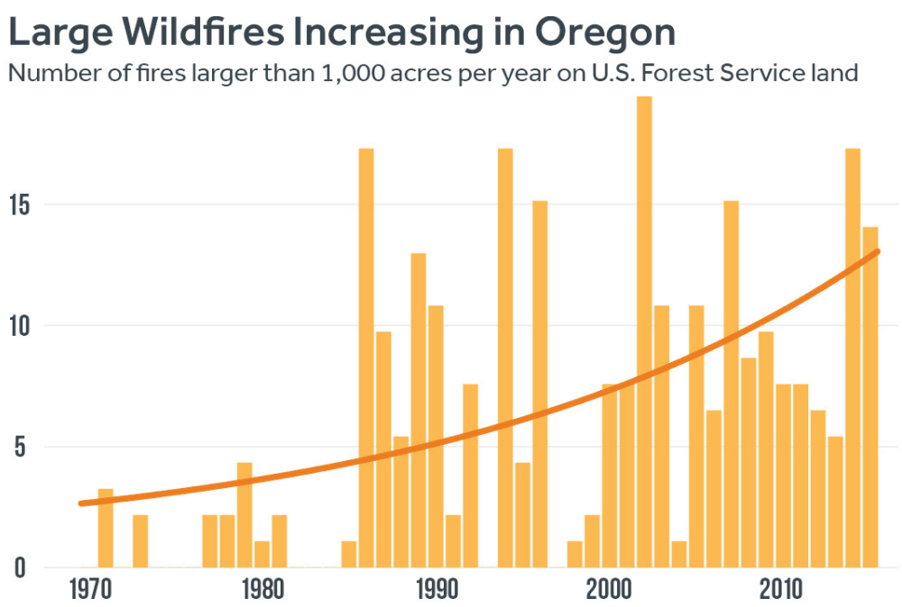
Oregon
~8 more large wildfires burning each year since 1970s
Projected to see 17 more days with high wildfire potential by 2050

Slide 33
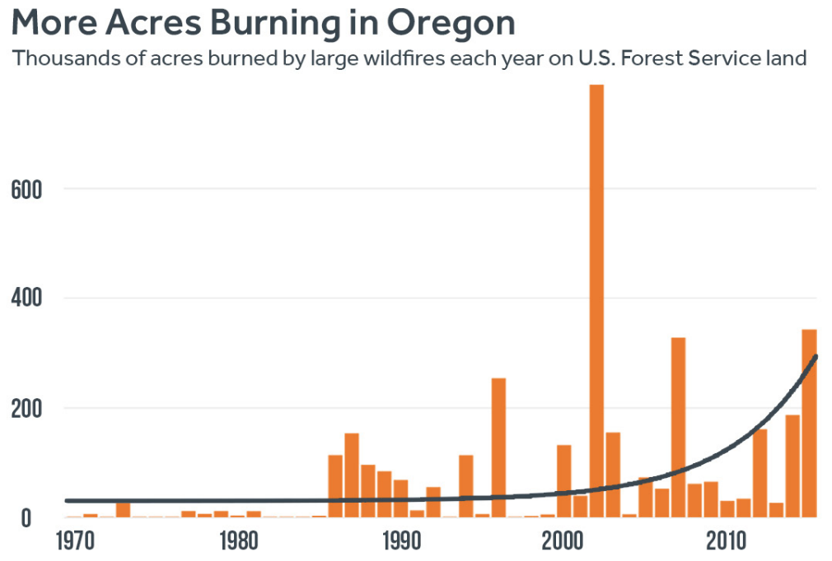
Oregon
~114,000 more acres burning each year
Spring and summer temps increasing by 1.32 degrees F since 1970s

Slide 34
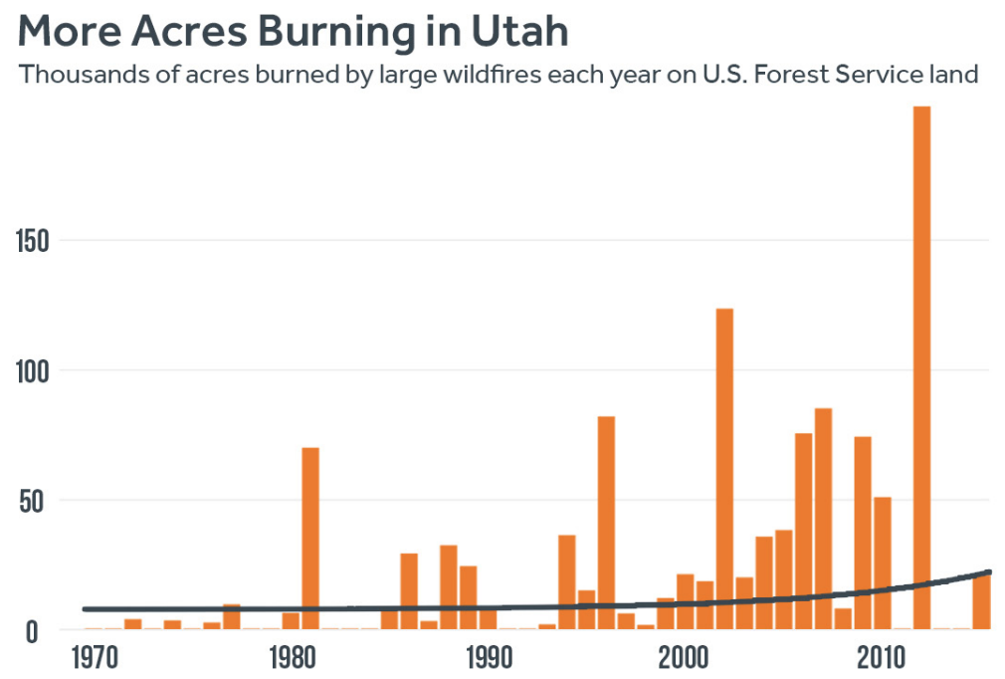
Utah
~2 more large wildfires each year compared to 1970s
~40,000 more acres burning in large wildfires since 1970s

Slide 35
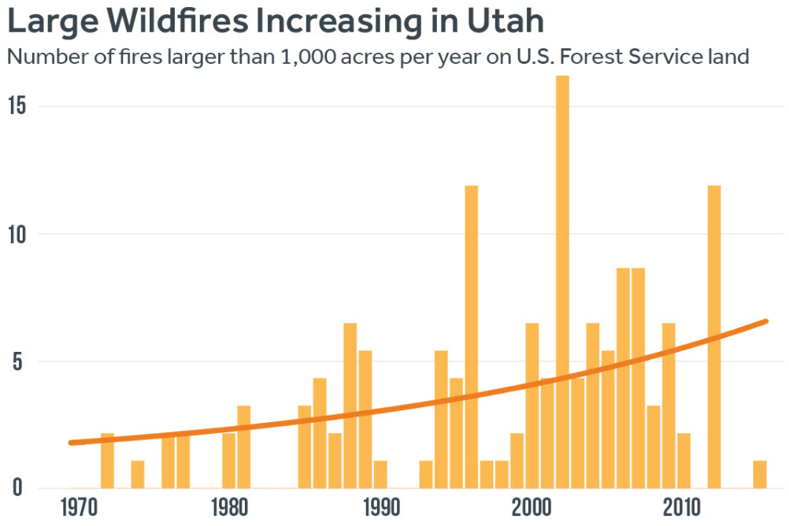
Utah
Projected to see 23 more days each year with high wildfire potential
Spring and Summer temps have increased 1.88 degrees F since 1970s

Slide 36
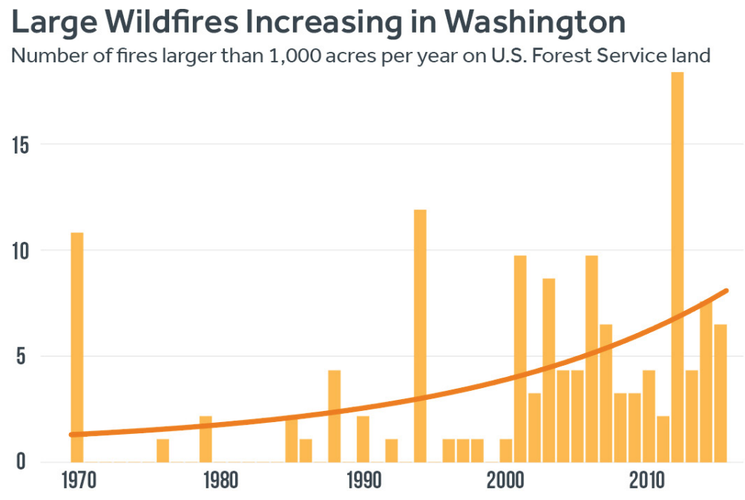
washington
Triple the number of high wildfire potential days by 2050 compared to 2000
Average 5 more large wildfires burning compared to 1970s

Slide 37
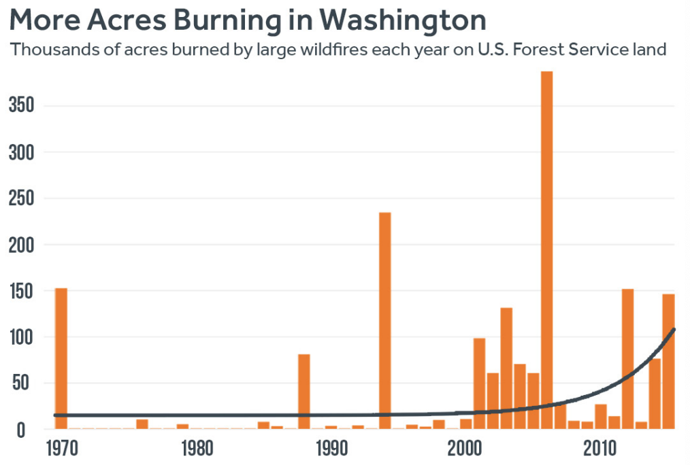
washington
Average of 49,000 more acres burning each year on Forest Service land compared to 1970s
Spring and Summer temps have increased by 1.22 degrees F since 1970s

Slide 38
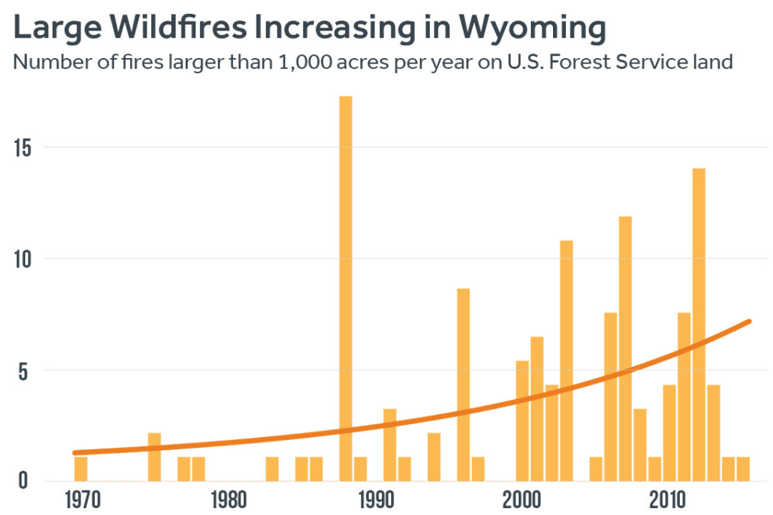
wyoming
Average of 10 times more large wildfires compared to 1970s
~5 more large wildfires burning each year since 1970s
Projected to see 8 more high wildfire potential days each year by 2050

Slide 39
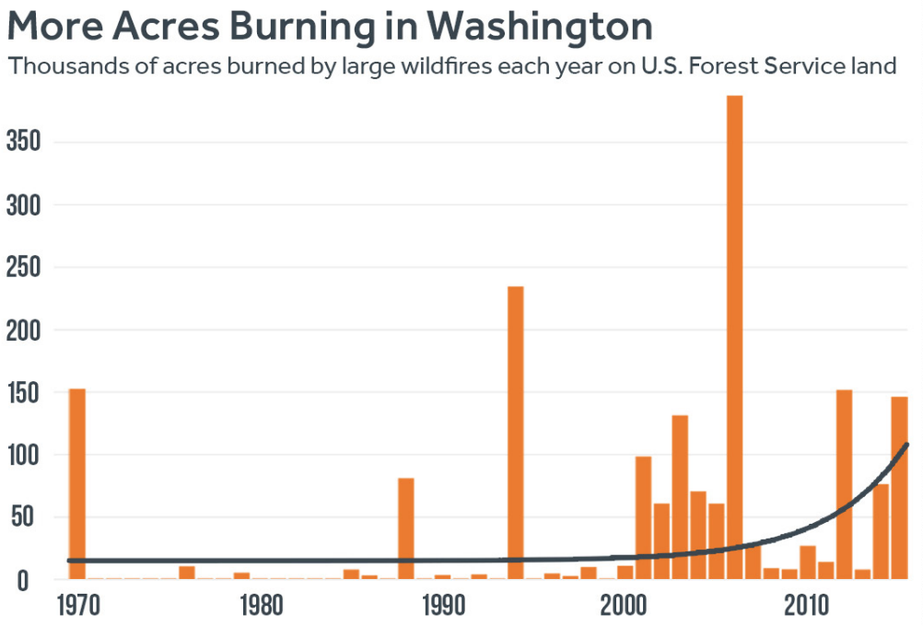
wyoming
Average of 63,000 more acres burning
50-fold increase
Spring and summer temps increased 1.88 degrees F since 1970s

Slide 40
Methodology
Wildfire trend analyses followed a previously published methods from The Age of Western Wildfires and The Age of Alaskan Wildfires
“These wildfires represent a significant percent of the total area burned each year in western wildfires, and thus they are a suitable representative of overall wildfire trends.”
Temperature trends came from data collected from the National Centers for Environmental Information

Slide 41
Conclusion
Overall, there will be more large wildfires burning each year and temperatures increasing and snowpack decreasing will enhance these large wildfires
Could paper be published in a typical peer reviewed journal?
It has potential but needs some work
There are few spelling errors and incorrect words
Needs to clarify more about Forest Service land vs all other burning land
5 of only 13 references are Climate Central

Slide 42
References
“Total Wildland Fires and Acres (1926-2017).” National Interagency Fire Center, www.nifc.gov/fireInfo/fireInfo_stats_totalFires.html.
The National Atlas of the United States of America. “Printable Maps.” Printable Maps - Federal Lands, nationalmap.gov/small_scale/ printable/fedlands.html.
Climate Central, 2016: Western Wildfires A Fiery Future. Princeton,NJ. http://assets.climatecentral.org/pdfs/westernwildfires2016v2.pdf
“Facts + Statistics: Wildfires.” Insurance Information Institute, www.iii.org/ fact-statistic/facts-statistics-wildfires.

Slide 43
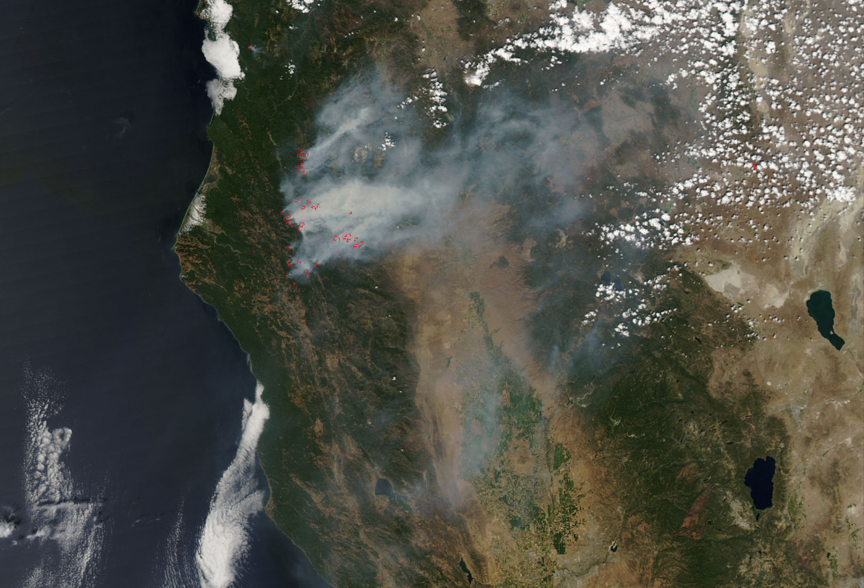
Questions?

