Slide 1

On the role of the Atlantic Ocean in forcing tropic cyclones in the Arabian Sea
Wei Zhang, Gabriele Villarini
2019
Siying Lu Feb. 25
This presentation is based on Zhang. Wei, Villarini. Gabriele (2019) On the role of the Atlantic Ocean in forcing tropic cyclones in the Arabian Sea. Atmospheric Search 220(2019), 120-124.

Slide 2

Outline
Reasons for choosing this paper
Pre-Introduction
Data & Methods
Results
Summary
Reference

Slide 3

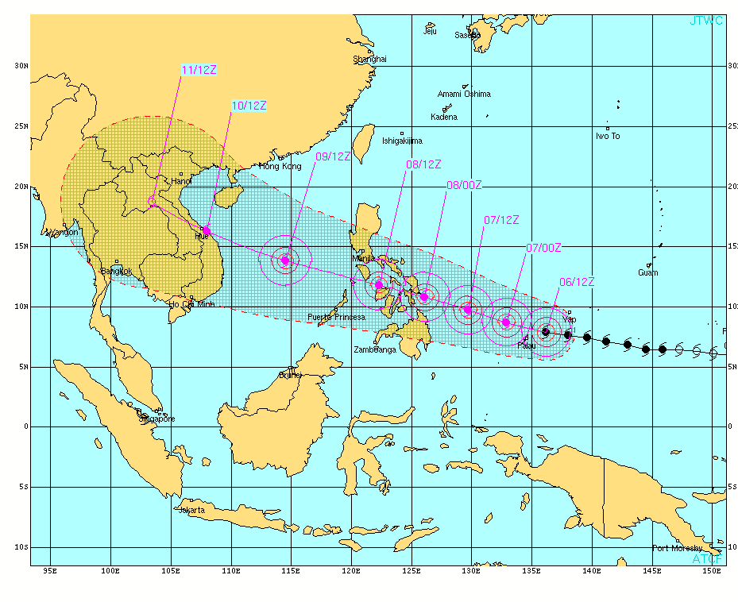
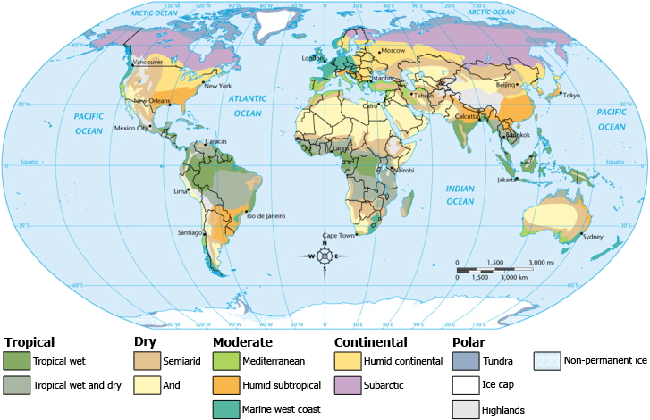
Why?
Reasons for choosing this paper
Climate & Meteorology
Typhoon
Notes:
I am interested in climate and meteorology, and I want to do my thesis about weather phenomena or the relationship about weather and climate. The second reason why I chose this paper is that I did my bachelor thesis about super typhoon Haiyan, so I am also interested in typhoon.
Introduce details about these pictures…make these pictures clear

Slide 4
Overview
Sea Surface Temperature (SST) anomalies in tropical South Atlantic Ocean
Frequency of tropic cyclones (TCs) in Arabian Sea
Pre-monsoon season (May-June)
Observations & Climate model experiments
Notes:
This study told us the impacts of (SST) anomalies in tropical South Atlantic on the frequency of the Arabian Sea tropical cyclones (TCs) during the pre-monsoon season (May–June) by using observations and climate model experiments.

Slide 5

?
Where is the Arabian Sea?
Did you ever notice the TCs in the Arabian Sea?
Notes:
Do you know where is the Arabian Sea? And did you ever notice the tropical cyclones in the Arabian Sea?

Slide 6
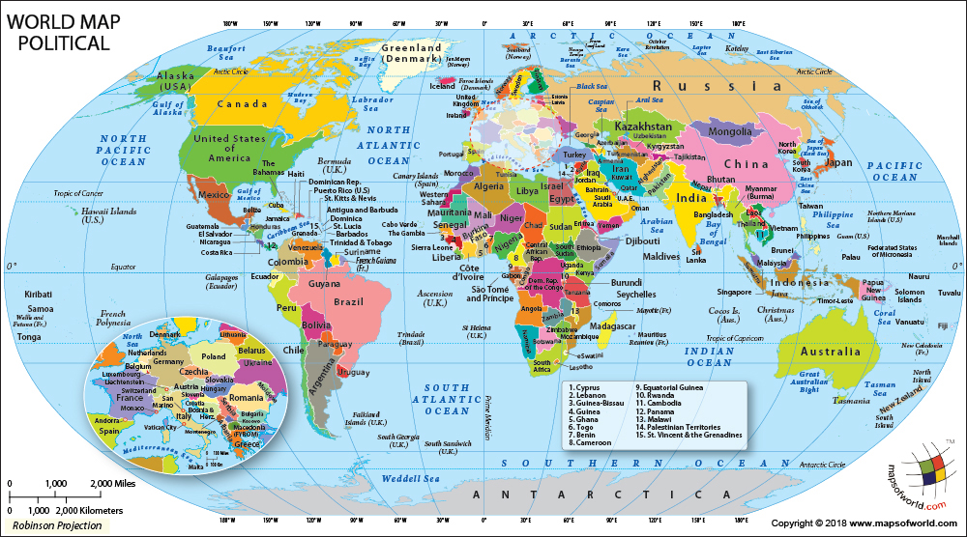
Map
Notes:
This small circle is Arabian Sea, and this big circle is South Atlantic Ocean where the anomalies SST happened.

Slide 7
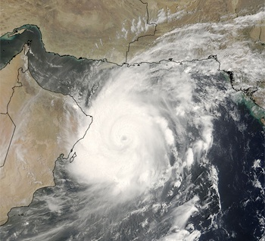
TCs Can be Disastrous
Only 3% of global TCs
Strong societal and economic damage
Iran
Oman
Super Storm Guno in June 2007
Landfall: Oman & Iran
Damages: about $4 billion
Fatalities: about 100
Notes:
Although the TCs in Arabian Sea are only 3 percent of global TCs, they are disastrous and they caused strong societal and economic damage. For example, the super storm Guno in June 2007. The main landfall are in Oman and Iran, and it cost about 4 billion dollars and about 100 fatalities.

Slide 8
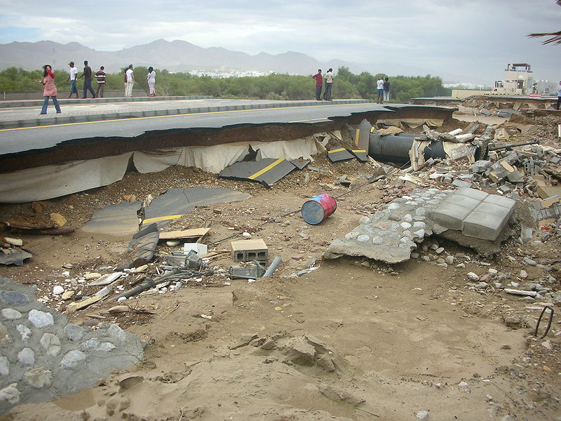
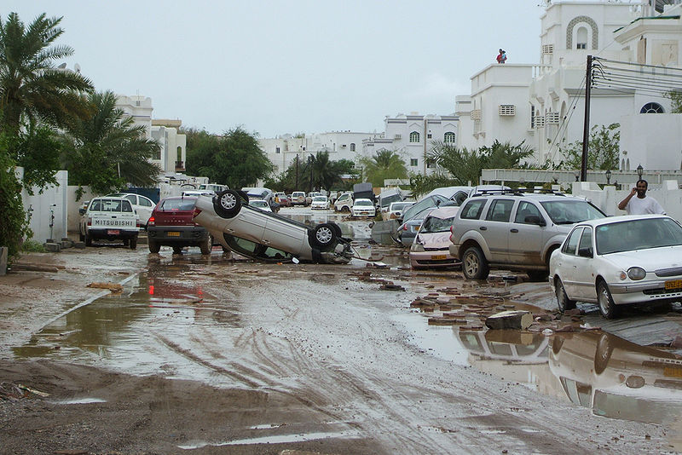
Super storm Guno
Road damage in Muscat, Oman
Flipped car and flooding on a street in Muscat, Oman

Slide 9
Atmospheric circulations affect TCs

Slide 10
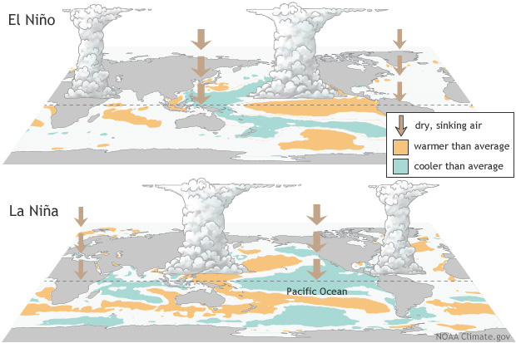
ENSO
Pre-Introduction
Notes:
ENSO including El Nino and La Nina. It is the warm and cool phase of a recurring climate pattern across the tropical Pacific. El Nino means the east of Pacific has warmer SST than average, so the air will goes up in that area. La Nina means the east of Pacific has cooler SST than average, so the air goes down in that area. ENSO can impact the climate around the world.

Slide 11
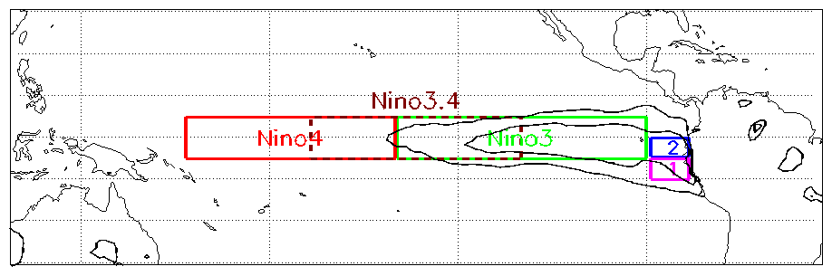
ENSO
Pre-Introduction
Notes:
These are the anomaly SST region of ENSO. The usual place of the temperature anomaly are Niño 1 and 2. Recently main anomalies happened in the region Niño 3.4, which leads to more hurricanes more frequently making landfall in the Atlantic

Slide 12
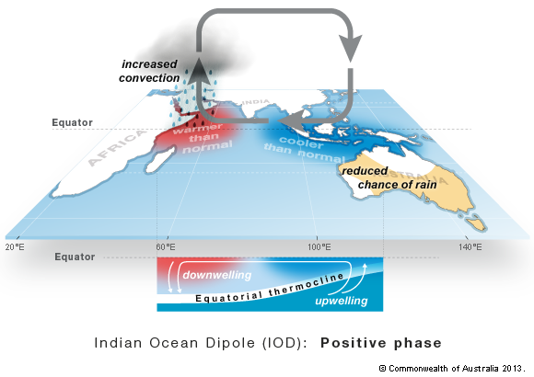
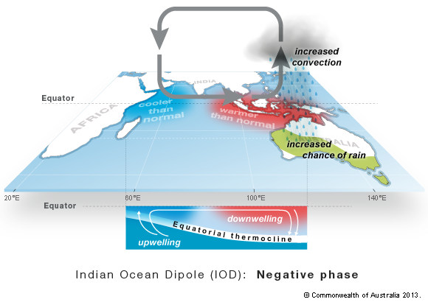
IOD (Indian Ocean Dipole)
Pre-Introduction
Positive phase
Negative phase
Westerly wind weaken
Westerly wind intensify
Cold water rise up
Positive: weaken convection over the eastern Arabian Sea → fewer TC
Notes:
The IOD means Indian Ocean Dipole. It has two phase, positive phase and negative phase. Positive phase means the east Indian Ocean is cold and the west Indian Ocean is warm. Negative phase means the east Indian Ocean is warm and the west Indian Ocean is cold. When the IOD is positive, warming in the western and cooling in the eastern part of the Indian Ocean can weaken convection over the eastern Arabian Sea, leading to fewer TC
Talk about the ocean flow (on the bottom of the picture)

Slide 13
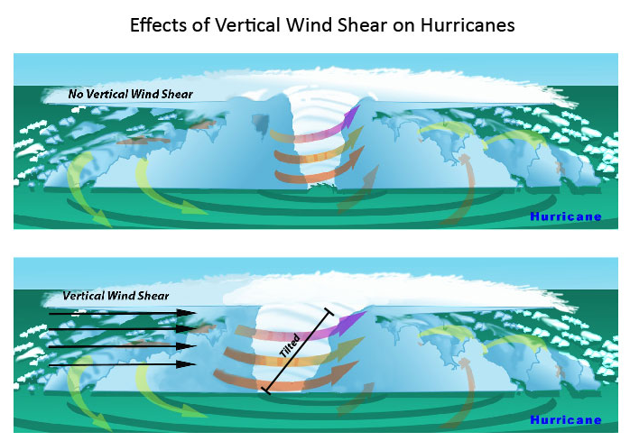
Vertical Wind Shear
Pre-Introduction
The vertical variation of the wind's speed or direction over a short distance within the atmosphere.
Bad for cyclones to develop.
Notes:
The most favorable condition for tropical cyclone development is the absence of wind shear. When wind shear is present, however, a storm’s core structure becomes vertically tilted in relationship to the wind shear, disrupting the flow of heat and moisture. Tropical cyclones are heat engines powered by the massive heat release associated with water vapor condensing into liquid water. Vertically-tilted systems are less efficient at drawing in warm and moist air from the surrounding ocean and will be less likely to develop and strengthen.

Slide 14
The classic Matsuno-Gill pattern for TC development
Pre-Introduction
H
L
200hPa
H
L
N
L
H
Equator
Heat
850hPa
L
H
S
Notes:
Add “H” and “L” in the circles

Slide 15
Previous Studies
El Nino/La Nina
(ENSO)
ENSO & IOD
Decrease in vertical wind shear
…
Strong Impact
TC genesis in the Arabian Sea
TCs in the North Indian Ocean
The increase of intensity and earlier occurrence of pre-monsoon Arabian Sea TCs
(Sumesh and Ramesh Kumar, 2013)
Impact
(Ng and Chan, 2012; Li et al., 2013; Murakami et al., 2013; Yuan and Cao, 2013; Wahiduzzaman et al., 2017)
Cause
(Evan et al., 2011,2012; Wang et al., 2013)
Notes:
Here are some previous studies about Arabian Sea TCs. El Nino and La Nina have strong impact on TC genesis in the Arabian Sea. ENSO and IOD can impact the TCs in the North Indian Ocean. The decrease in vertical wind shear will cause the increase of intensity and earlier occurrence of pre-monsoon Arabian Sea TCs. So, what are ENSO and IOD?

Slide 16
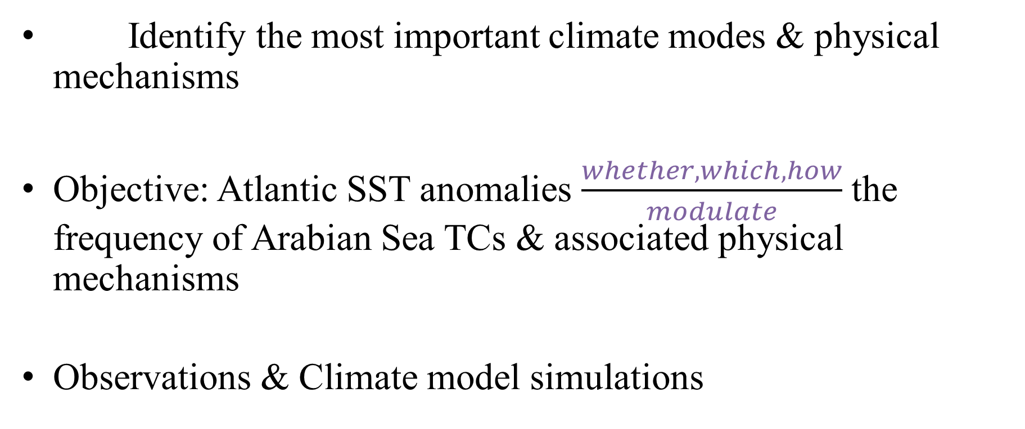
Reasons for writing this paper
Pre-Introduction
Identify the most important climate modes & physical mechanisms
Objective: Atlantic SST anomalies $\frac{whether, which, how}{modulate}$ the frequency of Arabian Sea TCs & associated physical mechanisms
Observations & Climate model simulations
Notes:
Although a lot of people did the researches about Arabian Sea TCs, it is still unclear what the most important climate modes associated with the frequency of Arabian Sea TCs and the underlying physical mechanisms are.
Therefore, the objective of this study is to examine whether, the extent to which and how Atlantic SST anomalies can modulate the frequency of Arabian Sea TCs and associated physical mechanisms using observations and climate model simulations.

Slide 17
TCs
Pre-Introduction
With intensity level equal to or higher than 34 knots (17 m/s)
With a lifespan lasting for at least 2 days
Pre-monsoon (May-June) TCs in the Arabian Sea (1979-2016)
Notes:
TCs in this paper are defined as those with intensity level equal to or higher than 34 knots and with a lifespan lasting for at least two days. This paper focus on the pre-monsoon (May and June) TCs in the Arabian Sea during the period 1979–2016.
Put a slide to introduce the difference about TCs, typhoons and hurricanes.

Slide 18
TC, Typhoon and Hurricane
Pre-Introduction
Different names in different region for the same phenomena
Hurricanes: the North Atlantic Ocean & the Northeast Pacific Ocean
Typhoons: the Northwest Pacific Ocean
TCs: the South Pacific Ocean & the Indian Ocean
Notes:
TCs in this paper are defined as those with intensity level equal to or higher than 34 knots and with a lifespan lasting for at least two days. This paper focus on the pre-monsoon (May and June) TCs in the Arabian Sea during the period 1979–2016.
Put a slide to introduce the difference about TCs, typhoons and hurricanes.

Slide 19
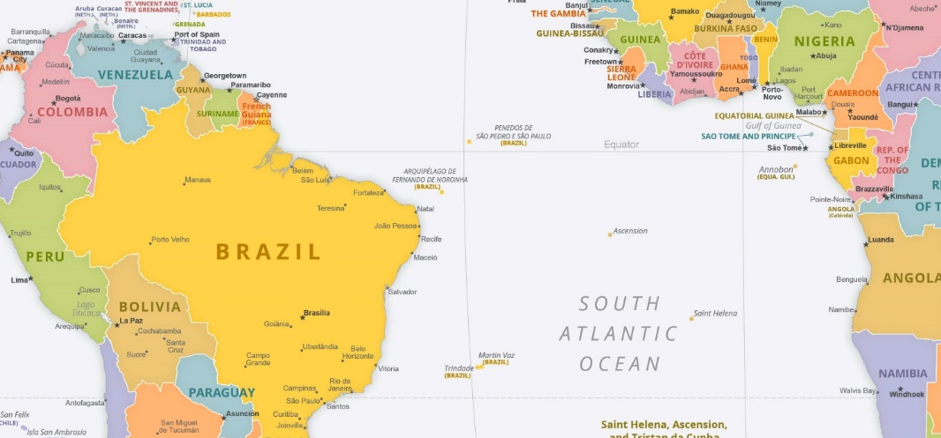
The Atlantic Sea Surface Temperature (ATSST) index
Pre-Introduction
the SST anomaly averaged (70°W–10°E & 20°S–Equator)
Notes:
The Atlantic SST index means the SST anomaly averaged in this area.

Slide 20
Data
Data & Methods
Tracks of TCs: Joint Typhoon Warning Center (JTWC) best-track data archived in the International Best Track Archive for Climate Stewardship (IBTrACS v3010)
Observed environmental large-scale factors (such as horizontal winds): ERA-Interim reanalysis data
Observed SST: Hadley Center Global Sea Ice and Sea Surface Temperature dataset (HadISST1)
***ERA-Interim is the latest global atmospheric reanalysis produced by the European Centre for Medium-Range Weather Forecasts (ECMWF).
Notes:
Where are the data comes from in this paper? Different data comes from different resources. For the tracks of TCs, the author used Joint Typhoon Warning Center best-track data archived in the International Best Track Archive for Climate Stewardship. They used ERA-Interim reanalysis data in observed environmental large-scale factors. And the data of observed SST is from Hadley center Global Sea Ice and Sea Surface Temperature dateset.

Slide 21
Methods
Data & Methods
International Centre for Theoretical Physics atmospheric general circulation model (ICTP AGCM) (V41)→ test the impacts of the Atlantic SST forcing
8 vertical levels, horizontal (3.75° × 3.75°)
Physically based parameterizations : large-scale condensation, shallow and deep convection, shortwave and longwave radiation, surface fluxes of momentum, heat and moisture, and vertical diffusion.
Notes:
a spectral truncation at total wave number 30

Slide 22
Experiments - 3
Data & Methods
1). CLIMO: the climatological seasonal cycle of SST
2). ATSST: the SST anomaly & the climatological seasonal cycle of SST (May-June)
3). Extend the SST anomaly (ATSST) to 30°S-30°N, 80°W-10°E responses to ATSST are sensitive to the region of SST anomaly?
test

Slide 23
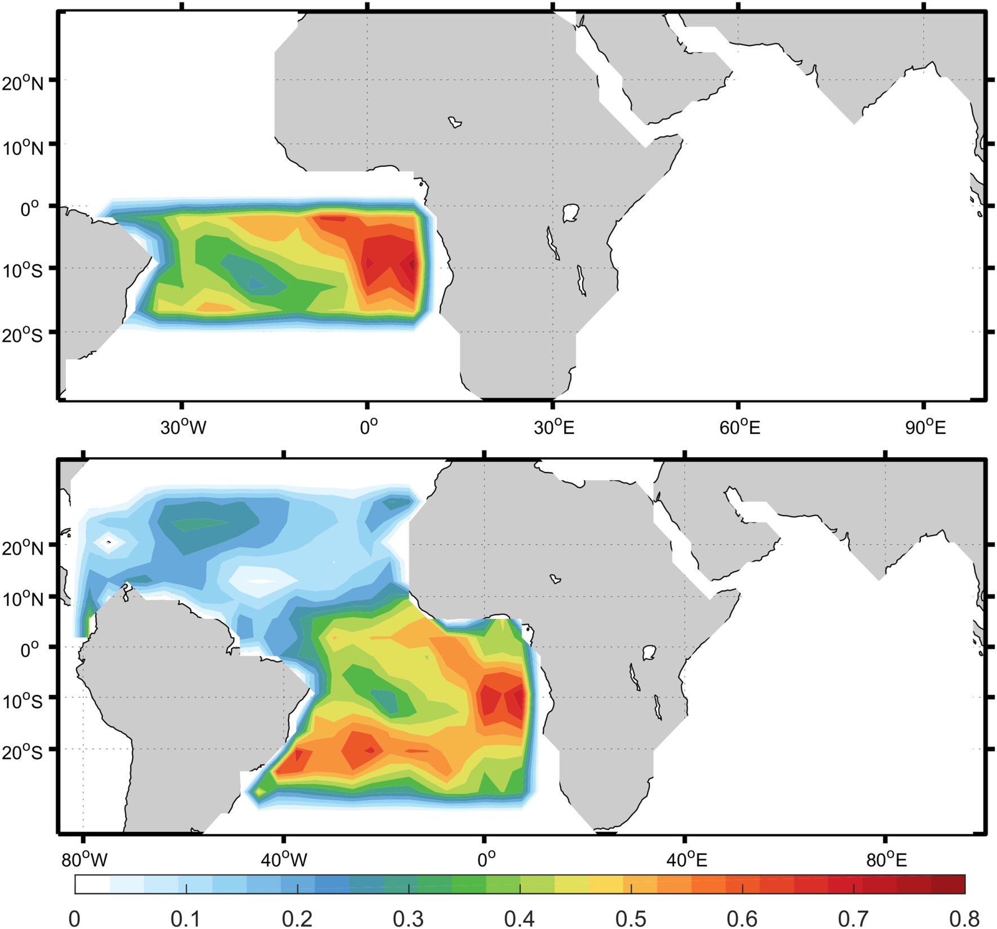
SST anomalies related to ATSST (unit: K) used in the experiments
20°S-0, 70°W–10°E
30°S-30°N, 80°W-10°E
Unit: K

Slide 24
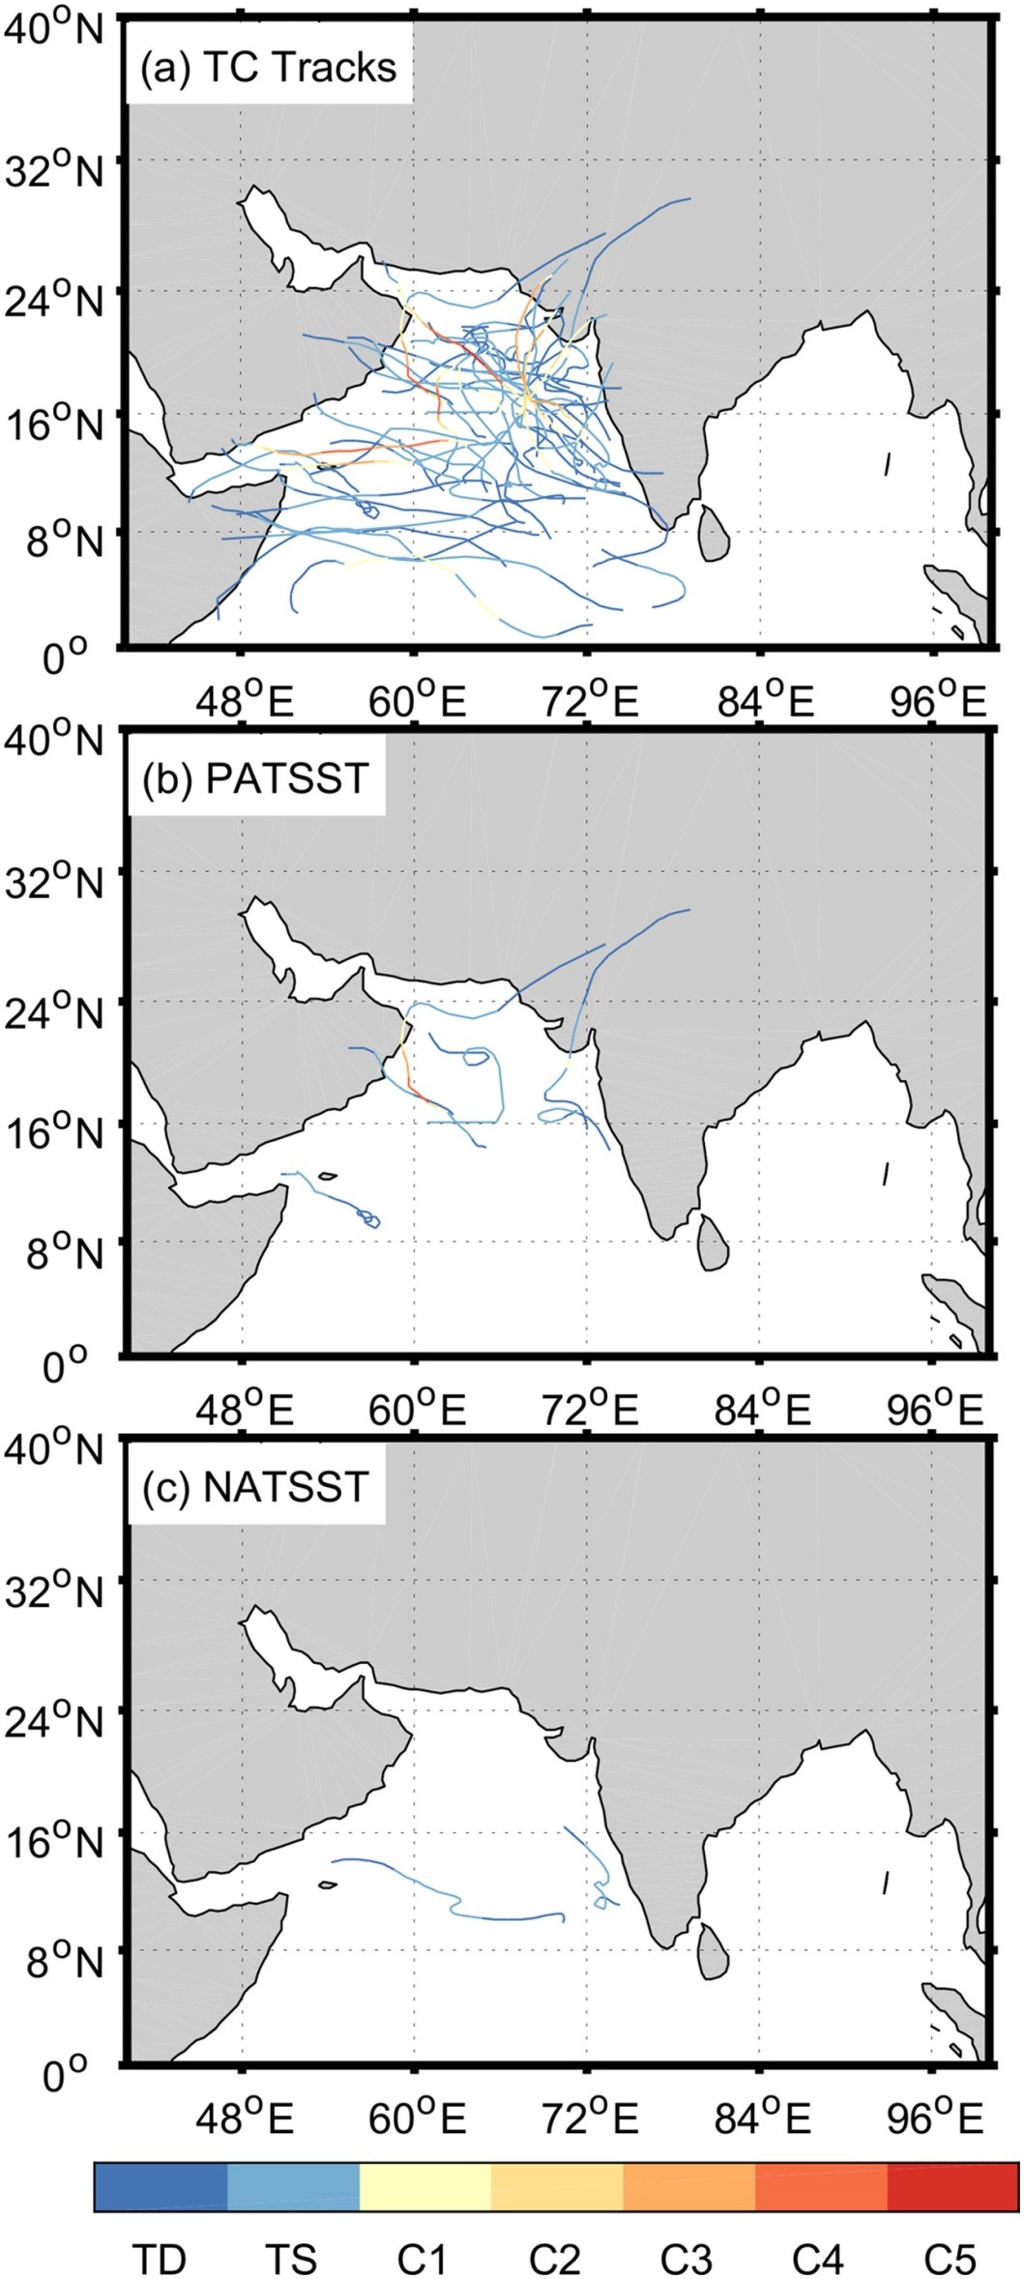



Observed Arabian Sea TCs for 1979–2016 (a)
Results
Iran
Pakistan
Oman
Yemen
India
Somalia
weaker
stronger
TD: tropical depression, with maximum surface winds of less than 17 m/s
TS: tropical storm, with maximum winds more than 17 m/s but less than 33 m/s
TC: tropical cyclone, with maximum winds more than 33 m/s
Notes:
Most of the Arabian Sea TCs make landfall over Somalia, Yemen, Oman, Iran, Pakistan and India because these storms are bounded by these coastal regions from the east, west, and north.
Many Arabian Sea TCs form over the ocean slightly west of the West Indian coast.
Explain the TD, TS…
Go to Coriolis…to explain why in the tropical area there is few TCs genesis but has a lot in the a little bit north area.

Slide 25
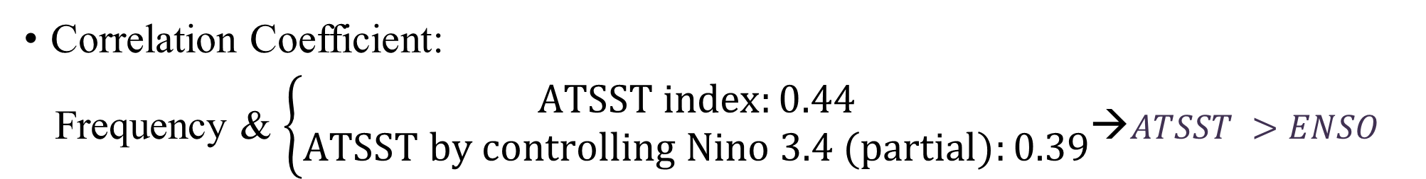
Observed Arabian Sea TCs for 1979–2016 (a)
Results
Correlation Coefficient:
Frequency & $\left\{\begin{aligned}ATSST index:0.44 \\ ATSST by controlling Nino 3.4 (partial):0.39\end{aligned}\right.$→$ATSST >ENSO$
$\left\{\begin{aligned}warm SST anomaly→high frequency \\ cold SST anomaly→low frequency\end{aligned}\right.$
Iran
Pakistan
Oman
India
Yemen
The Coriolis Force?
Somalia
Notes:
Most of the Arabian Sea TCs make landfall over Somalia, Yemen, Oman, Iran, Pakistan and India because these storms are bounded by these coastal regions from the east, west, and north.
Many Arabian Sea TCs form over the ocean slightly west of the West Indian coast.
Explain the TD, TS…
Go to Coriolis…to explain why in the tropical area there is few TCs genesis but has a lot in the a little bit north area.

Slide 26
Results
Positive ATSST: 6 TCs, one C4
Negative ATSST: only 2 TCs
Also might can affect intensity
ATSST: Atlantic Sea Surface Temperature anomalies
Notes:
Explain ATSST again

Slide 27
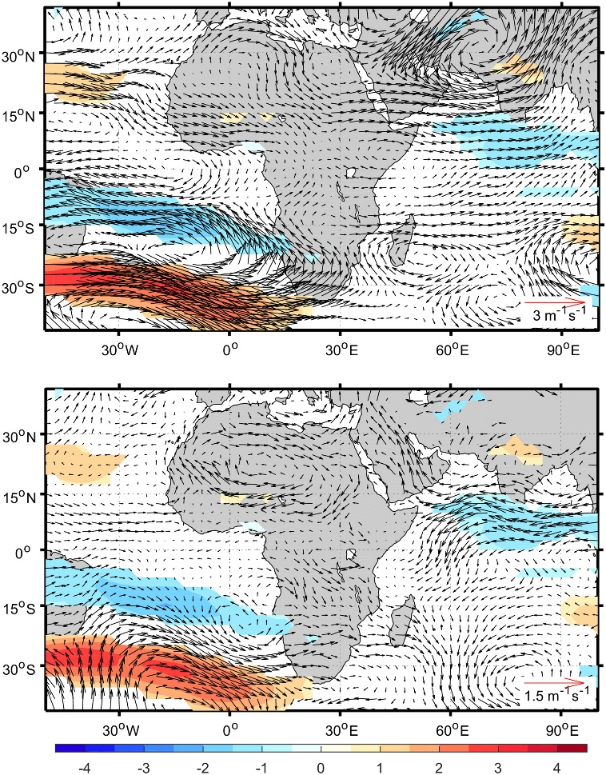
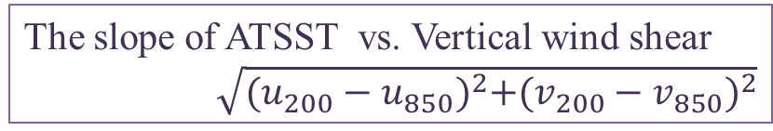
Observation
Results
Westerly
200hPa
ATSST warmer
than climatology
+ Low vertical
wind shear
Enhanced
TC activity
Easterly
850hPa
The slope of ATSST vs. Vertical wind shear
$\sqrt{{(u_{200}−u_{850})}^{2}+{(v_{200}−v_{850})}^{2}}$
Notes:
where u and v are the zonal and meridional winds
Go to units, wind speed is not so strong, so the vertical wind shear will not be large,
The colors means the relationship between ATSST and vertical wind shear

Slide 28
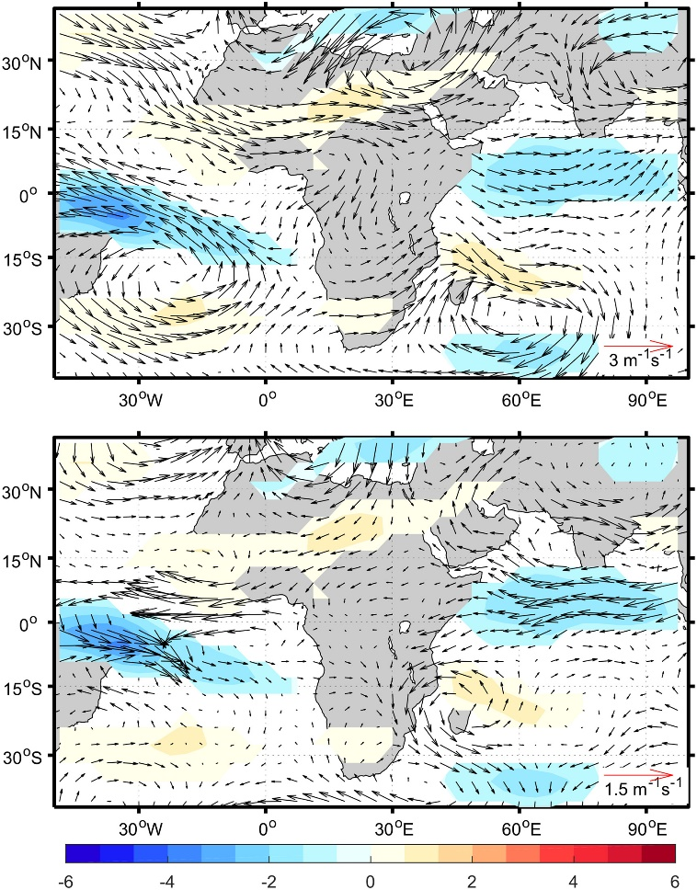
Climate model simulation
Results
ATSST-CLIMO:
similar to the observations
200hPa
Atlantic SST warming
reduced vertical wind shear
850hPa
Notes:
“…”means the statement from the authors

Slide 29
Results
Comparing Observation & ATSST-CLIMO Experiment
850hPa
850hPa
Spurious low-level easterly winds
Related to the confined southern SST anomaly region (20°S-0)?

Slide 30
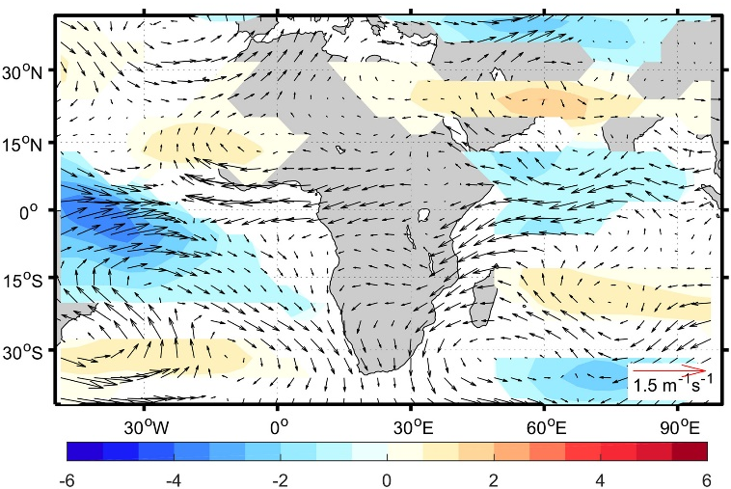
Extended ATSST index
(30°S-30°N, 80°W-10°E )
Results
Weaker spurious easterly wind at 850hPa
2nd
850hPa
Cutting the SST anomalies at the equator → spurious easterly winds
3rd
850hPa

Slide 31
Summary
From observation: The Atlantic Ocean Sea Surface Temperature (ATSST) anomalies have an important impact on the frequency of Arabian Sea tropic cyclones (TCs); positive (negative) ATSST can cause more (less) TCs.
From experiments: ATSST anomalies reduced the vertical wind shear over the Arabian Sea.
“Because of these new insights, future work can focus on the development of seasonal forecasting systems of Arabian Sea TCs using SST anomalies in the Atlantic as a potential predictor.”
Notes:
Say the whole words about ATSST & TC

Slide 32
Map
Tropical Cyclones
Sea Surface Temperature

Slide 33
Reference
Zhang. Wei, Villarini. Gabriele (2019) On the role of the Atlantic Ocean in forcing tropic cyclones in the Arabian Sea. Atmospheric Search 220(2019), 120-124.
T. Losada, B. Rodriguez-Fonseca, I. Polo, S. Janicot, S. Gervois, F. Chauvin and P. Ruti (2009) Tropical response to the Atlantic Equatorial mode: AGCM multimodel approach. Clim Dyn. Doi: 10.1007/s00382-009-0624-6
Gill, A.E., 1980: Some simple solutions for heat-induced tropical circulation, Q. J. Roy. Met. Soc., 106, 447-462.
“Cyclone Gonu”. Wikipedia, en.wikipedia.org/wiki/Cyclone_Gonu
Edward Pritchard, AOML. “Behind the 2015 Atlantic Hurricane Season: Wind Shear & Tropical Cyclones
”. National Oceanic & Atmospheric Administration, www.aoml.noaa.gov/keynotes/keynotes_0715_
windshear.html
“Indian Ocean influences on Australian climate”. Australian Government Bureau of Meteorology, www.bom.gov.au/climate/iod/

Slide 34
Thank you!

