Slide 1
Critical Surface Albedo and Its Implications to Aerosol Remote Sensing
F. C. Seidel and C. Popp
Atmospheric Measurement Techniques, 2012, 5(7): 1653-1665.
Seminar Talk
Jingting HUANG

Slide 2
Outline
Background
My research
Radiative transfer model
Role of critical surface albedo (CSA)
Sensitivity analysis
Errors in AOD retrievals related to surface albedo
Conclusion and future work
References
1

Slide 3
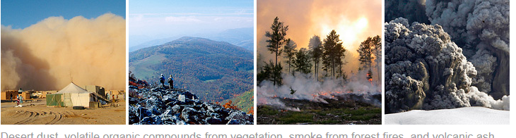
Background
01
Dynamic Processes of Atmospheric Aerosols
Optical and Physical Properties of Atmospheric Aerosols
Aerosol Types

Slide 4
Dynamic Processes of atmospheric aerosols
Courtesy of Dr. C.Y. Wu at University of Florida, http://aerosol.ees.ufl.edu/atmos_aerosol/section05.html
2

Slide 5
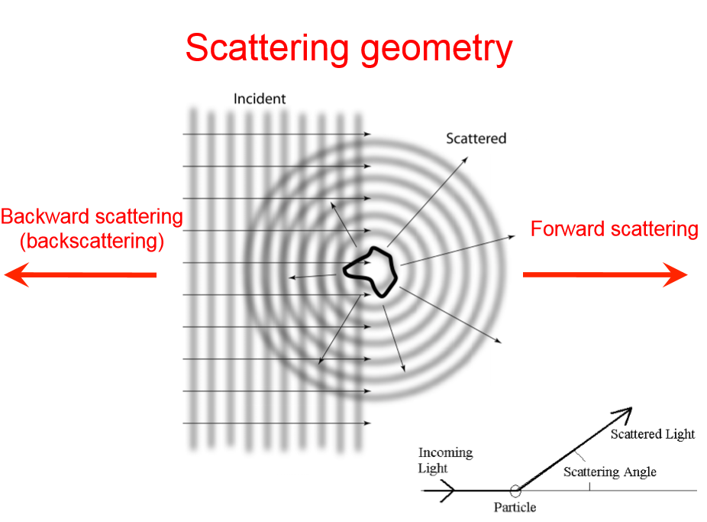
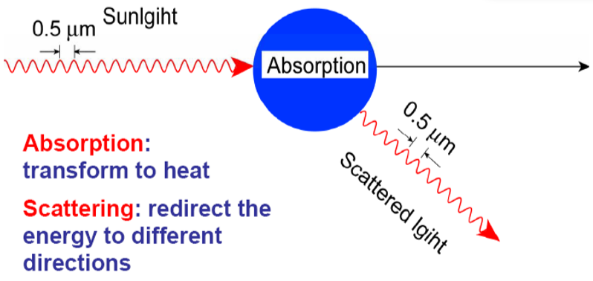
Optical and Physical Properties of Atmospheric Aerosols
Sunlight
light
3

Slide 6
Optical and Physical Properties of Atmospheric Aerosols
ω - Single Scattering Albedo
A measure of the amount of aerosol light extinction due to scattering.
g - Asymmetry Parameter
The average value of cosϴ for a large number of scattered photons.
g>0, forward scattering; g<0, backward scattering
P(ϴ)- Scattering Phase Function
The angle-dependent scattering of light incident on a particle.
ϴ - angle between the original direction and the scatted direction.
AE - Angstrom Exponent
Inversely related to the average size of the particles in the aerosol: the smaller the particles, the larger the exponent.
4

Slide 7
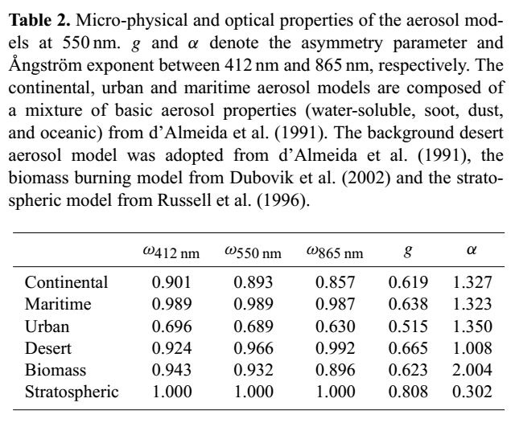
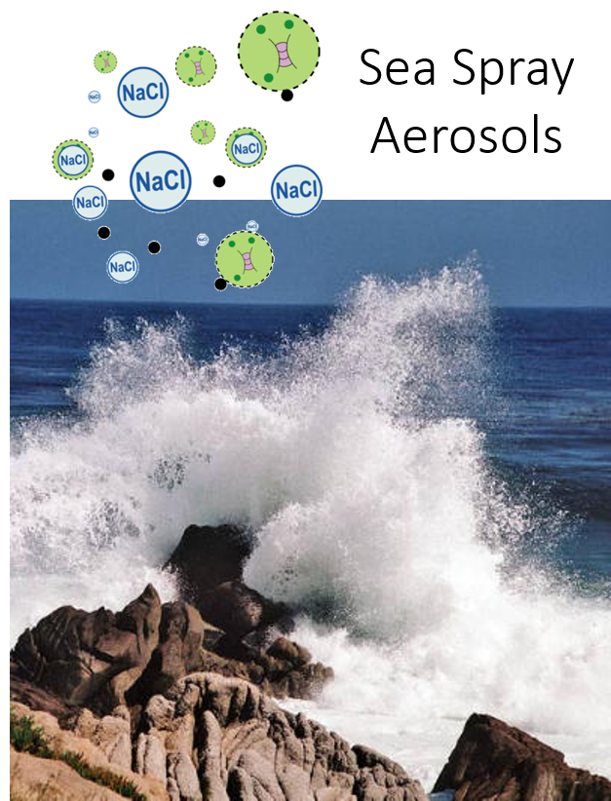
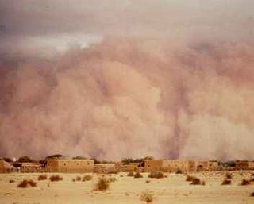
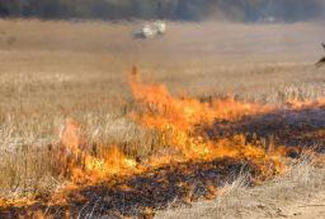
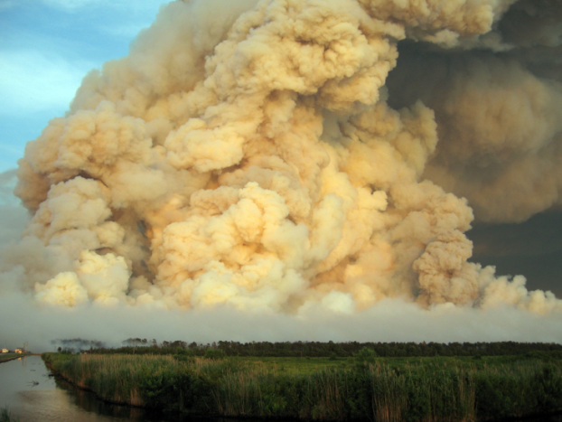
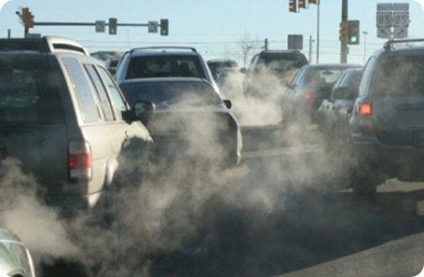
Aerosol types
AE
AE
Strongly absorbing aerosols
5

Slide 8
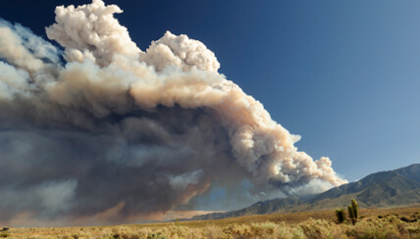
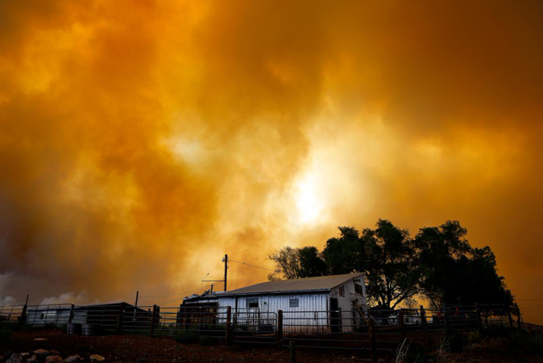
My Research
02
Real-time wildfire smoke transport and air quality prediction with fine spatial resolution

Slide 9
Motivation
Erratic Western wildfire behaviors
Smoke-induced unhealthful levels of PM
Costly air quality monitoring network
Infrequent updates (~ 6hrs )and limited spatial (~12km × 12km) resolution
in current smoke forecasting models
Challenges
Filling the missing data in coarse granularity of existing data
Heterogeneous data fusion
Big data processing speed
6

Slide 10
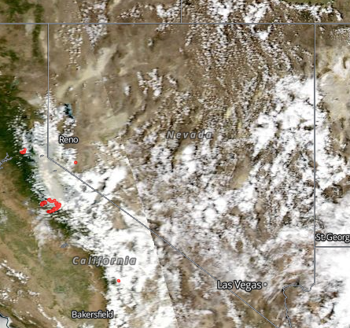
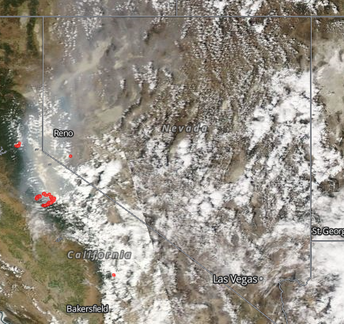
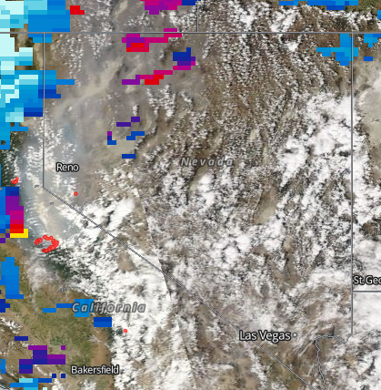
Related Work
2013 August 27 California Wildfires (BRD-Black Rock Desert)
BRD
BRD
BRD
Land reflectance Corrected reflectance(True color) Merged DT/DB AOD
8

Slide 11
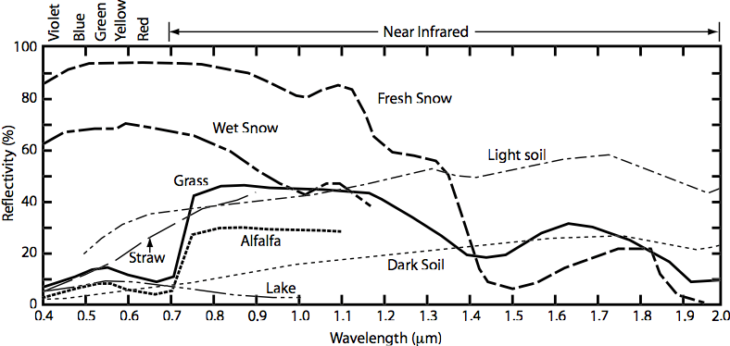
Spectral reflectivity of various surfaces
*Land surface albedo (LSA)
An important variable that governs shortwave radiation balance at the land surface by determining the amount of downward shortwave flux reflected back to the atmosphere (Liang, 2004). The quantity of a surface reflecting incident radiation varies according to the illumination and reflecting directions.
From Grant Petty’s “First Course in Atmospheric Radiation”
7

Slide 12
Related Work
*The bidirectional reflectance distribution function (BRDF)
An important concept for estimating LSA from multiangle satellite data. BRDF provides a mathematical description of the reflectance of the surface as a function of Sun - target - sensor geometry.
*Satellite remote sensing of AOD retrieval issues:
0.01 surface albedo uncertainty leads to approximately 0.2 AOD retrieval uncertainty (F. C. Seidel, 2012).
9

Slide 13
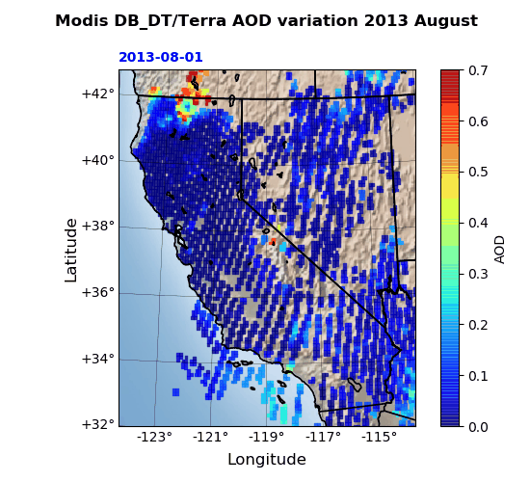
Related Work
*Reflections on filling the missing data gaps of daily MODIS AOD:
If the satellite is covered by clouds, then it will produce more data gaps (Kokhanovsky et al., 2007).
When relying on appropriate surface conditions under dark conditions, the inversion results will be poor in the desert or near the coast (Remer et al., 2005).
The DB algorithm could outperform the DT algorithm over bright surfaces such as arid regions to retrieve more accurate AOD values.
However, over surfaces with high surface reflectance (e.g., BRD), the DB algorithm was not able to adequately retrieve AOD and the retrievals are low quality.
10

Slide 14
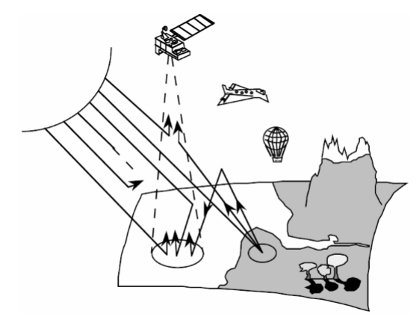
RT model
03
Second Simulation of a Satellite Signal in the Solar Spectrum - Vector (6SV)

Slide 15
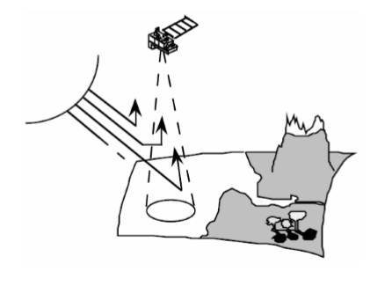
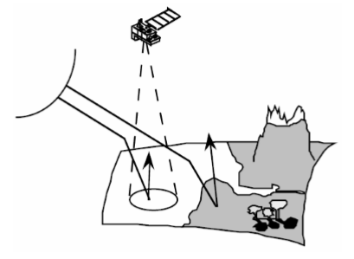
RT model
Schematic of Satellite Observations
Some of the photons do not reach the surface and are backscattered toward space.
The remaining photons contribute to the illumination of the ground by the way of scattered paths and compensate the attenuation of the direct solar paths.
11

Slide 16
RT model
Calculation of total spectral reflectance at TOA and wavelength λ ( )
- The atmospheric coupled molecular-aerosol contribution
- Surface contribution
12

Slide 17
RT model calculation
- Atmospheric intrinsic reflectance
Reflection of single scattering
Reflection of multiple-scattering
- Related to solar zenith angle
- Related to view zenith angle
- Single scattering albedo with the scattering and extinction efficiency
- The total optical depth composed of AOD and Rayleigh optical depth
- The scattering phase function for solar radiation as function of forward or backward scattering angle
13

Slide 18
RT model calculation
- Surface reflectance
（Lambertian reflectance）
- Surface albedo
- Spherical albedo to account for multiple surface and atmosphere scattering interactions
- Total down and upwelling transmittance
14

Slide 19
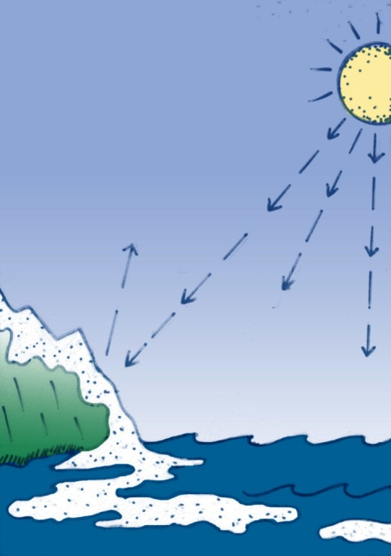
Role of CSA
04
Definition and importance of critical surface albedo

Slide 20
Importance of CSA
AOD (aerosol optical depth)
The vertical integral of aerosol extinction coefficients along the entire height of the atmosphere
CSA(critical surface albedo)
Strict definition:
The surface albedo where the reflectance at TOA does not depend on aerosol optical depth
（Kaufman, 1987; de Almeida Castanho et al., 2008; Zhu et al., 2011; Wells et al., 2012）
Inaccurate AOD retrievals at CSA
15

Slide 21
Calculation of CSA
According to the definition, if there are two different AODs leading to the same TOA reflectance,
Therefore the CSA is obtained by derivatives of the TOA reflectance with respect to AOD,
CSA is a function of the observation and solar geometry, wavelength, aerosol properties and AOD.
16

Slide 22
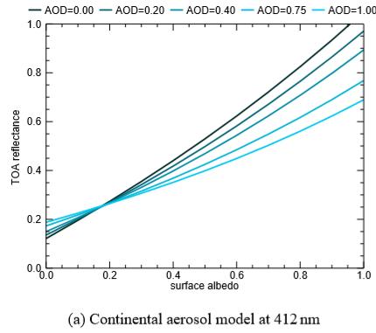
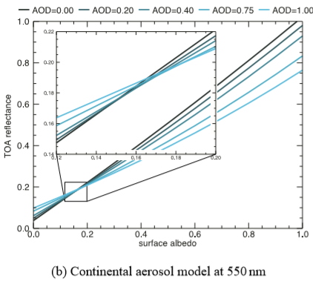
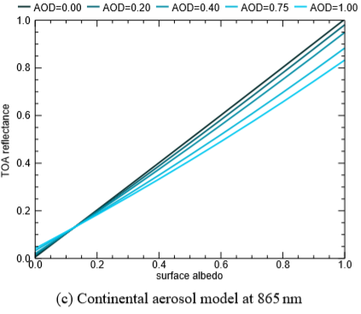
New definition of CSA
CSA represents a range of surface albedo values given by an ensemble of TOA reflectance crossings.
Not singular CSA!
17

Slide 23
Role of CSA
CSA serves as a method for SSA retrieval.
CSA decreases as decreasing SSA with wavelengths.
18

Slide 24
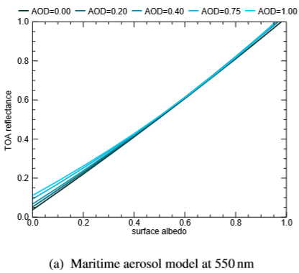
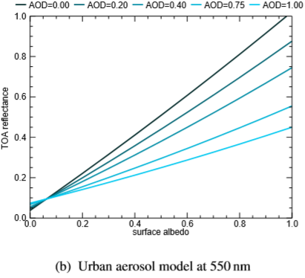
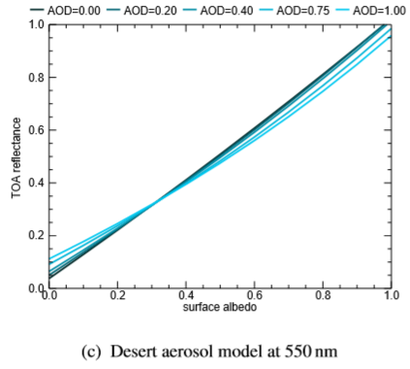
Role of CSA
CSA can help discriminate different the scattering aerosol types.
Absorbing aerosol types have a much lower CSA.
19

Slide 25
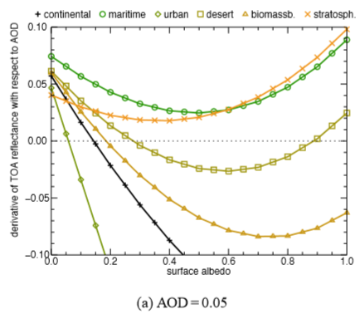
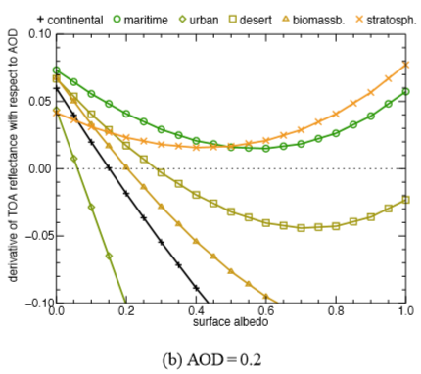
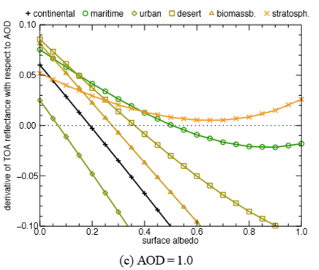
Role of CSA
CSA can help discriminate different scattering aerosol types.
Different relationship between derivative TOA reflectance with respect to AOD with surface albedo.
No CSA may occur for low or non-absorbing aerosol types.
CSA changes with aerosol type and AOD.
20

Slide 26
Sensitivity analysis
05
Sensitivity of CSA to SSA
Sensitivity of CSA to observation and solar geometry
Sensitivity of CSA to AOD

Slide 27
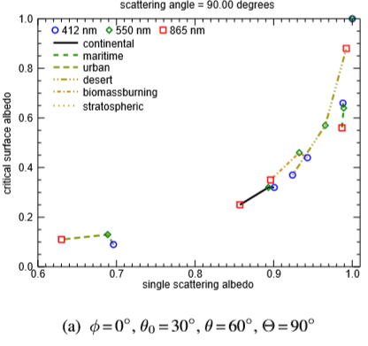
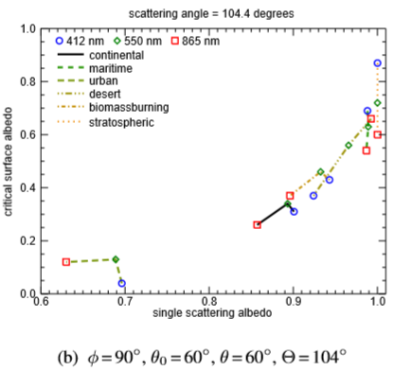
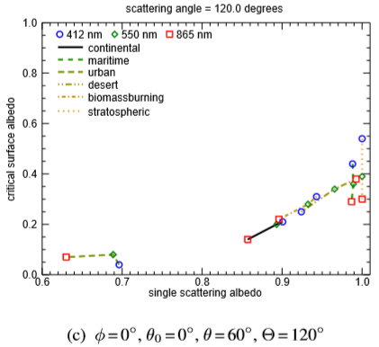
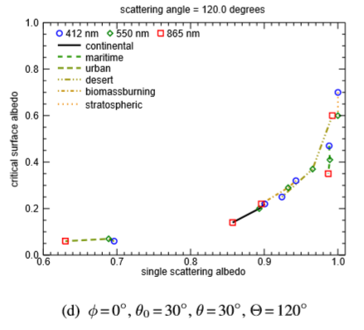
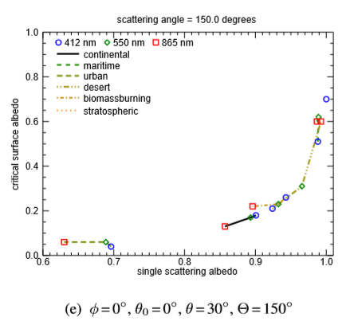
Sensitivity of CSA to SSA
21

Slide 28
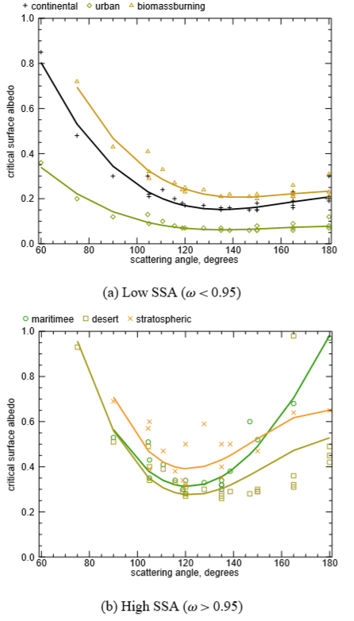
Sensitivity of CSA to observation and solar geometry
22

Slide 29
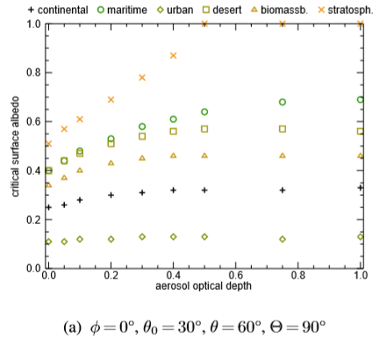
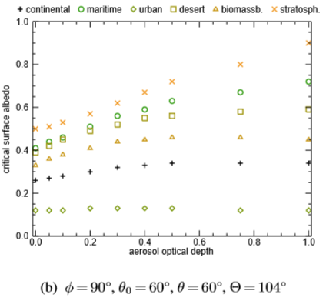
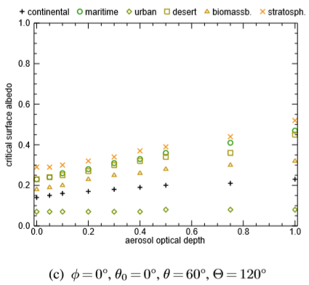
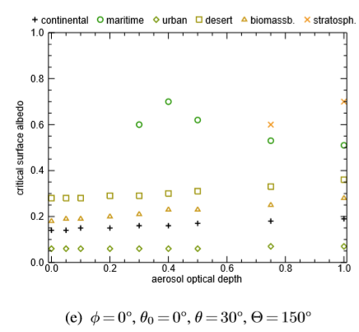
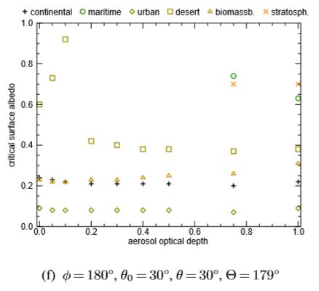
Sensitivity of CSA
to AOD
23

Slide 30
Errors in AOD retrievals related to surface albedo
06
AOD sensitivities to surface albedo

Slide 31
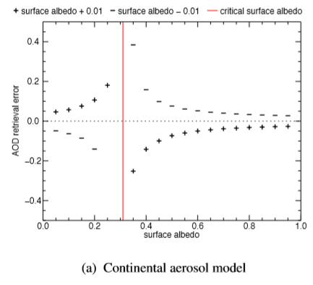
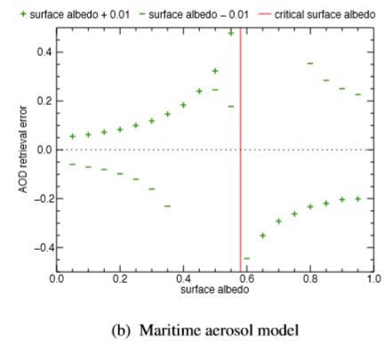
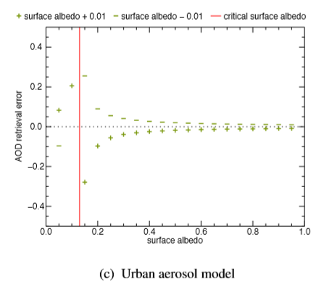
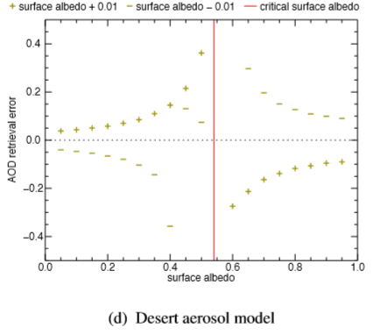
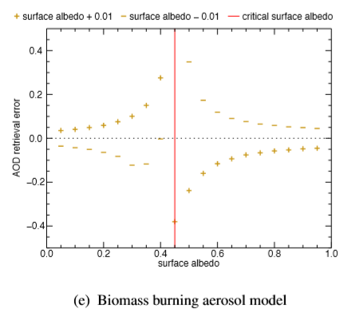
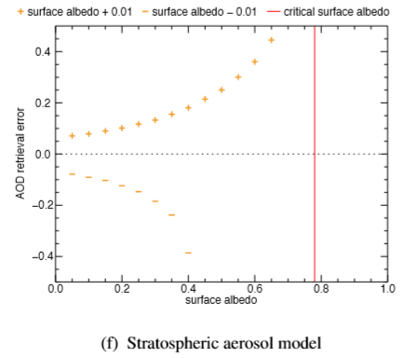
24

Slide 32
Implication in AOD
Surface albedo uncertainties result in large AOD retrieval errors, particularly close to the CSA.
Over 100% error in AOD when approaching CSA with 1% error in surface albedo
For surface albedo < CSA,
An overestimation of surface albedo -> positive retrieval error in AOD
For surface albedo > CSA,
An overestimation of surface albedo -> negative retrieval error in AOD
Decrease in TOA reflectance by increasing AOD over bright surface.
Increase in TOA reflectance by decreasing AOD over dark surfaces.
25

Slide 33
Summary
07
Conclusion
Future work

Slide 34
Conclusion
CSA mainly depends on SSA, scattering angles, and wavelengths, and slightly depends on AOD.
AOD retrievals over surfaces with albedo close to CSA would result in large errors.
Small inaccuracies of the estimated surface albedo lead to large AOD retrieval errors.
Conditions close to and at the CSA reduce the impact of AOD uncertainties in remote sensing data.
Future work
Add sensitivity information of the measured radiance to AOD in retrieval algorithm
Increase the number of surface albedo measurements
An intensive evaluation of albedo satellite retrievals to improve satellite-derived AOD
25

Slide 35
References
Seidel F C, Popp C. Critical surface albedo and its implications to aerosol remote sensing[J]. Atmospheric Measurement Techniques, 2012, 5(7): 1653-1665.
Seidel F C, Kokhanovsky A A, Schaepman M E. Fast retrieval of aerosol optical depth and its sensitivity to surface albedo using remote sensing data[J]. Atmospheric Research, 2012, 116: 22-32.
Boehmler J, Loría-Salazar S, Stevens C, et al. Development of a multispectral albedometer and deployment on an unmanned aircraft for evaluating satellite retrieved surface reflectance over Nevada’s Black Rock Desert[J]. Sensors, 2018, 18(10): 3504.
Manninen T, Riihelä A, de Leeuw G. Atmospheric effect on the ground-based measurements of broadband surface albedo[J]. Atmospheric Measurement Techniques, 2012, 5(11): 2675.
Gupta P, Levy R C, Mattoo S, et al. A surface reflectance scheme for retrieving aerosol optical depth over urban surfaces in MODIS Dark Target retrieval algorithm[J]. Atmospheric Measurement Techniques, 2016, 9(7): 3293-3308.

Slide 36
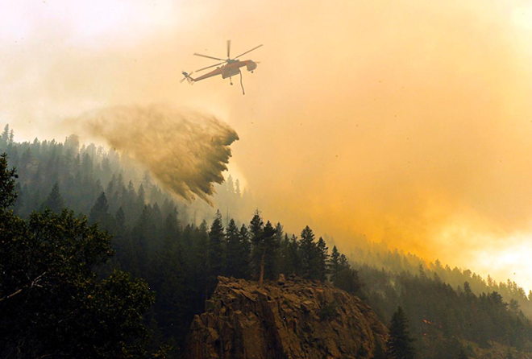
Thank you. Questions?
Jingting HUANG
Seminar Talk

