Slide 1
A Case Study of Anomalous Snowfall with an Alberta Clipper
Scott Rochette, Patrick Market, Chad Gravelle Thomas Niziol
Published October 31 2017
Presented by Mikhail Korotkin
Scott M. Rochette, Patrick S. Market, Chad M. Gravelle, and Thomas A. Niziol, “A Case Study of Anomalous Snowfall with an Alberta Clipper,” Advances in Meteorology, vol. 2017, Article ID 8406379, 14 pages, 2017. https://doi.org/10.1155/2017/8406379
All images are from Rochette et al. 2017 unless otherwise noted

Slide 2
Outline
What is an Alberta Clipper
Master’s Thesis: Thundersnow
Motivation
Rochette et al. 2017
Methods & Data
Analysis & Results
Conclusion

Slide 3
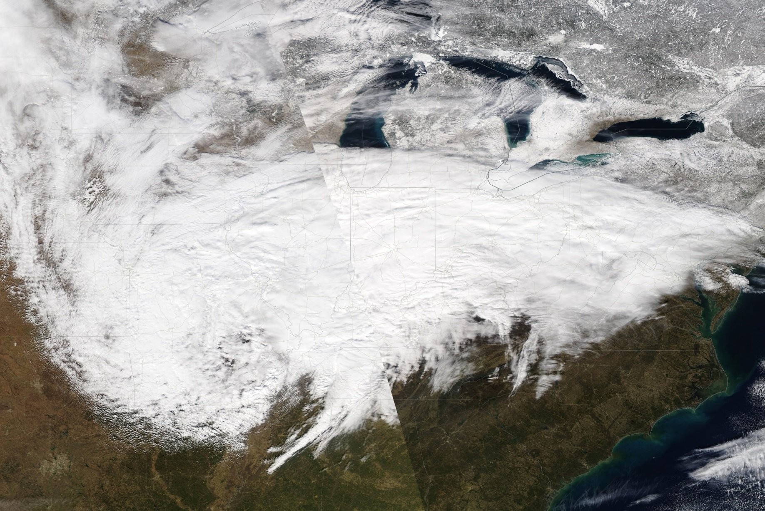
Alberta Clipper
https://earthdata.nasa.gov/labs/worldview/

Slide 4
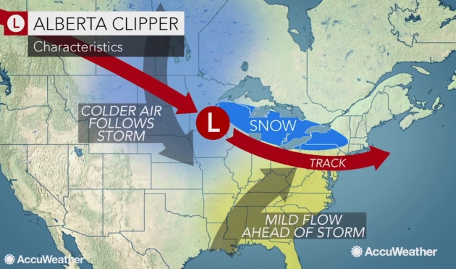
http://www.startribune.com/clipped-by-a-clipper-hints-of-march-in-extended-outlook/473274693/

Slide 5
Master’s Thesis
Formation of Convective Snowfall (Thundersnow) specifically in the Sierra Nevada
Specifically looking at the Synoptic & Mesoscale Conditions necessary
Fronts
Cyclones
Gravity Waves
Instability

Slide 6
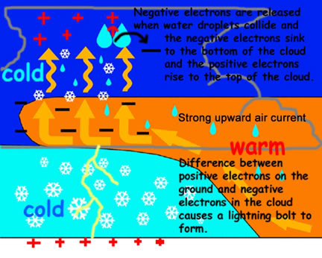
Thundersnow Formation
https://24.uggs-outlet.co/how-blizzard%27s-form-diagram.html

Slide 7
Cloud Seeding
Currently forecast weather conditions for the operation of cloud seeding generators across the Inter-Mountain West
Analysis of weather models/maps to understand the necessary conditions for cloud seeding

Slide 8
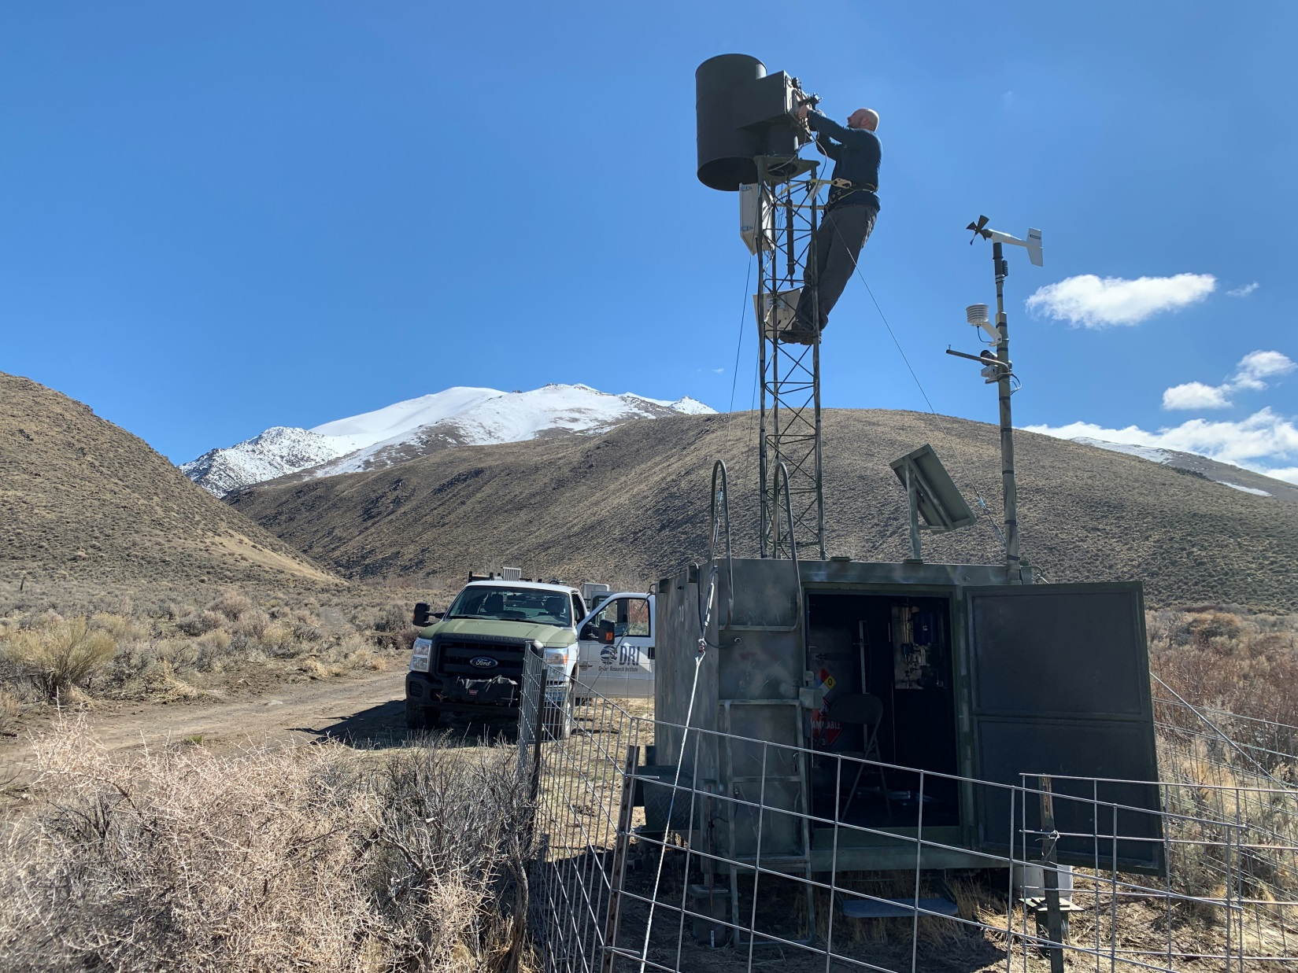
Cloud Seeding Generator
My Photo

Slide 9
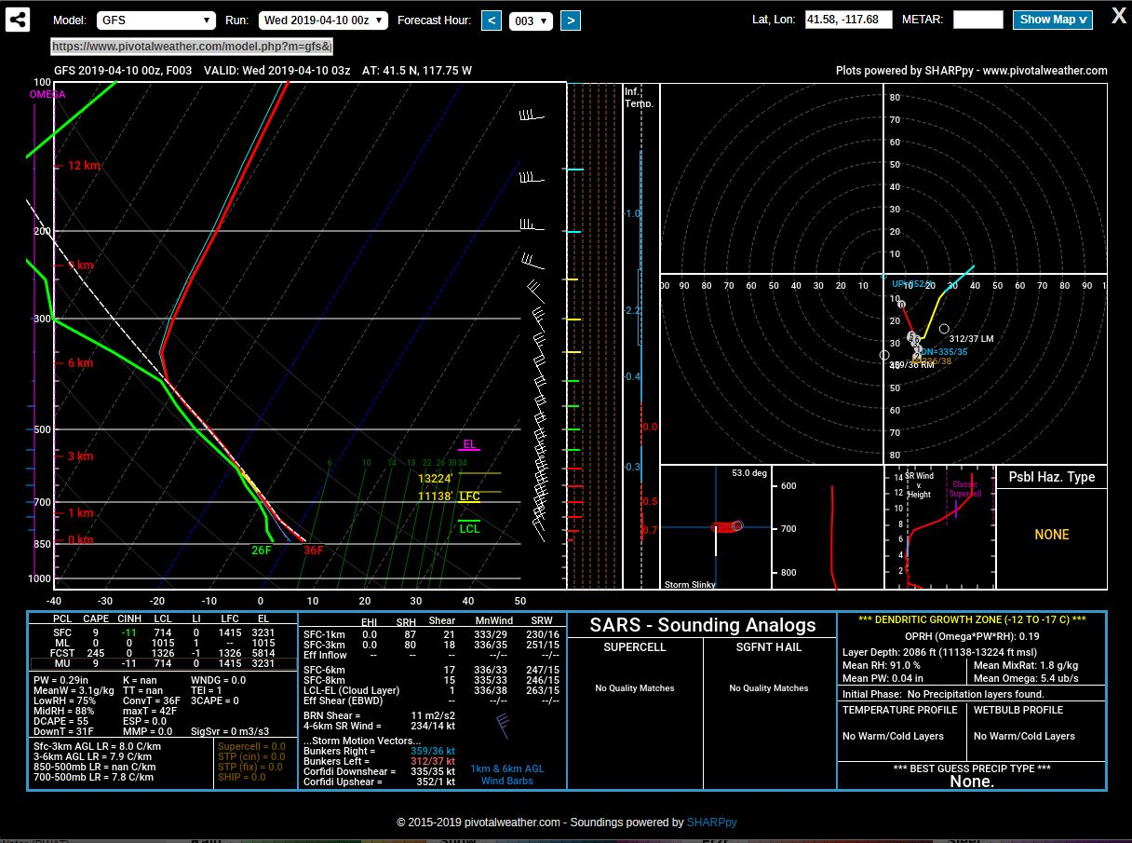
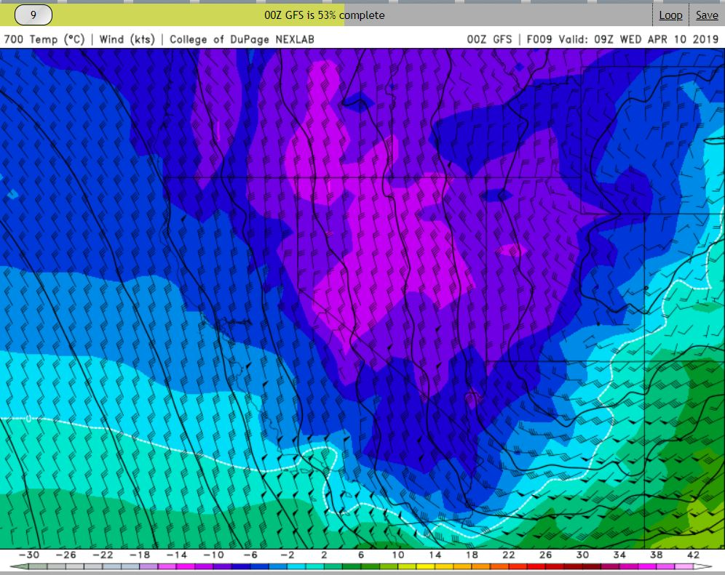
Maps & Models
https://weather.cod.edu/forecast/

Slide 10
Why Do We Want to Know?
Understanding Convective Snow will allow for better handling of wintertime convection in weather forecast models… More accurate forecasts overall
Convective Snowfall events can and typically produce substantial amounts of snowfall in short periods of time
Serious transportation hazard
Avalanche hazards
Ski Area Shutdowns (Lightning)

Slide 11
Rochette et al. 2017
Methods/Data
Analysis of Synoptic Features using Eta Model
Analysis of Mesoscale Features using RUC & HYSPLIT Models
Analysis
Synoptic Scale Forcing via Fronts: The Alberta Clipper
Mesoscale Features
Ascent
Moisture
Lake Effect Snow?
Instability
Radar Analysis
Notes:
Ingredients Based Methodology

Slide 12
Methods/Data
Eta Model used to analyze the upper level Synoptic setup of the clipper
Eta Model is the older equivalent of the WRF (Weather Research and Forecasting Model) or NAM (North American Mesoscale Model)
Eta Model is Hydrostatic and not convection allowing
80km grid spacing along with 50mb vertical spacing
Notes:
Course Resolution and Hydrostatic. Does not solve for vertical momentum like in a non hydrostatic model and thus using a QG approximation. Hydrostatic means that the vertical motion of the atmosphere is approximated and not sovled.

Slide 13
Methods/Data
RUC Model used to analyze the upper level Mesoscale Features focusing on ascent
RUC (Rapid Update Cycle) model is the older equivalent of the RAP (Rapid Refresh)
RUC Model is Hydrostatic and not convection allowing
25-50 grid spacing along with 25mb vertical spacing

Slide 14
Methods/Data
HYSPLIT (Hybrid Single Particle Lagrangian Integrated Trajectory) Model used to analyze parcel trajectories
Specifically used to determine the source of air parcels that were precipitated out over the region during the snowfall event
Also shows what sort of moisture and temperature changes the parcels underwent

Slide 15
Synoptic Setup
Lack of strong upper level forcing due to a fairly weak central pressure of the cyclone
Shortwave trough embedded in the overall trough was not particularly strong either
Clear Frontal Structure present with the moisture precipitating out along the Warm Front in the region of heaviest snowfall

Slide 16
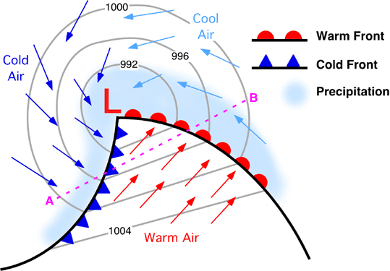
http://www.physicalgeography.net/fundamentals/7s.html

Slide 17
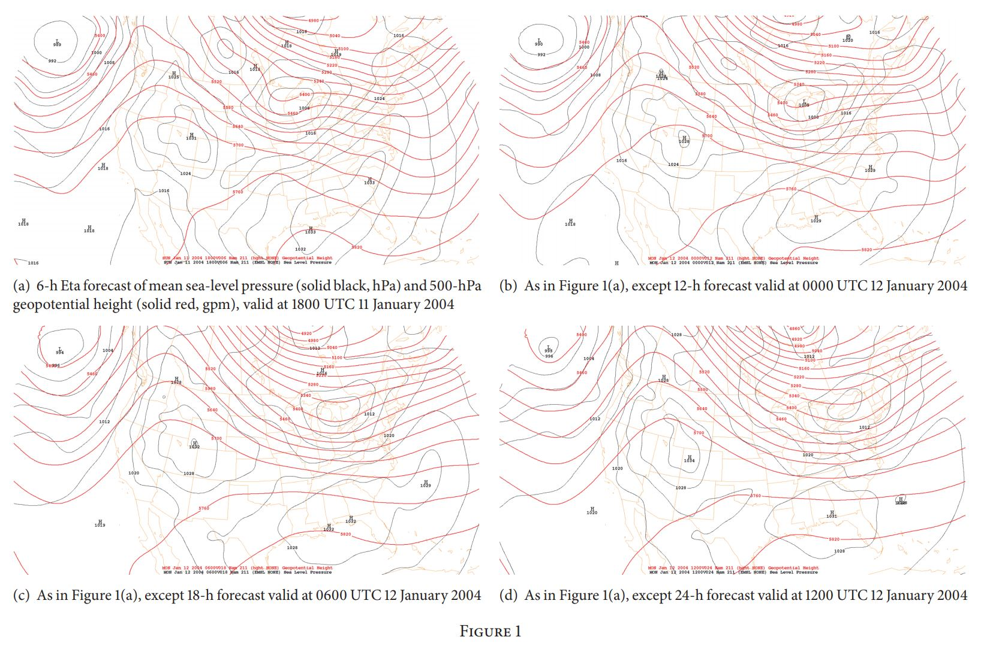
Notes:
Point out the ridges and troughs and the clearly not impressive central pressure

Slide 18
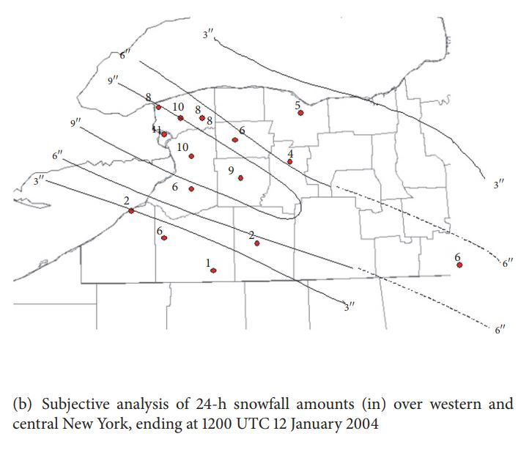
Snowfall

Slide 19
Mesoscale Forcing for Ascent
Analysis using the RUC model reveals clear areas of:
Positive Vorticity Advection (PVA) associated with the surface cyclone
Warm Air Advection (WAA) associated with the Warm Front
Upward Vertical Motion (UVM) that became more focused and intense during the period of heaviest snowfall
Notes:
Authors point out that this method for forcing for vertical motion is not ideal for using the QG omega equation but QG motion was not present based on the Q vectors analysis performed

Slide 20
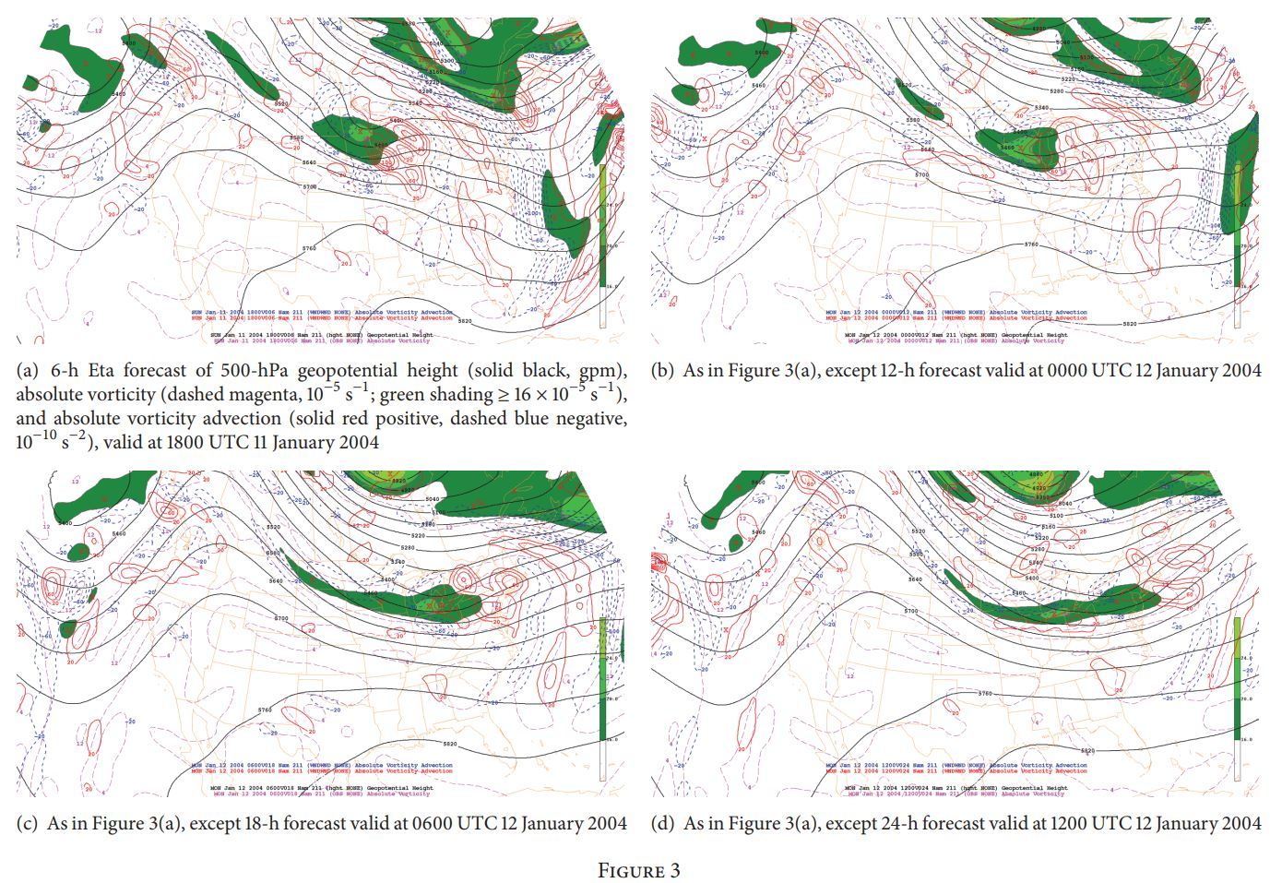
Notes:
Region of PVA associated with cyclone and then NVA associated with the passage of it

Slide 21
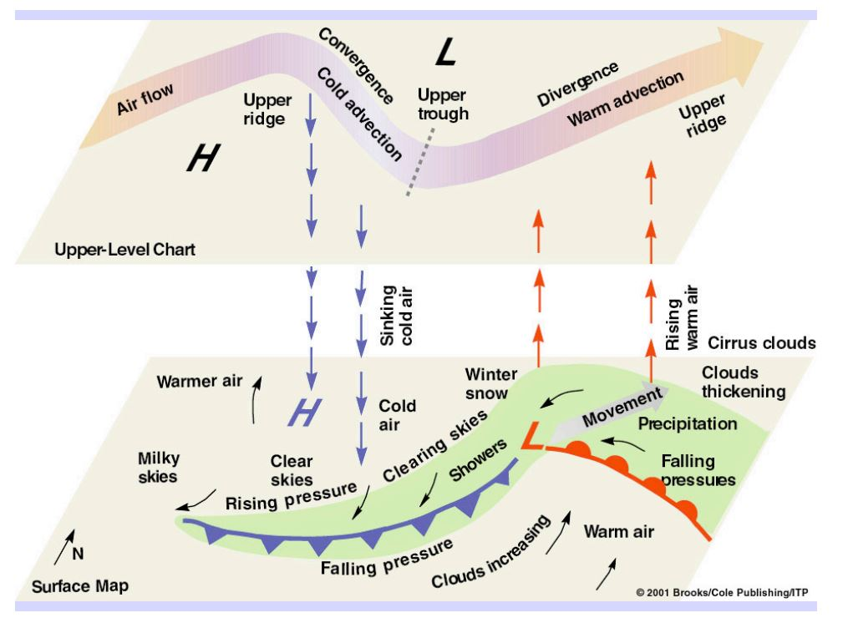

Slide 22
Advection
Transport of some physical quality of the atmosphere from one region to another
Vorticity Advection transfers spin (vorticity)
Temperature Advection transfers heat (and by extension energy just like vorticity)
Warm Air Advection is movement of air from a warmer air mass to a cooler one
Cold Air Advection is movement of air from a cooler air mass to a warmer one

Slide 23
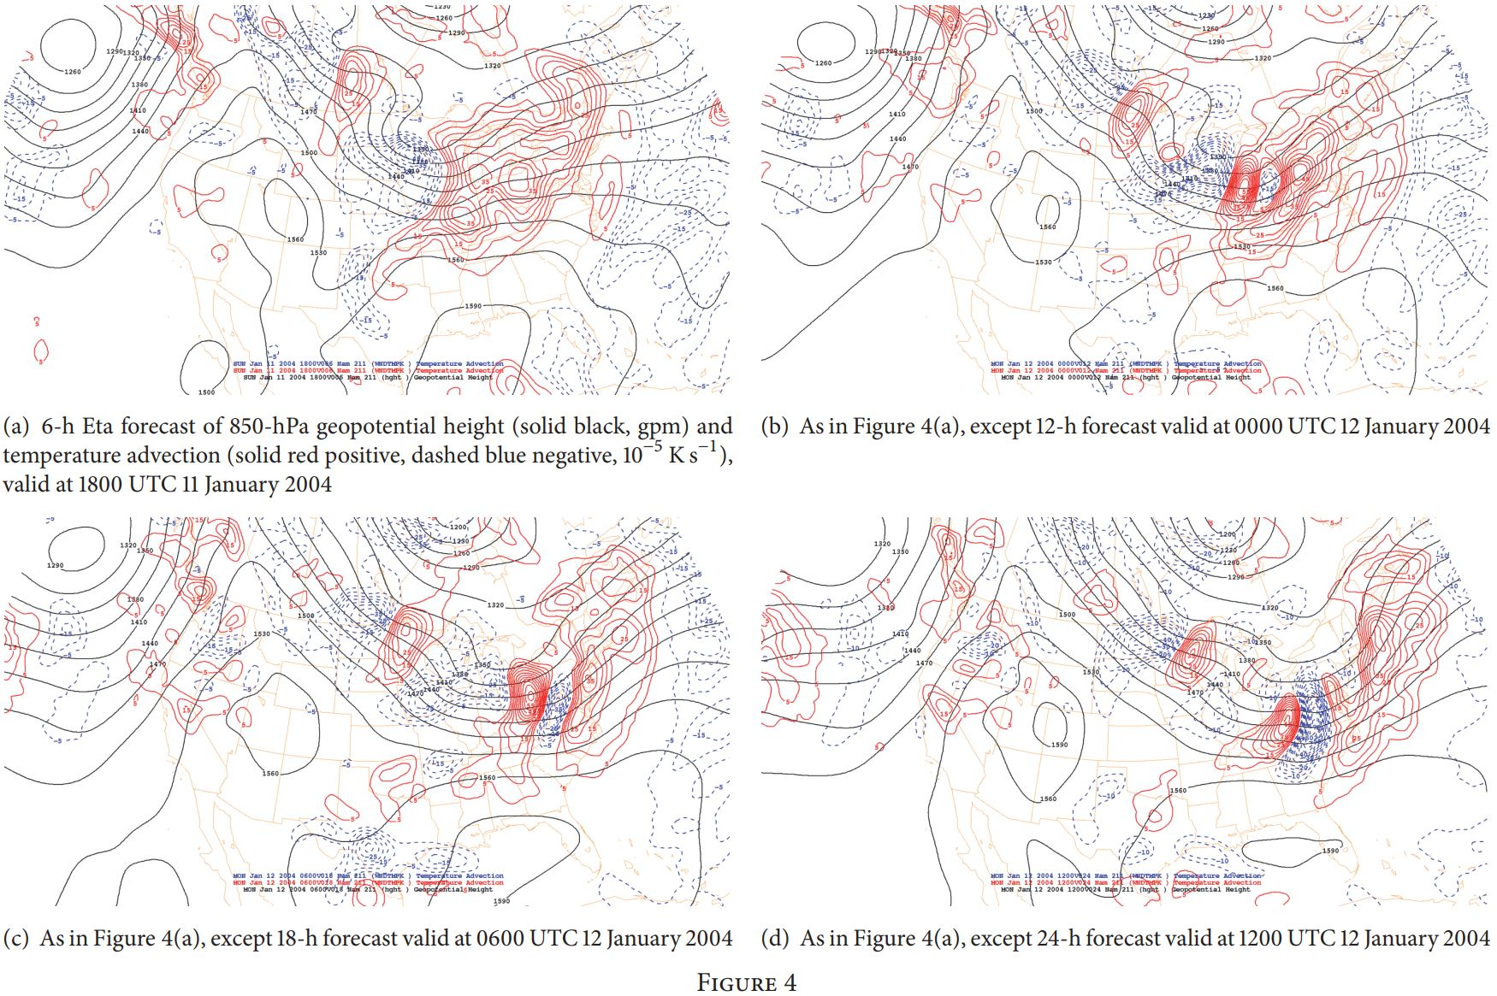
Notes:
Temperature advection with relation to the frontal structure

Slide 24
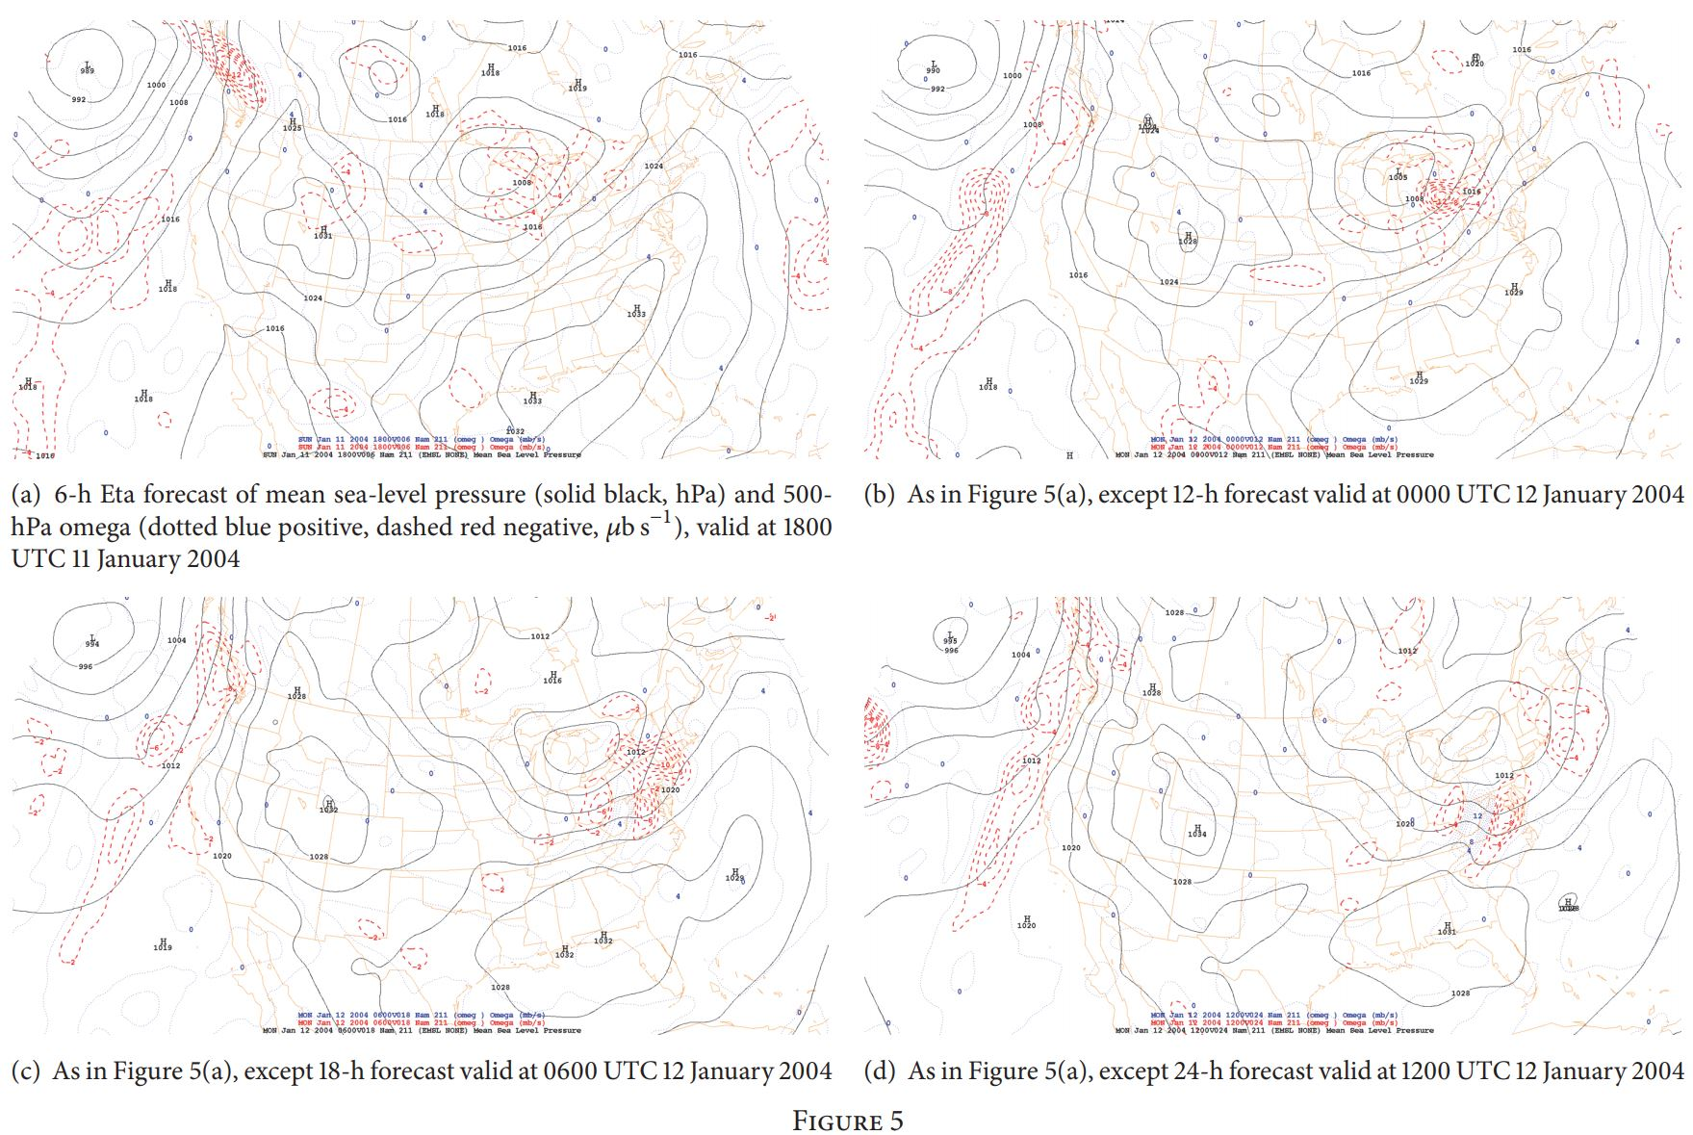
Notes:
Higher levels of ascent

Slide 25
Upper Level Jet Streaks
Analysis reveals:
2 Distinct Jet Streaks (regions of higher level winds at the 300mb level associated with the overall jet stream)
1 was centered over the region of highest snowfall
High divergence links the 2 jet streaks: Coupled Jet Streaks to force vertical motion (Ascent)
Cross Sectional Analysis reveals not only the jet streaks but also saturated warm air at the surface

Slide 26
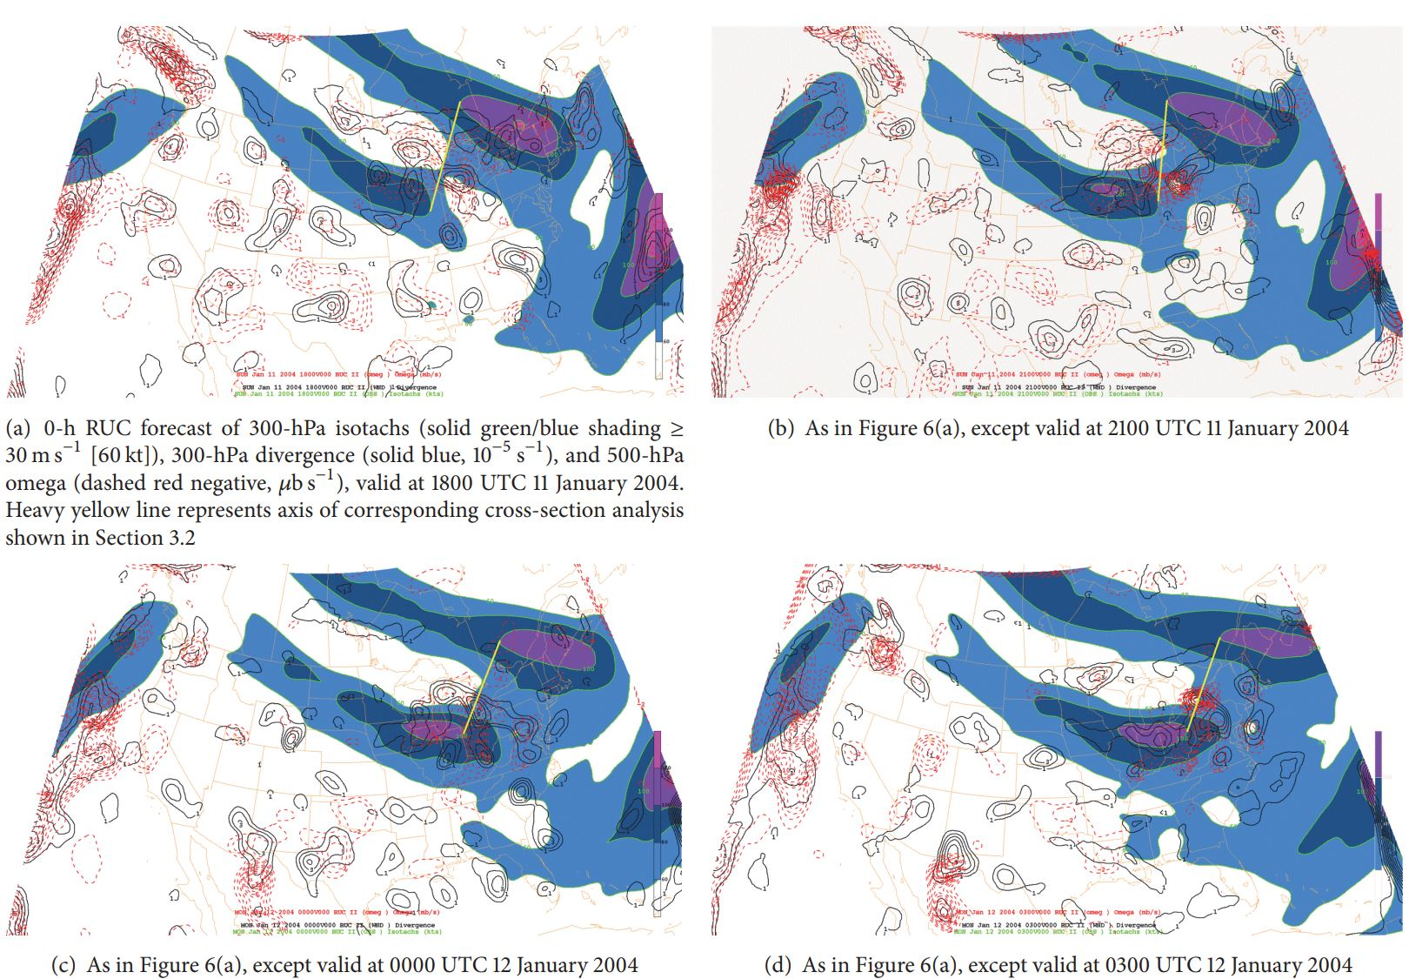
Notes:
Highest vertical motions and divergence in d. Divergence leads to the rising motions. Since the region has high divergence high rising motions to replace it… ie convection is more likely

Slide 27
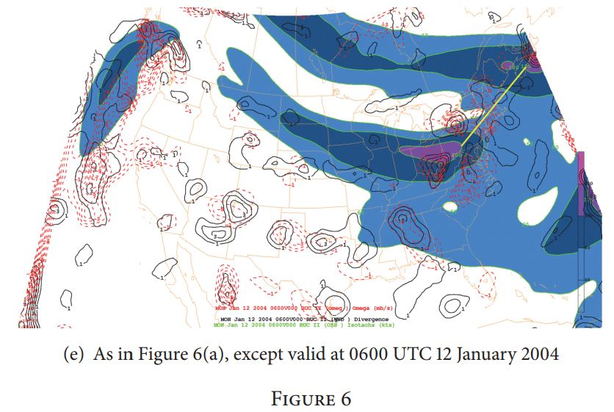

Slide 28
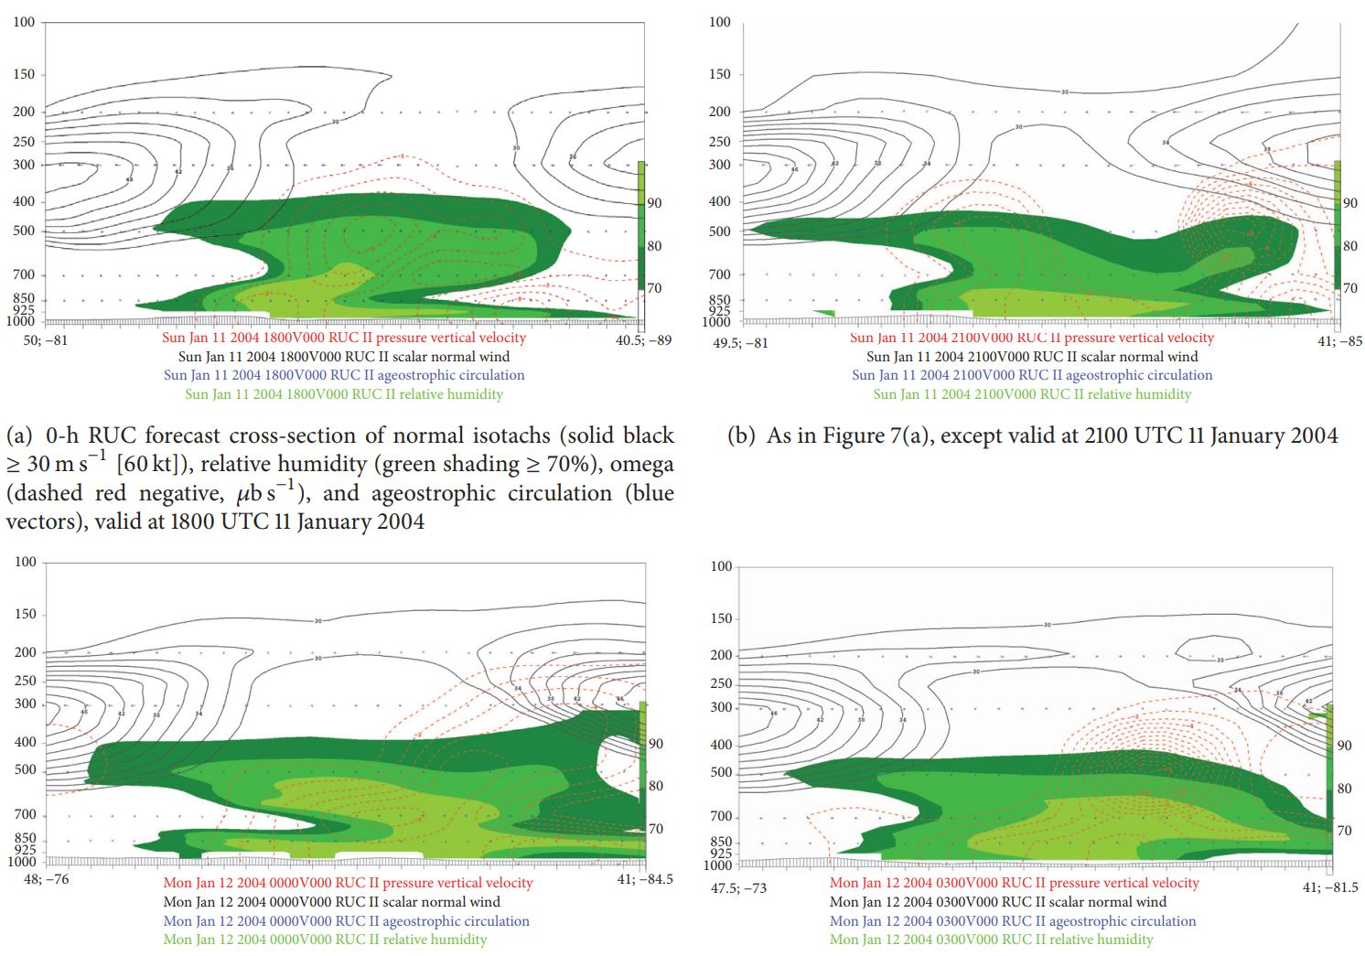
Notes:
Clear vertical motion by the coupling of the jets and below saturated air. Strongest signal in d

Slide 29
Moisture Analysis
Analysis using HYSPLIT reveals:
Surface Parcels: Cooling and moistening occurred 24 hours prior to the heaviest snowfall
1500m AGL Parcels: Ascended and moistened rapidly in the 12 hours prior to the end of the model run
3000m AGL Parcels: Clear cyclonic flow lee of the Rockies and 1800m ascent with substantial saturation15 hours before the snowfall
5400m AGL Parcels: 3000m ascent with moistening as well
Notes:
End time for trajectories is near the time of heaviest snowfall. 4 levels of air parcels

Slide 30
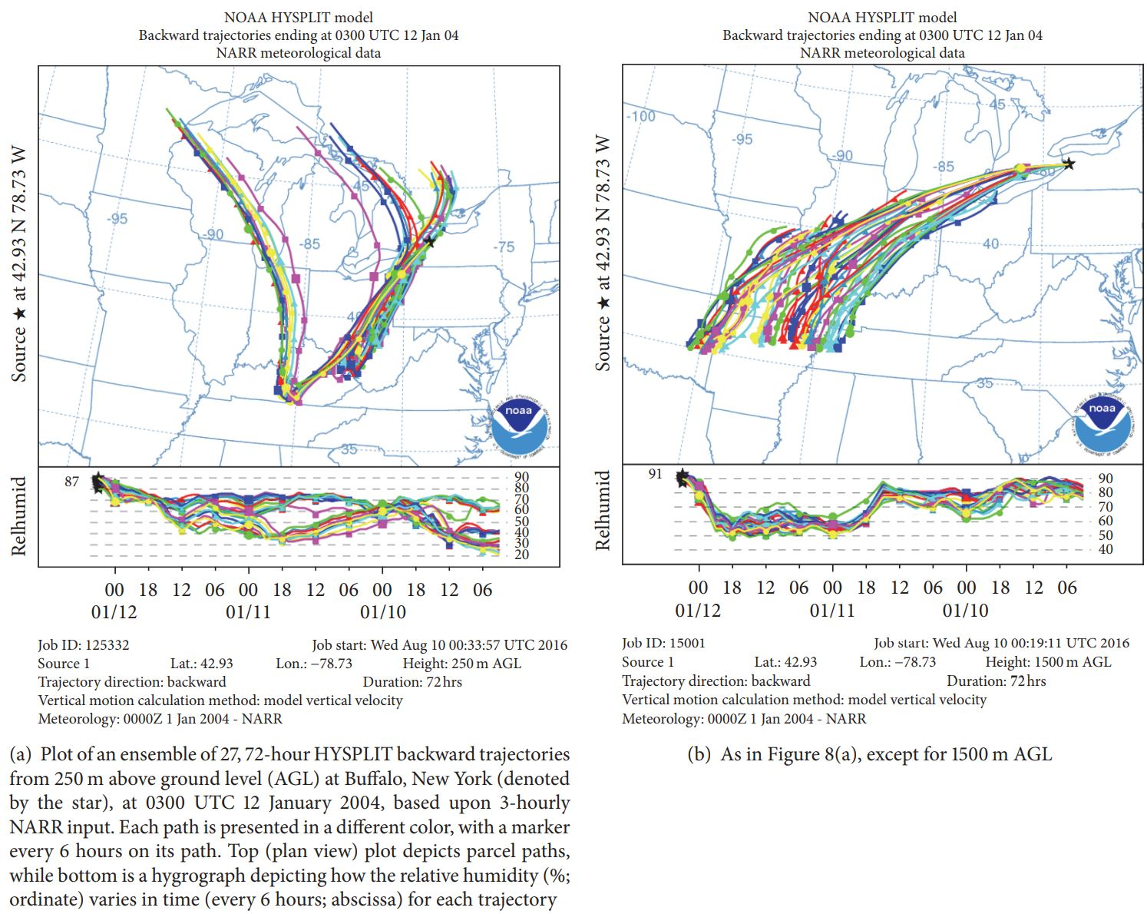
Notes:
End time for trajectories is near the time of heaviest snowfall. 4 levels of air parcels

Slide 31
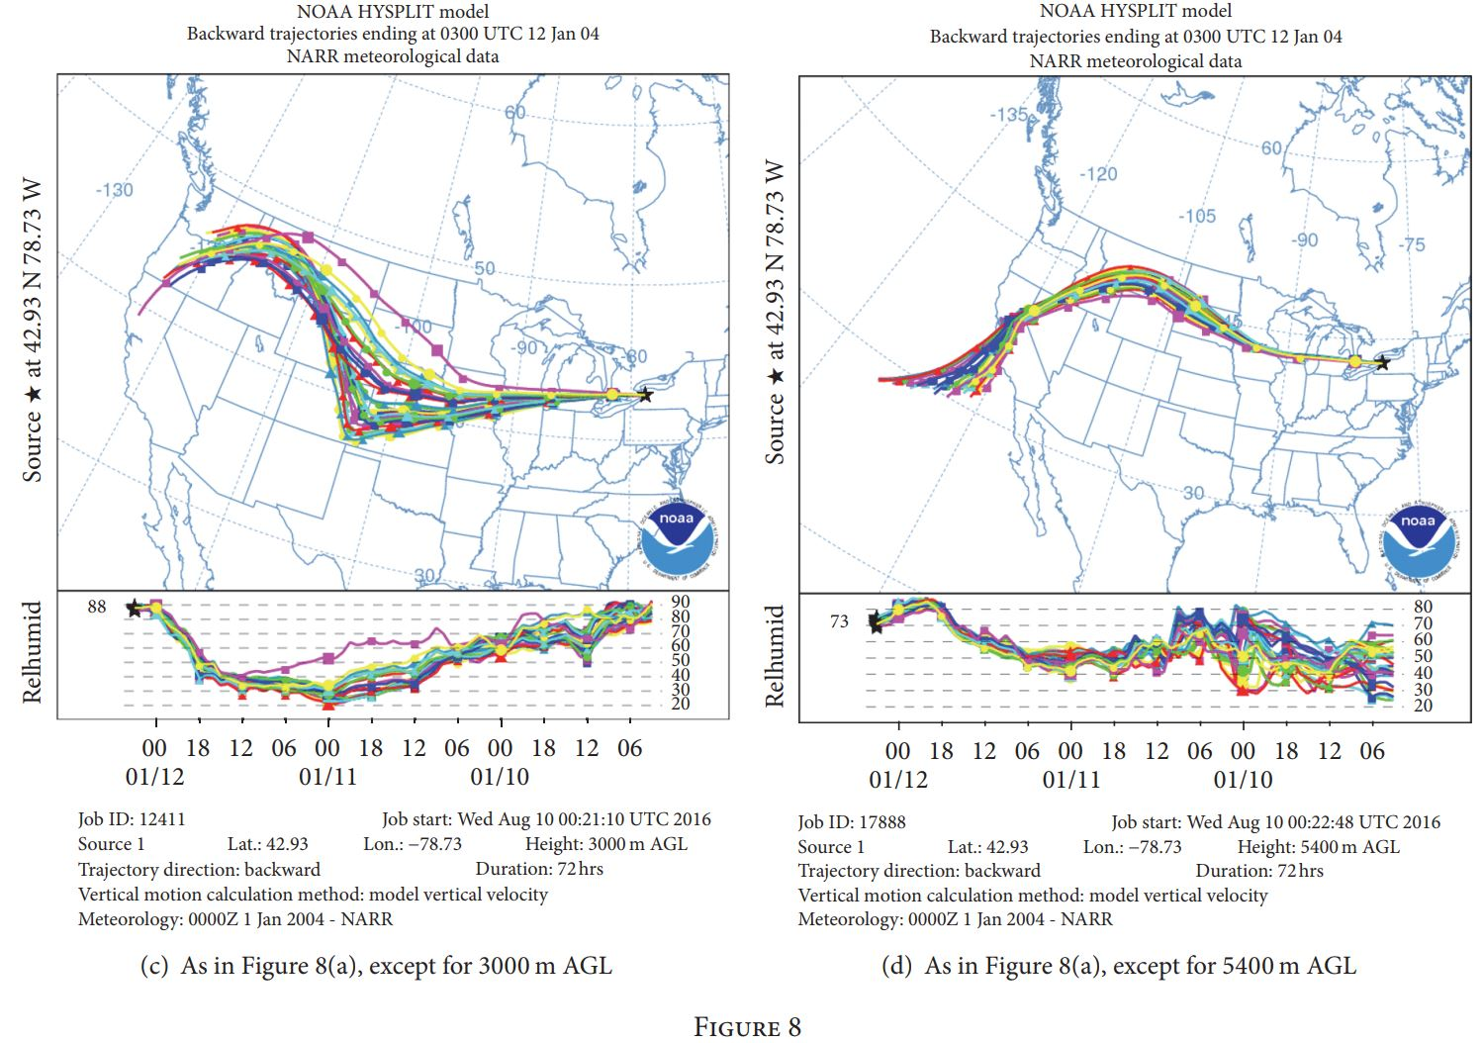

Slide 32
Moisture Analysis
Parcels did not originate in a region where there would be a substantial amount of moisture to cause anomalous snowfall
Precipitable water in the region of high snowfall was within climatological norms
Profile of trajectories suggests synoptic scale forcing but the mesoscale analysis suggested only a mild influence
Notes:
Points to the fact that the event was not caused by synoptic forcing but had to be between the jet interactions with some sort of instability

Slide 33
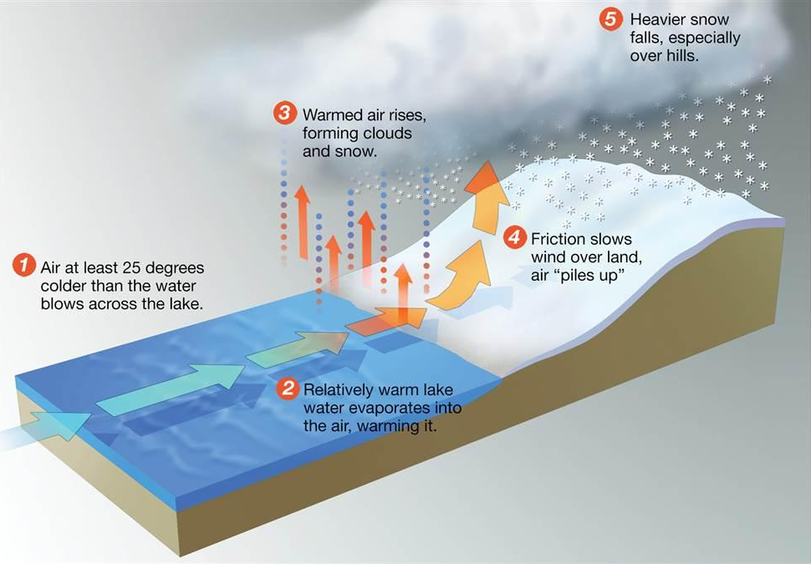
Lake Effect Snow
https://www.aopa.org/-/media/images/aopa-main/news-and-media/publications/flight-training-magazine/1802f/1802f_wx/1802f_wx_16x9.jpg?h=675&w=1200&la=en&hash=C11D965833A60BD2B7655218879F8B62CBE54FDB

Slide 34
Lake Effect Snow Analysis
Authors believed that the high precipitation rates were not stationary and part of a larger forcing mechanism
Latent and Sensible Heat Flux values were within climatological norms
They concluded that Lake Effect was not the cause of the event

Slide 35
Instability
NARR reanalysis of Sounding Profiles
North American Region Reanalysis assembles observational data to reproduce atmospheric qualities quantitatively
During the time of heaviest snowfall the profile indicated strong instability
Lifted Index (LI): Difference in temperature of a parcel lifted without any heat going into the parcel (adiabatic) and the environment at 500mb
Lapse Rate: Difference in temperature between 2 layers in the atmosphere
Notes:
32km grid for the NARR

Slide 36
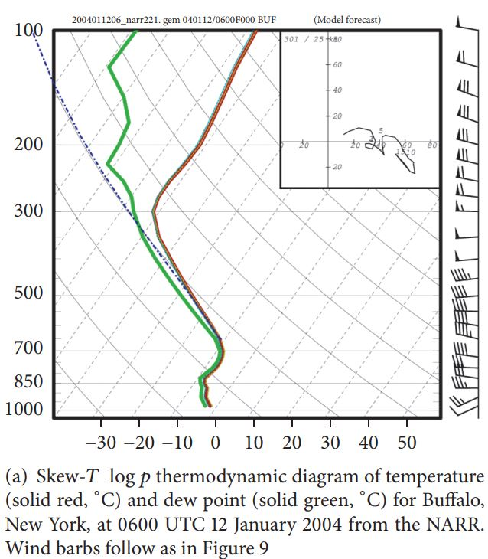
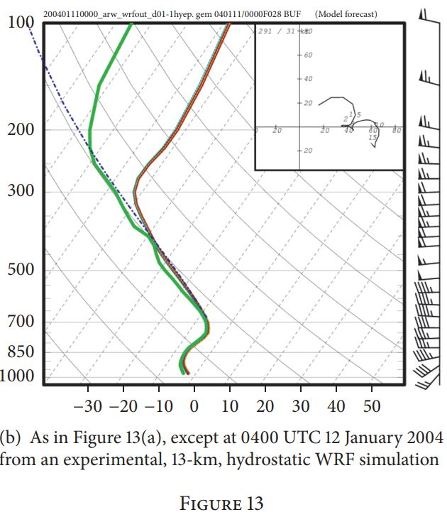
LI: 0
Lapse Rate: 7.2 K/km
Lower LI values indicate instability. Results align with cases of Convective Snow in the Midwest per Market et al.

Slide 37
Radar Analysis
Analysis reveals clearly more intense snowfall rates during the time of strongest jet coupling and vertical ascent
The left over snowfall the authors state is lake-enhanced alluding to some lake effect occurring after the synoptic snowfall had moved through the area

Slide 38
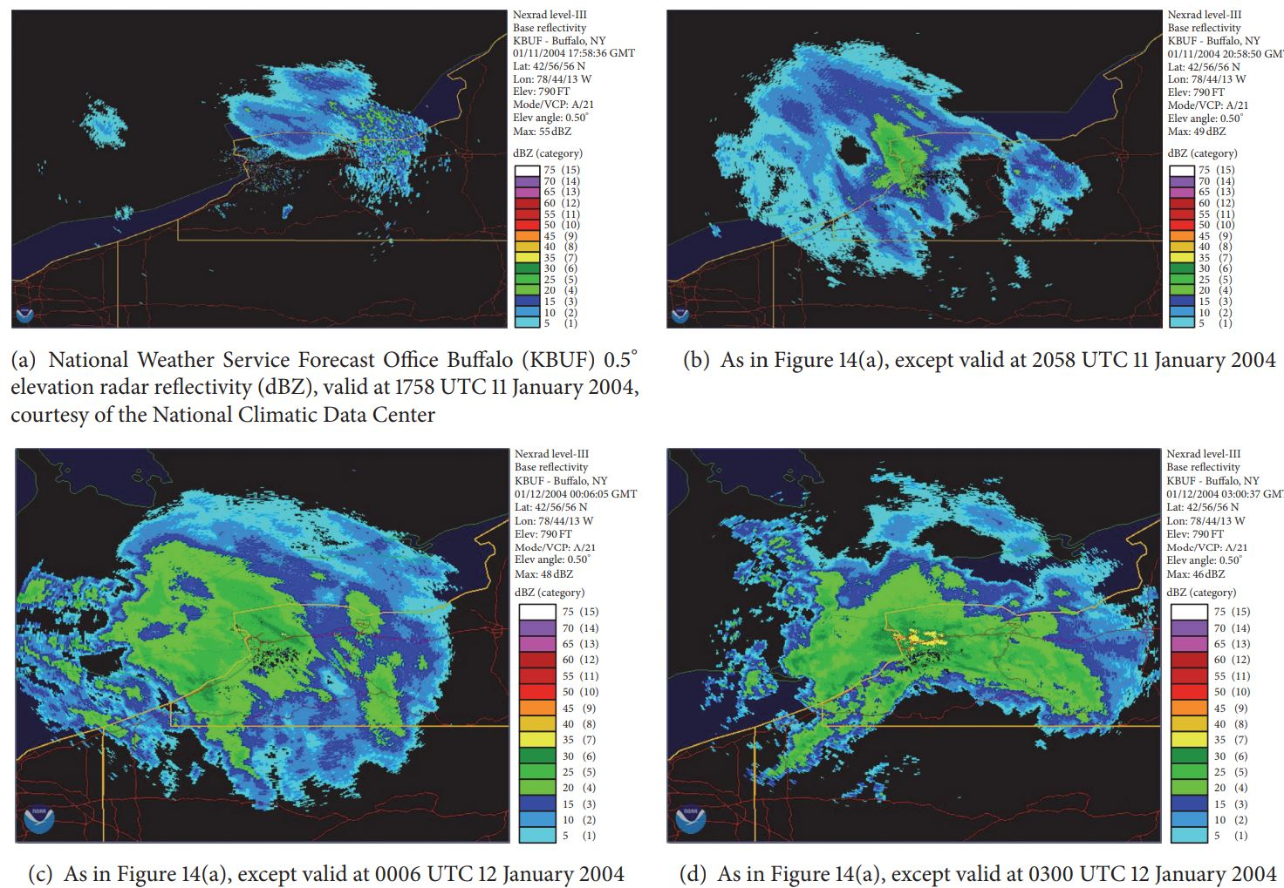

Slide 39
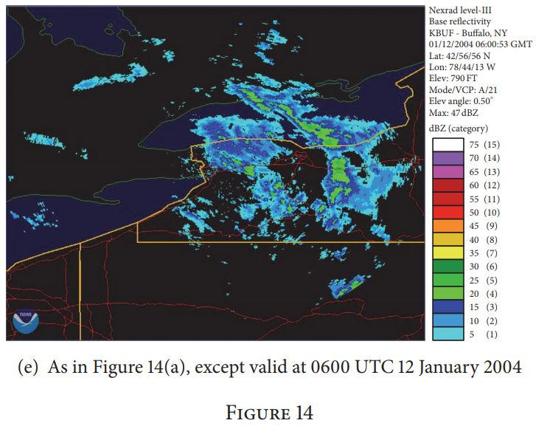

Slide 40
Conclusion
Based on the analysis provided a coupled jet interaction created the necessary upper level divergence to promote strong vertical motions
Strong vertical motions along with locally strong convective instability triggered the growth of convective snowfall producing anomalous amounts of snow for an Alberta Clipper

Slide 41
Thoughts
Ingredients Based Methodology not only makes the analysis specific but also confined
This could be both a fair and unfair treatment of the case
The authors analyzed the effect of Lake Effect Snow very briefly
Hydrostatic and non convection allowing models seemed to resolve the apparent convection that took place via divergence analysis of jet streaks
What would the analysis look like if they used modern models like the HRRR?
Notes:
Maybe should have looked at the temperature differences between the water and surroundings for the lake effect? HRRR allows convection and is non hydrostatic

