Slide 1




University of Nevada, Reno
Seminar Topic:
Characterization of Mineral Dust using XRD and Infrared Spectroscopy
Case study: Ilam, Iran
Presenter:
Mohammad Reza Sadrian
Professor Patrick Arnott
Professor Mae Gustin
ATMS 790 - Graduate Seminar in Atmospheric Sciences
Spring 2019

Slide 2
Outline
Introduction
Past studies
Proposed Work:
  Sample Location
  Sample collection
  Methods (Spectroscopy and XRD)
Initial Results ( Using SWIR, LWIR, and XRD)

Slide 3
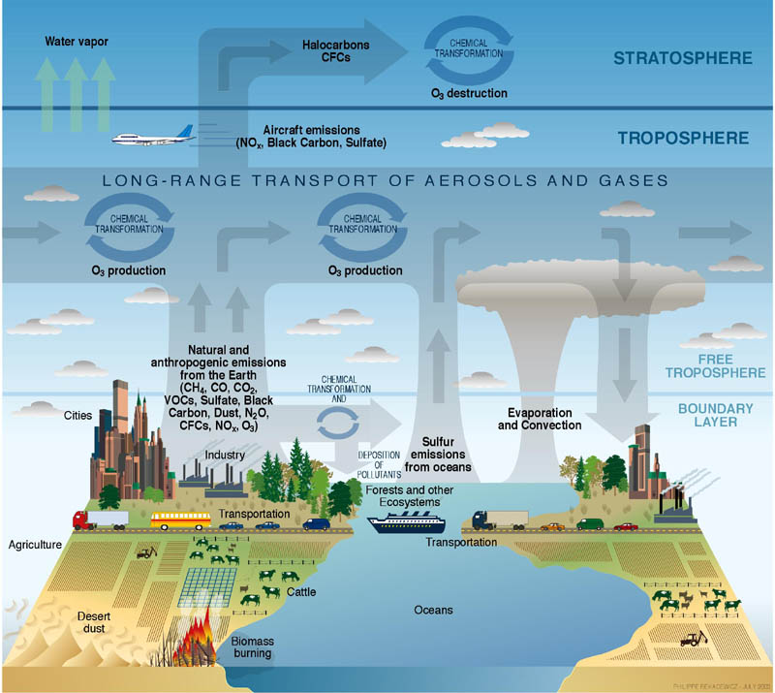
Sources of Air Pollution

Slide 4
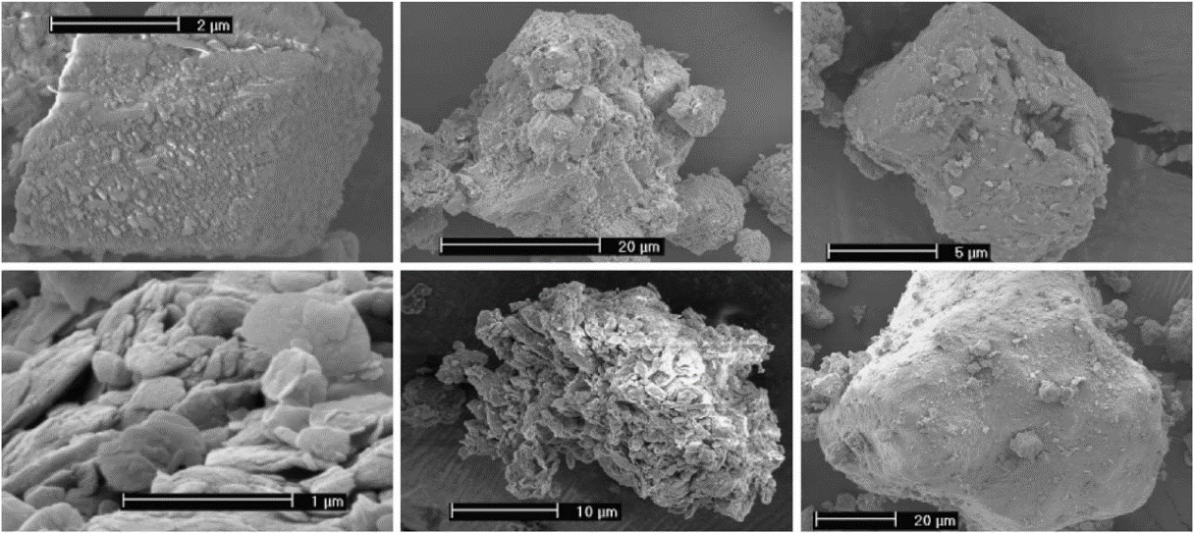
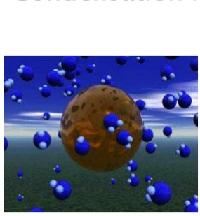
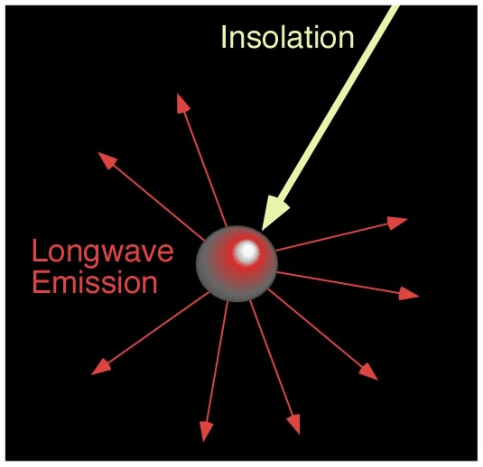
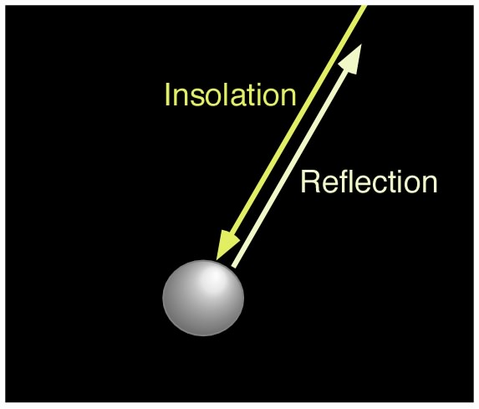
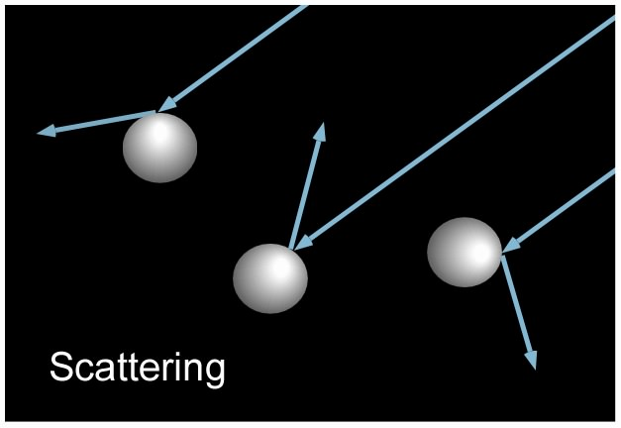
Introduction
Mineral dust
Health Hazard and Environment Effects:
Direct and Indirect effects on radiation:
Different type of dust: (PM₁₀ and PM_{2.5})
Common sources: Biomass burning, automobile, and etc…
PM_{2.5}: Incomplete combustion of petroleum products
PM₁₀: Soil dust, unpaved road dust
Electron-microscope images of sample mineral
Cloud Condensation Nuclei
Notes:
Mineral dust is atmospheric aerosols originated from the suspension of minerals constituting the soil. It is composed of various oxides and carbonates. Human activities lead to 30% of the dust load in the atmosphere.
- The dust-particle size distribution is often divided in to a clay(r<1mm), silt(1<r<25mm), andsand
fractions(r>25mm). Dust particles are not spherical, fragmentation during wind erosion which sill an unknown proccess.
Small size atmospheric particulate matter, PM₁₀ and PM_{2.5} (particulate matter with aerodynamic diameter less than 10 μm and less than 2.5 μm, respectively)

Slide 5
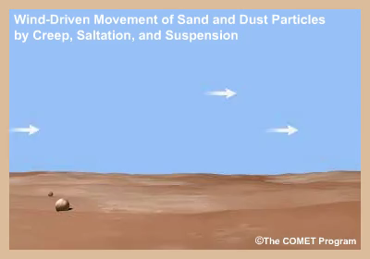
Dust moves through several processes:
Saltation
Creep
Suspension
Notes:
Suspension occurs when very fine dirt and dust particles are lifted into the wind. They can be thrown into the air through impact with other particles or by the wind itself. Once in the atmosphere, these particles can be carried very high and be transported over extremely long distances. Soil moved by suspension is the most spectacular and easiest to recognize of the three forms of movement.
Saltation - The major fraction of soil moved by the wind is through the process of saltation. In saltation, fine soil particles are lifted into the air by the wind and drift horizontally across the surface increasing in velocity as they go. Soil particles moved in this process of saltation can cause severe damage to the soil surface and vegetation. They travel approximately four times longer in distance than in height. When they strike the surface again they either rebound back into the air or knock other particles into the air.
Creep - The large particles which are too heavy to be lifted into the air are moved through a process called surface creep. In this process, the particles are rolled across the surface after coming into contact with the soil particles in saltation.

Slide 6
Let’s see how dust storms happen in desert area:
Link: https://www.youtube.com/watch?v=T_oqoxGHIc0
Link: https://www.aparat.com/v/Zlq3m/%D8%B7%D9%88%D9%81%D8%A7%D9%86_%D8%B4%D9%86_%D8%AF%D8%B1_%D8%B4%D9%87%D8%B1_%DB%8C%D8%B2%D8%AF

Slide 7
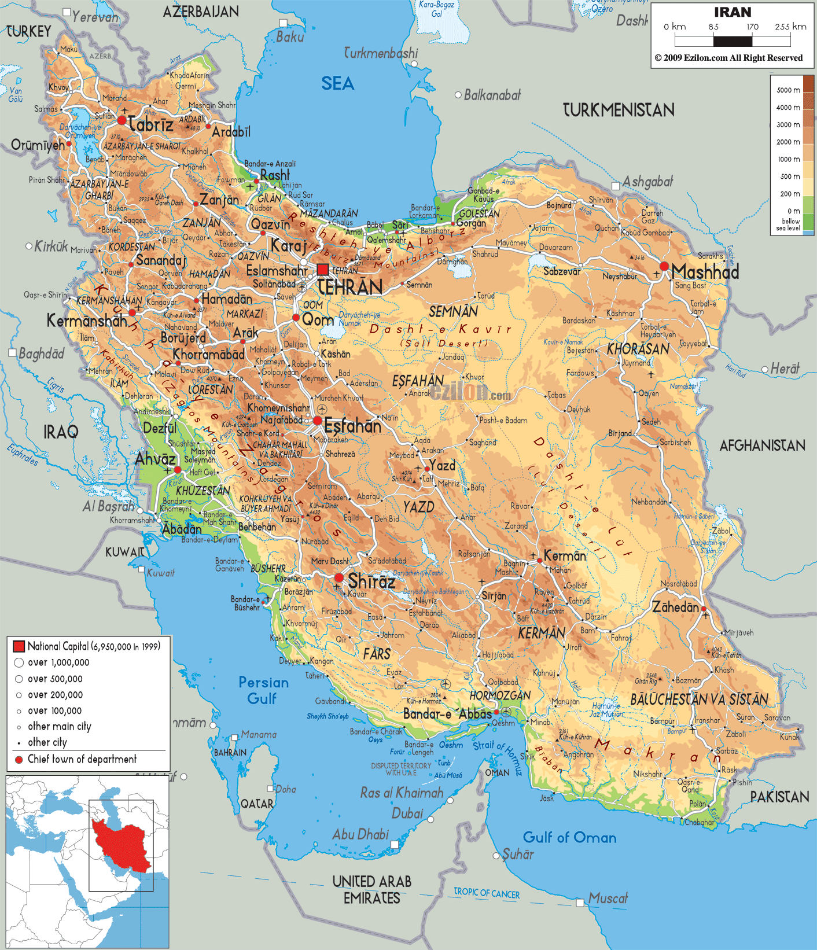


Slide 8
Location of 13 (Marble Dust Collector) MDCO deposition sites (S1-S13) within Ilam city
Collected in different 3 seasons
Total of 37 samples

Slide 9
Locality of 13 deposition samplers in Ilam city.

Slide 10
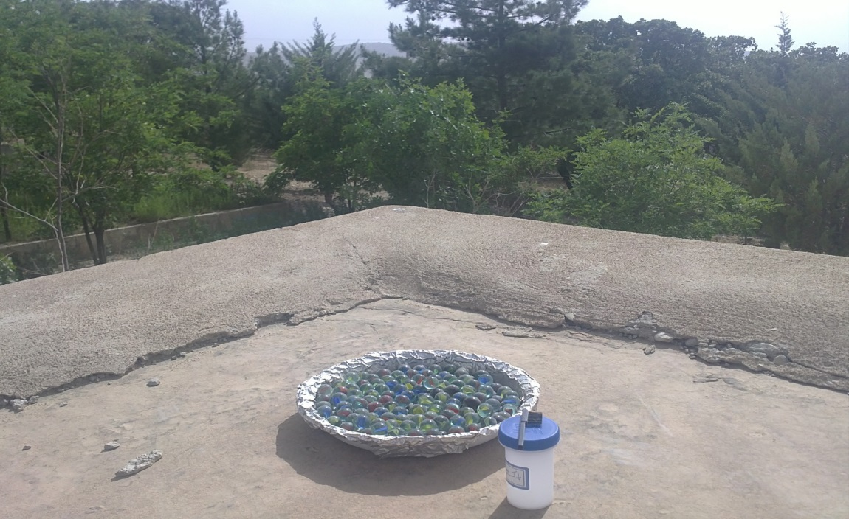
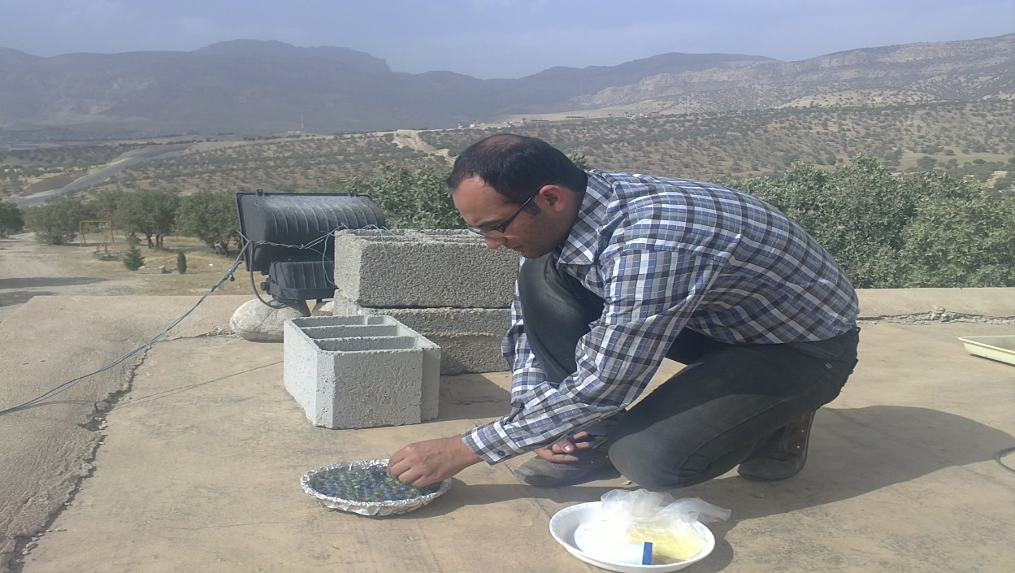
Sample Collection
Aluminum cover
Marble
Small brush
Sample bottle
MDCO (Marble Dust Collector) airborne dust collector Placing the marbles in sampler
(Goossens and Offer, 2000) and (Goossens et al., 2001).
Notes:
For the proposed work, to trap the dust samples in Ilam, marble dust collectors (MDCO) were used which was found to be more efficient in collecting dust particles in dry desert regions (Goossens and Offer, 2000). The device consists of a shallow plastic dish loaded with one or two layers of glass marbles, which is installed at ground level or off the ground on a pedestal. Different types of dishes are used, but the circular designs were better compared to the rectangular or square dishes, especially with variable wind directions. The plastic dishes are 22.5 cm in diameter, lined with an aluminum sheet to avoid a static electricity charge buildup between the dust particles, glass marbles, or the plastic dish. Standard glass marbles have a diameter of 1.6 centimeters. The reason for using glass marbles is to prevent the dust deposit from being blown out of the container during strong winds or severe rain storms (Goossens et al., 2001).

Slide 11
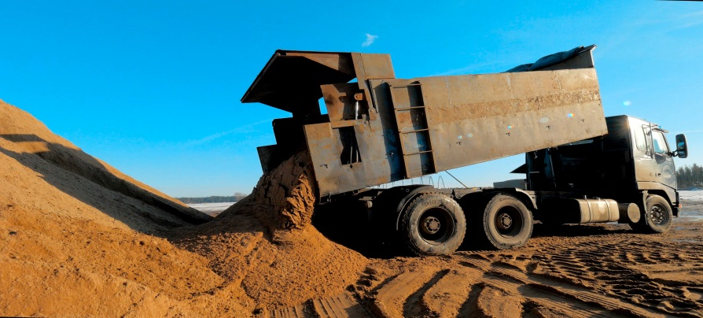
Three monthly deposition rates in three periods of sampling
4832 metric-tons (mt) over the entire city of Ilam (fall)
5328 mt (winter)
7233 mt(spring)
1 mt = semi truck?
1 metric ton = 1000 kg*
?

Slide 12
Significance of the Project:
Dust composition is poorly known and not linked to source regions.
Global soil mineralogy is not well defined.
How mineralogy changes with dust particle size is also unknown.
In particular SWIR measurements of mineral dust have not been previously made.
Measurements will define dust composition using tools that can be linked to global remote sensing to understand transport.
Spectral measurements can generate optical constants for use in atmospheric models.

Slide 13
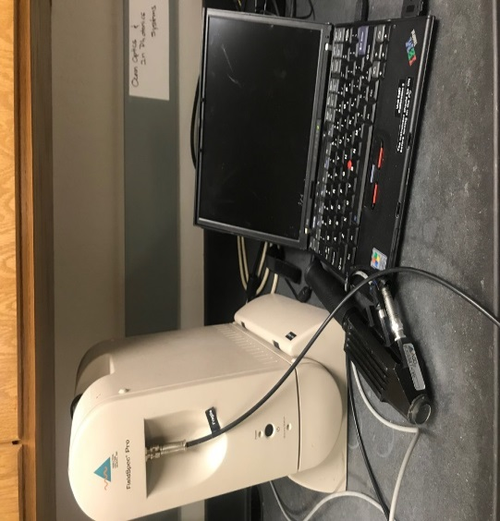
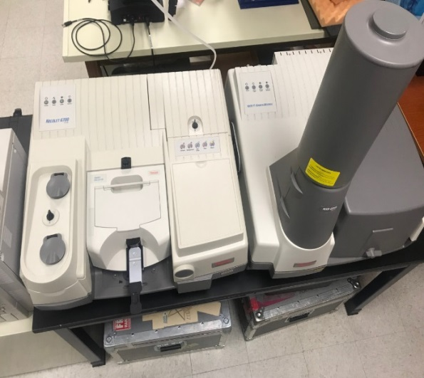
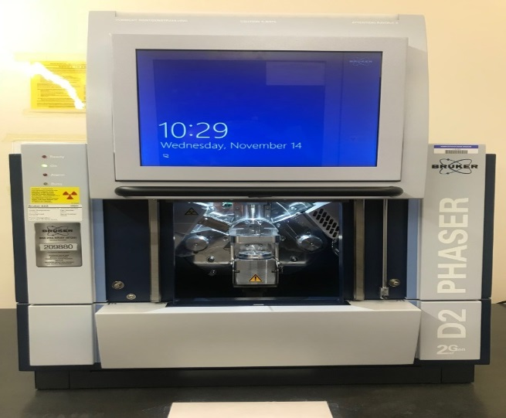
Preliminary Work
Techniques Methods
  Spectra (ASD and FTIR)
  XRD
Analytical Spectral Device (ASD):
In the visible, near infrared, and short-wave infrared (VNIR/SWIR) (0.4 to ~2.5 μm), absorption features arise due the electron orbital configuration of transition metals.
Fourier-Transform Infrared (FTIR ) Spectrometer:
The long-wave infrared (LWIR) (5 to 25 μm, or 2000 to 400 cm⁻¹), is sensitive to the fundamental molecular vibrations of ligand groups similar to the VNIR/SWIR.
Analytical Spectral Devices
The proposed research uses XRD to identify the presence of mineral in a dust sample.
Nicolet TM 6700
Bruker AXS D2 phaser
Notes:
Analytical Spectral Devices, Inc. (ASD) spectroradiometer is designed to measure from 350 nm – 2500 nm, providing uniform VNIR/SWIR data collection. Data are collected by placing the dust sample in a small sample holder and using a contact probe with a halogen light source. As part of regular calibration the contact probe measures a white halon plate. All sample measurements are automatically ratioed to the halon calibration target resulting in a measurement that is in reflectance.

Slide 14
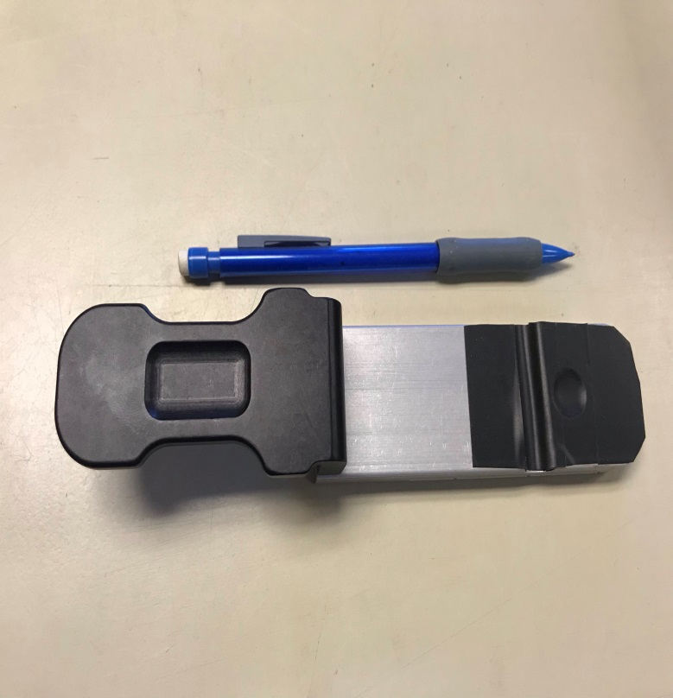
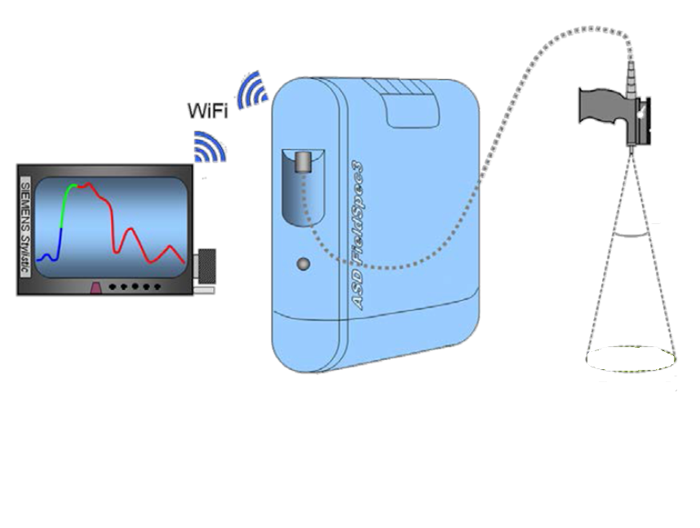
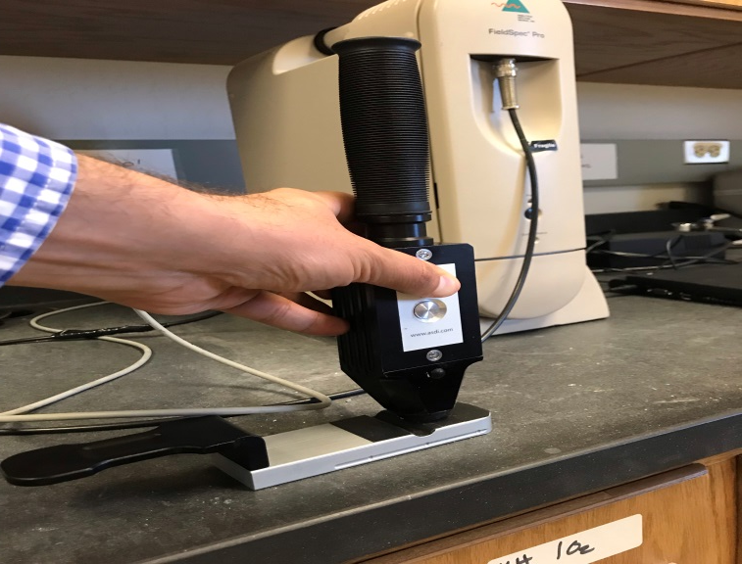
Sampling Strategy with ASD
Sample holder
Schematic illustration of the technical arrangement of a hyperspectral field- or laboratory measurement (Danner et al, 2015)
Contact probe
Notes:
Data are collected by placing the dust sample in a small sample holder and using a contact probe with a halogen light source. As part of regular calibration the contact probe measures a white halon plate. All sample measurements are automatically ratioed to the halon calibration target resulting in a measurement that is in reflectance.

Slide 15
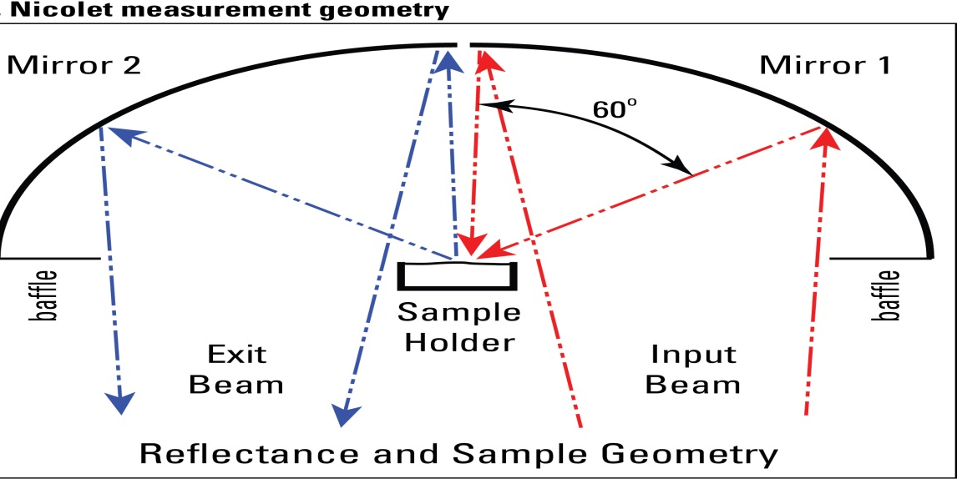
How FTIR works
The FTIR uses interferometry to record information about a material placed in the IR beam. The Fourier Transform results in spectra that analysts can use to identify or quantify the material.
An FTIR spectrum arises from interferograms being ‘decoded’ into recognizable spectra
Patterns in spectra help identify the sample, since molecules exhibit specific IR fingerprints
(Kokaly, R.F., et al. 2017)

Slide 16
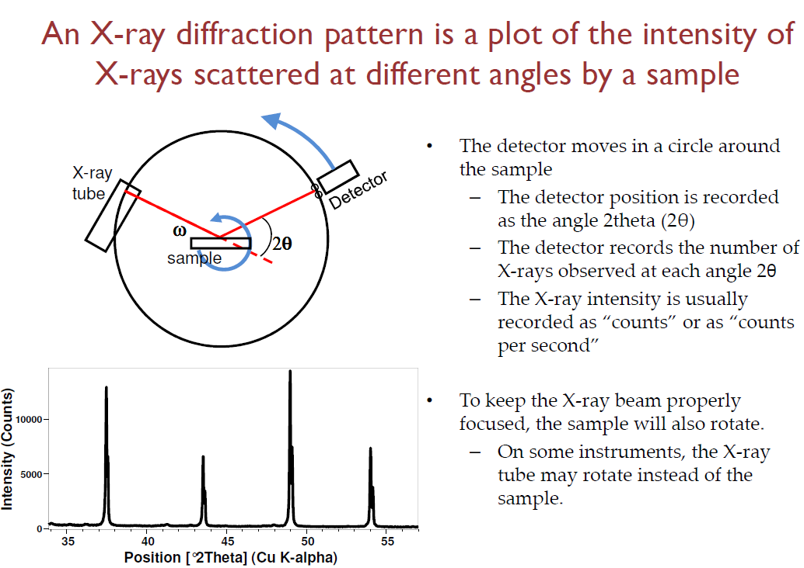

How XRD works!

Slide 17
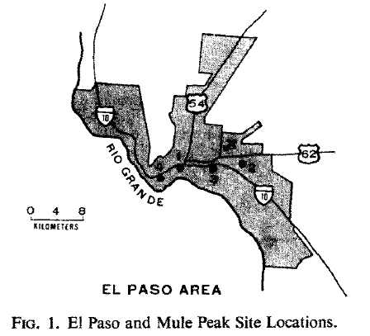
An Infra-Red spectroscopic view of atmospheric particulates over El Paso, Texas
Past Studies
Nine sets of atmospheric dust samples were collected at 5 km intervals along an east-west line from commercial, high population density residential, industrial, and low population density residential environments within the central urban area of El Paso, Texas
Blanco and McIntyre, 1972

Slide 18
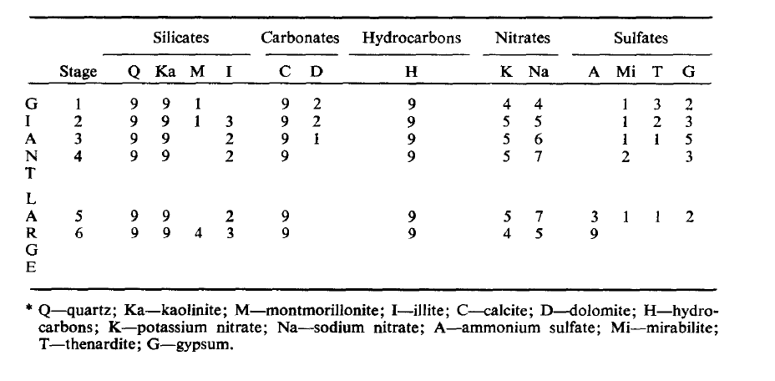
Frequency of identification as a function of particle size for each member of the five chemical families in the nine atmospheric dust samples containing a given constituent is indicated by the number in the appropriate column.
Notes:
The silicates, carbonates, and hydrocarbons were always present in the giant and large fraction; however, the nitrate and sulfates were sporadically identified in both fractions.

Slide 19
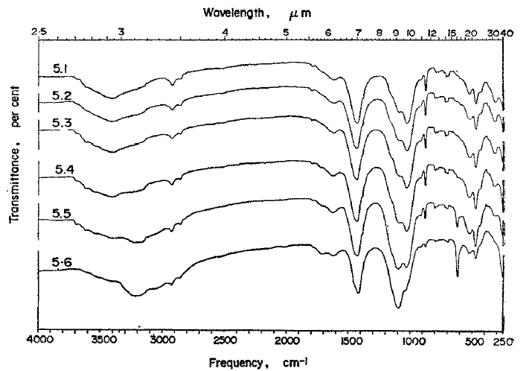
Transmittance Method
by stage 6 the silicate (1028 cm^-l) absorption band is no longer the strongest band. All sets of samples revealed the presence of ammonium sulfate in the large particle fraction and never in the giant particle fraction
of the sample.
Infra-red absorption spectra of atmospheric dust collected, sample 5 with stage l-6.

Slide 20
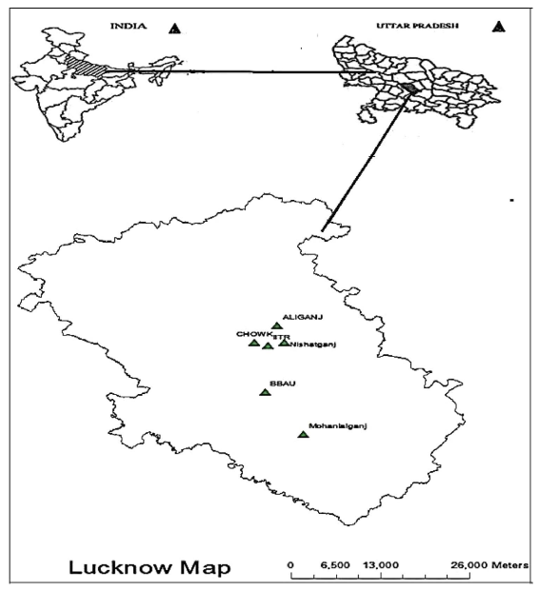
Past Studies
Characterization and morphological analysis of individual aerosol of pm₁₀ in urban area of lucknow, India.
Particulate matters were studied for morphological analysis, elemental composition and functional group variability with the help of Scanning Electron Microscope-Energy Dispersive Spectroscopy (SEM-EDS) followed by Fourier Transform Infrared spectroscopy (FTIR).
Different sampling sites at Lucknow
(Bharti, et al., 2017)

Slide 21
Past Studies
Sulphate and bisulphate was found integrated between 1000–1200 cm⁻¹ and 605–595.8 cm⁻¹ respectively.
Strong absorption at 1090–730 cm⁻¹ represents the dominance of quartz and kaolinite in the particulates.
Absorption between 461 and 467 cm⁻¹ indicates the presence of silicate ions in particulate matter, whereas, absorption between 776 and 796 cm⁻¹ is due to presence of silica.
FTIR spectra of particulate matter collected from various locations of Lucknow (NG =Nishatganj, MG =Mohanlalganj) (Bharti et al. 2017)

Slide 22
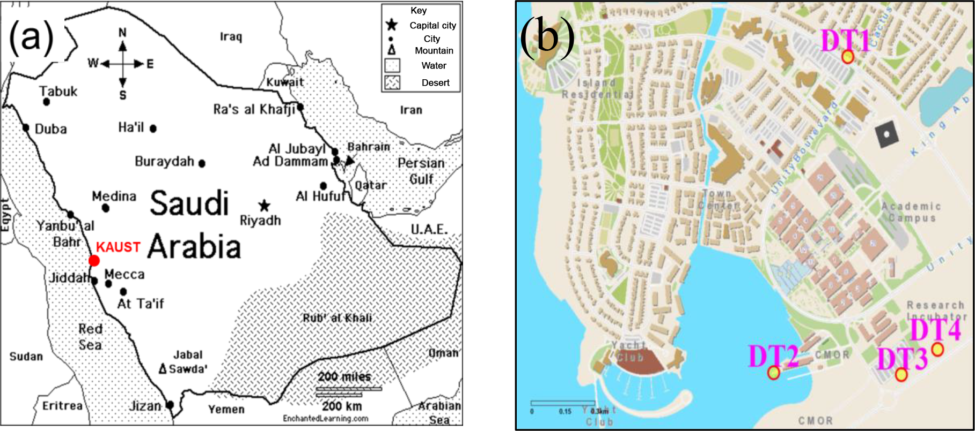
Physical properties of airborne dust over Arabian Red Sea coastal plain
Past Studies
Position of (a) the King Abdullah University of Science and Technology (KAUST) campus on the Arabian Peninsula (red marker), north of the coastal city of Jeddah, and (b) the Frisbee deposition sites (DT1-DT4) on the KAUST campus (Engelbrecht, et al., 2016)

Slide 23
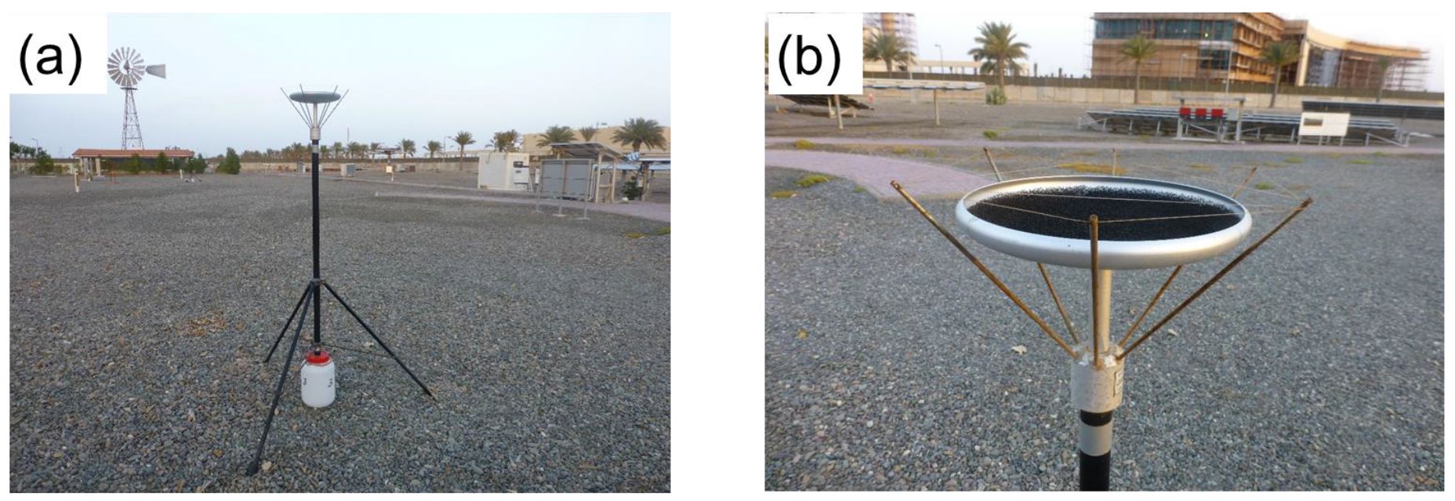
Sampling Method
Inverted Frisbee-type deposition sampler (a) on tripod and white plastic drainage bottle. (b) View showing the foam insert in the collection dish to help retain the deposited dust particles, as well as the spikes with nylon thread to prevent birds from readily perching on the dish.

Slide 24
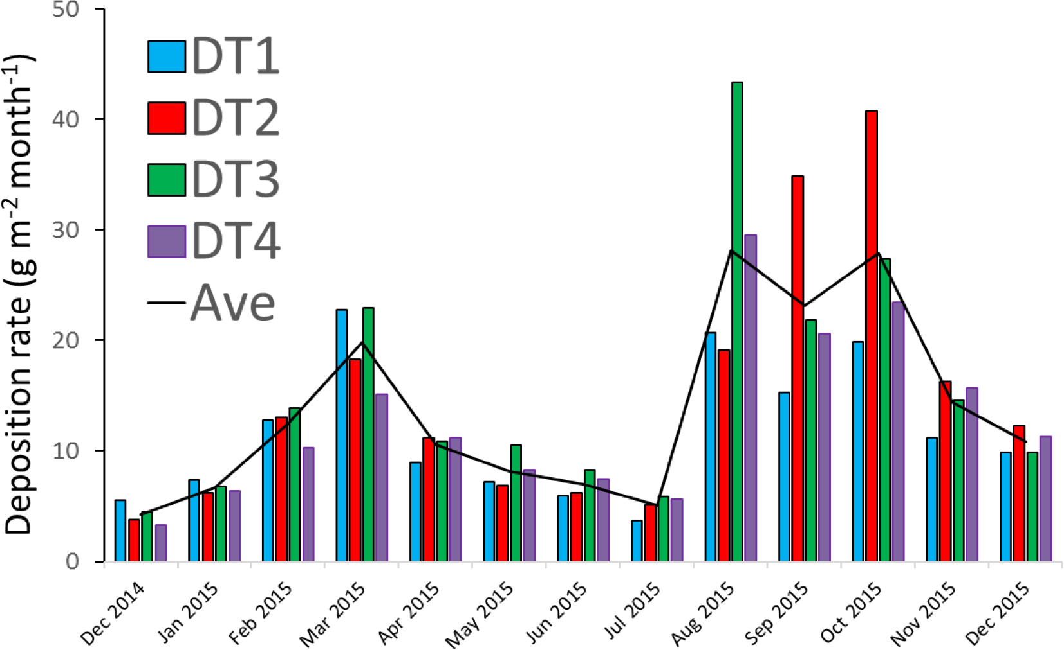
Gravimetric analysis
Monthly deposition rates (gm⁻²) from Frisbee samplers (DT1-DT4) at the KAUST campus. Also shown are the monthly averages for the four samplers.

Slide 25
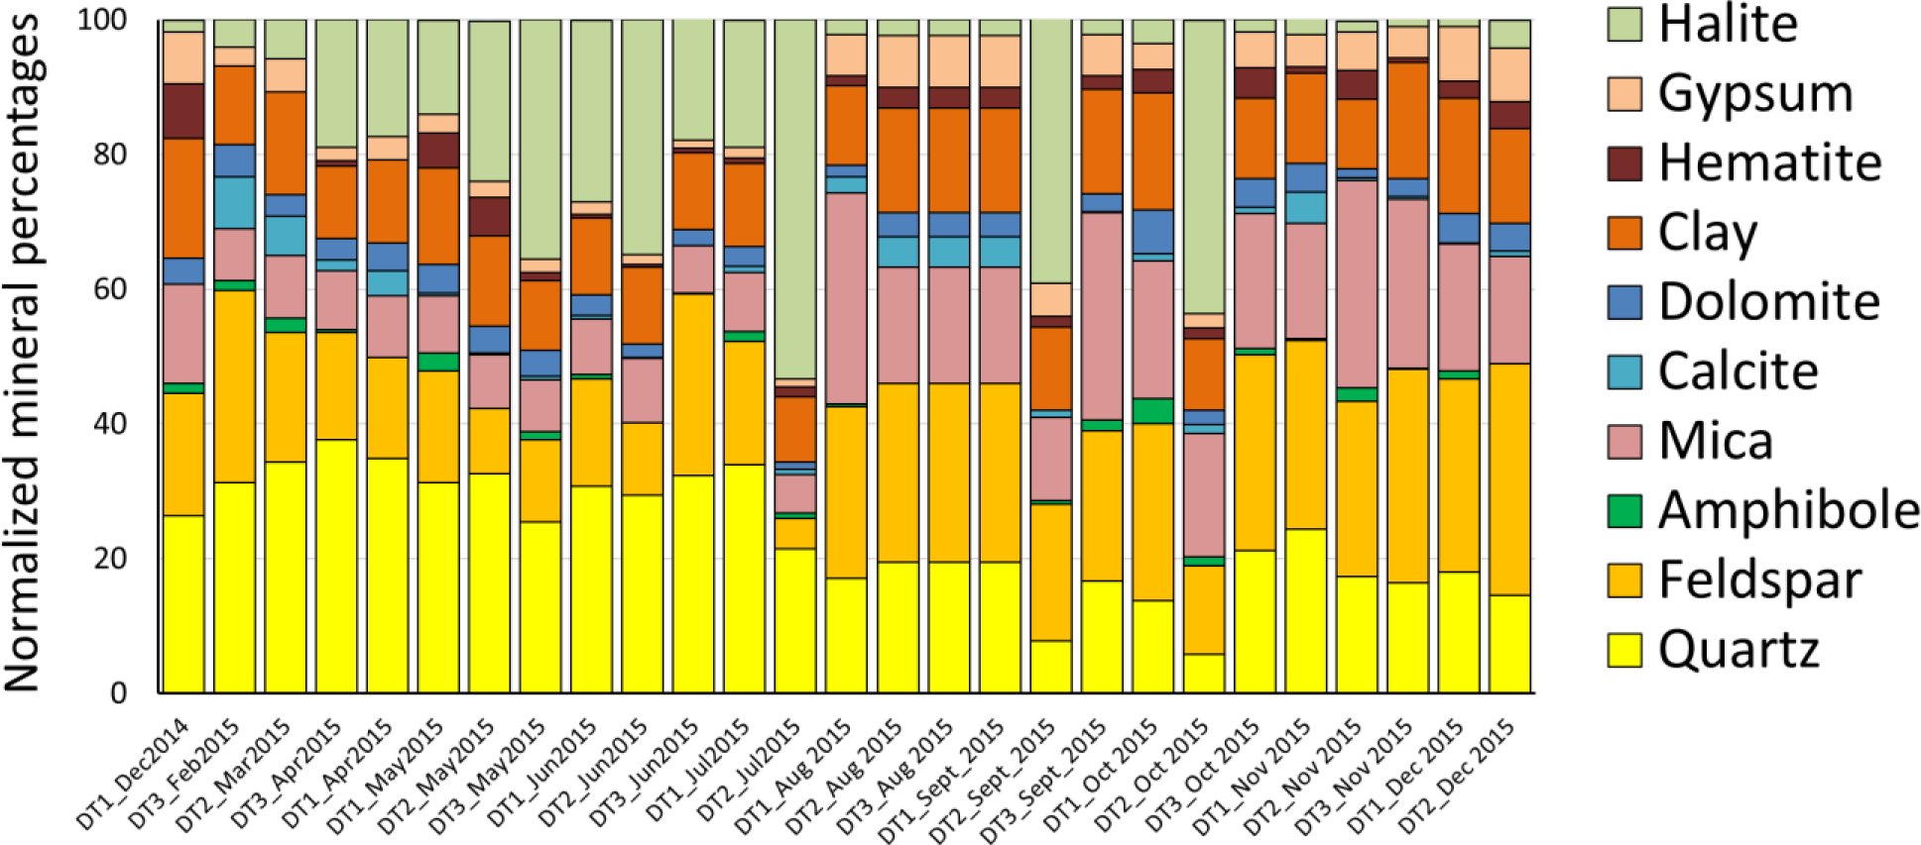
Mineral Analysis by XRD
?
Semi-quantitative XRD mineral analyses of monthly Frisbee samples collected at the three sites DT1–DT3, for the period December 2014 to December 2015.

Slide 26
Analysis to Date
Measured all 37 using XRD, SWIR and LWIR reflectance
Analysis Approach
  Group spectra by similar features (by ENVI software)
  Identify common features using libraries
  XRD uses instrument evaluation software to ID minerals

Slide 27
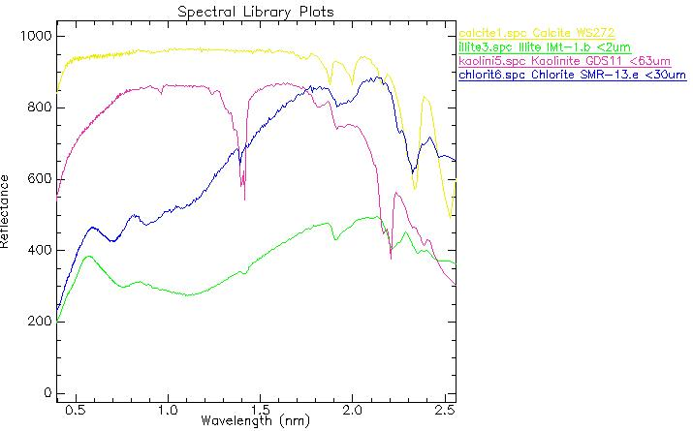
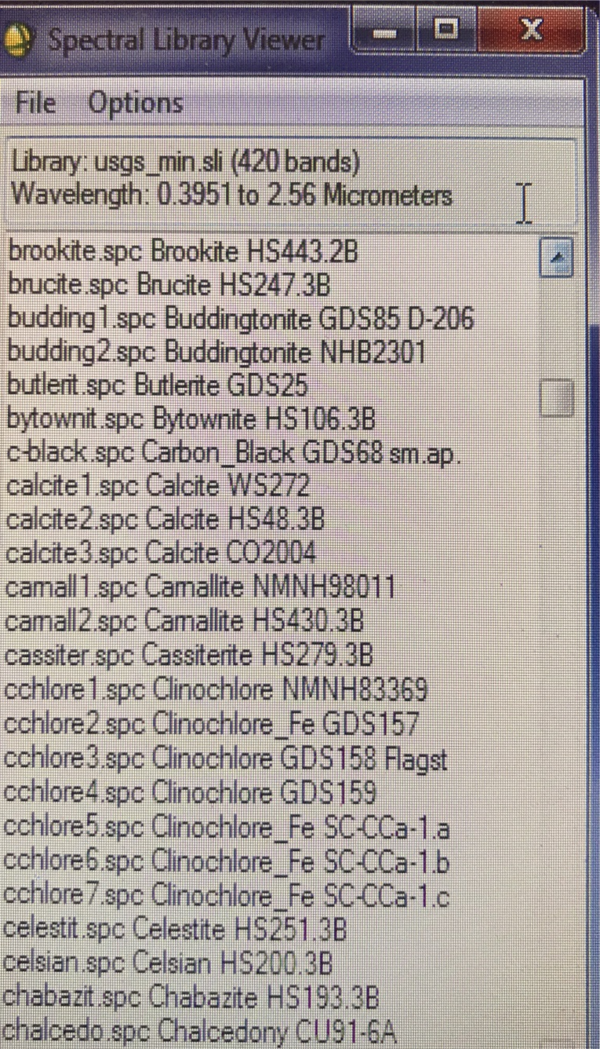
SWIR USGS Spectral Library
CO2
CO2
CO2
CO2

Slide 28
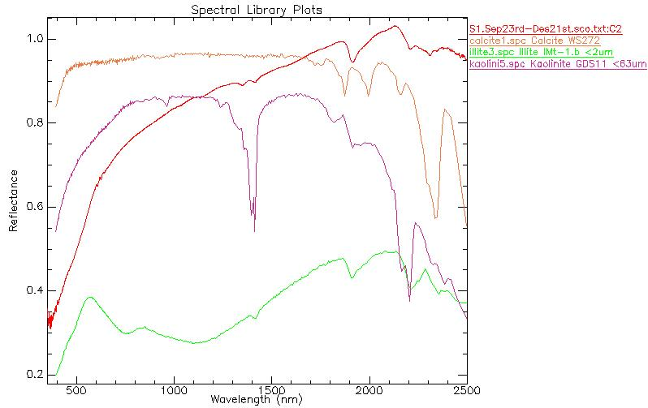
Preliminary Results for SWIR
No CO2 is detected

Slide 29
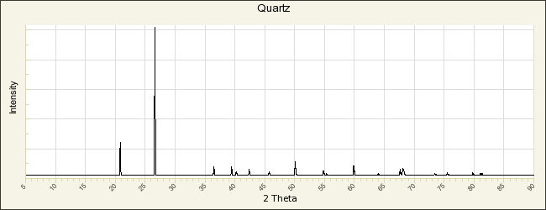
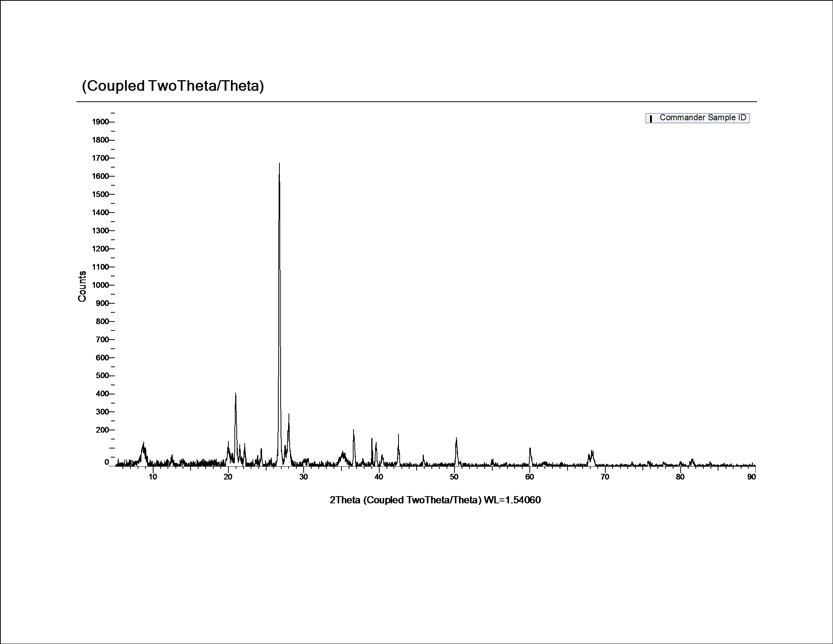
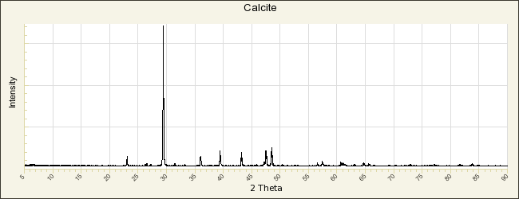
Preliminary Results for XRD
26.5̊
29.5̊
RRUFF Database

Slide 30
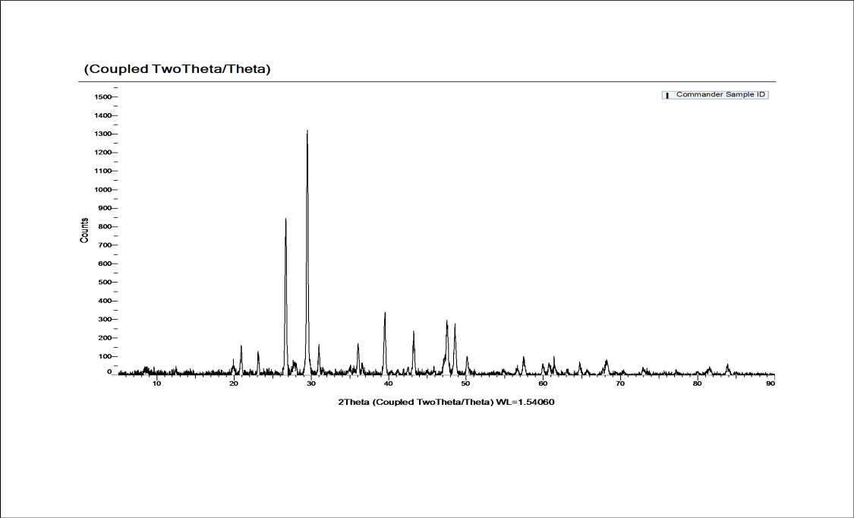
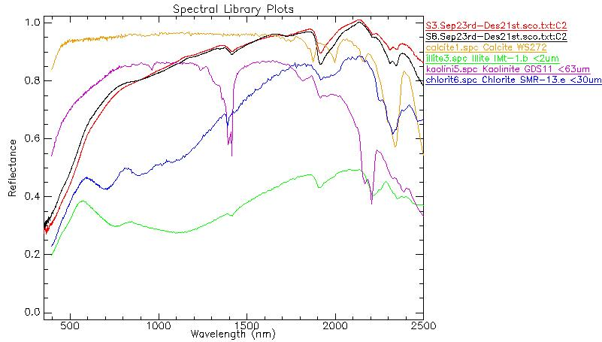
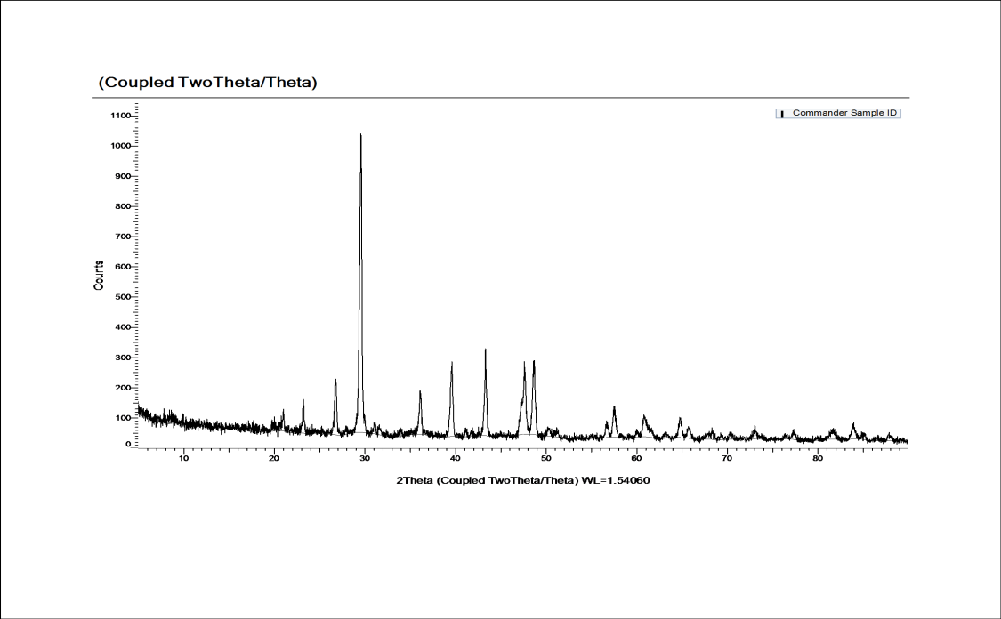
Initial spectral results:
S3.Sep23rd-Dec21st
Calcite
Chlorite
Illite
Kaolinite
S8.Sep23rd-Dec21st
Calcite
Chlorite
Illite
Kaolinite

Slide 31
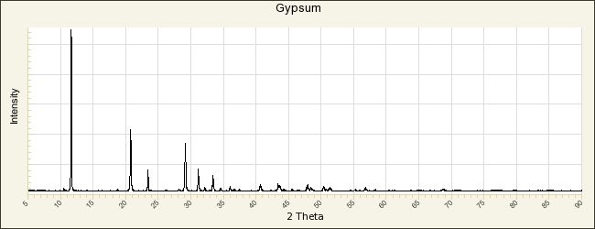
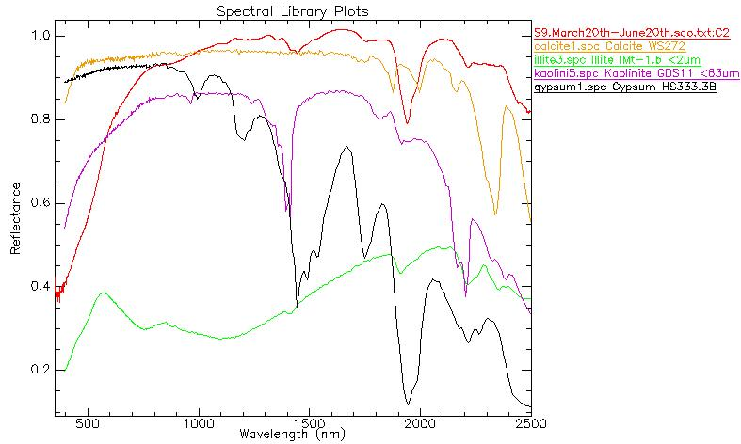
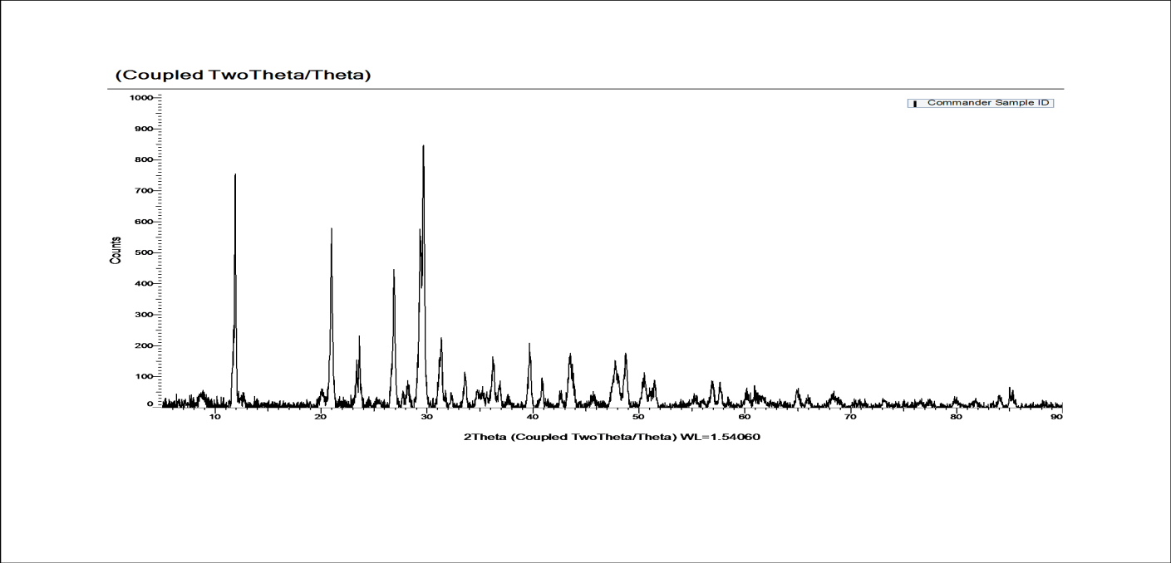
Initial spectral & XRD results:
From Library
American Mineralogical Crystal Structure Database
S9.March20th-June20th

Slide 32
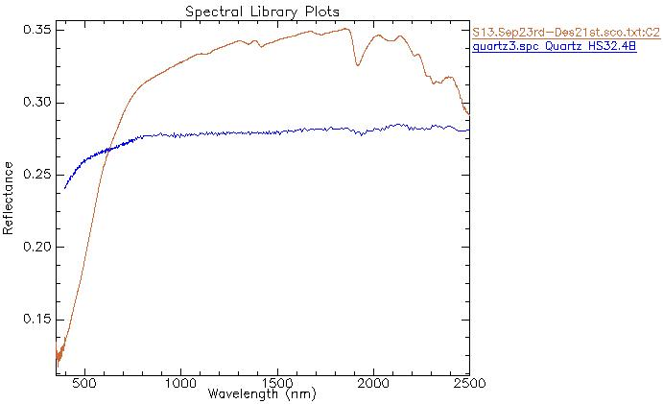
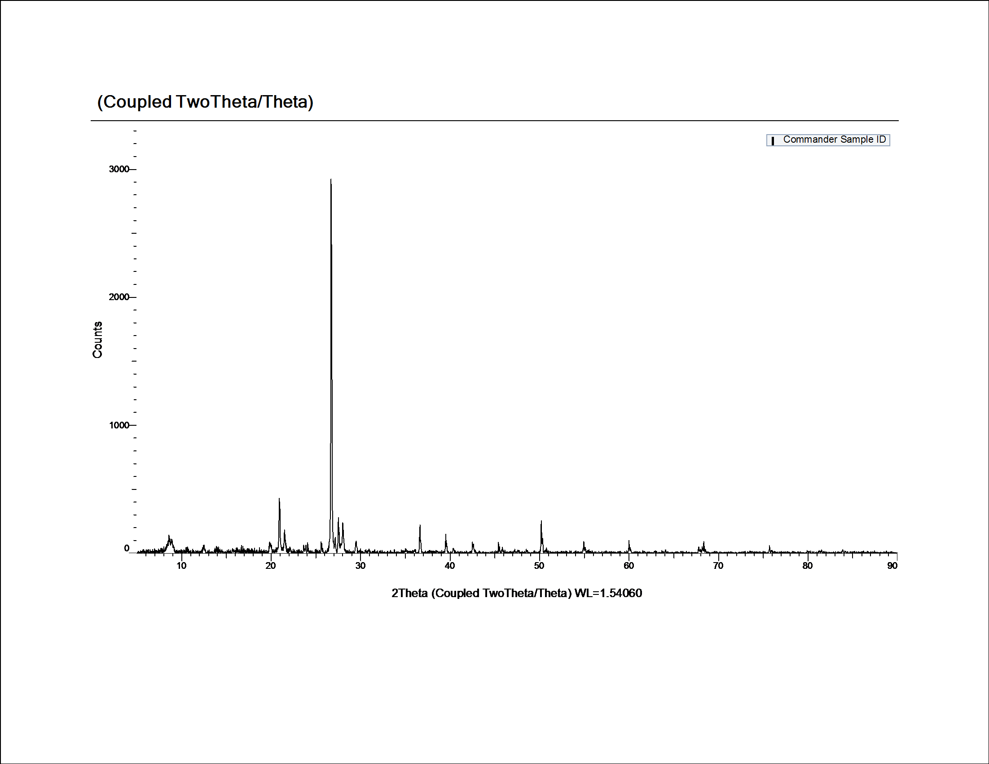
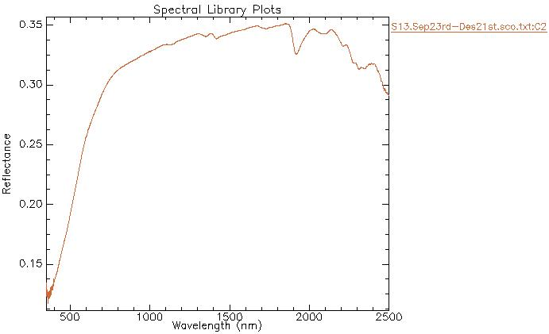
What about quartz fingerprint in SWIR?
26.5̊
The peak on 26.5̊ is attributed to quartz

Slide 33
Samples measured in my preliminary analysis by XRD, SWIR, and LWIR
Sample | X-Ray | Diffraction
 | Major | Minor
S1.Sep23rd-Dec21st | Quartz | Illite, Kaolinite
S1.Dec22nd-March19th | Quartz | Calcite, Illite, Kaolinite
S1.March20th-June20th | Quartz, Calcite | Illite, Kaolinite
S2.Sep23-Dec21 | Quartz | Calcite, Illite, Kaolinite
S2.March20th-June20th | Quartz, Calcite | Illite, Kaolinite
S3.Sep23-Dec21 | Quartz, Calcite | Illite, Kaolinite
S3.Dec22nd-March19th | Quartz, Calcite | Illite, Kaolinite
S3.March20th-June20th | Quartz, Calcite | Illite, Kaolinite
S4.Sep23-Dec21 | Quartz | Calcite, Illite, Kaolinite
S4.Dec22-Mar19th | Quartz, Calcite | Illite, Kaolinite
S4.March20th-June20th | Quartz, Calcite | Illite, Kaolinite, Gypsum
S5.Sep23-Dec21 | Quartz | Illite, Kaolinite
S5.Dec22-Mar19th | Quartz, Calcite | Illite, Kaolinite
S5.March20th-June20th | Quartz, Calcite | Illite, Kaolinite
S6.Dec22-March19 | Quartz, Calcite | Illite, Kaolinite
S6.March20th-June20th | Quartz, Calcite | Illite, Kaolinite
S7.Sep23rd-Dec21st | Quartz | Calcite, Illite, Kaolinite
S7.Dec22nd-March19th | Quartz | Calcite, Illite, Kaolinite
S7.March20th-June20th | Quartz, Calcite | Illite, Kaolinite
S8.Sep23-Dec21 | Calcite | Quartz, Illite
S8.Dec22nd-March19th | Quartz | Illite, Kaolinite
S8.March20th-June20th | Quartz, Calcite | Illite, Kaolinite
S9.Sep23rd-Dec21st | Quartz, Calcite | Kaolinite
S9.Dec22nd-Mar19th | Quartz, Calcite | Illite, Kaolinite
S9.March20th-June20th | Gypsum, Quartz, Calcite | Illite, Kaolinite
S10.Sep23rd-Dec21st | Quartz, Calcite
S10.Dec22nd-Mar19th | Quartz, Calcite | Illite, Kaolinite (very low)
S10.March20th-June20th | Quartz, Calcite | Illite, Kaolinite (very low)
S11.Sep23rd-Dec21st | Quartz, Calcite | Illite, Kaolinite (very low)
S11.Dec22-Mar19th | Quartz, Calcite | Illite, Kaolinite
S11.March20th-June20th | Quartz, Calcite | Illite, Kaolinite
S12.Sep23rd-Dec21st | Quartz, Calcite | Illite, Kaolinite, Gypsum
S12.Dec22nd-Mar19th | Quartz, Calcite | Illite, Kaolinite
S12.March20th-June20th | Quartz, Calcite | Illite, Kaolinite
S13.Sep23rd-Dec21st | Quartz | Calcite, Illite, Kaolinite
S13.Dec22nd-Mar19th | Quartz, Calcite | Illite, Kaolinite, (Gypsum)
S13.March20th-June20th | Quartz | Calcite, Illite, Kaolinite

Slide 34
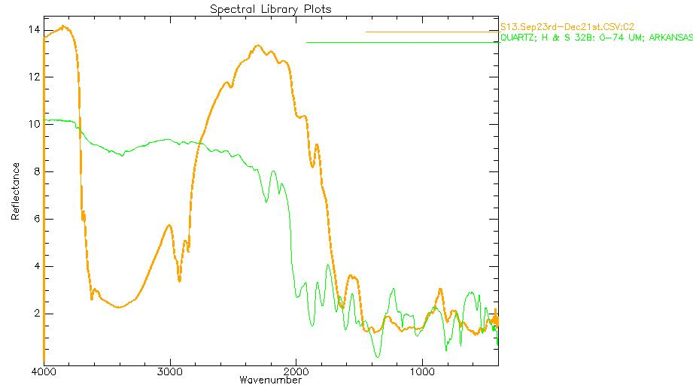
LWIR Reflectance
Interpretation still to be done.

Slide 35
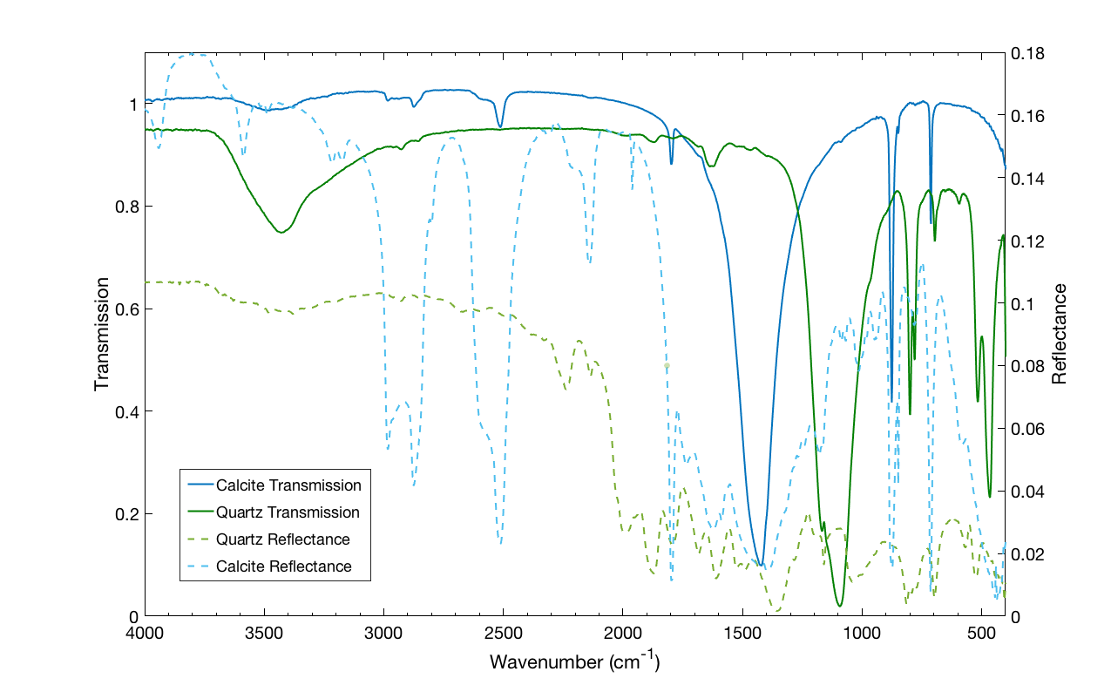
Transmittance Technique
Future Work
Verification of the spectroscopy against previously well characterized
samples will allow development of new, rapid methodologies for future dust sample mineral identification.
Contrasts reflectance (dashed lines) of fine-grained material vs transmission measurements of the same sample. Multiple scattering enhances weak features and may obscure fundamental vibrational absorptions which are clearly observed in transmission (solid lines).

Slide 36
References
Danner, M.; Locherer, M.; Hank, T.; Richter, K. (2015): Spectral Sampling with the ASD FieldSpec 4 – Theory, Measurement, Problems, Interpretation. EnMAP Field Guides Technical Report, GFZ Data Services. http://doi.org/10.2312/enmap.2015.008
Kokaly, R.F., Clark, R.N., Swayze, G.A., Livo, K.E., Hoefen, T.M., Pearson, N.C., Wise, R.A., Benzel, W.M., Lowers, H.A., Driscoll, R.L., and Klein, A.J., 2017, USGS Spectral Library Version 7: U.S. Geological Survey Data Series 1035, 61 p., https://doi.org/10.3133/ds1035.
Pidwirny, M. (2006). "Atmospheric Effects on Incoming Solar Radiation". Fundamentals of Physical Geography, 2nd Edition. Date Viewed. http://www.physicalgeography.net/fundamentals/7f.html
Nousiainen, T. (2009). Optical modeling of mineral dust particles: A review. Journal of Quantitative Spectroscopy and Radiative Transfer, 110(14), 1261-1279. doi:10.1016/j.jqsrt.2009.03.002
Goossens, D., Offer, Z.Y., Wind tunnel and field calibration of six aeolian dust samplers, Atmospheric Environment 34(2000), pp. 1043-1057.
Blanco, A. J., & McIntyre, R. G. (1972). An infra-red spectroscopic view of atmospheric particulates over el paso, texas. Atmospheric Environment (1967), 6(8), 557-562. doi:10.1016/0004-6981(72)90073-X
Bharti, S. K., Kumar, D., Kumar, N., Anand, S., Poonam, & Barman, S. C. (2017). Characterization and morphological analysis of individual aerosol of PM10 in urban area of lucknow, india. Micron, 103, 90-98. doi:10.1016/j.micron.2017.09.004
Engelbrecht, J., Stenchikov, G., Prakash, P., Lersch, T., Anisimov, A., & Shevchenko, I. (2017). Physical and chemical properties of deposited airborne particulates over the arabian red sea coastal plain. Atmospheric Chemistry and Physics, 17(18), 11467-11490. doi:10.5194/acp-17-11467-2017

Slide 37
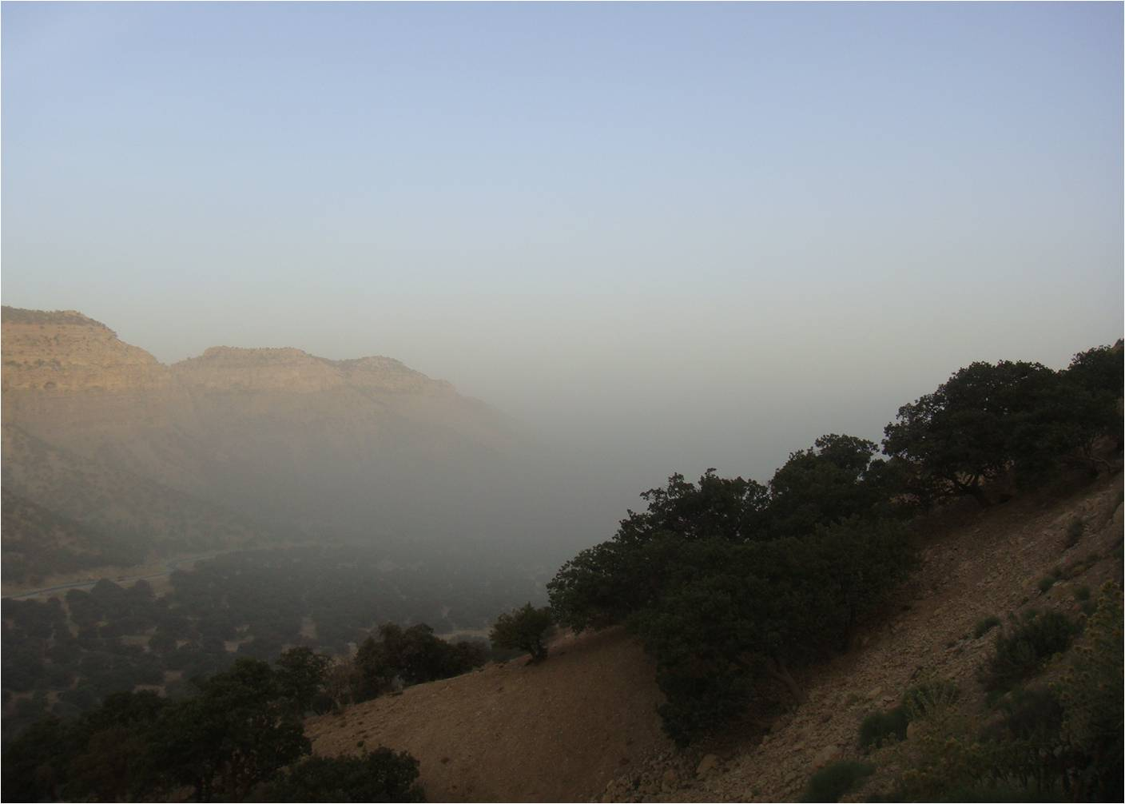
Thank you!
Questions?

