Slide 1
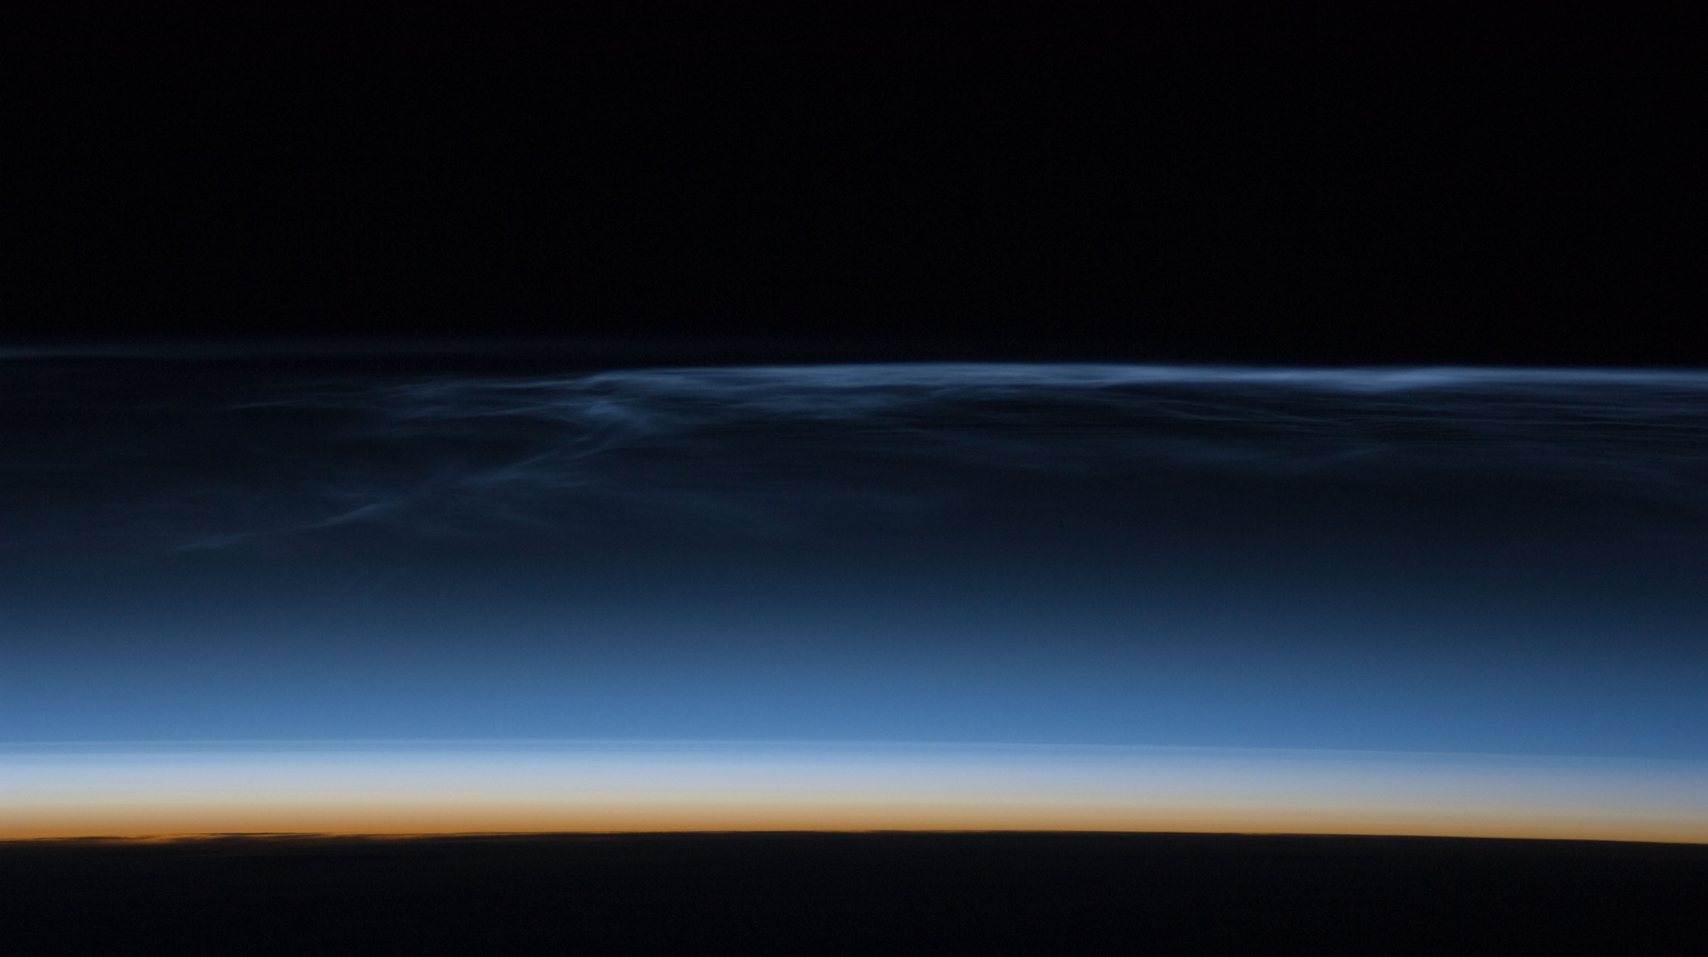
Temporal and spatial characteristics of the formation of strong noctilucent clouds
J. Kiliani, G. Baumgarten, F.J. Lubken, U. Berger, P. Hoffmann
Presented by Megan Rennie 2/11/2019
All images are taken from (J. Kiliani et al. 2013) unless otherwise noted.
https://spaceflight.nasa.gov/gallery/images/station/crew-17/hires/iss017e011632.jpg

Slide 2
Outline
Master’s thesis work
What are noctilucent clouds?
Temporal and spatial characteristics of the formation of strong noctilucent clouds
  Model description
  Results
Conclusion

Slide 3
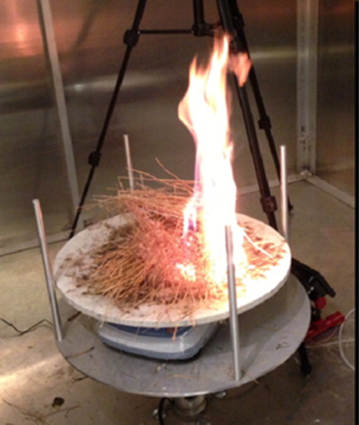
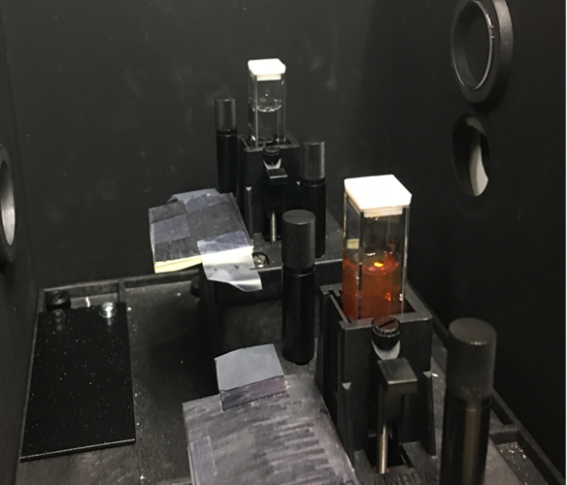
Master’s Thesis
Optical Properties of Aerosol from the Open Combustion of Cheatgrass (Bromus tectorum).
  CO/CO₂ and NO_{x}
  Mie Theory
  SSA
  Angstrom Exponent
Imaginary Refractive Index Spectrum of Hematite: A Novel Determination Using a Nanoparticle Colloid
  Mie Theory
  SSA
  Angstrom Exponent
(Samburova et al. 2016)

Slide 4
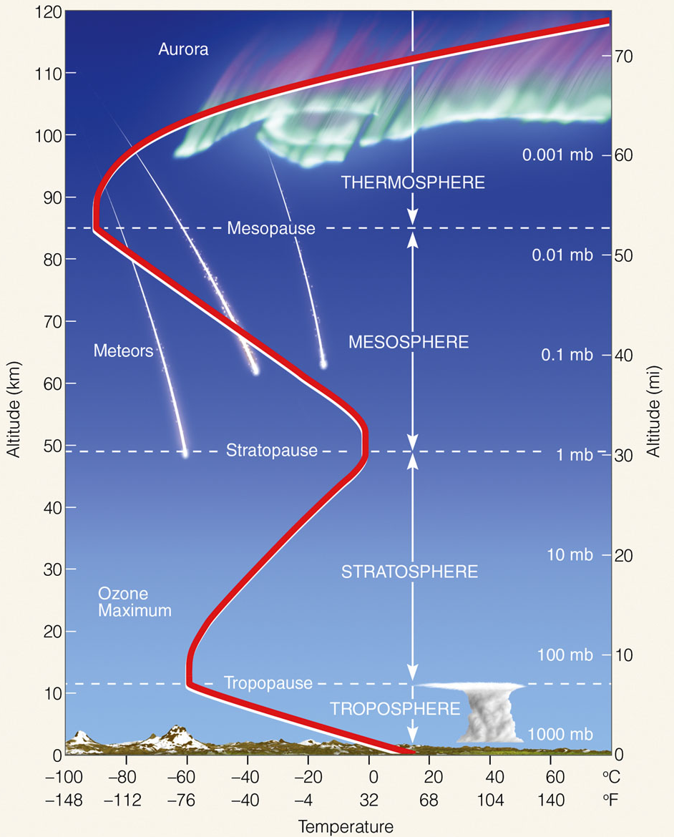
Noctilucent Clouds (NLC)
Altitudes of ≈ 83 km
Ice nucleates at temperatures colder than ≈150 K in this region
Visible to naked eye during nautical twilight
Particles are ≤ 100 nm
Meteors vaporize in the mesosphere providing cloud nuclei
http://www.geogrify.net/GEO1/Lectures/IntroPlanetEarth/FourSpheres.html
Notes:
first known to have been observed in 1885
Extremely dry, extremely low pressure, so you need very cool temperatures to make ice crystals form
adiabatic cooling was strongest at the region of the deep temperature minimum seen in the summer mesopause

Slide 5
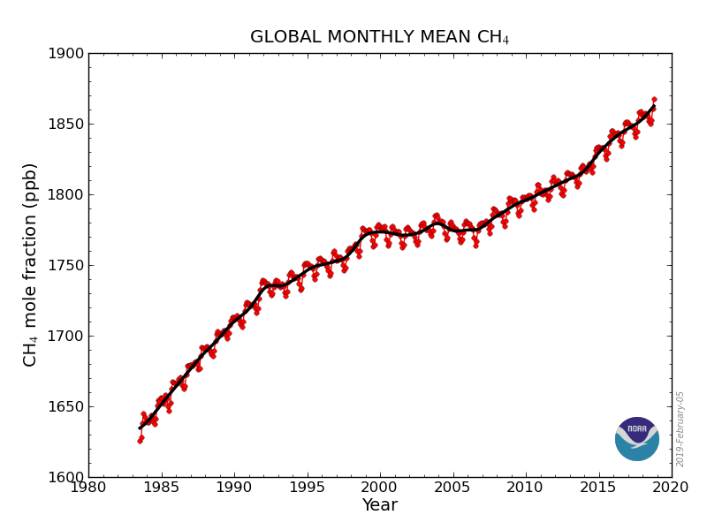
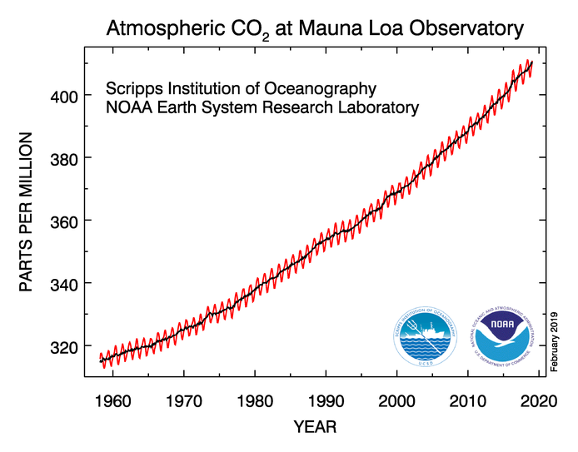
Methane Levels
https://www.esrl.noaa.gov/gmd/ccgg/trends_ch4/
https://www.esrl.noaa.gov/gmd/ccgg/trends/full.html

Slide 6
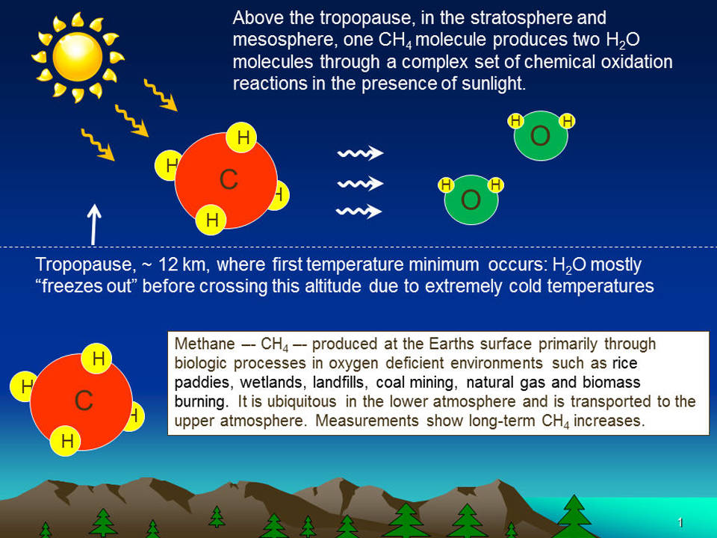
The Changing Climate
Methane is one of the most potent green house gases
  Warming potential 84 times greater than CO₂ (Myhre et al. 2013)
  Thaw lakes in North Siberia emit 3.8 teragrams of CH₄ per year (Walter et al. 2006)
NLC can be indicators of climate change (Lubken, Berger, and Baumgarten 2018)
  H₂O concentration mixing ratio has increased ∼40% (1 ppmv) due to methane since industrialization
  H₂O has led to increased brightness
https://www.nasa.gov/content/goddard/methane-boosts-water-in-upper-atmosphere
Notes:
NLC presumably existed centuries earlier, but the chance to observe them by the naked eye was extremely small before the twentieth century, whereas it is likely to see several NLC per season in the modern era.
H2O in the mesosphere is basically given by two effects: (i) transport of H2O from lower altitudes and (ii) oxidation of methane

Slide 7
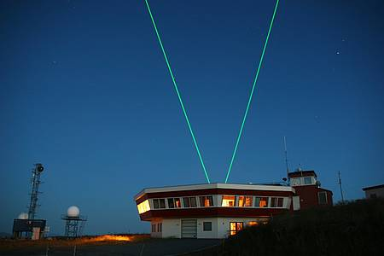
Temporal and Spatial Characteristics of the Formation of Strong Noctilucent Clouds
J. Kiliani, G. Baumgarten, F.J. Lubken, U. Berger, P. Hoffmann
https://www.iap-kborn.de/en/research/department-optical-soundings-and-sounding-rockets/instruments-and-models/alomar-rmr-lidar

Slide 8
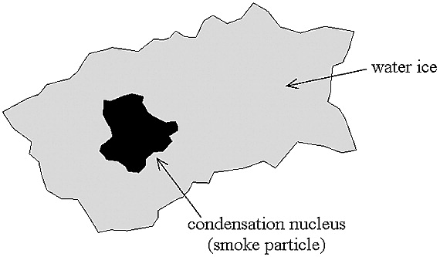
  Leibniz-Institute Middle Atmosphere (LIMA) model
Lagrangian ice transport model
Simultaneously investigate single particle evolution and ice development of the whole cloud
  Gives a more realistic modeling of background fields
532 nm wavelength is used to calculate the NLC distribution
https://agupubs.onlinelibrary.wiley.com/doi/full/10.1029/2002JD002409
Notes:
3D aerosol model focuses on mesosphere

Slide 9
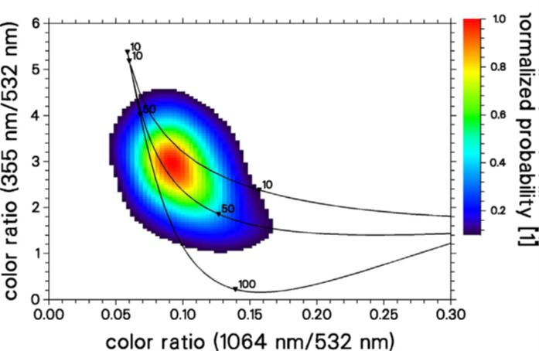
Is the Model Correct?
Simulate NLC using 40,000 ice particles
  1.2 to 3.7 nm
  Continuously relocated in model domain
Calculated the optical signal (color ratio) using spheroidal particles
Model distribution (top) compares well with ALOMAR measured (bottom) distribution
Notes:
One atom measure 0.1nm-0.3nm depending upon the element.
A sheet of paper is about 100,000 nanometers thick.
A human hair measures roughly 50,000 to 100,000 nanometers in diameter.
Model uses a zero eddy diffusion for particle distribution
Solid lines shows color ratios of monodisperse distributions of spherical particles (radius in nm), as well as color ratios of log normal distributions of spherical particles with STD: 1.4 (middle line) and STD-2 (upper line).
Log normal is gaussian but in log space
Inferring particle size with comparison between the 3 colors

Slide 10
Methods
50 NLC events within July 2009
  Trace particles for duration of each of their lifetimes
40,000 ice particles from strong NLC events
  Typically 99% of the backscatter signal
    Method I – signal weighted particles (t_{o})
    Method II – smaller ice particles, qualitative analysis
Focused on 3 locations
  ALOMAR, Spitsbergen, 60°N latitude and 15° wide longitude grid

Slide 11
Single NLC at 69°N
Growth begins slowly dr/dt = 0.3 nm/h
  Can be seen before t_{o}– 72 h
  Minor variations in background
T_{o}-24 h particle growth increases to dr/dt> 0.5 nm/h
  More background variation influences
T_{o}- 4 h growth rate reaches 15 nm/h
  Sedimentation takes over
Sublimation dominates after t_{o} dr/dt = -60 nm/h
Notes:
Ellipses show mean position and zonal/meridional distribution width.
Starts at first nucleation and ends after sublimation.
Thick is the mean path of clouds and thin are 10 single particle trajectories.

Slide 12
Ensemble Mean Development
Turbulent transport plays a significant role in final growth phase
  Dispersion mainly zonal
Nucleation of new particles occurs whenever ambient temperatures decreases
Ensemble brightness peaks almost at exactly t_{o}
Notes:
Oscillations encourage particle growth
Main growth period upward directed vertical winds cool atmosphere
Note that at 83km there are approximately 3 billion H2O molecules/cm3 where as at 88km there are only 50 million water molecules/cm3.

Slide 13
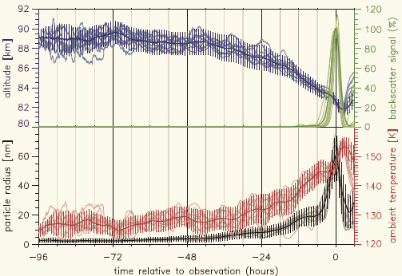
Ice Particle Age
Able to show particle age and nucleation altitude
Nucleation takes place in bursts
  Typically 6 hour bursts
No particles older then 4 days
  Older particles must survive several low supersaturation periods
Notes:
Method II is used to find mechanisms
Sublimate- solid to vapor state
to-26 large amount of sublimation gives large amount of nuclei at to-24 for a large burst to occur

Slide 14
Nucleation Times
Larger particles are about 4 hours older
  Smaller particles nucleate at the same altitude as large
During main growth phase
  Sedimentation velocity increases
  Particle mass increases
  Upward and downward turbulent motion decreases
Sublimation typically occurs at 81.3 ± 0.9 km
  Small particles survive longer
Notes:
Ellipses are mean distribution
Semi axes indicate variance
small particles are higher and take longer to sediment

Slide 15
Conclusions
Particle nucleation starts just below the mesopause
Nucleation bursts occur in areas of variable background temperatures and H₂O
Particles in turbulence and gravity waves are exposed to supersaturation and upward winds allowing for quick growth
Method I gives values of the most “visible” NLC with mean values for large particles
Age and altitude of the small and large particles are roughly the same
Mean particle age ranges 48 h to 18 h

Slide 16
References
Berger, U., and U. von Zahn. 2002. "Icy particles in the summer mesopause region: Three‐dimensional modeling of their environment and two‐dimensional modeling of their transport." Journal of Geophysical Research: Space Physics (1978–2012) 107 (A11):SIA 10-1. doi: 10.1029/2001JA000316.
Kiliani, J., G. Baumgarten, F. J. Lubken, U. Berger, and P. Hoffmann. 2013. "Temporal and spatial characteristics of the formation of strong noctilucent clouds." Journal of Atmospheric and Solar- Terrestrial Physics 104:151-166. doi: 10.1016/j.jastp.2013.01.005.
Lubken, F. J., U. Berger, and G. Baumgarten. 2018. "On the Anthropogenic Impact on Long-Term Evolution of Noctilucent Clouds." Geophysical Research Letters 45 (13):6681-6689. doi: 10.1029/2018gl077719.
Myhre, Gunnar; et al. (2013). Stocker, T.F.; Qin, D.; Plattner, G.-K.; Tignor, M.; Allen, S.K.; Boschung, J.; Nauels, A.; Xia, Y.; Bex, V.; Midgley, P.M., eds. Anthropogenic and Natural Radiative Forcing (PDF). Climate Change 2013: The Physical Science Basis. Contribution of Working Group I to the Fifth Assessment Report of the Intergovernmental Panel on Climate Change. Cambridge, United Kingdom and New York, NY, USA: Cambridge University Press. Retrieved 2016-12-22. See Table 8.7.
Walter, K. M.; et al. (September 2006). "Methane bubbling from Siberian thaw lakes as a positive feedback to climate warming". Nature. 443 (7107): 71–75. Bibcode:2006Natur.443...71W. doi:10.1038/nature05040. PMID 16957728.

Slide 17
Questions?
Thank you!
Notes:
With climate change the expectation of the NLC is an increase in brightness and an increase in days NLC occur.
TOA that usually cool may start to warm below clouds and cool above

Slide 18
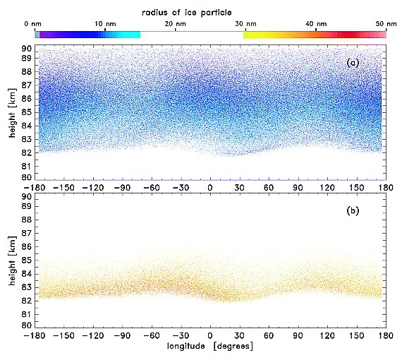
Ice Particle Distribution
Notes:
Local positions of 650,457 ice particles from an two million smoke particle ensemble after 2 day simulation time over the latitudinal circle of Andoya 69°N. The colored dots define the actual ice particle size. This simulation uses zero eddy diffusion.

