Slide 1
On the dynamics of an extreme rainfall event in northern India in 2013
Anu Xavier, M G Manoj and K Mohankumar
Journal Earth System science (2018)
By
Kalyan Chakravarthy Yesoda
Graduate PhD student, University of Nevada, Reno

Slide 2
Outline
Geography of India and seasons
Importance of Monsoon
Onset and Withdrawal dates of monsoon
Introduction
Data
Summary of Findings
Conclusions
My Current Research

Slide 3
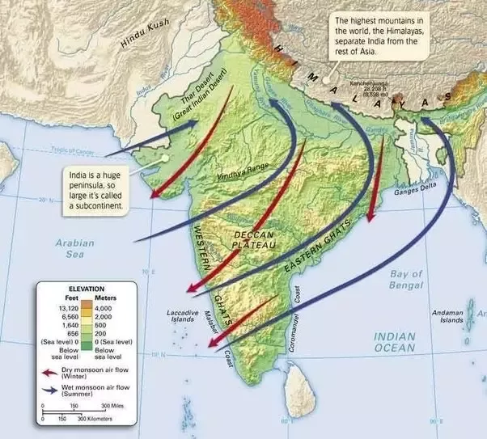
Seasons of India
Winter: January & February
Pre-Monsoon or Summer: March, April and May
Monsoon season: June, July, August & September
Post-Monsoon: October , November & December
Summer Monsoon Flow
Winter Monsoon Flow
Geography of India
Source: Image Source: s3.amazonaws.com/engrade-myfiles/4049789948277584/wh06as_c06map003aa_f.jpg

Slide 4
Importance of Indian Summer Monsoon
Agriculture is the backbone of India’s economy. Nearly 70% of the working population depends on agricultural activities for their livelihood.
India receives 80% of rainfall during summer monsoon season (June - September) significantly affects the agricultural production of the country by providing water for the two main crop growing seasons, Kharif (summer) and Rabi (winter).
Variations in the monsoon rainfall affect the total food grain yield of India and also the country’s economy, which largely depends on agriculture.
Factors That Impact Indian Summer Monsoon
Other factors influencing the monsoon include the impact of El Niño and its counterpart La Niña, IOD (Indian Ocean Dipole) and the Atlantic Niño. All these play a key role in the monsoon, but it is not always clear which affects what, and how.

Slide 5
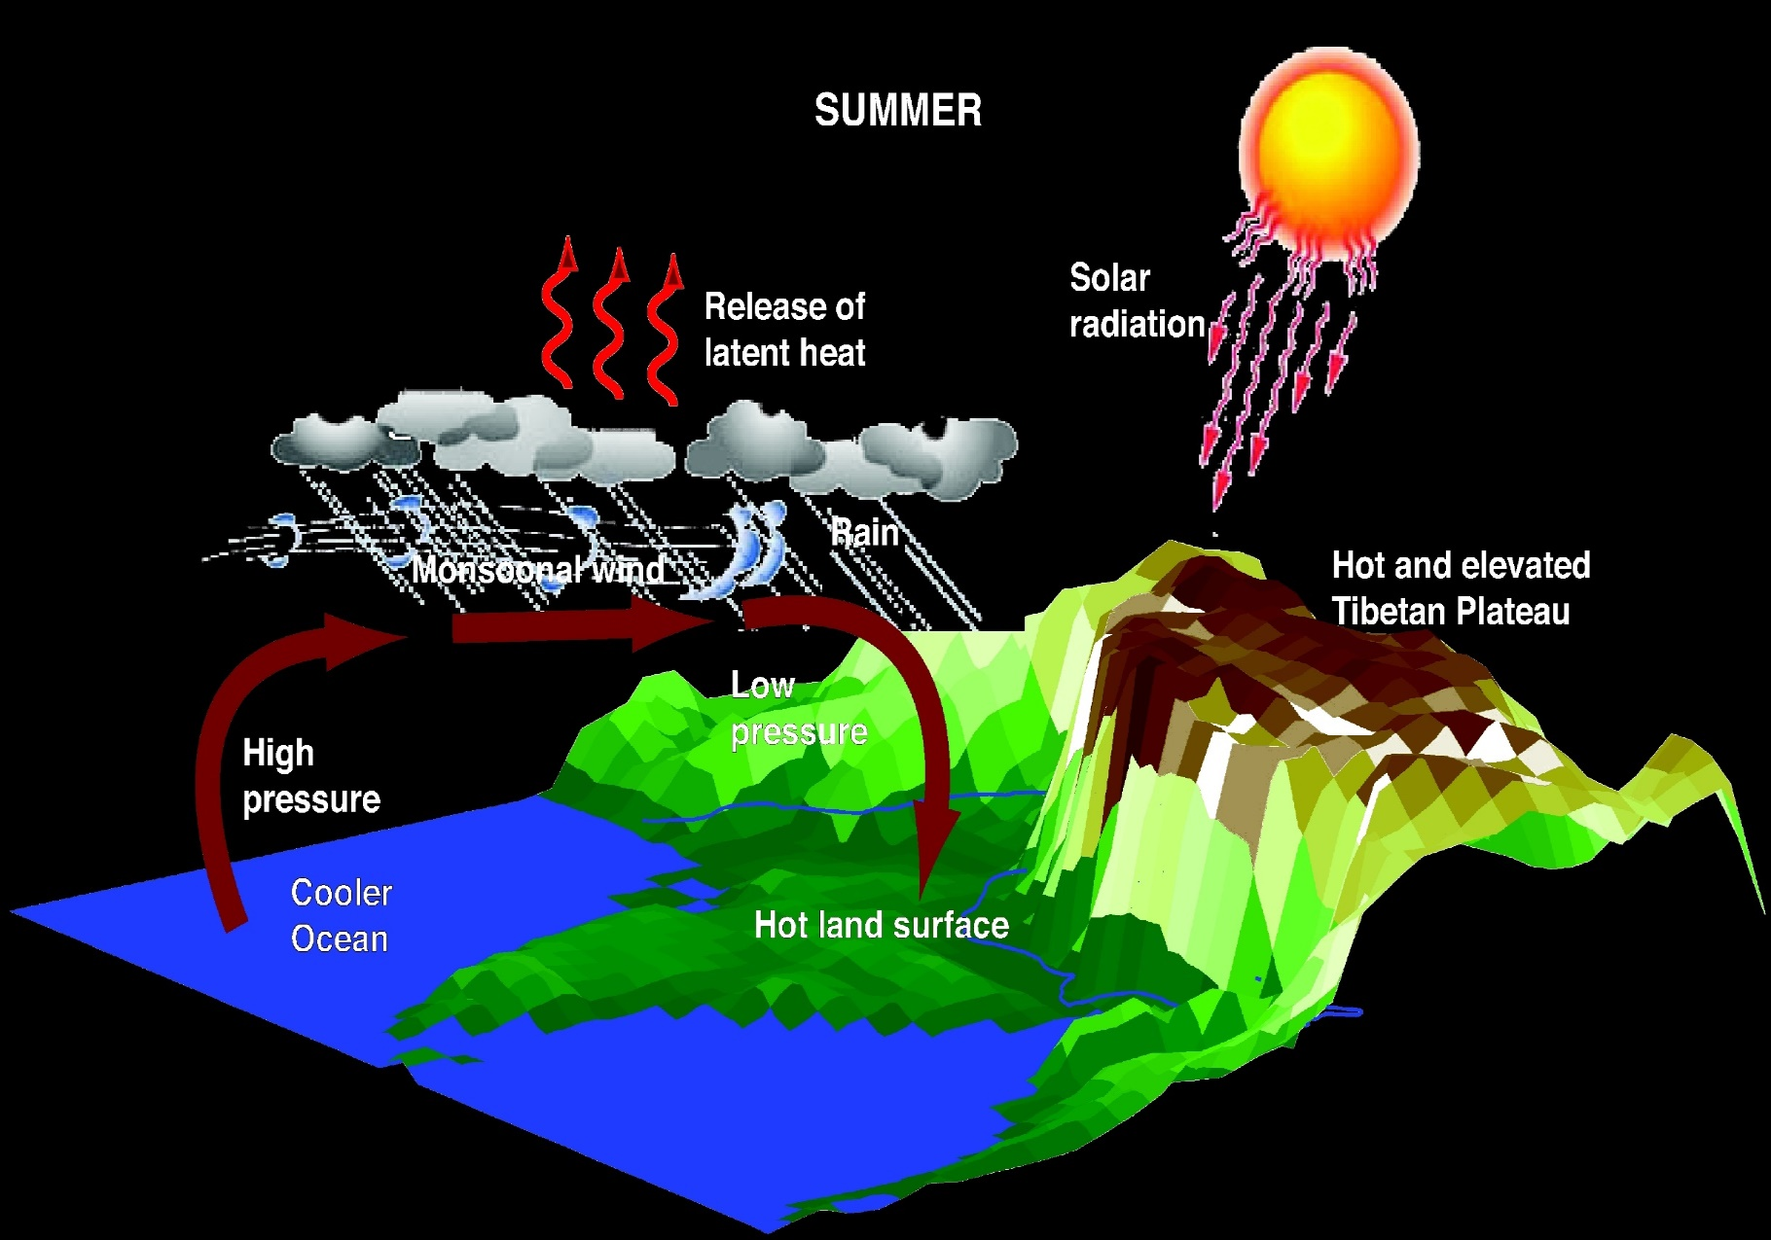
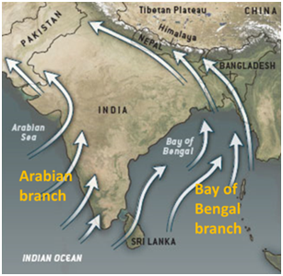
Mechanism of Summer Monsoon Onset
Two Branches of Monsoon Flow
1. Arabian Sea
2. Bay of Bengal Branch
Arabian sea branch is because of Western Ghats on West Coast
Source: https://iasmania.com/climate-of-india/

Slide 6
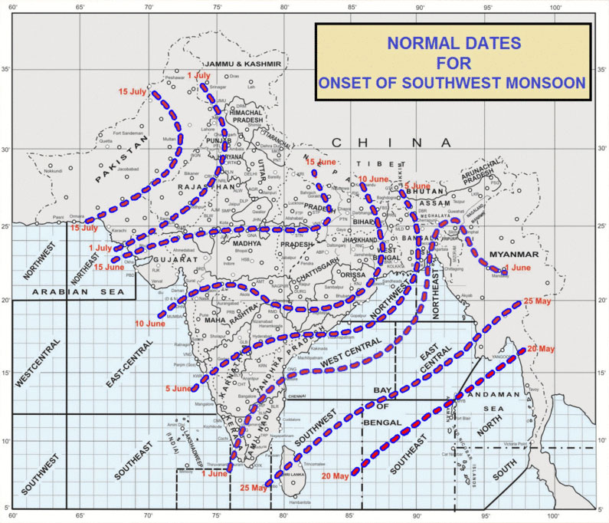
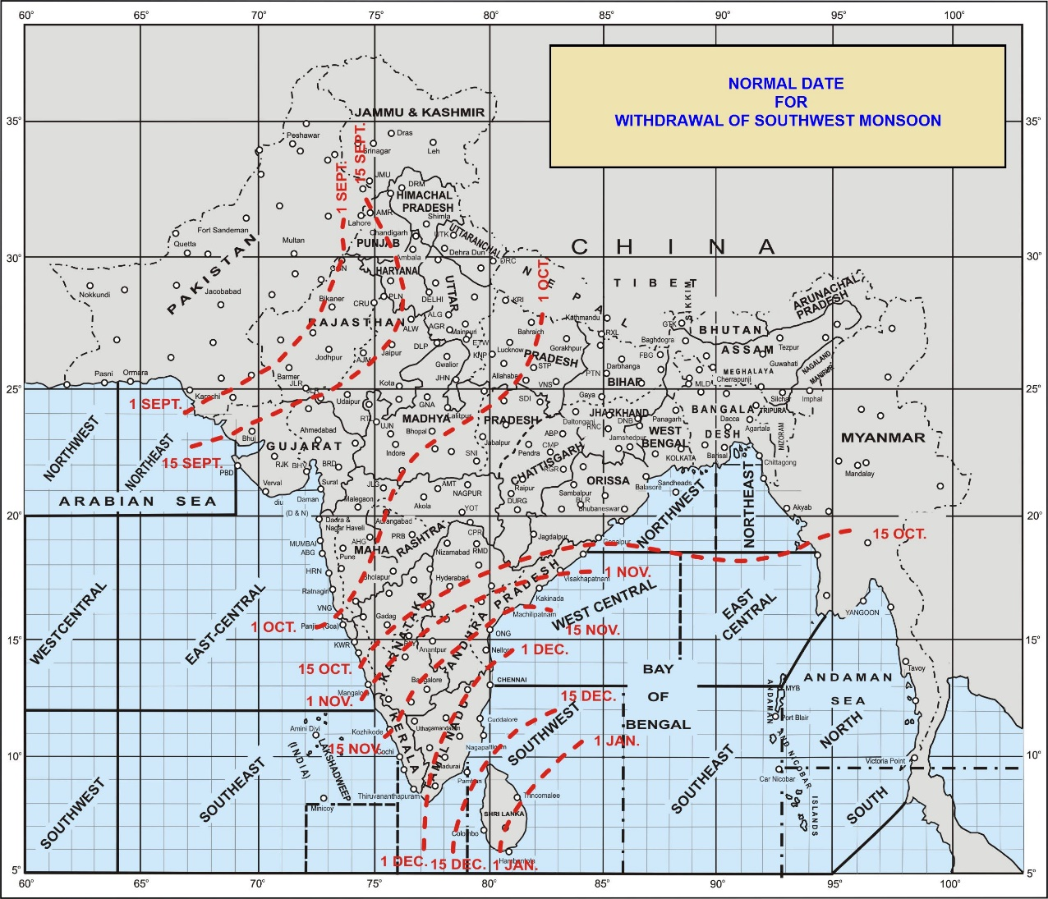
Onset and Withdrawal dates of monsoon
Source: India Meteorological Department

Slide 7
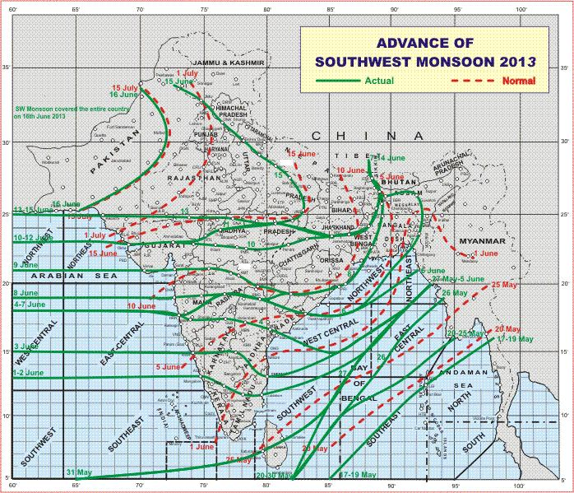
Onset During 2013 Monsoon
Source: India Meteorological Department

Slide 8
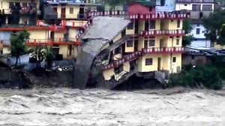
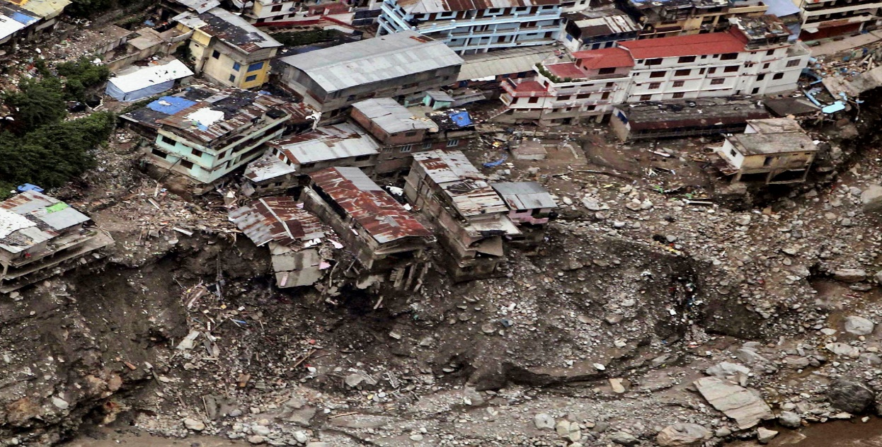
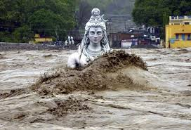
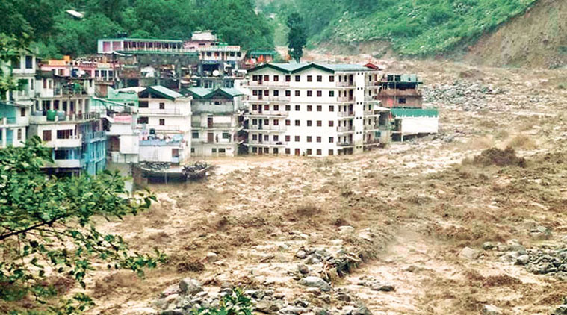
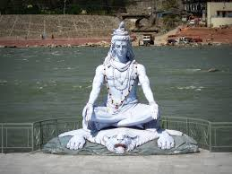
How extreme the event is?
4,500 villages are affected
~6000 people died
And also resulted in loss of property
The height of statue is 20 ft tall
Source: https://indianexpress.com/article/india/uttarakhand-floods-still-homeless-four-years-on-4919426/

Slide 9
Satellite Imagery

Slide 10
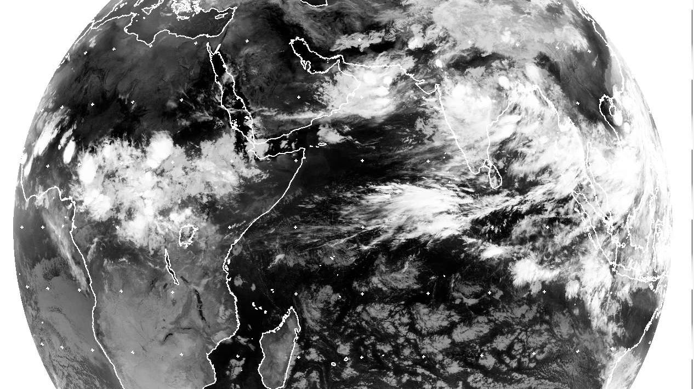
June 14, 00 UTC

Slide 11
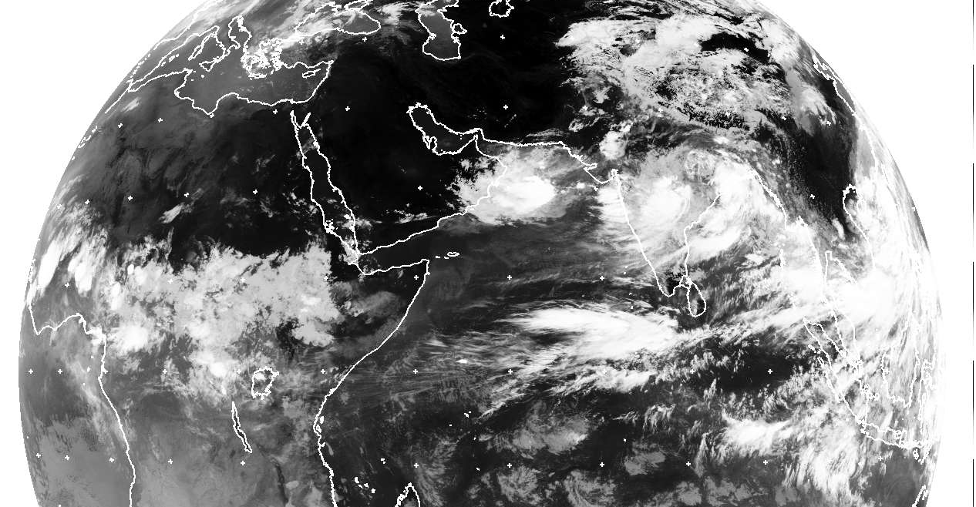
June 14, 06 UTC

Slide 12
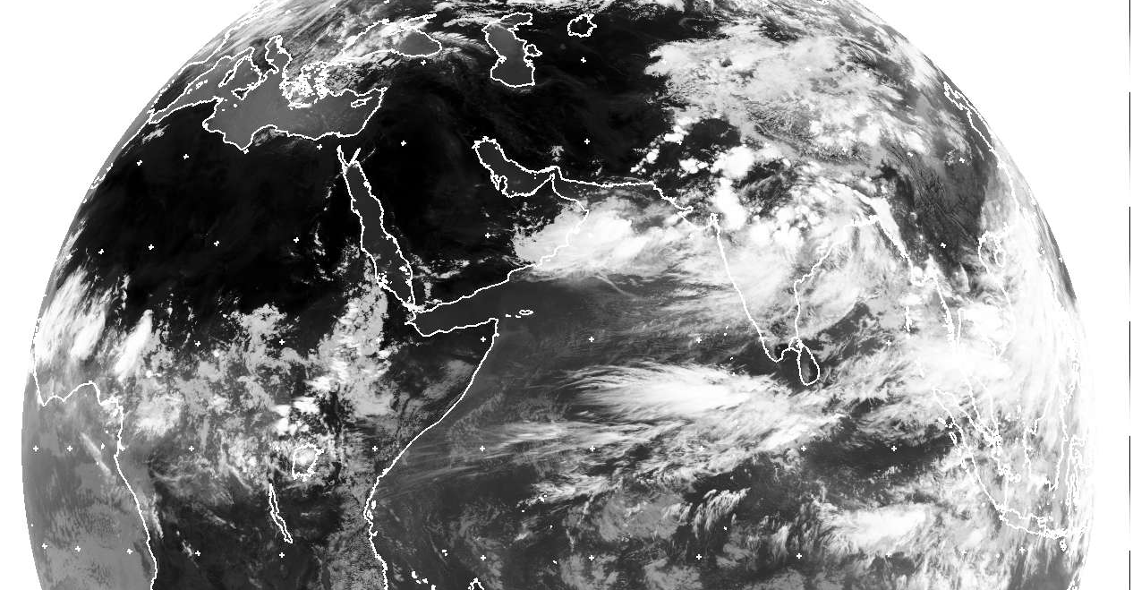
June 14, 12 UTC

Slide 13
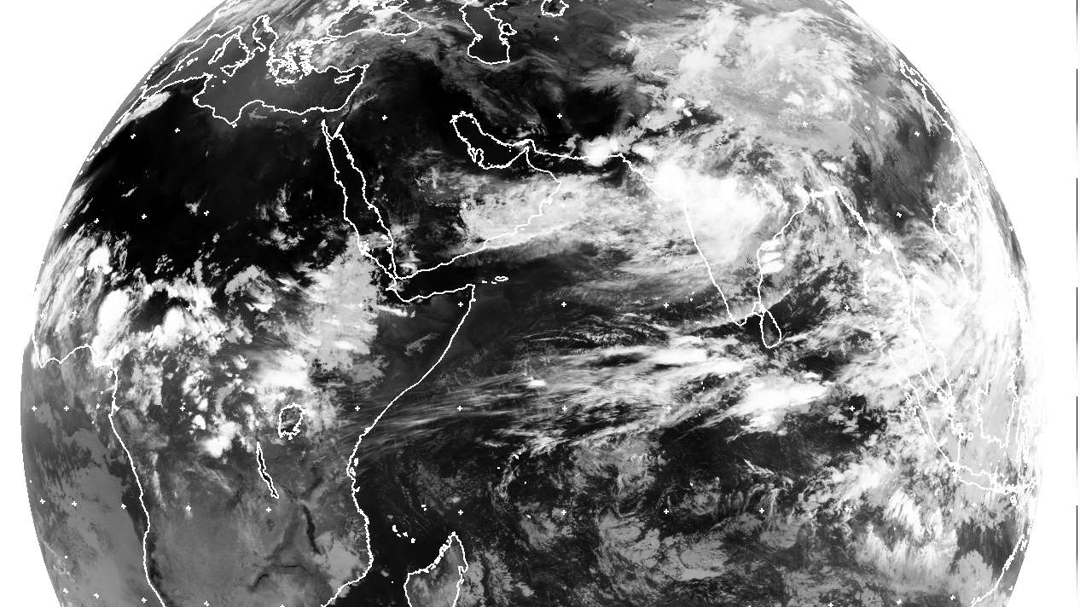
June 14, 18 UTC

Slide 14
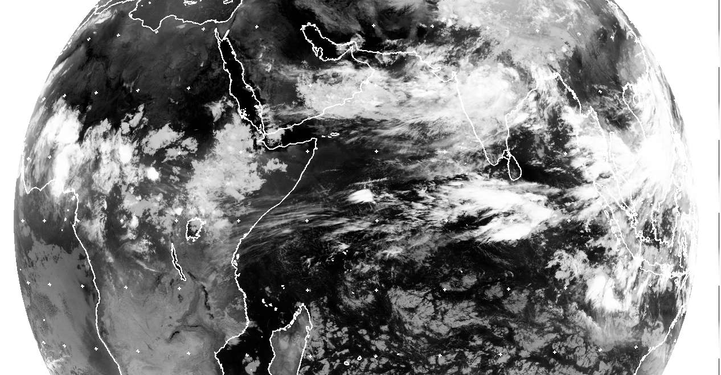
June 15, 00 UTC

Slide 15
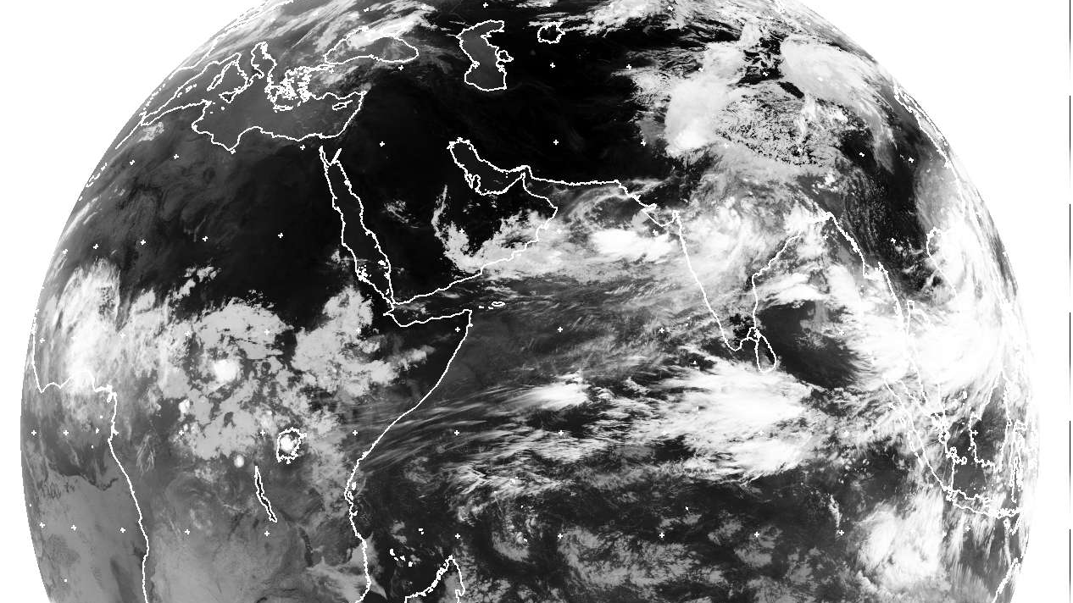
June 15, 06 UTC

Slide 16
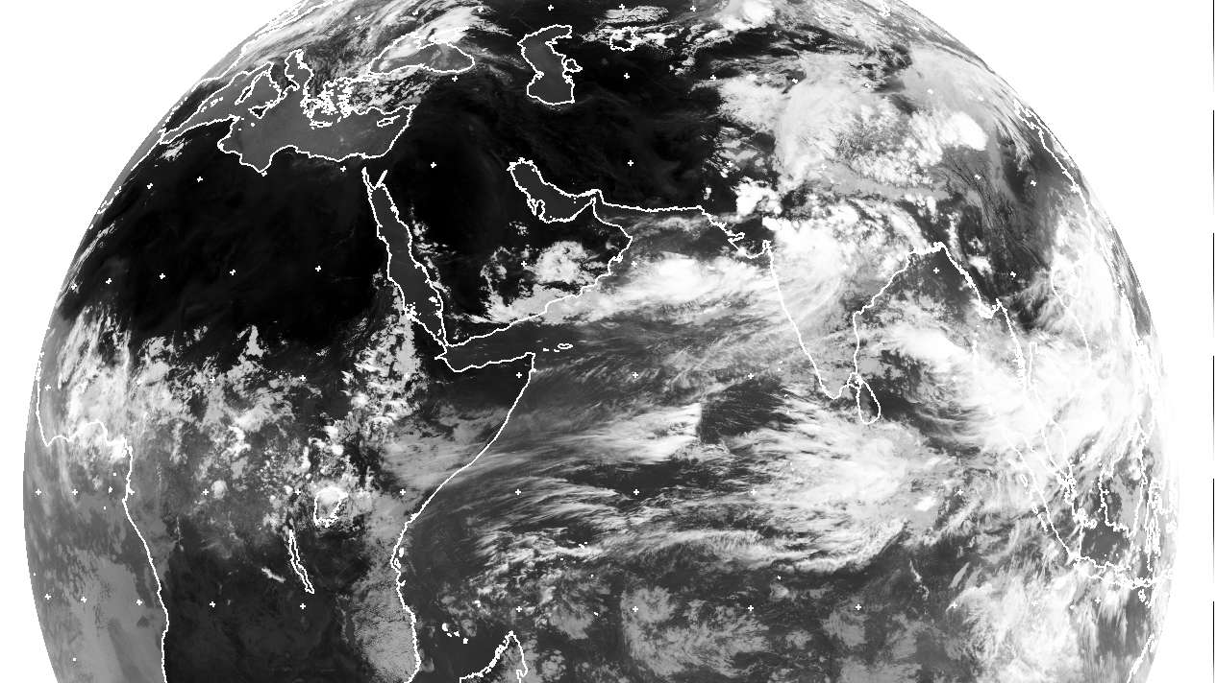
June 15, 12 UTC

Slide 17
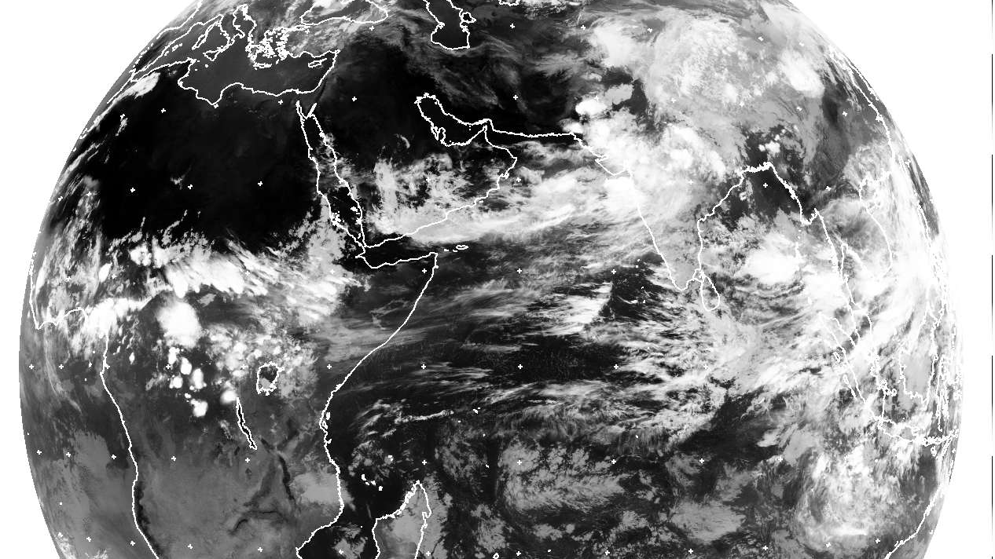
June 15, 18 UTC

Slide 18
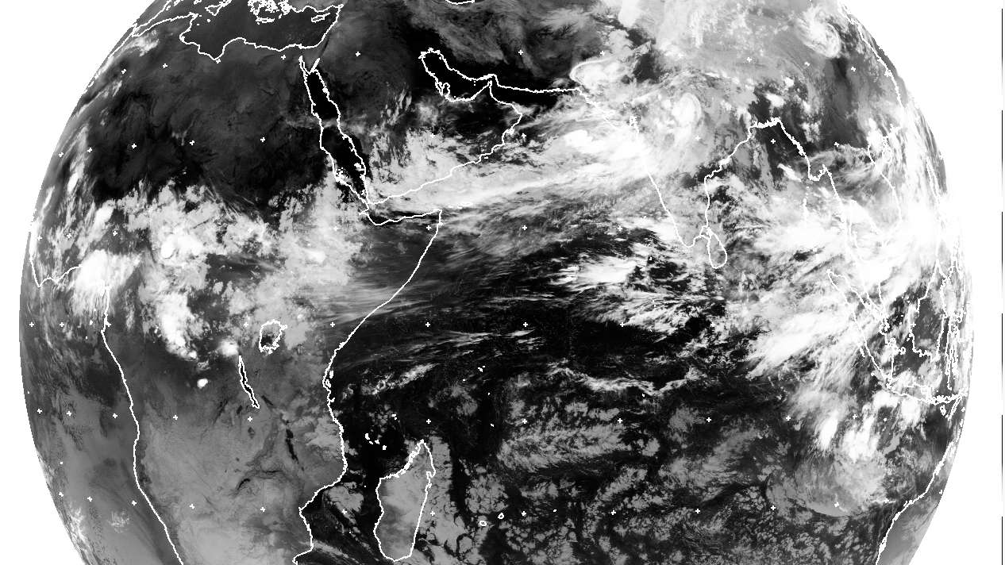
June 16, 00 UTC

Slide 19
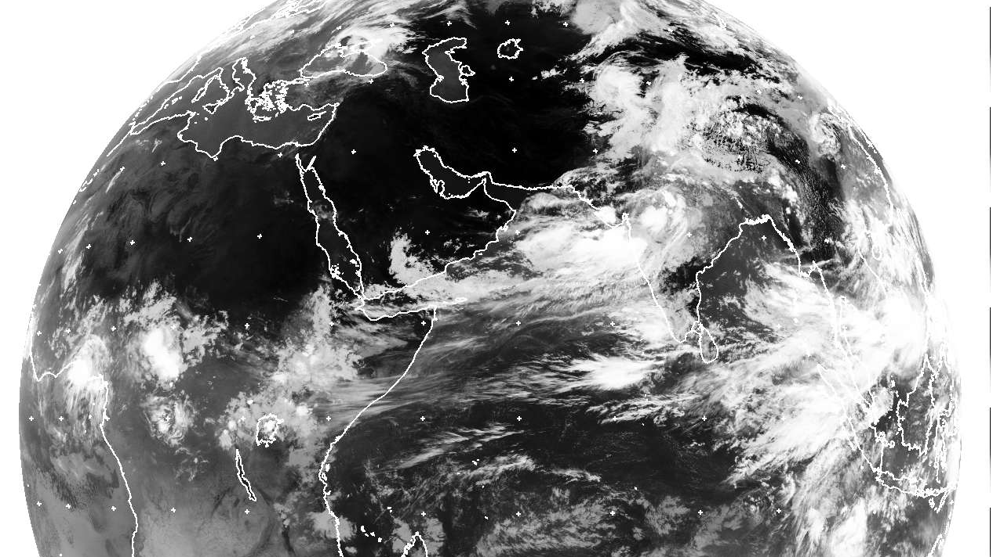
June 16, 06 UTC

Slide 20
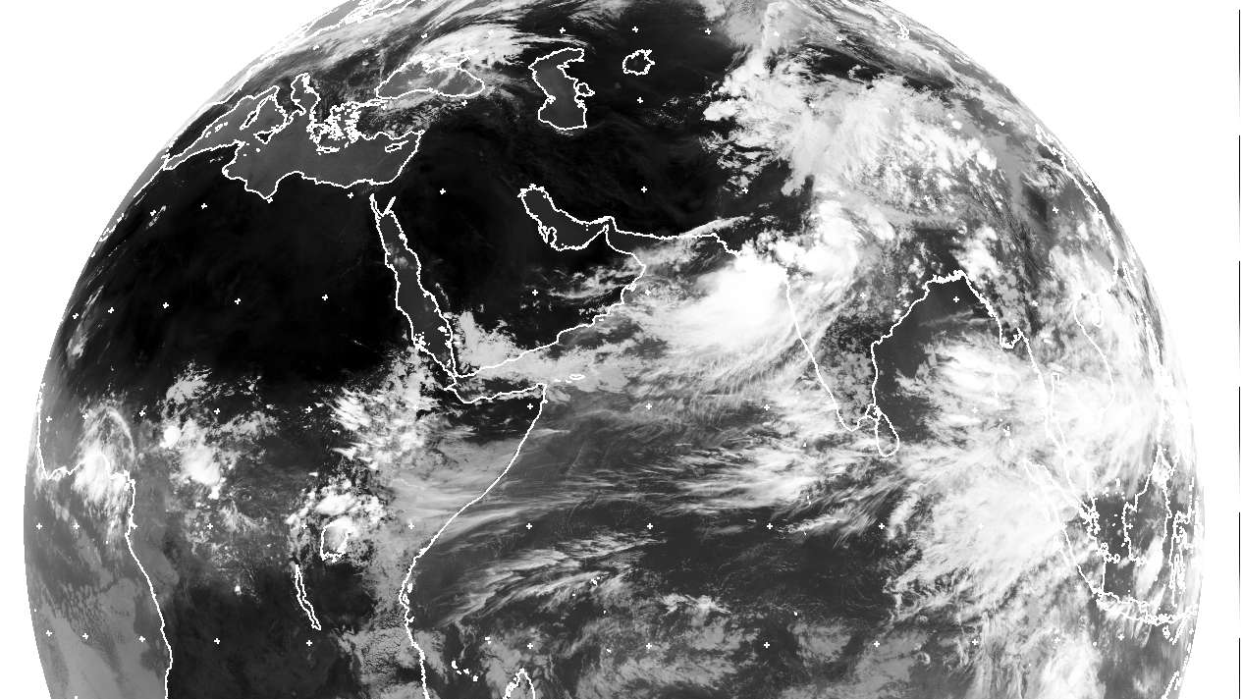
June 16, 12 UTC

Slide 21
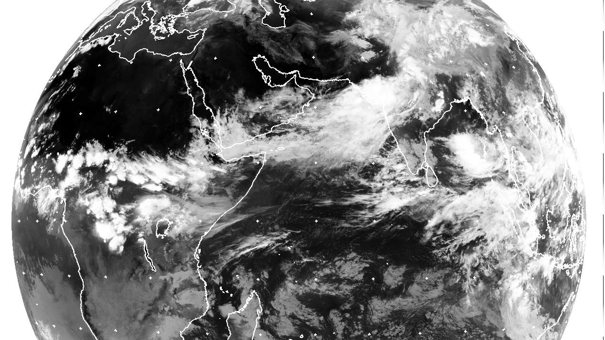
June 16, 18 UTC

Slide 22
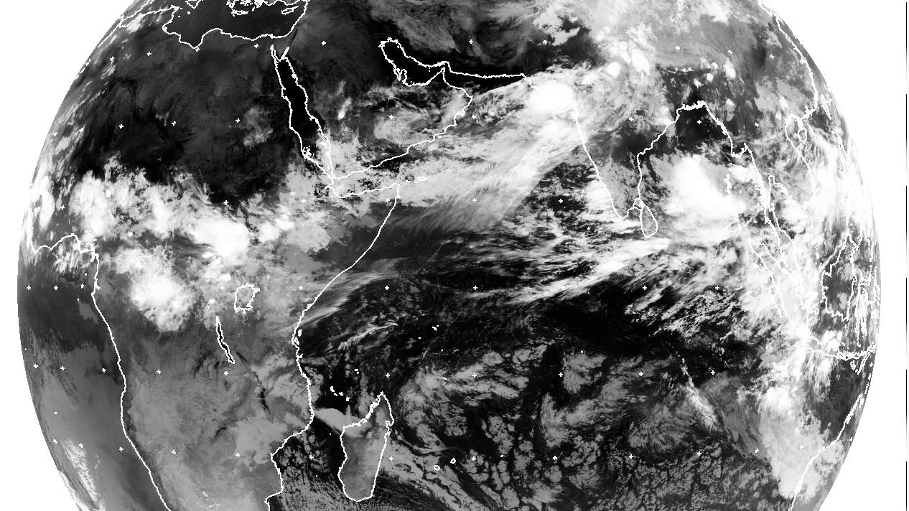
June 17, 00 UTC

Slide 23
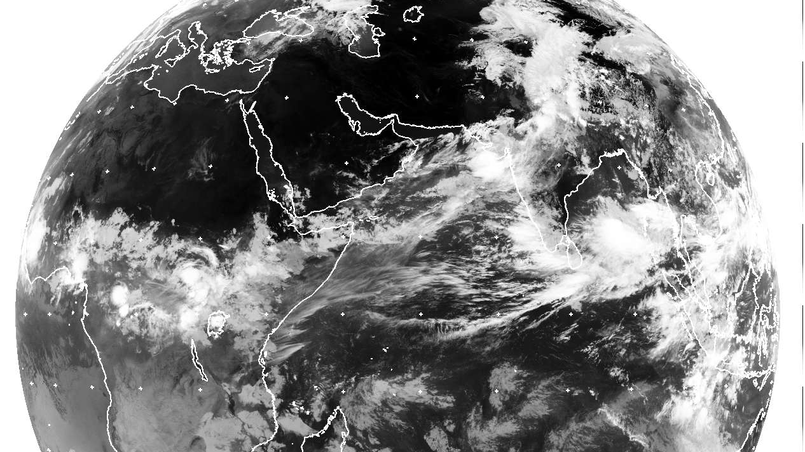
June 17, 06 UTC

Slide 24
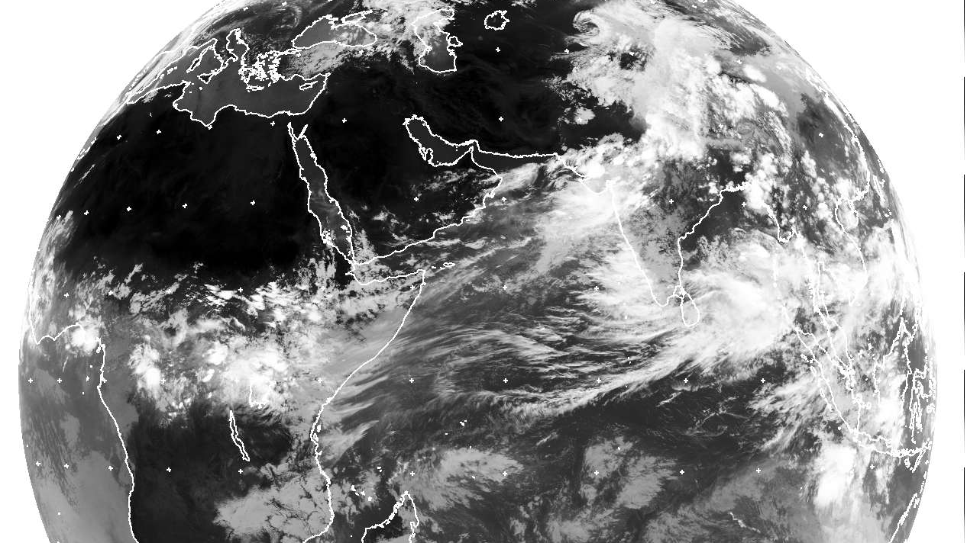
June 17, 12 UTC

Slide 25
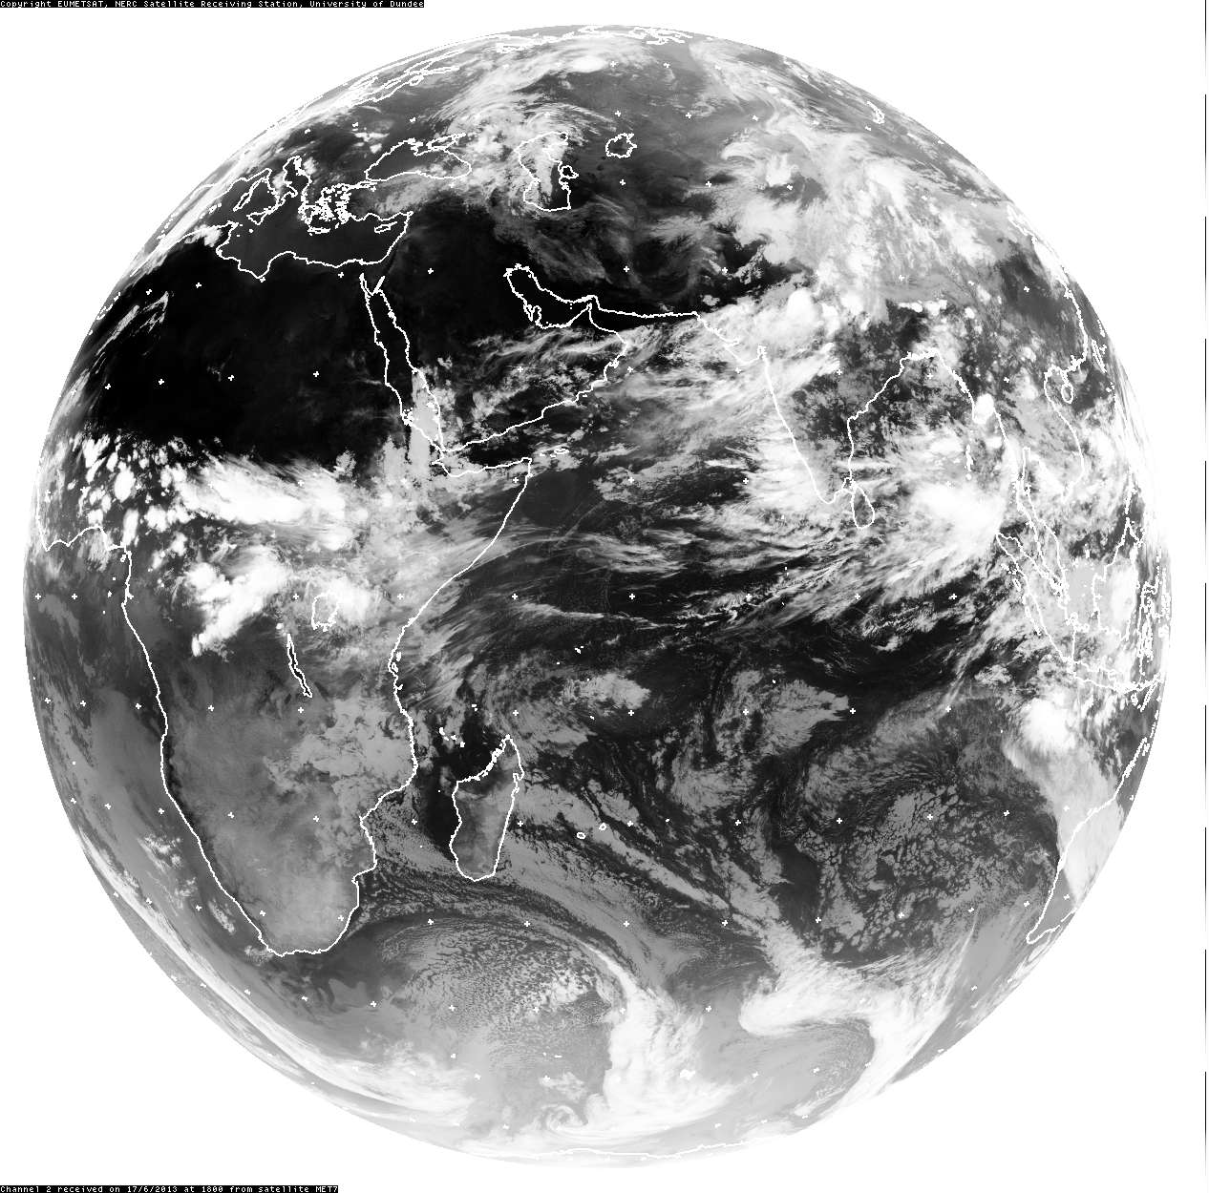
June 17, 18 UTC

Slide 26
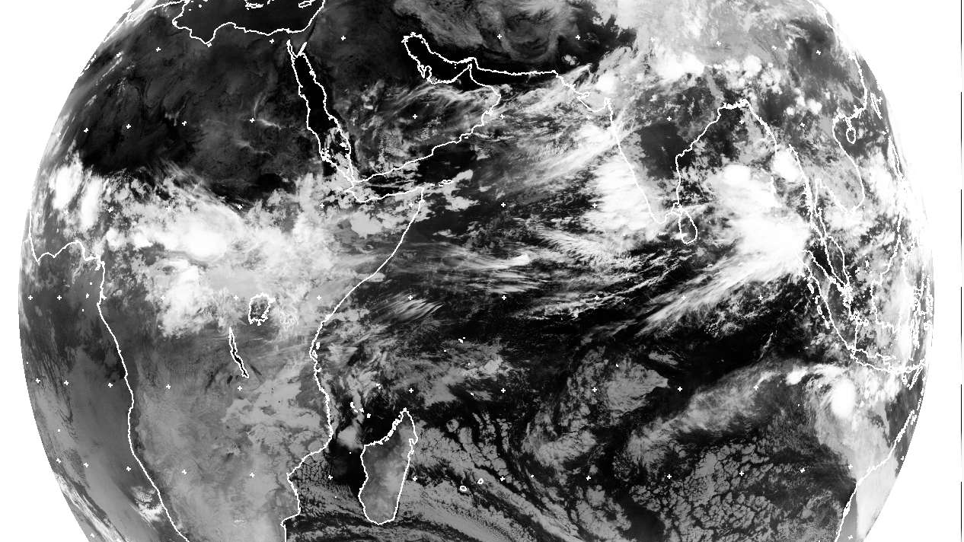
June 18, 00 UTC

Slide 27
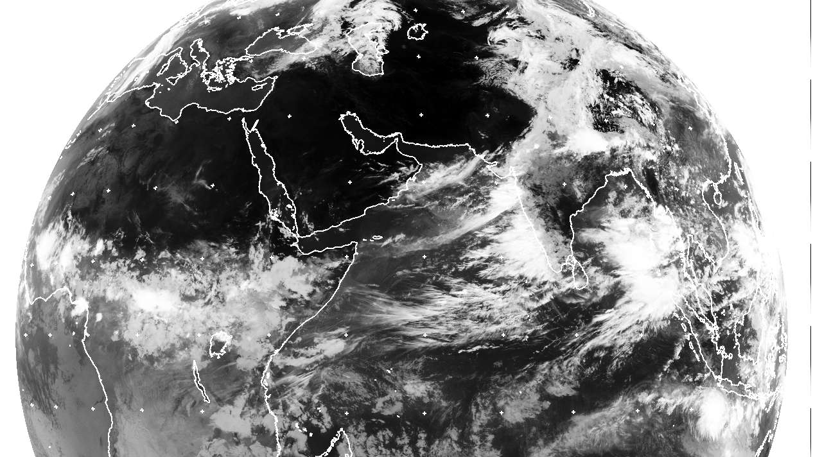
June 18, 06 UTC

Slide 28
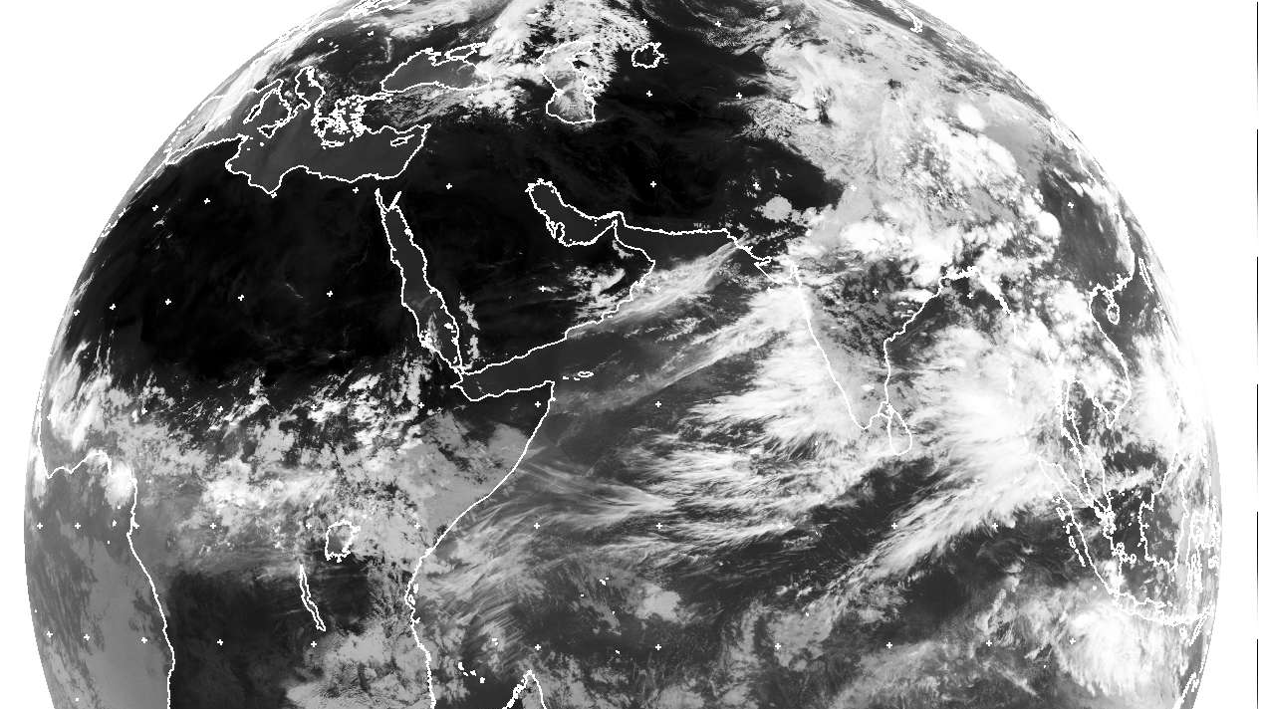
June 18, 12 UTC

Slide 29
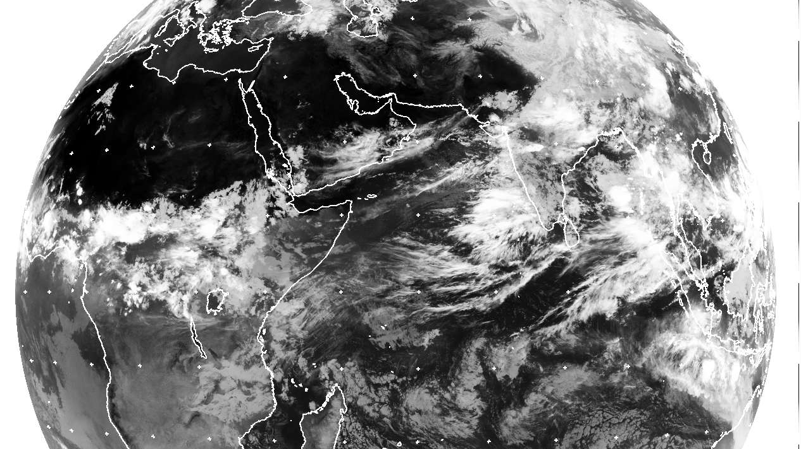
June 18, 18 UTC

Slide 30
Moisture flux (gm*m/sec) at 850 hPa from 14 to 17 June 2013 (source: NCEP/NCAR Reanalysis).
From picture it is seen that there is a strong moisture feeding from Arabian sea. Arabian sea acted a low level moisture source.
Source: D.R Sikka et.al, Current Science 2015

Slide 31
Daily Indian precipitation analysis formed by merging the IMD rain-gauge data with the TRMM satellite-derived rainfall estimates from 14 to 19 June 2013
Indicates the study region
Source: D.R Sikka et.al, Current Science 2015

Slide 32
Introduction
India experienced a heavy rainfall event in the year 2013 over Uttarakhand and its adjoining areas, which was exceptional as it witnessed the fastest monsoon progression.
This study aims to explore the causative factors of this heavy rainfall event leading to flood and landslides which claimed huge loss of lives and property.
The catastrophic event occurred from 14th to 17th June, 2013 during which the state received 375% more rainfall than the highest rainfall recorded during a normal monsoon season.

Slide 33
Objective
This study aims to explore the causative factors of this heavy rainfall event leading to flood and landslides.
For this study they have analyzed
Winds (200 hpa), Vertical Velocity
OLR
Vorticity
Equivalent Potential Temperature
Relation between NAO (North Atlantic Oscillation) to understand the influence of High latitude winds on Mid-latitude jets.

Slide 34
Data
Wind Data (u, v & vertical wind): ECMWF
In order to understand the southernmost latitudinal position of Sub Tropical Jet
OLR (interpolated OLR data) : NOAA
To study the cloud formation due to deep convection.
NAO data: CPC (Climate Prediction Center)
To understand the influence of high latitude winds on mid-latitude jets

Slide 35
Summary of Findings

Slide 36
June 12
June 15
June 18
Upper tropospheric wind at 200 hPa for (a–i) 12–20 June, 2013
June 13
June 16
June 19
June 14
June 17
June 20

Slide 37
They have examined the temporal evolution of circulation two days ahead, during and three days after the event (27N−34N, 70E−85E)
The wave like development of mid-latitude westerlies is seen to intensify and strengthened with wind speed reaching about 60 ms−1 on 16th June, 2013. The trough was observed to move south of 30◦N. From 18th June onwards, gradual retreating motion of STJ was seen with the westerly winds weakening within the box and easterlies strengthening south of the area.

Slide 38
June 12
June 15
June 18
June 13
June 16
June 19
Upper tropospheric wind anomaly at 200 hPa (a-i) for 12-20 June, 2013
June 14
June 17
June 20

Slide 39
wind anomaly at 200 hPa and found a larger positive anomaly. For the period 12th–20th June, 2013, strong winds were seen in general, and anomaly of mid-latitude westerlies attained speed of about 45–50 ms−1 from 15th to 18th June. In addition, the southward penetration can be clearly observed.
This clearly indicates that the winds at 200 hPa during June 2013 were stronger than the long term average.

Slide 40
Vertical winds (omega) for the month of June 2013
Negative values of omega indicate ascending
motion, which is associated with intense cloud and rain.
Strong ascending winds from 800 to 150 hPa were seen from 14th June to 18th June, which coincided with the heavy rainfall event.

Slide 41
Relative Vorticity
Westward tilt of trough with height is called negative tilt, it indicates strong advection and the thermodynamic instability (instability is caused due to warm air in the lower levels and cold air a loft).

Slide 42
Outgoing longwave radiation (OLR)
OLR value <200 Wm−2 indicates deep convection in the tropics (Fu et al. 1990; Zhang 1993).
June 12
June 15
June 18
June 13
June 16
June 19
Less OLR indicates higher height of clouds
June 14
June 17
June 20

Slide 43
Vertical Gradient of Equivalent Potential Temperature
Equivalent potential temperature is a thermodynamic property dependent on temperature and moisture.
It is related to the stability of air column in the atmosphere (Manoj et.al 2011).
In stable conditions, θe increases with height, and if
it decreases with height (dθe/dz < 0), then convection
can be triggered (Holton 2004).

Slide 44
strong negative pressure vertical velocity (ω at 500 hpa) at this level around the time of most of the rainfall events which substantiates that strong moist instability induced higher vertical velocity leading to vigorous convection.

Slide 45
NAO &Indian Summer Monsoon
The North Atlantic Oscillation is delineated as the sea level pressure (SLP) difference between Ponta Delagada, Azores and Stykkisholmur, Iceland (Hurrell 1995).
NAO was first identified by Sir Gilbert Walker (Walker 1924; Walker and Bliss 1932).
Summer NAO is shown to have an impact on summer rainfall of Northern Hemisphere (Hurrell and Folland 2002; Folland et al. 2009; Linderholm et al. 2011).
Negative NAO is associated with slowed polar vortex and polar jet stream (Mid latitude Jet Stream), and when jet slows, it moves in waveform pattern (Rossby waves) which is a result of weakening of both Icelandic low and Azores High, and cause decrease in pressure gradient.
The decrease in pressure gradient results in a decrease in the zonal westerlies that causes the cold air to move southward.

Slide 46
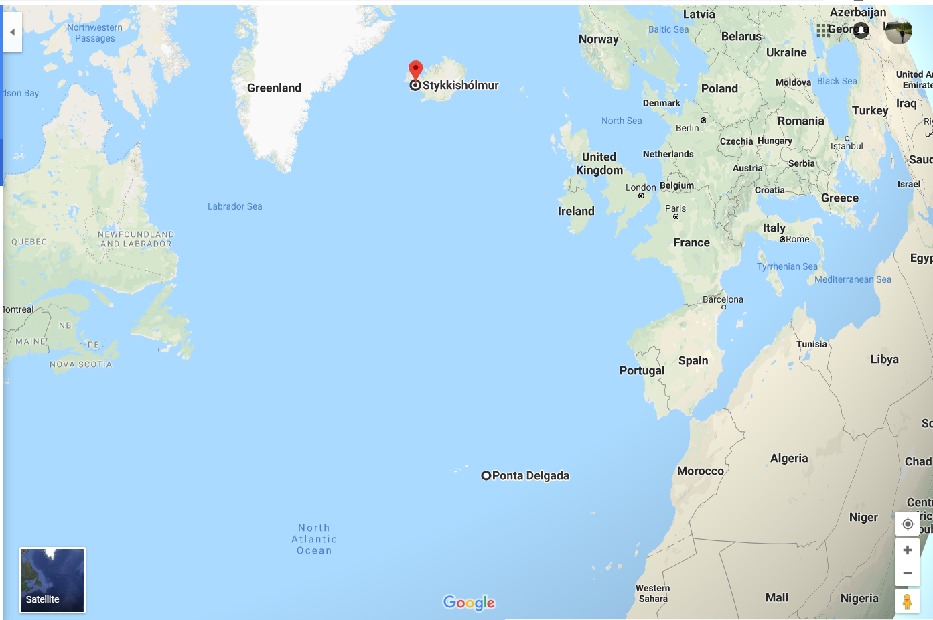
The North Atlantic Oscillation is delineated as the sea level pressure (SLP) difference between Ponta Delagada, Azores and Stykkisholmur, Iceland (Hurrell 1995).

Slide 47
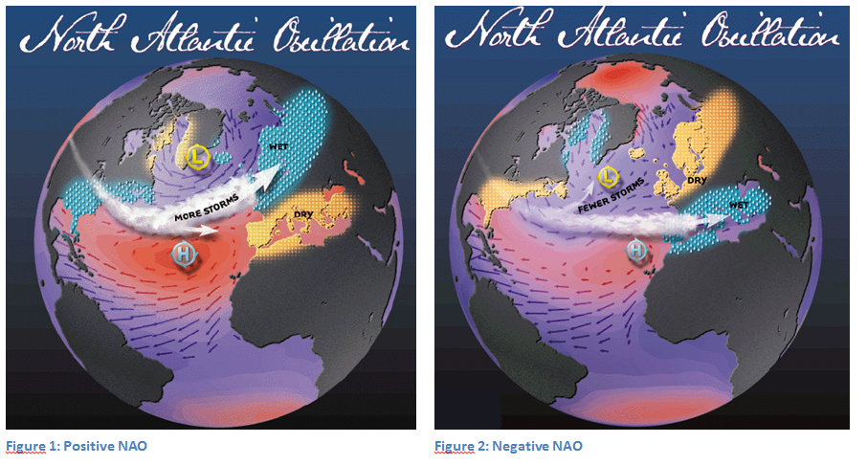
Positive & Negative Phases of NAO
Strong Low
Weak low
Strong high
Weak high
Positive Phase of NAO
Negative Phase of NAO
Associated with above-normal temperatures
Causes Strong Polar jet with strong westerlies
Associated with below normal temperatures
Causes weak Polar jet with weak westerlies in wavy nature
Source: http://alekistan.com/el-nino-and-nao/

Slide 48
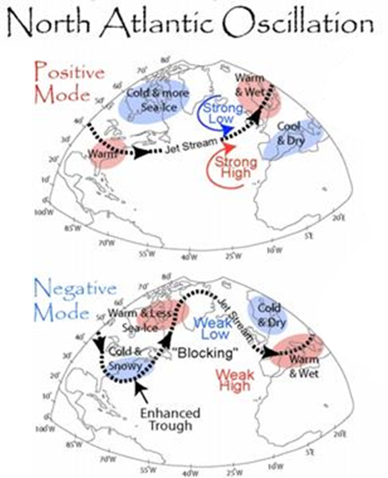
Source: MuchAdoAboutClimate - WordPress.com

Slide 49
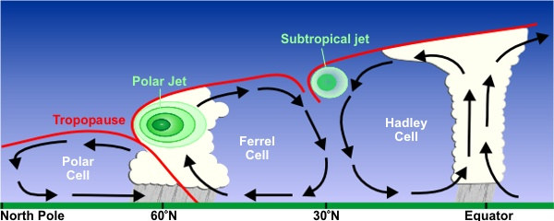
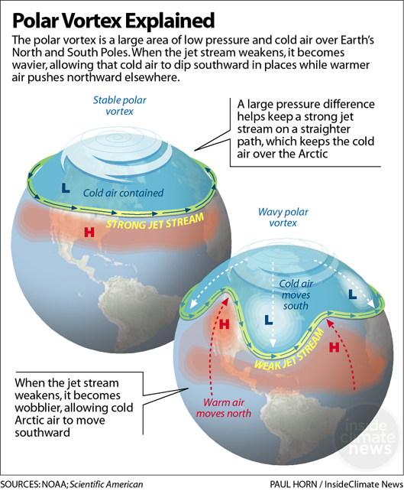
Jet Streams are boundaries of three contrasting air masses that transfer warm air from equator to poles.
Source: National Weather Service
Source: NOAA

Slide 50
During the event days NAO was observed to be negative as a result westerlies weakened and cold air moved south, which led to the southward intrusion of the mid-latitude westerlies south of its normal position.
Is there any lag?
Upper tropospheric wind at 200 hPa for (a–i) 12–20 June, 2013

Slide 51
Conclusions
Strong vertical winds, high cyclonic vorticity, low values of OLR, etc., provided a conducive atmosphere for the occurrence of heavy rainfall.
The westward tilt of the midlatitude trough with height intensified the system through transfer of potential energy of the mean flow.
mid-latitude westerlies which was pushed southward by the southward moving cold air is clearly evident from the negative North Atlantic Oscillation values seen prior and during the event days.

Slide 52
My Current Research Objective
My primary objective is to understand the role of teleconnections between Indian summer monsoon and other large scale atmospheric circulations (NAO, IOD, AO, ENSO, PDO, & MJO) and their impact during extreme precipitation events over Indian region.
(NAO: North Atlantic Oscillation, IOD: Indian Ocean Dipole, AO: Arctic Oscillation, ENSO: El-Nino Southern Oscillation, PDO: Pacific Decadal Oscillation, MJO: Madden Julian Oscillation)
At what accuracy we can predict them in advance by using numerical models.

