Slide 1
Insights into the Uptake Processes of Wastewater-Borne Pharmaceuticals by Vegetables
Paper by Myah Goldstein, Moshe Shenker, and Benny Chefetz
Environmental Science and Technology (2014)
Presentation by Grant Busse

Slide 2
Outline
Background
Uptake Factors
Paper’s Results
My Research

Slide 3
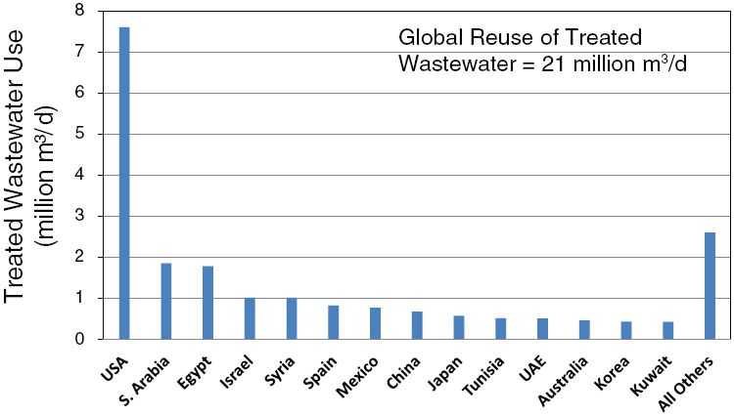
Background
Treated Wastewater makes up 50% of the total irrigation-water use in Israel, 17% in Spain, and 6% in California (from 2013)
2008 data
Notes:
https://www.nap.edu/read/13303/chapter/4#51

Slide 4
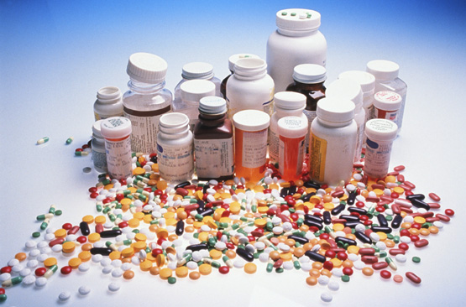
What are some factors you think affect uptake of pharmaceuticals by crops?

Slide 5
What are some factors you think affect uptake of pharmaceuticals by crops?
Physicochemical properties
Soil Type
Concentrations
Crop
Growing Conditions

Slide 6
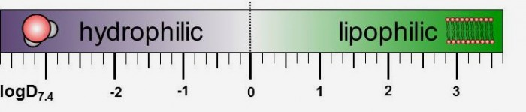
Physicochemical properties
Lipophilicity
Kow (Octanol-Water Partitioning Coefficient)
Concentration in Octanol Phase /Concentration in Water Phase
Notes:
http://jenike.com/industry/pharmaceuticals/

Slide 7
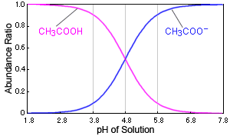
Charge
Non-Ionic
Ionic
pKa
Notes:
https://www.google.com/imgres?imgurl=https://www.shimadzu.com/an/sites/default/files/ckeditor/an/hplc/support/qn50420000002e5p-img/qn50420000006nbn.gif&imgrefurl=https://www.shimadzu.com/an/hplc/support/lib/lctalk/29/29intro.html&h=177&w=300&tbnid=hFgpbIhMj_CriM:&q=pka&tbnh=126&tbnw=214&usg=AI4_-kTkiAqsgZsrBPjIPpXGXA1fAQg8Lg&vet=12ahUKEwjS8svIn5vgAhVSCTQIHWRkDesQ9QEwAHoECAgQBg..i&docid=nQ2sIrSuWHvc-M&sa=X&ved=2ahUKEwjS8svIn5vgAhVSCTQIHWRkDesQ9QEwAHoECAgQBg

Slide 8
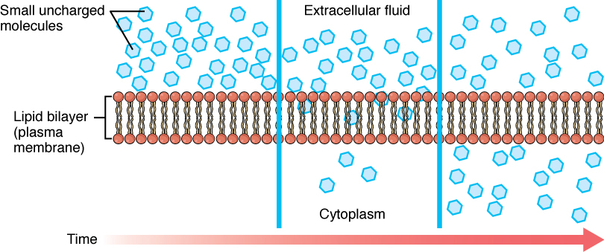
Cell Membrane
Ion Trapping
Notes:
https://opentextbc.ca/anatomyandphysiology/chapter/the-cell-membrane/

Slide 9
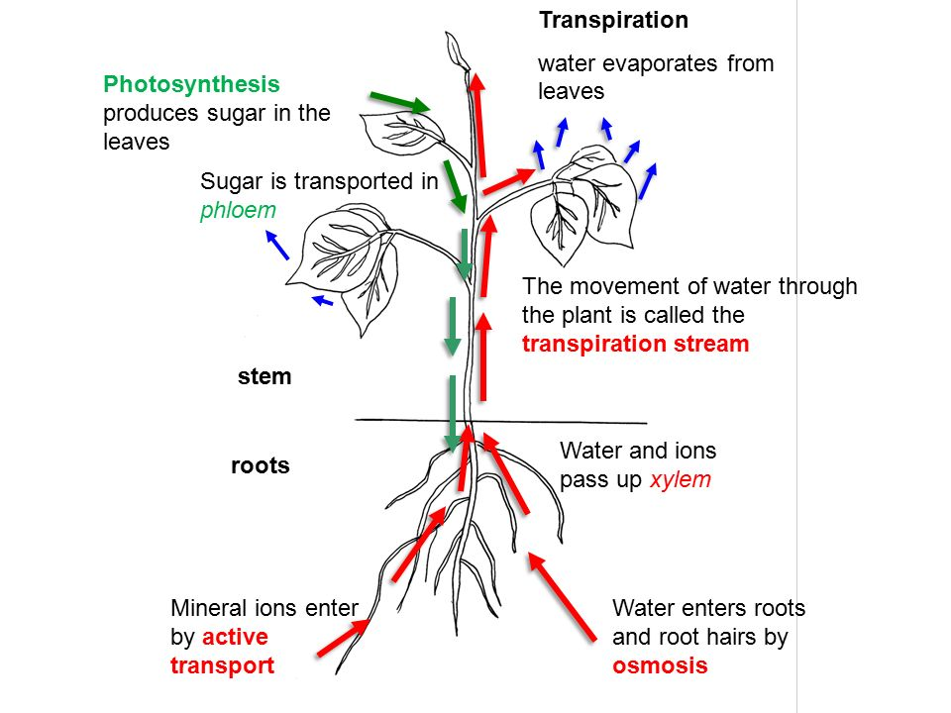
Compounds move through membranes from xylem to phloem and are transported with the direction of transpiration
Notes:
http://www.desertbruchid.net/4_GB2_LearnRes_fa11_f/4_GB2_LearnRes_Web_06Plan.html

Slide 10
If you were a compound trying to get into a plant:
Would you rather be lipophilic or hydrophilic?
Would you rather be non-ionic or ionic?

Slide 11
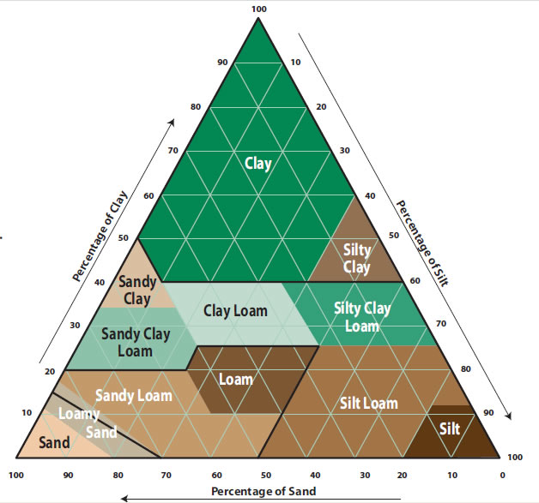
Soil Types used in Study
Aeolian Sand - Low amounts of soil organic matter and clay
Sandy Soil - Low amounts of soil organic matter and clay
Alluvial Sand - High amounts of soil organic matter and clay
Notes:
http://www.rainbird.com/homeowners/understanding-your-soil

Slide 12
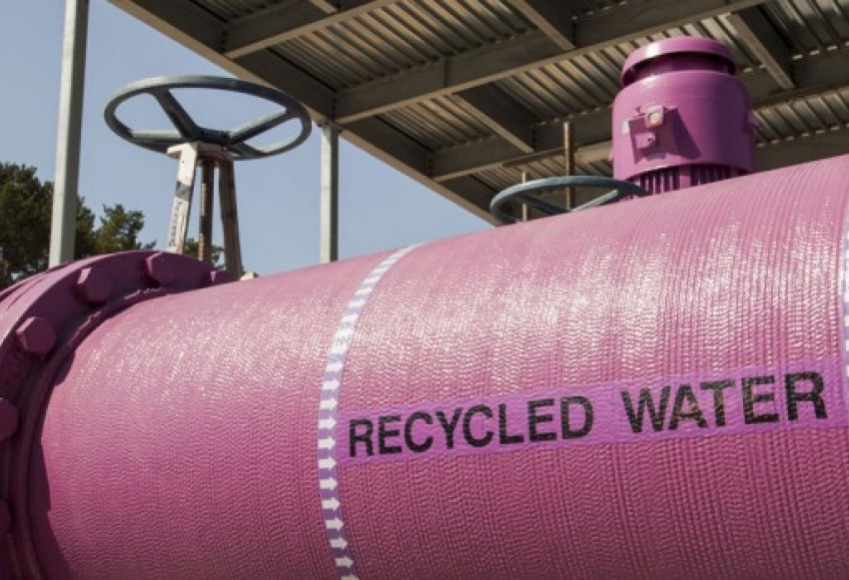
Water Treatments
Freshwater
Treated Wastewater
Spiked Freshwater
Spiked Treated Wastewater
Notes:
https://benitolink.com/features/recycled-water-adds-local-supply

Slide 13
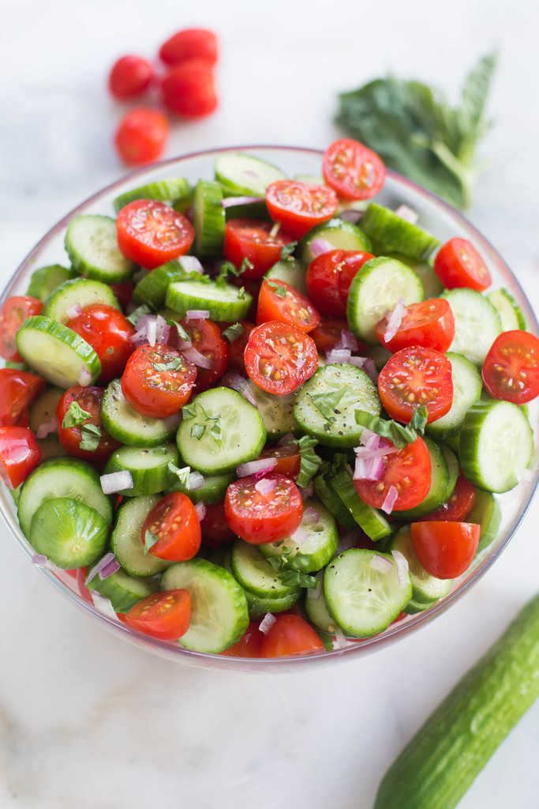
Crops Grown
Cucumber: transpires water through stomata
Tomato: fruit lack stomata for transpiration
Hence cucumber have more of a driving force for transpiration within the plant

Slide 14
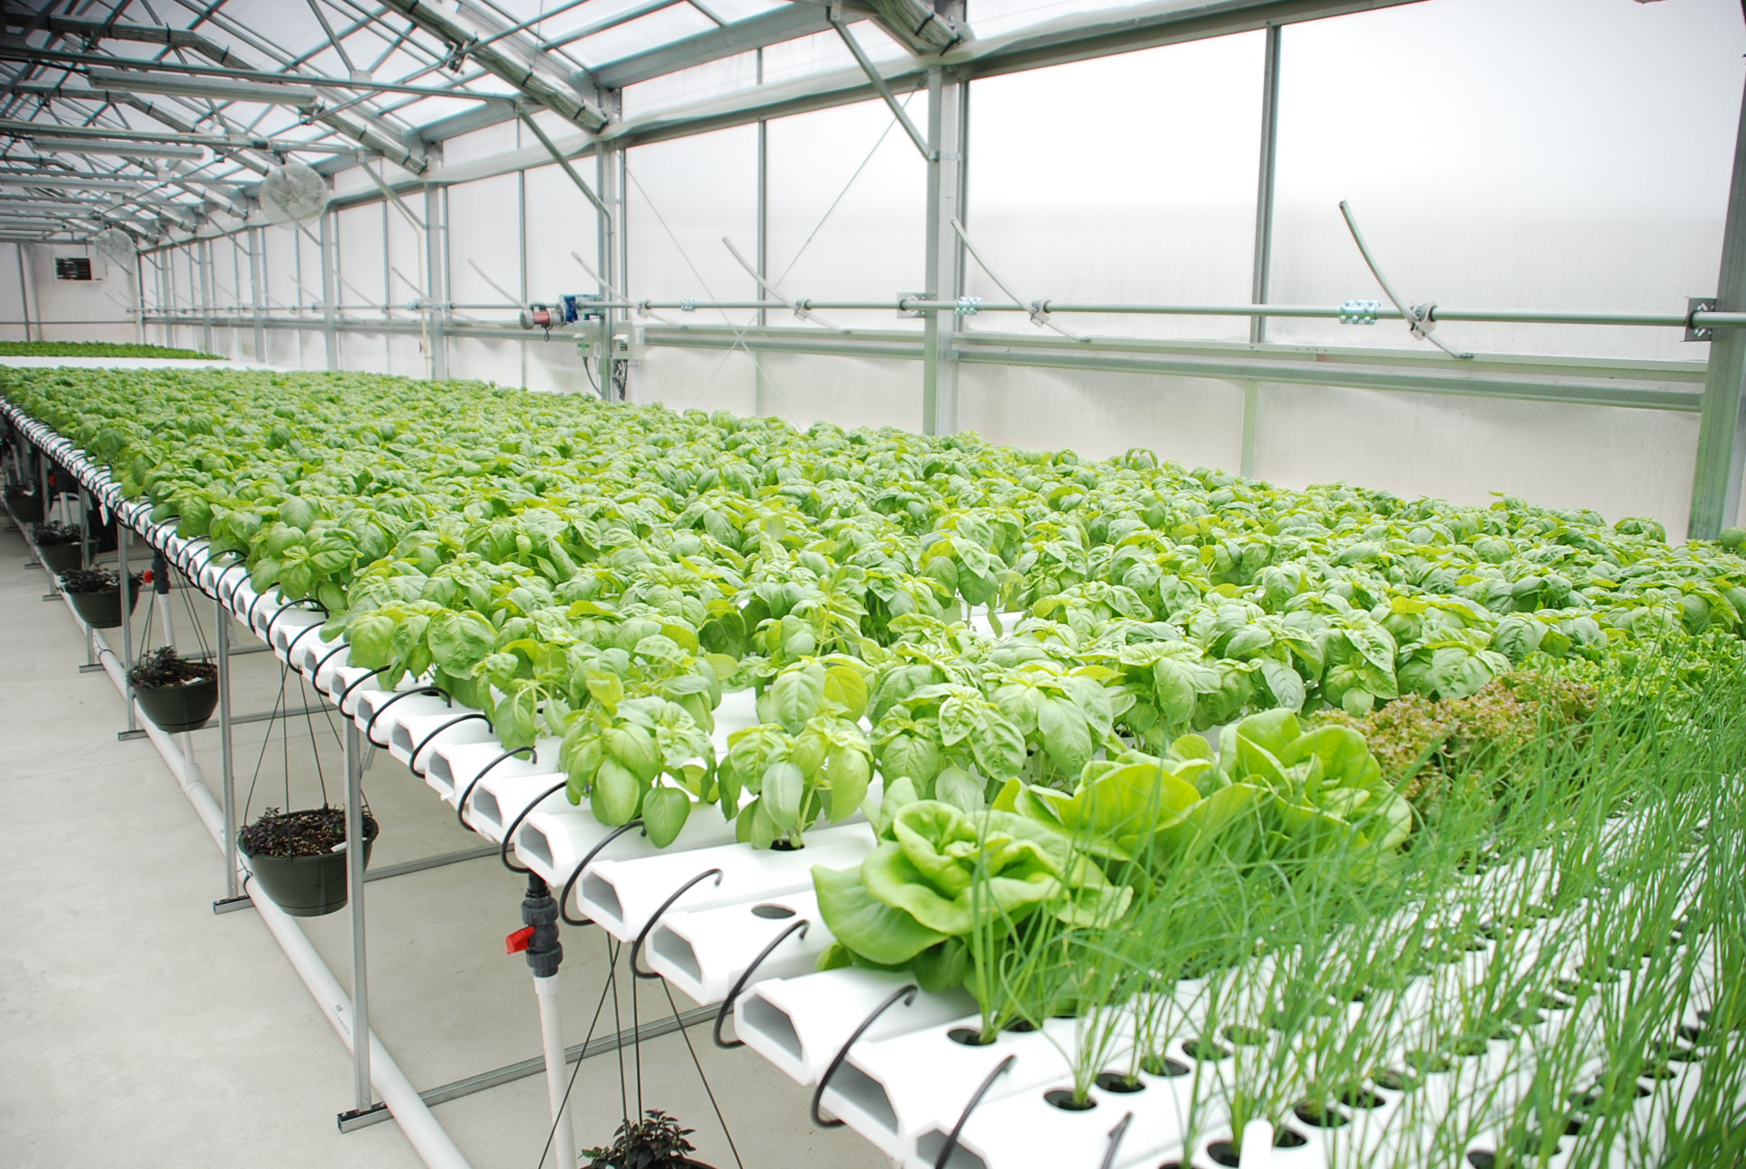
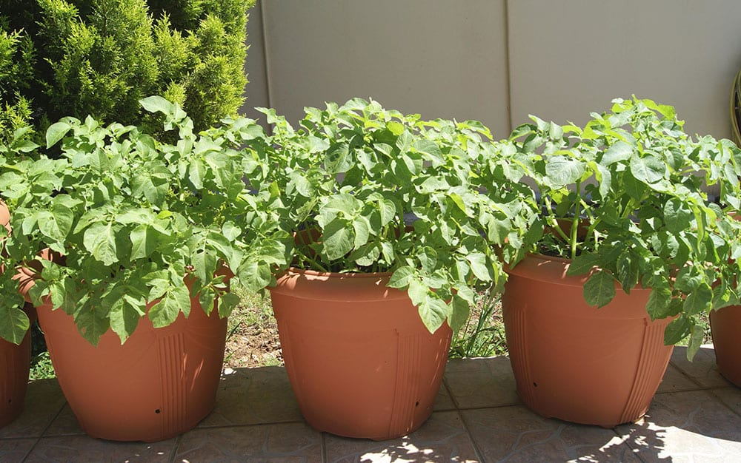
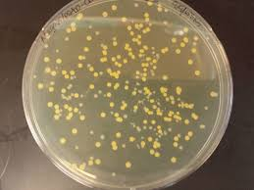
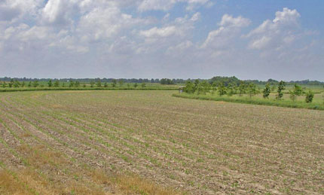
Growing Conditions
Hydroponic
Pot
Culture Media
Field
Notes:
Hydroponic: https://www.rimolgreenhouses.com/blog/5-reasons-hydroponic-growing-more-profitable-soil-growing
Pots: https://www.daviddomoney.com/10-top-vegetables-for-a-container-garden/
Culture: https://www.researchgate.net/post/What_kind_of_contaminant_do_I_have_in_my_E_coli_culture_on_an_ampicillin_agar_plate

Slide 15
Carbamazepine and Lamotrigine
Both Carbamazepine and Lamotrigine are anticonvulsant drugs used to control seizures
Carbamazepine log Kow 2.45 and pka 13.9
Lamotrigine log Kow: 2.57 and pka 5.7

Slide 16
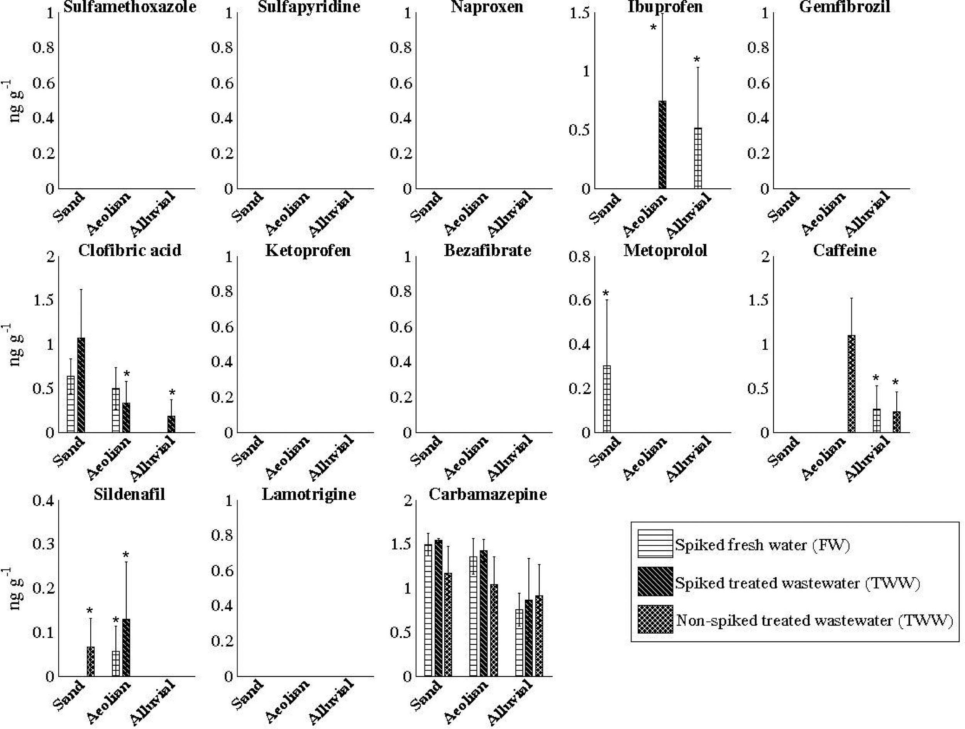
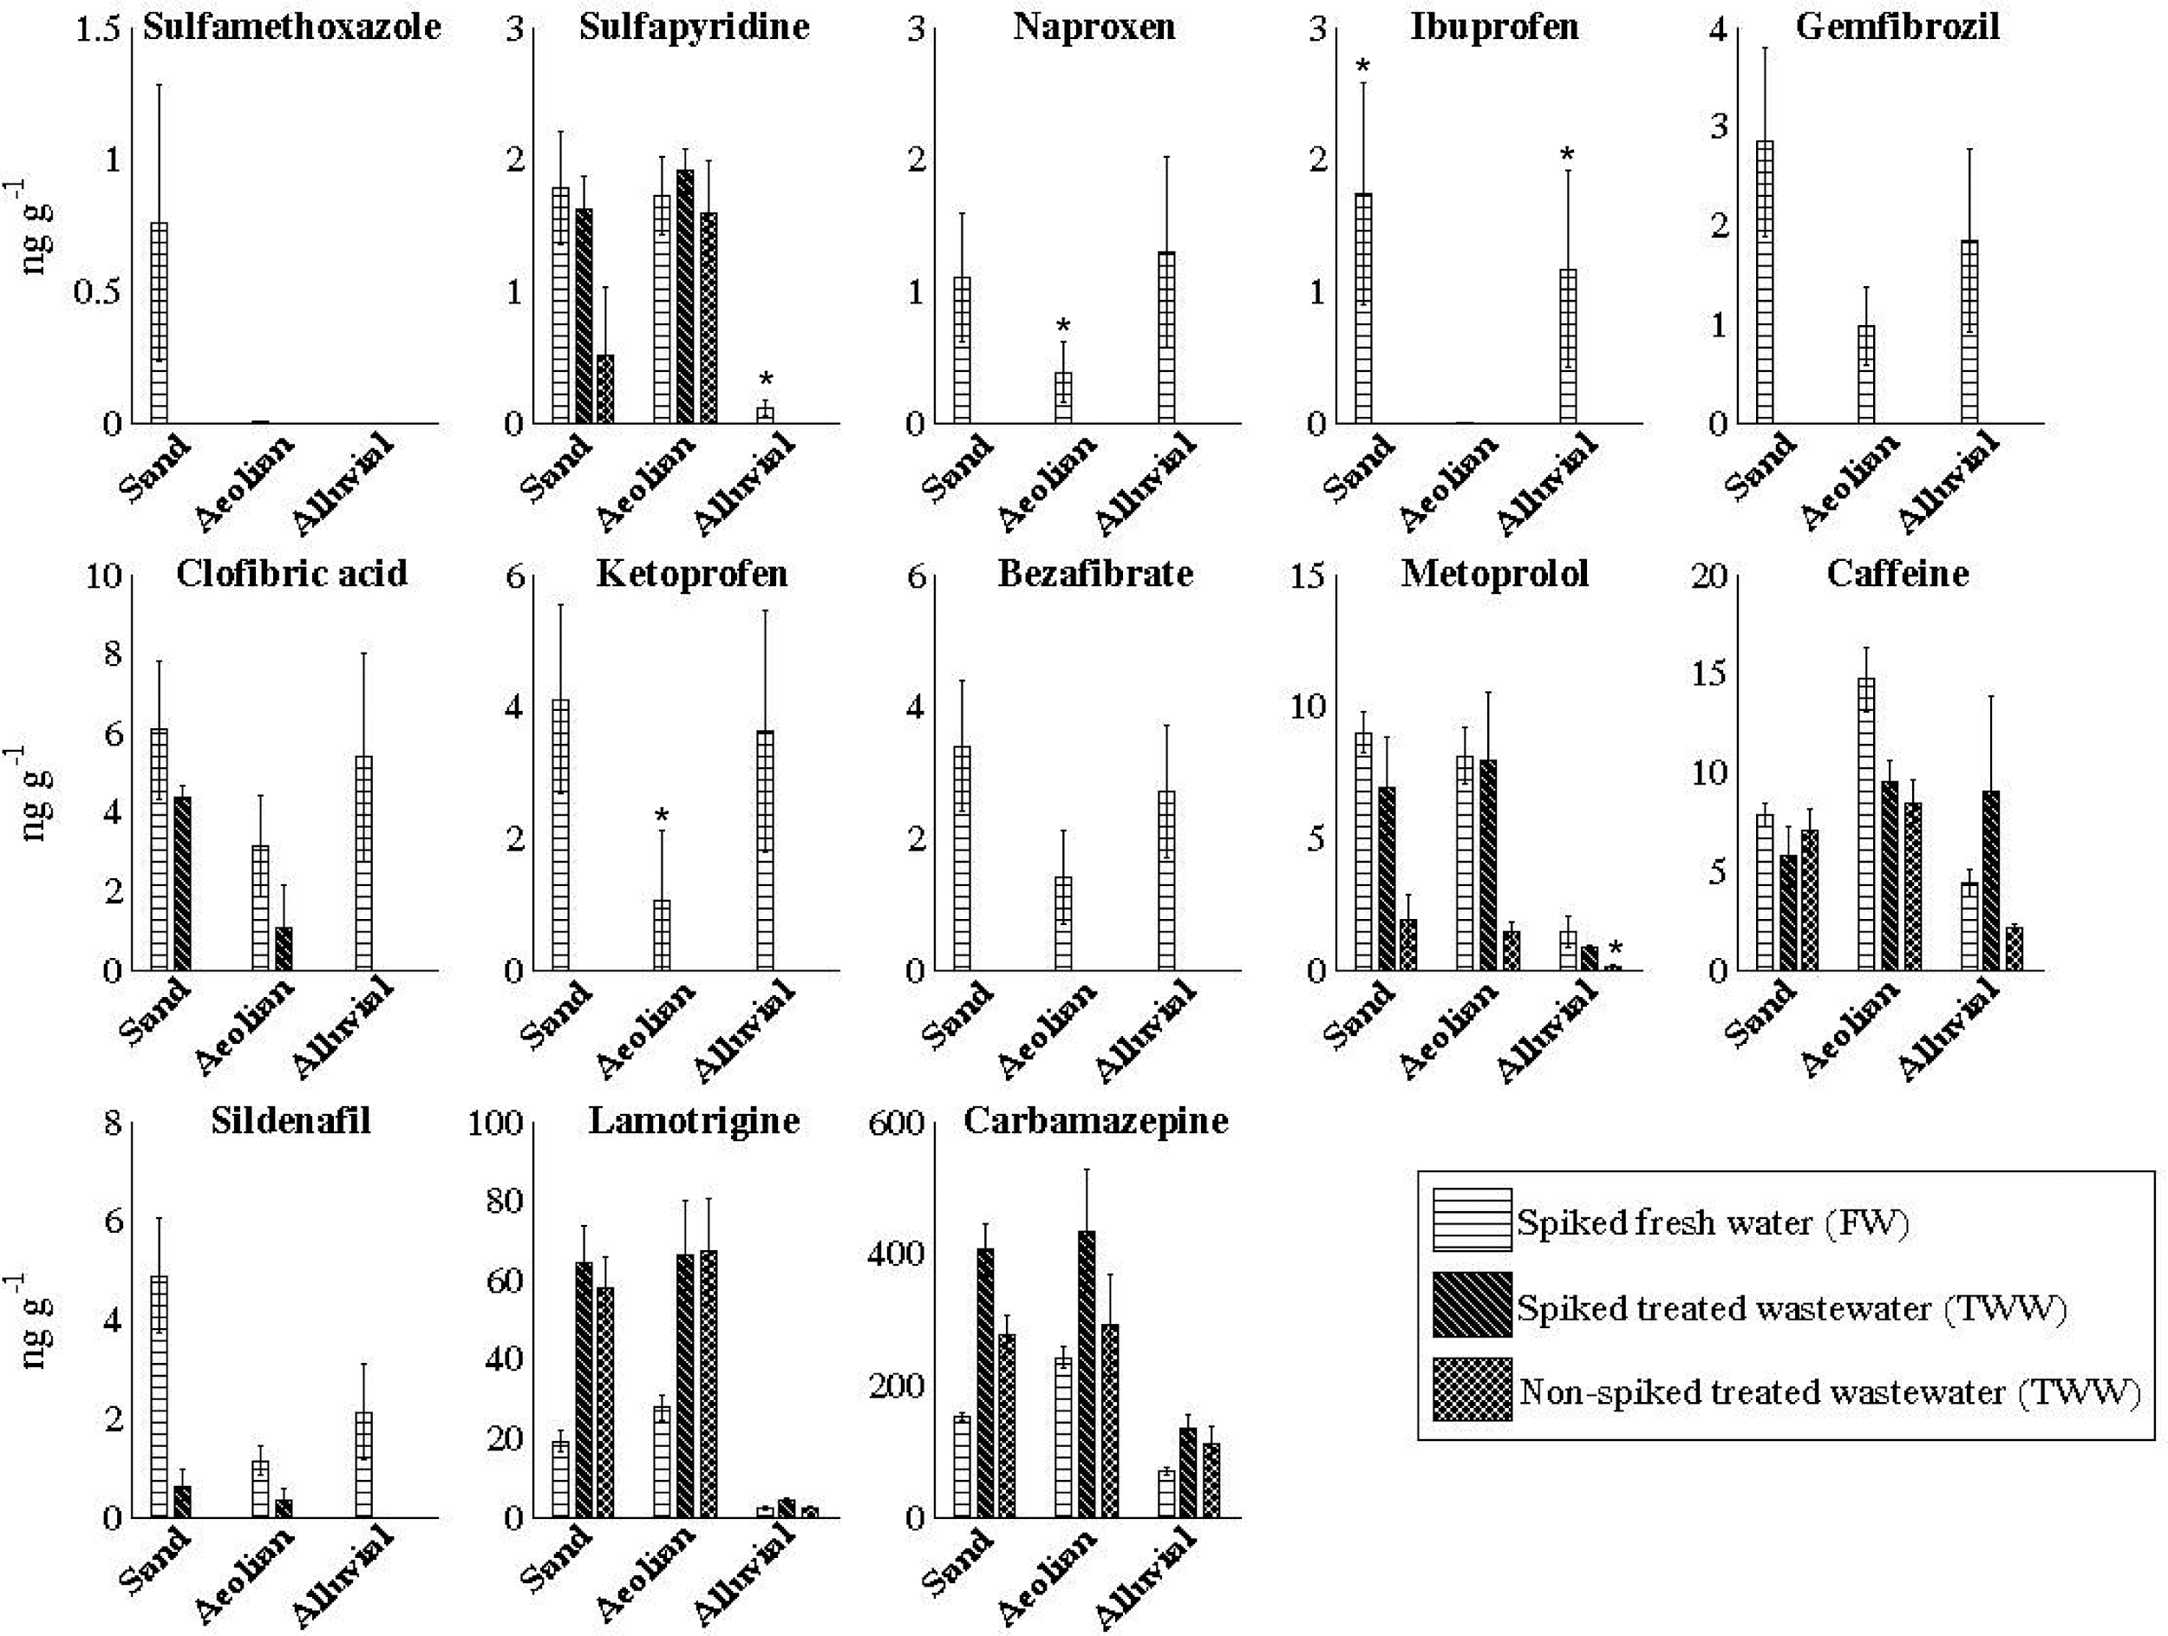
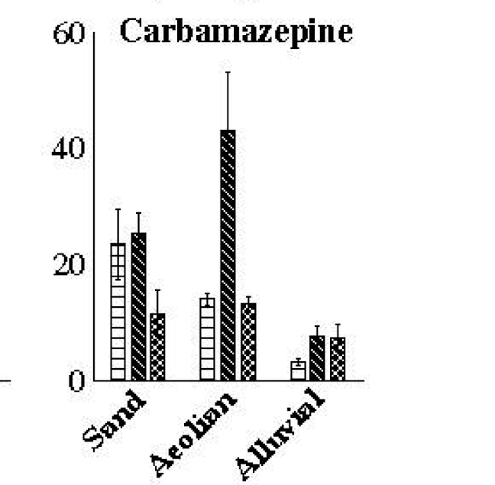
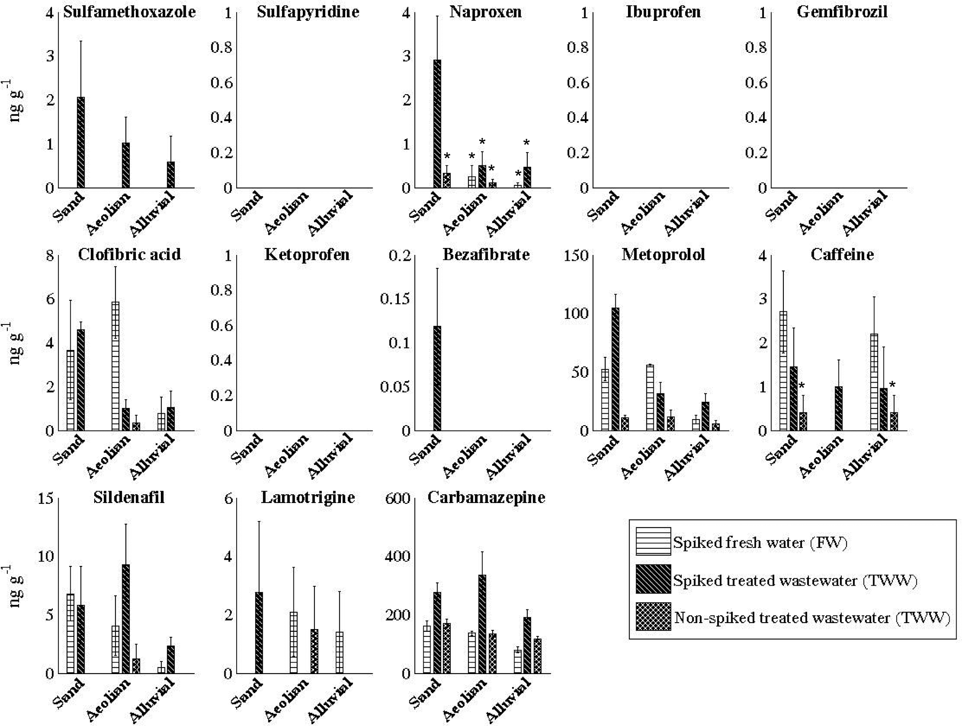
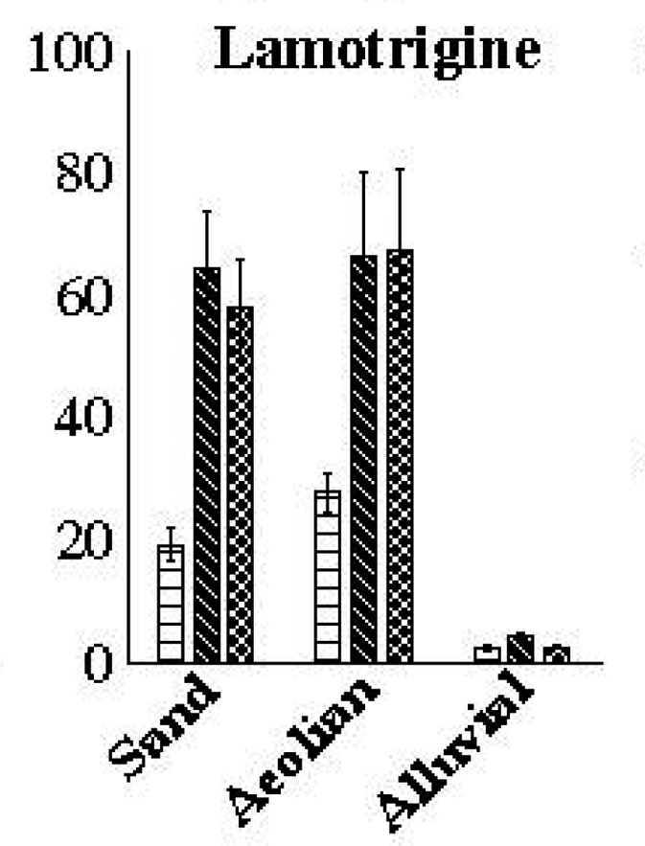
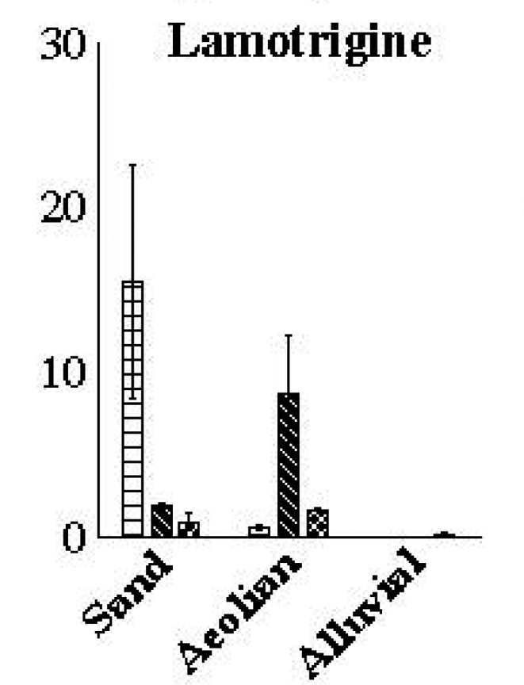
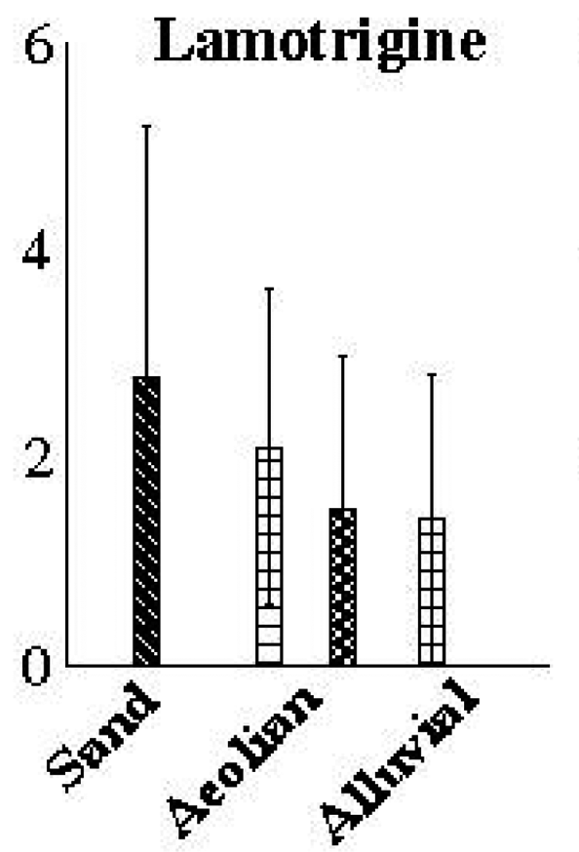
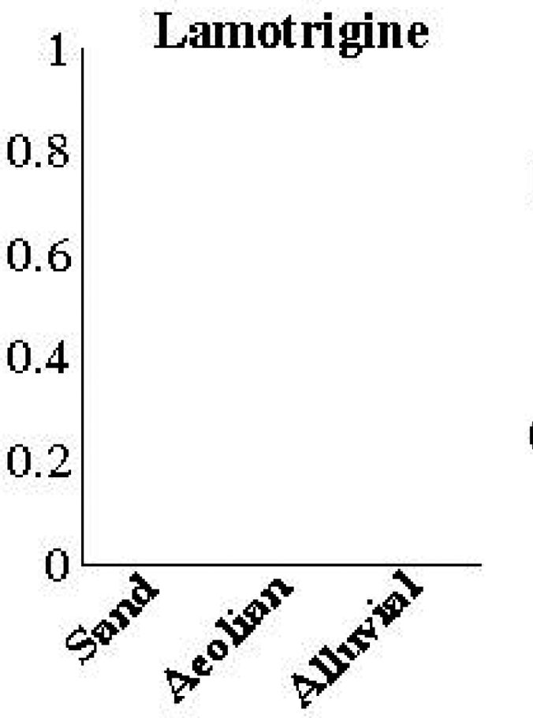
Results
Leaves in
Cucumber Plants
Fruit in
Cucumber Plants
Leaves in
Tomato Plants
Fruit in
Tomato Plants

Slide 17
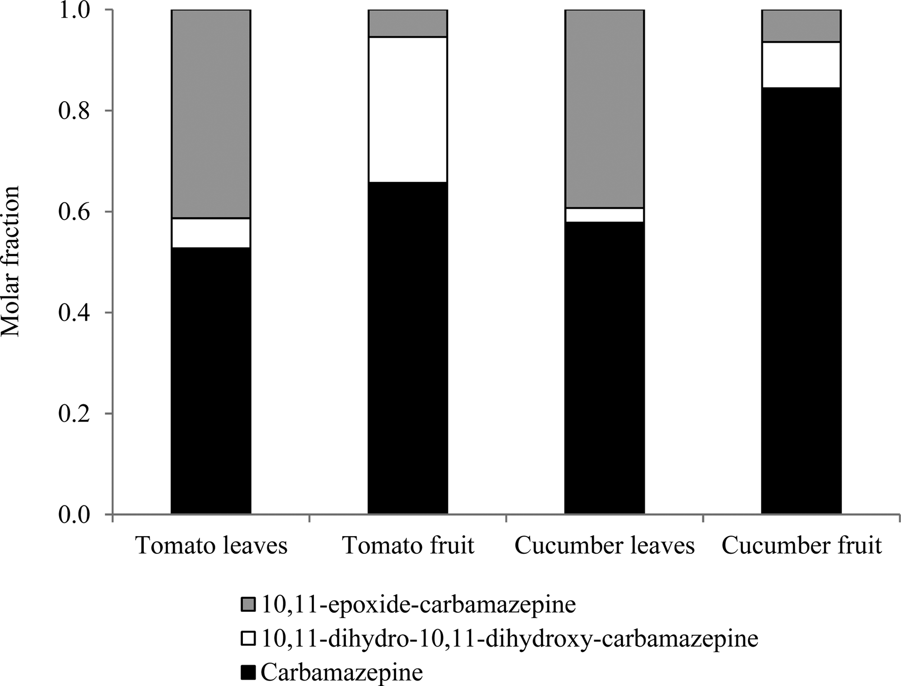
Results

Slide 18
My Research
Crops: Alfalfa and Wheatgrass
Water Treatments: Freshwater, Treated Wastewater, and Spiked Freshwater
Soil Treatment: One-half of the soil used has biochar

Slide 19
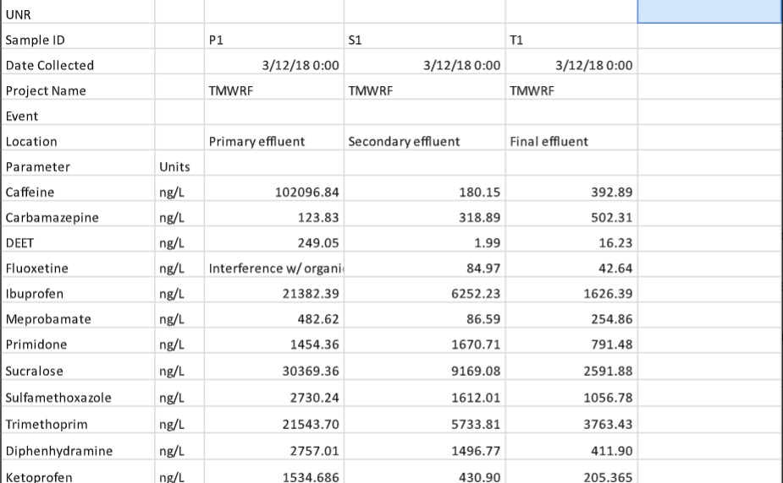
Truckee Meadows Water Reclamation Data
3
2
1

Slide 20
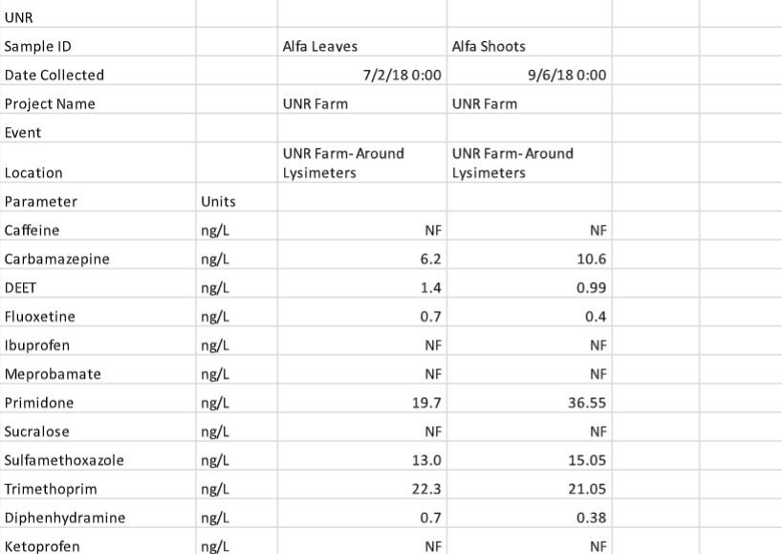
Truckee Meadows Water Reclamation Plant Data
2
3
1

Slide 21
Questions?

